Slide 1
Neutron Beam Shutter for R160 (Facility for Complimentary Experiments)
2nd DONES Users Workshop (19 – 20 October 2023)
Grzegorz Wojtania, Grzegorz Galazka, Santiago Becerril

Slide 2
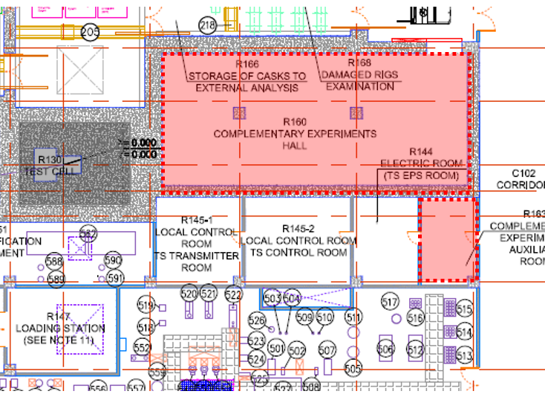
Neutron Beam Shutter location
Neutron Beam Shutter shields the room 160, an experimental hall that will house multiple experiment instrumentation.
Neutron Beam Shutter Location
Room 160
Test Cell
TestC/R160
Isometric view
Room 160

Slide 3
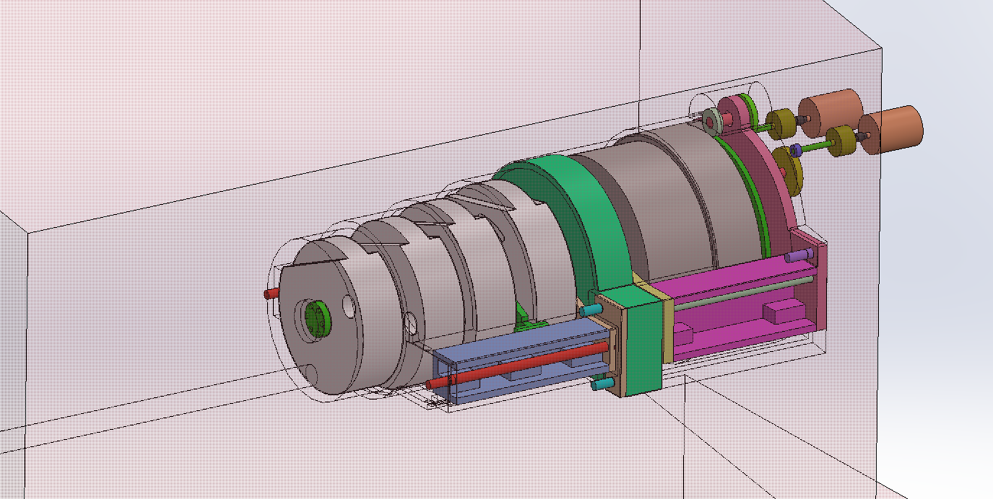
Neutron Beam Shutter operation
Shutter has 5 discs made of steel and concrete that shield R160 from Neutron beam coming from Test Cell and collimated in Neutron Beam Tube
Room 160
Support
Support
Disc 1
Disc 5
Disc 2
Disc 3
Disc 4
Mounting cart
Neutron Beam Tube
Neutron Beam from Test Cell
Mechanical design of NBS is currently in development

Slide 4
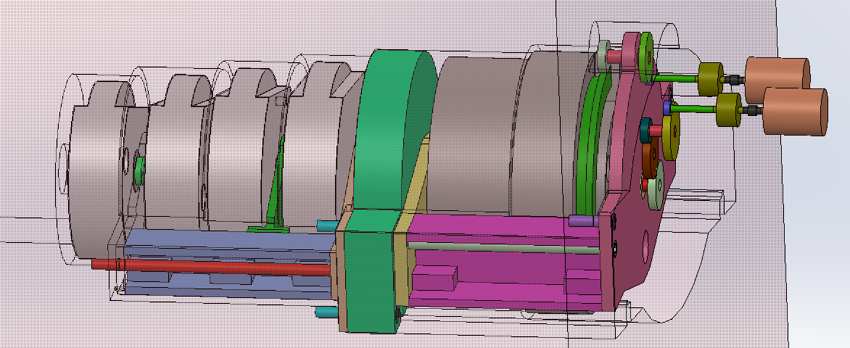
Shutter rotation
Shutter opens and closes by rotating the discs.
Discs 1 is driven by a motor (#2) through the shaft. Subsequent disc (2,3,4) rotates when previous disc latches to it.
Disc 5 is controlled from a separate motor (#1)
Shutter reaches open state when openings in all discs align and allow the beam from Test Cell pass to room 160.
Motor #1
Disc 1
Disc 5
Disc 2
Disc 3
Disc 4
Motor #2
In case of the blackout, the shutter rotates autonomically back to the starting position

Slide 5
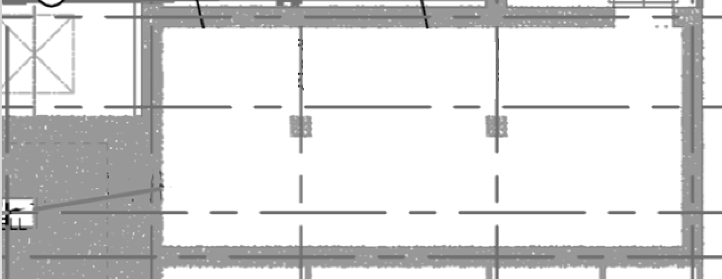
Proposed scientific features of Room 160 with Neutron Beam Shutter
Room 160 provides sufficient space and infrastructure for several (up to 6-8) scientific installations/setups that can operate using Collimated Neutron Beam
Proposed View of example setup for R160
Shield
Setup #5
Shield
Shield
Setup #3
Setup #1
Beam Dump
Setup #6
Shield
Test Cell
Setup #4
Shield
NBS
Shield
Beam line
Setup #2
Room 160
Possible applications: Neutronography, cold/ultracold/moderated Neutron experiments… List of possible experiments is open and can still be extended

Slide 6
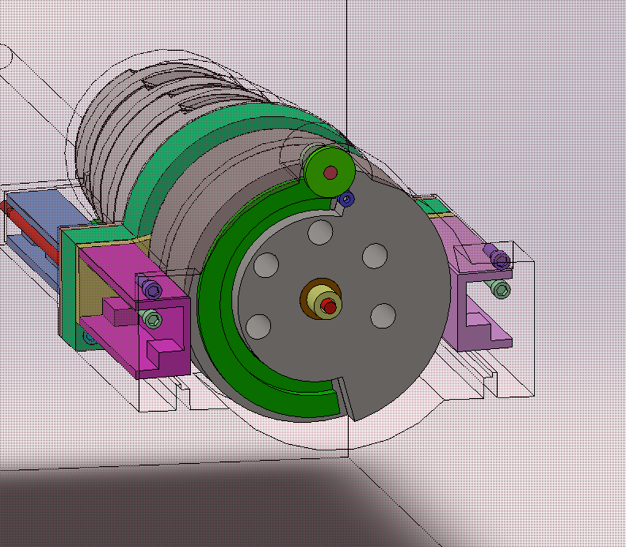
Proposed scientific features of NBS
As an option Shutter can provide slots in disc no.5 for irradiation or moderation purposes

Slide 7
Summary
Neutron Beam Shutter allows for controlled opening and closing the Collimated Neutron Beam from Test Cell.
Neutron Beam Shutter shields the room 160
Room 160 can house several experiment installations that operate using collimated neutron Beam
Disc 5 of Neutron Beam shutter can provide slots for other irradiation or moderation purposes

Slide 8
Thank you for your attention
G. Wojtania; G. Galazka; S. Becerril | 2nd IFMIF_DONES Users Workshop | 20th October 2023

