Slide 1
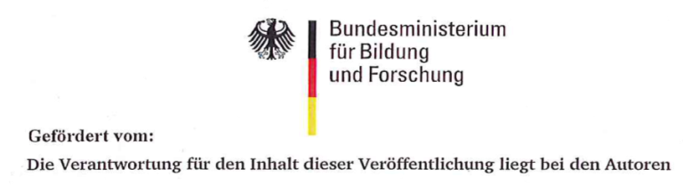




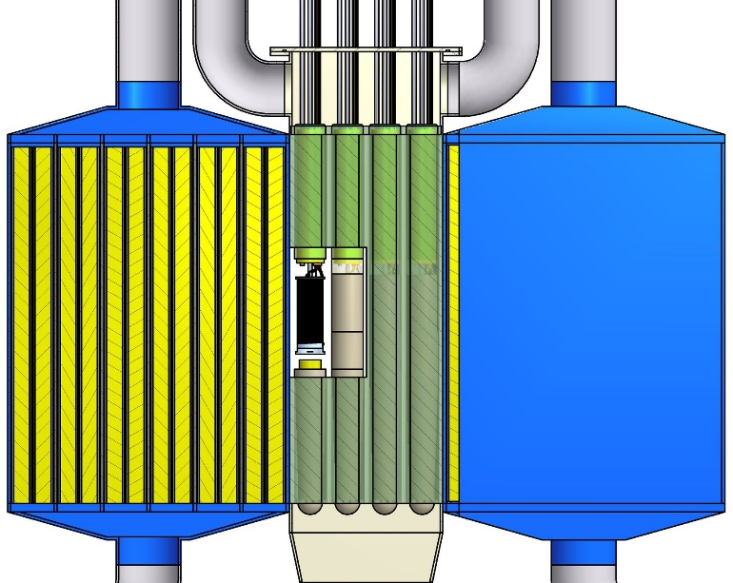
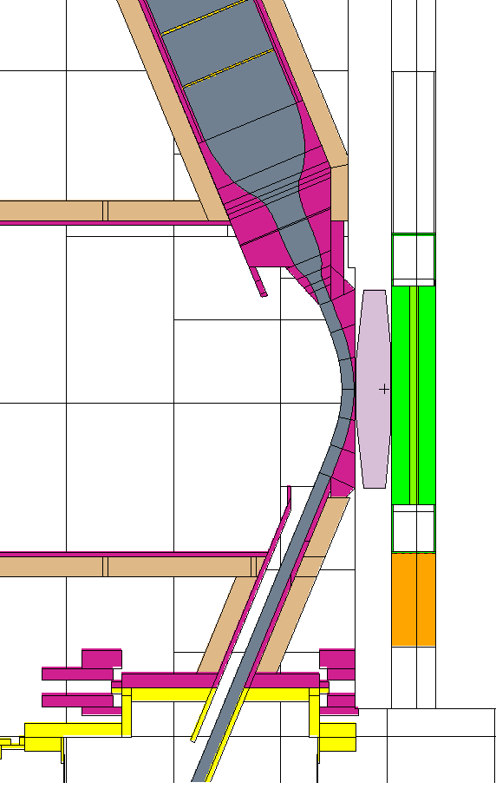
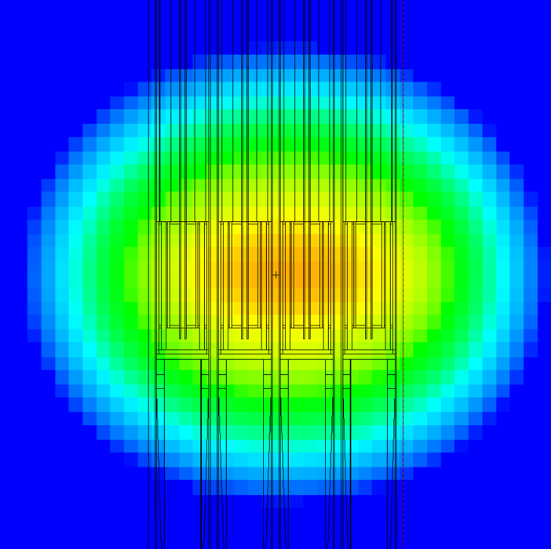
DONES Preparatory Phase
Tritium Release Test Module - design overview
Frederik Arbeiter (KIT), A. Abou-Sena (KIT), Y. Qiu (KIT), A. Valentine (UKAEA), H. Chohan (UKAEA)
Second DONES User Workshop, 19.–20. Oct. 2023, Granada, Spain.

Slide 2

Scope of reported work on “TRTM”
IFMIF/EVEDA 2011-2013 “Tritium Release Test Module”
KIT , “DDD-III”
  Conceptional design
  Neutronics, thermal, mechanical, tritium transport analyses
  Purge system, tritium analysis station
  CAD model + production drawings (capsule prototype parts fabricated)
DONES-PreP 2019-2021“In-Situ Ceramic Breeder Irradation Module”
KIT, UKAEA, “Del.8.3.2” + attached ICBIM DDD
  Update and detailing of neutronics (DONES specific)
  Update of test requirements

Slide 3
TRTM mission statement
The TRTM is the device dedicated for
  irradiation of breeder ceramics or solid neutron multiplier materials,
  at controlled temperatures ( 300 – 1100 °C ) in bounded intervals,
  in the high/medium flux region of the DONES neutron source,
  for long term periods (months),
  with the ability to monitor on-line the release of tritium species to a purge flow,
  with the ability to retrieve the irradiated materials for PIE.

Slide 4
Specific test objectives [DONES-PreP Del8.3.2]
1. Determination of time structure (so called residence time) of tritium release from Li ceramics, as reaction to transients {n-flux, temperature, purge gas} and as function of age.
2. Determination of chemistry of the purge gas and tritium / hydrogen species, i.e. fractions of HT, HTO etc. during irradiation
3. Determination of change of mechanical properties {dimensional stability, microstructural evolution, crushing load} - and physical properties {thermophysical properties, density, tritium diffusivity} by PIE

Slide 5
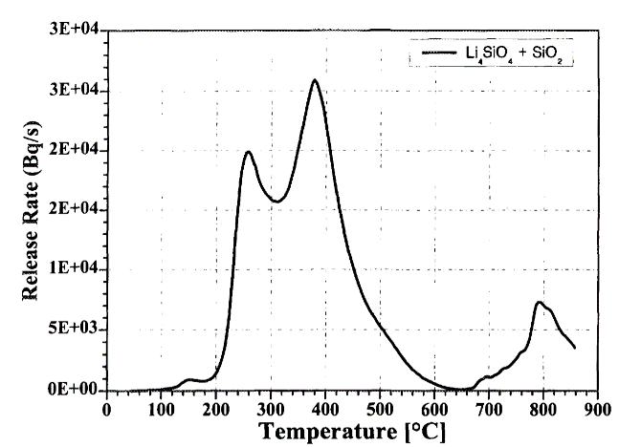
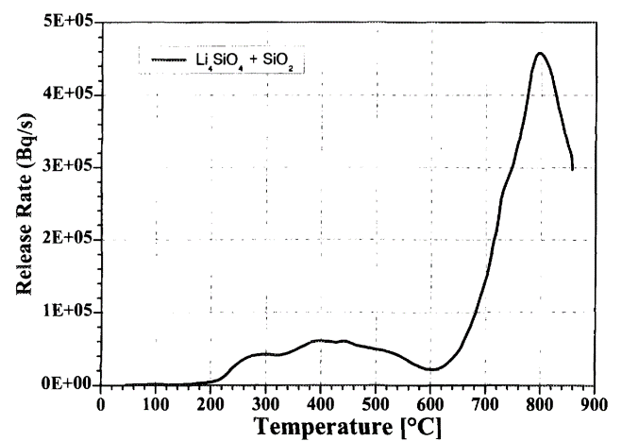
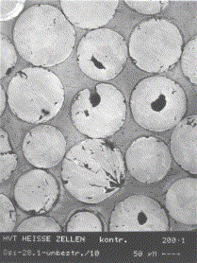
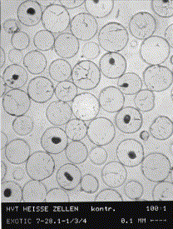
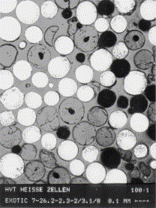
Some underlying physics questions
Transport mechanisms of tritium from “place of birth” into purge gas flow
Evolution of properties driven by progressing transmutation (Li-burnup), radiation damage and chemistry
Can only be studied with real breeding Li(n,T), otherwise T-source in volume can be achieved !
Tritium release rate determines the reactors
T-inventory /safety !
[Raffray, Abdou, Federici]
[Scaffidi-Argentina, Werle]
Thermal desorption tests
OSi pebbles EXOTIC-7
Li burnup:
10%
18%
10%
13%
18%

Slide 6
Example irradiation conditions (DEMO HCPB 2021)
Breeder material: KALOS-ACB pebbles :
Li₄SiO₄ with 30 mol-% of Li₂TiO₃
Polydisperse pebble bed 250 – 1250 µm (typical diameter 625 µm),
packing fraction 63-64%
Purge gas: helium with 0.1-wt% of H₂ at 0.2 MPa abs. (Changed to 8MPa!), superficial velocity 29 to 46.3 mm/s
Temperatures in the pebble bed are predicted at
  320 - 360°C minimum, given by the coolant helium outlet temperature from the FW
  around 600 - 800 °C in large bulk regions
  1055 °C peak
Neutron flux in BZ : 5×10¹³ to 7×10¹⁴ n/cm²/s
Tritium production : 0.5 – 1.7 ×10¹⁹ atoms(T)/m³/s in the breeder material
Volumetric heating in BZ : 4 – 20 W/cm³

Slide 7
TRTM mode of operation
Loading capsules with unirradiated specimen material
Inserting TRTM into DONES TC
During irradiation:
  Controlled setpoint changes
  {Temperature, purge gas, neutron flux} OR: observe long-term changes
  Registering time dependent {T-activity, Temperature, purge flow conditions etc.}
Retrieve TRTM, Extract specimens
Perform PIE on irradiated specimens {microstructure, mechanical, T-desorption}
n-flux
Example of transient
measurements with TRTM
T-activity
Simplified P&ID of TRTM in DONES
time

Slide 8

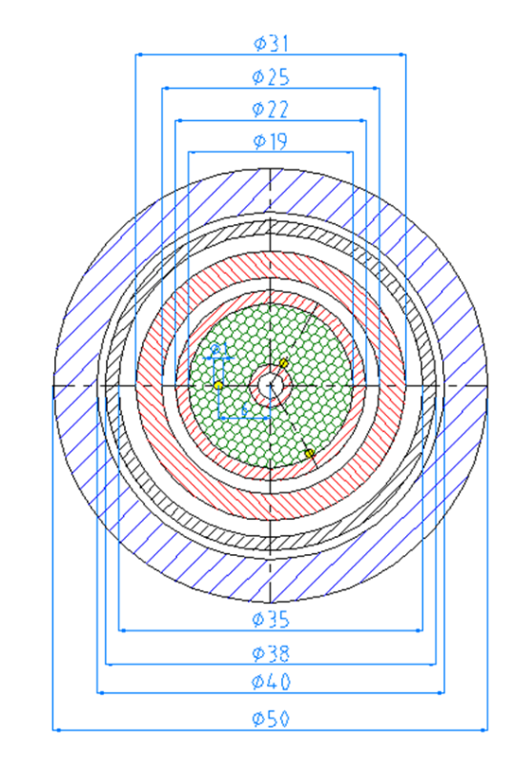
Design challenges (1) : Temperature management
Achieve high temperatures as in BZ (1100 °C)
  Electrical heater limits 600 – 1000 °C, worse under irradiation (RIC, RIED)
  Mechanical limits of materials (creep etc.)
Limit temperature spread within specimen region
specimen
Inner cylinder “specimen bin” contains specimens,
high-temp. alloy, no pressure-diff. effective
Two concentric gaps (stagnant gas) achieve thermal isolation, T_{heater} < T_{specimens}
Pressure bearing wall and final tritium diffusuion barrier “rig hull” is cold
Temperature difference within specimen stack is limited so that diffusivity varies by max. 10%
specimen capsule
inner gap
“heater can”
outer gap
rig hull
coolant
temperature
heater
Maximum temperature achieved (by analysis) ~ 900 °C
radius

Slide 9
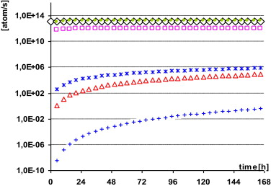
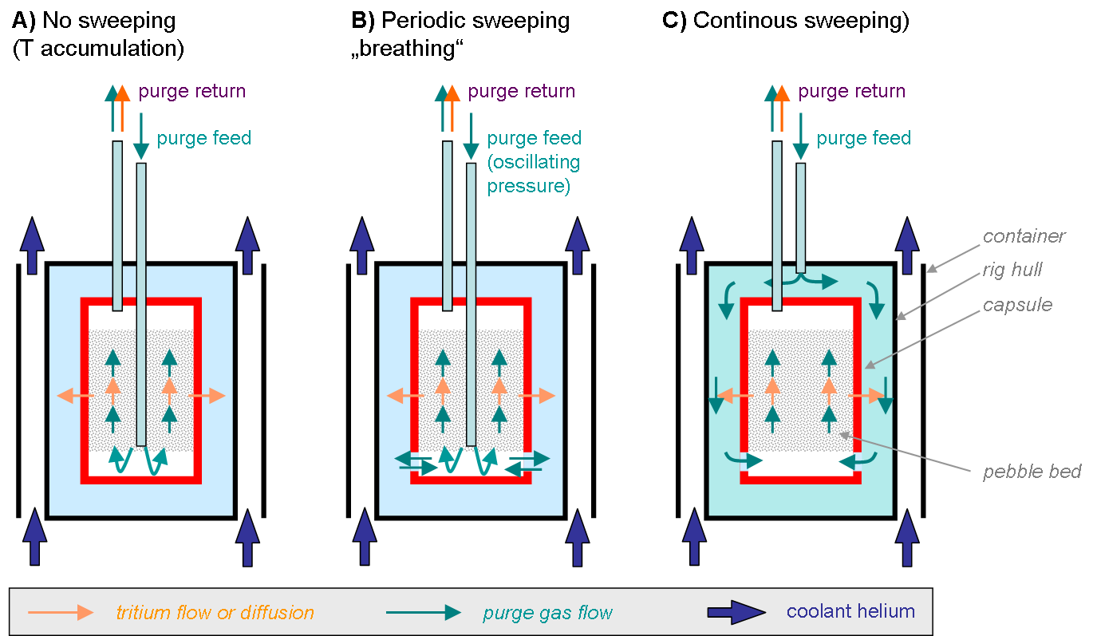
Design challenges (2) : tritium containment
Production
Loss f. capsule
T-fluxes
Loss f. rig
Without recovery, 94% of bred T reaches the analysis station (losses over hot capsule wall)
“Periodic sweeping” can be implemented by oscillating the purge gas pressure
(part of the 6% losses are recovered)
Losses from rig are < 10⁻⁴ “of production

Slide 10
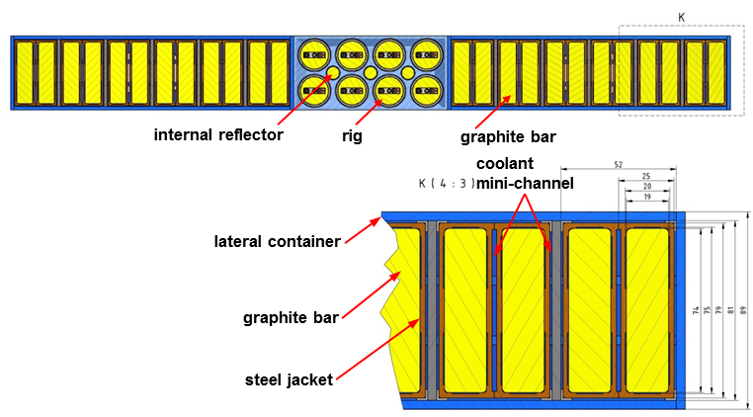
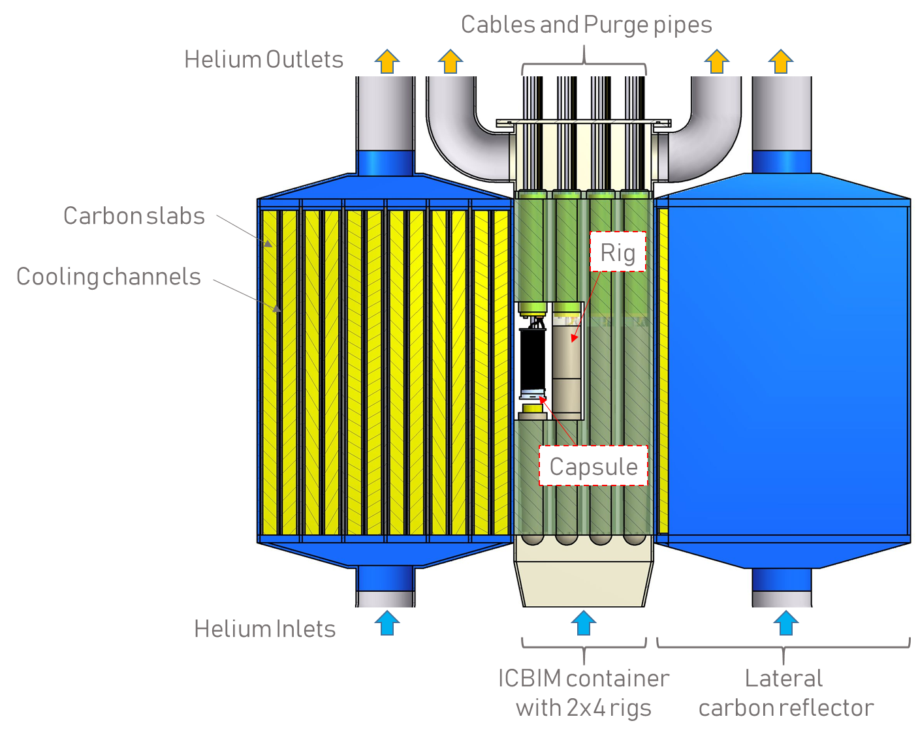
TRTM configuration
Container: 316L(N) stainless steel
Nuclear grade graphite
Mass ~350 kg + interface head
185mm

Slide 11
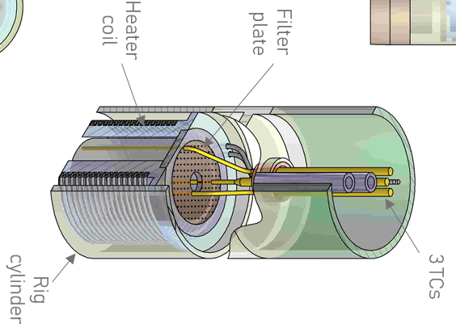
TRTM capsule
Specimen capsule made of High-Cr stainless steel
X15CrNiSi25-21
Specimen volume
D=19mm L=86mm 33 cm³
3 Thermocouples
Thermocoax heater (Inconel)
ID 4 mm purge tubes
86 mm

Slide 12

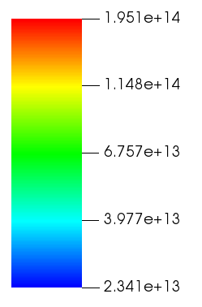
Nuclear analyses
W-Spectrum
Shifter
Neutron flux comparable to DEMO
T-production rate and heating about
1 order of magnitude < DEMO
Further optimization of neutron spectrum advisable
(higher flux in low energy range required for Li-6 breeding)
7.9 ×10¹⁷ T-atoms/m³/s
1.05 W/cm³
Li-Target
TRTM
9.0 ×10¹⁷ T-atoms/m³/s
1.20 W/cm³
HCPB DEMO BZ:
5×10¹³ to 7×10¹⁴ n/cm²/s
0.5 – 1.7 ×10¹⁹ T-atoms/m³/s
4 – 20 W/cm³
3.9 ×10¹⁷ T-atoms/m³/s
0.45 W/cm³
Nuclear analyses completed with activation, decay-heat and dose-rates after shutdown

Slide 13
Purge gas system, tritium measurements
Purge gas
supply
TRTM
capsule (33cm³)
Detector
system
Feed
pipe
Return
pipe
0.2 MPa
900 °C
U_{S}=47 mm/s
τ=0.7s
5.5×10⁴ Bq/s
0.15 MPa
20 °C
V=1L
τ=246s
1.36×10¹⁰ Bq/m³
DR=1.36×10⁷ Bq
1 mg/s He
0.25 mmol(He)/s
336 sccm
L=50m DI=4mm
τ=206s, 0.24 m/s
x_{T}=0.14 ppm
Antagonistic effect detection rate vs. time resolution as function of flow rate
Expected residence times in pebbles : O(hours)
Detectors: Ionisation Chambers (IC), Liquid scintillation counting, Beta induced X-Ray spectrometry (BIXS)
Typical detector properties: Volume 1 – 3 L
Resolution 37 - 37×10³ Bq/m³
Range 2×10⁶ - 8×10¹⁴ Bq/m³

Slide 14
Conclusions
Functions, requirements, mode of operation defined to 2021 HCPB needs
The TRTM is in an advanced conceptual status:
  CAD design + production drawings
  Neutronic, thermal, mechanical, tritium transport analyses
Design promises temperature range up to 900°C,
requirements go up to 1100°C
Neutron spectrum could be improved to match DEMO T breeding rate, ➔use of carbon reflectors
Effective tritium containment concept acc. to analyses
Achievable Purge gas- and Tritium measurement parameters (purge gas velocity, activity resolution, time resolution) are compatible with mission

Slide 15
R&D needs up to deployment
WPENS
‘24+’25
Interfaces definitions vs. DONES plant
Optimization on neutron flux / spectrum →DEMO by NSS and NR
Detailed development of purge gas analytics
Improvement of high-temperature capability
Development of RH-compatible interface head vs. Test Cell
Transient temperature steps analyses / control strategy
Detailed material grades selection and fabrication planning
Prototype fabrication (from capsule to module)
Thermal-hydraulic validation (both: coolant & purge loops)
Long-term (lifetime) test of heater at high temperatures

Slide 16
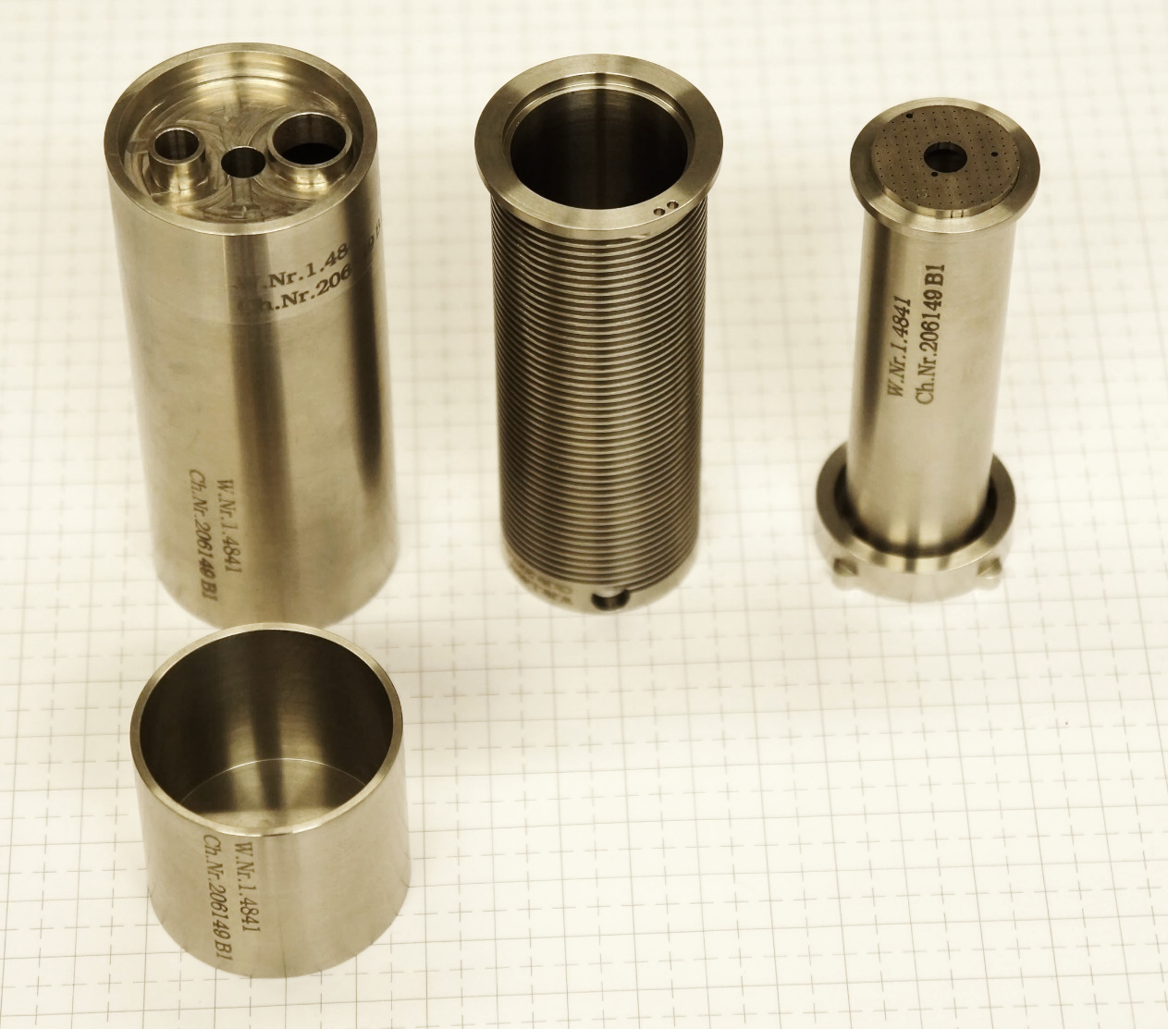
Fabricated TRTM capsule items

Slide 17
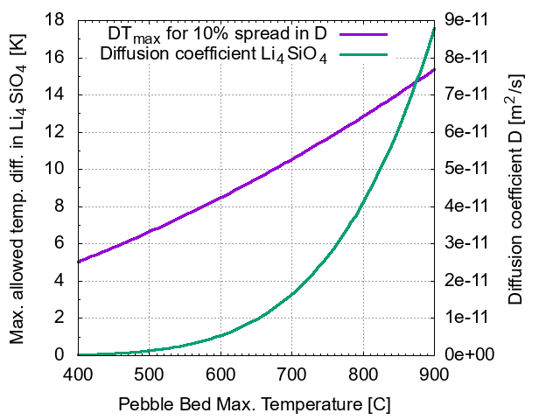
Limitation of temperature spread

