Slide 1
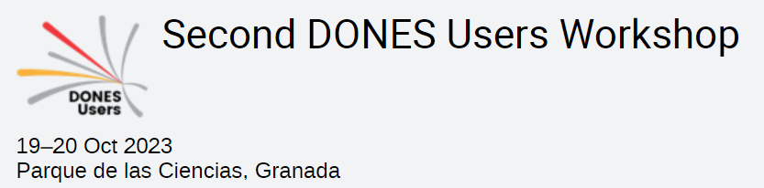

Solid Breeding Blankets: overview and key pending validation needs
Guangming Zhou, Francisco A. Hernández, Arkady Serikov (KIT)
Alessandro Spagnuolo, Salvatore D’Amico (EUROfusion DEMO Central Team)

Slide 2
Outline of content
Solid breeding blankets in Europe: Overview
  Helium Cooled Pebble Bed (HCPB)
  Water cooled Lead and Ceramic Breeder (WLCB)
Key pending validation needs

Slide 3
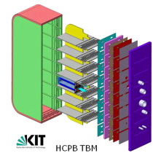
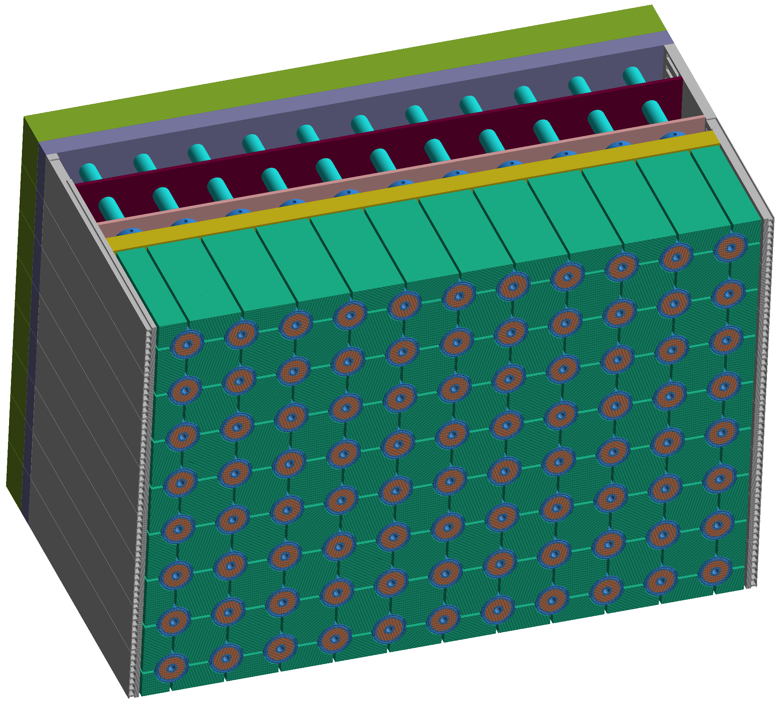
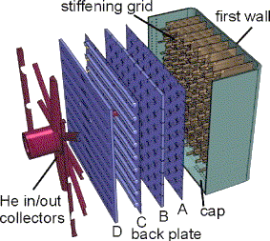
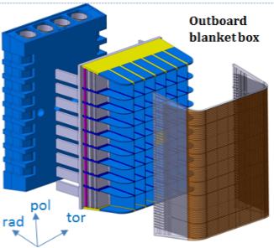
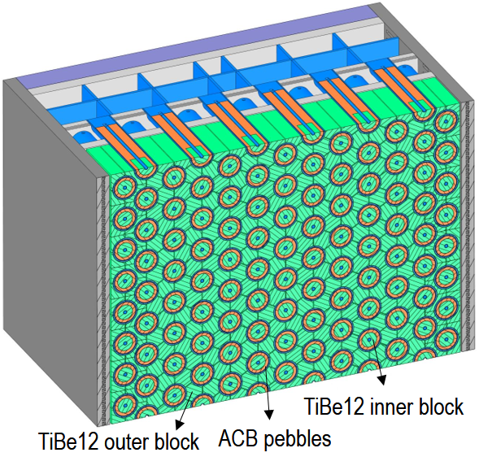
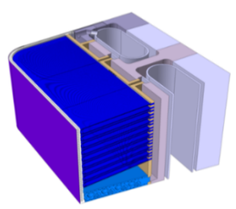
Solid breeding blanket in Europe: HCPB – Helium Cooled Pebble Bed
HCPB and WCLL are two driver blanket concepts for EU DEMO
Pre-Concept Design Phase (FP8)
  Coolant: He @80 bar, 300-520°C
  T-breeder: Li-ceramic pebbles
  n-multiplier: Beryllide
  T-extraction: purge gas
  Structural steel: Eurofer97
Concept Design Phase (FP9)
    ITER HCPB TBM „act-alike“
2021
G. Zhou et al. 2022. TOFE 2022
2022
2023
    PPCS Model B (HCPB)
    ↑↑ Robustness (in-box LOCA)
    ↓↓ TBR (1.06)
    ↑↑ Fabrication & assembly complexity
    ↑↑ ∆p (P_{pump}≈250MW, low TRL BoP)
''Beer-box''
G. Zhou et al. 2023. ISFNT-15
2014
    DEMO baseline 2014
    ↑ Robustness (in-box LOCA)
    ↑ TBR (1.20)
    ↓ Fabrication & assembly complexity
    ↓ ∆p (P_{pump}≈ 90MW, high TRL BoP)
    ↑ High reliability
2015
    DEMO baseline 2015
    ↑ Robustness (in-box LOCA)
    ↑ TBR (1.15)
    ↑ Fabrication & assembly complexity
    ↑ ∆p (P_{pump}≈150MW, low TRL BoP)
2016
''Sandwich''
2017
    DEMO baseline 2017
Beryllide block
80 bar
80 bar
    ↑ Robustness (in-box LOCA)
    ↑ TBR (1.20)
    ↓ Fabrication & assembly complexity
    ↓ ∆p (P_{pump}≈ 90MW, high TRL BoP)
    Low reliability, low availibility of DEMO
2 bar
80 bar
2 bar
2018
80 bar
2019
''Fuel-breeder pin''
Li-ceramic pebble
2 bar
80 bar
80 bar
2020
Hernández FA et al., 2020 Fusion Eng Des 157, 111614.
Guangming Zhou et al. | 2nd DONES Users Workshop | 19.10.2023 | 3/15

Slide 4
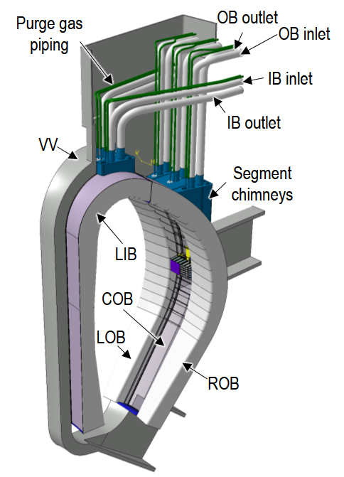
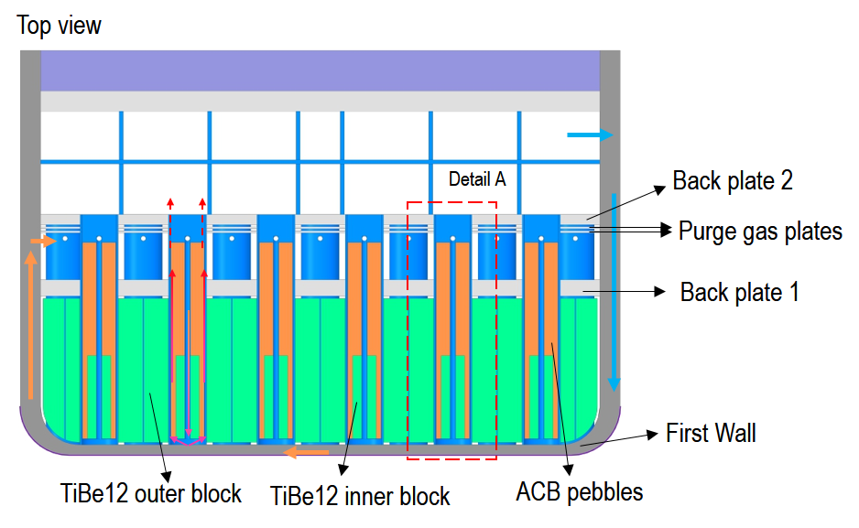
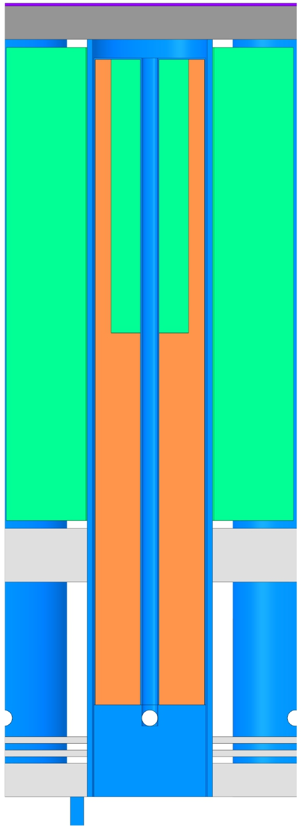

Solid breeding blanket in Europe: HCPB high pressure purge gas
Shield
80 bar
TiBe12 inner block
TiBe12 outer block
FW
Detail A: Fuel-breeder pin
ACB pebbles
Armor
  Coolant: He @80 bar, 300-520°C
  Structural steel: Eurofer97
  Fuel-breeder pins contain advanced ceramic breeder (ACB) pebble
  Beryllide neutron multiplier of triangular prism with lateral edges filleted
  T-extraction: He + 200 Pa H₂ @80 bar
  FW and critical structure thicker + cooler by fresh coolant
  Inner beryllide block inside ACB pebble
  Nuclear, thermal hydr. & thermal-mech. analysis confirmed soundness
Closing disk
HCPB-BL2017-HP-v1
Pressure tube
Guangming Zhou et al. | 2nd DONES Users Workshop | 19.10.2023 | 4/15

Slide 5
Exploring variant: WLCB – Water coold Lead and Ceramic Breeder
  Background:
    Idea started in FP8: HCPB issue with beryllium -> deep exploration of alternative n-multipliers -> Pb/Pb-alloy
    He-cooled molten lead and ceramic breeder blanket
    Curiosity for a water cooled version -> WLCB, as radial fuel-breeder pins
Hernández FA et al. 2019, Fusion Eng Des 146:1186–1191
Zhou G et al. 2019, Fusion Eng Des 146:1029–1034
Zhou G et al. 2021, Fusion Eng Des 168: 112397
WLCB
HCPB
WCLL
  Seen as a best trade-off between HCPB and WCLL:
    To avoid current issues in HCPB with shielding, multiplier technology and costs
    To mitigate issues with T-permeation and avoid T-extraction risks from PbLi in WCLL
    To avoid use of anti-permeation barriers in BB
    To use proven water PWR tech.
T extraction from ACB
Low T permeation (no need for T barriers)
Available TER technology
Good TBR in compact space
Proven water PWR tech
Excellent neutron shielding
More mature PHTS/BoP
HCPB: Helium Cooled Pebble Bed
WLCB: Water cooled Lead and Ceramic Breeder
WCLL: Water Cooled Lithium Lead
Hernández FA et al. 2023, ISFNT-15
Guangming Zhou et al. | 2nd DONES Users Workshop | 19.10.2023 | 5/15

Slide 6
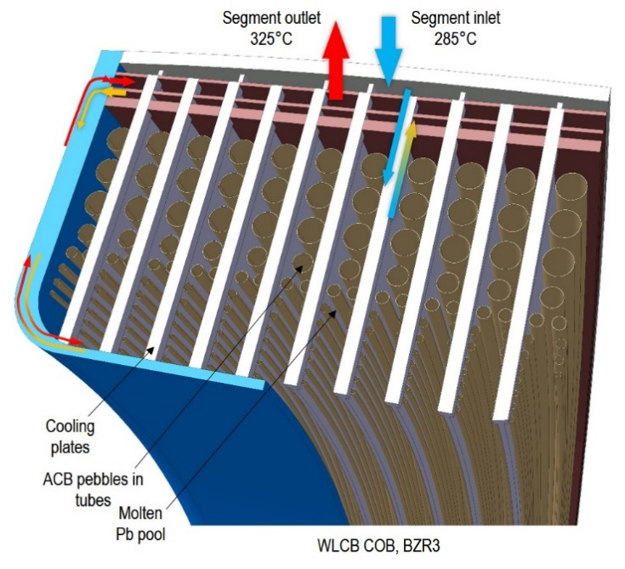
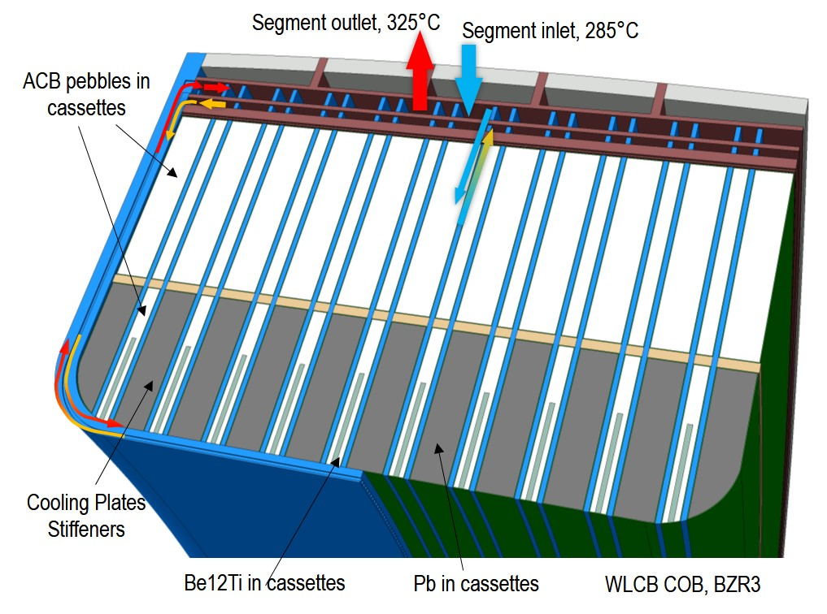
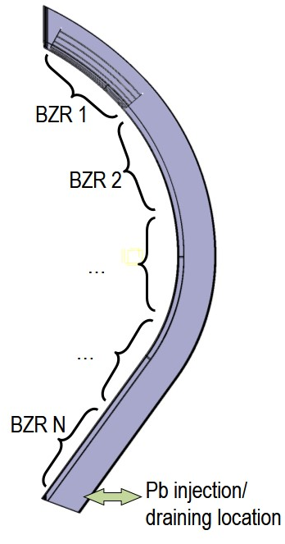
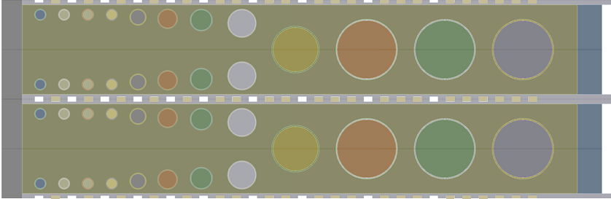
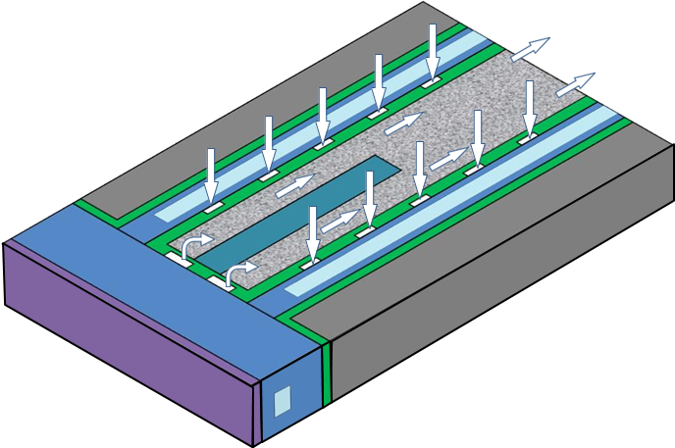
Exploring variant: WLCB Design evolution
Pre-Concept Design Phase (FP8)
Concept Design Phase (FP9)
Hernández FA et al. 2023, ISFNT-15
2019-2020
2021-2023
2023-
Zhou G et al. 2021, Fusion Eng Des 168: 112397.
ACB pebbles in tubes
Second pass, T extraction
First pass, advection
Cooling plates
Feasibility study of a WLCB based on the fuel-breeder pin architecture, in terms of T-breeding, temperature and stress limits.
Too many welds, low reliability, low availiability
Molten Pb pool
High reliability
Tritium breeding and T-permeation
Guangming Zhou et al. | 2nd DONES Users Workshop | 19.10.2023 | 6/15

Slide 7
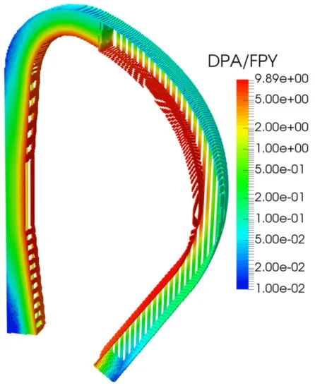
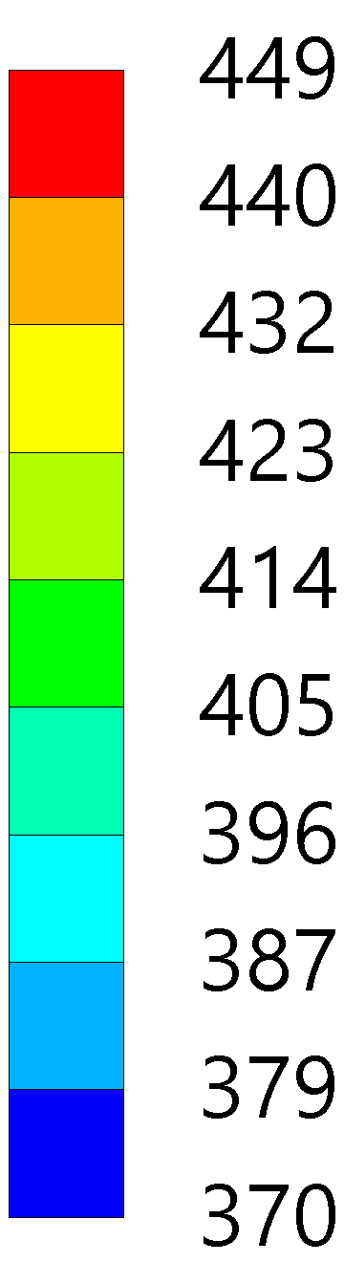

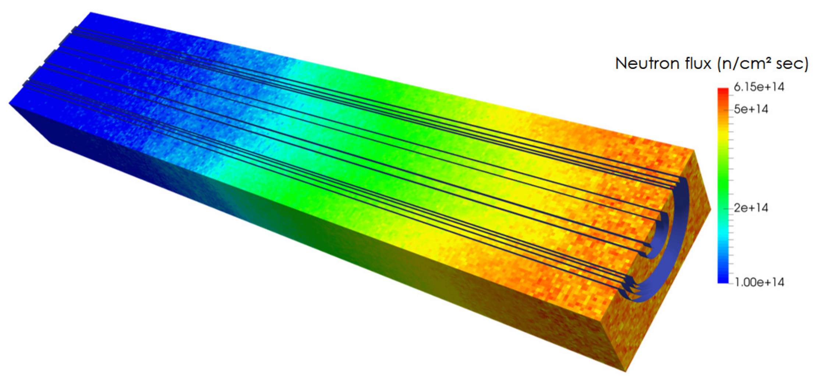

Challenging environment in fusion power plant
High dose rate
High pressure (80 bar for HCPB, 155 bar for WLCB)
High temperature gradient
$$\frac{dT}{dx}=\frac{\left(449−413\right)°C}{3 mm}=120\frac{°C}{cm}$$
80 bar
Temp. [°C]
3 mm
Neutron flux at breeding zone
Displacement per atom accumulation in the BB structure
Temp. on FW
Guangming Zhou et al. | 2nd DONES Users Workshop | 19.10.2023 | 7/15

Slide 8

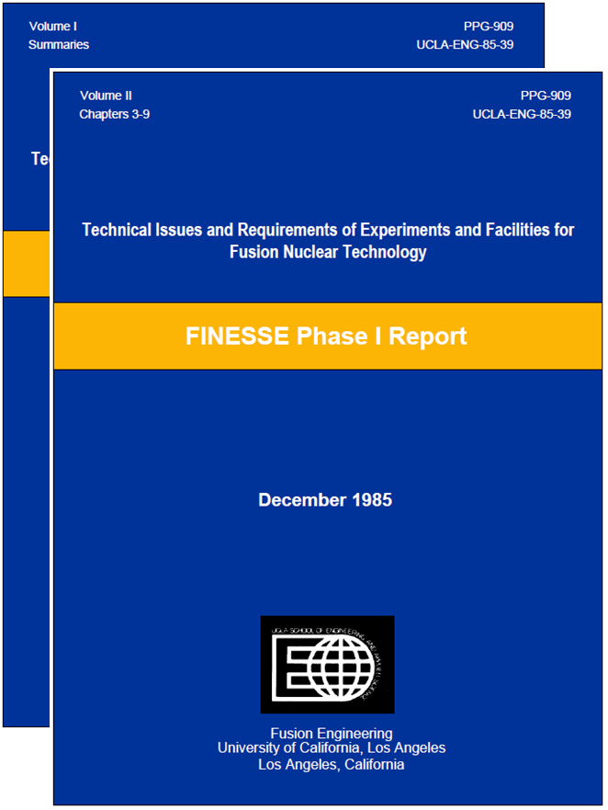
Challenges and pending validation needs of HCPB & WLCB
Spagnuolo A et al., this session
  Changes in properties and behaviour of materials
    Effect of heat flux and cycling on fatigue or crack growth-related failure
    Premature failure at welds
    Effect of swelling, creep and thermal gradients on stress
  Tritium permeation through the structure
    Tritium permeation through structure into coolant
    Effect of radiation on tritium permeation
  Structural activation product inventory
  Blanket supporting structure to Vacuum Vessel
  Failure modes & rates of blanket structure under fusion environ.
  Mechanical and materials interactions
    Corrosion
    Failure of coolant wall due to stress corrosion cracking
    Failure of coolant wall due to liquid-metal embrittlement
  Neutron-induced sputtering transp. of activated mat.
  Coolant/coatings/structure interactions
w/o neutrons
w/ neutrons
Fusion environment
Coolant / structure interactions
Structure
  Tritium release, recovery and inventory in solid breeder and multiplier
  Thermal conduct. changes of Breeder and Multiplier under irradiation
  Tritium transport in blanket system
  Breeder behaviour under high dpa
  Solid multiplier behaviour under high dpa
  Solid breeder mechanical and materials interactions
    Pebble-steel interaction under purge gas environment
    Load on wall induced by Pebble expansion/swelling
    Dust formation and transport of pebble bed
  Neutron multiplier mechanical interactions
    Beryllide swelling and interact with wall
    Cracking of Beryllide block due to thermal stress
    Compatibility of neutron multiplier and Li-ceramics
  Thermal interactions
    Breeder/multiplier-structure heat transfer (gap conductance)
Breeder/multiplier and purge
Solid Breeder / multiplier / structure interactions
  Uncertainties in required T breeding ratio
  Uncertainties in achievable T breeding ratio
  Tritium trapping
  Tritium permeation to blanket coolant
  Failure modes and rates
  Nuclear heating rate predictions
  Prediction and control of radioactive effluent
General for all concepts
Abdou MA et al. 1985, Fusion Technology 8:3, 2595-2645
Tungsten and EUROFER qualification & design code not included here, dealt in WPMAT.
Guangming Zhou et al. | 2nd DONES Users Workshop | 19.10.2023 | 8/15

Slide 9
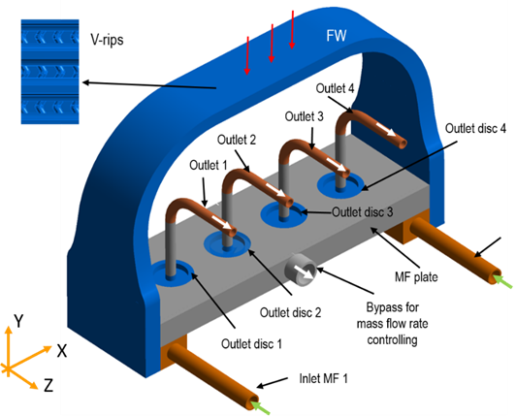
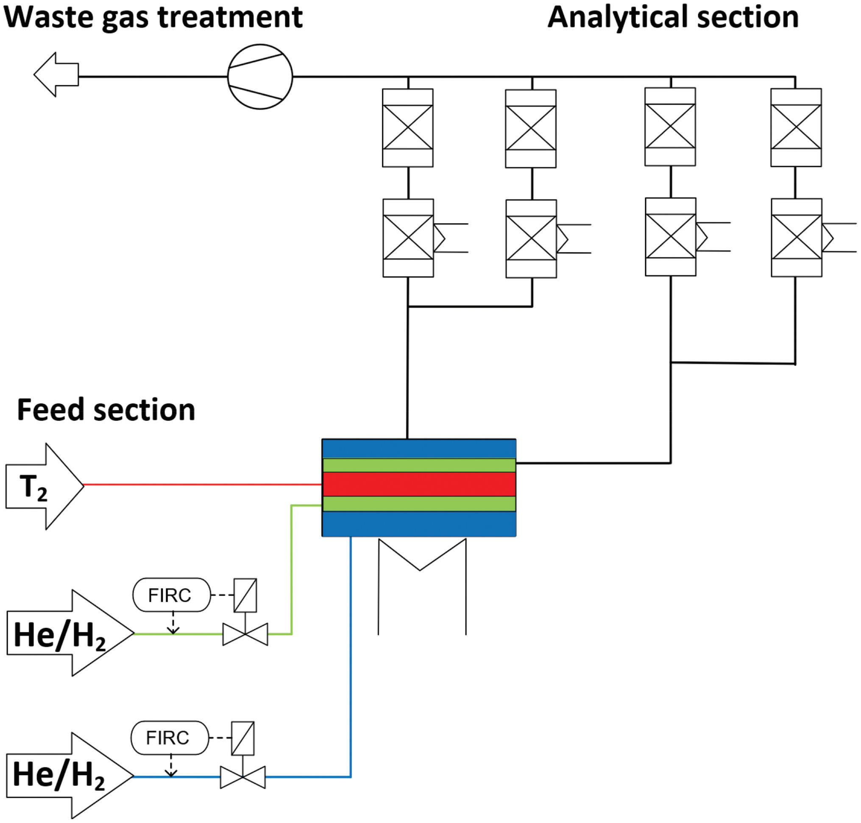
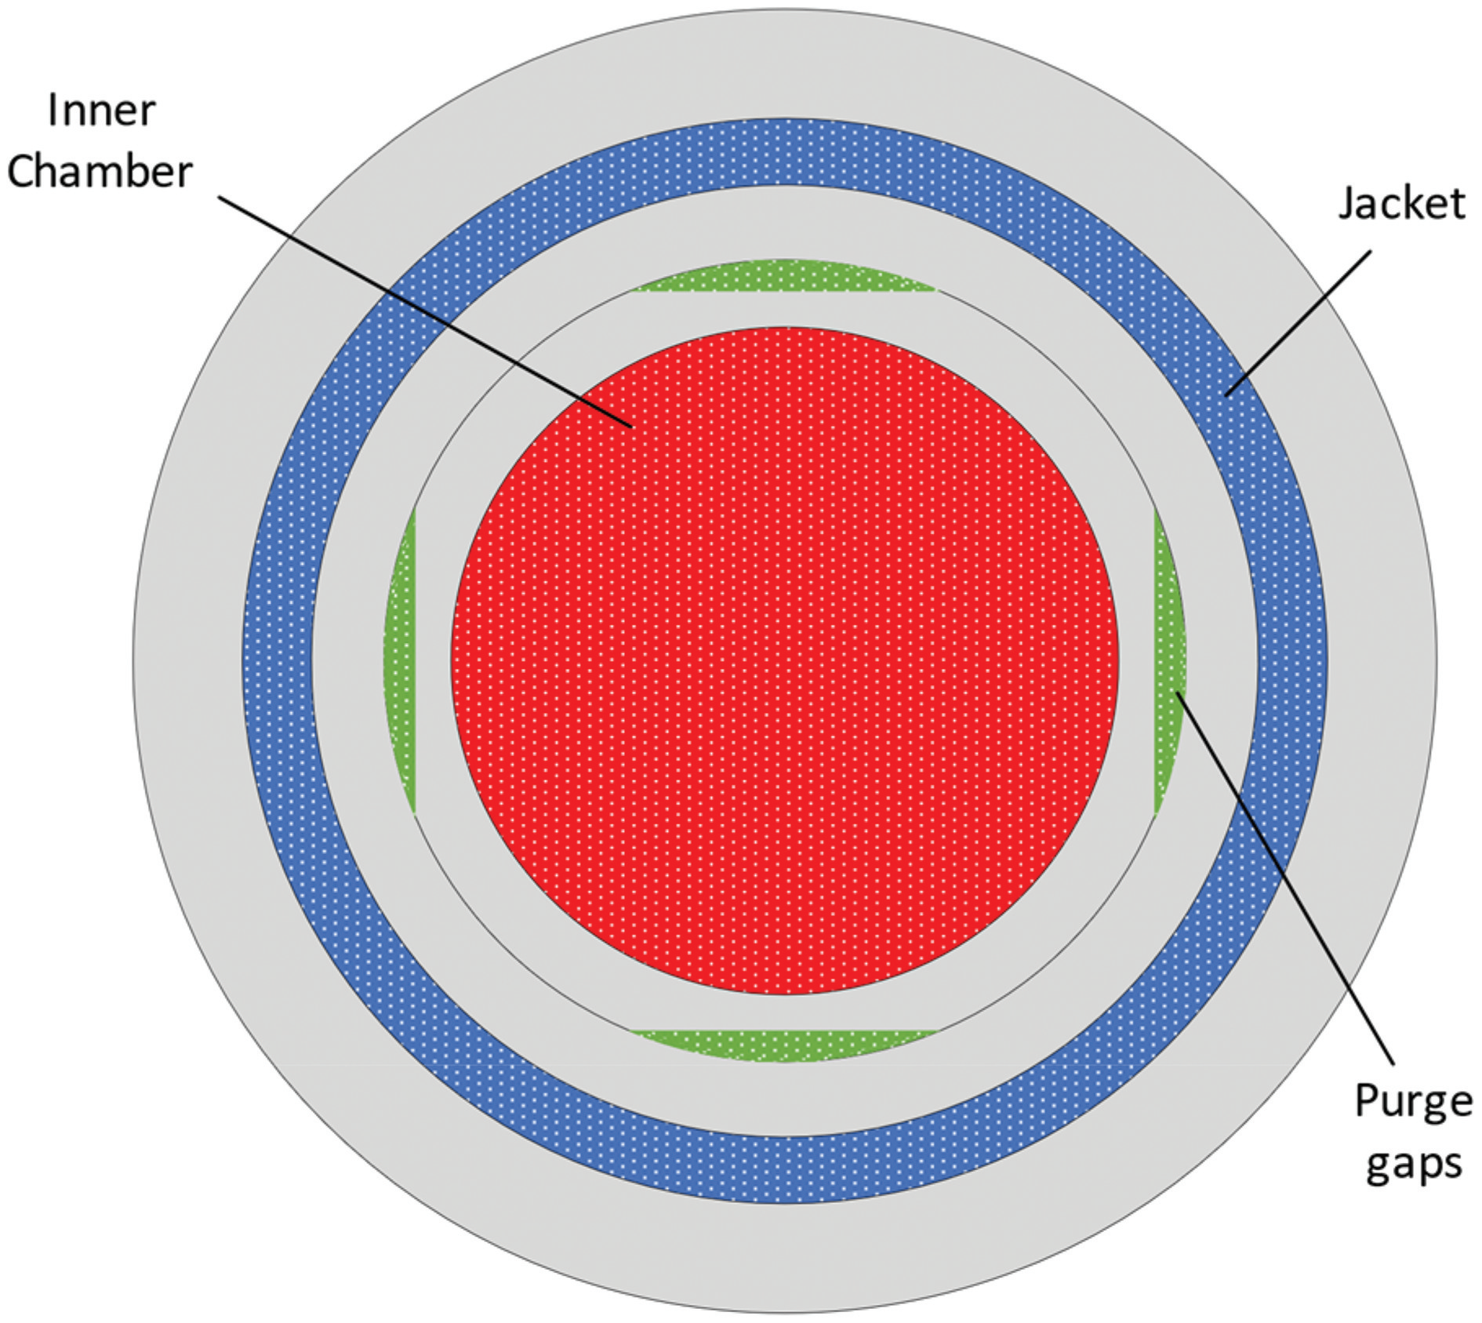
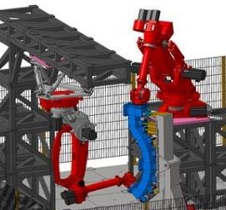
Ongoing activities
  Changes in properties and behaviour of materials
    Effect of heat flux and cycling on fatigue or crack growth-related failure
    Premature failure at welds
    Effect of swelling, creep and thermal gradients on stress
  Tritium permeation through the structure
    Tritium permeation through structure into coolant
    Effect of radiation on tritium permeation
  Structural activation product inventory
  Blanket supporting structure to Vacuum Vessel
  Failure modes & rates of blanket structure under fusion environ.
Thermomechanic cycling of FW at HELOKA
Zhou G et al., 2021, EUROfusion report
Structure
Tritium permeation cell at Tritium Laboratory Karlsruhe
w/o neutrons
w/ neutrons
Fusion environment
Kohpeiss J et al., 2023, Fusion Science and Technology
Remote Handling Test Facility
Crofts O. 2023, ISFNT-15
Guangming Zhou et al. | 2nd DONES Users Workshop | 19.10.2023 | 9/15

Slide 10
Ongoing activities
  Mechanical and materials interactions
    Corrosion
    Failure of coolant wall due to stress corrosion cracking
    Failure of coolant wall due to liquid-metal embrittlement
  Neutron-induced sputtering transp. of activated mat.
  Coolant/coatings/structure interactions und irrad.
WLCB
learn from fission
Coolant / structure interactions
w/o neutrons
w/ neutrons
Fusion environment
Guangming Zhou et al. | 2nd DONES Users Workshop | 19.10.2023 | 10/15

Slide 11
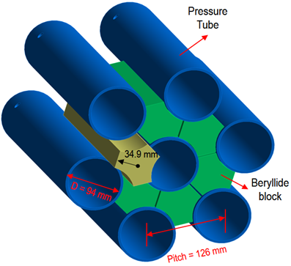
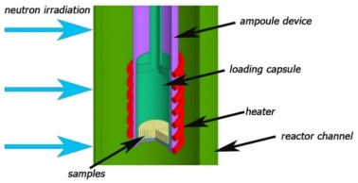
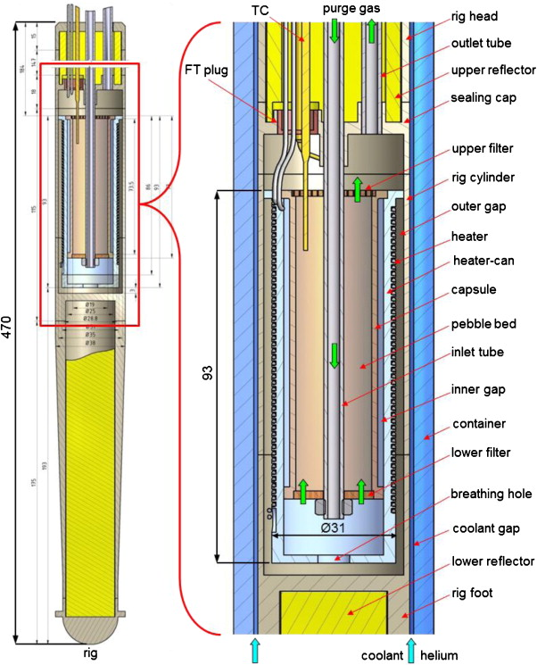
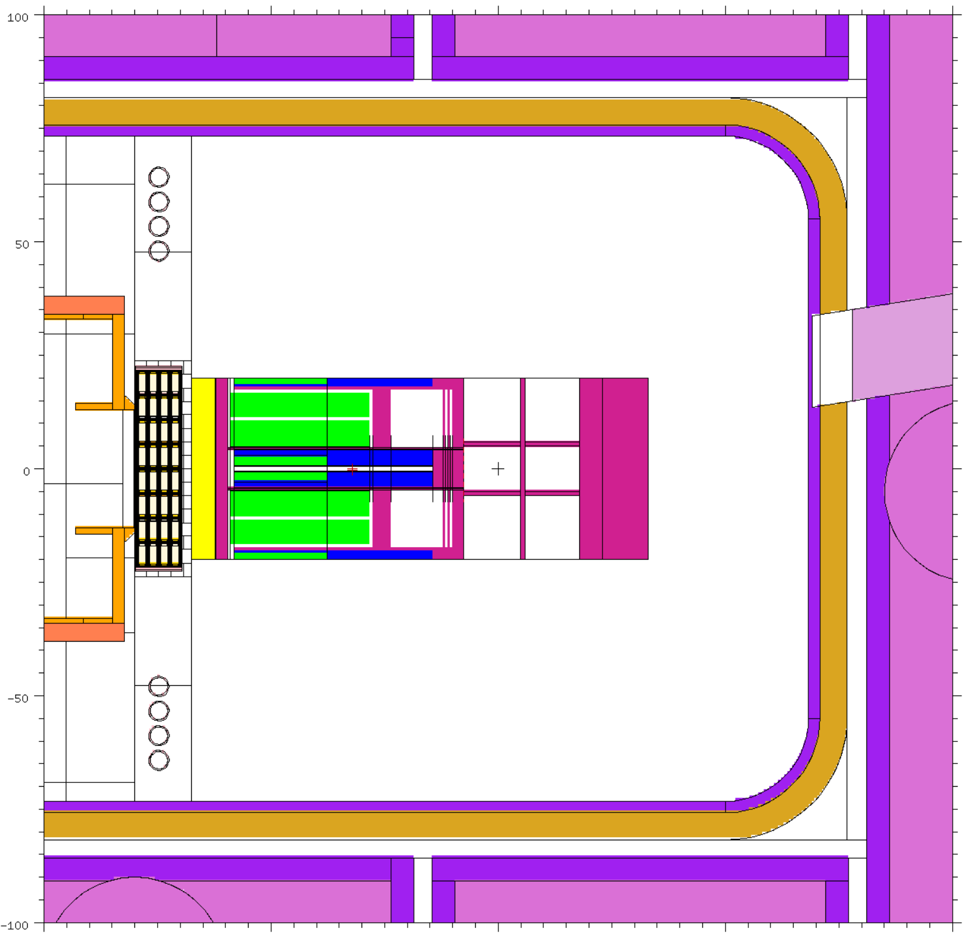
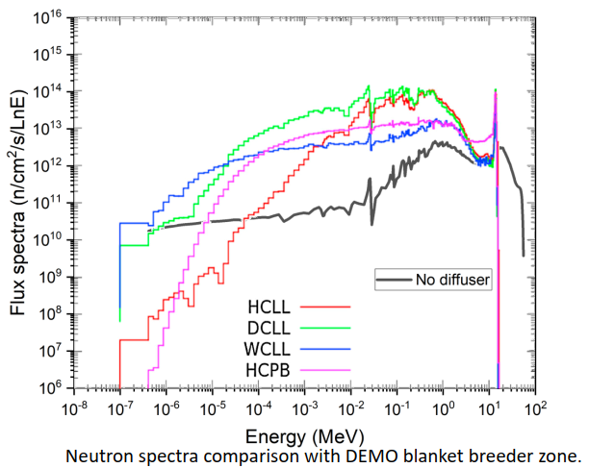
Ongoing activities
Irradiation campaigns at BR2, Belgium and WWR-K, Kazakhstan
Limited irradiation space
Φ22 mm in WWR-K
Kulsartov T et al., 2022, Nucl. Mat. Energ., 30:101115
345 mm
  Tritium release, recovery and inventory in solid breeder and multiplier
  Thermal conduct. changes of Breeder and Multiplier under irradiation
  Tritium transport in blanket system
  Breeder behaviour under high dpa
  Solid multiplier behaviour under high dpa
w/o neutrons
w/ neutrons
Fusion environment
Tritium Release Test Module in IFMIF/DONES
Breeder/multiplier and purge
Arbeiter F, this session
Qiu Y. 2023, private communication
400 x 400 x 950 mm³
Unit: mm
Abou-Sena A, Arbeiter F. 2013, Fusion Eng. Des. 88: 818-823
Space for breeder/multiplier
400
950
400
Guangming Zhou et al. | 2nd DONES Users Workshop | 19.10.2023 | 11/15

Slide 12
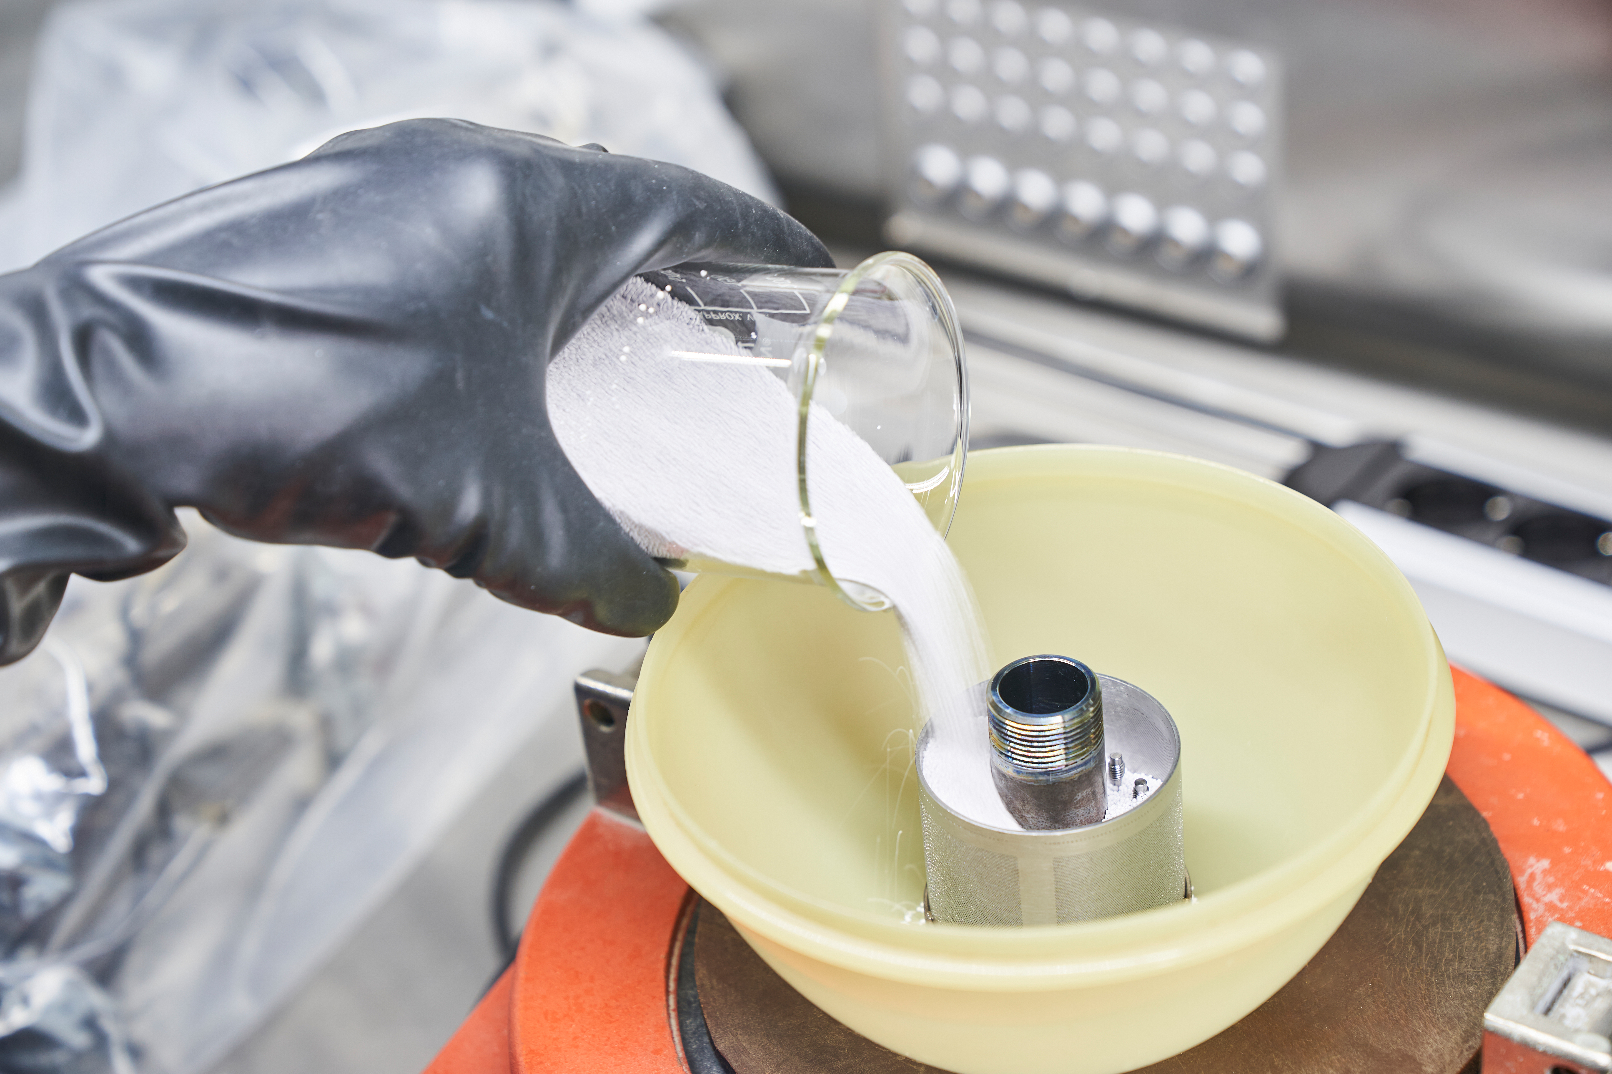
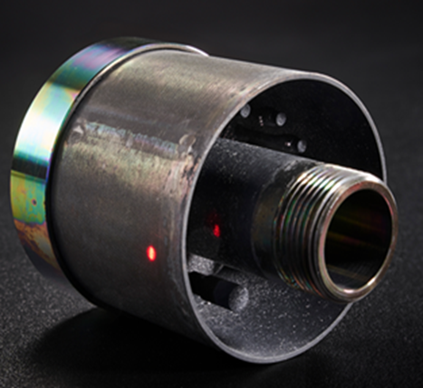
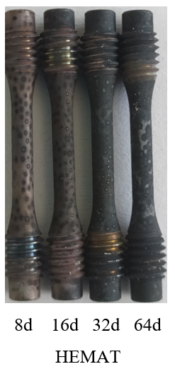
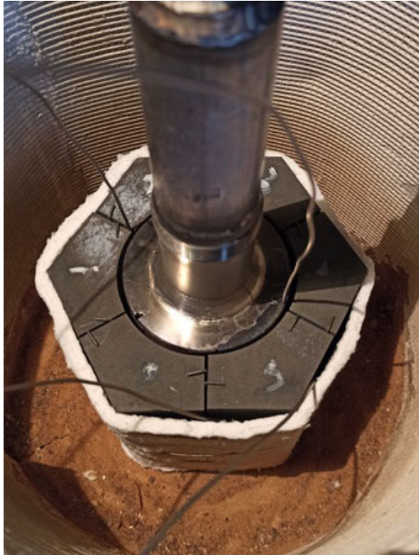
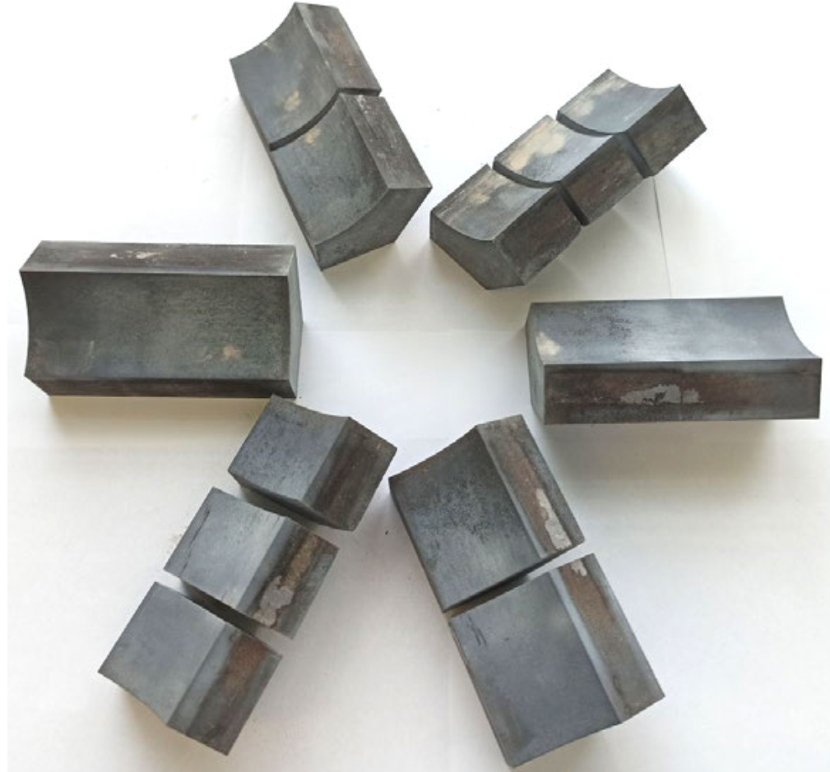
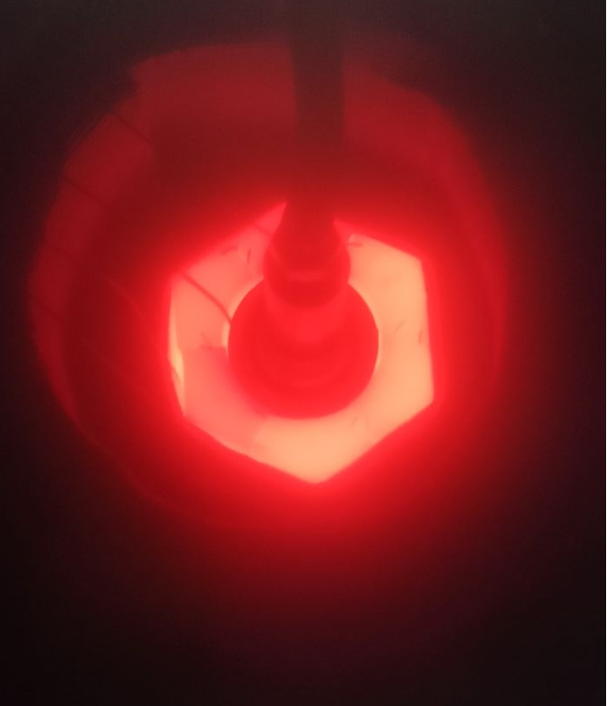
Ongoing activities
Ageing of Eurofer97 in contact with pebbles under purge gas environment, 550°C, HELOKA-HEMAT
Krüssmann R et al., 2023, ISFNT-15
  Solid breeder mechanical and materials interactions
    Pebble-steel interaction under purge gas environment
    Load on wall induced by Pebble expansion/swelling
    Dust formation and transport of pebble bed
  Neutron multiplier mechanical interactions
    Beryllide swelling and interact with wall
    Cracking of Beryllide block due to thermal stress
    Compatibility of neutron multiplier and Li-ceramics
  Thermal interactions
    Breeder/multiplier-structure heat transfer (gap conductance)
Gaisin R et al., 2022, 15th International Workshop on Beryllium Technology
Pebble Bed Test Module in DONES?
Solid Breeder / multiplier / structure interactions
After 200 cycles
Thermal cycling using induction heating at Ulba/KIT
w/o neutrons
w/ neutrons
Fusion environment
Solid Neutron Multiplier Test Module in DONES?
Guangming Zhou et al. | 2nd DONES Users Workshop | 19.10.2023 | 12/15

Slide 13
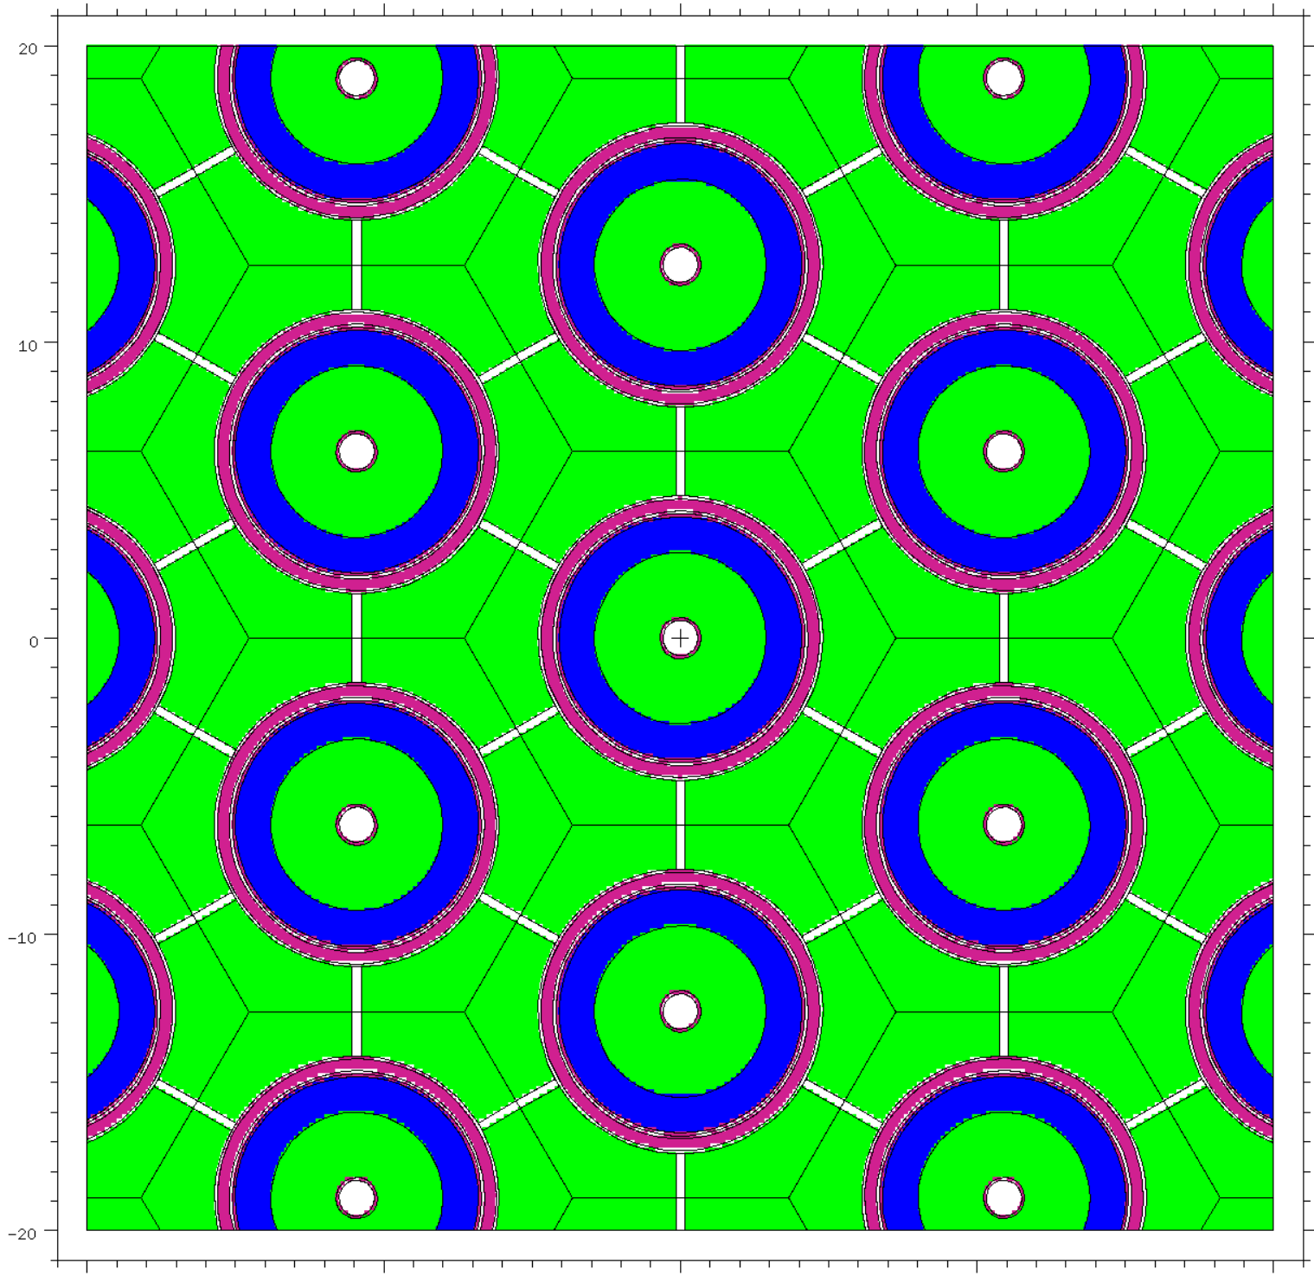
Challenges and pending validation needs of HCPB & WLCB
A-A
Fuel-breeder pin
of HCPB
A-A view
  Solid breeder mechanical and materials interactions
    Pebble-steel interaction under purge gas environment
    Load on wall induced by Pebble expansion/swelling
    Dust formation and transport of pebble bed
  Neutron multiplier mechanical interactions
    Beryllide swelling and interact with wall
    Cracking of Beryllide block due to thermal stress
    Compatibility of neutron multiplier and Li-ceramics
  Thermal interactions
    Breeder/multiplier-structure heat transfer (gap conductance)
DONES Test Cell
Pebble Bed Test Module in DONES?
Solid Breeder / multiplier / structure interactions
Blanket Functional Materials Module
in DONES?
w/o neutrons
w/ neutrons
Fusion environment
Solid Neutron Multiplier Test Module in DONES?
Guangming Zhou et al. | 2nd DONES Users Workshop | 19.10.2023 | 13/15

Slide 14
Challenges and pending validation needs of HCPB & WLCB
w/o neutrons
w/ neutrons
Fusion environment
  Uncertainties in required T breeding ratio
  Uncertainties in achievable T breeding ratio
  Tritium trapping
  Tritium permeation to blanket coolant
  Failure modes and rates
  Nuclear heating rate predictions
  Prediction and control of radioactive effluent
Fusion neutrons
with sufficient space for qualifying blankets
General for all concepts
Guangming Zhou et al. | 2nd DONES Users Workshop | 19.10.2023 | 14/15

Slide 15

Conclusions
  Changes in properties and behaviour of materials
    Effect of heat flux and cycling on fatigue or crack growth-related failure
    Premature failure at welds
    Effect of swelling, creep and thermal gradients on stress
  Tritium permeation through the structure
    Tritium permeation into coolant
    Effect of radiation on tritium permeation
  Structural activation product inventory
  Blanket supporting structure to Vacuum Vessel
  Failure modes & rates of blanket structure under fusion environ.
  Mechanical and materials interactions
    Corrosion
    Failure of coolant wall due to stress corrosion cracking
    Failure of coolant wall due to liquid-metal embrittlement
  Neutron-induced sputtering transp. of activated mat.
  Coolant/coatings/structure interactions
w/o neutrons
w/ neutrons
Fusion environment
Coolant / structure interactions
Structure
  Tritium release, recovery and inventory in solid breeder and multiplier
  Thermal conduct. changes of Breeder and Multiplier under irradiation
  Tritium transport in blanket system
  Breeder behaviour under high dpa
  Solid multiplier behaviour under high dpa
  Solid breeder mechanical and materials interactions
    Pebble-steel interaction under purge gas environment
    Load on wall induced by Pebble expansion/swelling
    Dust formation and transport of pebble bed
  Neutron multiplier mechanical interactions
    Beryllide swelling and interact with wall
    Cracking of Beryllide block due to thermal stress
    Compatibility of neutron multiplier and Li-ceramics
  Thermal interactions
    Breeder/multiplier-structure heat transfer (gap conductance)
Breeder/multiplier and purge
Solid Breeder / multiplier / structure interactions
  Uncertainties in required T breeding ratio
  Uncertainties in achievable T breeding ratio
  Tritium trapping
  Tritium permeation to blanket coolant
  Failure modes and rates
  Nuclear heating rate predictions
  Prediction and control of radioactive effluent
General for all concepts
Out-of-pile and in-pile tests in MTRs for basic tests
DONES could offer unique test platform for irrad. function. mat.
Fusion neutron source is needed for blanket qualification
Guangming Zhou et al. | 2nd DONES Users Workshop | 19.10.2023 | 15/15

Slide 16
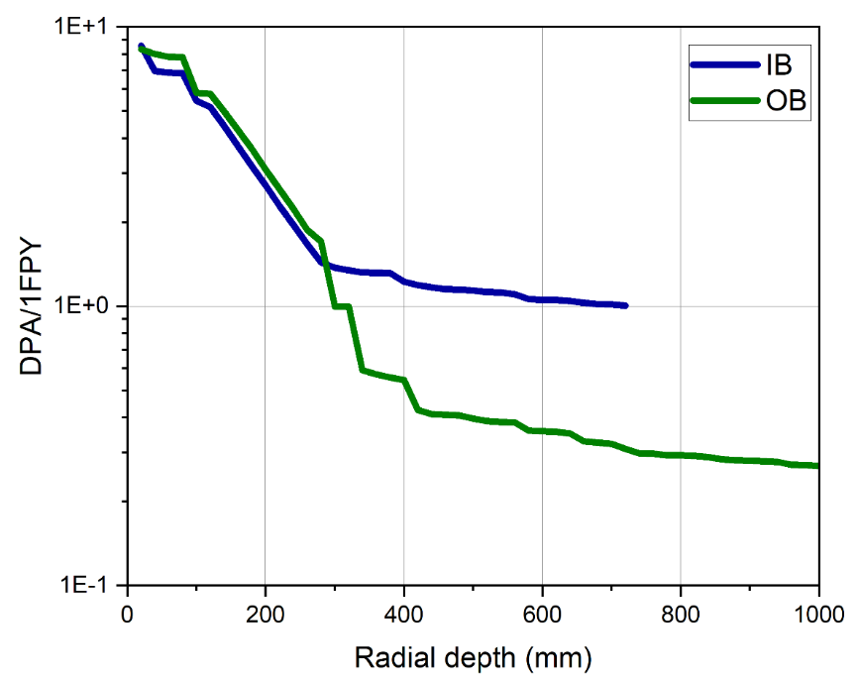
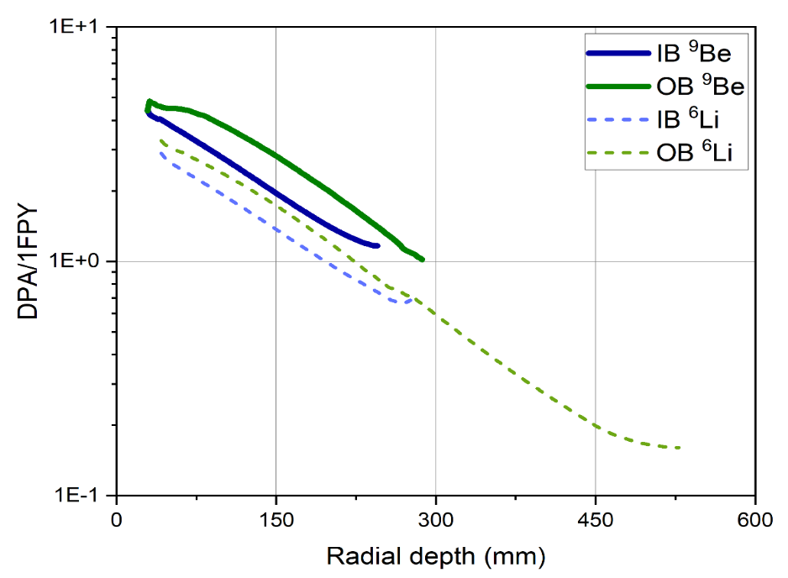
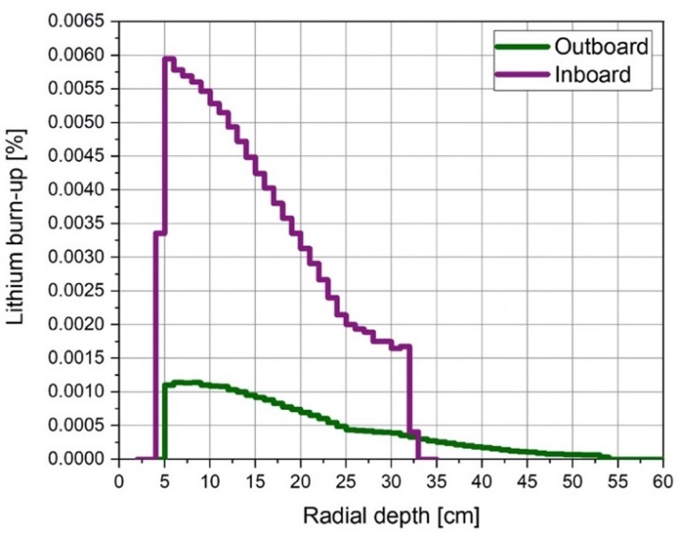
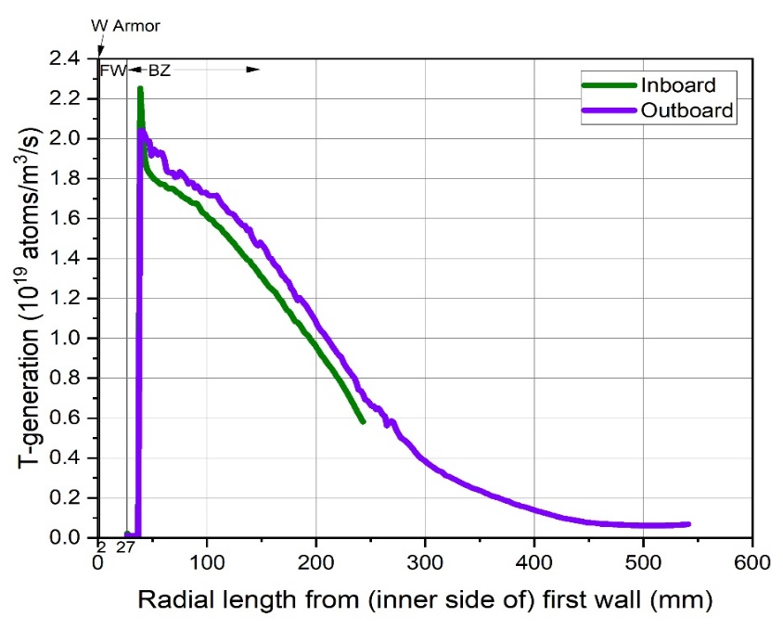
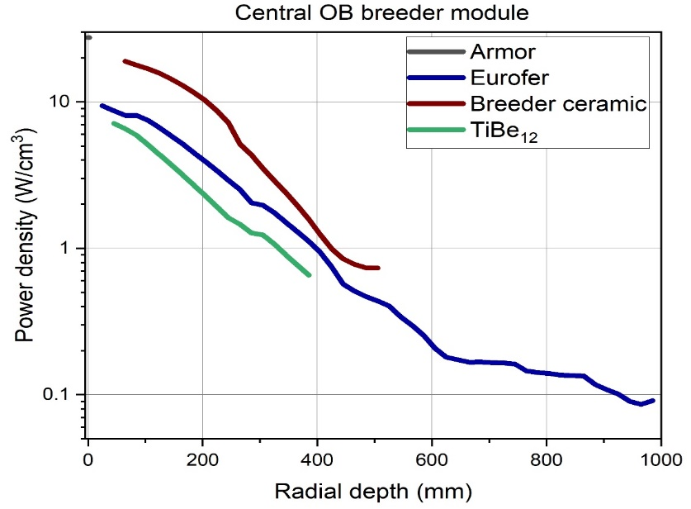
Backup slides: Nuclear responses of HCPB BB
Zhou G et al., 2023, HCPB Design and Analysis Report
5
DPA of E97
DPA of TiBe12 and Li-pebble
Neutron flux at breeding zone at contral IB
Burn-up/fpy
T-generation
Power density
16

Slide 17
Backup slides
Investigating the evolving behavior of the pebble bed and beryllide neutron multiplier together, for example, it can be that the breeder undergoes chemical processes (due to burn-up and due to contact to other material), the pebble bed can change its thermal conductivity and consequently shift the temperature field which is decisive for the tritium release residence times
The pebbles will mechanically deform and it will be interesting to study their interacting within the bed and also with the walls
Dust formation and transport of pebble bed in the purge gas flow path
Measuring the time structure of tritium release from this complex setup with broad temperature spread and realistic (not 1-D) purge flow path (as opposed to the well-defined "academic type" TRTM)
A specific question concerns the cracking/blistering of the berillyde block, which is larger than a TRTM capsule
17

