Slide 1

Liquid metals Breeding Blankets: overview and key pending validation needs
Second DONES Users Workshop
Thursday, 19 October 2023, 3:20 PM
Parque de las Ciencias, Granada, Spain
Alessandro Venturini (ENEA FSN-ING)

Slide 2
Outline
Introduction
Remarks on Breeding Blankets
Qualification
WCLL BB needs
Introduction to WCLL BB
Irradiation infrastructures (existing and planned)
Challenges
WCLL BB-related challenges
DONES potential contribution
Examples
Conclusive remarks

Slide 3




Introductory remarks on breeding blankets
L.V. Boccaccini, et Al., Objectives and status of EUROfusion DEMO blanket studies, Fusion Eng. Des., 109–111 (2016), pp. 1199-1206
The Breeding Blanket has to withstand severe operating conditions, ensuring (1) ³H self-sufficiency, (2) n-shielding and (3) coolant temperatures for an efficient power conversion cycle
Any Breeding Blanket consists of:
Breeding Material (solid or liquid, containing Li)
Neutron Multiplier (solid or liquid, containing Be or Pb)
Structural material (RAFM steel, SiC_{f}/SiC)
Coolant (water, He, PbLi)
Constraints for materials:
Tritium self-sufficiency
Compatibility with high neutron fluxes
High operating temperatures
European conceptual designs of breeding blanket
Solid breeder
  Helium Cooled Pebble Bed (HCPB)
Liquid breeder
  Helium Cooled Lithium Lead (HCLL)
  Dual Coolant Lithium Lead (DCLL)
  Water Cooled Lithium Lead (WCLL)
F. Cismondi, et Al., Progress in EU Breeding Blanket design and integration, Fusion Eng. Des., 136 (2018), pp. 782-792
F. Cismondi, et Al., Progress of the conceptual design of the European DEMO Breeding Blanket, Tritium Extraction and Coolant Purification Systems, Fusion Eng. Des., 157 (2020) 111640

Slide 4
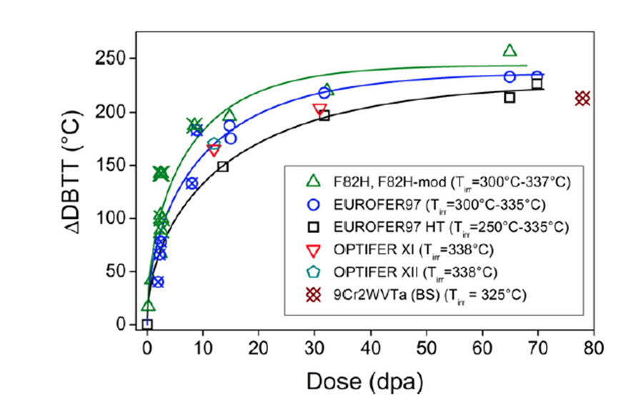
Introductory remarks on WCLL
The BB design and operational parameters, including the TER system and the heat transport system, are driven by the options chosen for the structural material, the breeder, the n-multiplier, and the coolant
Eurofer97 as structural material
  Ref. for DEMO breeding blanket
  Low activation material favorable for waste disposal
  Max operating T favorable for the use of water as coolant
  Challenges:
    Coolant water and PbLi compatibility
    Material performance and lifetime under irradiation
    DBTT limits operating temperature window
      water coolant temperature in normal operation
      close to 300°C (Tmin=295°C)
4/55

Slide 5
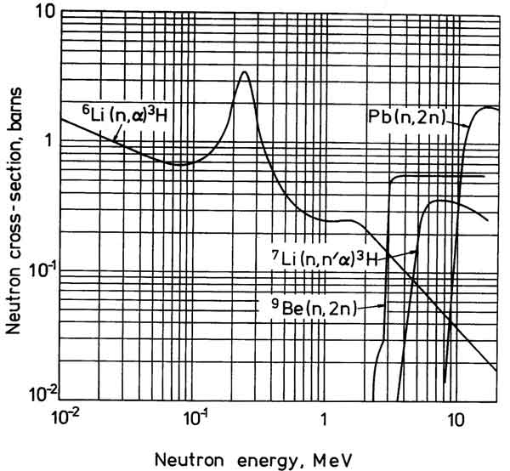
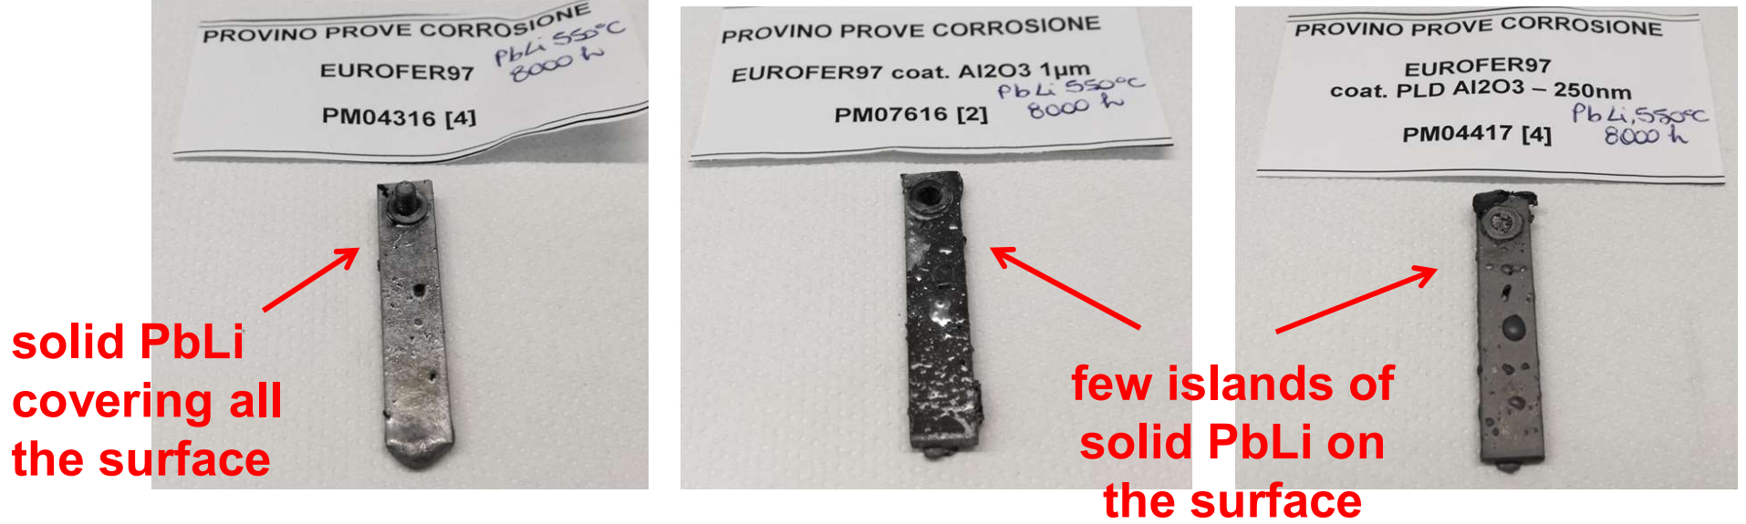
Introductory remarks on WCLL
The BB design and operational parameters, including the TER system and the heat transport system, are driven by the options chosen for the structural material, the breeder, the n-multiplier, and the coolant
PbLi as breeder and n-mult @ ~ 0.1 - 3.0 MPa; ~ 330 – 550 °C
  Eutectic alloy, Liquid phase > 235°C
  Good TBR performances → σ_{Pb} (n, 2n) excellent but high energy threshold
  Reasonable heat transfer performances conductivity (∼15 W/mK); convection but MHD
  Low T solubility, online T extraction, continuous Li recovery (unlimited lifetime)
  Challenges are connected with
    Possible T permeation in the cooling system
    Corrosion issues at high temperature
    “Moderate” reactivity with water
    (lower than Li)
    High density → high static pressure
    Activation products
Bare and coated EUROFER samples after 8000h in stagnant PbLi (RACHEL Lab. – CR Brasimone)
5/55

Slide 6
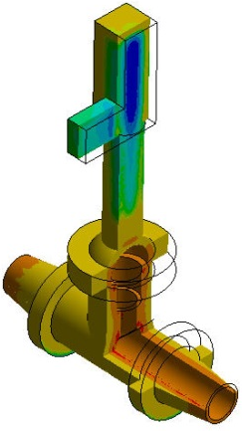

Introductory remarks on WCLL
The BB design and operational parameters, including the TER system and the heat transport system, are driven by the options chosen for the structural material, the breeder, the n-multiplier, and the coolant
Water as coolant @ ~ 15 MPa; ~ 300°C
  Cheap and largely available; excellent heat transfer features; widely used as coolant in NPPs
  Excellent in thermalizing the neutrons (i.e. ↑ for shielding,
  ↓ for Pb n-multiplication)
  Relevant coolant / material compatibility data
  Challenges:
    Coolant chemistry (Eurofer and nuclear fusion environment)
    Coolant purification (i.e. tritium permeation and ACP)
    Activation with fusion n irradiation
    Lithium reactivity (i.e. PbLi in WCLL)
Photonic Dose [MGy]
Isometric view of the upper pipe chase slice
P. Chiovaro, et Al., Assessment of the Dose Rates due to Water Activation on an Isolation Valve of the DEMO WCLL Breeding Blanket Primary Heat Transfer System, Fusion Eng. Des., 160 (2020) 111999
Calculated absorbed γ dose spatial distribution in the valve
6/55

Slide 7
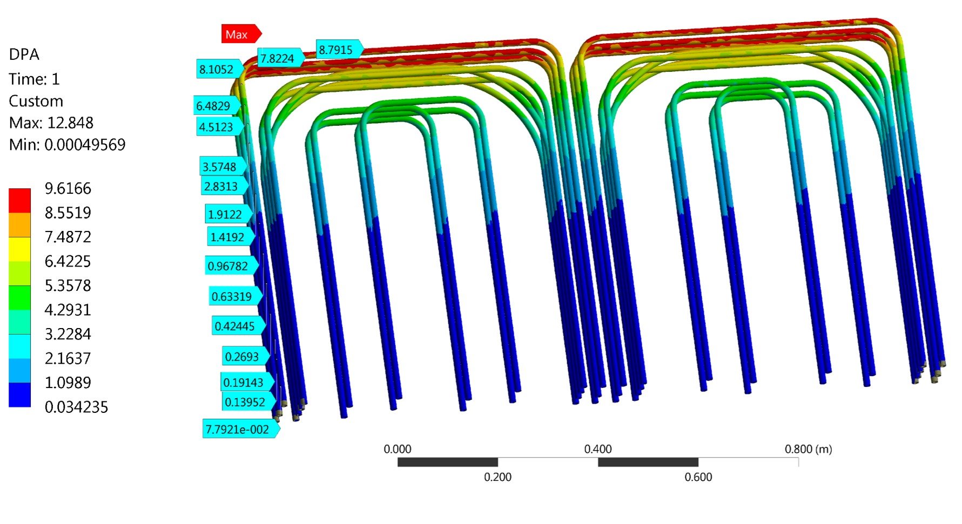
Qualification needs …
Fast flux neutron irradiation (up to 20-50 dpa)
Representative tokamak facility operating conditions
  simultaneous presence of high P and T
  remarkable temperature gradients
  relevant magnetic fields
  hazardous mechanical and chemical processes
Representative mock-up geometries and dimensions
An example: Double Wall Tubes (Eurofer97)
Expected conditions in DEMO:
Neutron flux: 10¹⁴ ÷ 10¹⁵ n/cm²/s
Irradiation dose: 0.2 ÷ 9 dpa/year
Water velocity inside the tubes: 1 ÷ 4 m/s
Water temperature: 295 ÷ 330°C
PbLi temperature: 300 ÷ 500°C
PbLi velocity: ~ mm/s
Tritium partial pressure: 100 ÷ 300 Pa

Slide 8
… and irradiation infrastructures
DEMO
MTR
Spallation
source
p/d LINAC
IFMIF
DONES
VNS
n energy | Low
n flux | Relevant
T gradients | No flexibility
B field/vacuum | No
Mock-ups | Small capsules
n energy | Representative
n flux | Reasonable
T gradients | Representative
B field/vacuum | yes
Mock-ups | Integral effect
n energy | High
n flux | Small
T gradients | No capability
B field/vacuum | No
Mock-ups | Small capsules
n energy | Representative
n flux | Reasonable
T gradients | Acceptable
B field/vacuum | No
Mock-ups | Scaled
n energy | Acceptable
n flux | Relevant
T gradients | Acceptable
B field/vacuum | No
Mock-ups | Scaled

Slide 9
Challenges related to the WCLL BB [1]
Structure
Changes in properties and behaviour of materials
  Deformation and/or breach of components
  Effect of first wall heat flux and cycling on fatigue or
  crack growth-related failure
  Magnetic forces within the structure (including disruptions)
  Premature failure at welds and discontinuities
  Failure due to hot spots
  Interaction of primary and secondary stresses and deformation
  Effect of swelling, creep and thermal gradients on
  stresses concentrations
  Failure due to shutdown residual stresses
  Interaction between surface effects and first wall failures
  Self-welding of similar and dissimilar metals
Tritium permeation through the structure
Effectiveness of tritium permeation barriers
Effect of radiation on tritium permeation
Structural activation product inventory and volatility
Coolant/structure interactions
Corrosion
Failure of coolant wall due to stress corrosion cracking
Failure of coolant wall due to liquid metal embrittlement
Flow sensitivity to dimensional changes
General blanket issues
D-T fuel self-sufficiency
Uncertainties in achievable TBR
Uncertainties in required TBR
Tritium permeation
Permeation from breeder to blanket coolant
Tritium inventory
Failure modes and frequencies
Nuclear heating rate predictions
Blanket response to near blanket failures
Recycling of irradiated lithium
Prediction and control of normal effluents associated with fluid radioactivity
Tritium processing
Tritium Monitoring and Accountability
Breeder Tritium Extraction Characteristics
Metal liquid breeder-multiplier
Geometric effects on flow distribution
Activation products in PbLi
Liquid breeder tritium extraction
[1] BB technical group in support of the Sub-group 1 for DEMO roadmap revisions

Slide 10
Challenges related to the WCLL BB and DONES impact
Structure
Changes in properties and behaviour of materials
  Deformation and/or breach of components
  Effect of first wall heat flux and cycling on fatigue or
  crack growth-related failure
  Magnetic forces within the structure (including disruptions)
  Premature failure at welds and discontinuities
  Failure due to hot spots
  Interaction of primary and secondary stresses and deformation
  Effect of swelling, creep and thermal gradients on
  stresses concentrations
  Failure due to shutdown residual stresses
  Interaction between surface effects and first wall failures
  Self-welding of similar and dissimilar metals
Tritium permeation through the structure
Effectiveness of tritium permeation barriers
Effect of radiation on tritium permeation
Structural activation product inventory and volatility
Coolant/structure interactions
Corrosion
Failure of coolant wall due to stress corrosion cracking
Failure of coolant wall due to liquid metal embrittlement
Flow sensitivity to dimensional changes
General blanket issues
D-T fuel self-sufficiency
Uncertainties in achievable TBR
Uncertainties in required TBR
Tritium permeation
Permeation from breeder to blanket coolant
Tritium inventory
Failure modes and frequencies
Nuclear heating rate predictions
Blanket response to near blanket failures
Recycling of irradiated lithium
Prediction and control of normal effluents associated with fluid radioactivity*
Tritium processing
Tritium Monitoring and Accountability
Breeder Tritium Extraction Characteristics
Metal liquid breeder-multiplier
Geometric effects on flow distribution
Activation products in PbLi
Liquid breeder tritium extraction
*only qualitative
“Partial” contribution [2]: contribution to one or more aspects from qualitative and quantitative point of view
[2] Abdou (1995), https://doi.org/10.1016/0920-3796(95)90122-1

Slide 11
Challenges related to the WCLL BB and DONES impact
Structure
Changes in properties and behaviour of materials
  Deformation and/or breach of components
  Effect of first wall heat flux and cycling on fatigue or
  crack growth-related failure
  Magnetic forces within the structure (including disruptions)
  Premature failure at welds and discontinuities*
  Failure due to hot spots
  Interaction of primary and secondary stresses and deformation
  Effect of swelling, creep and thermal gradients on
  stresses concentrations
  Failure due to shutdown residual stresses
  Interaction between surface effects and first wall failures
  Self-welding of similar and dissimilar metals
Tritium permeation through the structure
Effectiveness of tritium permeation barriers
Effect of radiation on tritium permeation**
Structural activation product inventory and volatility**
Coolant/structure interactions
Corrosion
Failure of coolant wall due to stress corrosion cracking
Failure of coolant wall due to liquid metal embrittlement
Flow sensitivity to dimensional changes
*substantial for parameters
General blanket issues
D-T fuel self-sufficiency
Uncertainties in achievable TBR
Uncertainties in required TBR
Tritium permeation
Permeation from breeder to blanket coolant
Tritium inventory
Failure modes and frequencies
Nuclear heating rate predictions
Blanket response to near blanket failures
Recycling of irradiated lithium
Prediction and control of normal effluents associated with fluid radioactivity
Tritium processing
Tritium Monitoring and Accountability
Breeder Tritium Extraction Characteristics
**14 MeV n
Metal liquid breeder-multiplier
Geometric effects on flow distribution
Activation products in PbLi
Liquid breeder tritium extraction
“Substantial” contribution [2]: contribution capable of resolving the issue
[2] Abdou (1995), https://doi.org/10.1016/0920-3796(95)90122-1

Slide 12
Example 1: no impact of DONES on a challenge
Issue: Magnetic forces within the structure (Structure)
Qualification needs:
Evaluation of neutron impact on material property changes and on the material’s responses to magnetic loading, including deformation and failure modes. Spectrum, fluence, and flux are important test parameters.
Issue: Failure modes and frequencies (General blanket issues)
Qualification needs:
Evaluation of failure modes and frequencies in relevant environmental condition.
The operating environment/parameters include the geometry of the first wall/blanket, expected operating temperature (300-600°C), neutron spectrum, flux, and fluence, heat flux, coolant velocity, and electromagnetic effects.
*In this case also DEMO will still give only partial data. More mature data will have to wait for commercial tokamak operation.

Slide 13
Example 2: partial impact of DONES on a challenge
Issue: Corrosion (Coolant/structure interaction)
Qualification needs:
Evaluation of corrosion phenomena in the coolant. The operating environment for mass transport depends on factors such as neutron fluence, geometry, temperature, velocity, solubilities, and diffusion coefficients. The magnetic field, bulk heating and dissolved hydrogen may substantially change the corrosion mechanism.
Issue: Activation products in PbLi (Metal liquid breeder-multiplier)
Qualification needs:
Evaluation of activation products in PbLi because of the gradual alteration of its composition over time due to transmutation reactions that result in the formation of various species. Testing parameters including neutron flux, spectrum, fluence, temperature are required to properly resolve this issue.

Slide 14
Example 3: Substantial impact of DONES on a challenge
Issue: Premature failure at welds and discontinuities (Structure)
Qualification needs:
Evaluation of material damage and determination of the effects of differential swelling between the weld and parent material. Testing parameters including neutron flux, spectrum, fluence, temperature, and atmosphere are required to properly resolve this issue.
*IFMIF DONES can be substantial from parameters point of view, but it is reported partial because of the synergic effect of loads and the size of the mockup.
Issue: Recycling of irradiated lithium (General blanket issues)
Qualification needs:
Evaluation of recycling of irradiated lithium and beryllium alloys. Testing parameters require expected operating temperature (300-600°C), neutron spectrum, flux, and fluence.

Slide 15
Example 4: Substantial impact, but with a twist…
Issue: Effect of radiation on tritium permeation (Structure)
Qualification needs:
Evaluation of radiation effects on tritium permeation (e.g, trapping, enhancement, etc.) Neutrons and gammas allow to properly assess this issue understanding any potential radiation effect. Testing parameters including neutron flux, spectrum, fluence, temperature are required to properly resolve this issue.
The high energy neutrons of > 14 MeV in IFMIF-DONES (or p/d-LINAC) can cause premature irradiation damage → need for a moderator/reflector for spectrum tailoring.

Slide 16
Conclusive remarks
IFMIF-DONES can have a significant role in the nuclear qualification of the WCLL BB
  because of the combination of:
    Representative neutron flux spectrum and reasonable irradiation performances
    Possibility to test relevant size mock-ups
    Acceptable temperature gradients
    Flexibility and room/time for designing new experiments
Further studies will be necessary to understand where DONES can contribute effectively to make fusion a reality

Slide 17
Alessandro Venturini
alessandro.venturini@enea.it

Slide 18
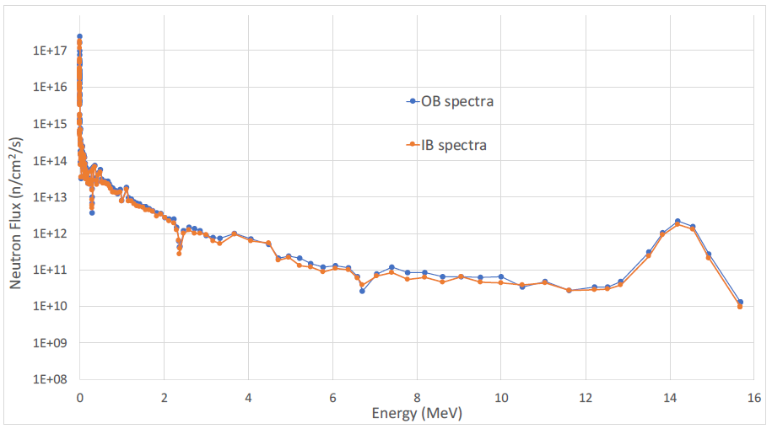
Neutron spectra - DWT
Total neutron fluxes are 5.29·10¹⁴ and 5.87·10¹⁴ n/cm²/s for IB and OB respectively

