Slide 1



















Possible experiments at DONES with pulsed deuteron beams
Second DONES Users Workshop
October 19-20, 2023, Granada
Bogdan Fornal, Łukasz Iskra (IFJ PAN) + contribution from the fnuc @ DONES working group
Presented by
Adam Maj (IFJ PAN Krakow)
This work has been carried out within the framework of the EUROfusion Consortium, funded by the European Union via the Euratom Research and Training Programme (Grant Agreement No 101052200 — EUROfusion). Views and opinions expressed are however those of the author(s) only and do not necessarily reflect those of the European Union or the European Commission. Neither the European Union nor the European Commission can be held responsible for them.am

Slide 2
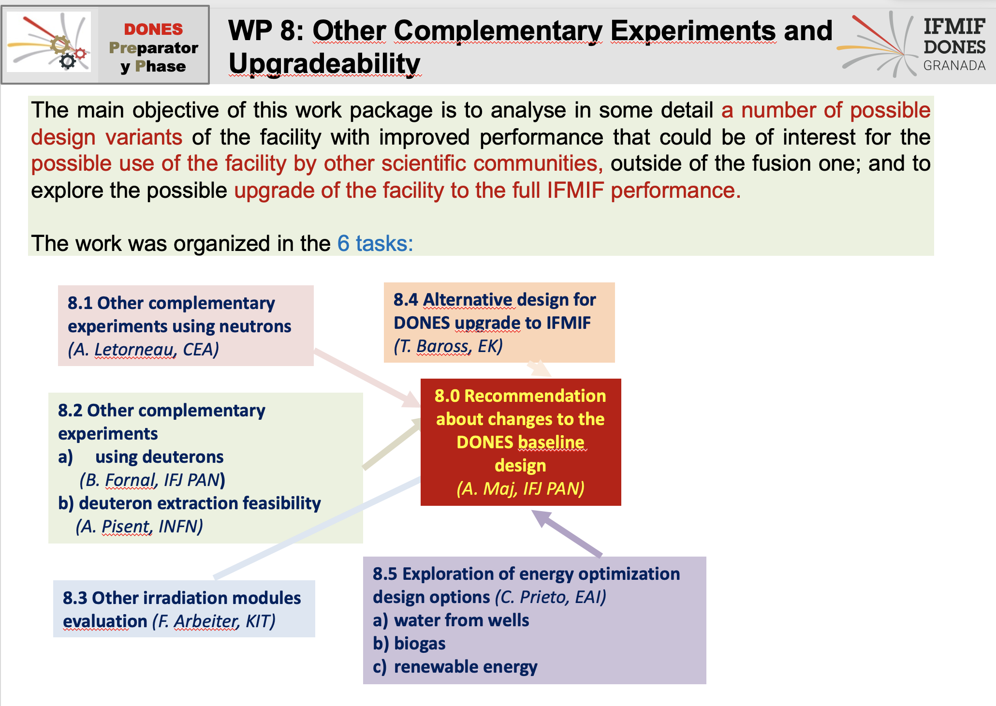
(A. Maj)

Slide 3
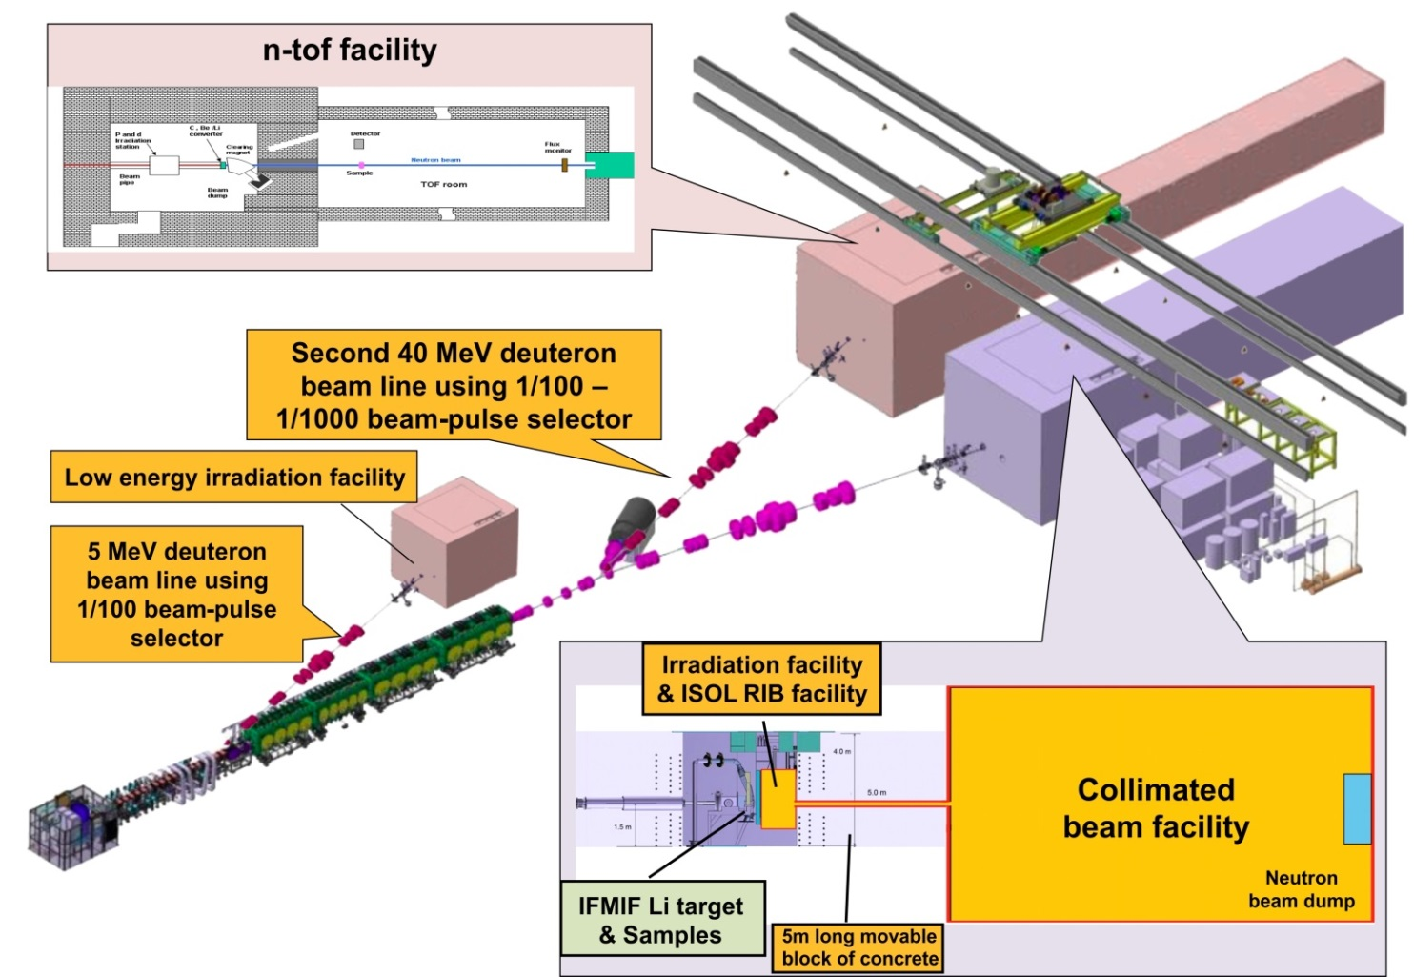
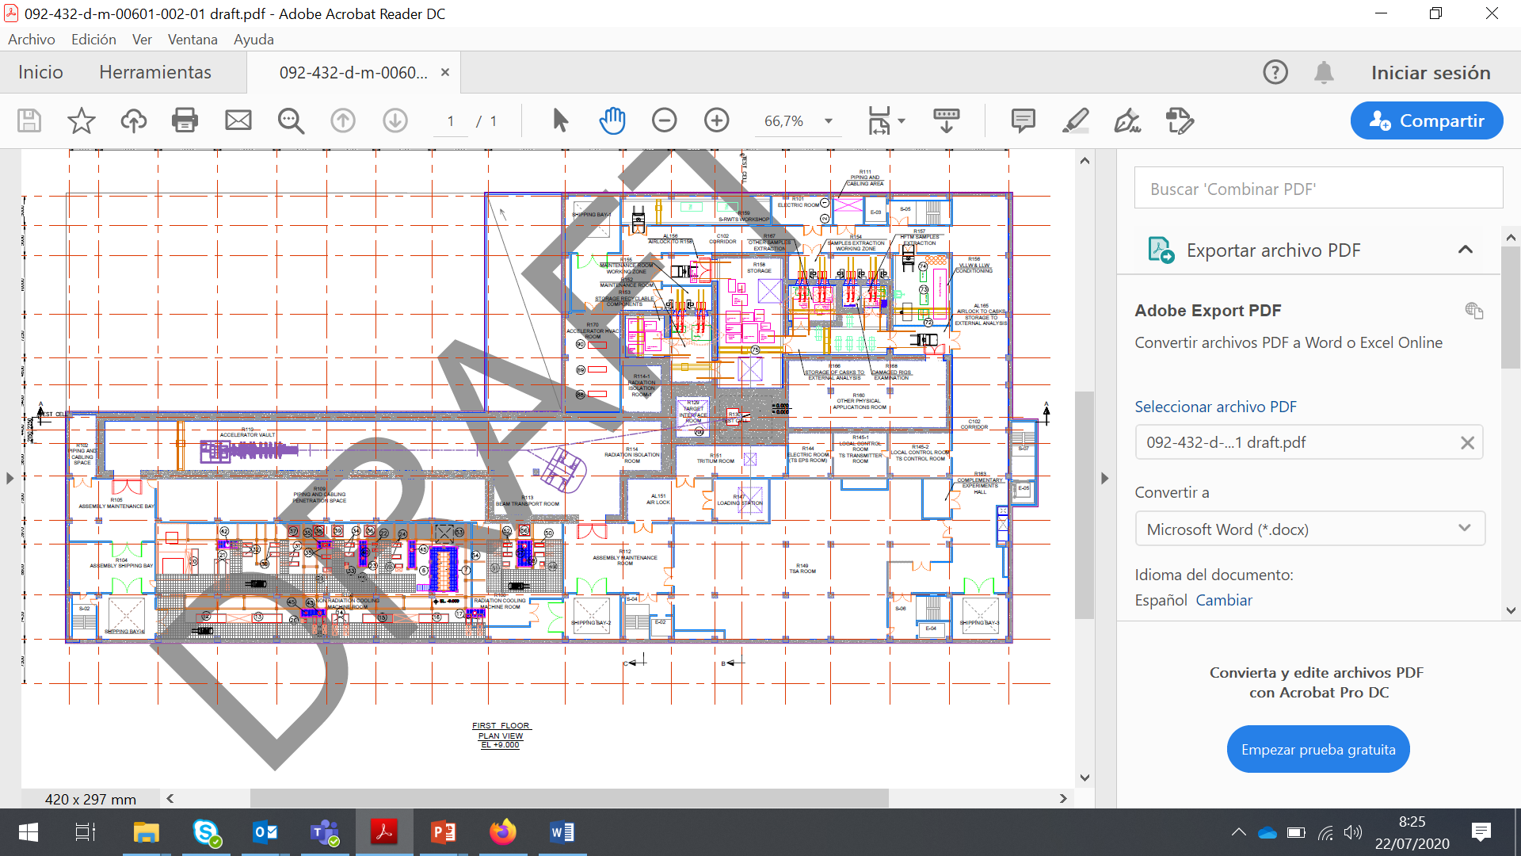
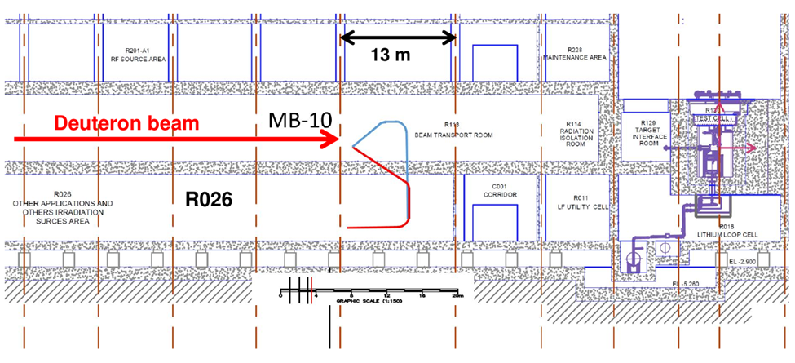
Experimental area
~80 m
~40 m
1/1000 fraction of 40-MeV deuterons
7.6 ns pulses
5.7 µs repetition time

Slide 4
1. Experiments using pulsed deutrons
2. Experiments using secondary (induced
by deuterons) pulsed beam of neutrons
1.1. Deuteron-induced reactions
2.1. Neutron-induced fission
(d,p) type – neutron transfer
²³⁸U(n,f), ²³²Th(n,f), ²³⁰Th, ²²⁶Ra, …
(d,t) type – neutron pick-up
(d,⁶Li) type – alpha pick-up
2.2. Investigation of pygmy dipole resonances
(d,³He) type – proton pick-up
2.3. Half-life measurements of long-lived isotopes
1.2. Radionuclides production
⁴⁴Ca (d,2n) ⁴⁴Sc
⁶⁴Ni (d,2n) ⁶⁴Cu
2.4. Neutron-induced reaction cross section
measurements in a wide neutron energy range.
Neutron Time-of-Flight Facility
¹⁸⁶W(d,2n)¹⁸⁶Re

Slide 5
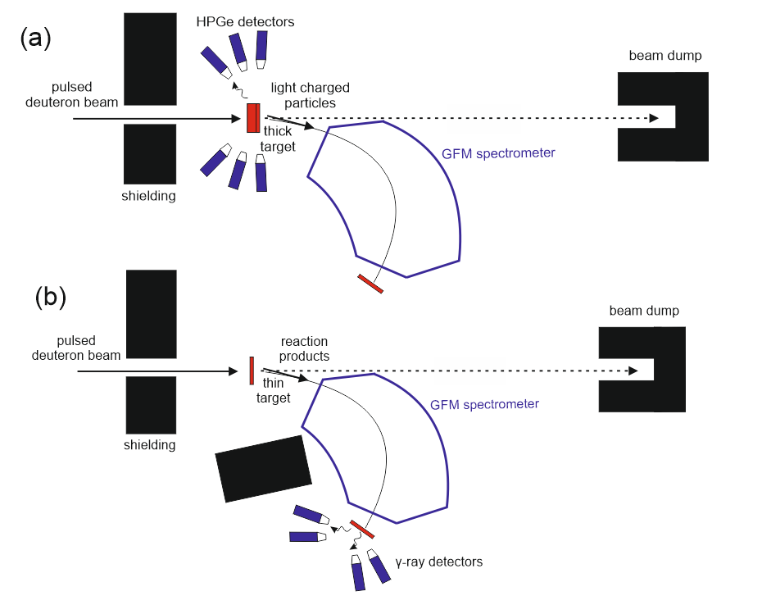
1.1. Deuteron-induced reactions
(d,p) type – neutron transfer
(d,t) type – neutron pick-up
(d,⁶Li) type – alpha pick-up
(d,³He) type – proton pick-up
detailed investigations of the decay of isomeric states
in products of the reactions induced by deuterons
on different stable and radioactive targets

Slide 6
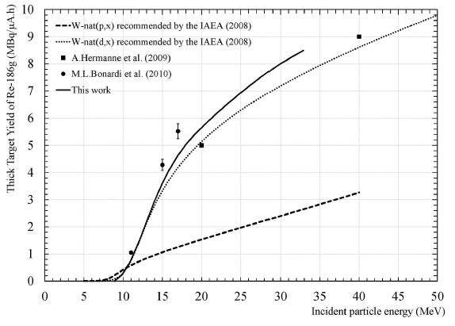
1.2. Radionuclides production
¹⁸⁶W(d,2n)¹⁸⁶Re
⁴⁴Ca (d,2n) ⁴⁴Sc
¹⁸⁶W(d,2n)¹⁸⁶Re
With deuterons production yield five times
higher than with protons.
¹⁸⁶W(p,n)¹⁸⁶Re

Slide 7
Experiments using secondary (induced by deuterons)
pulsed beam of neutrons
shielding
neutron converter
target
deuterons
neutrons
detector systems

Slide 8
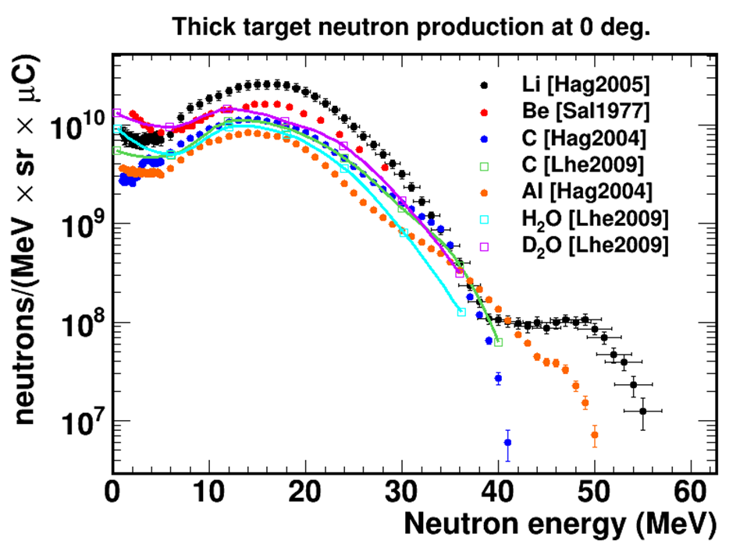
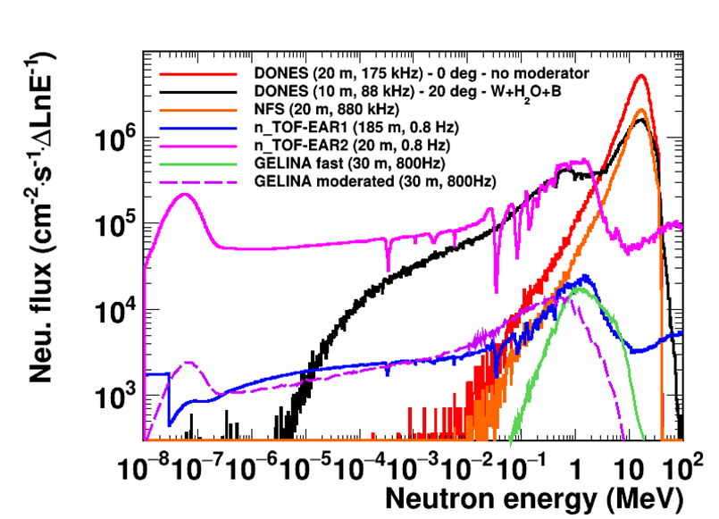
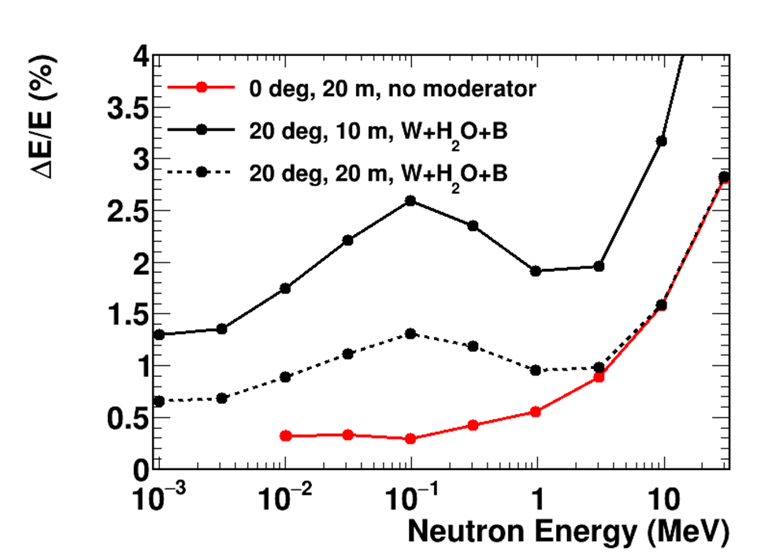
Deuteron-neutron convertion - Monte Carlo simulations
High nominal intensity in the 5 to 30 MeV neutron energy range
Excellent energy resolution
Various beam lines available with the potential of performing
various experiments at the same time

Slide 9
2.1. Fast-neutron-induced fission – gamma-ray spectroscopy of exotic products
²³⁸U(n,f), ²³²Th(n,f), ²³⁰Th, ²²⁶Ra, …

Slide 10
Occurence of microsecond isomers
in the known nuclei
²⁰⁸Pb
Proton number
¹³²Sn
expected low-lying high-spin isomers
- candidates for neutron-radioactivity
⁷⁸Ni
Neutron number

Slide 11
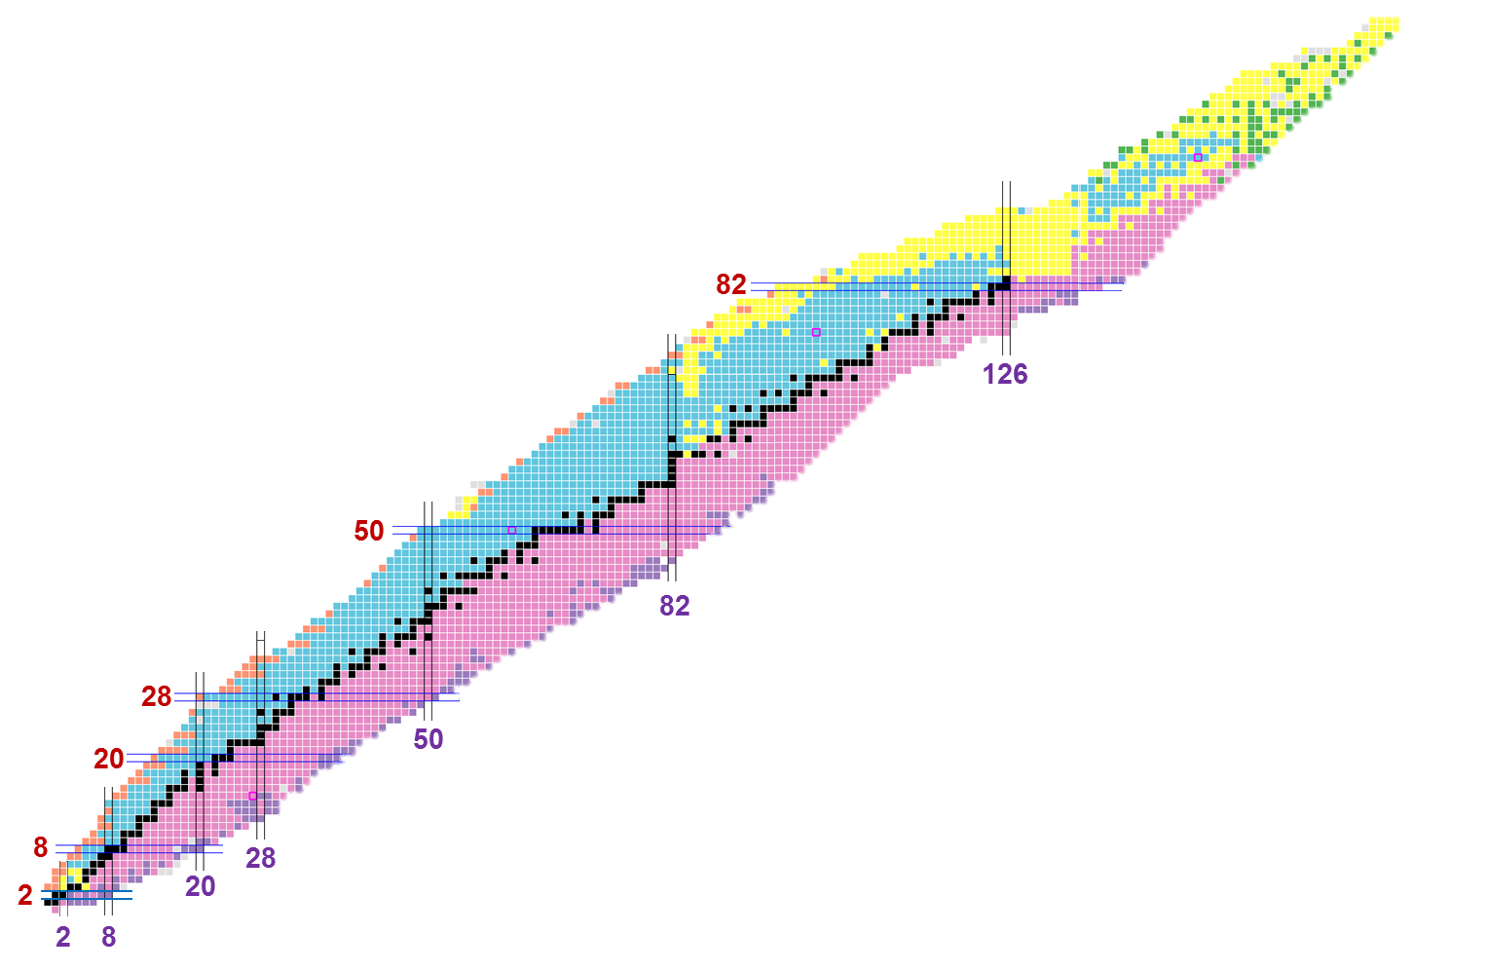
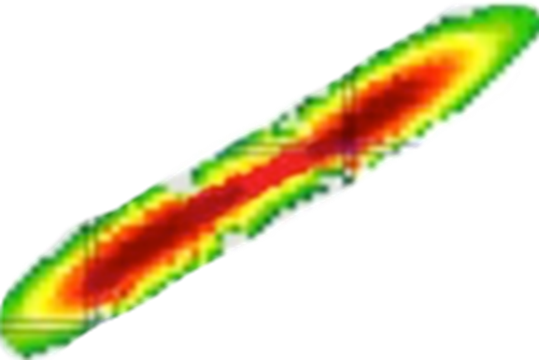
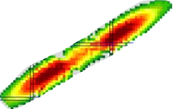
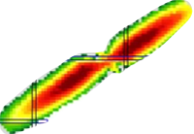
Fast-neutron-induced fission
of radioactive targets ²³⁰Th, ²²⁶Ra
²³⁵U
²³⁰Th
²³²Th
²²⁶Ra
Yields of products
from the 14 MeV-neutron
induced fission of ²³²Th
n(14 MeV) + ²³²Th
Thermal neutron induced fission
of ²³⁵U
Spontaneous fission of ²⁴⁸Cm
?

Slide 12
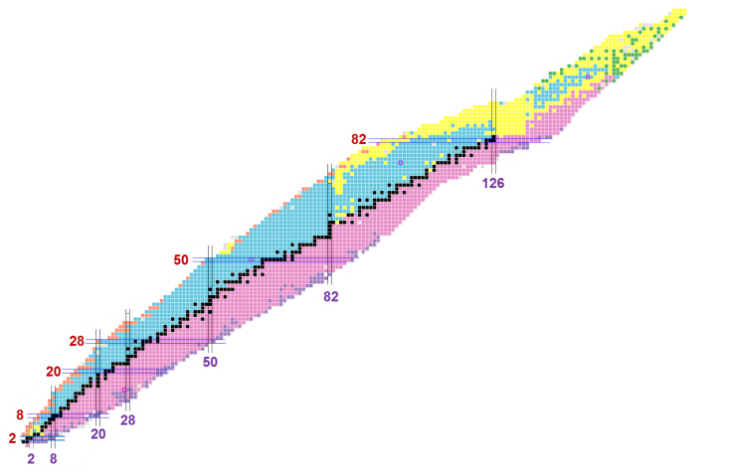
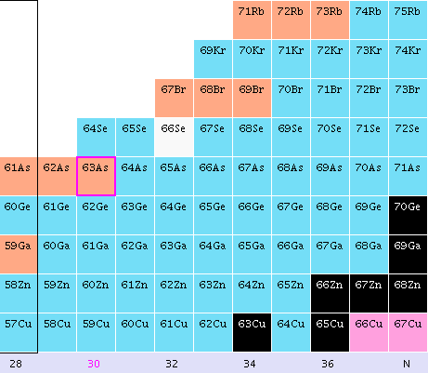
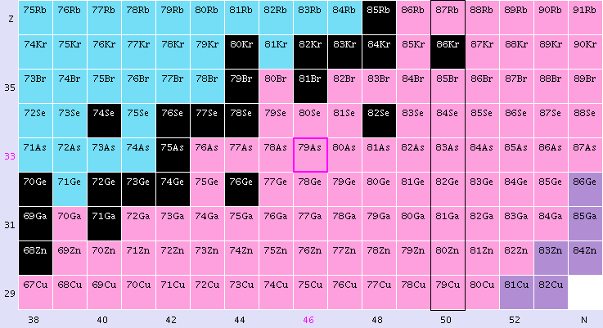
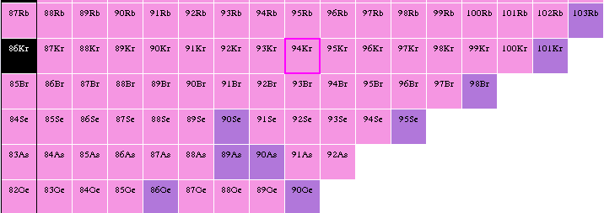
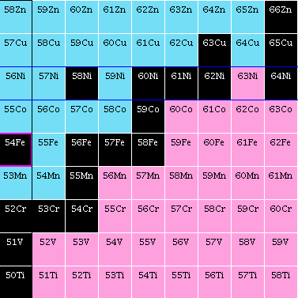
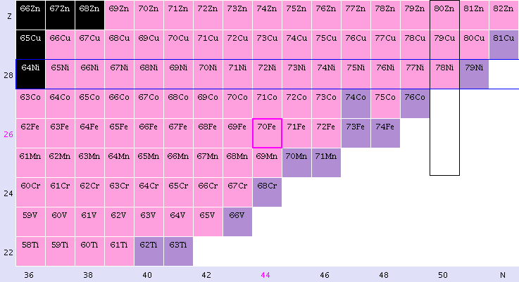
Yields of products from neutron
induced fission in the region
of interest
n(therm) + ²³⁵U
n(14 MeV) + ²³²Th
Rb
Kr
Br
Se
As
Ge
Ga
Zn
70Zn
Cu
Ni
⁷⁸Ni
Co
Fe
50
Mn
48
Cr
46
V
44
Ti
42
28
30
32
34
36
38
40

Slide 13
Gas-filled compact magnetic spectrometer
(the idea comes from ILL Grenoble where such spectrometer is being constructed)
Ge array
at focal plane
target
Ge array around
target
neutron
beam

Slide 14
Fast-neutron-induced fission on light actinide targets
target
fission product
toward
spectrometer
target
material
backing
„Left” fragment stopped in the backing
→ Doppler free prompt γ detection
coincidences
„Right” fragment will fly to the spectrometer
→ A, Z determination; delayed γ spectroscopy

Slide 15
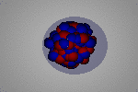
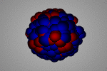
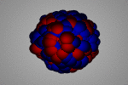
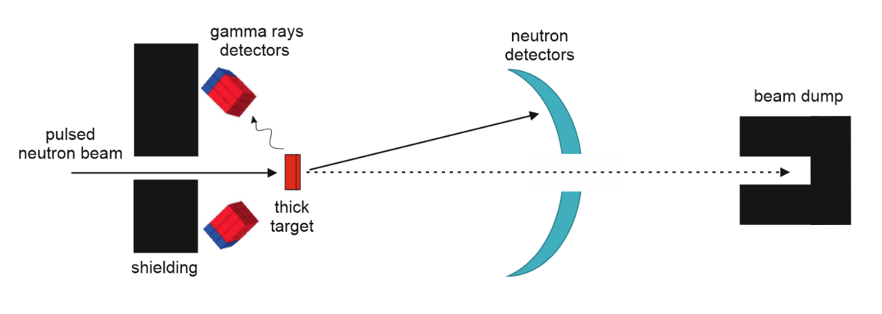
2.2. Investigation of pygmy dipole resonances
- synergy with the proposed experiments at NSF GANIL
DONES-IFMIF facility, providing a high-intensity neutron beam (with energies up to ~40 MeV) and 40-MeV deuteron beam, will be an ideal for such measurements.
PDR
IS GQR
IV GDR
0
B_{n}≈8
15
E* [MeV]
So far, investigations of Pygmy Dipole resonance were carried out using
the (γ, γ’), (p, p’), (α, α’) and (HI, HI’) inelastic scattering experiments.
Adding new probes, as neutron or deuteron, will allow to shed new light
on the origin of the PDR excitations.

Slide 16
2.2. Neutron-induced reaction cross section measurements
(on stable and radioactive targets)
in a wide neutron energy range.

Slide 17
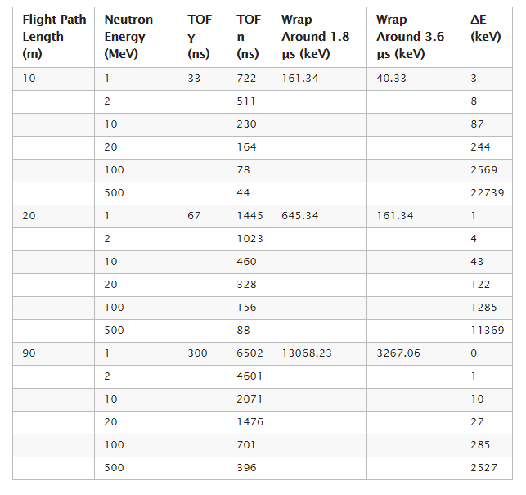
2.4. Toward Neutron Time-of-Flight Facility?
Neutron converter
deuterons
neutrons

Slide 18
The fnuc @ DONES working group
The Spanish nuclear physics network fnuc has promoted a study group for exploring the nuclear physics opportunities at DONES.
Coordinators: Daniel Cano-Ott (CIEMAT), Antonio Lallena (Univ. Granada)
WP1. Facility and simulations (E. Mendoza – CIEMAT)
WP2. Fundamental nuclear physics (C. Guerrero – Univ. Sevilla)
WP3. Applications (C. Domingo – IFIC)
Willingness to establish a close collaboration with the preparatory phase WPs working on the same activities!
Neutron Time-of-Flight facility based on a neutron-pulsed beam produced with 40-MeV deuterons ?

Slide 19
Summary
2. Experiments using secondary (induced
by deuterons) pulsed beam of neutrons
1. Experiments using pulsed deutrons
1.1. Deuteron-induced reactions
(d,p) type – neutron transfer
2.1. Neutron-induced fission
(d,t) type – neutron pick-up
²³⁸U(n,f), ²³²Th(n,f), ²³⁰Th, ²²⁶Ra, …
(d,⁶Li) type – alpha pick-up
(d,³He) type – proton pick-up
2.2. Investigation of pygmy dipole resonances
2.3. Half-life measurements of long-lived isotopes
1.2. Radionuclides production
⁴⁴Ca (d,2n) ⁴⁴Sc
2.4. Neutron-induced reaction cross section
measurements in a wide neutron energy range.
Neutron Time-of-Flight Facility
⁶⁴Ni (d,2n) ⁶⁴Cu
¹⁸⁶W(d,2n)¹⁸⁶Re
Exceptional opportunities at DONES for the advanced world leading nuclear physics investigations
Ł.W. Iskra, B. Fornal, D. Cano-Ott, E. Mendoza et al., „Report on possible complementary experiments to be developed in DONES using deuterons” https://idm.dones.irb.hr/op/op.ViewOnline.php?documentid=244&version=1

