Slide 1

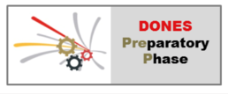
















Extraction of the parasitic deuteron beam at 40 MeV
2nd DONES Users WS
20th October 2023
I. Podadera on behalf of L. Bellan, W. Krolas and the WPENS AS Design Team
This work has been carried out within the framework of the EUROfusion Consortium, funded by the European Union via the Euratom Research and Training Programme (Grant Agreement No 101052200 — EUROfusion). Views and opinions expressed are however those of the author(s) only and do not necessarily reflect those of the European Union or the European Commission. Neither the European Union nor the European Commission can be held responsible for them.am

Slide 2

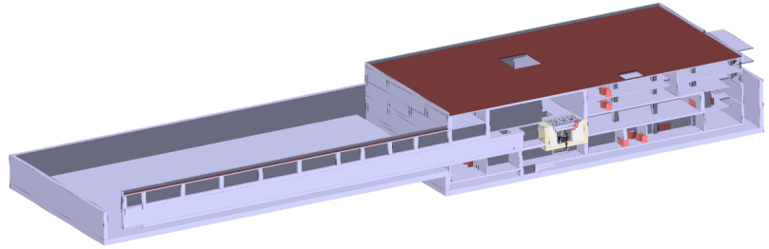
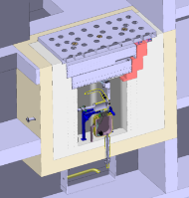
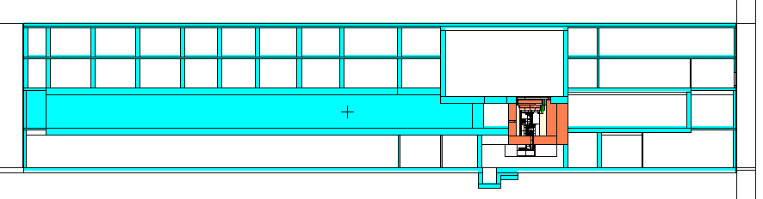
Facilities for complementary experiments
Collimated neutron beam facility – behind the Test Cell
XY plane (Z=0)
(horizontal)
DONES Test Cell
Possible implementation of dedicated irradiation modules, e.g. for the radioisotope production
Experiments with
continuous neutron beam
ZY plane (X=0)
(vertical)
Experiments with pulsed deuteron and neutron beams – pulsed, not continuous!
(one level below the accelerator vault) E.g. neutron Time-of-flight facility

Slide 3
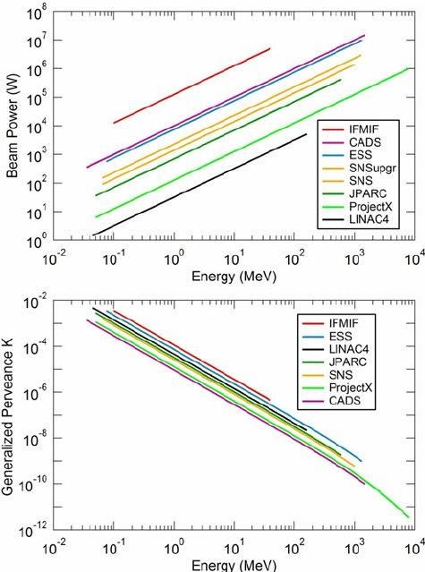
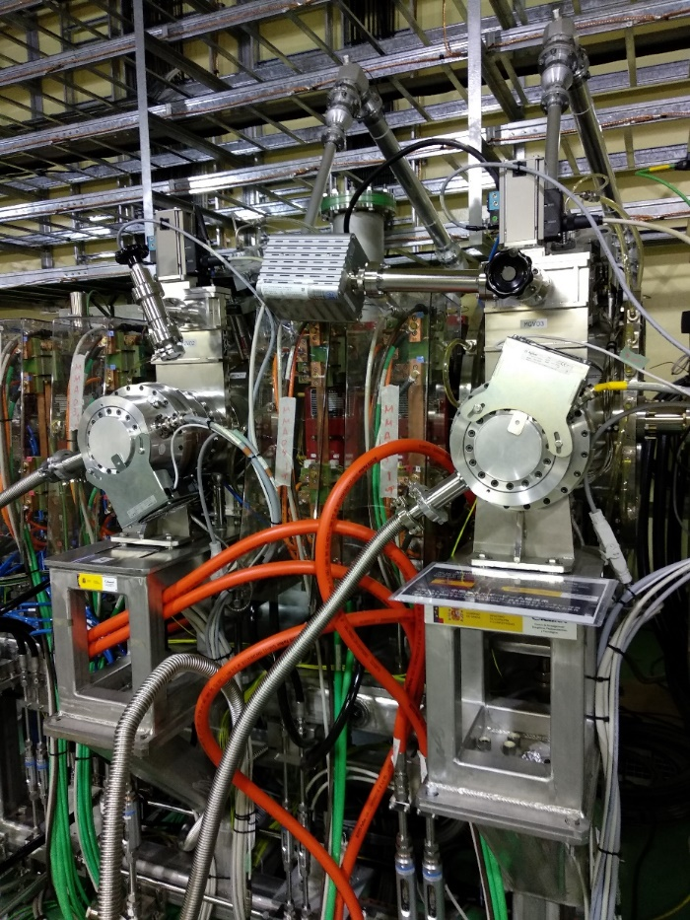
Extraction options- MEBT
Advantages:
Lower energy (5 MeV) and power (625 kW):
  easier extraction: less EM field required -> less extraction length.
  lower activation of non-clean extraction compared to the HEBT one.
Similar scheme to other projects.
Drawbacks:
No chopper present in the MEBT at the moment → complete redesign of the beam dynamics of MEBT and downstream. Very complex anyway due to the very high space charge. Probably more magnets and re-bunchers needed.
New hot point in the MEBT.
625 kW
DISCARDED
P. Nghiem et al., IPAC’16, THYA01
The LIPAC MEBT during Phase B1 operation

Slide 4
Extraction options- HEBT
Advantages:
  Bigger space available.
  Less space charge.
  Beam Dump for beam removal in case BDTL is used.
Drawbacks:
  Accommodate BES components
  High beam energy -> very difficult beam extraction (high EM field and extraction length required) and possible hot points in the beamline
  No full single bunch selection can induce hot points in the beamline
Alternatives:
  Fast extraction:
    Parasitic beam from the main beam to the lower floor experimental area
    Parasitic beam from the BDTL to the lower floor experimental area (only during no lithium operation).
  Slow extraction: long macropulses (>seconds) by slow modification of the magnetic parameters.

Slide 5
“Requirements” of selected extraction system
D⁺ beam
Peak current: 4.5·10⁹ particles/bunch (eq. 125 mA @ 175 MHz)
Energy: 40 MeV
Bunch length: <10 ns
D.C.: 1 – 0.1 % (1.75 – 0.175 MHz)
Avoid interference with the nominal operation for fusion experiments
Minimize the modifications to the Accelerator nominal optics and mechanical design
The main difficulty in such study is given by the separation stage between the bunch and the nominal beam

Slide 6
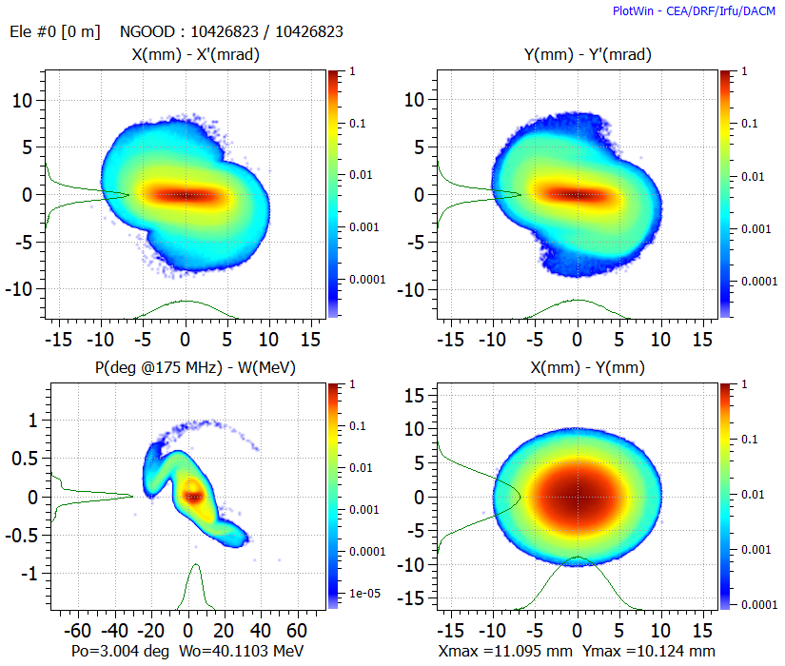
HEBT layout
BES could be located at the first section of the HEBT (red rectangle)
Mechanical design of building penetration not performed
Beam characteristics
@ SRFs – HEBT interf.
To Lithium target
SRF LINAC
To
Pulsed beam experimental area

Slide 7
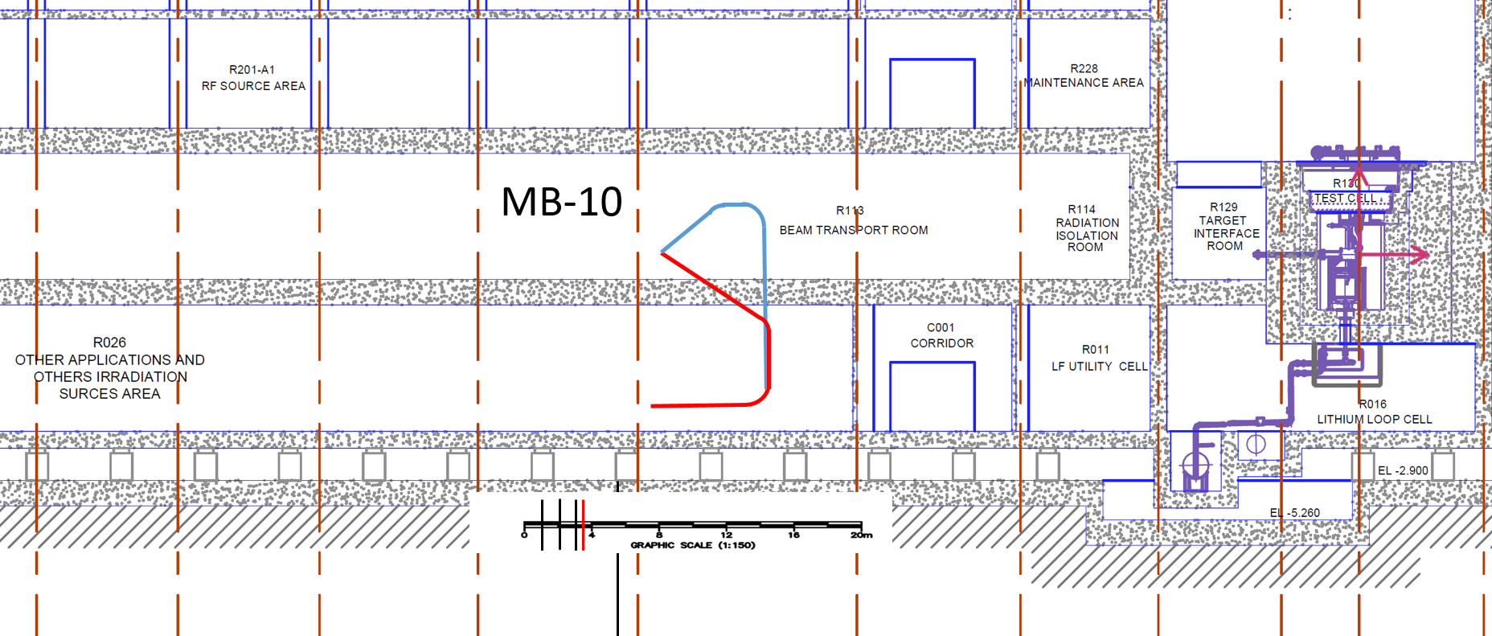
Possible layouts
Two solutions possible:
Down
Up - down

Slide 8
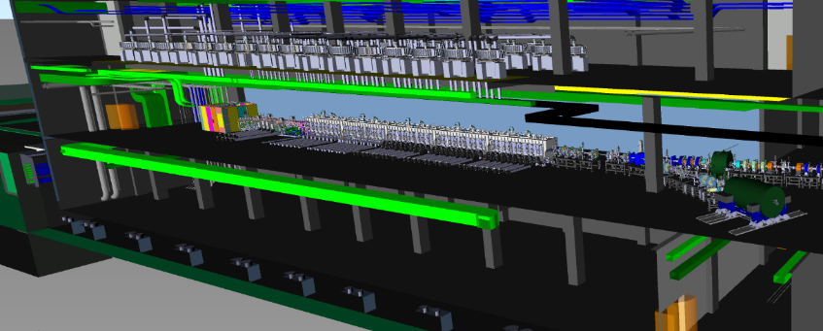
Pulsed beam experimental area
D+ parisitic beam extraction between QP3 and QP4 of the HEBT → interesting also for optimized beam handling
0.1
5.0
8.4
14.2
21.8
30.7
40 MeV
Injector
LEBT
RFQ
MEBT
Superconducting cavities
HEBT
R026 – pulsed beam area
CAD model, courtesy of D. Sánchez

Slide 9
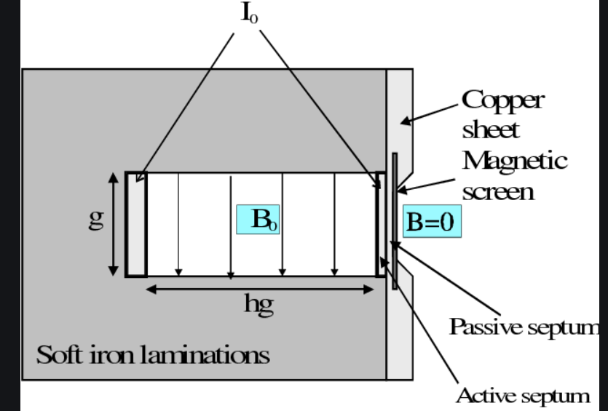




Single Bunch Extraction scheme
The configuration of the kicker-meander+ electrostatic septum+ septum magnet (with double vacuum chamber)
Multiple Kicker (Meander type) vacuum line for fast selection of a single bunch
Septum magnet to extract and bend parasitic beam by 34°
Two additional dipoles to complete the whole 180° of the beam
Four quadrupole (QP) doublets to keep the parasitic beam focused
Extraction simultaneous to the ongoing irradiation of the Li target
Septum magnet
Kicker (Meander line)
+
Electrostatic septum
+
$$y^{′}=y_{0}^{′}+\frac{zeV_{0}L}{mc^{2}β^{2}γd}$$
$$\frac{zeV_{0}L}{mc^{2}β^{2}γd}≅\frac{LV_{0}}{{2V}_{ext}d}$$
For γ $≅$ 1
It is important to integrate this optics within the nominal one: as a matter of fact the nominal one affects the separation process through its betatron function and the transverse phase advance.
$$∆x=\sqrt{β_{k}β_{sept}}\sin{(∆φ)Δθ}$$

Slide 10
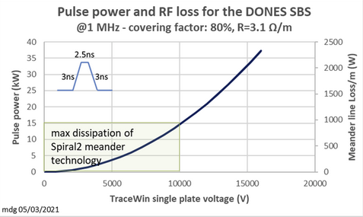
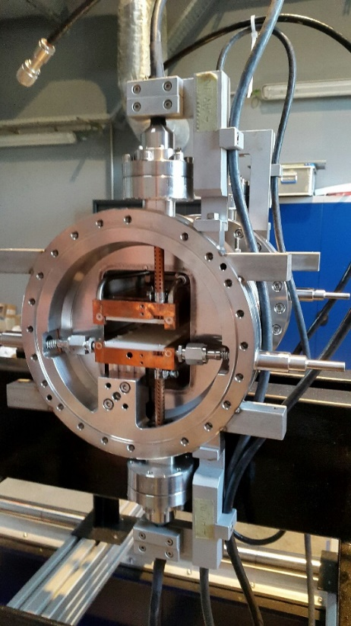
Kicker requirements
Limit pulsed beam DC from 1% to 0.1%
Total Voltage between 30 – 40 kV
FID Power Supply:
FPG 20-200NM3
Maximum amplitude into 50 Ohm - 20 kV
Amplitude adjustment range - 10-20 kV
Polarity - positive (or negative, fixed in production - specify in PO)
Rise time - 1,5-2 ns
Pulse duration at 90% - 2-2.5 ns
Fall time - 2-3 ns
Maximum energy in pulse - about 30mJ
Maximum PRF - 200 kHz
Maximum average power to load - 6 kW
Triggering - Internal and external 5V @50 Ohm, rise time 5-10ns, duration 100-1000 ns
Input power - AC 3 phase
Dimensions
pulse power block 448x177x500 mm
power supply block 448x177x500 mm
Water cooling via customer supplied external heat exchanger or chiller
CEA-Ganil meander line
(2.5 kV, β=4%, 1 MHz/ 88 MHz)
M. Di Giacomo et al., JINST 15 T12011, 2020

Slide 11
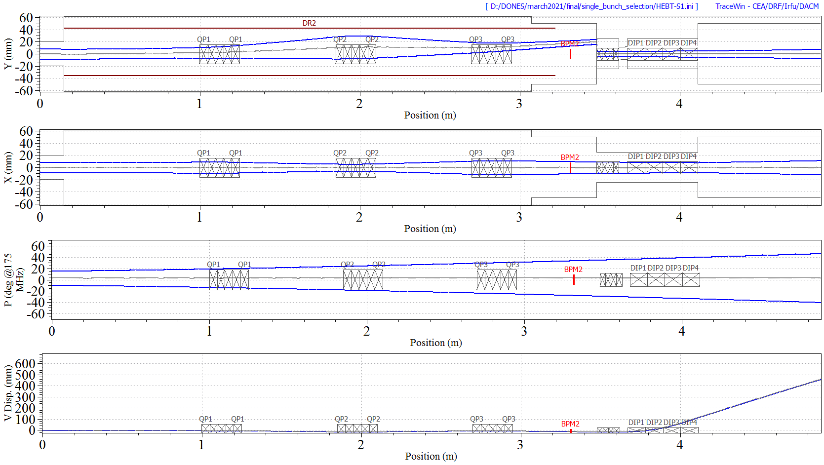
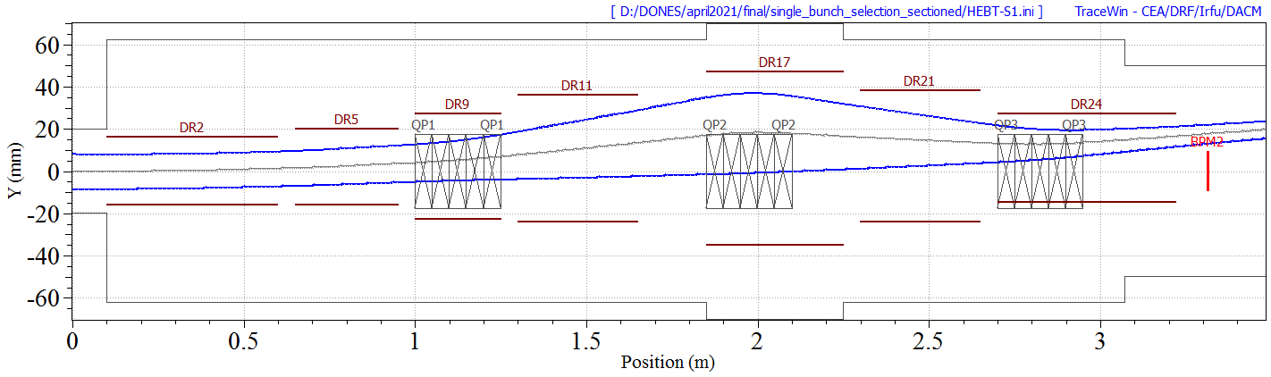
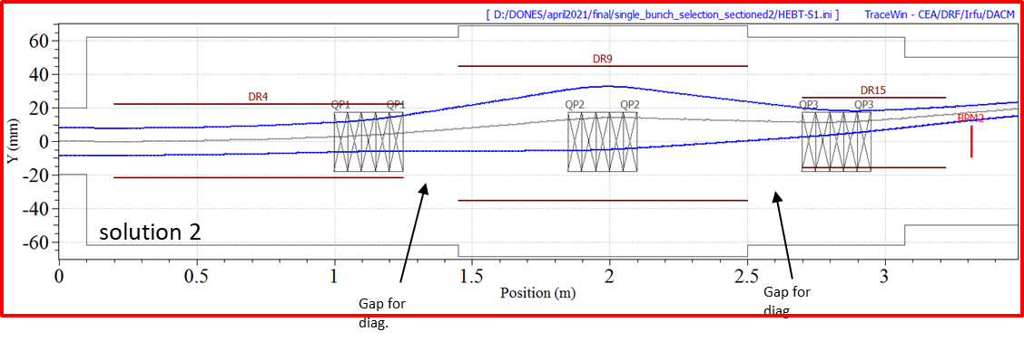
BES Beam Dynamics
Present reference alternative
3 x kickers:
  Single plate voltage: <+/-20 kV
  Length ~1 m
  Aperture <80 mm
Electrostatic septum <10 MV/m (<200 kV)
Magnetic septum <1.7 T
Beamline bending of ~35° + 180°
solution 1

Slide 12
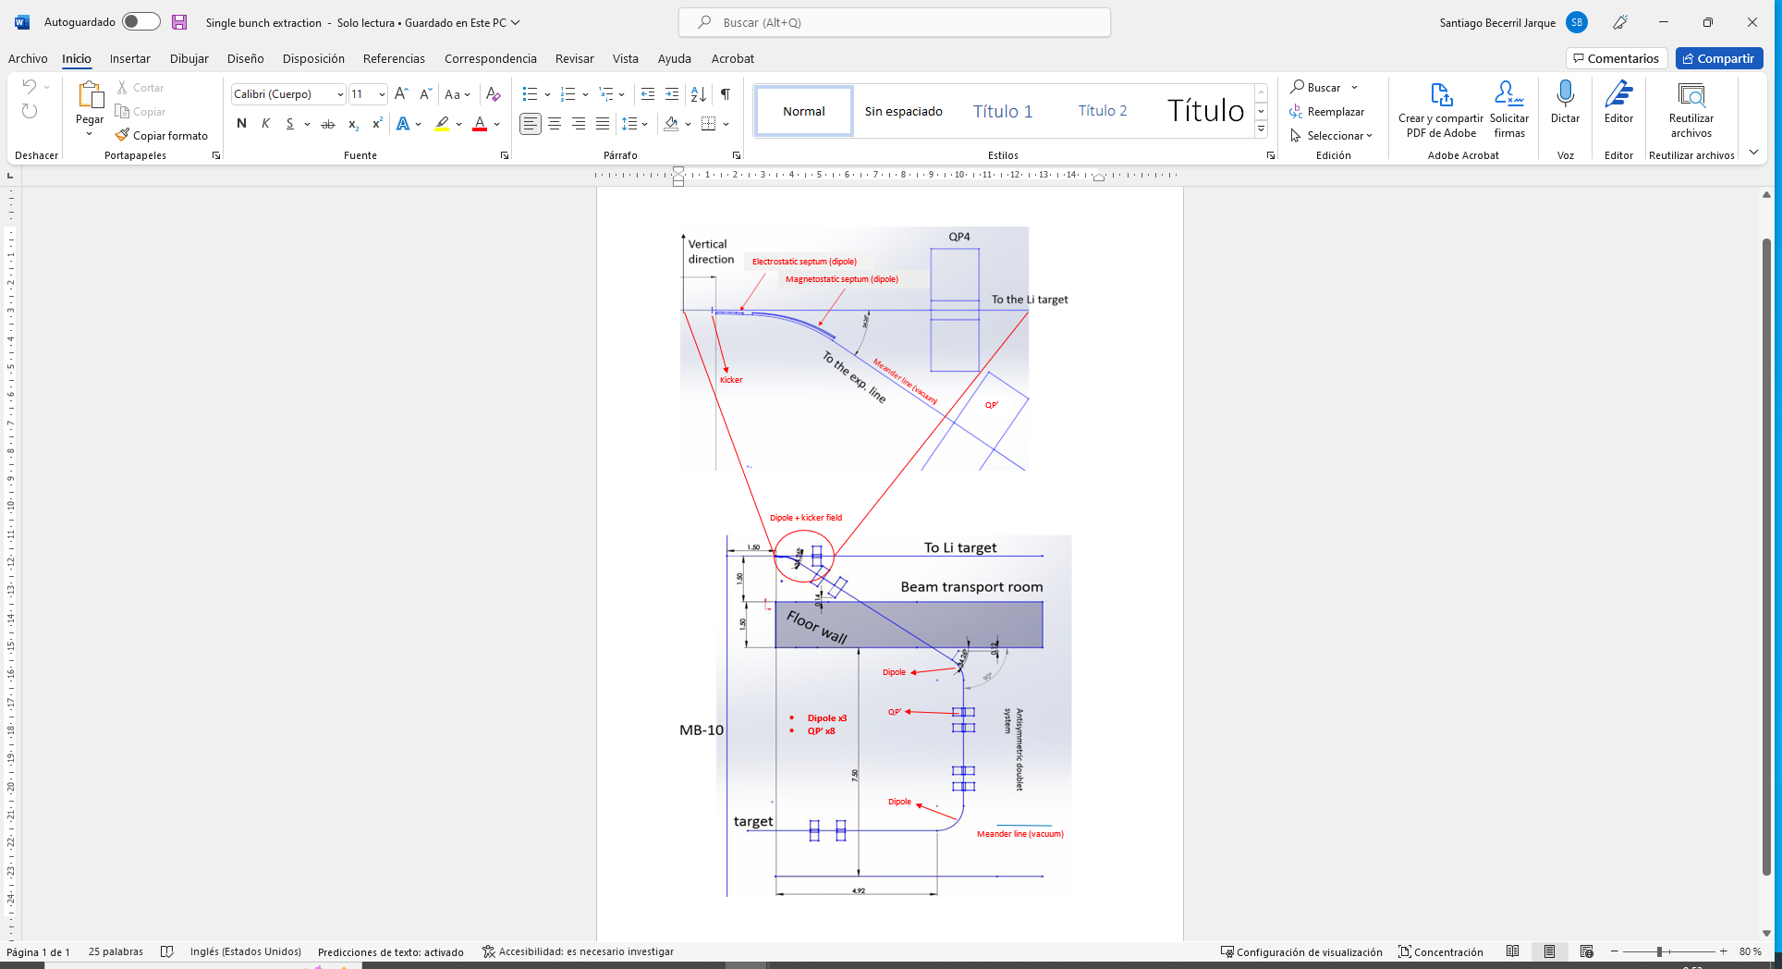
Beam to target (preliminary)
For reaching R026 irradiation area, keeping the pulse structure within 10 ns, we would need a periodic line with bunchers and quadrupoles.
L. Bellan, M. Comunian, A. Pisent LNL INFN
M. Di Giacomo, M.H. Moscatello CEA GANIL

Slide 13
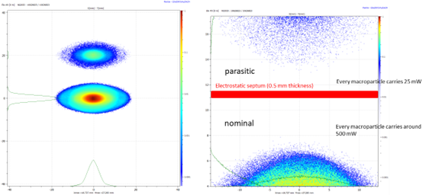
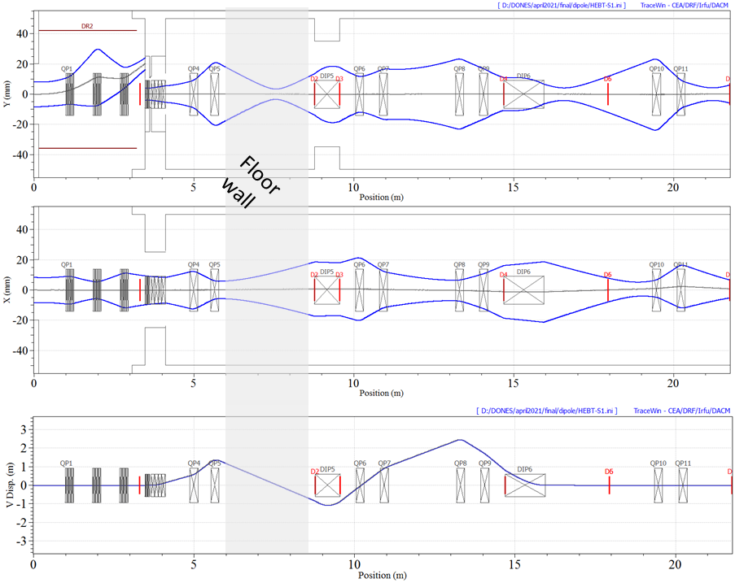
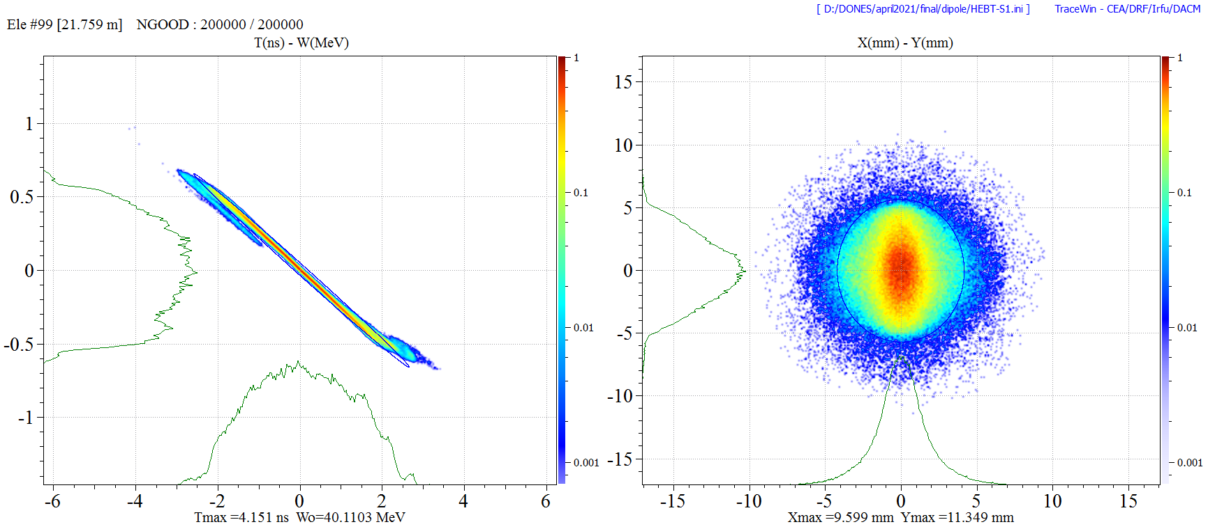
Beam to target (preliminary)
Beam @ elec septum
No beam manipulation yet, neither emittance growth optimization etc..
Target station @ ~20 m from last kicker
At this stage, the beam pulse is longitudinally constrained within 7.6 ns interval (<10 ns)
Beam @ target

Slide 14
Switching dipole solution
LEBT chopper permanently inserted
Switching dipole in the main beamline

Slide 15
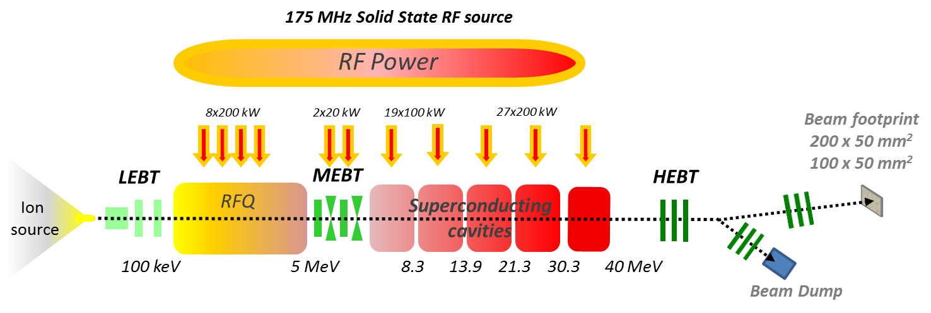
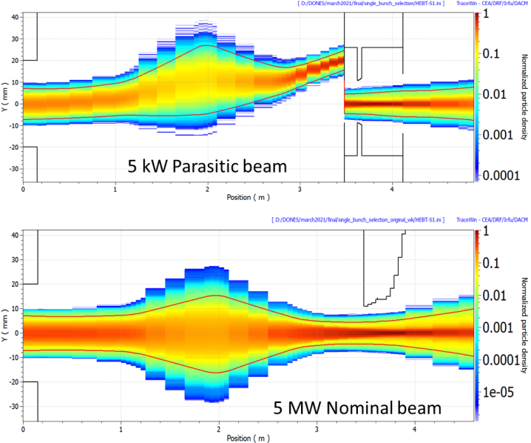
Summary
D+ ion beam 125 mA, energy 40 MeV
8.4
14.2
21.8
30.7
Planned extraction of a fraction – ca. 0.1% - of the beam at 40 MeV:
BES at first section of the High Energy Beam Transport line
BES made of a set of kickers + electrostatic septum + septum magnet
Kicker R&D ongoing:
  LNL (Antonio and Francesco) with SPIRAL2 support (Marco) are performing the electromagnetic simulations, important step before the engineering. Some iteration with BD may be needed before proceeding with the engineering.
  Innovative project from industry in collaboration with CIEMAT/IFIC exploring a prototype for technological validation.
HEBT design in the main beamline to accommodate the BES
Preliminary definition of the target station location
Penetrations, RP and shielding analysis not yet performed
Conceptual design of BES beamline to target(no diagnostics studies or sizing of components).
Other alternatives a slow extraction, more flexible, also being studied

Slide 16
Next steps
Progress on the design of the beamline to requirements:
  Interface required between users and the accelerator physicist in order to better detail the requirements:
    Bunch length,
    Bunch energy spread,
    Beam size,
    Target position,
    Beam line layout
    ….
    Users wish-list TBD from this Workshop and work to be continued during the Consolidation Phase
R&D on the main components of the extraction (kicker and septa)
  Kicker design not trivial for such beta (focus of the RF team workforce)
  Septa are commonly used and design in such extractions

Slide 17

