Slide 1






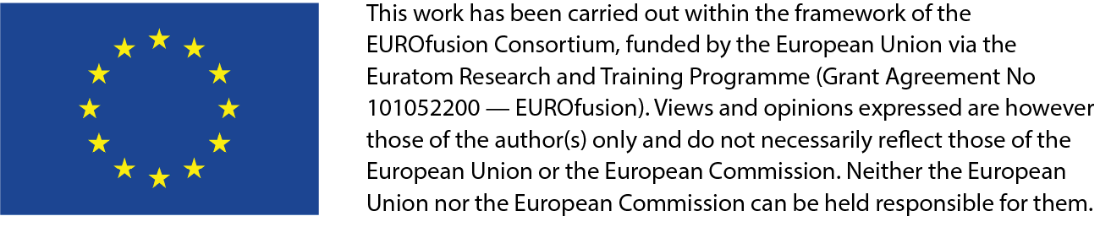








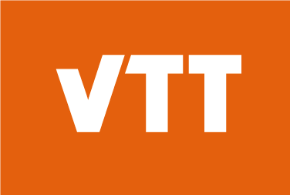


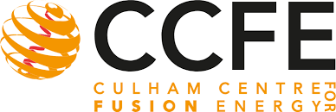
Notes for discussion on methodology, how to prepare the Irradiation program proposal
A. Ibarra (IFMIF-DONES España & CIEMAT, Spain) and the full DONES team
2nd DONES Users Workshop, Granada, October 19-20th 2023

Slide 2
Summary of experimental capabilities on DONES
Reminder on facility flexibility

Slide 3
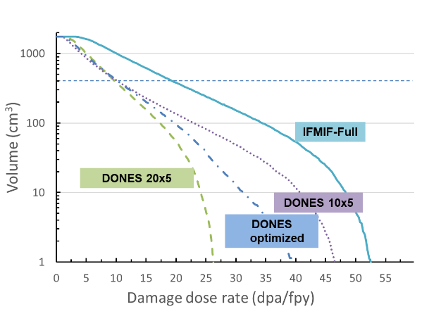
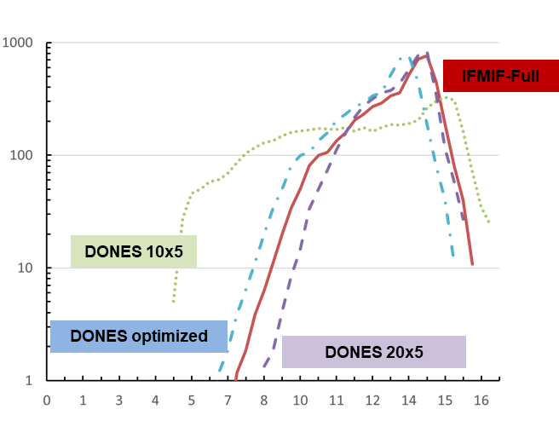
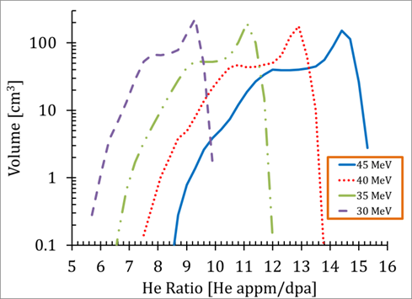
IFMIF-DONES flexible design
Irradiation volume available (cm3) as function of the dpa level in the HFTM area for different beam configurations
Variation of the damage dose rate of the central part of the HFTM for different IFMIF-DONES paramenters
Available irradiation volume of the central part of the HFTM vs He appm/dpa for different IFMIF-DONES D energy
Irradiation volume available (cm3) as function of the He/dpa ratio in the HFTM area for different beam configurations
IFMIF-DONES design is highly flexible (beam size, beam energy, irrad temperature, irrad modules,…), in order to accommodate for different irradiation conditions

Slide 4
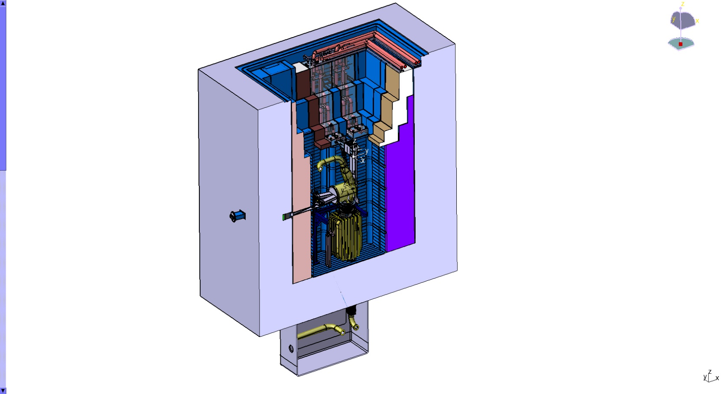
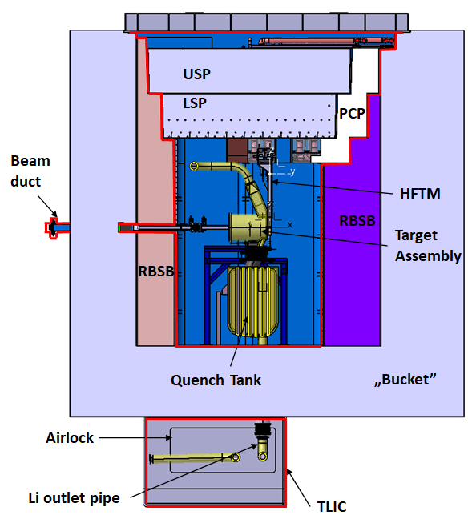
  Other irradiation modules are also feasible (sequentially or simultaneously to the HFTM)
Available space for additional irradiation modules

Slide 5
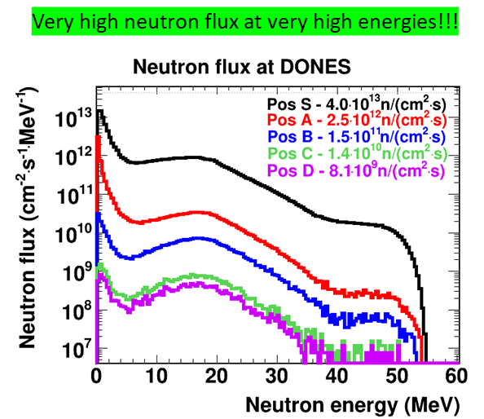
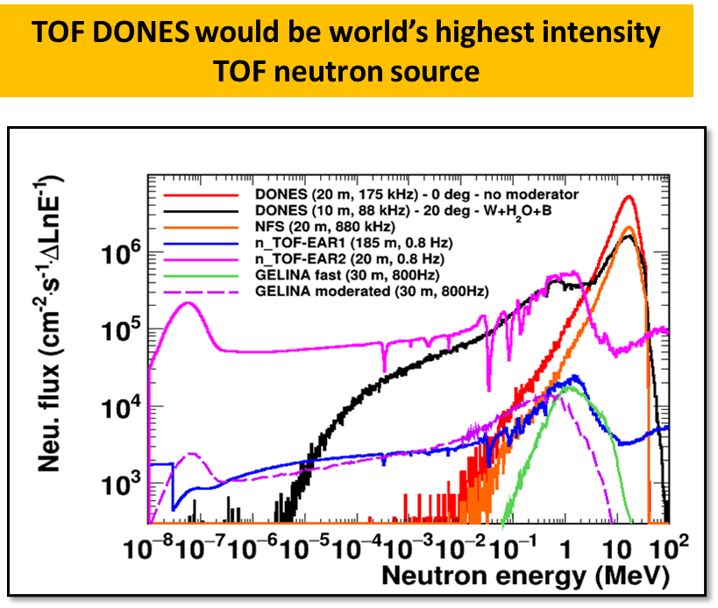
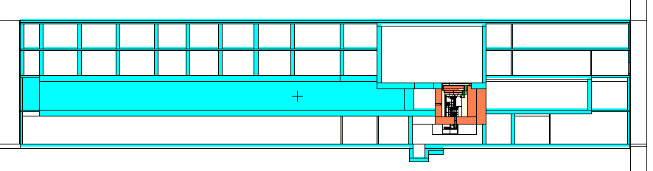
Additional experimental areas
XY plane (Z=0)
(horizontal)
Experiments with
continuous neutron beams
ZY plane (X=0)
(vertical)
Experiments with pulsed neutron + deuteron beams

Slide 6
Summary of experimental capabilities on DONES
Reminder on facility flexibility
Experimental capabilities
  Fusion related
    Structural materials qualification
    Trititum technologies development
    Model “materials systems”: mainly breeding blankets but also others (divertor mock-ups, diagnostics,…)
  Non-fusion related (less clearly defined)
    Isotopes production
    Nuclear Physics
    Basic research (i.e. pulsed vs continous irradiation effects; irrad under magnetic fields; low T irrad;…)
    Industrial applications
    Biological applications
    …..
Due to several reasons, last years activities has been focused on structural materials qualification: HFTM design

Slide 7
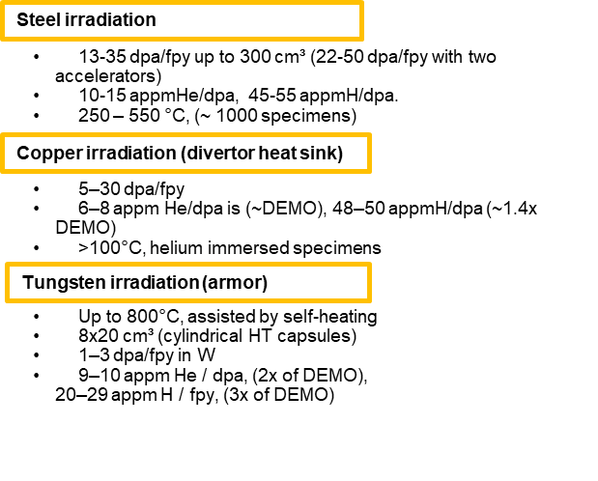
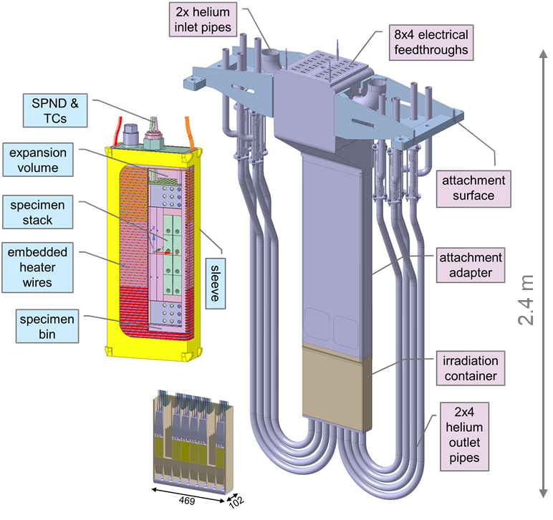

Summary of IFMIF-DONES experimental capabilities
Materials qualification
Experiments to be developed in the irradiation area with the highest neutron flux are managed by specific irradiation modules that can be replaced (and modified) after each irradiation campaign
Present baseline design activities focuses on the High Flux Test Module (HFTM) for high-priority structural materials irradiation
Specimen capsule
(Eurofer)
F. Arbeiter (KIT)
SSTT specimens
HFTM assembly
(316LN)
Adaptation for ODS-steels and vanadium materials can be easily implemented

Slide 8
Summary of experimental capabilities on DONES
Reminder on facility flexibility
Experimental capabilities
  Fusion related
    Structural materials qualification
    Trititum technologies development
    Model “materials systems”: mainly breeding blankets but also others (divertor mock-ups, diagnostics,…)
  Non-fusion related (less clearly defined)
    Isotopes production
    Nuclear Physics
    Basic research (i.e. pulsed vs continous irradiation effects)
    Industrial applications
    Biological applications
    …..
Due to several reasons, last years activities has been focused on structural materials qualification: HFTM design
Next few years (WPENS) it will be developed more in detail other fusion-related irradiation modules
Next few years (DONES-Con) it will be developed more in detail other fusión and non-fusion related irradiation modules
Objective1: to develop a “catalog” of posible irradiation experiments that:
    will evolve with time (both in the number and in the engineering design status
    will help future users to understand the facility capabilities

Slide 9
Summary of experimental capabilities on DONES
Reminder on facility flexibility
Experimental capabilities
  Fusion related
    Structural materials qualification
    Trititum technologies development
    Model “materials systems”: mainly breeding blankets but also others (divertor mock-ups, diagnostics,…)
  Non-fusion related (less clearly defined)
    Isotopes production
    Nuclear Physics
    Basic research (i.e. pulsed vs continous irradiation effects)
    Industrial applications
    Biological applications
    …..
Due to several reasons, last years activities has been focused on structural materials qualification: HFTM design
Next few years (WPENS) it will be developed more in detail other fusion-related irradiation modules
Next few years (DONES-Con) it will be developed more in detail other fusión and non-fusion related irradiation modules
Carefull coordination will be required
Objective1: to develop a “catalog” of posible irradiation experiments that:
    will evolve with time (both in the number and in the engineering design status
    will help future users to understand the facility capabilities

Slide 10
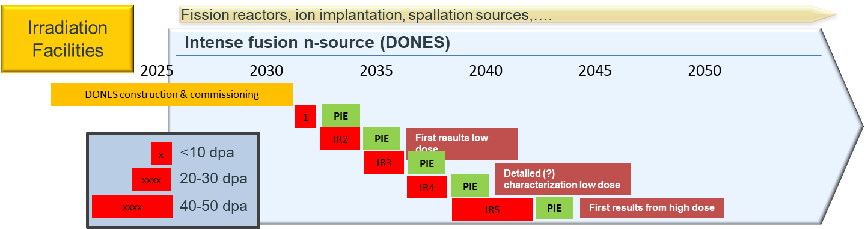
DONES Experimental Programme
In parallel to this work, we need to better understand the materials community, DEMO designers and other communities needs
(there were work about this many years ago –W-GIFT- but it has not been properly updated)
Finaly, based on these needs, it should be prepared a preliminary DONES experimental programme. My proposal is to focus initially on the materials qualification topic (it is the best defined at this moment)
Objective2: to prepare a report compiling needs from the different users communities point of view that:
    will evolve with time
    will help future DONES engineers to understand the future needs
Objective3: to prepare a first version of a DONES experimental programme

Slide 11
Notes

