Slide 1


















María José Martínez-Echevarría Romero (Universidad de Granada)
Piotr Prochoń (Warsaw University of Technology)
Monica Lopez Alonso (University of Granada)
Rafał Michalczyk (Warsaw University of Technology)
Armando Arvizu Montes (University of Granada)
Łukasz Ciupiński (Warsaw University of Technology)
Santiago Becerril Jarque (IFMIF-DONES España)
Kazimierz Józefiak (Warsaw University of Technology)
Yuefeng Qiu (Karlsruhe Institute of Technology)
Hari Chohan (UKAEA)
Martin Ansorge (Nuclear Physics Institute of the CAS, Rez near Prague)
Magdalena Wojtkowska (Warsaw University of Technology)
Concrete optimization and qualification for IFMIF/DONES and fusion program
Second DONES User Workshop | Granada 19-20/10/2023
Tomasz Piotrowski, D.Sc. Eng.
Warsaw University of Technology (POLAND)

Slide 2
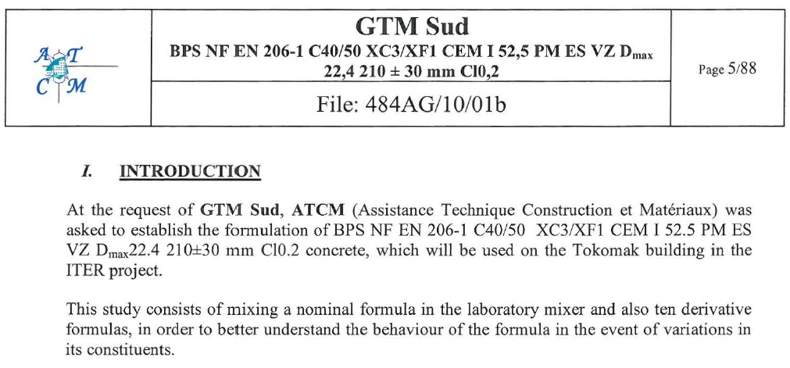
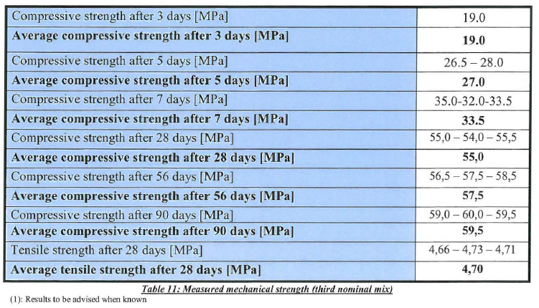
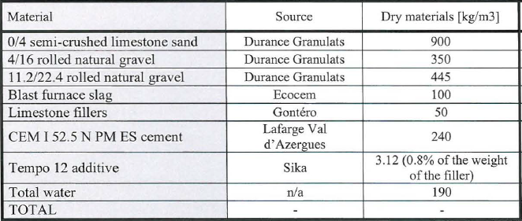
ITER concrete

Slide 3
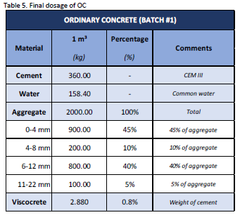
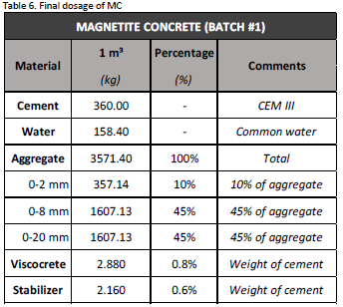
OC/MC Ordinary/Magnetite Concrete

Slide 4
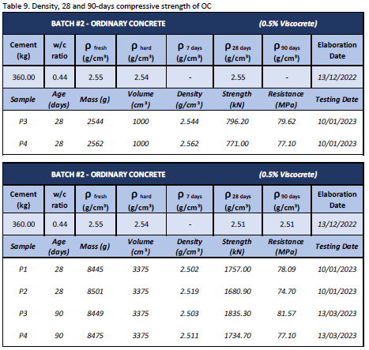
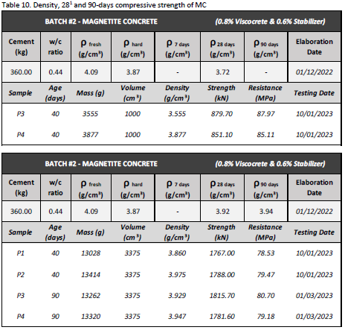
OC/MC 28/40/90-days Compressive strength

Slide 5
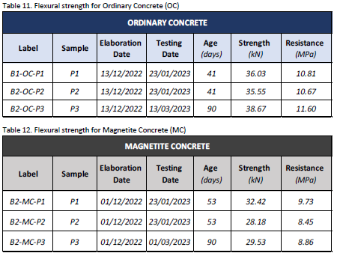
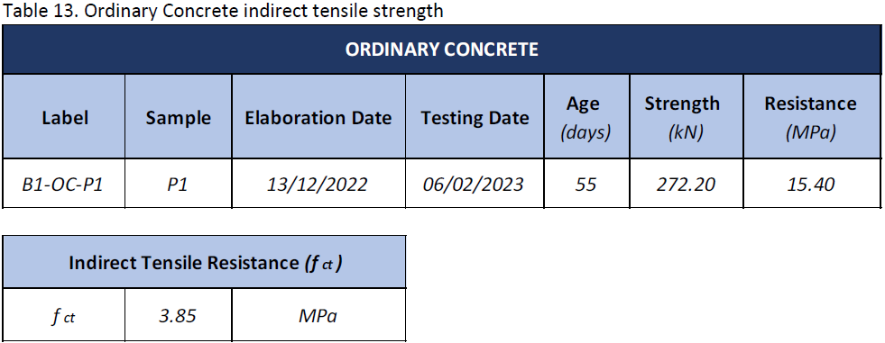
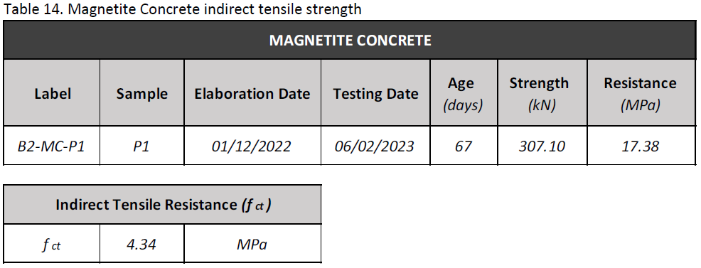
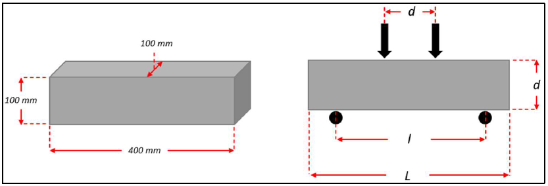
OC/MC Flexural and tensile strength

Slide 6
Task in 2023
Evaluation and optimisation of structural and shielding concrete for the IFMIF-DONES
Accurate measurement of the atomic composition of ordinary and heavy concrete samples using advanced techniques such as X-ray Fluorescence (XRF), x-ray diffractogram (XRD) Microscopy, and other reliable methods.
Accurate estimation of the hydrogen content, which has a significant impact on neutron shielding characteristics, through available experimental infrastructure.
Simulations to optimize the gamma and neutron shielding efficiency by adjusting the concrete compositions.
Simulations and measurements of the structural and technological properties, and thermal properties for heat removal.
Studies on the durability of concrete and reinforcement due to corrosion and the long-term temperature influence on concrete.
New mock-ups will be prepared if requested in the case of further experiments needed to provide additional data for the experiment defined in 2022.

Slide 7
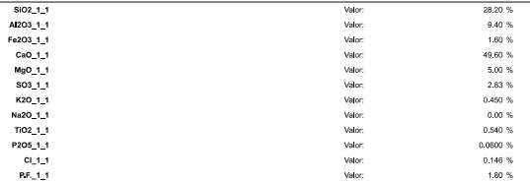
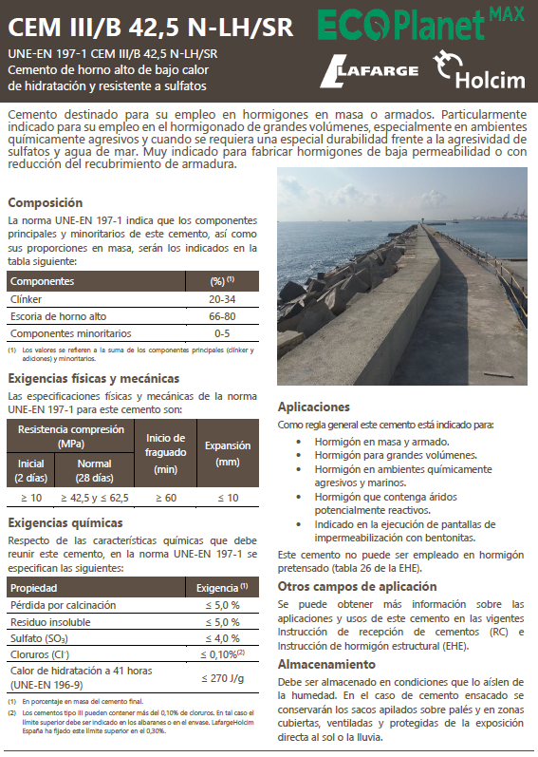

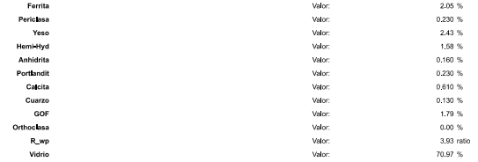
Cement atomic composition XRF/XRD

Slide 8
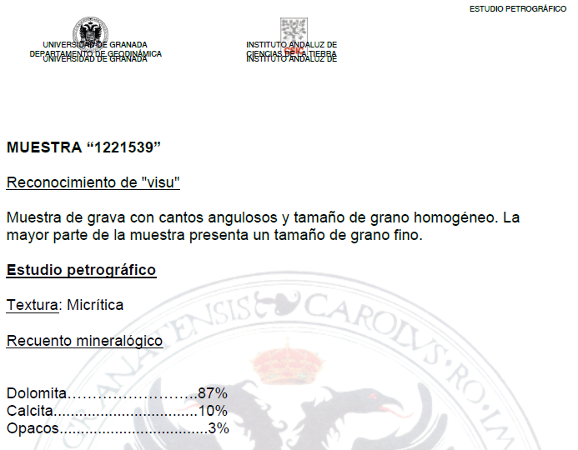
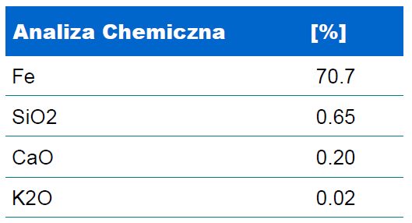
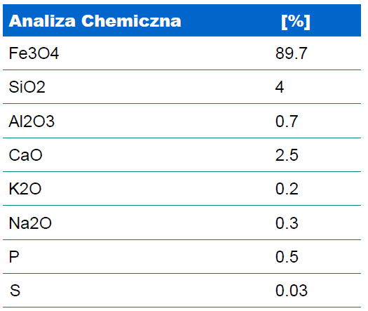
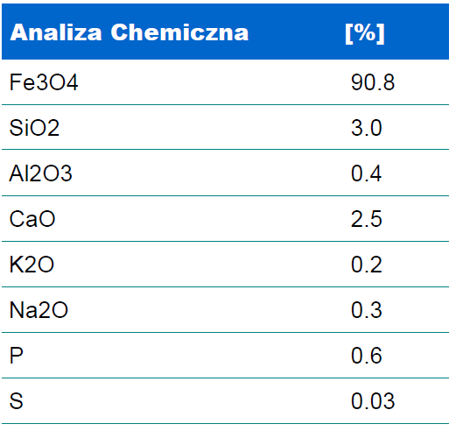
Aggregate atomic composition
0/2 mm
0/8 mm
0/20 mm
Ca has two potential sources. Dolomite which is (Ca,Mg)·(CO₃)₂ and from calcite [CaCO₃] of secondary character that grows in craks.

Slide 9
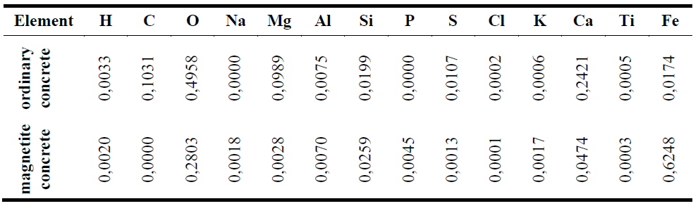
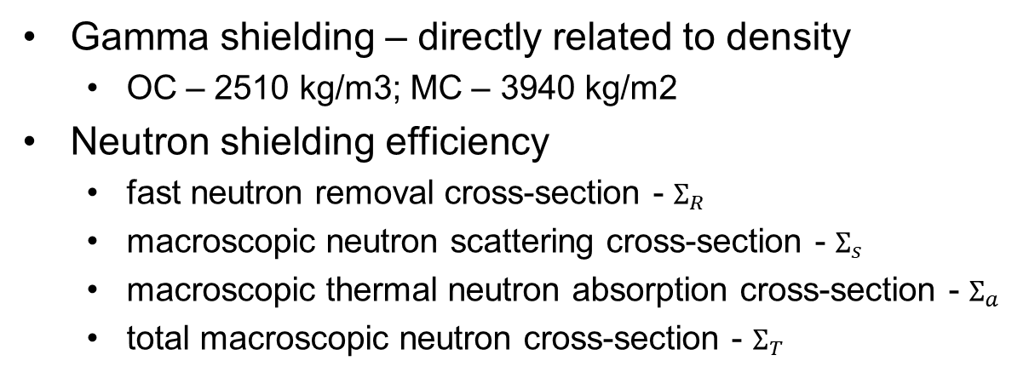
Gamma and neutron shielding efficiency
Gamma shielding – directly related to density
  OC – 2510 kg/m3; MC – 3940 kg/m2
Neutron shielding efficiency
  fast neutron removal cross-section - $Σ_{R}$
  macroscopic neutron scattering cross-section - $Σ_{s}$
  macroscopic thermal neutron absorption cross-section - $Σ_{a}$
  total macroscopic neutron cross-section - $Σ_{T}$
Cement for concrete was CEM III/B 42,5 N-LH/SR and its oxide composition was obtained from XRF analysis. Dolomite aggregate was 87% pure dolomite with 10% of calcite and 3% of iron sulfide.
Magnetite aggregate contained more that 90% of Fe₃O₄ with minor content of Silica, Calcium and Aluminum oxides.
It was assumed that only 20% of the water is chemically bound water by cement hydration.

Slide 10
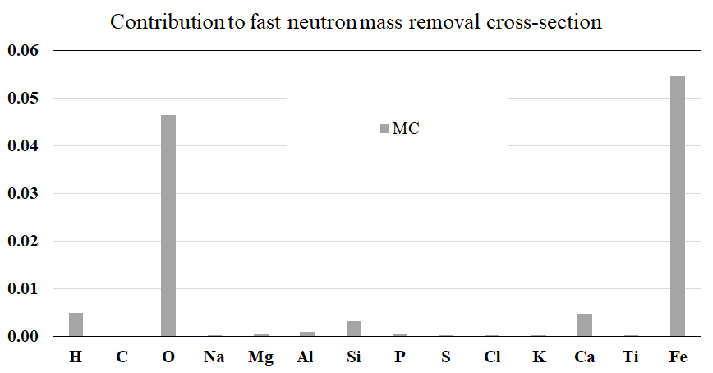
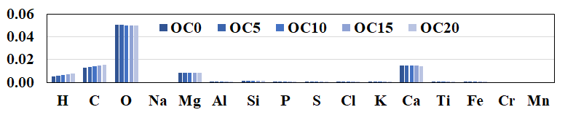
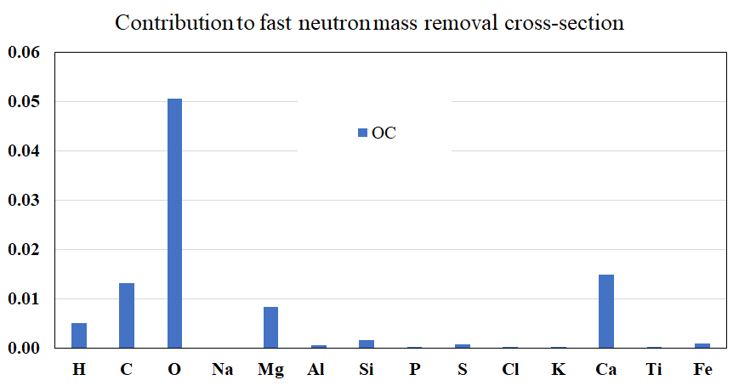
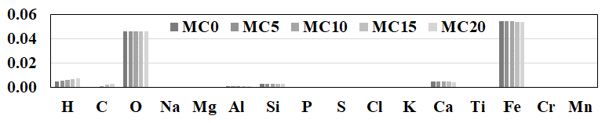


Fast neutron removal cross-section
$$Σ_{R}=0.116 cm−1$$
+22%
$$Σ_{R}=0.095 cm−1$$

Slide 11
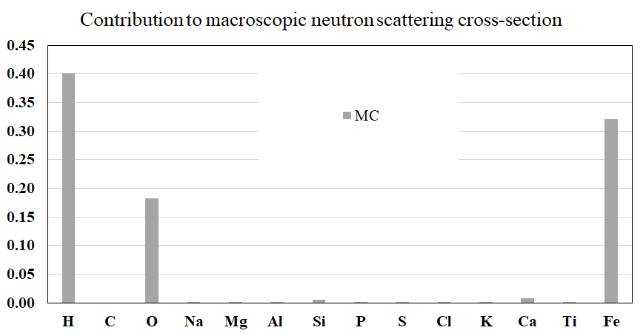
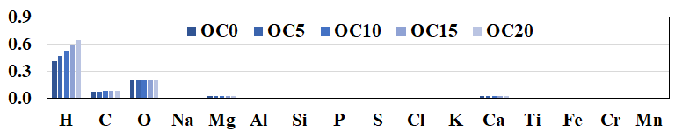
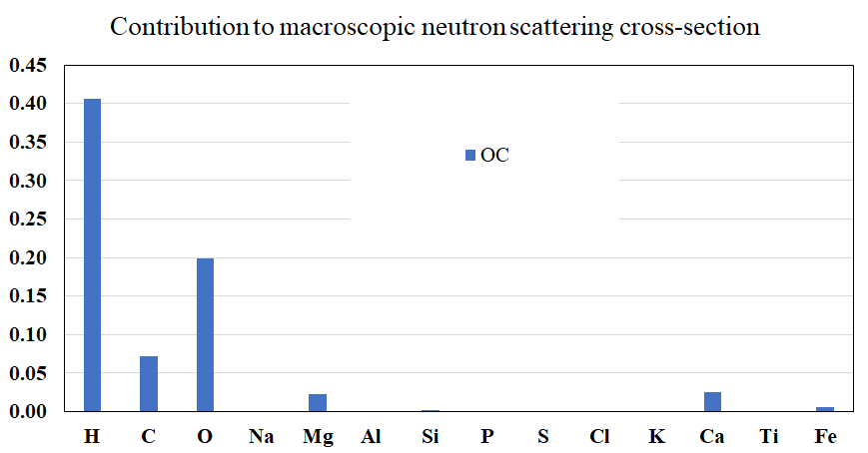
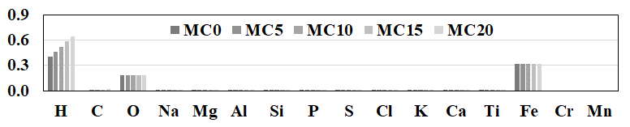


Macroscopic fast neutron scattering cross-section
$$Σ_{s}=0.921 cm−1$$
+25%
$$Σ_{s}=0.735 cm−1$$

Slide 12
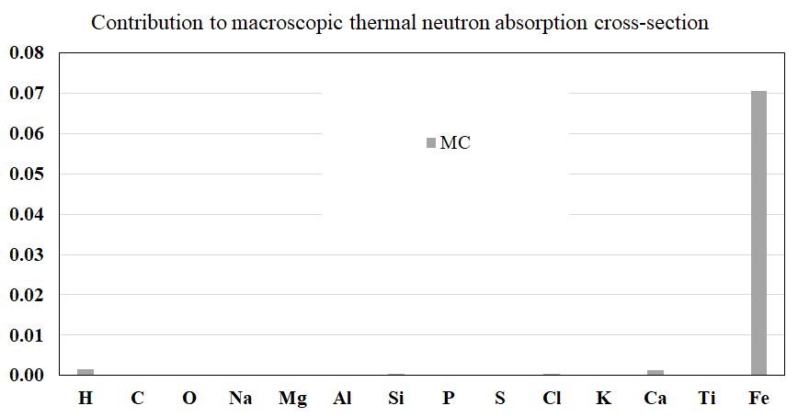
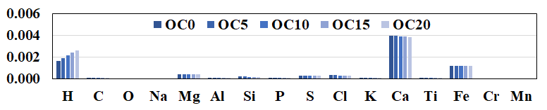
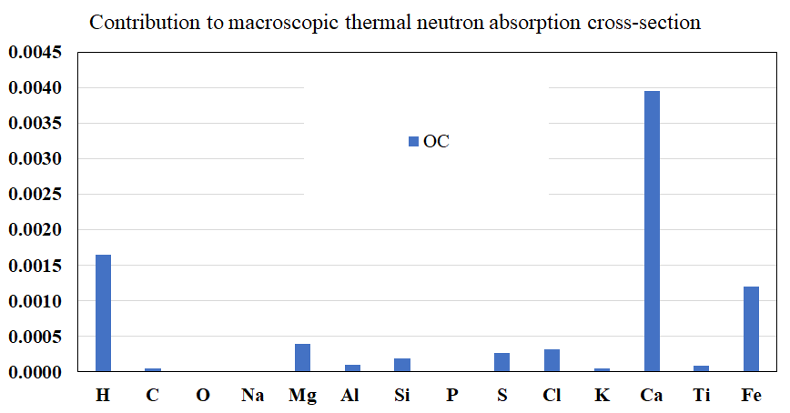
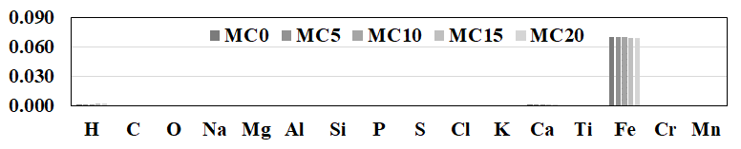


Macroscopic thermal neutron absorption cross-section
$$Σ_{a}=0.0748 cm−1$$
+804%
$$Σ_{a}=0. 0083cm−1$$

Slide 13
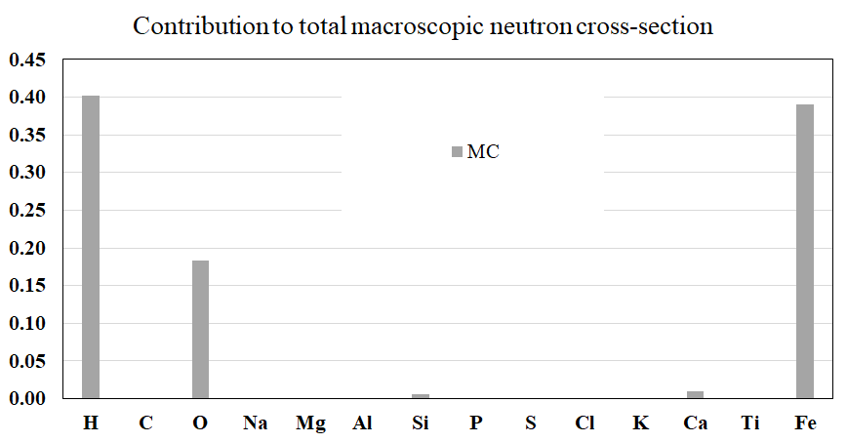
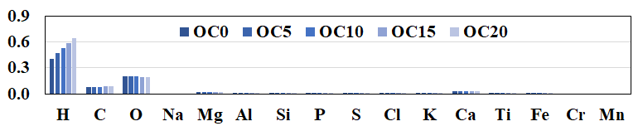
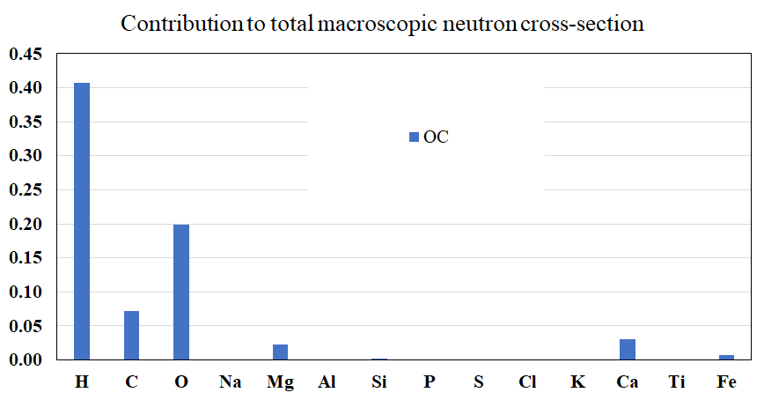
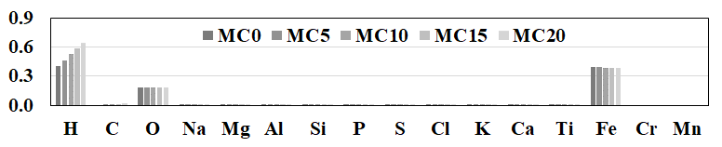


Total macroscopic neutron cross-section
$$Σ_{T}=0.996 cm−1$$
+34%
$$Σ_{T}=0. 743cm−1$$

Slide 14
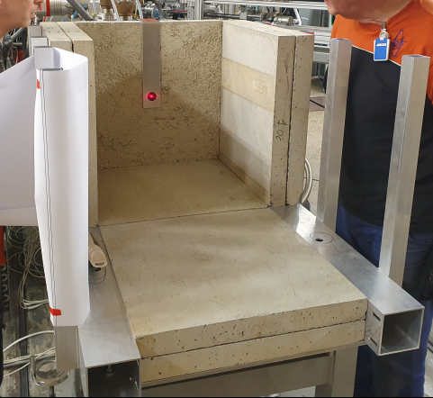
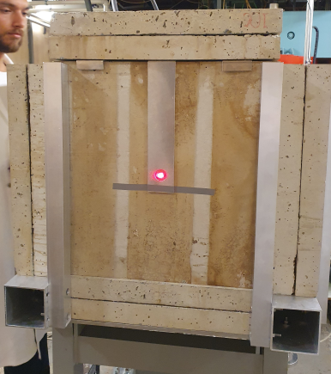
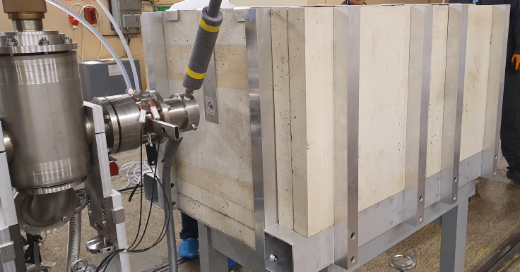
Shielding mock-up experiment

Slide 15
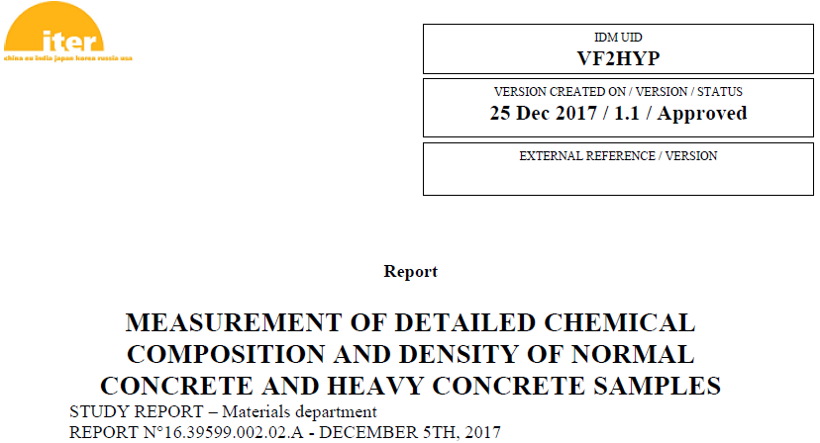
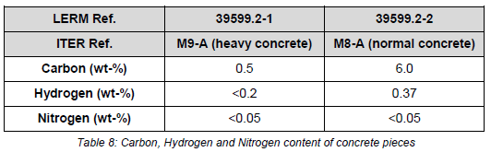
Hydrogen content TCD
4.6 Determination of Carbon, Hydrogen and Nitrogen contents
Carbon, hydrogen and nitrogen contents are determined by measurement in a thermal conductivity
detector (TCD) after sample burning and separation of combustion gases through a chromatographic column.
Results are reported in Table 8.

Slide 16
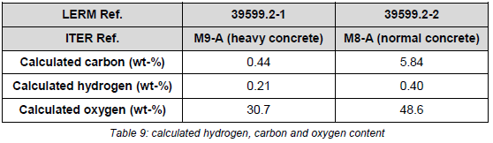
Hydrogen content TGA
Control of measured value:
Content of carbon and hydrogen can be controlled by using values of previous results.
Then hydrogen can be estimated from bounded water determined by thermogravimetric analysis TGA.
Calculation of carbon, hydrogen and oxygen is carried out by introducing molar ratios.
Results are shown in the Table 9.

Slide 17
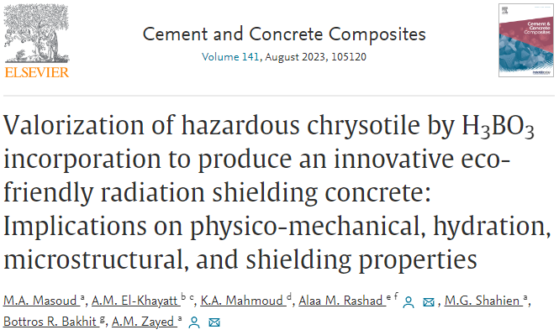
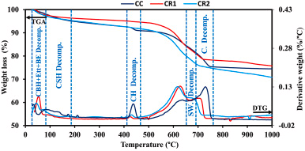
Hydrogen content TGA
Regarding TG/DTG, it was conducted under a nitrogen atmosphere at a temperature range from ambient temperature to 1000 °C (10 °C/min) using the SDT Q600 V20.9 Build 20/TA Instrument. TG/DTG was assigned in conjunction with XRD and FTIR analyses to distinguish between the different hydration products by determining their weight losses and temperature ranges related to their decomposition. TG/DTG was also employed to determine the water ratio from which the hydrogen content was assessed.
„… weight losses stemming from the decomposition of CSH (75–180 °C), CH (410–465 °C), and C (685–760 °C)…”
„… Water contents are also determined to be 11.52, 9.69, and 10.39% for CC, CR1, and CR2, respectively…”

Slide 18
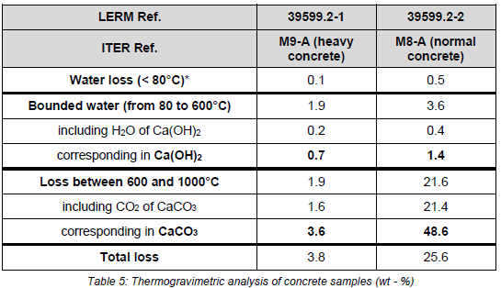
Hydrogen content TGA
4.4 Thermogravimetric analysis
Thermogravimetric analysis TGA is carried out under nitrogen atmosphere from 20°C to 1000°C on powder sample (< 125 μm). This technique allows following the mass variation of a sample depending on time and temperature. It is coupled with DTA (Differential Thermal Analysis), which compares the differentia thermal flow between the sample and an inert reference. Then, exothermic or endothermic changes in
the sample are detected.
Results expressed in weight percentage are reported in Table 5.

Slide 19
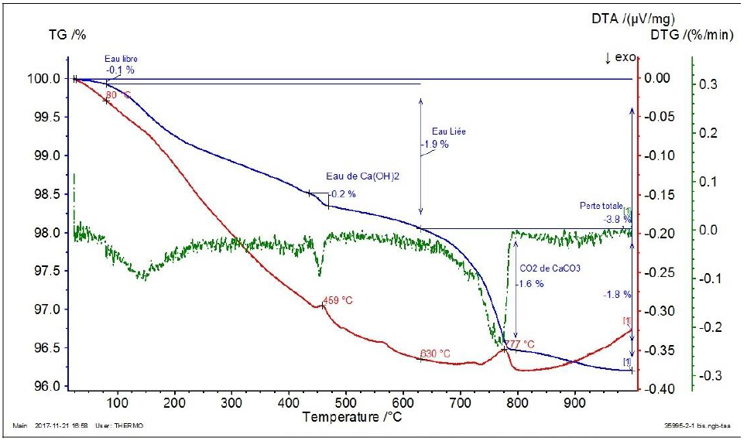
Hydrogen content TGA – Ordinary concrete

Slide 20
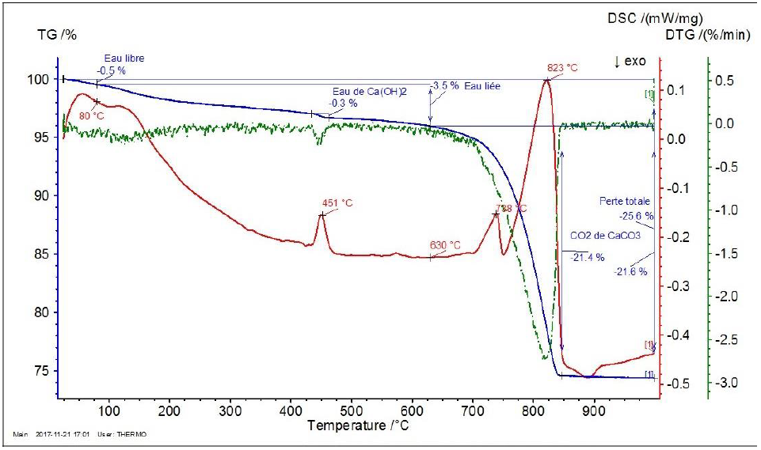
Hydrogen content TGA – Heavy concrete

Slide 21
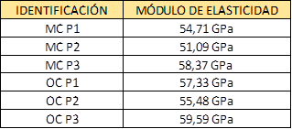
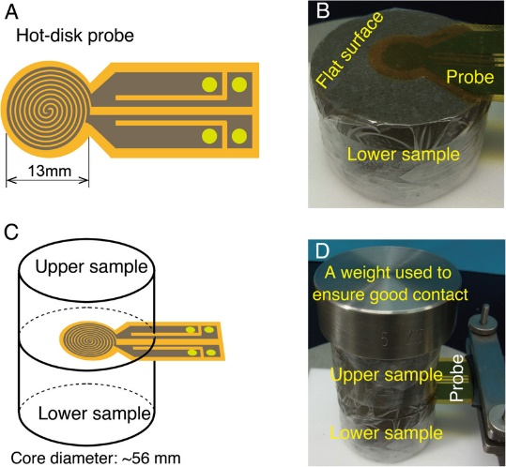
Tests to be continued in 2023
in 2023:
  Structural and technological properties
    Elastic modulus and Poisson ratio
  Durability due to corrosion of concrete
  and reinforcement (UGR)
    Carbonation, Chloride corrosion
  Durability due to long term temperature influence on concrete (WUT)
    Temperature 90°C
    No humidity
    Time 1-3-6-12 months in the owen
    Properties: density, UPV Ultrasonic Pulse Velocity, compressive strength
  Thermal properties for heat removal
    Specific heat, thermal conductivity, heat transfer conductivity – Hot Disc Test
Lin, W., Fulton, P.M., Harris, R.N. et al. Thermal conductivities, thermal diffusivities, and volumetric heat capacities of core samples obtained from the Japan Trench Fast Drilling Project (JFAST). Earth Planet Sp 66, 48 (2014). https://doi.org/10.1186/1880-5981-66-48

Slide 22
Thank You for Your kind attention
Concrete optimization and qualification for IFMIF/DONES and fusion program
Tomasz Piotrowski, D.Sc. Eng.
tomasz.piotrowski@pw.edu.pl

