Slide 1
Roadmap on the development and qualification of Small Scale Test Technologies
M. Serrano¹, R. Hernández¹, R. Gallego², R. Palma²
1 CIEMAT, Materials of Energy Interest Division CIEMAT, Avda. Complutense 40, 28040 Madrid
2 UGR, E.T.S. de Ingeniería de Caminos, Canales y Puertos, Universidad de Granada, Campus Universitario de Fuentenueva (Edificio Politécnico) 18071 Granada
IFMIF-DONES Users Workshop Granada, 19-20 de October 2023

Slide 2
Contents
Some slides on introduction about small specimens
Actions towards standarization
  Fission
  Fusion
  Non nuclear actions

Slide 3
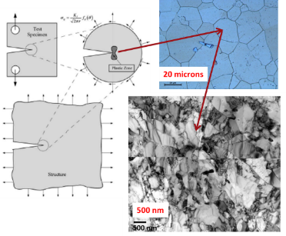
Why we talk about SSTT
Mechanical properties are driven by the microstructure and stress state and thus “relevant volume” should be tested to determine properties that are independent of the specimen size to be transferred to engineering structures
Materials used in engineering applications as structural components are subject to loads, defined by the application purpose.
The mechanical properties of materials characterize the response of a material to loading.
Mechanical properties are determined following standards, which define testing machines, specimen shapes and sizes, experimental procedures, and data interpretations.
  Consistent,
  Uniform, and
  Reproducible
Transferability
Test specimen
Structure

Slide 4
Why we talk about SSTT in IFMIF/DONES
The verification of the structural components of a fusion power reactor requires design criteria developed specifically for those components at the unique conditions at which they are operated
The RCC-MRx design and construction code constitutes a single document that covers in a consistent manner the design and construction of mechanical components for high temperature reactors, research reactors and fusion reactors
Need to acquiring and gathering the data which describe the physical and mechanical behaviour of the material, necessary to apply the component design rules available in the RCC-MRx code
Materials and Design rules have been extended in order to be applicable for nuclear components likely to operate:
  in creep conditions (significant creep)
  in irradiated conditions (significant irradiation)
Mechanical data at RELEVANT irradiation conditions
Key challenge for fusion reactor –> main reason why IFMIF/DONES is required

Slide 5
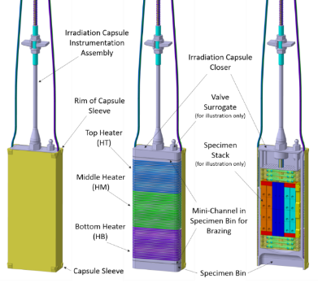
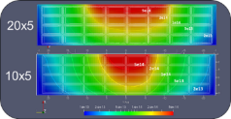

Why we talk about SSTT in IFMIF/DONES
Each capsule of IFMIF/DONES offers a cuboid volume 79 mm x 39 mm x 16.5 mm (54 cm³) for specimens
A standard fracture toughness specimen, with a thickness of 16 mm to be accommodated within the capsule, has a dimensions of 40 mm x 38.4 mm x 16 mm
hardly two standard specimens should be irradiated within the same capsule
Reduce the dimensions of the testing specimens
Neutron flux (n/cm2/s) distribution on the horizontal cut-plane
Qiu, Y. “IFMIF-DONES HFTM neutronics modeling and nuclear response analyses” Nuclear Materials and Energy Volume 15, May 2018, Pages 185-189

Slide 6
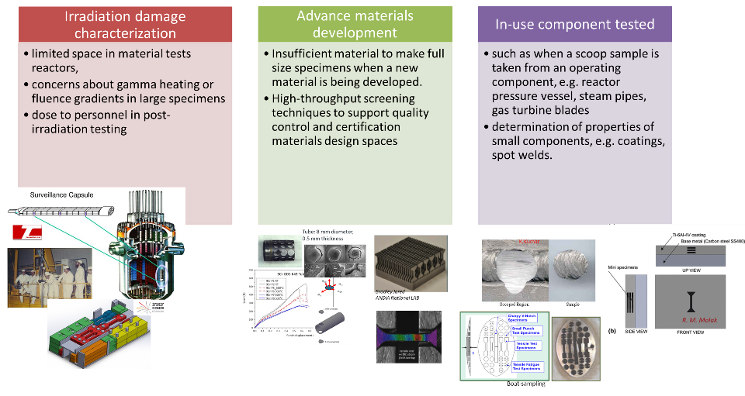
Advantages of SSTT -> Small volume

Slide 7
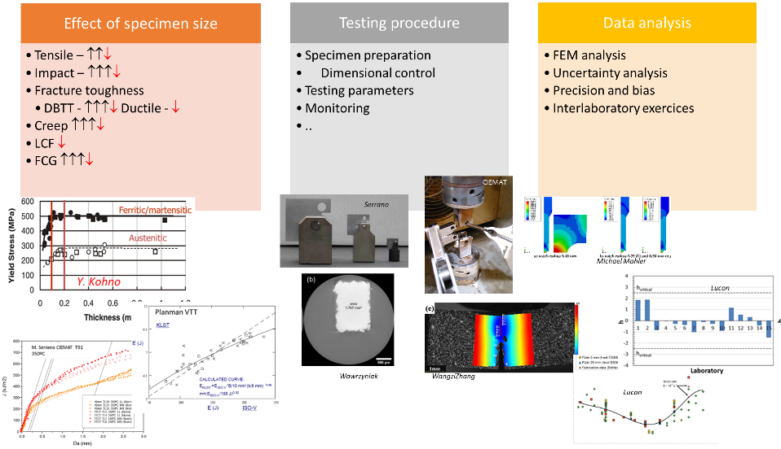
Challenges on the use of SSTT- > Lack of standards (for some techniques)

Slide 8
Actions towards standarization
Previous activities
Nuclear Fission
  EURATOM funded Project FRACTESUS
Nuclear Fusion
  EUROFUSION
  IAEA Towards the Standardization of Small Specimen Test Techniques for Fusion Applications CRP II
Non Nuclear actions

Slide 9
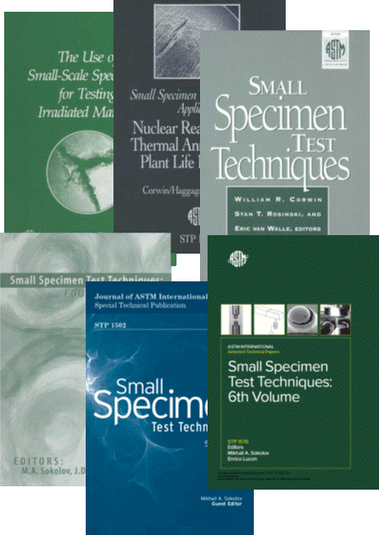
Previous activities
The lack of standardization, not only for the specimen geometry but also for the testing protocol and data uncertainty analysis, is highlight in all the SSTT activities since decades
Early effort for standardization on the use of SSTT for fission and fusion applications was launched by ASTM in the 80’s and a task group was thus formed under the auspices of ASTM Subcommittee E10.02 on “Behavior and Use of Metallic Materials in Nuclear Systems” to consider whether a set of recommended practices for individual small-specimen techniques might be useful and, if so, to write such practices.
They agree to organise a serie of symposium on small-specimen testing, being the first held in 1983 in Albuquerque, New Mexico, and focused on test techniques for fusion reactors and the last one was held in 2014 in Houston.

Slide 10

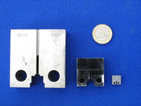
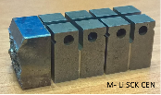
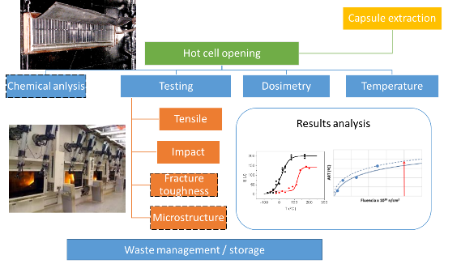
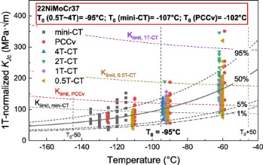
Nuclear Fission - FRACTESUS
EURATOM funded Project FRACTESUS Fracture mechanics testing of irradiated RPV steels by means of sub-sized specimens Euratom work programme 2019-2020 GA 900014
  The objective is the validation of the use of small CT specimen for the determination of the T₀ transition reference temperature –> Reactor pressure vessel surveillance
Li, M., Chaouadi, R., Uytdenhouwen, I., & Pardoen, T. (2023). Engineering Fracture Mechanics, 290, 109486.
RPV surveillance tests

Slide 11

Nuclear Fusion - IAEA
IAEA Coordinated Research Project (CRP) Towards the Standardization of Small Specimen Test Techniques for Fusion Applications (F13017) 2017-2021
  to provide a set of guidelines for SSTT based on common agreed best practices on main test techniques (tensile, creep, low cycle fatigue, fracture toughness, fatigue crack growth) valid for reference structural Fusion materials (RAFM steels)
  to establish supporting experimental activities and
  to elaborate datasets and elements needed for a full standardization of the SSTT by an international authority like ASTM or ISO.
Note: the standardization process itself was not part of the CRP
IAEA Sehila M. Gonzalez de Vicente
Rapporteurs
  Eberhard Diegele (independent expert)
  Roland Heidinger (independent expert)
Shanghai Jiao Tong University China
KIT Germany
Osaka University Japan
QST Japan
NIFS Japan
CIEMAT Spain
UKAEA UK

Slide 12

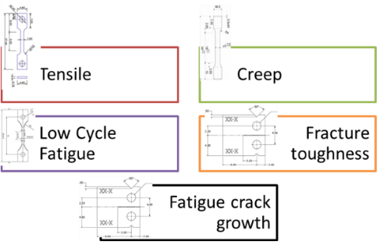
Nuclear Fusion - IAEA
The CRP includes an expert and in-depth literature review for the tests selected that is unique in its scope addressing a wealth of tests and types of specimen.
“Reference” guidelines have been established, following international standards, for the five different test techniques. Subsequently, they have been applied in the course of the CRP to get immediate feedback in terms of applicability and verification.
“Round Robin”: Respective test matrices (selection of specimens, materials and common “test conditions”, test methodologies) were agreed
Heavely affected by COVID lockdown
Tensile: 375 completed at 4 labs.
Creep: 20 tests completed
LCF: 147 test completed @RT, @550C
Master Curve: 34 completed
Brittle (local) Approach: 43 completed
Ductile Approach: 96 completed
FCG: 8 completed at 2 labs, all @RT

Slide 13
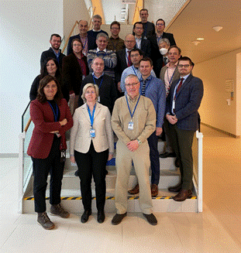
Nuclear Fusion - IAEA
IAEA Coordinated Research Project (CRP) Towards the Standardization of Small Specimen Test Techniques for Fusion Applications PHASE II (2023-2026)
To provide the bases for the standardization of SSTT specimens making them available for their use in Fusion material irradiation facilities. This includes:
  (a) to provide a set of guidelines for SSTT based on common agreed best practices on main test techniques (tensile, creep, low cycle fatigue, fracture toughness, fatigue crack growth) valid for reference structural Fusion materials (RAFM steels);
  (b) to establish supporting experimental activities and
  (c) to elaborate datasets and elements needed for a full standardization of the SSTT by an international authority like ASTM or ISO.
IAEA [Sehila M. Gonzalez de Vicente]
Rapporteurs
  Eberhard Diegele (independent expert)
  Roland Heidinger (independent expert)
Comision Nacional de Energia Atomica Argentina
SCK CEN Belgium
Shanghai Jiao Tong University China
KIT Germany
Centre for Energy Research Hungary
Osaka University Japan
QST Japan
NIFS Japan
CIEMAT Spain
National Nuclear Laboratory UK
UKAEA UK
Oxford Sigma UK
University of California, Berkeley USA
1st Research Coordination Meeting
30 January to 01 February 2023
IAEA Headquarters, VIC, Vienna, Austria

Slide 14

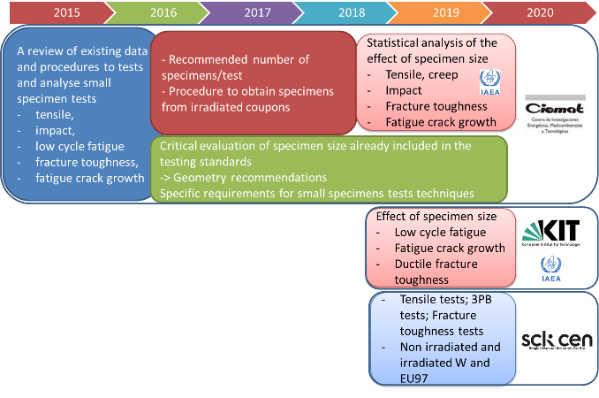

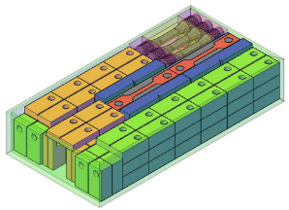


Nuclear Fusion - EUROFUSION
H2020 EUROFUSION 2015-2020
HE EUROFUSION 2021-2024
transversal activity between ENS / DONES and MAT (DEMO: EDDI / SDQ / HHFM / IRRAD; TBM),
RAFM, CuCrZ, W
Tensile, LCF, FT
Roadmap for standarization

Slide 15
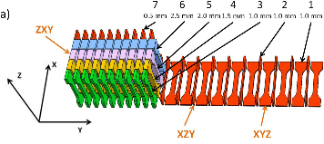
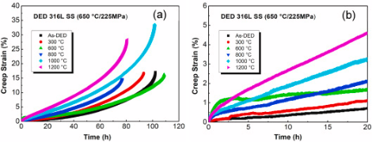

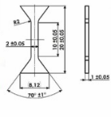
Non-nuclear actions
Characterize additive manufactured materials, especially for metal-based technologies. [J. Dzugan et al mainly]
  high costs (raw material),
  high number of samples needed to fully characterize a batch of material.
  traceability at various locations and anisotropy
ASTM WK83107
(see later)
Dzugan, J., Seifi, M., Prochazka, R., Rund, M., Podany, P., Konopik, P., & Lewandowski, J. J. (2018). Effects of thickness and orientation on the small scale fracture behaviour of additively manufactured Ti-6Al-4V. Materials Characterization, 143, 94-109.
Li, Y., Krajňák, T., Podaný, P., Veselý, J., & Džugan, J. (2023). Thermal stability of dislocation structure and its effect on creep property in austenitic 316L stainless steel manufactured by directed energy deposition. Materials Science and Engineering: A, 873, 144981.

Slide 16
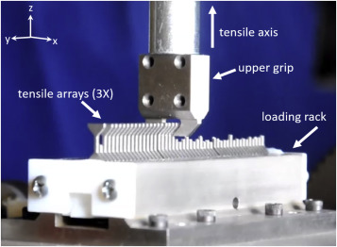
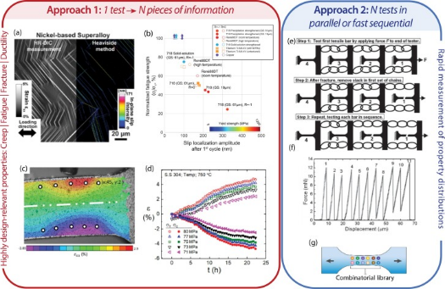
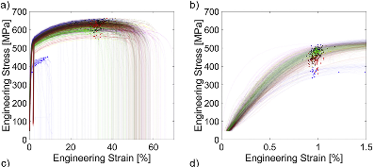
Non-nuclear actions
Data-driven evaluation of mechanical properties - high-throughput materials evaluation techniques
Heckman, N. M
Daniel S. Gianola
Heckman, N. M., Ivanoff, T. A., Roach, A. M., Jared, B. H., Tung, D. J., Brown-Shaklee, H. J., ... & Boyce, B. L. (2020). Automated high-throughput tensile testing reveals stochastic process parameter sensitivity. Materials Science and Engineering: A, 772, 138632.
Gianola, D. S., della Ventura, N. M., Balbus, G. H., Ziemke, P., Echlin, M. P., & Begley, M. R. (2023). Advances and opportunities in high-throughput small-scale mechanical testing. Current Opinion in Solid State and Materials Science, 27(4), 101090.

Slide 17
MAT-T.01.03-T017 D001 Interaction with regulatory body (URG/CIEMAT)
Roadmap under development within EUROFUSION WPMAT-EDDI-SSTT
ASTM route was selected as some ongoing activities on SSTT already exists
EUROFUSION PILOT RUN:
  Objectives
  Organization
  Labs, Test method and protocol
  Time table

Slide 18





Standarization route
www.astm.org
ASTM New Standard Activity
Determine if new standard is needed
Identify key stakeholders
Identify Committee and Subcommittee
Committee E10 – Nuclear Applications or Committee E08
Register a Work Item
ASTM Stimulates participation from outside of task group
Balloting
Final publication

Slide 19
Standarization route
An interlaboratory study (ILS) is a multi lab study done for the specific purpose of producing data that will be used to develop a Precision & Bias statement and
Research Report in order to demonstrate the expected variability of a test method.
ASTM E691 − 19 An American National Standard Standard Practice for Conducting an Interlaboratory Study to Determine the Precision of a Test Method
Where numerical data have been
generated to establish the precision
and bias of a test method, a
research report is required
ASTM Work Item
  1. Scope
  2. Referenced Documents
  3. Terminology
    3.1 Definitions
  4. Significance and Use
  5. Apparatus
  6. Test Specimens
  7. Procedure
  8. Post-Test Examination
  9. Report
  10. Precision and Bias (MANDATORY)
  11. Keywords
13. Pilot Run
13.1 Before investing laboratory time in the full scale ILS, it is usually wise to conduct a pilot run with only one, or perhaps two, material(s) to determine whether the test method as well as the protocol and all the ILS procedures are clear, and to serve as a familiarization procedure for those without sufficient experience with the method (see 9.3).
The results of this pilot run also give the task group an indication of how well each laboratory will perform in terms of promptness and following the protocol. Laboratories with poor performance should be encouraged and helped to take corrective action.

Slide 20

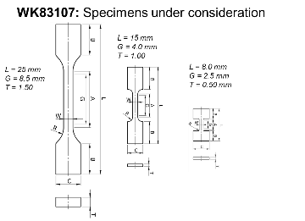
MAT-T.01.03-T017 D001 Interaction with regulatory body (URG/CIEMAT)
EXAMPLE OF AN EXISTING WK ON SSTT (TENSILE)
ASTM ongoing activities on SSTT
  Subcommittee E28.04.01 (Task Group on Small Specimens in E8/E8M) to publish an annex providing guidelines to uniaxial tensile testing of subscale geometries WK83107
  Additional efforts are underway through ASTM Subcommittee F42.01 (New Test Method for Additive Manufacturing – Test Artifacts – Miniature Tension Testing of Metallic Materials),
ASTM WK83107 . Rationale
  There are situations where standard ASTM E8/E8M specimens are too large. These are often because a particular part or component from which the test specimen is to be excised is small. Excising miniature specimens is a logical conclusion, however there are some important considerations that need to be addressed. Tensile test procedures and properties can be dramatically affected by specimen size. This annex is intended to address the problems that can arise from testing miniature tensile specimens.
STILL NOT APPROVED
ASTM Interlaboratory Study to Establish Precision Statements for Tensile Testing of Miniature specimens using ASTM E/E8M

Slide 21
MAT-T.01.03-T017 D001 Interaction with regulatory body (URG/CIEMAT)
TO BE DISCUSSED at Next WPMAT-EDDI SSTT meeting
Pilot run on tensile properties
2023
Tensile properties at room temperature
  First draft of the ASTM WK including ILS
  ILS results submitted to the ASTM ILS section for approval
ASTM Committe selection
ILS on tensile properties at room temperature
Pilot run on high temperature tensile
2024
Tensile properties draft (room temperature)
Pilot run on fracture toughness
2025
Tensile properties at room temperature
  Draft standard in the ASTM format
  Ballotting of the draft standard

Slide 22
MAT-T.01.03-T017 D001 Interaction with regulatory body (URG/CIEMAT)
PLANNED ACTIVITIES in 2023: PILOT RUN
  Send material to Labs (SCK-CEN)
  Finish protocol and test method (Task Group)
  Follow draft of AX1 for E8/E8M balloting

Slide 23

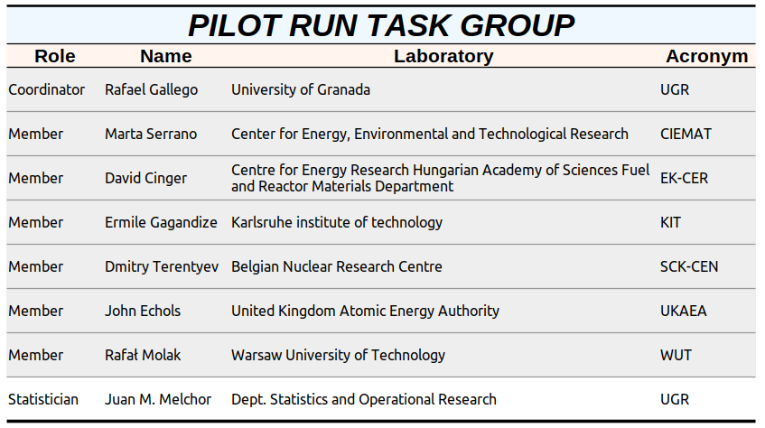






MAT-T.01.03-T017 D001 Interaction with regulatory body (URG/CIEMAT)
Pilot run on tensile properties at room temperature

Slide 24
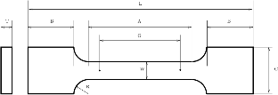
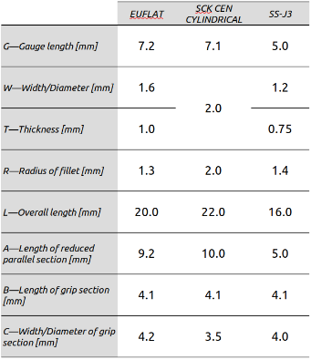
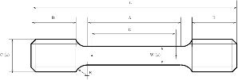
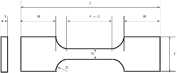
MAT-T.01.03-T017 D001 Interaction with regulatory body (URG/CIEMAT)
Definition of tensile geometries
EU FLAT
Modification of “DONES” geometry to fulfil Standard requirements on proportionality
SCKCEN ROUND
Same geometry used for EUROFER97 irradiation campaigns
SS-J3
Extensilevly used, e.g. IAEA CRP on SSTT

Slide 25
MAT-T.01.03-T017 D001 Interaction with regulatory body (URG/CIEMAT)
Finish protocol and test method (Task Group)

Slide 26
Summary
Different actions towards the standardization of small specimens to determine mechanical properties are presented (past and present)
Within nuclear fusion two main action are already run in parallel and connected:
  IAEA Coordinated Research Project (CRP) Towards the Standardization of Small Specimen Test Techniques for Fusion Applications
  MAT-T.01.03-T017 D001 Interaction with regulatory body (URG/CIEMAT)
First step for the standardization of SSTT has been launched within EUROFUSION WPMAT-EDDI-SSTT
  2023 Pilot run on tensile properties at room temperature launched

