Slide 1
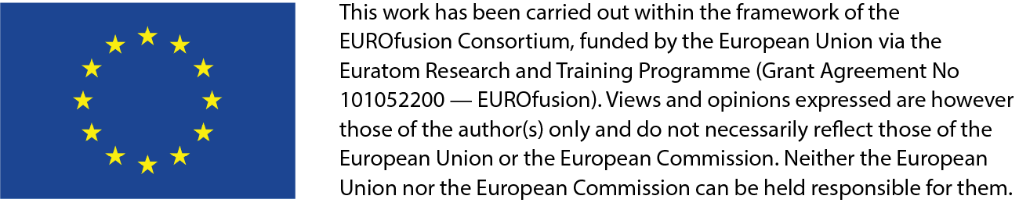
Post-Irradiation Examination for IFMIF-DONES
H.-C. Schneider¹, D. Terentyev², G. Pintsuk^{3,*}, M. Rieth¹
¹ KIT, Institute for Applied Materials
² SCK CEN, Institute Nuclear Materials Science,
³ FZJ, Institute for Energy and Climate Research

Slide 2
Objectives
How could the post-irradiation examination of samples irradiated in IFMIF-DONES be organized? Where should this be done? Who should be involved? How to optimize the benefit from competencies at the European partners’ sites? How to use synergies? How to reduce transports of radioactive material? How to ensure redundancies? How to avoid overcapacities? How to prevent bottlenecks? …
Expected activity for 24 rigs after one year of irradiation
Design of rig and capsule for IFMIF-DONES
F. Arbeiter et al., Nucl. Mater. Energy 9, 2016

Slide 3
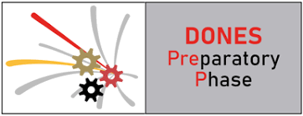


The IFMIF-DONES Preparatory Phase project
These questions were addressed during the IFMIF-DONES Preparatory Phase project¹ in Work Package 9, Support Facilities and Exploitation of Results
Task 9.2: Irradiated materials exploitation (2019-2021)
https://ifmif-dones.es/projects/dones-prep/
Partners in T9.2:
¹ The DONES Preparatory Phase project has received funding from the Euratom research and training programme 2014-2018 under grant agreement No 870186.

Slide 4
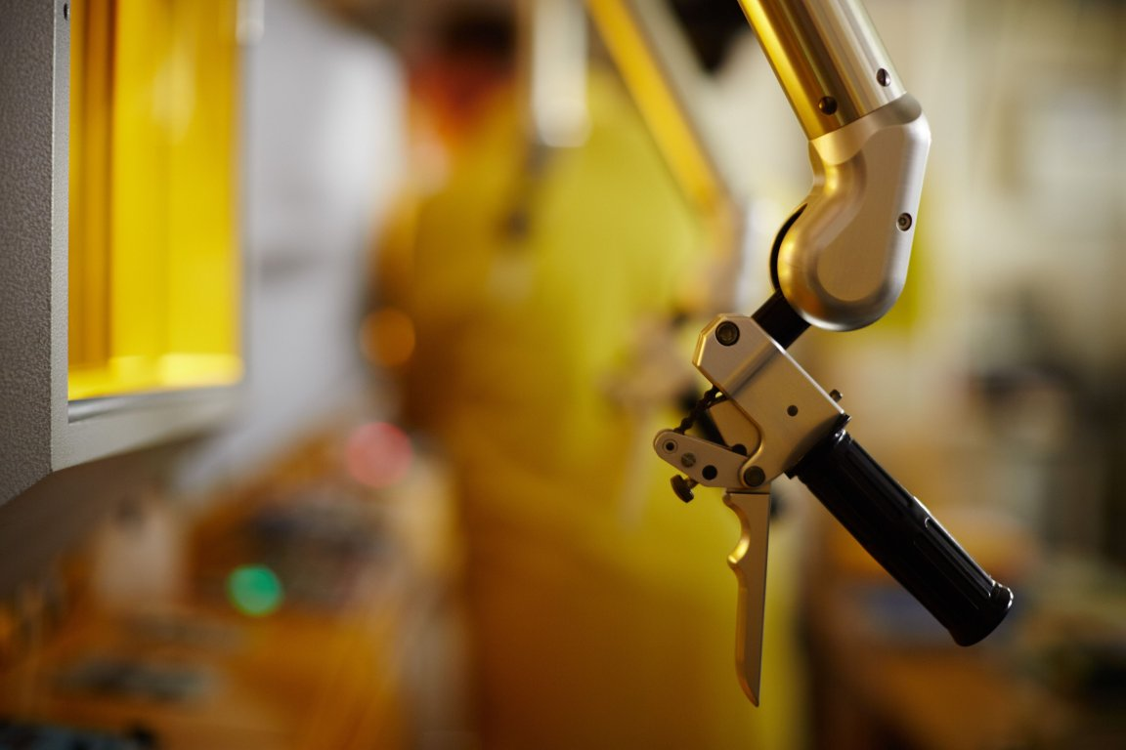
Topics identified within DONES-PreP T9.2
Definition of requirements for the facilities to be used for DONES-PIE
  Identifying and defining the requirements of facilities needed for handling and analysis at PIE phase
  Based on definition of samples and QA requirements for standardized, SSTT, and non‐standardized tests
Evaluation of facilities that could be used for DONES-PIE
  Present and prospective status (10‐15 y timeframe)
  Staff, competencies, installations available and planned (including risks)
  Nuclear installations, capability to handle capsules filled with NaK
  Quality assurance and safety procedures
  Trade‐off study in order to evaluate the possibilities of
  On‐site materials characterization
  Off‐site materials characterization in existing labs
  Or even a combined approach, in which some properties are analyzed on‐site and others in a distributed network of labs

Slide 5
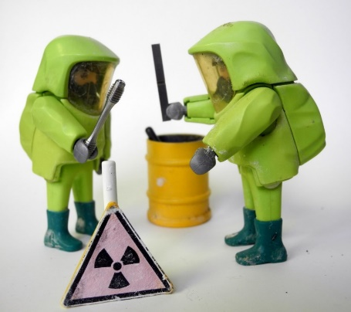
1. Definition of requirements for the facilities to be used for DONES-PIE
Transportation Coordination Office for external transports from DONES to nuclear PIE laboratories and further to non‐nuclear laboratories
Activities of 700 TBq (module), 80 TBq (rig), or 0.1 TBq (specimens) will however require Type B containers for transport
Hot Cell to dismantle irradiation modules on DONES site will relax requirements on transport and reduce the amount of activity and volume transported
A list of primary mechanical tests needs to be specified (others will also be needed)
Guidance will be necessary for accreditation, internal document management systems, and for internal operational procedures for tests

Slide 6
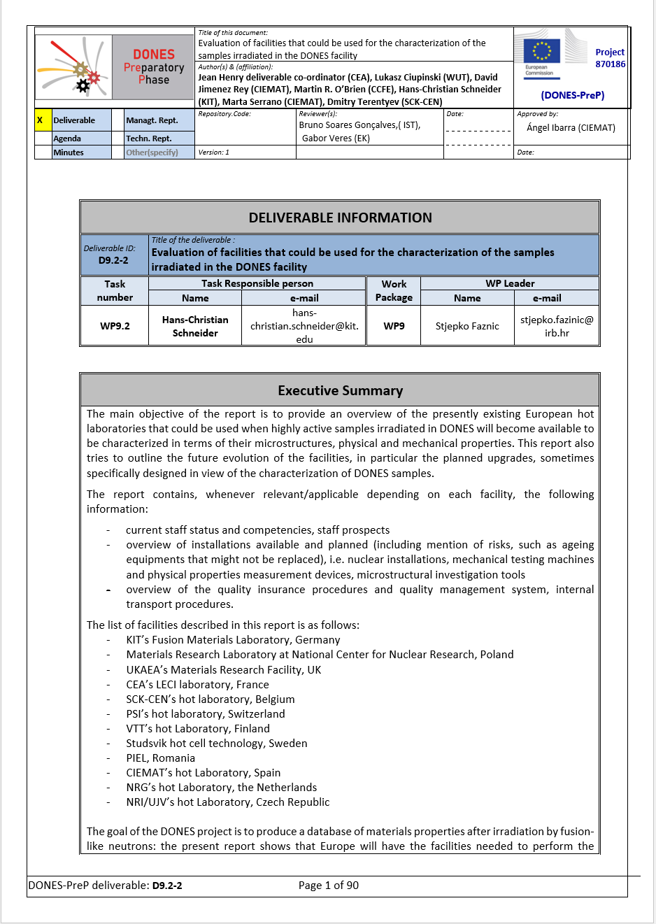
2. Evaluation of existing facilities that could be used for DONES-PIE
Goal: a database of materials properties after irradiation by fusion-like neutrons
Conclusions of the report:
Europe will have the facilities needed to perform the required tests when irradiated samples become available, based on the current status and planned evolution of the nuclearized (“hot”) laboratories.
In addition to mechanical tests and physical properties measurements, microstructural investigations will be required for a thorough understanding of irradiation-induced modifications of materials microstructures.
The hot laboratories in Europe possess the necessary tools, including state-of-the-art instruments for performing microstructure analysis down to atomic scale.

Slide 7
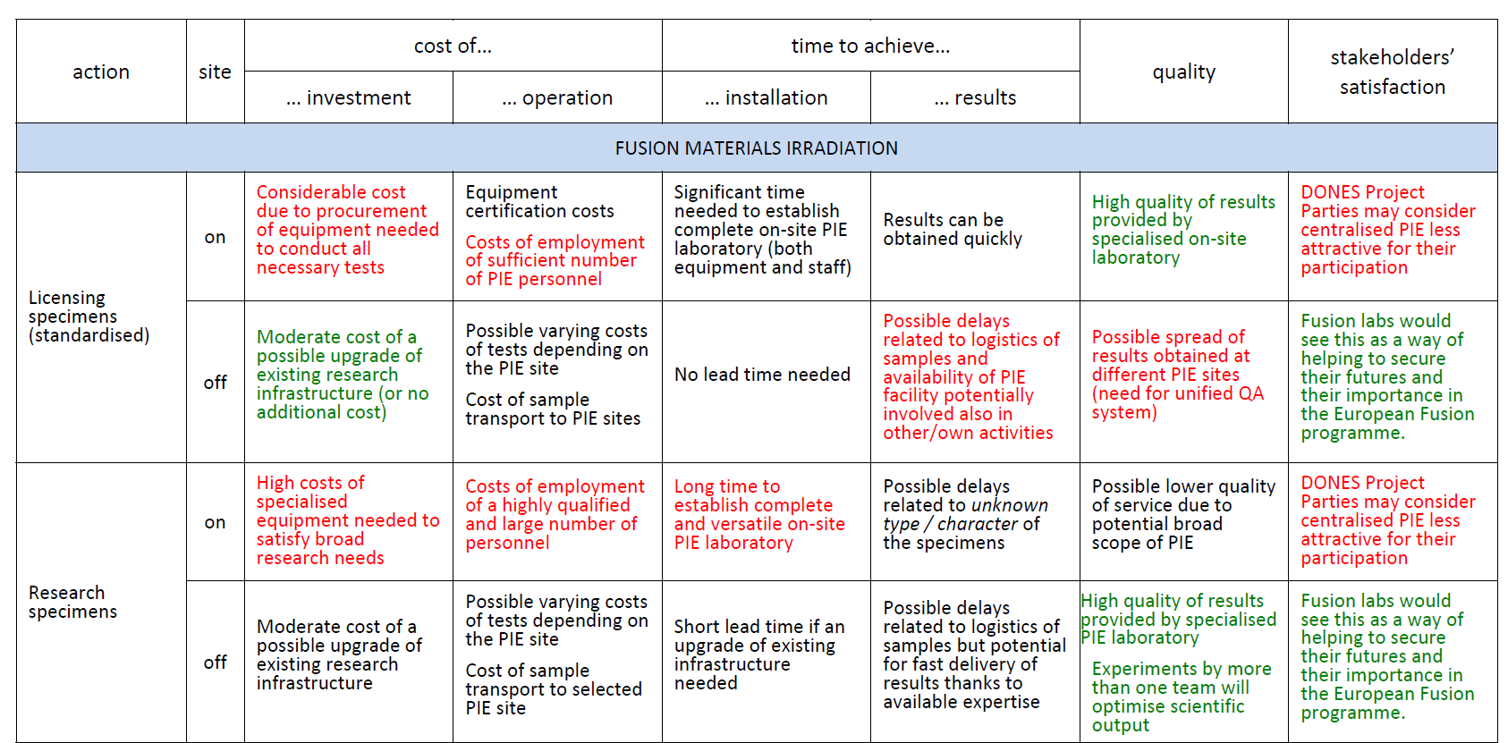
3. Trade‐off study in order to evaluate on-site vs. off-site DONES-PIE (I)
First approach: considering the two extremes
  all PIE completely on-site at DONES
  all PIE in currently existing European laboratories
Taking account of time-effectiveness and the various technical, financial, staffing and research-political advantages and disadvantages
Both extreme options turn out to be flawed by major critical disadvantages
Third option: combined approach
  Draining and capsules’ unpacking, and the simplest, quickest analysis is on-site
  with the remainder undertaken at specialist laboratories around Europe
Example of impact assessment of implementation location for various technical actions

Slide 8
3. Trade‐off study in order to evaluate on-site vs. off-site DONES-PIE (II)
DONES should be able to test and inspect first irradiated specimens on-site (no need for the capacity and the staff to treat in-time 100%).
  basic mechanical testing
  metallography and optical microscopy
  basic scanning electron microscopy
  infrastructure for quick distribution of samples to other labs
Access to the best experts for PIE by sending specimens to them or welcome the best experts for a secondment for the start of operation
Comparison of the damage by (first) fusion-relevant neutrons with all relevant preceding works should be done by those leading experts with the deepest experience – and they are expected to be in the European laboratories
Building a PIE complex (hot cell laboratory) @ DONES for 100% of PIE required would overburden the project by financial investment and time-wise due to planning/engineering, recruiting experts and licensing required

Slide 9

3. Trade‐off study in order to evaluate on-site vs. off-site DONES-PIE (III)
The advanced PIE techniques existing at other sites could include more high-resolution microscopy and atom probe characterisation, nano computer tomography and micromechanics, and new facilities that will be deployed by the time DONES completes the irradiation.
Suitable balance between having experienced staff needed on-site to operate a range of equipment, and many more specialist staff at several facilities around Europe, many of whom will be international experts applying their skills to Fusion PIE as well as other areas of materials science.
The involvement of facilities in many European countries in the exploitation of DONES aligns with the principles of ESFRI, which stipulate engagement of multiple European countries in development and exploitation of ESFRI “branded” facilities.

Slide 10
Acknowledgements
The Euratom research and training programme 2014-2018 is acknowledged for the support of the IFMIF-DONES Preparatory Phase project .
Special thanks to the further contributors in the Task 9.2 Irradiated materials exploitation:
  Łukasz Ciupiński (WUT)
  Stjepko Fazinić (IRB)
  Jean Henry (CEA)
  Mirosław Kruszewski (WUT)
  Martin R. O’Brien (CCFE)
  David Jimenez Rey, (CIEMAT)
  Marta Serrano (CIEMAT)
Figures and tables without reference are extracted from DONES-PreP reports T9.2-1, T9.2-2, or T9.2-3 or are contributed by the authors.

