Slide 1
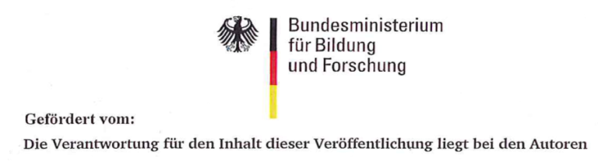

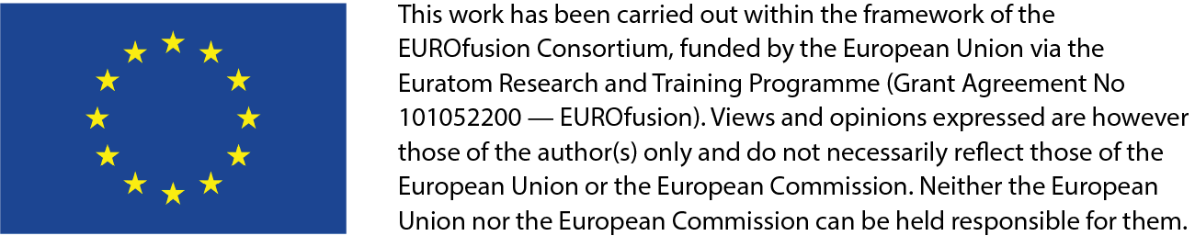
IFMIF-DONES HFTM : design overview and
strategy to obtain high-dpa samples
Frederik Arbeiter, Yuefeng Qiu, and the IFMIF-DONES team

Slide 2

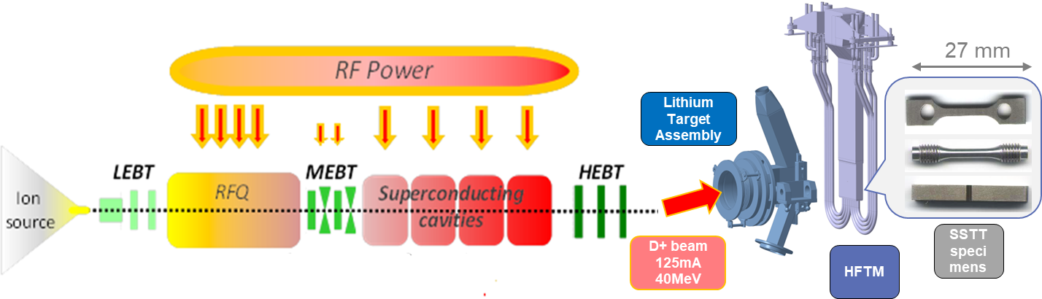
Mission of the DONES HFTM
HFTM = High Flux Test Module
Utilization of the “high flux” region directly behind the IFMIF-DONES neutron source
Irradiation of (SSTT) specimens for PIE
The current development aims to facilitate the irradiation of SSTT specimens of RAFM steels (Eurofer, F82H, …) at conditions of the DEMO First Wall (FW)
Insertion for
irradiation
1 – 2.5 years
Retrieval, Dismantling,
Extraction of specimens
For Post Irradiation Examination
Neutron flux
~5×10¹⁴ #/cm²/s

Slide 3
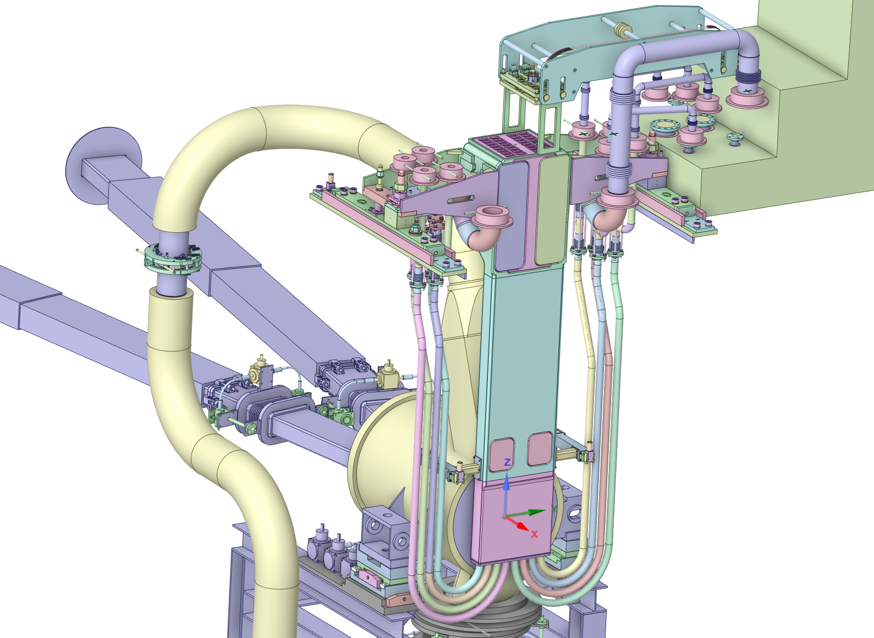
HFTM installed behind DONES Li-Target
Liquid
Lithium
Feed pipe
HFTM
media&signal
interfaces
Test Cell
Piping&Cabling
Plug
Accelerator
Beam tube
(125mA x 40 MeV
Deuterons)
High
Flux
Test
Module
Target assembly

Slide 4
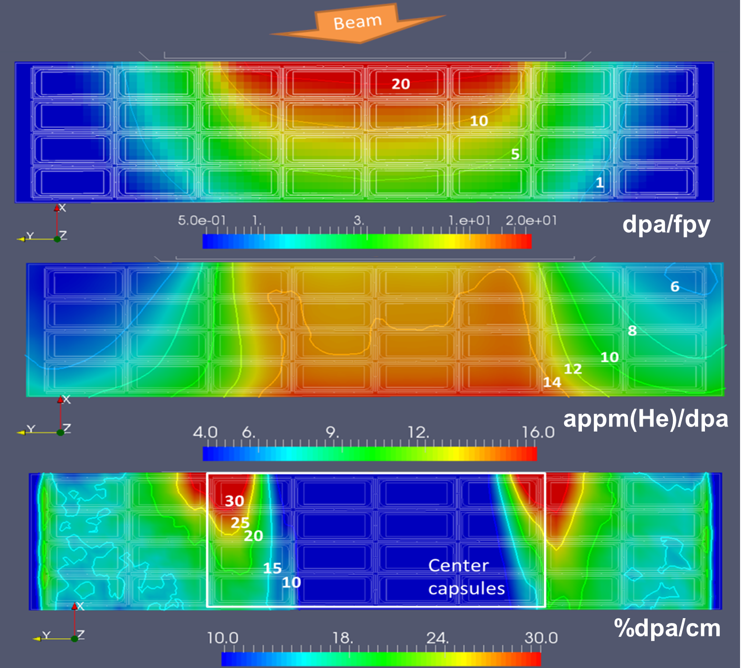
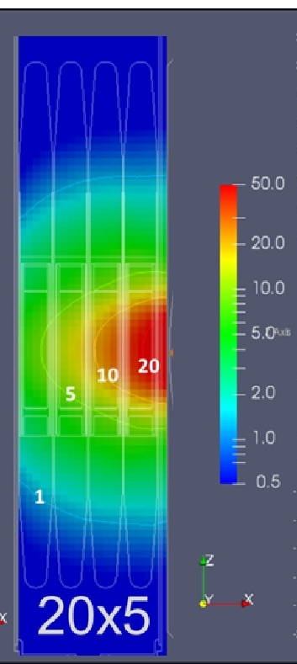

Neutron irradiation conditions
Incident neutron flux:
5×10¹⁴ n/cm²/s
12 – 25 dpa/fpy are reached in a volume of 306 cm³
(~850 specimens)
The HFTM structure receives up to 25 dpa/fpy
13-15 appm(He)/dpa,
50-60 appm(H)/dpa
Good match to DEMO
conditions at First Wall
Significant gradients at beam edges !
15.4
5.6
Nuclear responses in horizontal cut on beam (20x5cm²) level
Vertical cut

Slide 5
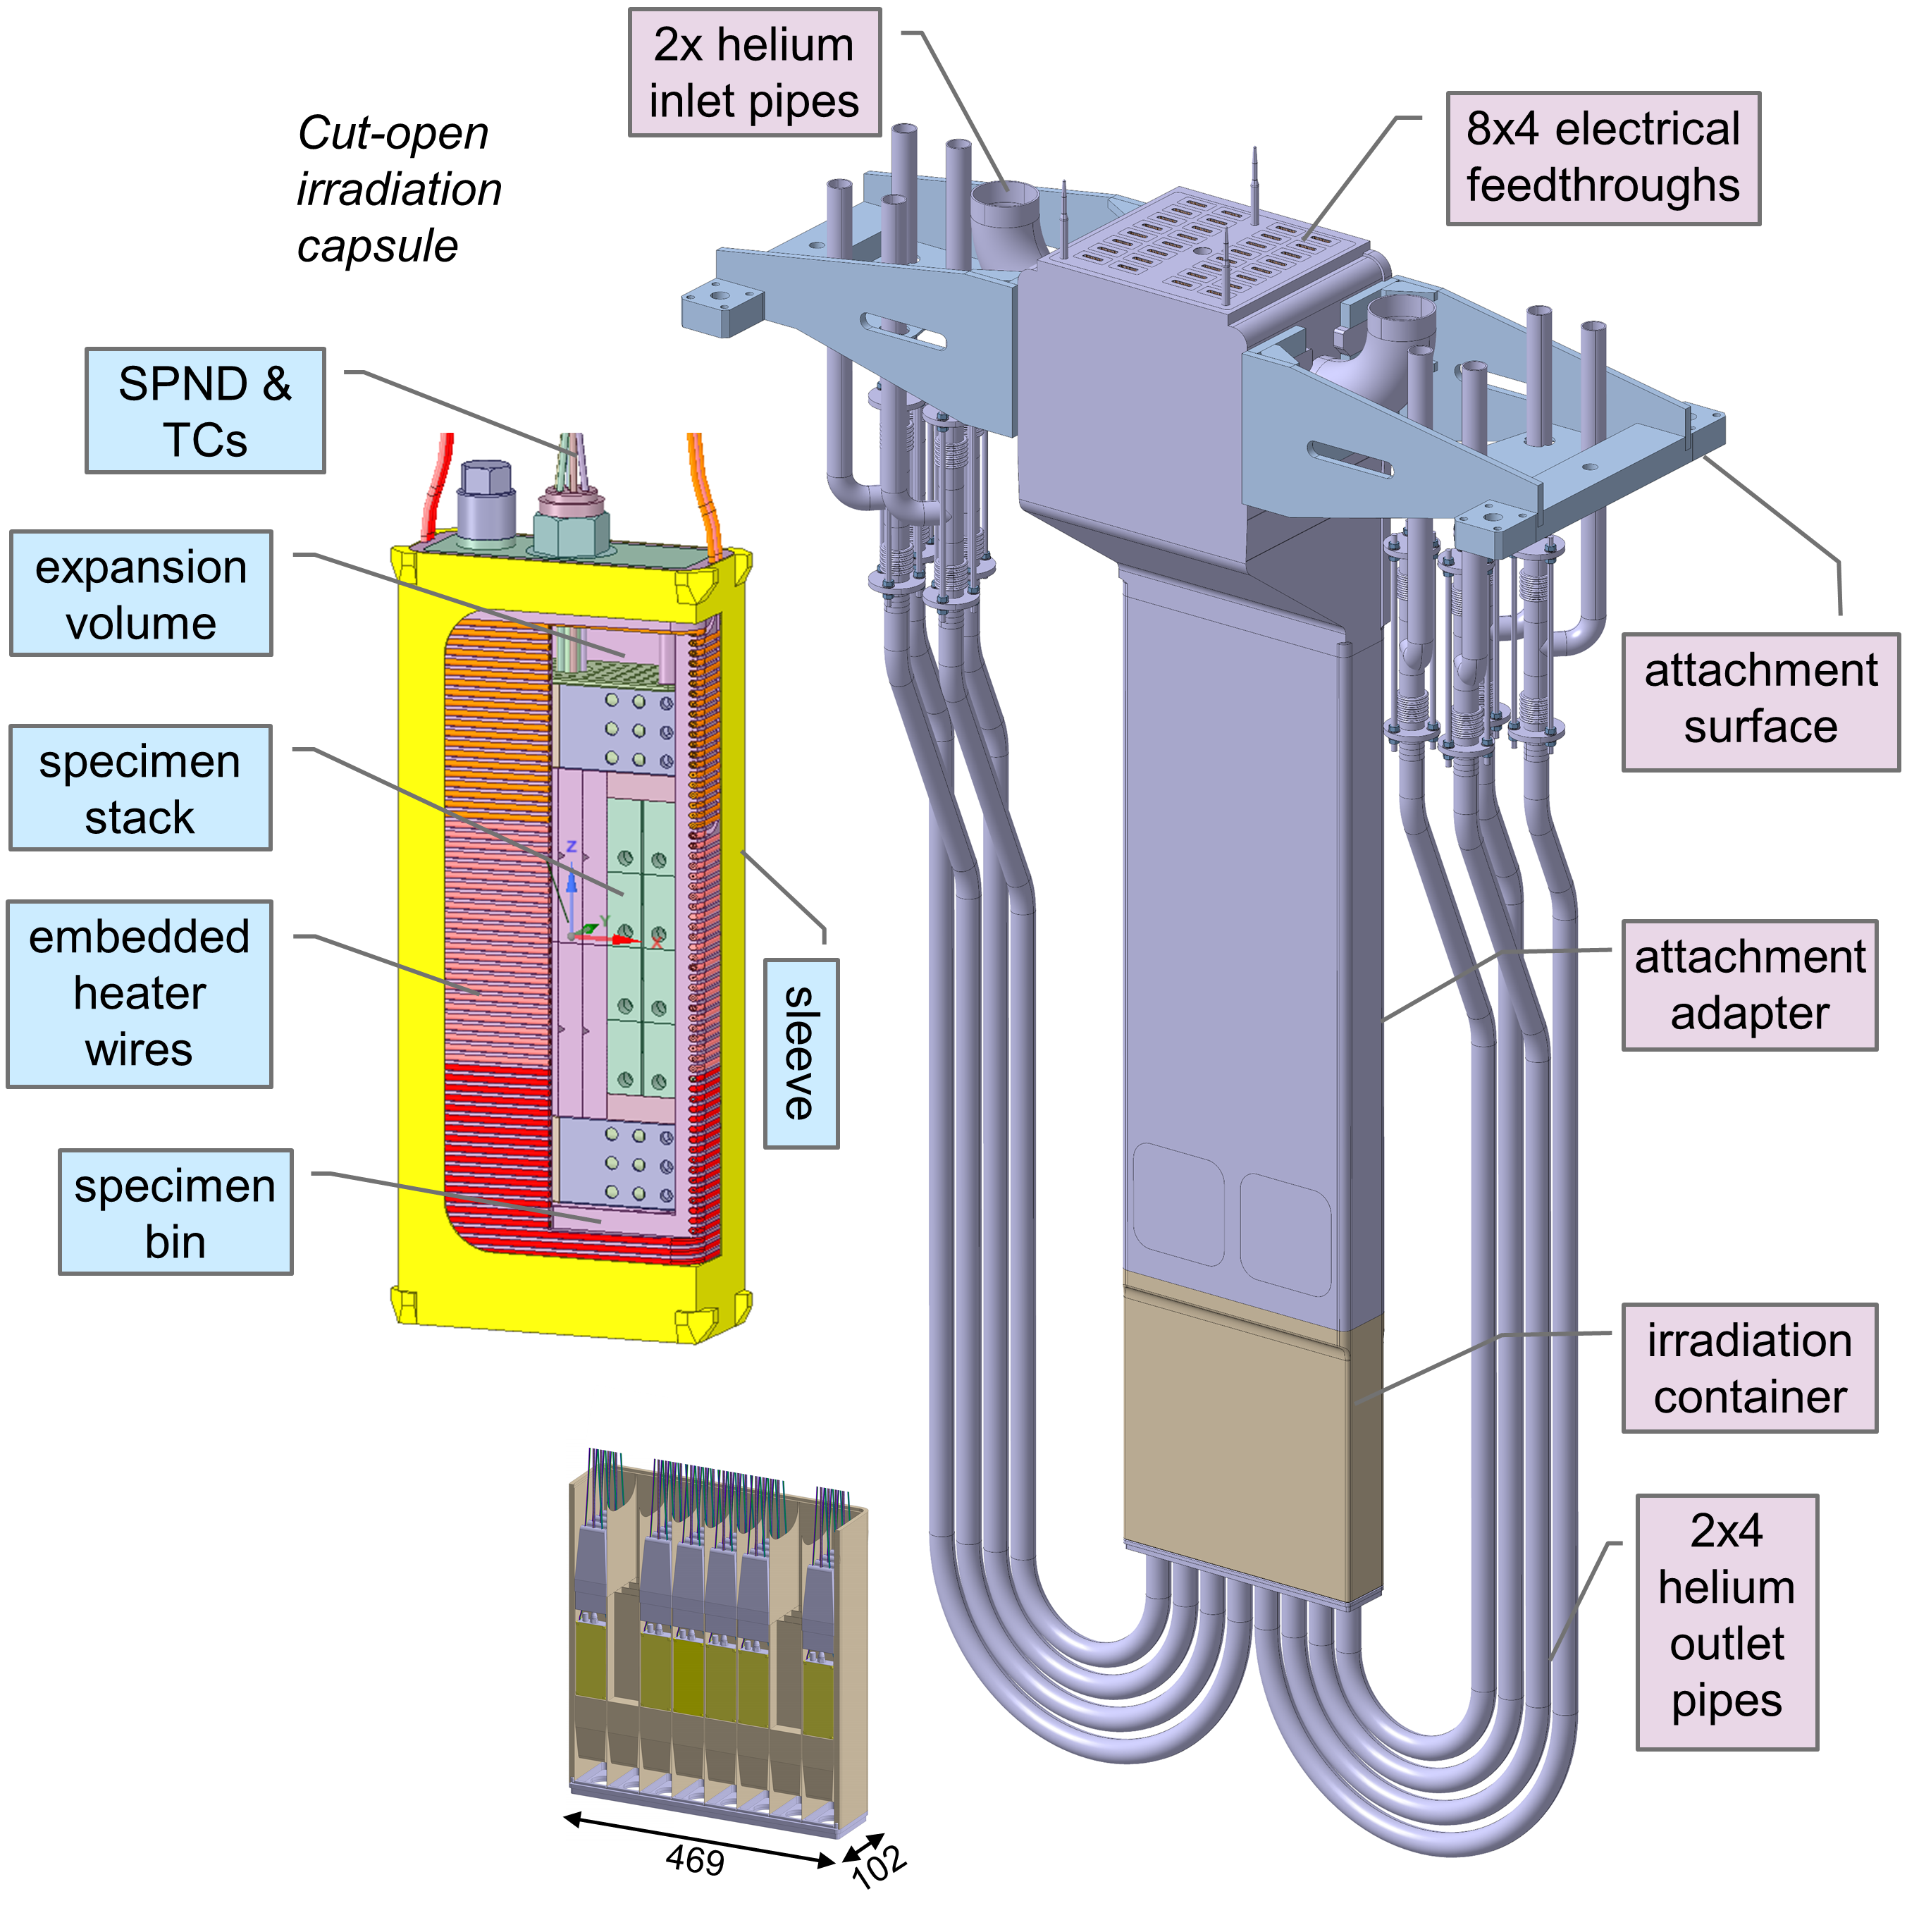
The HFTM overall design
2.6m high stainless steel body
Irradiation container on beam level
Slots for 8x4 irradiation capsules
16.9 kW complete nuclear heating
Cooled by 180 g/s Helium at 3.5 bara, 50 °C
Interfaces on the the top end
Neutron reflectors (axial, lateral) are provided
(implemented by capsules)
50 x 200 mm²
n-beam footprint

Slide 6
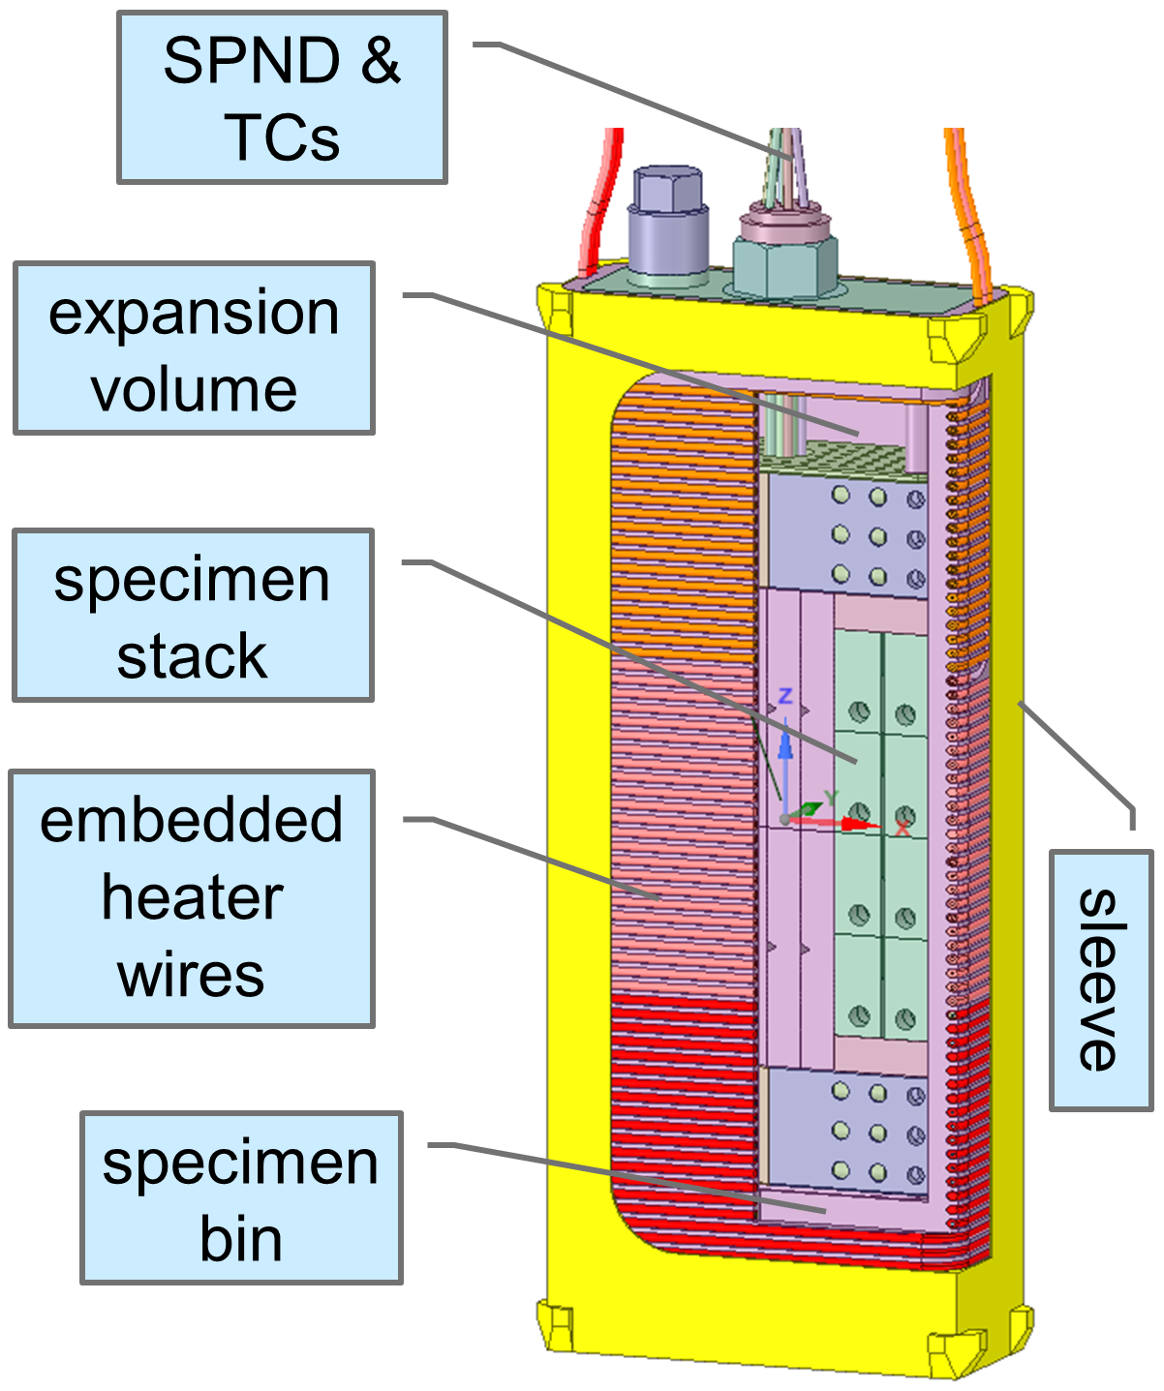
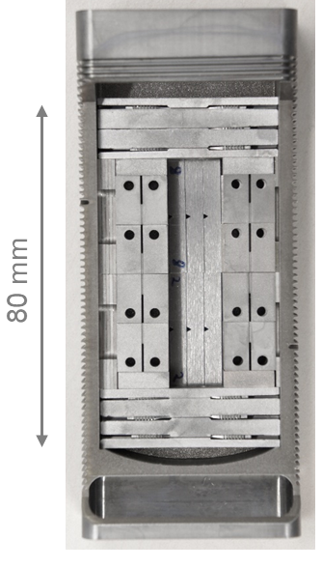

HFTM irradiation capsule
Body made by high temperature brazing from EDM-manufactrured Eurofer parts
Filled with Sodium & evacuated
Specimen payload
15x39x80 mm³ O(100) SSTT specimens per capsule
Instrumentation by
  3x2 thermocouples
  1 central SPND
  distributed activation samples
3 controlled electrical heater sections (up to 575W each)

Slide 7
Design driving requirements
Compatibility with high neutron flux / fluences
➔ required lifetime to 50 dpa, 3years
Irradiation temperatures 250 – 550 °C
Allowing well-controlled experiments & analyses
➔ sufficient monitoring (temperature, fluxes, fluences)
➔ low temperature spread (+/-3 %)
➔ temperature control independent of neutron source
Maximization of irradiation payload (neutron economy)
➔Shape compatibility with DONES neutron source & test cell
➔Minimization of parasitic volumes
Antagonism of lifetime vs. irradiation payload !

Slide 8
HFTM materials strategy
The HFTM is the first-ever pressure-bearing component to endure high doses of fusion-like neutrons
The HFTM body (PS = 4 MPa, TS = 200 °C)
  must withstand significant primary stresses (membrane + bending)
  Is a large welded structure (hermetic)
  Can be operated at selectable temperature (by designing the cooling)
  Only loaded with moderate safety functions (SIC-2)
  ➔ Is made of X2 CrNiMo 17-12-2 (N) austenitic steel as in RCC-MRx
HFTM specimen-capsules
  Must operate at temperatures 250 – 550 °C as emerging from irradiation mission
  Contain (9%Cr steel) specimens immersed in liquid sodium
  Can be relieved of pressure loads by design
  Not loaded with safety functions (non-SIC)
  Body is made of same material as specimens, Eurofer 97
  Mineral-insulated metal-shielded heaters (and thermocouples) are brazed on (!)

Slide 9
HFTM body irradiation limits
60°C
200 °C
330 °C
400 °C
HFTM body operation conditions: 50-160 °C, 25 dpa/1fpy
Solution annealed 316 steel, ORR+HFIR irradiation, 10-12 appm(He)/dpa, [Robertson 1997] :
RCC-MRx (A3.1S) X2 CrNiMo 17-12-2 (N) sol.ann. :
"For temperatures ≤ 400°C and irradiation damages < 24 dpa, the swelling is negligible."
Maximum allowable irradiation damage at 20 – 375 °C is 53 dpa.
Between 20 – 350 °C, saturated values of Rp and Rm are reached at 7 dpa
Between 20 – 250 °C, minimum total elongation at maximum force saturates at Agt = 1.8%
Formula by [Kalchenko 2013] for 18Cr 10Ni Ti steel : incubation phase 46-52 dpa @ 150 °C
➔ Survival of HFTM body (≤150 °C), to ~50 dpa expected acc. to fission neutron experiences

Slide 10
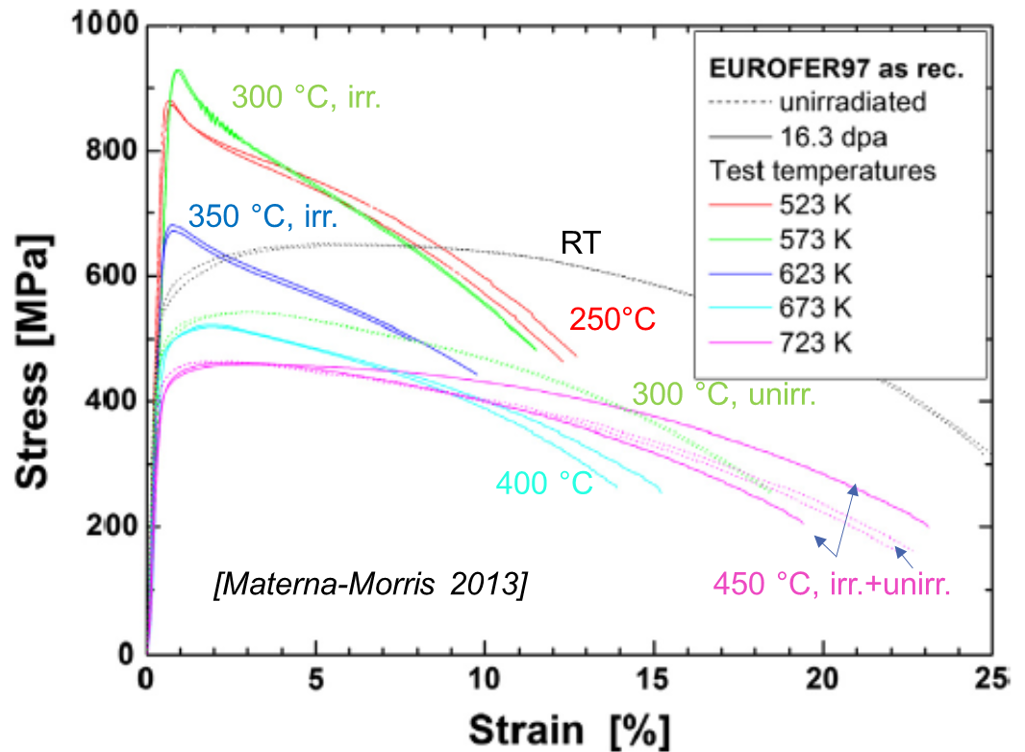
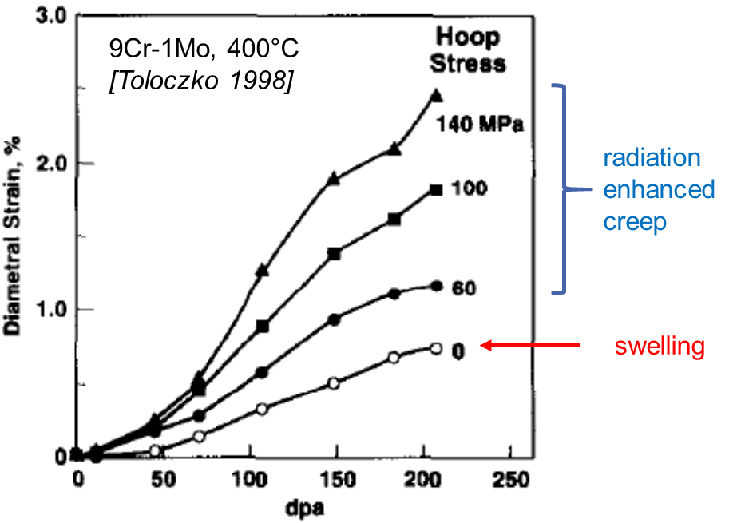
HFTM capsule body
Requested temperature range 250 – 550 °C spans (intentionally!) several regimes of irradiation behaviour of RAFM steels
  Loss of plasticity, hardening, embrittlement for T < 350 °C
  Softening (small effect) for T > 400 °C
Very favourable swelling properties of bcc lattice
15-16.3 dpa
[Gaganidze 2011]

Slide 11
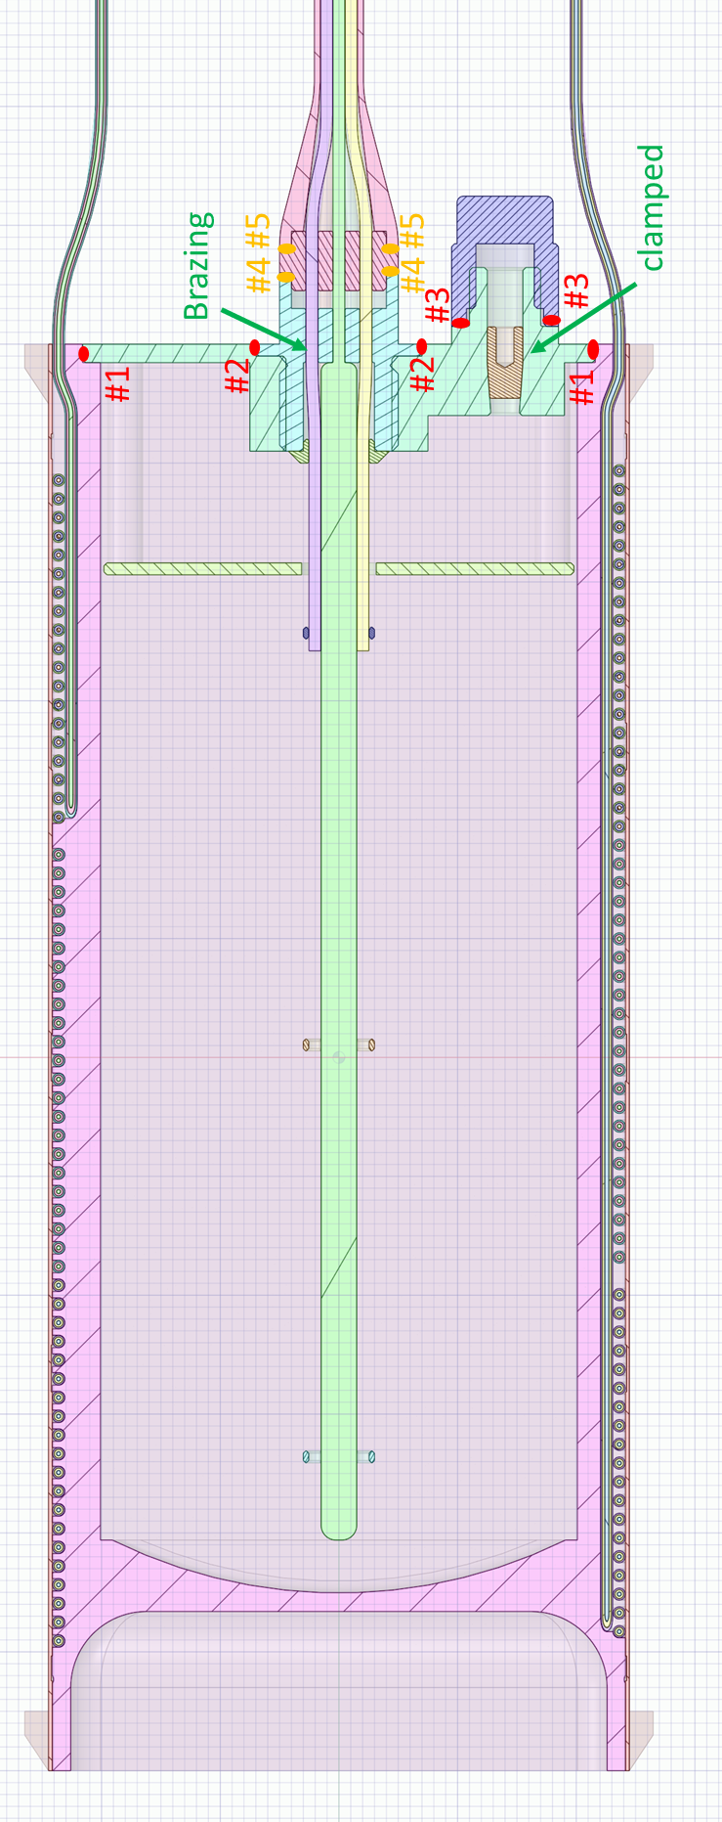
Design approach towards radiation resistant design of the specimen capsules
no PWHT possible !
The temperatures are fixed by the mission: 250 / 350 / 450 / 550 °C
➔ embrittlement at 250 °C
➔ creep at 550 °C
After specimens insertion: no heat treatment allowed.
➔ no post-weld heat treatment possible !
Approaches:
IFMIF/EVEDA: inert gas filling, up to 6 bar int. pressure at 550 °C
new design : Evacuation after filling to avoid stresses (→ creep), replacement of NaK by Na to avoid Argon gas production
IFMIF/EVEDA: prismatic body with welded bottom plug
➔ new design: Avoidance of welds where possible (die sink erosion)
Theoretically, different grades / thermomechnical treatments are possible, optimized for each temperature level (not yet studied)
weld avoided

Slide 12
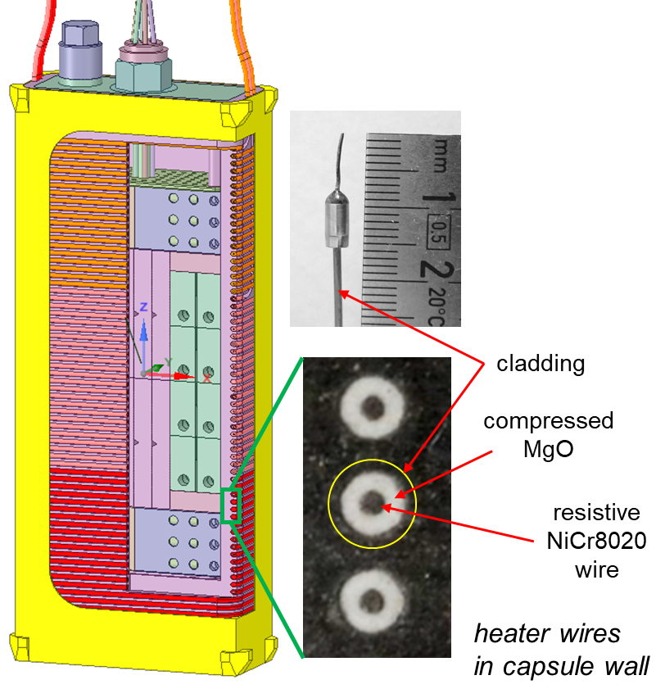
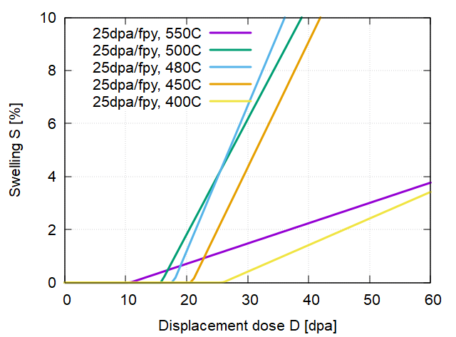
Capsule heater wires
Capsule heaters are NiCr8020 resistive wire,
embedded in compressed MgO/Al₂O₃ within a cladding.
Issues:
The cladding and wire may experience swelling. Peak swelling for 18Cr10NiTi (example) is at 440 – 480 °C
The ceramic insulation may suffer of RIC & RIED loss of insulation properties (see next page)
{316L, 321, Inconel, Nimonic}
Problems for > ~1year/30dpa.
Inconel alloys could be a solution
In the critical temperature range.
[Powell 1981]: <2.4% swelling at 87 dpa, 400 – 650 °C for
Inconel X750 and 718

Slide 13
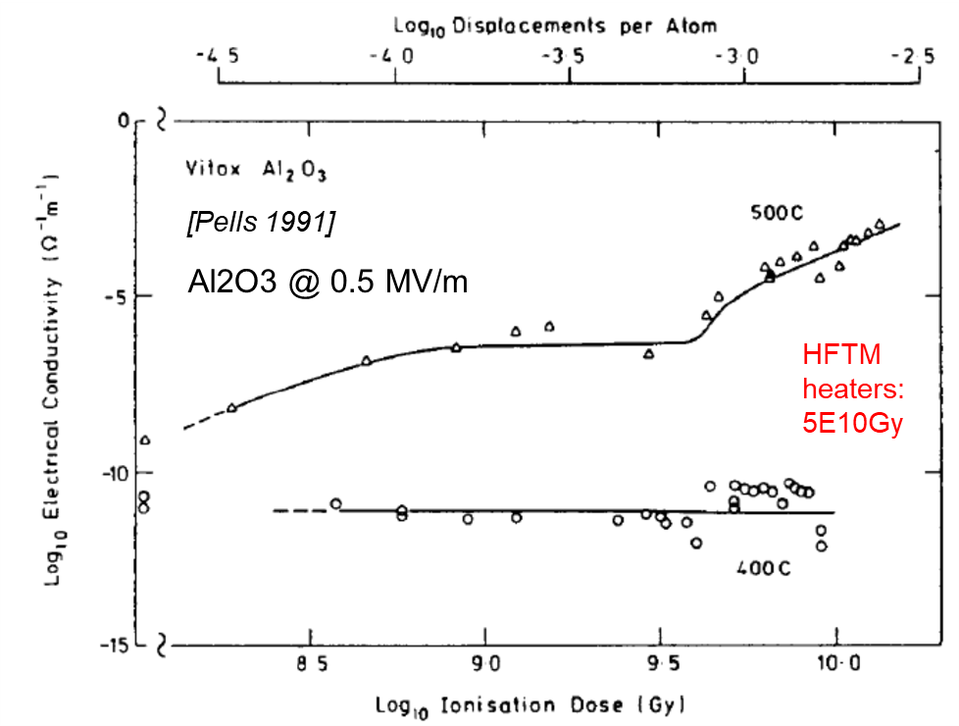
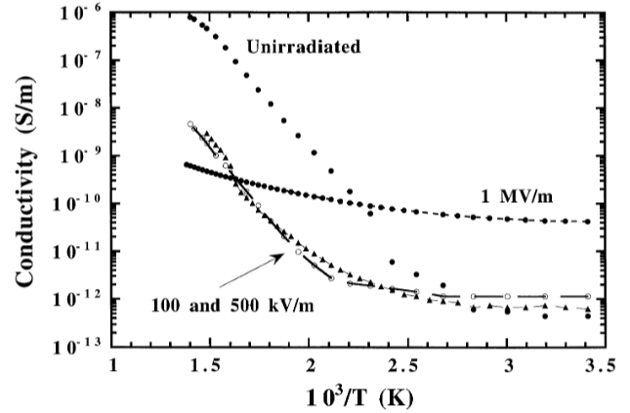
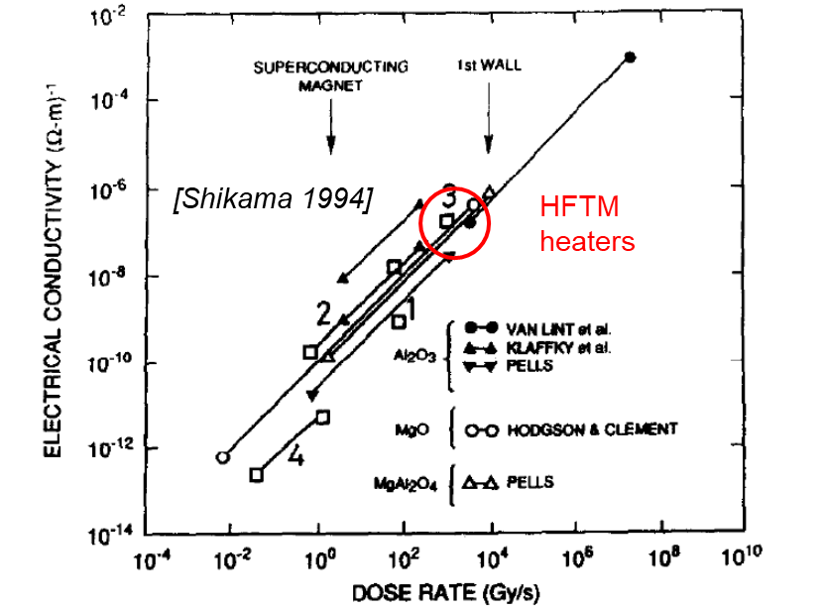
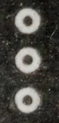

Loss of heater wire insulation resistance
Initial resistances of heaters are > 10 GΩ (>1×10¹⁴ Ω m)
Semiconductor behaviour: resistivity drops factor 10⁸ from RT to 600 °C
[Shikama 1994] RIC at
O(10³ Gy/s) ~ factor 10⁶
RIED f(dose, temp., E-field)
  Most loaded heater parameters in HFTM:
  140V (0.76 MV/m), 550 °C, estim. 5×10¹⁰ Gy
  [Pells 1991] : (10¹⁰ Gy @ 500°C for Al₂O₃) resistivity dropped factor ~10⁸
Heaters (insulators) are at/beyond the expected limits of their operation regime at 1 fpy and may prove to be lifetime-limiting
MARIA irradiation for testing
Design adaptations planned
WESGO AL995
[Hodgson 2000]
0.76 MV/m ?
RIED : dose
dependent
550 … 250 °C
cladding
compressed
MgO
resistive
NiCr8020
wire
ΔR=0.185mm
RIC : dose-rate
dependent
heater wires
in capsule wall
$$σ=σ_{0}+k⋅DR^{δ}$$

Slide 14
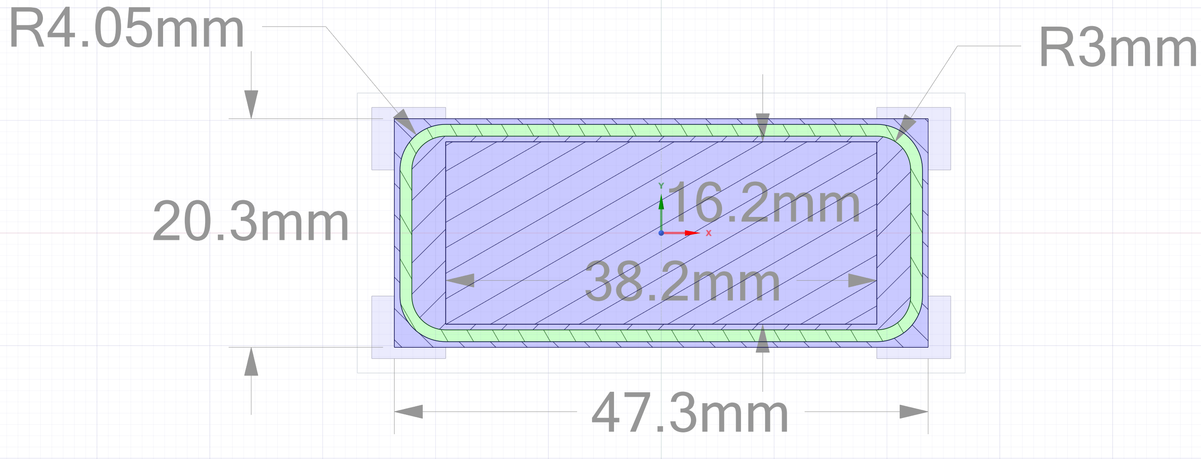
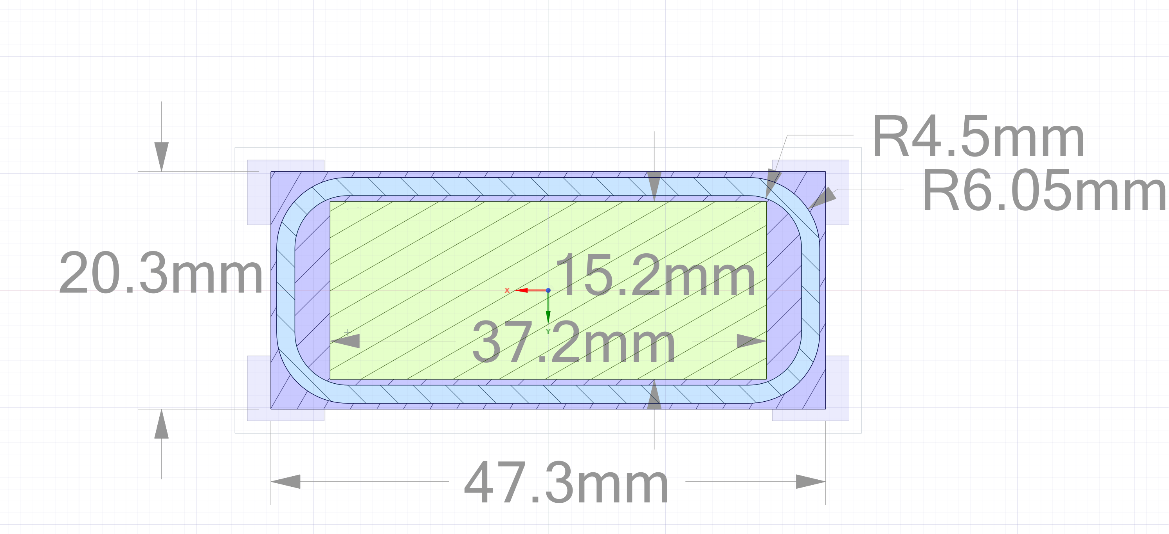
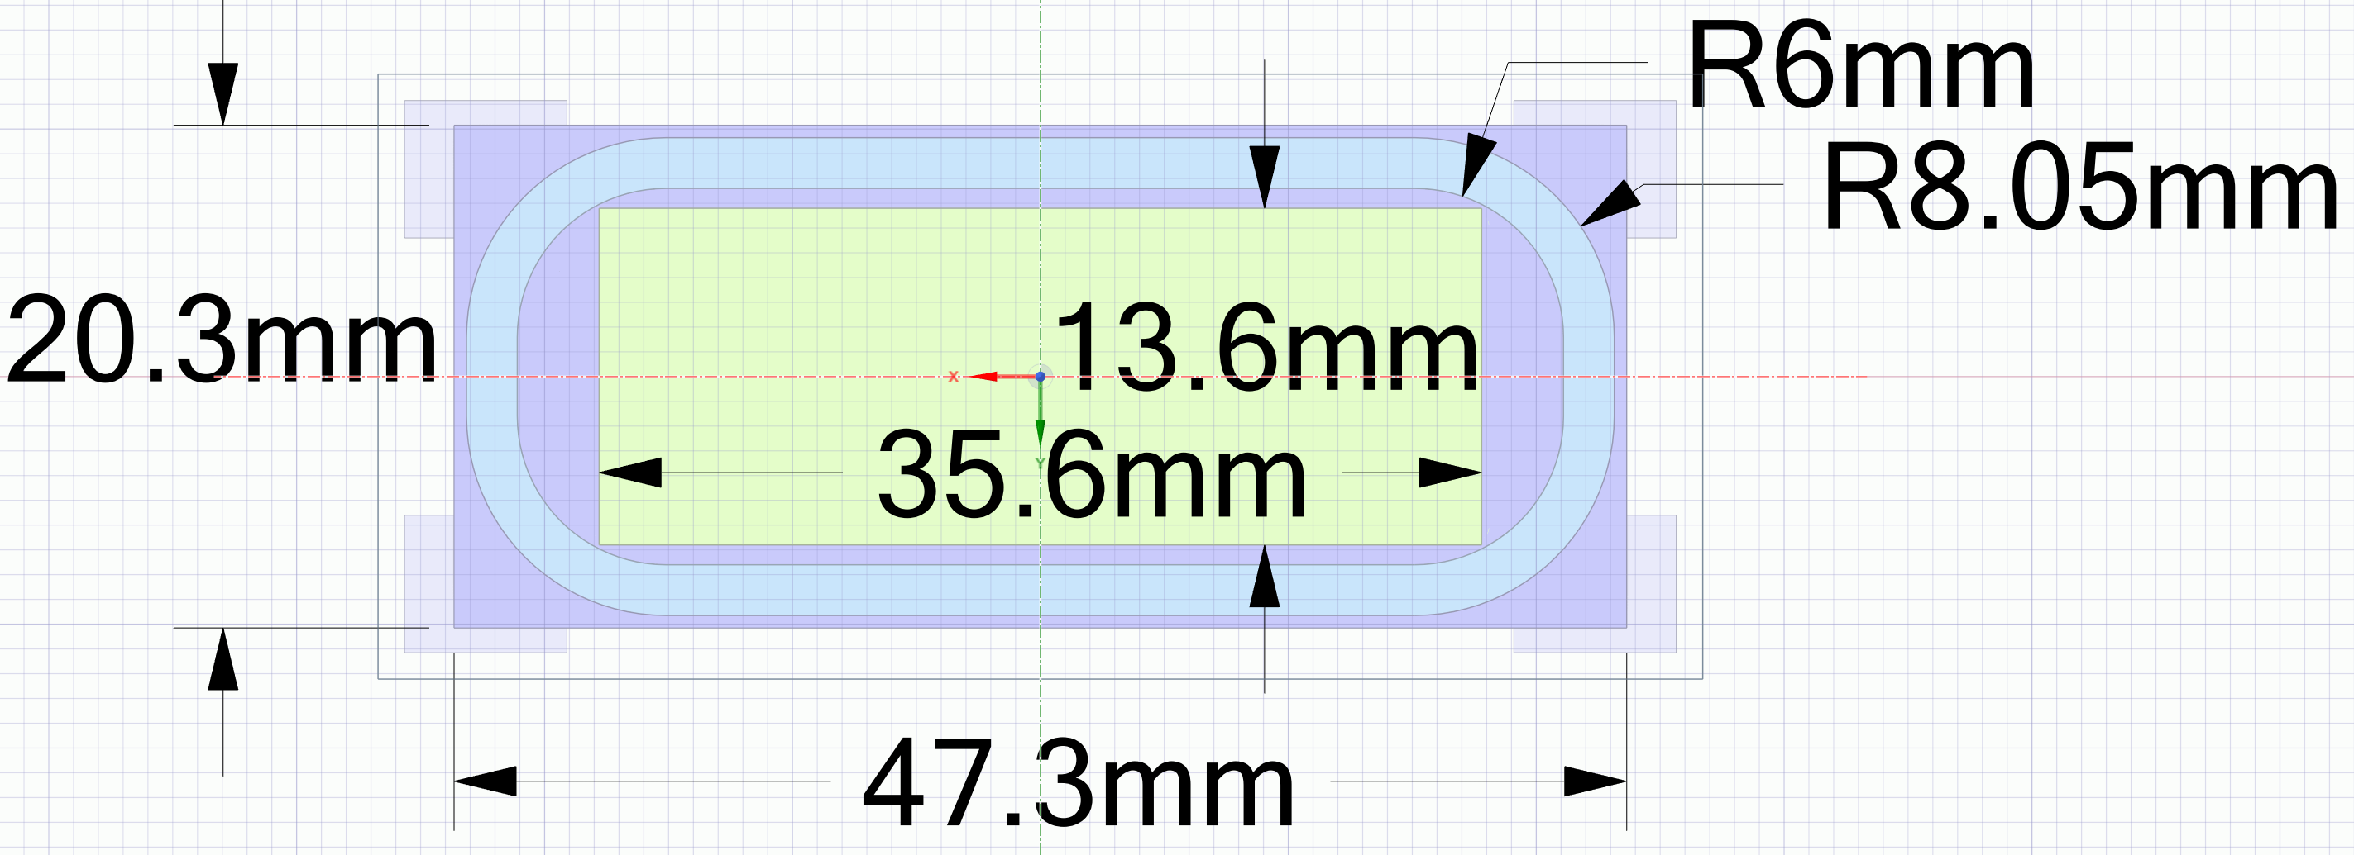
Design option for heater lifetime extension
Increasing heater wire thickness:
  Increase start-value of insulation resistance
  Increase insulation thickness, decrease required voltage ➔ decrease E
Geometry variation: keep outer capsule dimension, t
thicker heater wires → 1.5mm / 2.0mm OD
Bending radius R=3*OD must be conformed
OD=1mm
OD=1.5mm
OD=2.0mm
➔ Approach is very effective! E-field is reduced by factor 5.5
by increasing OD from 1mm to 2mm. But : payload reduced by 22 %
Missing space for
Wire returns!

Slide 15
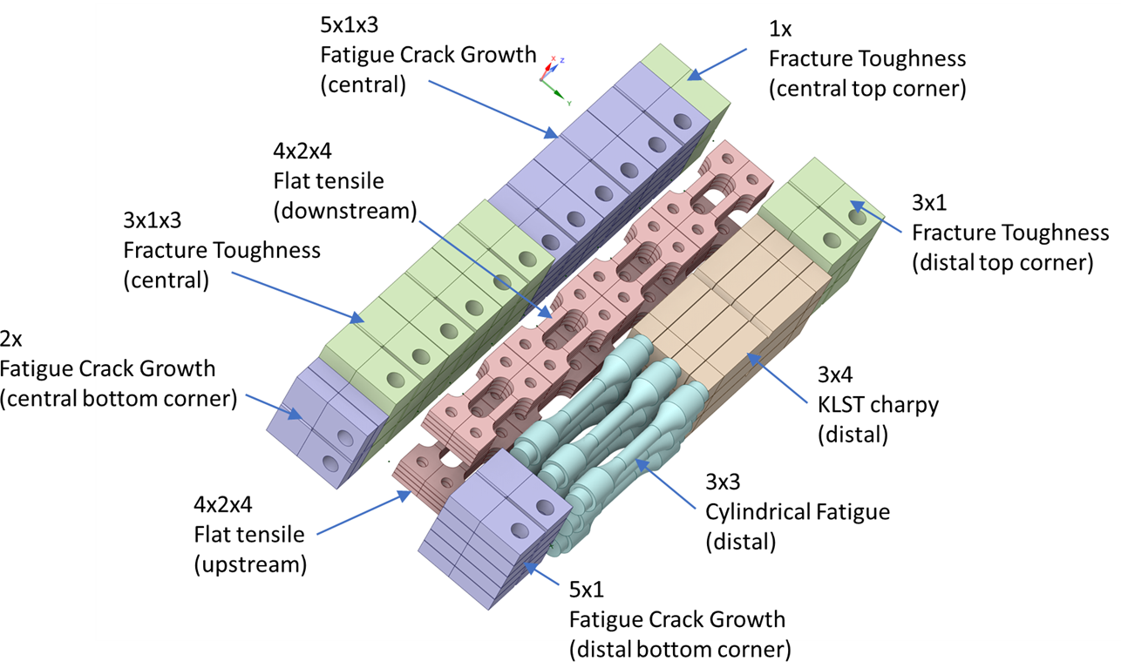
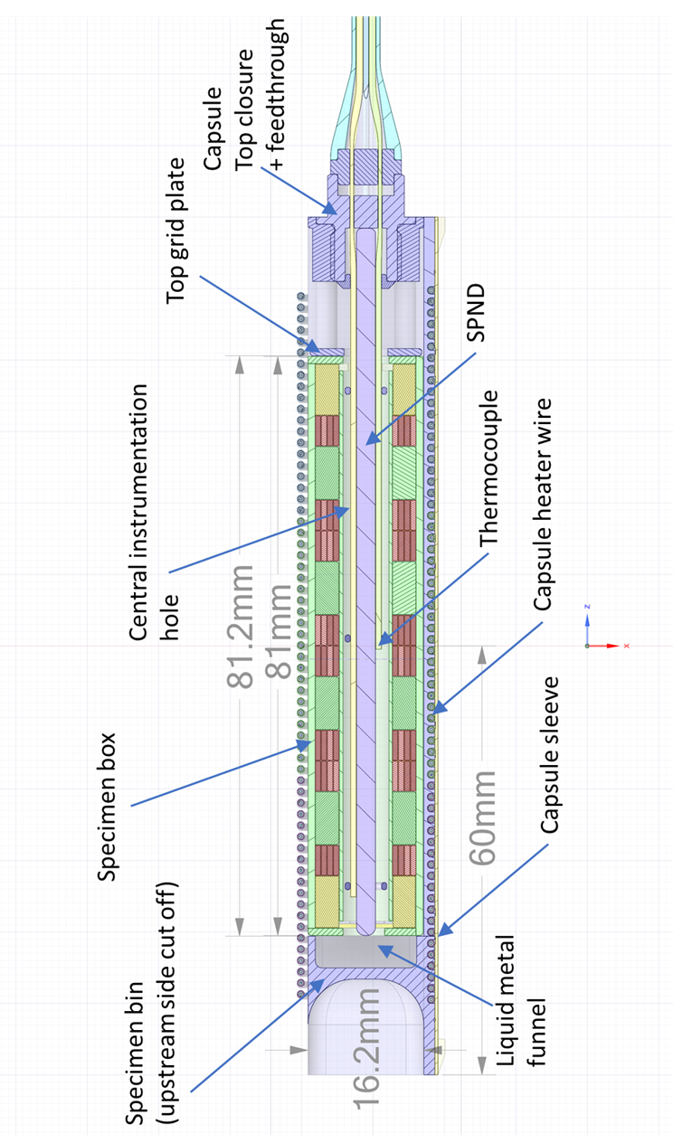
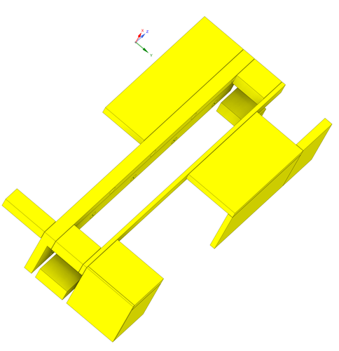
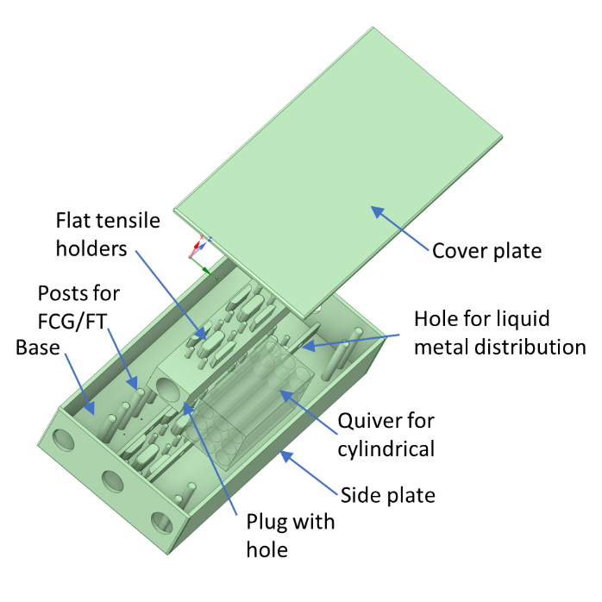
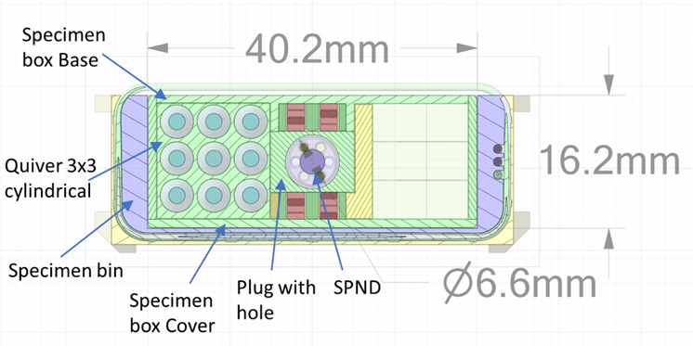
Capsule loading configuration
Component / entity | Volume [mm³]
Enclosing capsule volume 81.2x41.2x16.2 | 54'169
Solid volume of specimen box parts + quiver | 15'266
Solid volume of spacer objects | 6'482
Solid volume of specimen payload w/o quiver | 20'842
Remaining = liquid metal + instrumentation rod | 11'579
Approx. instrumentation rod 1SPND, 6TC, 3 ring | 825
Effective void = liquid metal | 10'753
Material
Specimens
(120 pcs)
38% of volume
Inside capsule are
Specimens !
Box and specimen
holders
Spacer
objects
Additional contents:
Placement of activation
samples for dose & spectrum
(milligrams per isotope)

Slide 16
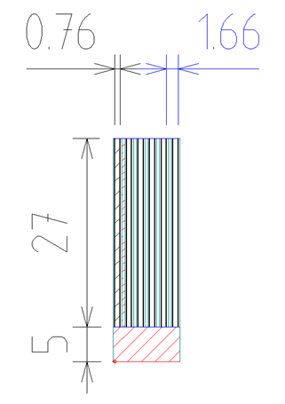
Backup-strategy to capsule : solid slab
Clamping+cutting
provision
Specimen
t=0.76
“ What if ” …
the capsule failure rate is too high
liquid metal corrosion effects need to be excluded.
The capsule with pre-fabricated specimens can be replaced by a solid slab (wound-on heaters, drillings for thermocouples),
with specimen fabrication in PIE.
Allowances for clamping, cutting, and finishing are estimated (based on specific cutting plans) to reduce the available specimens to 33 – 50%
Post-irradiation fabrication bears risks of damaging/annealing/inducing surface stresses
Hot cells need to be equipped with relatively complex tools. Feasibility is supported by SCK-CEN experiences.
finishing
provision
Example: cutting losses
For flat tensile specimens

Slide 17
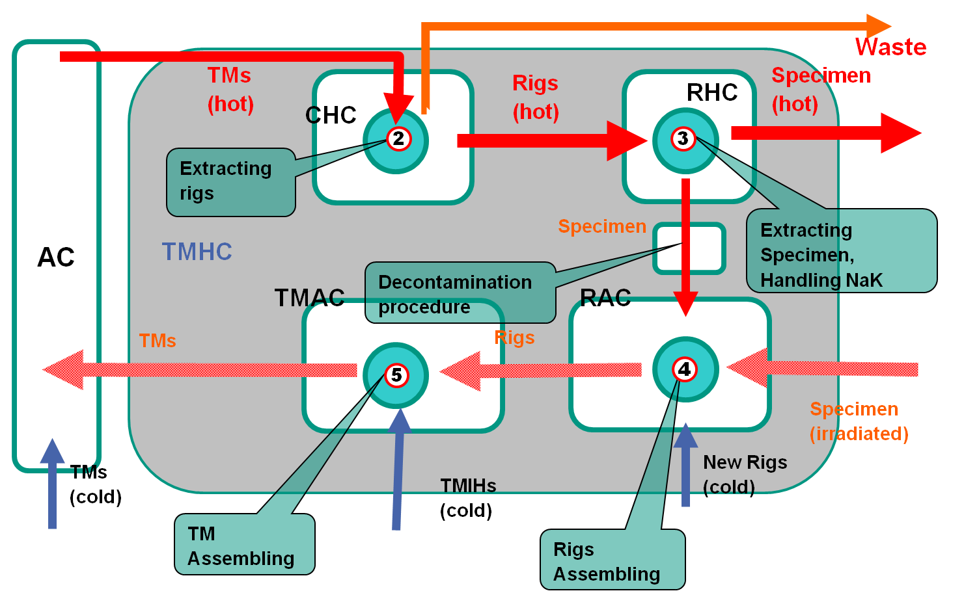
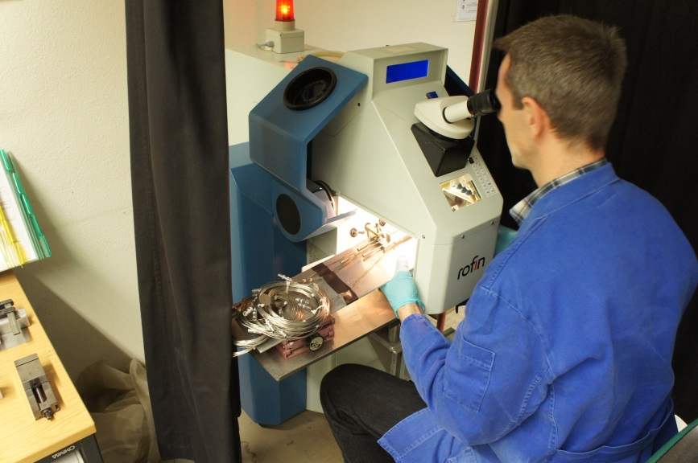
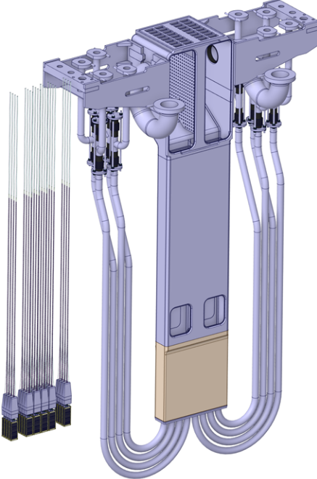
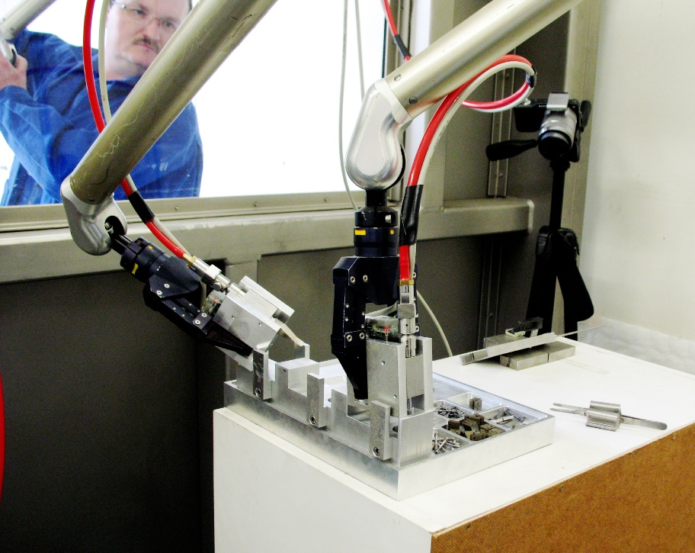
Specimen re-irradiation capability
Lifetime limitations of the HFTM can be “bypassed” if it is possible to re-insert already irradiated specimens into a new HFTM for the next irradiation period
  This is not the baseline for the WPENS HFTM (2023)
  It was a requirement to the IFMIF/EVEDA HFTM (2014) : R&D pursued, but no fully validated procedure
[HFTM-DDD 2014]
“RAC”, a hot cell to
  Insert specimens into capsule
  Fill Na, weld close capsule, do QA (leak tightness, electrical, …)
“TMAC”, a hot cell to
  Insert capsules/rigs into the HFTM body
  Hermetically weld close HFTM body, do QA (leak tightness, pressure test, …)
Relatively delicate / fine mechanical tasks need to be “translated” to become hot-cell compatible !

Slide 18
Lifetime limiting conditions in high flux irradiation
Pressure bearing shell “container” made from RCC-MRx X2 CrNiMo 17-12-2 (N) stainless steel
  Allowed by code up to 53 dpa (fission neutrons!)
  Temperatures 50 – 160 °C ➔ low swelling regime
Specimen capsules made from 9%Cr steels (Eurofer97)
  No irradiated data in code ➔ no safety function
  Temperatures 250 – 550 °C ➔ embrittlement .. creep
Capsule heaters are mineral insulated metal sheated (MIMS) wires (NiCr resistive alloy, MgO insulation)
  Dose rate near O(10³ Gy/s) , significant RIC expected
  Dose limit for RIED (10¹⁰ Gy @ 500°C for Al2O3) may limit lifetime

Slide 19
Conclusions
The top-level lifetime requirements aims at 50 dpa, 3 years.
Based on fission neutron experiences :
  The HFTM container (316L(N), 150°C) lifetime is predicted to 46 … 53 dpa
  The capsule body (Eurofer, 250…550°C) is not limited by swelling or creep,
  failure effect of top-weld without PWHT is uncritical for successful operation
  Capsule heater claddings (austenitic, 250 … 550 °C) when operated at 450…500 °C may experience failure due to swelling > 10% after 30dpa / >1year .
  Option of Inconel claddings tbd.
  Heater insulations (MgO, 250 – 550 °C) may fail by RIED after ~1 year in the front row. MARIA irradiation ongoing.
Irradiation for 1 year / 25 dpa is supported by current design & experiences.
Prospect of improving heater lifetime by electric field reduction
Option of re-irradiation of specimens would enable irradiation beyond HFTM lifetime

Slide 20
To be reflected by the DONES user commuunity
The design has to balance
  Lifetime in irradiation
  Usable specimen payload
  Thermal requirements
Ongoing PI activity : balancing the “lifetime” vs. “specimen payload” requirements. Discussed options:
  Priority for “lifetime”, best-effort as lower constraint on specimen payload
  Prescription of “minimum payload” (i.e. “69 specimens”)
  Maximization of product “dpa x specimen-volume”
➔Input by users to properly set and weight the requirements are welcome!

