Slide 1
Overview on high heat flux and functional qualification needs
G. Pintsuk
G. Aiello, M. Vila, M. Wirtz

Slide 2
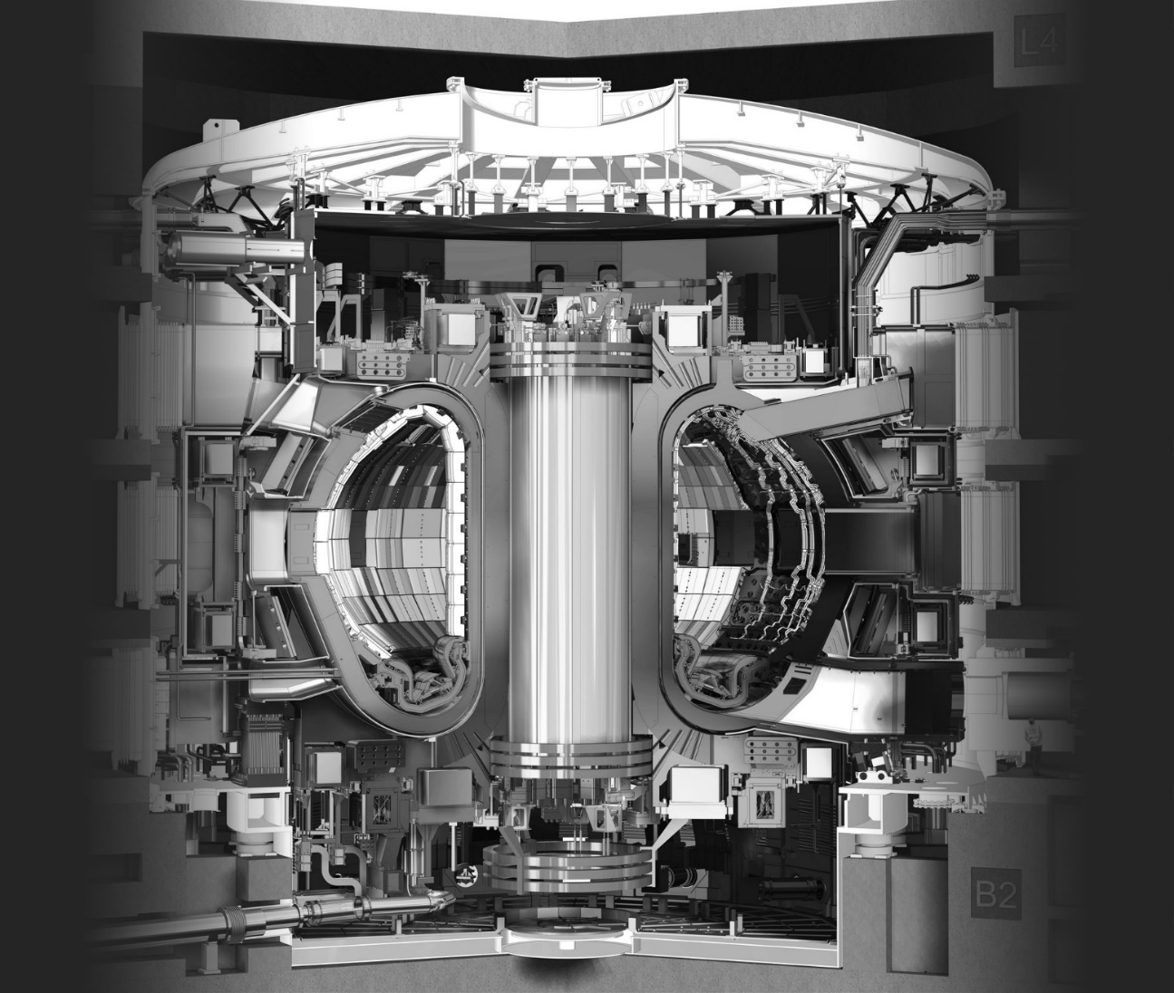
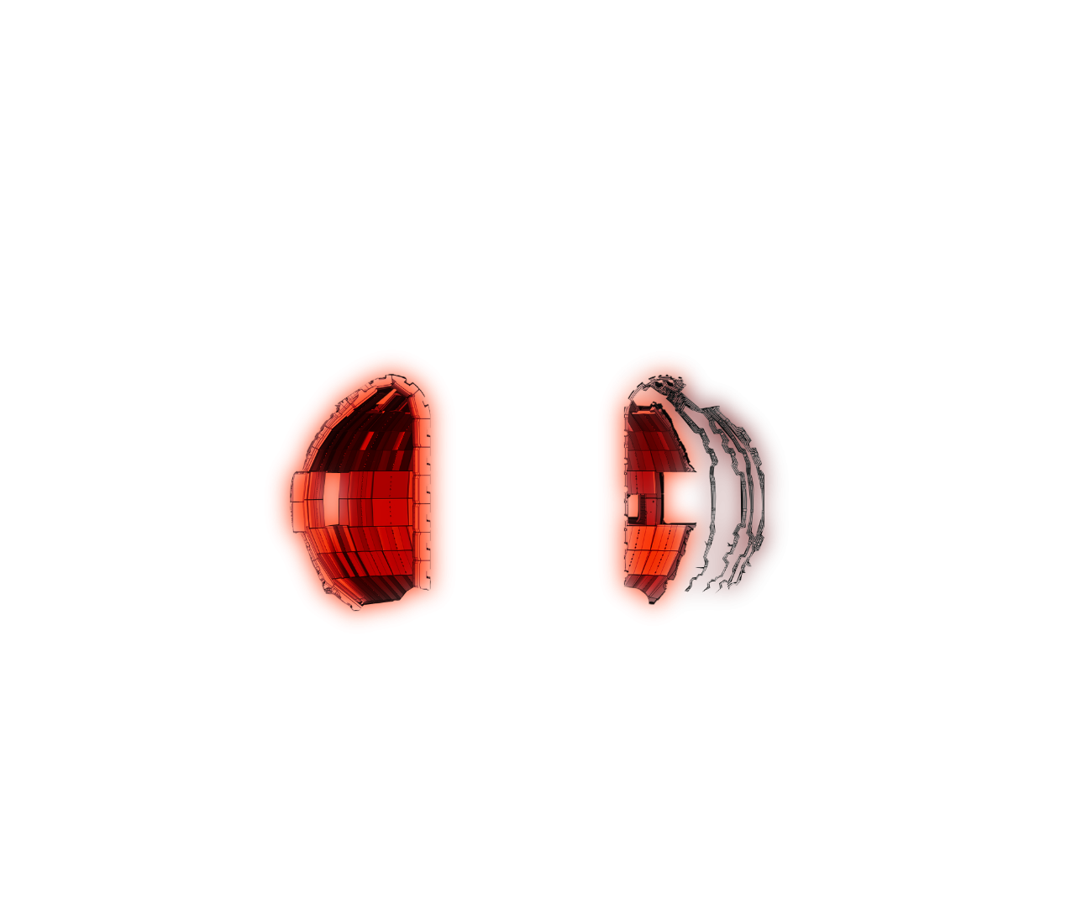

Introduction
High heat flux materials
Plasma facing materials
Tungsten (baseline) and tungsten based materials (First Wall, divertor)
Heat sink materials
CuCrZr (baseline) and Cu-based materials (divertor, limiter)
Functional materials
Optical materials (windows), dielectric materials (diagnostics, insulators): Silica, alumina, spinels, ...
Breeder materials (not tackled here)

Slide 3
High heat flux material: plasma facing materials for BB
Tungsten (based materials)
Coating / plating (2-3 mm thickness) on the First Wall of the Breeding Blanket
High fast (14 MeV) neutron fluence (dpa in steel divided by ~3) but no structural function
Distance to cooling water (~2 mm RAFM steel) might potentially lead to increased Re-transmutation by moderated neutrons
“Low” heat flux (0.5 - 1 MW/m²) in non-irradiated condition no serious problem for the joint; cracking perpendicular to W/steel interface due to CTE-difference to RAFM-steel alleviates stresses
Surface damage potentially an issue for plasma operation
First Wall:
schematic view
Irradiation needs
Bulk material basic properties: high dose effects (incl. H/He) interesting but low priority
Tungsten/EUROFER-joints: “no serious problem” statement requires confirmation at high dose – medium / high priority
Yu. Igitkhanov et al., JNM 2013

Slide 4
High heat flux material: plasma facing materials for divertor
Tungsten (based materials)
Divertor monoblock: schematic view
Monoblock tiles in the divertor (5-8 mm thickness above the cooling tube)
Reduced fast (14 MeV) neutron fluence due to geometry and location (~1 dpa/fpy at the strike point and 1.9 dpa/fpy at the baffle, You et al. FED 2022)
Distance to cooling water (~2-2.5 mm CuCrZr/Cu) will lead to increased Re-transmutation by moderated neutrons in the “cold” (brittle) area around the cooling tube
No structural function but complete failure (e.g. macro-crack formation down to the cooling tube) may influence the performance of the cooling tube or may lead to distortions / leading edges at the surface
Sufficient cyclic high heat flux (10 MW/m² steady state and up to 20 (25) MW/m² during ramp-up in DEMO) stability in the non-irradiated condition
W Armor
Coolant
CuCrZr + Cu
Irradiation needs
Bulk material basic properties: dose effects (incl. H/He) at medium to high temperature – medium priority

Slide 5
High flux materials: heat sink materials for divertor
CuCrZr (Cu-based materials)
Divertor monoblock: schematic view
Cooling tube in divertor components
Significant fast (14 MeV) neutron fluence (~3 times the dpa in tungsten): baffle region up to 7 dpa/fpy
He-transmutation rate similar to steel (~8 appm/dpa)
Structural function as containment for the coolant
Sufficient cyclic high heat flux (10 MW/m² steady state and up to 25 MW/m² during ramp-up in DEMO) stability in the non-irradiated condition
W Armor
Coolant
CuCrZr + Cu
Irradiation needs
Influence of fast neutron induced H/He transmutation in CuCrZr on basic properties – medium / high priority
Additional hardening / swelling of the pure Cu interlayer by H/He transmutation – medium / high priority

Slide 6
High heat flux materials: joints for divertor
Tungsten / Cu / CuCrZr joints
Assessment normally done by irradiation of divertor mock-ups
Mock-up irradiation with relevant geometries requires comparably large space - to be done in Material Test Reactors only in the low flux region
Does irradiation of components at (low) uniform temperature determine the “worst case scenario”?
High heat flux performance evaluation after irradiation in correlation with bulk material properties and ideally interface properties (benchmarking for design by analysis)
Testing of interface properties requires complicated and small test specimen geometries when taking samples from mock-ups (feasibility evaluation actually ongoing at SCK.CEN)
Irradiation needs
Determination of interface properties in IFMIF-DONES essential for design by analysis – medium / high priority
Irradiation of mock-ups for benchmarking and validation of modelling – might be required not for the start-up phase but for the extension of licensing and need to be done either in a FNS or in a VNS

Slide 7
Functional materials
Optical and dielectric materials
Windows, insulators, materials for diagnostics
Normally rather far from the plasma, e.g. windows (line of sight or via mirrors?) – low to medium dose
PIE data on 14 MeV for functional materials limited to low dose (e.g. Evans, 1979: up to 2E-4 dpa)
High dose only in Material Test Reactors - for most applications this is a suitable neutron spectrum
Irradiation needs
Determination of the effect of He and H transmutation on material properties in combination with high dose
Answer the question if insulators can be used closer to the First Wall and if there are differences to irradiation in fission reactors → this is a highly interesting but low priority risk mitigation topic

Slide 8











WPMAT / WPPRD-MAT Members
Ecole Royale Militaire
Laboratory for Plasma Physics
Institute of Plasma Physics
Academy of Sciences of the
Czech Republic
Technical University
of Denmark
Technical Research Centre
of Finland
AUSTRIA
BELGIUM
Ruđer Bošković Institute
University of Tartu
FINLAND
CROATIA
CZECH REPUBLIC
DENMARK
ESTONIA
The French Alternative
Energies and Atomic Energy
Commission
National Centre for Scientific
Research “Demokritos”
Italian National Agency for
New Technologies, Energy
and Sustainable Economic
Development
Centre for Energy Research
FRANCE
GERMANY
GERMANY
GERMANY
GREECE
HUNGARY
ITALY
Institute of Plasma Physics
And Laser Microfusion
Institute for Atom Physics
Jožef Stefan Institute
LATVIA
POLAND
PORTUGAL
ROMANIA
SLOVENIA
Centre for Energy, Environment
And Technology Research
Swedish Research Council
Kharkov Institute of Physics
and Technology
SPAIN
SWEDEN
SWITZERLAND
UKRAINE
UNITED KINGDOM

