Slide 1




Detailed irradiation parameters assessment of the IFMIF-DONES HFTM irradiation capsules
I. Álvarez, M. Anguiano, F. Mota, R. Hernández, Y. Qiu, F. Arbeiter, J. Park

Slide 2
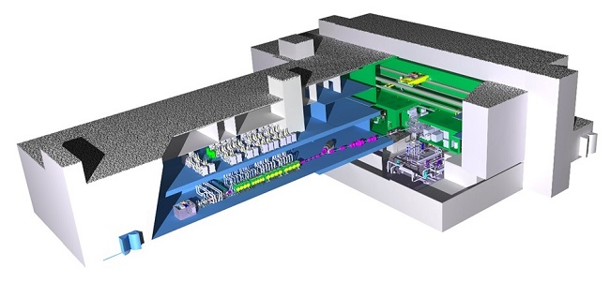
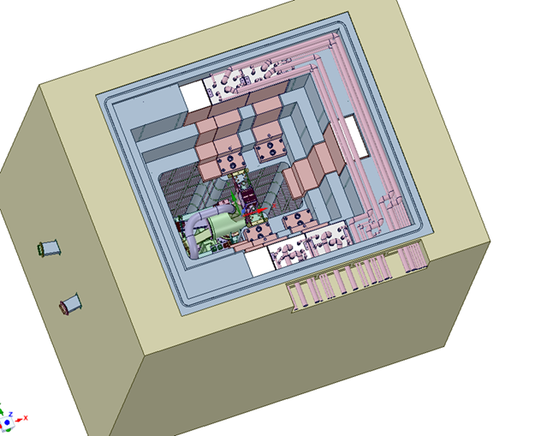
Introduction
IFMIF-DONES
Test Cell

Slide 3
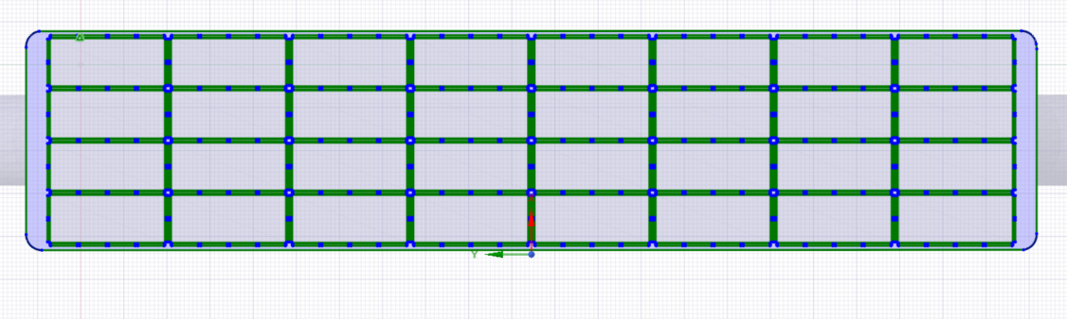
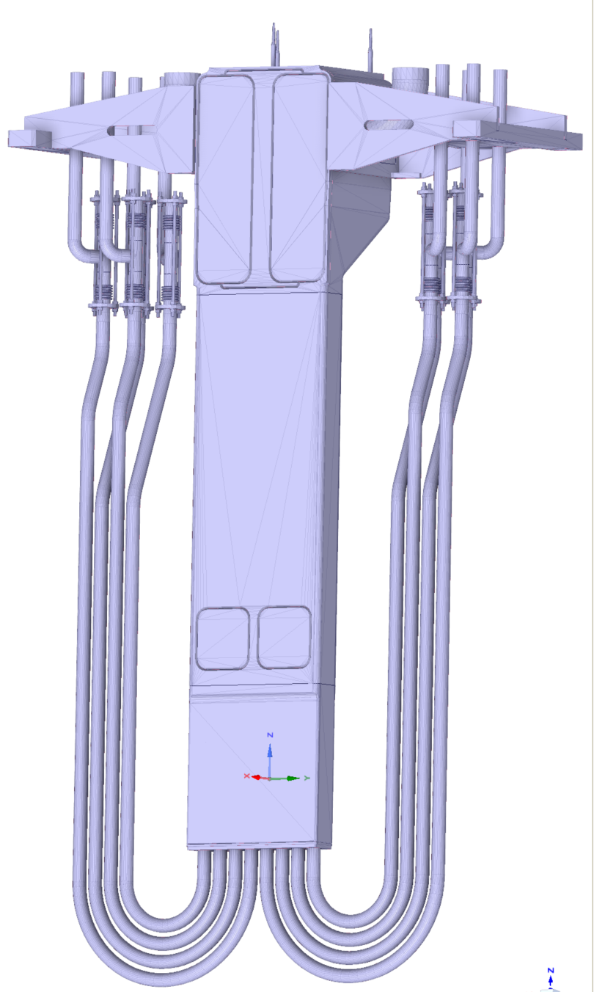
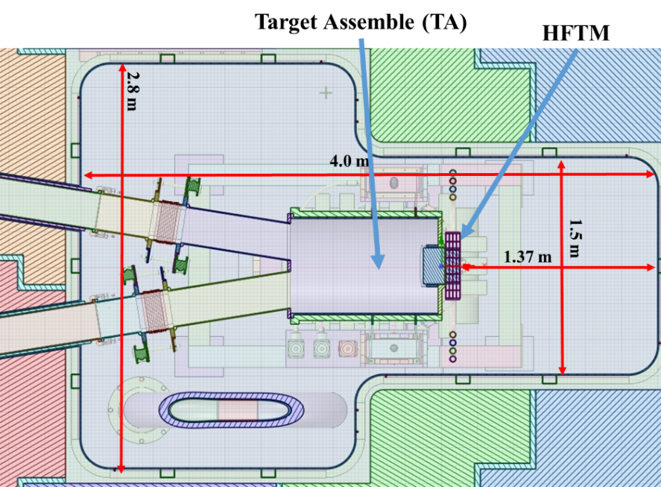
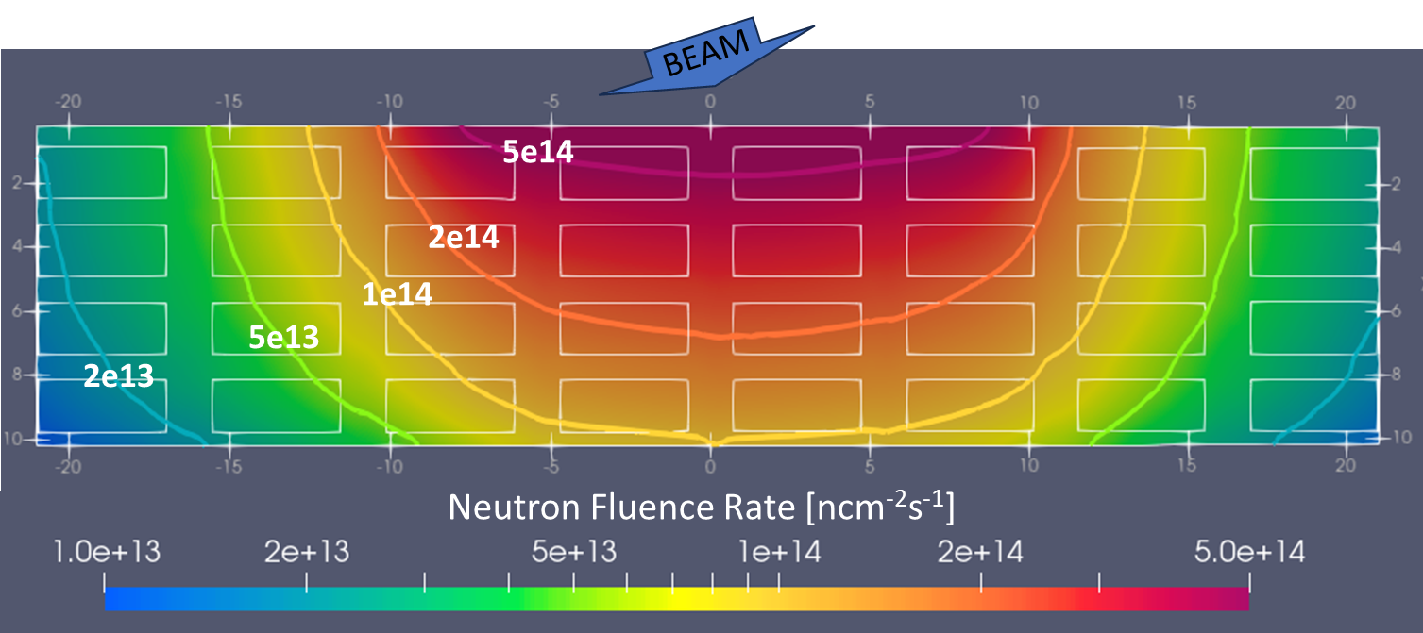
High Flux Test Module
469.1 mm
106 mm
Test Cell
32 RIG
HFTM

Slide 4
Considerations
The neutron fluence rate is very different from one capsule to another and also within the same capsule
Objective of this work: estimate dose uncertainties in specimen evaluation
To study how the specimens distribution influences the dose and its uncertainty
To study the different configurations available for the rigs, analysing the neutron fluence rate, the NRT_dpa and the gas production

Slide 5

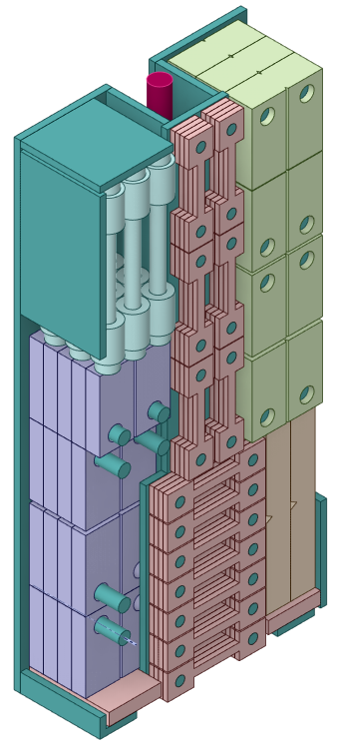
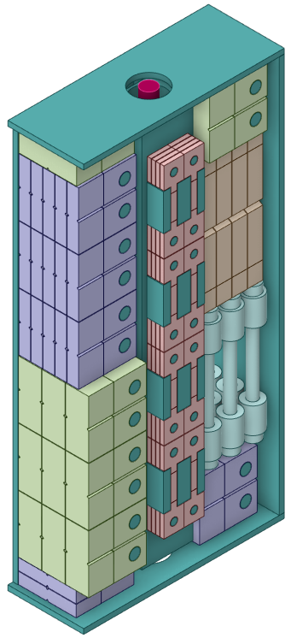
STACK MODELS
Characteristics of specimen distribution
 | Homogeneous | CLC.v1.0 | CLC.v2.0
Eurofer volume [%] | 75 | 48.16 | 84.76
Liquid metal (Na) [%] | 25 | 21.86 | 12.92
Specimens per rig | Not defined | 101 | 120

Slide 6
Methodology
IFMIF-DONES TC MCNP model version used: mdl9.2.0 (2020) and mdl9.2.8 (2023), KIT/INR
McDelicious 2017
Nuclear Data libraries used:
  FENDL3.1d nuclear data libraries for neutron transport calculations
  JEFF3.3DPAarc nuclear data libraries for primary displacement damage calculations in eurofer. (26001.32y)
The statistic relative error has been lower than 0.05 for all bins.
Deuteron IFMIF-EVEDA E= 40 MeV, 125 mA, footprint size 20x5 and 10x5 cm²
Full power year (fpy) = 365.25 days
Volume has been obtained by meshtal for HFTM and tallies for specimens cells
Notes:
For particle transport we have used, the McDelicious code, based on MCNP, and the latest version of the test cell. Here we indicate the libraries used. He have obtained data for two deuteron beam size: 20x5, 10x5

Slide 7
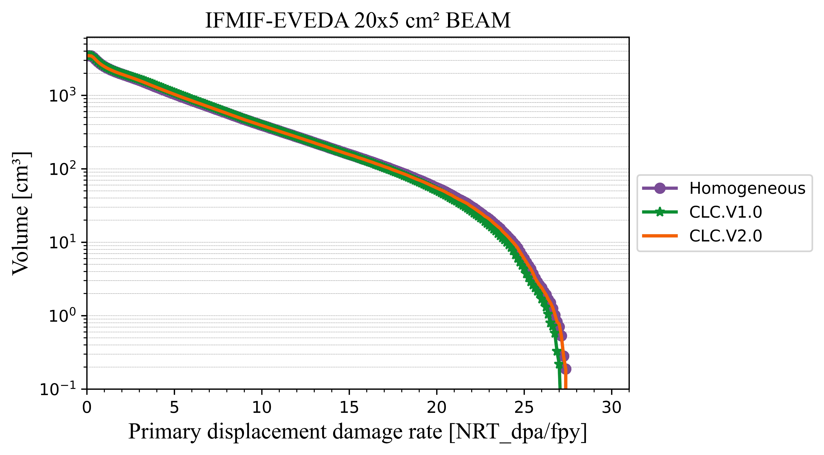
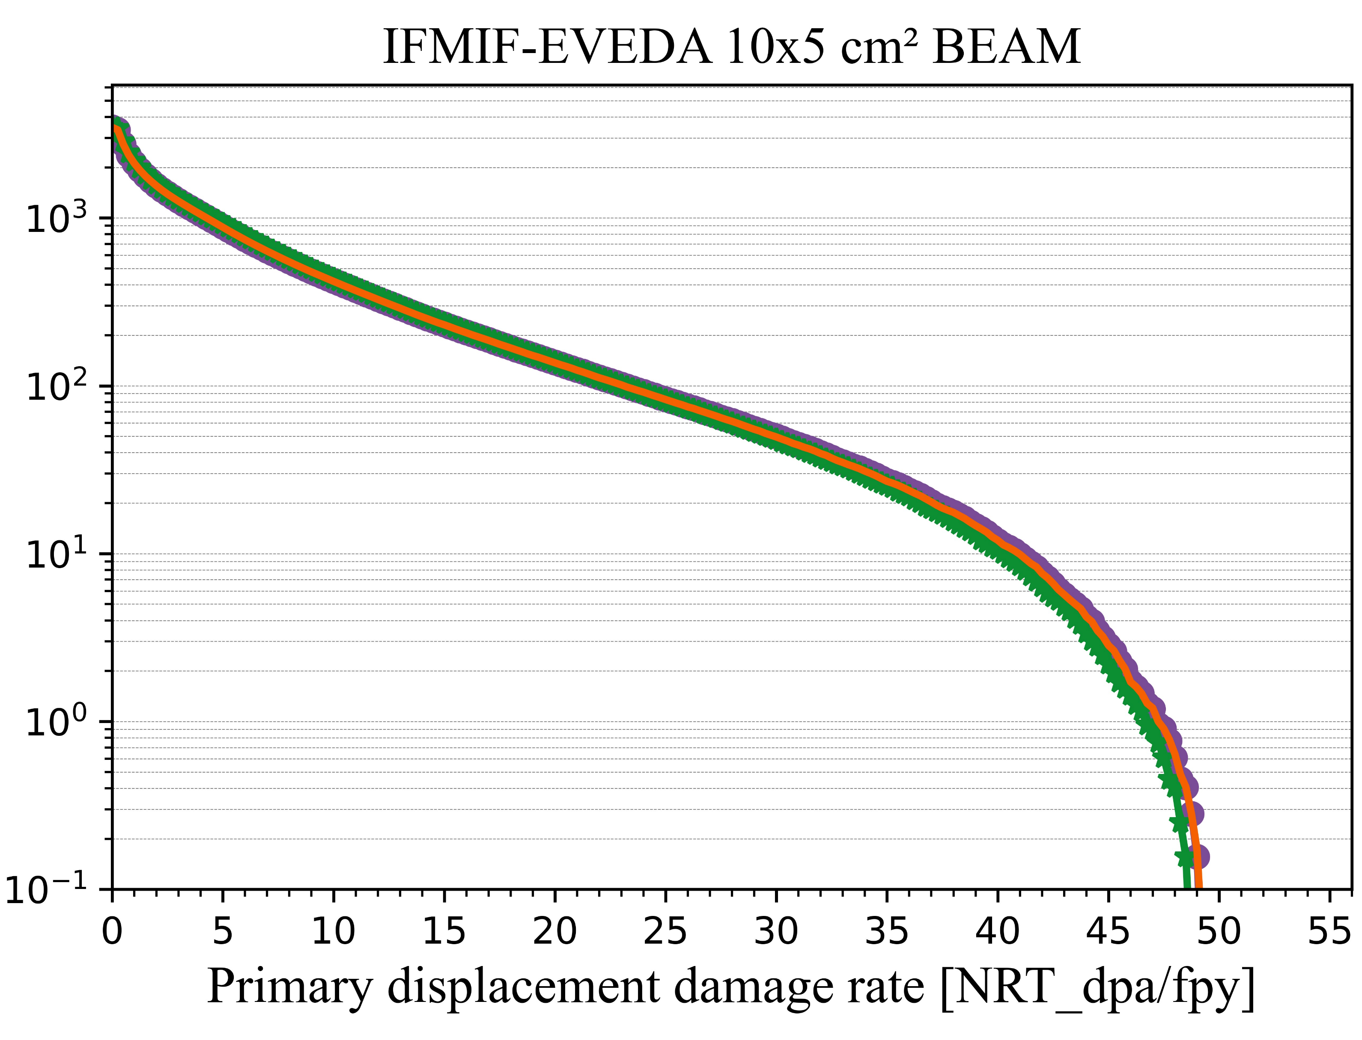
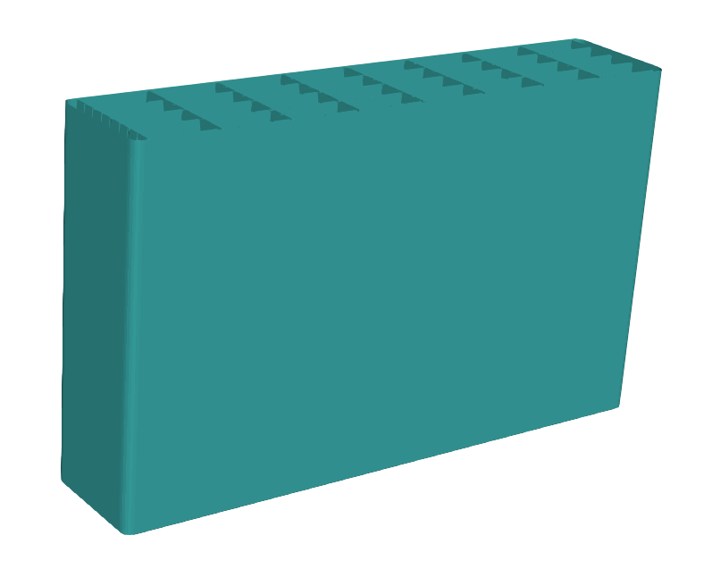

Primary displacement damage rate
Integrated HFTM volumen in specimens region
Volume DPA requirements [L] |  |  | Results [L]
 |  | Target value | Homogeneous/CLC.v1.0/CLC.v2.0
 | Beam |  | 10x5 | 20x5
R-1 | 8-12 NRT_dpa/fpy | 0.3 | 0.2 | 0.3
R-2 | >16.7 NRT_dpa/fpy | 0.1 | 0.2 | 0.1

Slide 8
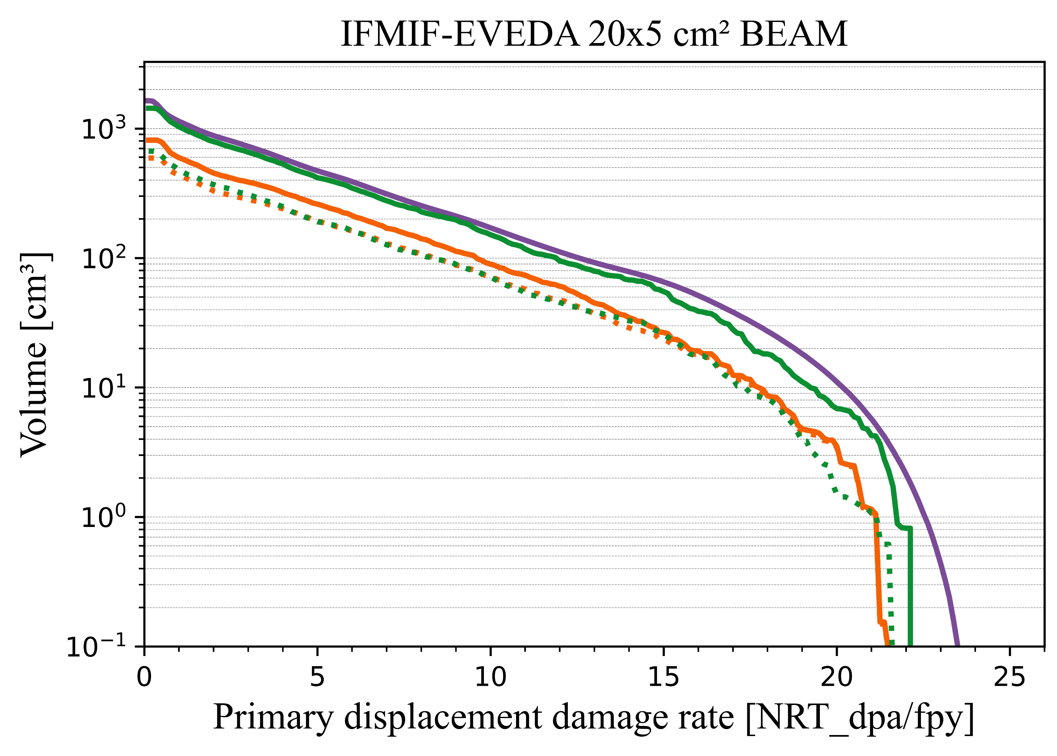
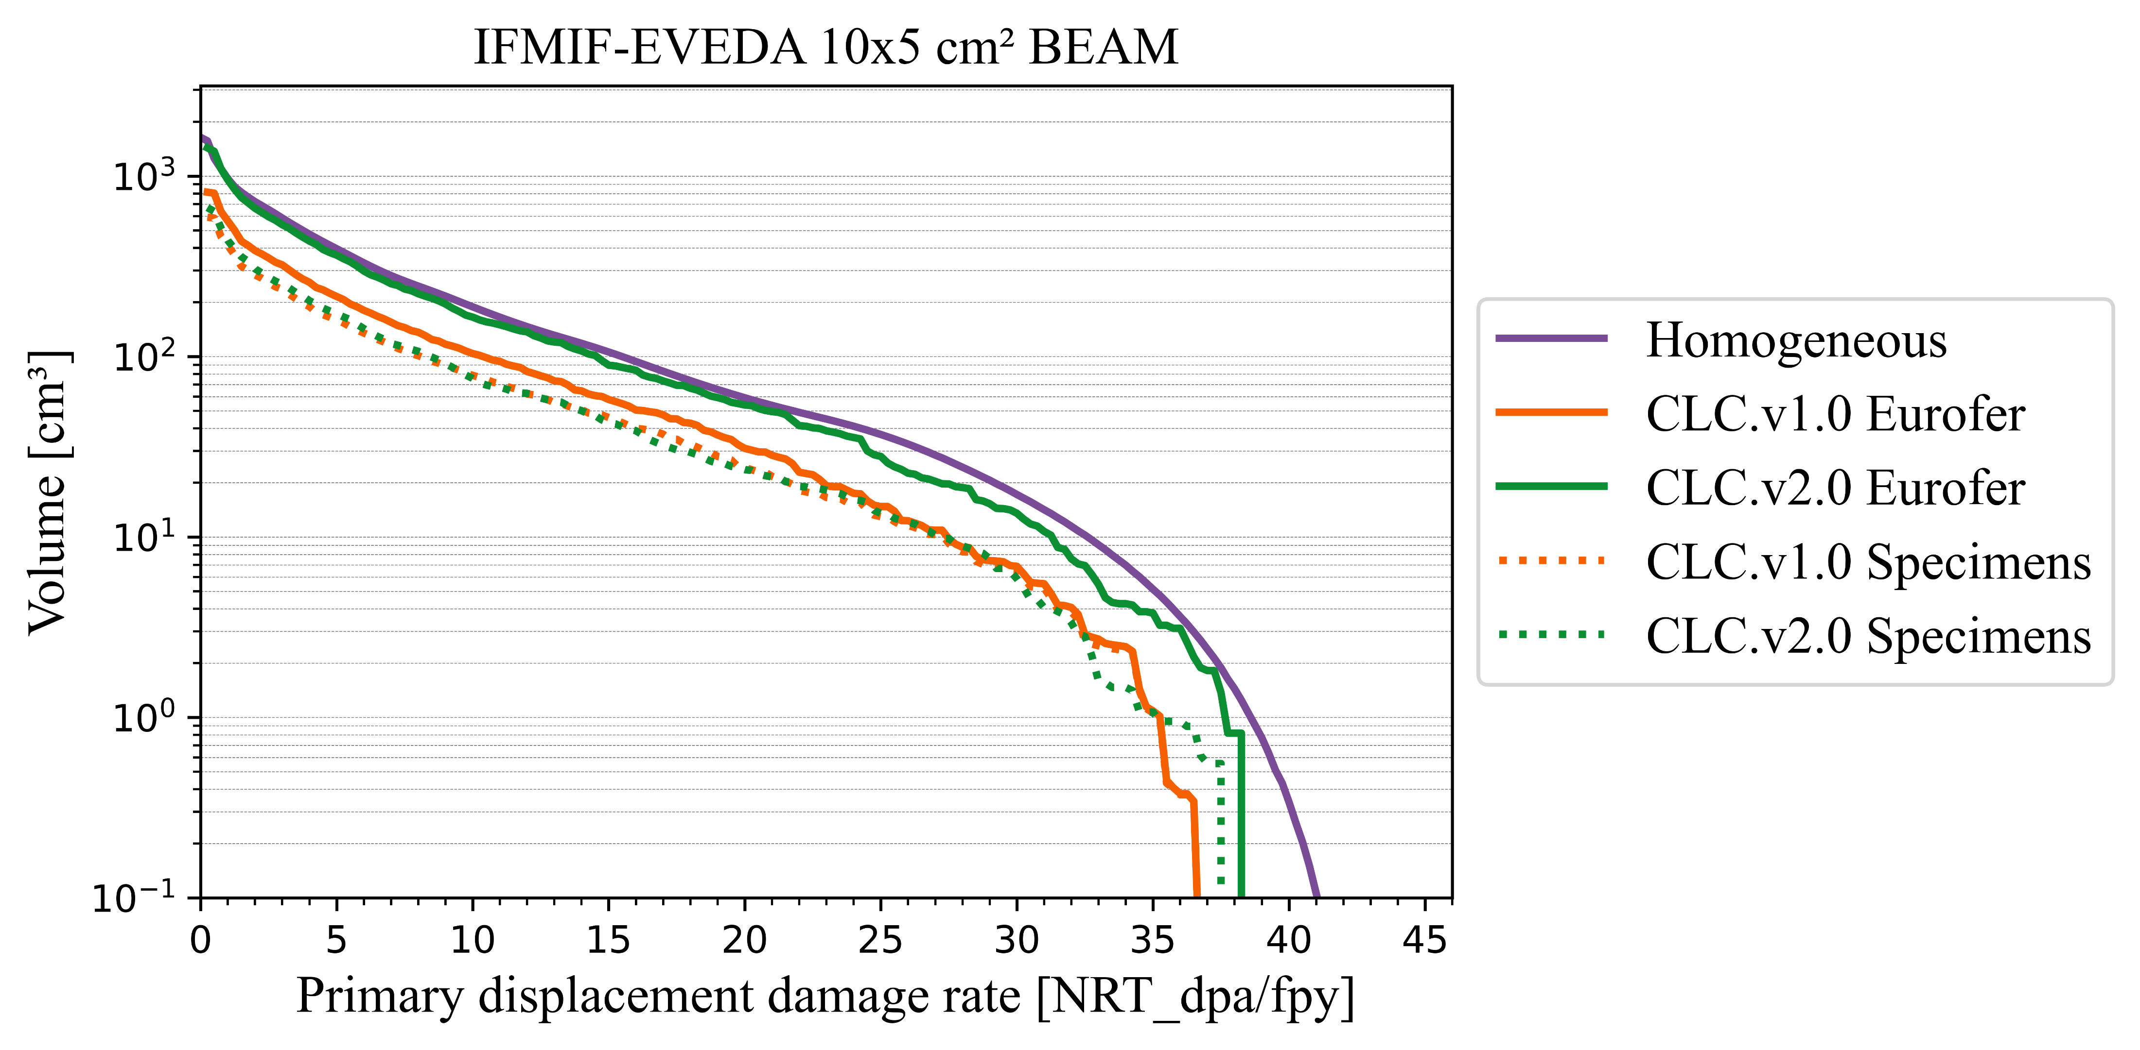
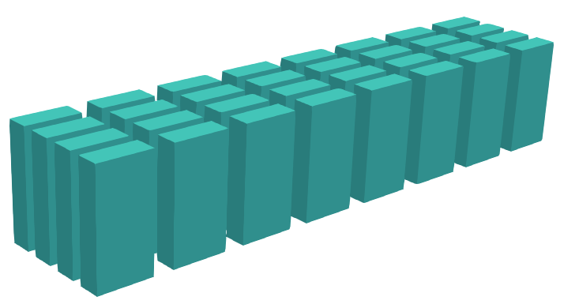
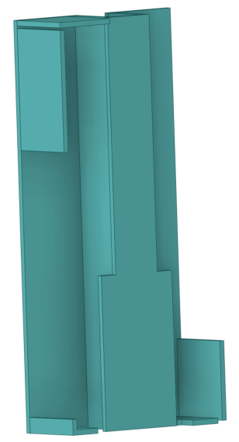

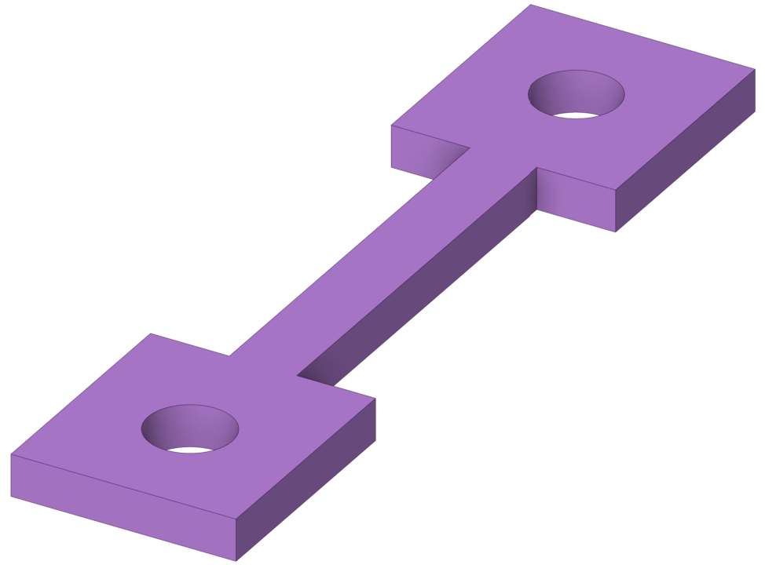
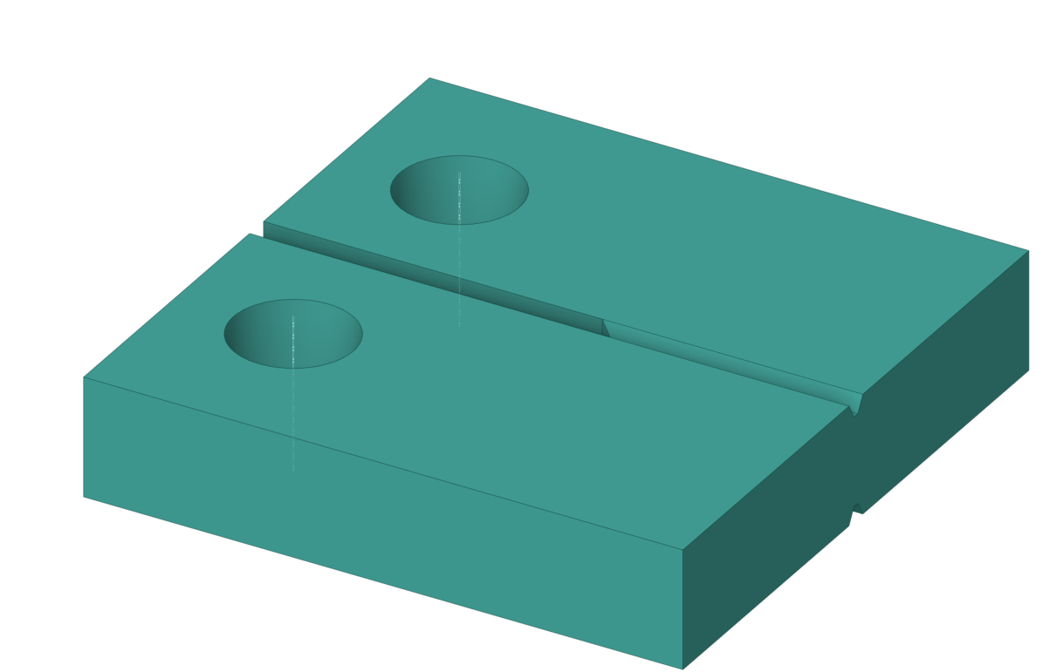
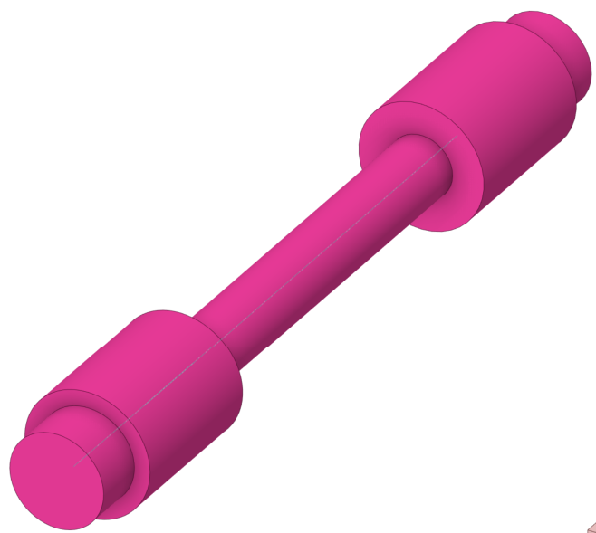
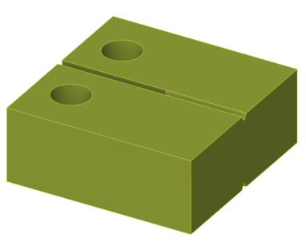
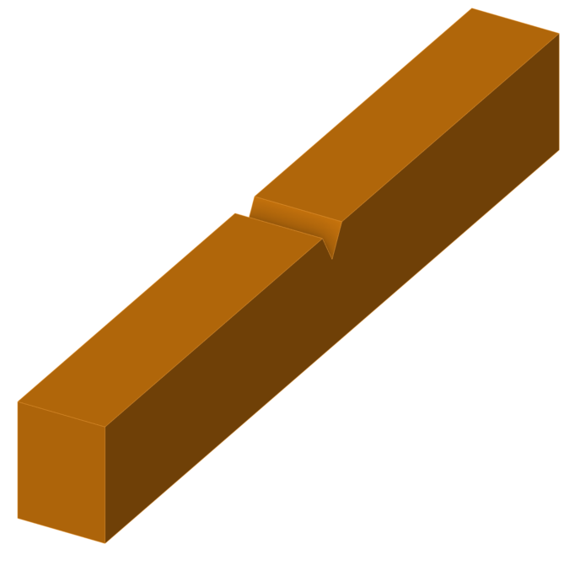
Primary displacement damage rate
Integrated stack and specimens in HFTM volumen
Eurofer
Box, filling objects | Specimens

Slide 9
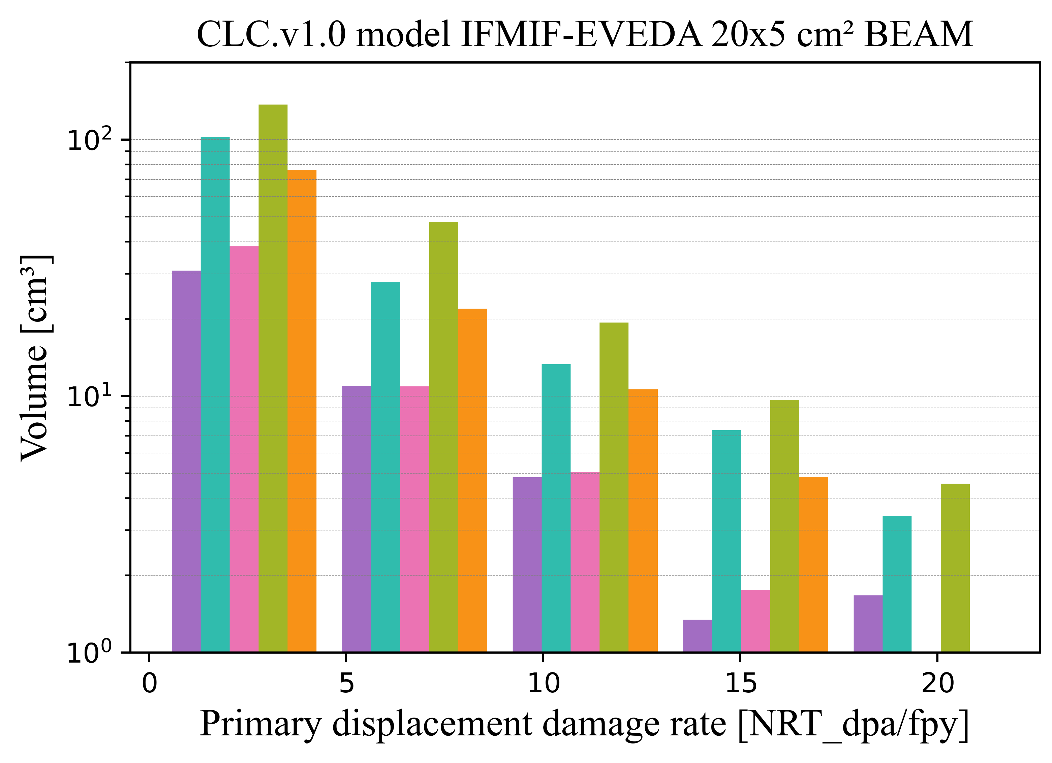
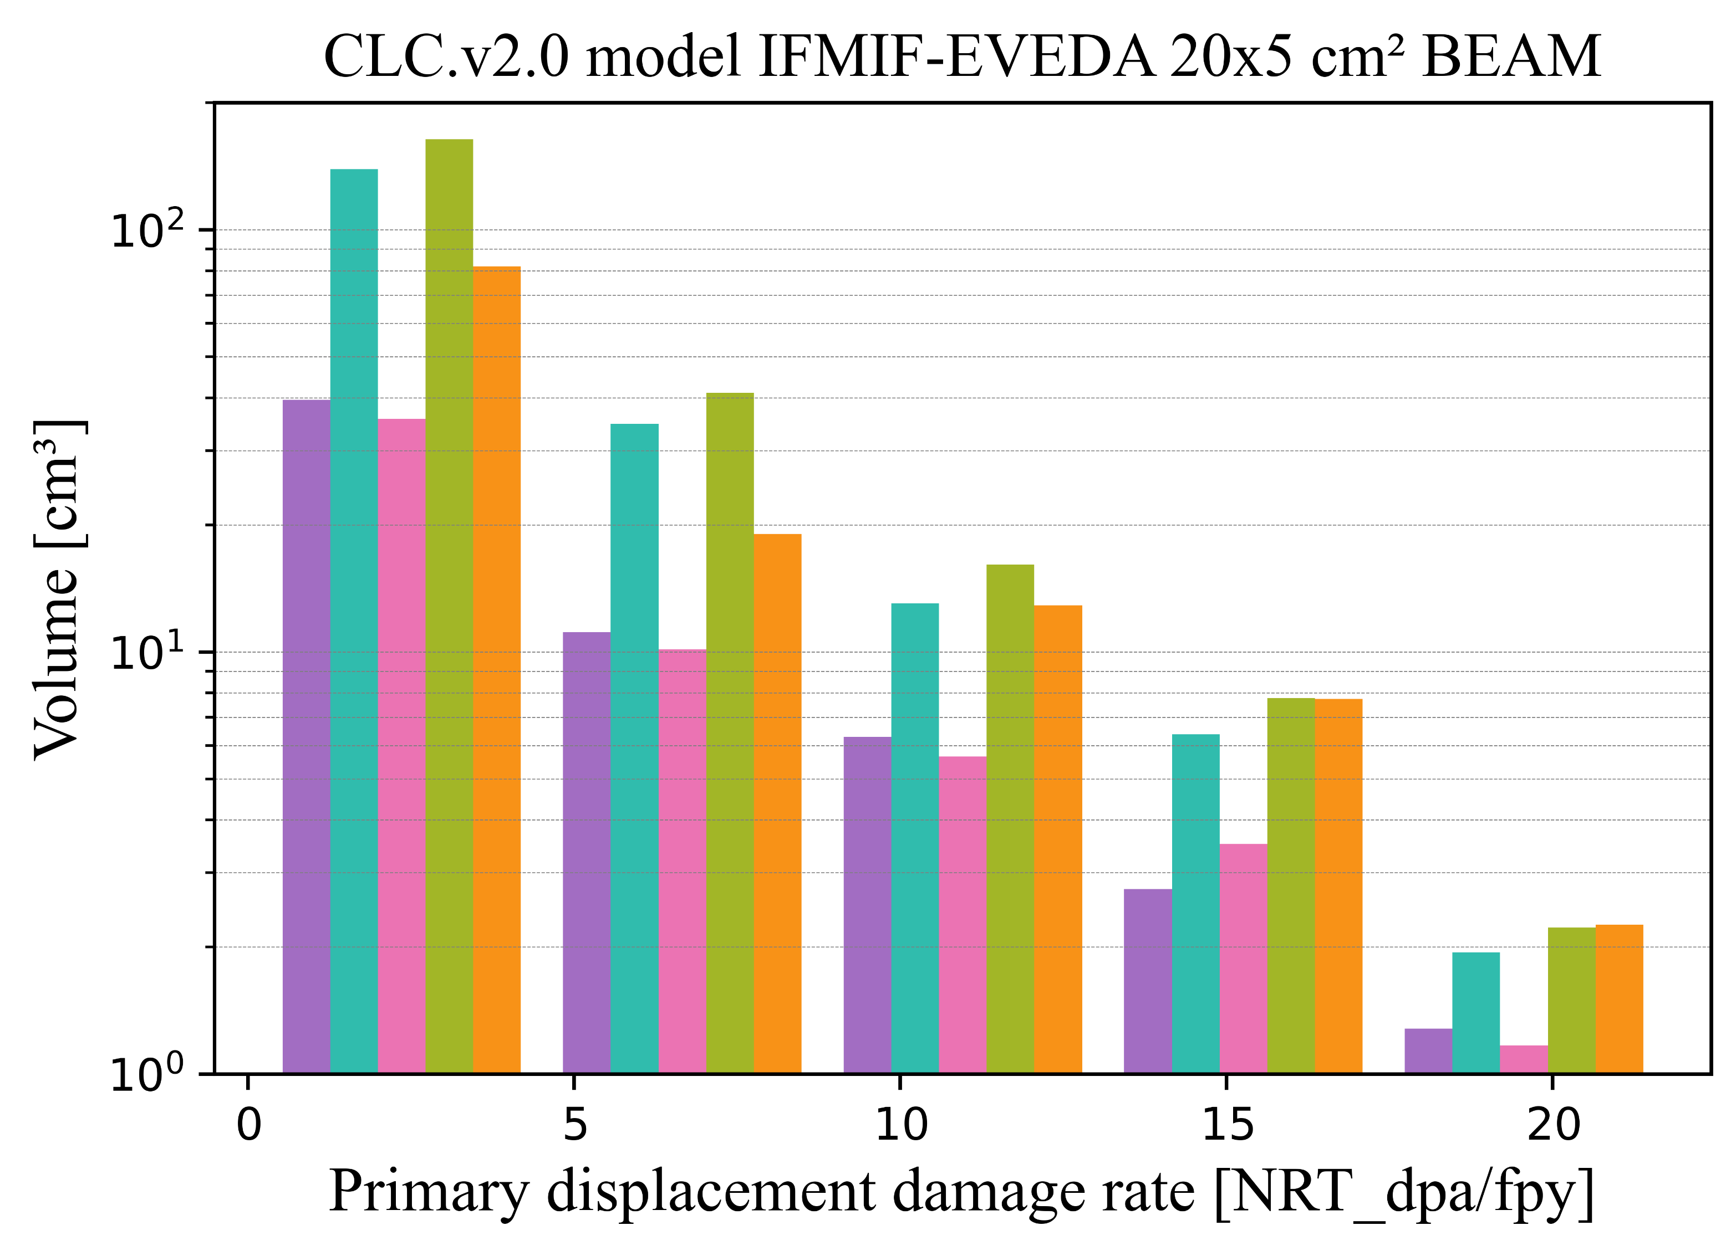
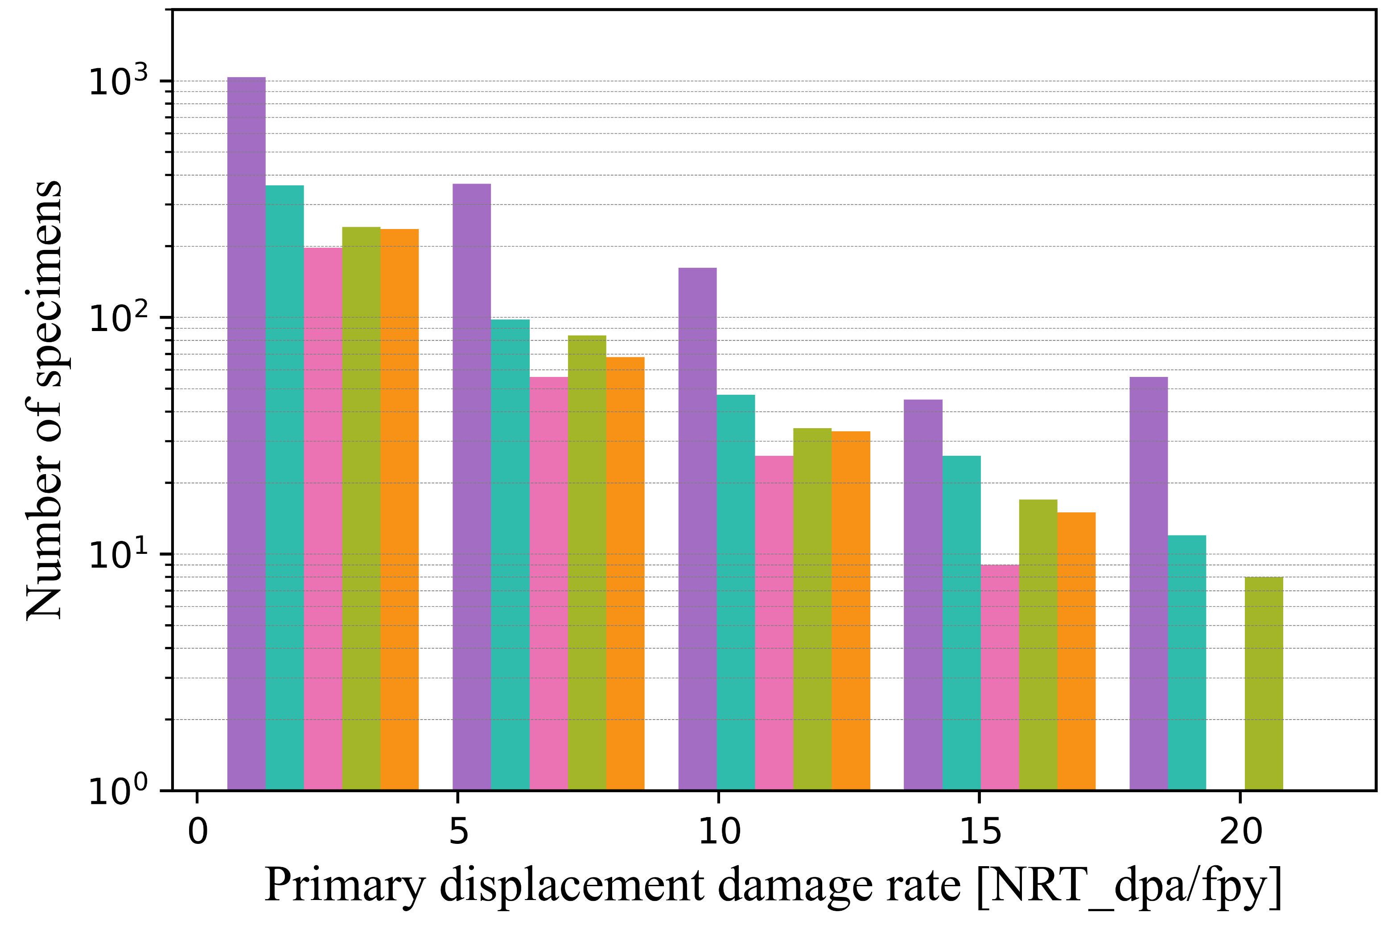
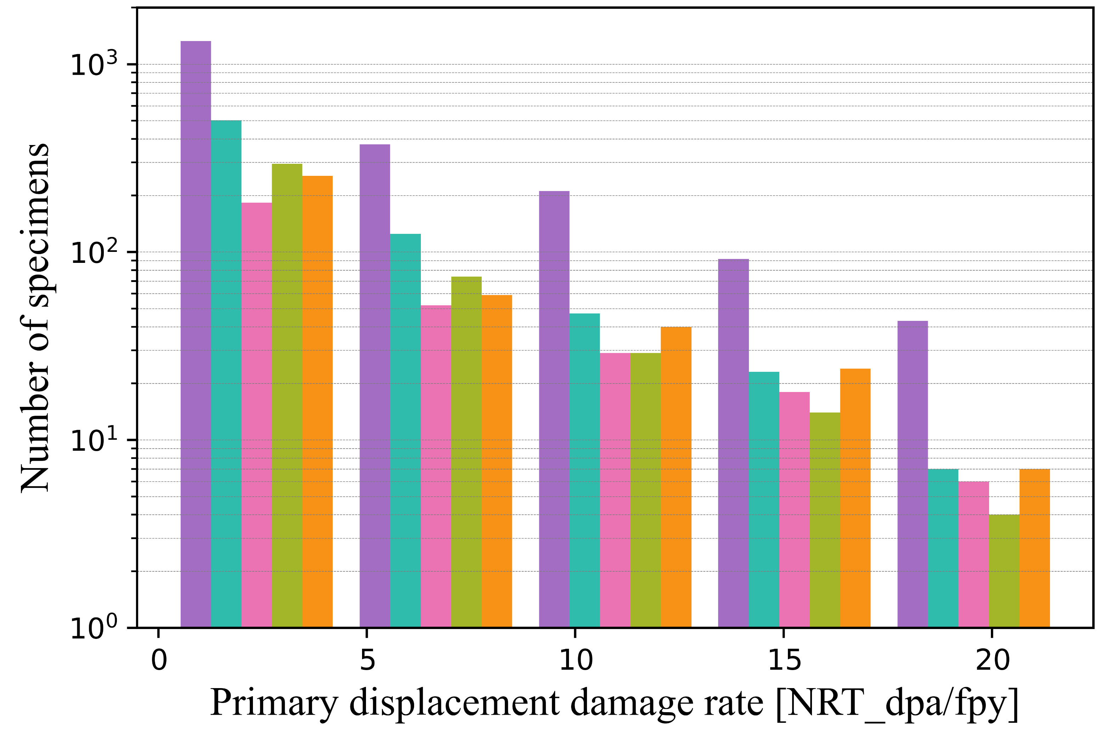
Primary displacement damage rate
DPA variation by specimen type in 20x5 cm² beam footprint
CLC.v1.0 model
CLC.v2.0 model
Units/rig
 | Type | CLC.v1.0 | CLC.v2.0
Tensile |  | 52 | 64
FCG |  | 17 | 22
Fatigue |  | 9 | 9
FT |  | 11 | 13
KLST |  | 12 | 12
Volume [cm³]
No. of specimens
Primary displacement damage rate [NRT_dpa/fpy]

Slide 10
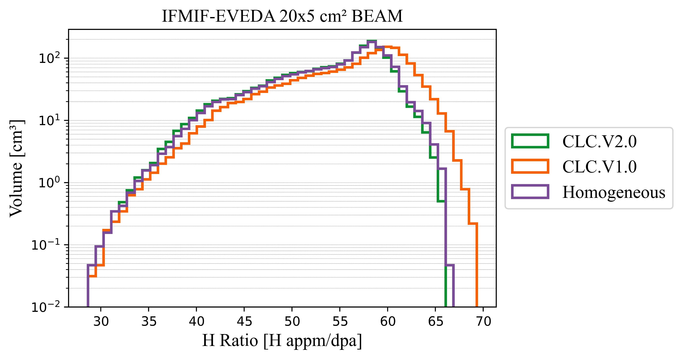
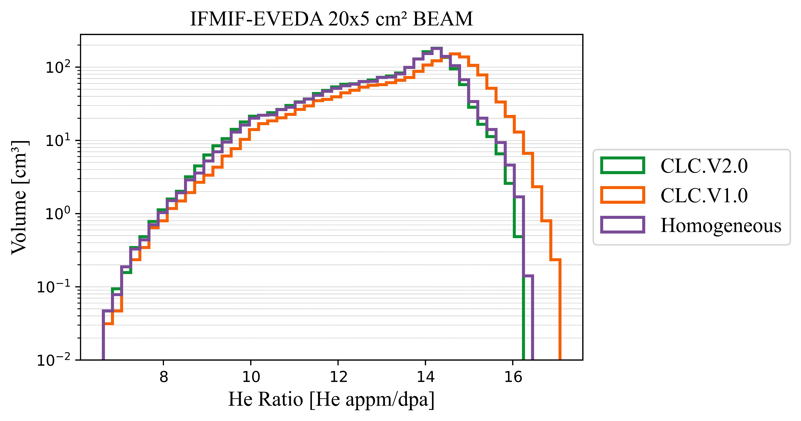
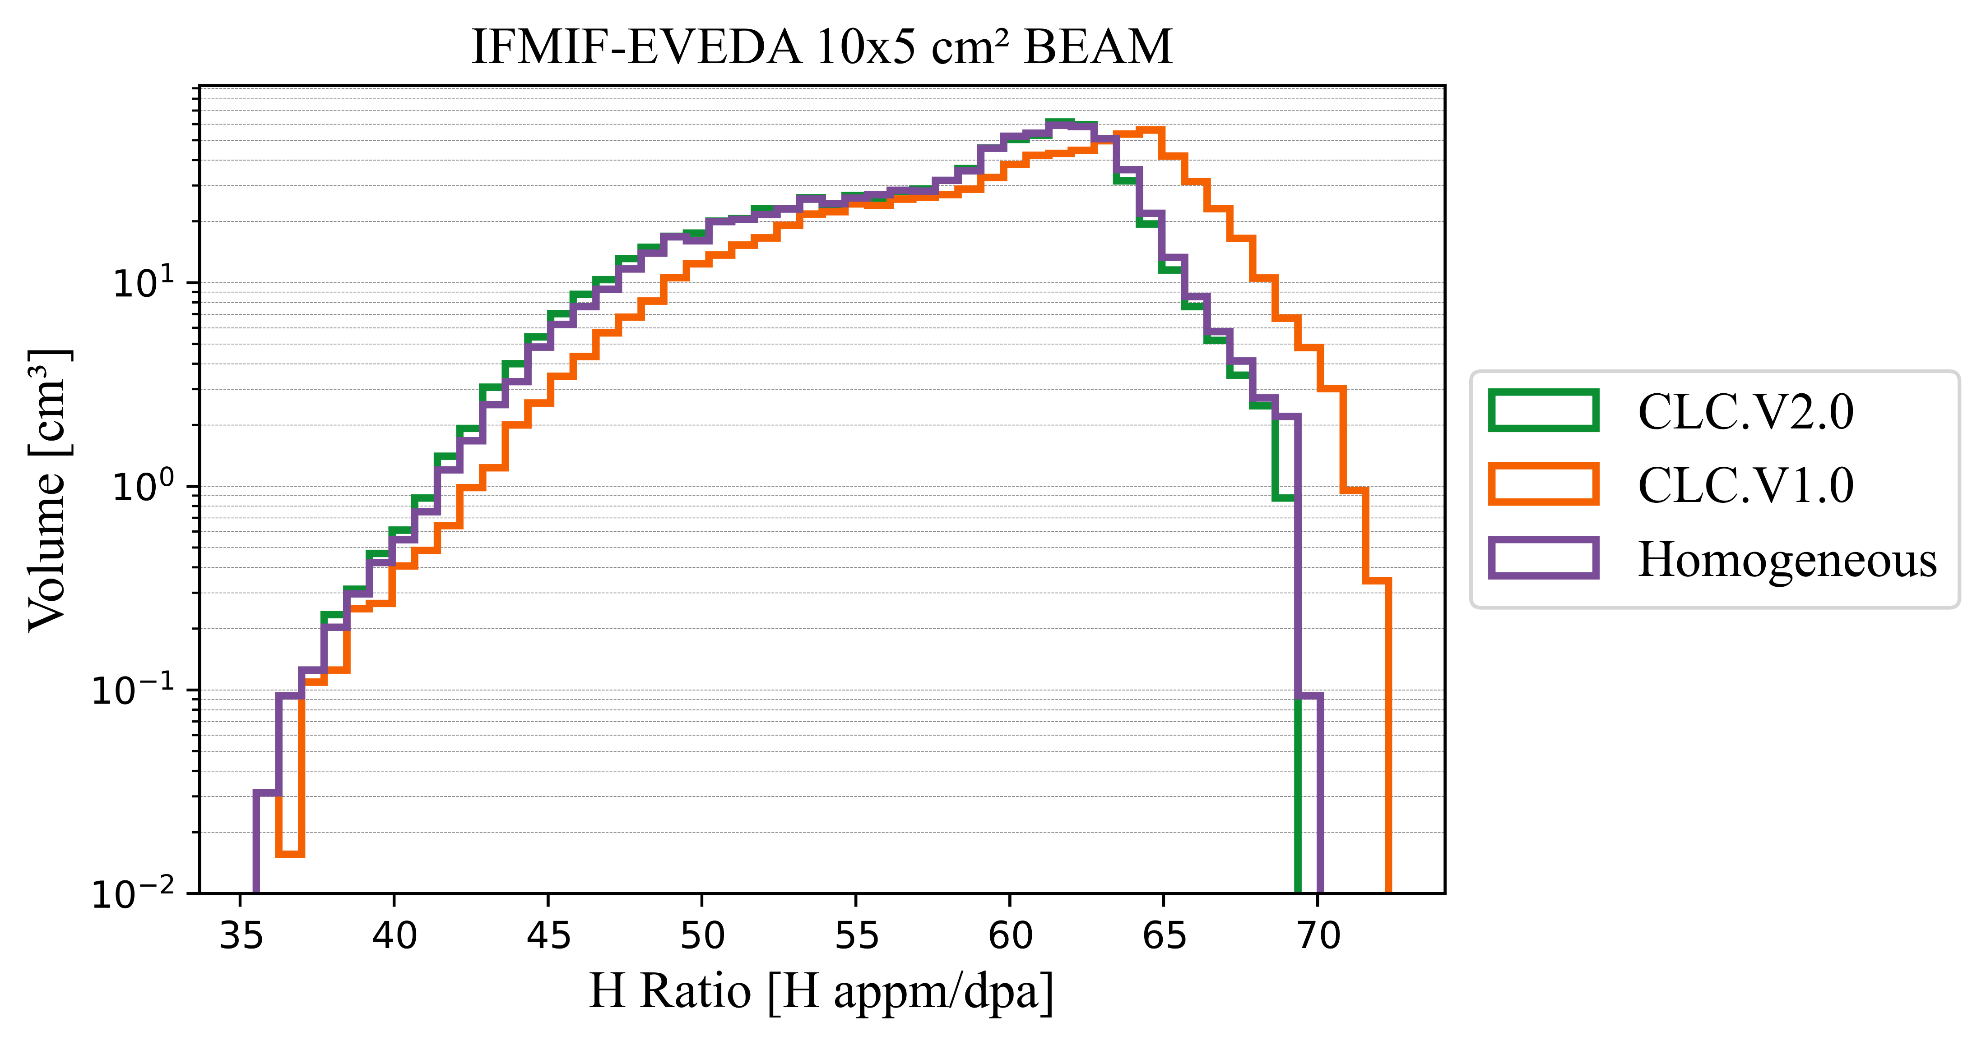
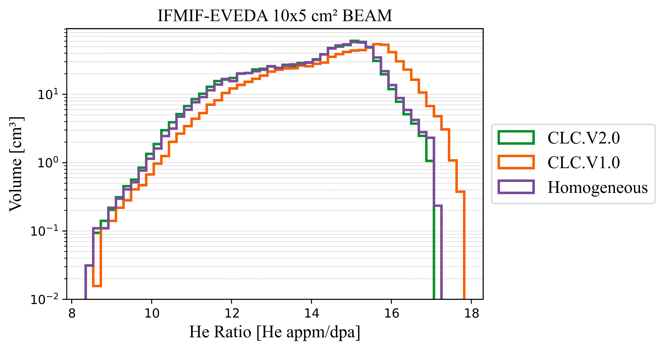

Gas –production

Slide 11
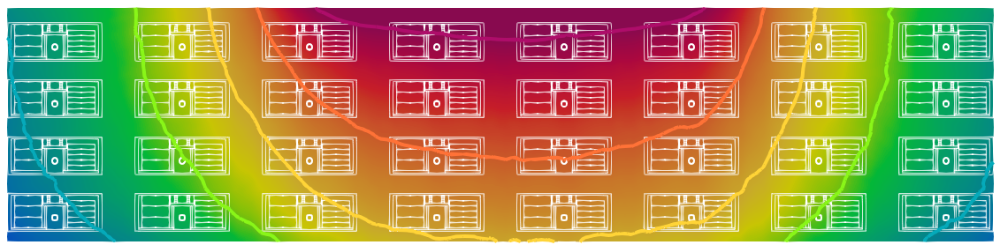
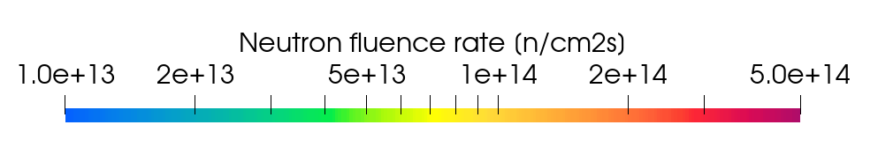
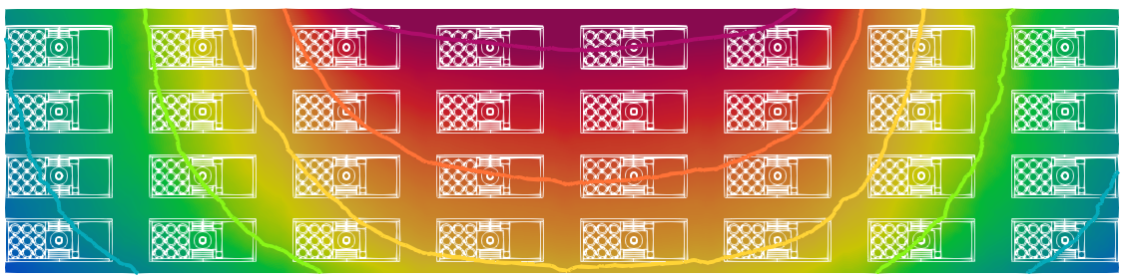
Neutron fluence rate [n/cm²s­]
CLC.v1.0 model
BEAM
1∙10¹³
5 ∙10¹⁴
2∙10¹³
2 ∙10¹⁴
5∙10¹³
1 ∙10¹⁴
2∙10¹³
5∙10¹³
CLC.v2.0 model
5 ∙10¹⁴
1∙10¹⁴
2 ∙10¹⁴
5∙10¹³
2∙10¹⁴
1 ∙10¹⁴
2∙10¹³
5∙10¹⁴

Slide 12
Neutron fluence rate [n/cm²s­]
CLC.v1.0 model
RIG 43
BEAM
RIG 26
1∙10¹³
2∙10¹³
Self Powered Neutron Detector
(SPND)
5∙10¹³
CLC.v2.0 model
RIG 43
RIG 26
1∙10¹⁴
2∙10¹⁴
5∙10¹⁴

Slide 13
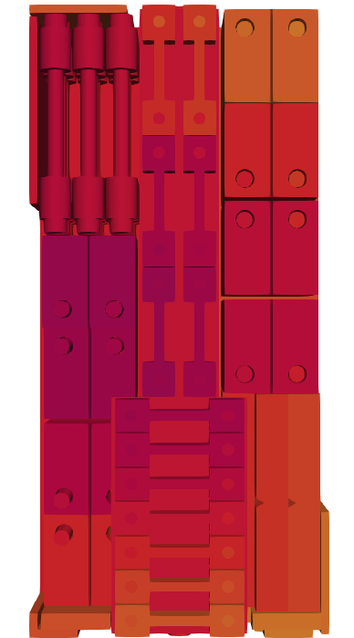
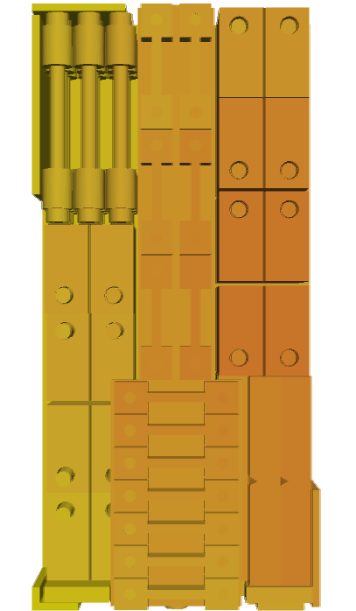
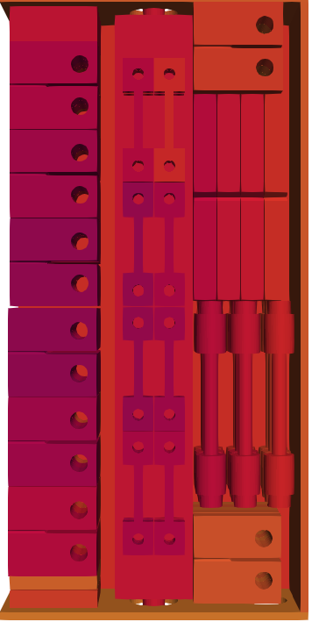
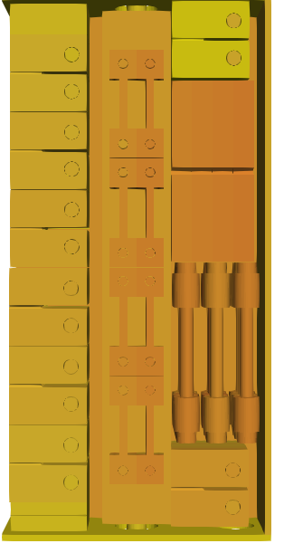
Neutron fluence rate
Neutron fluence rate 20x5 cm² beam footprint [10¹⁴ n/cm²s]
Model | CLC.v1.0 |  |  |  | CLC.v2.0
RIG | 43 |  | 26 |  | 43 |  | 26
Layout
Min | 1.58 | -44.8% | 0.76 | -29.5% | 1.77 | -42.7% | 0.78 | -30.9%
Max | 4.54 | 58.7% | 1.60 | 48.1% | 4.84 | 56.6% | 1.50 | 38.9%
Average | 3.12 | 9.1% | 1.16 | 7.4% | 3.23 | 4.5% | 1.15 | 1.8%
SPND | 2.86 |  | 1.08 |  | 3.09 |  | 1.13
1∙10¹³
2∙10¹³
5∙10¹³
1∙10¹⁴
2∙10¹⁴
5∙10¹⁴

Slide 14
Neutron fluence rate
Neutron fluence rate 20x5 cm² beam footprint [10¹⁴ n/cm²s]
Model | CLC.v1.0 |  |  |  | CLC.v2.0
RIG | 43 |  | 26 |  | 43 |  | 26
Layout
Min | 1.58 | -44.8% | 0.76 | -29.5% | 1.77 | -42.7% | 0.78 | -30.9%
Max | 4.54 | 58.7% | 1.60 | 48.1% | 4.84 | 56.6% | 1.50 | 38.9%
Average | 3.12 | 9.1% | 1.16 | 7.4% | 3.23 | 4.5% | 1.15 | 1.8%
SPND | 2.86 |  | 1.08 |  | 3.09 |  | 1.13
1∙10¹³
2∙10¹³
5∙10¹³
1∙10¹⁴
2∙10¹⁴
5∙10¹⁴

Slide 15
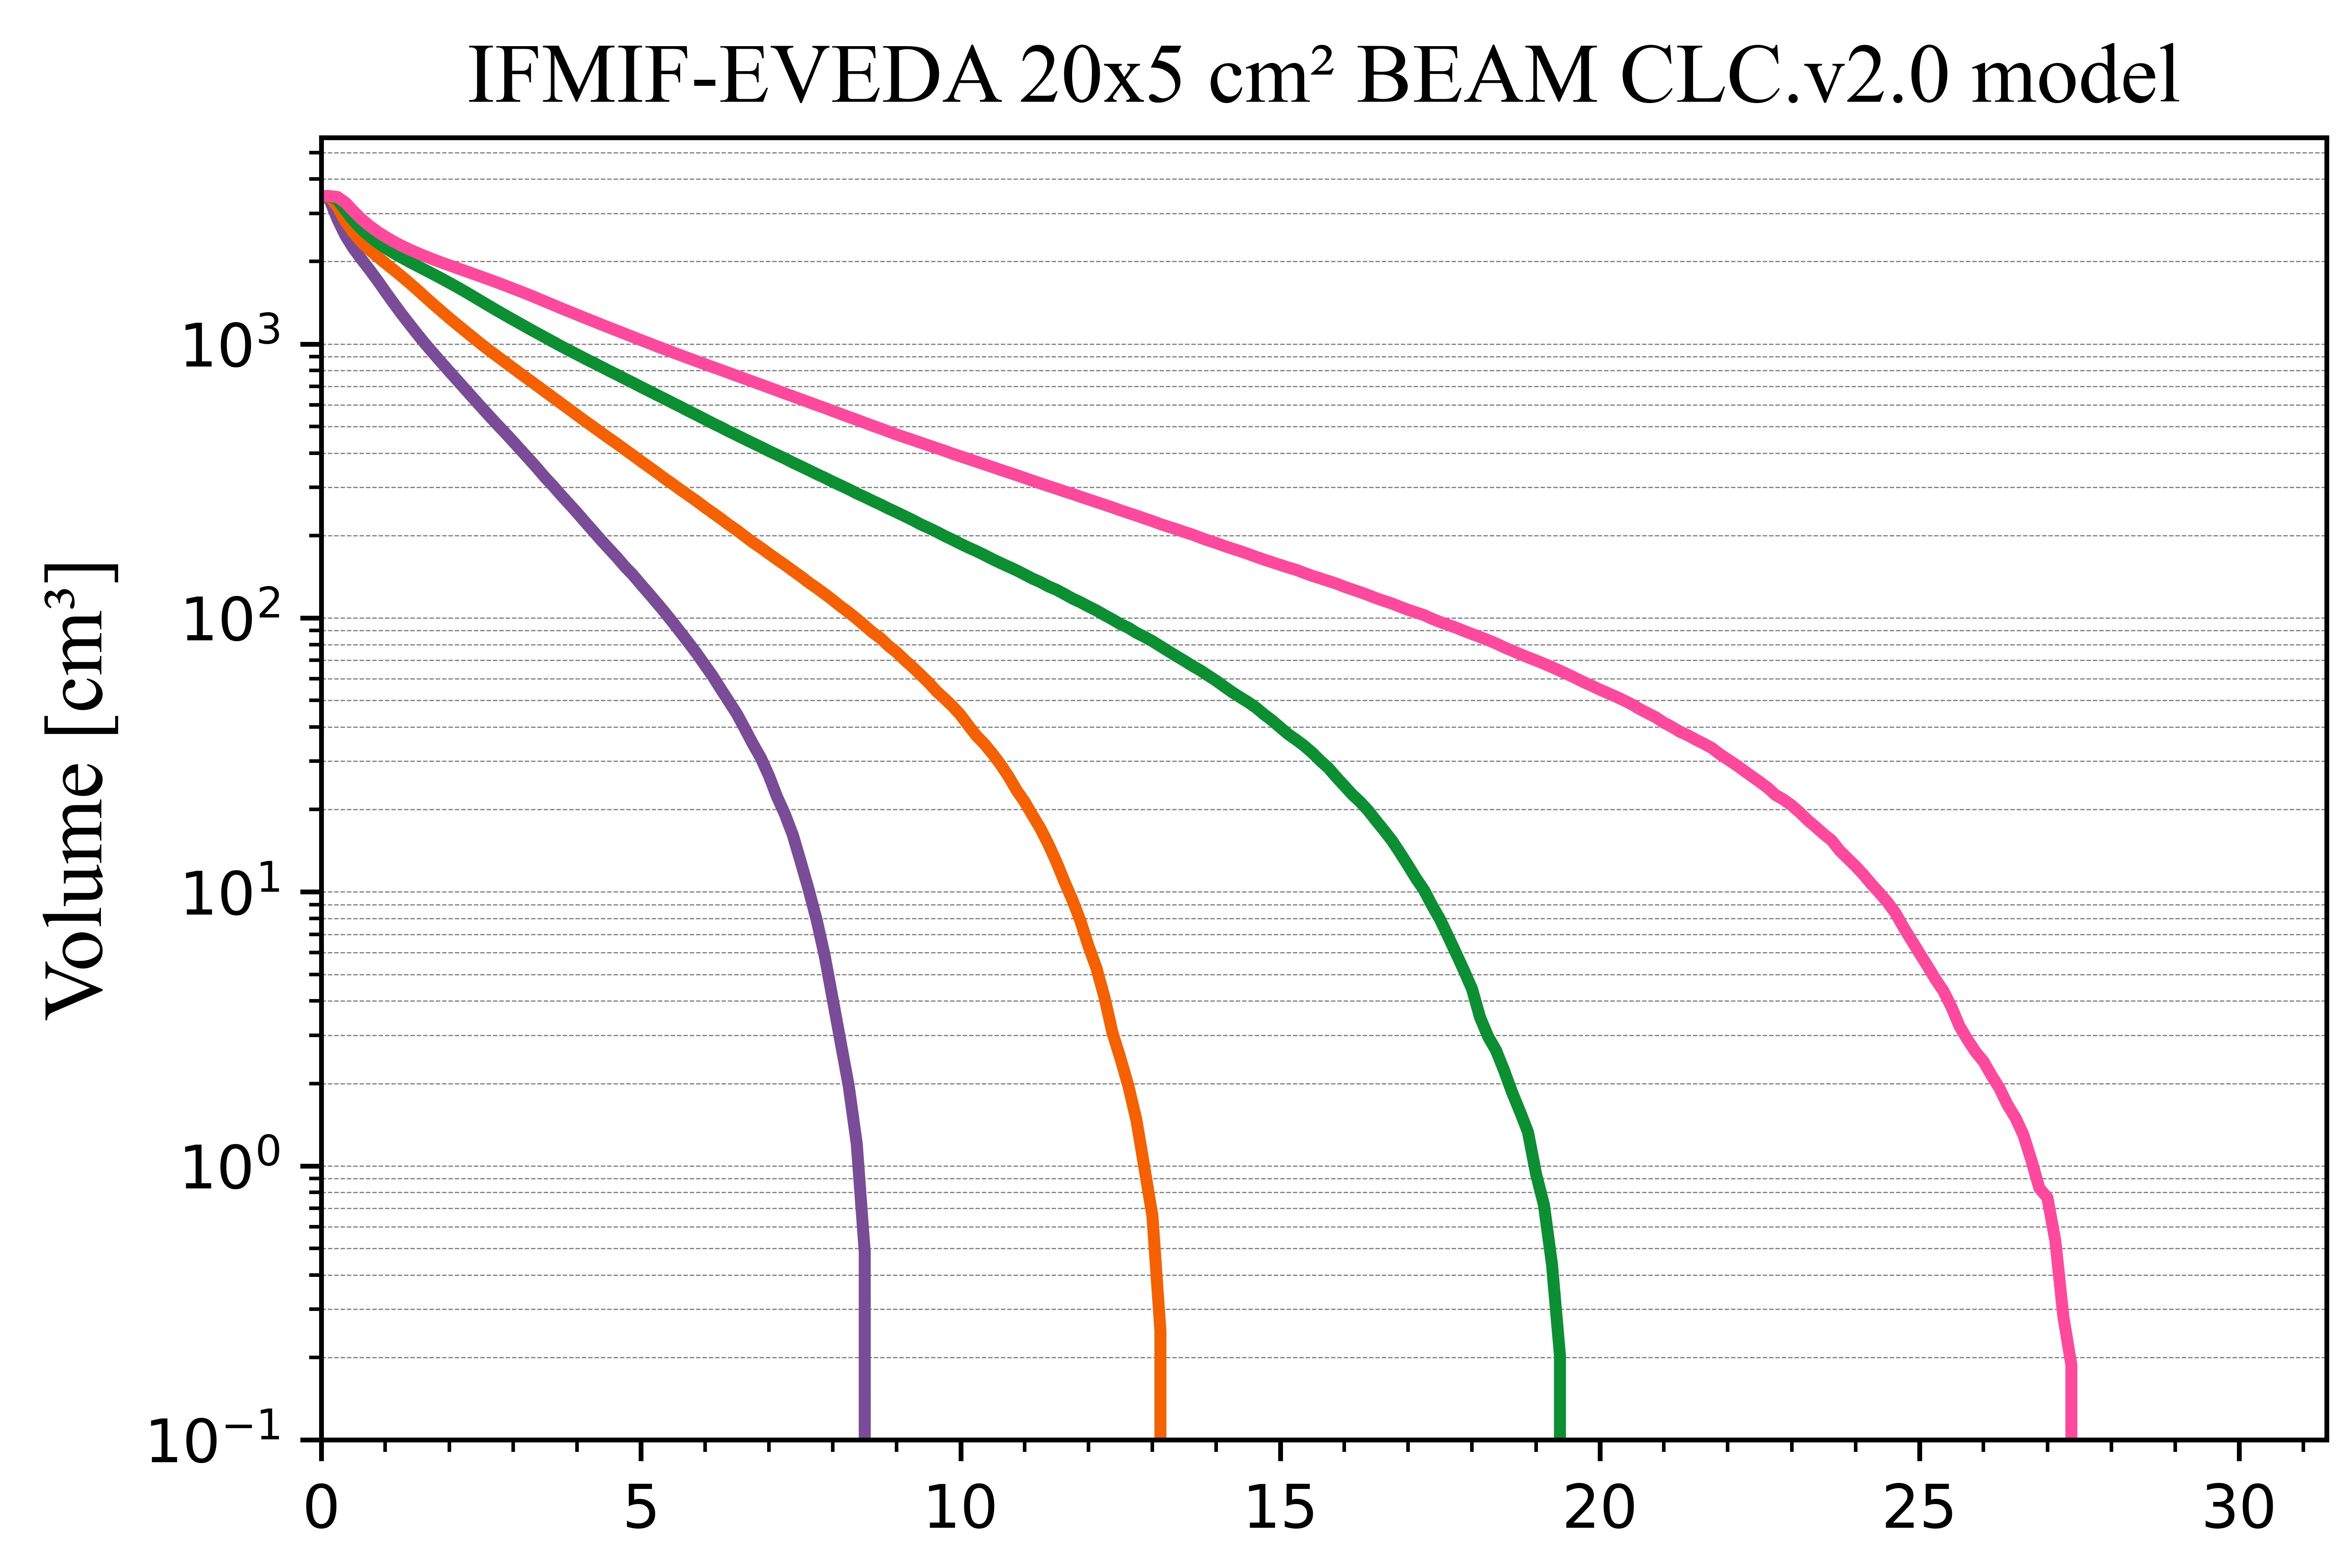
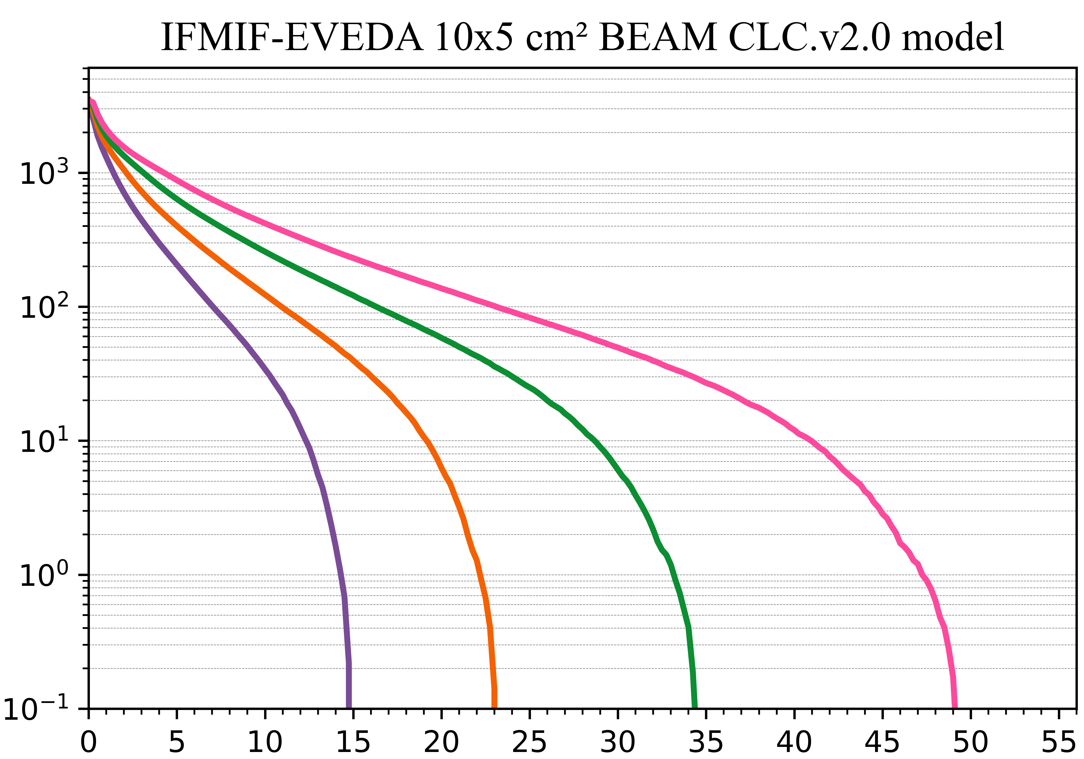
Primary displacement damage rate
Different deuterom beam energy for the CLC.v2.0 model HFTM volume
IFMIF-EVEDA 20x5 cm² BEAM
IFMIF-EVEDA 10x5 cm² BEAM
40 MeV
40 MeV
35 MeV
35 MeV
30 MeV
30 MeV
25 MeV
25 MeV
Primary displacement damage rate [NRT_dpa/fpy]

Slide 16
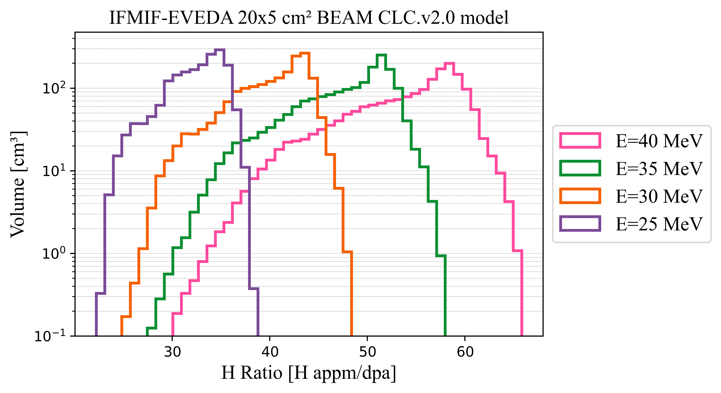
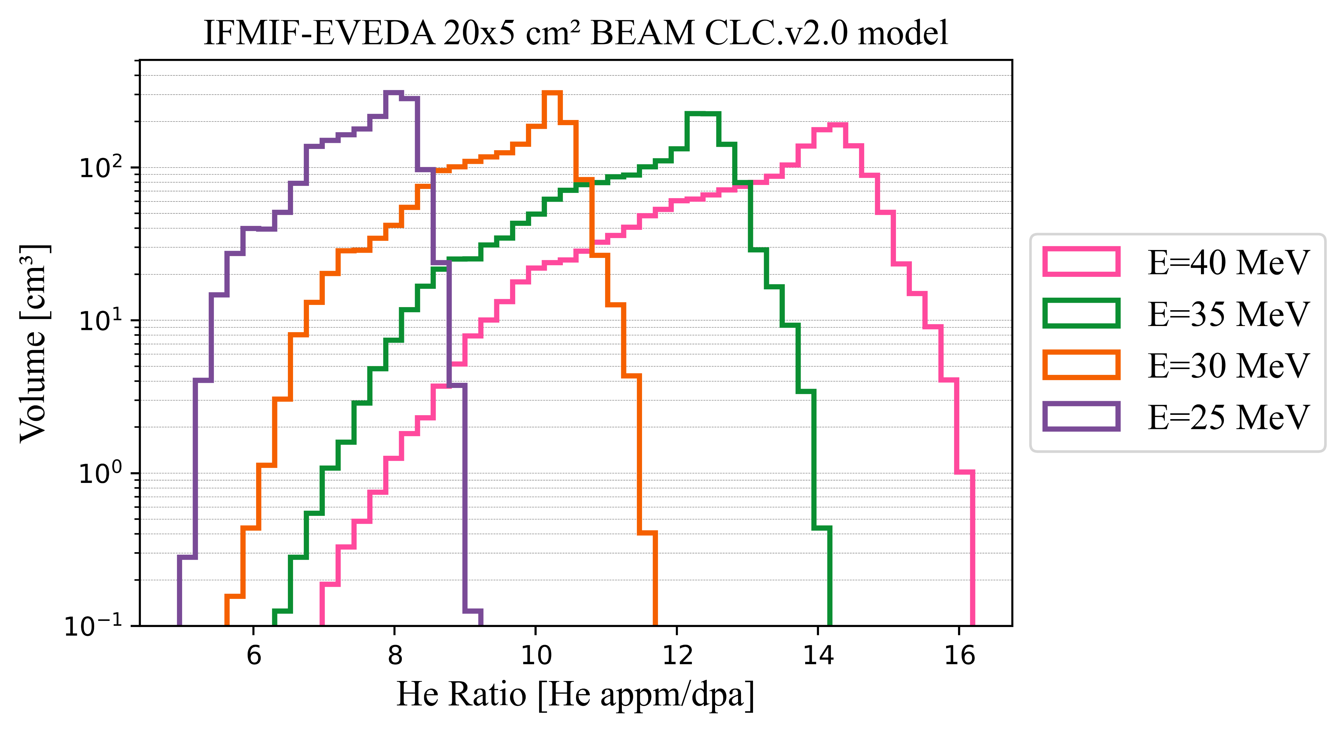
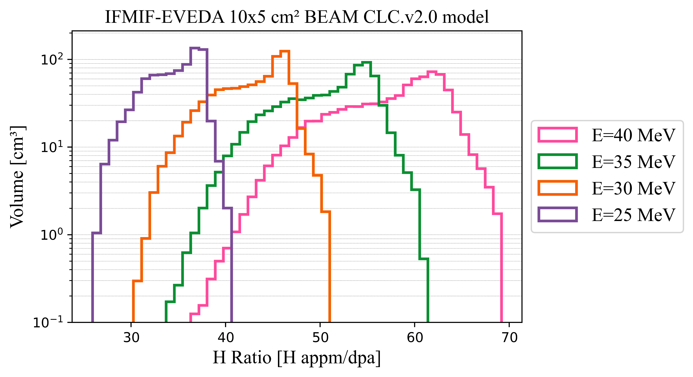
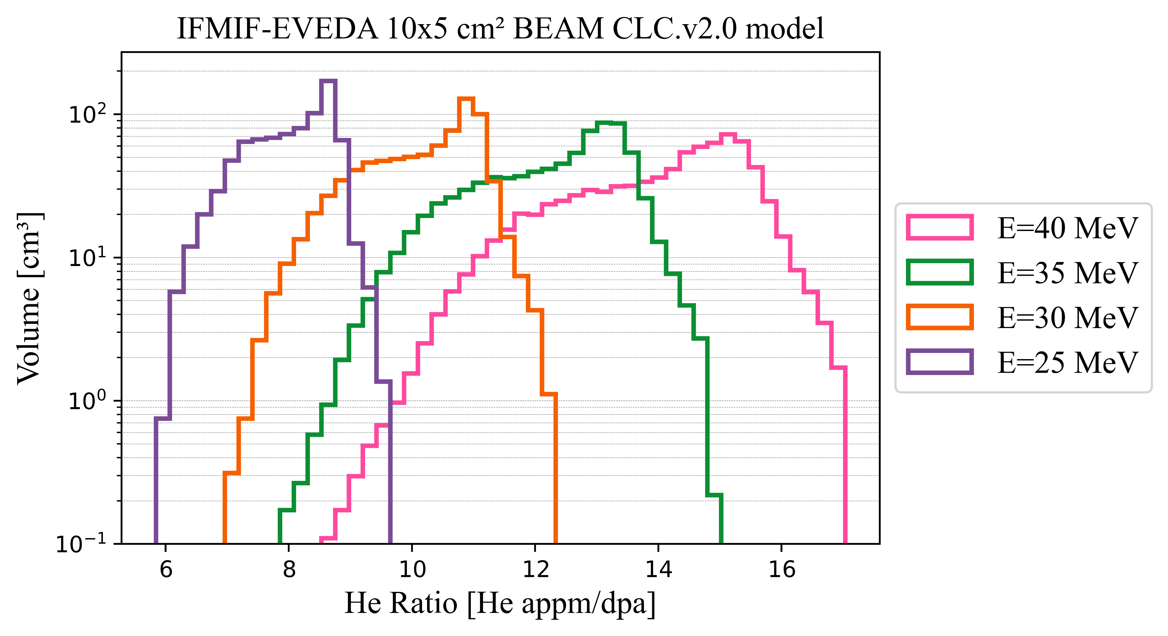
Gas-production
IFMIF-EVEDA BEAM
25 MeV
30 MeV
35 MeV
40 MeV
25 MeV
30 MeV
35 MeV
40 MeV
Different deuterom beam energy for the CLC.v2.0 model
20x5 cm² Beam
25 MeV
30 MeV
35 MeV
40 MeV
25 MeV
30 MeV
35 MeV
40 MeV
10x5 cm² Beam
H Ratio [H app/dpa]
He Ratio [H app/dpa]

Slide 17
Conclusions
Considering the whole volume of the HFTM, R-1 and R-2 criteria of dpa are fulfilled

Slide 18
Conclusions
Considering the whole volume of the HFTM, R-1 and R-2 criteria of dpa are fulfilled
NRT_dpa histograms by specimen type show the versatility of this facility, because depending on the specimens distribution design, it is possible to obtain different values. The gradient inside a rig must be also considered

Slide 19
Conclusions
Considering the whole volume of the HFTM, R-1 and R-2 criteria of dpa are fulfilled
NRT_dpa histograms by specimen type show the versatility of this facility, because depending on the specimens distribution design, it is possible to obtain different values. The gradient inside a rig must be also considered
The gas production ratios cover the expected values for DEMO

Slide 20
Conclusions
Considering the whole volume of the HFTM, R-1 and R-2 criteria of dpa are fulfilled
NRT_dpa histograms by specimen type show the versatility of this facility, because depending on the specimens distribution design, it is possible to obtain different values. The gradient inside a rig must be also considered
The gas production ratios cover the expected values for DEMO
By changing the beam energy, the desired dpa ranges can be changed, as well as the gas production

Slide 21
Future work
Results will be obtained for different materials such as W or CuCrZ
The isotopic composition of these materials and eurofer will be obtained, because they will also affect the macroscopic properties of the material
Estimation the signal in the SPND and activation foils
Thank you very much for your attention
Irene Álvarez Castro (iac@ugr.es)
PhD Student
Department of Atomic, Molecular and Nuclear Physics
University of Granada

