Slide 1
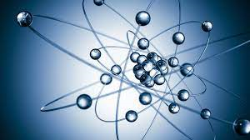
Challenges and opportunities
in Nuclear Medicine and Radiopharmacy at DONES
Laura Fernández Maza
PhD. FEA Radiofarmacia
H.U. Punta de Europa

Slide 2
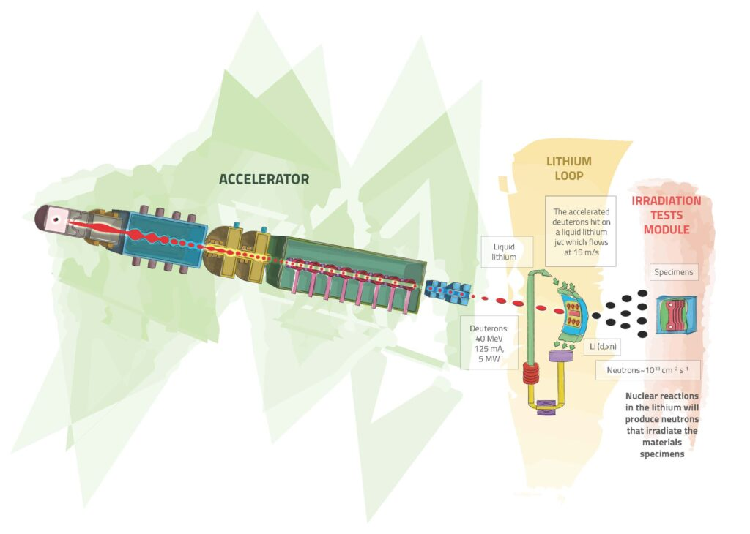
DONES neutron source
Notes:
As you know, the facility will produce a 125 mA deuteron beam accelerated up to 40MeV. The stripping reaction at litium target will generate a large ammount of neutrons, an excedent of which, can be used for other purposes such as the obtention of medical radioisotopes.

Slide 3
Medical radioisotopes under study at DONES
Isotope | Half life | Conventional reaction | Reaction at DONES | Application
¹¹C | 20 min | p + ¹⁴N | ¹⁰B(d,n) low E | PET
¹³N | 10 min | p + ¹³C | ¹²C(d,n) low E | Cardiac PET
¹⁵O | 2 min | p + ¹⁵N | ¹⁴N(d,n) low E | Cardiac PET
¹⁸F | 109 min | p + ¹⁸O | d+²⁰Ne-> α+¹⁸F | PET
⁶⁸Ge/⁶⁸Ga | 270d / 68 min |  | ⁶⁹Ga(d,3n) high E | PET
⁹⁹Mo/ ^{99m}Tc | 66 h / 6h |  | ¹⁰⁰Mo(n,2n)⁹⁹Mo | gamma
⁶⁴Cu | 12.6h |  | ⁶³Cu(d,p) low E | ImmunoPET
⁸⁹Zr | 78 h |  | ⁸⁹Y(d,p) low – high E | ImmunoPET
¹⁷⁷Lu | 6 d | n + ¹⁷⁶Yb | ¹⁷⁶Yb(d,p) high E | β- Therapy, gamma
⁹⁰Y | 64 h |  | ⁸⁹Y(d,p) | β- Radioembolisation liver tumour, synoviorthesis
²²⁵Ac | 10 d |  | CHALLENGE | α Therapy
¹⁶¹Ho | 2.5 h |  | ¹⁶¹Dy(d,2n) high E | Auger electron Therapy
¹²⁵I | 59 d |  | ¹²⁶Te(d,3n) high E | Auger electron Therapy
¹¹¹In | 2.8 d |  | ¹¹²Cd(d,3n) high E | Auger electron Therapy
^{195m}Pt | 4 d |  | ^{nat}Pt(d,x) high E | Auger electron Therapy
Courtesy of Prof. Javier Praena
University of Granada
Notes:
Most common radioisotopes for PET could be obtained, but their short halves lives make difficult to get to the hospitals. F-18 is the most suitable isotope for PET imaging all over the world. Germanium 68 is very interesting for medical generators. Its use is increasing exponentially in the last two decades. Mo-99 generator is still being useful and supposes 80% of the conventional nuclear medicine and it is important to get alternative production as we will see later.
Isotopes with longer halve lives are useful for immunoPET, in such a way as to allow the ag-ab binding. Lu177 is arising at theragnosis. A pure beta emmiter, Y-90 is employed in the treatment of joint pathologies, and recently for radioembolisation of liver tumours, with the isotope adsorbed in glass microspheres.
Ac-225 might be a promising challenge, it has the same theragnostics applications than Lutetium, but its Alpha particle emmision, localizes radiation more than beta emmitters. Its very low availability difficults the development of new radiopharmaceuticals. And the last ones could be interesting in Auger electron therapy.

Slide 4
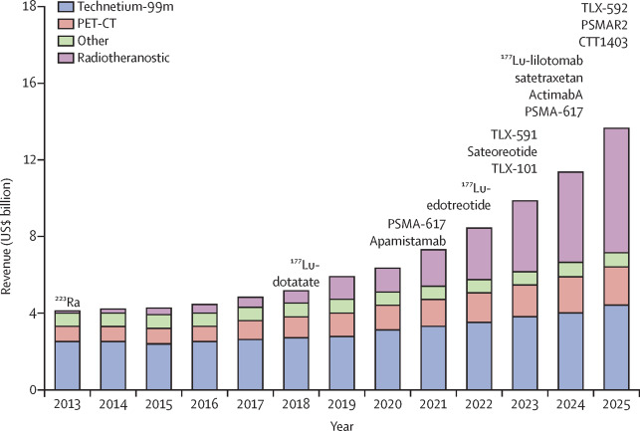
Emerging medical radioisotopes
Sung et al. Imaging-guided targeted radionuclide tumor therapy: From concept to clinical translation
Advanced Drug Delivery Reviews , November 2022
Notes:
Here we can see the evolution in the use of medical radioisotopes. We can see the conventional nuclear medicine with Tc-99m is still being useful and even has a slight increase. PET radiopharmaceuticals obviously have further increase, but the exponential aparition of theragnostics must be considered, because it offers hundred of possibilities to treat inoperable cancer or diseases for which there is no alternative.

Slide 5
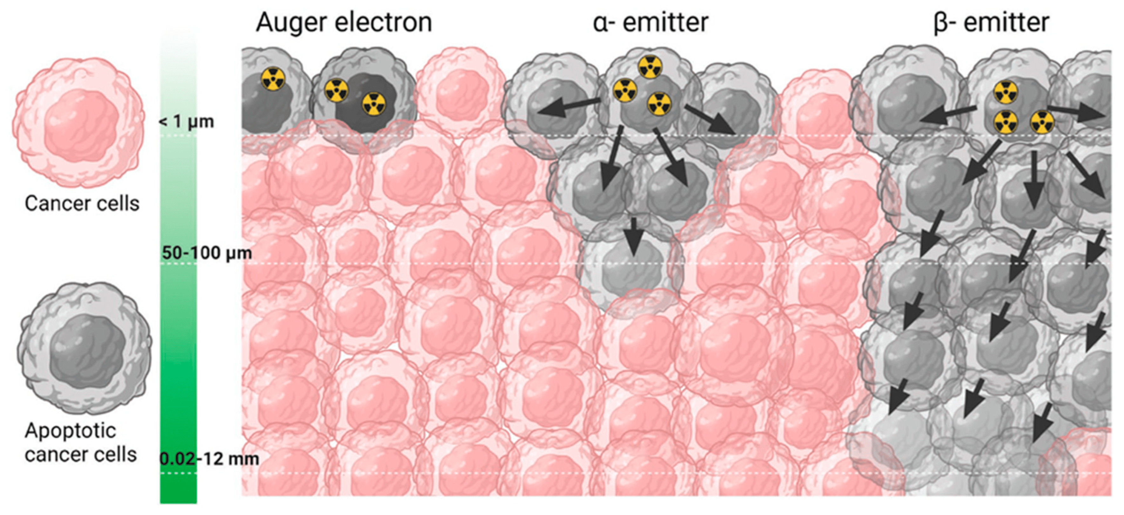
Medical radioisotopes. Biological effects
Chakraborty et al. Advanced in radionuclides and radiolabelled peptides for cancer therapeutics. Pharmaceutics 2023
Notes:
New radiolabelled conjugates for targeted radiotherapy have been designed to deliver radiation directly to cancer cells with improved specificity and minimal damage to the surrounding normal tissue.
Damage caused by radioactive emision from auger electrons and Alpha emitters can cause DNA damage, the latter exhibit high density ionization effects. Beta emitters can cause reparable damage to single strand DNA.

Slide 6
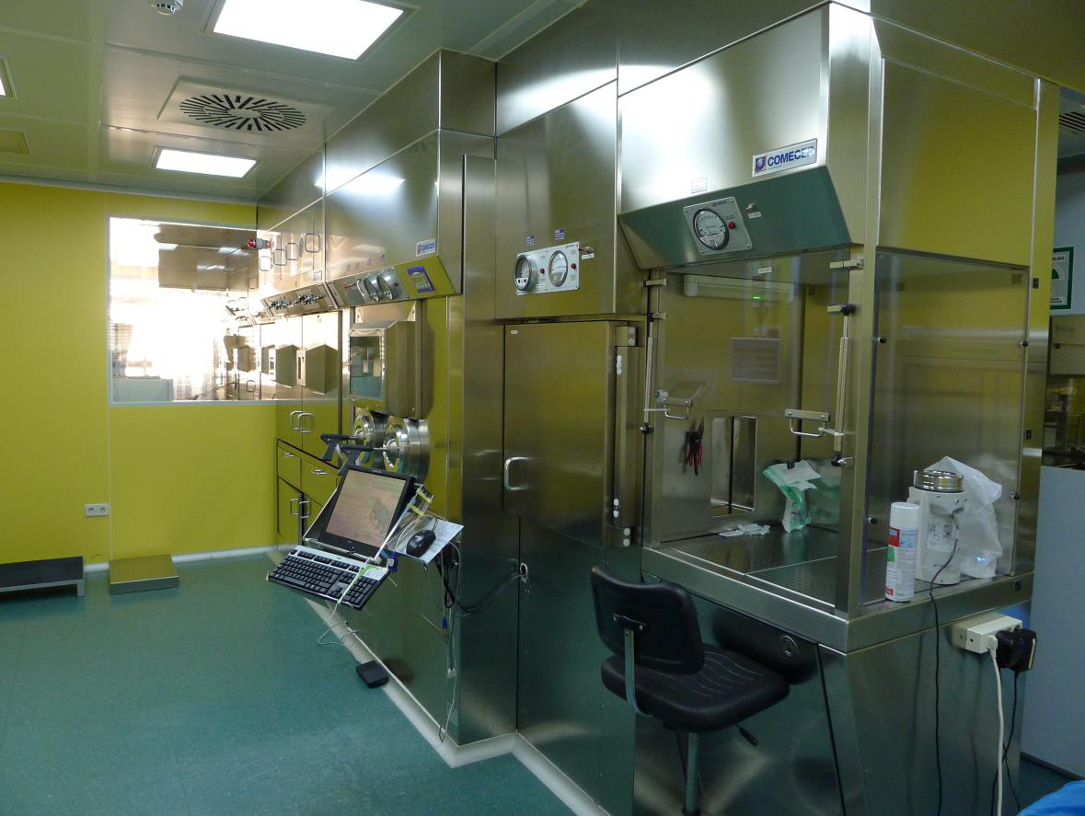
Medical radioisotopes to radiopharmaceuticals
Radiopharmacy
● Desirable at accelerator proximities
● R+D of new molecules
● Production of radioisotopes for industrial
radiopharmaceuticals
● Production of radioisotopes for medical
generators
● preclinical studies
● Clinical trials → GMP compliance
Notes:
To move from radioisotopes to radiopharmaceuticals, it should be considered to install a radiopharmacy close to the accelerator. It would let you R+D of new molecules, obtention of radioisotopes for well known authorised radiopharmaceuticals, such FDG, FMISO, FLT… obtention of radioisotopes for medical generators. Also preclinical research and, at a higher point, clinical trials for which you must have the GMP compliance certificate.

Slide 7
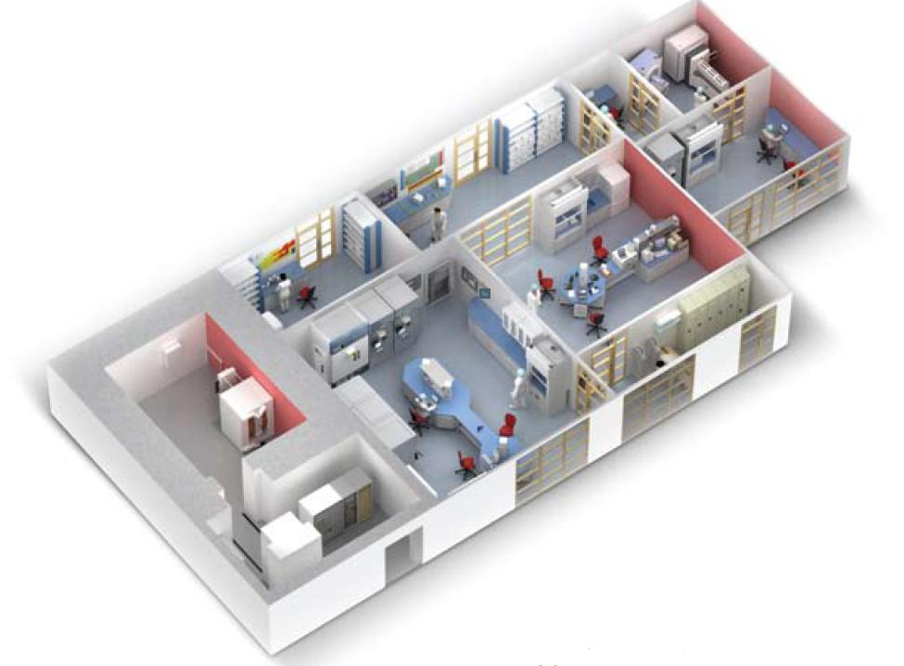
Radiopharmacy design
● Accelerator → 2m concrete shielding
● Hot cells for radiopharmaceuticals synthesis
● Quality control lab
Courtesy of General Electric
Notes:
This could be a Radiopharmacy design. I took this model from GE, in which the Accelerator (cyclotron in the image) is shielded by 2 m of concrete. This shielding is safe enough for industrial production of radioisotpes. In my experience we obtained 20Ci of F-18 , So in the case of R+D purpose, the shielding is by far, secure. Next to the Accelerator there must be a laboratory of synthesis, with hot cells with also a shielding of about 7 cm of lead. This laboratory must be as close as posible to the Accelerator, to facilitate manteinance, and avoid leaks.

Slide 8
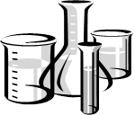
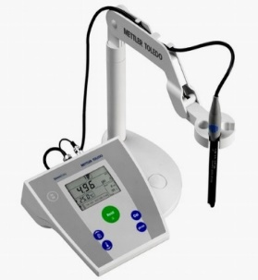
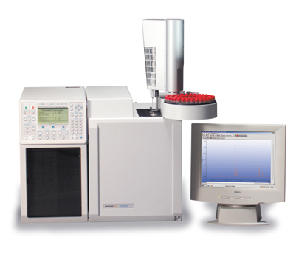
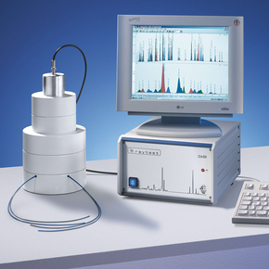
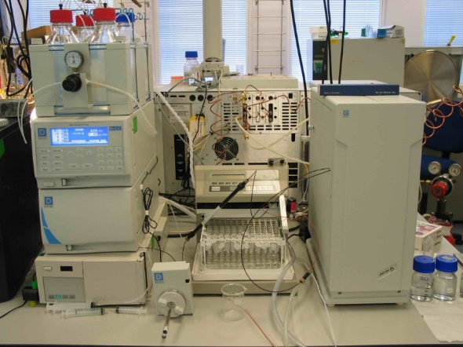
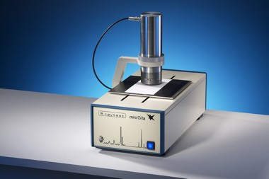
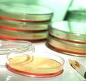
Quality controls of radiopharmaceuticals
For clinical purpose
● Absence of particles
● pH
● Chemical purity
● Radiochemical purity
● Radionuclidic purity
● Sterility, apirogenicity
Notes:
When the radiopharmaceuticals are being used for clinical purpose you must do all these quality controls before injection to the patient. You have to verify the absence of particles, control of pH, ensure the chemical purity with gas chromatograph for residual solvents, radiochemical purity with radioHPLC and thin layer cromatography. Identify your radionuclide with a spectrometer to ensure the absence of other radioisotope contamination. And of course, sterility and apirogenicity of injectable drugs.

Slide 9
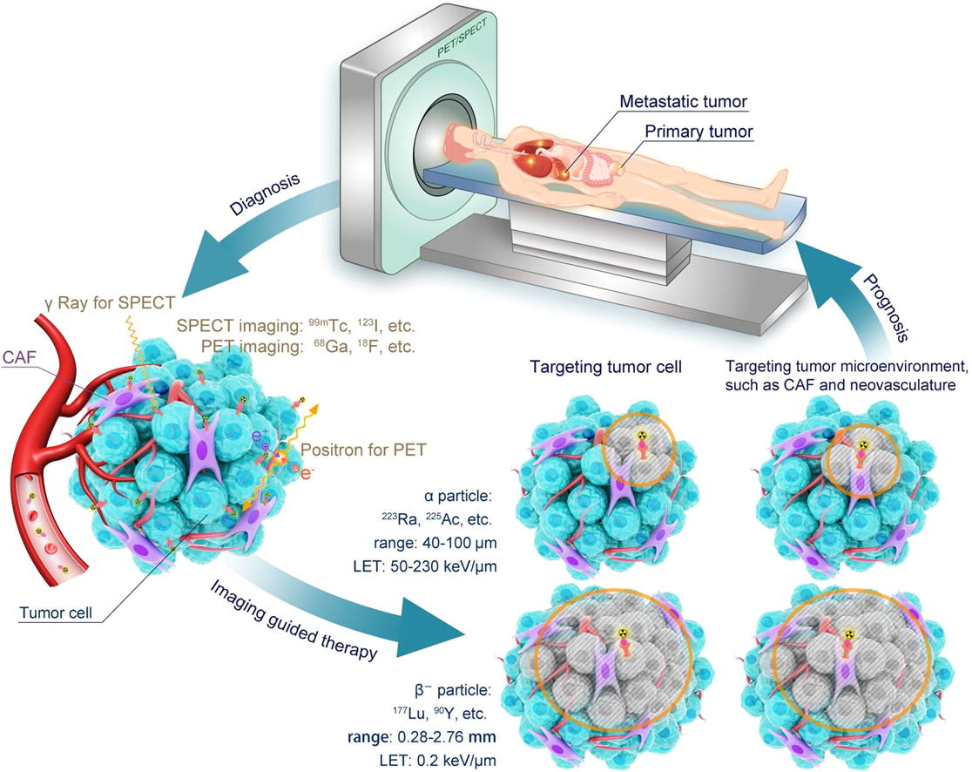
Theragnosis
Personalized medicine
● Combines diagnosis and therapy
● Small molecules, antibodies, peptides, nanoparticles,
cells and tissues
● Molecular imaging is useful in R+D of new drugs
● Preclinical studies → biodistribution pharmacokinetics
mechanism of action
efficacy
● Therapeutic agents labeled with radioisotopes help
in monitoring therapy simultaneosuly.
Develop of drugs and technology for radiation theragnosis. Jeong et al. Nuclear Engineering and Technology IAEA 2016
Notes:
Personalized medicine is a tailored medical treatment that targets the individual characteristics of each patient. Theragnosis, combinig diagnosis and therapy, plays an important role in selecting appropiate patients, because not all therapies are useful for all patients.
Non invasive in vivo imaging can trace small molecules, antibodies, peptides, nanoparticles, cells and tissues. Molecular imaging is useful not only for clinical studies but also for developing new drugs and new treatment modalities. Preclinical and early clinical molecular imaging shows distribution, pharmacokinetics, mechanism of action, and efficacy. When therapeutic materials are labeled using radioisotopes, you treat diseases and monitor therapy simultaneosly. Such nuclear medicine technology is defined as radiation theragnosis.

Slide 10
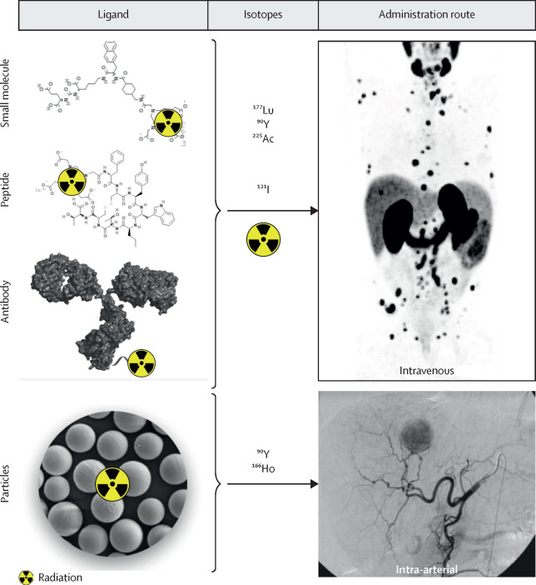
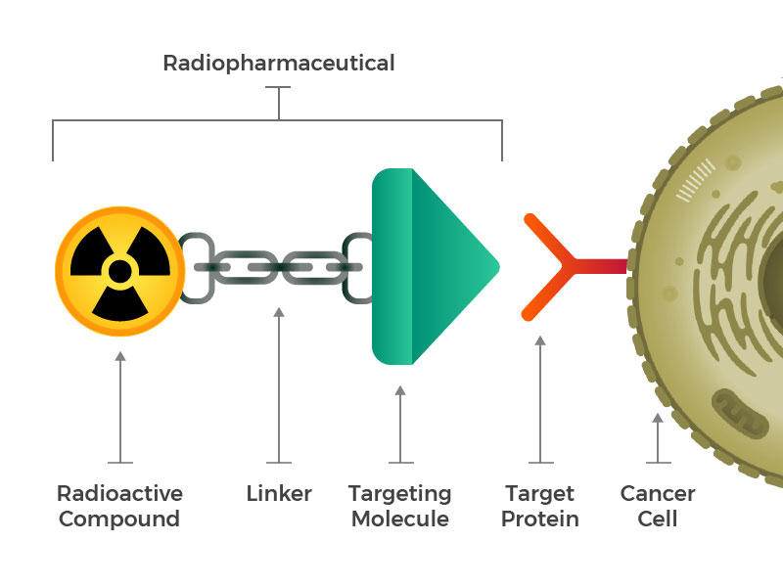
Theragnosis
Imaging-guided targeted radionuclide tumor therapy: From concept to clinical translation
Sung et al. Advanced Drug Delivery Reviews, November 2022
Notes:
A theragnostic radiopharmaceutical consist of a radioactive compound with a linker that conects the radioisotope with a target molecule, directed to a target protein (or a peptide, or a small molecule in the cell surface. Depending on the isotope, it woul be a diagnostic or a therapeutic agent.This scheme can be applied to all the isotopes mentioned above. When the targeting molecule is an organic compound, you can administer the radiopharmaceutical intravenously. When the radiopharmaceutical consist of glass microspheres, such as itrium microspheres, they must be injected directly to the tumour arteries.

Slide 11
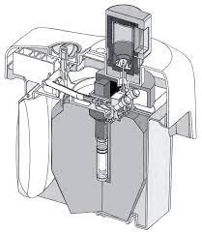
⁹⁹Mo/^{99m}Tc generators
● ^{99m}Tc scintigraphy still accounts for 80% of diagnostics in conventional nuclear medicine
● few reactors to produce ⁹⁹Mo. Manteinance and obsolescence → GLOBAL CRISIS 2010, 2022…
● IAEA encourages research centres to develop alternative production of ⁹⁹Mo
● DONES can produce ⁹⁹Mo for industrial production of generators
● Estimated production of 13 TBq ⁹⁹Mo in 6 days of irradiation
● Pharmaceutical companys are interested in any ⁹⁹Mo source to avoid
future shortages
● Posible source of funding
Subtítulo
Courtesy of Prof. Javier Praena University of Granada
Notes:
One of the proposed challenges is the obtention of Mo. Its daughter, 99mTc still accounts for 80%...
At present time, only a few reactors produce Mo. Manteinance and obsolescence of that reactors led to an important crisis in 2010, that delayed thousands of diagnostics. More recently november of 2022, and may 2023, we had more shortages, not so important, but we had no technetium for a few weeks. So the IAEA encourages research centres to develop alternative production of Mo.

Slide 12
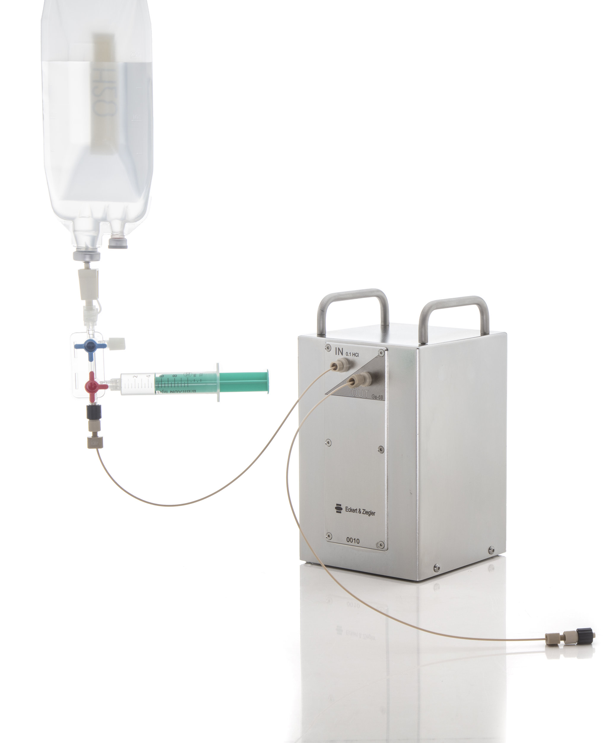
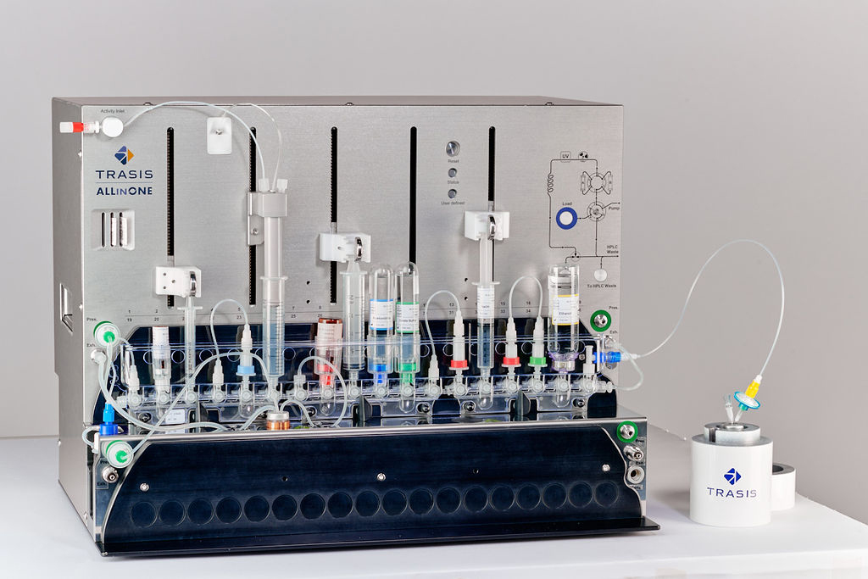
⁶⁸Ge/⁶⁸Ga generators and radiopharmaceuticals
● Increasing interest in PET imaging of cancer, infection, cardiology, neurology.
● Chelating agents such DOTA, NOTA, TATE, NODAGA… lets the labeling of hundreds of molecules
● Cyclotron-independent radiopharmaceuticals “on demand”
● Availables at hospitals far away from cyclotrons or production sites
● Secular equilibrium between ⁶⁸Ge and ⁶⁸Ga
● In three half lives of ⁶⁸Ga (3.4h) nearly 91% of maximum activity generated
● Up to three elutions/day, depending on the initial activity and its age
● Automated synthesis modules improve radiation protection of personnel and
facilitate transfer for routine clinical use
Notes:
The second more used generator is Ge/galium generator. It has gained a formidable interest for PET molecular imaging, from cancer to infection, cardiac pathologies or neuropaties.
Bifunctional chelating agents…
This generator lets the obtention of PET radiopharmaceuticals on demand, being availables at hospitals far away from cyclotrons or production sites.
The secular equilibrium between the father, 68Ge, and the daughter, 68Ga, lets up to 3 elutions a day, because in three halve lives of 68Ga, nearly 91% of máximum radiactivity is regenerated.
Radiolabeling developed in preclinical research often starts with a manual optimization phase of reaction conditions. However in order to improve the radiation protection of personnel and facilitate transfer for routine clinical use, automated modules have been developed. They are piloted by a software that allows remotely control the sequence of operations required for labeling.

Slide 13
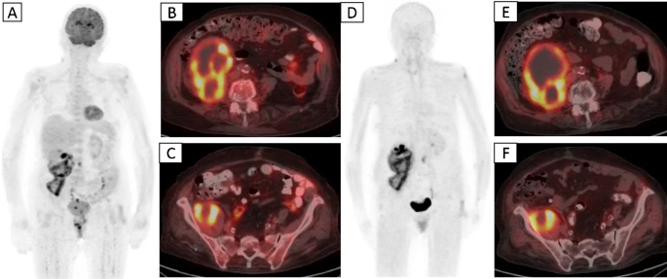
⁶⁸Ga & ¹⁷⁷Lu-radiopharmaceuticals. PET imaging & Therapy
● Major clinical impact for the theragnostic pair 68Ga and 177Lu –labelled counterpart
● Applications are steadily increasing, following clinical demand
● Promising new radiotracers such as CXCR4 and FAPI ligands are eagerly awaited
● [68Ga]Ga-DOTATOC and [177Lu]Lu-DOTATATE
● [68Ga]Ga-PSMA-11 and [177Lu]Lu-PSMA
● [68Ga]Ga-Pentixafor and [177Lu]Lu-CXCR4 antagonist
● [68Ga]Ga-FAPI-4 and [177Lu]Lu-analogue
Civan, C., et al. The role of [68 Ga]Ga-FAPI-04 PET/CT in renal cell carcinoma: a preliminary study. Eur J Nucl Med Mol Imaging (October 2023)
Notes:
It has gained routine use, with succesful radiopharmaceuticals such as somatostatine analogs Ga-DOTATOC and Ga-DOTATATE for neuroendocrine tumours, Psma ligands for prostate cancer. It represents a major clinical impact , particularly in the context of theranogstics, Ga68-radiopharmaceuticals coupled with their 177Lu-labelled counterparts.
The repertoire of applications is steadely increasing, following clinical demand. Promising new radiotracers such as CXCR4 and FAPI ligands are eagerly awaited. Chemokine receptor 4 is over expresed in numerous tumour types and plays a critical role in tumor growth and invasiveness, as well as metastasis.
Fibroblas activation proteins (FAPS) overexpresed in a variety of tumours, are involved in several tumour-promoting activities and represent a prospective theranostic target

Slide 14
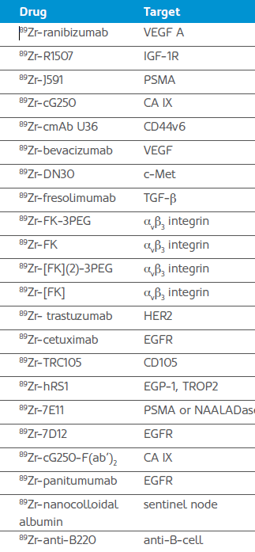
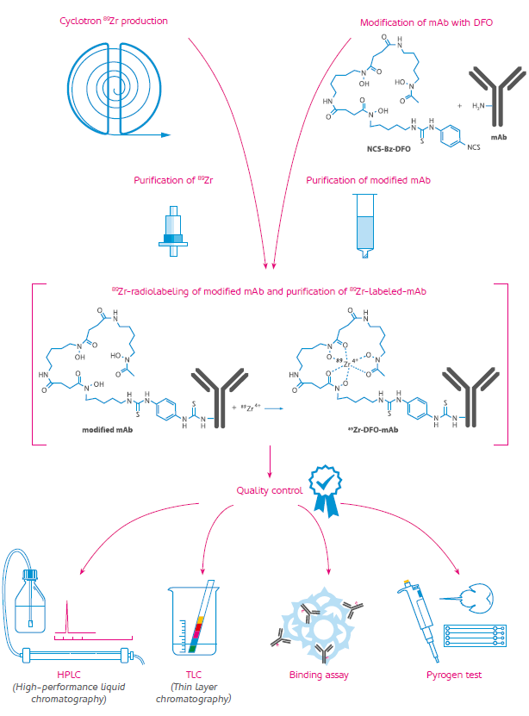
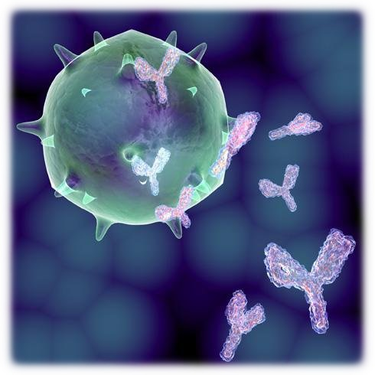
⁸⁹Zr-radiopharmaceuticals
Notes:
IAEA also encourages the production of Zr-89 for immunoPET. Its long half life of 72h lets our radioactive ab bind to its ag at the surface of tumours. So, there is a list of new drugs directed to different target to treat different tumours by radioimmunotherapy or to find out by a molecular imaging study wether it is posible for the patient to benefit from immunotherapy (without radiation)

Slide 15
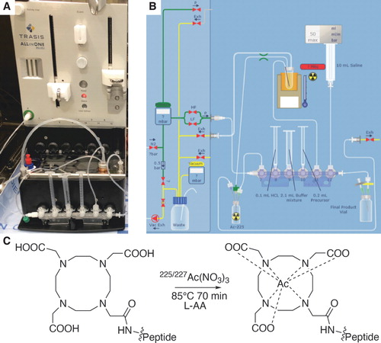
²²⁵Ac-radiopharmaceuticals
Courtesy of Fusion
Very low availability of Ac-225
Notes:
Even better than the pair 68Ga/177Lu, might be the theragnostic pair 68Ga/225Ac, because of its Alpha emision, that deposites radiation at the precise site of the lesion, with higher LET and avoiding damage to the surrounding tissues. Cyclic chelators are being useful in the development of actinium radiopharmaceuticals, via click chemistry. The problem is the very low availability of this very promising radioisotope for targeted Alpha therapy.

Slide 16
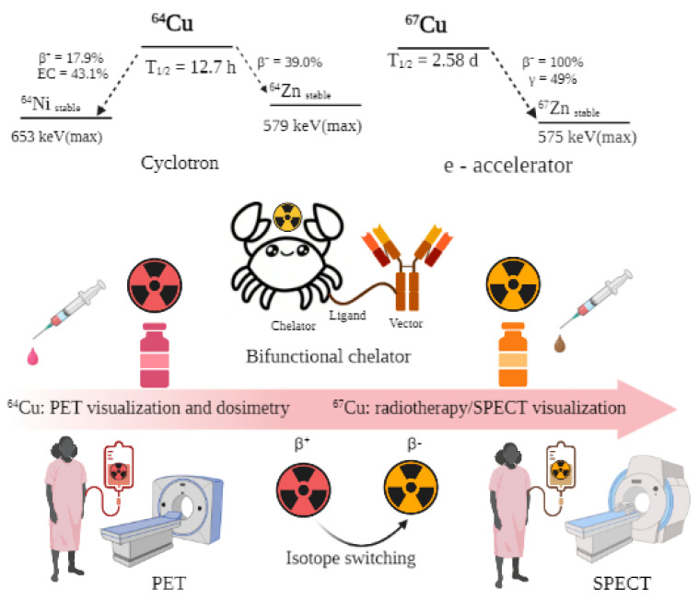
⁶⁴Cu and ⁶⁷Cu radiopharmaceuticals. ImmunoPET imaging and therapy
● ⁶⁴Cu t_{1/2} → 12.7h. PET imaging (β+)
● ⁶⁷Cu t_{1/2} → 61.8h. β- (therapy) and gamma
“ideal but inaccesible isotope”
● The well-established coordination chemistry of copper opens up a wide research line of this theragnostic pair
Krasnovskaya et al. Recent Advances in ⁶⁴Cu/⁶⁷Cu-Based Radiopharmaceuticals. International Journal of Molecular Sciences. 2023
… and so many radiopharmaceuticals…
Notes:
The theragnostic pair copper-64, and copper-67 is also interesting. Copper-64 (T1/2 = 12.7 h) is suitable for positron emission tomography (PET) imaging. Copper-67 (T1/2 = 61.8 h) is a beta and gamma emitter, appropriate for radiotherapy β-energy and gamma suitable for single-photon emission computed tomography (SPECT) imaging. The chemical identities
of 64Cu and 67Cu isotopes allow for convenient use of the same chelating molecules for sequential PET imaging and therapy.
The 67Cu isotope has long been regarded as an “ideal but inaccessible” radionuclide for radiotherapy and radioimmunotherapy, due to its excellent energy characteristics and
long half-life. The well-established coordination chemistry of copper opens up a wide research line of this theragnosctic pair.

Slide 17
Conclusions
● The development of radioisotopes with alpha, beta and gamma emissions is crucial to the advance of
theragnostics
● The installation of non-power research reactors and isotope accelerators is necessary to achive this goal
● New radiopharmaceuticals are needed for the treatment of inoperable cancer, Alzheimer desease…
● Production of medical radioisotopes at DONES boots the likelihood of developing radiopharmaceuticals for
efficient diagnosis and treatment
● ⁹⁹Mo/^{99m}Tc production at DONES may help mitigate global ^{99m}Tc deficit for conventional Nuclear Medicine
● At DONES every step, from radioisotope to patient, is completely new → INNOVATION

Slide 18
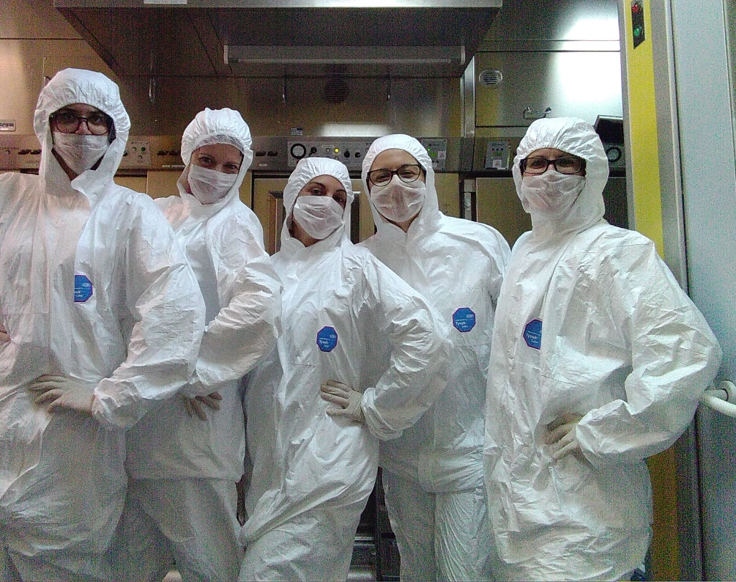
THANKS

