Slide 1
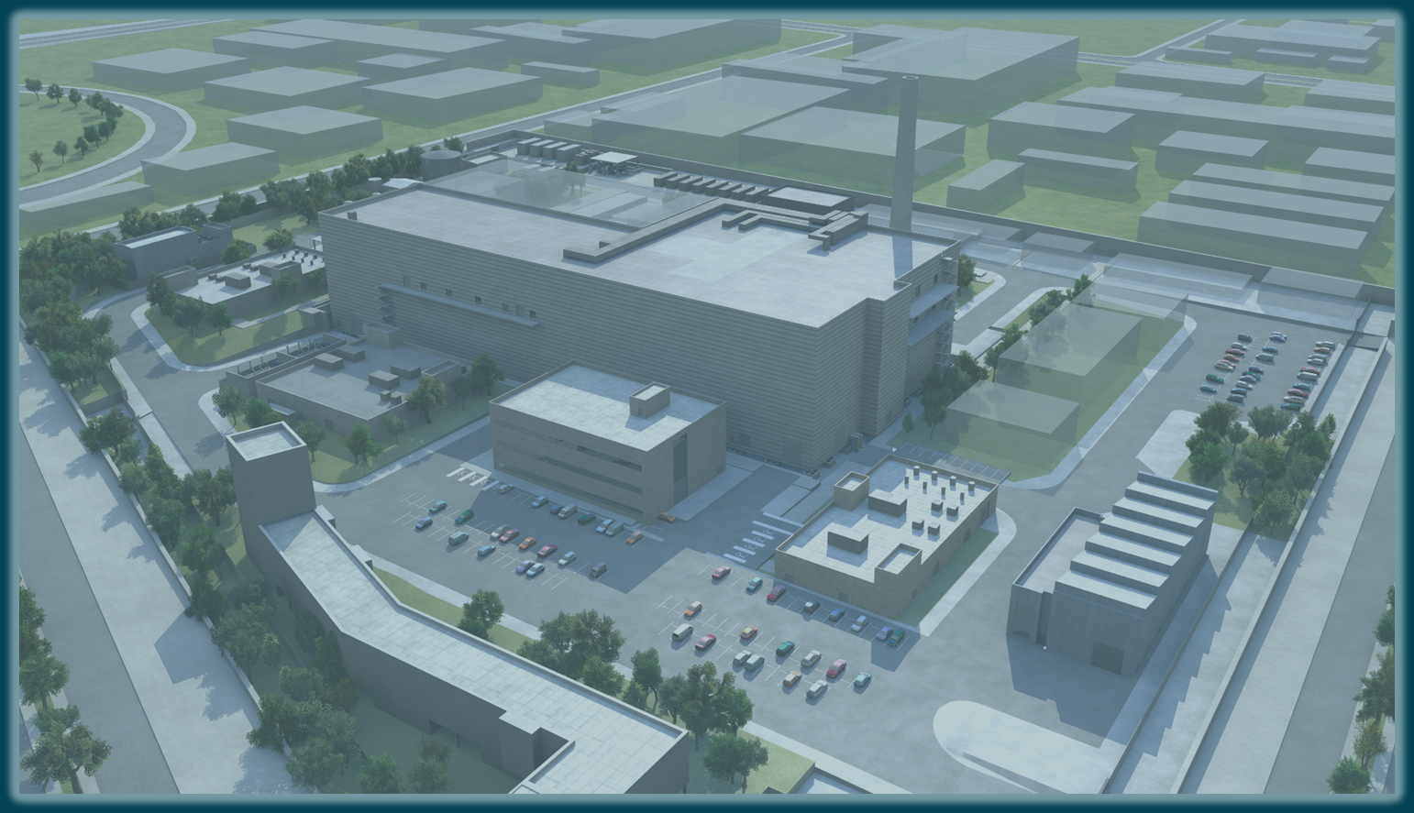
Current status of the IFMIF-DONES users community

Slide 2
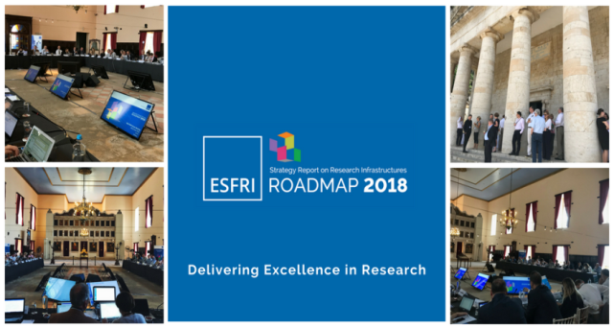
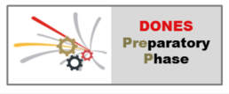
IFMIF-DONES – a multidisciplinary neutron facility
In 2018 DONES recognized by the ESFRI European Strategy Forum on Research Infrastructures, included in the roadmap.
The key mission of the facility is the irradiation and qualification of materials for DEMO and fusion reactors but it has unique characteristics that must be available for other scientific purposes

Slide 3
DONES users community
109 participants, 25 presentations
100 participants (70 in-person)
45 presentations
The key objective of this Second DONES User´s Workshop is to contribute and consolidate the international DONES Users Community representing all the different scientific and technological areas that could be interested in this facility.
Initially, one of the main roles for the DONES Users Community was to establish a stable link of communication between the DONES engineering activities and the future users in such a way, that requirements coming from the potential users can be evaluated in terms of technical feasibility, ease of implementation and available budget and factored in during the construction phase of the facility.
Taking this into account, this workshop will focus on two specific objectives:
To establish a permanent DONES Users Committee that will formally interact with the recently established DONES Programme Team, and
To initiate the process to develop a first preliminary version of a DONES Irradiation Programme based on the review of the needs of the DONES Users Community.

Slide 4
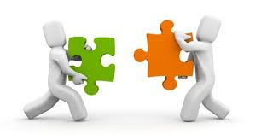
Users community integrating fusion and non-fusion areas
The key objective of this Second DONES User´s Workshop is to contribute and consolidate the international DONES Users Community representing all the different scientific and technological areas that could be interested in this facility.
Proposed areas of scientific interest:
Material qualification for DEMO and the fusion program
Tritium technologies validation at DONES
Irradiation program proposal
Complementary experiments – collimated neutron beam facility
Medical and industrial application of neutrons
Neutron time-of-flight facility at DONES and other experimental ideas
fusion
non-fusion

Slide 5
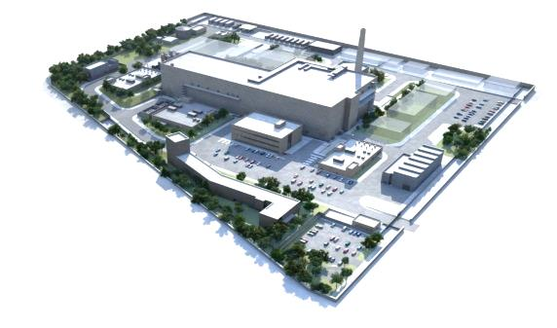
DONES Users Committee proposal
Considering the success of the present workshop (in terms of program and participation) we propose to ask members of the workshops’ Scientific Advisory Panel to serve as the first international DONES Users Committee – for a 2 years term
Frederik Arbeiter (KIT)
Daniel Cano-Ott (CIEMAT)
Antonio Lallena (U. Granada)
Alain Letourneau (CEA Saclay)
Marek Lewitowicz (GANIL)
Adam Maj (IFJ PAN Kraków)
Gerald Pintsuk (FZ Jülich)
Javier Praena (U. Granada) David Rapisarda (CIEMAT)
Michael Rieth (KIT)
Hiroyasu Tanigawa (QST)
….. pending confirmation and/or change!
At the same time a dedicated DONES Users community space will be established at
http://ifmif-dones.es
containing information for users, allowing registrations and, in the future, election of the DUC
We have also established a contact address for all user’s inquiries: users@ifmif-dones.es

Slide 6
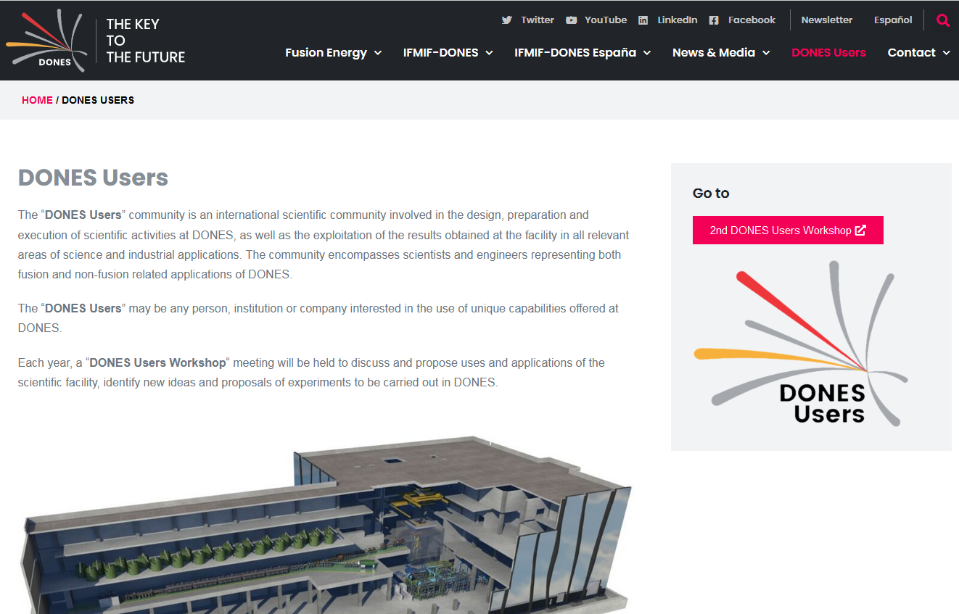
DONES Users web site
mailto:
users@ifmif-dones.es

Slide 7
DONES Users Committee proposal
Proposed first international DONES Users Committee: (for a 2 years term)
Frederik Arbeiter (KIT)
Daniel Cano-Ott (CIEMAT)
Antonio Lallena (U. Granada)
Alain Letourneau (CEA Saclay)
Marek Lewitowicz (GANIL)
Adam Maj (IFJ PAN Kraków)
Gerald Pintsuk (FZ Jülich)
Javier Praena (U. Granada) David Rapisarda (CIEMAT)
Michael Rieth (KIT)
Hiroyasu Tanigawa (QST)
….. pending confirmation and/or change!
… any other nominations?
Charter for the DONES Users Committee:
To provide coordination and leadership in discussions related to DONES experimental programme, for both fusion and non-fusion applications
To participate in the drafting of the first preliminary DONES Irradiation Programme
To participate in the discussion on most relevant and promising ideas for the complementary experimental program and other irradiation modules
To validate the selection of experiments based on scientific merit and attractiveness
To advise the DONES Engineering Design Team in matters of implementation of the irradiation program and the complementary experiments
To promote further development of the DONES users community
… any other proposals, comments?

Slide 8
Non-fusion experiments – decision to include in baseline
Proposed procedure on how to make the decision which non-fusion applications are to be included in the DONES design baseline:
Based on the presentations and discussion at the Users WS2 compile a report on "DONES experimental capabilities ..." (WKS, others)
Submit it to DONES Users Committee for endorsement (members of DUC can also take part in the preparation of the report)
Submit it to the DONES Programme Team, discuss at a dedicated meeting the necessary changes to the baseline, their feasibility and consequences
DONES Programme Team in discussion with the DUC selects a number of non-fusion applications and includes them in the baseline
Define one responsible / liaison for each experiment to work with the DONES Programme Team on the implementation (space reservation, plant systems, interfaces, safety, operation mode, maintenance and logistics, etc.)

Slide 9
