Slide 1
IFMIF DONES (nuclear physics) users support in Spain
D. Cano-Ott
Nuclear Innovation Unit – CIEMAT
daniel.cano@ciemat.es
on behalf of the Spanish Nuclear Physics Network fNUC@DONES study group

Slide 2
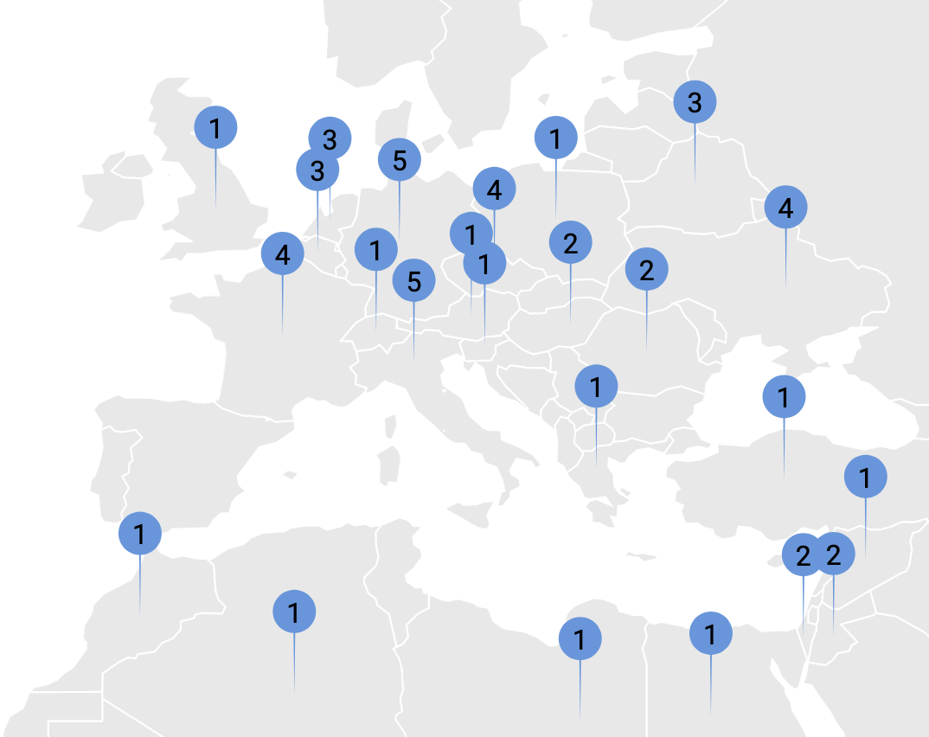
Neutron sources in Europe
33 research reactors in the EU
4 large neutron TOF sources
1+1 spallation neutron sources for material science
Tenths of compact accelerator sources
ESS
ISIS
JRC GELINA
HZDR nELBE
SPIRAL2 NFS
Spain
Strong ²⁵²Cf + AmBe sources (CIEMAT, universities)
CERN n_TOF
5 MV tandem at CMAM
HISPANoS TOF neutron source: p-Be, d-Be, p-⁷Li, d-d reactions with the 3 MV tandem at CAN (Seville)

Slide 3
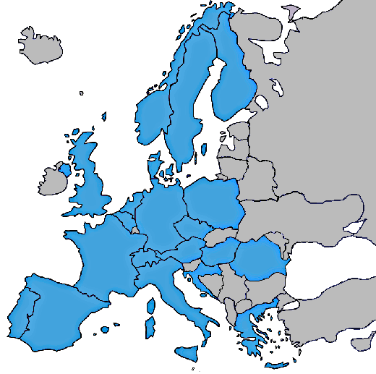
We are used to “traveling science”
Cyclotron Laboratory
at the University of Jyvaskyla
RIKEN
YALINA research reactor
NPL
JRC – Geel
PTB Braunschweig – Reference neutron beams
GANIL/SPIRAL2
GSI / FAIR
Orsay
Budapest Research Reactor
CERN: n_TOF
ISOLDE
LNL
CMAM
CNA
Centro Nacional de Aceleradores

Slide 4
Demo Oriented NEutron Source - DONES
40 MeV deuterons.
Broad beam profile: 20 cm x 5 cm.
125 mA
~90 m
Liquid lithium neutron production target
Medium Energy Beam Transport
5 MeV
Injector + ECR
100 keV
HE beam transport
40 MeV
SC Linac
40 MeV
RFQ
5 MeV
ESFRI facility proposed in Granada.

Slide 5
The Spanish nuclear physics community considered immediately that DONES is a
Decisive Opportunity for NEutron Science in Spain

Slide 6
Decisive Opportunity for NEutron Science in Spain - DONES
We decided to look for exciting fundamental science programmes, experiments and applications with this superb accelerator under the following premises:
To be internationally competitive.
To minimise interference with the normal operation of the facility for the irradiation of materials.
To satisfy the scientific demands of the fusion and non-fusion communities: nuclear data, development of monitors, development of diagnostics…
To cover some relevant (industrial) applications and nuclear technologies.
Minimising the costs. We are talking about infrastructures probably below the uncertainty of the construction budget of DONES.

Slide 7
What could we do at DONES?
fNUC@DONES study group collected 30 Expressions Of Interest received from the different groups for experiments with continuous and pulsed neutron beams.
Many of these ideas are not original:
- GANIL/SPIRAL2 Neutrons For Science.
- White Book for DONES in Poland (Polish nuclear physics community).
- ISOLDE community.
- Other international facilities.
We benefit also from the excellent work of our international colleagues. Thank you!!!
I. Fundamental nuclear science
Nuclear reaction studies (I. Podadera’s talk on a kicker+buncher, E. Mendoza’s talk on TOF facility, C. Domingo’s talk on nuclear astrophysics…)
Nuclear structure studies (A. Maj’s talk on experiments)
Calibration and development of instrumentation.
II. Nuclear physics & industrial applications
Radiobiology (A. Lallena’s & M.Carmen Ruiz’s talk)
Neutron imaging (C. Guerrero’s talk)
Isotope production for various purposes (medical, radiotracers, industry…) (F. Mota’s talk)
Irradiation of electronics (M. Dentan and M. Cecchetto…)
Irradiation of plant seeds.
R&D on cargo inspection and homeland security.

Slide 8
Spanish experience with neutron beams
Spanish institutions form 20% of the collaboration and are leading 20% of the experiments. Large experience in neutron physics and nuclear instrumentation (FAIR, n_TOF and ISOLDE @ CERN…)
Beam from the CERN Proton Synchrotron
EAR-2
20 m vertical flight path
High intensity (300 x EAR-1)
EAR-1
185 m flight path
High resolution
Lead spallation target
NEAR station 6 m flight path
Experiments at ILL-Grenoble and other experimental reactors.
First Spanish proposals at the new Neutrons For Science (NFS) facility at SPIRAL-2 (France).

Slide 9
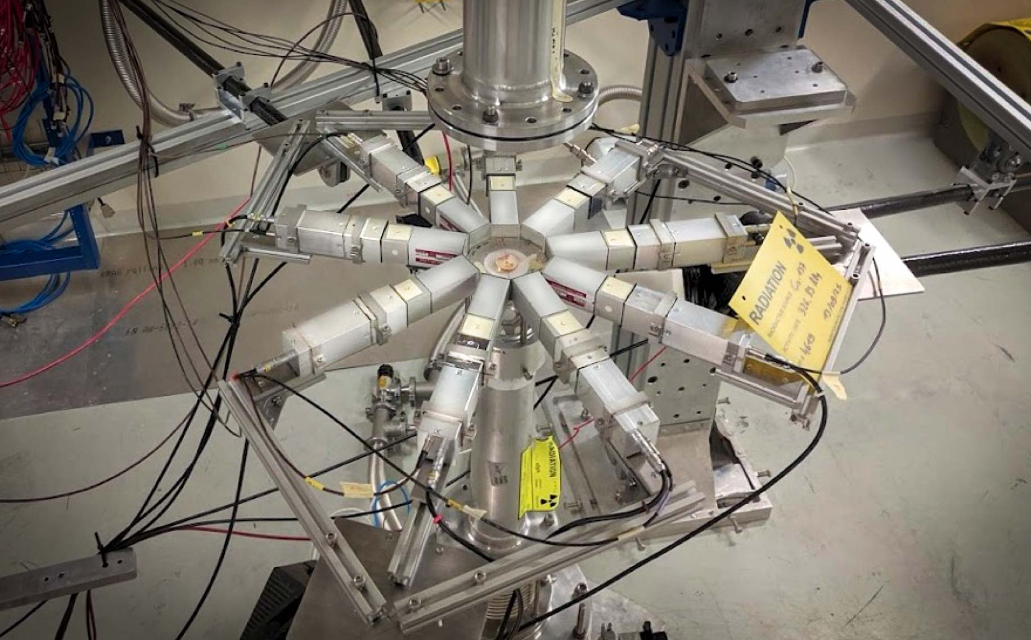
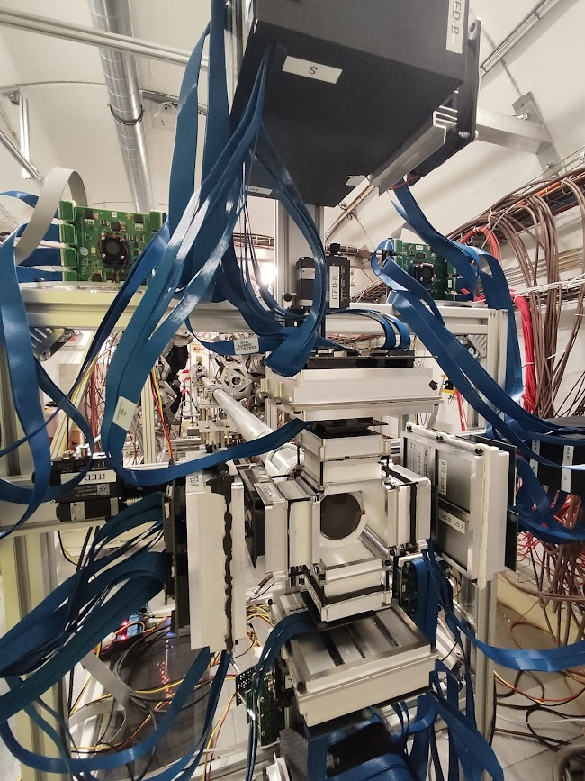
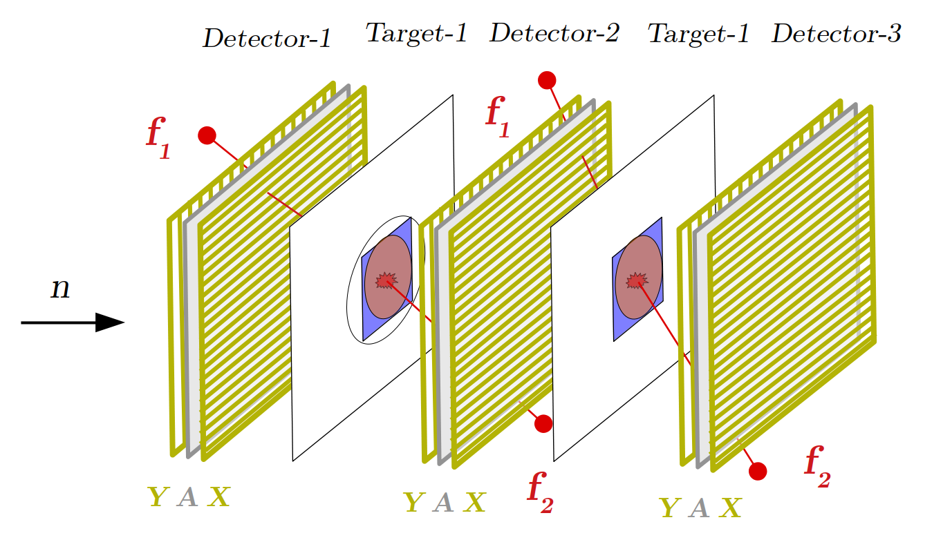
“Spanish” detectors at n_TOF
iTED γ-ray Compton imager
IFIC - Valencia
sTED segmented total energy detector
CIEMAT
(n,γ) - capture
Developed by IPN – Orsay and the Universidad de Santiago de Compostela
(n,f) - fission
γ
neutron-beam
(n,γ) - capture
₁ ₁ ₁
₂ ₂ ₂
₃ ₃ ₃

Slide 10
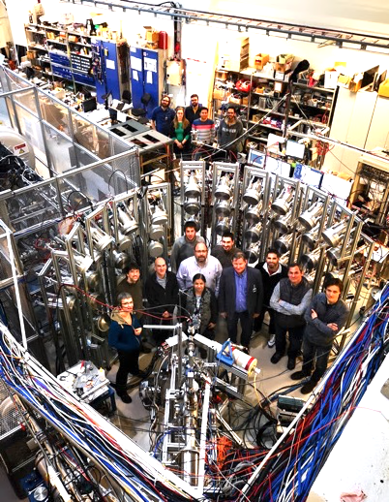
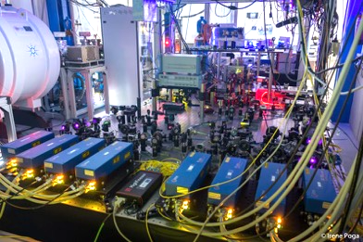
Construction of nuclear instrumentation (FAIR)
MATS Preparation trap
Coordinator U. Granada deputy spokesperson
MONSTER neutron detector
Coordinator CIEMAT
Used already at NFS@SPIRAL2

Slide 11
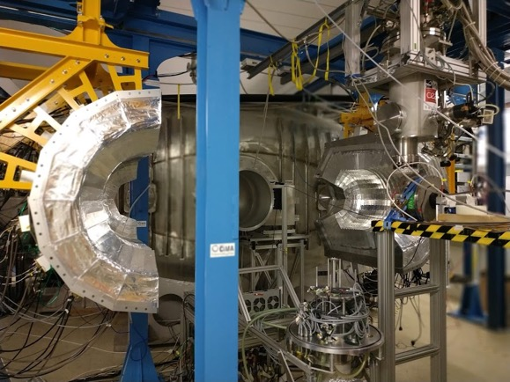
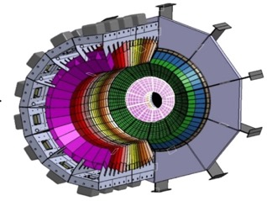
CALIFA Detectors (USC; Uvi, IEM)
Coordinator USC
R³B spokesperson

Slide 12
Large ³He array
BELEN -48 detector
Coordinator UPC (in operation)
Large NaI calorimeter
DTAS, Coordinator IFIC Valencia proposed for FAIR-0

Slide 13
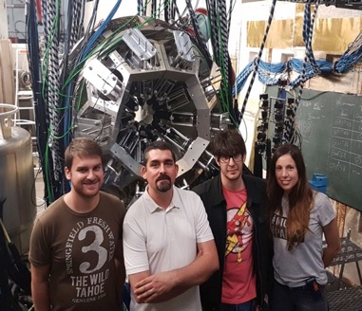
AGATA, demonstrator in operation Coordinator IFIC Valencia
Beam tracking detectors
Univ. Sevilla
FATIMA array, in operation
Coordinator U Complutense
proposed for FAIR-0

Slide 14
The role of Spain in the international nuclear data community
Coordination of the last 4 nuclear data European Projects (> 30 institutions): NUDATRA (FP-6), ANDES (FP-7), CHANDA (H2020), SANDA (2020) and the new APRENDE proposal for Horizon Europe.
Participation in a large number of European nuclear physics projects (ENSAR, ENSAR2…)
Participation in the different transnational access programs: previous projects + EUROLABS + OFFER + ARIEL.
Spain will host the next largest nuclear data conference in the world: Nuclear data for science and technology 2025 (Madrid).

Slide 15
Summary and conclusions
We have a mature nuclear physics community (21 groups/~100 scientists) who could exploit the non-fusion experiments and infrastructures at IFMIF-DONES:
International leadership and visibility.
Technical capabilities for designing and building infrastructures & detectors in collaboration with industry & international partners.
Strong participation in the European scenario via projects, participation in infrastructures and collaborations.
We could:
contribute to increase the scientific production of IFMIF-DONES (papers, theses, masters’ theses).
Attract to Granada an additional scientific community.
Do science necessary for fusion. DONES has the right neutron spectrum for producing large amounts of nuclear data for the neutronics of fusion reactors. There are strong analogies with the development of nuclear fission.

Slide 16
Instead of considering nuclear physics applications as parasitic,
we propose to consider them as symbiotic!

Slide 17
Towards a successful users’ group
Improve the integration of our ideas & proposals in the DONES project.
- Meet the other groups working at DONES (fusion and non-fusion) and look collaborations for the design of experiments and infrastructures. –> List of topics/experiments prepared by the users group.
- Identify the points of common interest and needs of the different users.
Continuous beams: collimators, shielding, beam dump, design of experimental setups and instrumentation, design team, radioprotection.
Neutron TOF-DONES: accelerator team (kicker), engineering team, design of beam optics and shielding, production target.
Production of isotopes: test cell, elsewhere?.
Prepare a list of needs and pending activities. What needs to be done and who could do it.

Slide 18
Towards a successful users’ group
- Strengthen the interaction with the design & engineering teams. –> List of who is who in the project.
- Identify what is easy to do, possible, difficult, very difficult , science fiction and impossible.
- Understand the conditions of the irradiations in the test cell (i.e. materials in the neutron beam, time) -> impact on the beam in room 160.
- Use synergies between our ongoing projects and DONES’ related activities.
- Explore additional funding sources (national and European).

