Slide 1
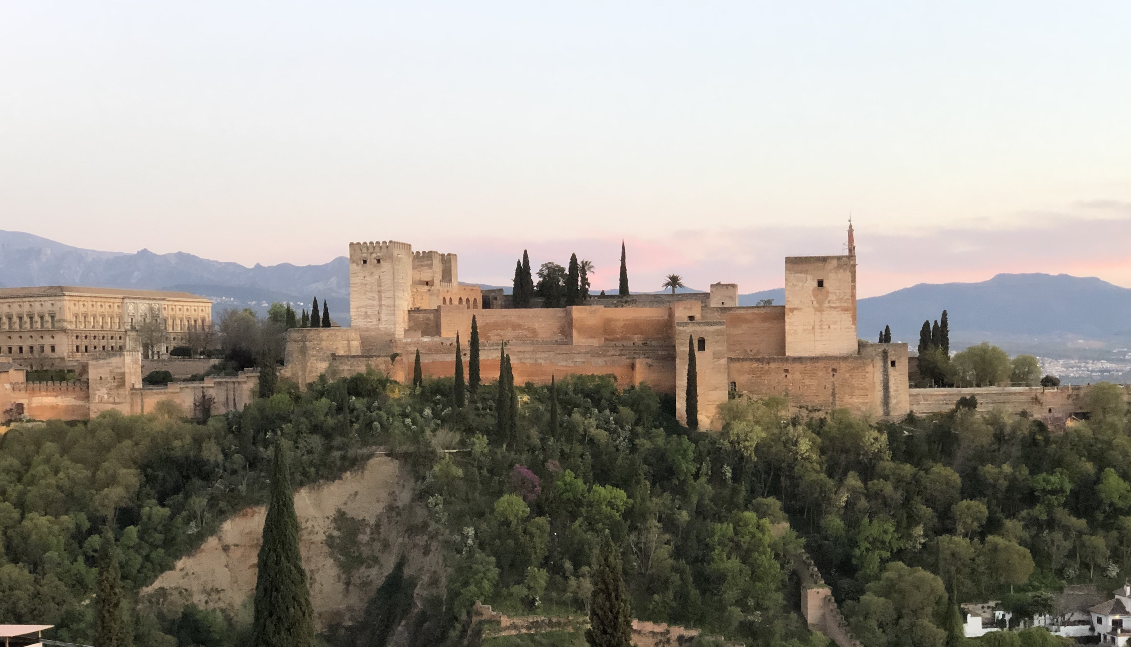
Users community and access
to research infrastructures –
the example of EURO-LABS
Second DONES Users Workshop
October 19-20, 2023, Granada
Adam Maj
IFJ PAN Kraków

Slide 2
History of Nuclear Physics in EU projects
FINUPHY (2000-2005)
coord. Jean Vervier, coord. inst. GSI
EURONS (2005-2008)
coord. Alex Mueller, coord. inst. GSI
ENSAR (2010-2014)
coord. Muhsin Harakeh, deputy Marek Lewitowicz, coord. inst. GANIL
ENSAR2 (2016-2021)
coord. Muhsin Harakeh, deputy Marek Lewitowicz, coord. inst. GANIL
ERINS –
coord. Angela Bracco, coord. inst. INFN
EURO-LABS (2022-2026)
coord. Navin Alahari, deputy Maria Colonna, coord. inst. INFN
ERINS: European Research Infrastructures for Nuclear Science
3 communities grouped together:
Nuclear Physics
HE Accelerators
HE Detectors

Slide 3
What is EURO-LABS?

Slide 5
Governing Board
Project Coordinator (GANIL) + 3 Deputies
Project Office INFN
WP1
Management
WP2
Access to RI for Physics
WP3
Access to RI for Accelerators
WP4
Access to RI for Detectors
WP5
Open Diverse and Inclusive Science
Task 1 | Project Management
Task 1 | Stable Beam Facilities
Task 1 | Material Testing Facilities
Task 1 | Test Beams
Task 1 | Diversity Dissemination
Task 2 | Information Flow
Task 2 | Radioactive Ion Beams
Task 2 | Technology Infrastructures
Task 2 | Detector Characterization
Task 2 | Open Data
Task 3 | Neutron Beam Facilities
Task 3 | Electron and Plasma Beam Facilities
Task 3 | Irradiation Facilities
Task 3 | Machine Learning
Task 3 | Contacts
Task 4 | Theoretical support for Experiments
Task 4 | Applications
Task 4 | Service Improvements
Task 4 | Training
Management Team
Task 5 | Service Improvements
Project Office
Governing Board

Slide 6
Goals of WP2
The scientific goal of the WP2 is to provide enhanced opportunities for exploring nuclei under extreme conditions:
at high temperatures (T)
at high angular moment (L)
at large isospin (N/Z), i.e. nuclei close to the proton or neutron dripline
with extreme masses (A)
This will be achieved by providing potential users a Transnational Access to various RIs providing
a wide portofolio of beams of
stable ions: ranging from protons to uranium ions;
radioactive ions: unstable nuclei far from the stability valley, developed either by Isotopic Separation On-Line, or by fragmentation induced by fast projectile and then by In-flight separation;
neutrons
at various energies: ranging from few MeV up to 2 GeV.
This will be achieved also by providing potential users a Virtual Access to Theory4Exp facility, with user friendly codes for theoretical preparation and discussion of experimental project.
Moreover, the project will provide service improvements to all the facilities:
streamlining the access to RIs, development of the biomedical applications, improving the ion source and target developments and helping in installations and running traveling detectors.

Slide 7
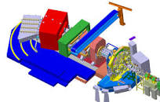
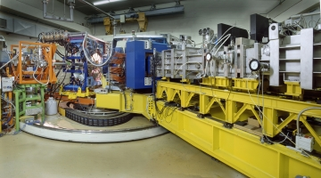
WP2: access to RI and instrumentation
Having TA to Research Infrastructures with a large portofolio of different types of beams is necessary for production of nuclei at extreme conditions, but not sufficient for their studies.
These facilities must also offer the state-of-the-art equipment:
Spectrometers and separators: (Super)-FRS, VAMOS, LISE, PRISMA, RITU, MARA, …
Examples of large acceptance spectrometers and separators
VAMOS@GANIL
MARA@Jyvaskyla
PRISMA@LNL
@GSI/FAIR

Slide 8
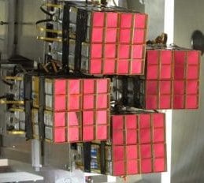
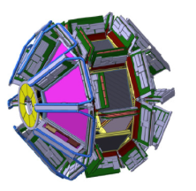
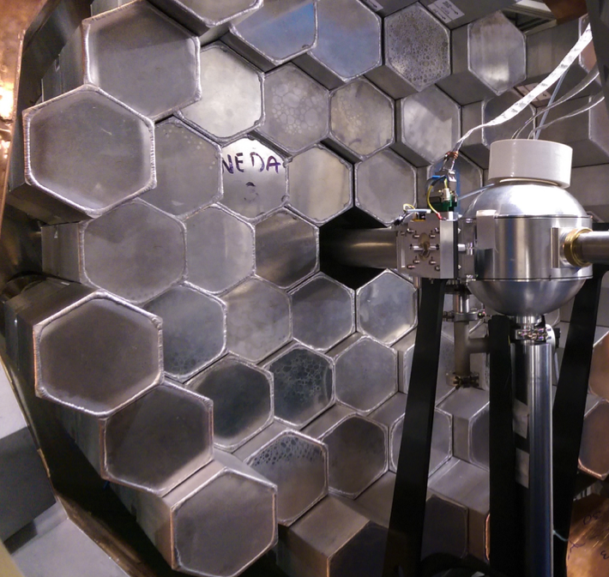
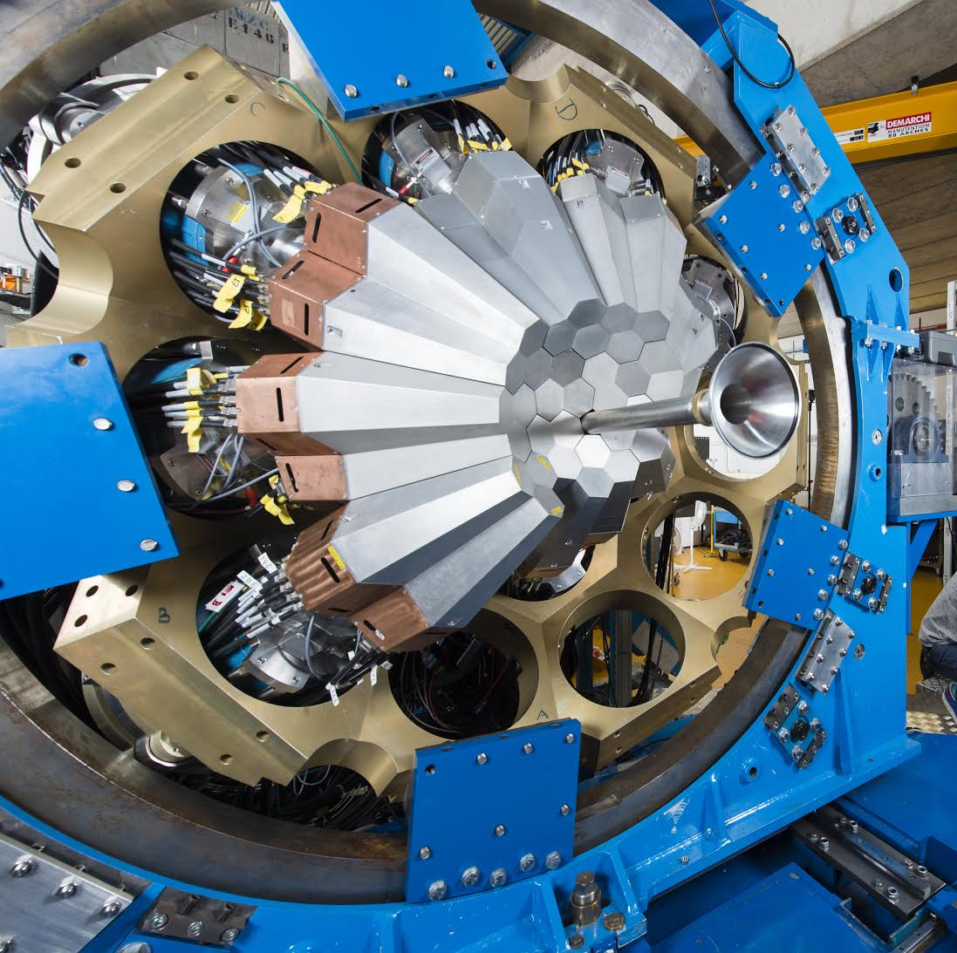
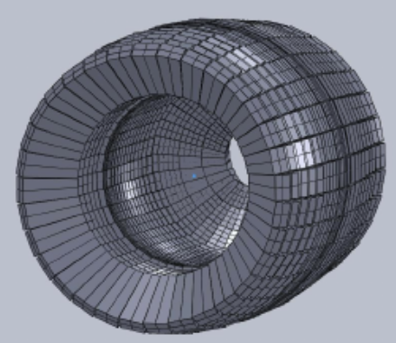
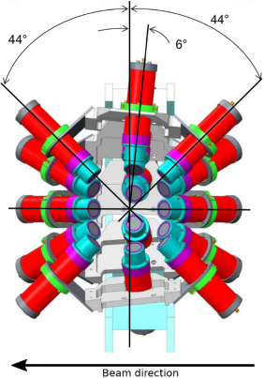
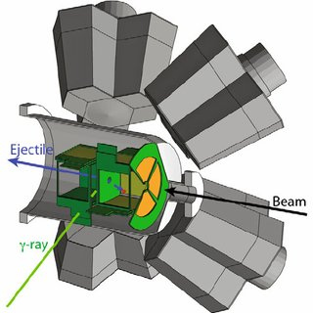
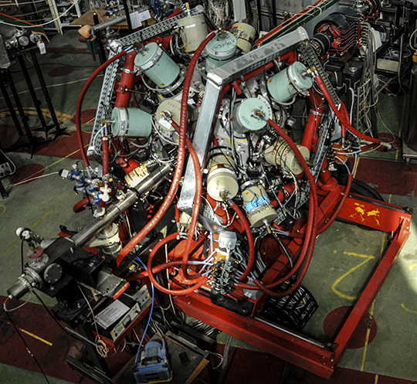
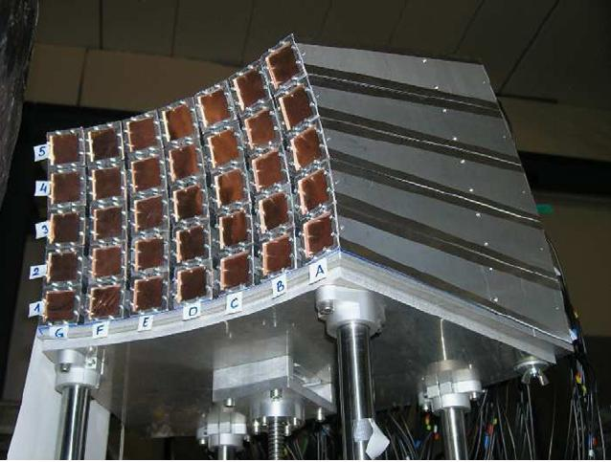
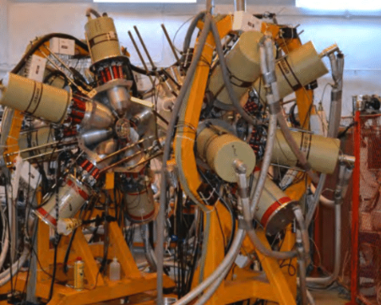
WP2: access to RI and instrumentation
In addition these facilities must offer :
Novel detector setups: AGATA, PARIS, NEDA, FAZIA, MUGAST-GRIT, nu-Ball, R3B, CALIFA, FATIMA, ACTAR TPC, COLLAPSE, T-REX, ROSPHERE, GALILEO, EAGLE, KRATTA, BINA,…
Examples of novel detector setups - some of them *) are travelling detectors
AGATA*
PARIS *
FAZIA *
MUGAST-GRIT *
NEDA *
CALIFA@R3B
FATIMA *
T-REX
EAGLE
KRATTA *
ROSPHERE

Slide 9
Goals of WP2
The general approach of WP2 is to offer potential users the transnational and virtual access to those RIs,
which in a complementary way span opportunity for investigation of important nuclear physics phenomena that are pertinent to answer Big Questions like:
How does the complexity of nuclear structure arise from the interaction between nucleons?
What are the limits of nuclear stability?
What governs the dynamics of nuclear collisions
The RIs included in WP2 provide access to an extremely broad range of installations and services, focused on delivering excellence in fields including, but not limited to:
Fundamental Nuclear Science,
Nuclear Astrophysics,
Neutron Physics,
Physics beyond the Standard Model,
Interdisciplinary Research,
Applications of Nuclear Science,
Atomic Physics,
Biophysics,
Medical Physics
Materials Science

Slide 10
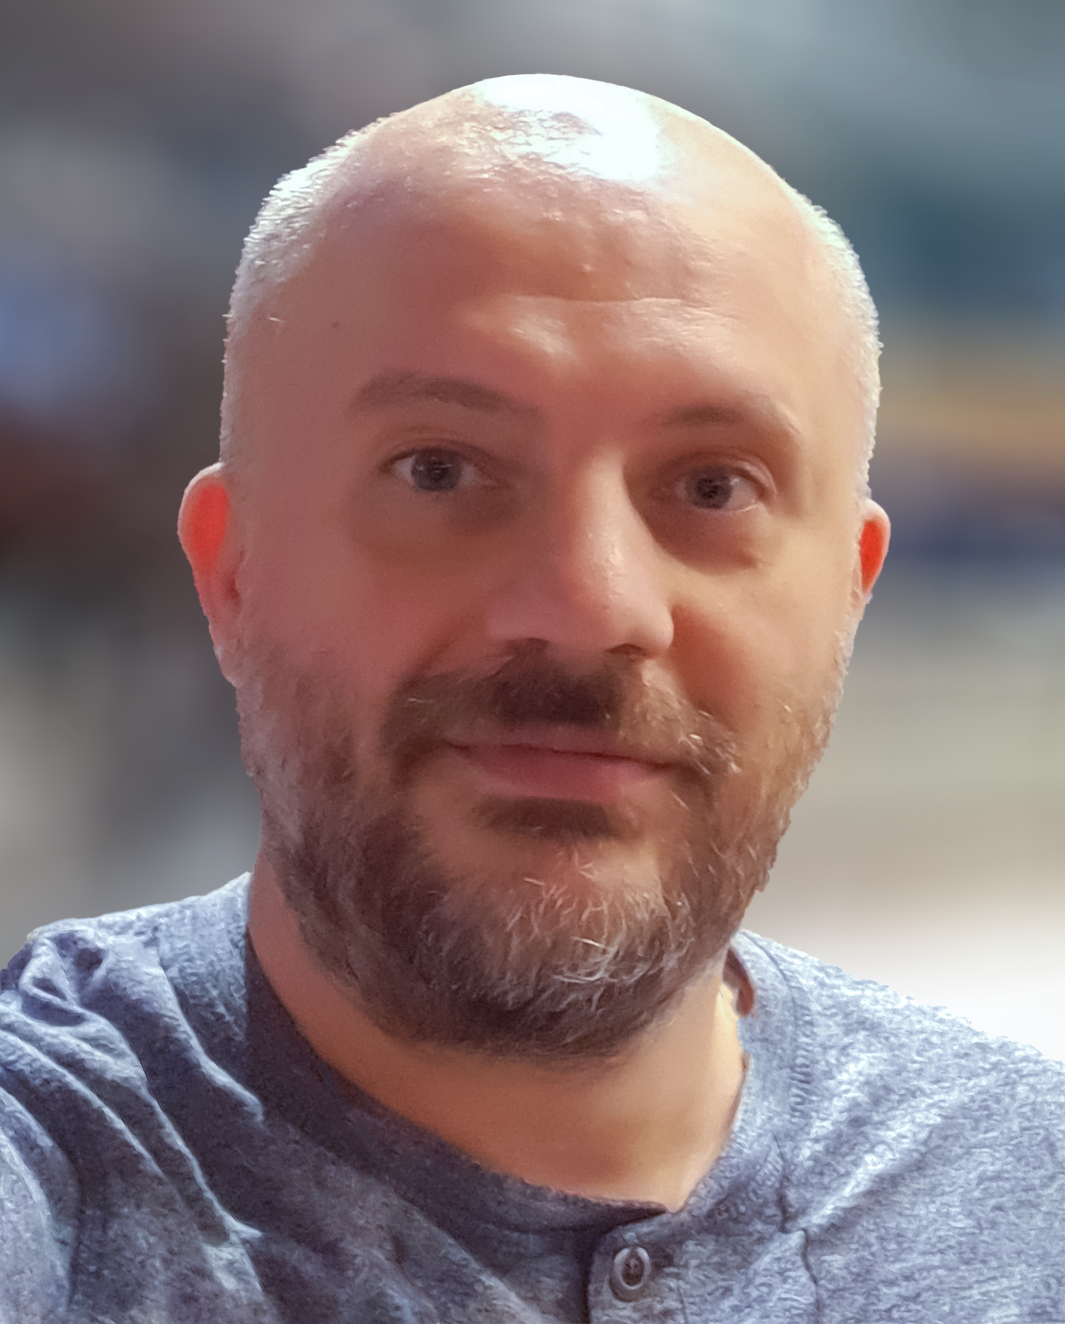
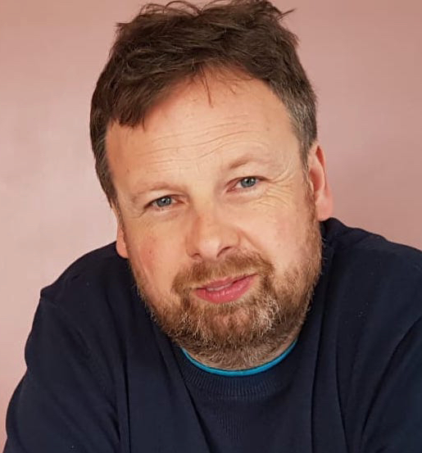
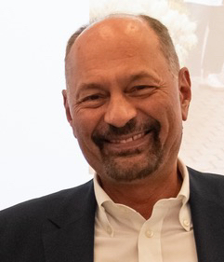
Organization of WP2
WP2 coordination: Adam Maj (IFJ PAN Krakow)
Task | WP2.1 Stable Ion Beam Facilities | WP2.2 Radioactive Ion Beams Facilities | WP2.3 Neutron Beam Facilities | WP2.4 Theoretical Support for Experiments | WP2.5 Service Improvements
Coordinator | Paul Greenlees JYFL Jyvaskyla | Iulian Stefan IJCLab Orsay | Alberto Mengoni CERN | Gert Aarts Swansea Uni & ECT* | Marco Durante GSI
RI | JYFL (Finland) LNL-LNS (Italy) GANIL-SPIRAL2 (France) ALTO (France) GSI/FAIR (Germany) NCL-SLCJ (Poland) NLC-CCB (Poland) IFIN Tandem (Romania) USE-CLEAR (Spain) ATOMKI-CLEAR (Hungary) IST-CLEAR (Portugal) | ALTO (France) ISOLDE (CERN) GSI/FAIR (Germany) GANIL-SPIRAL2 (France) LNL-LNS (Italy) JYFL (Finland) | n-TOF (CERN) GANIL-SPIRAL2 (France) ALTO (France) LNL-LNS (Italy) USE-CLEAR (Spain) ATOMKI-CLEAR (Hungary) | ECT* (Italy) VA Theo4Exp: MeanField4Exp (Poland) Reaction4Exp (Spain) Structure4Exp (Italy) Manuela Rodriguez-Gallardo (U. Sevilla, Spain) | Streamlined procedures + Remote access Bio medical lon source improvements Target developments Traveling detectors
 | TA | TA | TA | TA/VA
10

Slide 11
Offer for te international users community
Each facility promised certain amount of beam time for the Project.
The costs of this amount of beam time is partially reimbursed (ca.20%) by the project.
In addition, the facility receives certain amount of money to cover the costs of travel and staying expences for the eligible groups.
Which user group is eligible?
The majority of the users must work in a country other than the country(ies) where the installation is located.
So if experimental group applied for a beam time for given facility, and if the local PAC approved the beamtime, the user group may apply for the TA suppport.
The suport is evaluated by the appropriate User Selection Panels

Slide 12
WP2 User Selection Panels (USPs)
LNL/LNS:
Alessia Di Pietro
Tommaso Marchii
Marialuisa Aliotta)
Kouichi HAGINO (PAC member)
GANIL:
Patricia Rousell-Chomaz
Emmanuel Clement
Stephan Oberstedt (SPIRAL2 - PAC Chair)
Silvia Leoni (SPIRAL2 - GUEC Chair)
IFIN-HH:
Constantin Mihai
Philippe Dessagne
Peter Thirolf
ISOLDE/CERN:
Sean Freeman
Gerda Neyens
Karsten Riisager
David Sharp
n-TOF/CERN:
Alberto Mengoni
Rosa Vlastou
Rene Reifarth
Nicola Colonna
Enrique Gonzales
Frank Gunsing
Enrico Chiaveri
NLC-SLCJ:
Władysław Trzaska (PAC Chair)
Katarzyna Wrzosek-Lipska
NLC-CCB:
Mushin Harakeh (IAC Chair)
Adam Maj
ECT*:
Gert Aarts
Almudena Arcones
Constantia Alexandrou
David Kaplan
Marek Lewitowicz
Alessandre Obertelli
Barbara Pasquini
Vittorio Somà
Urs Wiedemann
IJCLab/ALTO:
Jonathan Wilson
Augusto Machiavelli (PAC Chair)
JYI/JYFL
Hans Otto Fynbo (PAC Chair)
Thomas Elias Cocolios
Dolores Cortina Gil
Kathrin Wimmer
Dirk Rudolph (JYU/JYFL)
Tomas Raúl Rodríguez Frutos
GSI-FAIR:
Christoph Scheidenberger
Christine Hornung
Marina Petri
Paul Greenlees
CLEAR (USE-IST-ATOMKI:
Adam Maj (CLEAR PAC Chair)
Javier García
Teresa Pinheiro
Ferenc Ditroi
The User Selection Panels meet (in-person or online) after submission of TA requests, evaluates them and makes decisions for the support.
As a rule all approved experiments that fulfil the TNA eligibility criteria are supported.
The level of funding is in general in proportion to the number of beam hours and preparation time recommended by the corresponding PAC, with a priority to new users and young researchers.

Slide 13
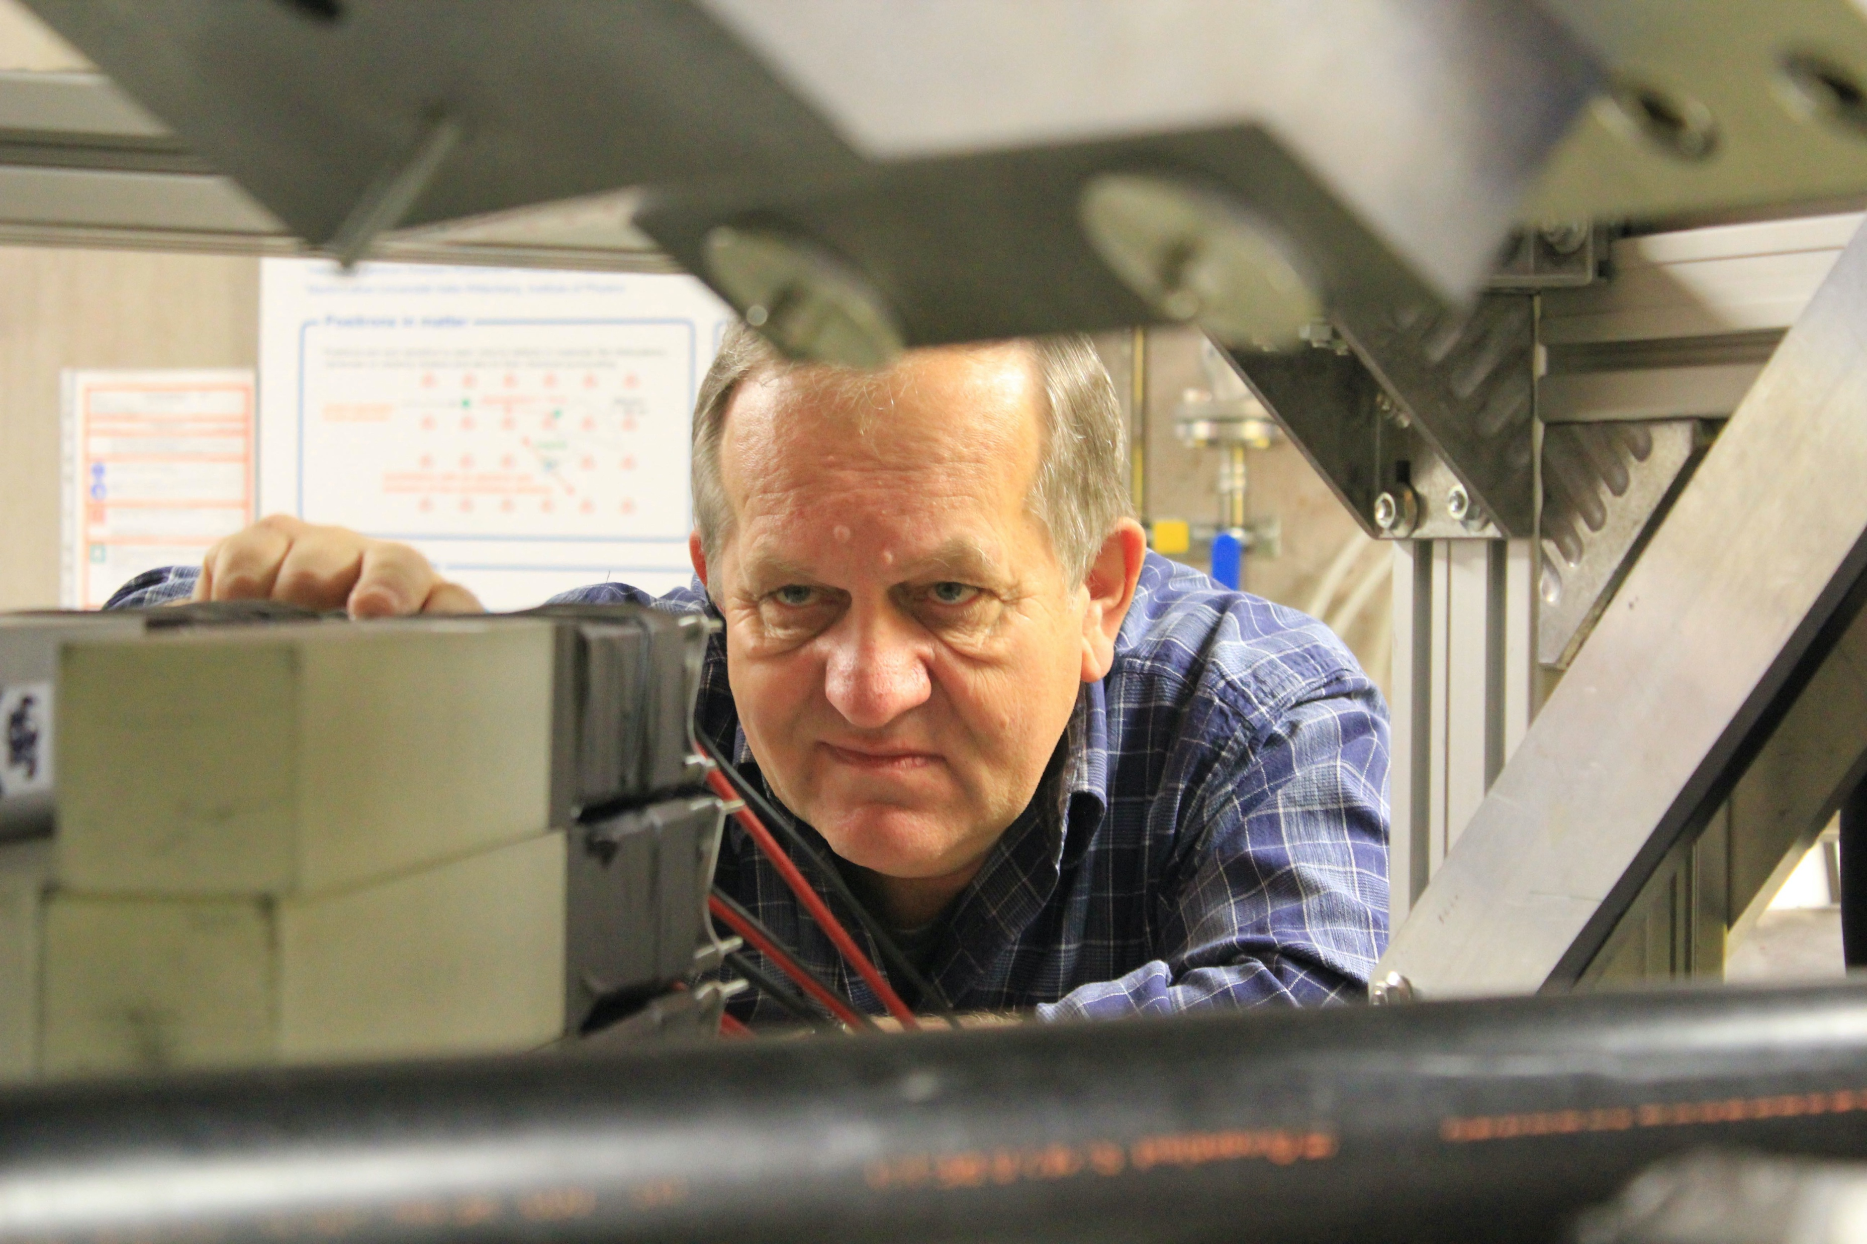
WP2: Summary
The RIs contributing to Tasks 1-3 of WP2 are complementary, for the beam offer and the associated instrumentation.
They all offer trans-national access for the international users comunity.
Access has to be asked by submitting a written proposal. An additional application form has to be submitted by the users interested in the TA EURO-LABS support.
Theoretical support in the Task 4 of WP2, offers Transnational Access to ECT* theoretical facility in Trento, and also Virtual Access to Theo4Exp infrastructure, localized in 3 installations: MeanField4Exp in Krakow, Reaction4Exp in Seville, and Structure4Exp in Milano.
Task 5 of WP2 provide improvements of the services offered by the RIs from the Tasks 1-3. Service improvement is a foremost perk of EURO-LABS, whose goal is indeed to provide advanced, state-of-the-art services to users of the RIs, to make them more attractive and competitive.
The work of the WP2 is performed in a synergy with the 2 other TA work packages: WP3 and WP4, and also profit from the transversal work packages: WP1 (general coordination, web page) and WP5 (Dissemination, Open Data, Machine Learning).
Adam.Maj@ifj.edu.pl

Slide 14
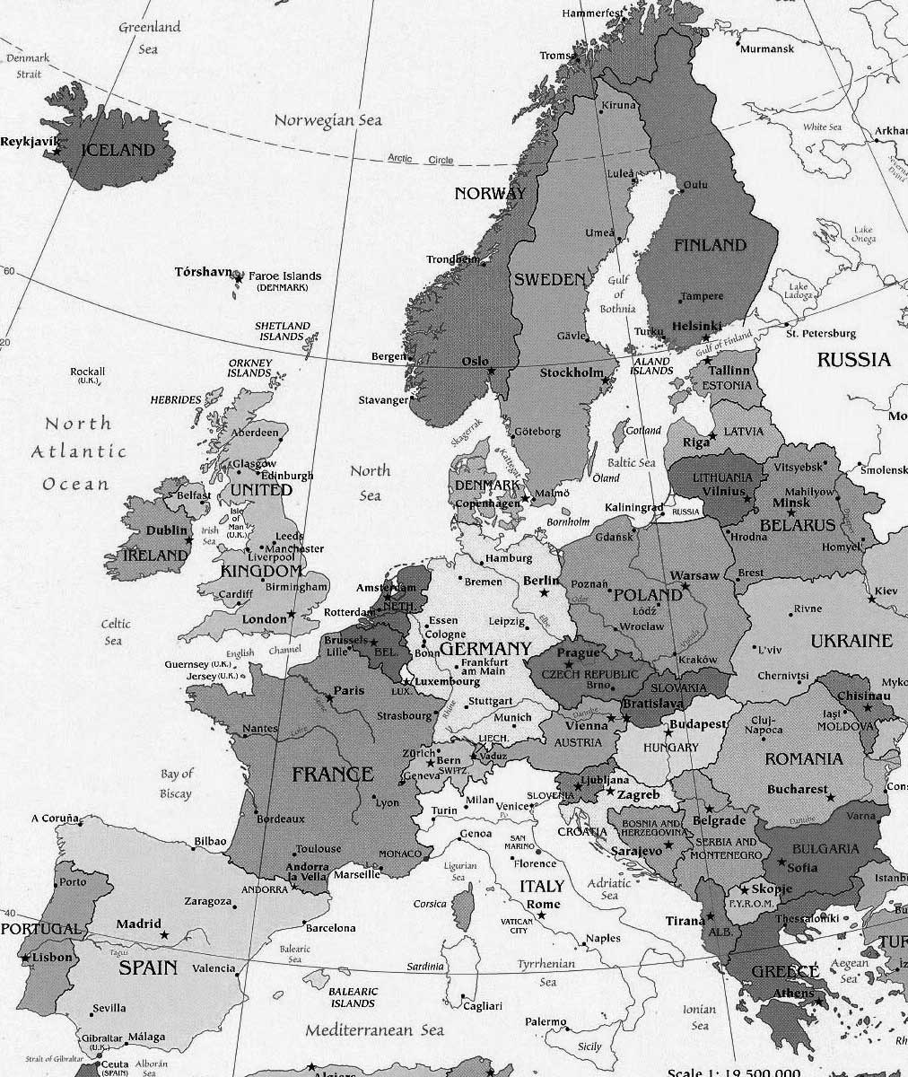
Map of Nuclear Physics facilities in WP2
17 TA/VA facilities
in 9 countries
JYFL
16 beneficiaries
in 11 countries
Community: 2500-3000 scientists and highly qualified engineers
NLC (Warsaw & Krakow)
I
GANIL-SPIRAL2
GSI/FAIR
ATOMKI-HAS
ECT*
ELI-NP / IFIN-HH
ALTO-CNRS
ISOLDE & nTOF-CERN
LNL-INFN
IST
UMIL
USE
LNS-INFN
14

Slide 15
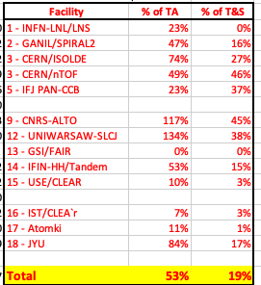
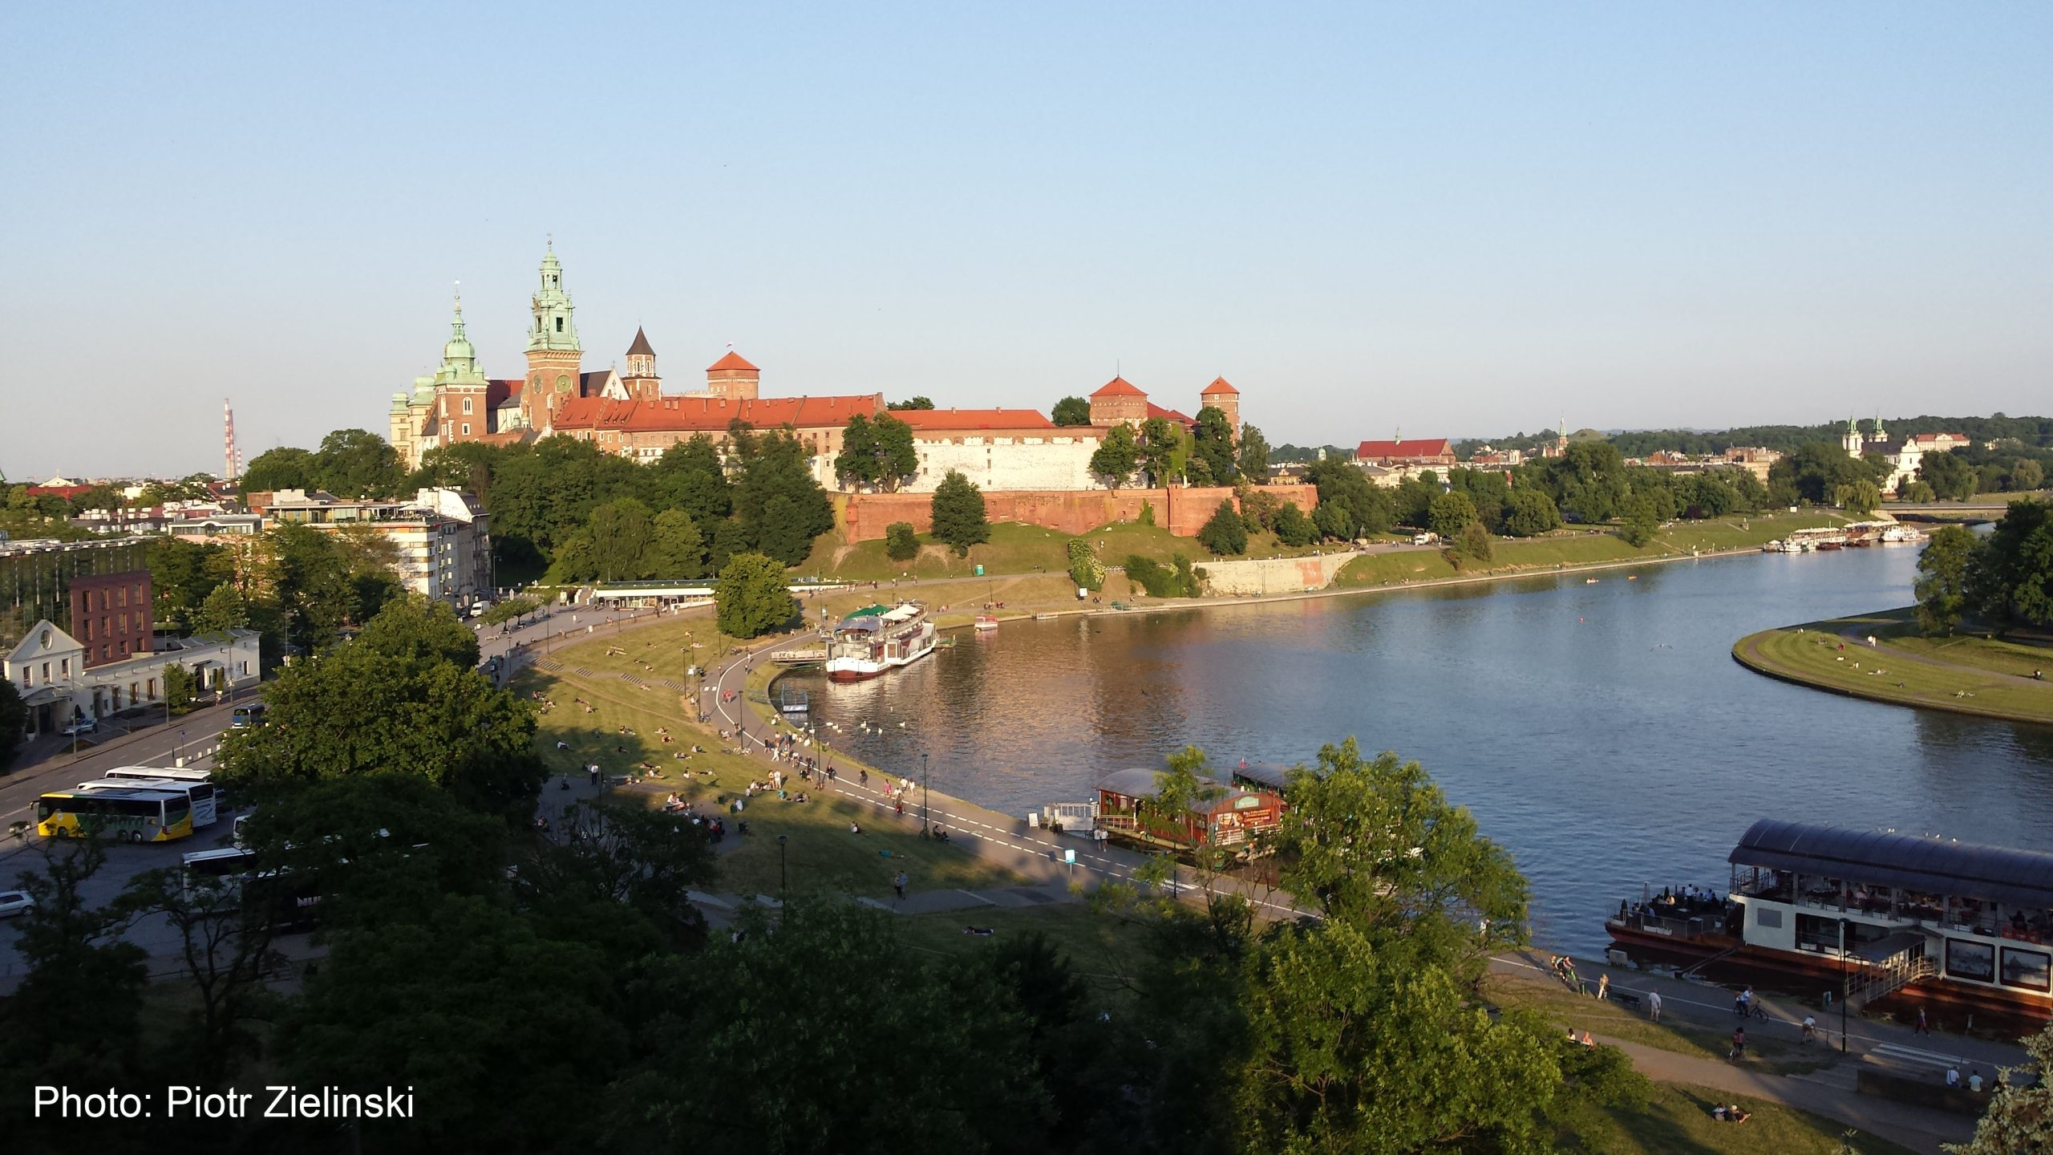
Second Annual Meeting (SAM) of EURO-LABS
was held October 9th –11th, 2023
in Kraków (Poland)
IFMIF-DONES, when running, would fit perfectly in such a project and the User Community would get a additional means to access the IFMIF-DONES infrastructure

