Slide 1
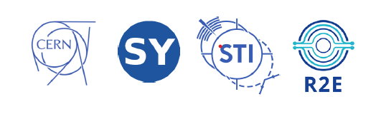




Notes about Medical and Industrial Apps
Javier Praena (UGR)

Slide 2
Summary of Medical and Industrial Session
Industrial Apps:
  CERN itself is the main user of the studies on electronics and material damage.
  CERN Accelerator complex is composed of many facilities with different purposes.
  DONES should try to develop a programme in collaboration with companies that could be interested in the future use of the facility.
  JEDEC (Joint Electron Device Engineering Council) standard procedure?
  Location of the possible facility? R160?

Slide 3
Summary of Medical and Industrial Session
Radiobiology:
  Wide field on studies of RBE by fast neutrons.
  Radioprotection, Mars mission…
  Location?
Javier Praena – Universidad de Granada
2nd DONES Users Workshop, Granada – 19-20/10/2023

Slide 4
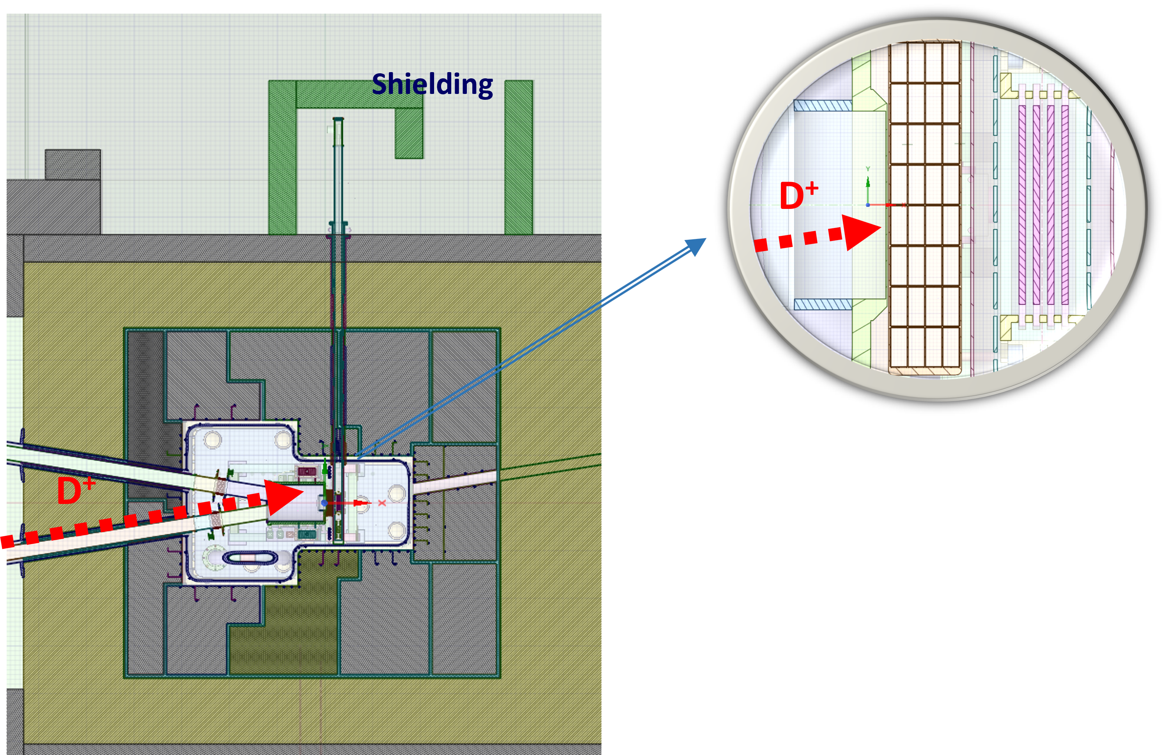
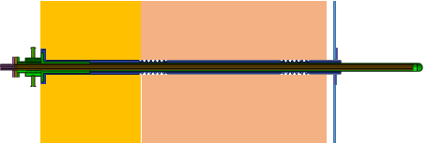
Summary of Medical and Industrial Session
Medical Radioisotopes produced with neutrons:
  Production with neutrons (TC) at highest flux.
  Major radioisotope ⁹⁹Mo/^{99m}Tc could be produced to feed Spanish needs, at least.
  Other radioisotopes as ⁹⁰Y with (n,p) and (n,alpha) reactions could be produced in important amounts.
Enriched MoO₃ (95% ¹⁰⁰Mo) | SPECIFIC ACTIVITY GBq/g ¹⁰⁰Mo | ACTIVITY (TBq)
Plate 1 | 24.14 | 21.59
Plate 2 | 20.85 | 18.65
Plate 3 | 17.81 | 15.93
Plate 4 | 15.24 | 13.63
TOTAL |  | 69.80
Javier Praena – Universidad de Granada
2nd DONES Users Workshop, Granada – 19-20/10/2023

Slide 5
Summary of Medical and Industrial Session
Medical Radioisotopes produced with deuterons:
  40 MeV 1.25 mA is a very high powerful beam for radioisotope production.
  New devices are being developed as upgraded versions of conventional ones.
  The possibilities are huge.
  Solid, liquid and gaseous targets.
Javier Praena – Universidad de Granada
2nd DONES Users Workshop, Granada – 19-20/10/2023

Slide 6
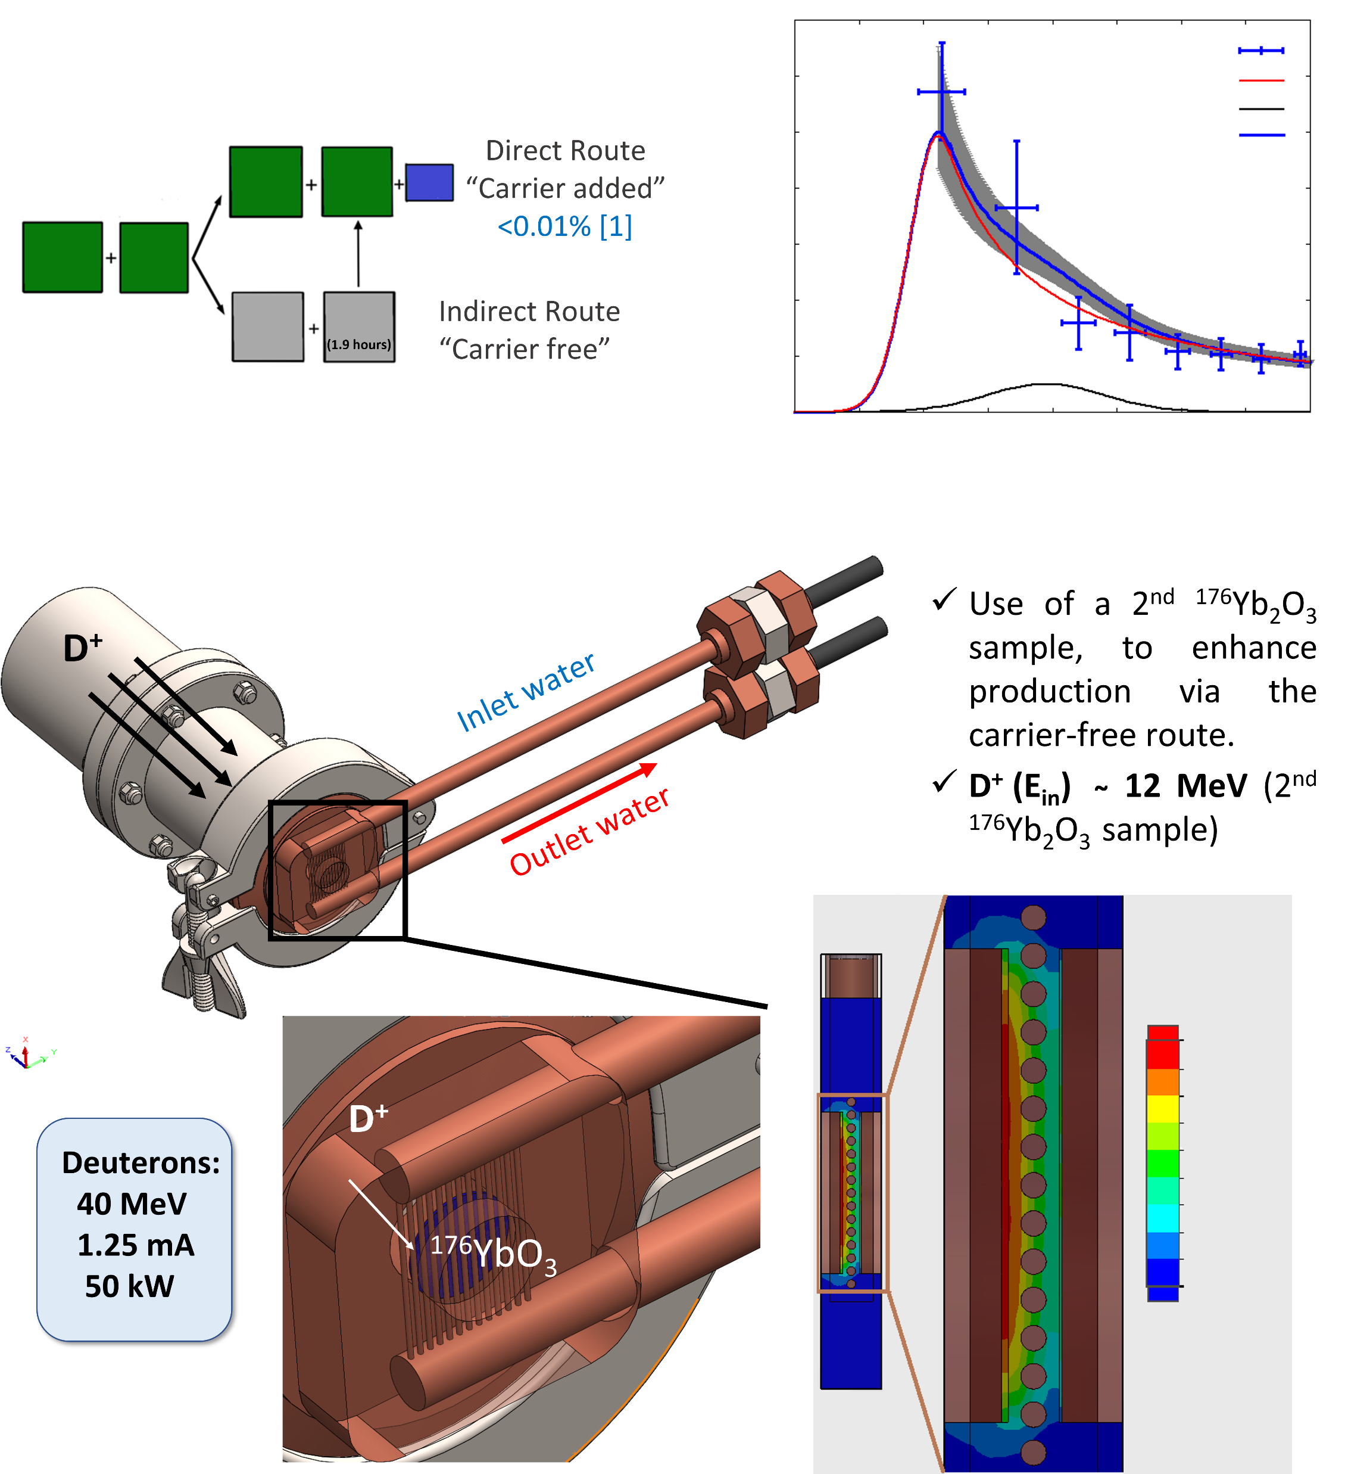
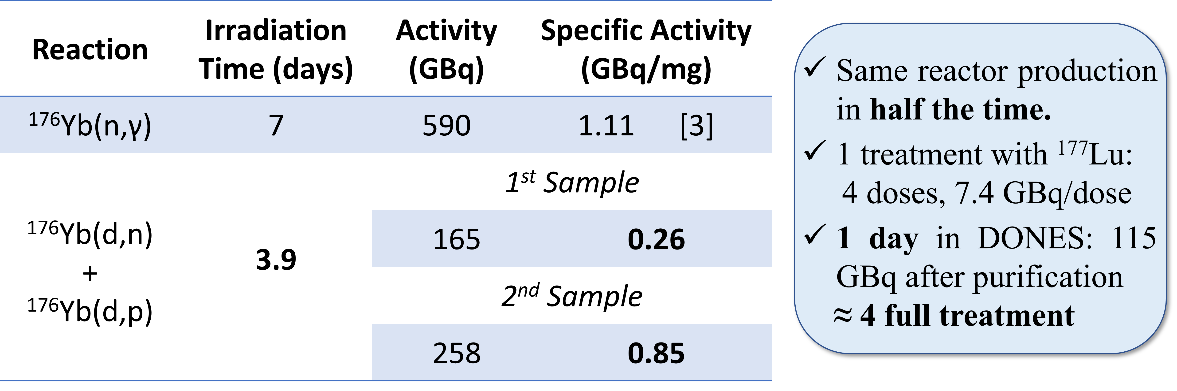
Summary of Medical and Industrial Session
Medical Radioisotopes produced with deuterons:
  40 MeV 1.25 mA is a very high powerful beam for radioisotope production.
  First case that we have studied: Lu177 with deuterons.
Javier Praena – Universidad de Granada
2nd DONES Users Workshop, Granada – 19-20/10/2023

Slide 7
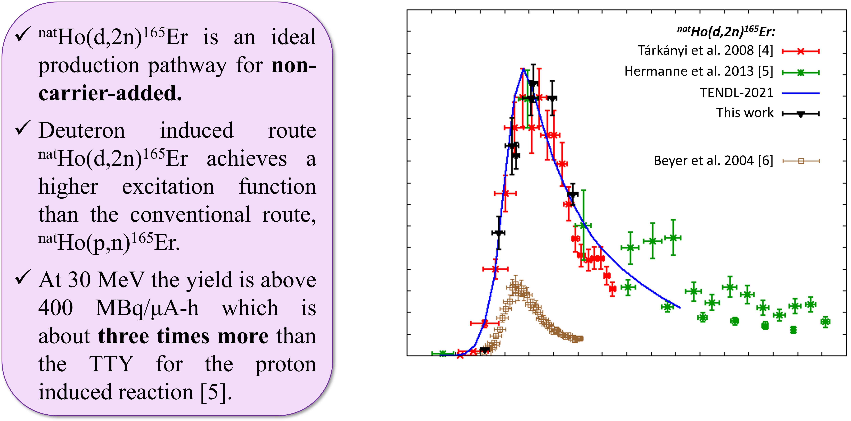
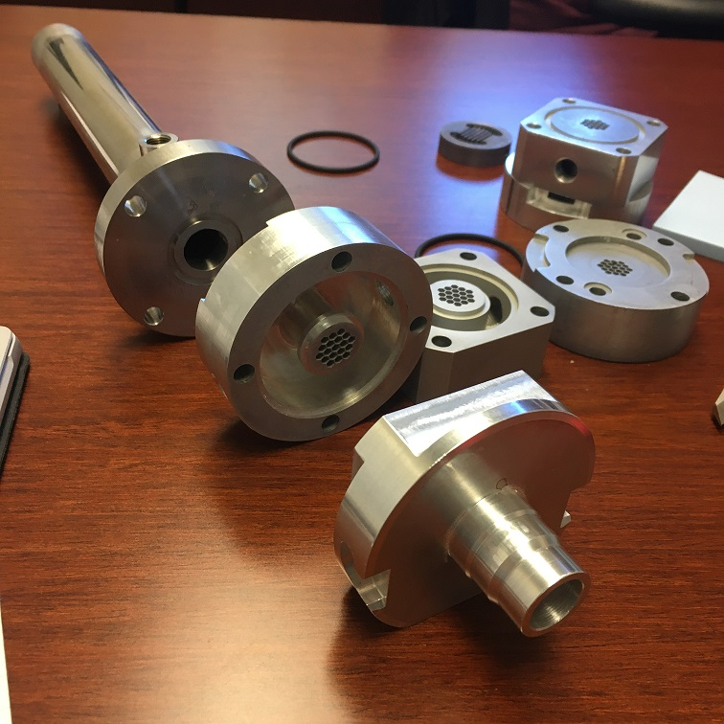
Summary of Medical and Industrial Session
Medical Radioisotopes produced with deuterons:
  40 MeV 1.25 mA is a very high powerful beam for radioisotope production.
  Nuclear data are needed at present.
  We performed an experiment at Orleans Cyclotron for the production of Er156.
  Future experiments at DONES?
Javier Praena – Universidad de Granada
2nd DONES Users Workshop, Granada – 19-20/10/2023

Slide 8
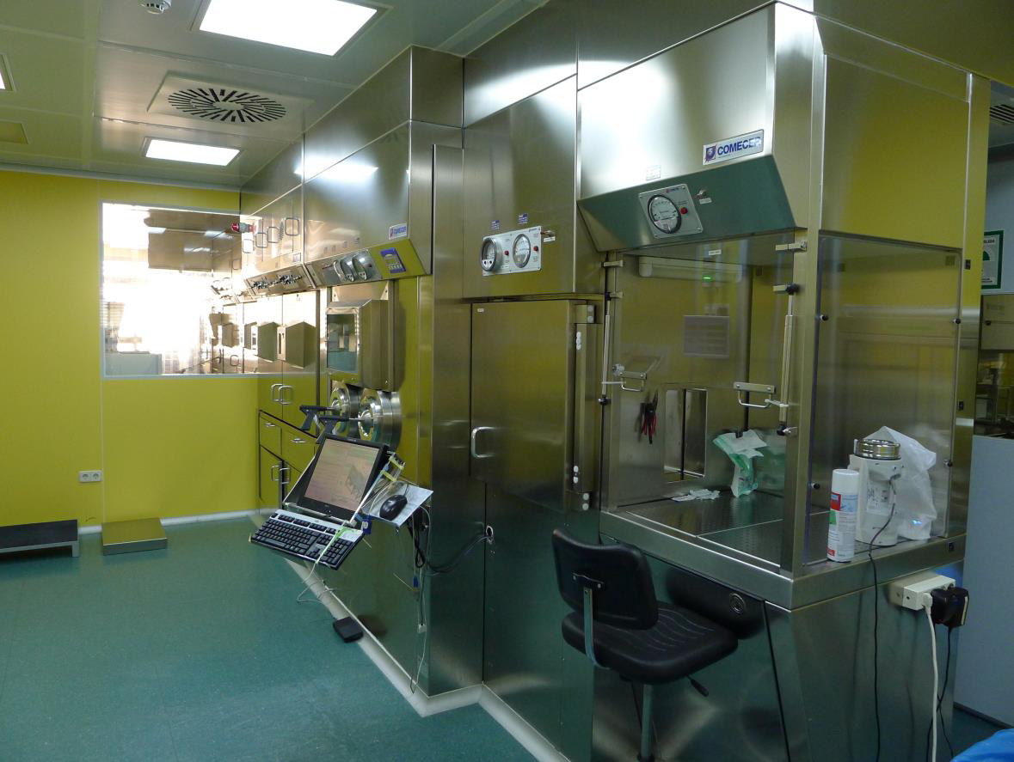
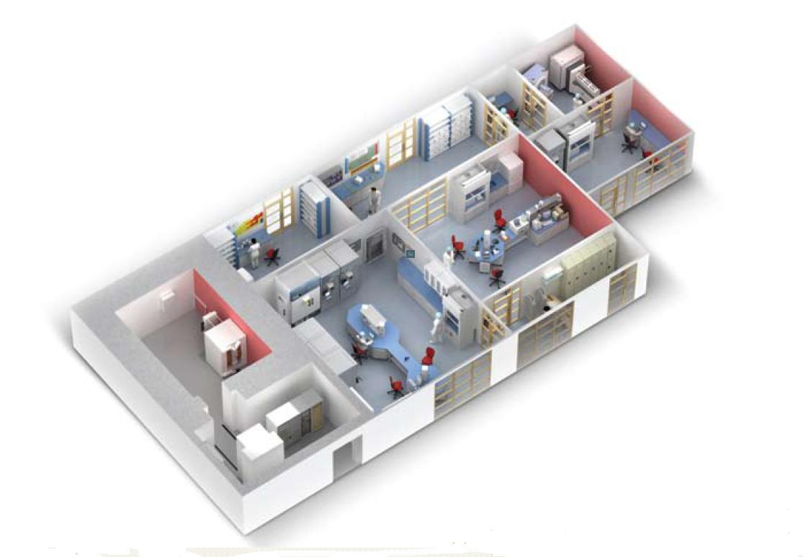
Summary of Medical and Industrial Session
Medical Radioisotopes produced with deuterons:
  40 MeV 1.25 mA is a very high powerful beam for radioisotope production.
Javier Praena – Universidad de Granada
2nd DONES Users Workshop, Granada – 19-20/10/2023

Slide 9
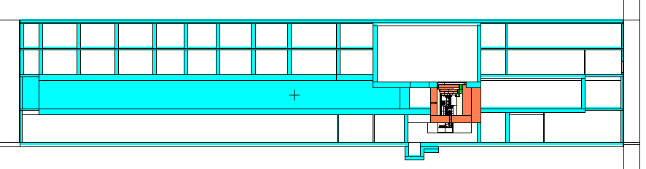
Summary of Medical and Industrial Session
Medical Radioisotopes; THE COMPLETE PICTURE
Connexion between the two locations for production?
Javier Praena – Universidad de Granada
2nd DONES Users Workshop, Granada – 19-20/10/2023

Slide 10
Notes

