Slide 1
Preliminary Safety Assessments of IFMIF-DONES for Users and Experimental Proposals
Claudio Torregrosa
F. Martin-Fuertes, J.C Marugan, M. Vázquez and IFMIF-DONES Safety Team
2nd DONES Users Workshop 19/10/2023

Slide 2
Outline
Introduction: Top Level Regulation Framework
Activity Permits & Operational Permits Schedule, Documentation, Safety Analysis Report
Complementary Experiment (CE) Proposals (R026, R160, TC)
Some Safety Implications of the Complementary Experiments
Safety Integration of CE within IFMIF-DONES Safety Design
Conclusions and some Take-home Hints ☺
1
2
3
4
5
6

Slide 3
INTRODUCTION: Top-level Regulation Framework
IFMIF-DONES will be a 1st Category Radioactive Facility
In accordance with the Royal Decree 1836/1999, point 3 of Article 34.2(b) “Complex facilities in which very high inventories of radioactive substances are handled or beams of very high-energy radiation are produced, making the potential radiological impact of the facility significant“
It does not belong to "Nuclear Facility" classification
In accordance with Royal Decree 1836/1999 Art 11. Nuclear Installations are:
Nuclear Power Plants
Nuclear Reactors
Nuclear Fuel Manufacturing Facilities
Nuclear Waste Storage Facility
Fission or Fusion Facilities or Devices

Slide 4
Types of Permits Required for IFMIF-DOMES
Construction Permits
Activity Permits (non-radiological, Industrial Safety)
Operation Permits (radiological)
Issued by the local and regional authorities after submission of the corresponding Documentation
Issued by the local and regional authorities after submission of the corresponding Documentation
Relevant for the Complementary Experiments
Issued by the Ministry (MITECO) after authorization by the Regulatory Body (CSN)
Needed to start Operation with Radiological Implications

Slide 5
Activity Permits (non-radiological, Industrial Safety)
Once the Construction of the Main and Auxiliary buildings are being finished, Activity Permits (Licencia de Uso) shall be requested to the Escúzar City Hall.
The requested Documentation is (among others):
Final Construction Project
Report of Activities and Non-Radiological Safety Assessments
Certificates of conformance with the regulations issued by the regional Government (Junta Andalucía), such as:
Pressurized Equipment’s Regulation
Regulations of Machinery/Cranes..
Acoustic Protections Regulation
Low/medium Voltage Regulation
Fire Protection Regulations
Thermal Installations in buildings Regulation
...Other Applicable Harmonized Regulations
Designs following the corresponding Spanish and European
Harmonised Standards
Documentation and Quality Plans will be delivered to the local and regional administrations to obtain the
“Activity Permits”

Slide 6
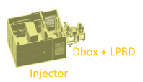
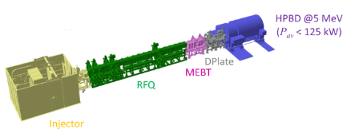
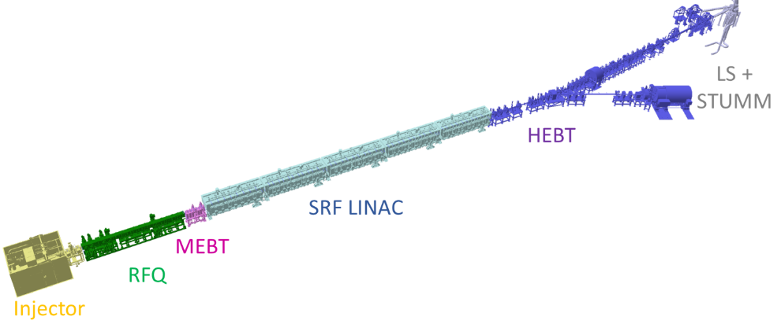
Operation Permits – Gradual Strategy
Gradual Strategy, based on Temporary Permits until the Full-Permit is Granted, consistent with the Commissioning Phases of the Facility
2nd Category Radioactive Installation
(Temporary Permits)
PHASE I -> Injector + Low Power Beam Dump
PHASE II -> Injector + RFQ + Low Power Beam Dump
PHASE III -> Accelerator + High Power beam Dump (Pulse mode)
1st Category Radioactive Installation
PHASE IV-> Full Facility
(Accelerator + Target Li loop + Irradiation Modules)
Relevant for the Complementary Experiments

Slide 7
Licensing Timeline
Some important dates for Complementary Experiments with Significant Safety Implications
Licensing Milestones
Activity Licenses Requests and Grantings
Granted pre-OP Phase III
Request OP Phase III
Request OP
Phase IV Full-Facility
Granted Pre-Op
Phase IV Full Facility
Request of Phase IV Operational License in 2029
Construction License Request
Construction License
Granted
Request OP Phase II
Granted pre-OP Phase II
Request OP Phase I
Granted pre-OP Phase I
2031
To be granted by 2032
2024
2025
2026
2027
2028
2029
2030
Start Phase III
2032
Start Phase II
Start
Construction Sites and Main Building
Start Phase I
Commissioning
Start Phase IV
(Full Facility)
Commissioning
Finish
Construction Main Building and Services
Project Milestones
Most relevant key Safety Information of Complementary Experiments with significant Safety Implications in the Licensing and Safety Design shall be provided years in advance 2029, to be integrated in the Safety files and Op. Licence Request

Slide 8
Operation Permits (Radiological) – Documentation
Documentation Required for Category I Radioactive Facility Operation Authorization (RD 1836/1999):
Descriptive Report of the facility (including site and surrounding land)
Safety Analysis Report
Verification of the facility (Compliance tests and documentation including maintenance & periodic inspection plans)
Operating Rules. Including:
Quality Assurance Manual
Radiation Protection Manual
Technical Specifications of Plant operation (Performance Tech. Specifications)
Internal Emergency Plan
Provisions for closure and financial coverage
Economic budget of the investment to be made
Physical Protection Plan (Security)

Slide 9
Safety Analysis Report
Safety Analysis Report (SAR) -> Reference Document in continuous Update
General Description of the Facility
Main Design Criteria
Design Basis of the Facility
Conduct of Operation
Protection Against Radiation and Waste Management
Accident Analyses
Safety Requirements
...
#41 Reference Accident Scenarios Identified and Analysed
Definition of Safety Requirements, Safety Important Components, and Confinement
Deterministic Analysis
/Reduction of conservative uncertainties

Slide 10
Outline
Introduction: Top Level Regulation Framework and Procedures
Activity Permits & Operational Permits Schedule, Documentation, Safety Analysis Report
Complementary Experiment (CE) Proposals (R026, R, TC)
Some Safety Implications of the Complementary Experiments
Safety Integration of CE within IFMIF-DONES Safety Design
Conclusions
1
2
3
4
5
6

Slide 11
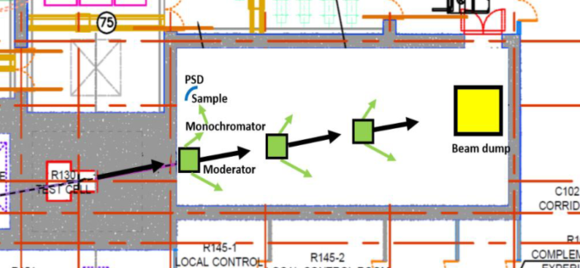
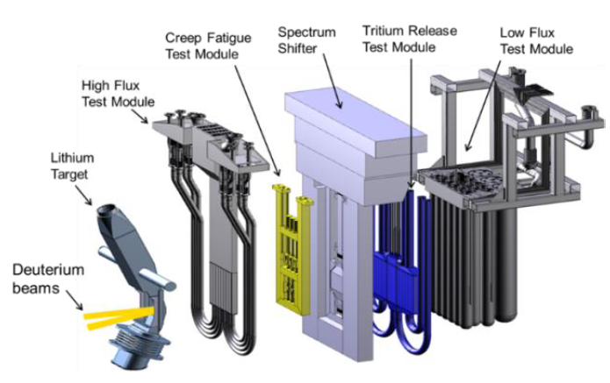
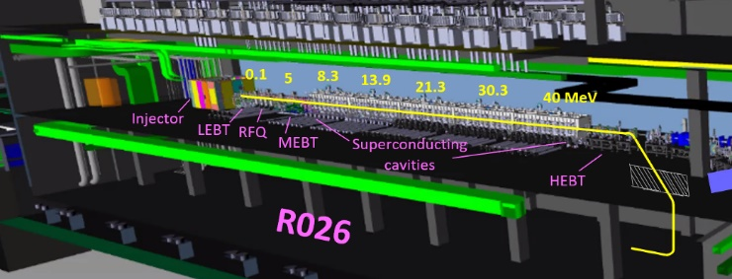
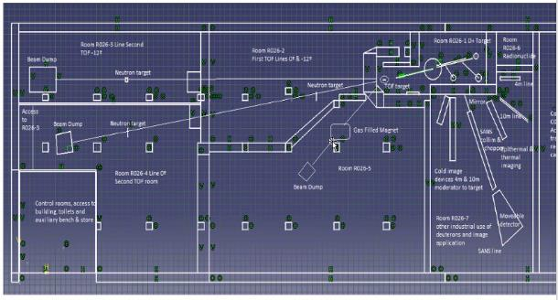
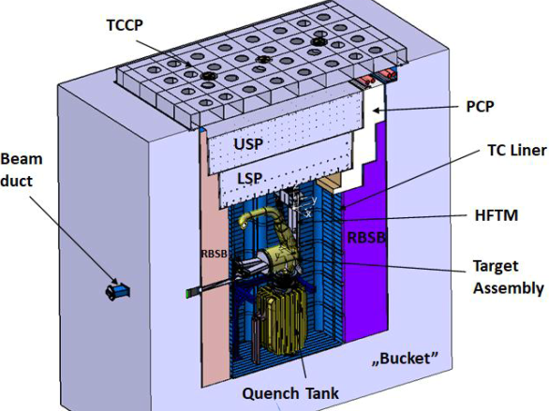
Areas of Complementary Experiments
R160:
Same floor as the Test Cell
Profiting from a continuous neutron beam from the TC via a Neutron Beam Aperture/Collimator (Ø20-12 cm)
Room of 26.6 m x 11.25 m (300 m2).
Estimated neutron flux at the duct exit:
2∙10¹⁰ n/cm²/s, 99.5% of fast neutrons, En > 100 keV
In the Test Cell:
High flux Modules
Medium Flux Modules
Low Flux Modules
R160
R026:
Ground floor, below the Accelerator Vault
Profiting from Pulsed Deuterons beams via a beam extraction from the accelerator
Room of 60 m x 36 m.
Deuteron extraction at 40 MeV (1 % intensity)
Experiment using deuterons & pulsed neutrons (by neutron production with a Target)

Slide 12
Preliminary List of Potential Experiment Proposals
R160
R026
Test Cell
1) Fundamental particle physics studies with cold and ultra-cold neutrons.
1) Experiments using Pulsed Deuterons Beams
Production of radionuclides with intense deuteron beams
Deuteron-induced reactions
1) Experiments Irradiating Material Specimens
Creep Fatigue Test Module (CFTM)
2) Neutron scattering experiments with moderated beams:
2) Experiments Irradiating Components
Activated Corrosion Product Test Module (ACPTM)
Irradiation of Instruments and Diagnostics
In-situ Ceramic Breeder Test Module
2) Experiments using Pulsed Neutron Beams (nTOF):
Neutron Cross-section measurements
Gamma-spectroscopy of the nuclei produced in fast-neutron-induced fission reaction
Half-life measurements of long-lived isotopes
3) Experiments with samples exposed to neutrons:
Activation of small samples by neutrons
Characterization of materials by radiation analysis
Neutron imaging
Fast neutron irradiation of components, devices or bio-samples
3) Experiments on Tritium Breeders Materials
Ceramic breeders
Lithium breeders
4) Medical treatment of patients using neutrons. BNCT
4) Radioisotopes Production

Slide 13
Introduction: Top Level Regulation Framework and Procedures
Activity Permits & Operational Permits Schedule, Documentation, Safety Analysis Report
Complementary Experiment (CE) Proposals (R026, R, TC)
Some Safety Implications of the Complementary Experiments
Safety Integration of CE within IFMIF-DONES Safety Design
Conclusions
1
2
3
4
5
6

Slide 14
Some Safety Implications that shall be considered
Radioactive Inventory and Contribution to Material at Risk
Impact of the Experimental Setups to eventual Reference Accidents Scenarios -> Definition of Safety-credited components for prevention/detection/mitigation (applicable)
Radioprotection Aspects
Industrial-Conventional Safety (non-radiological)

Slide 15
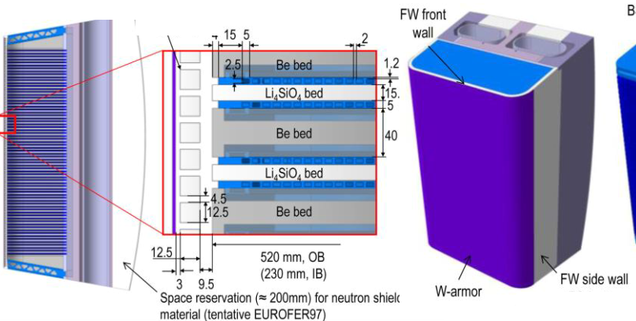
Radioactive Inventory and contribution to Material at Risk
Particularly relevant for Tritium Breeders, Radioisotopes Production and non-encapsulated samples of actinides.
For the case of Tritium Breeders or Radioisotope Production, it could influence some design decisions regarding overall Safety Strategy and Experiments Designs.
Example:
Just Very rough estimations!
Tritium Ceramic Breeders:
Assuming a tritium production of 6.35∙10¹¹ atoms-T/g-CB/s
Leads to an activity production of 1.13∙10³ Bq/g-CB/s
Is this compatible with the Breeders Research Needs?
Let´s Iterate!
If we have a “Tritium Activity Budget” inside the TC in the order of 50 TBq (RCC-MRx Class 3)
Total MAR inventory of IFMIF-DONES is 2340 TBq.
Ceramic Breeding contribute only to 2 % of total inventory
This leads to 1 year irradiation of max of 2 kg of Ceramic Breeder Material
We could be producing 0.14 g of Tritium per year.

Slide 16
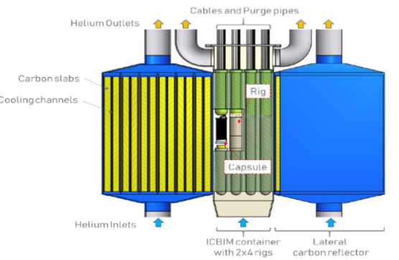
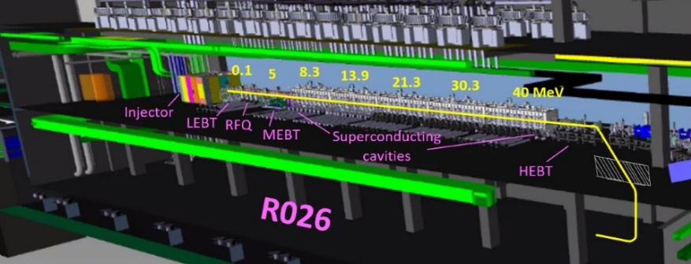
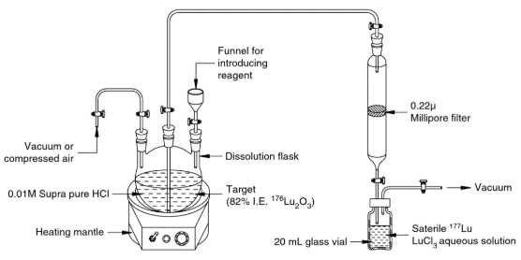
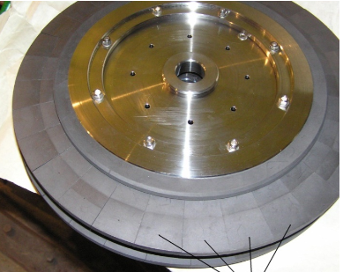
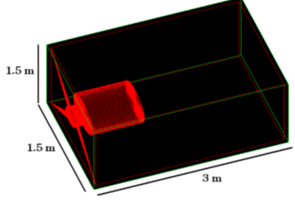
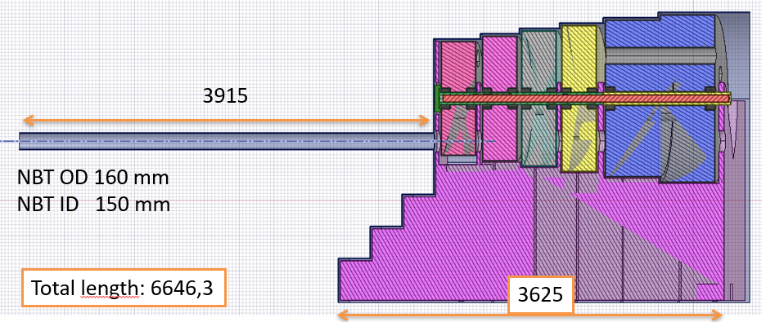
Impact of Complementary Experiments on RAS?
Deuteron Beam Extraction Line: (5 kW extraction)
Tritium Breeders Modules Failure: (Tritium leaks)
Control of the extracted deuteron beam power. (risk of damage the downstream window/neutron production target in case of over-intensity extraction).
Safety/MP aspects related to extraction fail and beam impact of the vacuum chambers. (prompted dose)
Radioisotopes Modules / Process Failure:
Contribution air inrush RAS
Beam windows:
Neutron Production Target/Converter
Neutron beam line to the R160 (shutter)
R160 Neutron Beam Dump

Slide 17
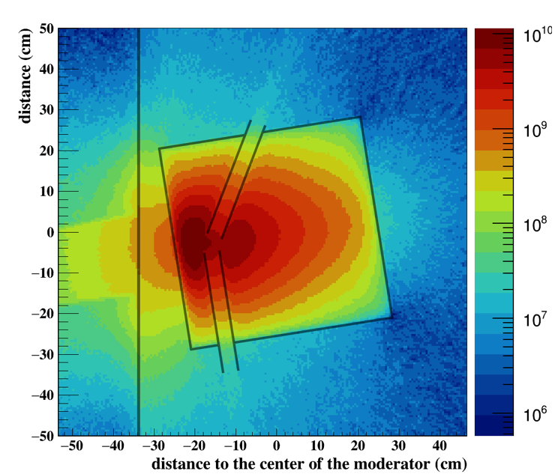
Radioprotection Aspects
Key Information:
Access of Personnel and Intervention times in Complementary Experimental Areas. Maintenance?
Contribution to Occupational Radiation Exposure ORE)
Operational Modes, Activation and Prompt Radiation to adjacent Areas
Will it be necessary to have additional shielding?
Risk of Contamination?
How the experimental setups assemblies will be activated?, preference of using low activation materials..
Management of Radioactive Waste and Decommissioning of the Experimental Setups

Slide 18
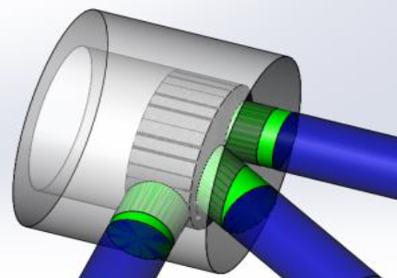
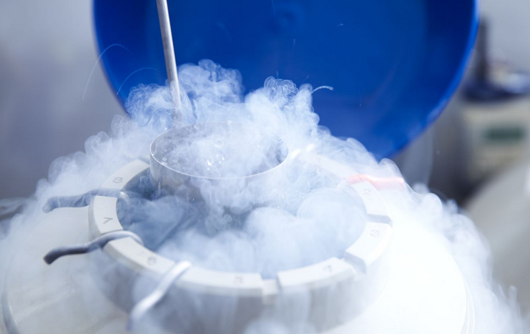
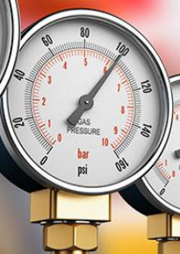
Industrial-Conventional (non-radiological) Safety
Liquid CH₄
BeO
Examples:
Cryogenics
Gaseous releases
Oxygen Deficiency Hazard (ODH)
Explosive gases?
Pressurized Equipment
Machinery
Fire hazards
Electric hazards
Cold Moderator
Liquid H₂
Designs must follow the corresponding Spanish and European
Harmonised Standards

Slide 19
Introduction: Top Level Regulation Framework and Procedures
Activity Permits & Operational Permits Schedule, Documentation, Safety Analysis Report
Complementary Experiment (CE) Proposals (R026, R, TC)
Some Safety Implications of the Complementary Experiments
Safety Integration of CE within IFMIF-DONES Safety Design
Conclusions
1
2
3
4
5
6

Slide 20
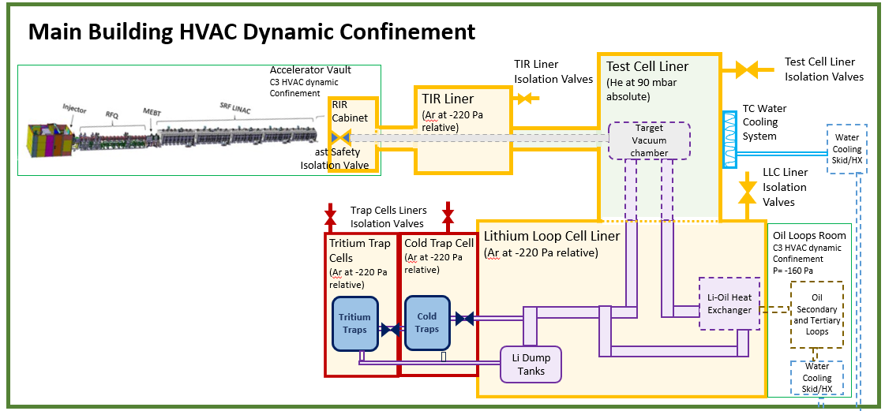
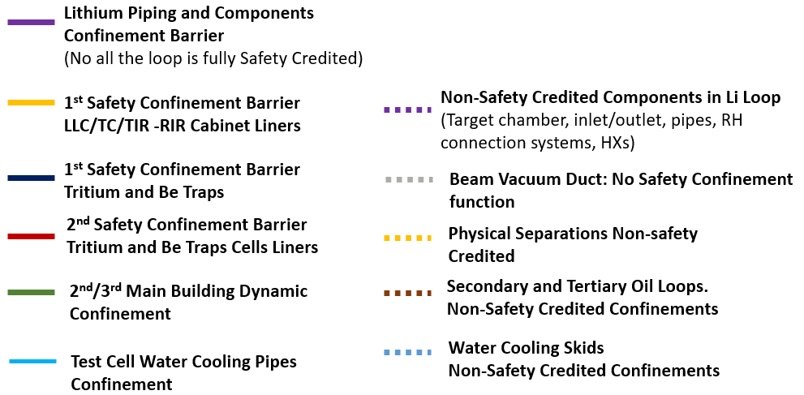
IFMIF-DONES Confinement Barriers
Complementary Experiments in the Test Cell. Inside the 1st Safety TC/LLC/TIR Barrier (Metallic Liner)
Complementary Experiments in R160 and R026 will be inside the HVAC-Dynamic Confinement Barrier
Any pipe-penetration that may be required through the liner in the
TC-complementary experiments shall be equipped with Safety-Credited Isolation Valves

Slide 21
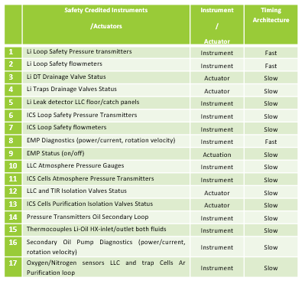
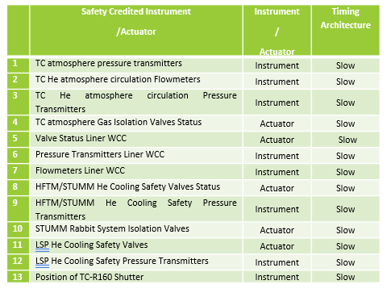
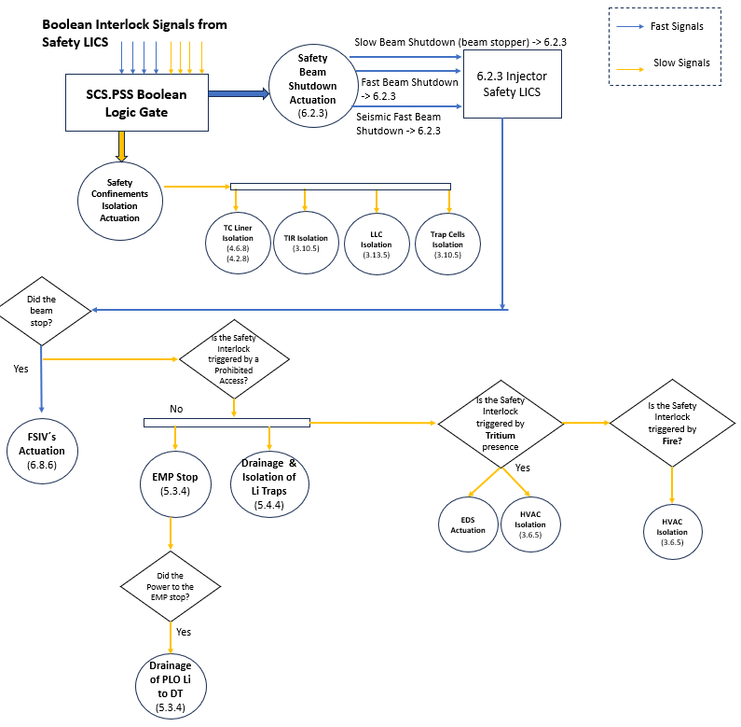
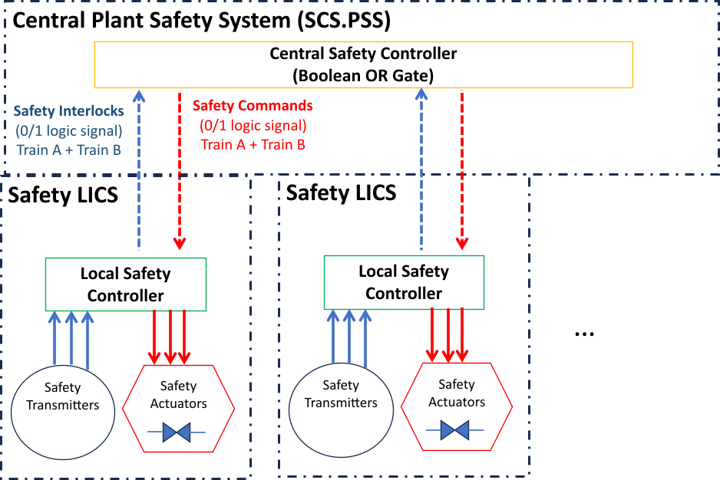
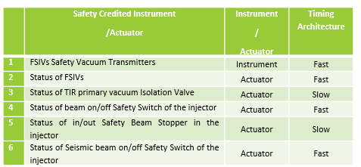
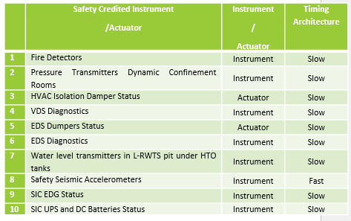
Safety Control System-Plant Safety Subsystem (SCS-PSS)
31 Safety Interlocks (Instruments)
Control Logics to bring the Facility to "Plant-Safe-State"
18 Safety Commands (Actuations)
Complementary Experiments that may require Safety-credited Instrumentation and the actuation of Safety Interlock Commands (i.e. Beam Safety Shutdown) shall integrate them within the SCS-Plant Safety System

Slide 22
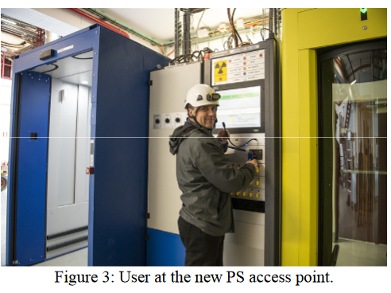
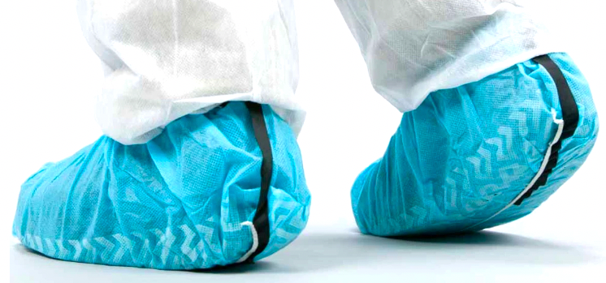
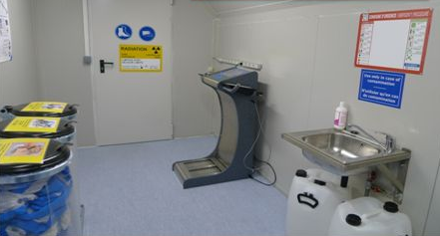
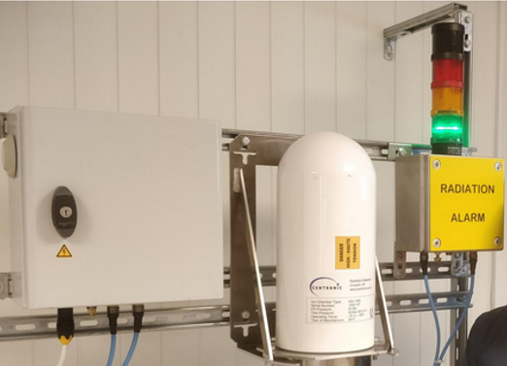
PASS and RAMSES
Personal Access Safety subsystem (PASS):
“Personal Access Interlock Subsystem.”
In access mode: no beam or hazard in the zone;
In beam mode: no personnel in the zone and the beam shall be stopped immediately in case of an intrusion.
Very Relevant for the Complementary Experiments in which Access to Experimental Rooms will be necessary while the Facility is in Operation Mode
CERN’s PS Access System
RAdiation Monitoring Subsystem for the Environment and Safety (RAMSES)
CERN’s CROME
Interfaces with the Complementary Experimental Areas. Also, in case of eventual needs of cooling systems with potential coolant activation.

Slide 23
Introduction: Top Level Regulation Framework and Procedures
Activity Permits & Operational Permits Schedule, Documentation, Safety Analysis Report
Complementary Experiment (CE) Proposals (R026, R160, TC)
Some Safety Implications of the Complementary Experiments
Safety Integration of CE within IFMIF-DONES Safety Design
Conclusions and some Take-home Hints ☺
1
2
3
4
5
6

Slide 24
Conclusions and Take-home Hints
Complementary Experiments, as part of the IFMIF-DONES Facility, shall be well integrated within its Safety Requirements.
While the extremely interesting and valuable Experimental Proposals are made and the designs are maturing, please, take also in mind Safety Aspects and Implications and gather this information. Some of it:
Material at Risk (i.e. mobilizable inventory)
Possible Contribution to Reference Accidents Scenarios
Radioprotection Aspects (Operation modes, activation, intervention times, etc.)
Industrial Safety (non-radiological)
The earlier interaction with the Safety Team and inclusion of Safety Assessments in the Experiment Proposals the better for the implementation success!
Safety
Experiment Proposals and Designs
We remain fully-available to any question and pursuing valuable feedback to be integrated in this iterative process.

Slide 25
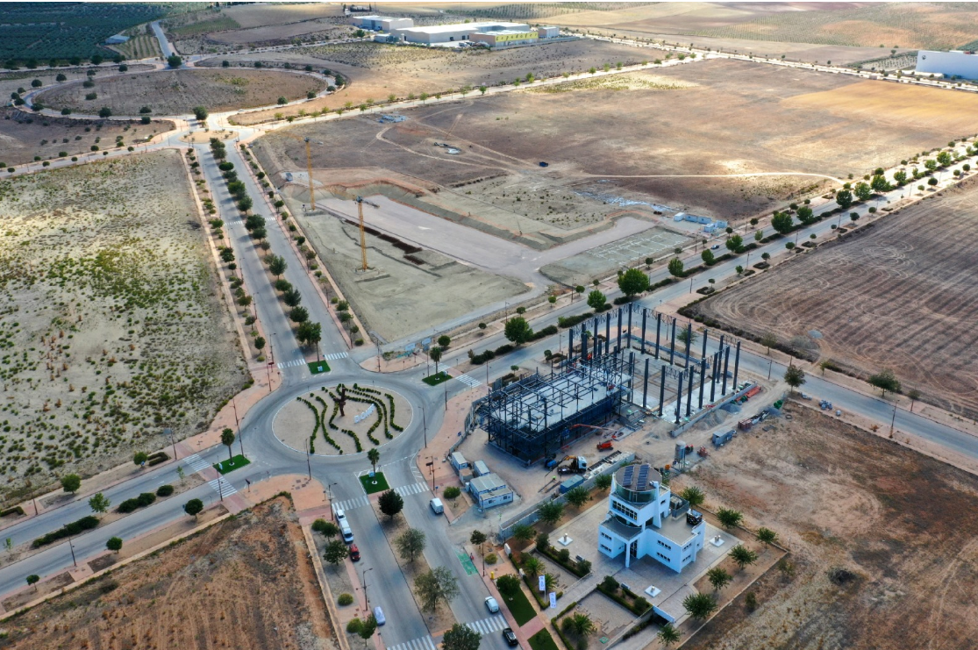
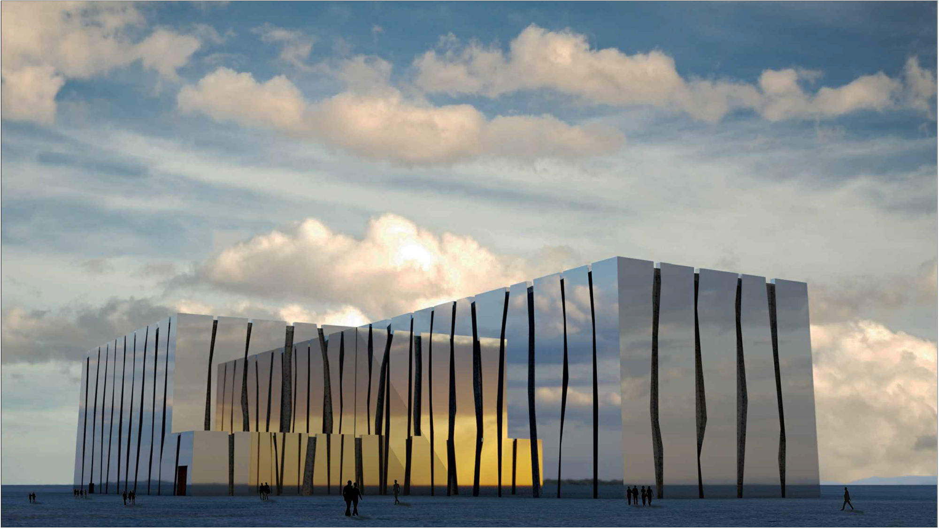
Thanks very much!!
Questions?

