Slide 1
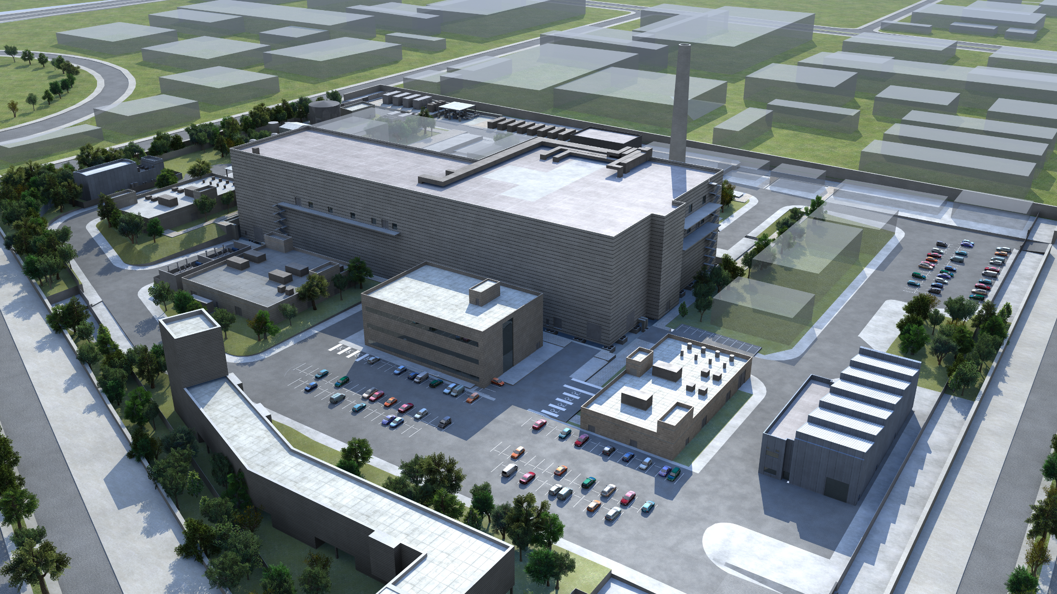
Present status of the DONES Programme Granada, October 18th 2023
P. Cara

Slide 2
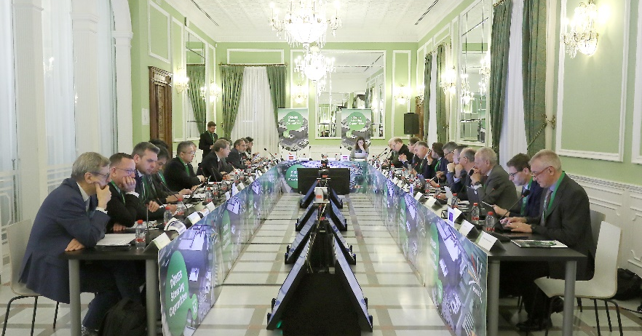
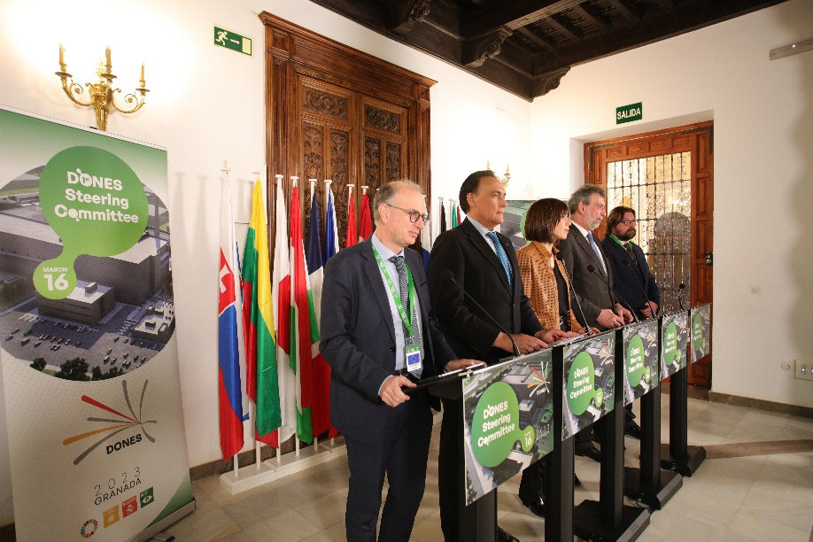
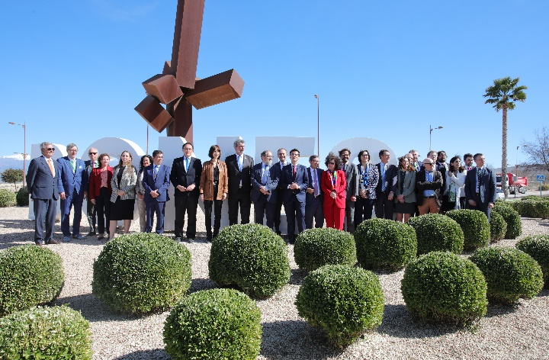
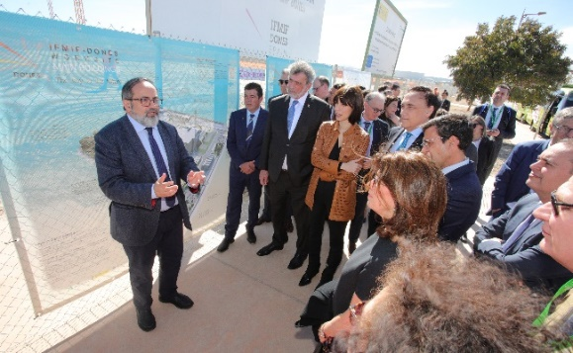
1st DONES Steering Committee was held in Granada, March 16th 2023 (it means the start of the Construction Phase of the DONES Programme)

Slide 3
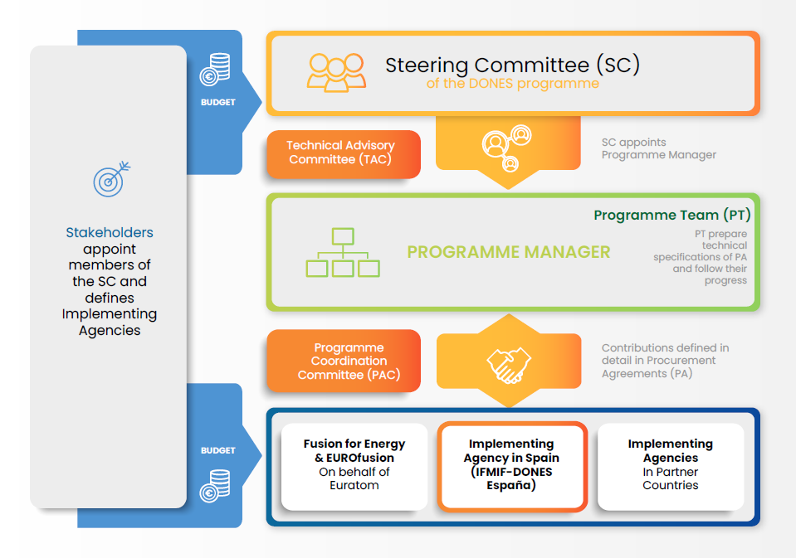
Mission and Governance
DONES Programme Mission
The mission of the DONES Programme is to develop a database of fusion-like neutron irradiation effects in the materials required for the construction of fusion power reactors
DONES Programme Objectives
To provide a neutron source producing fusion-like neutrons at sufficient intensity and irradiation volume.
Generate materials irradiation test data for DEMO
Generate data base for benchmarking with computational material science
To develop a "Complementary Experiments" work program
The IFMIF-DONES Facility
The fusion relevant neutron source and that will allow to fulfill the objectives of the Programme
Project run by flexible Programme Team and relying on In-Kind Manpower contributions from different partners
Design Authority with the Programme Team
Owner/Operator responsibility on the Spanish Legal Entity

Slide 4
DONES Programme Timeline

Slide 5
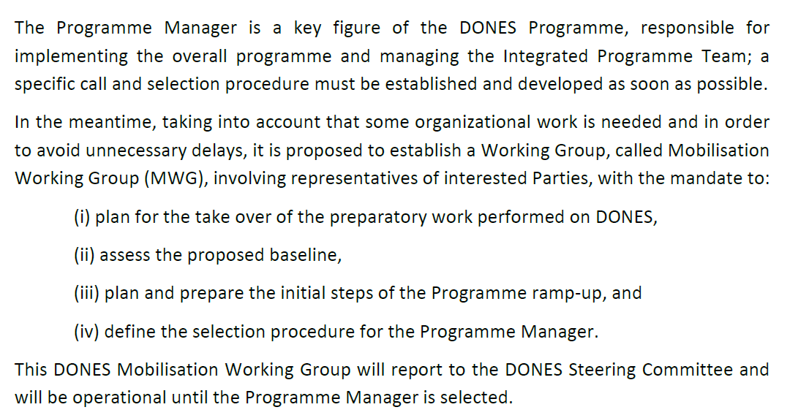
Mobilisation Working Group: Mission

Slide 6
Mobilisation Working Group: Deliverables
Propose a ToR for the WG activities (to be approved by the DONES SC by written procedure) to address the following:
Review the proposed baseline and assess the present status of the DONES, Programme, including all technical and management documentation,
Define a procedure for the selection of the Programme manager and Chief Engineer (to be approved by the DONES SC by written procedure),
Prepare a set of Programme Management documents for the initial ramp-up of the Construction Phase of the Facility (e.g. Programme Team (PT) charter Execution Plan, System Engineering Plan, Organization Plan, Resource Plan, Quality Plan, Management of the Handover from IFMIF/EVEDA and WPENS and a template for the future Procurements Agreements…)
Propose an IP rights agreement, and
Contribute to the promotion of the participation of new Parties to the DONES Programme.

Slide 7
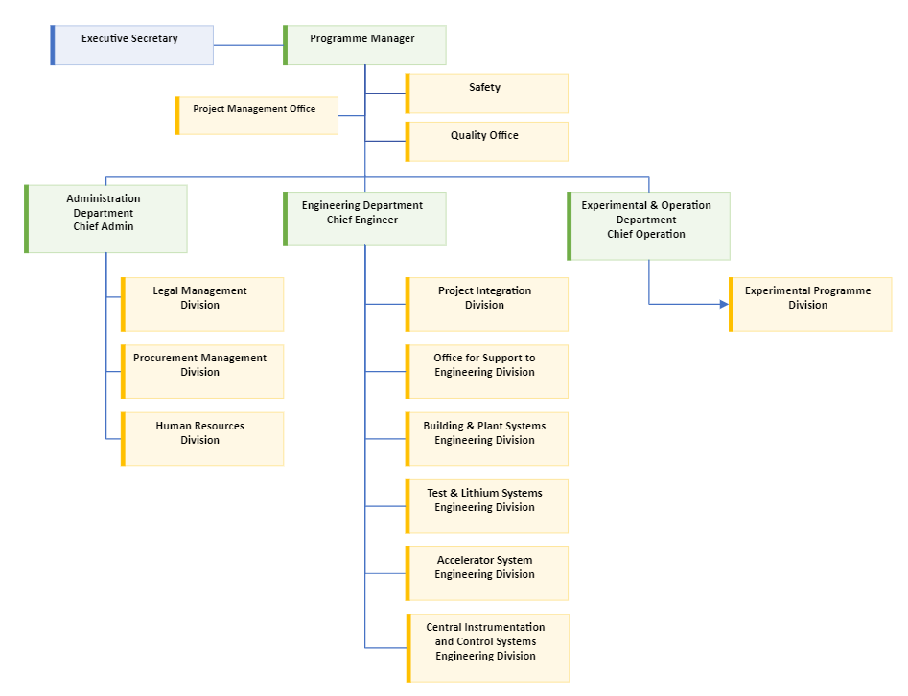
MWG working as Interim Programme Team (PT)
Head of the MWG: Philippe Cara (F4E- Onsite)
Members:
F4E (remote/onsite) – 5 pers
→ Procurement, Legal, IPR, PM
IFMIF-DONES España (Onsite) ~ 10
→ Engineering and operation department
CEA (remote) – 1 pers
→ Accelerator
KIT (remote) – 1 pers
→ DONES Irradiation capabality

Slide 8
Current Status
The DONES Baseline Review was organized 2 & 3 October 2023
Name | Institution | Meeting Role
Marek Lewitowicz | GANIL-SPIRAL2, France | Chair
Jose Miguel Jimenez | CERN, Switzerland | Member
Elena Gaio | Consorzio RFX, Italy | Member
Rolf-Dieter Heuer | CERN | Member
Atsushi Kasugai | QST, Japan | Member
Francois Javier | ITER, France | Member
The outcome of the review was positives, no showstopper identified !

Slide 9
Current Status
Within the MWG, we are continuing to prepare the ramp-up of the DONES Programme which includes:
The setup of the Programme Management Documents (PEP, PMP, SEMP,…),
Preparation for the management of the Handover from IFMIF/EVEDA and WPENS,
Consolidation of the current DONES Baseline,
…
Engineering design activities with hrDONES and esDONES related to their contribution to the IFMIF-DONES Facility.

Slide 10
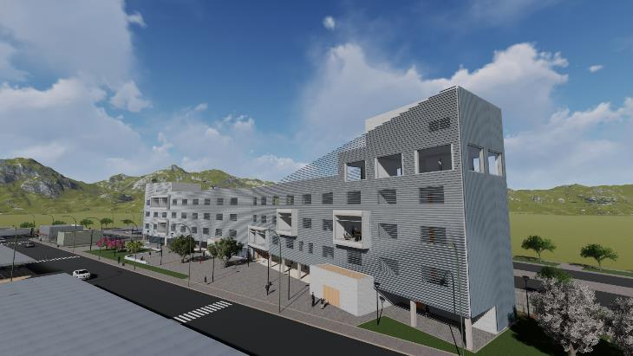
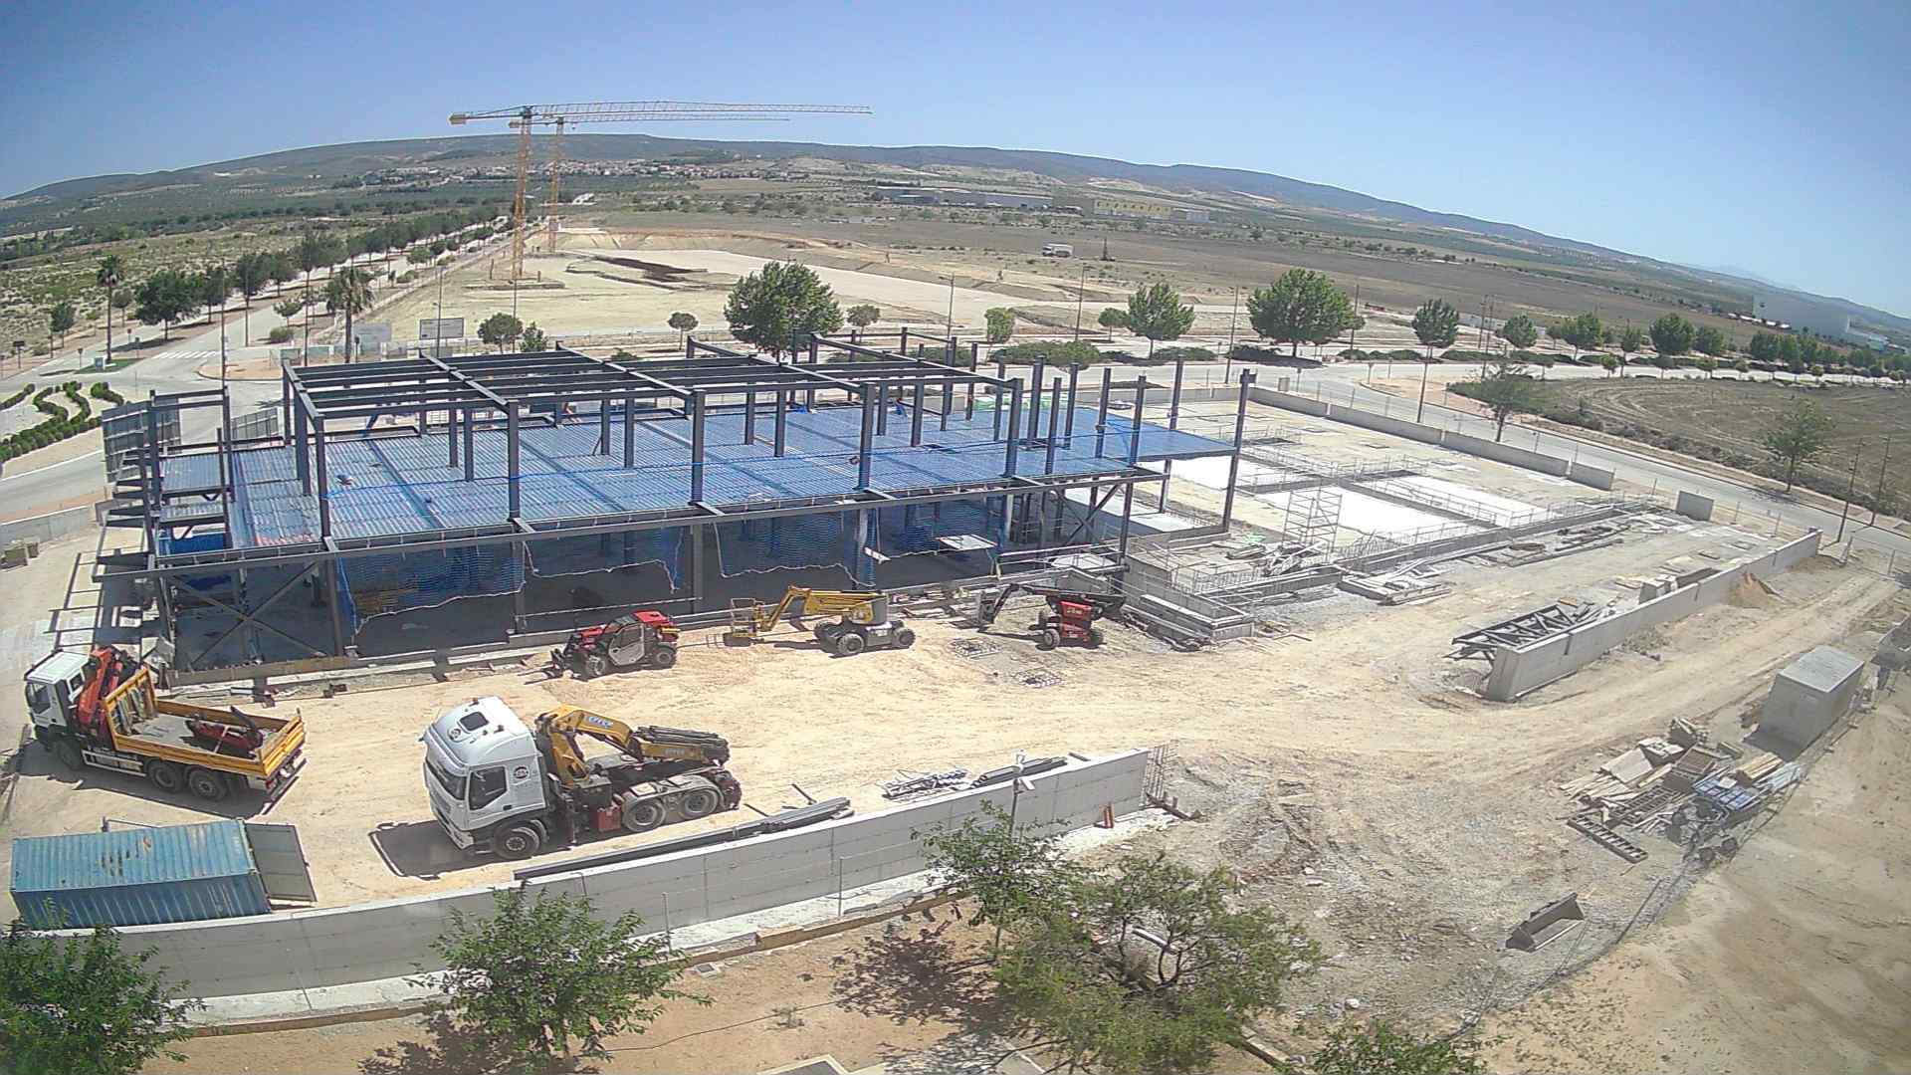
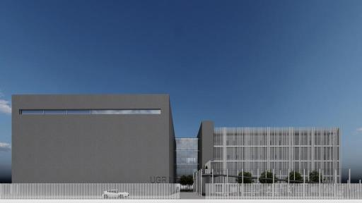
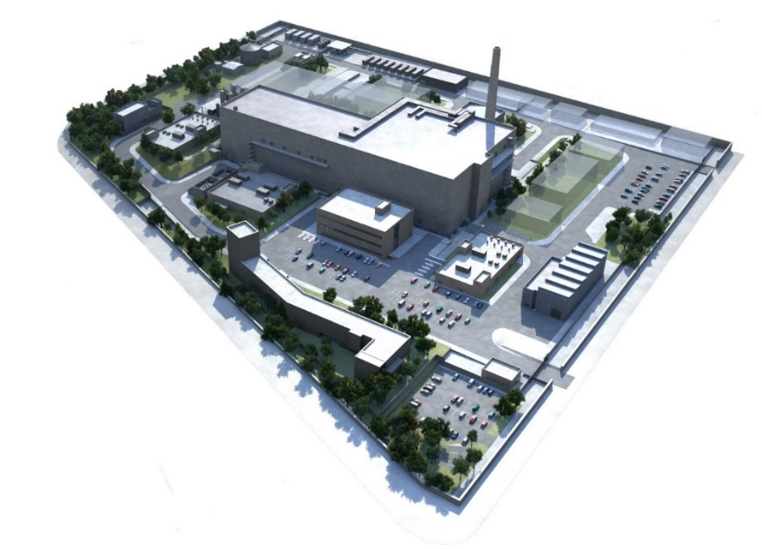
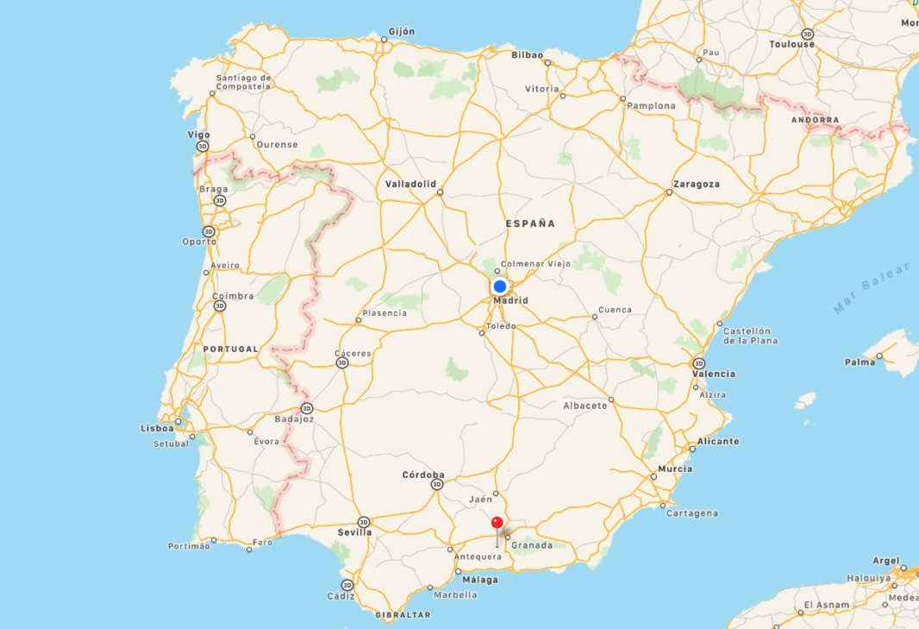
Construction of First Auxiliary Buildings
The site is located at Escúzar -18 km southwest from Granada city- Spain

Slide 11
Outlook
27 October 2023 : 2nd DONES SC
With the positive conclusions of the DONES Baseline Review, we can expect the engagement of additional stakeholders.
Work Programme 2024 will be presented with important programme milestones to be met (e.g. First PAs Signed, consolidation of the Baseline…)
The nomination of the Programme Manager and implementation of the Programme Team is expected within the first semester 2024.
The DONES user workshop is an important asset and input for the DONES Programme. This coordination will be developed further next year with the MWG and lately with the PT.

Slide 12
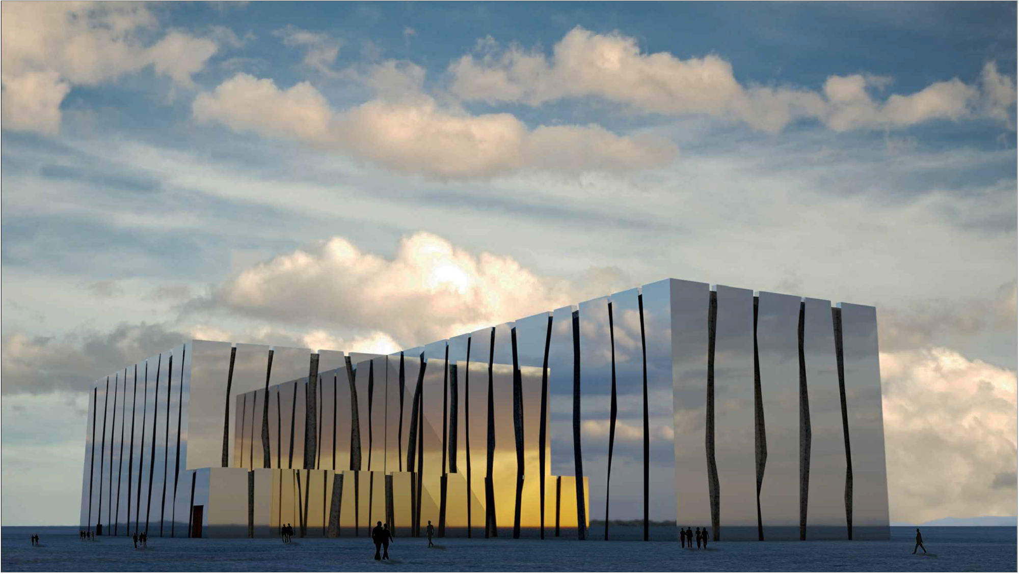
www.ifmifdones.org

