Slide 1
Overview on DONES-related activities
A. Ibarra (IFMIF-DONES España & CIEMAT, Spain) and the full DONES team
2nd DONES Users Workshop, Granada, October 19-20th 2023

Slide 2
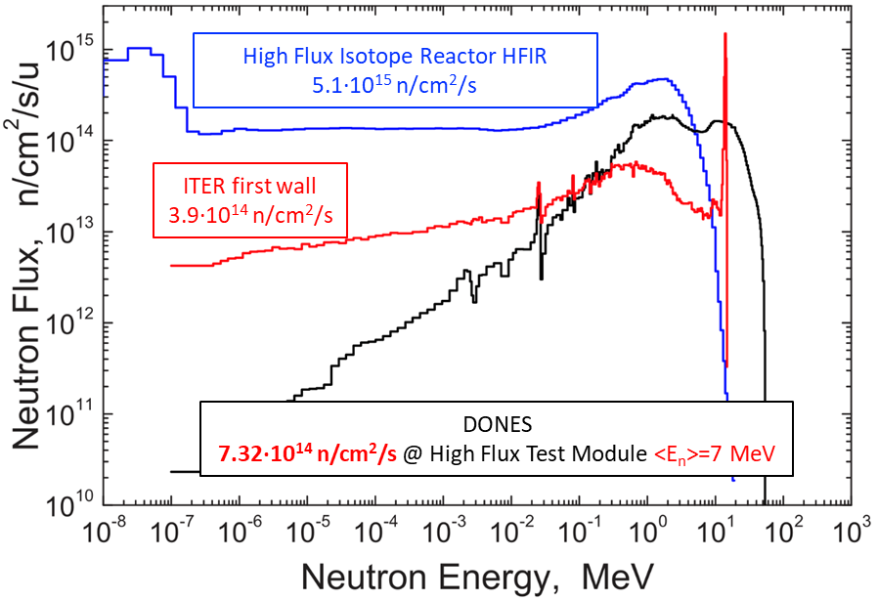
What is IFMIF-DONES Facility?
A fusion-like neutron source required for the qualification of the materials to be used in the EU DEMO
High Flux Test Module:
20 dpa/fpy in 130 cm³
10 dpa/fpy in 400 cm³
Controlled Temperature:
250 < T < 550 ºC
Stripping reaction
A neutron flux of ~ 10¹⁵ n/cm²/s is generated with a neutron spectrum up to 55 MeV energy
15
Heat removal by high velocity Li flux
Identified as high priority in the EU Fusion Roadmap
Included in the ESFRI Roadmap as a EU strategic facility

Slide 3
Based on widely spread efforts!!!
The need for a facility of this type was identified long time ago and work has been carried out by using different frameworks. In the last 15 years, key projects are:
(2007-today) Design and Validation Activities
IFMIF/EVEDA
(included in the BA)
design seems feasible
WPENS
(EUROfusion WP)
(2015-today) Design and Validation Activities
Defining the design: ready for construction!!!
DONES-PreP
(EURATOM CSA)
(2019-2021) Elaborate and draft the international consortium agreement
DONES Preparatory Phase
international implementing scheme defined
DONES-PRIME/UGR
(Spanish projects)
DONES-PRIME
DONES-UGR
(2021-2023) Engineering and Construction Activities
Starting the work on site (first auxiliary buildings)

Slide 4
Based on widely spread efforts!!!
The need for a facility of this type was identified long time ago and work has been carried out by using different frameworks. In the last 15 years, key projects are:
(2007-today) Design and Validation Activities
IFMIF/EVEDA
(included in the BA)
design seems feasible
WPENS
(EUROfusion WP)
(2015-today) Design and Validation Activities
Defining the design: ready for construction!!!
DONES-PreP
(EURATOM CSA)
(2019-2021) Elaborate and draft the international consortium agreement
DONES Preparatory Phase
international implementing scheme defined
Recently complemented with another CSA just approved: DONES Consolidation
DONES-PRIME/UGR
(Spanish projects)
DONES-PRIME
DONES-UGR
(2021-2023) Engineering and Construction Activities
Starting the work on site (first auxiliary buildings)

Slide 5
Objectives for the Preparatory Phase
Main objective:
To prepare a draft agreement on the international implementation of the DONES Facility project
in order to do this:
Propose a legal, governance and management framework for the project
Propose a financial framework for the project
Prepare the required specific Licesing and Permitting
Prepare for the use of Structural Funds
Evaluate possible technical alternatives of strategic interest (not included in the baseline)
A model similar to the Broader Approach has been be proposed and later on implemented
A full set of project-related documents is ready
Regular contacts with CSN stablished
A special effort to promote non-fusion users is being made
DONES User´s Comunity under development

Slide 6
DONES-ConP1 Objectives
Main objectives:
Consolidation of the DONES Programme partners in the process of defining their contributions to the programme before national funds are available
Consolidation of a wide DONES Users Community
To promote a DONES Users Group
To develop a DONES Fusion Experimental programme for DEMO and non-DEMO users
assess the different alternatives of irradiation modules
Coordination between machine and users requirements
To develop a DONES non-Fusion Experimental programme, Identified and to be developed:
Nuclear physics applications: nTOF facility with parasitic D+ beam & Experimental area behind the Test Cell
production of radioisotopes with expected shortage in medium term like Tc-99m for nuclear medicine,
test stations for industry
Secondary objectives:
To attract new partners not only to Construction Phase, but also to Operation and Exploitation.
To consolidate the positive view within the general public with proper communication plan of the project activities

Slide 7
DONES vs IFMIF
The 2014 EU Roadmap concluded that DEMO requirements can be fulfilled with a smaller neutron source
IFMIF-DONES (Demo-Oriented Neutron Source)
Main IFMIF-DONES technical characteristics
Based on IFMIF Preliminary Engineering Design and on the objective to reduce cost
One full energy (40 MeV) accelerator with angular incidence
Full size IFMIF Test Cell: only half cooling needed
Full size IFMIF Li loop: only half cooling, half purification system needed
Reduced number of irradiation modules to be used: no need of Tritium online measurements and strong simplification of PCPs
Minimum irradiated materials (modules, target,…) manipulation in the plant: irradiated HFTM transferred in a cask to an external facility, if possible
Waste management reduced to the minimum
Modified: transfer of simples presently planned
Upgrade to full IFMIF feasible
Upgrade to several other irradiation modules feasible
These are the basis of the present baseline

Slide 8
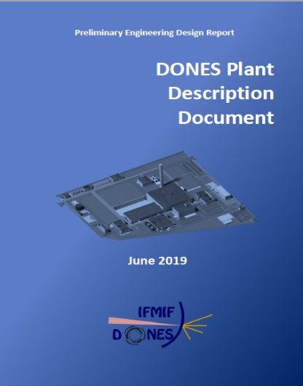
DONES Design Status
Engineering design
Developed for IFMIF (and a generic site) up to 2013 in the framework IEA and BA (IFMIF/EVEDA)
Developed for IFMIF-DONES from 2015 in the framework of the ENS WP of EUROfusion (+ FWC)
July 2023
Ready to start the construction and manufacturing phase
PEDR (Granada)
July 2023

Slide 9
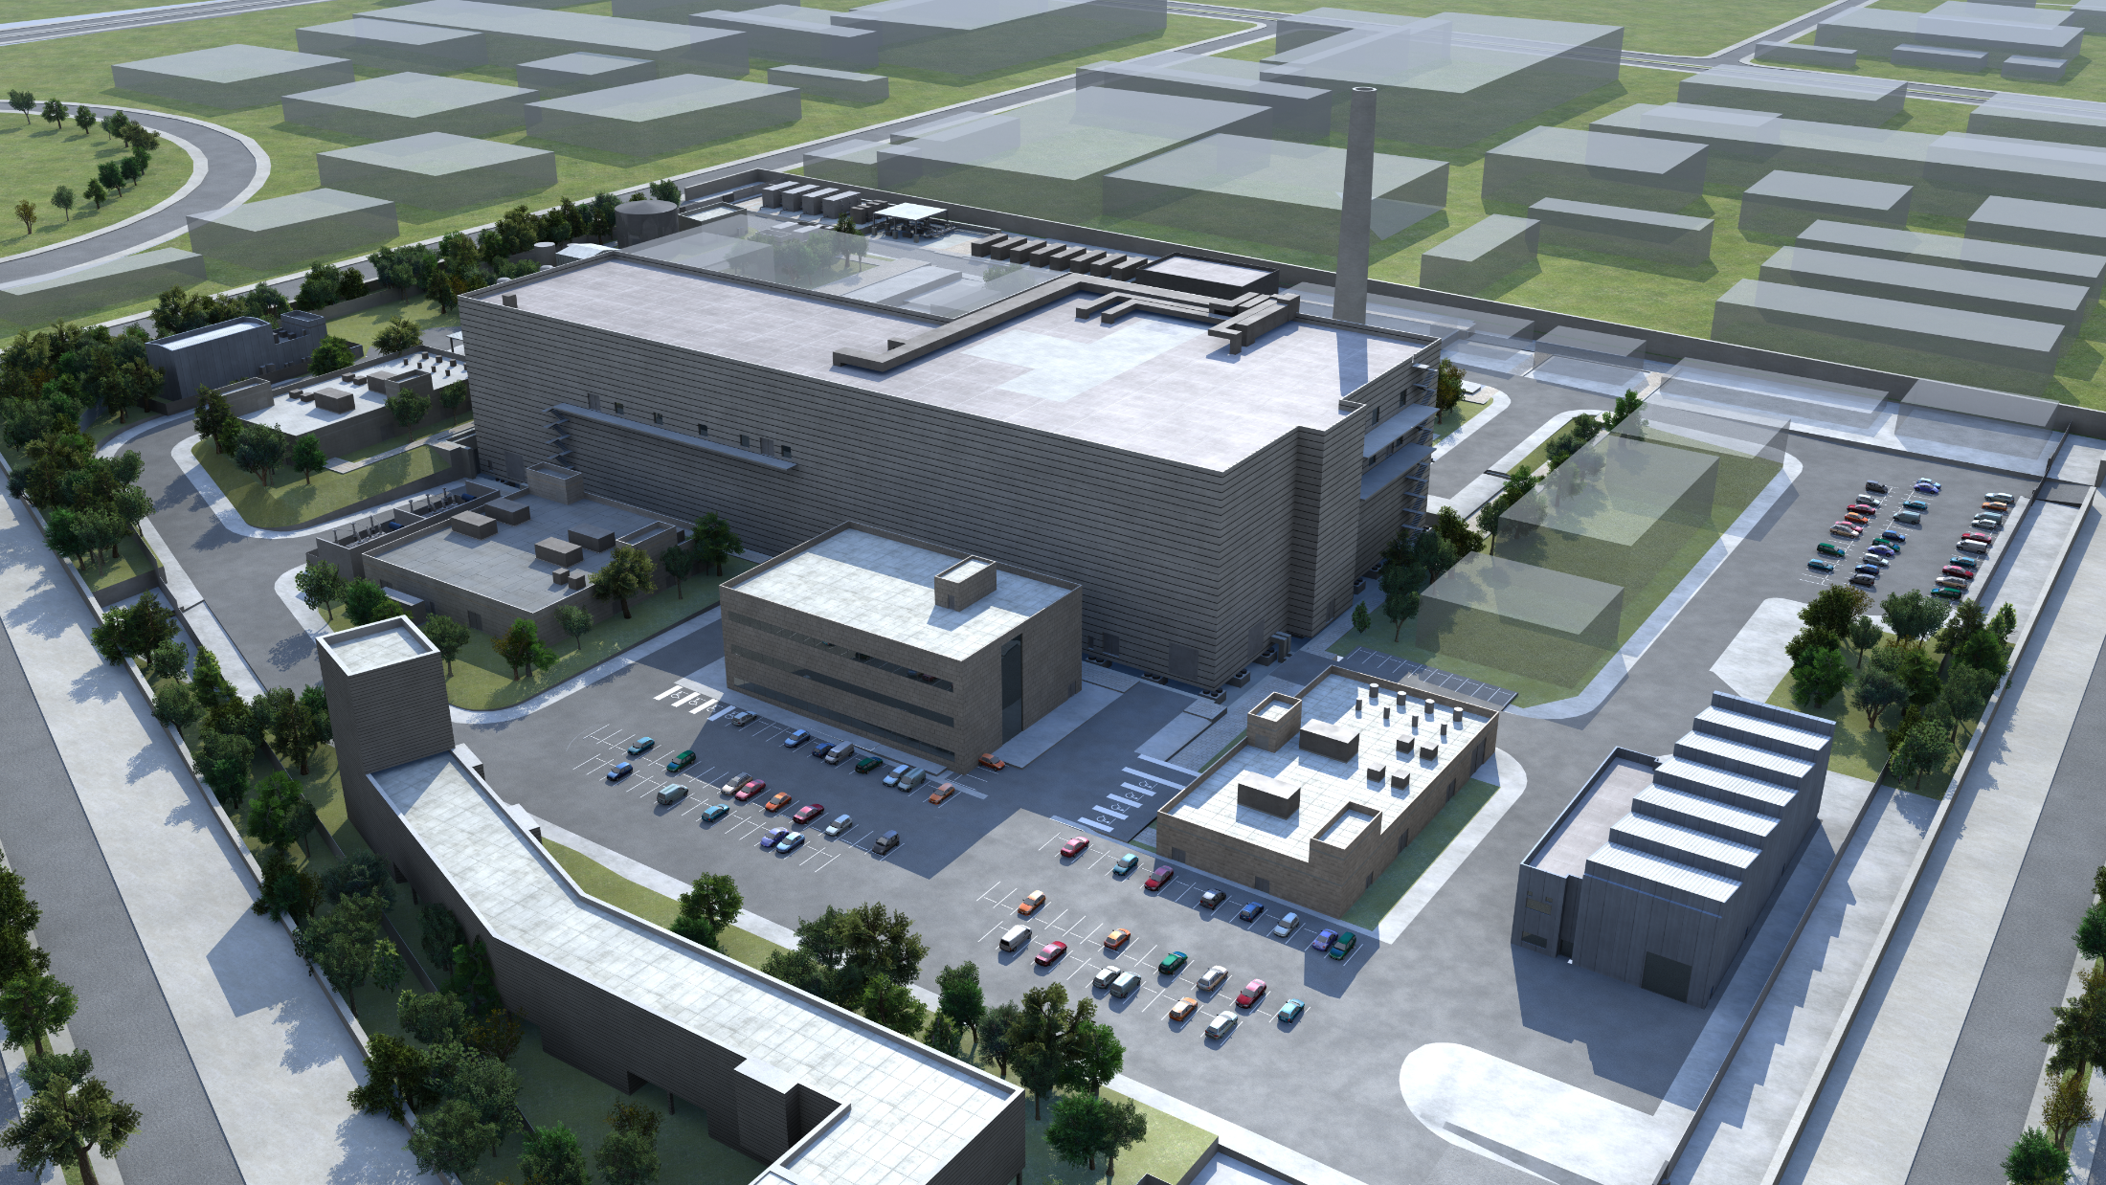
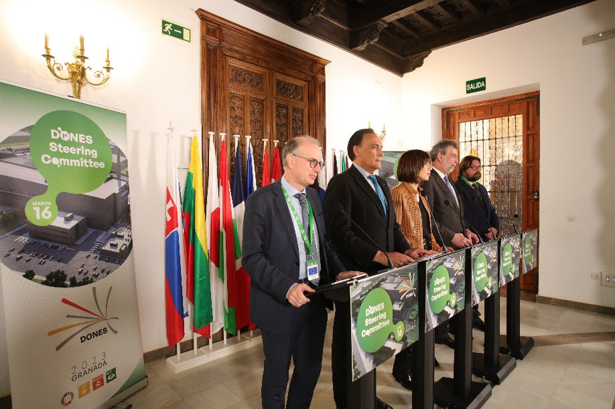
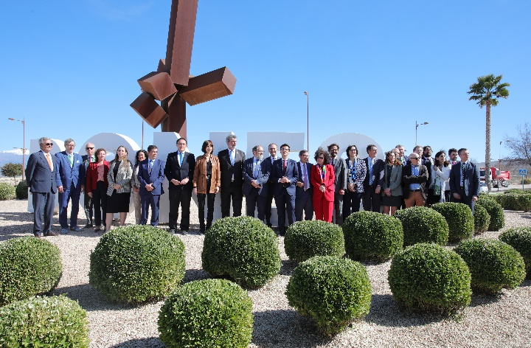
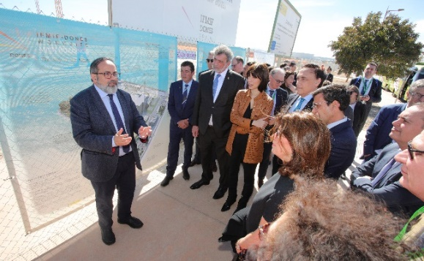
1st DONES Steering Committee was held in Granada, March 16th 2023 (it means the start of the Construction Phase of the DONES Programme)
2023 status

Slide 10
1st DONES Steering Committee was held in Granada, March 16th 2023 (it means the start of the Construction Phase of the DONES Programme)
2023 status
A Programme Team will be stablish to manage the Programme from the technical point of view
The role of all supporting projects will change!!!

Slide 11
FP9 (Horizon Europe) WPENS
Key objectives later on:
Key objectives for initial years:
to continue with the IFMIF-DONES design activities:
Draft specifications for the main building and conventional plant systems contracts
To assure readiness for handover to the Project Team
To identify pending validation activities and build up relevant prototypes
Effort on experimental results
Effort on upgrades and alternatives
Effort on preparation and technologies for operation phase
WPENS also takes care of all BA activitivies not related to LIPAc
DONES-PRIME
DONES-UGR
UE Contract for Engineering Activities

Slide 12
FP9 (Horizon Europe) WPENS
Key objectives later on:
Key objectives for initial years:
to continue with the IFMIF-DONES design activities:
Draft specifications for the main building and conventional plant systems contracts ready in 1-2 years
To assure readiness for handover to the future Project Team
To identify pending validation activities and build up relevant prototypes
Effort on experimental results
Effort on upgrades and alternatives
Effort on preparation and technologies for operation phase
WPENS also takes care of all BA activitivies not related to LIPAc
The transition period has started!!!
DONES-PRIME
DONES-UGR
UE Contract for Engineering Activities

Slide 13
Handover from WPENS to Programme Team
Handover of engineering work from WPENS to Programme Team (and later on to In-kind contributor) will take place
Handover means that the responsability for engineering development of a given system is transfer to the Programme Team (we can continue doing some work but on request)
Formally Handover will require the preparation of a Handover Documentation Package (contents still to be defined)
Handover will take place step by step along a period of time of around two years (or even longer)
First step will be a high level Design Review (to take place around summer time). Maybe there Will be other more detailed Technical Design Review for some systems
Next steps will include handover of the Access Cell cranes, Oil circuits of the Li loops (around autumm this year)
Later on Main Building, some Plant Systems, HEBT&BD and other components (beginning 2024)
….

Slide 14
Taking into account these challenges, also the IFMIF concept required specific prototyping and validation actions:
At the concept level: Mainly developed with some prototypes before 2005 and in the framework of the IFMIF/EVEDA Project (LIPAc, Li loop, corrosión database, HFTM stability)
At the preliminary design level: Mainly developed with some prototypes in IFMIF/EVEDA and WPENS
At the final design and transversal topics level: IFMIF/EVEDA, WPENS as well as in the future in-kind contributors
Needs identified in detail in a TRL analisis (2021) that also includes a summary of the results obtained up to that moment

Slide 15
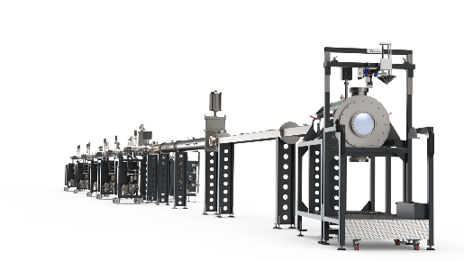
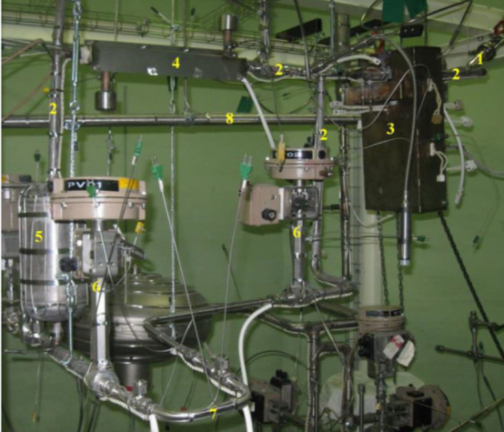
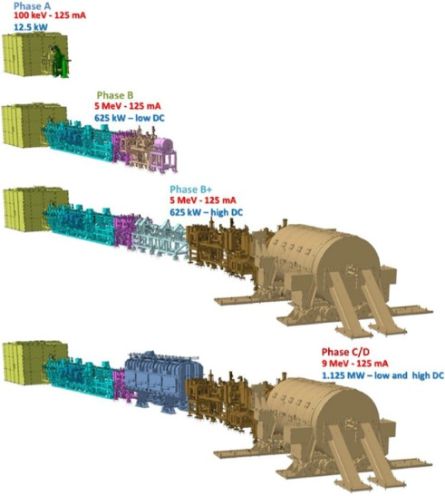
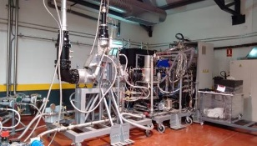
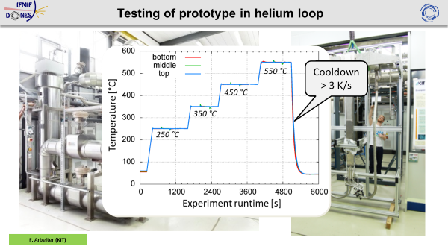
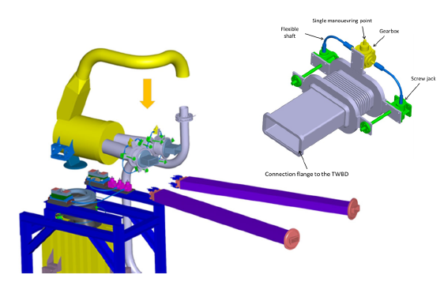
Prototyping and Validation Overview
LIPAc (Rokkasho)
Start-Up Monitoring Module (STUMM). Irradiation module to used during the commissioning phase in order to fully characterize radiation map
Quick Disconnecting System (QDS). To validate RH conection system
Multipurpose VaCuum accidental scenarios (MuVaCas). To analyze different posible accidental scenarios
Electromagnetic Pump prototype. To characterize pump performance
Li purification prototipe loop (LITEC) to test impurities control technology
LIFIRE facility to study Lithium fire risks
High Beta cavity & RF coupler
Meander-type beam extraction system
SSPA @175 MHz 200 kW CW
Shielding benchmarking using a 35 MeV (p, Be) neutron source
VALERIA for virtual reality RH simulation
Digital Mockup development
125 mA of D+ in pulsed mode transmitted by the RFQ with very high efficiency

Slide 16
Posible DONES upgrades and/or acceleration strategies
Discussions are presently going on in order to define posible acceleration strategies for fusion development. They can have some impact on DONES future baseline
Add reloading capabilities:
It will allow to go over to 50 dpa limit
It will be required additional hot cell capabilities to manage reloading of irradiatied materials in a new irradiation module
Add partial on-site facilities:
It will allow acceleration to obtain critical results after the irradiation (1-2 years faster)
It will be required additional hot cell capabilities for PIE
Add a second Accelerator:
It will allow a significant acceleration (results to be obtained a factor around 1,75 faster)
it will be required an additional complete Accelerator, some addtional AS+TS auxiliaries systems, bigger building, upgrade of some Plant Systems
Others…. (including all the ones related to the non-fusion related activities

Slide 17
