Slide 1

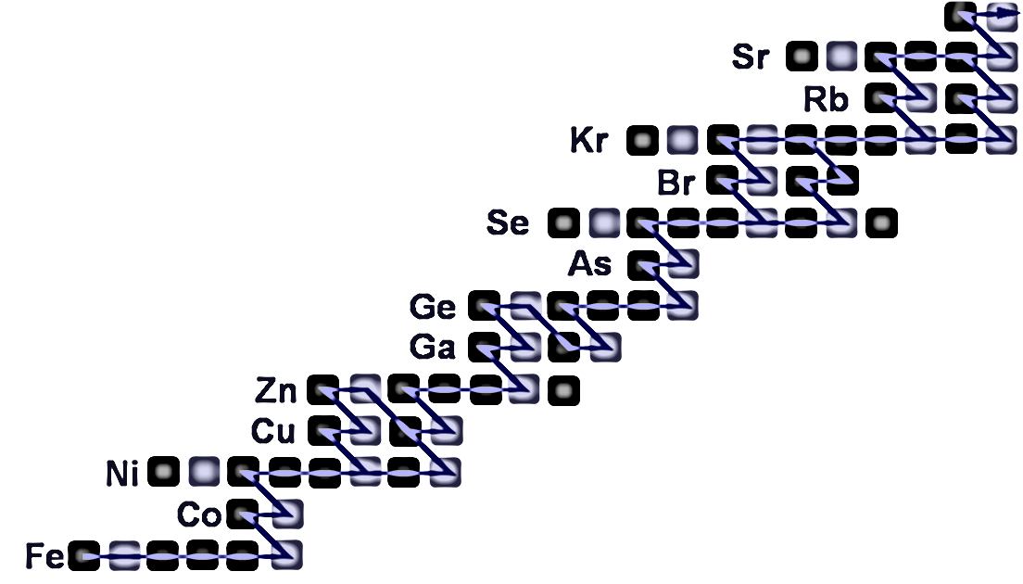



Nuclear Astrophysics Prospects at DONES
C. Domingo Pardo, on behalf of the fNUC@DONES working group
IFIC (CSIC-University of Valencia)
C. Domingo-Pardo, 2nd DONES Users Workshop, Granada, 19-20 October 2023

Slide 2
Outline
Nuclear Astrophysics Prospects at DONES
Introduction: neutrons in astrophysics and key open questions
(Neutron) Nuclear Data Needs in Astrophysics
Potential TOF and Activation XS measurements at DONES
Novel approaches that could be implemented at DONES
Summary & Outlook
C. Domingo-Pardo, 2nd DONES Users Workshop, Granada, 19-20 October 2023

Slide 3
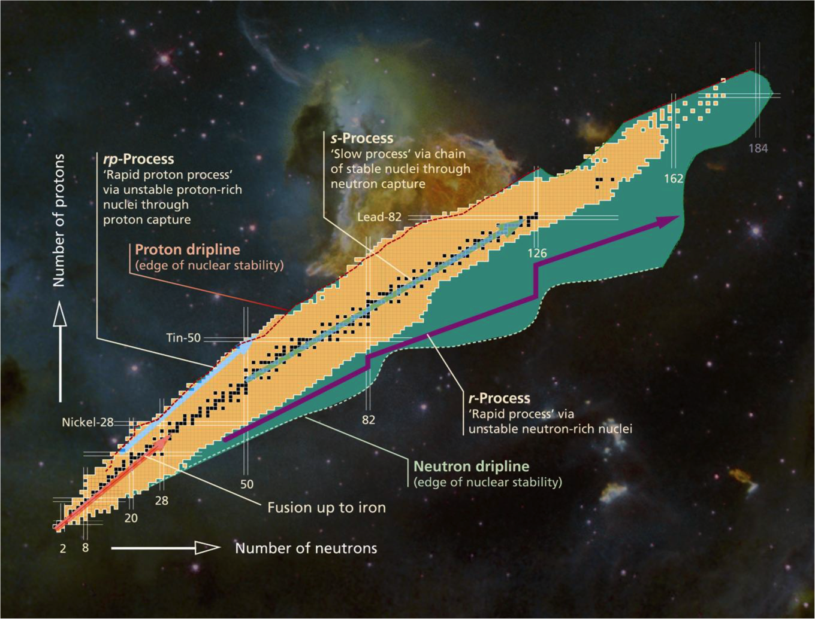
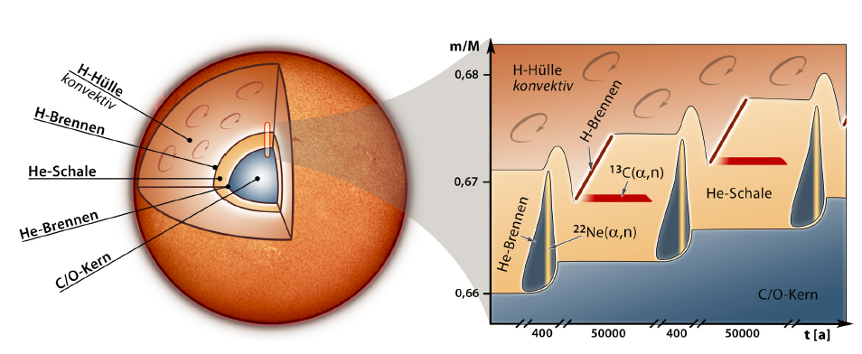
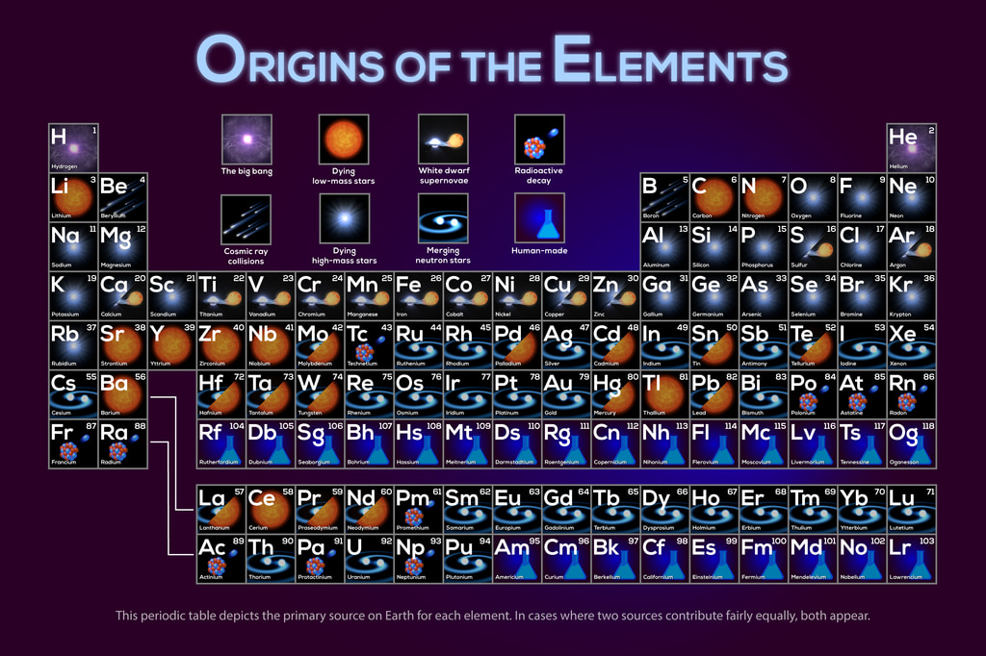
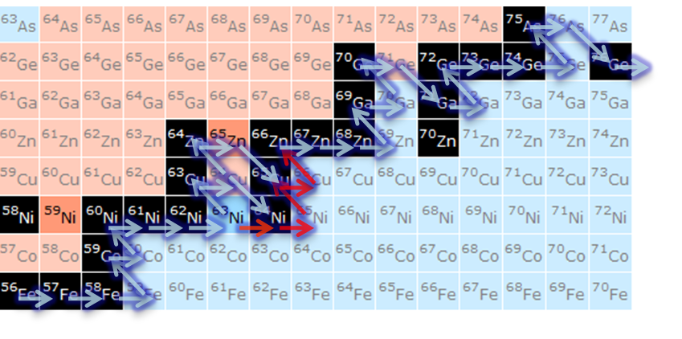
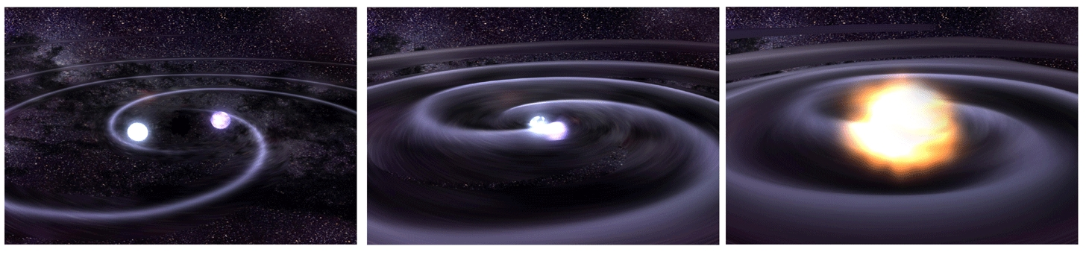
Red-giant stars
10⁶-10¹² n/cm³
NSMs, SNe, etc
>10²⁰ n/cm³

Slide 4
Outline
Nuclear Astrophysics Prospects at DONES
Introduction: neutrons in astrophysics and key open questions
(Neutron) Nuclear Data Needs in Astrophysics
Potential TOF and Activation XS measurements at DONES
Novel approaches that could be implemented at DONES
Summary & Outlook
C. Domingo-Pardo, 2nd DONES Users Workshop, Granada, 19-20 October 2023

Slide 5
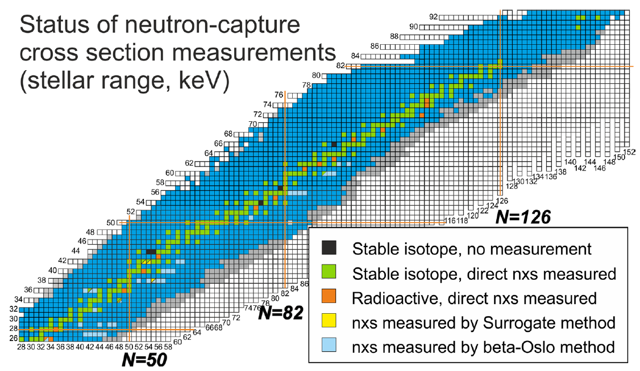
Neutron Data Needs in Astrophysics
Nuclear Astrophysics Prospects at DONES
Introduction: neutrons in astrophysics and key open questions
(Neutron) Nuclear Data Needs in Astrophysics
Activation and TOF measurements at DONES
Novel approaches
Summary & Outlook
I. Dillmann et al. Eur. Phys. Jour. A (2023)
C. Domingo-Pardo, 2nd DONES Users Workshop, Granada, 19-20 October 2023

Slide 6
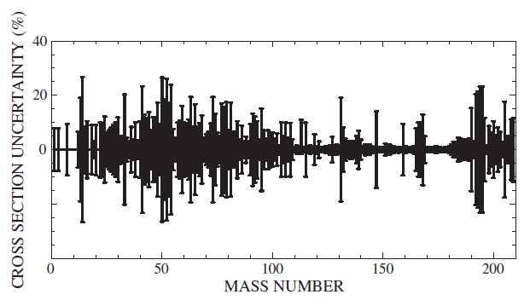
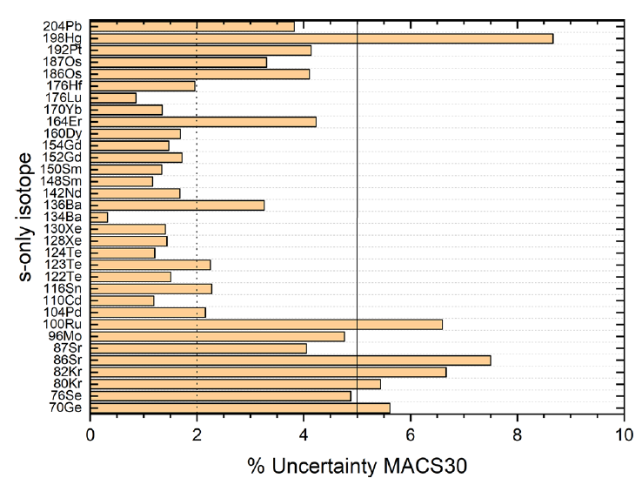
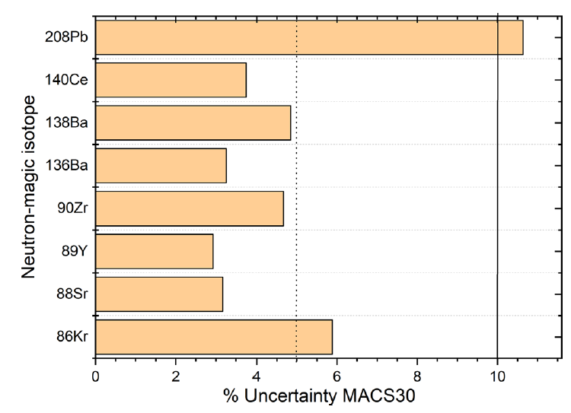
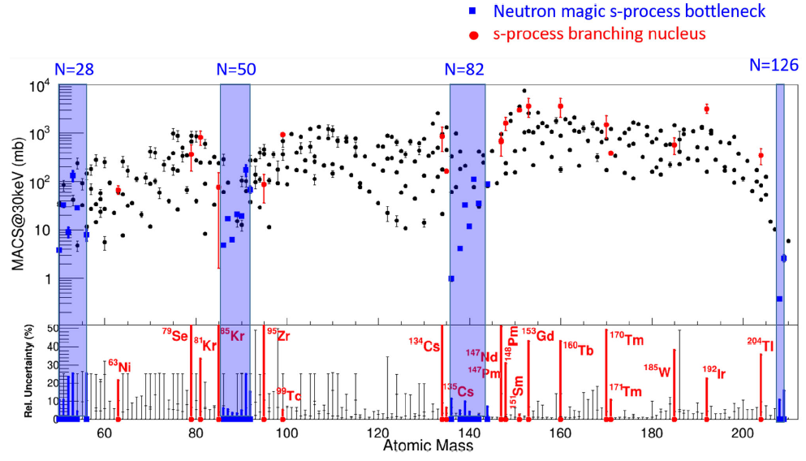
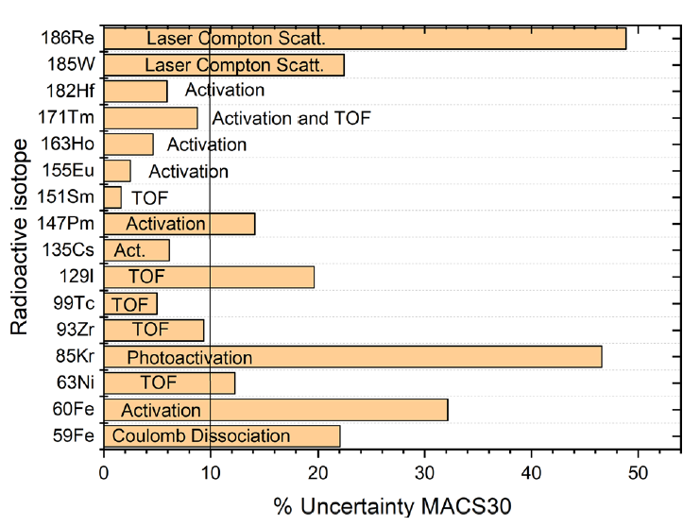
Neutron Data Needs in Astrophysics: s-process
Nuclear Astrophysics Prospects at DONES
MACS UNCERTAINTY @ 30 keV (%)
F. Käppeler et al. Rev. Mod. Phys. (2011)
I. Dillmann et al. Eur. Phys. Jour. A (2023)
C. Domingo-Pardo et al. Eur. Phys. Jour. A (2023)
C. Domingo-Pardo, 2nd DONES Users Workshop, Granada, 19-20 October 2023

Slide 7
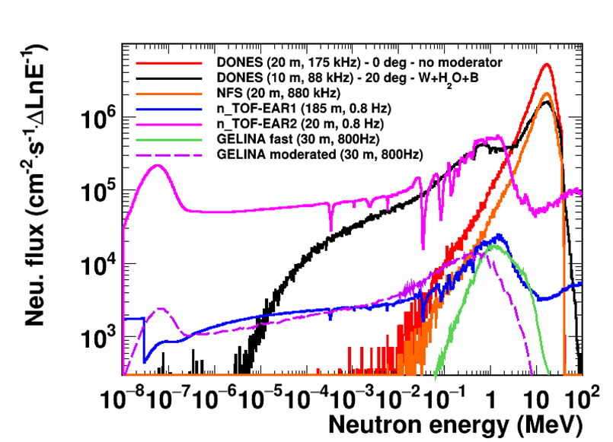
Neutron Data Needs in Astrophysics: s-process
Nuclear Astrophysics Prospects at DONES
COULD BE MEASURED AT DONES VIA TOF (OR ACTIVATION)!
MACS UNCERTAINTY @ 30 keV (%)
Stellar energy range of interest, where present uncertainties are large!
Later more on radioactive isotopes XS measurements
C. Domingo-Pardo, 2nd DONES Users Workshop, Granada, 19-20 October 2023

Slide 8
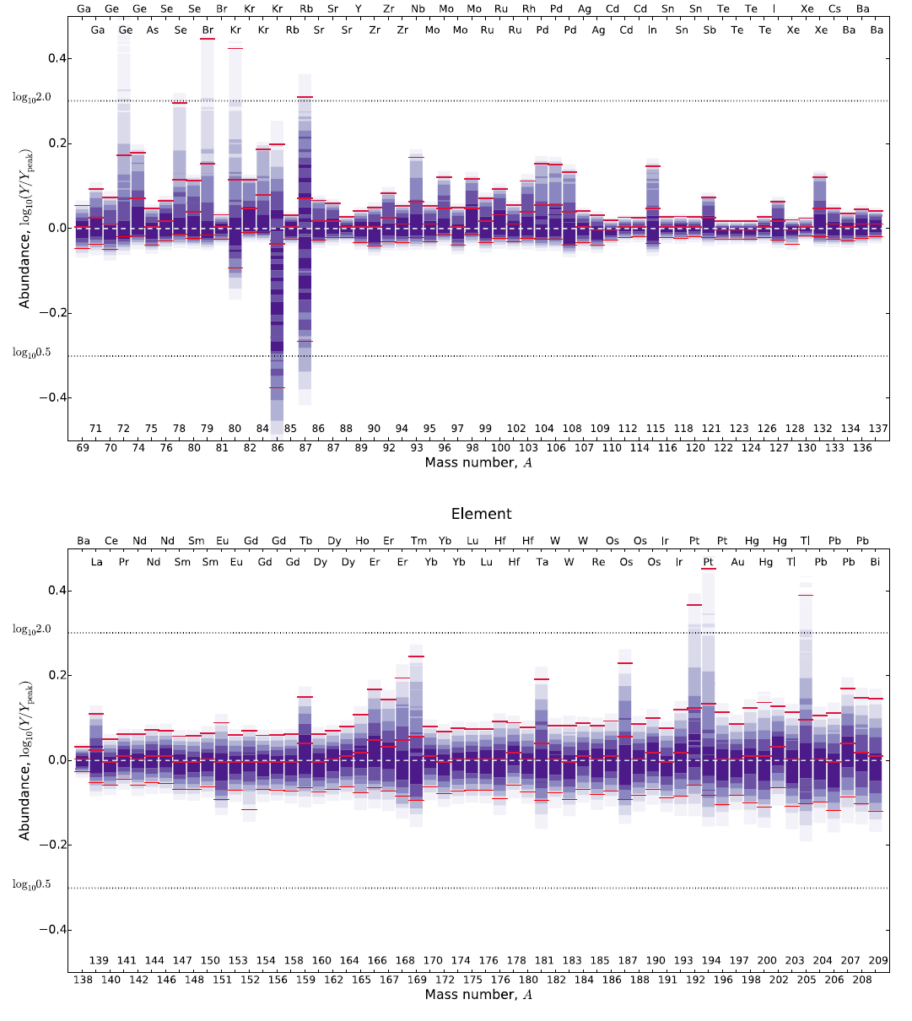
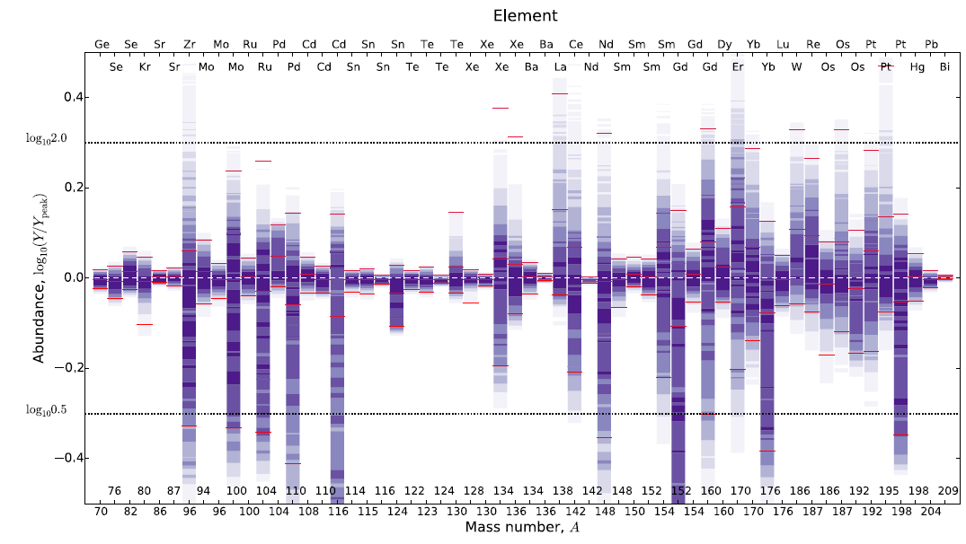
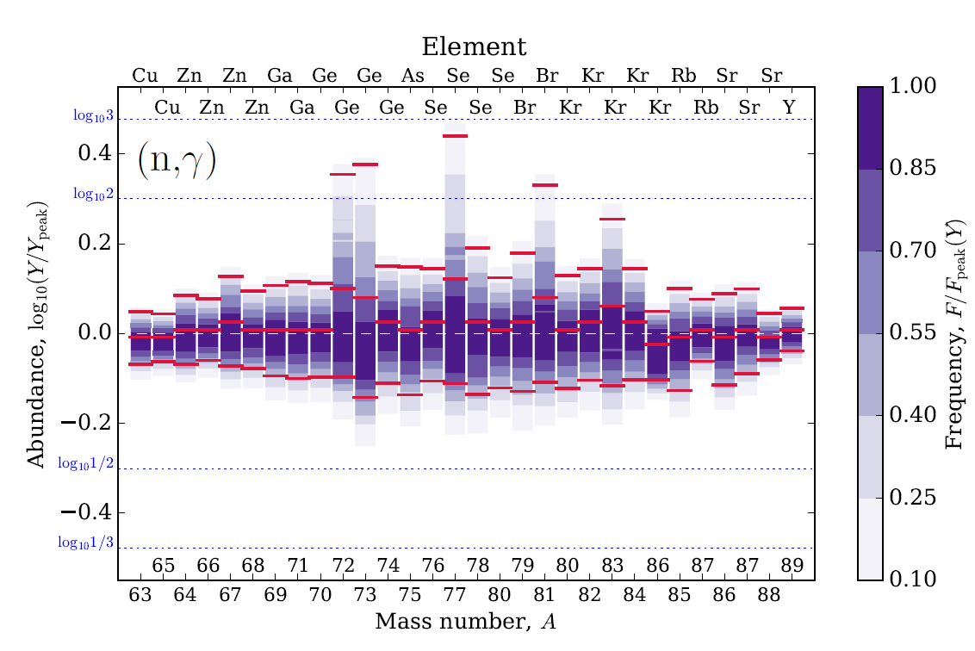
Neutron Data Needs in Astrophysics: s-process needs
Nuclear Astrophysics Prospects at DONES
“Several further reactions are of particular interest because of their broader impact: 56Fe(n,γ), 64Ni(n,γ), 138Ba(n,γ), and 140Ce(n,γ)”
All these stable nuclei could be measured at DONES via TOF (prev. Talk by E. Mendoza), especially in the high-energy (1keV-100keV) range for astrophysics!
Dying low-mass red-giant stars:
G. Cescutti et al. MNRAS (2018)
N. Nishimura et al. MNRAS (2016)
C. Domingo-Pardo, 2nd DONES Users Workshop, Granada, 19-20 October 2023

Slide 9
Outline
Nuclear Astrophysics Prospects at DONES
Introduction: neutrons in astrophysics and key open questions
(Neutron) Nuclear Data Needs in Astrophysics
Potential TOF and Activation XS measurements at DONES
Novel approaches that could be implemented at DONES
Summary & Outlook
C. Domingo-Pardo, 2nd DONES Users Workshop, Granada, 19-20 October 2023

Slide 10
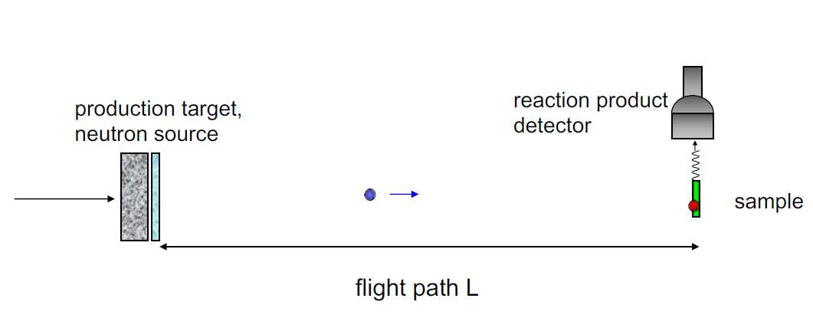
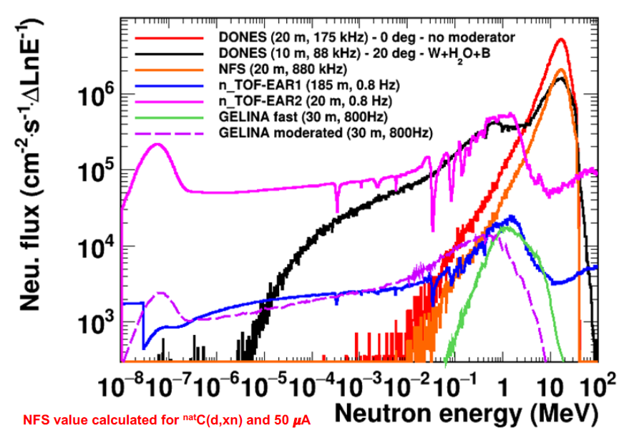
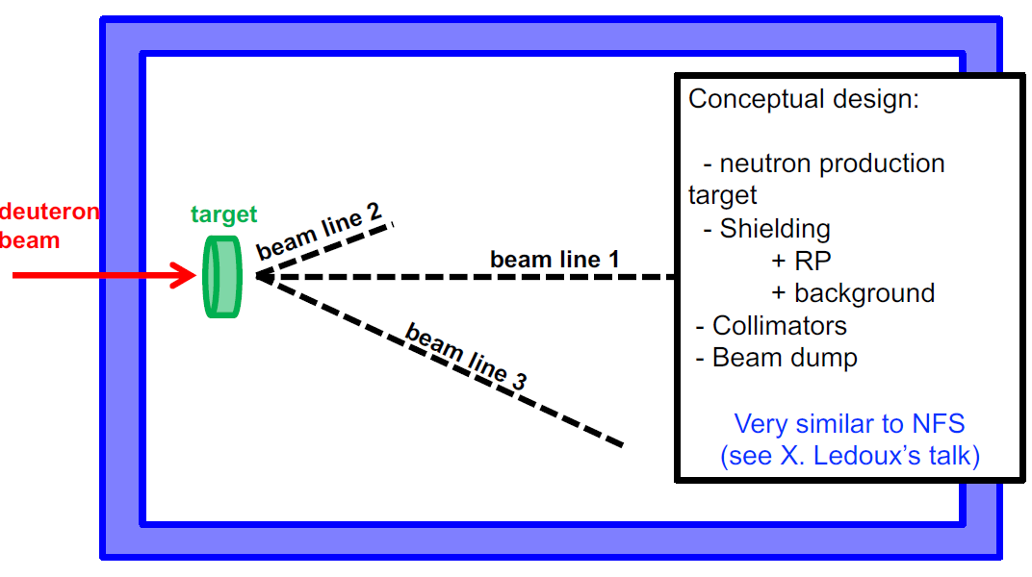
Activation and TOF measurements at DONES
Nuclear Astrophysics Prospects at DONES
TOF already covered in the previous talk by E. Mendoza at this workshop
See talk by E. Mendoza in this workshop and talk by D. Cano-Ott in 1st DONES Users Workshop 2022.
TOF Measurements require at least 1x10¹⁸ sample atoms!
C. Domingo-Pardo, 2nd DONES Users Workshop, Granada, 19-20 October 2023

Slide 11
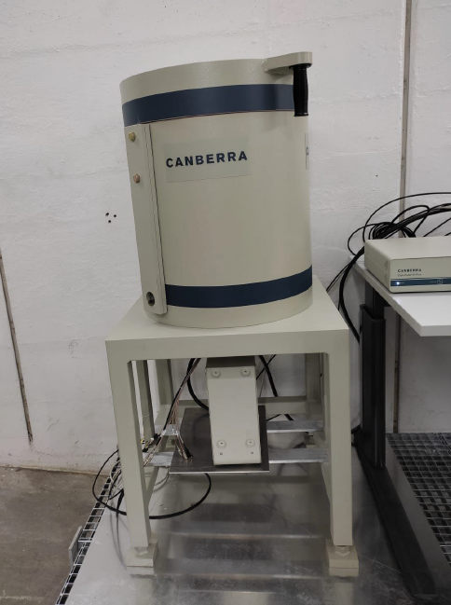
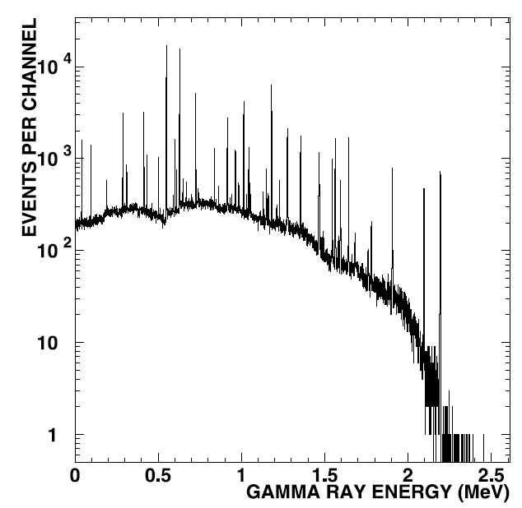
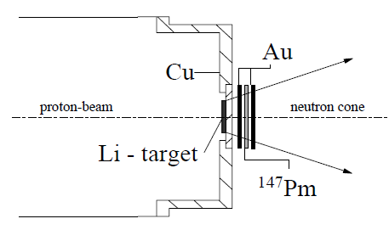
Activation and TOF measurements at DONES
Nuclear Astrophysics Prospects at DONES
TOF already covered in the previous talk by E. Mendoza at this workshop
Activation technique: most sensitive method nowadays (when applicable) to measure neutron-capture XSs
60Fe(n,γ)61Fe (t1/2 = 2.62 My), measured at FZK Karlsruhe with the activation method with a sample of 1.35 μg, corresponding to 1.35 × 10¹⁶ atoms, or ¹⁴⁷Pm(n,g) mesured with only 28 ng or 10¹⁴ atoms only!
“Typical” neutron-capture activation experiment:
Step 1: neutron irradiation in a Maxwellian spectrum
Step 2: measure decay activity
TOF Measurements require at least 1x10¹⁸ sample atoms!
R. Reifarth et al., The Astro. Jour. (2003)
C. Domingo-Pardo, 2nd DONES Users Workshop, Granada, 19-20 October 2023

Slide 12

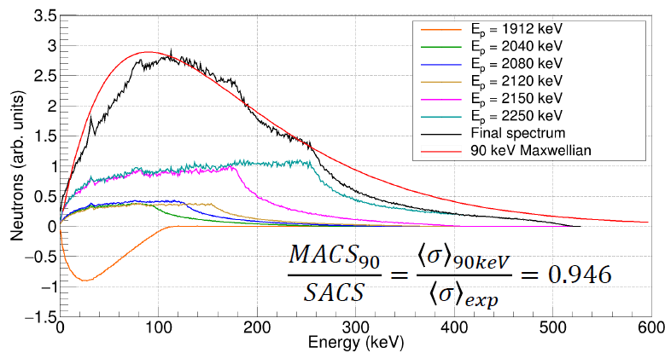
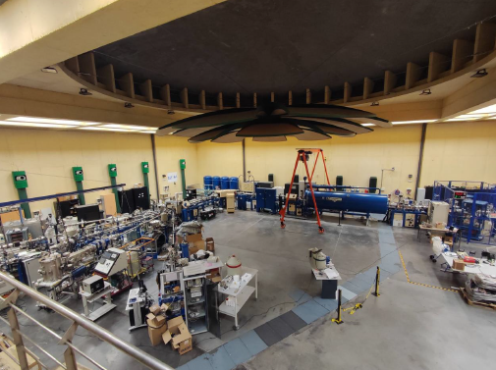
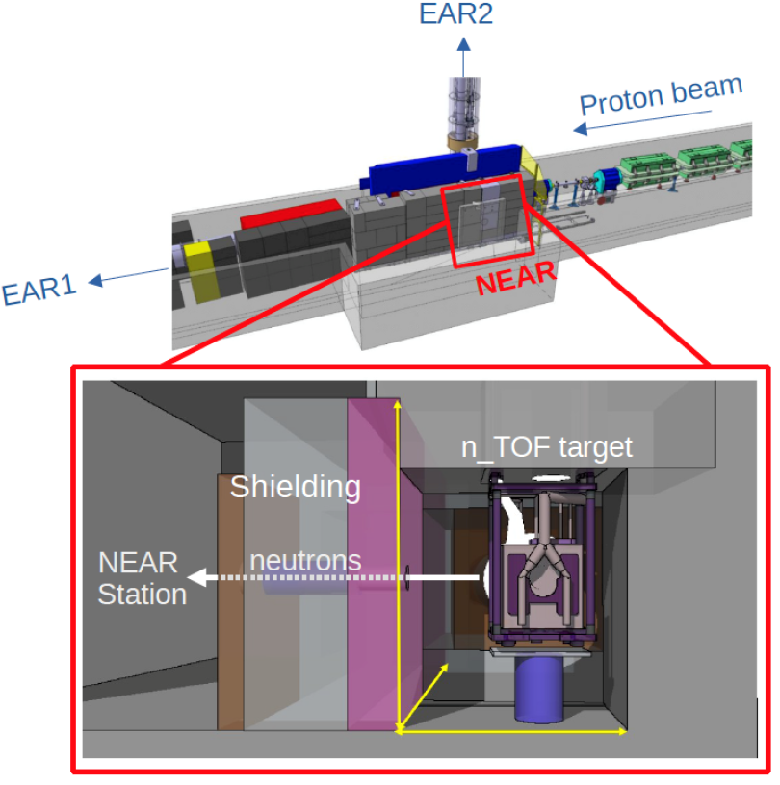
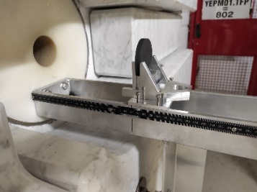
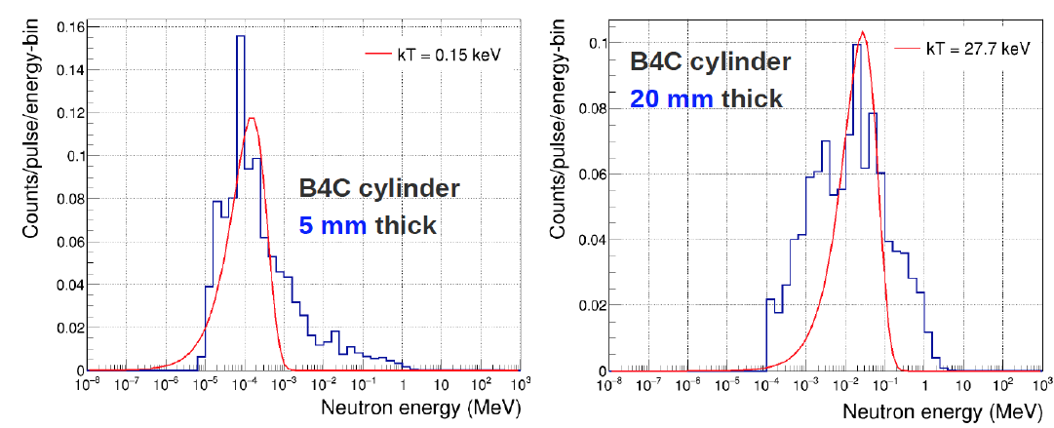

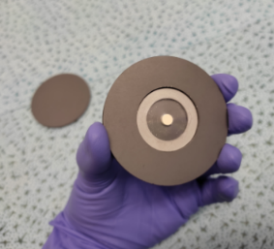
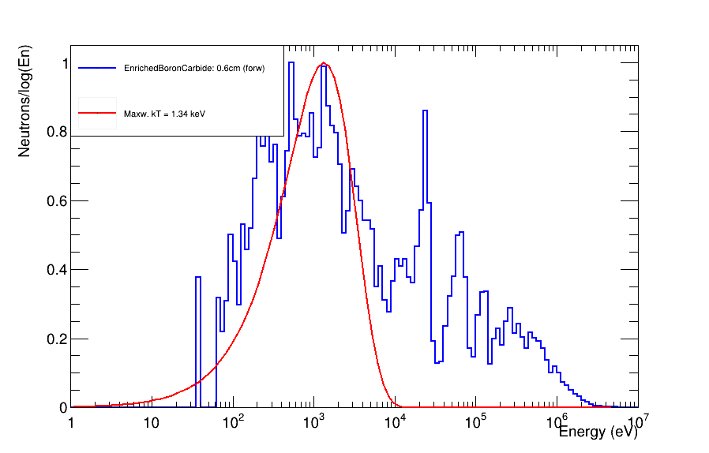
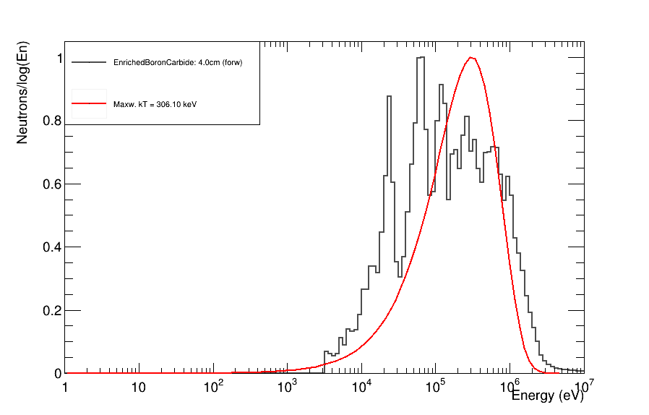

Activation and TOF measurements at DONES
Nuclear Astrophysics Prospects at DONES
→ Key question is how to produce a suitable Maxwellian energy spectrum
P. Pérez-Maroto, C. Guerrero et al., V CPAN Days, Santander 2023
6mm = 1 keV
40mm = 306 keV
A.Mengoni et al. (n_TOF Col.) CERN-INTC-I-222
https://cds.cern.ch/record/2737308
C. Domingo-Pardo, 2nd DONES Users Workshop, Granada, 19-20 October 2023

Slide 13
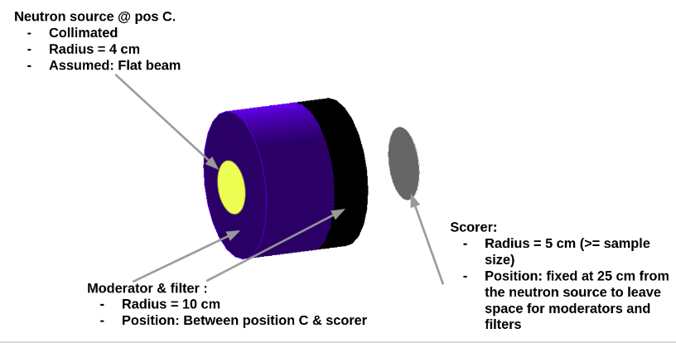
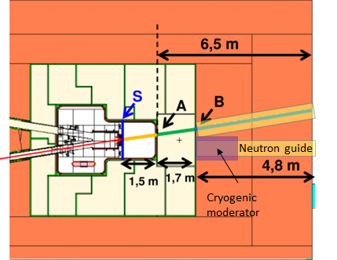
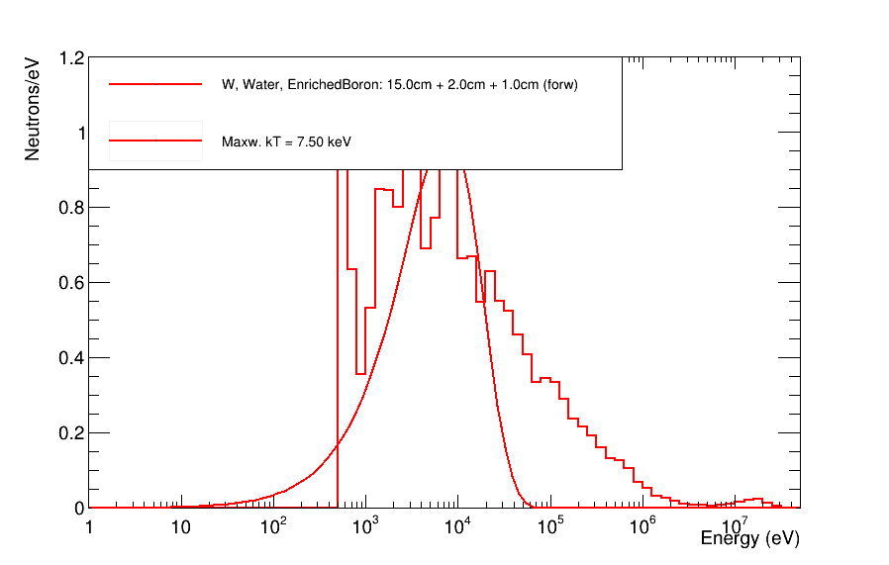
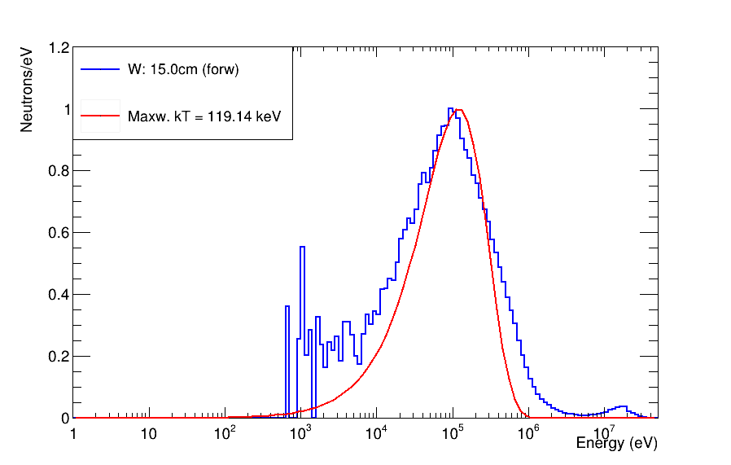
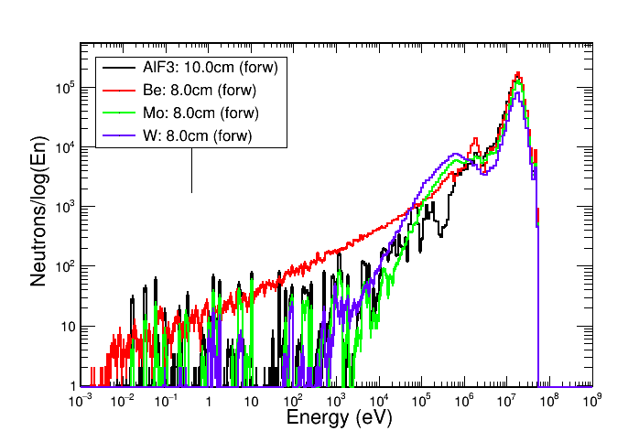
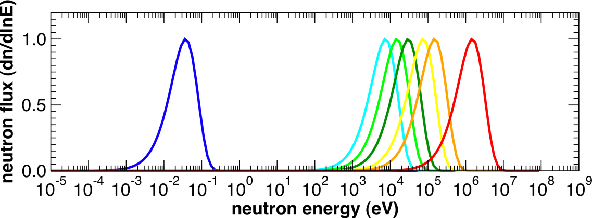
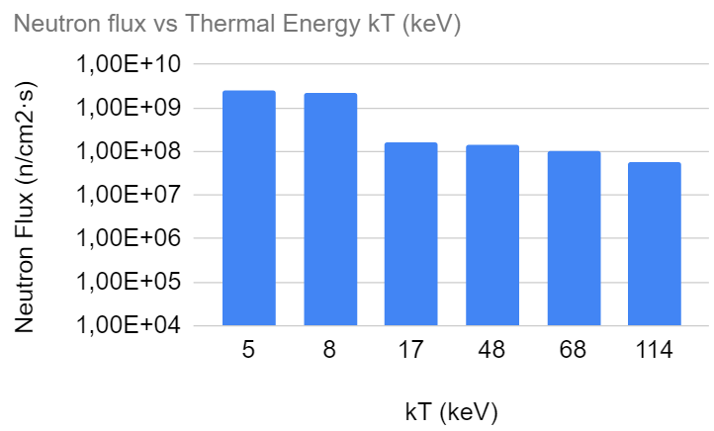
Activation and TOF measurements at DONES
Nuclear Astrophysics Prospects at DONES
C
B
kT = 120 keV
kT = 8 keV
Calculations by J. Lerendegui-Marco, IFIC (2022)
C. Domingo-Pardo, 2nd DONES Users Workshop, Granada, 19-20 October 2023

Slide 14
Outline
Nuclear Astrophysics Prospects at DONES
Introduction: neutrons in astrophysics and key open questions
(Neutron) Nuclear Data Needs in Astrophysics
Potential TOF and Activation XS measurements at DONES
Novel approaches that could be implemented at DONES
Summary & Outlook
C. Domingo-Pardo, 2nd DONES Users Workshop, Granada, 19-20 October 2023

Slide 15
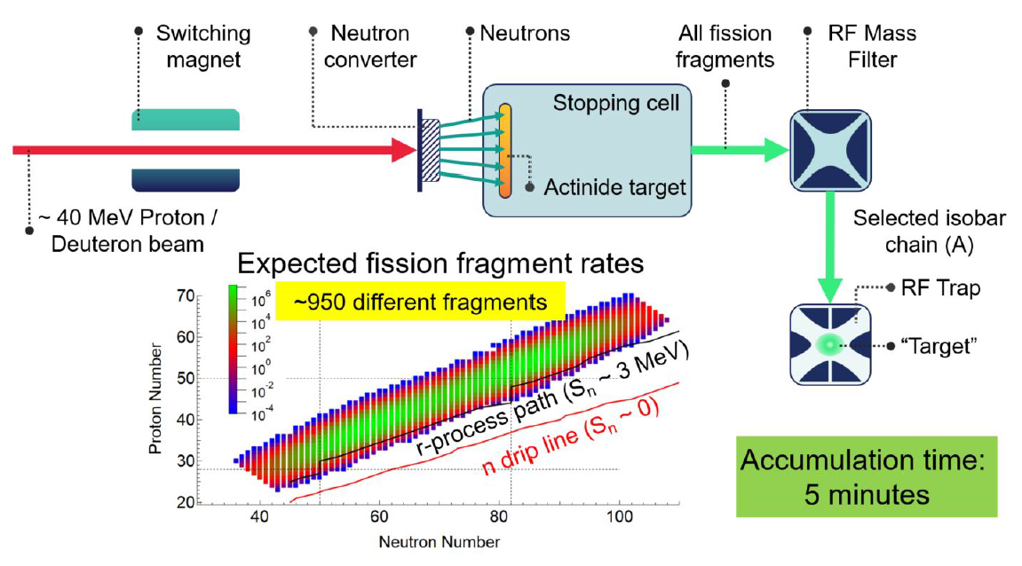
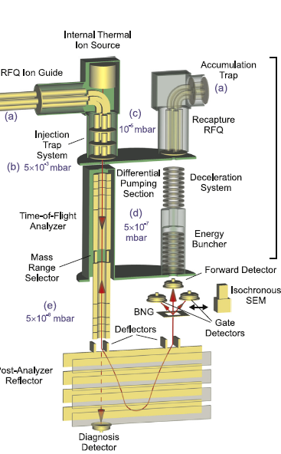
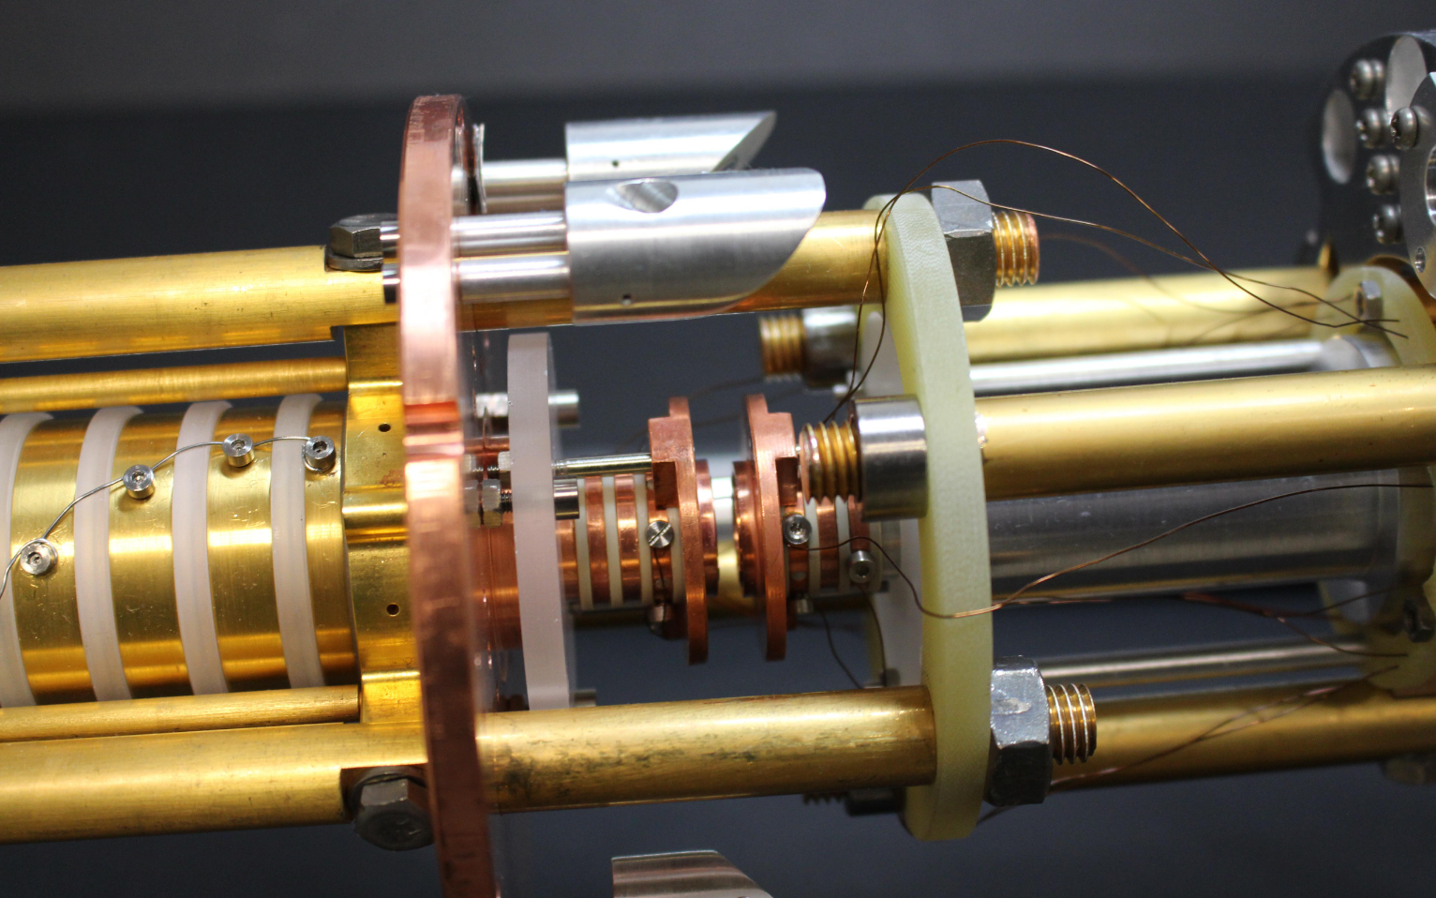
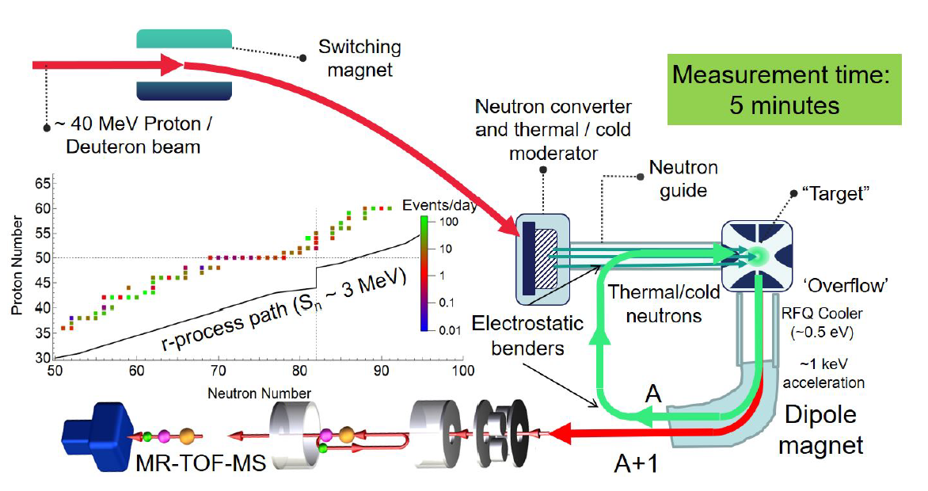
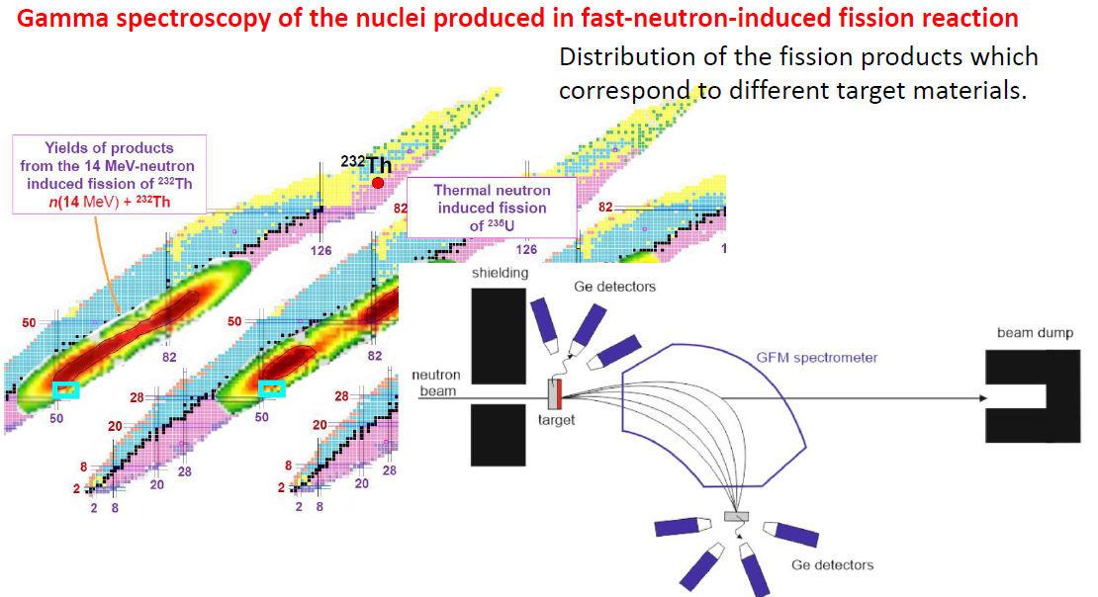
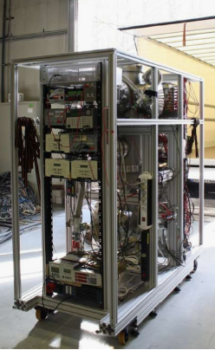
Novel activation concepts applicable at DONES: r-process
Nuclear Astrophysics Prospects at DONES
Step 1: produce a “sample” of trapped radioactive ions
Liq Li
10¹⁵n/s
10¹⁰ f/s
D, 40 MeV, 5 mA CW
6x10⁷ ions/s
PI: D. Rodriguez
10¹⁰ ions
MR-TOF-MS at Univ. Giessen (Germany)
Step 2: irradiate the radioactive ions with neutrons and measure via MR-TOF
A. Maj’ talk
10¹⁰n/s
10⁹ ions/s
→ See T. Dickel et al., EPJ-WC (2022) and refs. therein, Col. Giessen Univ. + SARAF
C. Domingo-Pardo, 2nd DONES Users Workshop, Granada, 19-20 October 2023

Slide 16
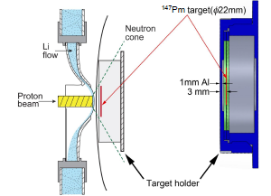
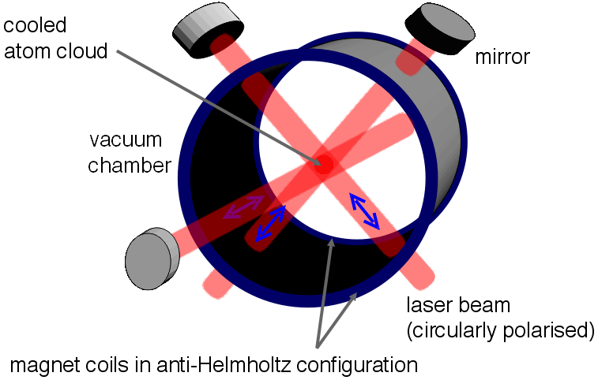
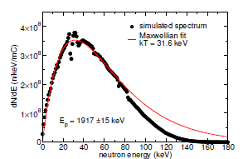
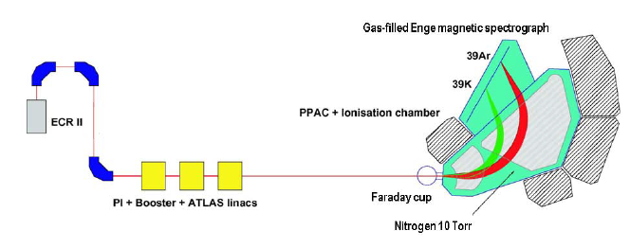
Novel activation concepts applicable at DONES: r-process
Nuclear Astrophysics Prospects at DONES
Soreq SARAF-LiLiT neutron source:
→ Counting activation products via ATTA, e.g. ^{80,84}Kr(n,γ)
Atom
Trap
Trace
Analysis
Ion-Trap experts at Univ. Granada (D. Rodriguez)
→ Counting activation products via AMS, e.g. ^{36,38}Ar(n,γ)
I. Mardor et al., arxiv, 2018
C.Y. Chen et al., Science, 1999
M. Paul et al. EPJ-WC, 2020
AMS experts at CNA-Sevilla
C. Domingo-Pardo, 2nd DONES Users Workshop, Granada, 19-20 October 2023
Notes:
ATTA: Atom Trap Trace Analysis. A particular isotope is selectively captured and repeatedly excited by resonant laser light in a magneto-optical
trap (MOT) and detected by observing its fluorescence. The isotopic ratios are measured by trapping successively
the rare isotope and a reference isotope by shifting the laser frequency accordingly and comparing the measured ratios to those of a Kr sample considered as standard.
AMS:

Slide 17
Summary & Outlook
DONES and its possible ancillary TOF-DONES and neutron-activation research facilities represent a unique opportunity to study a wealth of neutron-capture reactions of great interest in astrophysics.
A large need exists in the astrophysics community (s-process) regarding neutron-capture cross section measurements using stable isotopes, particularly in the “high” neutron-energy range (1keV-1MeV), which can be particularly well covered at DONES
Challenging experiments for r-process studies using radioactive samples could be investigated with the development and implementation of advanced techniques based on ion-traps, MR-TOF-MS and AMS.
There exists a broad and varied expertise in this field in Spain, both in terms of neutron capture experients utilizing the TOF technique (CERN n_TOF EAR1, EAR2 and HISPANOS@CNA) and activation experiments (CERN n_TOF NEAR and HISPANOS@CNA). For the most advanced detection concepts, such as AMS and Ion Traps, expertise is available nearby, at CNA Seville and University of Granada.
The implementation and development of these concepts at DONES would represent a unique opportunity to tackle top priority experiments of key relevance for astrophysics.
Thanks for your attention!

Slide 18
Backup slides

Slide 19
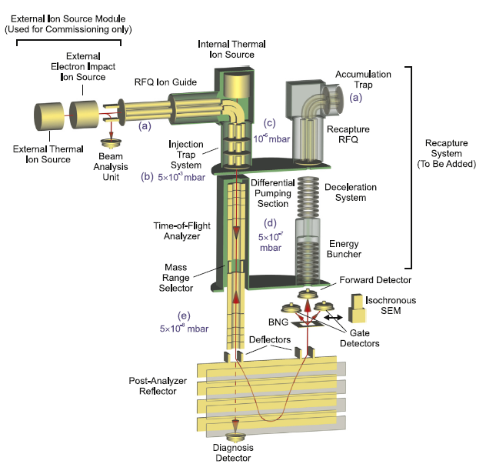
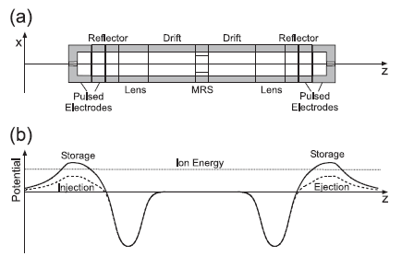

Multi-Reflection Time-Of-Flight Mass Spectrometry
T. Dickel et al.,Nucl. Instr. Meth. A 2015 http://dx.doi.org/10.1016/j.nima.2014.12.094

Slide 20
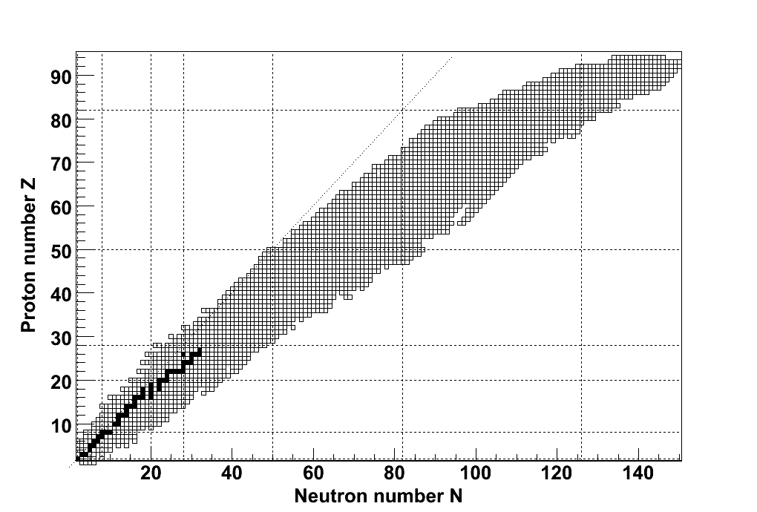





The s-process mechanism
φ_{n} small
λ_{β} >> λ_{n,γ}
τ_{β} << τ_{n,γ}
s process in red giant stars
s process
core He-burning shell C-burning
3-3.5·10⁸ K ~1·10⁹ K
kT=25 keV kT=90 keV
10⁶ cm⁻³ 10¹¹-10¹² cm⁻³
²²Ne(⁴He,n)²⁵Mg
= ^{A}Z(n,γ) ^{A+1}Z
Main input needed:
(n,γ) Cross Sections

Slide 21
The s-process mechanism
φ_{n} small
λ_{β} >> λ_{n,γ}
τ_{β} << τ_{n,γ}
s process in red giant stars
s process
core He-burning shell C-burning
3-3.5·10⁸ K ~1·10⁹ K
kT=25 keV kT=90 keV
10⁶ cm⁻³ 10¹¹-10¹² cm⁻³
²²Ne(⁴He,n)²⁵Mg
(!)
=
= ^{A}Z(n,γ) ^{A+1}Z
Pick-up message:
(n,γ) Cross Sections
Branching nuclei

Slide 22






(n,γ) Cross sections via prompt γ-ray(s) detection
BaF₂ Total Absorption Calorimeter (TAC)
n
(Z,A)
(Z,A+1)
+
C₆D₆ based Total Energy Detector (TED)
César Domingo-Pardo

Slide 23

Two different s-process sites
Two components were identified and connected to stellar sites:
Main s-process 90<A<210
Weak s-process A<90
TP-AGB stars 1-3 M⊙
massive stars > 8 M⊙
shell H-burning He-flash
0.9·10⁸ K 3-3.5·10⁸ K
kT=8 keV kT=23 keV
10⁷⁻10⁸ cm⁻³ 10¹⁰-10¹¹ cm⁻³
¹³C(α,n)¹⁶O ²²Ne(α,n)²⁵Mg
core He-burning shell C-burning
3-3.5·10⁸ K ~1·10⁹ K
kT=26 keV kT=91 keV
10⁶ cm⁻³ 10¹¹-10¹² cm⁻³
²²Ne(α,n) ²⁵Mg

Slide 24




CERN n_TOF facility
Water moderated
Stellar spectra
Fission & Fusion
Gen-IV
ADS
Present
reactors
  p(⁷Li,n)⁷Be @CNA
  D-D, D-T,… @CNA
Many

