Slide 1
IFMIF-DONES: Planned experimental areas and general capabilities
2nd DONES Users Workshop (19 – 20 October 2023)
S. Becerril, J. Castellanos, C. Meléndez, A. Zsakai, T. Dezsi, R. Michalczyk, U. Wiacek, A. Kurowski, G. Wojtania, R. Prokopowicz, G. Galazka, R. López, C. Prieto, I. Podadera, F. Arbeiter, D. Bernardi, W. Krolas, A. Ibarra

Slide 2
Contents
Spaces for tests and experiments
Ground floor
First floor
Test Cell (R130)
Envelope and service plugs
Neutron flux regions
Other Irradiation Modules
Ancillaries
R160
Facility for experiments with neutrons
Space and ancillaries
Potential experiments with neutrons
R026
Space and ancillaries
D+ beam extraction modes
Potential experiments
Other capabilities and systems potentially involved
Final conclusión
References

Slide 3
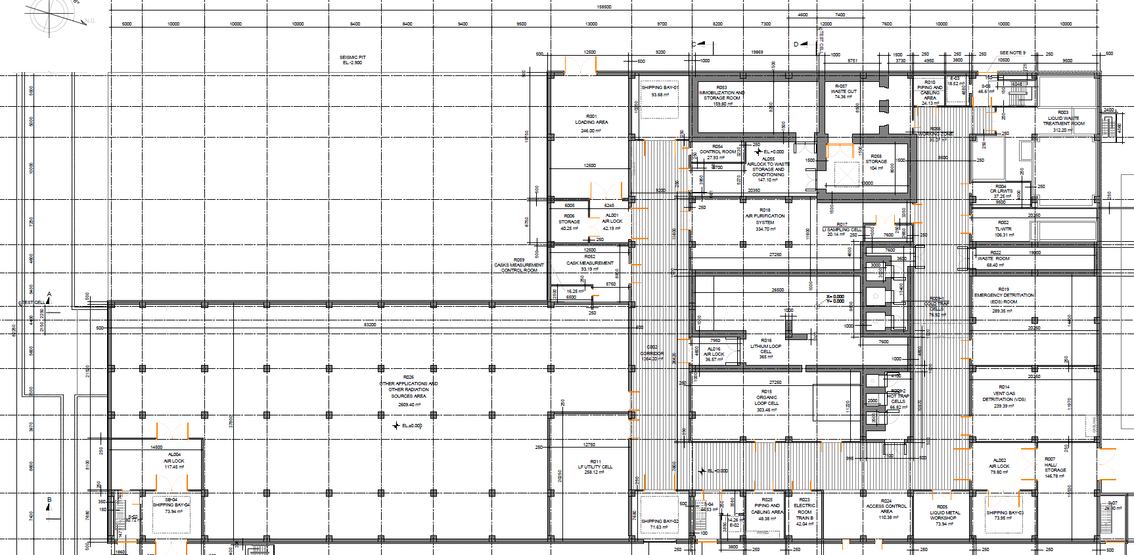
Spaces for tests and experiments – Ground floor
R026 ➔ Complementary experiments based on D+ beam
Below Accelerator Vault (R110)

Slide 4
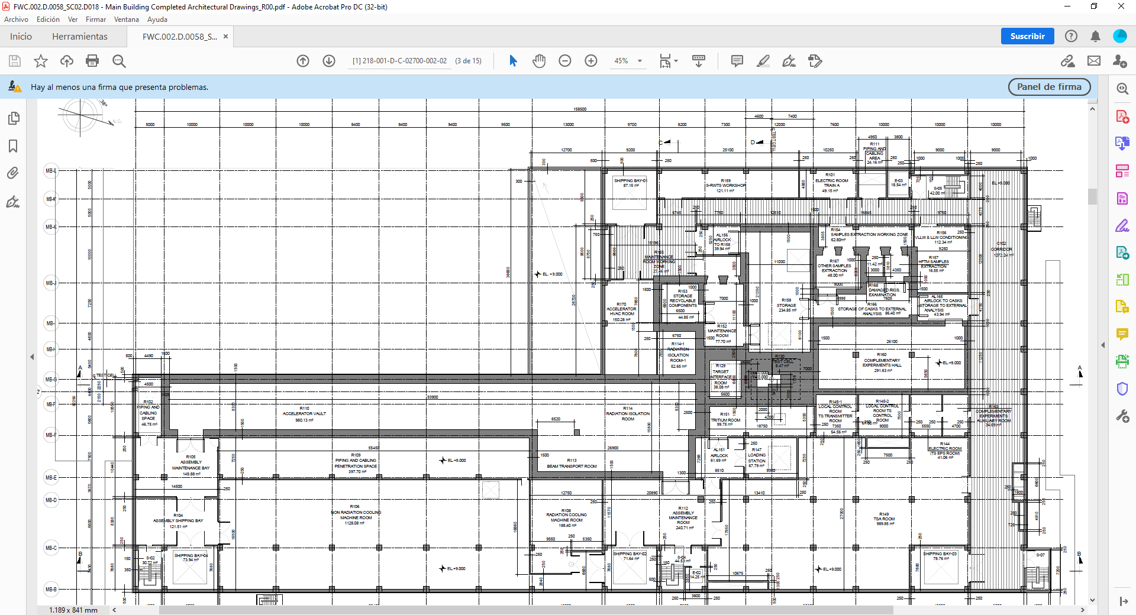
Spaces for tests and experiments – First floor
R130 (Test Cell) ➔ Highest flux neutron irradiation area
R160 ➔ Experiments based on neutron beam
Downstream to the TC
Some ancillaries rooms available

Slide 5
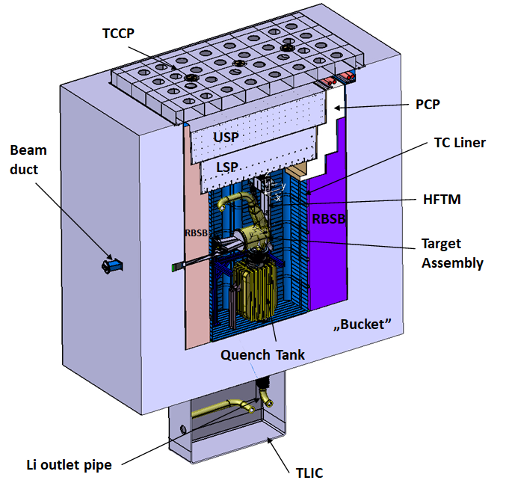
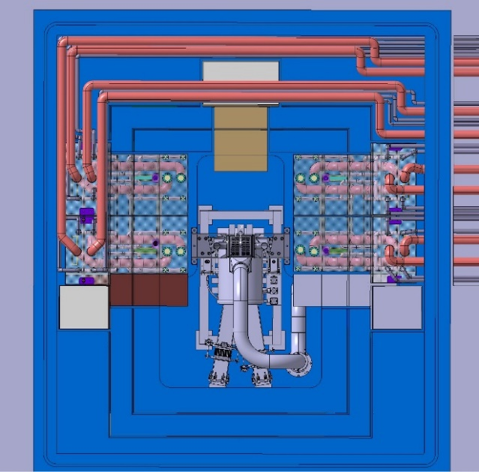
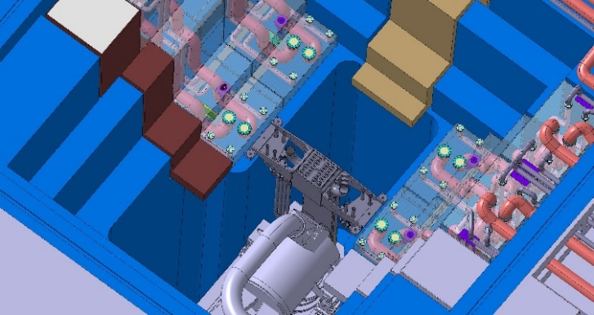
Test Cell – Envelope and service plugs
Envelope available for modules to be irradiated inside the Test Cell
1.3 - 1.5 m behind the Li target (X)
1.5 m (Y)
5.8 m high (Z)
Dedicated Piping and Cabling Plugs (PCP) for cablind and fluid service to the modules to be irradiated in the Test Cell
PCP
PCP
PCP
PCP
D+ beam

Slide 6
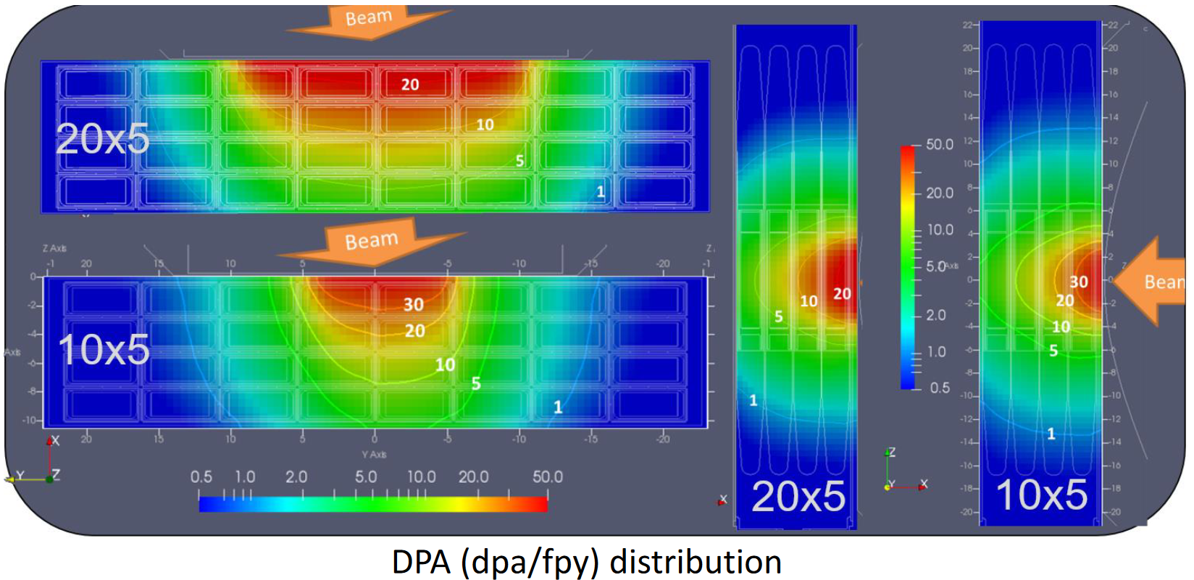
Test Cell – High-flux region
High-flux irradiation region
More than 300 cc submitted to 12 dpa/fpy
Around 200 cc submitted to 16.7 dpa/fpy
Compatible with top-level requirements

Slide 7
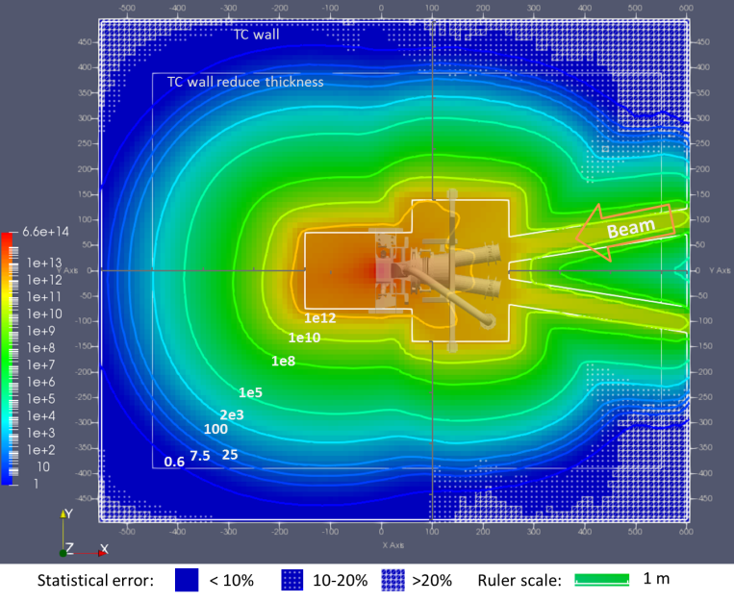
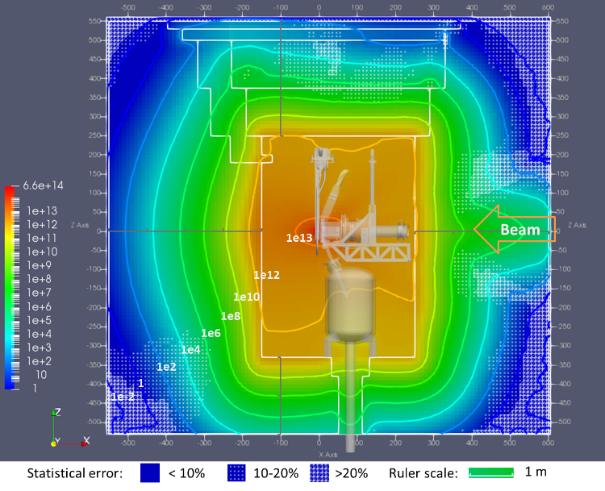
Test Cell – Medium and low-flux neutron regions
[MEDIUM FLUX REGION] Behind the HFTM → Around 3·10¹³ n/(cm²·s)
[LOW FLUX REGION] TC Liner walls downstream from the HFTM → Around 1·10¹² n/(cm²·s)
Courtesy of Y. Qiu

Slide 8
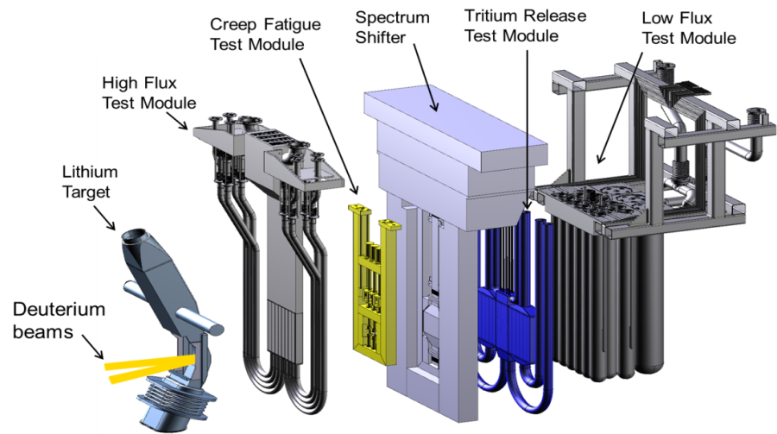
Test Cell – HFTM and Other Irradiation Modules
High Flux Test Modules (HFTM; A) for:
Reduced Activation Ferritic Martensitic Steels (250 – 550 °C)
Copper alloys (100 – 350 °C)
SiC or Tungsten alloys (1100 – 1200 °C)
Creep Fatigue Test Module (CFTM; B) for:
Reduced Activation Ferritic Martensitic Steels (250 – 550 °C)
Vanadium alloys (750 – 800 °C)
SiC or Tungsten alloys (1100 – 1200 °C)
Model Blanket Module (MBM) for:
Material compatibility in the Breeder Zone (HCPB)
Tritium Permeation
Structural behaviour of materials submitted to high pressure
Tritium Release Test Module (TRTM; C) for:
Ceramic Breeder materials or Berylium (300 - 1000 °C)
Liquid Breeder Validation Module (LBVM; D) for:
Liquid breeder materials
Test Module for superconductors irradiated at cryogenic temperature
Low Flux Test module (LFTM; E) for:
Vaccuum vessel materials
Others…
A
E
B
C
D
[See diverse talks about Irradiation Modules today and tomorrow: F. Arbeiter, G. Zhou, A. Spagnuolo, A. Venturini, B. Garciñuno, F. Mota, A. Serikov]
[See M. Serrano talk]

Slide 9
Test Cell – Ancillaries
Test Systems Ancillaries (TSA)
GICS (Gas Inventory Control System)
Provides the gas specimen (He, Ar) and pressure inside.
GPS (Gas Purification Unit)
Conditions the atmosphere temperature and purity.
WCS (Water Cooling System)
Provides cooling to TC Liner and external TC components.
HCS-LP (Helium Cooling System – Low Pressure)
Provides helium cooling (3.5 bar) to the HFTM.
HCS-MP (Helium Cooling System – Mid Pressure)
Provides helium cooling to Other Irradiation Modules (OIM; PBS4.5).
Rooms for TSA
R151 (Tritium Room)
Purification Units for GPS, HCS-MP y HCS-LP
R149
GICS, rest of GPS, WCS, HCS-MP and HCS-LP
R145-1
TS LICS (Local Instrumentation and Control)
First-order assessment on space reservation to accommodate needs from Test Modules is ongoing
R145-1
R151
R149

Slide 10
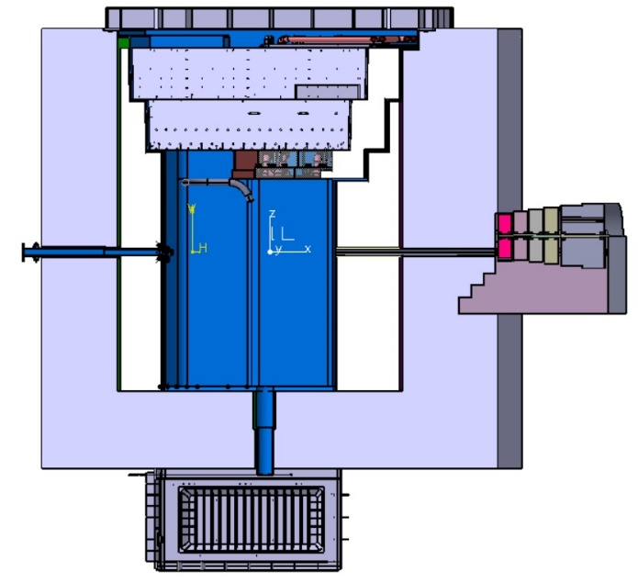
R160 – Facility for experiments with neutrons
R160 is fed by the neutron field produced in the TC through the stripping reaction (D+, Li)
The Neutron Beam Tube (NBT) provides a free channel downstream for neutrons coming from TC
Neutron Beam Shutter (NBS)
Open → Enables experiments (access forbidden to R160)
Closed → Limited access allowed (yellow area) while TC in working conditions
Neutron flux density at the exit of the Neutron Beam Shutter (open) → About 2·10¹⁰ n/(cm²·s)
Neutron moderators needed to adjust neutron spectrum for experiments
Appropriate shieldings inside the R160 likely necessary
Neutron Beam Dump → Foreseen to avoid production of secondary neutrons and photons (20 m away from NBS exit)
Neutron Beam Tube
R160
R130
Neutron Beam Shutter
R160 floor
Courtesy of D. Oravecz
[See specific talk tomorrow about the Neutron Beamline and Shutter]

Slide 11
R160 – Facility for experiments with neutrons

Slide 12
R160 – Space and ancillaries
R160 (292 m²; 8 m high)
Placed downstream to the Test Cell (R130)
Test Systems Ancillaries (TSA)
GICS (Gas Inventory Control System)
Provides the gas specimen (He, Ar) and pressure inside.
GPS (Gas Purification Unit)
Conditions the atmosphere temperature and purity.
WCS (Water Cooling System)
Provides cooling to TC Liner and external TC components.
HCS-LP (Helium Cooling System – Low Pressure)
Provides helium cooling (3.5 bar) to the HFTM.
HCS-MP (Helium Cooling System – Mid Pressure)
Provides helium cooling to Other Irradiation Modules.
Rooms for TSA and Complementary Experiments with neutrons
R151 (Tritium Room)
Purification Units for GPS, HCS-MP y HCS-LP
R149
GICS, rest of GPS, WCS, HCS-MP and HCS-LP
R163: Ancillary Room for Complementary Experiments
R151
R163
R151
R149
R149

Slide 13
R160 – Potential experiments with neutrons
Fundamental particle physics studies with cold and ultra-cold neutrons
Neutron scattering experiments with moderated neutron beams
Experiments with samples exposed to neutrons
Analysis of neutron-rich isotopes production by neutron induced fission
Maxwellian-averaged capture cross-section for some stellar nuclear reactions by activation techniques with neutrons
Analysis of radioisotope production routes by nuclear decay induced reactions
Characterization of materials by radiation analysis (for medicine, chemistry, biology, forensics,…)
Imaging techniques with neutrons
Fast neutron irradiation of components, devices or bio-samples
Medical treatment of patients using neutrons.

Slide 14
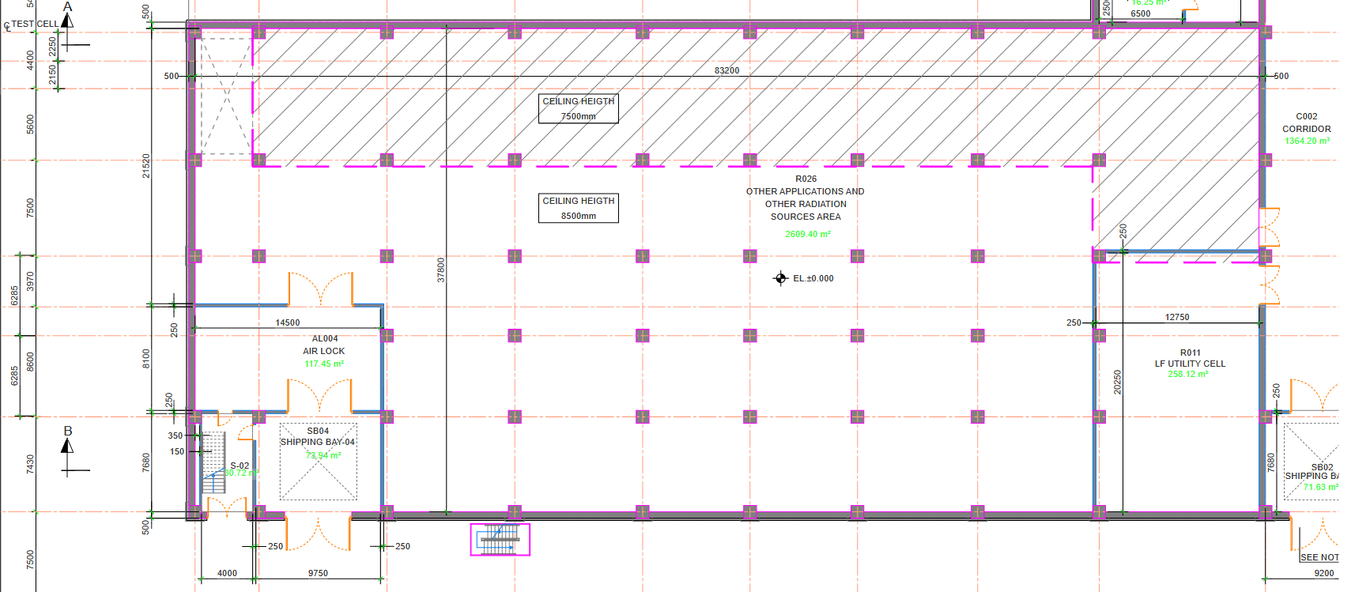
R026 – Space and ancillaries
Area: 2609 m²
Height: 7.5 m (dashed area) / 8.5 m
Huge area likely able to include many ancillaries and appropriate shieldings for the experiments to be held in there.

Slide 15
R026 – D+ Beam extraction modes
D+ parisitic beam extraction between QP3 and QP4 of the HEBT → Very interesting also for quality management of the beam [see I. Podadera’s talk tomorrow about the D+ beam extraction]
Single Bunch extraction
Meander vacuum line
Kicker + Electrostatic septum + Septum magnet to extract and bend the parasitic beam by 34° downwards
2 additional dipoles to complete the whole 180° of the beam
4 quadrupole (QP) doublets to keep the parasitic beam focused
Simultaneous to the irradiation of the Li target
Courtesy of M. Vázquez
0.1
5
8.3
13.9
21.3
30.3
40 MeV
Injector
LEBT
RFQ
MEBT
Superconducting cavities
HEBT
R026
R026
Courtesy of D. Sánchez

Slide 16
R026 – D+ Beam extraction modes
Beam extraction between QP3 and QP4 of the HEBT
Slow extraction
Meander vacumm line
Selection of macropulses by means of a switching field from a permanent chopper in LEBT section
Optional chopper in MEBT section for tails removal of the macropulse
Non-simultaneous operation. The irradiation of the Li target needs to be interrupted
0.1
5
8.3
13.9
21.3
30.3
40 MeV
Injector
LEBT
RFQ
MEBT
Superconducting cavities
HEBT
R026
Courtesy of D. Sánchez

Slide 17
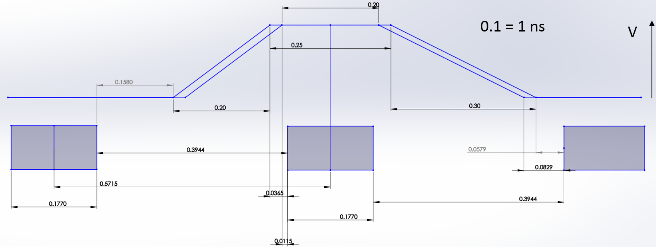
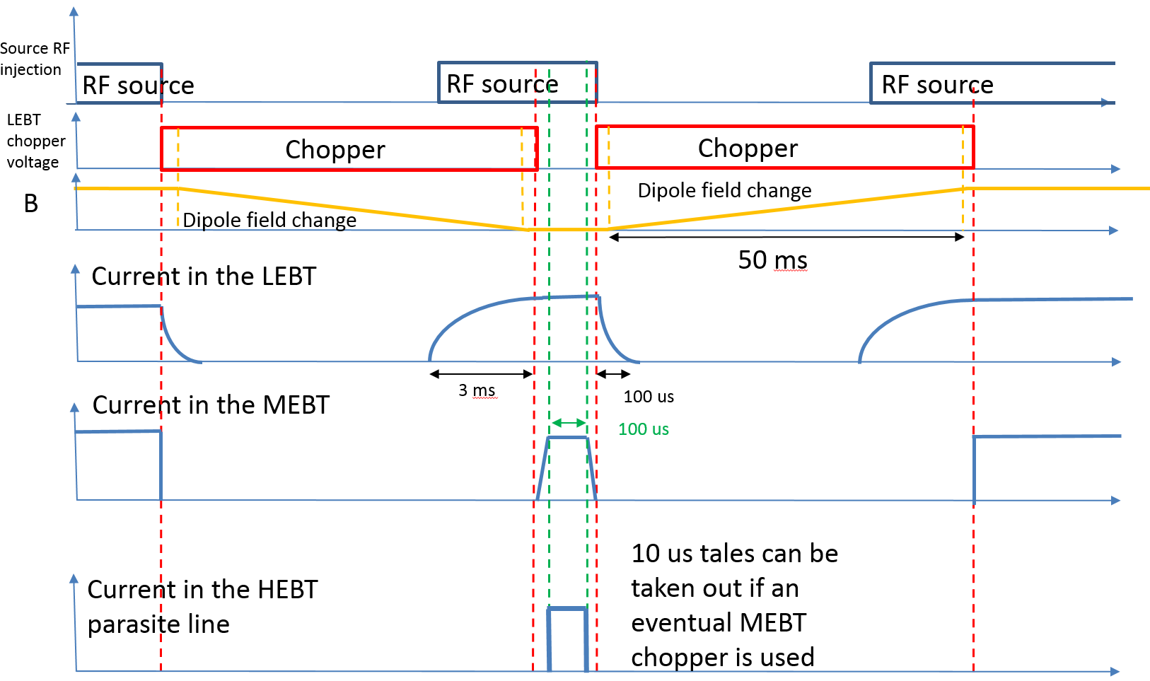
R026 – D+ Beam extraction modes
Main beam → D+ ion beam 125 mA / 40 MeV (5 MW) @ 175 MHz (CW, 5.7 ns period)
Single bunch extraction
Extraction of a fraction (0.1 - 1%) of the beam @ 40 MeV
For 0.1% case
125 µA (averaged current)
40 MeV
175 kHz
5 kW (averaged power)
Bunch length < 10 ns
Slow extraction (whole beam)
Based on a switching dipole solution
Fastest chopper field switch = 50 ms
Example of bunch timing conditions (Single bunch)
Bunch extracted
T = 5.7 ns
T = 3.9 ns
1.8 ns
Shortest time to restore normal operation = 100 ms
Chopper activation every 10 s for 1% usage

Slide 18
R026 – Potential experiments
With pulsed neutron beam (ToF-DONES facility)→ A neutron production target is necessary
Neutron cross section measurements
Gamma-spectroscopy of nuclei produced in fast-neutron-induced fission reaction
Investigation of pygmy dipole resonances (PDRs) via (n, n’γ) reaction
With deuterons
Production of radionuclides with a high intense deuteron beam
Deuteron induced reactions
Half-life measurements of long-lived isotopes
Neutron time-of-flight facility (n_TOF)

Slide 19
Other capabilities and systems potentially involved
Depending on the further definition of the experiments to be held other systems might be involved
Radioactive Waste Treatment Systems (RWTS) for management of activated products produced during the operation of the experiments
Heating, Ventilation and Air Conditioning (HVAC) for management of potential air contamination occured during the operation of the experiments in R026/R160.
Other systems involved in the safety of the operation of the experiments.
[See talk by C. Torregrosa’s about the safety implications of experiments in R026/R160]
Other service systems like Service Gas System (SGS) and similar.
Start-Up Monitoring Module (STUMM) for radiation field characterisation prior to irradiation of other modules in the Test Cell.
Facilities for Post-Irradiation Experiments (PIE) of the irradiated samples are under evaluation.
Further capabilities by extension to IFMIF (two accelerators) → All the systems are currently required to be designed such a way to enable its feasibility for an eventual extension to 2 accelerators.

Slide 20
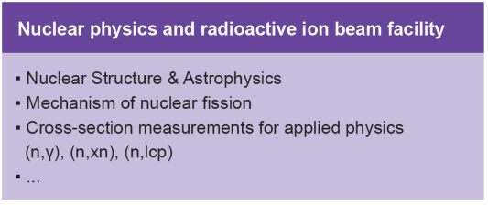
Final conclusion
IFMIF-DONES offers very high versatility and unique/very competitive range of capabilities for fusion-related critical needs and for experiments in other research areas both with neutrons (R160/R026) and deuterons (R026) of great interest for the community in many fields like: medical applications, fundamental physics, nuclear physics, micro-imaging techniques, radionuclide production and other industrial applications

Slide 21
References
L. W. Iskra et al., “Report on posible complementary experiments to be developed in DONES using deuterons”, DONES-PreP WP8.2-1
A. Pisent et al., “Evaluation of the extraction of a deuteron beam for other complementary experimens”, DONES-PreP WP8.2-2
A. Letourneau, “Report on the complementary experiments with neutrons”, DONES-PreP WP8.1-1
F. Arbeiter, “Catalogue of posible irradiaton modules for DONES”, DONES-PreP WP8.3-1
F. Arbeiter, “Report on conceptual design of other irradiation modules for DONES” DONES-PreP WP8.3-2
M. Vázquez, C. Torregrosa, F. Martín-Fuertes, J. C. Marugán, “Identification of Complementary Experiments in R160 and preliminary safety implications”
M. Vázquez, C. Torregrosa, F. Martín-Fuertes, J. C. Marugán, “Identification of Complementary Experiments in R026 and preliminary safety implications”
A. Maj, N. Harrakeh, M. Lewitowicz, W. Krolas, A. Ibarra, “White Book on the Complementary Scientifique Programme at IFMIF-DONES”, Krakow, November 2016

Slide 22
Thank you for your attention
S. Becerril; J. Castellanos | 2nd IFMIF_DONES Users Conference | 19th October 2023

Slide 23
R026 – D+ Beam extraction modes
Main beam → D+ ion beam 125 mA / 40 MeV (5 MW) @ 175 MHz (CW, 5.7 ns period)
Single bunch extraction
Extraction of a fraction (0.1 - 1%) of the beam @ 40 MeV
For 0.1% case
125 µA (averaged current)
40 MeV
175 kHz
5 kW (averaged power)
Bunch length < 10 ns
Slow extraction (whole beam)
Based on a switching dipole solution
Fastest chopper field switch = 50 ms
Example of bunch timing conditions (Single bunch)
Bunch extracted
T = 5.7 ns
T = 3.9 ns
1.8 ns
Shortest time to restore normal operation = 100 ms
Chopper activation every 10 s for 1% usage

