Slide 1
Draft of users’ form on the Request for Transnational Access on IFMIF-DONES Facility
Andreja Gajović*, Alen Vodopijevec, Mirna Benat, Krunoslav Juraić, Tonči Tadić
Ruđer Bošković Institute, Bijenička cesta 54, Zagreb, Croatia

Slide 2
OUTLINE
Motivation and introduction
Software application specification
Example of on-line users’ access form
Instead of conclusion - input needed

Slide 3
OUTLINE
Motivation and introduction
Software application specification
Example of on-line users’ access form
Instead of conclusion - input needed

Slide 4
Motivation
IFMIF-DONES is an ESFRI facility
- it should have users’ friendly system for application of research proposals
Numerable research facilities in EU have calls for proposals for access to infrastructures:
- state-of-the-art electron microscopy research infrastructures through ESTEEM3
- the high brilliance 3rd Generation Synchrotron Radiation Source at DESY (Deutsches Elektronen-Synchrotron) PETRA III DESY
- European Synchrotron Radiation Facility (ESRF) Grenoble
- Elettra Sincrotrone Trieste
- Central European Research Infrastructure Consortium (CERIC)
RBI already prepared Integrated Data Management system for DONES PreP (https://idm.dones.irb.hr)
Presented at: General Assembly Mtg, Madrid (Spain) | October 10th 2019, A. Vodopijevec| WP1 T1.4 Reporting

Slide 5
Introduction - DOCUMENTS
D3.4-1 Report on User Access Strategy for DONES (2021)
The scientific exploitation of DONES would be divided in three separate experimental programmes (EPs):
EP.1 An experimental program focused on high-priority fusion-related experiments i.e. irradiation campaigns of fusion materials’ samples;
EP.2 An experimental program focused on other fusion-related experiments;
EP.3 An experimental program focused on so called Complementary Research activity, i.e. experiments related to research fields out of fusion.

Slide 6
Introduction - DOCUMENTS
Periodic Technical Report, Part B
Period covered by the report: from [01/10/2019] to [01/04/2021]
Work package 8 Other complementary experiments and Upgradeability
Task 8.1 Other complementary experiments using neutrons
-experiments that can take place in room R160 adjacent to the test cell
Without moderator: the neutrons with kinetic energy >1 MeV (10 MeV). At the entrance of room R160 the flux 1.67 1010 n/cm2/s.
With moderator placed at the entrance of room R1: kinetic energies <400 meV, fluxes of about 9. 106 n/cm2/s.
Task 8.2 Other complementary experiments using deuterons
Measurements that could be conducted with a pulsed deuteron beam of 40 MeV or pulsed neutron beam produced in deuteron-induced reactions in room R026.

Slide 7
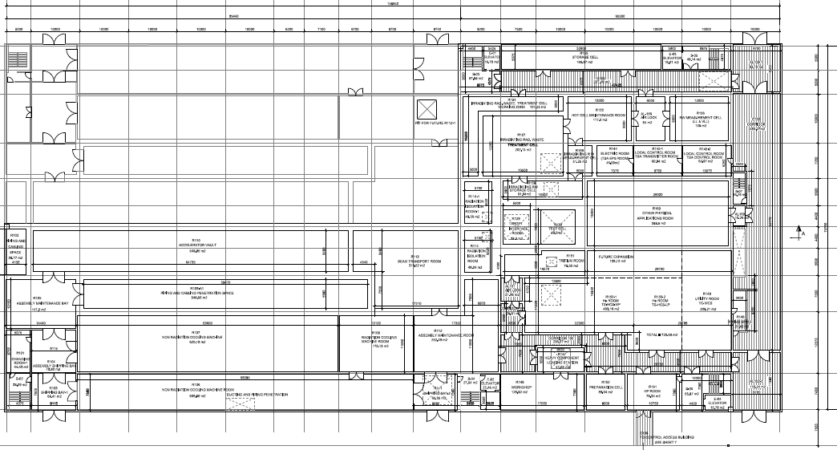
Radiation Isolation
Room (RIR)
Complementary Research activity using neutrons (EP3.1)
Accelerator
Room
Beam Transport
Room (BTR)
Target Interface
Room (TIR)
Test Cell (EP1, EP2)

Slide 8
REQUREMENTS:
the administration should be user friendly and kept to a minimum
evaluation process of proposals by specialists (different fields)
beam/experimental time shoud be assigned to users by IFMIF-DONES (?!)

Slide 9
OUTLINE
Motivation and introduction
Software application specification
Example of on-line users’ access form
Instead of conclusion - input needed

Slide 10
Software application specification
User interface
Evaluator interface
IFMIF-DONES Admin interface
results

Slide 11
Software application specification
Features
User interface
Authentication and profile creation
Facility application requests management
New application
List of applications
Application status
Copy/Cancel application

Slide 12
Software application specification
Features
User interface
Evaluator interface
Authentication and profile creation
Scientific expertise definition
List of relevant applications
Application assessment and evaluation by defined criteria

Slide 13
Software application specification
Features
User interface
Evaluator interface
IFMIF-DONES Admin interface
List of evaluators
Authorization
Definition of experimental programme for evaluation
List of applicants
Approval, deleting, …
List of applications
Filtering, searching
Sort by evaluation results

Slide 14
Software application specification
Features
User interface
Evaluator interface
IFMIF-DONES Admin interface
Definition of the application form for user interface:
Draft application form:
Defining EP
Defining specific research area and experiment
Defining specific requirements based on chosen area/experiment.

Slide 15
Software application specification
Draft forms are built using Limesurvey software.
For the production system we will develop custom web application built with standard open source tools.

Slide 16
OUTLINE
Motivation and introduction
Software application specification
Example of on-line users’ access form
Instead of conclusion - input needed

Slide 17
https://survey.czi.irb.hr/q/index.php?r=survey/index&sid=247174&newtest=Y&lang=en

Slide 18
Initial page after log in:

Slide 19
Initial page after log in:

Slide 20
Initial page after log in:

Slide 22
Initial page after log in:

Slide 32
Initial page after log in:

Slide 35
https://survey.czi.irb.hr/q/index.php?r=survey/index&sid=247174&newtest=Y&lang=en

Slide 36
OUTLINE
Motivation and introduction
Software application specification
Example of on-line users’ access form
Instead of conclusion - input needed

Slide 37
OUTLINE
Motivation and introduction
Software application specification
Example of on-line users’ access form
Instead of conclusion - input needed
Please discuss with us about:
Predicted experiments and suggestions: Andreja.Gajovic@irb.hr
Software solutions: Alen.Vodopjevec@irb.hr

Slide 38
Thank you for your attention!

Slide 39
Thank you for your attention!
...and input in the future

