Slide 1
Impact of installation of the Tritium Release Test Module in the IFMIF-DONES Test Cell on the neutron spectra inside the Complementary Experiments Room collimated by Neutron Beam Tube and Shutter
A. Serikov ¹, G. Zhou ¹, Y. Qiu ¹, B. Bienkowska ², R. Prokopowicz ³
¹ Karlsruhe Institute of Technology (KIT), Institute for Neutron Physics and Reactor Technology, Eggenstein-Leopoldshafen, Germany
² Institute of Plasma Physics and Laser Microfusion, Warsaw, Poland
³ National Centre for Nuclear Research (NCBJ), Otwock-Swierk, Poland

Slide 2
Neutronics analyses for DONES Test Cell and CER
To conduct variety neutronics experiments, collimated neutrons from the DONES Test Cell (TC) will be directed to Complementary Experiments Room (CER) through the Neutron Beam Tube and Shutter (NBT&S) system.
Neutronics analyses performed in this work continue the task of neutron spectra assessments [1] inside the Complementary Experiments Room (CER) collimated by the Neutron Beam Tube and Shutter (NBT&S) system. The NBT&S system is developed to supply neutrons from the D-Li target of the IFMIF-DONES Test Cell (TC) to the CER (Room R160) for conducting experiments with neutron spectra variated from fast to thermal.
The neutron and photon radiation transport has been performed by the McDeLicious-17 code package – MCNP modification, which simulates the deuteron-lithium (d-Li) nuclear reactions.The neutronics results were normalized to a 125 mA deuteron beam of 40 MeV deuterons impinging the lithium target.
As fusion neutrons are necessary for Breeding Blanket qualification, it is proposed in this work to place the irradiated breeding materials close to the D-Li neutron source, where the materials get the highest neutron loads and, therefore, the space is most valuable for materials irradiation. Such space is behind the High Flux Test Module (HFTM), in the region of the Medium Flux Test Module (MFTM). In this work, initial steps in developing the neutronics models to simulate the radiation conditions suitable for the breeding two .
Tritium Release Test Module (TRTM) - geometry has been implemented into the final reference test cell model at the EVEDA phase [2], with updates during the DONES PreP phase.
DEMO Helium Cooled Pebble Bed (HCPB) Breeding Blanket (BB) module – as module is large, DONES D-Li source could not cover uniformly the whole FW surface of the BB. Therefore, decision was to perform neutronics analyses to test the HCPB BB in radiation conditions of DONES MFTM, and based on the results of the performed analyses, decide about the conceptual designing as a potential “Other” Irradiation Module (OIM) in DONES.
Reference:
[1] A. Serikov et al., “Neutrons supply to the IFMIF-DONES Complementary Experiments Room through the neutron tube and neutron beam shutter”, First IFMIF-DONES Users Workshop, September 26-27, 2022, https://agenda.ciemat.es/event/3879/contributions/4128/.
[2] K. Kondo et al., “Neutronic Analysis of the IFMIF Tritium Release Test Module Based on the EVEDA Design”, Fusion Science and Technology, 66:1 (2014), 228-234, https://doi.org/10.13182/FST13-74310.13182/FST13-743

Slide 3
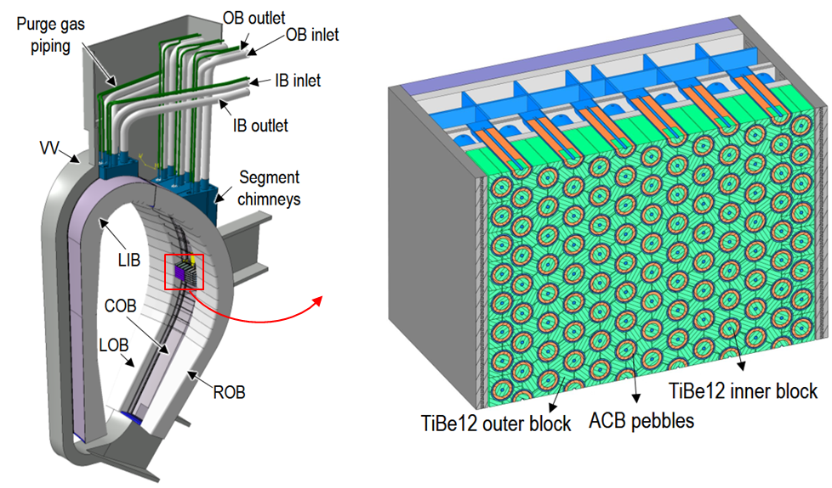
Introduction
We propose to develop OIM based on the actual version of the HCPB BB because its implementation permits a wide scope of neutron irradiation and material tests. Nuclear, thermal hydraulic and thermal-mechanical analyses confirmed soundness of the HCPB BB design [3].
HCPB Breeding Blanket (BB) module
Ref.[3] G. Zhou, et al., “Solid Breeding Blankets: overview and key pending validation needs,” Second IFMIF-DONES Users Workshop, Granada, October 2023.

Slide 4
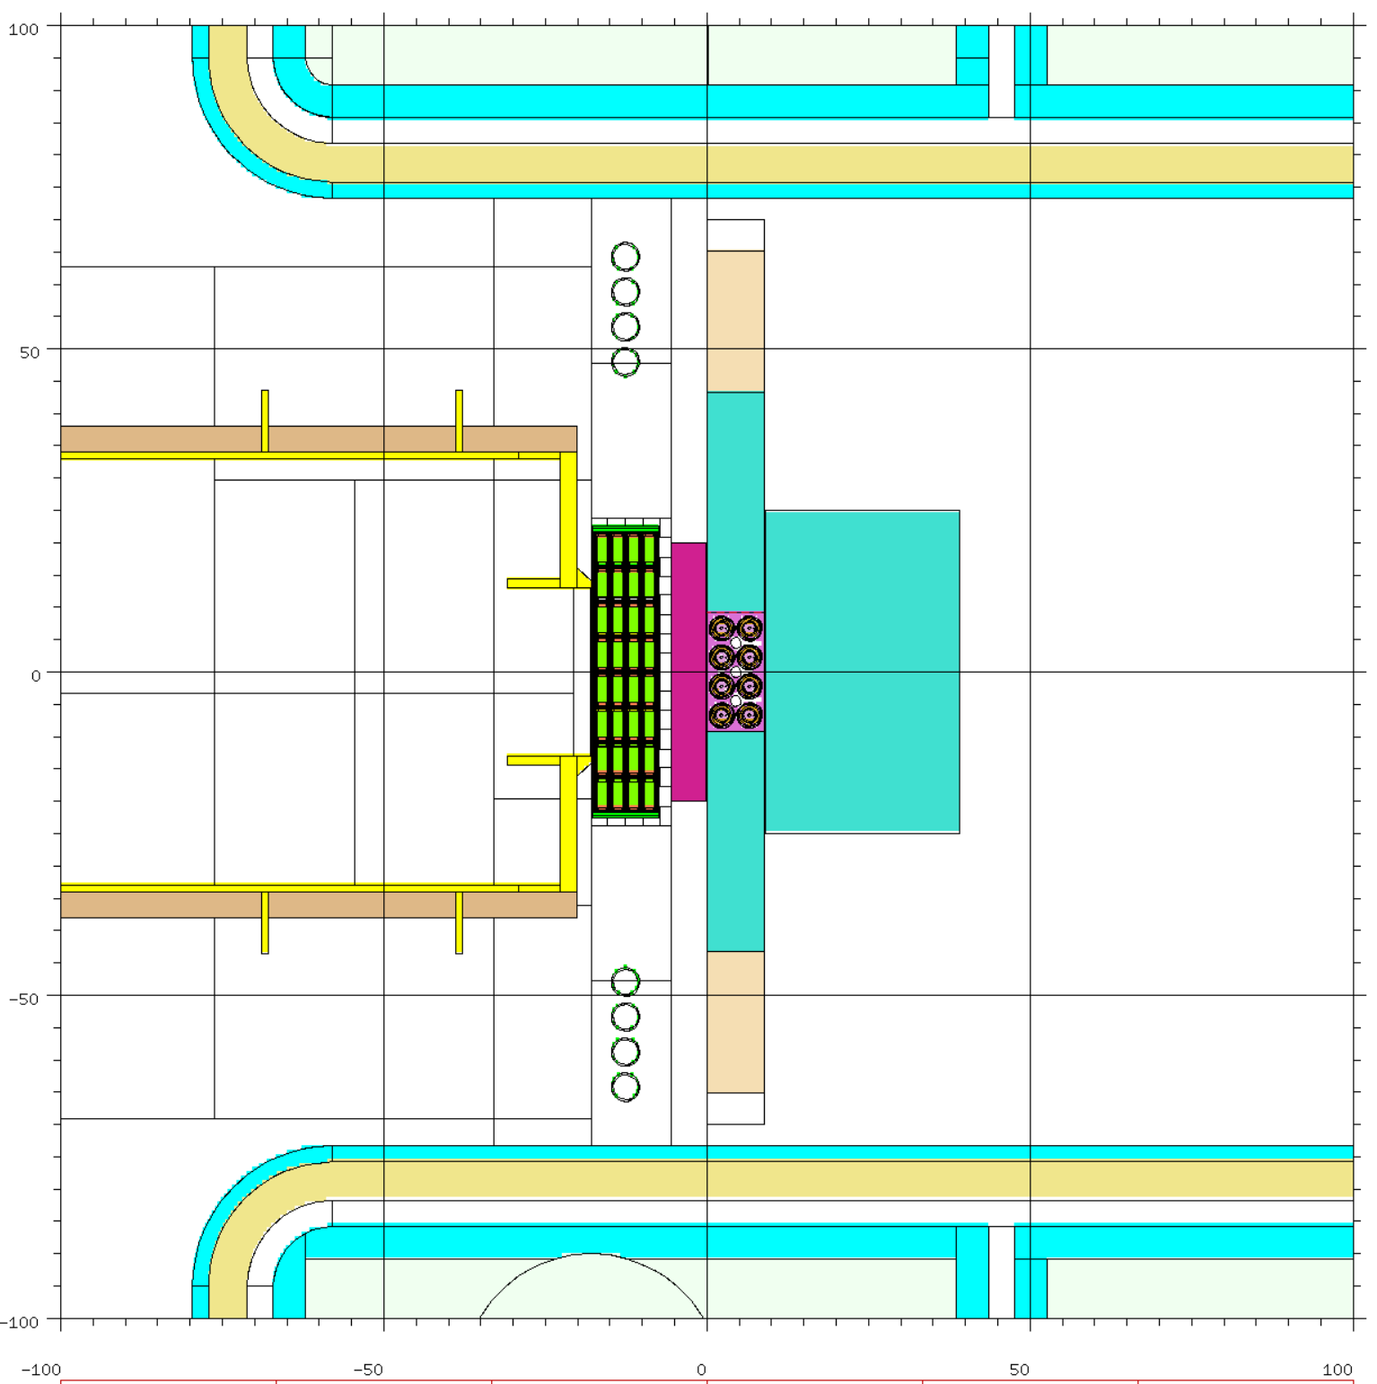
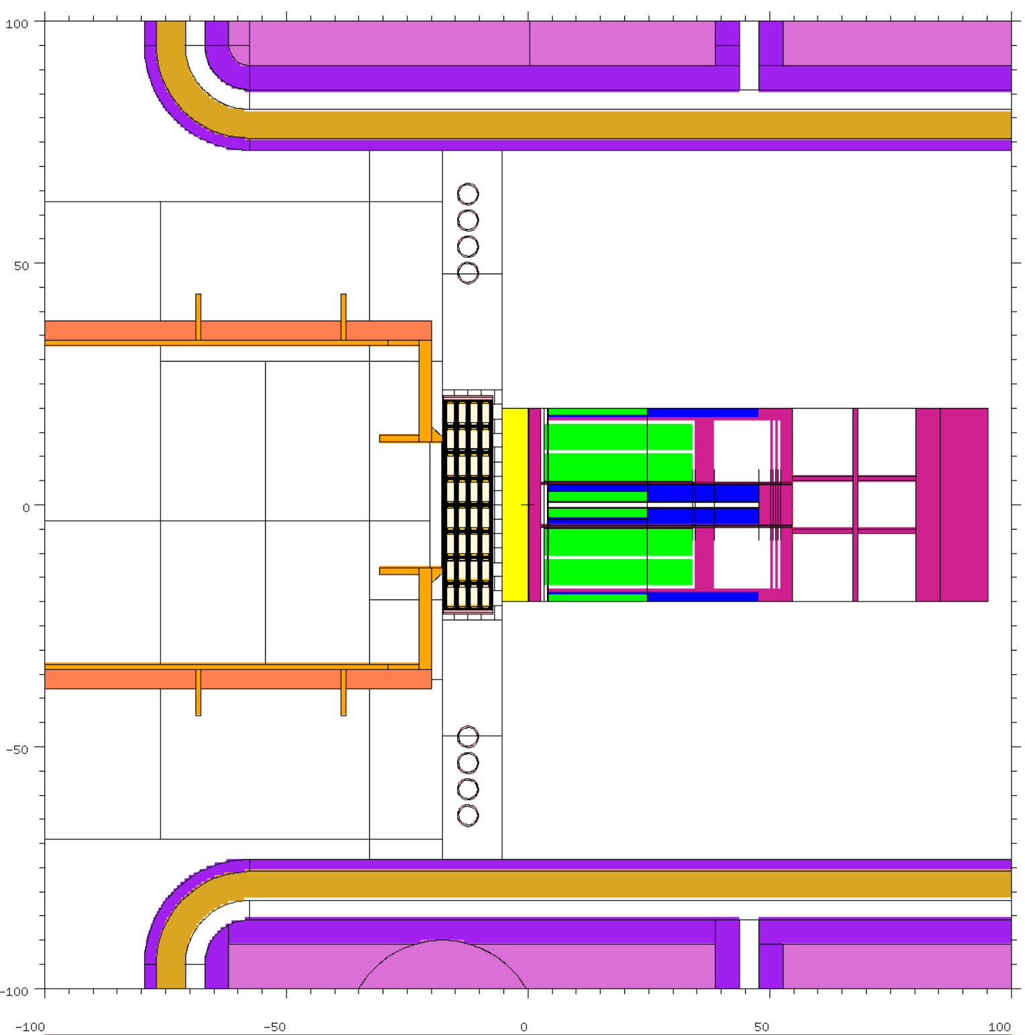
Developed MCNP models for two breeding concepts: TRTM and HCPB BB inside DONES TC Horizontal cross-sections of the two MCNP models
EU DEMO HCPB BB design:
Advanced ceramic breeder ACB pebbles (lithium orthosilicate, 35mol% lithium metatitanate)
Titanium beryllide
Structural steel: Eurofer97
HFTM
HFTM
NSS
NSS
TRTM
TRTM graphite reflectors:
back-side
lateral
7 full-size pins of HCPB BB integrated inside DONES TC:
1)-blue, 2) –green, 3)- magenta
TRTM
HCPB BB

Slide 5
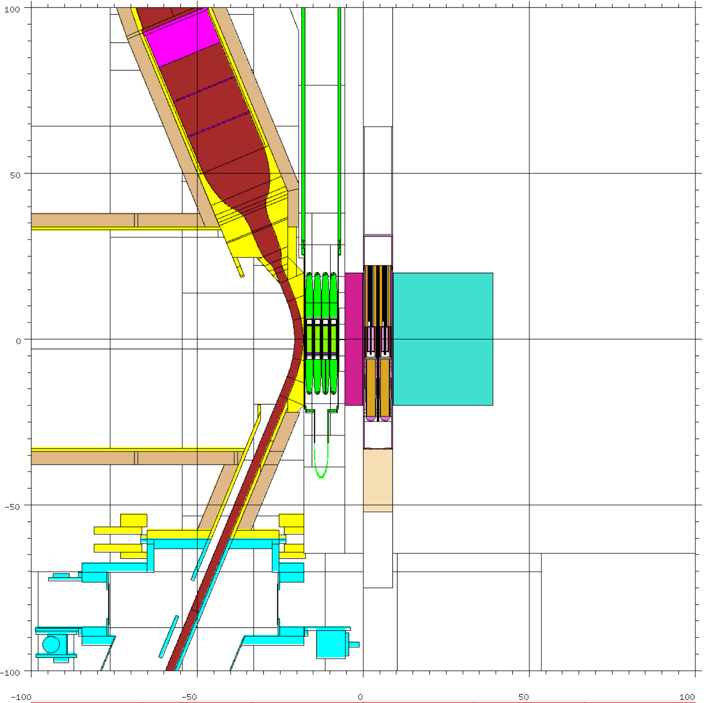
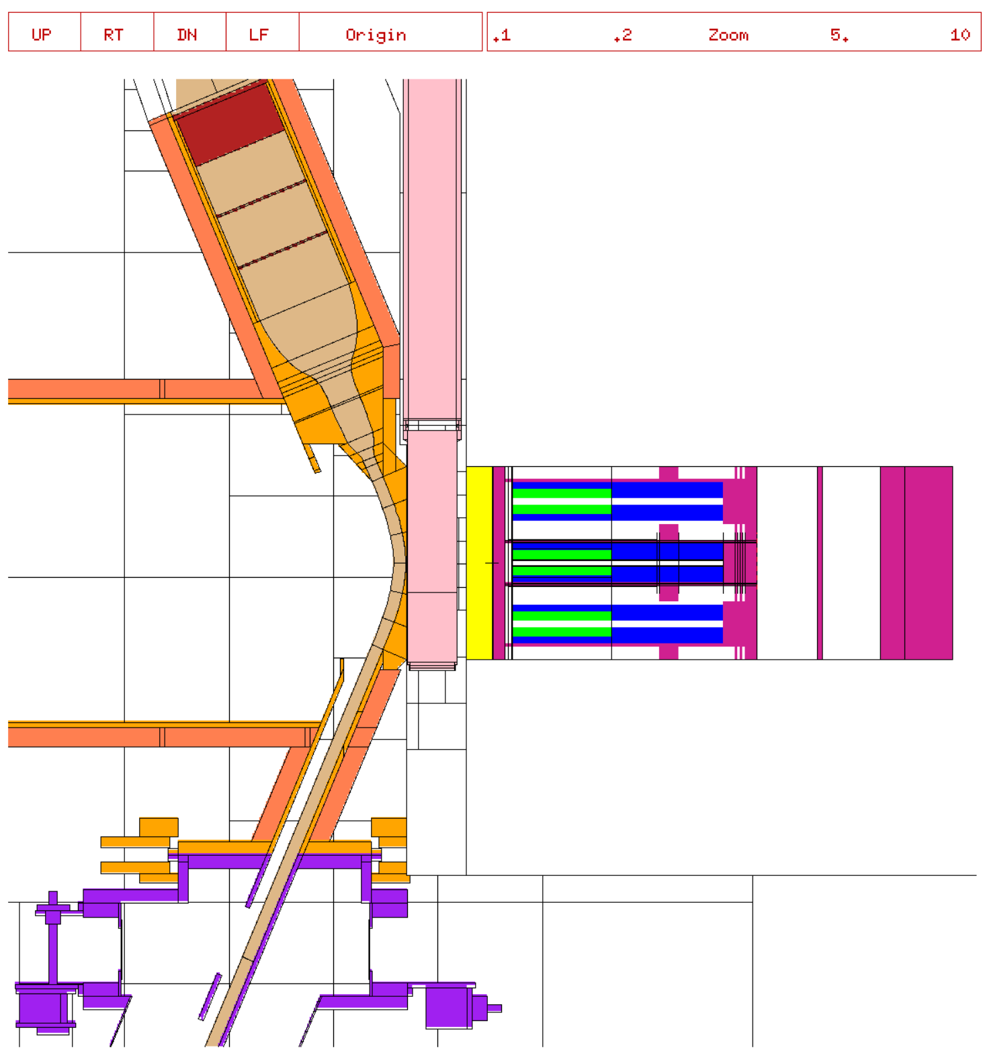
Developed MCNP models for two breeding concepts: TRTM and HCPB BB inside DONES TC Vertical cross-sections of the two MCNP models
TRTM
HCPB BB

Slide 6
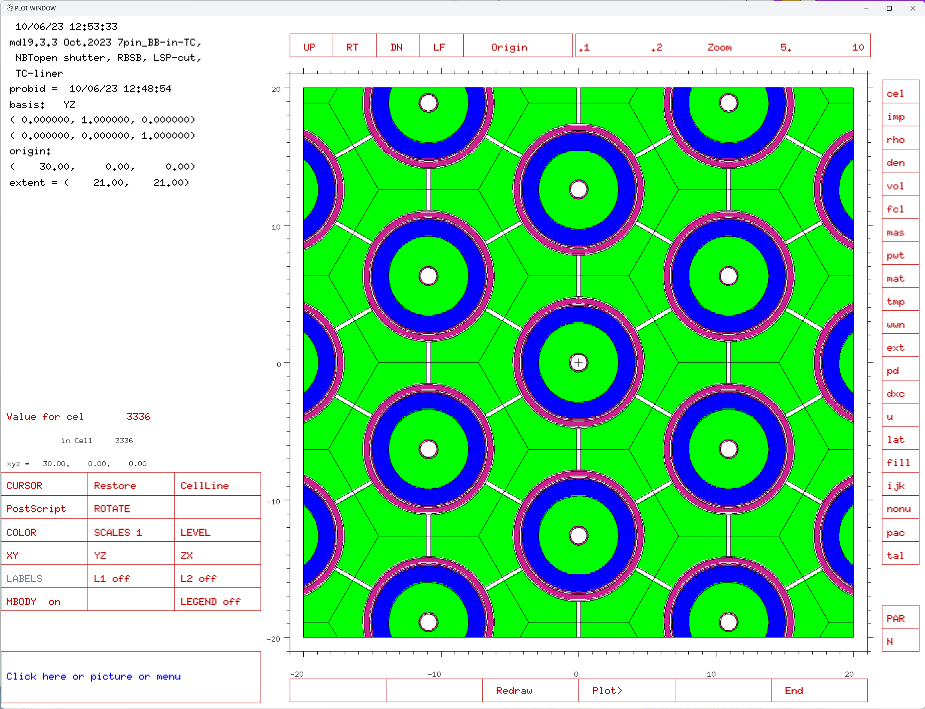
7 full-size pins of HCPB BB integrated inside DONES TC
EU DEMO HCPB BB design:
Advanced ceramic breeder ACB pebbles (lithium orthosilicate, 35mol% lithium metatitanate), Li4SiO4 +35% Li2TiO3, Li6 = 60% dens = 1.753 g/cc;
Titanium beryllide;
Structural steel: Eurofer97.
1)-blue, 2) –green, 3)- magenta

Slide 7
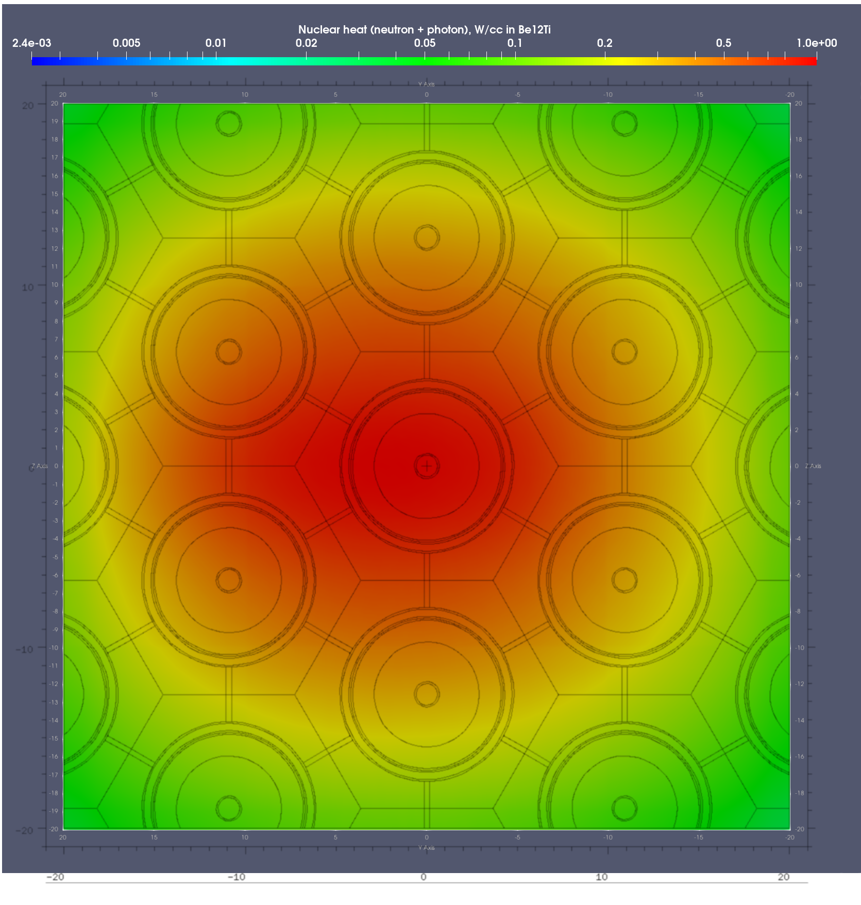
Nuclear heat map overlayed with the BB pin geometry modeled with MCNP.
The overlayed map represents the nuclear heat in Be12Ti calculated at the first wall of the HCPB BB model with 7 full-size breeder pins.

Slide 8
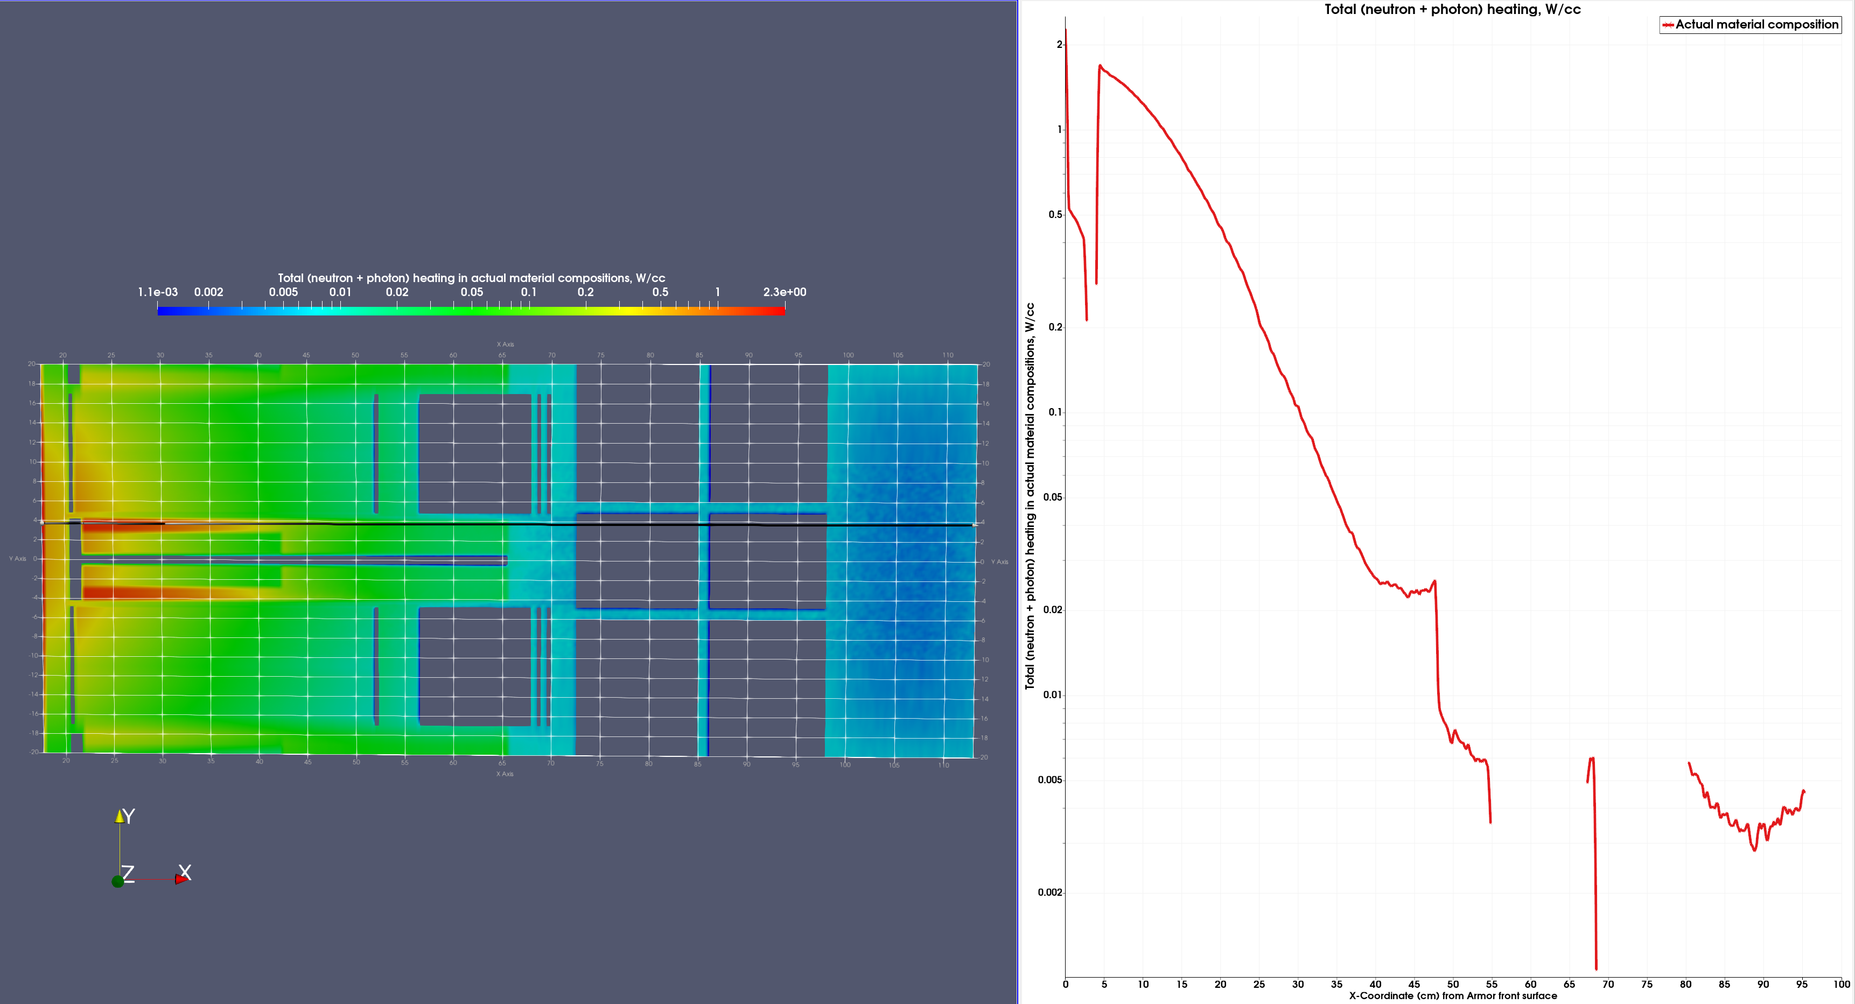
Heating data along the axial line at a distance of Y=3.7 from the central x-axis.
That is the distance of Li-ceramic pebbles.
Y=3.7 cm
0
X

Slide 9
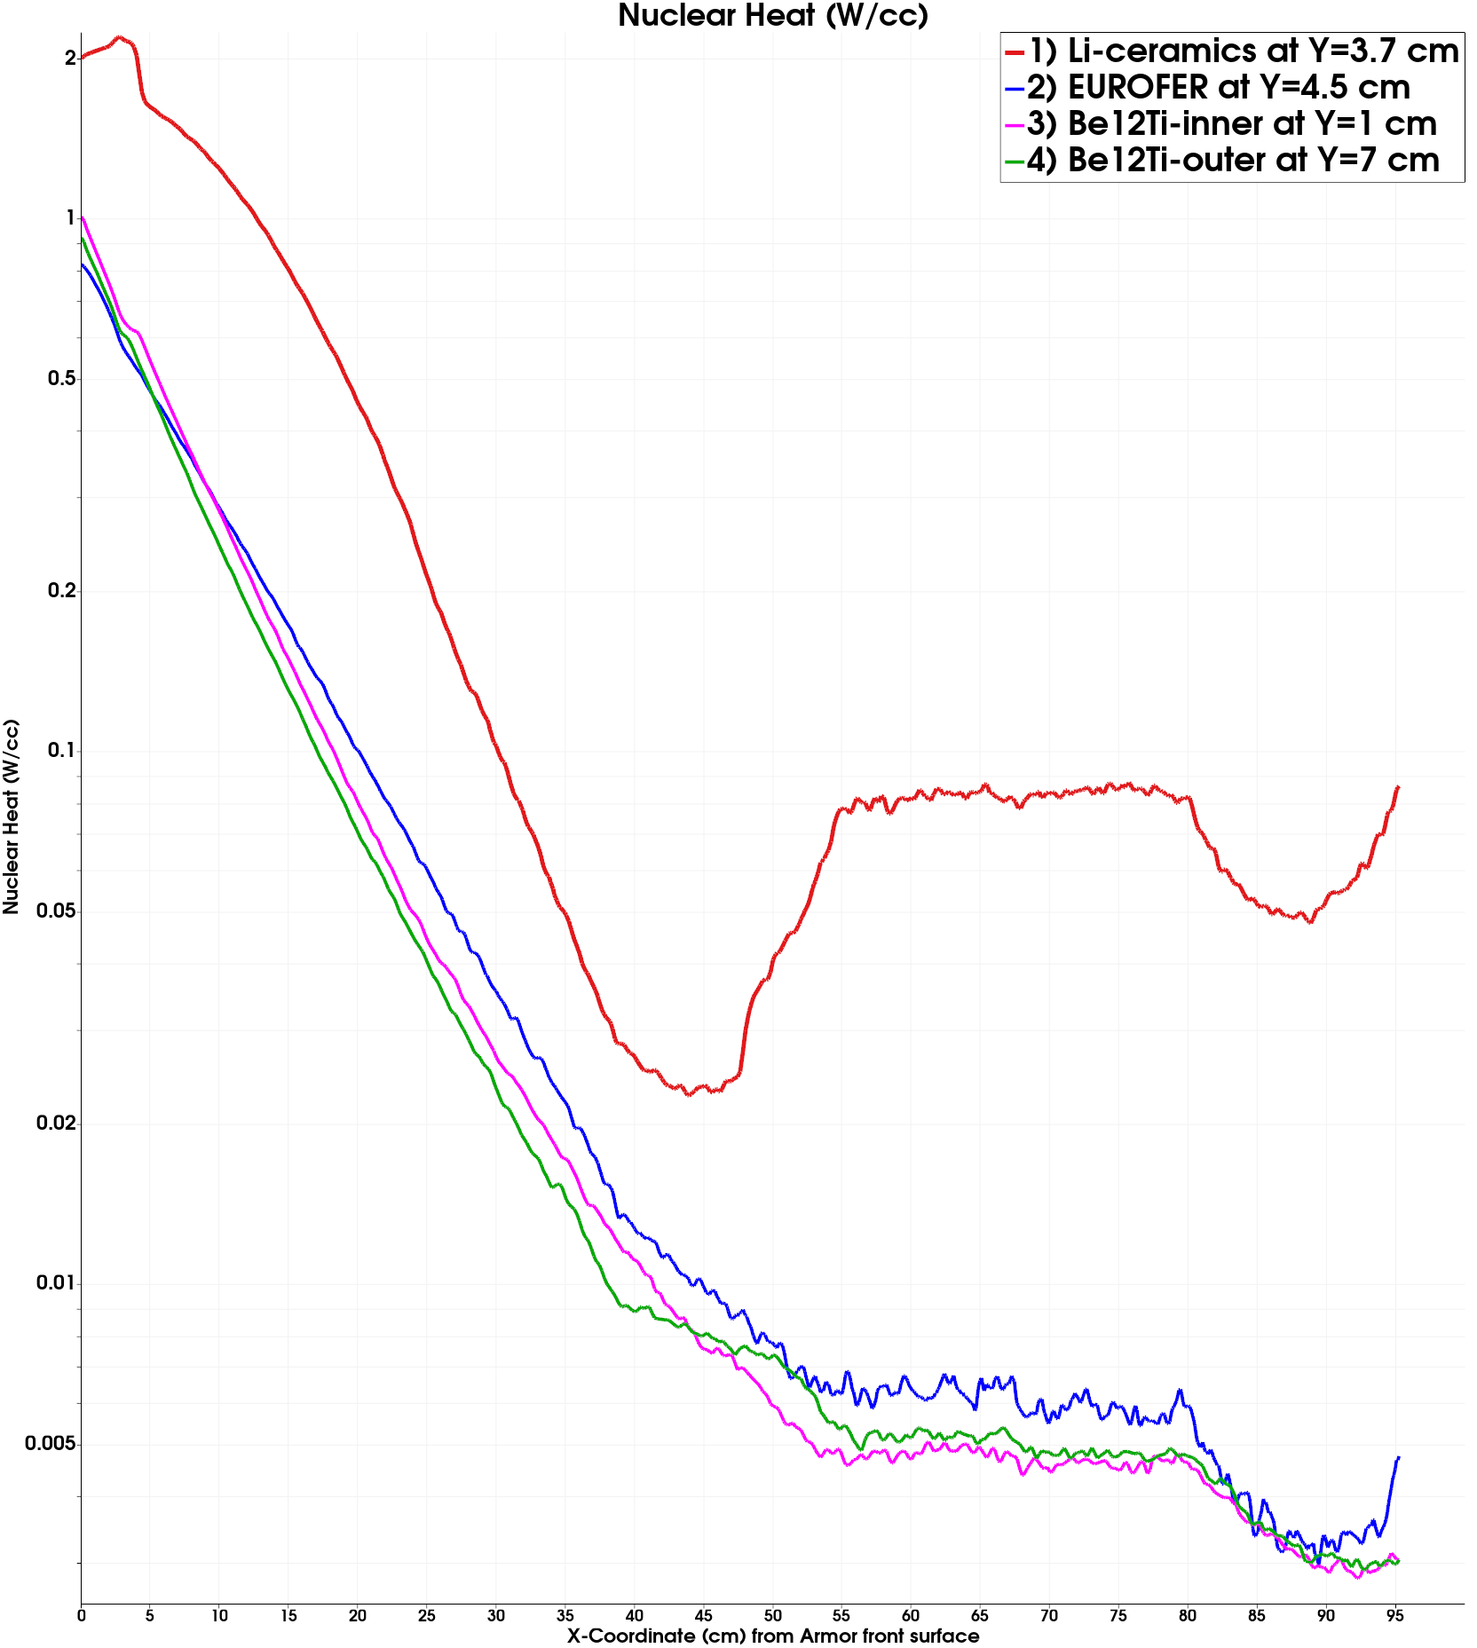
Four axial profiles of volumetric nuclear heating (W/cc) in separate materials
1
2
3
4

Slide 10
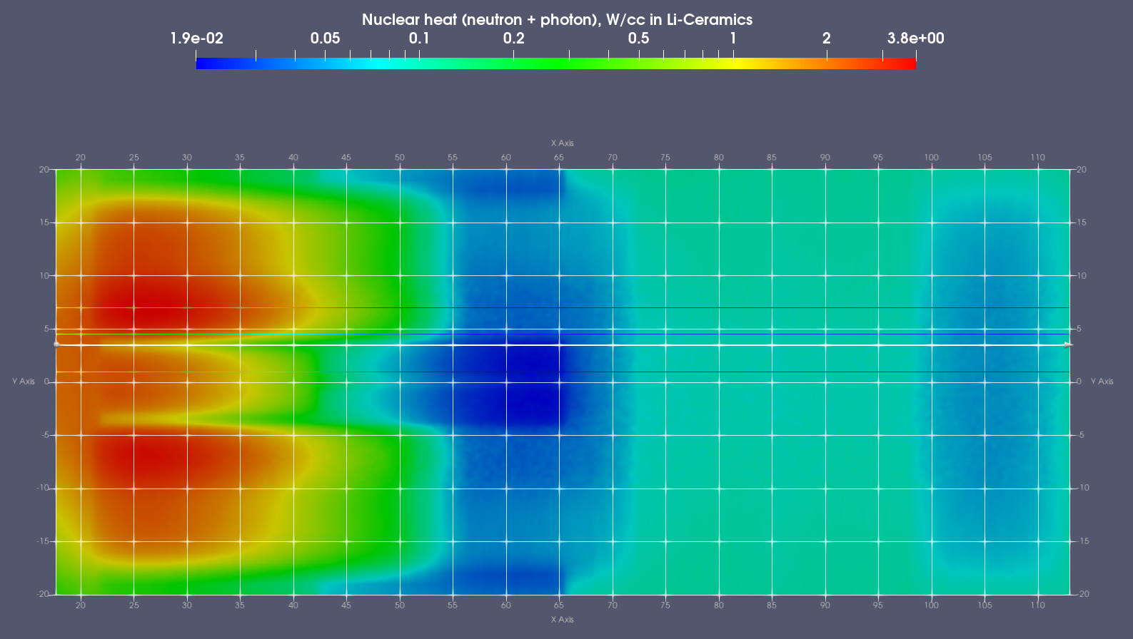
Profile #1 of volumetric nuclear heating (W/cc) in Li-ceramics at a distance of Y=3.7 cm

Slide 11
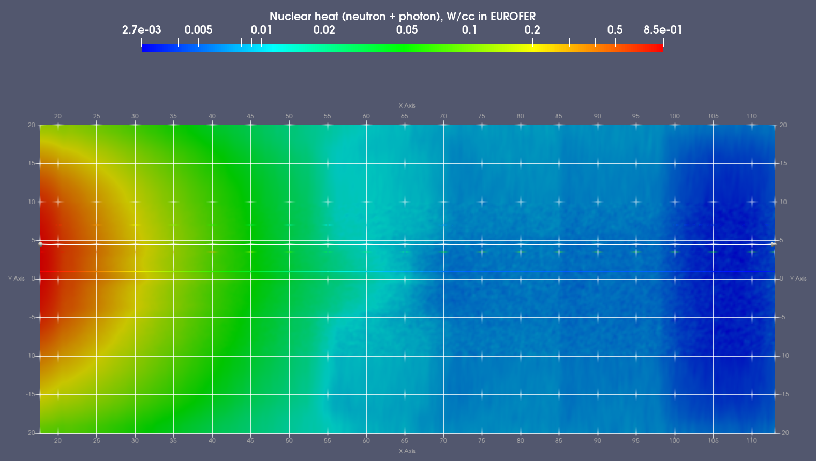
Profile #2 of volumetric nuclear heating (W/cc) in EUROFER at a distance of Y=4.5 cm

Slide 12
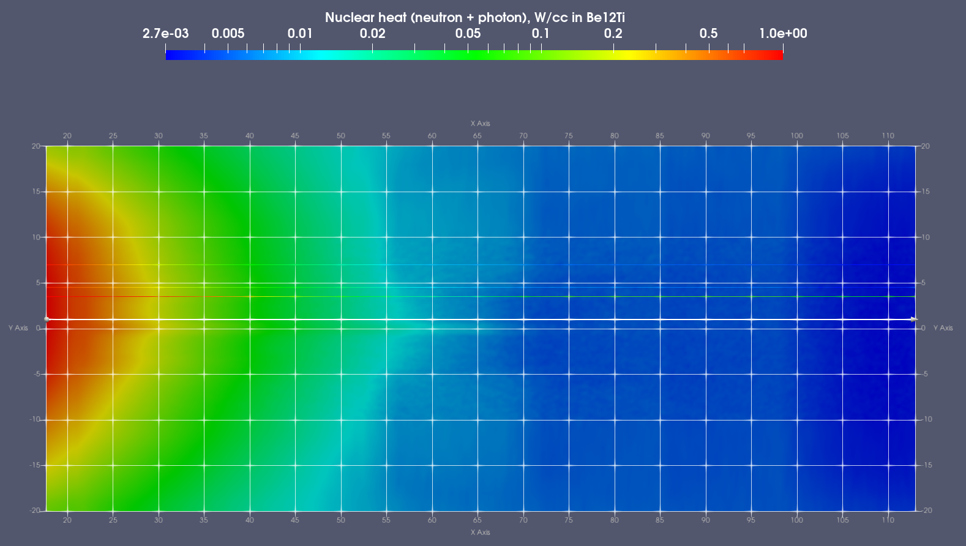
Profile #3 of volumetric nuclear heating (W/cc) in Be12Ti-inner block at a distance of Y=1 cm

Slide 13
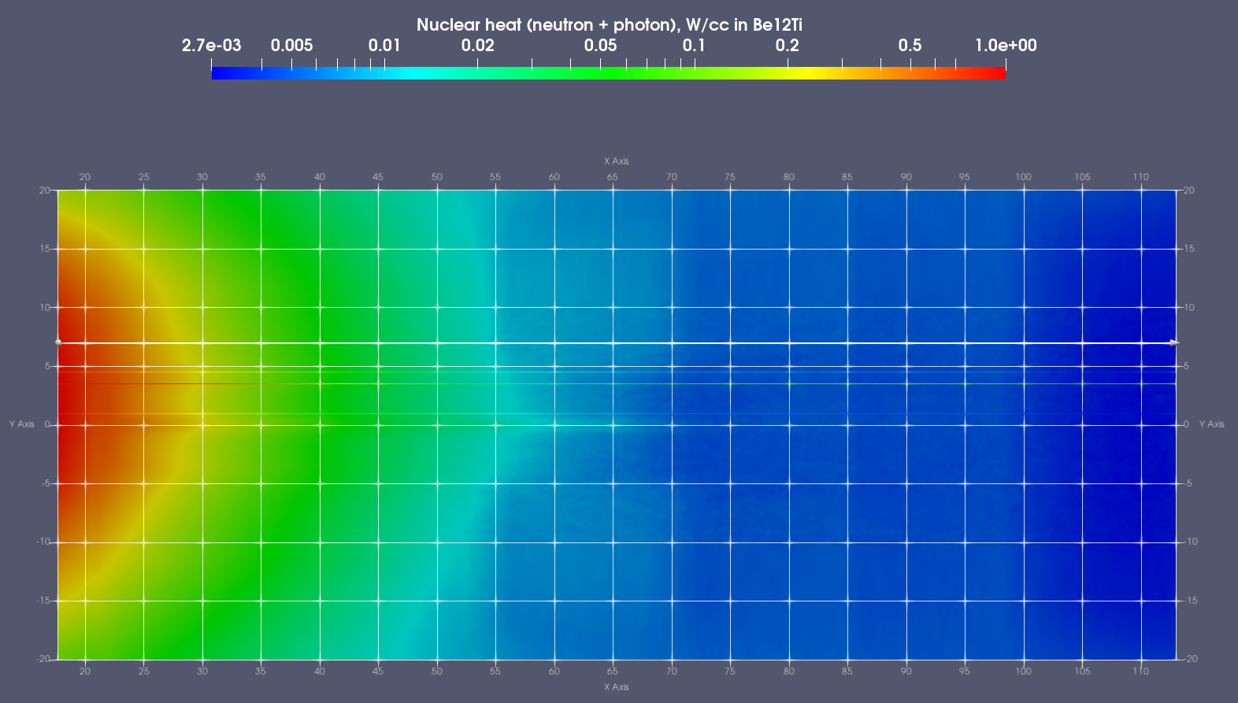
Profile #4 of volumetric nuclear heating (W/cc) in Be12Ti-outer block at a distance of Y=7 cm

Slide 14
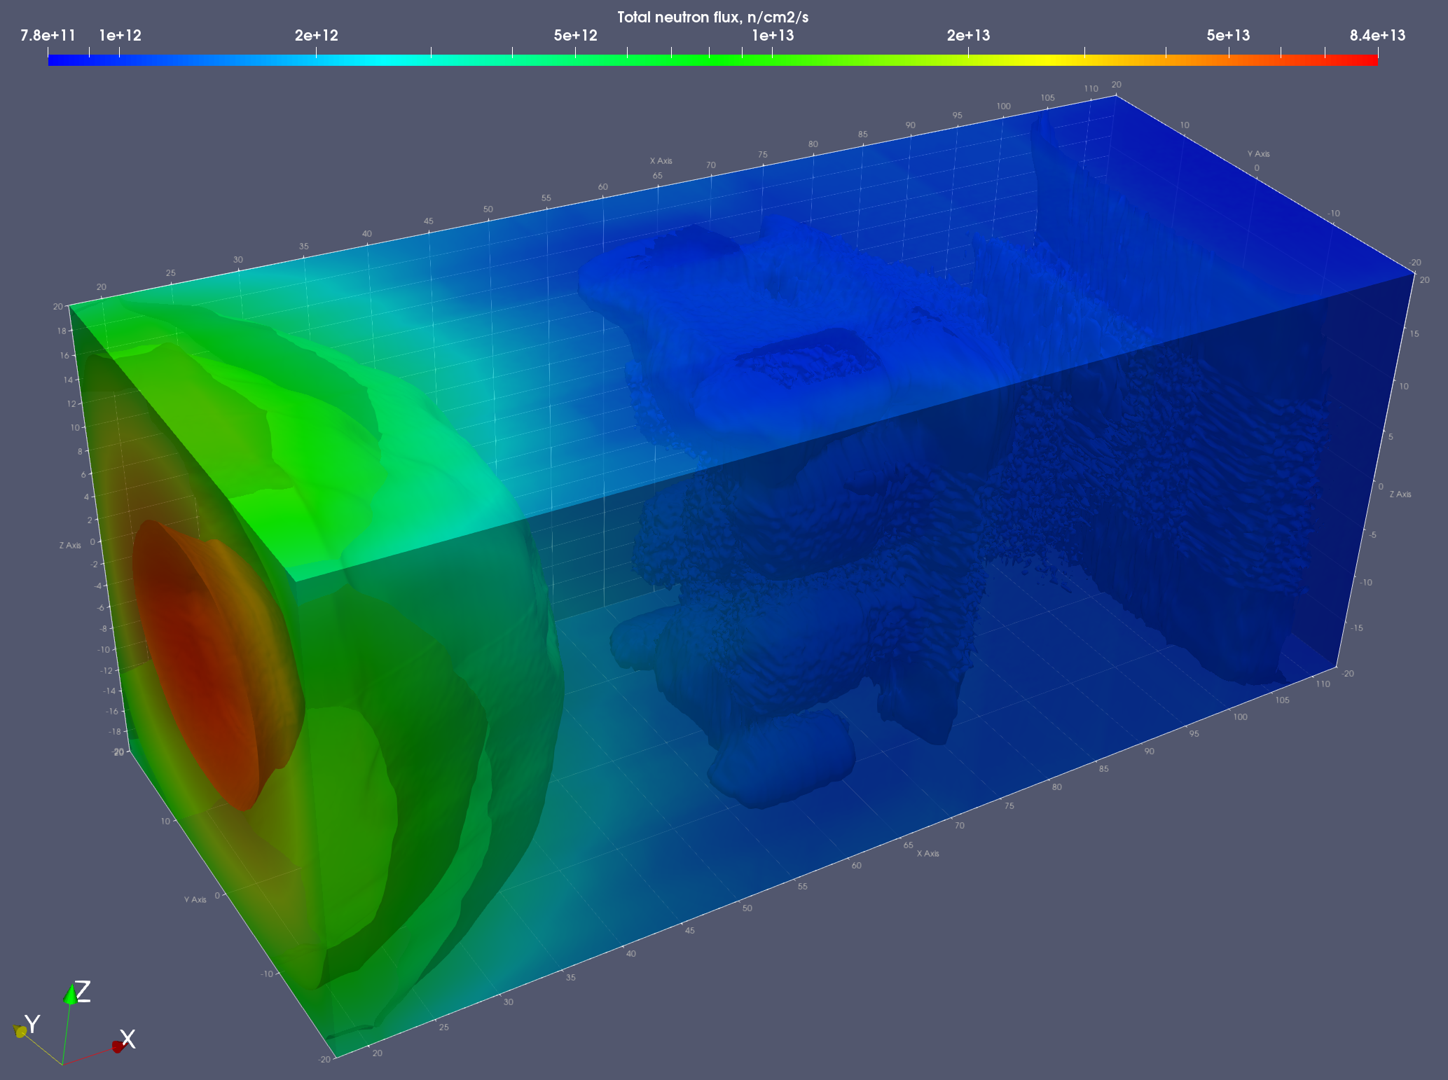
Four iso-surfaces of total n-flux:
1e12
5e12
1e13
5e13

Slide 15
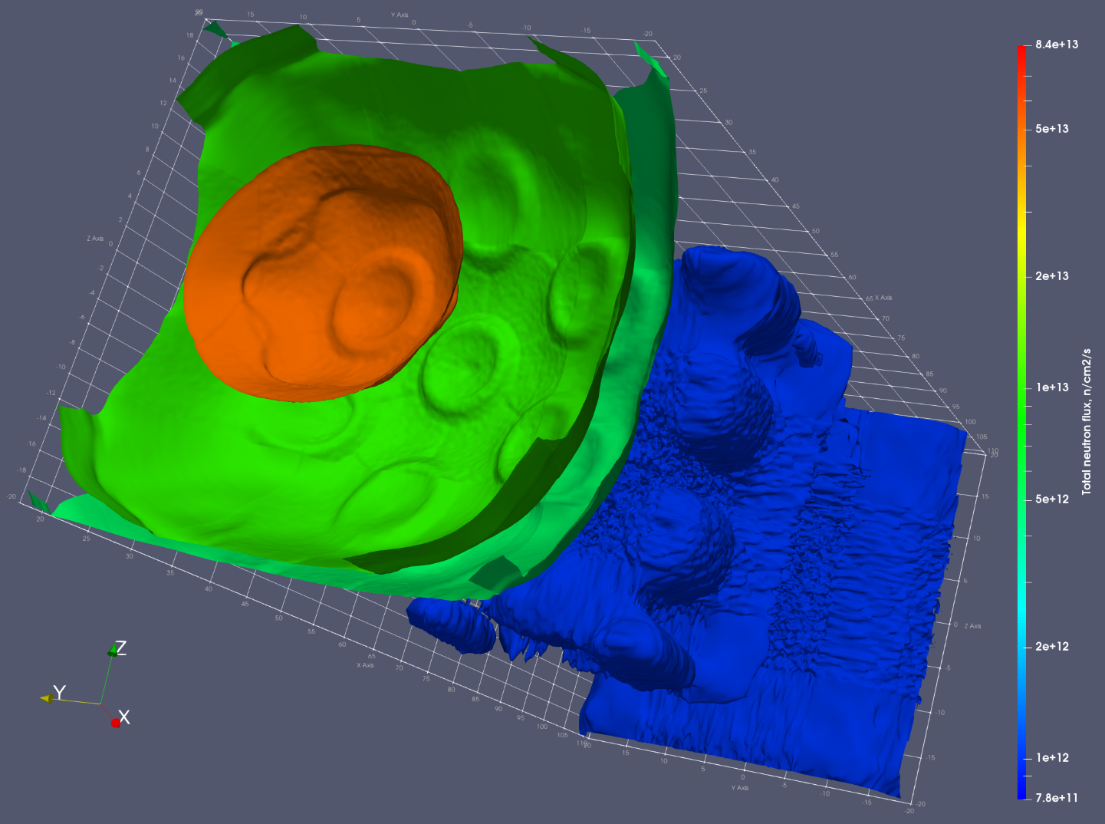
View on the Total Neutron Flux to show similarity with the Six-Petal Narcissus Flower

Slide 16
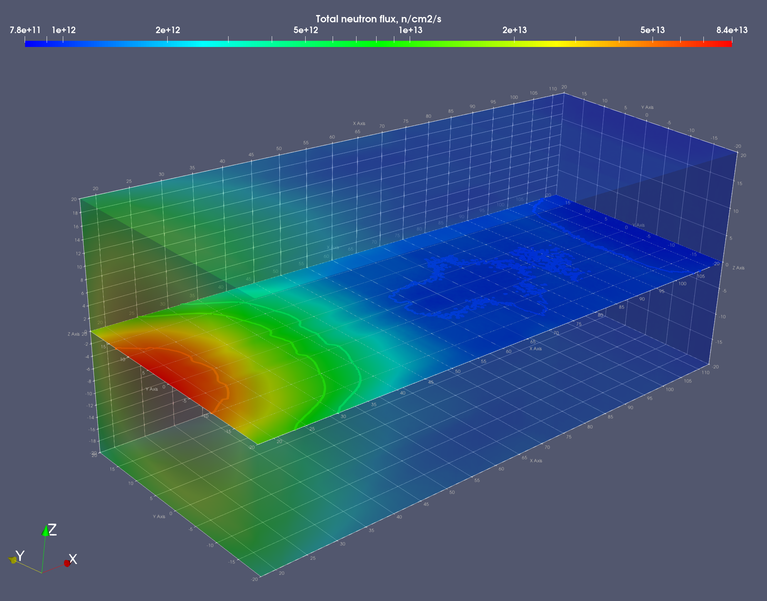
Central slice by plane PZ=0 perpendicular to the Z-axis

Slide 17
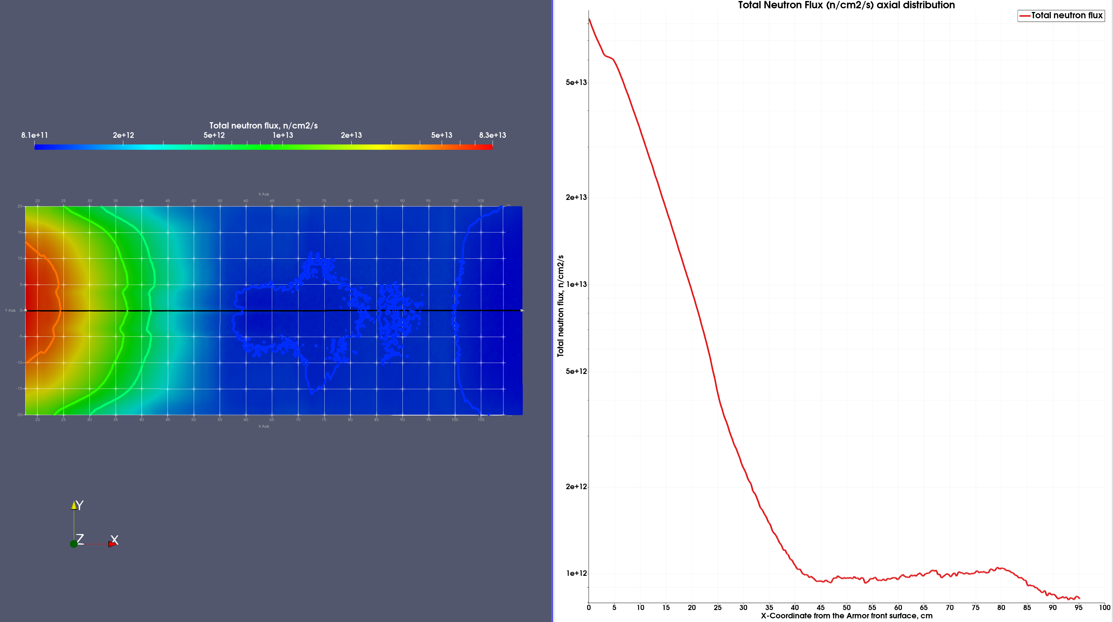
1e12
1e12
5e13
1e13
5e12

Slide 18
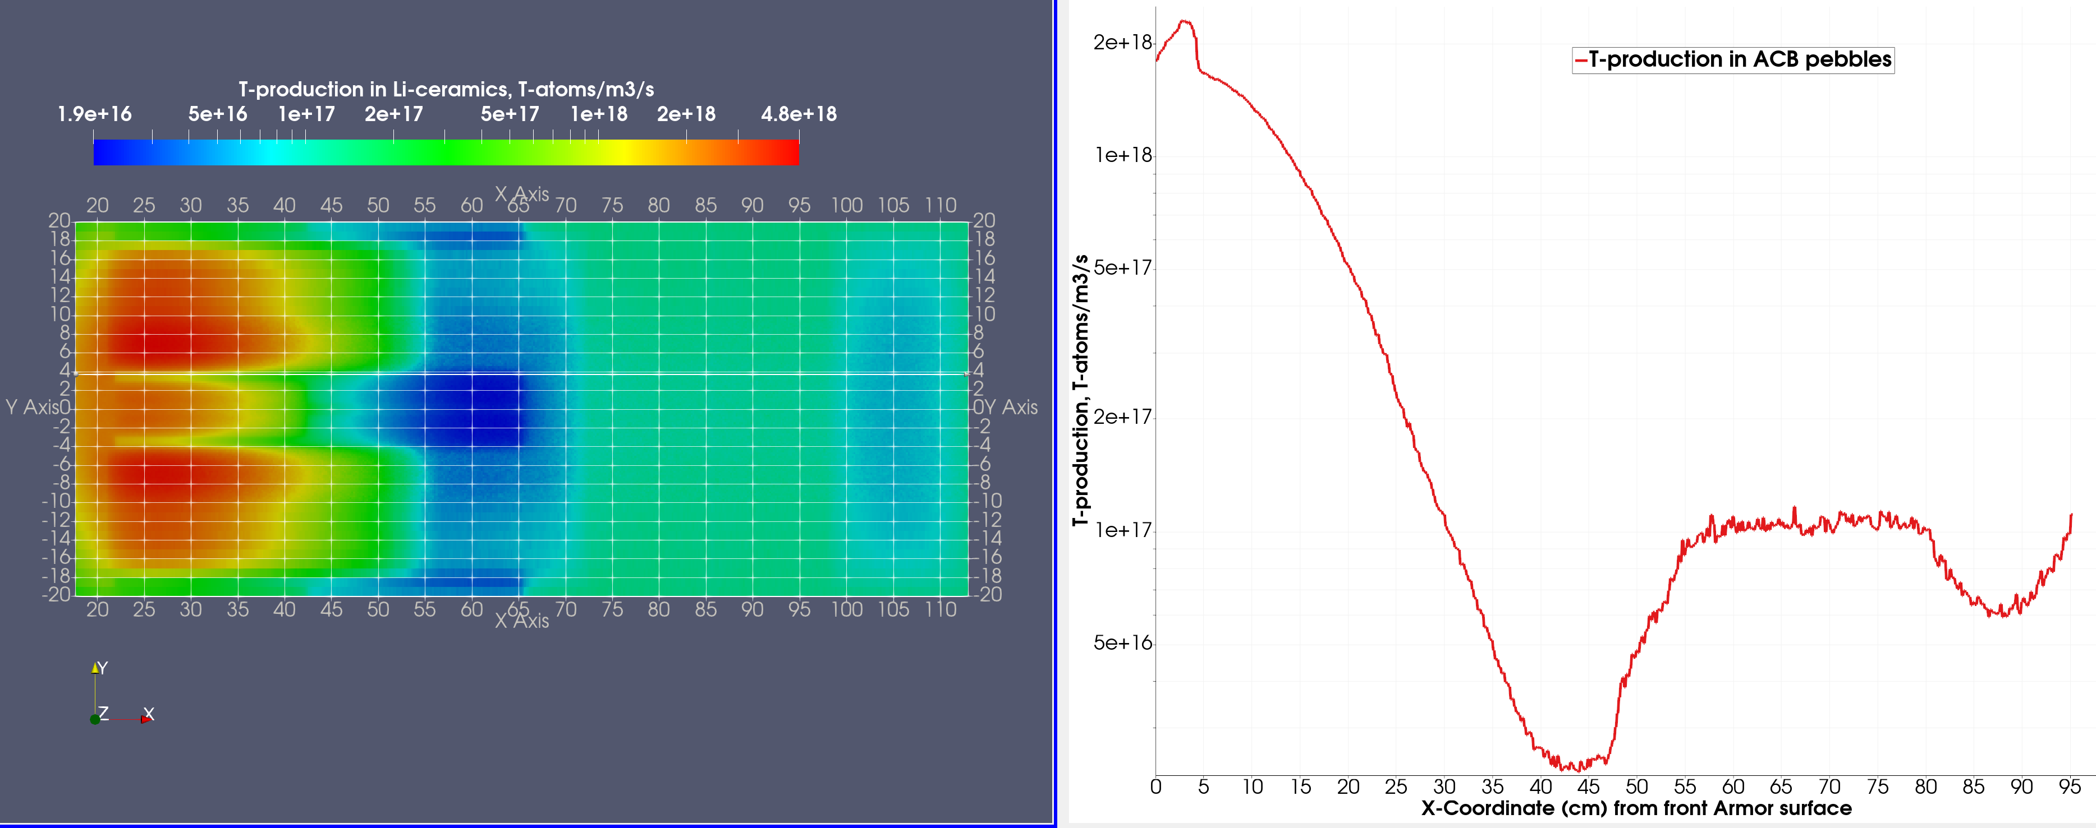
T-production rate in ACB pebbles map with 1D plot along the axial line at a distance of Y=3.7 from the central x-axis. Case of one accelerator beam run I=125 mA
1-Accelerator run: Max T-production in ACB ~1.7e18 / 1.75/1e6 = 9.71e+11 atoms-T/g-ACB/s ~1e12 atoms-T/g-ACB/s

Slide 19
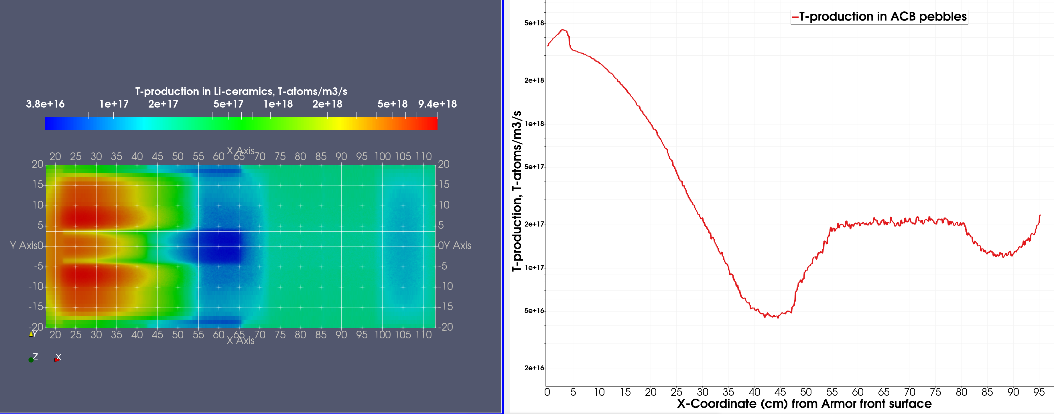
T-production rate in ACB pebbles map with 1D plot along the axial line at a distance of Y=3.7 from the central x-axis. Case of two accelerators’ beam run I=250 mA
2-Accelerators run: Max T-production in ACB ~3.4e18 / 1.75/1e6 = 1.94e+12 atoms-T/g-ACB/s ~ 2e12 atoms-T/g-ACB/s

Slide 20
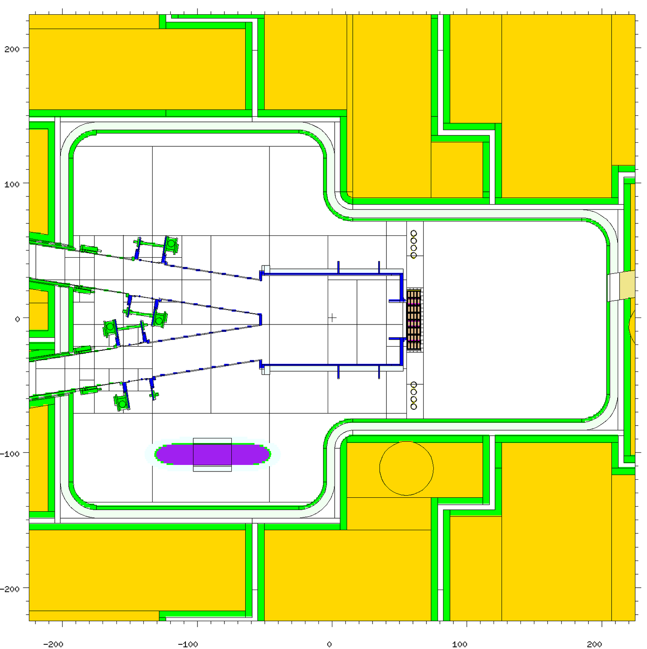
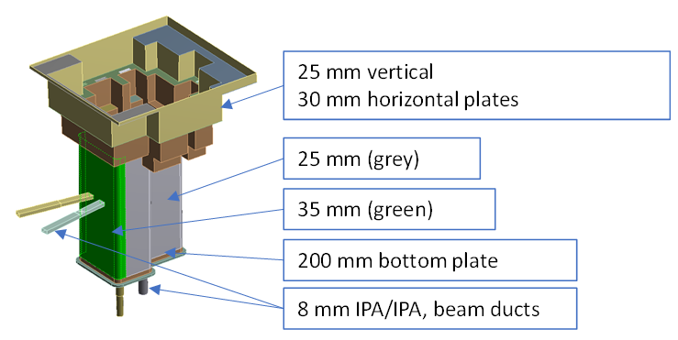
35-25-8 mm composed TC liner
Border line
35 mm
25 mm
TC liner = 35 mm
TC liner = 25 mm
Actual CAD model of the TC liner:
TC liner thickness shift from 35 mm to 25 mm
Grooved TC liner = 8 mm
100 mm TC bottom plate
TC liner = 25 mm

Slide 21
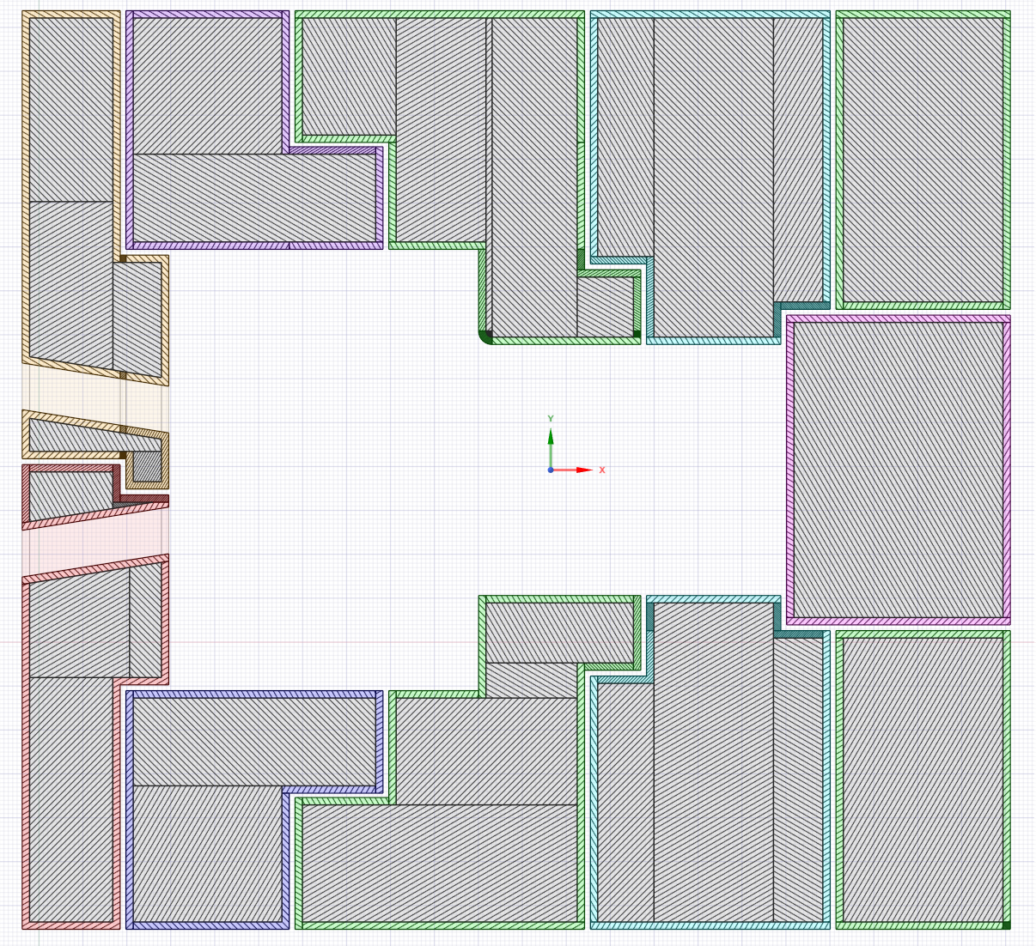
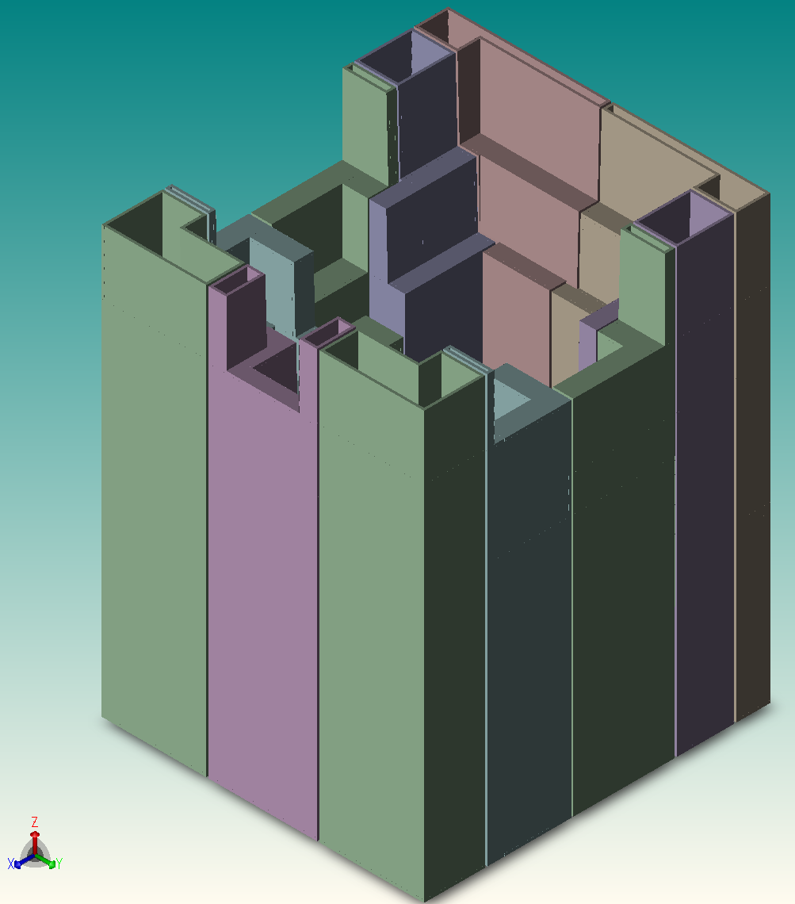
CAD model of the actual design of RBSB
RBSB design characterized:
5-cm liners (SS316L steel)
4-cm gaps
The gaps are shifted in a dog-leg shape to prevent neutron and gamma streaming.
The shielding filling of the RBSB is composed of Heavy concrete with rebar and water/pipe mixture. The shielding filling has density 3.495 g/cc.
Horizontal cut of the RBSB design
5-cm liners
shielding filling
CAD view of 5-cm liners

Slide 22
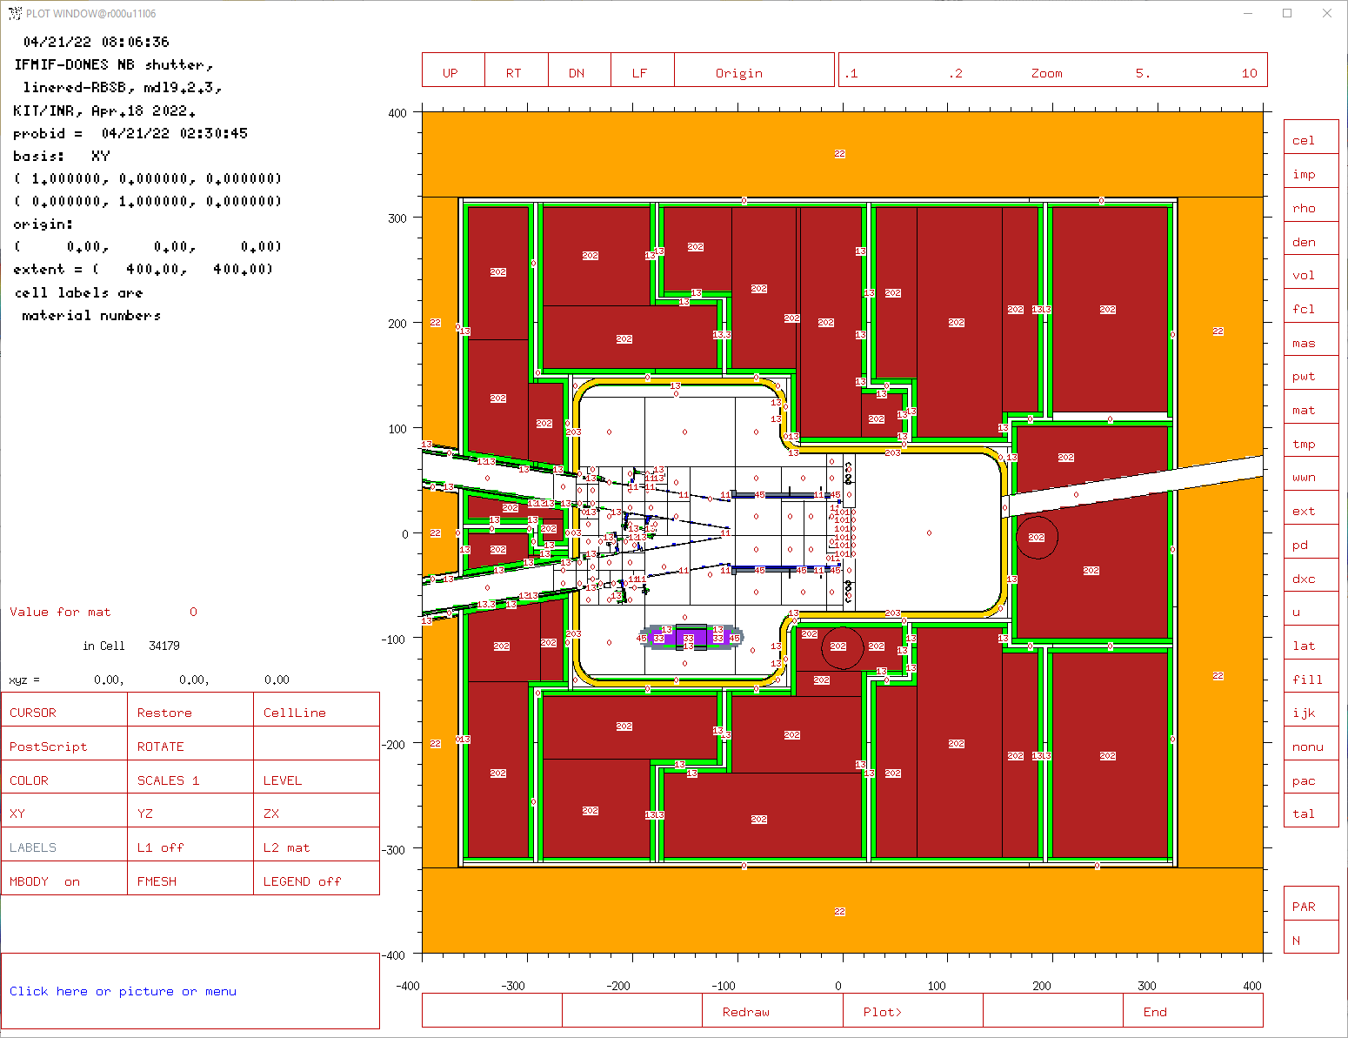
MCNP material numbers set at horizontal cut pz=0:
TC neutronics model update 2022: design of RBSB with liners
Bucket
RBSB
M13 = SS316L, density 7.93 g/cc - Steel
M22= Ordinary Concrete, 2.33 g/cc - Bucket
M33 = Lithium with impurities, density 0.512 g/cc
M45 = “Microtherm” thermal insulation, 0.35 g/cc
M105 = Lithium pipe heater mixed with SS316L shielding, 6.3867 g/cc
M201 = Heavy concrete with rebar, 3.513 g/cc
M202 = Heavy concrete with rebar and water/pipe mixture,
density 3.495 g/cc- RBSB filling
M203 = TC liner cooling layer, 1.1438 g/cc, its mixture composed of materials with the following volume fractions: Water(M43): 20.345% , SS316L pipe (M13): 10.30%, kaowool (M23): 68.885%, Aluminum(M34): 0.5%.

Slide 23
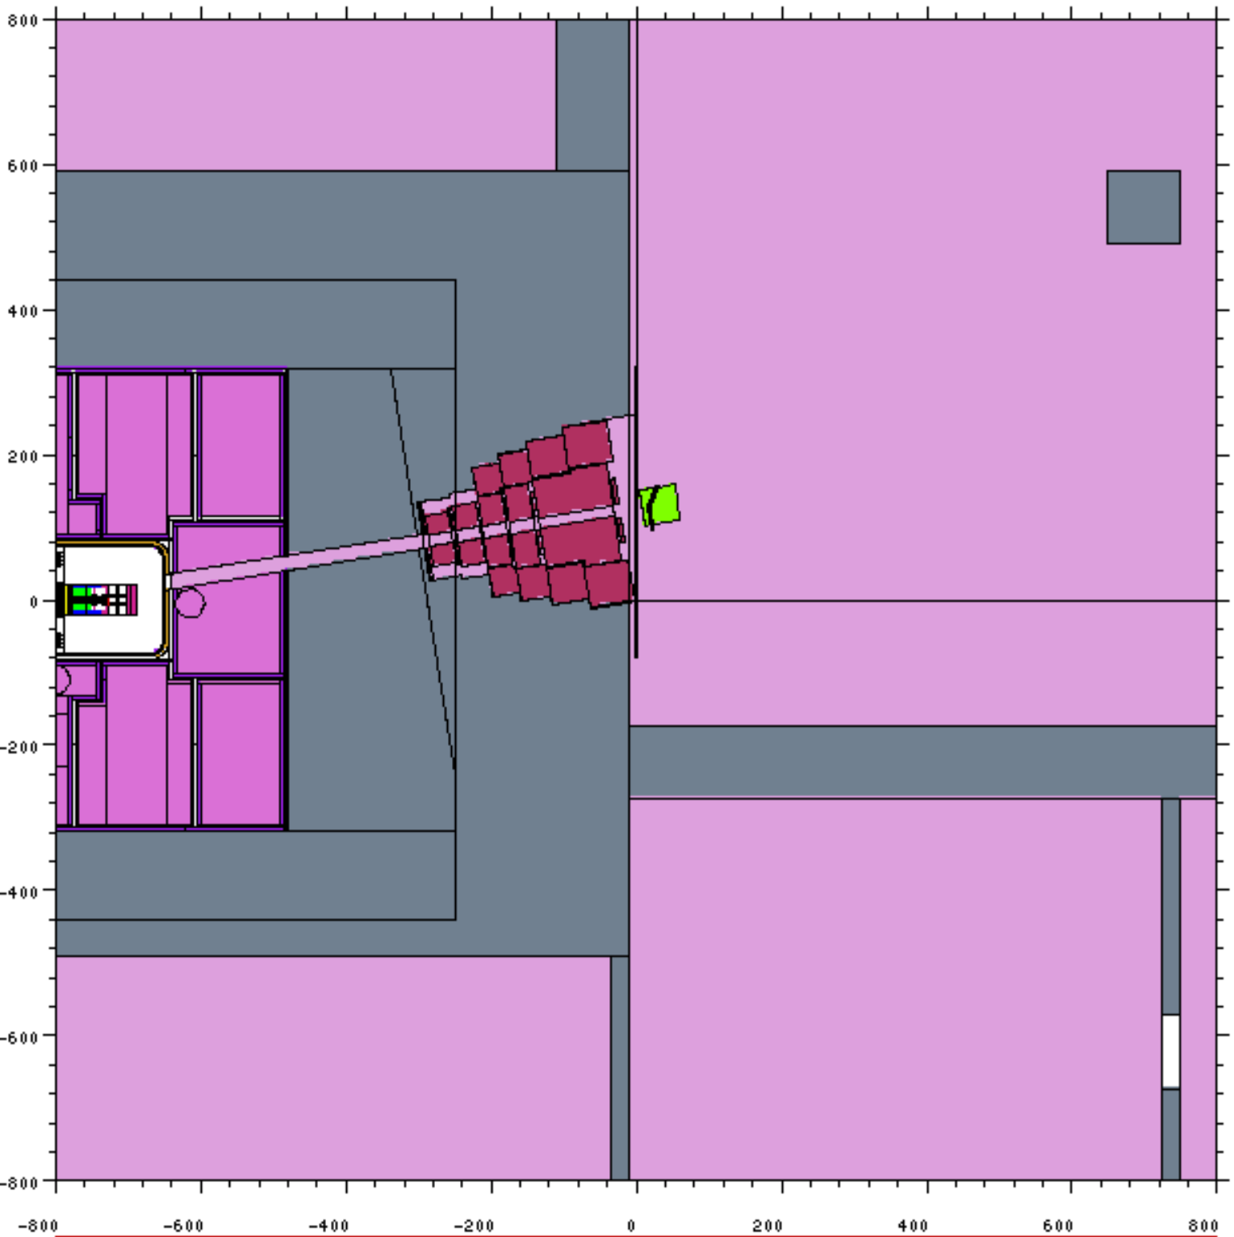
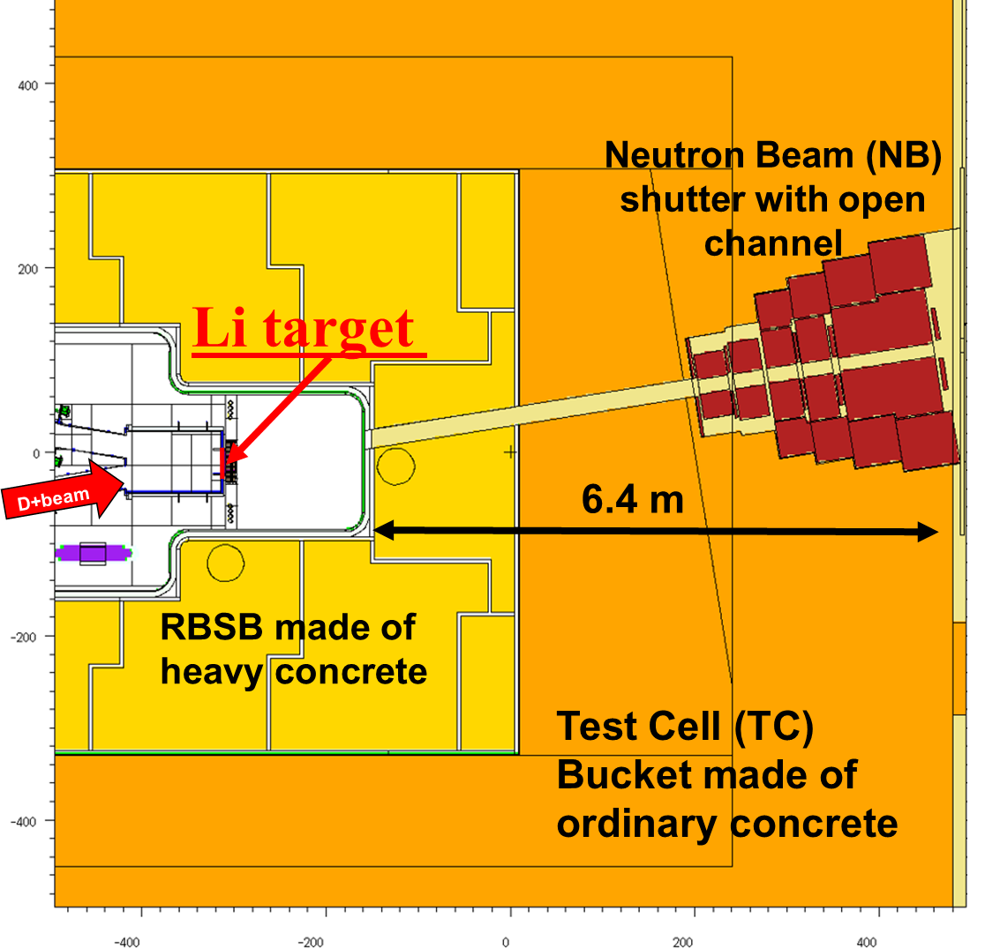
Neutron flux computations in TC-CER using the MCNP mesh-tallies
Compl. Exp. Room (CER)
R160
Maps of neutrons streaming from Test Cell (TC) through the Neutron Beam Tube and Shutter (NBT & S) system to CER. The collimated neutrons will be supplied to conduct variety neutronics experiments inside CER.
Test Cell (TC)
Column
Area covered by MCNP mesh-tally
NBTube

Slide 24
Collimated neutrons in CER : Neutron Beam Tube and Shutter (NBT & S) system
NB shutter
Subject: Analyses of neutron fluxes in broad energy groups at the entrance to CER from TC through the open NB shutter.
Method: Using OTF variance reduction, n-fluxes maps have been calculated with MCNP mesh-tallies of in three e-groups :
Thermal neutron flux (En< 0.625E-6 MeV)
Epithermal neutron flux (0.625E-6 MeV<En< 0.5 MeV)
Fast neutron flux (0.5 MeV<En<100 MeV)
Central open channel
In all the presented MCNP calculation results, all channels of the NB shutter have been empty.
The position of “open NB shutter” is formed when the NB shutter central channel coincides with the NB Tube.
The “closed NB shutter” – when all channels inside the rotated “Revolver-type” drums are at the farthest position to the NB Tube.
In future studies, the 5 open channels in the last drum will be filled with materials to function as neutron filters and neutron spectral shifters.

Slide 25
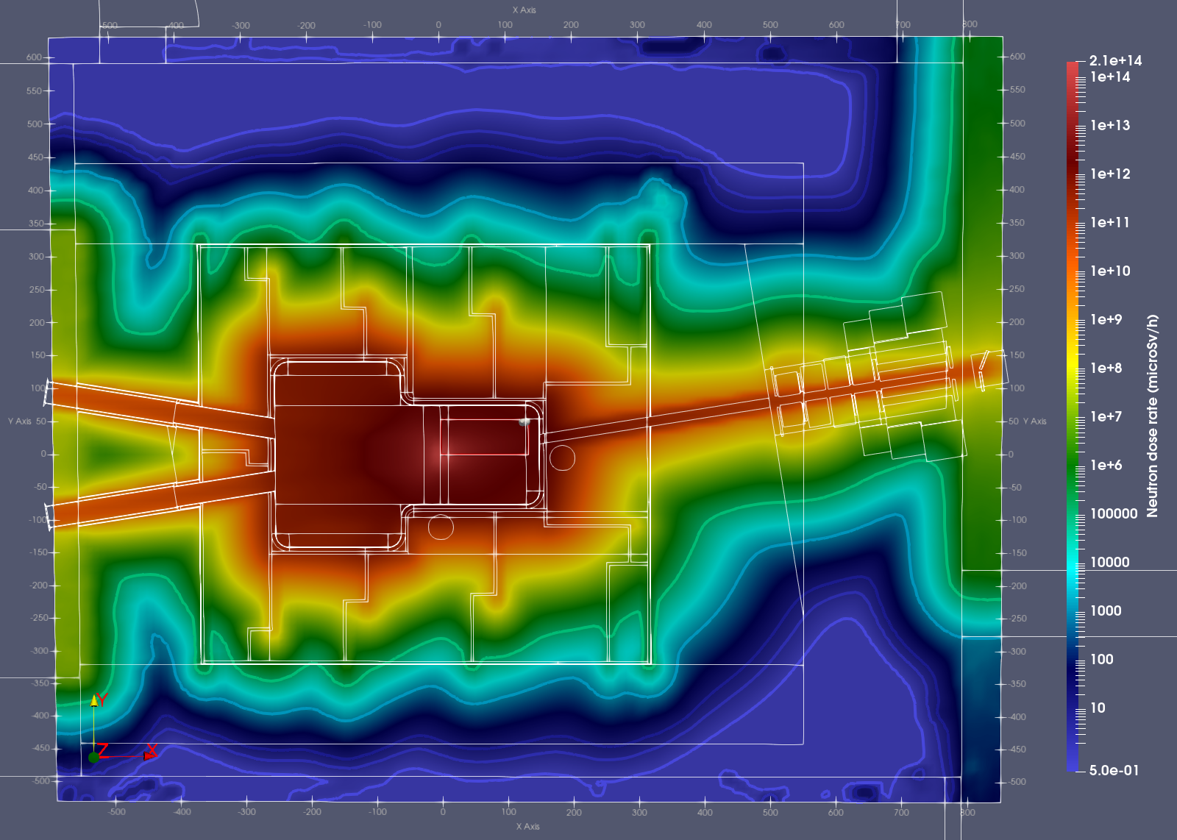
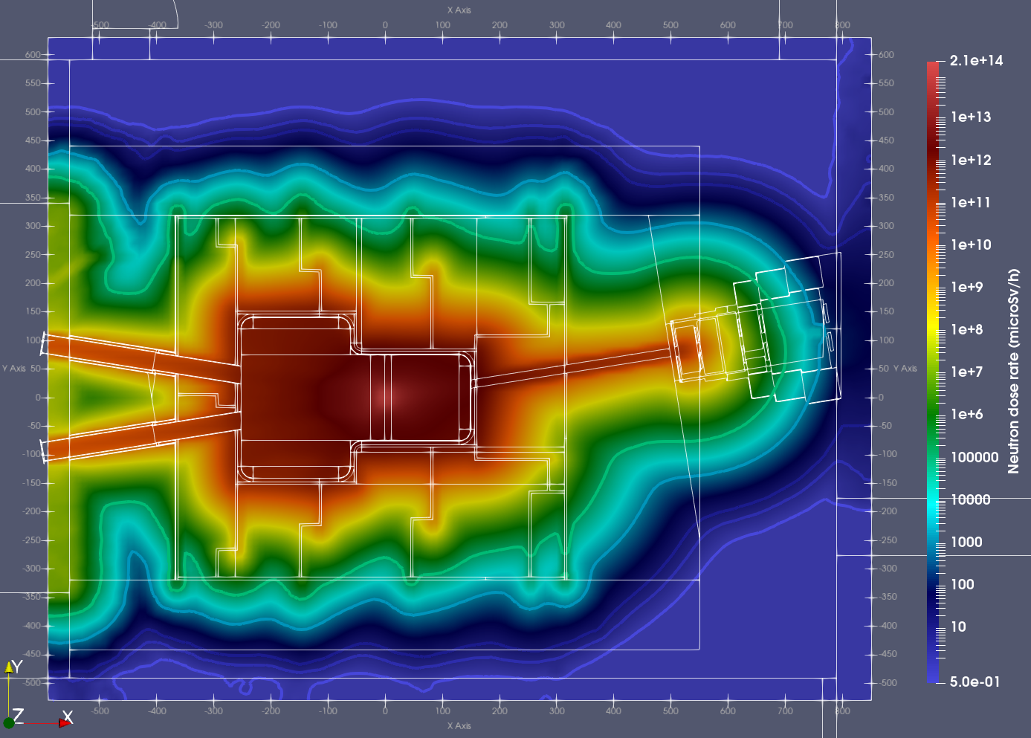
Neutron dose rate maps for two positions of the NB shutter
Position #1: Open NB shutter
Position #2: Closed NB shutter
1e5
1e5
1e5
1e3
1e3
10
10
3
3
1e5
0.5
0.5
CER is Red (forbidden) radiation zone: DR>1e5 microSv/h
CER is Yellow (limited regulated) rad. zone: (10<DR<1e3) microSv/h

Slide 26
Neutron maps in TC & CER
for the MCNP model with empty DONES TC behind HFTM

Slide 27
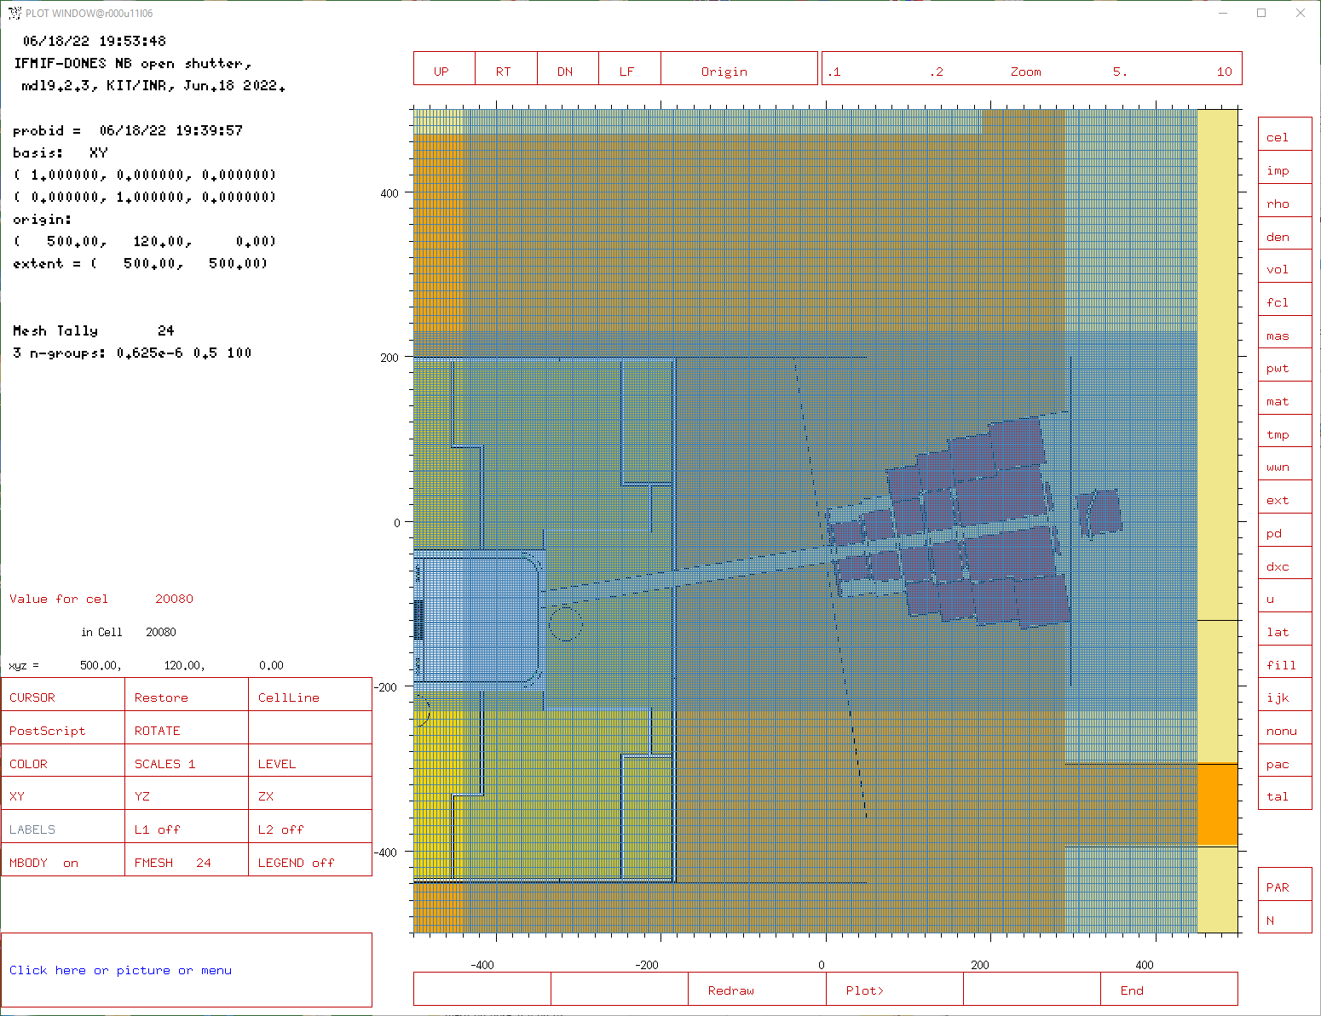
High resolution (2-cm) mesh-tally around NB-shutter

Slide 28
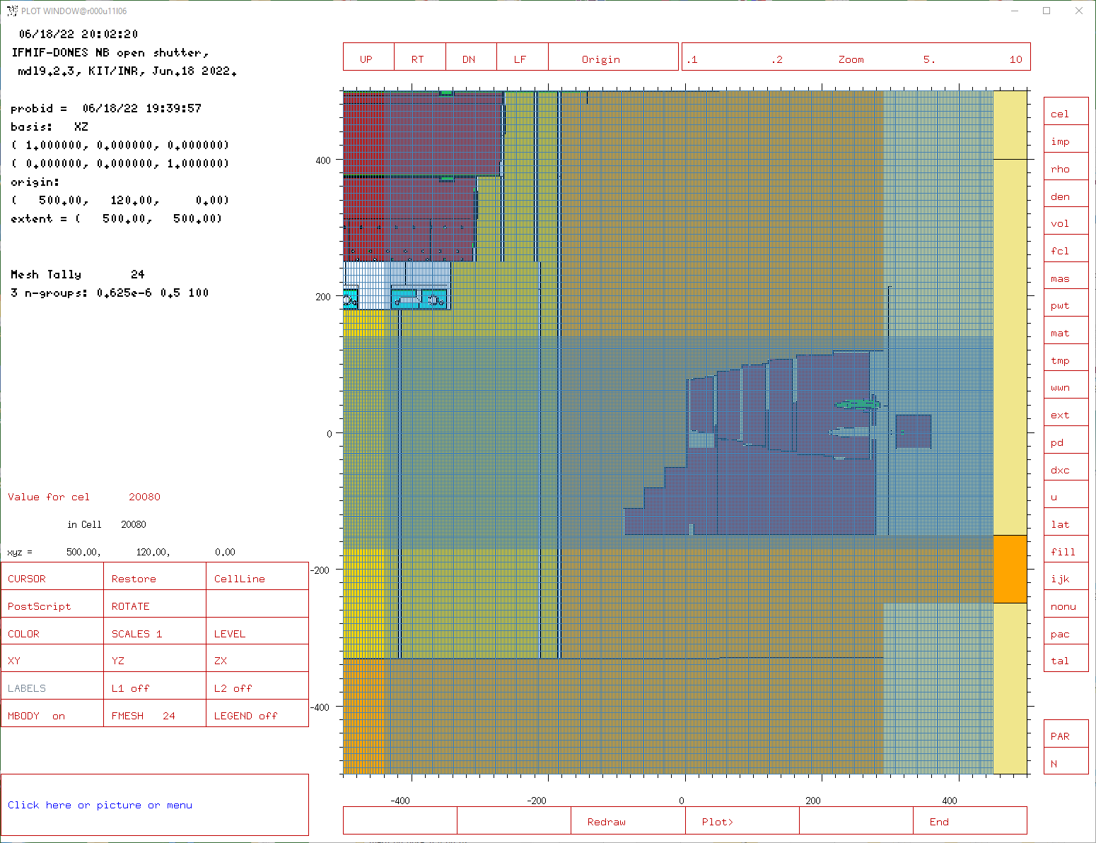
High resolution (2-cm) mesh-tally around NB-shutter

Slide 29
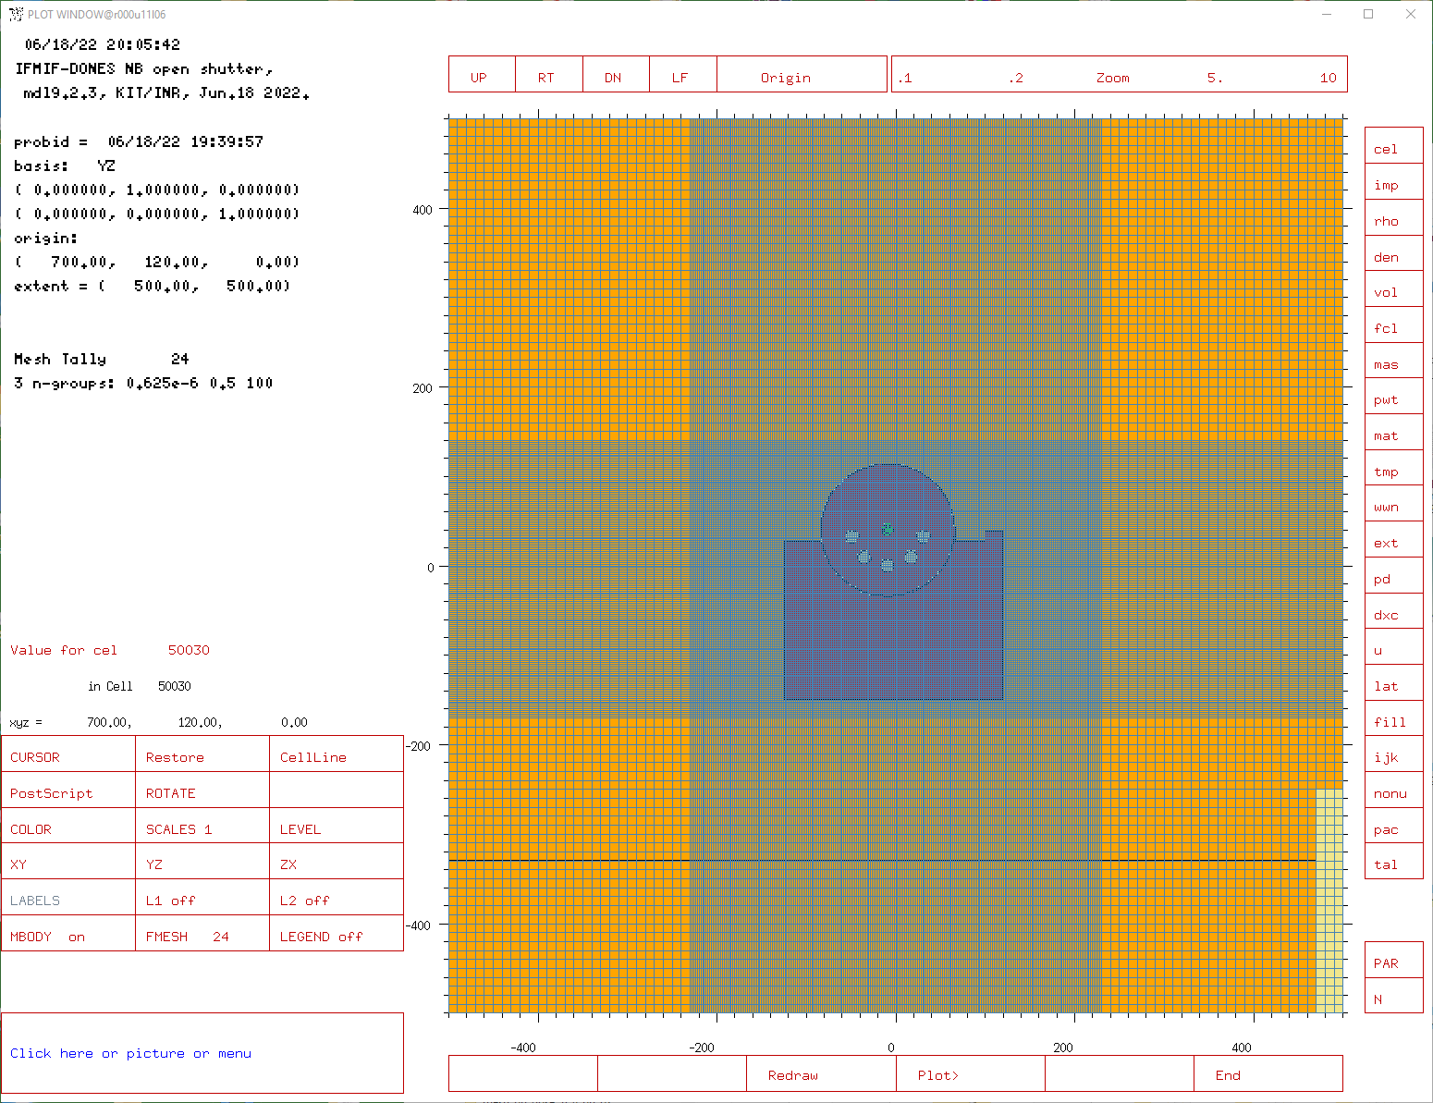
High resolution (2-cm) mesh-tally around NB-shutter

Slide 30
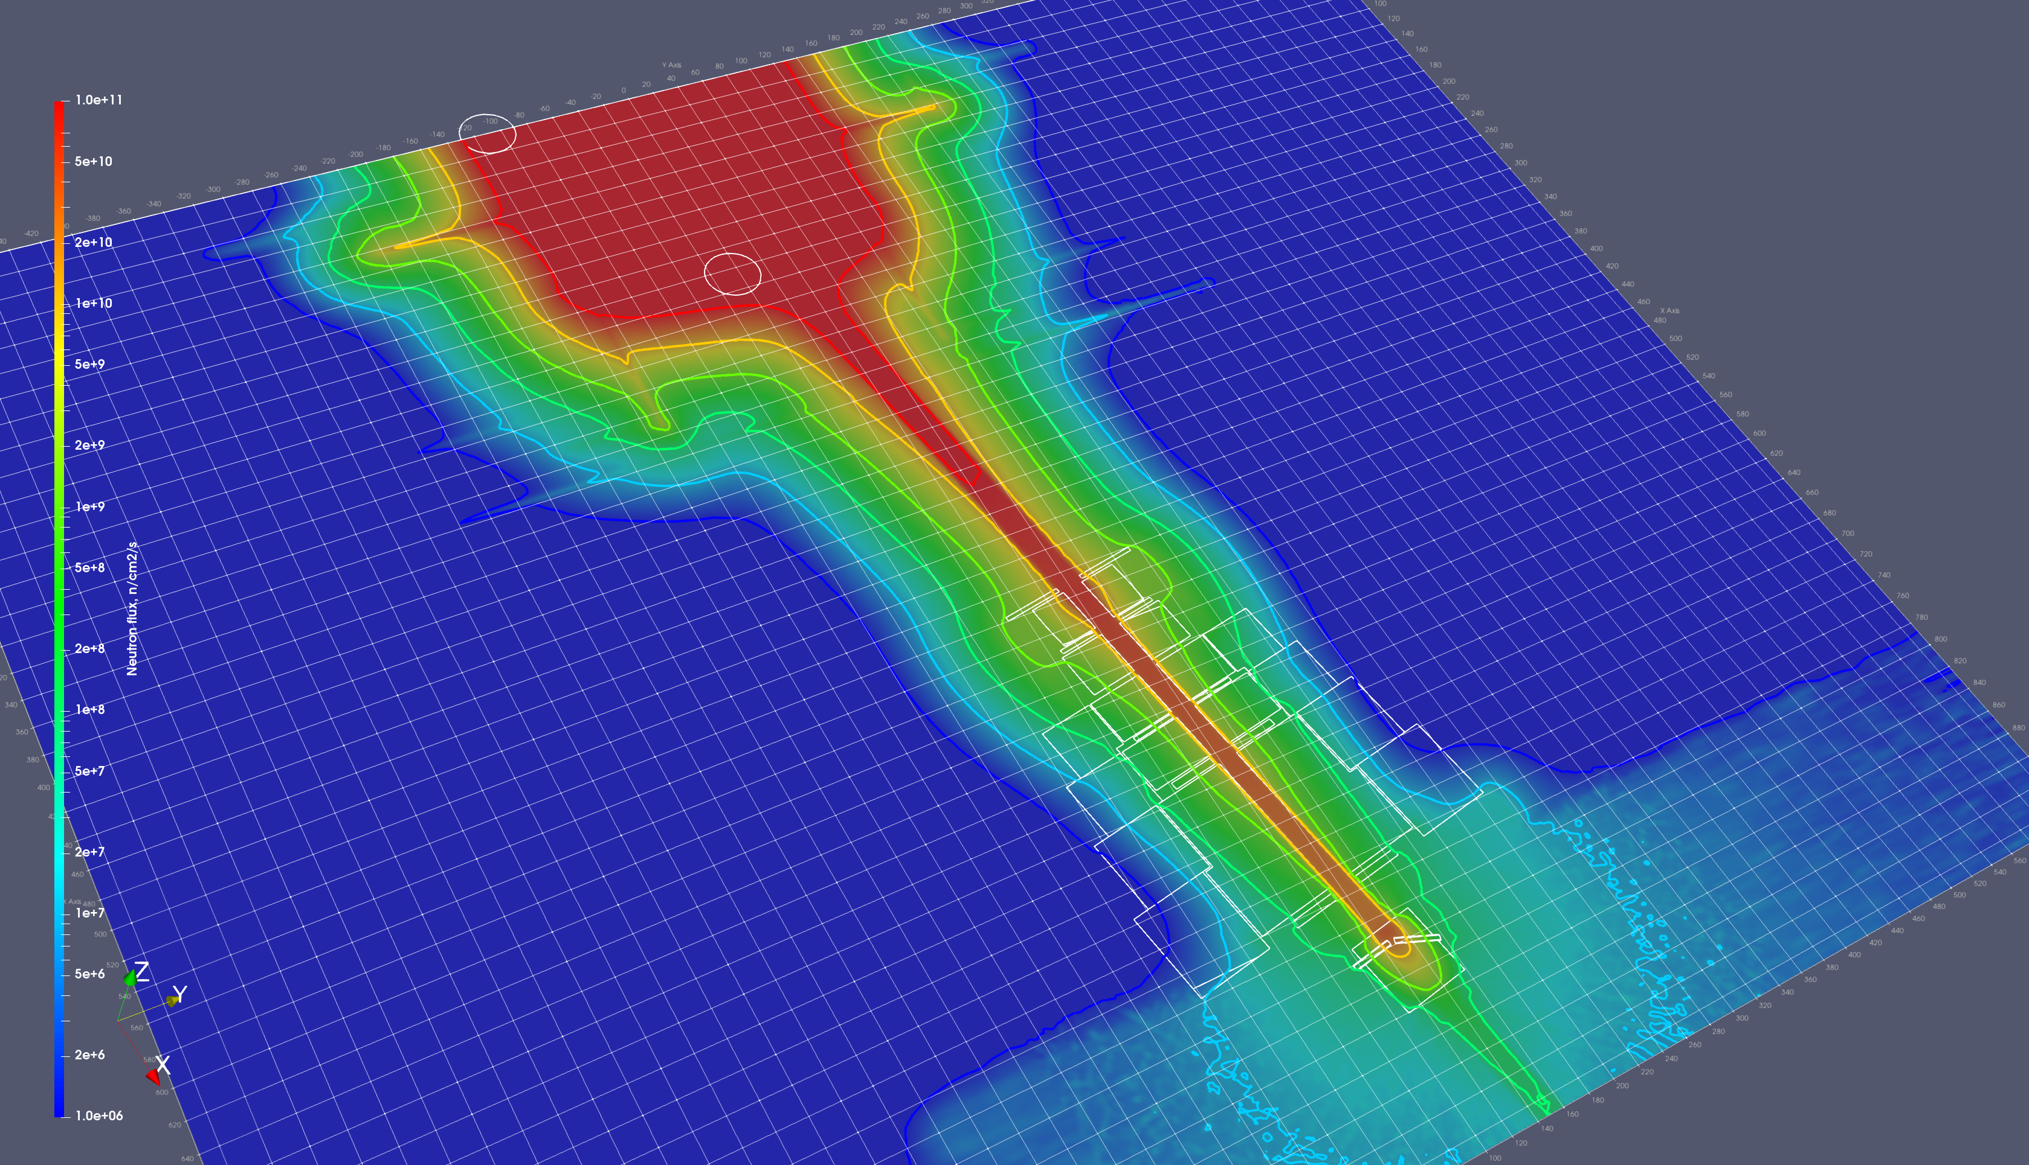
Total n-flux with open NB shutter and 8 mm TC liner
1e11
1e10
1e11
1e9
1e8
1e7
1e6
TC wall
CER
1e10

Slide 31
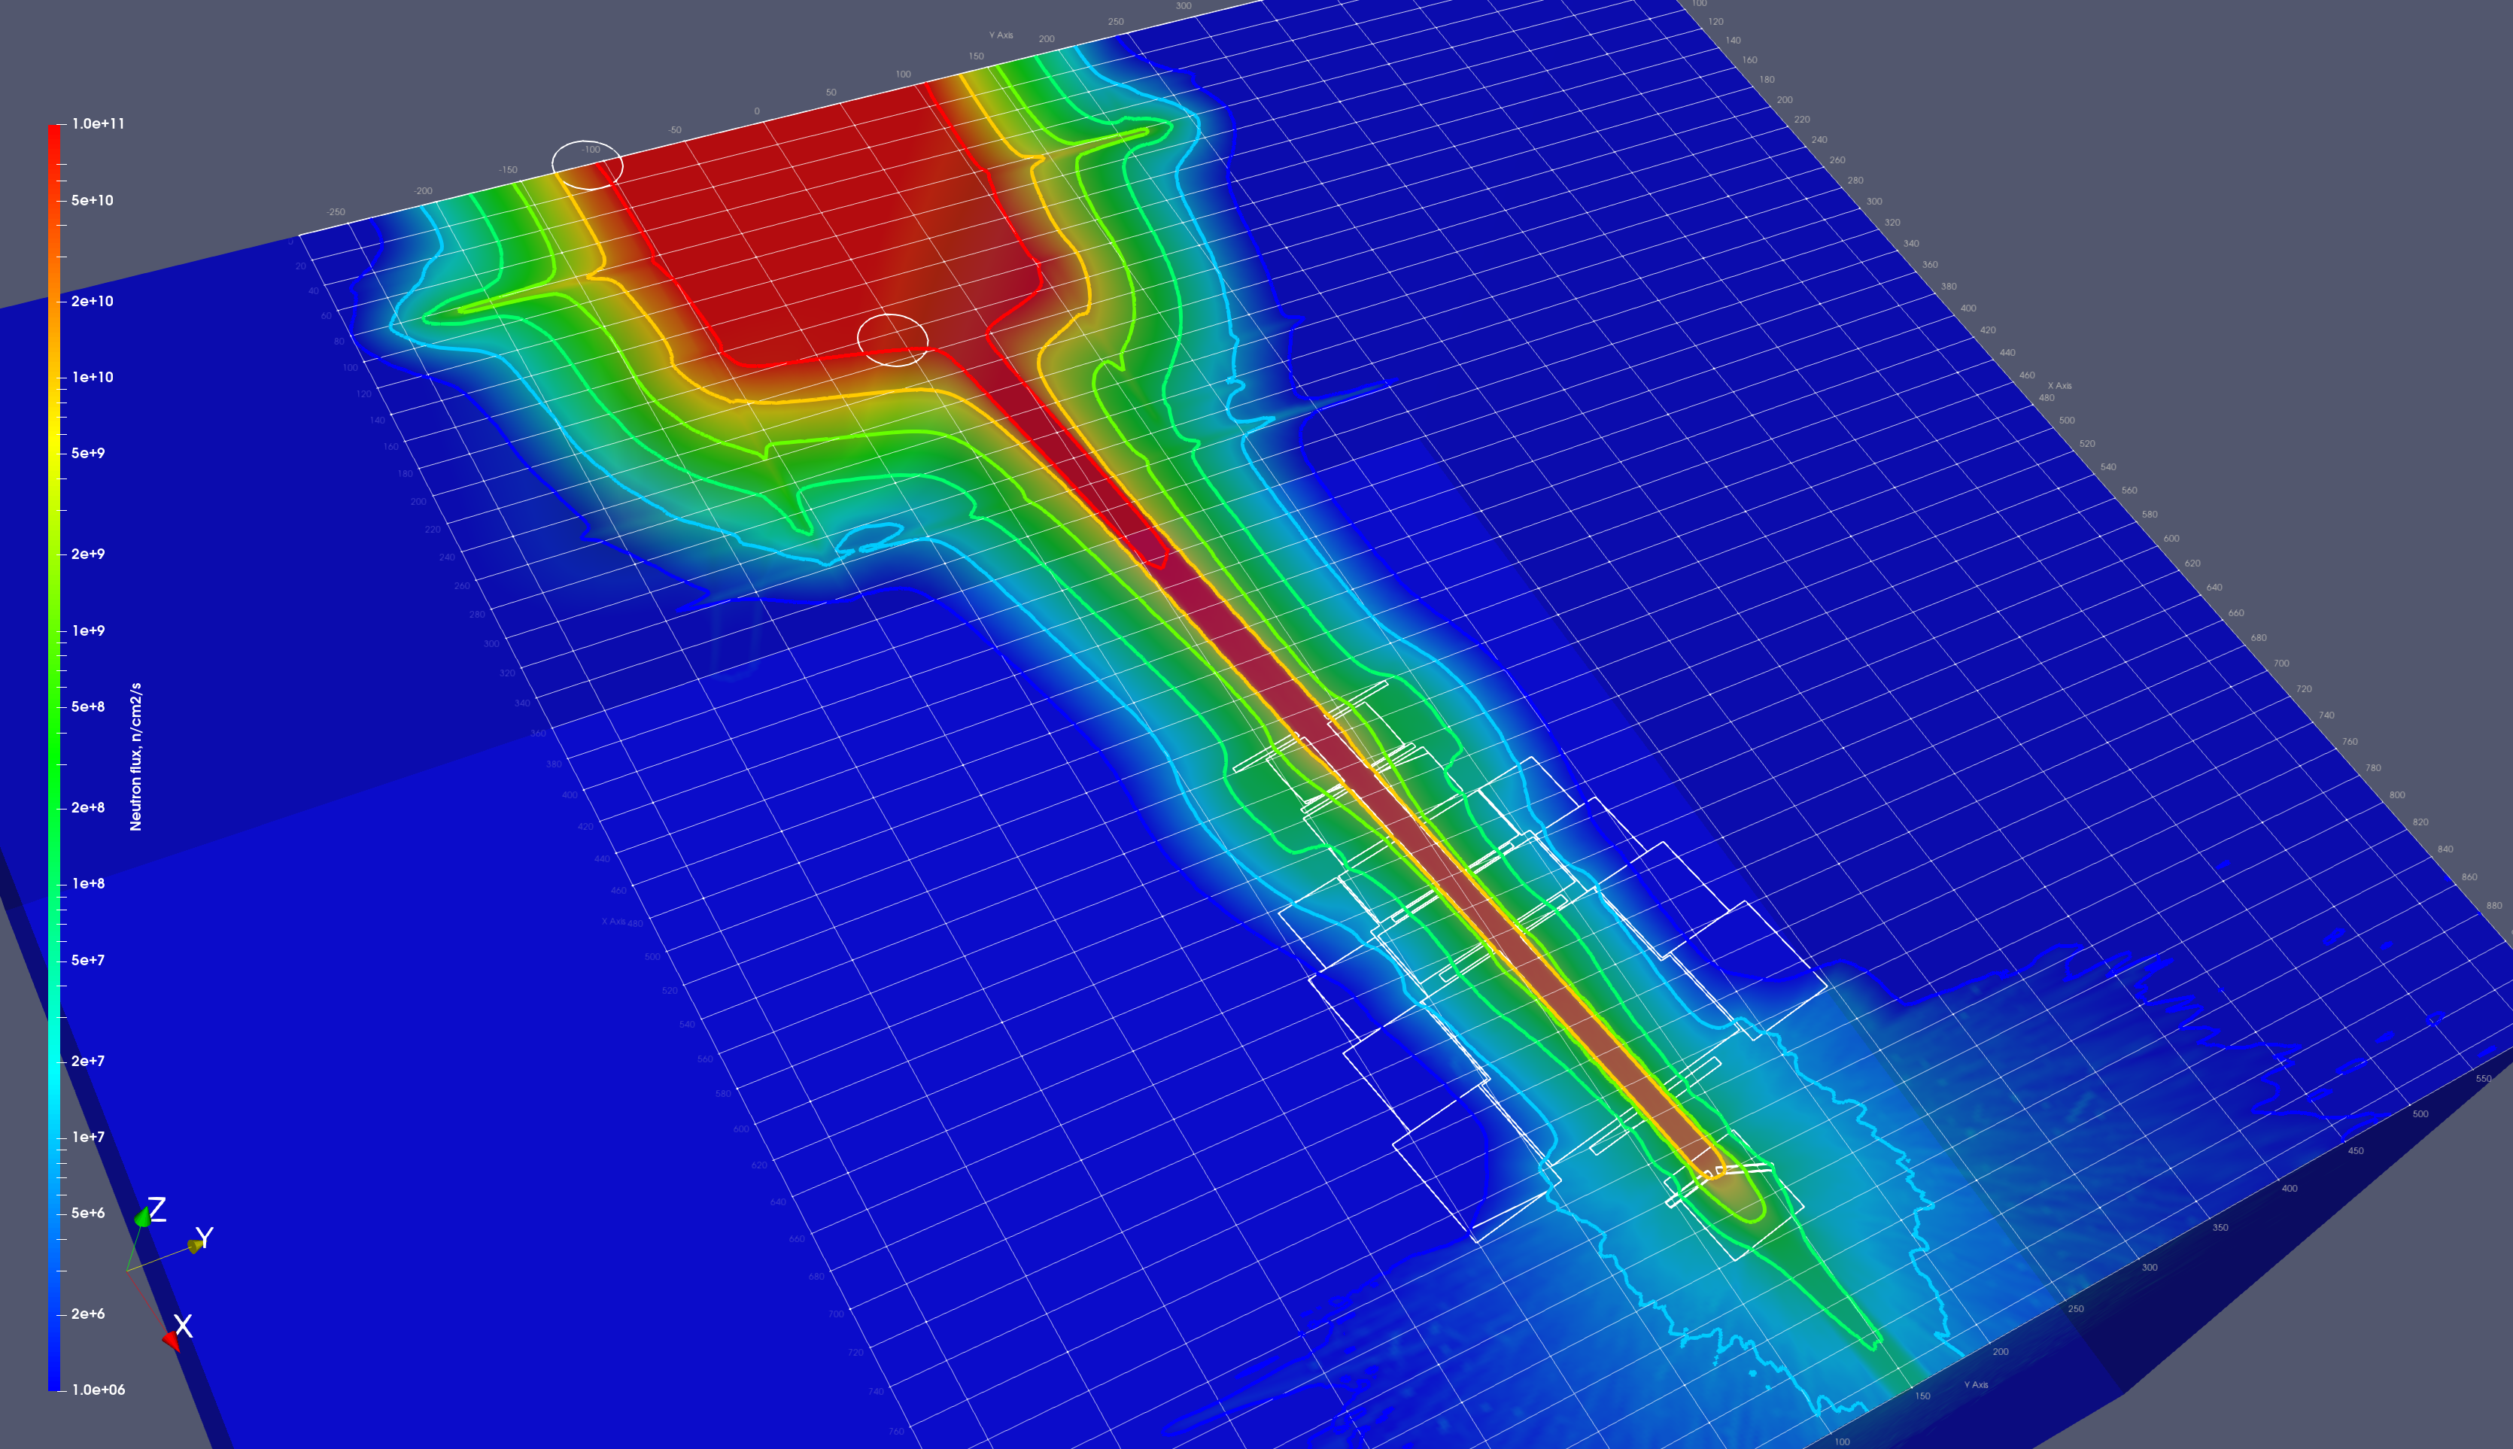
Fast (En>0.5 MeV) n-flux with open NB shutter and 8 mm TC liner
1e11
1e11
1e10
1e9
1e8
1e7
1e6
TC wall
CER
1e10

Slide 32
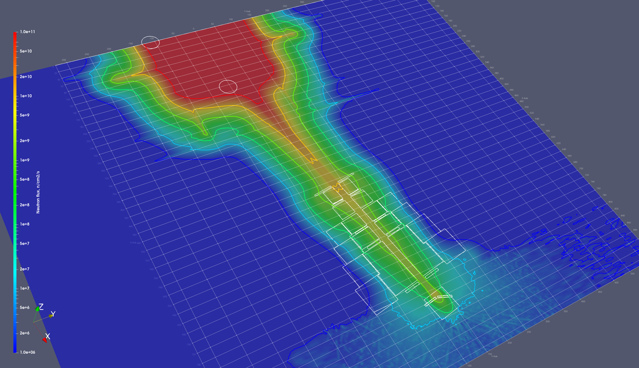
Epithermal neutron flux (0.625E-6 MeV<En< 0.5 MeV), open NB shutter, 8 mm TC liner
1e11
1e11
1e10
1e9
1e8
1e7
1e6
TC wall
CER
1e9

Slide 33
Neutron maps in TC & CER
for the MCNP model with HCPB BB in DONES TC behind HFTM

Slide 34
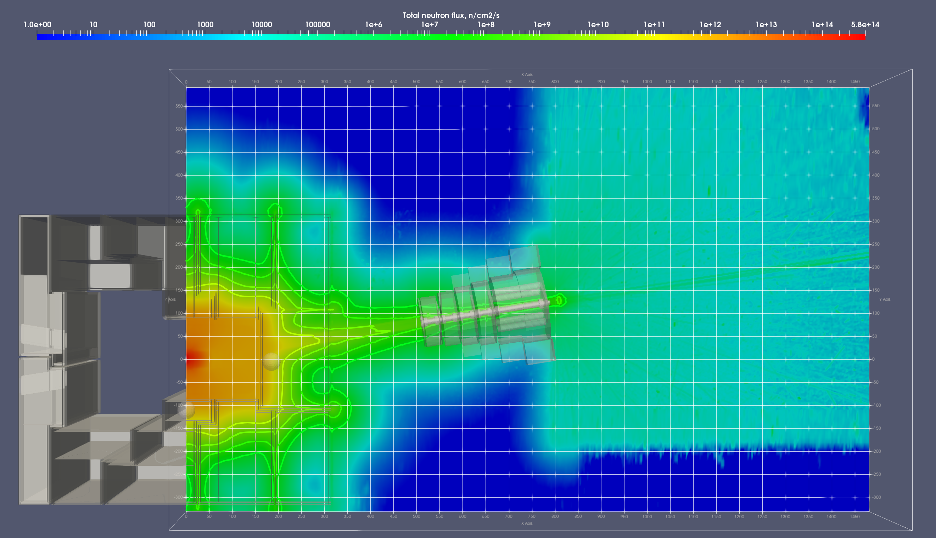
HCPB BB module - Total neutron flux horizontal central cut at entrance to CER from TC

Slide 35
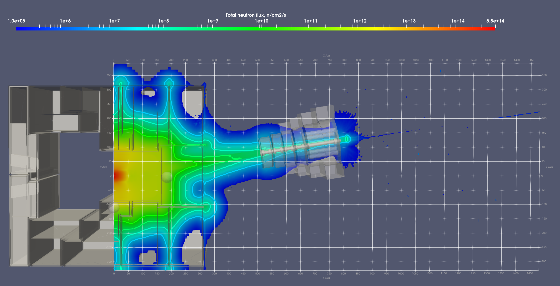
HCPB BB module - Total neutron flux horizontal central cut at entrance to CER from TC

Slide 36
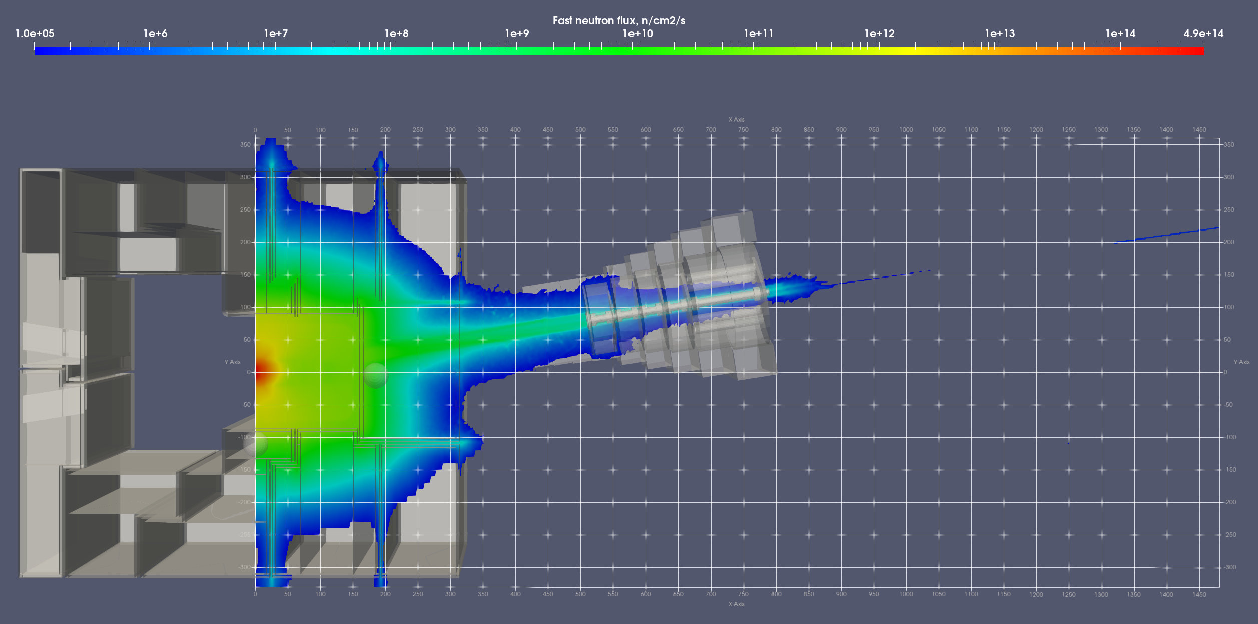
HCPB BB module - Fast neutron flux

Slide 37
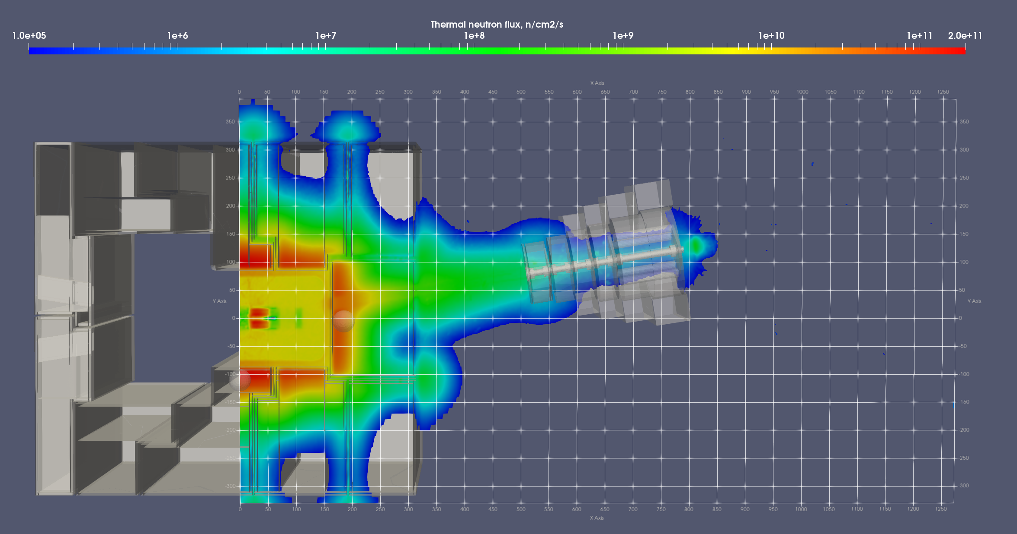
HCPB BB module - Thermal neutron flux

Slide 38
Neutron maps in TC & CER
for the MCNP model with TRTM in DONES TC behind HFTM

Slide 39
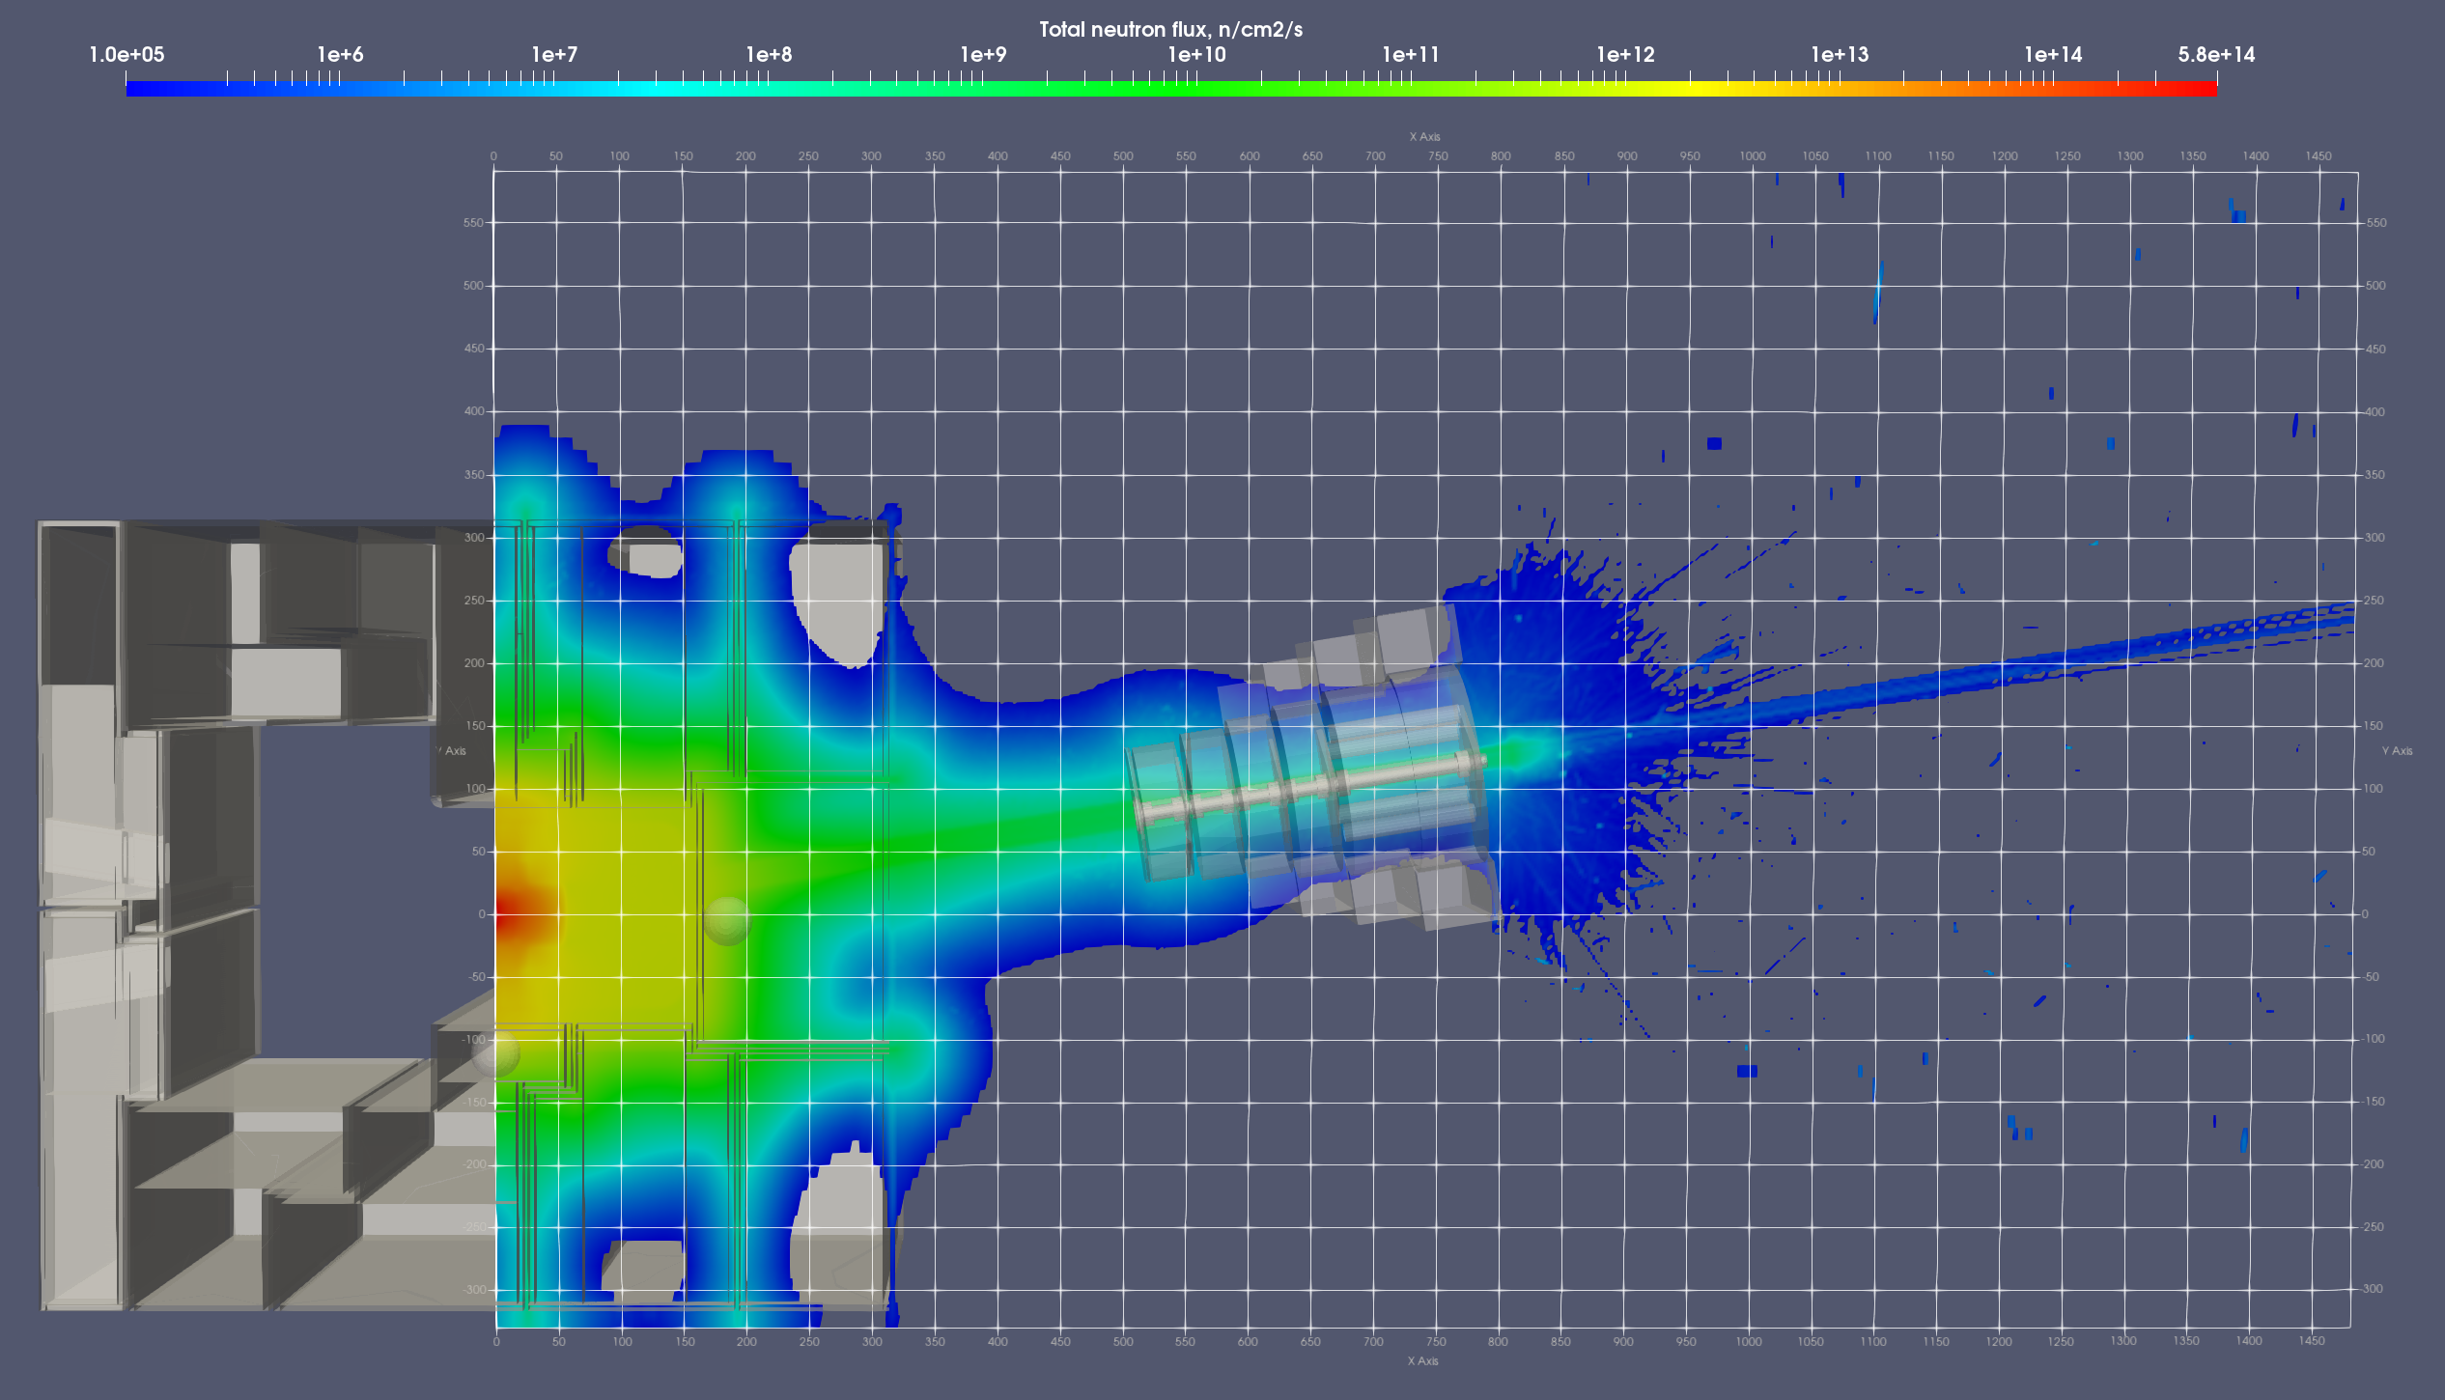
TRTM total neutron flux horizontal central cut at entrance to CER from TC
TC
RBSB + TC Bucket concrete
CER

Slide 40
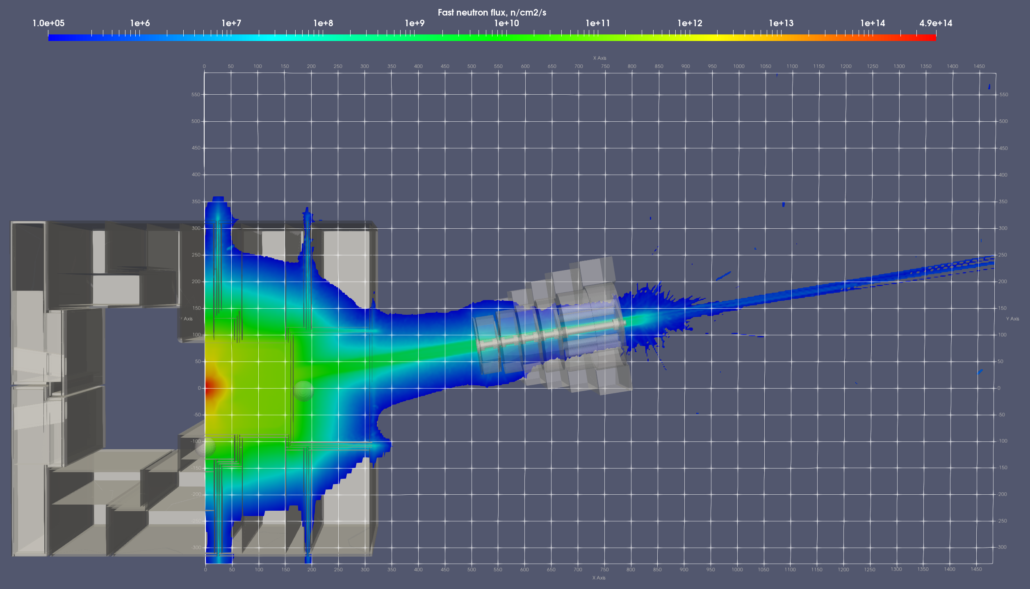
TRTM fast neutron flux
TC
RBSB + TC Bucket concrete
CER

Slide 41
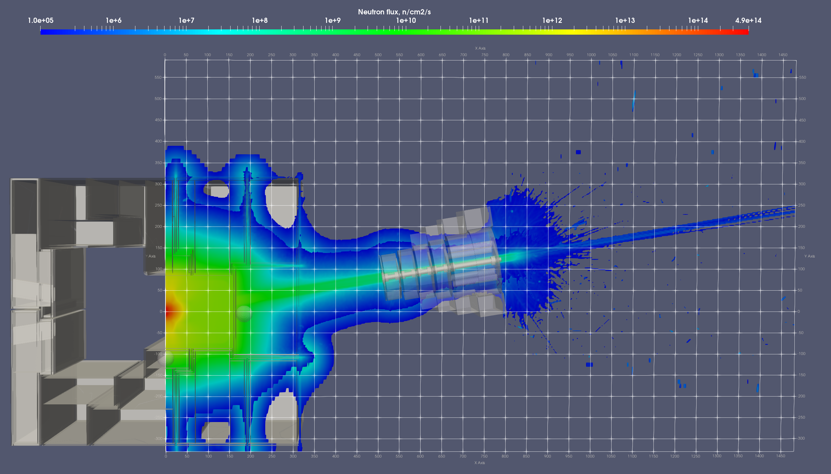
TRTM total & fast neutron fluxes – Overlaid maps
TC
RBSB + TC Bucket concrete
CER
Total contour
Fast contour

Slide 42
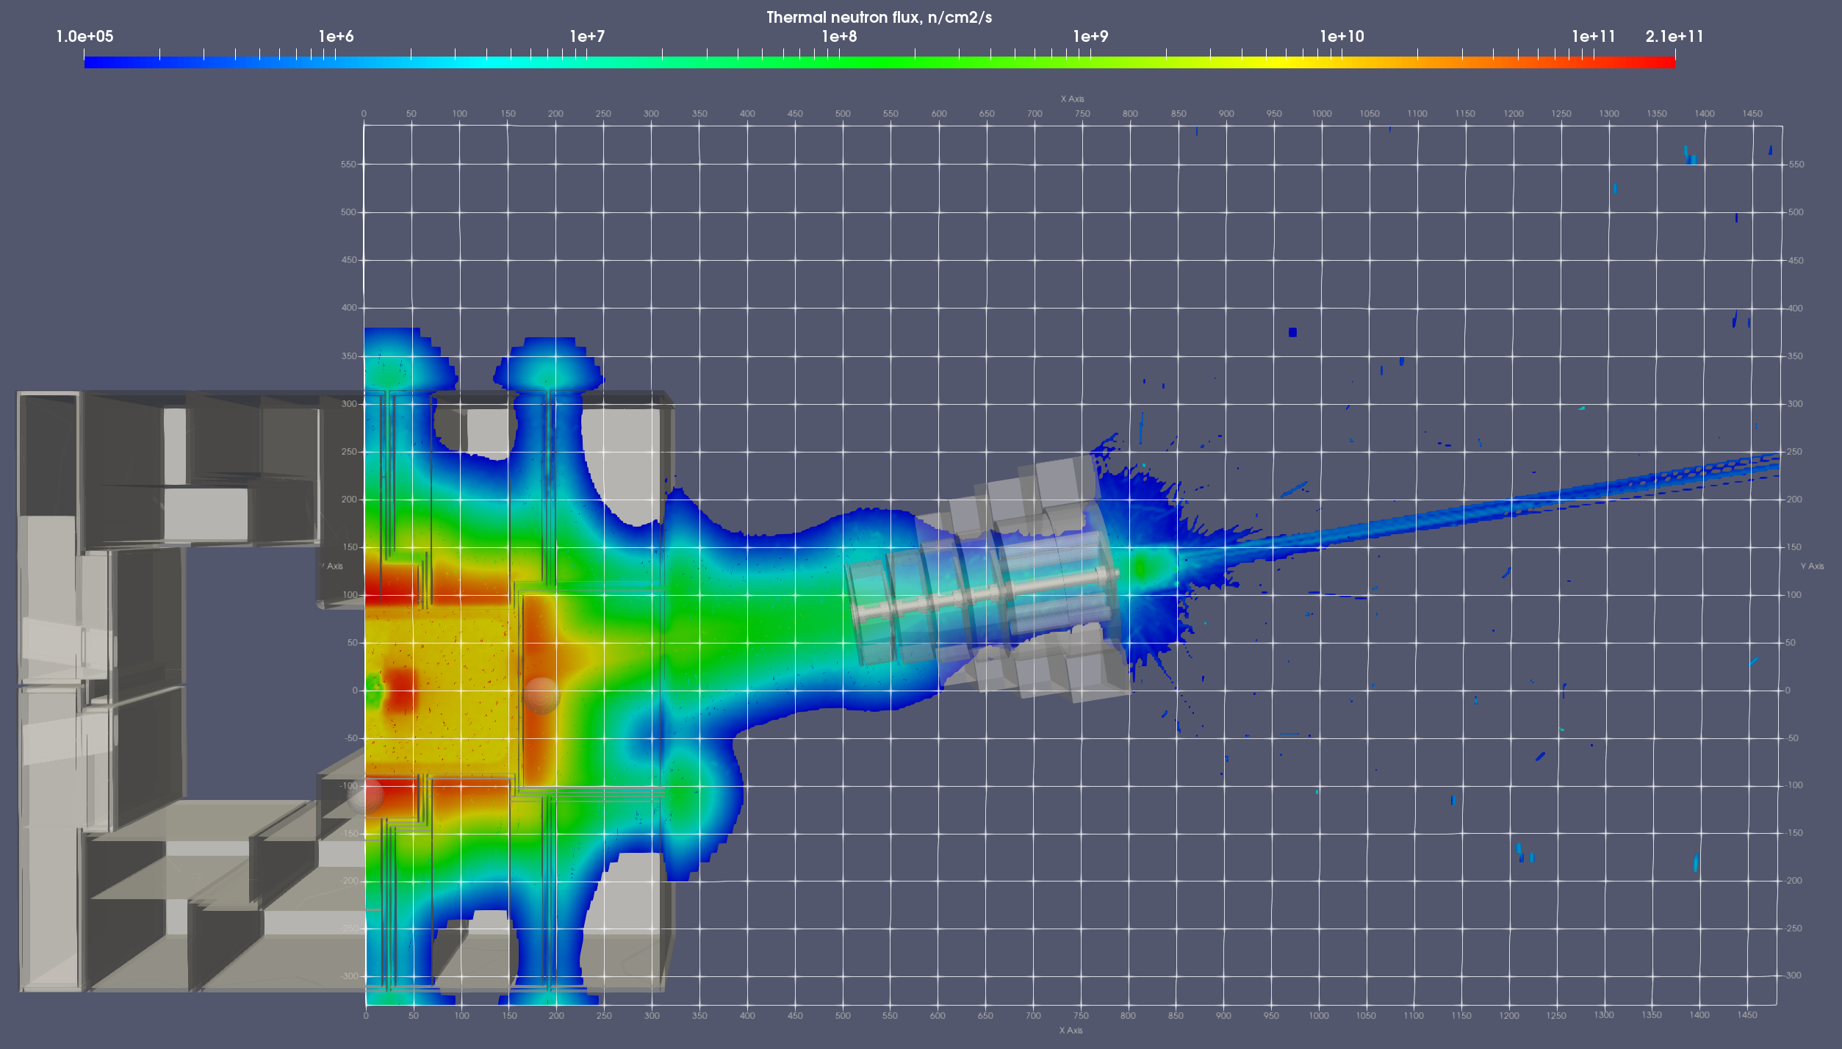
TRTM thermal neutron flux
TC
RBSB + TC Bucket concrete
CER
Detector #1 – sphere R=20cm
Detector #2 - sphere R=20cm

Slide 43
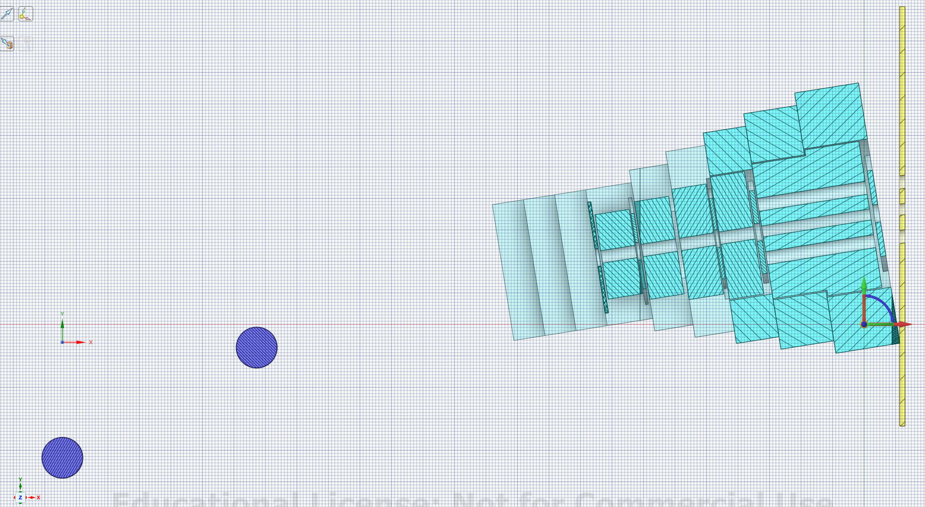
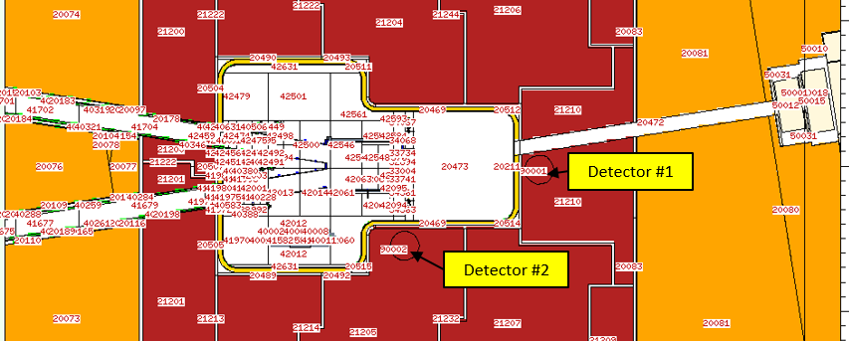
Six detectors in open NB-shutter configuration (two spheres and four disks)
MCNP model
Neutron Beam (NB) shutter with open channels
Detector #3
Detectors #4, 5, 6
at open channels
Detector #1 – sphere R=20cm
CAD model
Detector #2 - sphere R=20cm

Slide 44
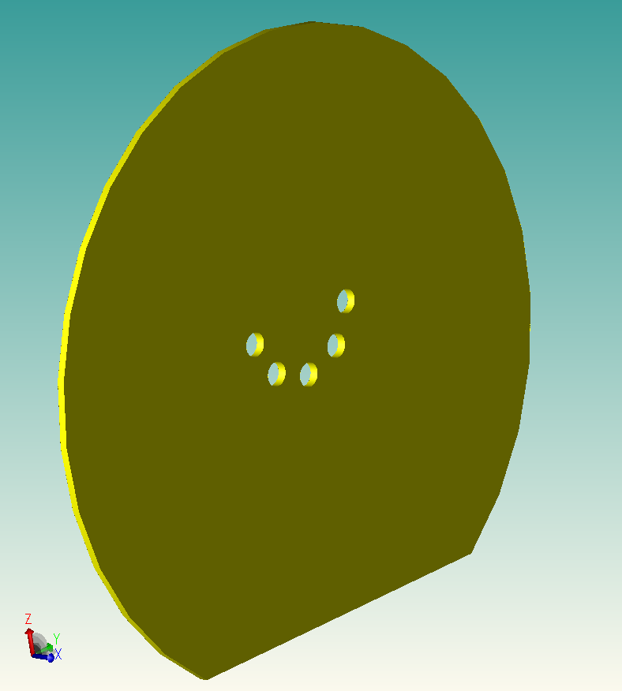
Disk detectors at the entrance to CER (R160)
Det. #3 is a truncated disk with thickness d=5 cm, radius R=200 cm
Detector #3
Detectors #4, 5, 6 outside the five open channels of revolving drum
Central open channel
The 5 open holes of Detectors #4, 5, 6 coincide with 5 open channels of rotated “Revolver-type” drum. The dominate radiation streaming was detected in the central open channel.

Slide 45
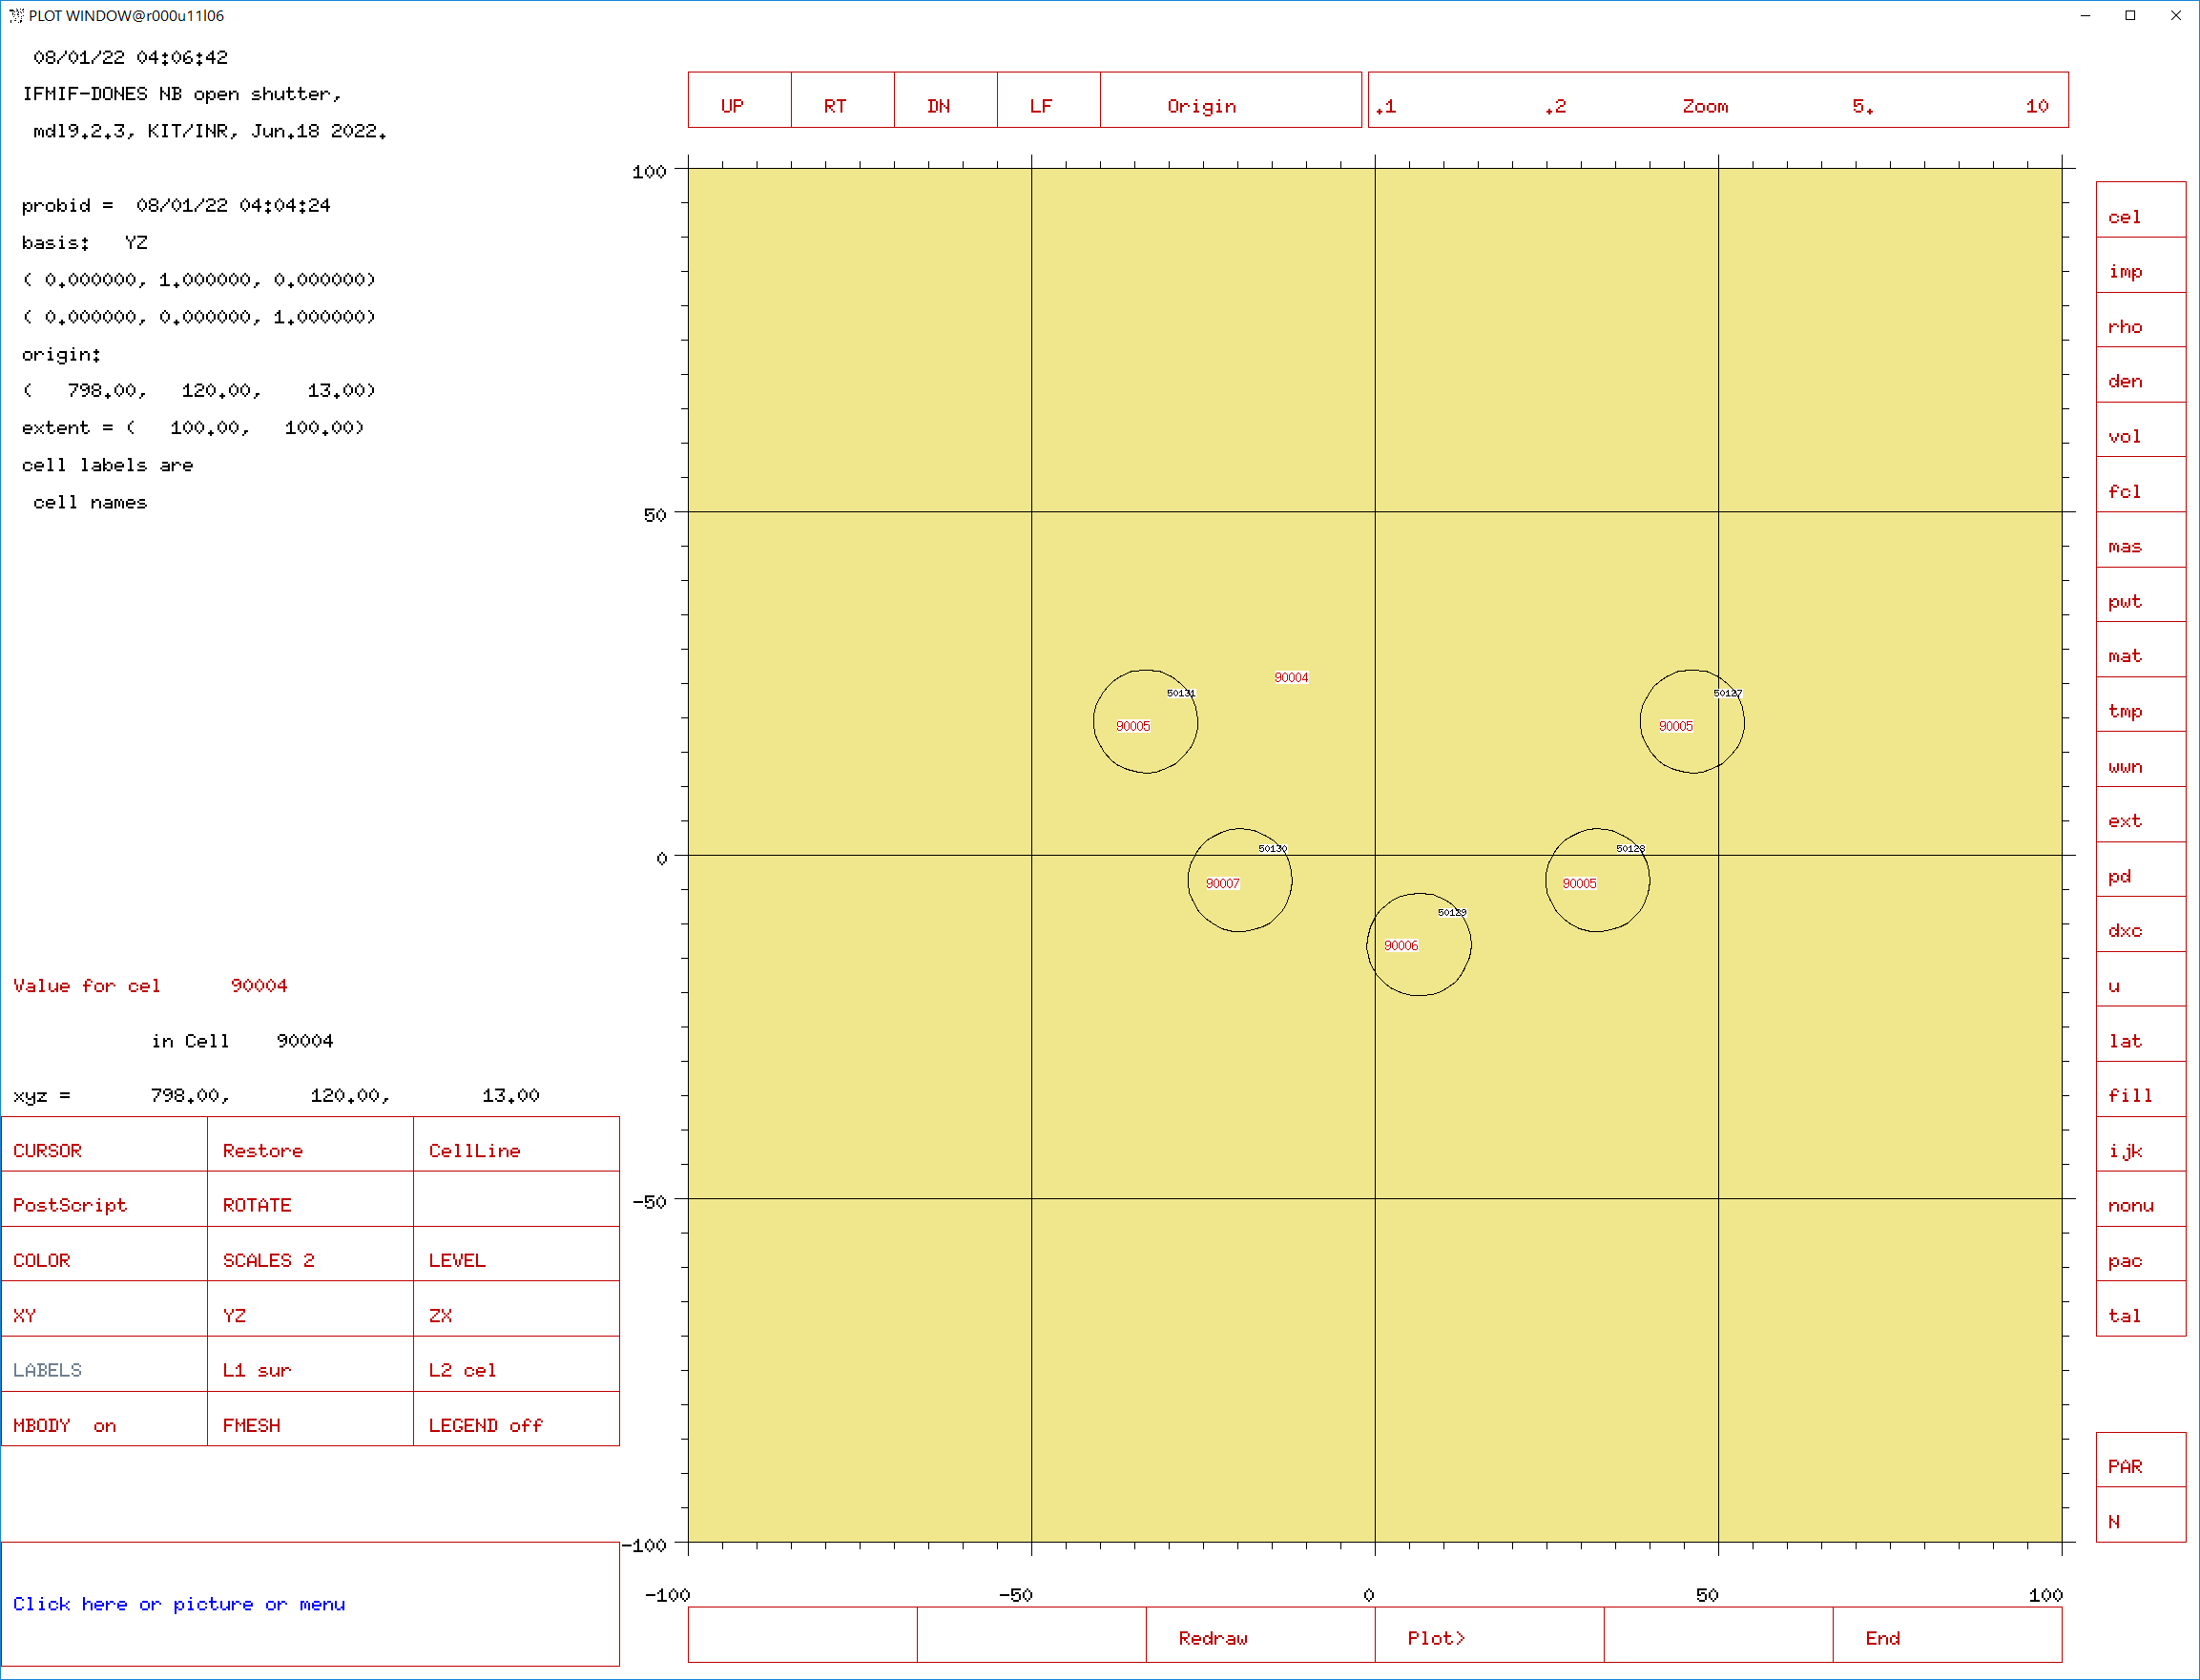
Disk detectors at the entrance to CER (R160)
c ccccccccccccccccccccccccccccccccccccccccccccccccccccccccccccccccccccccccccccccccccccccccccc
c detector behind the NB shutter:
90004 301 -1.2E-3 -90004 11529 50138
(50127 50128 50129 50130 50131)
imp:n=1 imp:p=1 $ tally for NB shutter
c detector for open channels in NB shutter:
90005 301 -1.2E-3 -90004 11529 50138
(-50127:-50128:-50131)
imp:n=1 imp:p=1 $ tally for open channels in NB shutter
c detector for open channels in NB shutter:
90006 301 -1.2E-3 -90004 11529 50138
-50129
imp:n=1 imp:p=1 $Central open channel of the NB shutter
90007 301 -1.2E-3 -90004 11529 50138
-50130
imp:n=1 imp:p=1 $ Side open channel of the NB shutter
c ccccccccccccccccccccccccccccccccccccccccccccccccccccccccccccccccccccccccccccccccccccccccccc
Detector #3
Detector #3: MCNP cell #90004 - air of truncated disk with thickness d=5 cm and radius R=200 cm – Outside all 5 disks
Detector #4
Detector #4: MCNP cell #90005 - air of three side detectors, far from open
Detector #5
Detector #6
Detector #6: MCNP cell #90007 - air of one side channel, neighboring to open
Detector #5: MCNP cell #90006 - air of central open channel
Detector #7 = United disk detector for all disk detectors (3+4+5+6)

Slide 46
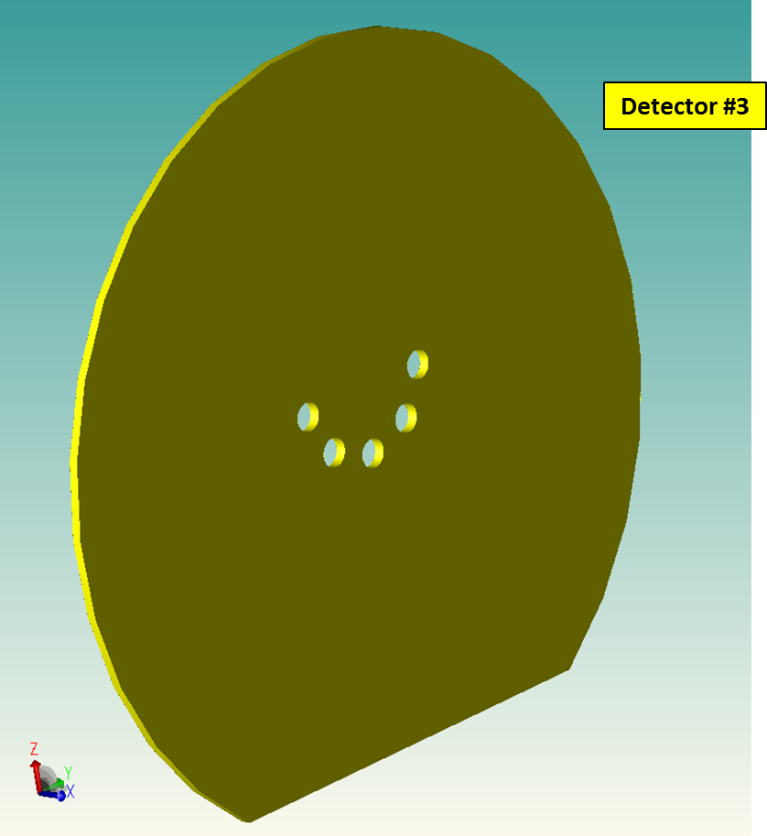
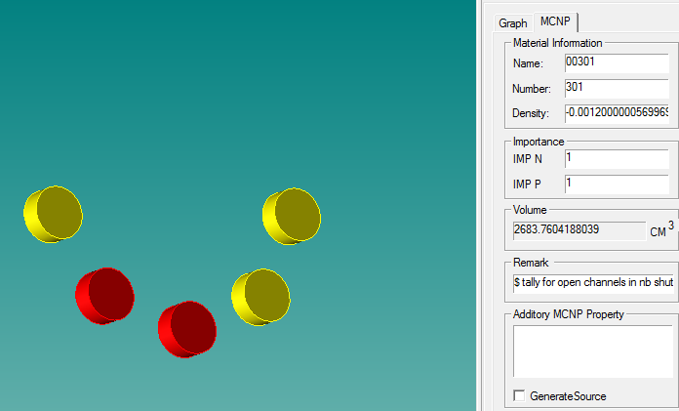
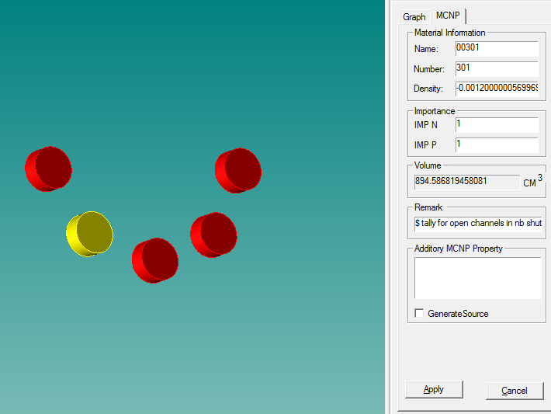
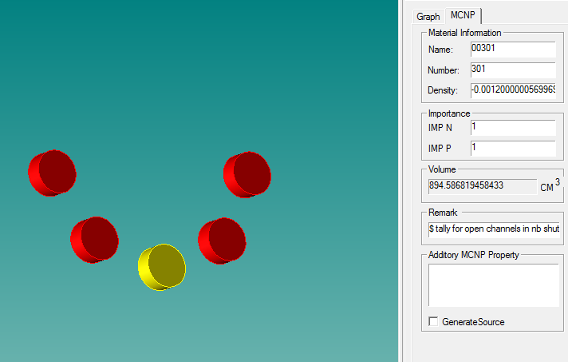
Volumes of disk detectors at the entrance to CER (R160)
Detector #4
Detector #6
Detector #5

Slide 51
Conclusions
Two MCNP neutronics models have been developed to simulate the radiation conditions in DONES MFTM suitable for the breeding:
Tritium Release Test Module (TRTM)
DEMO Helium Cooled Pebble Bed (HCPB) Breeding Blanket (BB) module – 7 full-size pins of Advanced ceramic breeder ACB pebbles (lithium orthosilicate, 35mol% lithium metatitanate), Li4SiO4 +35% Li2TiO3, Li6 = 60% - Ref. [1]. Titanium beryllide with the composition TiBe12 has been used for neutron multiplication. TiBe12 stands out from other beryllides for fusion because it has the highest neutron-multiplication characteristic, with the added benefit of higher temperature performance capability compared to beryllium metal [2].
The MCNP mesh-tally reveled the dominancy of fast neutrons in the total neutron flux at the exit from NB shutter to CER in the initial model without any MFTM. By adding breeding modules the spectrum is getting softer, allowing to conduct experiments in CER (R160) requesting more thermal neutrons. For this reason HCPB BB module is preferential.
Neutron broad group | Percentage of the group in HCPB BB model | Percentage of the group in TRTM model
Fast | 23.0% | 49.1%
Epithermal | 66.1% | 42.2%
Thermal | 10.9% | 8.7%
Neutron broad group | Percentage of the group in model without any MFTM
Fast | 88.5%
Epithermal | 8.2%
Thermal | 3.3%
Spectrum is getting softer
One accelerator gives the peaking T-production rate of 1e12 atoms-T/g-ACB/s in ACB of HCPB BB, by adding the second accelerator, the value is doubled: 2e12 atoms-T/g-ACB/s in ACB of HCPB BB.
References:
[1] R. Knitter, M.H.H. Kolb, U. Kaufmann, A.A. Goraieb, Fabrication of modified lithium orthosilicate pebbles by addition of titania, J. Nucl. Mater. 442 (2013) 433–436, https://doi.org/10.1016/j.jnucmat.2012.10.034.
[2] Christopher K. Dorn, et al., A review of physical and mechanical properties of titanium beryllides with specific modern application of TiBe12,
Fusion Engineering and Design, 84 (2009) 319-322, https://doi.org/10.1016/j.fusengdes.2008.11.009

