Slide 1
Assessment of radioisotopes production in IFMIF-DONES Test Cell
F.Mota*, M.I. Ortiz, E. López-Melero, I. Porras, J. Praena, M. Alcantud, N. Ballesteros, A. Dilla, E. Fernández, J.Gallo, J.C. Marugan, C. Prieto, I. Cobo, O. Oliva, D. Terán

Slide 2
Index
Why use IFMIF-DONES for Radioisotope production
Assessment of the ⁹⁹Mo production in IFMIF-DONES
High level requirements of the RadioIsotope Production Device (RIPD)
Proposals of concepts design for the RIPD
⁹⁹Mo assessment production considering the first RIPD mockups
Radioisotope production device vs Neutron Spectral Shifter
Conclusions and Future works

Slide 3
Index
Why use IFMIF-DONES for Radioisotope production
Assessment of the ⁹⁹Mo production in IFMIF-DONES
High level requirements of the RadioIsotope Production Device (RIPD)
Proposals of concepts design for the RIPD
⁹⁹Mo assessment production considering the first RIPD mockups
Radioisotope production device vs Neutron Spectral Shifter
Conclusions and Future works

Slide 4
Why use IFMIF-DONES for Radioisotope production
⁹⁹Mo is the precursor of Technetium-99m (^{99m}Tc), which is used for radiopharmaceutical applications
^{99m}Tc are used in Single Photon Emission Computed Tomography (SPECT) Thanks to its short half-life T1/2 (6 h) and the 140 keV γ-ray emission
Ideal features for imaging and low radiation dose to the patient
Radiopharmaceuticals based on ^{99m}Tc are used in more than 30 million procedures per year, accounting for about 85% of all nuclear medicine diagnostics
⁹⁹Mo is currently produced in nuclear fission reactors as a by-product of ²³⁵U fission.
However, a global shortage of ⁹⁹Mo emerged in the late 2000s because of the frequent shut down due to extended maintenance periods of the main reactors for ⁹⁹Mo production: NRU Chalk River Reactor (Canada) and the High Flux Reactor (HFR) at Petten (The Netherlands).

Slide 5
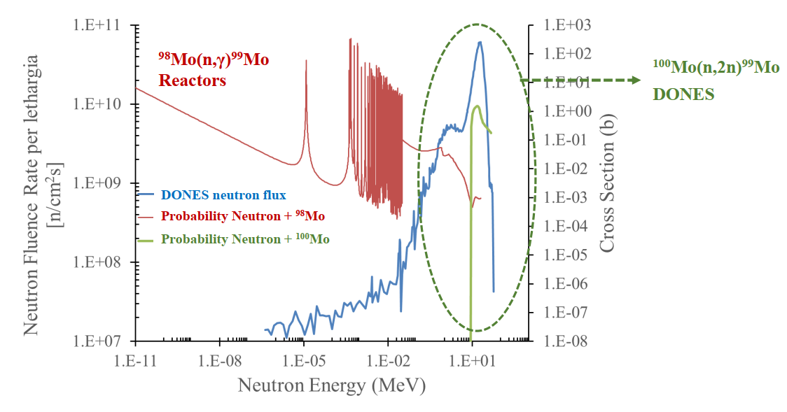
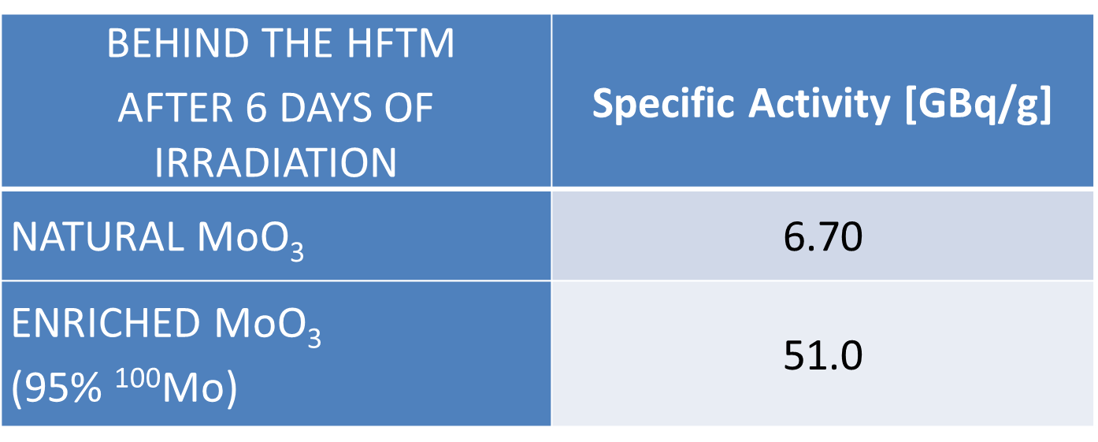
Why use IFMIF-DONES for Radioisotope production
An alternative of ²³⁵U fission method is to irradiate directly Molybdenum to produce ⁹⁹Mo. It is produced by two ways the ⁹⁸Mo(n,γ)⁹⁹Mo and ¹⁰⁰Mo(n,2n)⁹⁹Mo reactions.
However the ¹⁰⁰Mo(n,2n)⁹⁹Mo cross section has a threshold energy at about 7 MeV then this way of production is not reached by conventional reactors.
Neutron Energy of Fission below 7 MeV
DONES neutron source up to 55 MeV
Ratio
Ratio
1.17 %
⁹⁸Mo(n, γ)⁹⁹Mo
1.17 %
⁹⁸Mo(n, γ)⁹⁹Mo
98.83 %
¹⁰⁰Mo(n, 2n)⁹⁹Mo
98.83 %
¹⁰⁰Mo(n, 2n)⁹⁹Mo
Taking into account that only there is a 9.82 % of ¹⁰⁰Mo in a natural composition, higher amount of ⁹⁹Mo could be obtained enriching the Molybdenum in ¹⁰⁰M.
Taking into account that only there is a 9.82 % of ¹⁰⁰Mo in a natural composition, higher amount of ⁹⁹Mo could be obtained enriching the Molybdenum in ¹⁰⁰M.

Slide 6
Index
Why use IFMIF-DONES for Radioisotope production
Assessment of the ⁹⁹Mo production in IFMIF-DONES
High level requirements of the RadioIsotope Production Device (RIPD)
Proposals of concepts design for the RIPD
⁹⁹Mo assessment production considering the first RIPD mockups
Radioisotope production device vs Neutron Spectral Shifter
Conclusions and Future works

Slide 7
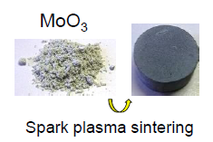
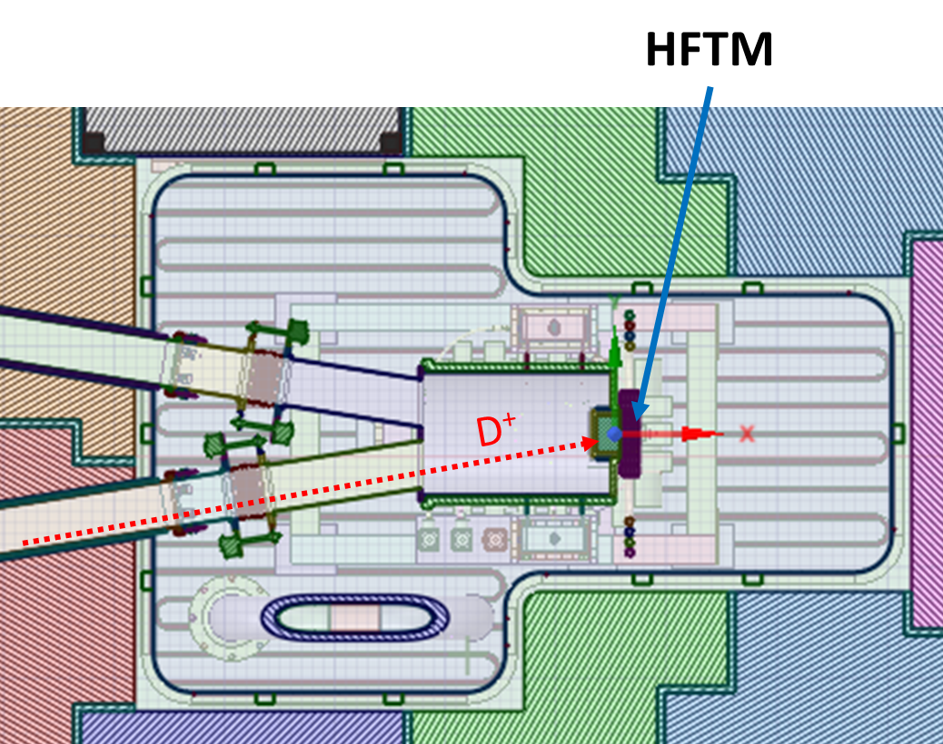
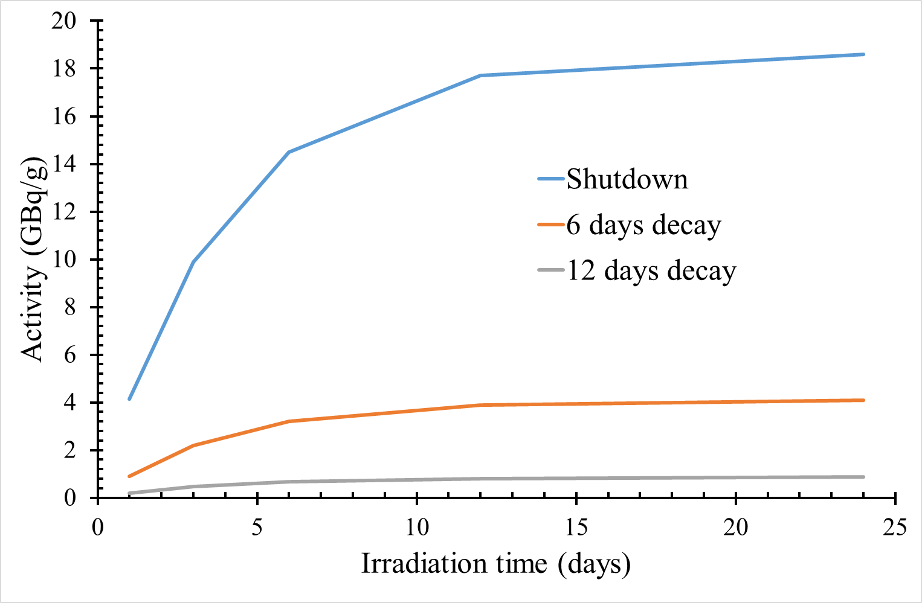
Assessment of the ⁹⁹Mo production in IFMIF-DONES
Irradiation time determination of the molybdenum samples of MoO₃
After 6 days of irradiation the sample is extracted from the TC to be purified and then transported outer the IFMIF-DONES installation
After 6 days of irradiation the sample is extracted from the TC to be purified and then transported outer the IFMIF-DONES installation

Slide 8
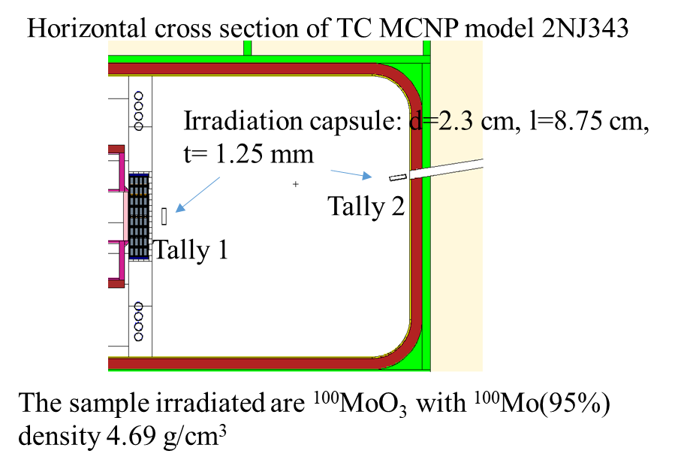
Assessment of the 99Mo production in IFMIF-DONES
Assessment for ⁹⁹Mo production in the TC area
The ¹⁰⁰Mo(n,2n) and ⁹⁸Mo(n,γ) reaction have been taken into account for the ⁹⁹Mo production
The ¹⁰⁰Mo(n,2n) and ⁹⁸Mo(n,γ) reaction have been taken into account for the ⁹⁹Mo production
6 irradiation day | Specific Activity (GBq/g Mo)
Behind of HFTM | 51
Just in front of Duct | 2.24
6 irradiation day | Activity (GBq/g Mo)
Behind of HFTM | 51
Just in front of Duct | 2.24
“The (n, γ) process produces 99Mo of relatively low specific activity, from a low of 3.7 GBq/g to a high of 74 GBq/g depending on the neutron flux available in the reactor”.
“The (n, γ) process produces 99Mo of relatively low specific activity, from a low of 3.7 GBq/g to a high of 74 GBq/g depending on the neutron flux available in the reactor”.

Slide 9
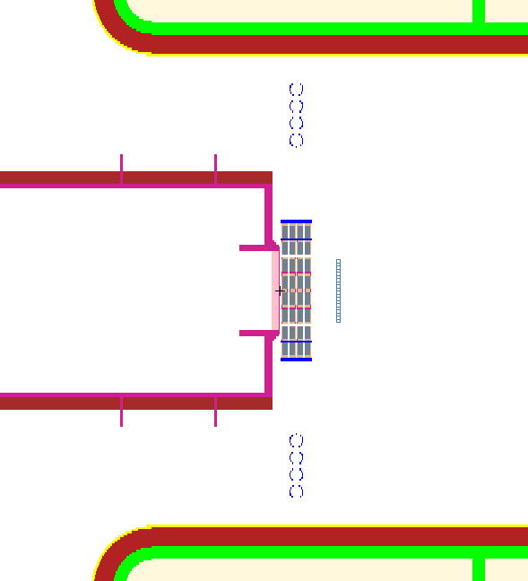
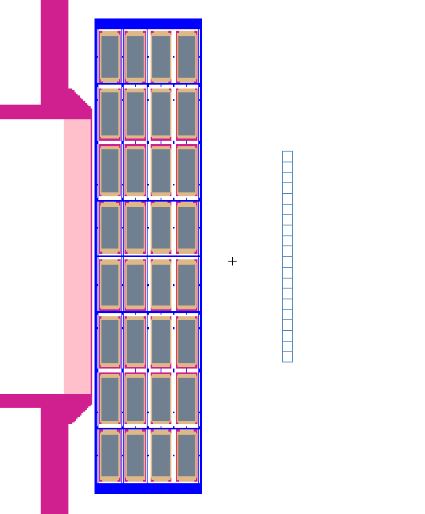
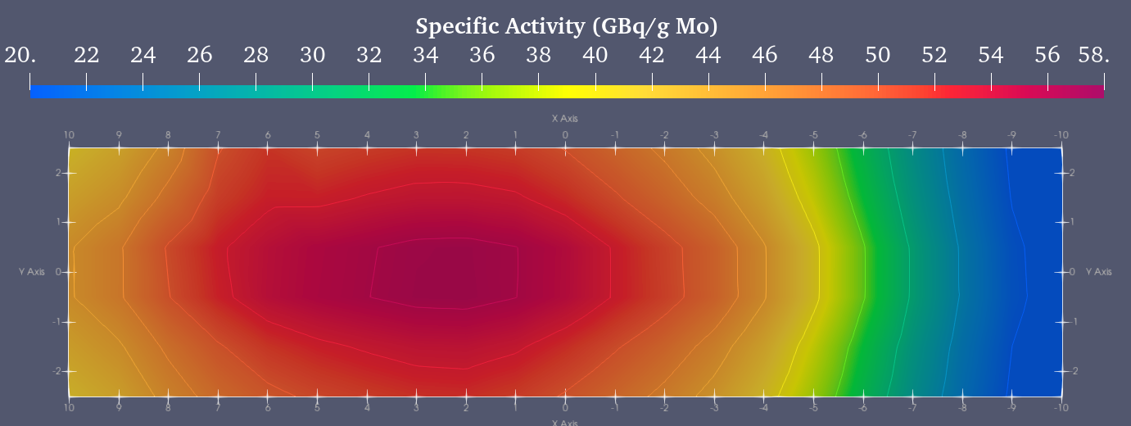
Assessment of the ⁹⁹Mo production in IFMIF-DONES
Sensitivity analysis of the ⁹⁹Mo production behind of HFTM
Mesh used for Neutron spectra calculation
~8 cm
20 cm
Considering an average production of 44 GBq/g in the Mesh and taking into account a density of 3.17 g/cm³ of Mo in 4.69 g/cm³ of ¹⁰⁰MoO3 and mesh volume of 100 cm³, the total activity reached of ⁹⁹Mo would be about 14 TBq after 6 days of irradiation.
It would supply ⁹⁹Mo generators to cover the demand of Andalucía (100 GBq per ^{99m}Tc generator)

Slide 10
High level requirements of the RadioIsotope Production Device (RIPD)
Do not disturb the normal operation of the IFMIF-DONES.
The targets should be introduced and extracted in periods of 6-day without opening the TC
Automatic insertion and extraction of targets
mechanical or pneumatic extraction and insertion
Lateral or vertical access
To keep the integrity of the TC shielding
The target has to be solid or encapsulated to avoid contamination
Maximization of the irradiation volume to maximize the production rate.
The handling of the targets has to be done remotely.
The system must be cooled to maintain a constant temperature during irradiation.
Having an Hot Cell for handling irradiated targets.
To define specific safety protocols to insertion, extraction, purification and introduction in generators to be exported to Hospitals and research centers.

Slide 11
Index
Why use IFMIF-DONES for Radioisotope production
Assessment of the ⁹⁹Mo production in IFMIF-DONES
High level requirements of the RadioIsotope Production Device (RIPD)
Proposals of concepts design for the RIPD
⁹⁹Mo assessment production considering the first RIPD mockups
Radioisotope production device vs Neutron Spectral Shifter
Conclusions and Future works

Slide 12
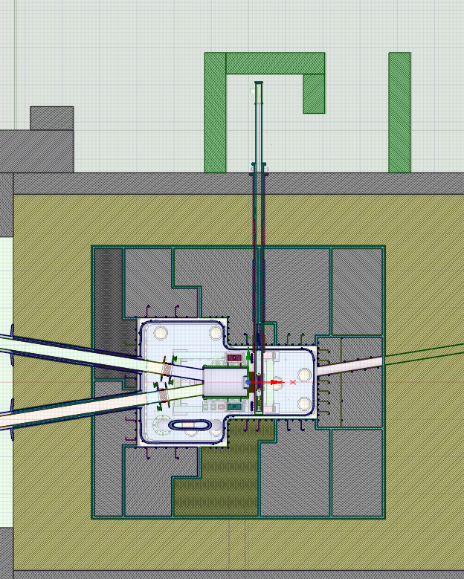
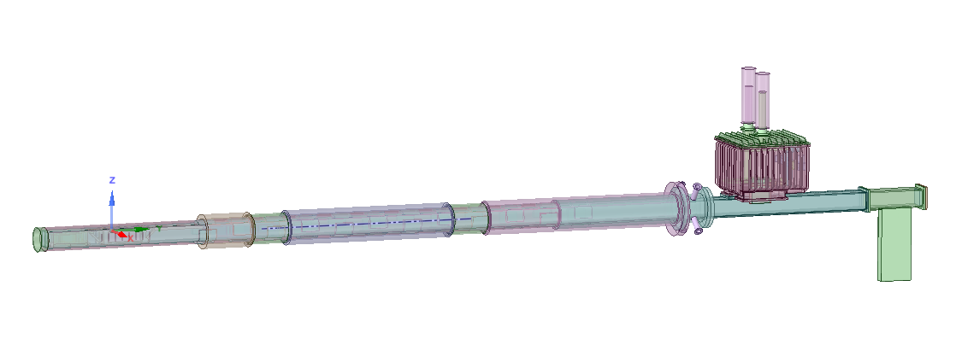
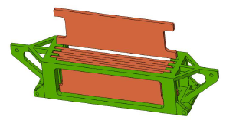
Proposals of concepts design for the RIPD
R158
Proposals of EAI (to meet with the high level requirements)
PROPOSAL 1: lateral mechanical sample insertion device for Radioisotope production
Based on the Japanese proposal (O. Nasayiuki, FED 2021))
Transverse duct for sample
Shielding plug during irradiation
The dimensions of each plate is 0.9x27.5x11.4 cm³. (V=282.15 cm³)
Ø =20 cm
Ø =28.5 cm
¹⁰⁰Mo sample holder
Shielding plug during samples extraction
The sealing of the inner of the TC is kept
The dimensions of each plate is 0.9x27.5x11.4 cm³. (V=282.15 cm³)

Slide 13
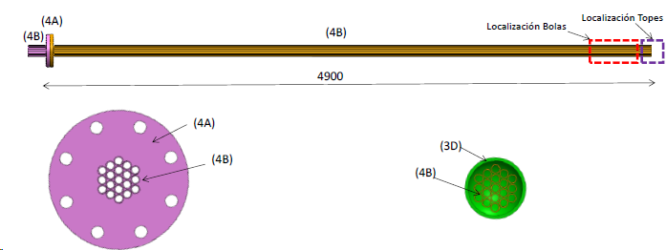
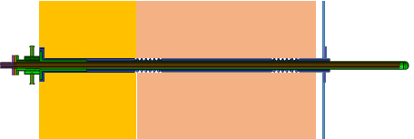
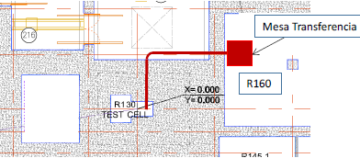
Proposals of concepts design for the RIPD
PROPOSAL 2: lateral sample insertion using a Rabbit system
Transverse duct for sample
Inside the duct there are several smaller ducts to transport the spherical specimens. Inner diameter of the duct could be 13 mm
Spherical specimens of 10.5 mm diameter
Transference table

Slide 14
Index
Why use IFMIF-DONES for Radioisotope production
Assessment of the ⁹⁹Mo production in IFMIF-DONES
High level requirements of the RadioIsotope Production Device (RIPD)
Proposals of concepts design for the RIPD
⁹⁹Mo assessment production considering the first RIPD mockups
Radioisotope production device vs Neutron Spectral Shifter
Conclusions and Future works

Slide 15
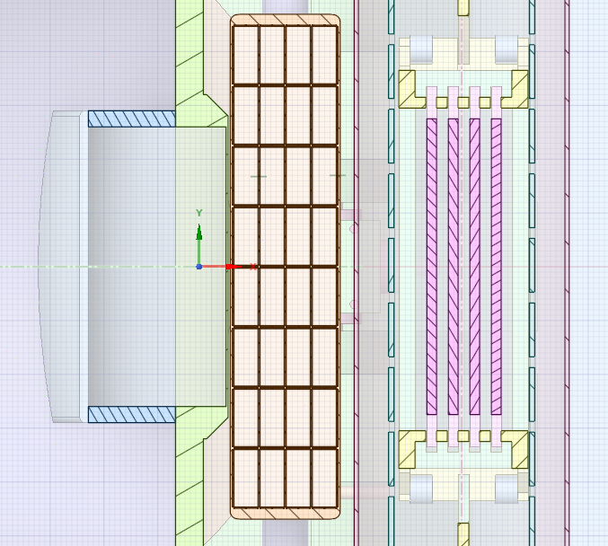
⁹⁹Mo assessment production considering the first RIPD mockups
Neutron transport calculations performed to determine the ⁹⁹Mo production rate considering proposal 1
Shielding
D⁺
The length from HFTM to the Radioisotope Production Device is 1.3 cm
D⁺
The length from HFTM to the first ¹⁰⁰MO₃ plate is 8 cm
The distance between ¹⁰⁰MoO₃ plates is 1.1 cm
The dimensions of each plate is 0.9x27.5x11.4 cm³. (V=282.15 cm³)

Slide 16
⁹⁹Mo assessment production considering the first RIPD mockups
Under these conditions, it is possible to produce ~ 69.80 TBq de ⁹⁹Mo/^{99m}Tc, per week
1 2 3 4
Considering that one ^{99m}Tc generation has about an activity of 46 GBq, which could be equivalent to considering a 100 GBq just before taking out the sample.
It means that we could obtain about 700 generators per week
Taking into account that a hospital could need 2 generators per week, we could supply to 350 hospitals.
⁹⁹Mo activity obtained in each plate after 6 days of irradiation using an average neutron fluence rate in each plate.
Enriched MoO₃ (95% ¹⁰⁰Mo) | SPECIFIC ACTIVITY GBq/g ¹⁰⁰Mo | ACTIVITY (TBq)
Plate 1 | 24.14 | 21.59
Plate 2 | 20.85 | 18.65
Plate 3 | 17.81 | 15.93
Plate 4 | 15.24 | 13.63
TOTAL |  | 69.80

Slide 17
Index
Why use IFMIF-DONES for Radioisotope production
Assessment of the ⁹⁹Mo production in IFMIF-DONES
High level requirements of the RadioIsotope Production Device (RIPD)
Proposals of concepts design for the RIPD
⁹⁹Mo assessment production considering the first RIPD mockups
Radioisotope production device vs Neutron Spectral Shifter
Conclusions and Future works

Slide 18
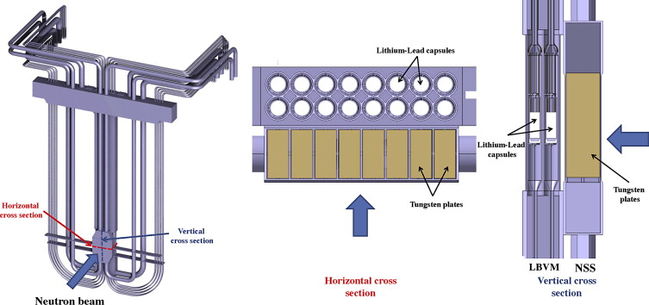
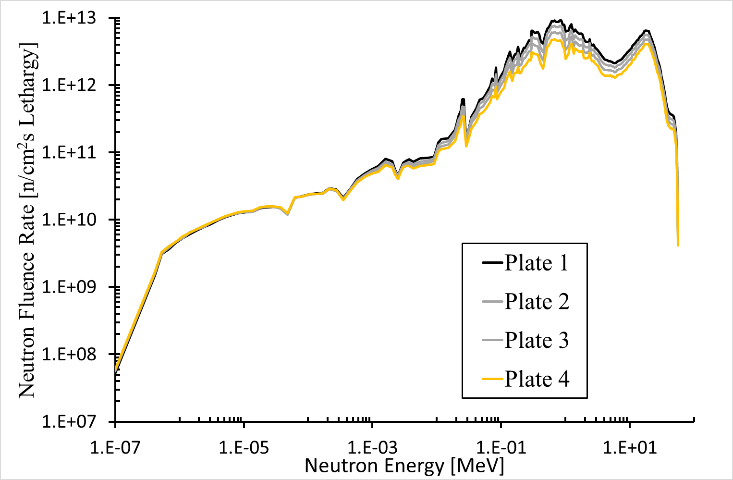
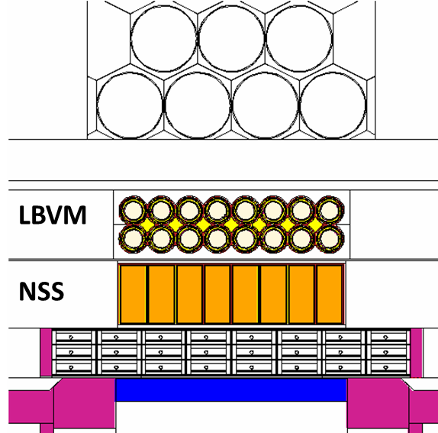
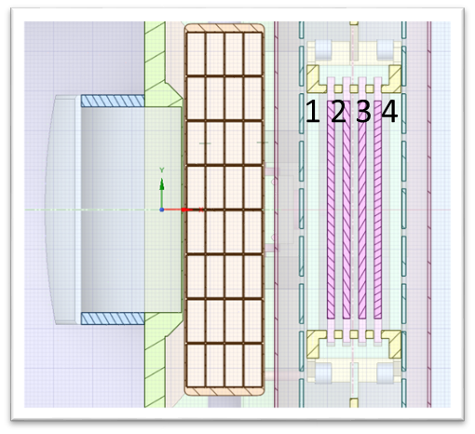
Radioisotope production device vs Neutron Spectral Shifter
The Radioisotope production device could have a similar effect like the Neutron Spectral shifter module (NSS) due to the ¹⁰⁰Mo(n,2n)⁹⁹Mo reaction
D⁺

Slide 19
Index
Why use IFMIF-DONES for Radioisotope production
Assessment of the ⁹⁹Mo production in IFMIF-DONES
High level requirements of the RadioIsotope Production Device (RIPD)
Proposals of concepts design for the RIPD
⁹⁹Mo assessment production considering the first RIPD mockups
Radioisotope production device vs Neutron Spectral Shifter
Conclusions and Future works

Slide 20
Conclusions and Future works
A ⁹⁹Mo production assessment has been performed in IFMIF-DONES TC taking in advance the neutrons that cross the HFTM.
Two mock-ups for the Radioisotope production devices have been proposed.
Considering the mechanical insertion proposal conditions, it would be possible to cover the necessities of 350 hospitals of ~⁹⁹Mo/^{99m}Tc per week.
Then, the benefit of radioisotope production in IFMIF-DONES has been demonstrated starting from the assessment production of one of the most demanding radioisotopes for cancer diagnostics. This could mean a great social benefit since the demand of a large number of inhabitants could be covered and a great benefit for IFMIF-DONES project, on the one hand for its social impact and on the other because it could mean important funding for IFMIF-DONES operation.
The works are ongoing to validate the different RIPD concepts proposed respect to the productions rates, radiation hazards, safety issues and design analysis.

