Slide 1
Neutron-dominated mixed-field irradiation tests areas at CERN: present, future and applications
AP.Bernardes (SY/STI) on behalf of many people
Second DONES Users Workshop, 20th October 2023

Slide 2
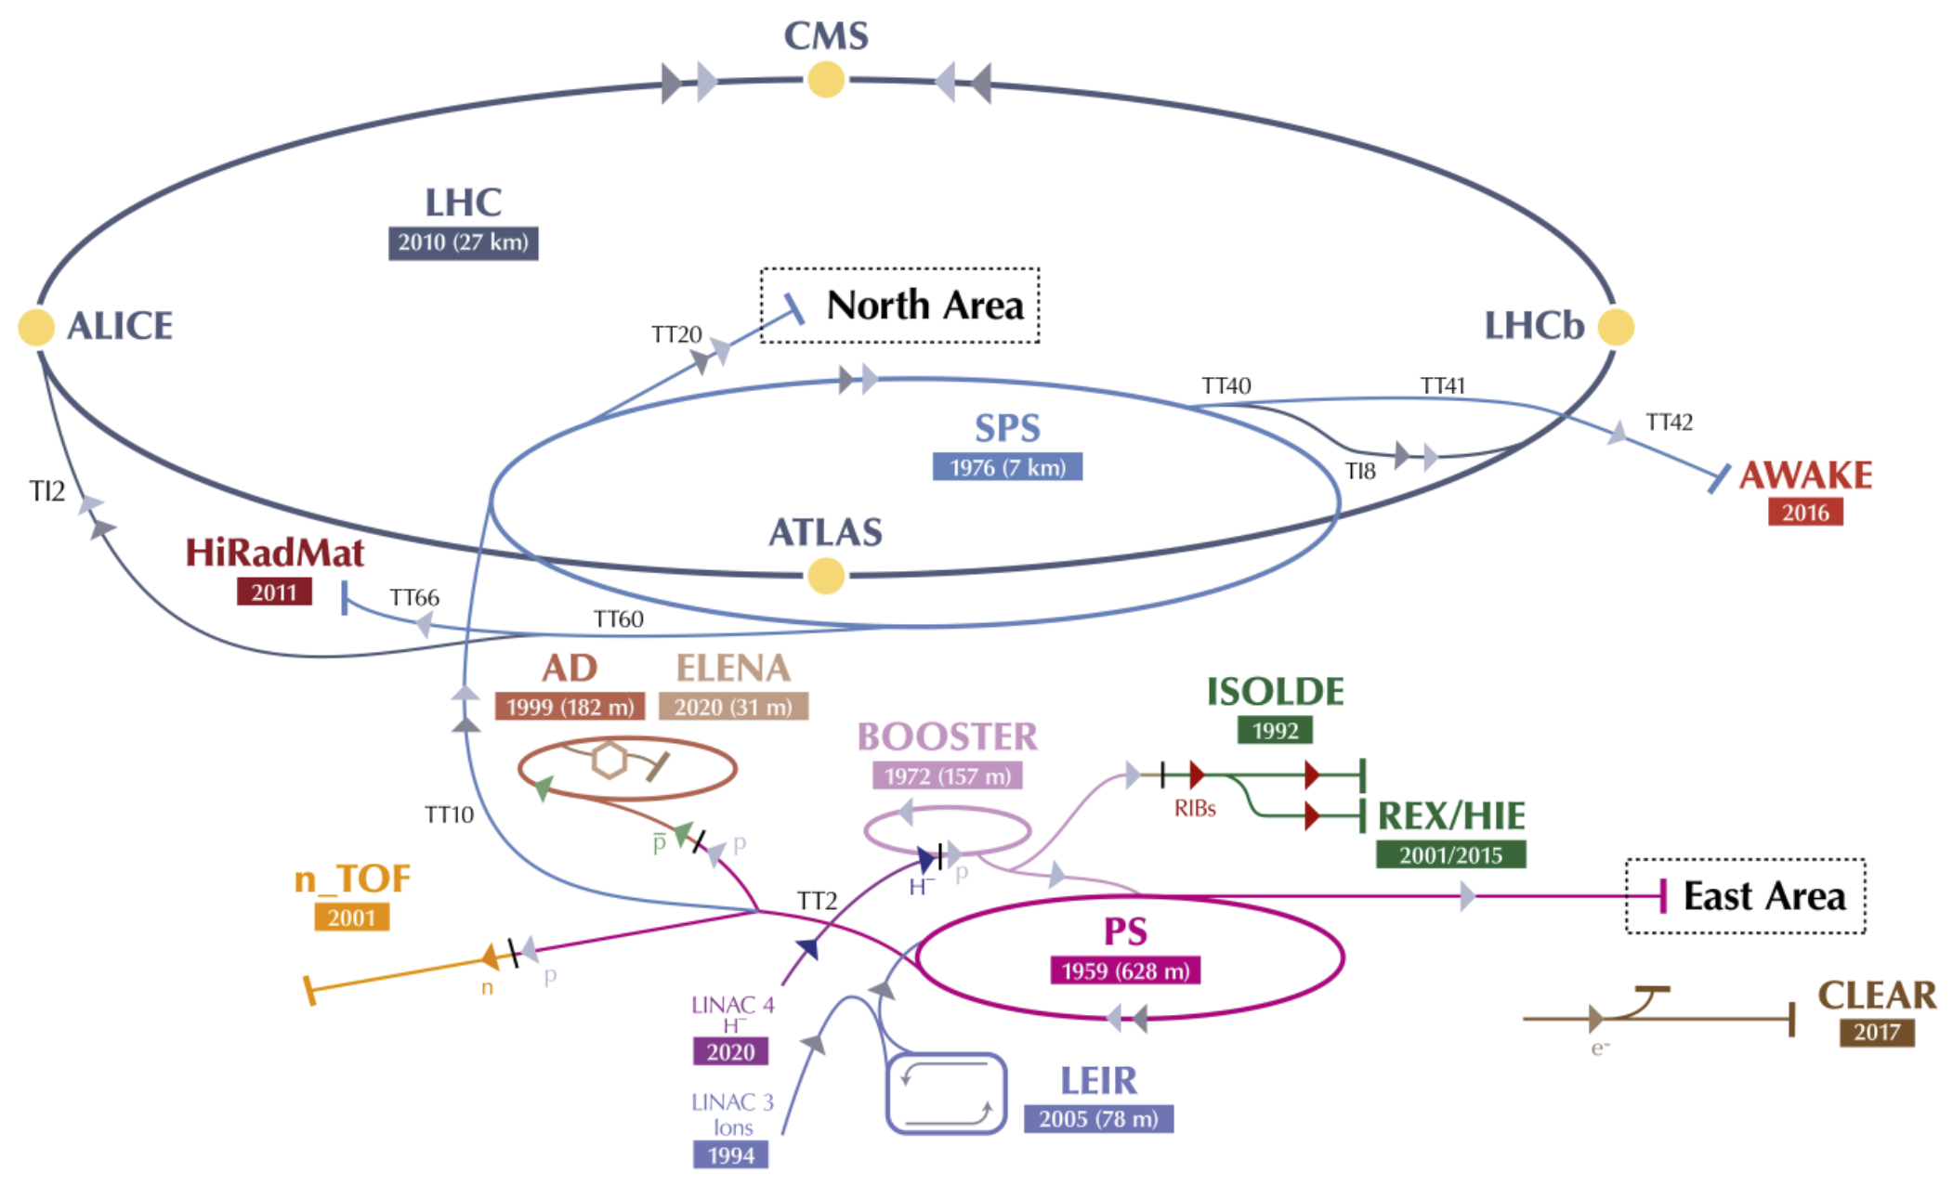
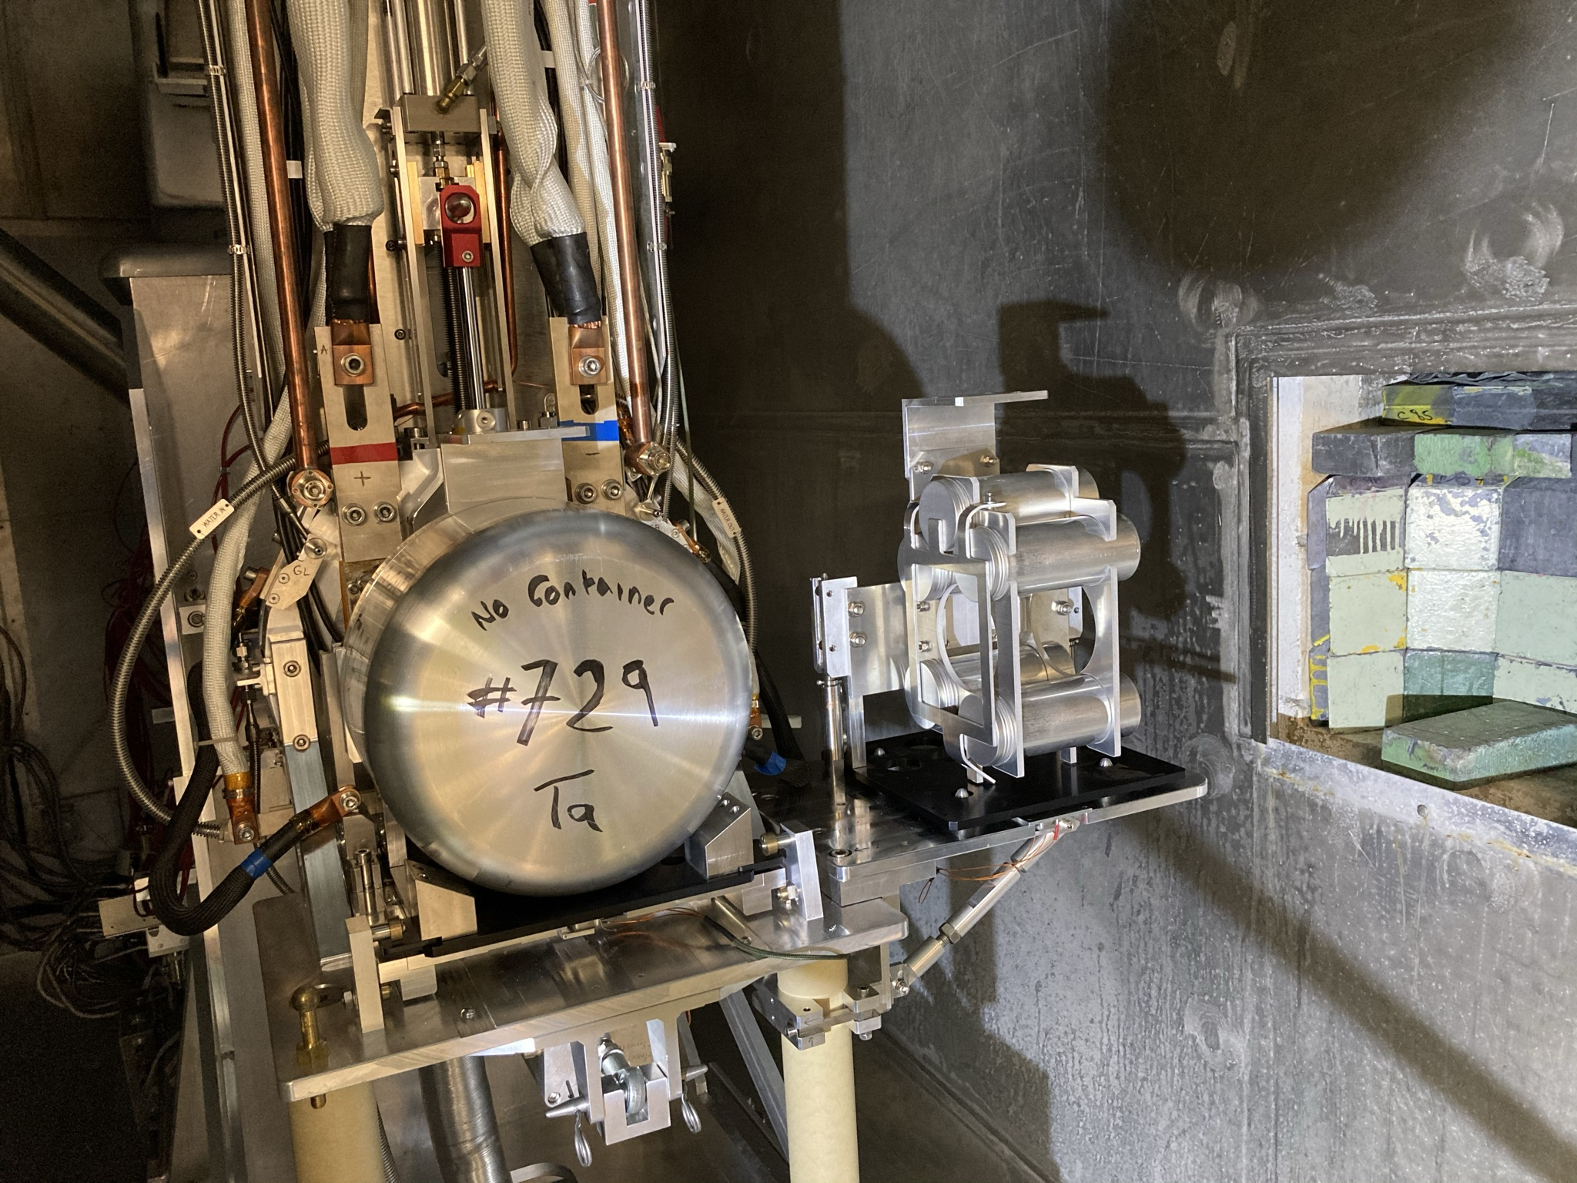
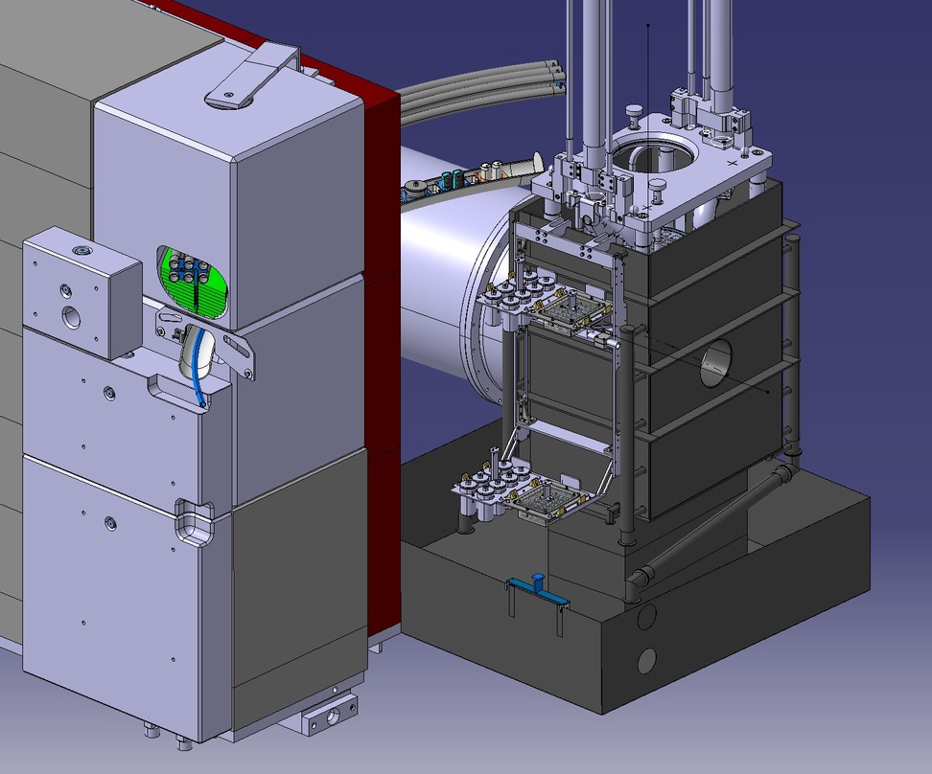
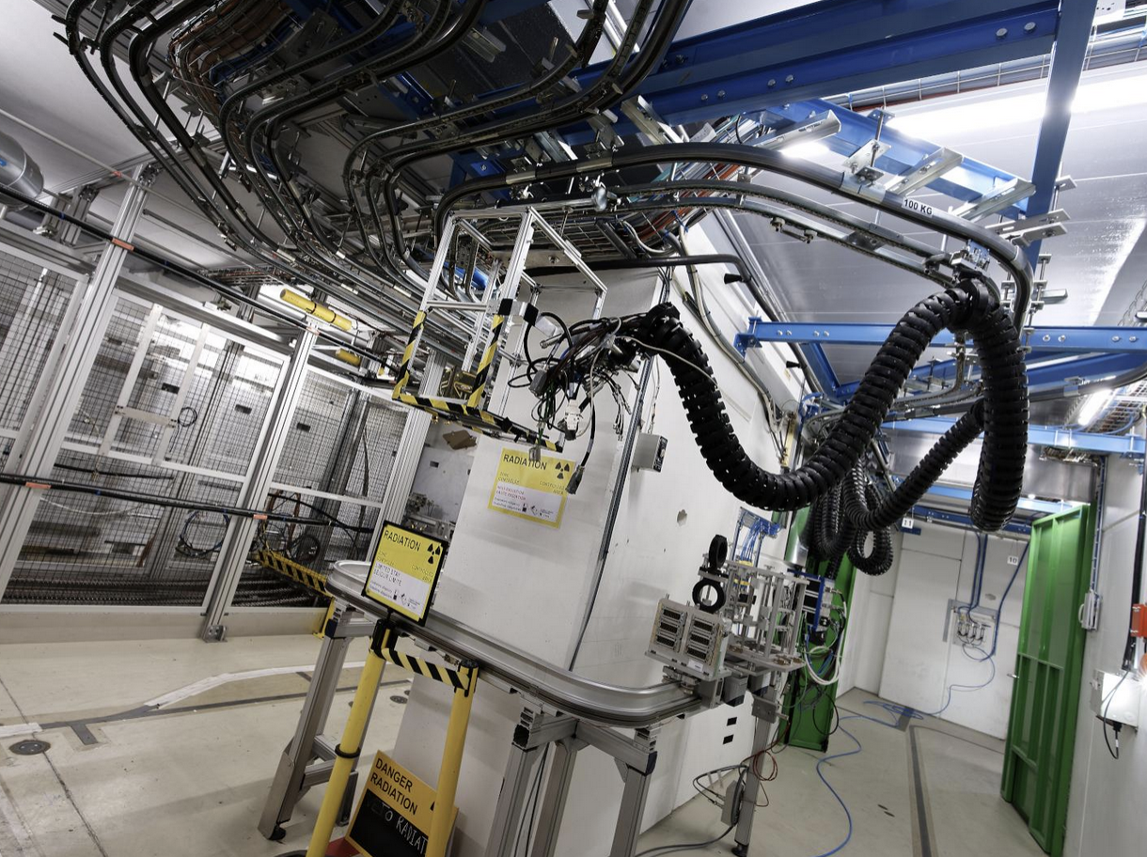
Mixed field irradiation station at CERN
Irradiation test area in operation
Irradiation Facility in operation
Project of future Irradiation test area
ISIS at ISOLDE
CHARM
See M.Cechetto presentation
NEAR at n_TOF
CHARM

Slide 3
Mixed field irradiation station at CERN
ISIS at ISOLDE
NEAR at n_TOF

Slide 4
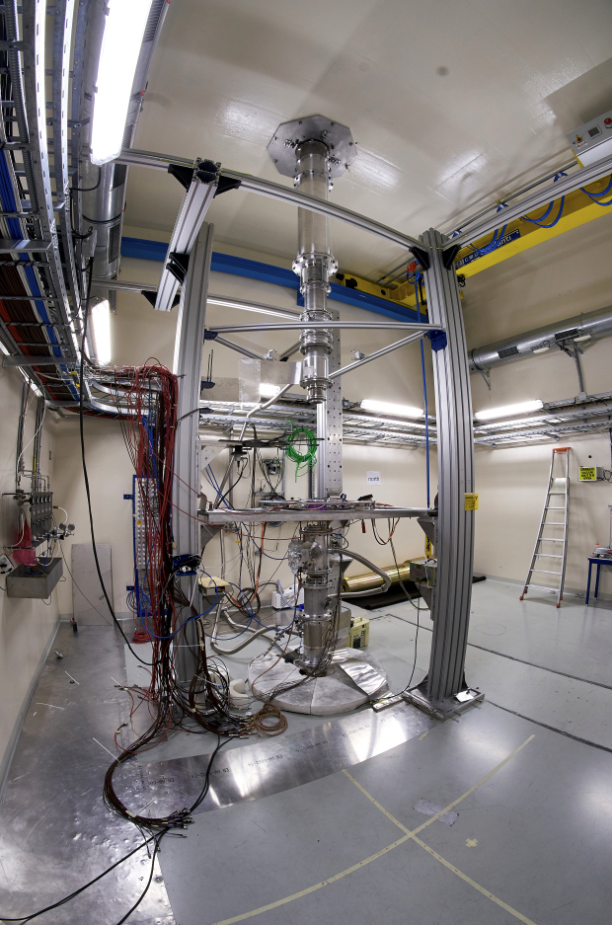
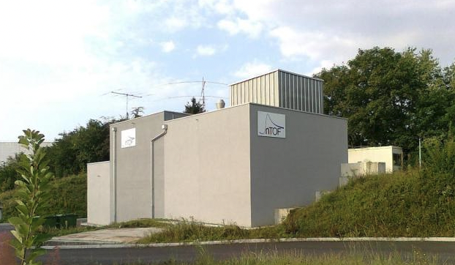
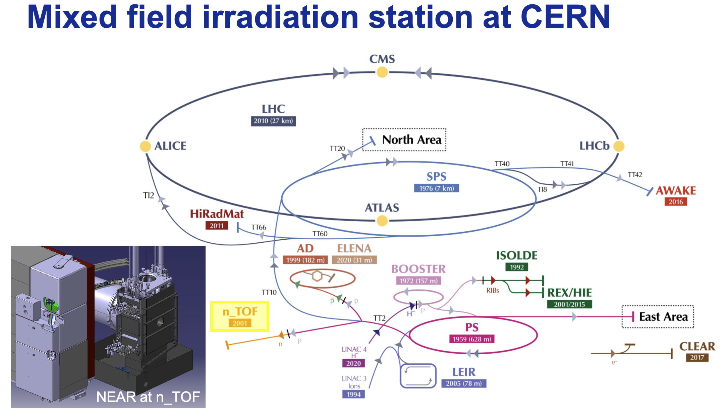
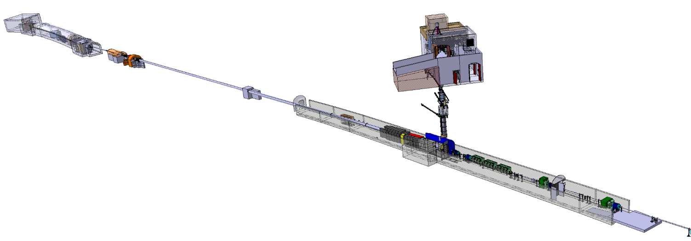
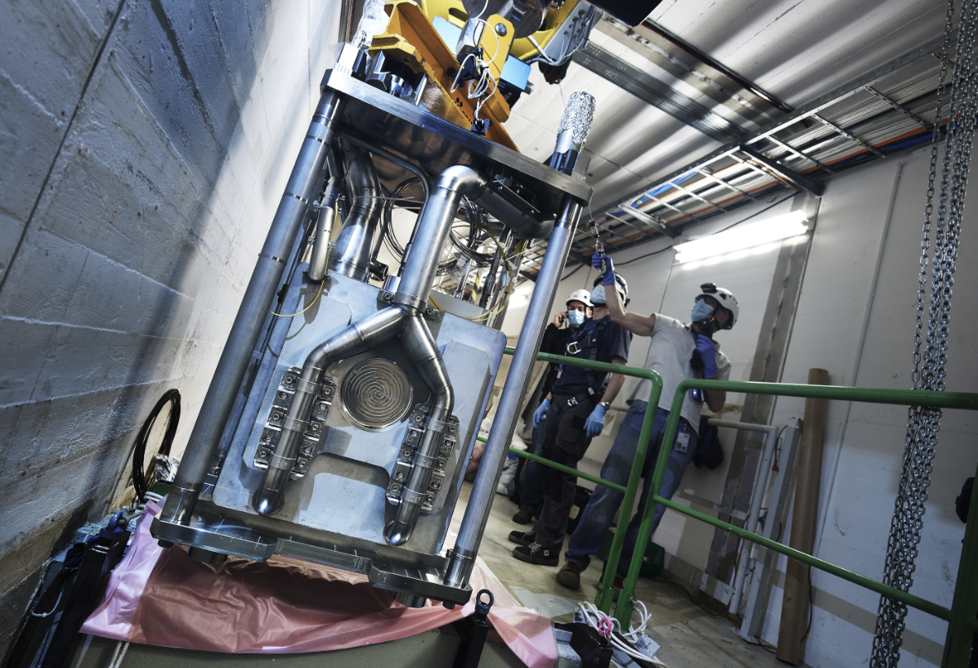
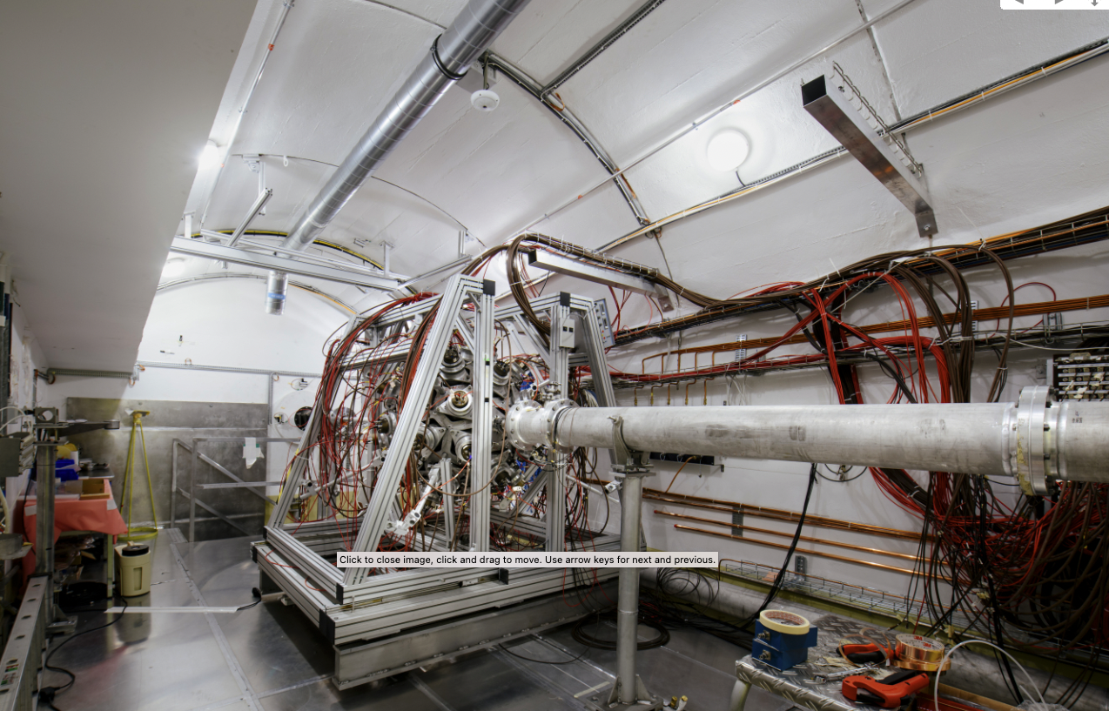
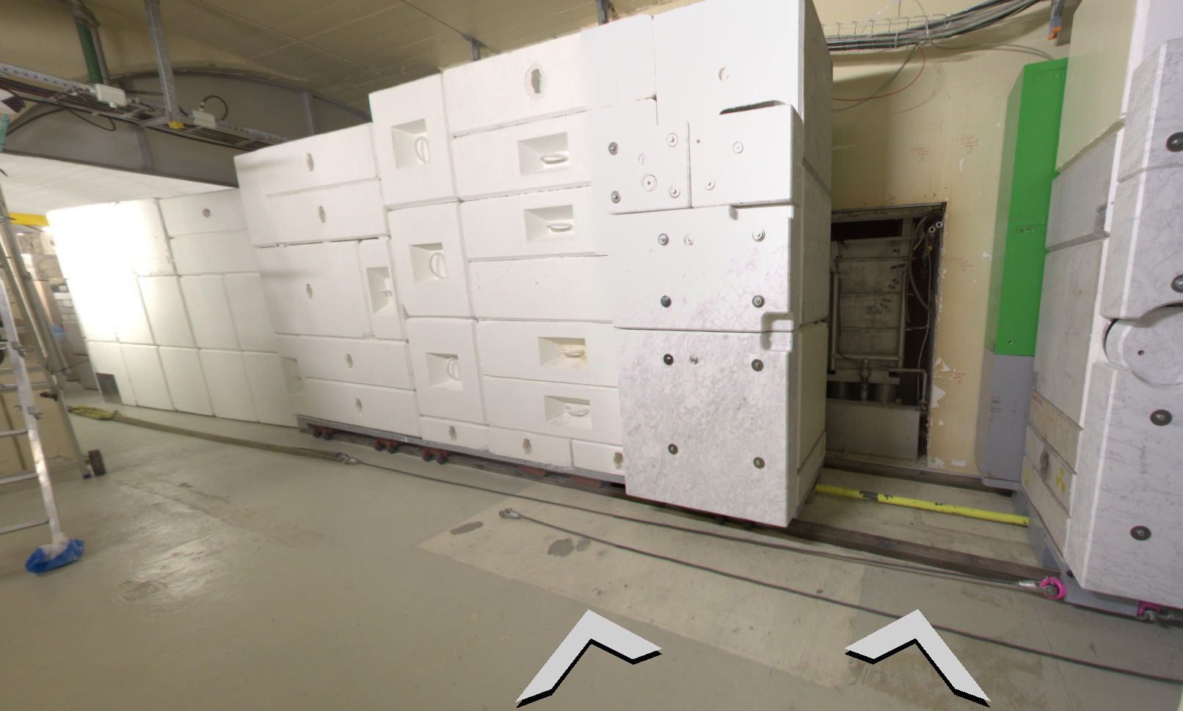
NEAR at n_TOF
Neutron time-of-flight facility
Time of flight measurements
EAR2
EAR1
200m fligh path
Time of flight measurements
n_TOF lead target inside pit, on its way to the n_TOF target area
Pulsed Protons beam from PS
n_TOF target area and NEAR position

Slide 5
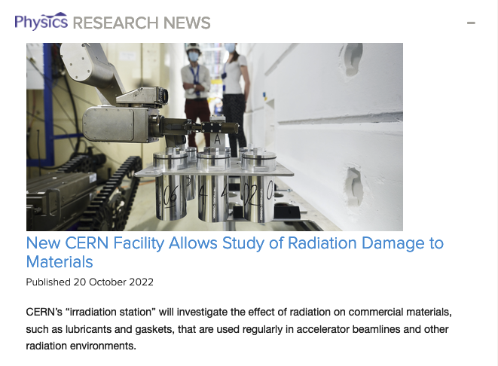
NEAR at n_TOF
NEAR can be divided in two areas:
  i-NEAR – focused on parasitic irradiation – developed in the framework of the R2E Project (R2M sub-activity) and dedicated to MGy-range irradiation in mixed field (unique in the world)
  a-NEAR – focused on activation for physics measurements – run and exploited by the n_TOF Collaboration
    Can be used for R2E clients as well, parasitically
See M.Cechetto presentation
Matteo Ferrari & All: Design development and implementation of an irradiation station at the neutron time-of-flight facility at CERN
https://journals.aps.org/prab/abstract/10.1103/PhysRevAccelBeams.25.103001

Slide 6
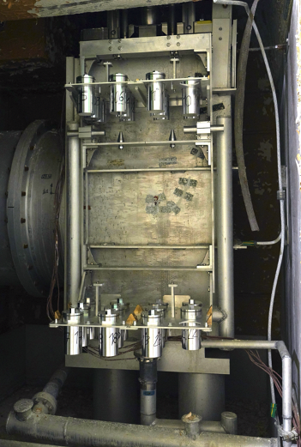
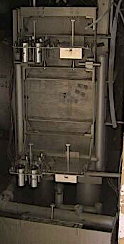

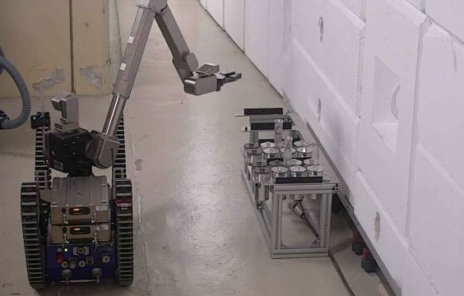
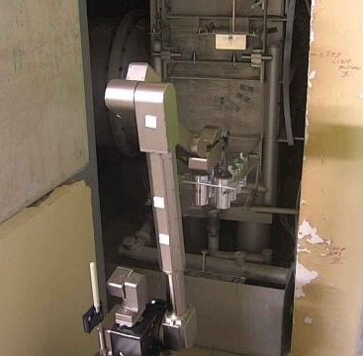
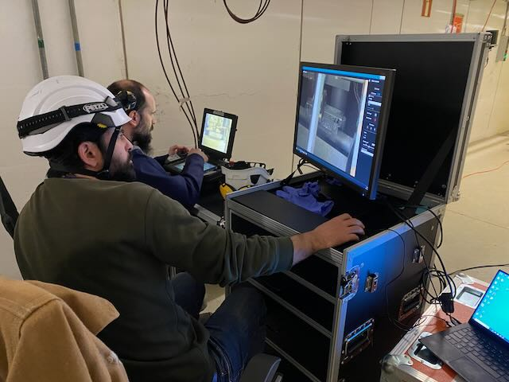
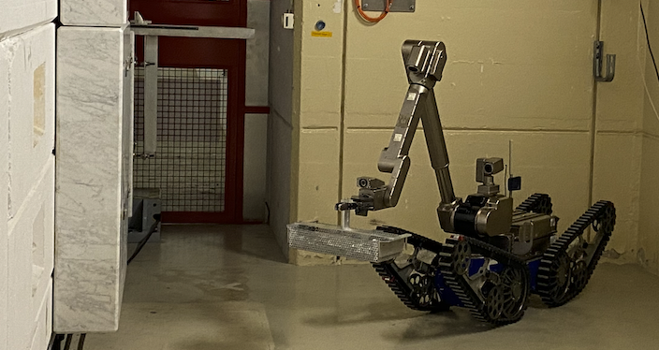
NEAR at n_TOF
n_TOF target area Shielding OPEN
NEAR irradiation area (i-NEAR)
i-NEAR
Access during shut-down only
(1 year irradiation)
Robotic installation/removal
Manual acces forbidden
Long duration samples irradiation (1 year min)
Versatile container shapes
Several mSv/h depending cool down time

Slide 7
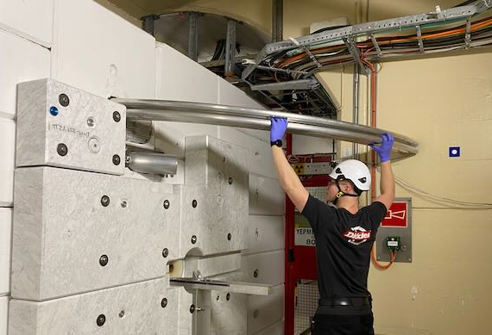
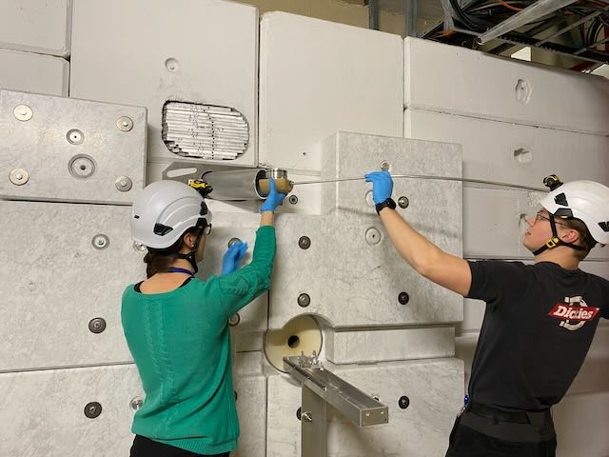

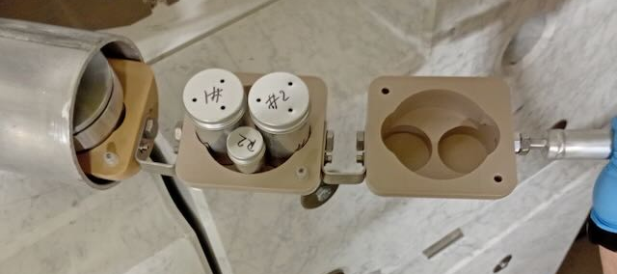
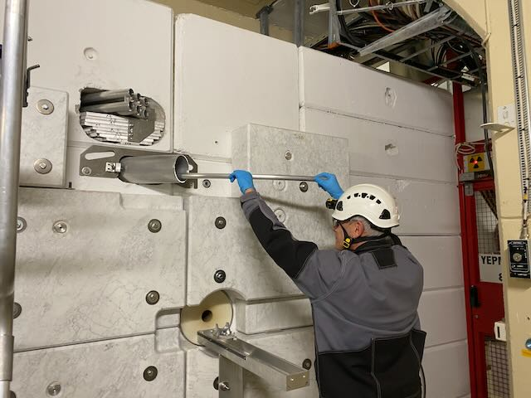
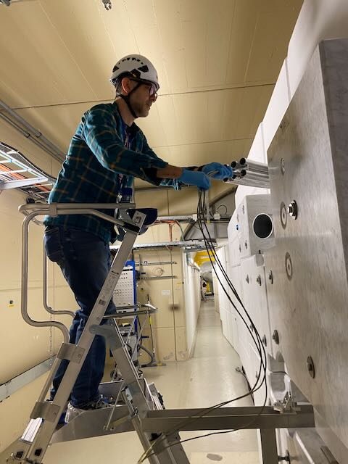
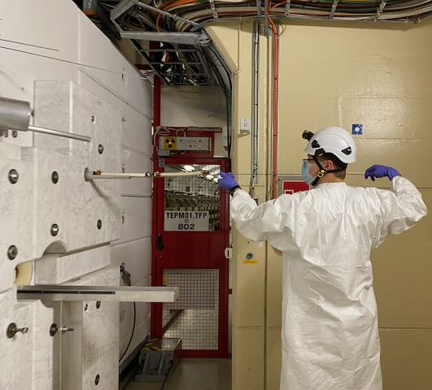
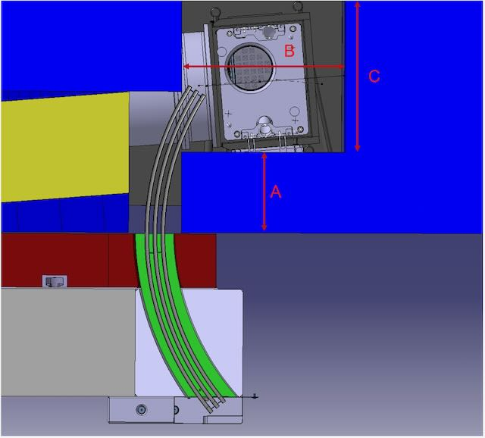
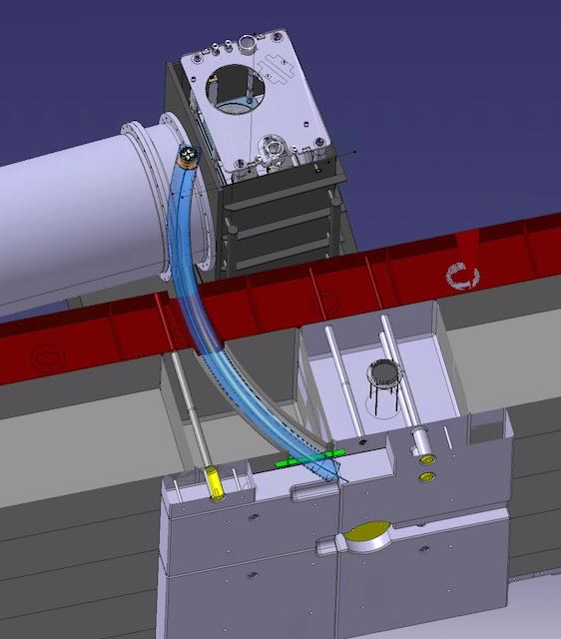
NEAR at n_TOF
Target
300 uSv/h after 6 hours cool down
Flexible duration samples irradiation
Sample sizes limited by tubes diameters
Target
Target
Access during operation Manual installation/removal

Slide 8
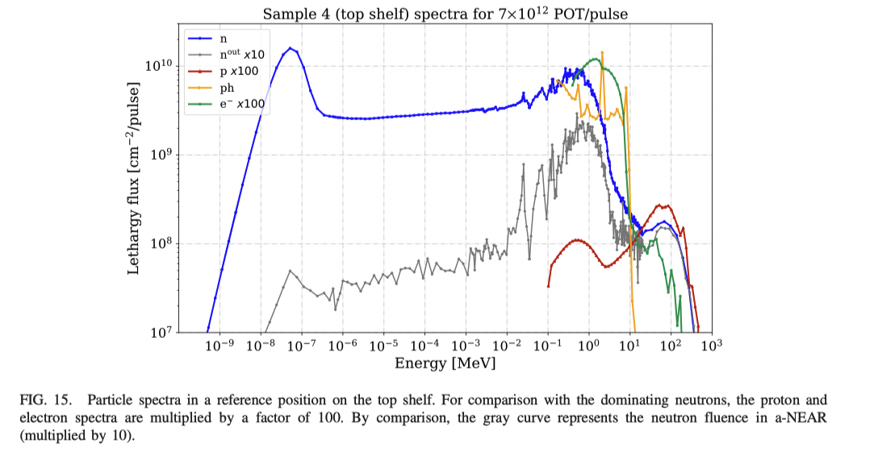
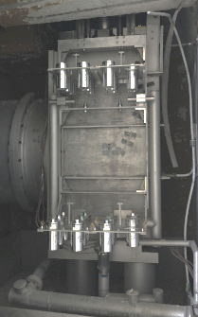
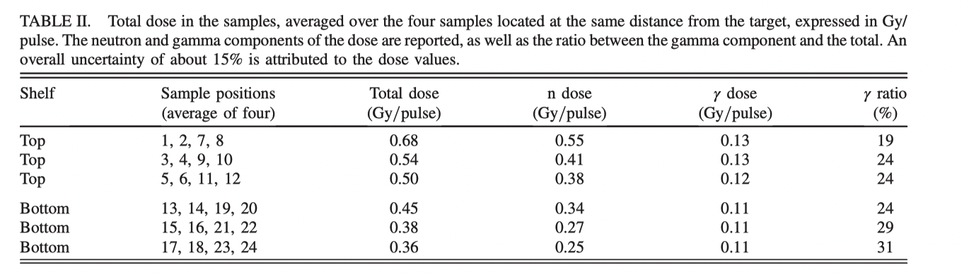
NEAR Fluence
i-NEAR
1.2 (lowest value on the bottom shelf) to 2.5 MGy/year (highest value on the top shelf).
Neutron-dominated doses in the MGy range with a satisfactory homogeneity for macroscopic samples of up to 100 cm 3 of volume.
a-NEAR
i-NEAR
9E10 n/cm2/s
Inside shielding
Matteo Ferrari & All: Design development and implementation of an irradiation station at the neutron time-of-flight facility at CERN
https://journals.aps.org/prab/abstract/10.1103/PhysRevAccelBeams.25.103001

Slide 9
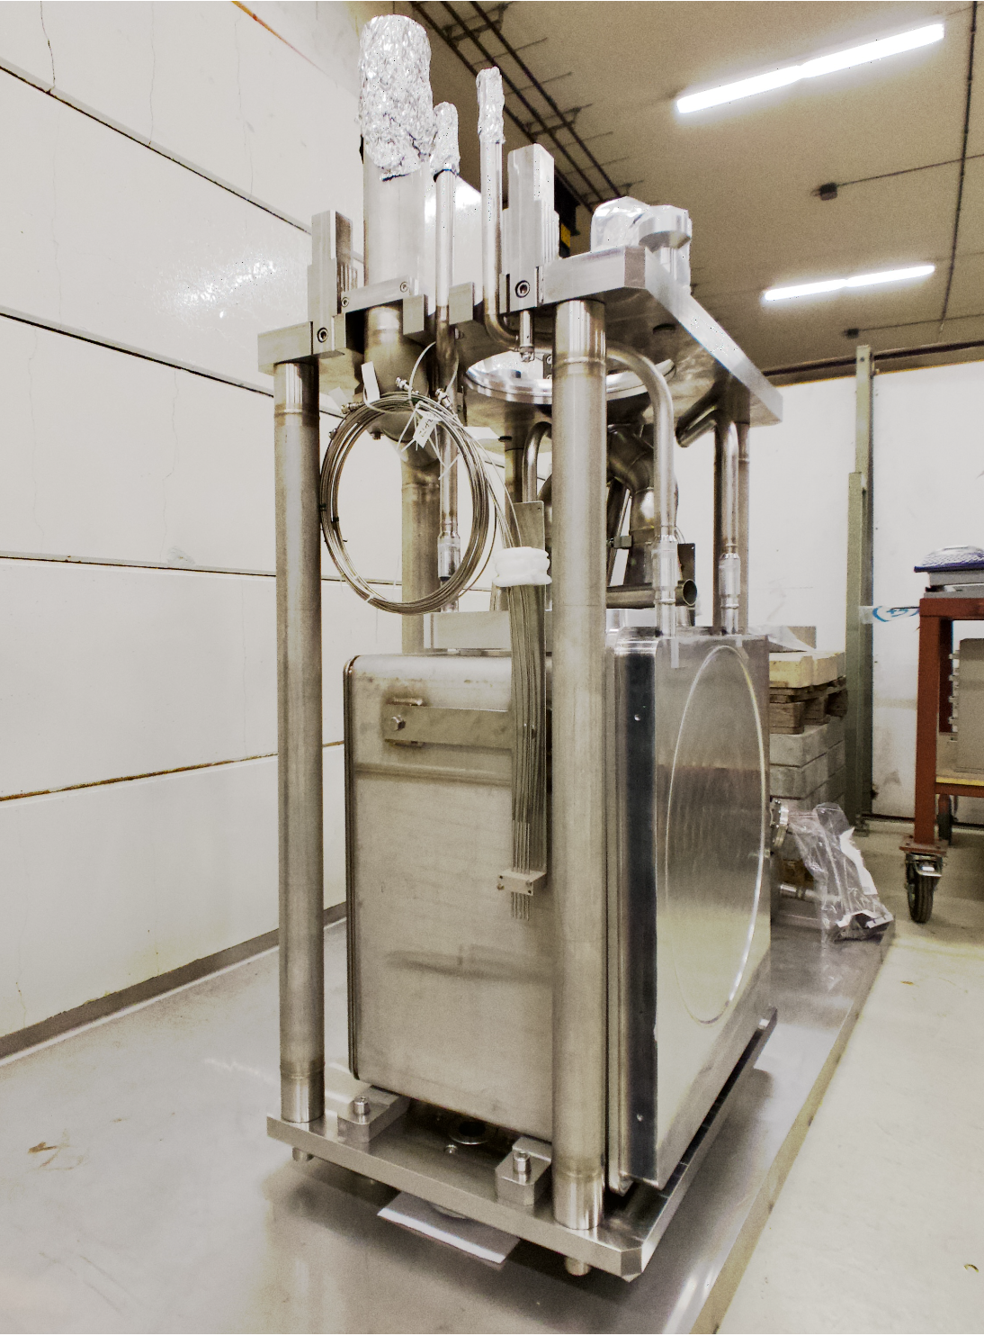
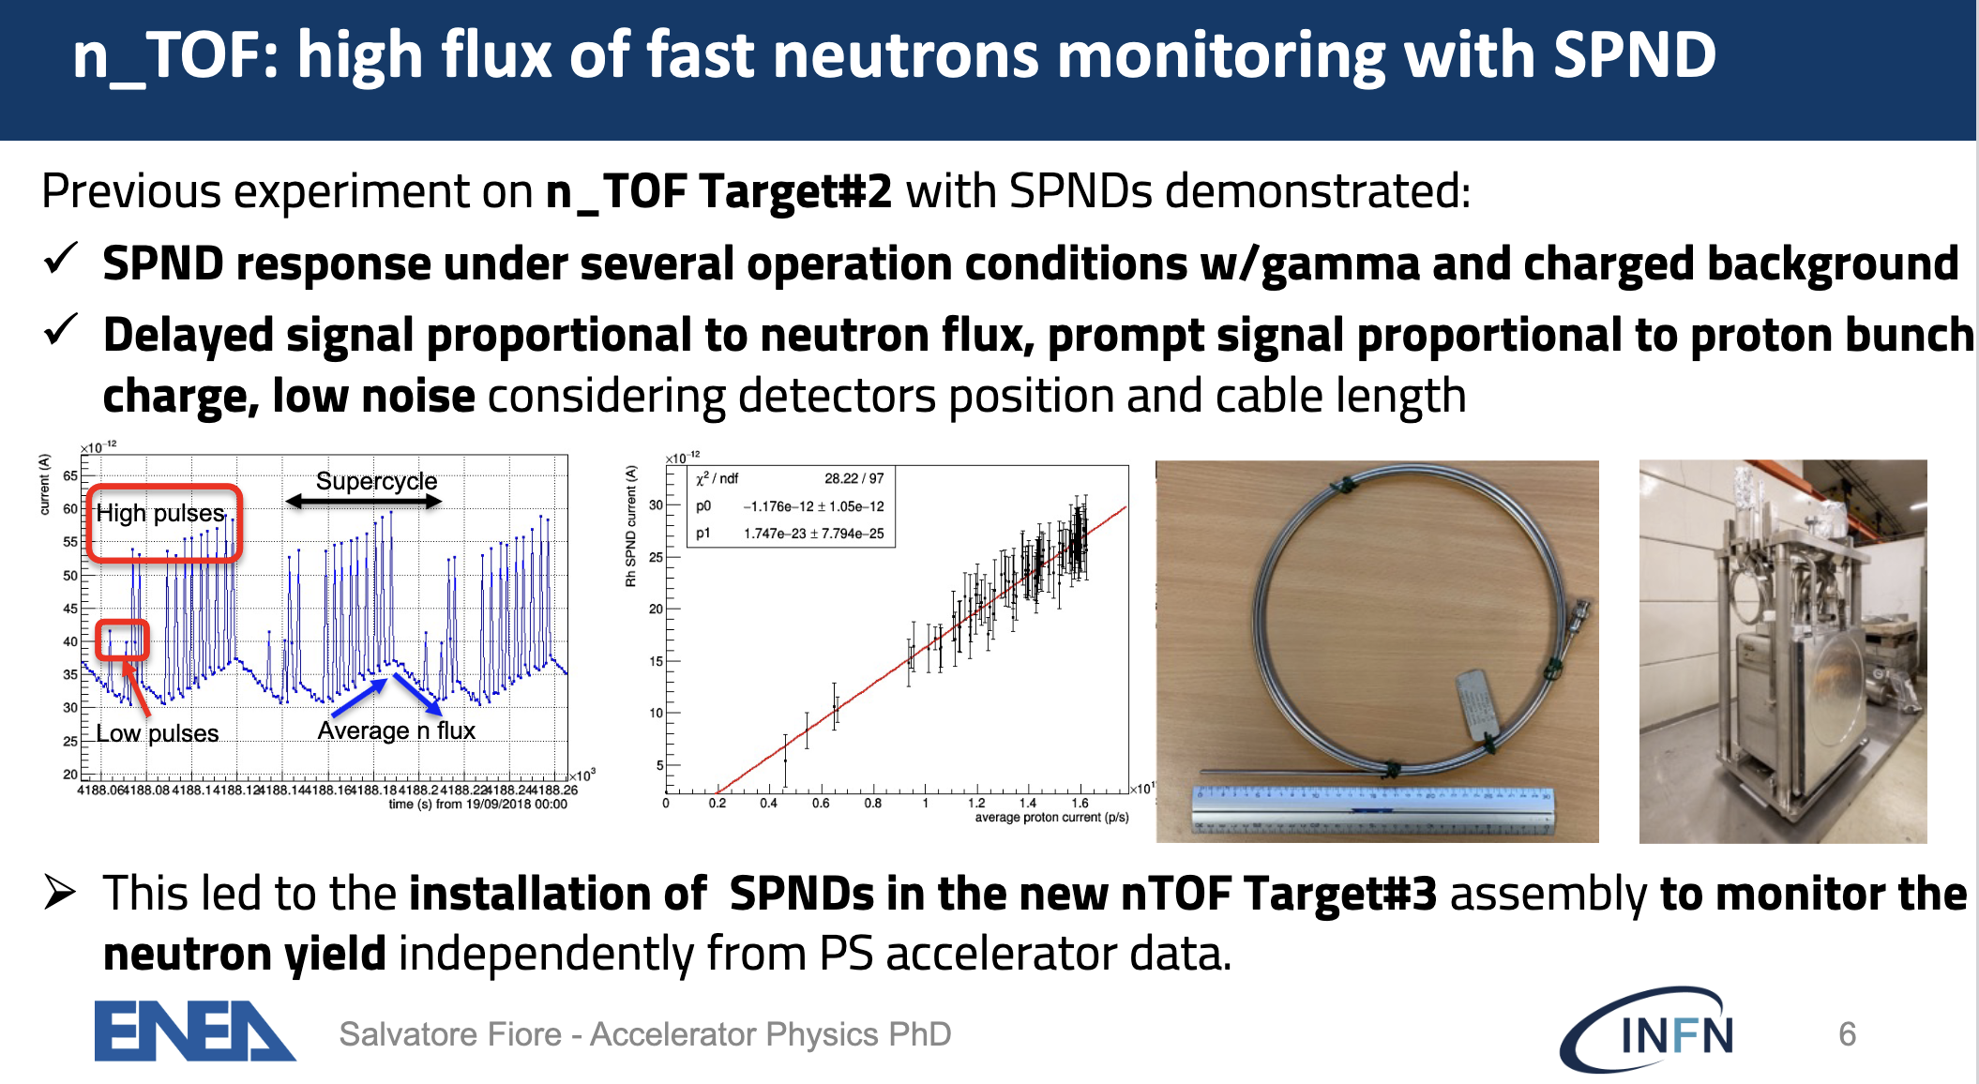
SPND at n_TOF
Protons bunches hit target every 1.2s. SPND response has a sharp peak due to prompt target emission, proportional to pulse intensity.
Very important for target monitoring
SPND on n-TOF target#3
Acknowledgement: S.Fiore BE-CEM

Slide 10
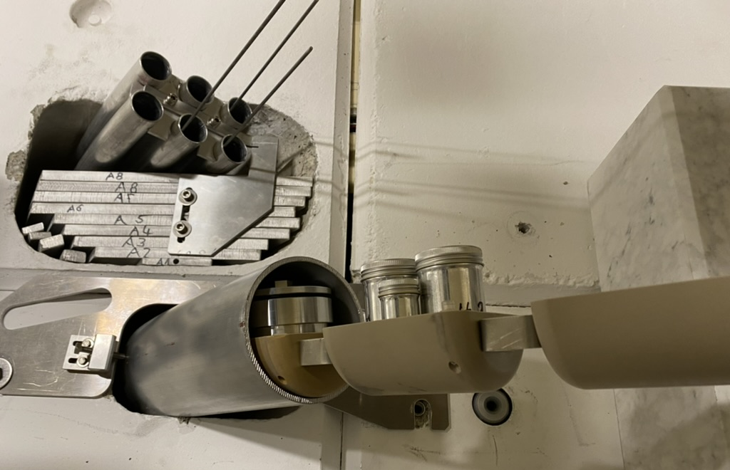
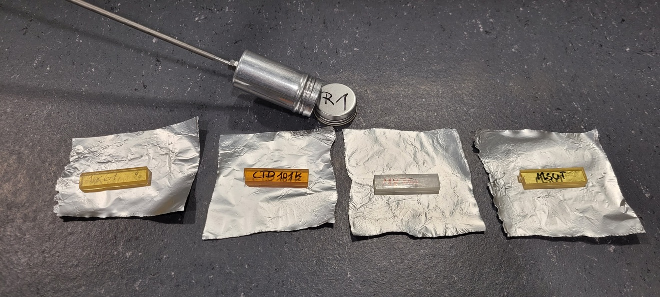
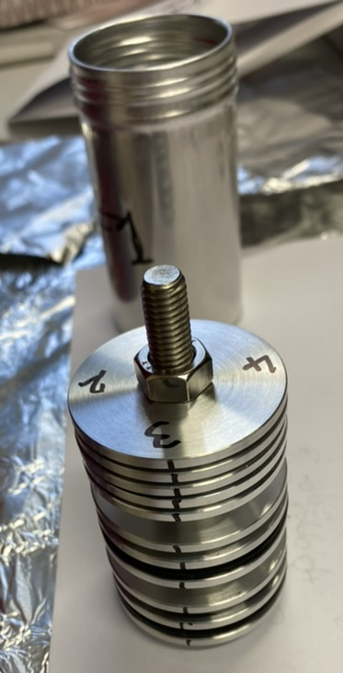
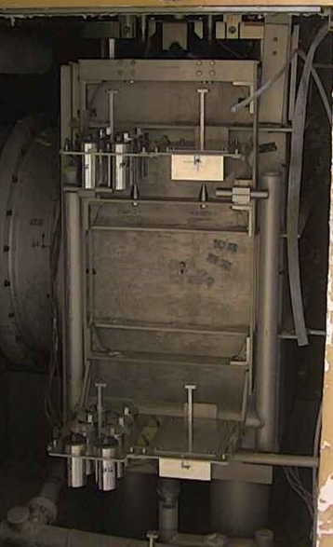
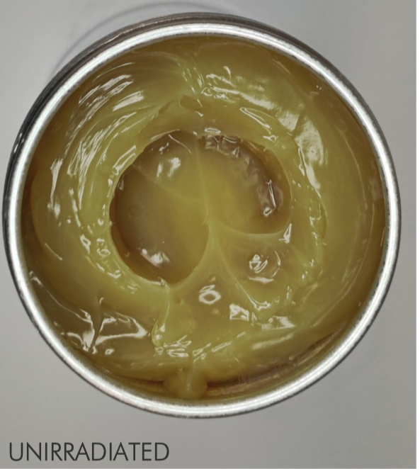
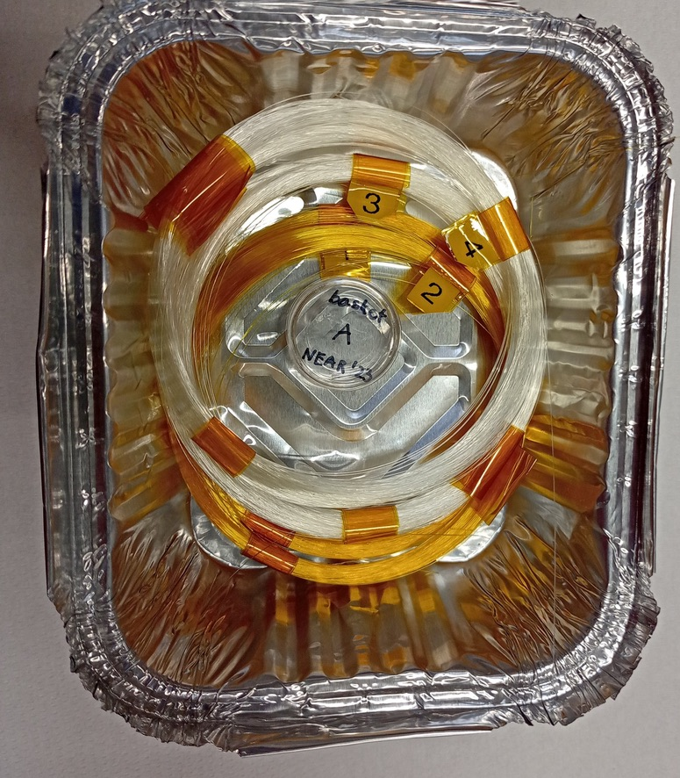
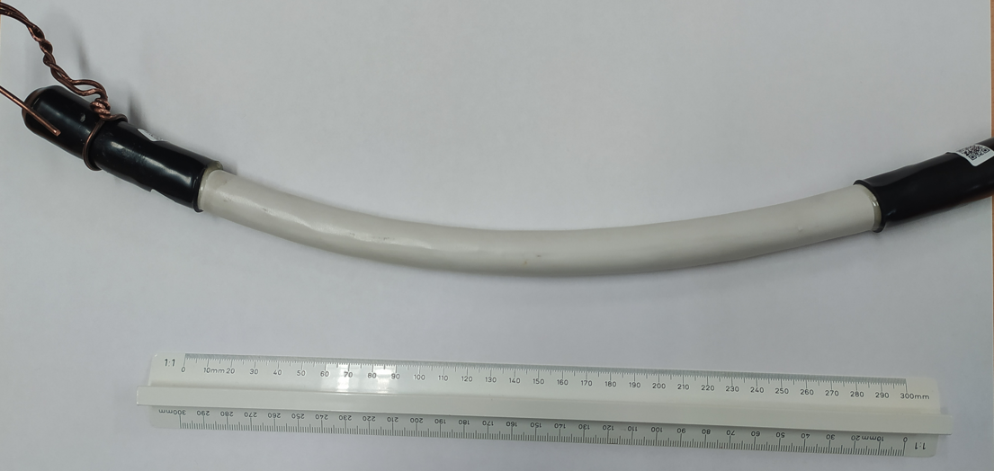
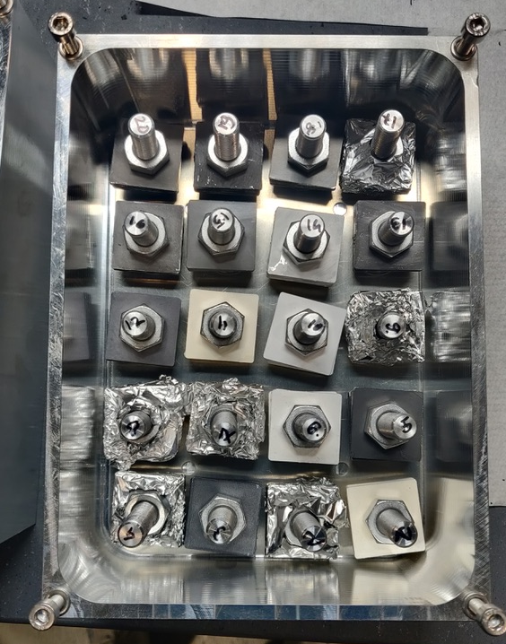
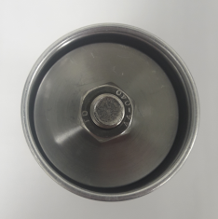
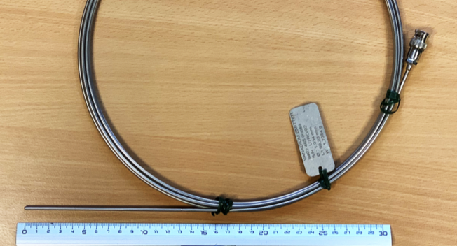
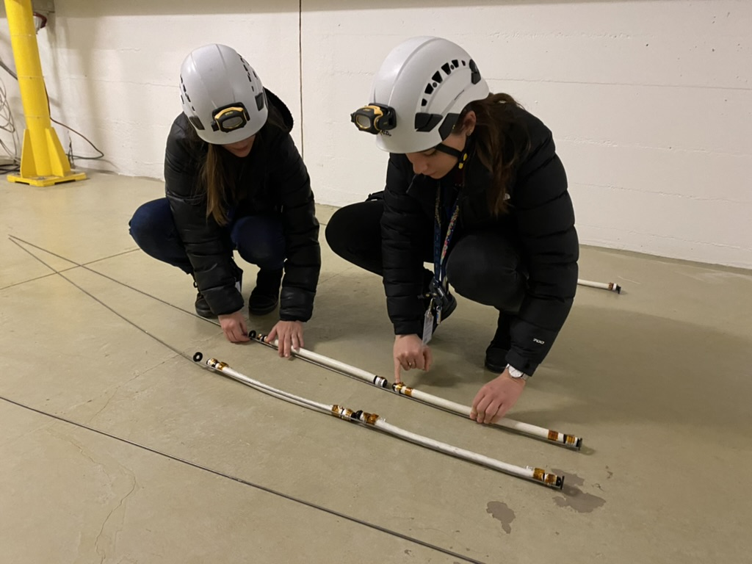
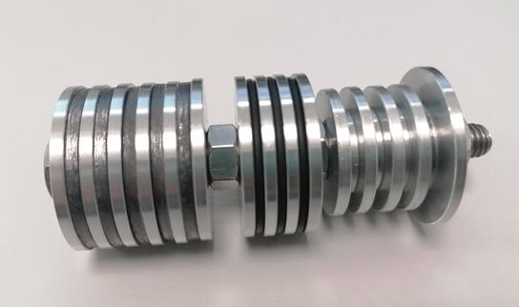
NEAR – n-TOF and R2M activities
new
Magnet resine TE/MSC
Shelve positions
Optical Fibers collaboration UJM
Elastomere SY-STI
Lubricant SY-STI
Cables HSE-OHS
Large variety of samples can be installed
Versatile system
INTC-I-247
Coating SY-STI
INTC-I-247 Installation of a detector support in the n_TOF target shielding for high flux neutron and gamma detector irradiation (S.Fiore BE-CEM)
Compressed EPDM seals

Slide 11
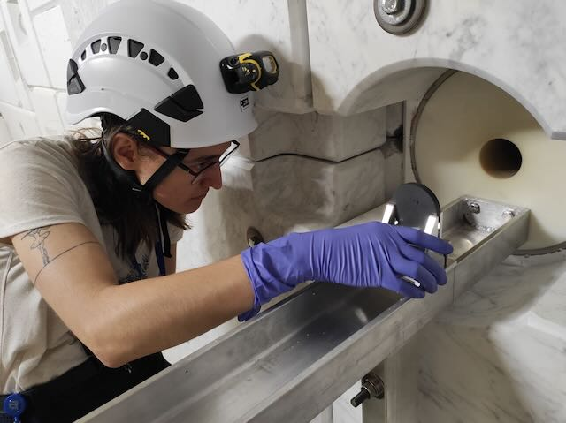
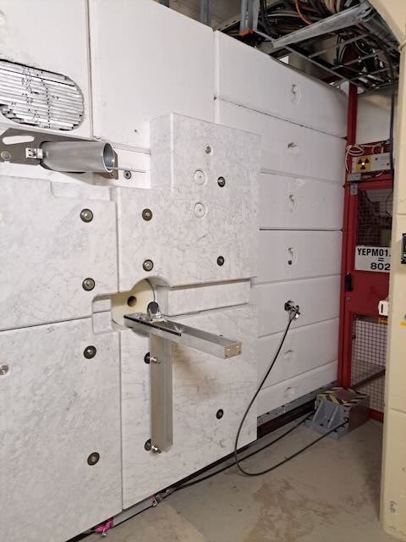
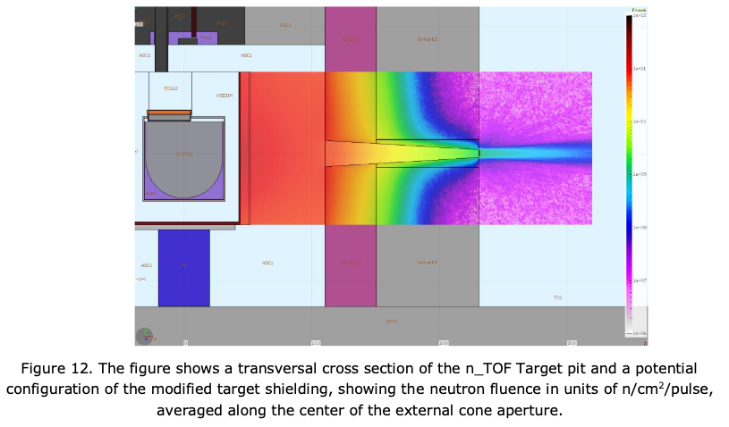
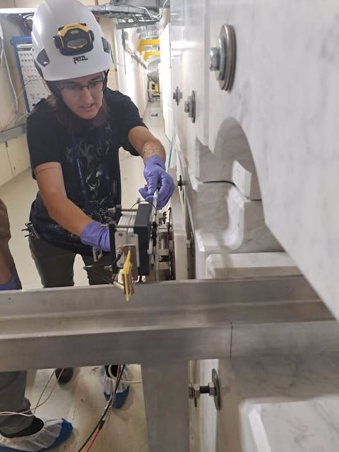
NEAR at n_TOF
NEAR activation area (a-NEAR)
n-TOF target area Shielding CLOSED
a-NEAR
2.8E7 n/cm2/s in front collimator
Access during operation Manual installation/removal

Slide 12
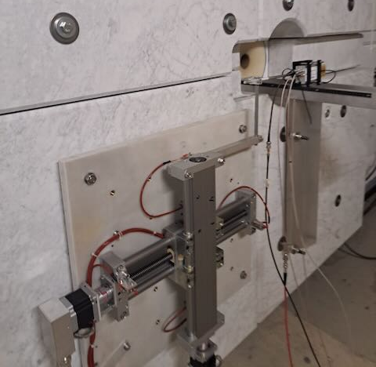
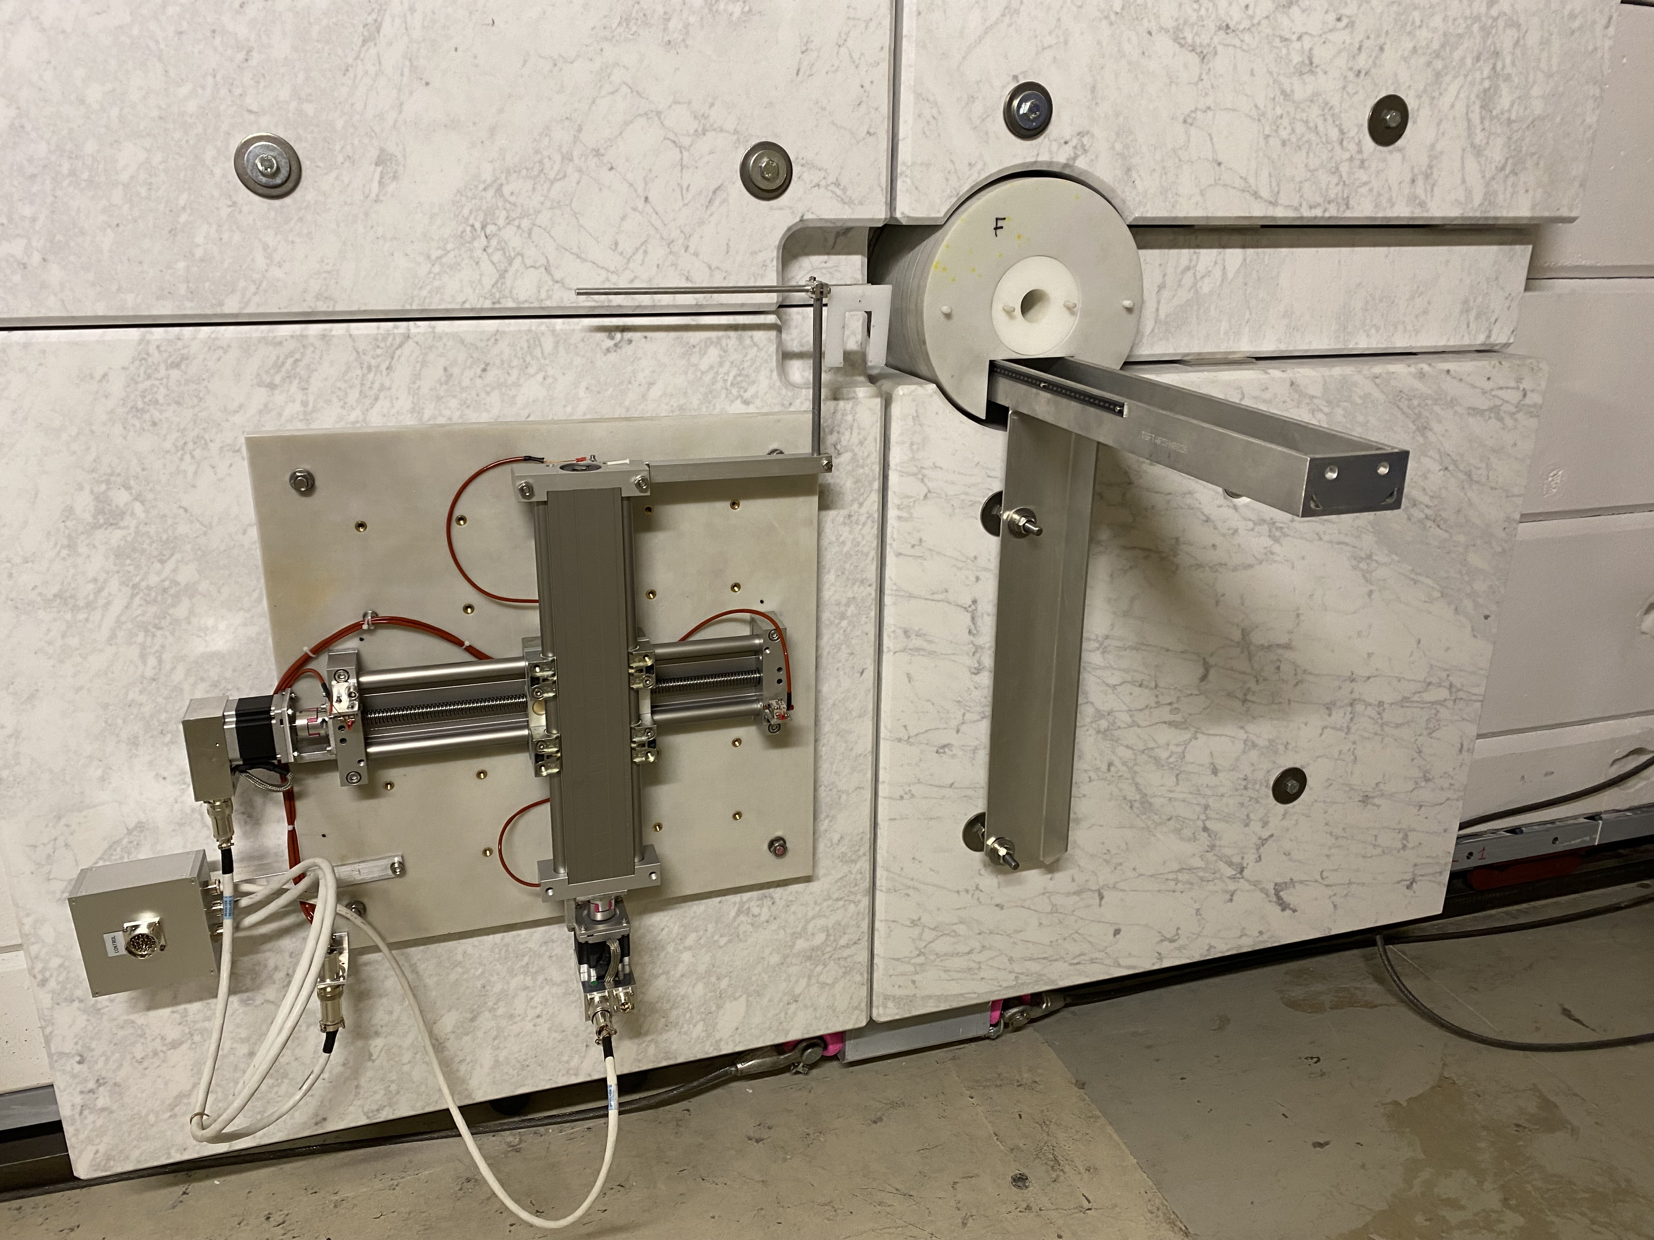
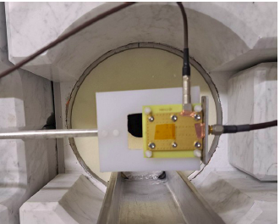




a-NEAR – n_TOF activities
new
Collimator modification ready for INTC-I-241 experiment
INTC-I-241 Measurement of the radiation background at the n TOF NEAR facility to study the feasibility of cyclic activation experiments
(M.Lerendegui, M.Bacack)
INTC-P-631 Direct measurement of the n TOF NEAR neutron fluence with diamond detectors
(M.Diakaki, M.Bacack)
INTC-P-631
INTC-P-623 Neutron capture cross section measurements by the activation method at the n_TOF NEAR station
(E.Stamati, A.Manna and G.Gervino)
INTC-P-631
Remotely controllable xy table already for cyclic activation experiments
Silicon carbide detectors development prestudy (S.Amaducci)
INTC-I-241
INTC-P-623
INTC-P-623
SiC detectors
SiC detectors

Slide 13

Mixed field irradiation station at ISOLDE
Irradiation test area in operation
The on-line isotope mass separator ISOLDE is a facility dedicated to the production of a large variety of radioactive ion beams
ISIS at ISOLDE
Parasitic irradiation as for MEDICIS*
NEAR at n_TOF
*CERN-MEDical Isotopes Collected from ISOLDE (MEDICIS) designed to produce high-purity isotopes for developing the practice of patient diagnosis and treatment.

Slide 14





ISIS at ISOLDE
GPS target station
New irradiation point: ISIS
Target Area
ISIS
Parasitic irradiation
Kuka robot target handling
ISolde Irradiation Station (ISIS)
ISIS
Class A lab building
Montrac Conveyor system

Slide 15





ISIS at ISOLDE
A
B
C
Target area not accessible during operation
C
A
B
C
Acknowledgements: S.Allegretti and S.Marzari SY-STI

Slide 16







ISIS at ISOLDE
Very versatile R2M irradiation station: ISIS target may be adapted to user requierements
1-2MGy Dose rate in few week of irradiation (mix field)
Remote handling installation and removal
ISIS station with two targets (ISOLDE + ISIS)
ISIS station without target
ISIS targets different shapes

Slide 17




ISIS at ISOLDE
4 days of irradiation
Acknowledgement S.Niang SY-STI

Slide 18
Mixed field irradiation station at CERN
Project of future Irradiation Facility
ISIS at ISOLDE
NEAR at n_TOF

Slide 19
Recall of BDF/SHiP Target Complex
beam
Acknowledgement J.-L. Grenard, M.Calviani

Slide 20

Prompt radiation produced in BDF target
400 GeV/c protons at 4*10¹³ ppp will generate an unprecedented prompt radiation field, dominated by neutrons – thanks to the use of a high-Z (Mo/W) target
For the time being, all will be absorbed in the surrounding 180 m³ shielding – is there any interest in doing something with these neutrons (or protons)?
Acknowledgement: M.Calviani

Slide 21

Where could we imagine placing components?
BIRR_Internal
BIRR_Prot
BIRR_Mix
Acknowledgement: M.Calviani

Slide 22

Some data & relevant quantities
Orders of magnitude level (!)
PRELIMINARY
BIRR_Internal | BIRR_Mix | BIRR_Prot
±50-400 MGy/y (mixed field, neutron dominated, including HE neutrons) | O(0.1-10) MGy (including HE neutrons) (lower values for more exernal volumes) | 4*10¹³ p/pulse
10¹⁸-10²⁰ cm⁻²*y⁻¹ | O(10¹⁴-10¹⁶) HEH*cm⁻²*y⁻¹ | Beam spot area depending on diluted or “centered” beam (1σ=30-35 mm)
“Small” volumes (fit inside the space between target & proximity shielding) | Larger volumes (need to find space within shielding) | Upstream BDF, area to be determined
Caveat: accessibility parasitic to operation of the BDF/SHiP infrastructure
Acknowledgement: M.Calviani

Slide 23
Summary
Several Neutron-dominated mixed-field irradiation tests areas available at CERN (internal users and external collaborators)
Most of them (excluded CHARM) are parasitic irradiation tests areas
Increased demands for mixed-field irradiation
Future Mixed-field irradiation tests areas under investigation

Slide 24
Thank you very much !

