Slide 1

Needs of ferritic-martensitic steels qualification in Japan
2nd DONES Users Workshop
19-20 October 2023, Parque de las Ciencias, Granada
Takashi Nozawa*, Masami Ando, Yoshiyuki Watanabe, Hiroyasu Tanigawa
National Institutes for Quantum Science and Technology, Rokkasho, Aomori, Japan
*Corresponding author: nozawa.takashi@qst.go.jp

Slide 2
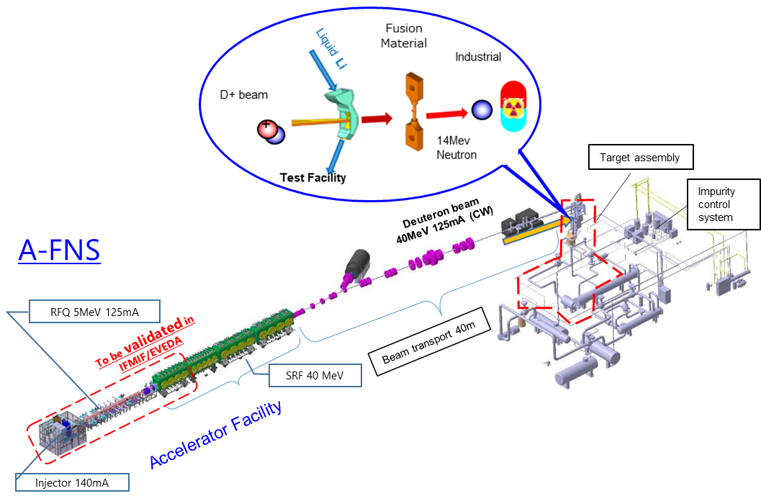
Outline
Introduction: Basic strategy of material R&D toward DEMO
Overview of F82H qualification toward DEMO
Specimen requirements
Summary
14 MeV fusion neutron irradiation facility for fusion DEMO
19th October, 15:10
Y. Watanabe, “Role of fusion neutron source facilities in modeling and simulation studies of irradiation effects of fusion reactor materials”
19th October, 15:30
A. Kasugai, “Neutron Irradiation Plan in A-FNS for DEMO and Industrial Application”

Slide 3
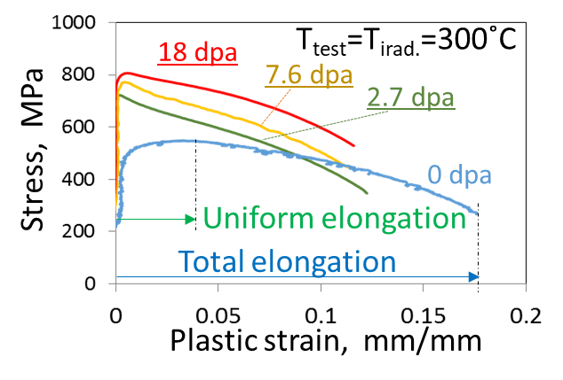
Significance of irradiation hardening & loss of ductility
Hardening and embrittlement are the critical irradiation effects.
Deformability reduction which appeared as the loss of uniform elongation and the reduction of total elongation are also significant.
Expected stress-strain curve in design code
Ultimate tensile strength Su
Margin by work hardening
Yield stress Sy
Stress, σ
High ductility
Assumption:
The structural material behaves as elastic perfectly plastic solid
Strain, ε
High deformability (ductility and plastic hardenability) is the basic presupposition as the safeguard for the allowable stress design method to prevent plastic collapse, prevent ratcheting, and make it possible to ignore the impacts of very small flaws and defects.

Slide 4
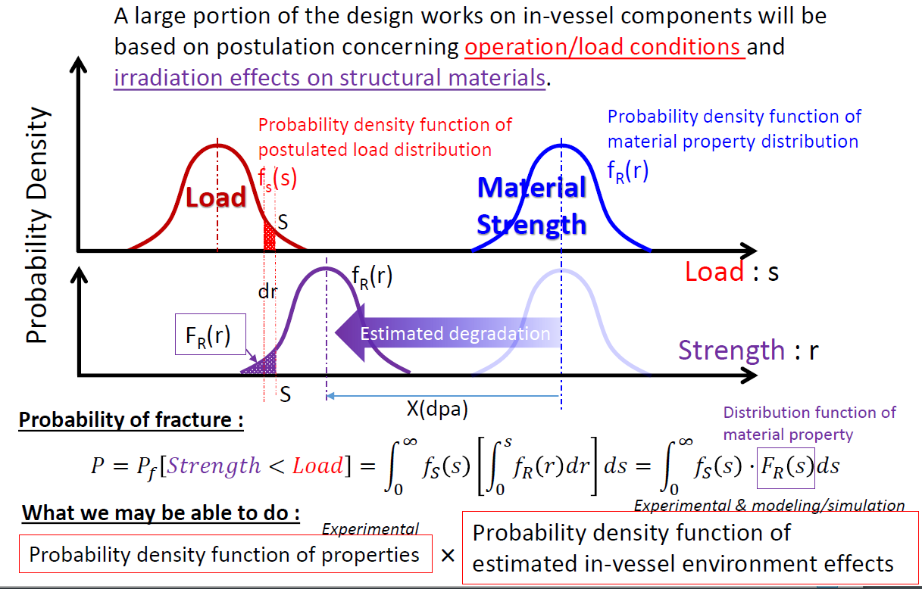
From deterministic approach to probabilistic approach
The deterministic approach, widely adopted in the design of structural components, systematically (often empirically) defines the design limits of a structure with a safety factor.
This approach is not always appropriate because structures are subjected to a variety of loads in the practical environment, which may give an overestimate.
A more rigorous probabilistic approach that incorporates material strength distributions has recently become an important solution.
The probability density function of material strength is the basic input to determine the design criteria.
H. Tanigawa et al. ISFNT-13 (2017)

Slide 5
Basic strategy of material R&D toward DEMO
Need to complete the conceptual design without any experimental verification in the 14 MeV fusion at the timing of JA's intermediate C&R in the mid-2020s, which will deliberate on the decision to move to the engineering design phase.
--> Basic strategy = Fission reactor irradiation data + modeling & simulation
Need to establish a reasonable logic (e.g., DEMO design criteria) to show the feasibility specific to DEMO components.
--> Draft guideline with comprehensive material file (ongoing in the BA phase II)
Three important design limits to be considered in DEMO design:
Negligible irradiation,
Critical condition to show the deviation between fission and fusion,
Maximum allowable condition under 14 MeV fusion neutron (with He).
Negligible irradiation
Max. allowable condition if any
100

Slide 6
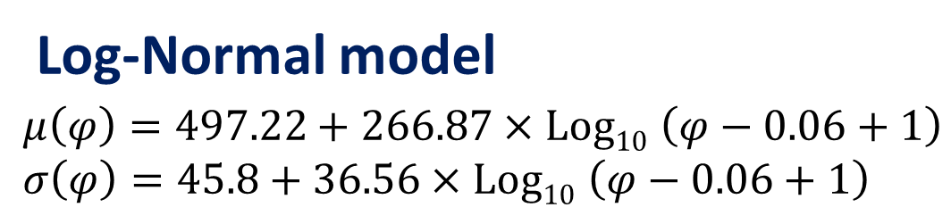
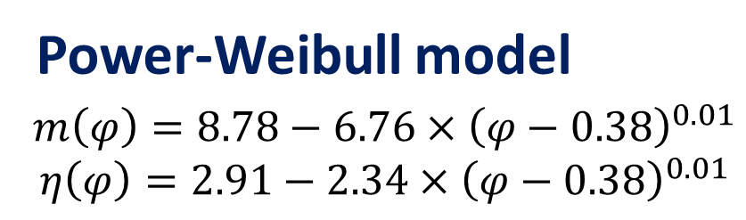
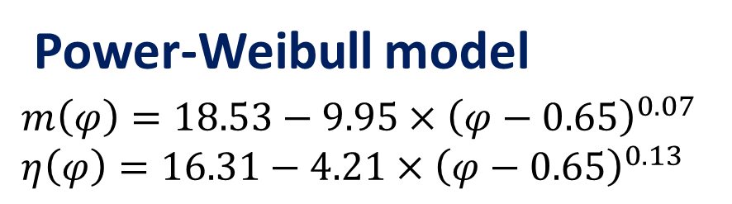
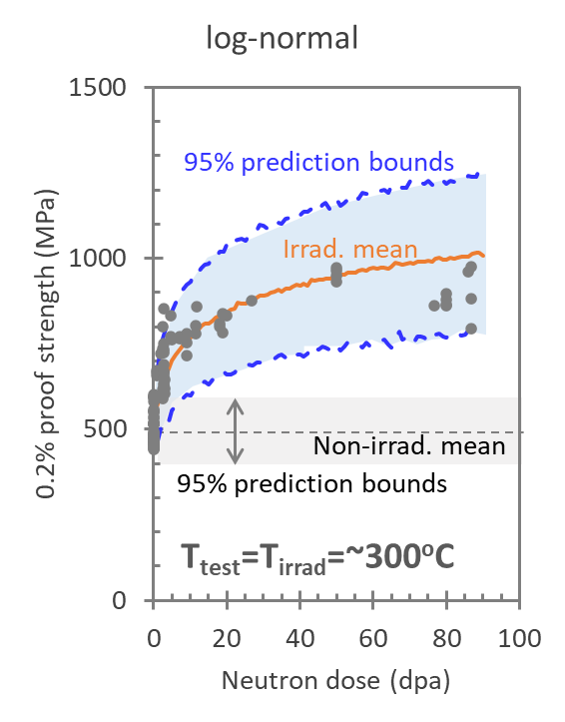
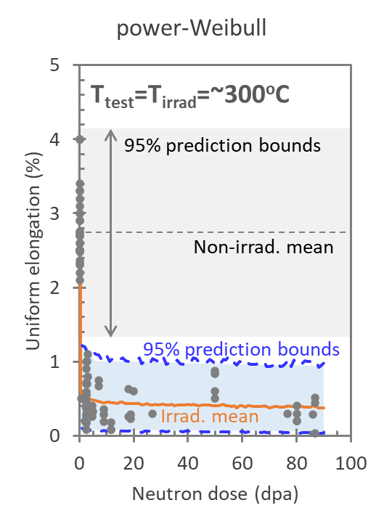
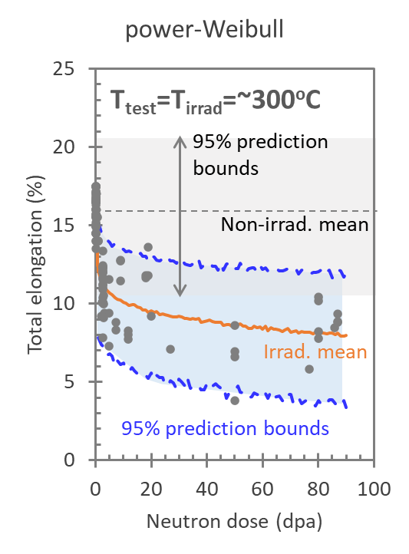
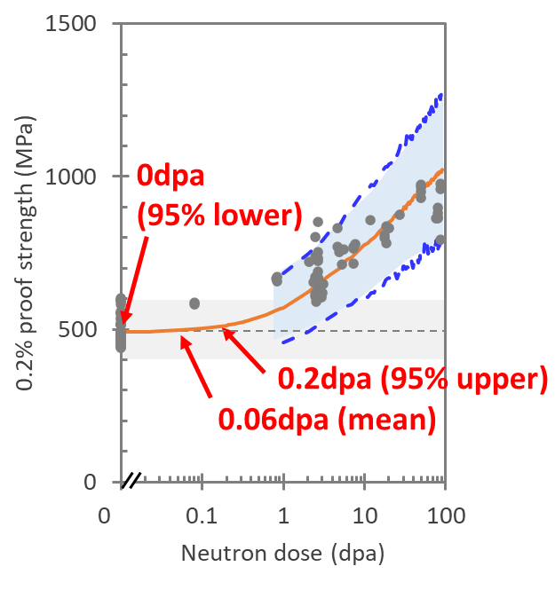
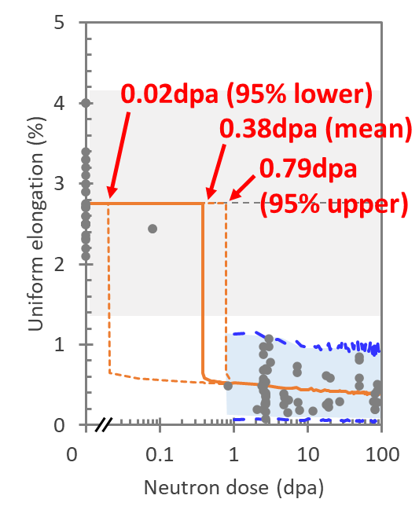
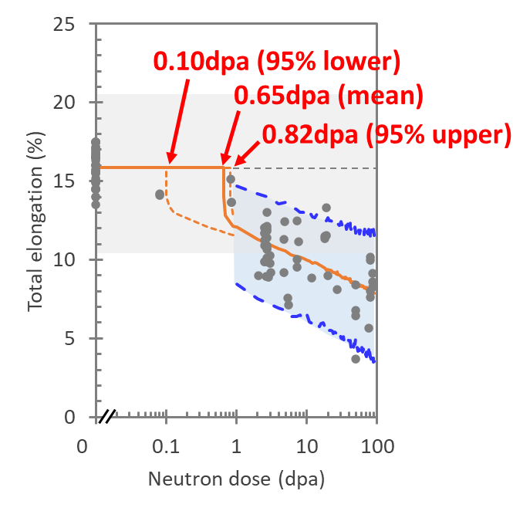
Summary of reactor irradiation experiments for F82H

Slide 7
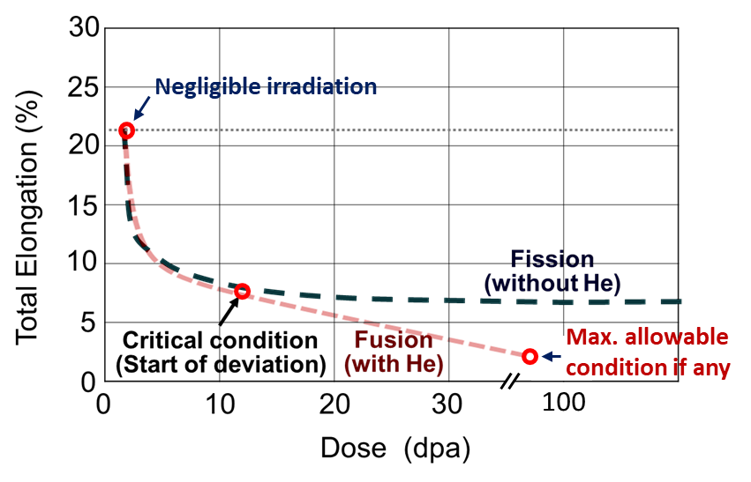
Role of 14 MeV fusion neutron source
Verification of modeling & simulation
Demonstration by experiments

Slide 8
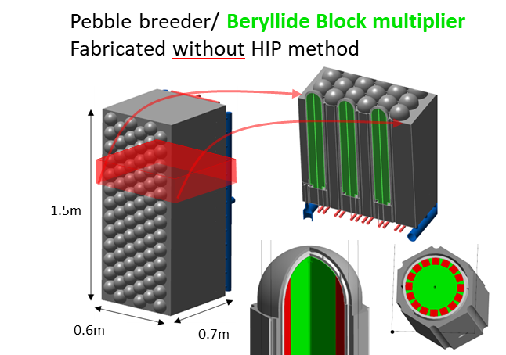
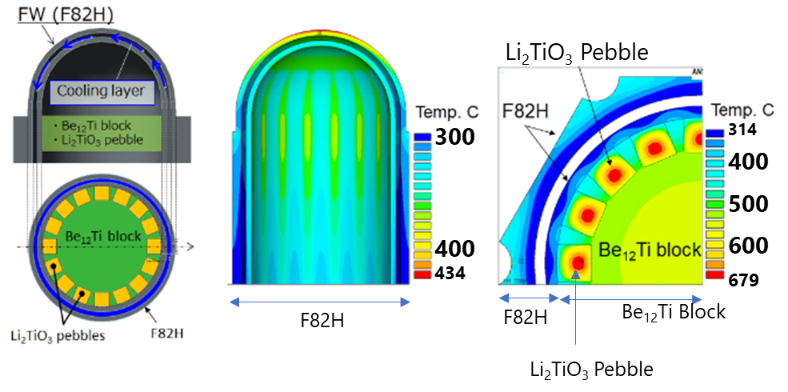
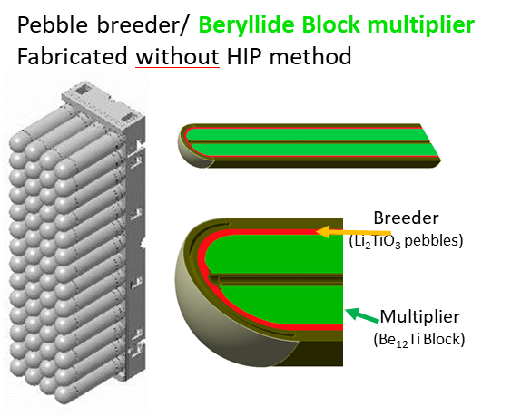
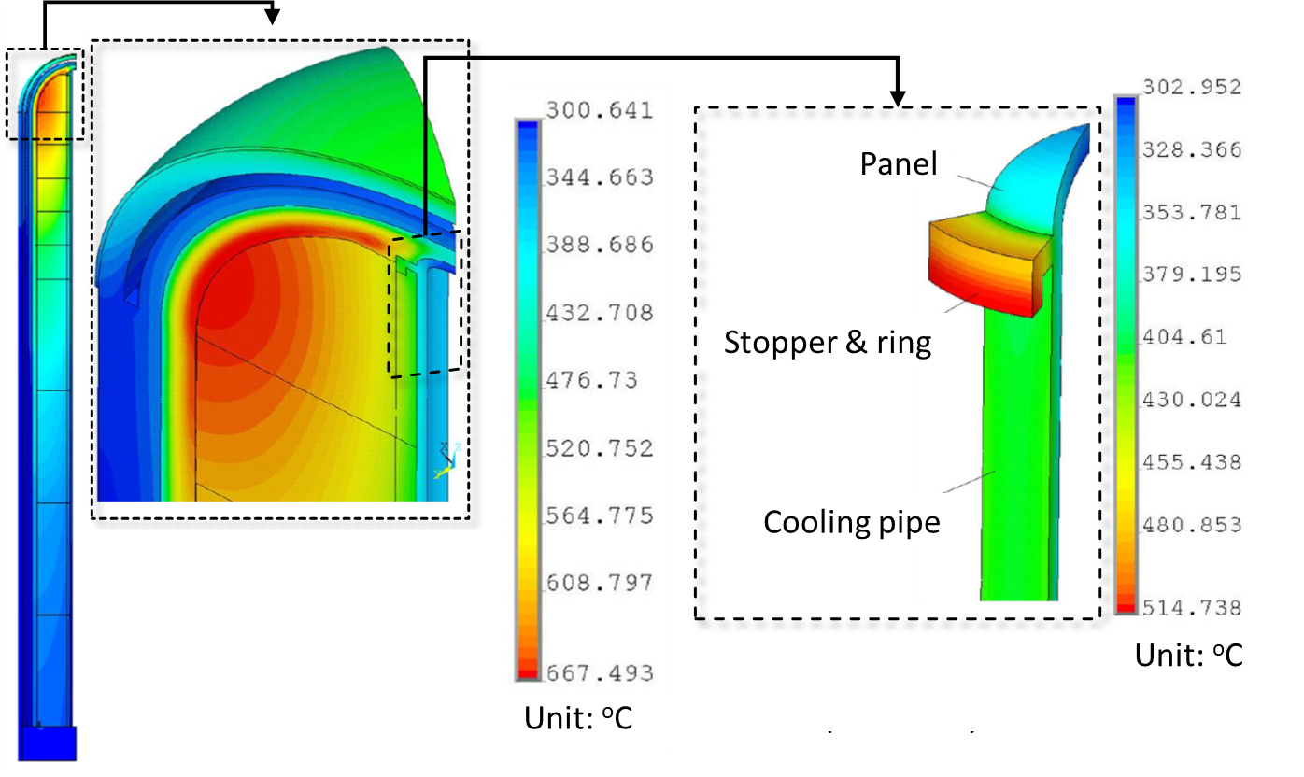
JA DEMO blanket conditions: Temperature
Local TBR = 1.21
F82H <434ºC
Li₂TiO₃ <679ºC
Be₁₂Ti <546ºC
Local TBR = 1.24
F82H (body) <483ºC
F82H (stopper) <515ºC
Li₂TiO₃ <667ºC
Be₁₂Ti <658ºC

Slide 9
JA DEMO blanket conditions: Neutron fluence
・Neutron wall load: average 1.0 MW/m² (max. 1.66 MW/m²)
・dpa rate: 10 dpa / (1.0 MW/m²)

Slide 10
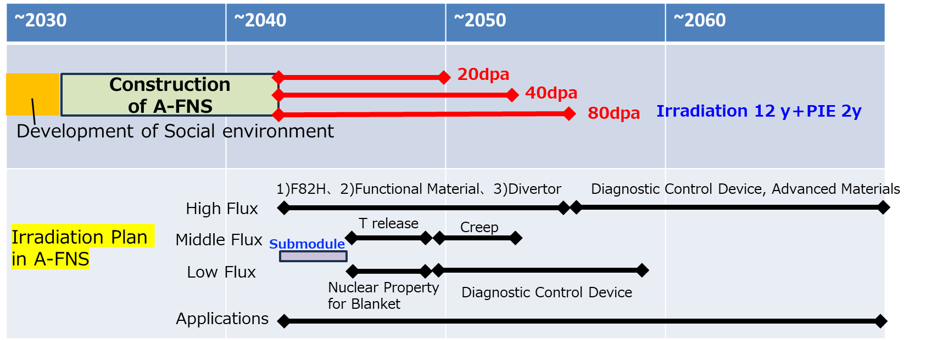
Overview of F82H qualification toward DEMO
Blanket
Temperature: max. 483ºC (first wall), 290-325ºC (coolant)
Neutron dose: 16.6 dpa/FPY (max. at horizontal plane)
Target operational period: 2.5-5 years
Irradiation plans according to Japanese roadmap
Divertor (cooling pipes)
Temperature: primary: 290-325ºC, option: approx. 200ºC
Neutron dose: 6 dpa/FPY (maximum)
Target operational period: 1 - 2 years
(＊FPY: Full Power Year)
Data acquisition timing | Objectives | Materials | Target irradiation temp. | Target neutron dose | Target year
Design Phase | Verification of irradiation data obtained by fission reactor | Base metal | 300, 400, 500ºC | 10 dpa | ~2040
DEMO Phase I (Pulse operation) | Acquisition of licensing data for steady-state operation | Base metal | 300, 400, 500ºC | 20 dpa | 2050
 |  | Welds | 300, 400ºC | 20 dpa | 2050
DEMO Phase II (Steady-state operation) | Acquisition of licensing data for steady-state operation (long-term) and confirmation of the capability for a commercial fusion reactor | Base metal | 300, 400, 500ºC | 40, 80 dpa | ~2055
 |  |  | 200ºC (divertor) | 12 dpa | ~2055
 |  | Welds | 300, 400ºC | 40, 80 dpa | ~2055

Slide 11
Important requirements of irradiation facility
Capsule reloading function with on-site specimen cleaning is mandatory in case of high-dose irradiation campaign.
On-site PIE capabilities are preferable to check status of irradiation timely and periodically.
General procedure
Cold work
Assembly
Assembly
Assembly
Assembly
Irradiation
IR1
IR2
IR3
IR4
Hot-cell work
Disassembly
Disassembly
Disassembly
Disassembly
Reloading procedure
Cold work
Assembly
Assembly
Irradiation
IR1
IR2
IR3
IR4
Hot-cell work
Re-assembly
Re-assembly
Disassembly
Disassembly

Slide 12
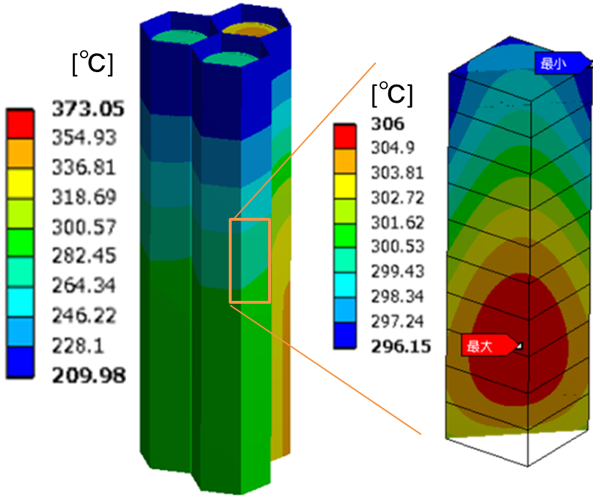
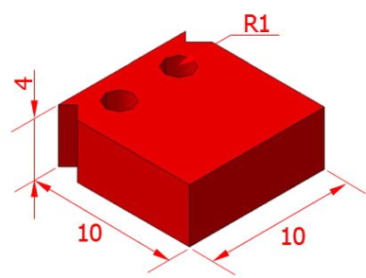
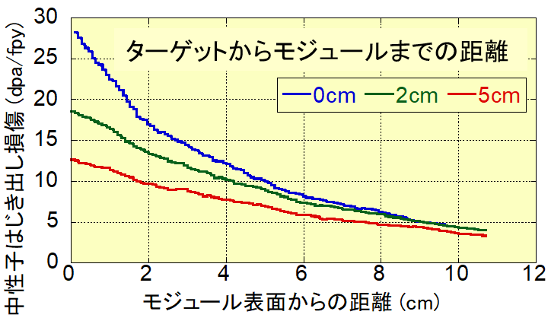
General requirements of specimens & PIE techniques
Test variation required for F82H qualification:
Tensile and toughness is mandatory.
Fatigue (including fatigue crack growth) is more addressed for pulsed operation in JA DEMO phase 1.
Identifying irradiation creep - fatigue diagram is challenging issue.
PIE technologies:
Simple arrangement is preferable.
State-of-art hot-cell technologies such as non-contact measurement and automated remote handling are encouraged to adopt to increase quality of data.
CT toughness
Distance from target to module surface
Neutron fluence (dpa/fpy)
Establishing SSTT is essential to
allow limited volume of the capsule,
mitigate temp. and neutron gradients inside the specimen,
increase number of specimens for statistical analysis.
Distance from the module surface (cm)

Slide 13
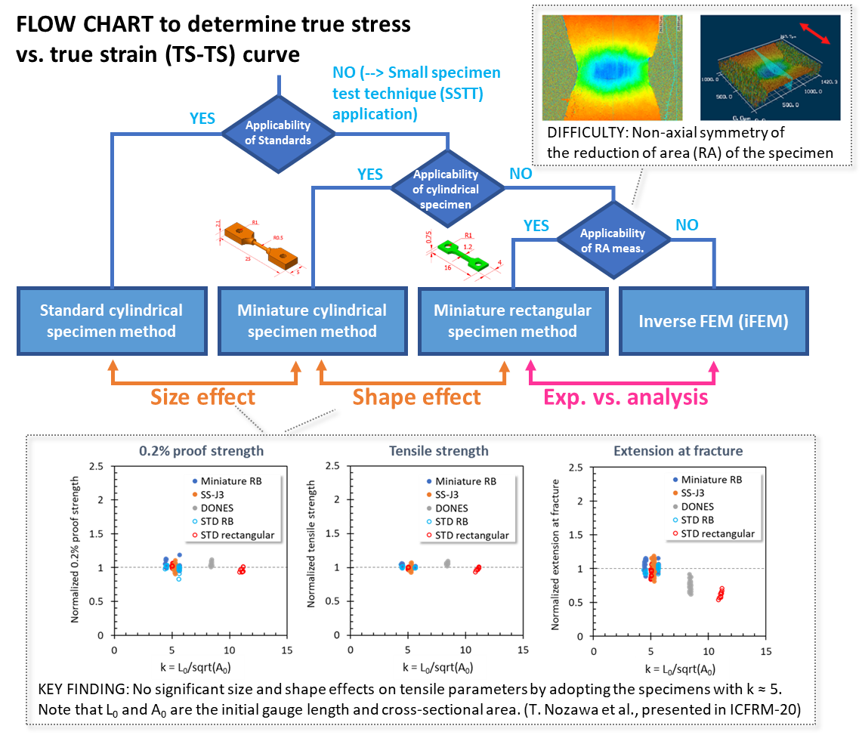
Tensile evaluation: Specimen size & shape effects
Primary opt. – Round bar type
Uniform deformation due to axial symmetry
--> Advantage in reduction of area evaluation
Disadvantage in temperature control during irradiation compared with the flat type
--> Possibly conquered by using liquid metal (e.g., Li, NaK) as heating medium
Alternative opt. – Flat dog-bone type
Widely utilized in neutron irradiation study
Effective in minimizing specimen volume and achieving good thermal contact for each
--> Effective in minimizing gradients of φ and T_{irr} inside each specimen
Need to consider complicated stress state and stress triaxiality during fracture
Disadvantage in measuring reduction of area at the fracture initiation (i.e., necking initiation)

Slide 14
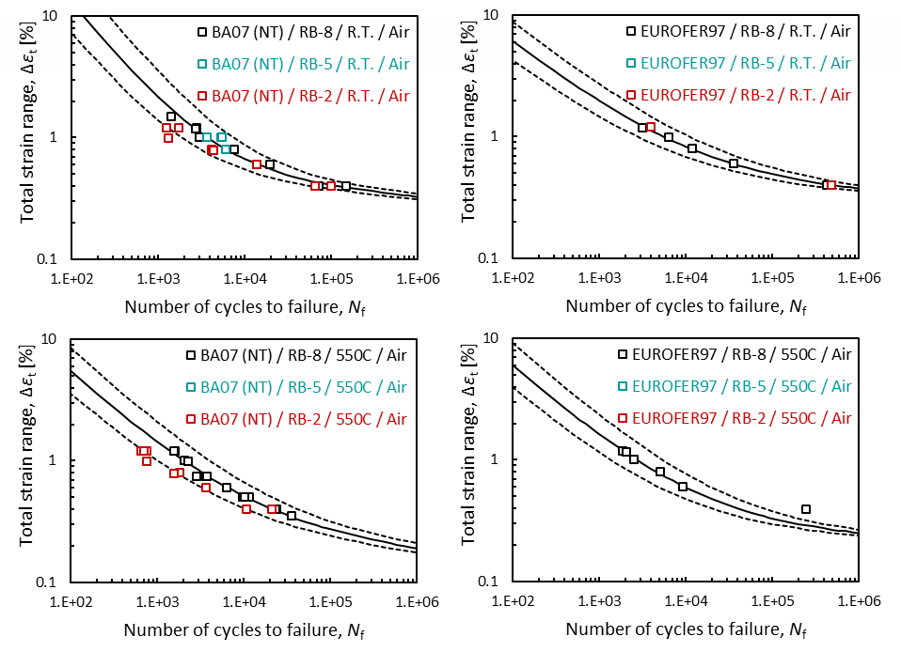
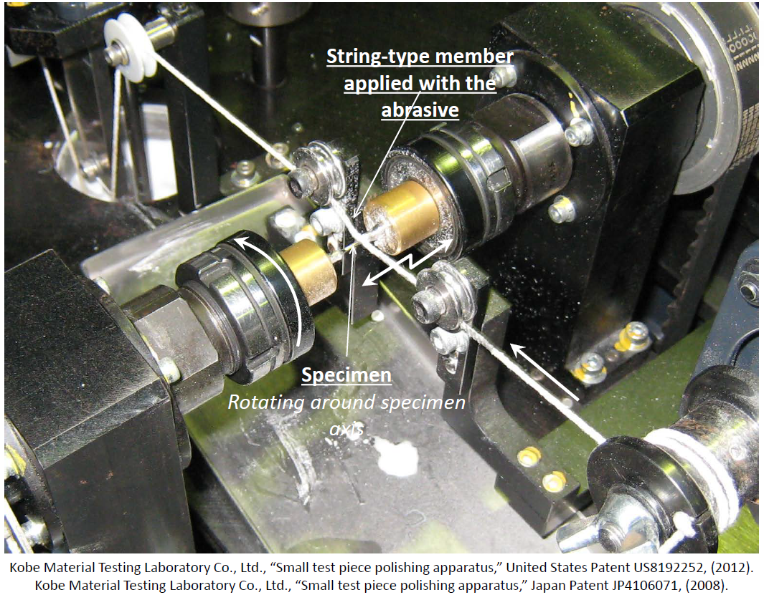
Special requirements for low-cycle fatigue evaluation
Fatigue life is very sensitive to the surface condition of the specimen.
--> Special technique for axial polishing required
Specimen size effect cannot be ignored to achieve high quality of data.
--> φ5mm round bar type (tentative)

Slide 15
Summary
Basic strategy of material R&D toward DEMO
As well as irradiation data-basing, 14 MeV neutron irradiation source will be utilized in
  - verification of modeling methodology, which can specify the critical condition to show the deviation between fission and fusion at early stage of DEMO design,
  - demonstration of the maximum allowable condition under 14 MeV fusion neutron (with He).
Overview of F82H qualification toward DEMO
Staged approach: 10, 20, 40 and 80 dpa at varied temperatures (200-500ºC)
Reloading capability is strongly required for high-dose irradiation.
Fatigue is more significant in early DEMO operation.
Specimen requirements
Understanding size and shape effects is mandatory.
Adopting new analytical approaches and PIE technologies is encouraged for better understanding of the behavior with increased reliability.

Slide 16
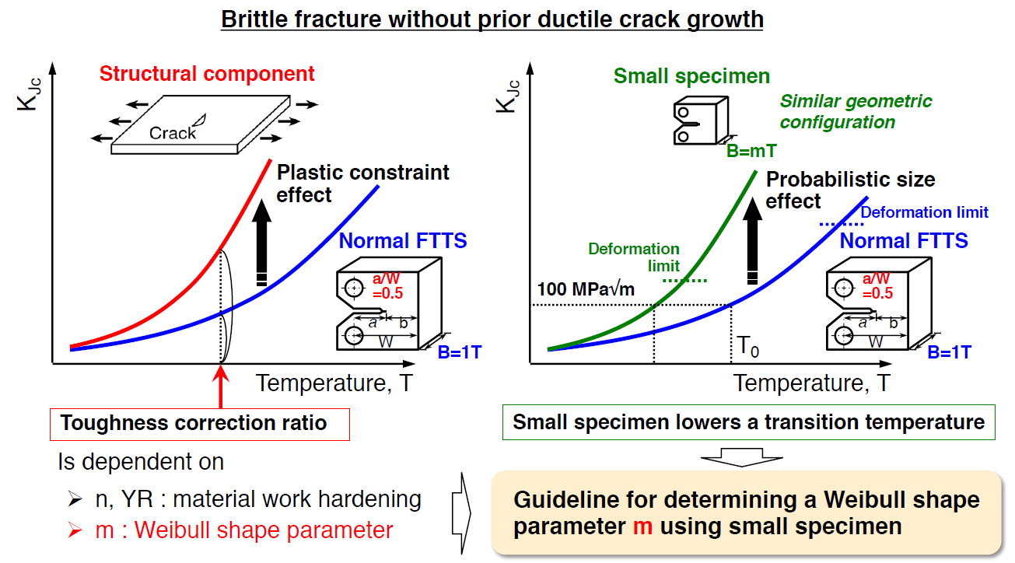

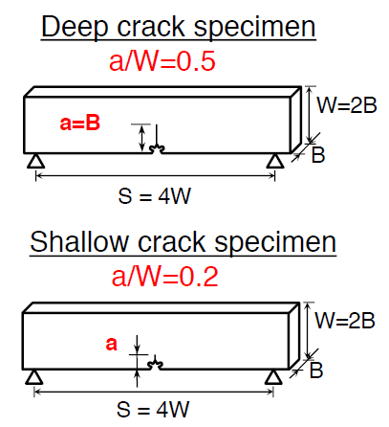
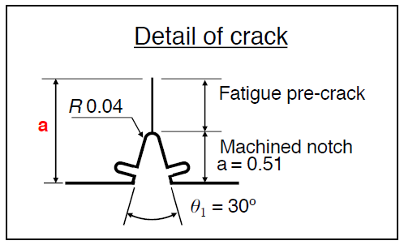
Toughness correction by the Local Approach

Slide 17
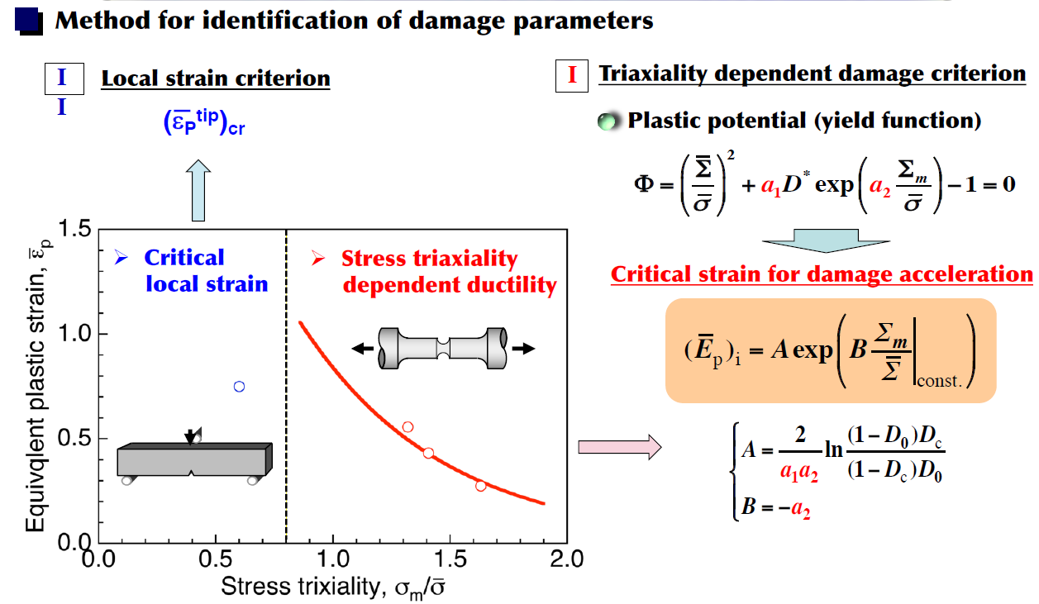
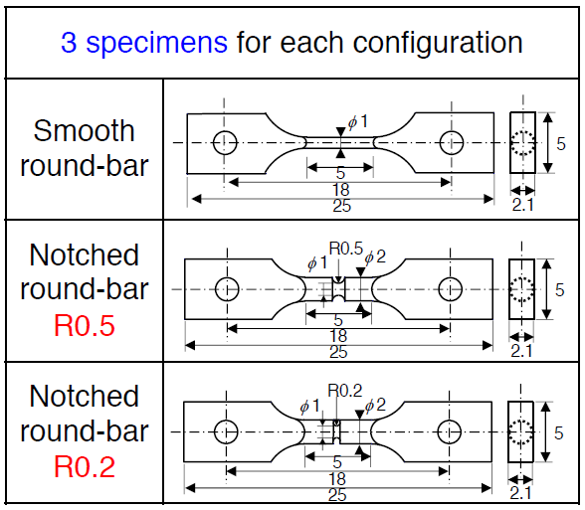
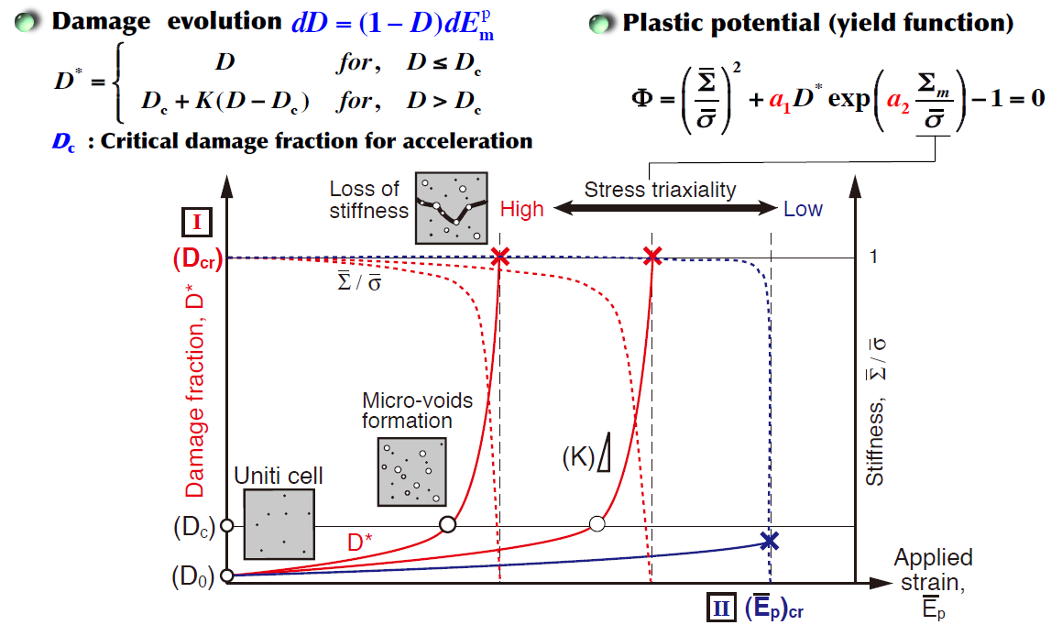
Proposed damage model for predicting DCG resistance

Slide 18
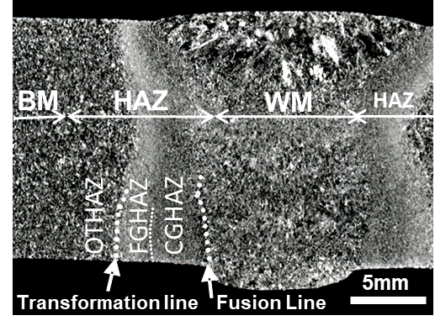
Neutron irradiation (50dpa@300ºC) on F82H TIG welds
T_{irrad} = T_{test} = 300℃
Irrad.
Irrad. BM
Irrad. WM
Irrad. FGHAZ
Irrad. OTHAZ
Non-irrad.
Non-irrad. WM
Non-irrad. FGHAZ
Non-irrad.
Non-irrad. BM
Non-irrad.
OTHAZ
BM: Base metal
WM: Weld metal
CGHAZ: Coarse-grained heat-affected zone
FGHAZ: Fine-grained heat-affected zone
OTHAZ: Over-tempered heat-affected zone
Irrad.
BM
WM
FGHAZ
OTHAZ
WM and HAZ undergo hardening and loss of ductility to the base metal level by irradiation

Slide 19
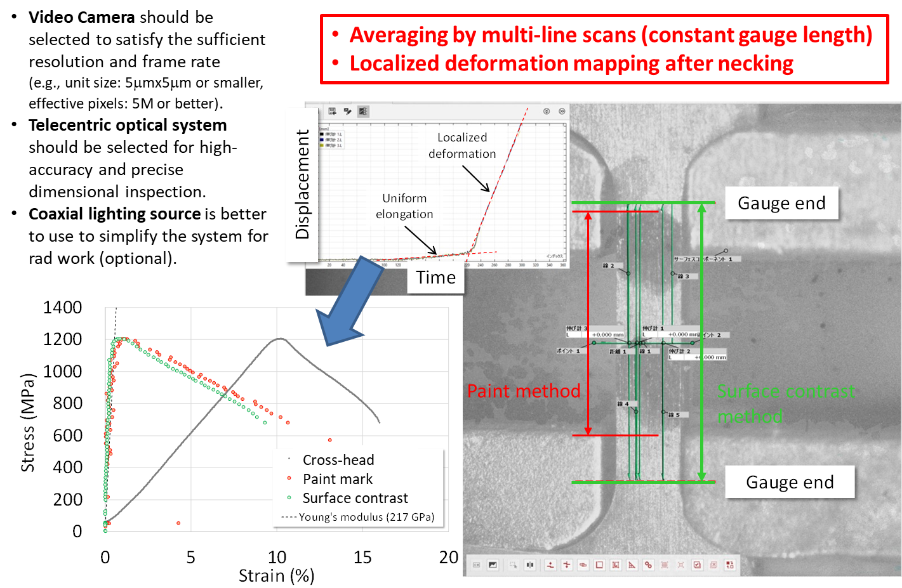
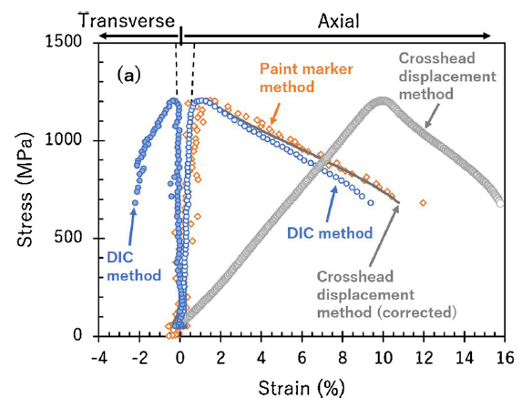
Impact of strain measurement methods
The DIC method can achieve more accurate strain measurement.
Compliance correction methods have been widely applied in early generation of data.
Strain measurement technique by digital image correlation (DIC)
T. Nozawa et al. Fusion Eng. Des. 157 (2020) 111663

Slide 20
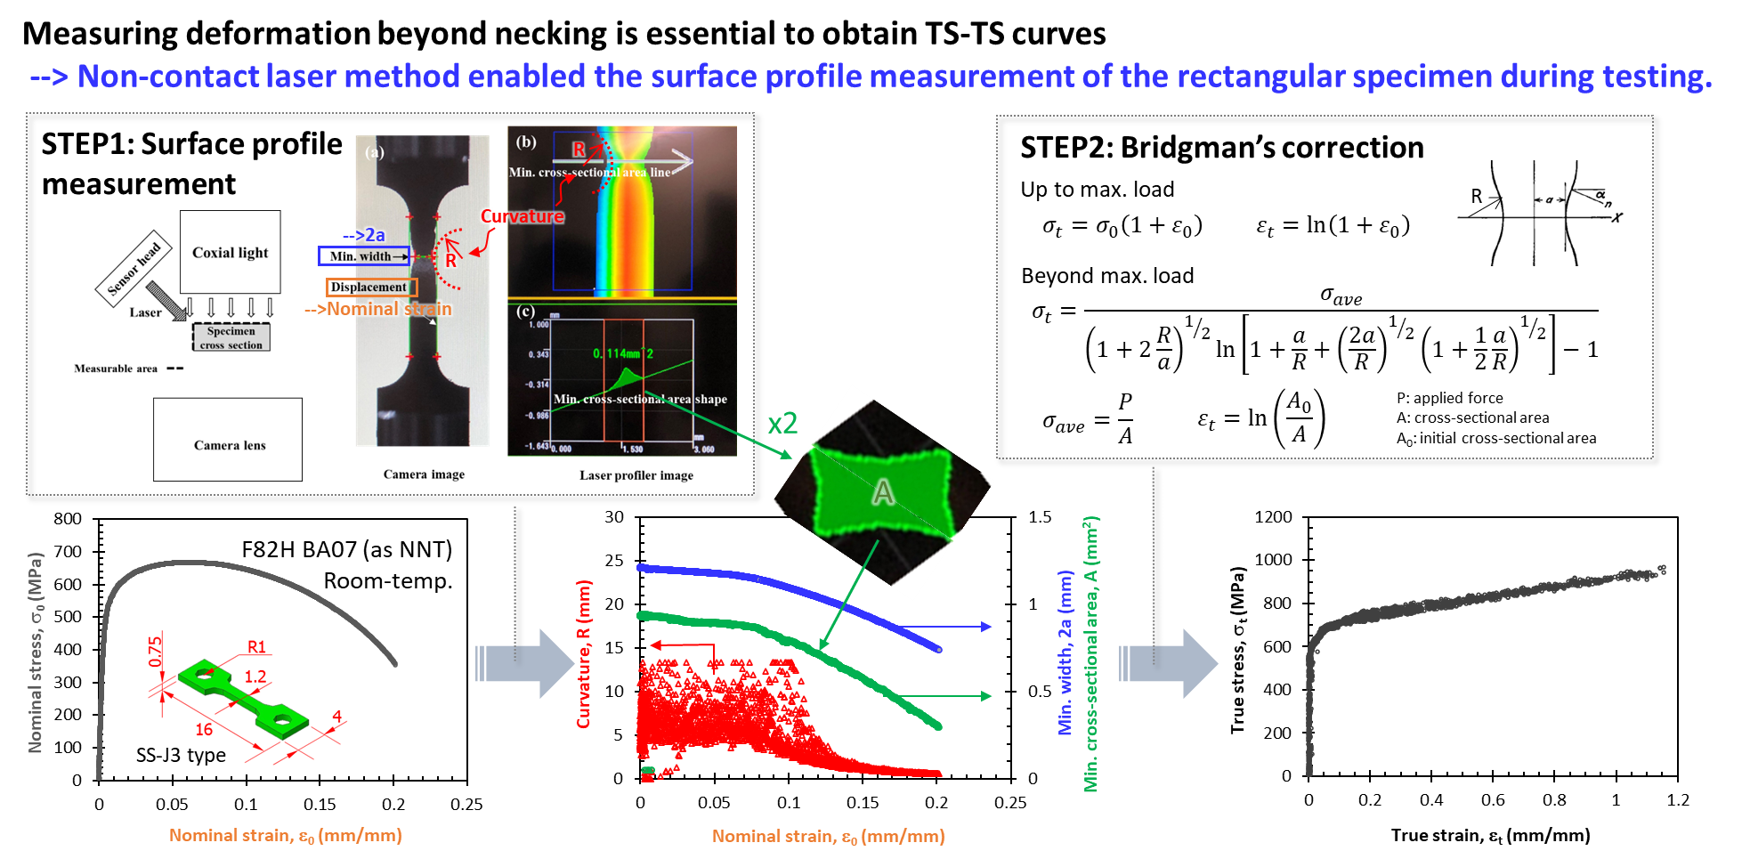
Experimental & analytical method for TS-TS evaluation
T. Kato et al., Meas. Sci. Technol. 34 (2023) 075015

Slide 21
Assessment of F82H MPH status by attribute guides
(*) color code :
✓ White (blank) for properties not addressed, lack of data
✓ Black : potential showstopper identified
✓ Red : lack of data and potentially challenging
✓ Blue : lack of data, NOT challenging
✓ Orange : data available, results not good enough, further optimization needed
✓ Green : data available, results are good, concept is mature
n/a : not applicable
  Key R&D issues remained
  Creep-fatigue diagram
  More toughness data
  Fatigue and fatigue crack growth test data
  Corrosion test data under irradiation
  Magnetic properties at higher doses
  etc.

