Slide 1


2nd DONES Users Workshop​
19-20 October 2023, Parque de las Ciencias, Granada
Role of fusion neutron source facilities in modeling and simulation studies of irradiation effects of fusion reactor materials
Yoshiyuki Watanabe*,
Masami Ando, Takashi Nozawa, Hiroyasu Tanigawa
National Institutes for Quantum Science and Technology, Japan

Slide 2
Outline
Background/motivation for modeling and simulation studies on irradiation effects of materials for fusion DEMO reactor.
Present status of modeling and simulation studies on JA side in BA activity
Role of fusion neutron source facilities in modeling and simulation studies of the material irradiation effects
Summary

Slide 3
Background and objectives
T. Muroga & H. Tanigawa, Fusion. Sci. Technol. 72 (2017) 389.
F82H steel
T_{test}=T_{irad.}=300˚C
＋
Design region of DEMO
Material performance
(Total elongation, %)
Critical condition
(start of deviation)
Fission n-irrad. data
Fusion n-irrad. Data
He
Irradiation dose （dpa）, He production (appmHe)
The fusion DEMO reactor should be designed within the range of fission neutron irradiation data.
Identification of the critical conditions of fusion neutron irradiation effects is important.
The irradiation performance of fusion DEMO is quite different from other alternative facilities (e.g., fission reactors and ion beam irradiation) .
Theoretically understanding material behaviors under different irradiation fields is necessary to develop a mechanistically-based prediction techniques.

Slide 4
Present status of modeling and simulation studies on JA side in BA activity
Void swelling is a volumetric expansion phenomenon that causes from accumulation of cavities (voids/helium bubbles) of irradiation defects.
Modeling and simulation of microstructural evolution is very important to predict the void swelling.

Slide 5
Objective and method
Theoretical understanding void swelling of RAFM steel under different irradiation fields with focusing on nucleation and growth behaviors of cavities.
Method: Reaction rate theory with atomistic simulation (DFT/MD calculations).

Slide 6
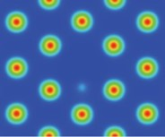
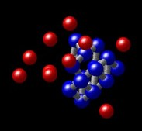
Outline of the rate theory model
Research target
Nucleation and growth model of helium bubbles
The matrix of a
block component
of F82H
Vacancy binding energy
(Parameter of thermal stability)
Reactions between defects during irradiation
DFT
MD
C. Domain & C.S. Becquart, PRB 65 (2001) 024103.
C.S. Becquart & C. Domain, NIMB 202 (2003) 44.
T. Seletskaia et al., PRL 94 (2005) 046403.
C.C. Fu et al., Nat. Mater. 4 (2005) 68.
K. Morishita et al., Fusion. Sci. Technol. 44 (2003) 441.
Simultaneous rate equations for point defects and their clusters were constructed.
Then, about 1,100 rate equations were computationally solved with a ODE solver (MATLAB/MathWorks, Inc.).
Notes:
This is the outline of the rate theory model.
The research target is the matrix of a block component of F82H steel.
And, as shown in this figure, Under irradiation conditions,
first, vacancies and SIAs are homogenously produced by high-energy-neutron irradiation.
Also, helium atoms are produced.
Here, notice that the formation of defect clusters in collision cascades is neglected for simplicity.
And, those produced point defects are absorbed into the dislocation sink.
As to formation of defect clusters, SIAs form dislocation loops.
And vacancies and helium atoms form helium bubbles.
Here, those point defects are dissociated depending on temperature like this.
Next, let me describe a nucleation and growth model of helium bubbles.
First, a helium bubble is characterized by bubble size and He/V ratio.
In this study, this ratio is limited to the range from 0 to 2 in order to neglect the SIA-emission from the bubble.
And, as shown in this figure, helium bubbles are classified into two types of categories.
The first one is small bubbles, where the bubble size is in the range from 1 to 50, and the number of helium atoms is in the range from 0 to 100.
Here, you now, the He/V ratio is limited to the range from 0 to 2. So, the target bubbles are in yellow.
And then, bubbles beyond the size of 50 are classified into average large bubbles.
For each of bubbles, the influx and outflux of point defects are calculated.
And, those fluxes are described like these.
Based on the rate theory model I showed here, simultaneous rate equations for point defects and their clusters were constructed.
And then, about 2,700 rate equations were numerically solved.

Slide 7
Irradiation temperature and dose rate dependence of void swelling
Y. Watanabe, et al. FED 194 (2023) 113899.
(a)
Void swelling strongly depends on irradiation temperature and dose rate, and there is one unique peak temperature for each dose rate.
As dose rate increases, the peak temperature shifts to higher temperatures and the peak swelling decreases.
Peak swelling is determined by the void number density and size.
F82H
30 dpa
Void swelling (ΔV/V₀) [%]
10⁻⁷ dpa/s
10⁻⁶
10⁻⁵
10⁻⁴
10⁻³
(b)
As dose rate increases,
the vacancy concentration in the matrix becomes high;
then, more vacancy inflow into bubbles, resulting in enhancement of the “cavity nucleation”.
Number density of voids [1/m³ ]
Mean diameter of voids [nm]
Irradiation temperature [℃]

Slide 8
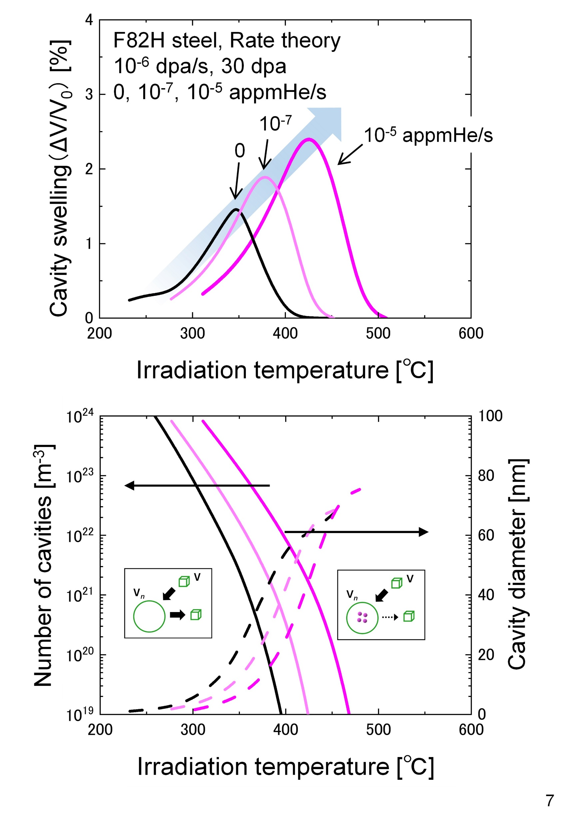
Irradiation temperature and He production rate dependence of void swelling
Peak temperature of void swelling shifts to higher temperatures with increasing He production rate.
This is due to the increase in the number density and decrease in the size of bubbles associated with the nucleation enhancement by helium.
Void swelling (ΔV/V₀) [%]
As He production rate increases,
the helium concentration in the matrix becomes high;
then, more helium inflow into bubbles, resulting in enhancement of the “cavity nucleation”.
Number density of voids [1/m³ ]
Mean diameter of voids [nm]

Slide 9
How strong is helium effect on void swelling?
The calculation indicates that
- at around 20 dpa, there is no significant difference for the peak temperature and peak swelling between
fission(HFIR/FFTF) and fusion DEMO: He effects is small.
- larger dpa, He effect becomes stronger and significant difference appeared.
- the peak temperature at 60 dpa in fusion DEMO is about 20 ℃ higher than that in the fission;
the peak swelling is 15 % larger.
Notes:
additive element：添加元素
nuclear transformation reaction：核変換反応
This can increase the He production.

Slide 10
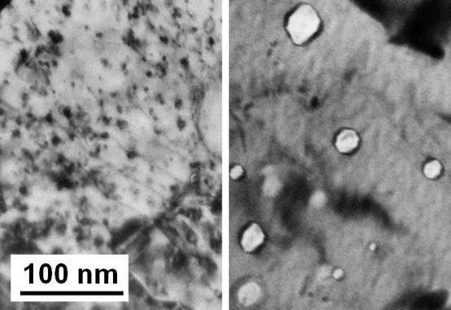
Role of fusion neutron source facilities in modeling and simulation studies of the material irradiation effects
In BA activity we are developing a mechanistic model of microstructural evolution for blanket structural RAFM steel based on theoretical understating.
Going forward, we plan to develop prediction models of irradiation effects such as volumetric swelling and yielding phenomena of the material.
In order to validate the prediction models, irradiation data obtained from fusion neutron source are required.
Modeling & simulations
Fusion neutron source
Research issue | Method / Analysis | Expected calculation data
Theoretical understanding of microstructure evolution | Reaction rate theory KMC calculation CRA | Microstructures: number density & size distribution of irradiation defects for voids(cavities), dislocation loops, black dots, etc. Identification of critical conditions of fusion neutron irradiation effects (Evaluation B)
Theoretical understanding of degradation of mechanical properties and dimensional stability with microstructure evolution | FEM CP-FEM MD | Elastic stress-strain distribution in material Volumetric swelling (ΔV/V₀), void/loop swelling Yield strength (Δσ_{y}), elongation

Slide 11
Summary
In order to predict material irradiation effects of fusion DEMO reactors with high accuracy, to develop a mechanistic model is necessary based on theoretically understating the material behaviors under different irradiation conditions.
In BA activity we are developing a mechanistic model of microstructural evolution of irradiated blanket structure RAFM steel with focusing on helium effects on void formation and swelling.
- The calculation shows a comparable trend of the experimental irradiation data.
- The calculation indicates that the maximum void swelling in the fusion DEMO reactor at 60 dpa is
about 15% higher than that in a fission reactor (HFIR/US).
- Going forward, we plan to develop prediction models of irradiation effects for larger scales.
We expect that the fusion neutron source would obtain the material irradiation data to validate those prediction models such as microstructural evolution, volumetric swelling, yield strength, etc.
Notes:
Finally, let me summarize my presentation
In this study, formation kinetics of He-bubbles in a RAFM steel were investigated by the reaction rate theory under a wide range of irradiation conditions.
We found that

