Slide 1
















Design and execution of experimental tests on the online Hydrogen Sensor in relevant conditions 2023 TM17 | 05/07/2024
Nils Holstein, KIT
IAM-AWP-KOR-FMT

Slide 2
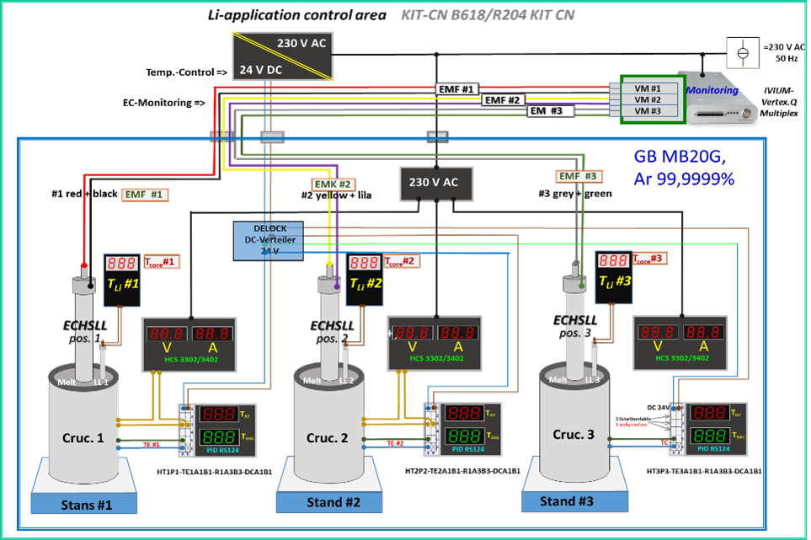
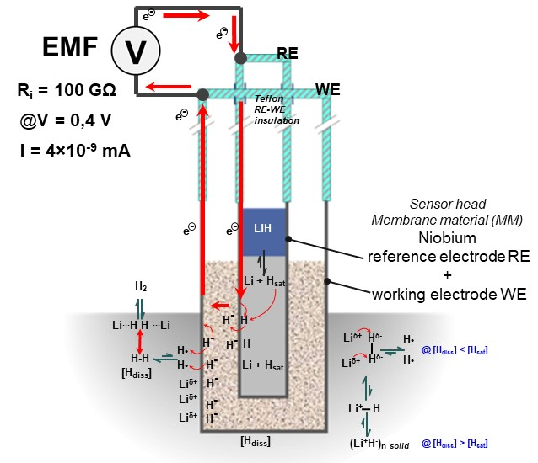
TM#17 2023, Subtask 5.4.5.1
Overview TM#17
1 Reduced sensor diameter
2 Rotating Lithium Electrode
3 H-Isotope measuring approach
4 LITEC considerations
▪ flow dynamics RE // Li-H
▪ H-D exchanges
▪ geometries
[Ref.: details see document EFDA_D_2PK42W]

Slide 3
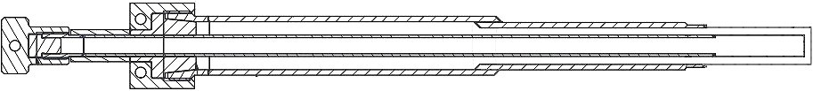
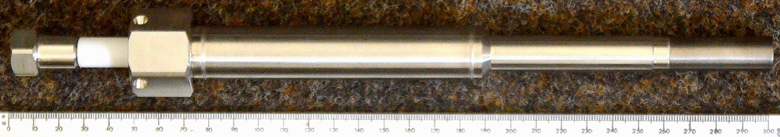
1.1 ECHSLL-Series 04 current reduced geometries
WE head size/diameter, Nb-membrane thickness;
Electrochemical hydrogen sensor for Liquid Lithium (ECHSLL),
Last edition Series 04, Nb-heads WE=14mm/RE=08mm
Steel 1.4571
Niobium 300 µm RE WE
4mm contacts, to voltmeter
WE-contact
all sizes in mm
RE-contact
o.d. = 20
o.d. = 15
o.d. = 14
10
15
21
24
117
72
40
299
259
N. Holstein | TM 17 | Jul. 24 2024 | Page 3

Slide 4
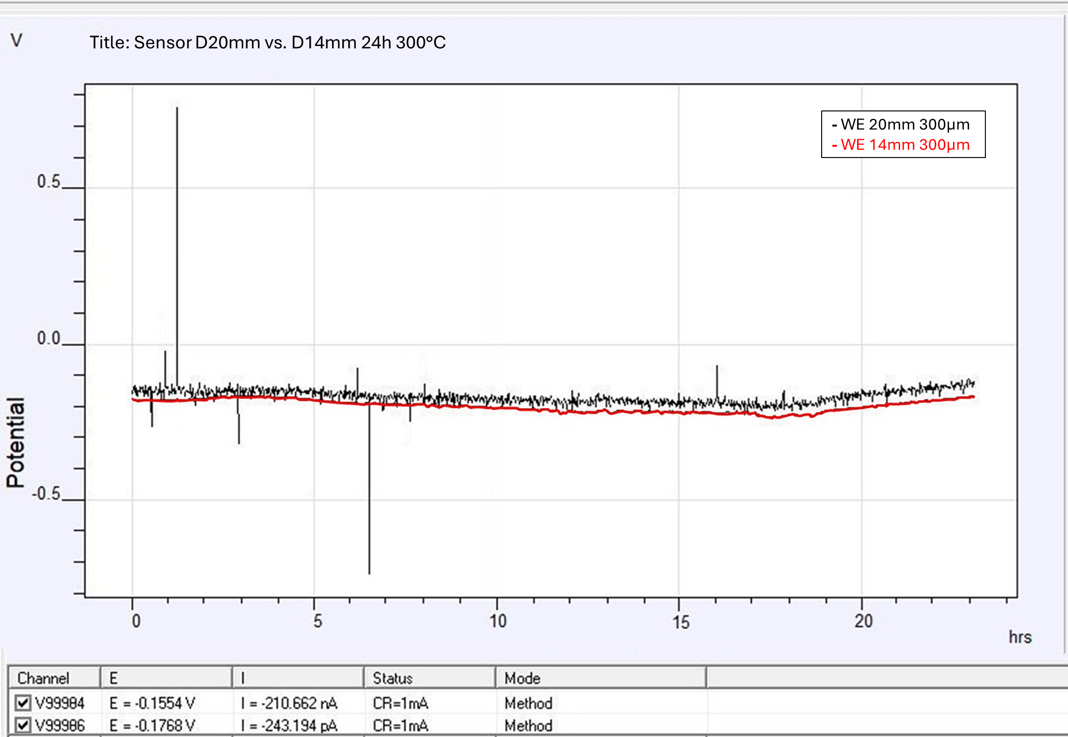
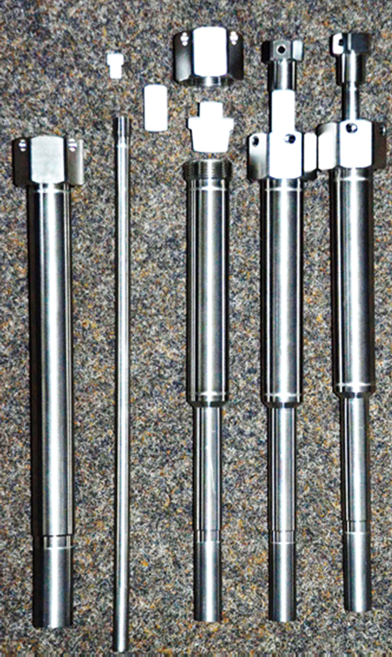
1.2 ECHSLL-Series 04
Comparison under relevant conditions
Measurement in Li-H melt
Standarzised sensor contact side for all ECHSLL series for RE and WE instrumentation
20 mm diameter Steel-section
14 mm diameter Steel-section
Nb-head 14mm diameter
Properties D20 vs D14:
amount HCE V = 8,36 cm³ ⬄ 3,88cm³
WE Nb-Li surface a (depth 25mm): 15,7 cm² ⬄ 11,0 cm² (a/V = 2,8⬄ 1,8)
eff. Current D14 << D20, less distorsions, less noise, higher a/V
Ser03+Ser RE=20 mm, Nb-head 300 µm
Ser03 WE=20 mm, Nb-head 300 µm

Slide 5
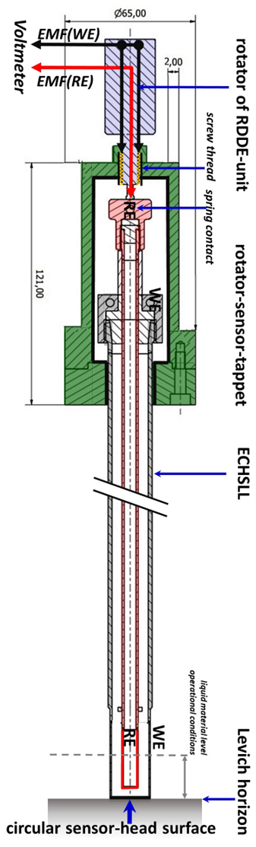
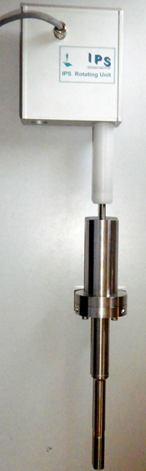
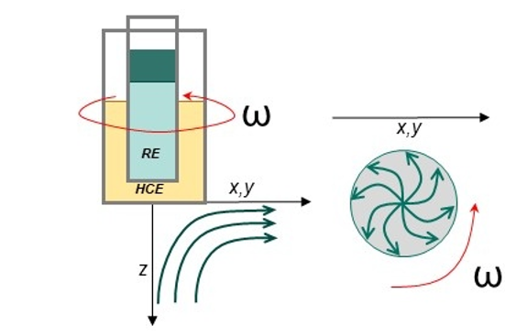
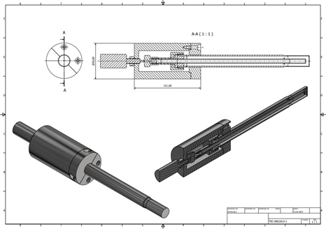
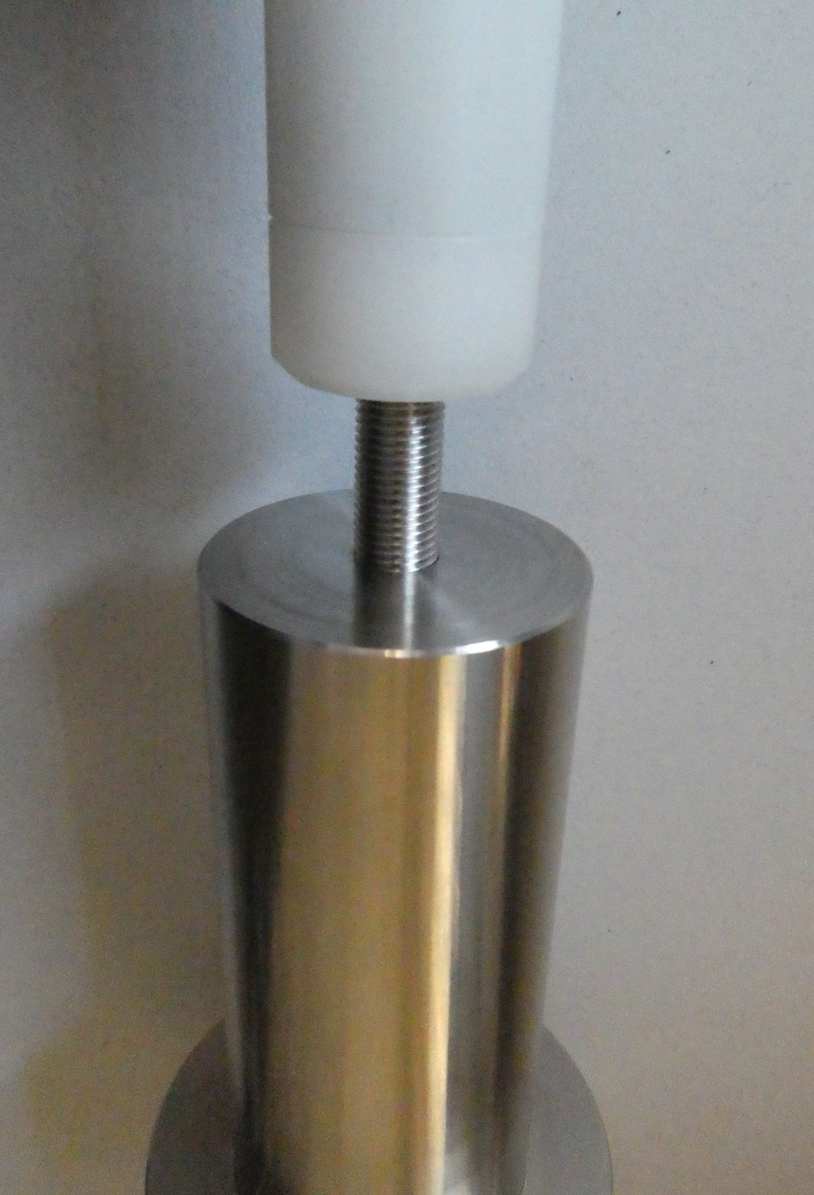
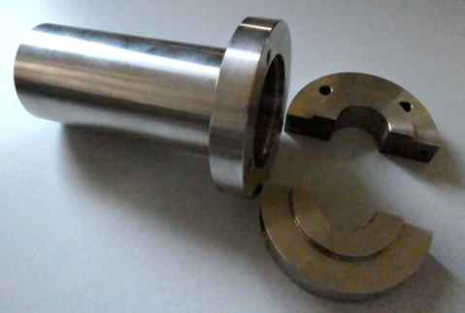
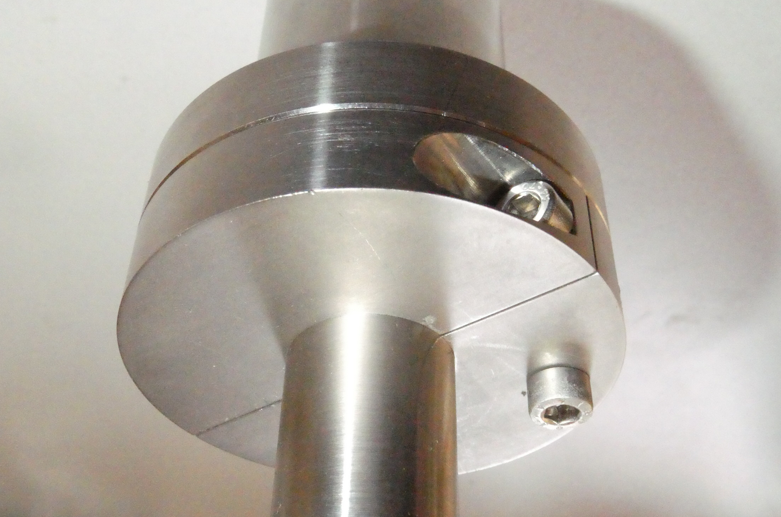
2.1 RLE
fluid dynamics
Idea: possibility to get measurable Li-flow dynamics in lab set-ups designed as stagnant systems, strengthen isotope effects..
hydrodynamics at a rotating electrode surface (side and lateral view)
RE and WE
Contacts,
=> B
lim. Current I_{L}
√ω
n = number of electrons transferred (H=1)
F = Faraday constant (C/mol),
a = electrode area (cm2),
D = diffusion constant (cm2/s),
ω = angular rotation rate (rad/s),
v = kinematic viscosity (cm2/s),
c = analyte concentration (mol/cm3).
Increase of current by rotaton speed:
Levich-equation: I_{L} = 0.62∙n∙D^{2/3}∙F∙a∙ν^{-1/6}∙ω^{1/2}∙c

Slide 6
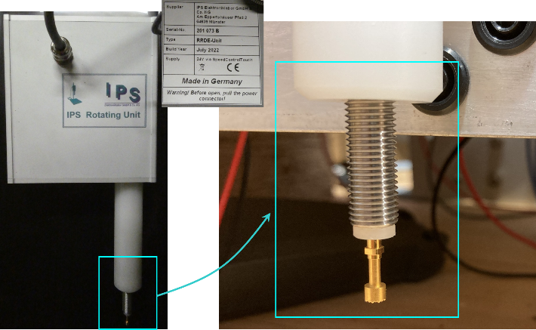
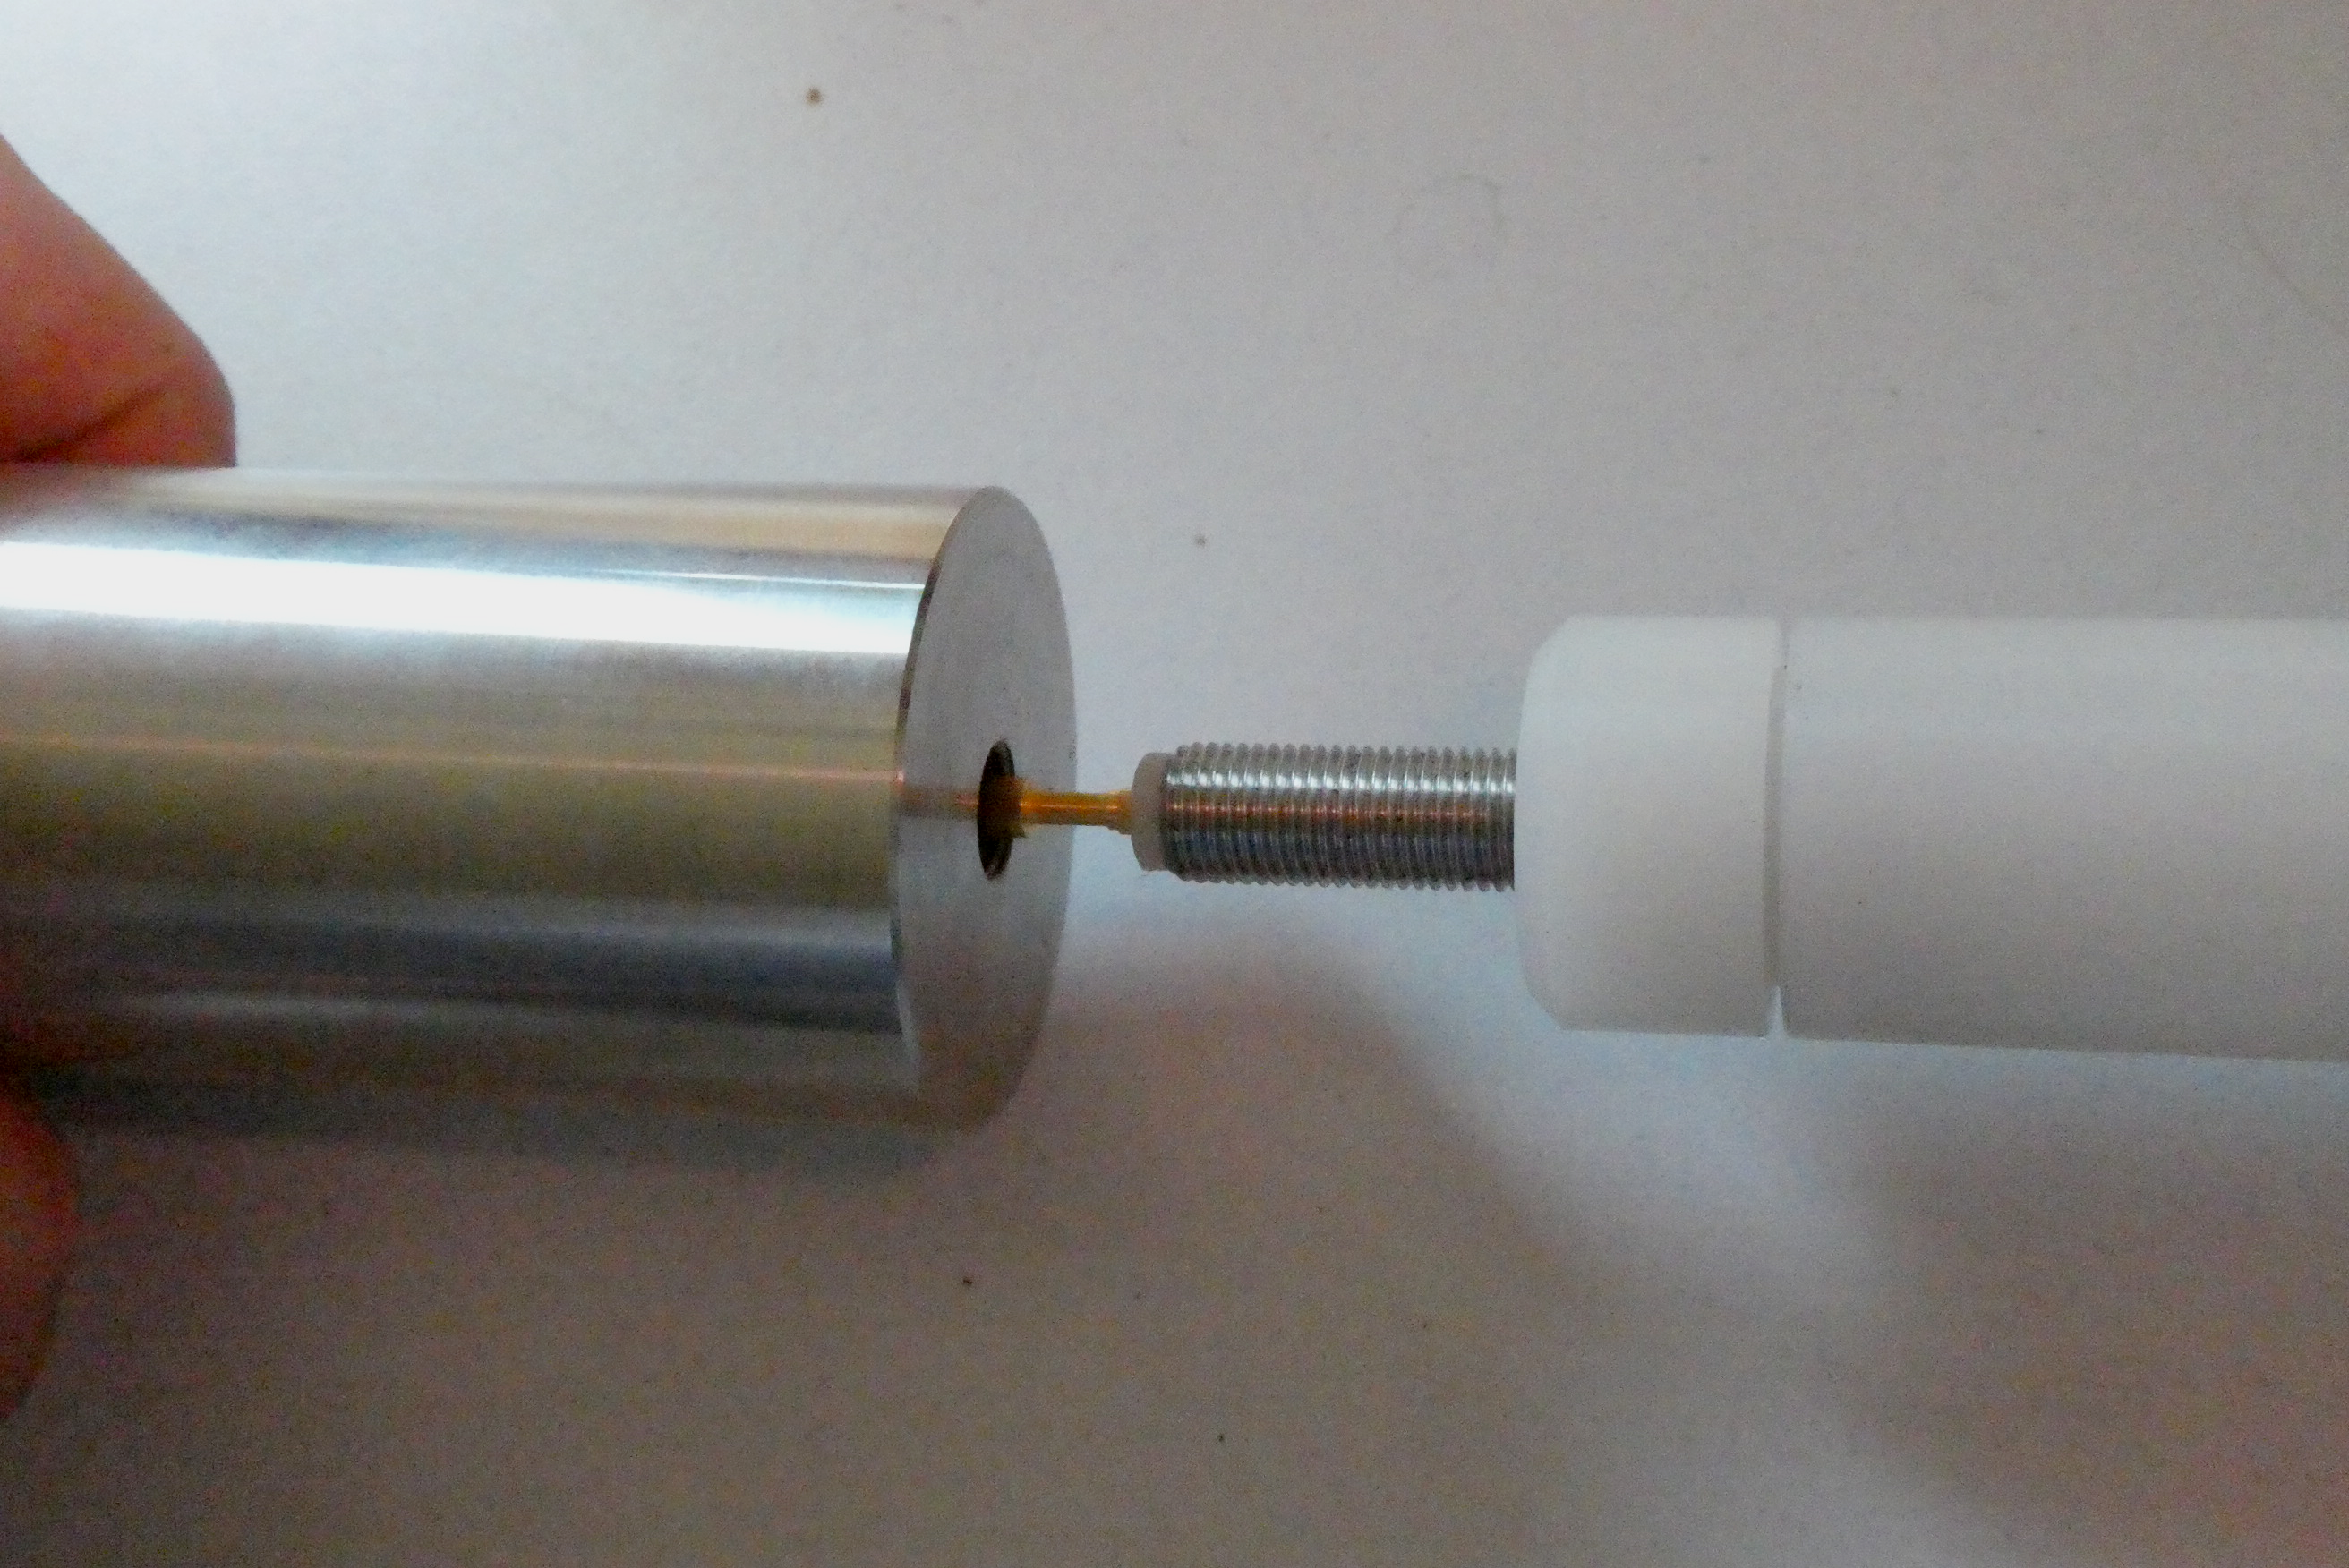
2.2 Rotating Lithium Electrode
Design and Assembling
B: RDE electrical potential transfer
Tappet device and WE contacts
RDDE-unit showing rotator drive, screw thread (WE) and RE brass feather contact (reinforced for KIT);
RE and WE insulated by Teflon tube
RDE assembling
Feather contact to ECHSLL-RE
Support shaft
(Fixed)
Central feather contact is connecting the enclosed inner RE-contact haed, whereas outer screw head ensures contact to WE.
Rotating drive

Slide 7
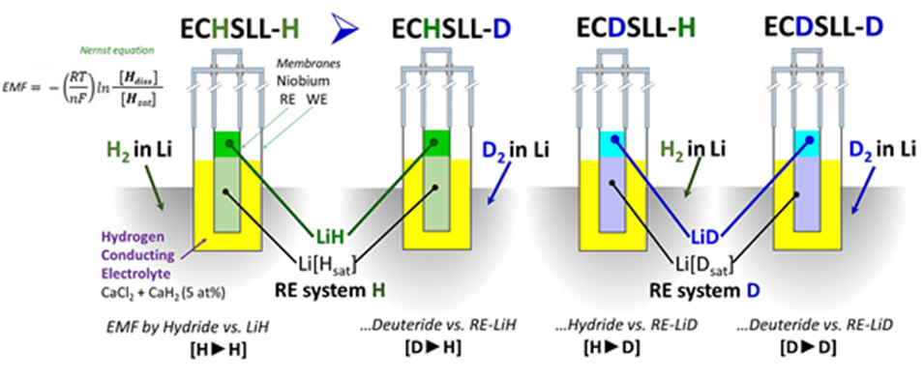
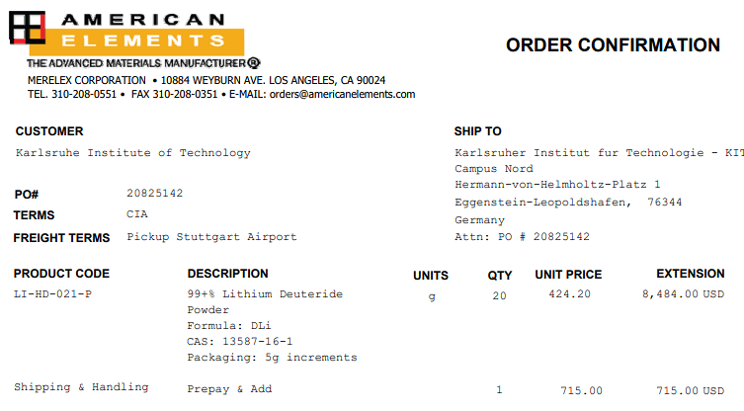
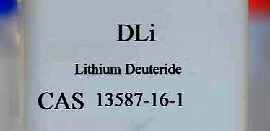
3.1 Approach of H-D-Monitoring
Lithiumdeuteride application
Comparing EMF measurements in Li-melts and RE systems
Approach of comparing EMF measurements in Li- melts and RE systems in the 4 possible variants with protium (H) and replacement by deuterium (D) via LiD in melt and RE-electrolyte.
Realization delayed by rare availability and cancelled delivery contracts, but supply now being realized from American Elements and to be tested asap.

Slide 8
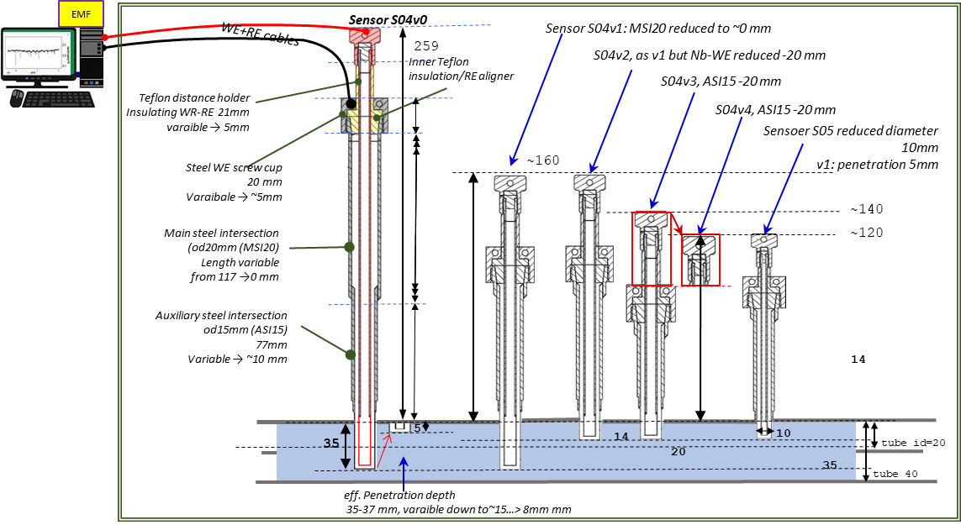
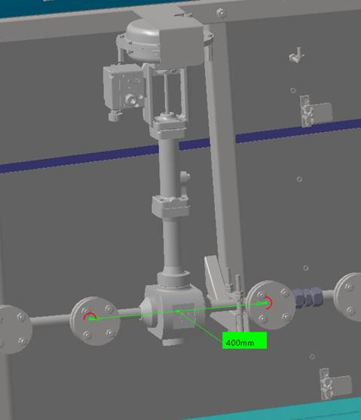
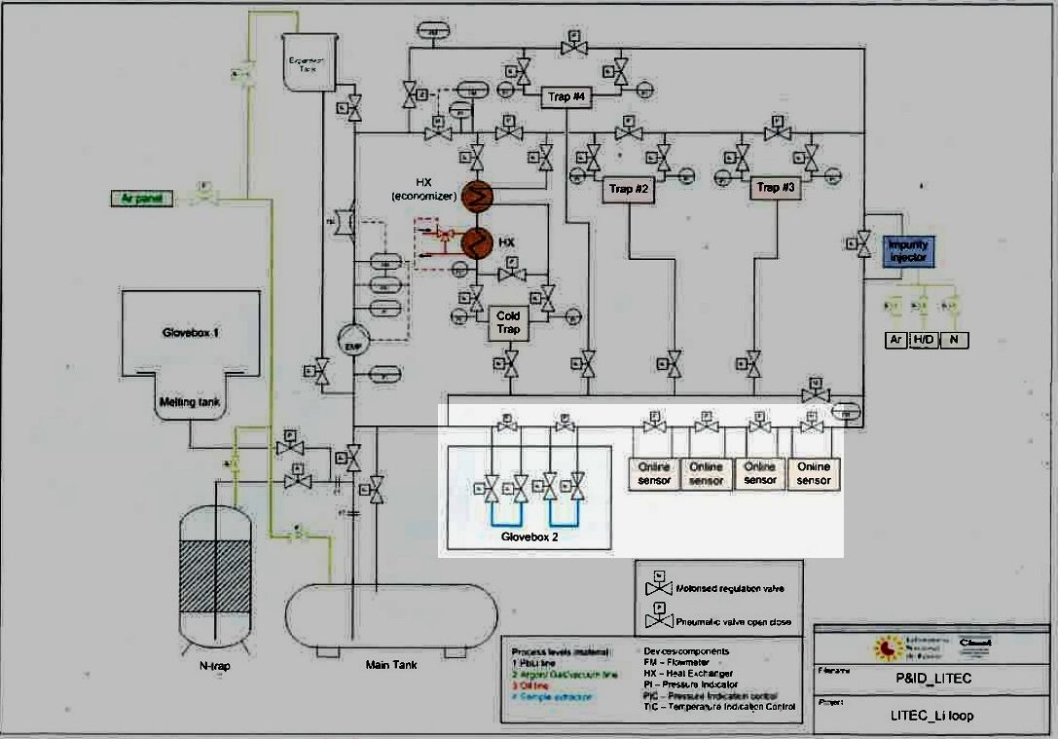
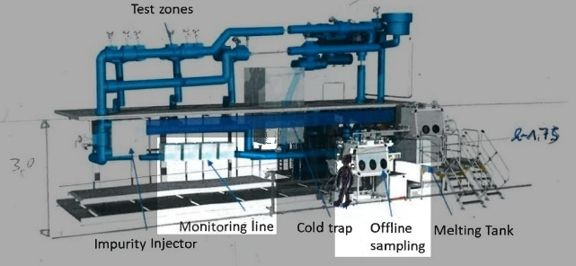
4.1 KIT Contribution LS-Subtask ENS-5.4.5.1-T021-04
Study of a prototype of the Electrochemical Hydrogen Sensor for LITEC
Since 2024, first considerations of possible principally adjustment/design variations of H-sensor for LITEC
(geometries lengths and diameters).
Space in LITEC for space available of 0.5m x 0.5m x 0.5m [B. Garcinuño], therefore so no significant or major design changes seem to be necessary.
3D design of LITEC with components with H-sensor relevance [from B. Garcinuño et al, FUSENGDES-D-23-00801]

Slide 9

TM#17 Summary and Outlook
Summary and results
Introduction and first initial tests with Series 04 sensors (D=14mm MM= 0,3mm)
Realization and assembling of Rotating Lithium Electrode RLE
Opening ENS-5.4.5.1-T021-04: First considerations and ideas of integration in LITEC
Next steps (short-termed and mid-termed)
Test series with Series 04 sensors as new standard sensor
Isotope effects: application of LiD of H-isotops (initially Li-D melt vs LiH-RE resp. Li-H melt vs LiD-RE),
- stagnant solutions and combined with RLE
Further integration and transfer in LITEC

Slide 10

Thank You for Your attention !

