Slide 1
Design of LITEC experimental equipment 2023
J. Mollá, M. Sánchez-Arenillas, S. Hendricks, B. Garcinuño, J. Patiño.
(Fusion National Laboratory, CIEMAT)

Slide 2
Introduction
LITEC
Li Loop not including any experimental device (neither traps nor monitors)
1:1 scale of the IFMIF/DONES ICS
Execution of experiments for testing and validation of impurity monitors and impurity traps to be used in the Impurities Control System of DONES.
Getter material for the N trap
Cold Trap (O)
H-Trap
Resistivimeter (N)
Plugging meter (O)
Electrochemical meter (H)
LITEC equipment to be installed and commissioning later

Slide 3
Introduction / LITEC equipment inst.,comm.& experiments
LITEC Commissioning
(end of construction contract)
Check out of basic systems (heating and temp. Control, pump and flowmeter, safety sys., sample extraction …
LITEC Equipment Des. & Manuf.
Sampler test and
commissioning of chemical analysis lab.
Extraction of samples and chemical analysis to check that we are able to do it
Resistivimeter commissioning
Check that we are able to measure something representative of the impurity content
Plugging meter commissioning
Comparison with chemical anal.
LITEC Equipment commissioning
Electrochemical H monitor commissioning
CT commissioning
Reduction of the O content down to acceptable level for N getters
NT getter commissioning
Reduction of the N content down to acceptable level (corrosion)
Impurities injection systems
commissioning and experiments
Checkup that we are able to introduce different kind of impurities and measure to which extent we can control the process
NT getter and resistivimeter experiments
Experimental program related to the NT (if required)
CT and plugging meter experiments
Experimental program related to the CT and the plugging meter
LITEC Exp. Programme
HT and electrochemical H monitor experiments
Experimental program related to the HT and the electrochemical H-monitor
Permeation-based H-monitor
Testing feasibility of this kind of monitor

Slide 4
Introduction
Activities 2022:
  Design of Experimental Programme to be executed in LITEC for validation of impurity Control in the Li loop (completed)
Activities 2023:
  Manufacturing of the H-trap for LITEC (on-going, almost completed)
  Basic technical requirements and specifications for the LITEC Cold-trap prototype (completed)
  Conceptual design for LITEC plugging meter (completed)
Activities 2024:
  Manufacturing of the Cold-trap for LITEC (on-going, starting)

Slide 5
Experimental Programme to be executed in LITEC
Cold Trap and plugging monitor experiments
Hydrogen Trap and electrochemical H sensor experiments

Slide 6
Experimental Programme to be executed in LITEC
Cold Trap and plugging monitor experiments
  Plugging monitor state of the art
  Cold trap state of the art
  Assumptions
  Cold Trap equations
  Experiments to be performed for testing the cold trap and the plugging monitor
  Expected outcomes from experiments to be performed for testing the cold trap and the plugging monitor
Hydrogen Trap and electrochemical H sensor experiments
  …

Slide 7
Experimental Programme to be executed in LITEC
Cold Trap and plugging monitor experiments
  …
Hydrogen Trap and electrochemical H sensor experiments
  Electrochemical H sensor: state of the art
  H-trap state of the art
  Assumptions
  H-trap equations
  Typical experiment proposed for testing the H-trap and the monitoring system
  Experimental parameters (temperature, flow rate, Y amount and shape, …) to be studied
  Thermal desorption experiments (for potential recovery of Y getter material)
  Expected outcomes following the experimental campaign of the H-trap and the electrochemical H-sensor

Slide 8
Introduction
Activities 2022:
  Design of Experimental Programme to be executed in LITEC for validation of impurity Control in the Li loop (completed)
Activities 2023:
  Manufacturing of the H-trap for LITEC (on-going, almost completed)
  Basic technical requirements and specifications for the LITEC Cold-trap prototype (completed)
  Conceptual design for LITEC plugging meter (completed)
Activities 2024:
  Manufacturing of the Cold-trap for LITEC (on-going, starting)

Slide 9
Manufacturing of the H-trap for LITEC
Design performed by IDOM
Starting point: Technical requirements defined by Ciemat
ED by IDOM was the staring point for the manufacturing at Ciemat

Slide 10
Manufacturing of the H-trap for LITEC
Work done and Present status:
3D model adapted to the Ciemat workshop manufacturing possibilities
Production of manufacturing drawings
Procurement of materials: On going; almost completed waiting for some piping
Manufacturing of components: On going; almost completed waiting for some piping
Welding and assembly: On going; almost completed waiting for some piping
✓
✓
Missing pipes

Slide 11
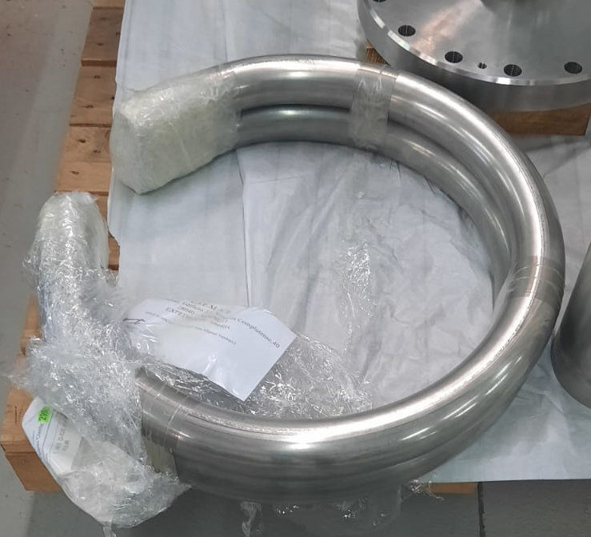
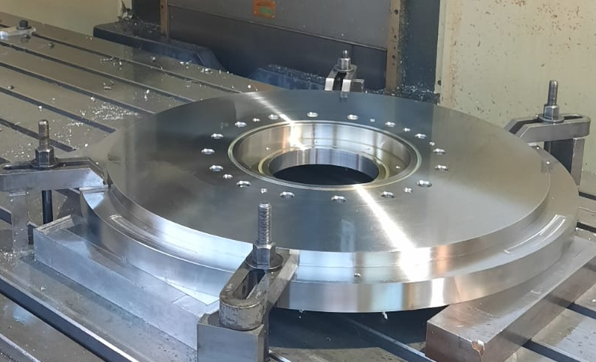
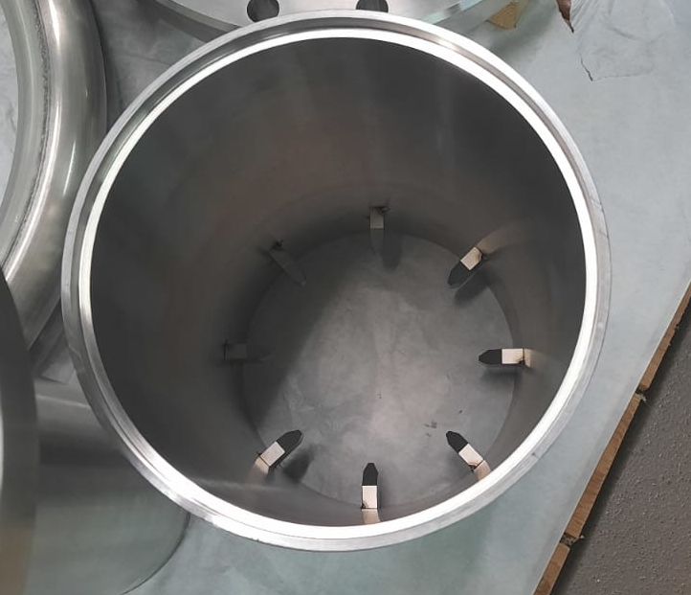
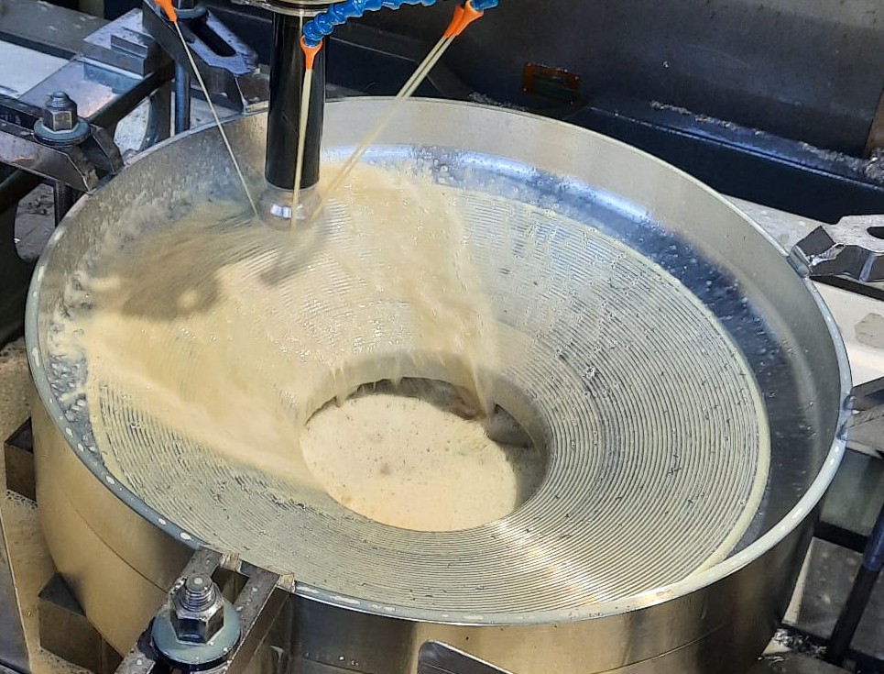
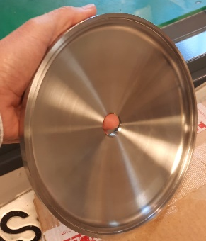
Manufacturing of the H-trap for LITEC
Outlet pipe
Vessel cover
Cylindrical body
Vessel bottom
Conical transition

Slide 12
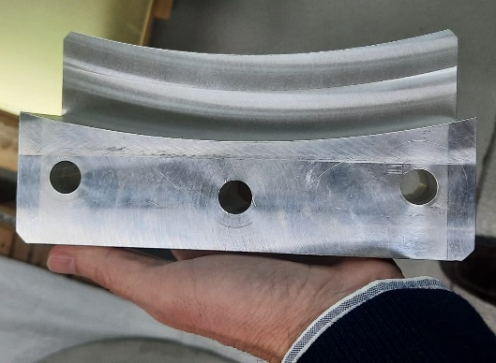
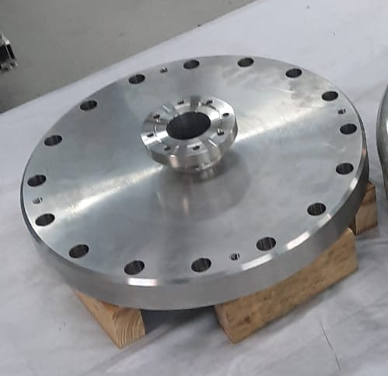
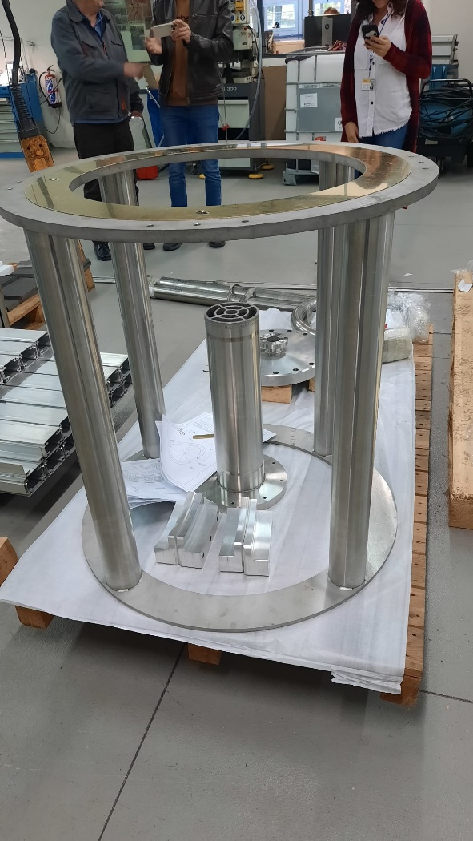
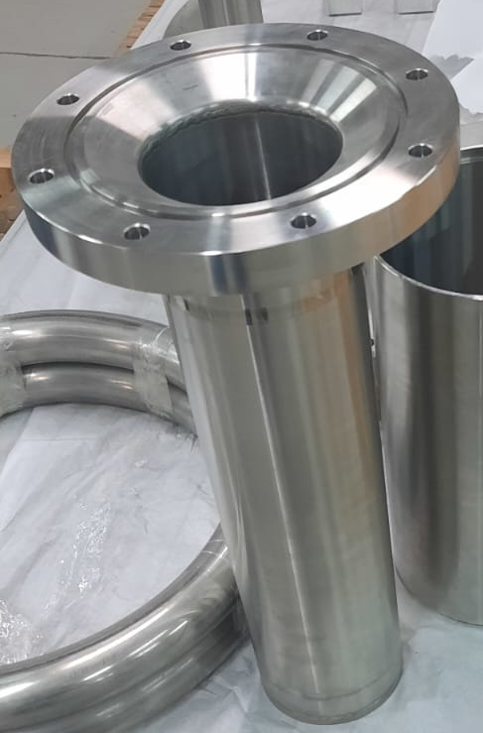
Manufacturing of the H-trap for LITEC
Fixing elements
Upper flange
Supporting structure
Inner getter container

Slide 13
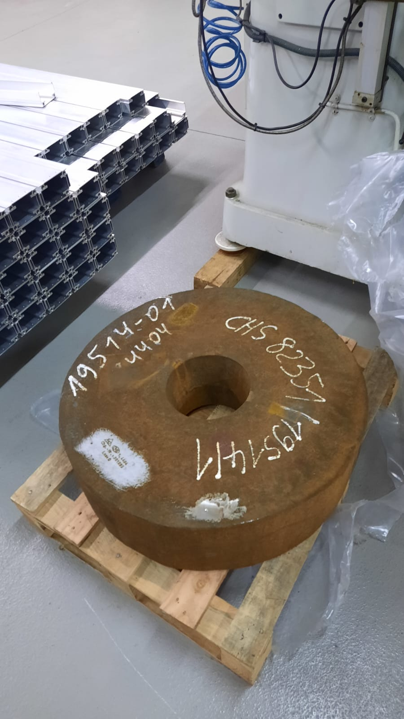
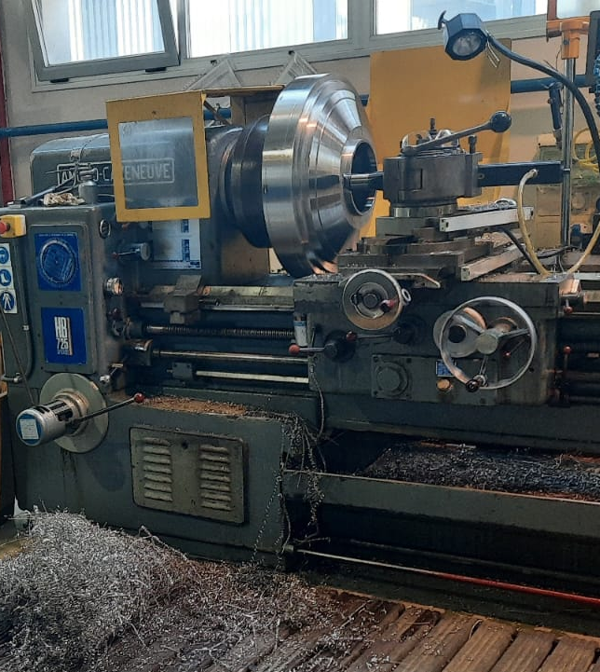
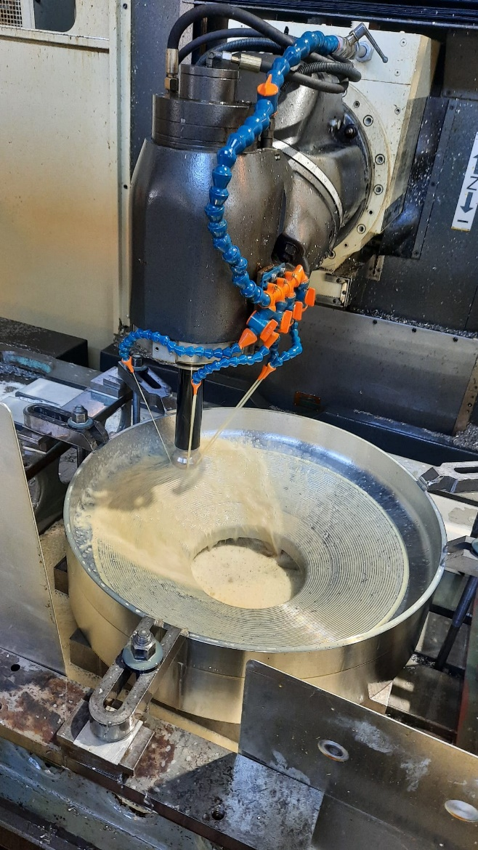
Manufacturing of the H-trap for LITEC
Manufacturing conical transition

Slide 14
Introduction
Activities 2022:
  Design of Experimental Programme to be executed in LITEC for validation of impurity Control in the Li loop (completed)
Activities 2023:
  Manufacturing of the H-trap for LITEC (on-going, almost completed)
  Basic technical requirements and specifications for the LITEC Cold-trap prototype (completed)
  Conceptual design for LITEC plugging meter (completed)
Activities 2024:
  Manufacturing of the Cold-trap for LITEC (on-going, starting)

Slide 15
Basic technical requirements and specifications for the LITEC Cold-trap prototype
Summary
  Li volume: 100 l
  Crystallization surface: 55 m²
  Maximum size: 2.5 m height, 1.5 m in horizontal directions
  Operation temperature: 190ºC - 350ºC
  Maximum temperature at external insulating layer: 50ºC
  Maximum pressure: 6 bar
  Pressure drop: 0.6 bar
  Maximum weight: 600 kg
  Flow rate. 0,4 l/s – 2 l/s
Available in IDM: https://idm.euro-fusion.org/?uid=2QPCKJ

Slide 16
Introduction
Activities 2022:
  Design of Experimental Programme to be executed in LITEC for validation of impurity Control in the Li loop (completed)
Activities 2023:
  Manufacturing of the H-trap for LITEC (on-going, almost completed)
  Basic technical requirements and specifications for the LITEC Cold-trap prototype (completed)
  Conceptual design for LITEC plugging meter (completed)
Activities 2024:
  Manufacturing of the Cold-trap for LITEC (on-going, starting)

Slide 17
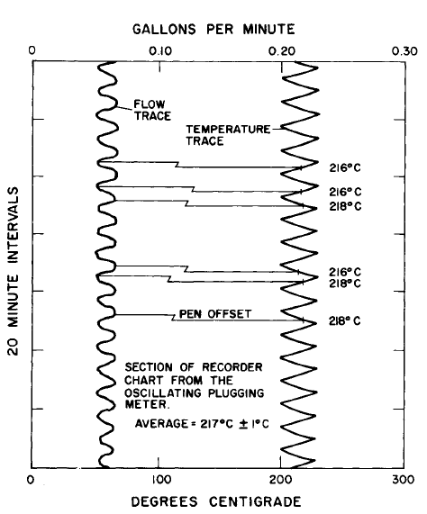
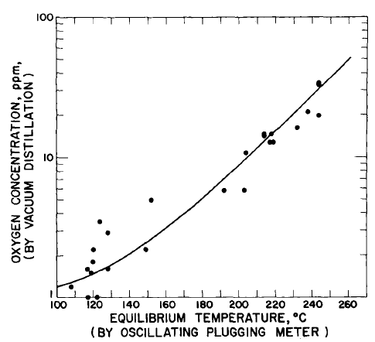
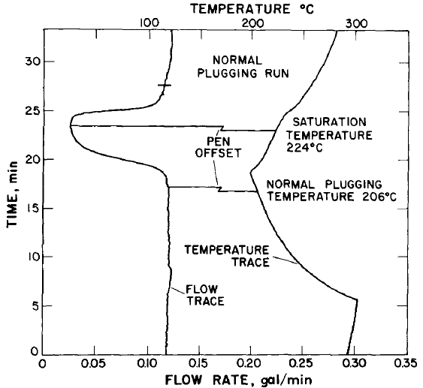
Conceptual design for LITEC plugging meter
Measurement of flow rate decrease due to precipitates in a thin channel determines the precipitation temperature → Determination of O content
Chem. Analysis
Plugging monitor
Temperature decrease produce a drop of flow rate
O content is derived accurately from the temperature dependence of solubility
Saturation temperature → dQ/dt=0 (max. and min)

Slide 18
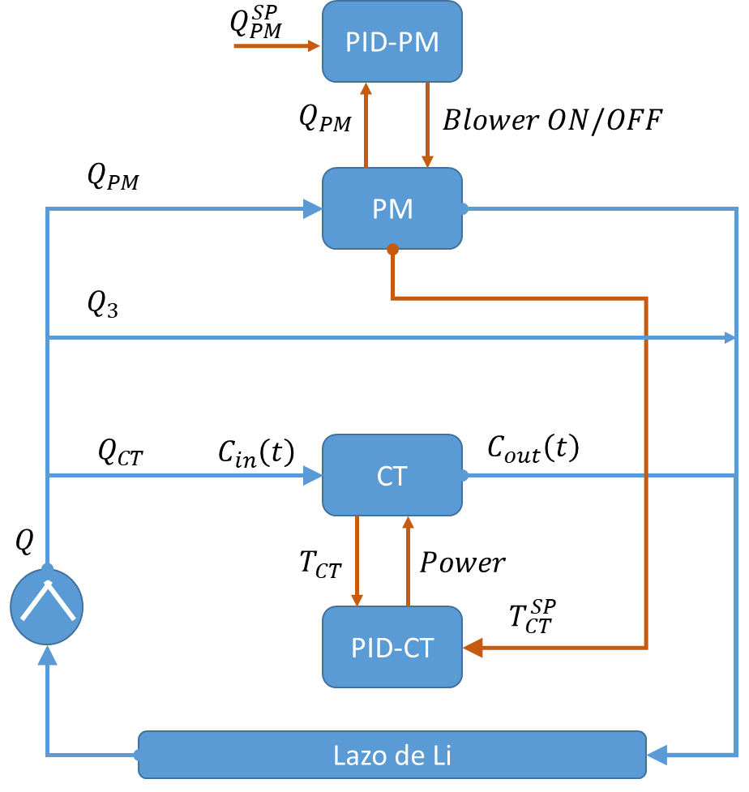
Conceptual design for LITEC plugging meter
Bibliography revision → State of the art
  Several procedures and geometries tested since the 60’s in Na loops
Proposed procedure:
  Oscillating plugging meter: the control system adjust the temperature to keep the flow rate close to a predefined set value
  The temperature of the plugging meter is used also to set the cold trap temperature

Slide 19
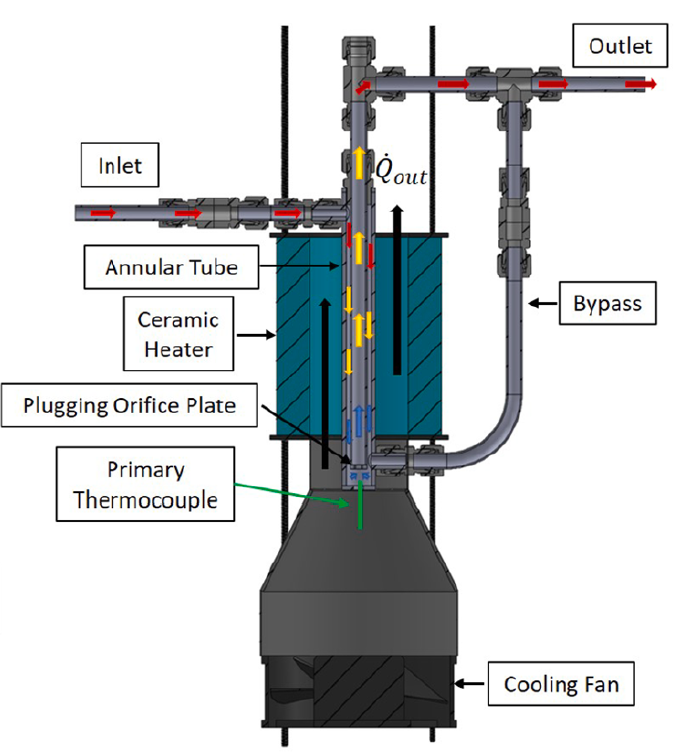
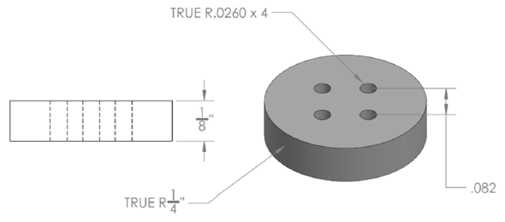
Conceptual design for LITEC plugging meter
Proposed conceptual design based on the latest reference found (Mangus, 2021)
Document available in the : https://idm.euro-fusion.org/?uid=2RJ7S9
Plugging orifice plate (several geometries may be tested)

Slide 20
Introduction
Activities 2022:
  Design of Experimental Programme to be executed in LITEC for validation of impurity Control in the Li loop (completed)
Activities 2023:
  Manufacturing of the H-trap for LITEC (on-going, almost completed)
  Basic technical requirements and specifications for the LITEC Cold-trap prototype (completed)
  Conceptual design for LITEC plugging meter (completed)
Activities 2024:
  Manufacturing of the Cold-trap for LITEC (on-going, starting)

Slide 21
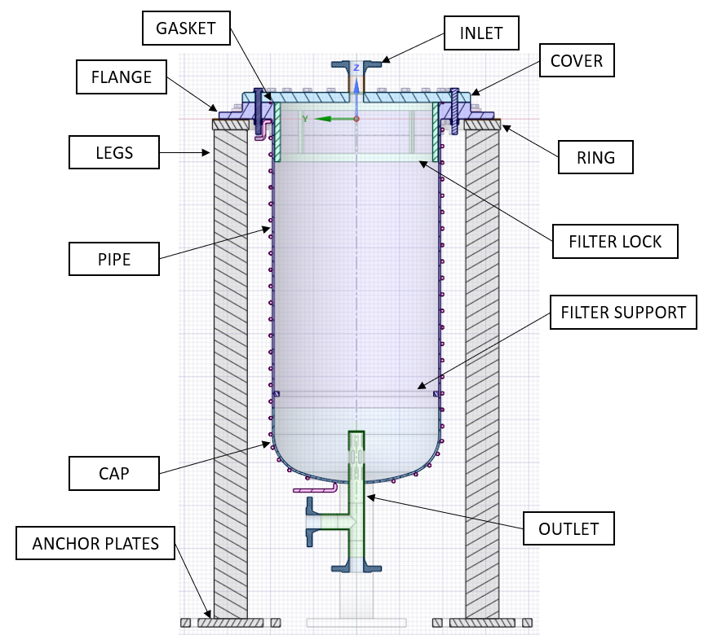

Manufacturing of the Cold Trap
Upper counter flange
Flange: non-standard flange
Metallic mesh, 125 discs
Cylindrical body: DN500 pipe
With the exception of the flange and counter-flange, the main components may be purchased in standard industry
Vessel bottom cap: cap for DN500 pipe
Mechanical support

Slide 22
Conclusions
Activities 2022:
  Design of Experimental Programme to be executed in LITEC for validation of impurity Control in the Li loop (completed)
Activities 2023:
  Manufacturing of the H-trap for LITEC (on-going, almost completed)
  Basic technical requirements and specifications for the LITEC Cold-trap prototype (completed)
  Conceptual design for LITEC plugging meter (completed)
Activities 2024:
  Manufacturing of the Cold-trap for LITEC (on-going, starting)

