Slide 1
Lithium purification experiments at laboratory scale
S.J. Hendricks, J. Molla, D. Jiménez, J. Navas, J. Patiño, M. Sanchez-Arenillas

Slide 2
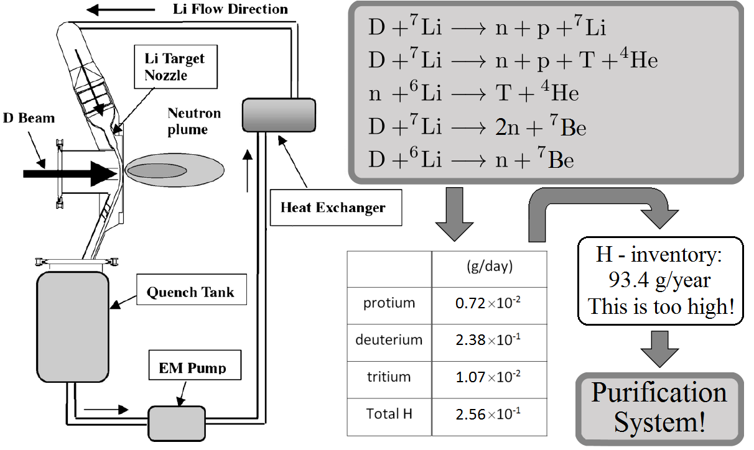
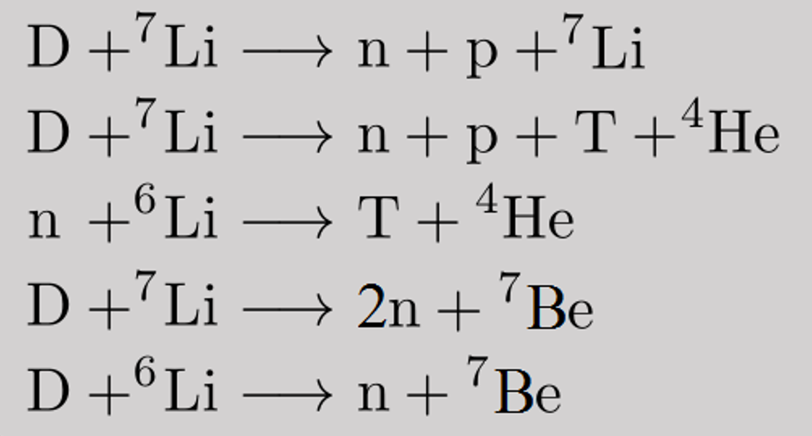

The problem of hydrogen isotope accumulation in DONES
Sketch of DONES main Li loop:
Collision of D⁺ beam with the liquid Li target causes:
D⁺ ray
International Atomic Energy Agency, 2023
$V_{\text{Li}}≈14{\text{m}}^{3}$
 | H-isotopes in Li [g/yr]
T | 3.9
D | 86.87
H | 2.63
Accumulation of H isotopes leads to an increase in corrosion in the pipe system!
Radioactive nature of generated tritium is a severe safety issue!
!
Nakamura, 2002

Slide 3
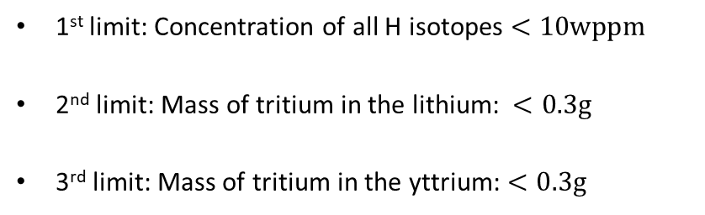

Need for hydrogen isotope purification in DONES
Sketch of DONES main Li loop:
Requirement for DONES:
1st limit: Concentration of all H isotopes $<10\text{wppm}$
2nd limit: Mass of tritium in the lithium: $<0.3\text{g}$
3rd limit: Mass of tritium in the yttrium: $<0.3\text{g}$
D⁺ ray
Without purification: Tritium limit exceeded after 28 days!
Hydrogen isotopes should be absorbed by a getter trap that contains a hydrogen absorbing metal like yttrium, uranium or ZrCo.
Yttrium metal forms the most stable metal-hydrides (YH₂) and can take up to three hydrogen isotopes per yttrium atom.
Yttrium is chemically compatible with corrosive liquid lithium.
The solubility of hydrogen in yttrium is several orders of magnitude higher than the solubility of hydrogen in lithium.
$V_{\text{Li}}≈14{\text{m}}^{3}$
Nakamura, 2002
Flow of H into Y getter until chemical equilibrium!

Slide 4
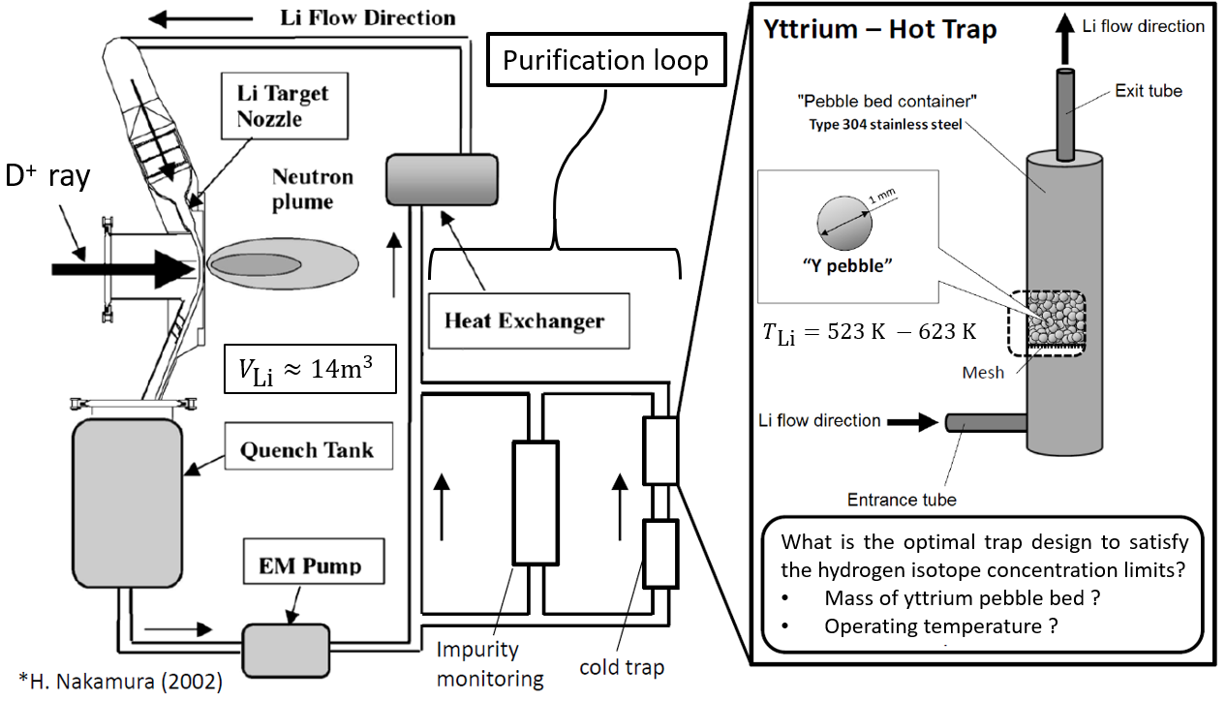
Motivation and objective of work
Nakamura, 2002
Objective: Experimentally studying hydrogen isotope capture by an yttrium pebble bed to help defining the design parameters for an hydrogen trap which shall be capable of keeping the tritium content in the DONES lithium system below imposed concentration limits!

Slide 5
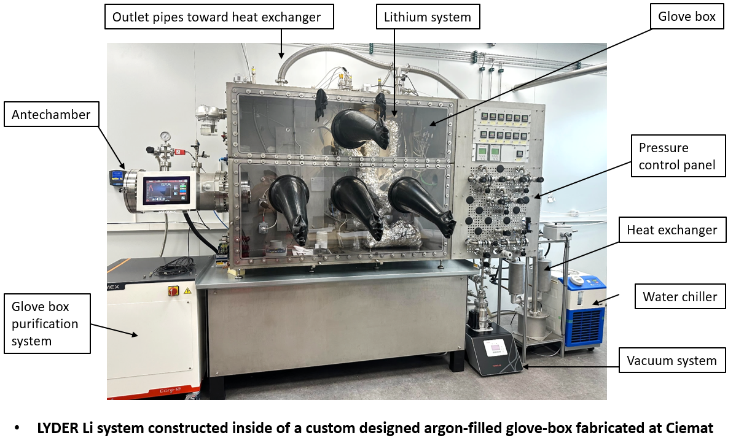
LYDER: Lithium experiment for Yttrium-based DEeuterium Retention
A new liquid lithium experiment is designed and constructed to perform D retention experiments.

Slide 6
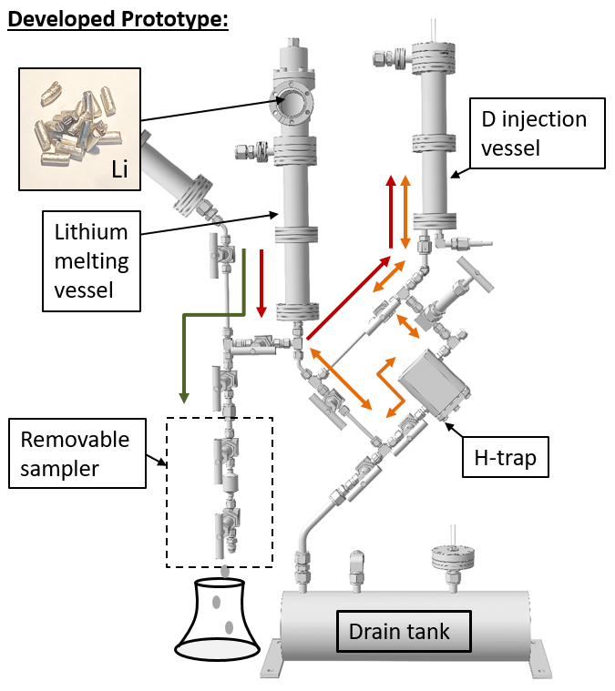
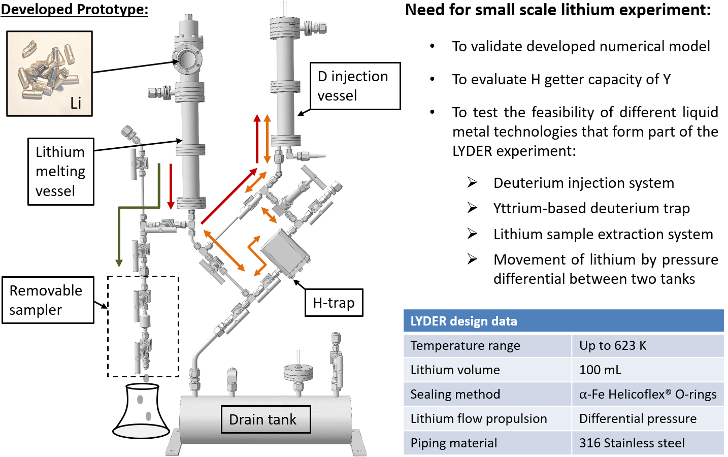
LYDER: Lithium experiment for Yttrium-based DEeuterium Retention

Slide 7
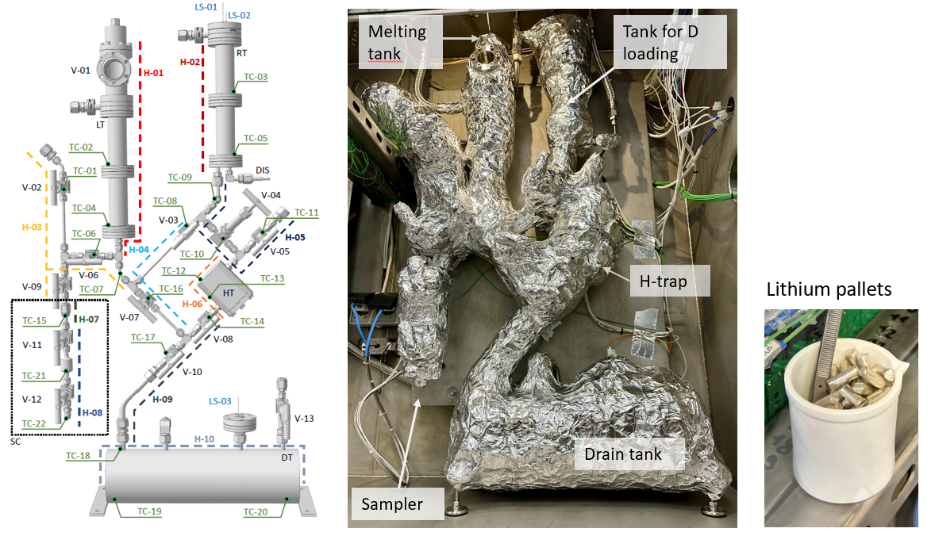
Design of the LYDER heating system
D₂ injection system
The lithium system is heated by 13 resistant heating cables and 28 thermocouples.
Commissioning: Heating system tested to 350 C, Glove box cooling and purification system tested!

Slide 8
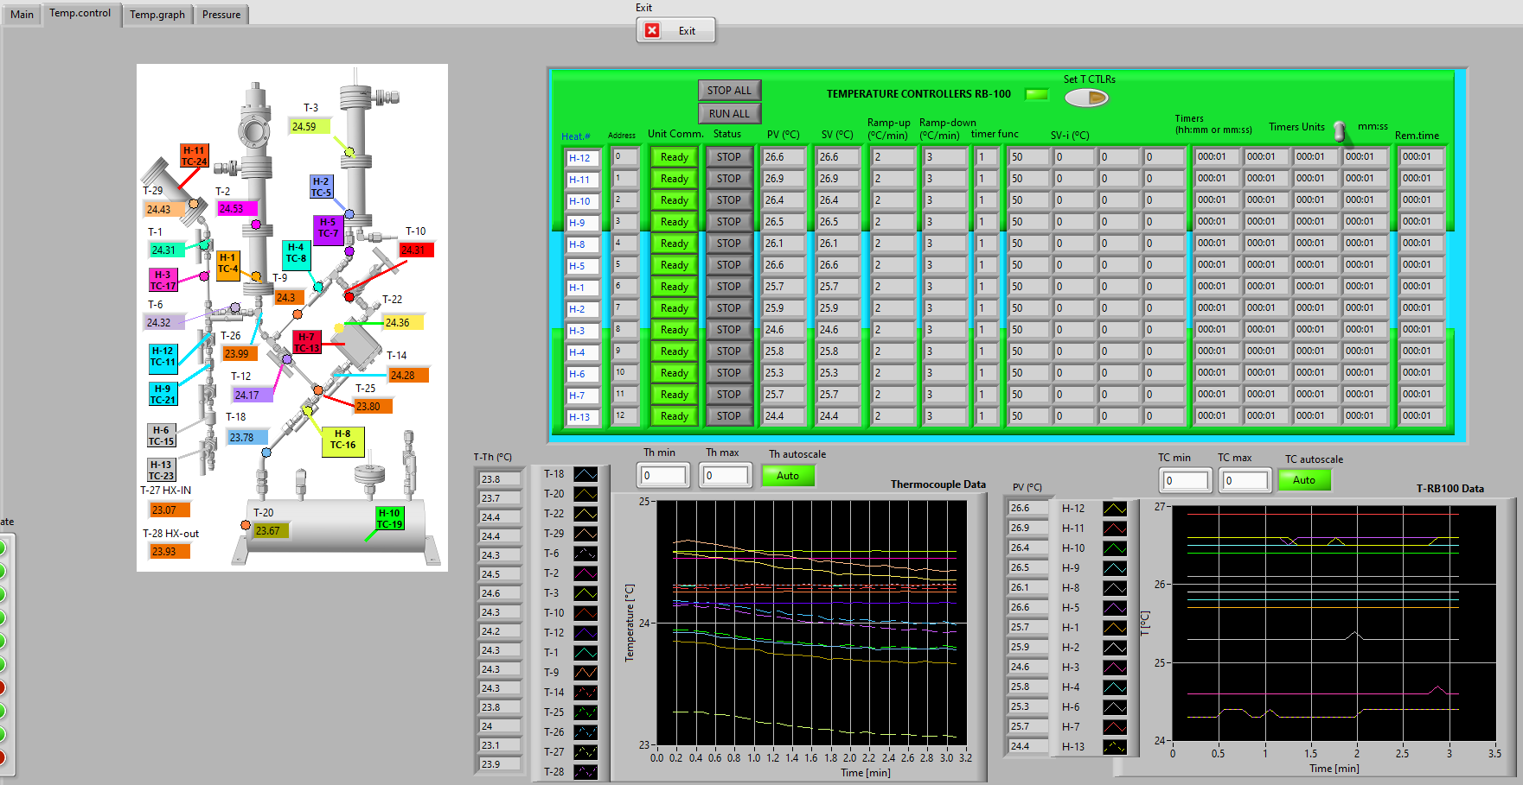
LYDER LabVIEW control program
A LabVIEW program is created to control and monitor the heating and vacuum system of the LYDER experiment.

Slide 9
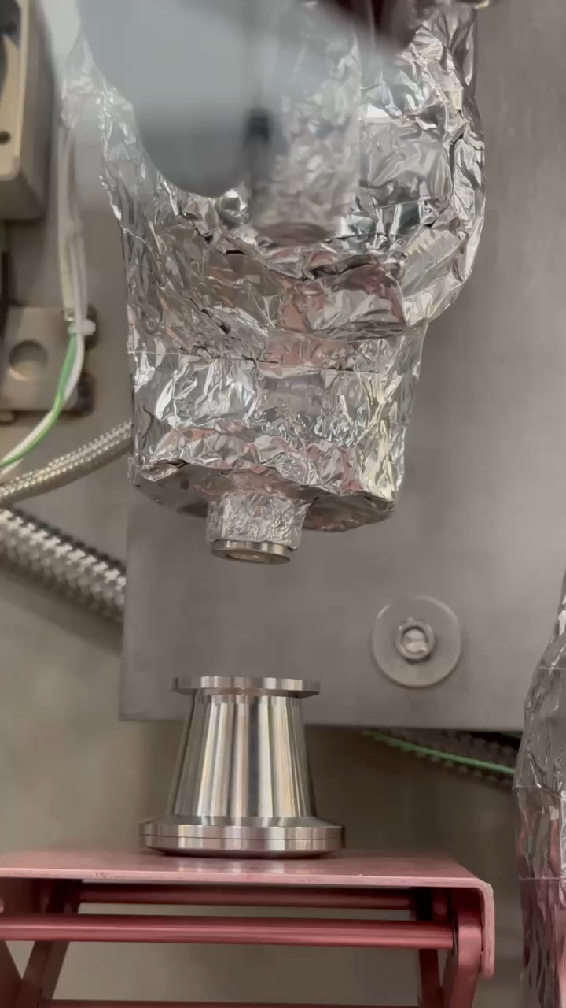
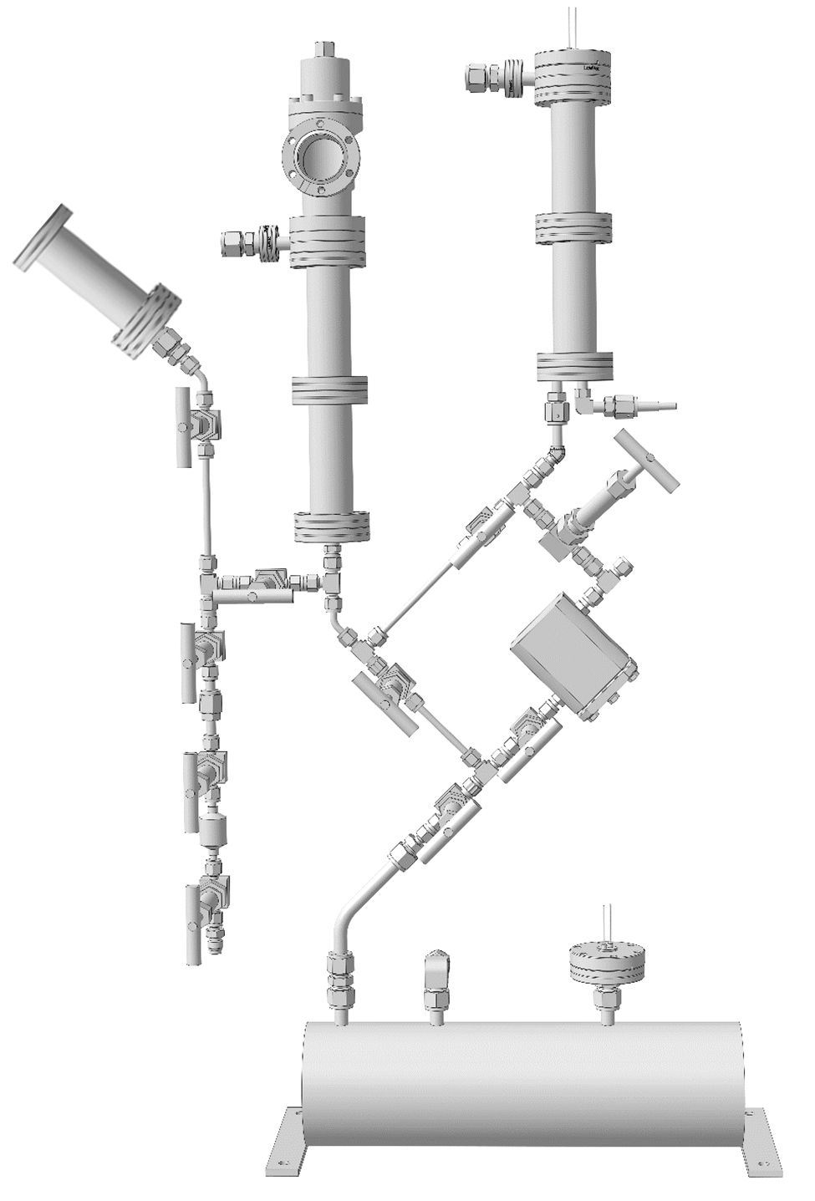
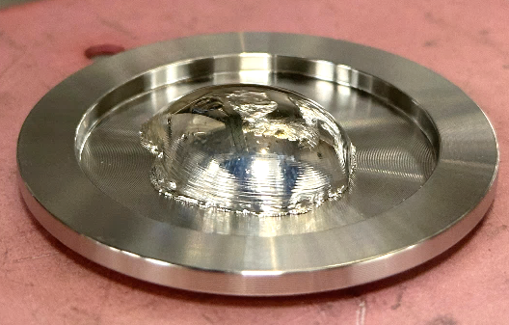

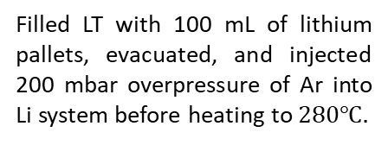
First experiment: Test Li motion & Li extraction without D
Lithium insertion and melting:
Test of lithium movement:
Test of sample extraction system:
bypass
level meters
Filled LT with 100 mL of lithium pallets, evacuated, and injected 200 mbar overpressure of Ar into Li system before heating to $280℃.$
RT
LT
Increased pressure in LT by 50 mbar and opened bypass valve to pump Li into RT.
By continuously injecting gas into LT the 50 mbar was maintained while Li surface rose in RT.
After 1 min level sensor circuits closed and pressure increase in LT showed disruptions signaling that all Li has arrived in RT.
Then, Li was pumped back to LT through the deuterium trap.
$$2ml$$
drain valve
2mL of Li was extracted in sampler and dropped on a steel plate in the glove box

Slide 10
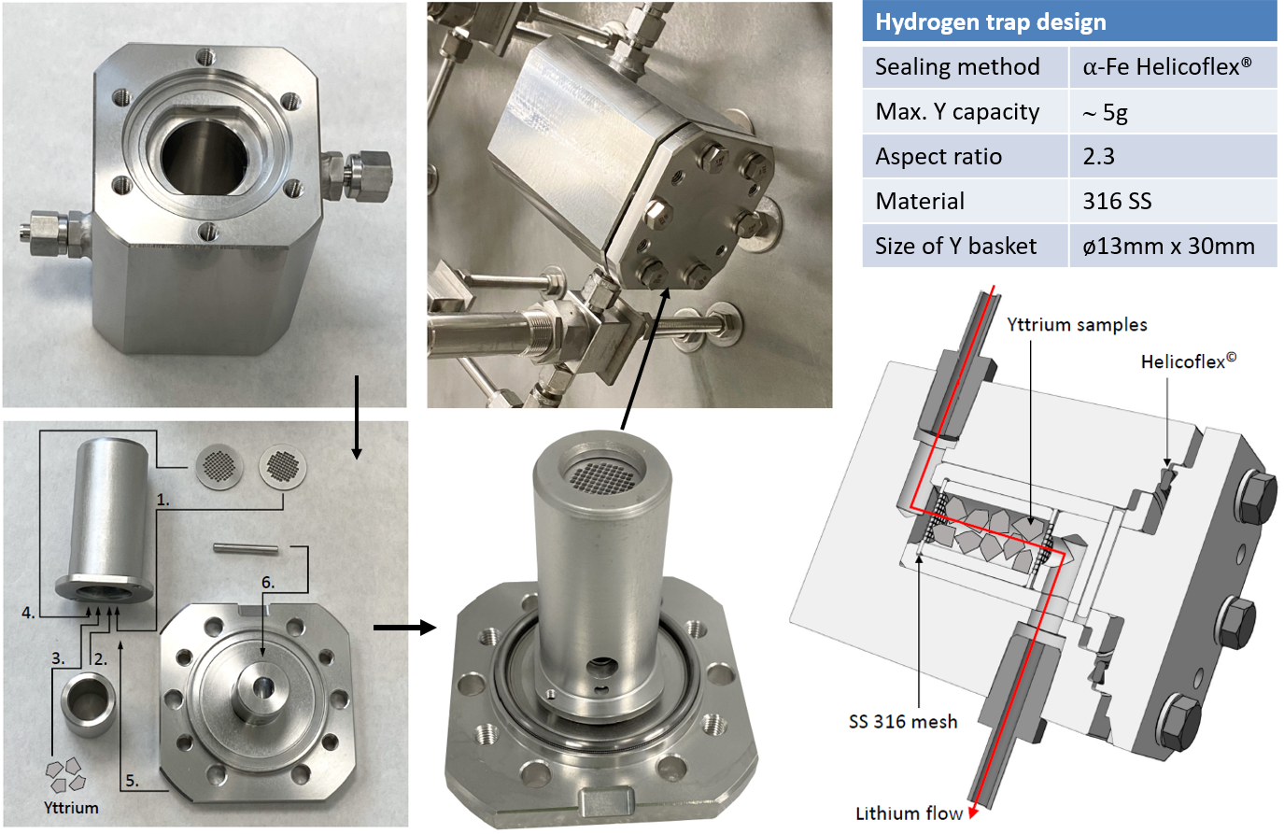
The LYDER deuterium trap based on an yttrium bed
An yttrium-based D-trap is designed, manufactured and installed into the LYDER system.

Slide 11
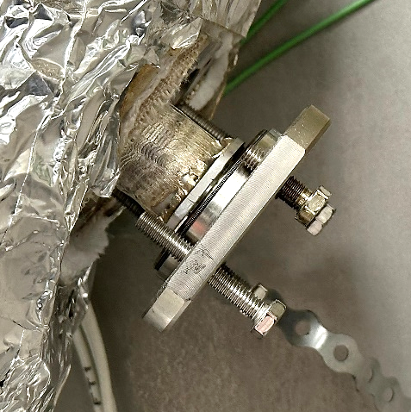
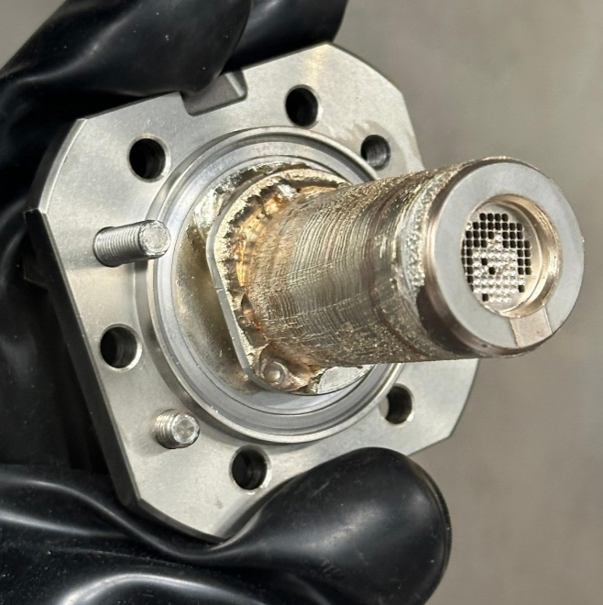
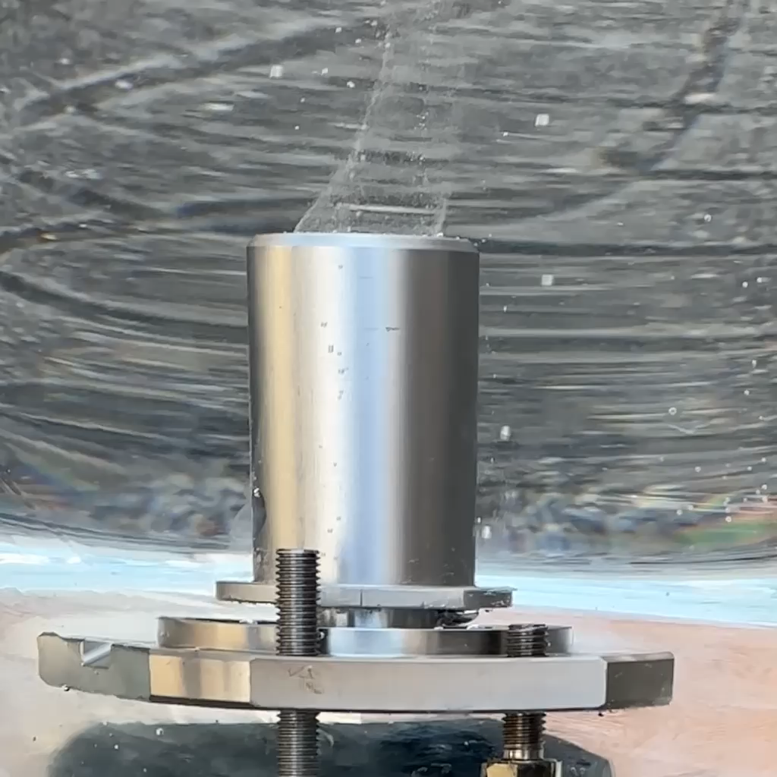
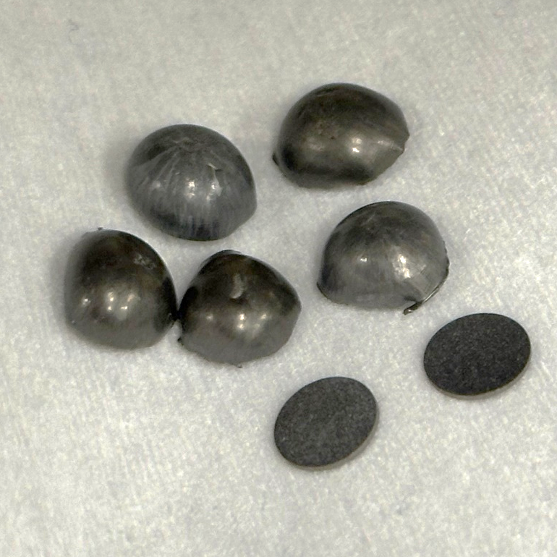
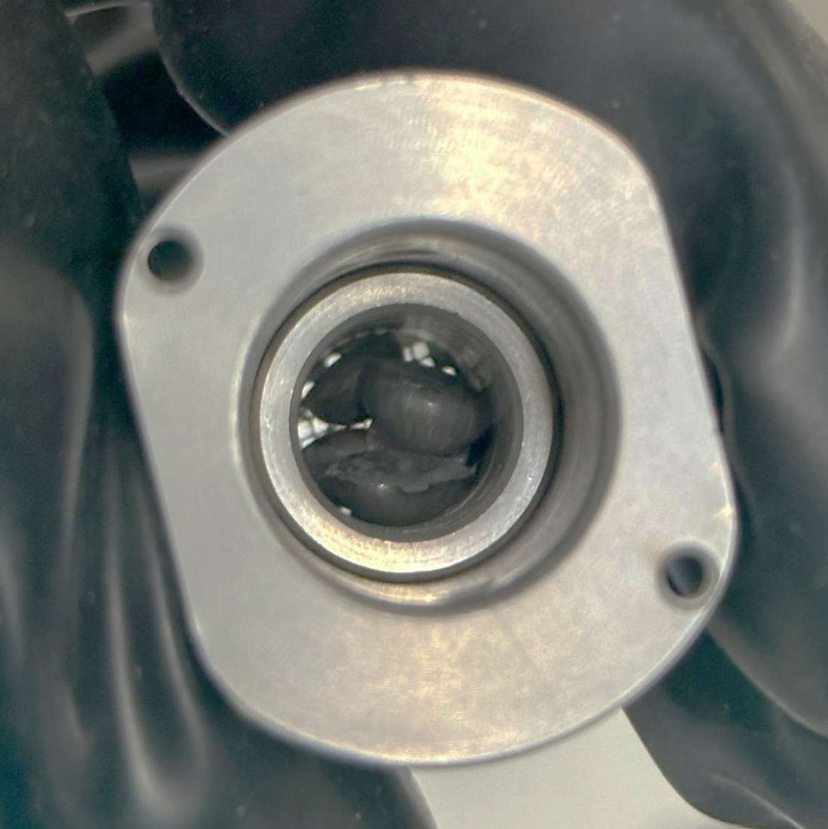
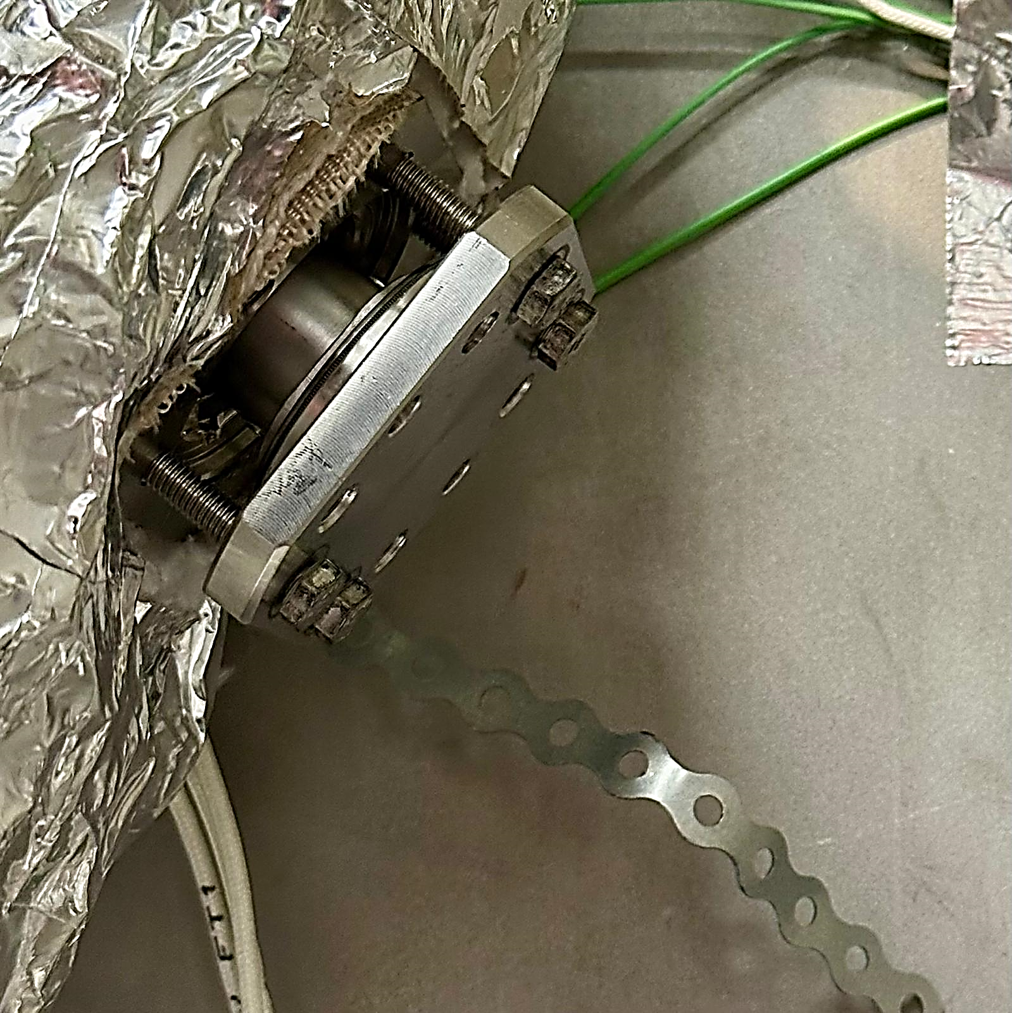
Experimental progress after first experiment
1.
2.
Cleaning of trap in water
3.
Removal of H trap container
Proof of Li flow through trap
5 mm
4.
5.
6.
5g of yttrium pieces selected
Insertion of yttrium into trap
Mounting of Y-filled trap in LYDER

Slide 12
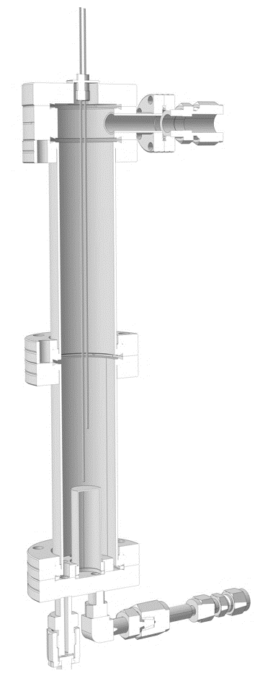
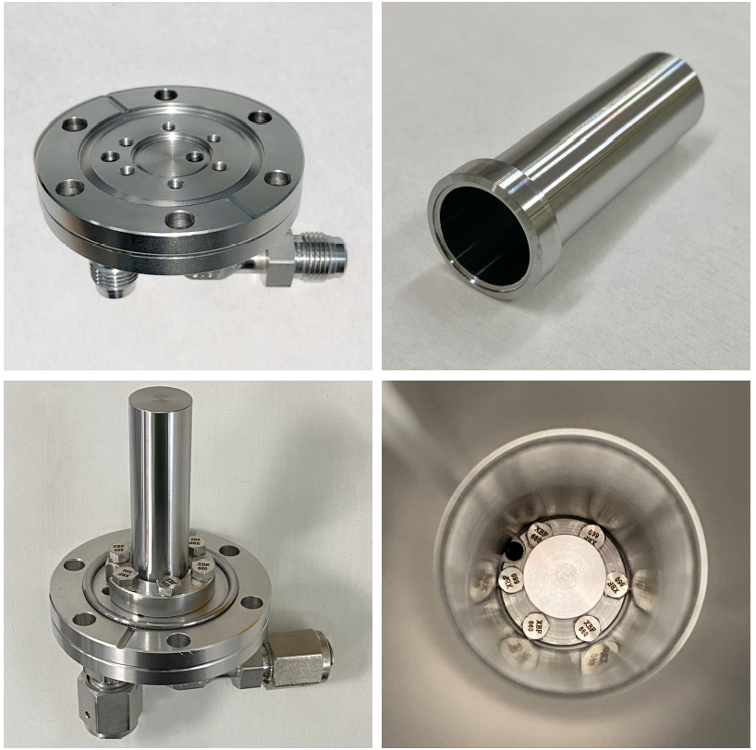
Design of the LYDER deuterium injection system
The deuterium injection system has been manufactured and installed at the bottom of the right tank.
Custom modified 40CF flange
Fabricated 0.5 mm thick Fe tube
Argon gas inlet/outlet
Right tank
Li level sensor I:
90 mL of Li has entered
Li inlet
D2 gas inlet
Li level sensor II: Fe tube covered
View from above into right tank
D injection
system
Lithium inlet

Slide 13
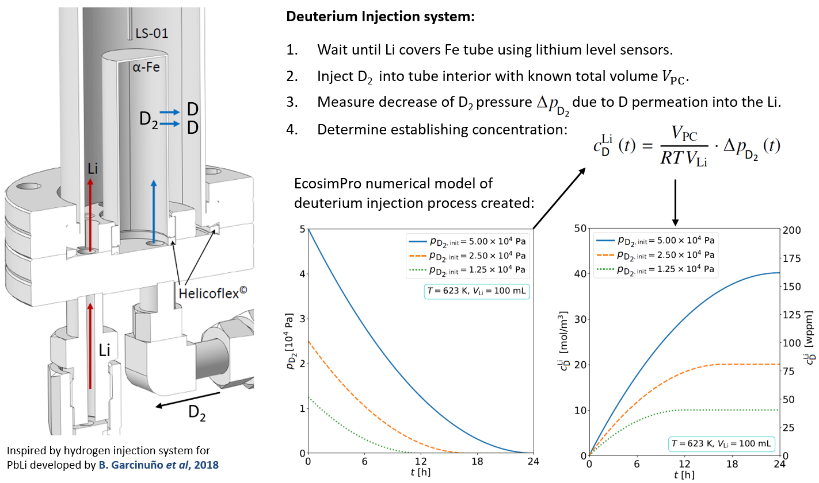
Numerical model of the LYDER deuterium injection system
The deuterium injection system for liquid Li is designed based on a developed model with EcosimPro©.
Injection method: Permeation of deuterium from gas chamber through a hollow α-Fe tube into liquid lithium!
A similar design could be employed in future liquid lithium research loops to inject hydrogen impurities (e.g., LITEC)

Slide 14
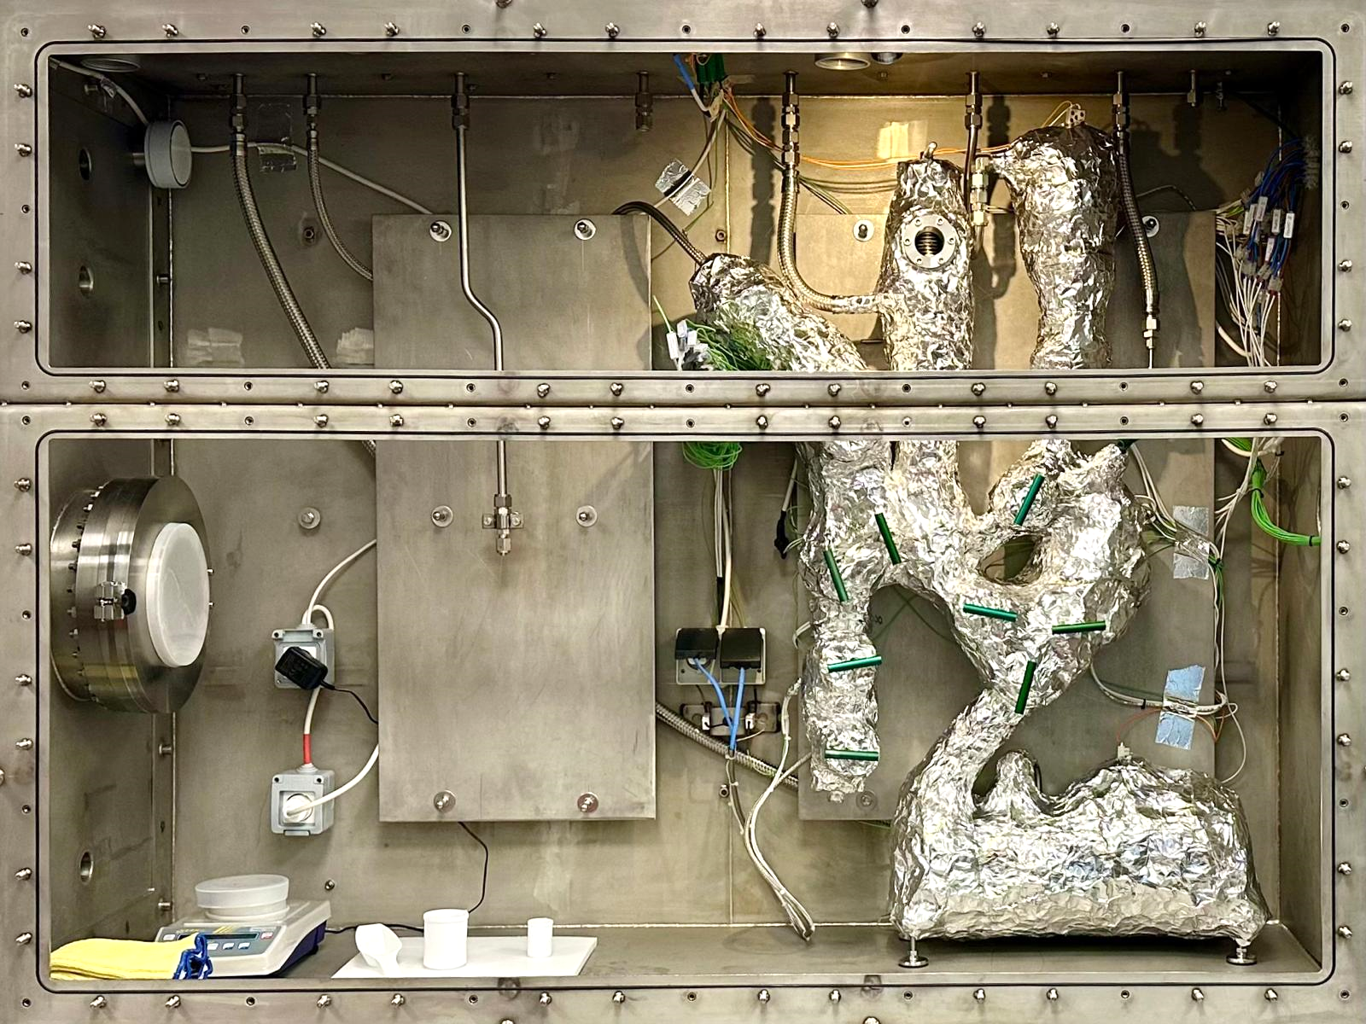
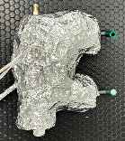
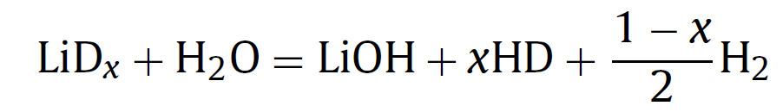
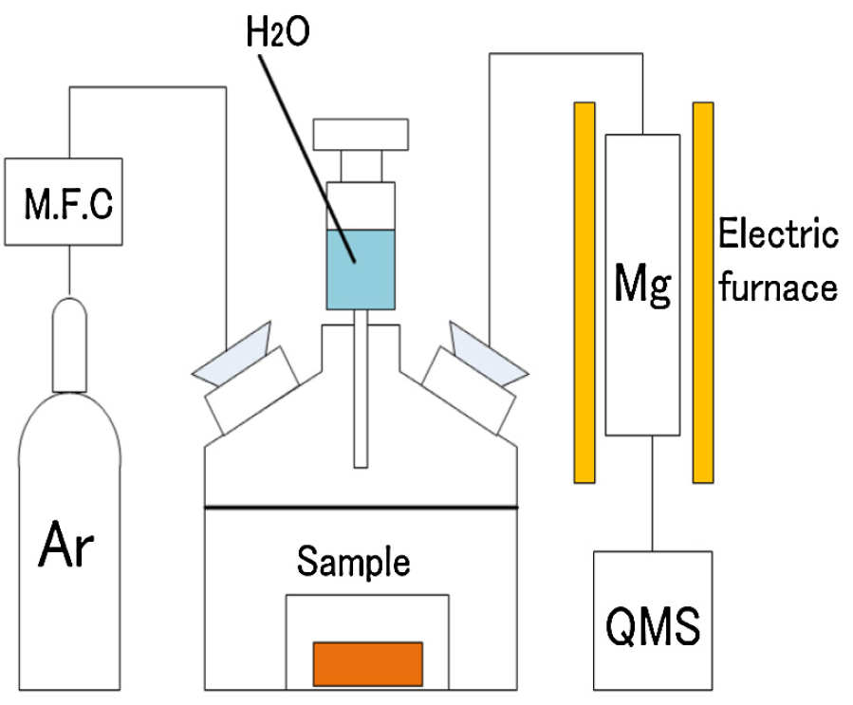
Next experiment: Test D injection and measure D content
Testing of deuterium injection system:
In a next experiment, the Li will be loaded with D.
A lithium sample will be extracted.
The Li will be pumped through trap several times.
Another lithium sample will be extracted.
Thermal desorption branch
D₂
Measuring D concentration in Li samples:
Alternative 1: Extracted samples will be analyzed on their Li concentration by TDS by plugging the sampler to the TDS branch.
Alternative 2: Samples will be dropped into container and analyzed by the chemical dissolution method.
Thermal desorption spectroscopy
T
Chemical Dissolution:
Desorption flux
Measure desorption flux in vacuum with leak detector
Deuterium content
t
*Hiyane et al, 2016

Slide 15
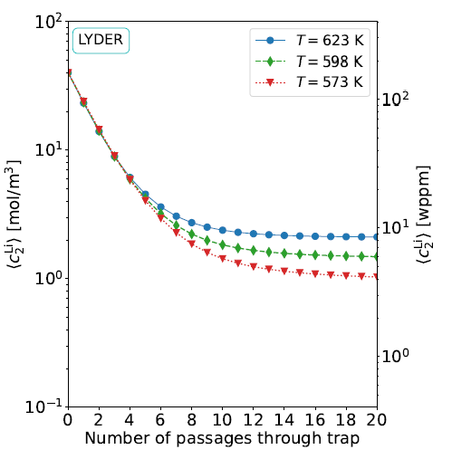
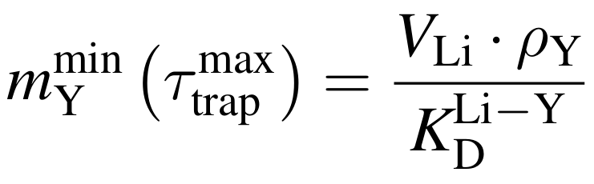
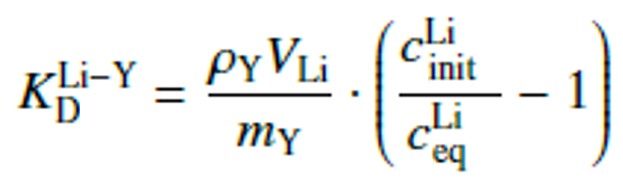


Future work: Measure Y-Li distribution coefficient K_{D}
EcosimPro model of LYDER lithium branch was created to simulate concentration decrease.
Minimum required Y mass for H-trap during DONES operation if replacement rate 28 days:
$$c_{init}^{Li}$$
$$c_{eq}^{Li}$$
Measurement of temperatura-dependent
dissociation coefficient K_{D} :
Only ratio of concentrations must be measured!
S.J. Hendricks et al, Impact of yttrium hydride formation on multi-isotopic hydrogen retention by a getter trap for the DONES lithium loop, Nucl. Fusion 63 (2023) 056012 (27pp), https://doi.org/10.1088/1741-4326/acc31a
S.J. Hendricks et al, Modeling and experimental design to characterize permeation and gettering of hydrogen isotopes in fusion materials, Doctoral Dissertation (2023), https://info.fusion.ciemat.es/PhDThesis/Hendricks.pdf

Slide 16
Conclusion and work pending
Work pending
Test of successful functioning of the LYDER deuterium injection system.
Test of thermal desorption spectroscopy and chemical dissolution method to determine deuterium concentration in extracted lithium samples.
Measure deuterium concentration in lithium samples before and after exposure to the yttrium bed.
Determine distribution coefficient of the Y-Li-D system to obtain min. required Y mass for DONES.
Problems that caused delay of experimental progress
A heating wire has broken and had to be replaced which required opening the glove box and removing and reattaching thermal insulation.
The glovebox purification system failed causing the argon in the box to be contaminated. It is currently waited for the purification system to be repaired which might take one to two months.
Conclusion
The LYDER lithium system is fully constructed and the heating and cooling systems successfully commissioned.
The movement of liquid lithium in LYDER could be demonstrated as previsioned in the initial design.
The functioning of the lithium level sensors and the extraction of liquid lithium samples could be demonstrated.
The removal and subsequent installation of the lithium-exposed LYDER D-trap could be demonstrated.
Test of D injection and D concentration measurement pending due to failure of heater and Ar purification system.

Slide 17
Thank you very much for your attention!

Slide 18
Appendix

Slide 19
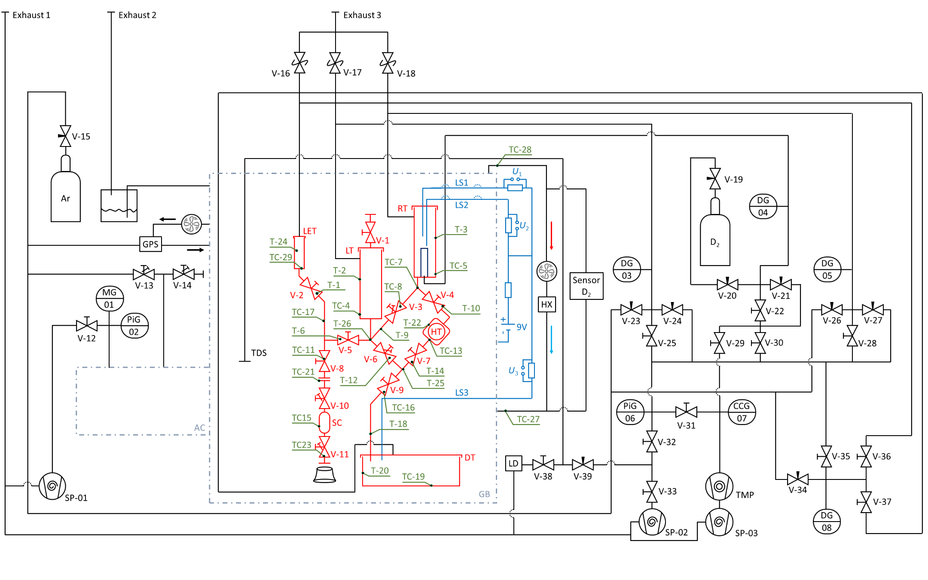
LYDER - Lithium Yttrium system for DEuterium Retention studies

Slide 20
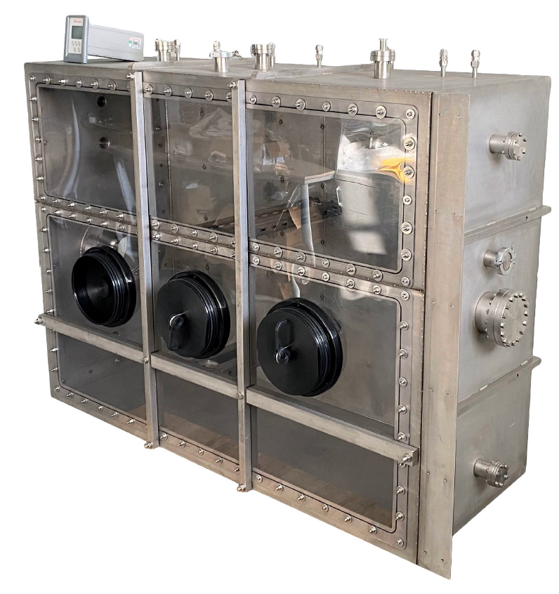
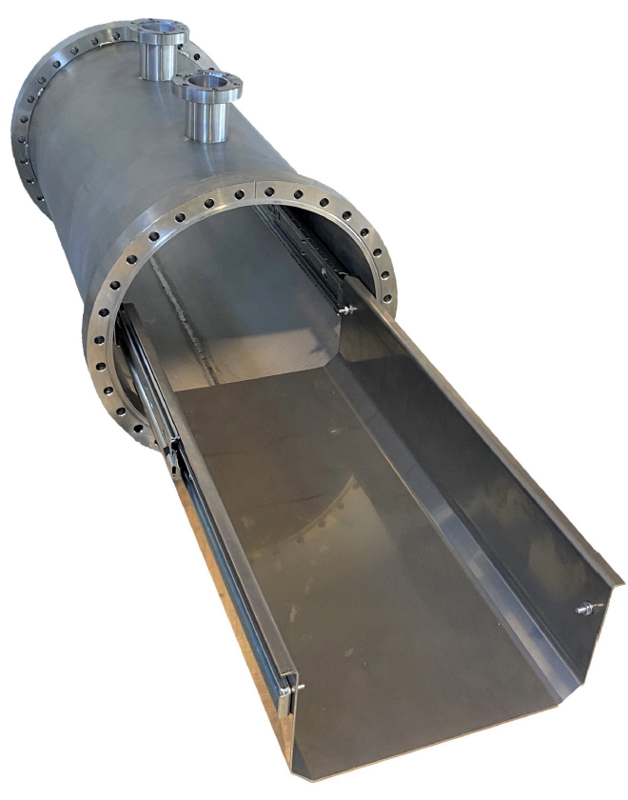
Design and manufacturing of homemade glovebox system
Glovebox airlock system for sample insertion:
Glovebox adapted to needs for the LYDER lithium experiment:
120 cm
160 cm
Glovebox and antechamber has been designed and manufactured within scope of the PhD!
60 cm

Slide 21
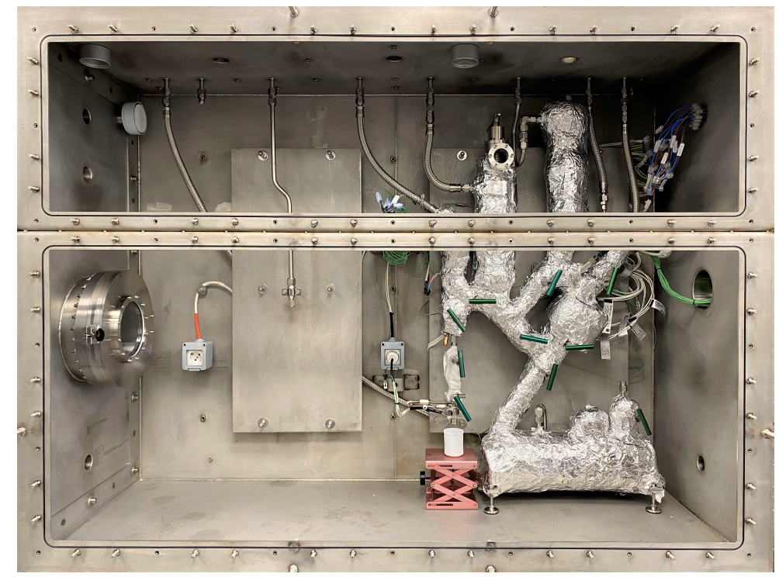
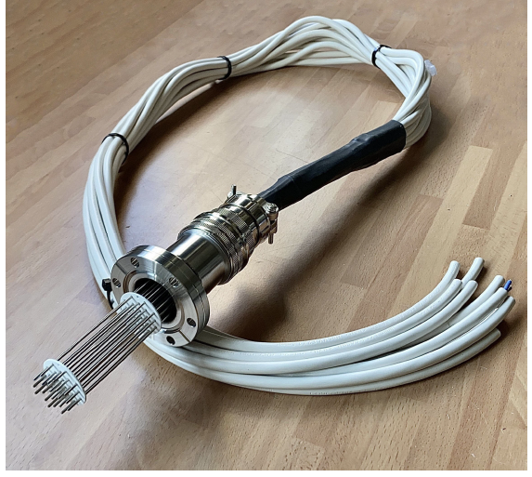
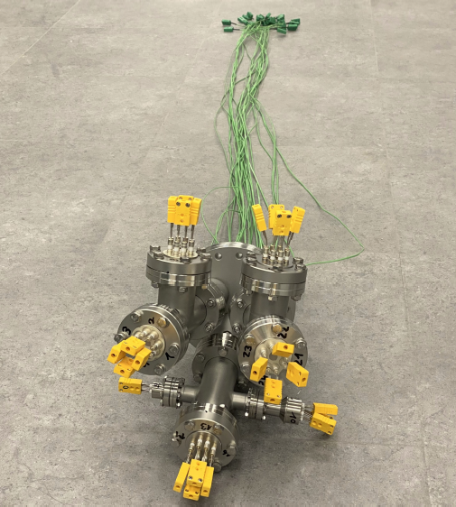
LYDER - Lithium Yttrium system for DEuterium Retention studies
Thermal desorption branch
Mounted electrical feedthrough for heating wires
Glovebox antechamber
Electrical feedthrough for heaters

Slide 22
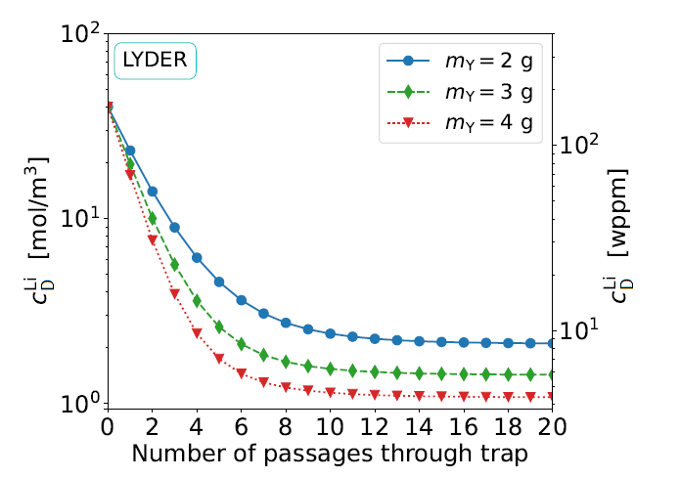
Measuring techniques
Thermal desorption spectroscopy
T
Chemical Dissolution:
Desorption flux
Measure desorption flux in vacuum with leak detector
Deuterium content
t
Hiyane et al, 2016
EcosimPro model of LYDER lithium branch created!
D₂
TDS
Connect
sampler

Slide 23
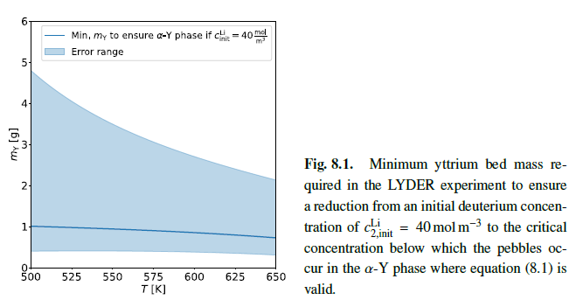
Appendix

Slide 24
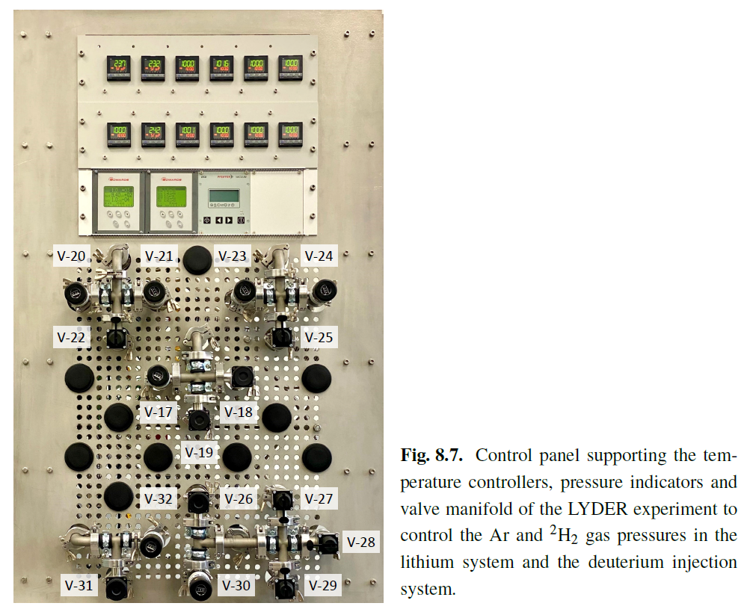
Appendix

Slide 25
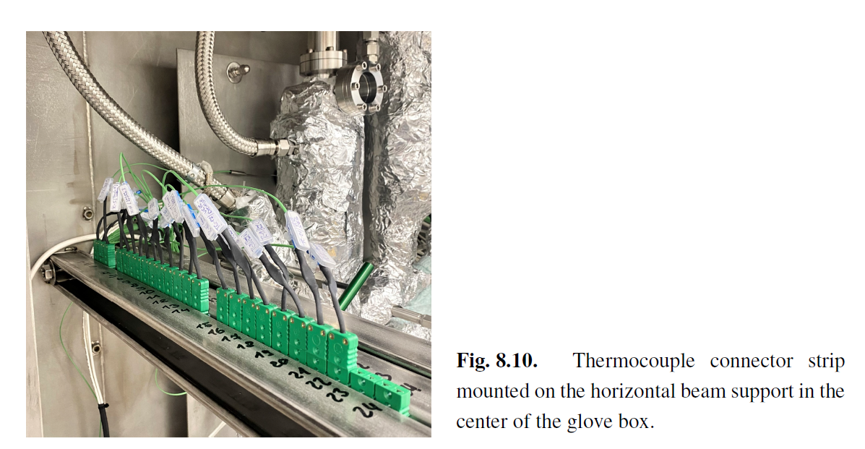
Appendix

Slide 26
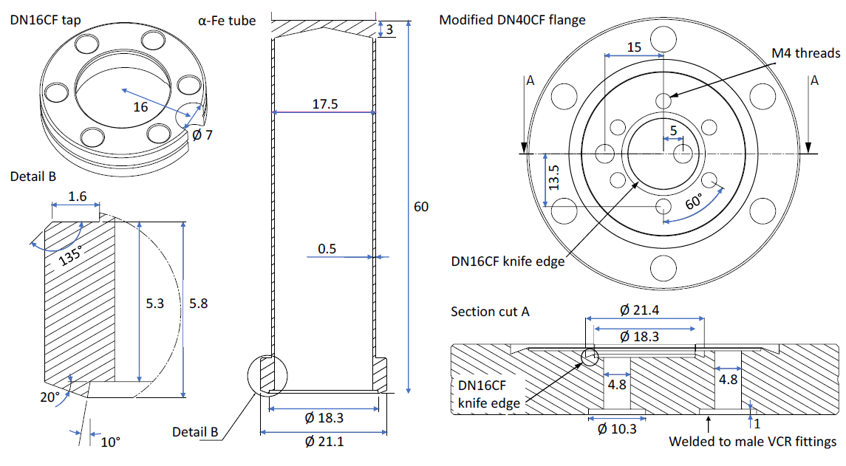
Appendix

Slide 27
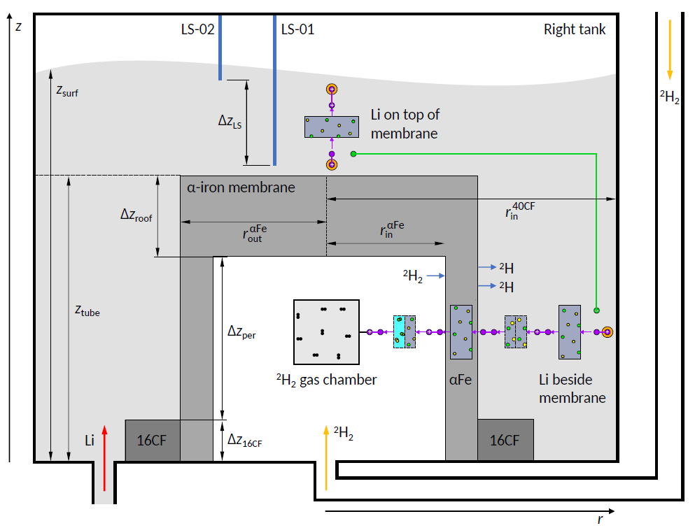
Appendix

Slide 28
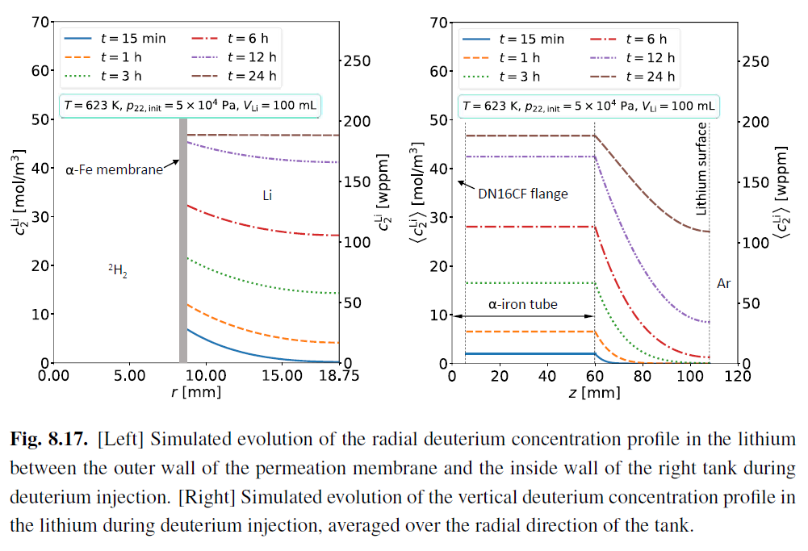
Appendix

Slide 29
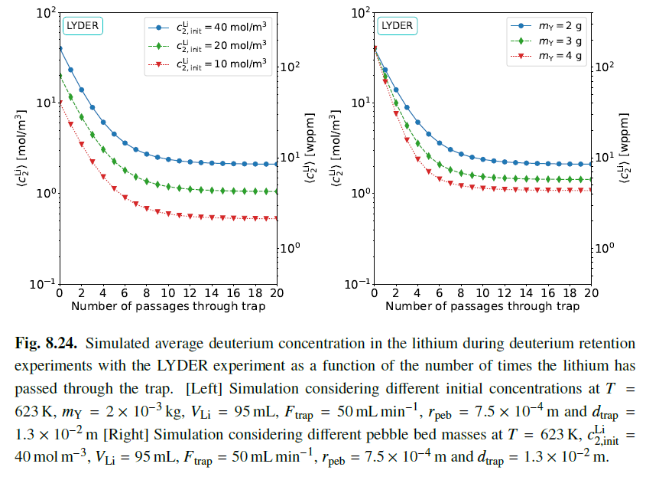
Appendix

Slide 30
Future experiments
EcosimPro model of LYDER lithium branch was created to simulate concentration decrease.
Minimum required Y mass for H-trap during DONES operation if replacement rate 28 days:
$$c_{init}^{Li}$$
$$c_{eq}^{Li}$$
Measurement of temperatura-dependent
dissociation coefficient K_{D} :
Only ratio of concentrations must be measured!
S.J. Hendricks et al, Impact of yttrium hydride formation on multi-isotopic hydrogen retention by a getter trap for the DONES lithium loop, Nucl. Fusion 63 (2023) 056012 (27pp), https://doi.org/10.1088/1741-4326/acc31a
S.J. Hendricks et al, Modeling and experimental design to characterize permeation and gettering of hydrogen isotopes in fusion materials, Doctoral Dissertation (2023), https://info.fusion.ciemat.es/PhDThesis/Hendricks.pdf

Slide 31
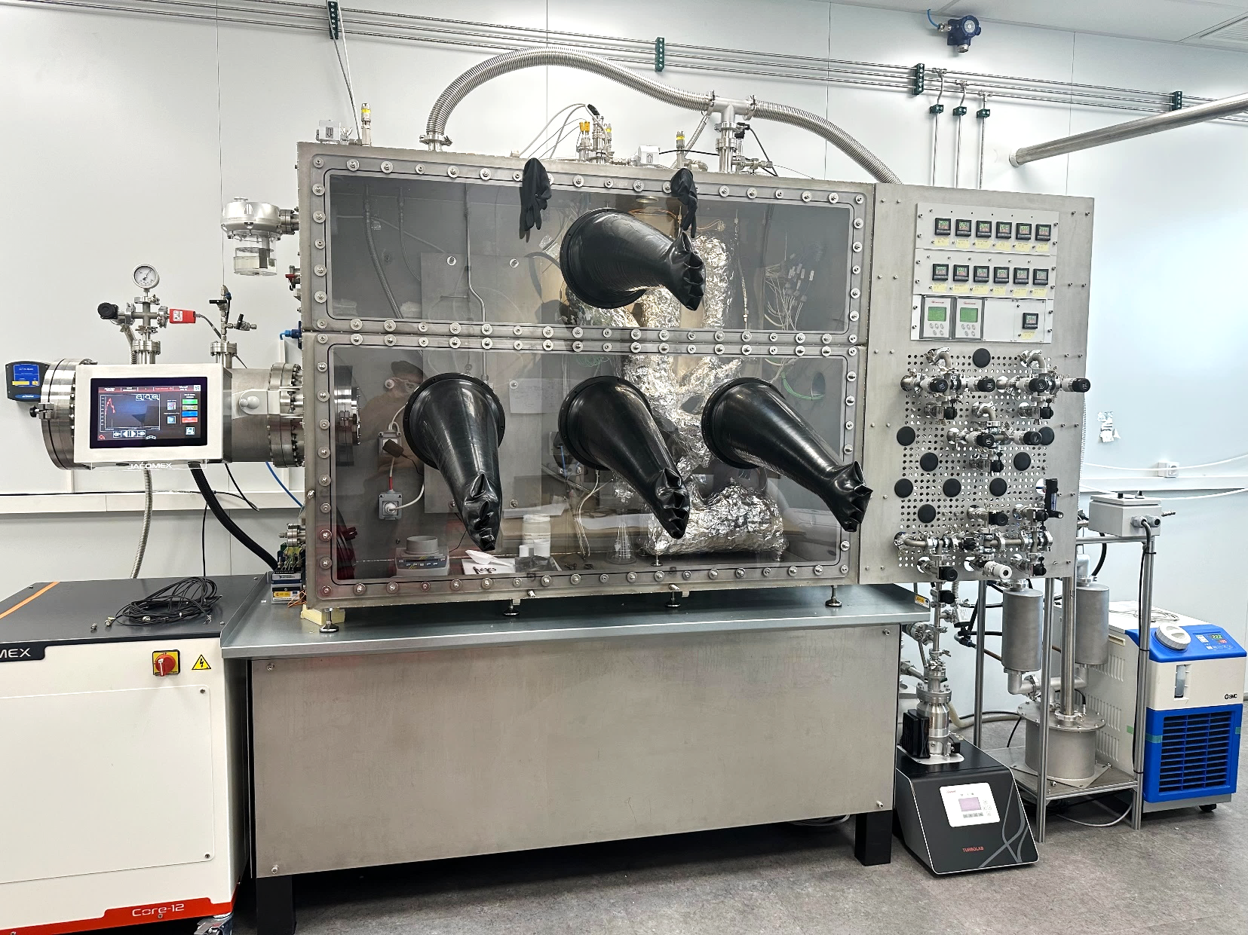
Fully mounted LYDER experimental setup
Outlet pipes toward heat exchanger
Lithium system
Glove box
Antechamber
Pressure control panel
Heat exchanger
Glove box purification system
Water chiller
Vacuum system
LYDER Li system constructed inside of a custom designed argon-filled glove-box fabricated at Ciemat

