Slide 1

Engineering design of the Cold-trap prototype for LITEC
M. Mallouli (mariem.mallouli@idom.com ) E. Llinàs (eduard.llinas@idom.com)
J. Molla (joaquin.molla@ciemat.es)
F. S. Nitti (francesco.nitti@enea.it)
J. Maestre (jorge.maestre@ifmif-dones.es)

Slide 2


Engineering design of the Cold-trap prototype for LITEC
Task Specification
Task Scope:
Design of Cold Trap prototype in accordance with the Technical Requirements and Specification
Cold Trap heater analysis
Cold Trap heat insulation design
Thermomechanical calculation to ensure the structural integrity
Cost estimation of the manufacturing
Task Deliverables:
Objective 2 :
Structural integrity
Verification
Technical report ENS-5.4.4.2-T012-09-R1: “Engineering design of the Cold trap prototype”
Technical note ENS-5.4.4.2-T0012-09-N1: “Technical specification for the manufacturing of the Cold trap prototype”
3D CAD model of the Cold trap prototype

Slide 3
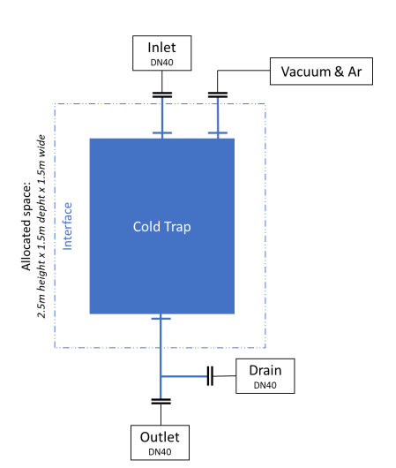
Engineering design of the Cold-trap prototype for LITEC
Introduction
The Cold Trap, a critical component of the LIThium Experimental Circuit (LITEC) prototype used for purifying lithium. The Cold Trap will reduce the content of non-metallic impurities by precipitation of their compounds with Li.
The objective of Cold trap prototype in LITEC context is to investigate the influence of various working parameters on the efficiency and effectiveness of the trap in precipitating impurities.
The main parameters examined include the working temperature, residence time and metallic mesh configuration.
Objective 2 :
Structural integrity
Verification

Slide 4
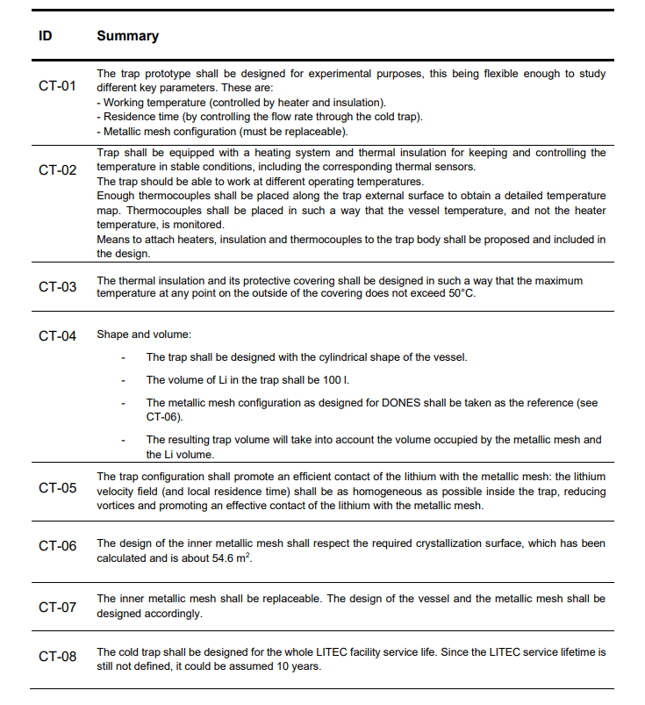
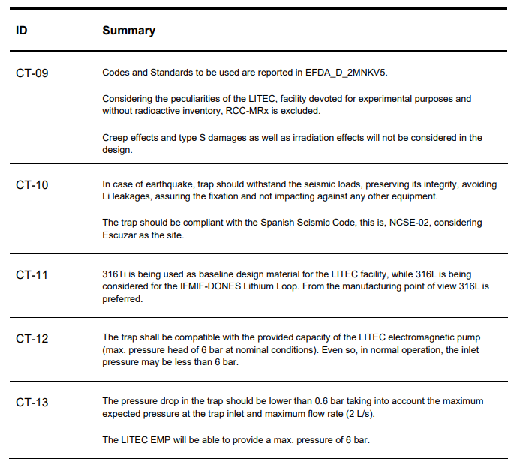
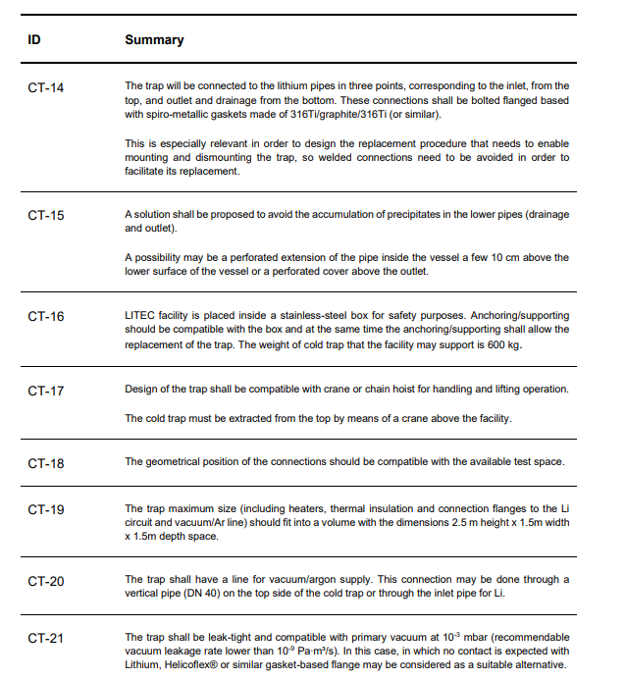
Engineering design of the Cold-trap prototype for LITEC
Design Requirements
Design Requirements
Functional Requirements
Mechanical Requirements
Interface Requirements

Slide 5
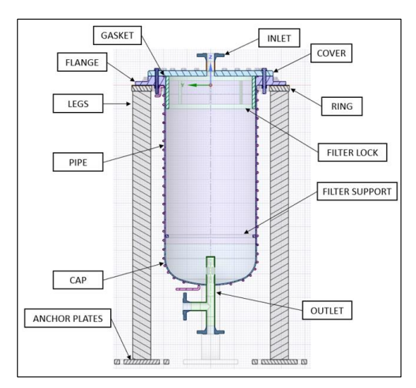
Engineering design of the Cold-trap prototype for LITEC
Design Description
A main body constituted by the cover, the cylindrical body, and the flange.
Filter Lock inserted in the Cold Trap after the filter and its function is to limit the vertical movement of the filter.
The Gasket that will ensure the tightness of the assembly.
The supporting ring holds the equipment, the underside of the flange rests on the ring and four Legs HEB100 profiles are welded to the underside of the ring to connect it to the floor.
The upper cover and flange are held together by 24 M16 bolts.
The flange is connected to the support ring by 8 M16 bolts.

Slide 6
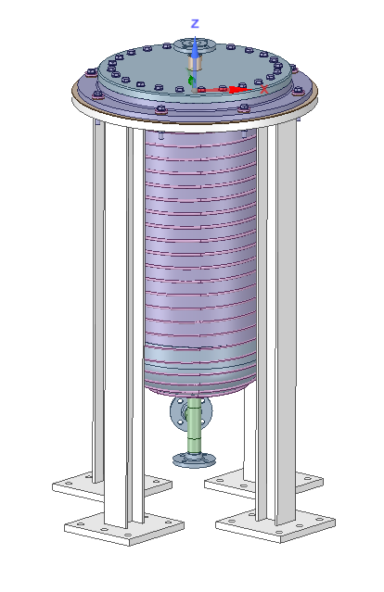
Engineering design of the Cold-trap prototype for LITEC
Assembly Process
The assembly of the Cold Trap involves several steps to ensure proper installation and functionality:
  Install the supporting ring: fix the anchor plates to the building and place the support on top, then weld the beams to the anchor plates.
  Position the Cold Trap: Using the lifting equipment, carefully lift the Cold Trap and introduce it into the supporting ring.
  Bolt tightening and torque checking
  Inspection and Quality Check

Slide 7
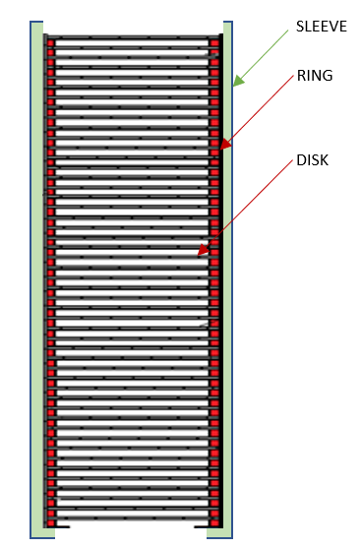
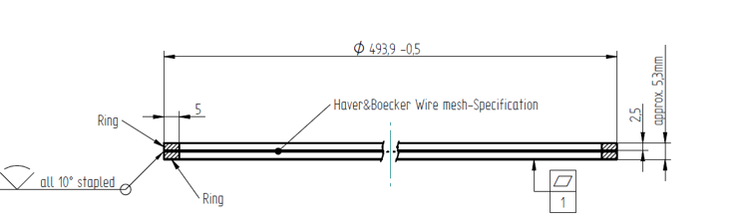
Engineering design of the Cold-trap prototype for LITEC
Prelimanary Calculations
  Filter Performance
The solid precipitation and retention can be improved by employing a stainless-steel wire mesh inside the Cold Trap as a packing material.
The selected type of filter consists of several cylindrical discs, stacked on top of each other and encased in a sleeve and Each of these discs contains a wire mesh.
Disk proposed by Haver&Boecker
The crystallisation surface and the Lithium volume will depend on the number of disks.
To obtain the desired crystallization surface (54.65 m²) 125 disks are required

Slide 8
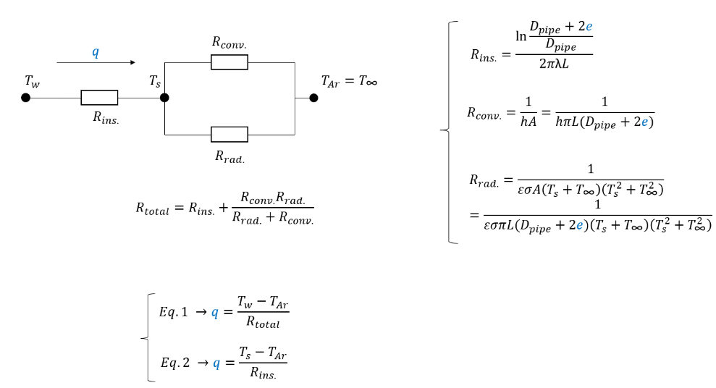
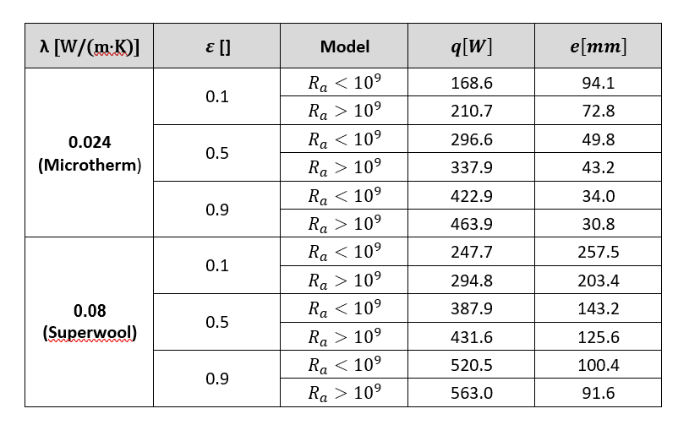
Engineering design of the Cold-trap prototype for LITEC
PRELIMINARY CALCULATIONS
  Insulation Thickness Estimation
The heat will flow from the vessel at 350ºC through the insulation (conduction) and the Argon atmosphere and the container box will absorb this heat (by convection and radiation).

Slide 9
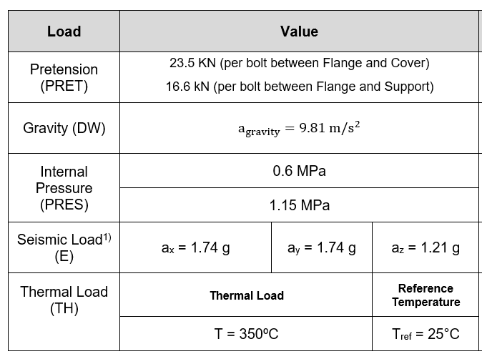
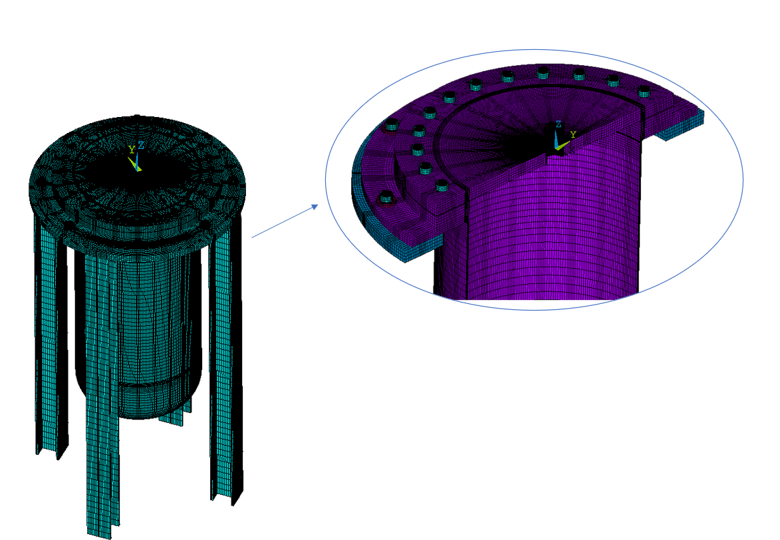
Engineering design of the Cold-trap prototype for LITEC
Thermo-Mechanical Analysis
First a thermal analysis has been perfomed then mapped to the mchanical mesh for the thermo-mechanical FE calculation.
Conservatively, the envelope combinations of the loads have been considered for the stress assessment .
Cold Trap FE Model
Mechanical Single Load Cases

Slide 10
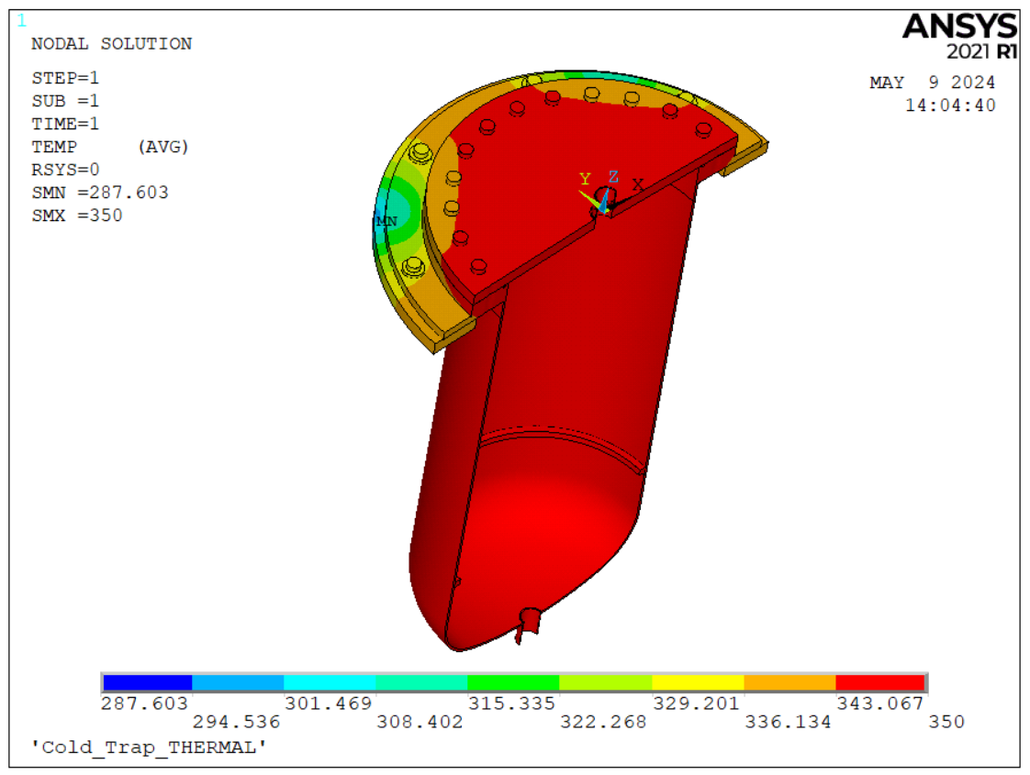
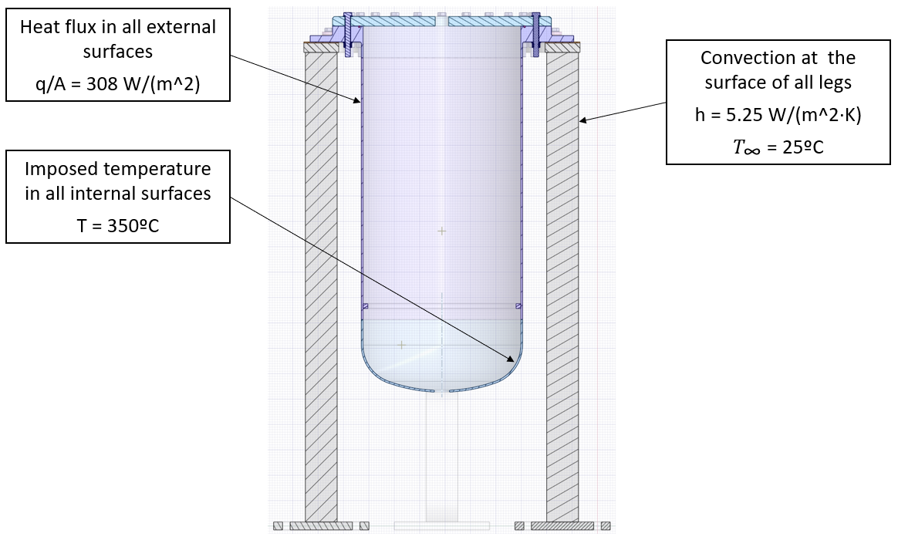
Engineering design of the Cold-trap prototype for LITEC
Thermo-Mechanical Analysis
Thermal Results
Loads and Boundary conditions for Thermal Analysis
Field temperatures (ºC)

Slide 11
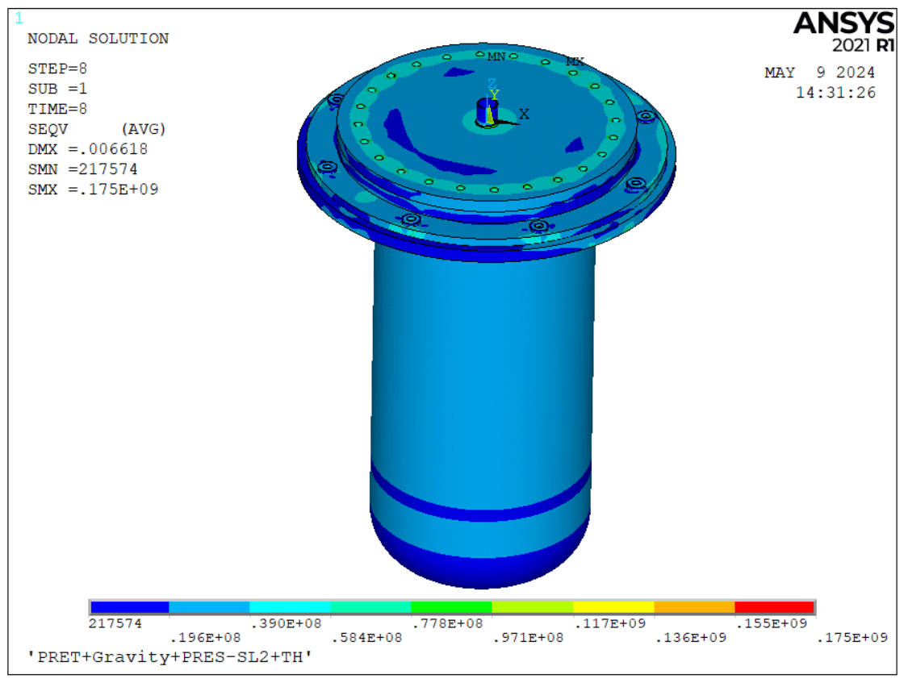
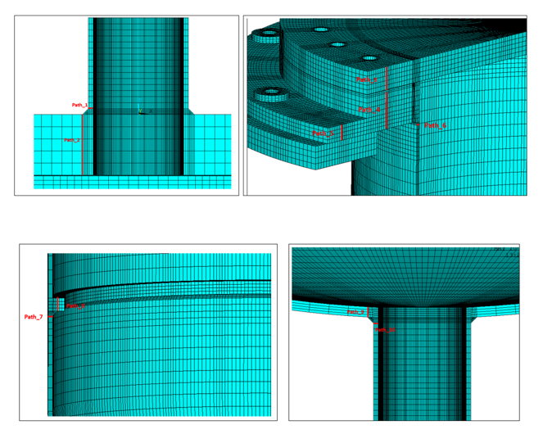
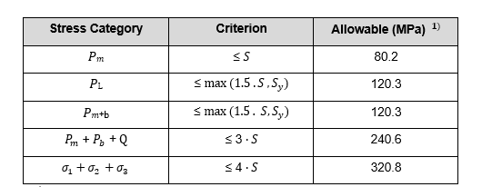
Engineering design of the Cold-trap prototype for LITEC
Thermo-Mechanical Analysis
Mechanical Results: Stress Assesment (ASME BPVC Section VIII Div. 2 Part 5)
The highest usage factor is 0.66, obtained for the path 1 (in the junction between inlet and cover), due to primary membrane stress.

Slide 12
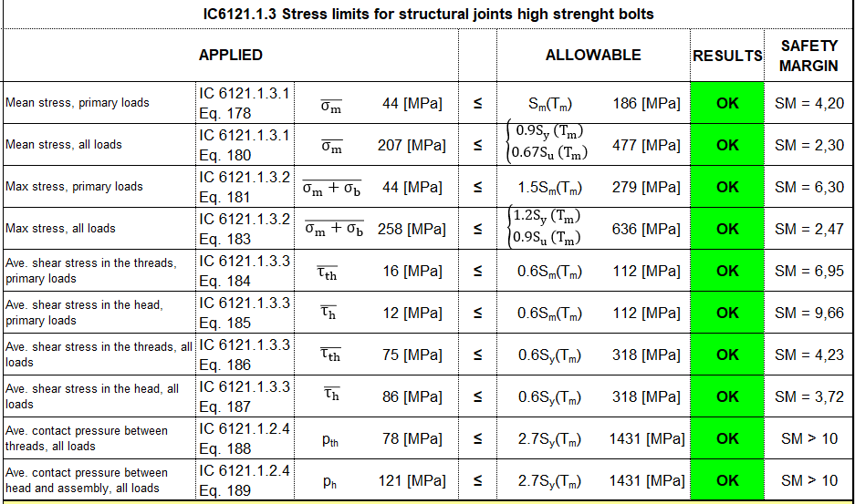
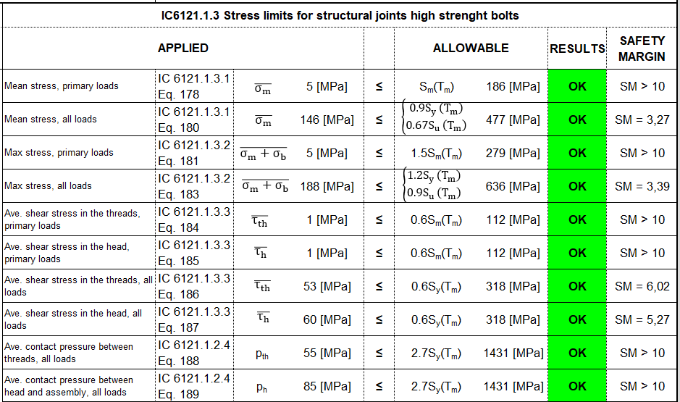
Engineering design of the Cold-trap prototype for LITEC
Thermo-Mechanical Analysis
Mechanical Results: Bolts Assesment (SDC-IC)
Bolts between Flange and Cover
Bolts between Flange and Ring Support
The highest usage factor is 0.43, obtained for the worst bolt between flange and cover, which corresponds to a safety factor of 2.3
The M16 bolts and their inserts in AISI 660 material can withstand all the mechanical loads.

Slide 13
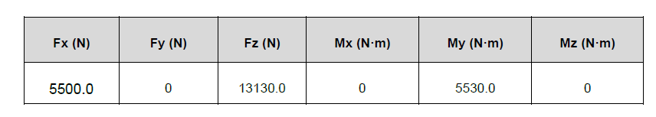
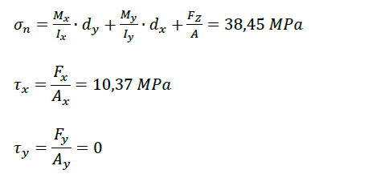

Engineering design of the Cold-trap prototype for LITEC
Thermo-Mechanical Analysis
Mechanical Results: Support Legs Assesment (Eurocode 3)
The maximum internal forces at the most stressed section for the legs obtained by the FE analysis are used to calculate the maximum normal stress and the maximum shear stress.

Slide 14
Engineering design of the Cold-trap prototype for LITEC
Conclusion
The Cold Trap design has been defined according to the functional, mechanical, and specific requirements set by CIEMAT.
A filter mesh configuration has been proposed and the required number of desks have been estimated.
The insulation thickness has been estimated and calculated for different Materials.
thermomechanical calculation has been performed to assess the structural integrity of the Cold Trap with respect to the codes and standards compliance.
From the analysis carried out, It is concluded that the Cold Trap meets structurally all the mechanical requirements.

Slide 15
Thanks for your attention!

