Slide 1
Radiation resistance of the alternative coolant fluid for the Li loop heat exchanger
M. Fernández, J. M. Cobo and L. Amigo

Slide 2
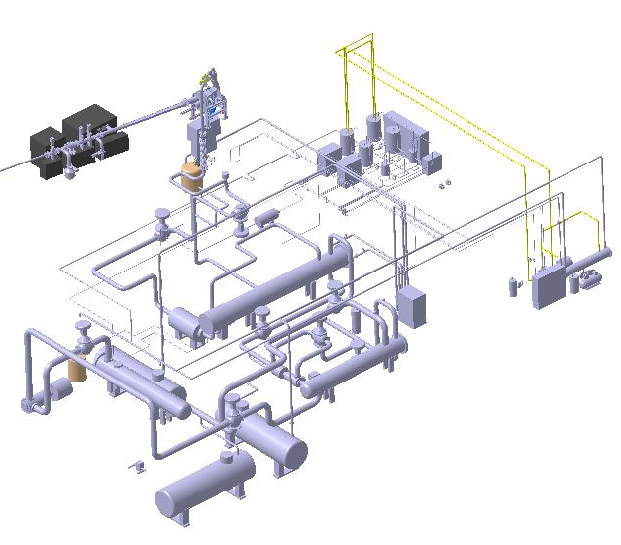
Introduction
Selection of HTF for Primary HX system (HX1)
Thermal stability over operating temperature range:
Operating temperature limit
Low vapour pressure
Pyrolysis phenomena
Target Assembly
Beam ducts
Impurity control system
Radiation resistance at expected doses :
Radiolysis
  Appearance of corrosive chemical compounds mainly acidic species
  Variation in physical characteristics
Activation by irradiation
Primary HX
(Li/Oil1)
Tertiary HX
(Oil2/Water)
Secondary HX
(Oil1/Oil2)
Synthetic organic oils
M. Fernández | TM#17 |05 July 2024| Page 2

Slide 3
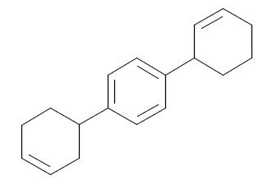
Introduction
Pre-selected oil for the HX1 loop
Compound | Hydrogenated Terphenyls
Chemical formula | C₁₈H₂₂ (CAS: 61788-32-7) (EC 262-967-7)
Trade name | Therminol 66 - Dowtherm HT - Paratherm HT
Study of the stability of HTF subjected to radiation (2nd half 2021 – 1st half 2022)
No significant variation in purity related to the irradiation process was detected
The irradiated samples do not show appreciable variations when compared to the non-irradiated oil
An increase in viscosity with irradiation, from 14 mm²/s cm in the not irradiated sample to 23 mm²/s in the oil irradiated
M. Fernández | TM#17 |05 July 2024| Page 3
Notes:
Among them, the partially hydrogenated terphenyls were the fluids initially proposed fluids proposed. these oils are commercially available under various trade names.
Its thermal stability was well known since these compounds have been used successfully in high temperature heat transfer applications for many years. So, its thermal stability was well known but there was no data on its behavior under irradiation.
To this end, during 2021 and 2022 an experimental assessment of terphenyl stability under radiation was carried out, which concluded that:
- In terms of composition, no significant variations were observed between irradiated and non-irradiated samples but there was a significant increase in viscosity depending on the absorbed dose.

Slide 4
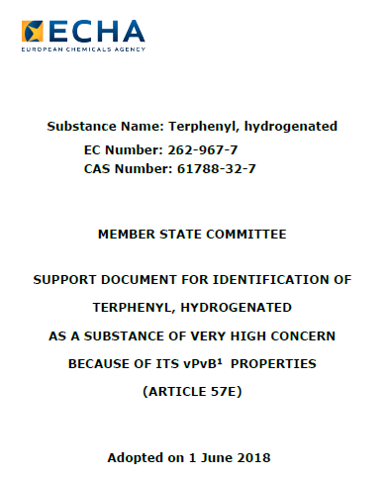
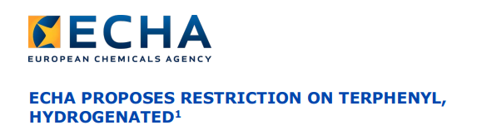
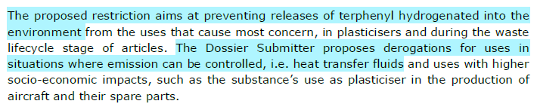
Approach and goal
Taking into account the environmental standards based on European and Japanese law and the possibility of restrictions for the use of the selected HTF initially proposed, the National Institutes for Quantum and Radiological Science and Technology (QST) conducts a research on alternative oils of HX1 on as well as radiation resistance
1 vPvB means very persistent and very bioaccumulative
M. Fernández | TM#17 |05 July 2024| Page 4

Slide 5
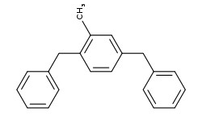
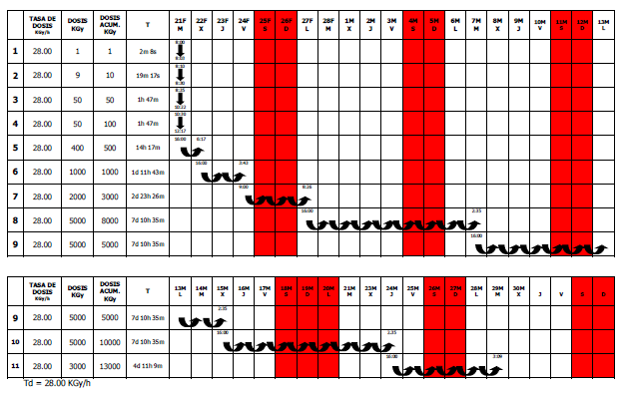
Alternative fluid
Compound | Dibenzyltoluene
Operating temperature limit | 340℃
Freezing point | < -20℃
Viscosity @180℃ | 0.93 mPa s
Thermal conductivity@340℃ | 0.103 W/m・K
Specific heat@340℃ | 2.648 kJ/kg・K
Harmful material | Not a target substance
Irradiation process
M. Fernández | TM#17 |05 July 2024| Page 5

Slide 6
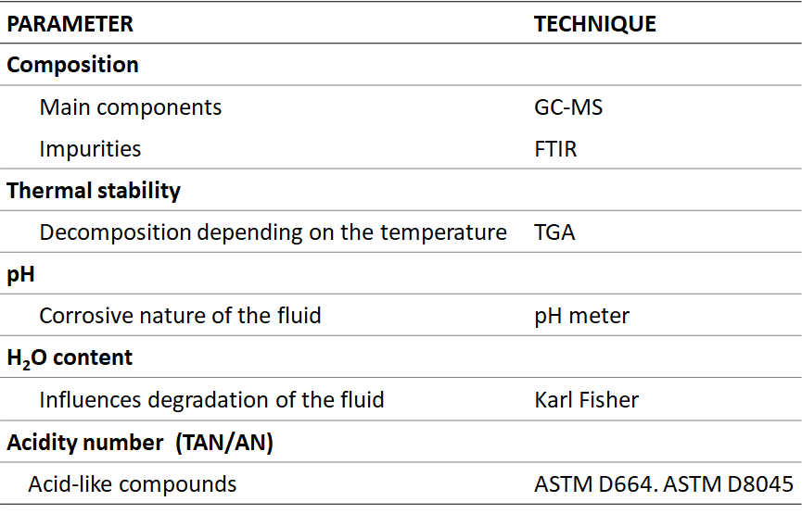
Fluid characterization
GC and HPLC-MS
M. Fernández | TM#17 |05 July 2024| Page 6

Slide 7
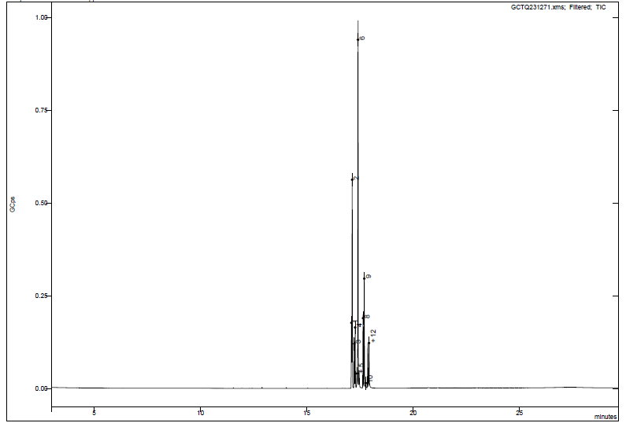
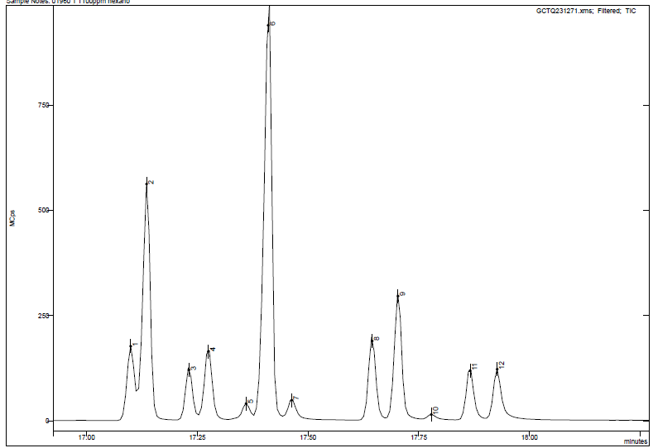
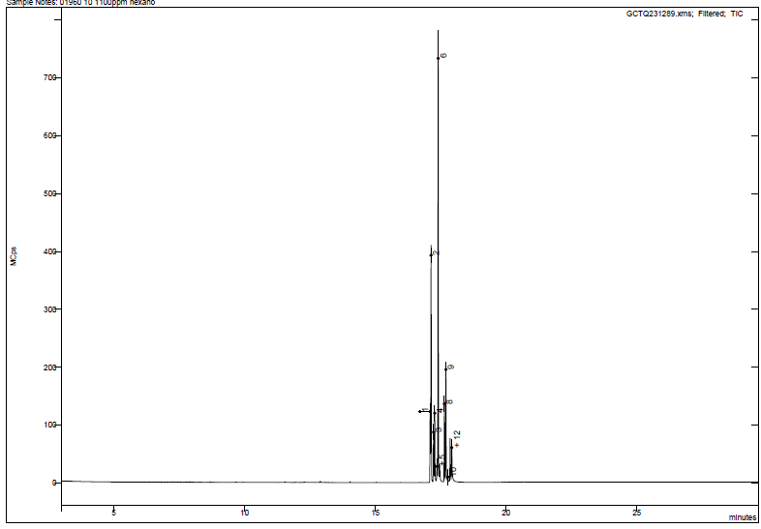
Results. Main components
GAS CHROMATOGRAPHY
Non-irradiated sample
Peak intensity (x10⁶ cps)
Irradiated sample
Peak intensity
Retention time (min)
The resulting chromatograms are similar and the order of magnitude of the integral of the areas of each peak is the same, with some deviation due to the injection.
M. Fernández | TM#17 |05 July 2024| Page 7

Slide 8
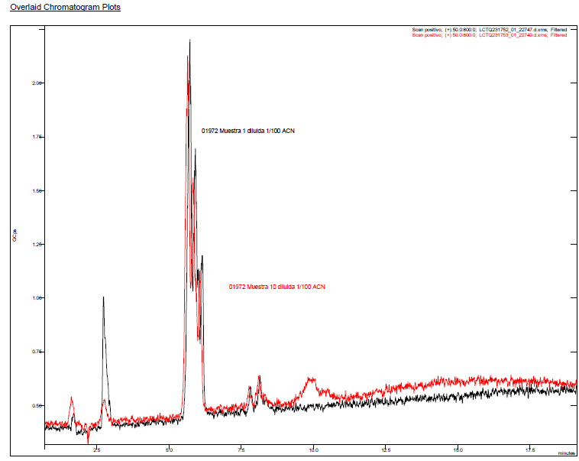
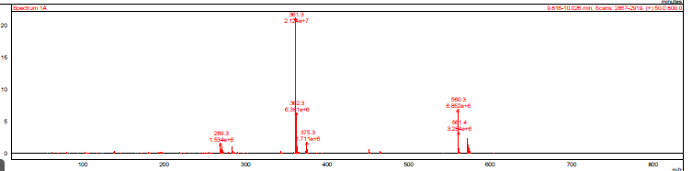
Results. CompositionEn cromatografía
LIQUID CHROMATOGRAPHY – MASS SPECTROMETRY (HPLC)
In the chromatogram of the irradiated sample at 10 MGy appears a new peak at a retention time of 9.90 minutes
Mass spectrum
The MS peaks correspond to a compound with a higher molecular weight than DBT (272 amu).
↓
Evidence of possible polymerization
Overlaid chromatograms plots of 1 KGy irradiated (black) and 13 MGy irradiated (red) samples
M. Fernández | TM#17 |05 July 2024| Page 8

Slide 9
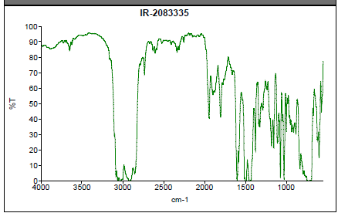
Results. Acid-like species
FOURIER TRANSFORM INFRARED SPECTROSCOPY
The IR spectrum (1750-3600 cm⁻¹) is identical for all samples regardless of the absorbed dose.
IR signals are typical of aromatic compounds.
↓
No absorption bands corresponding to hydroxyl, carbonyl or carboxyl groups appears
ACID – BASE TITRATION
Total Acid Number TAN
The data range between 0.05 and 0.09 mg KOH/g fluid, without showing any trend with the irradiation level.
The formation of acid-like compounds as a consequence of irradiation is not detected
M. Fernández | TM#17 |05 July 2024| Page 9

Slide 10
Results. Viscosity
Results obtained shown an increase in viscosity with irradiation, starting with 16 mm²/s cm in the initial sample and reaching 23 mm²/s in the oil irradiated with 10 MGy
M. Fernández | TM#17 |05 July 2024| Page 10

