Slide 1
Design status of the EMP for the main Li Loop, including coast-down test on 60 l/s and design of 100 l/s Na EMP
Lithium Systems TM#17, July 5, 2024
L.Buligins, I.Bucenieks, L.Goldšteins, O.Mikanovskis
Institute of Physics, University of Latvia

Slide 2
Content
Coast-down test
EMP simulation and production activities
EMP components testing activities
EMP integration in loop related activities
Conclusions

Slide 3
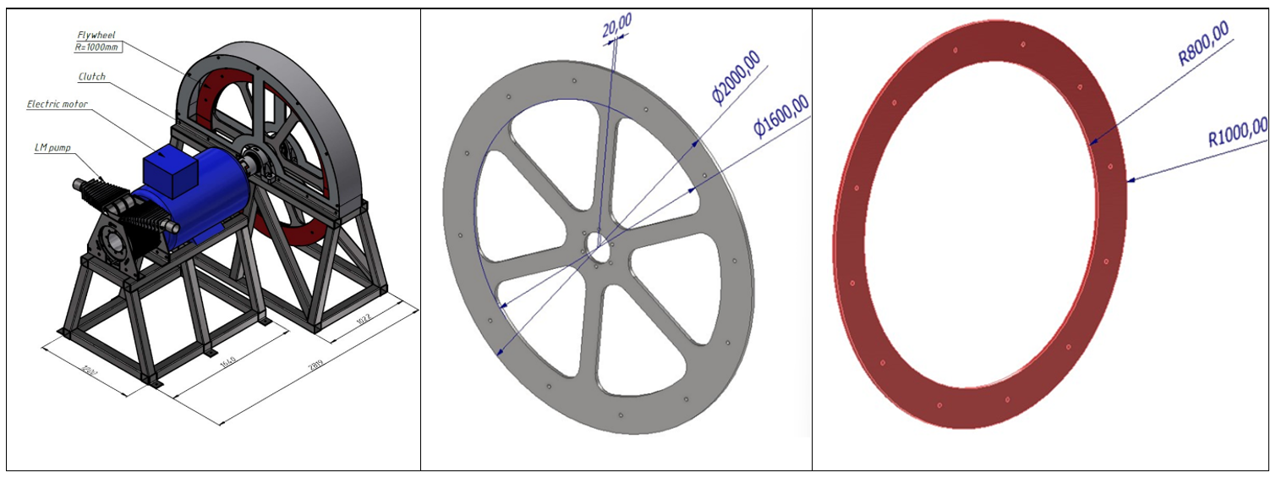
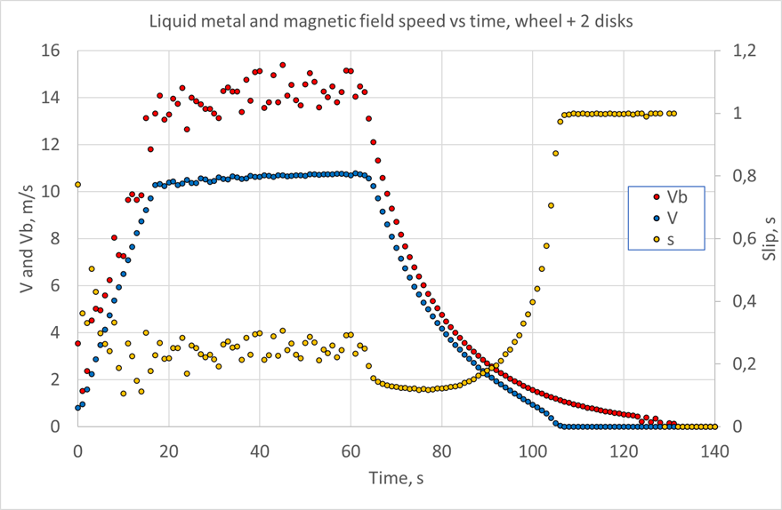
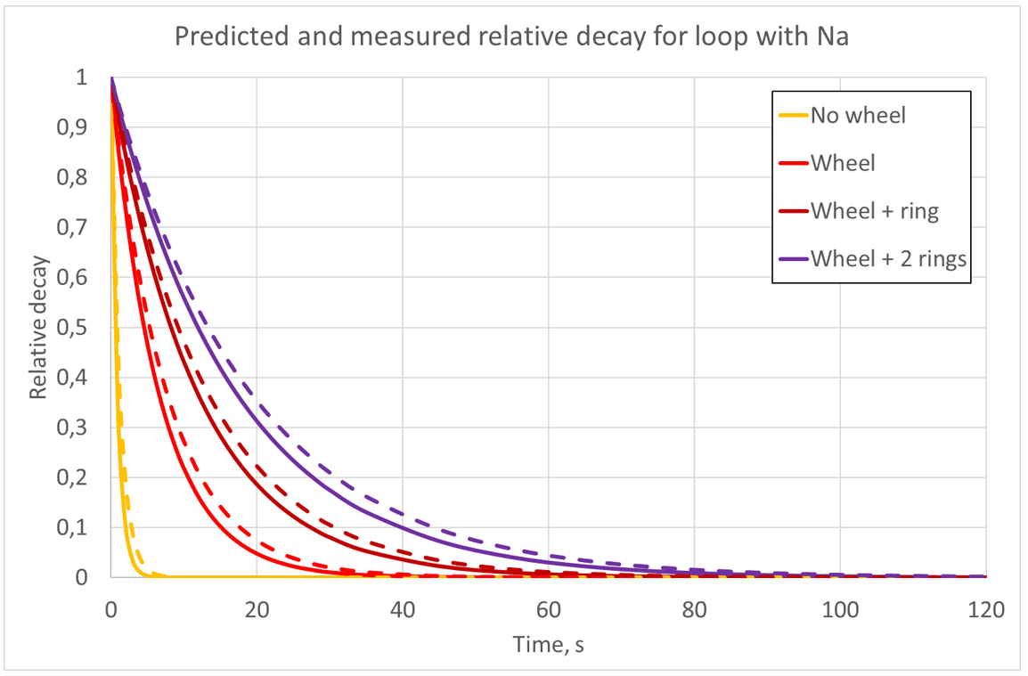
Coast-down test

Slide 4
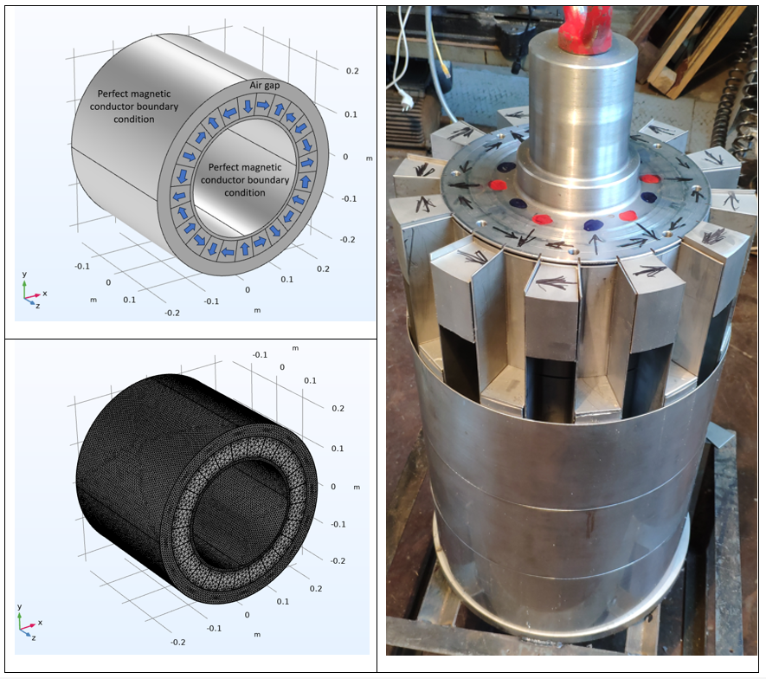
Rotor in assembling process and it’s models

Slide 5
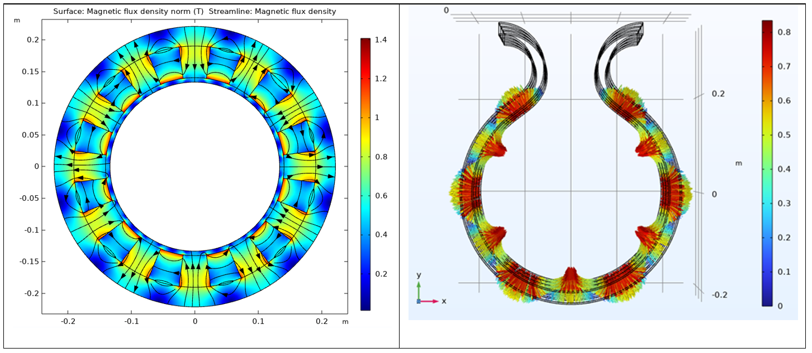
Calculated by COMSOL magnetic field and applied field in channel

Slide 6
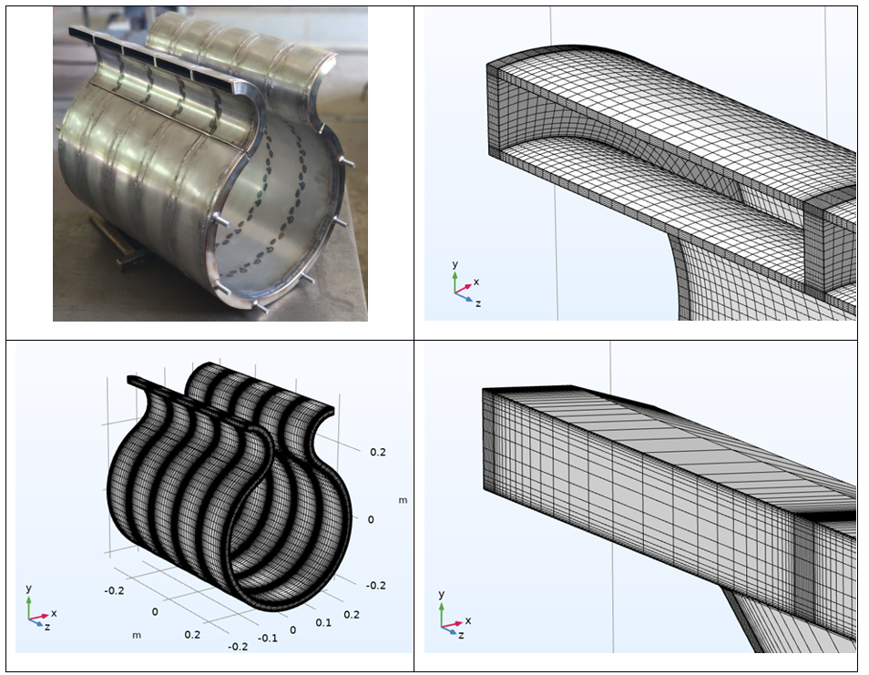
COMSOL models
EMP channel with 5 subchannels and overall mesh used for HD calculation – right – zoom in of meshes for EM and hydrodynamics,

Slide 7
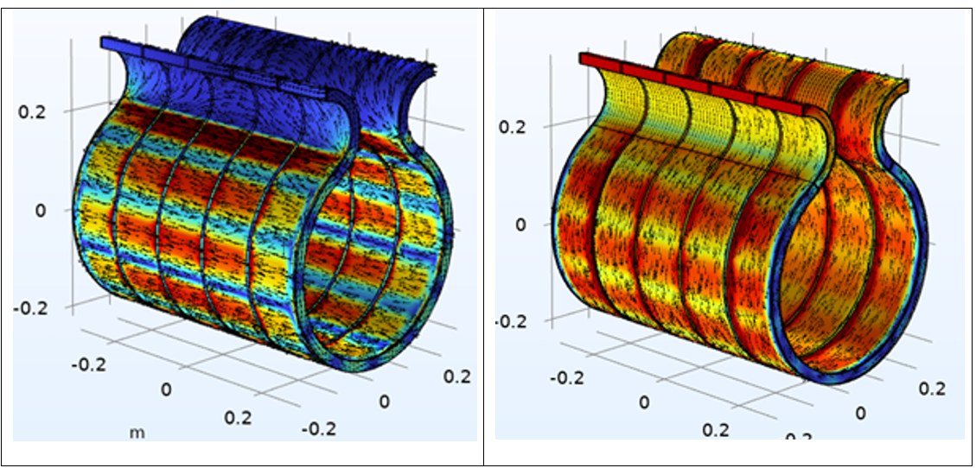
Eddy currents and velocity vectors

Slide 8
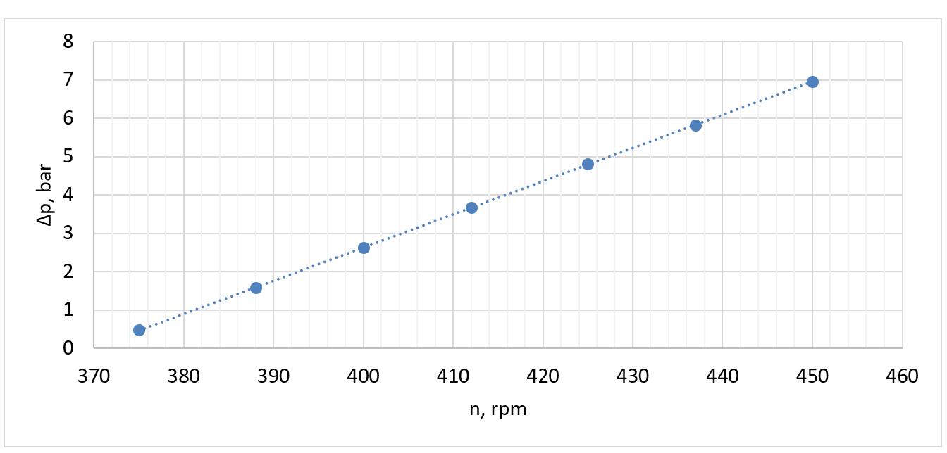
Developed pressure as function of magnetic field rotation speed

Slide 9
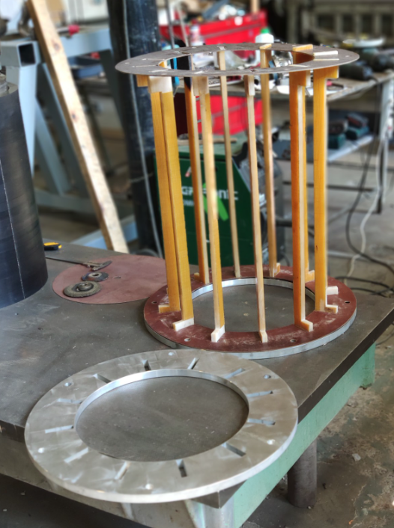
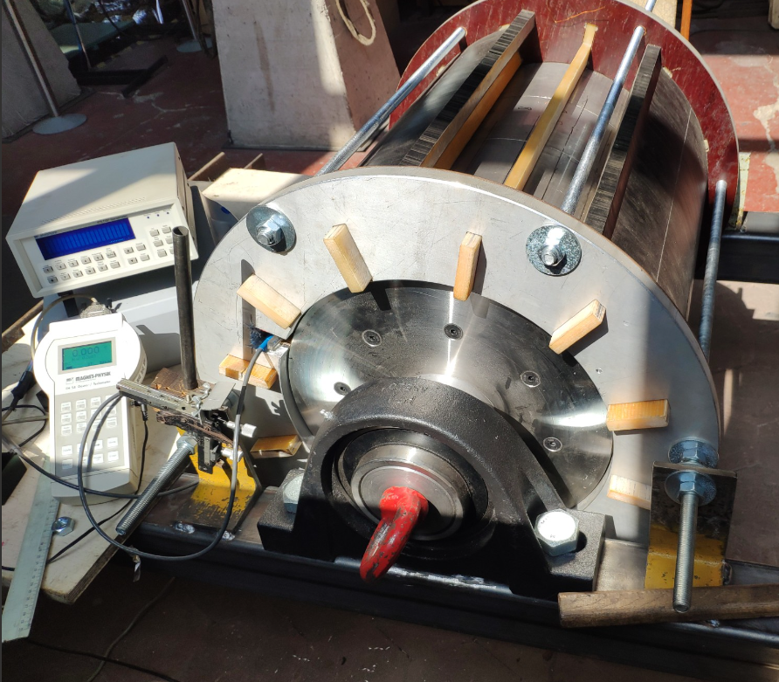
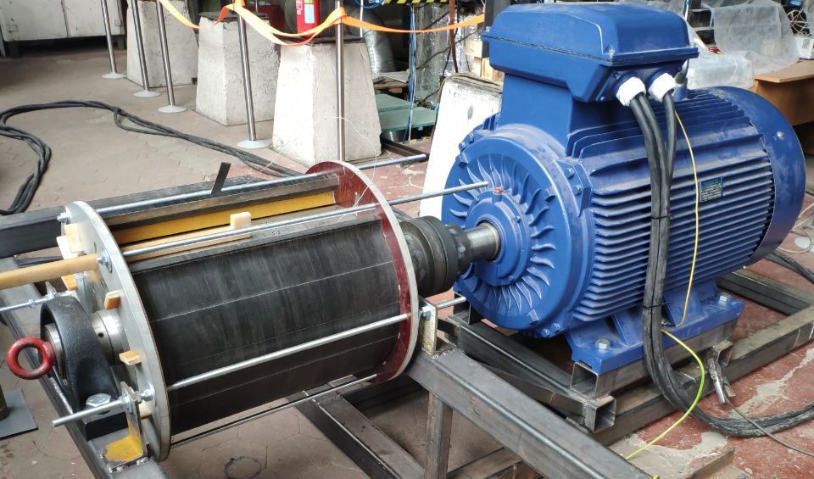
EMP components testing activities

Slide 10
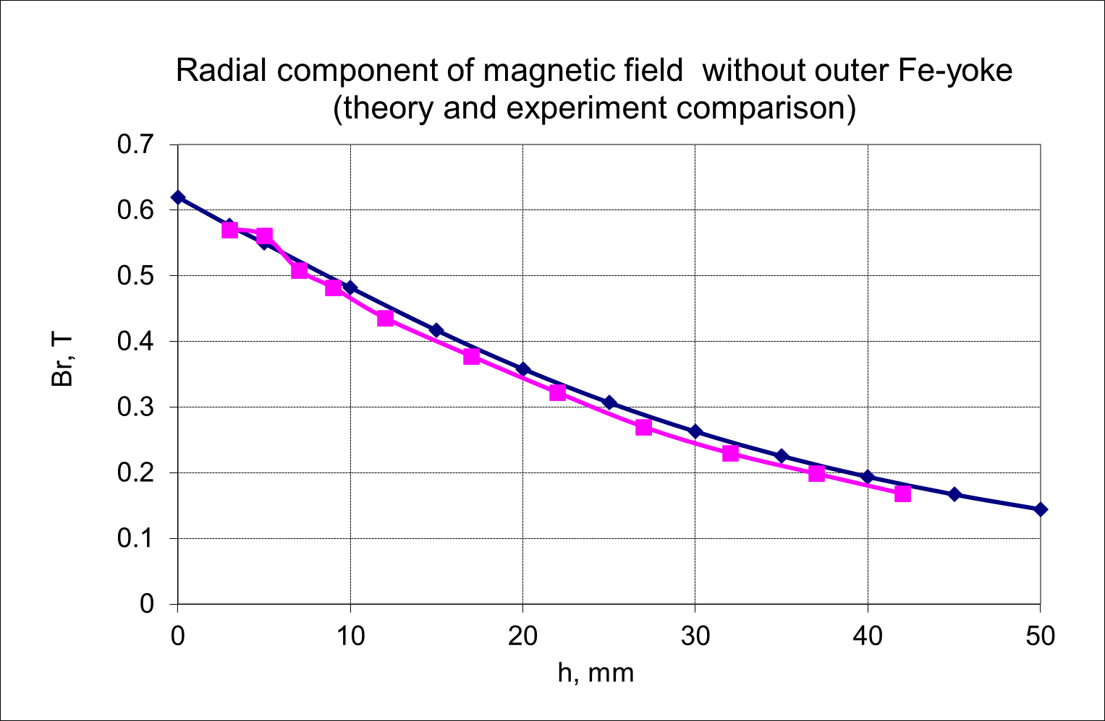
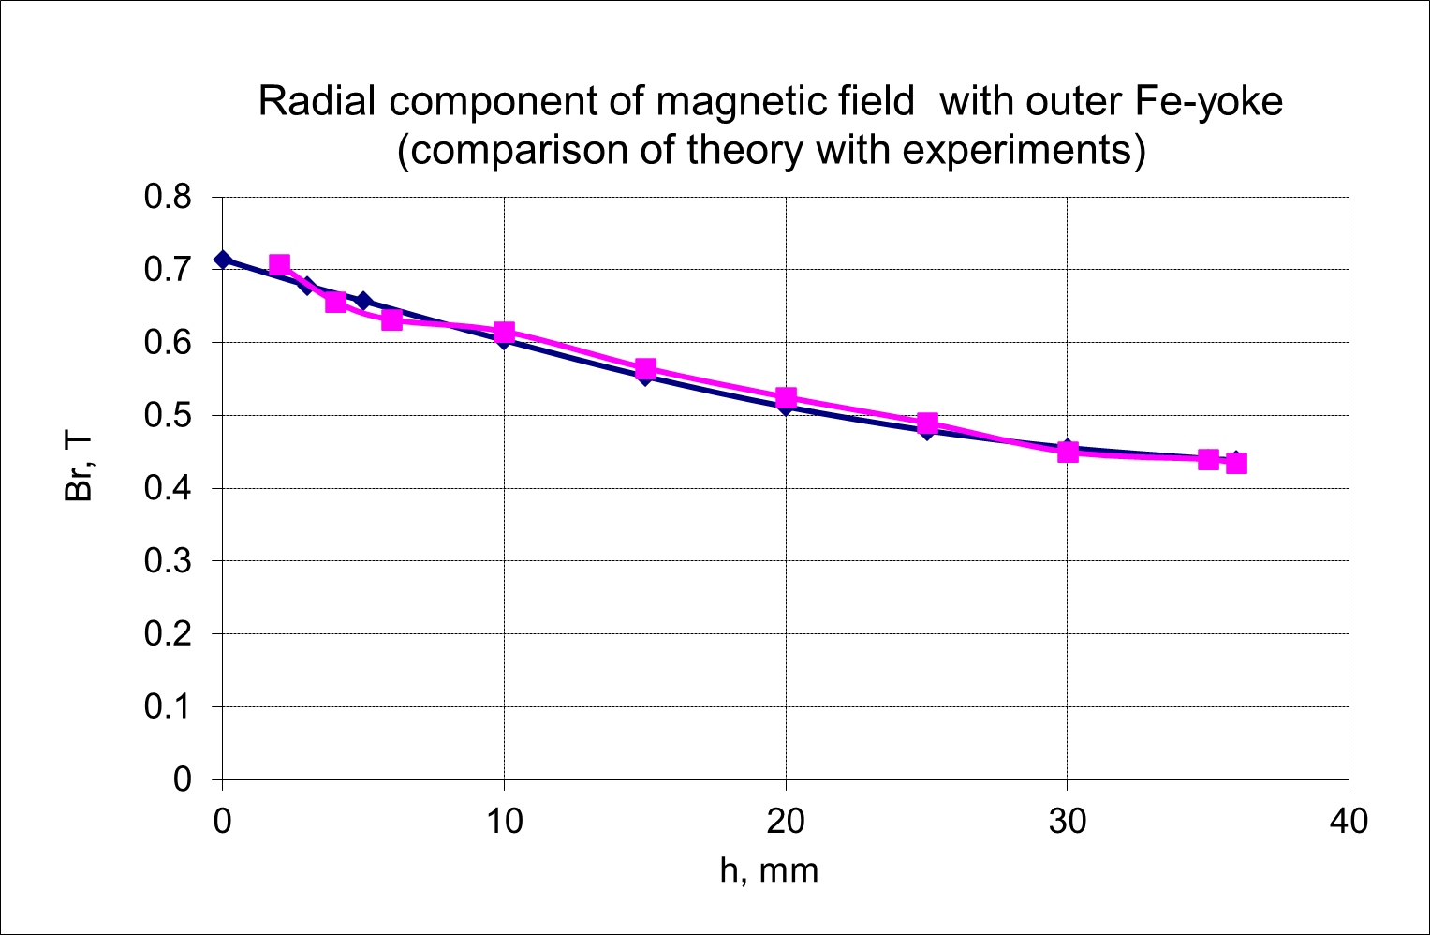
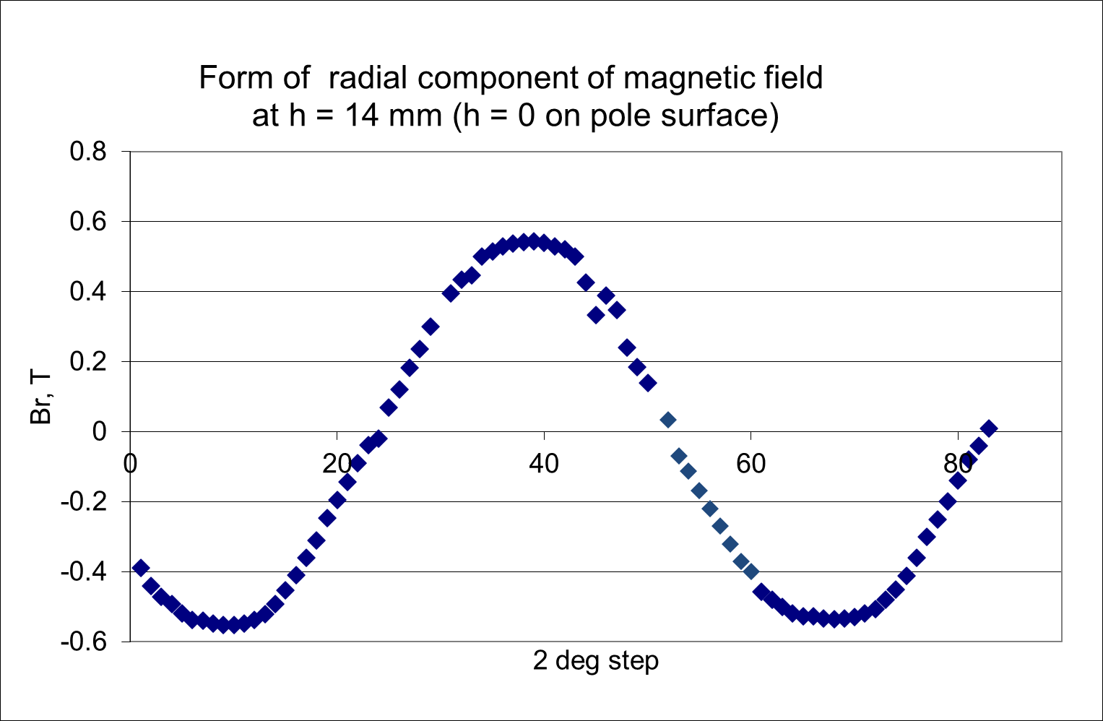
Magnetic field measurements
Measurements provide informatio for:
Testing simulation models
Estimation of EMP performance
Design modifications (e.g.channel height modification)

Slide 11
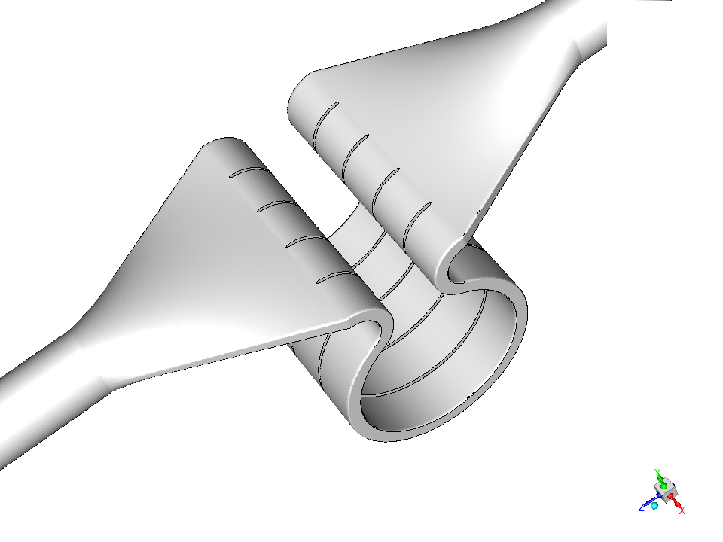
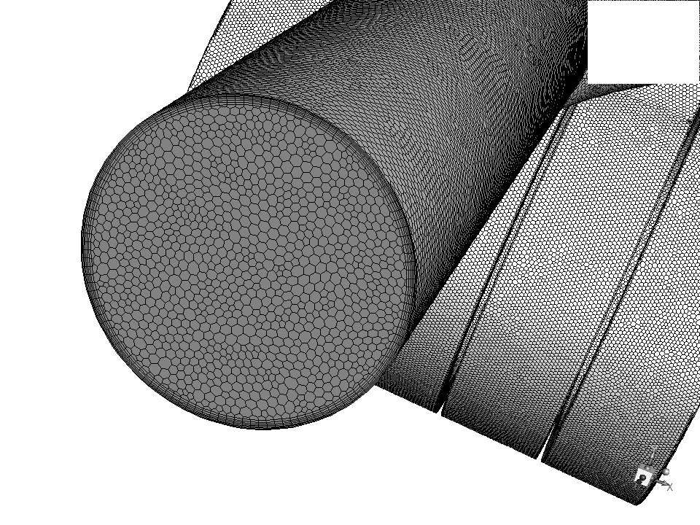
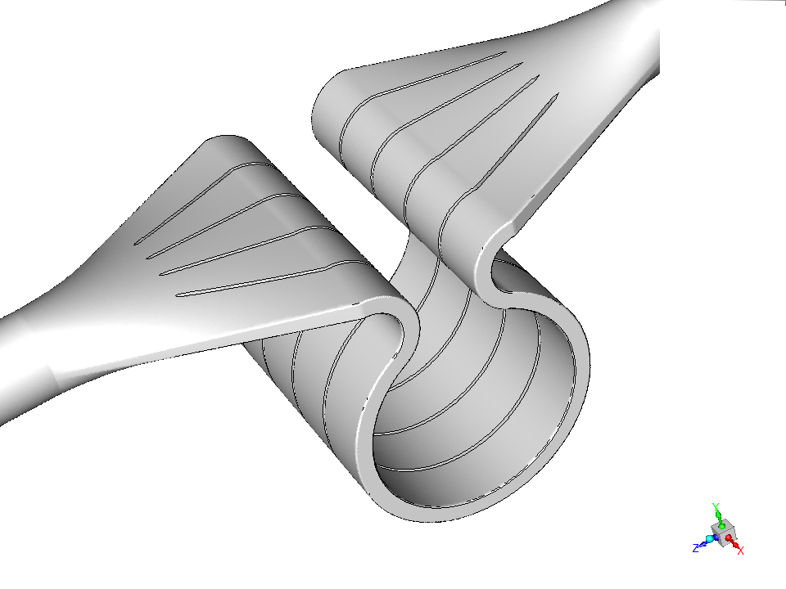
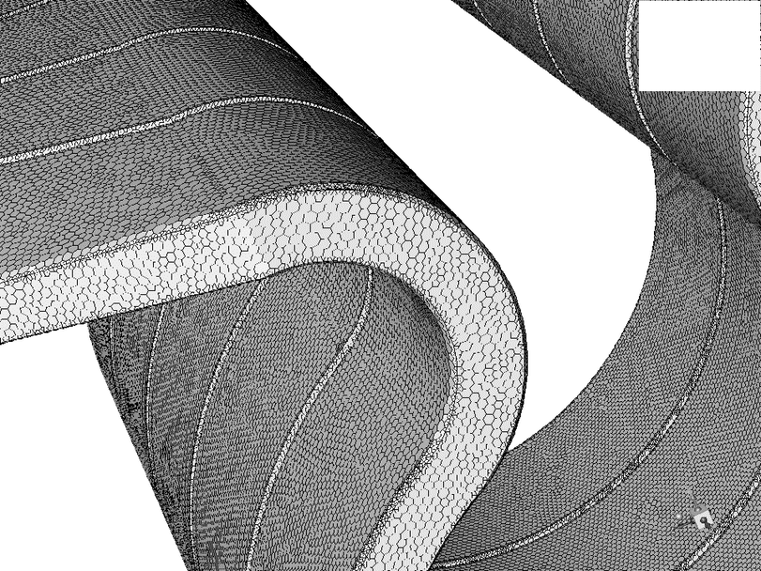
EMP integration in loop related activities
Mesh Size
Cells Faces Nodes
3379596 15563987 9737945

Slide 12
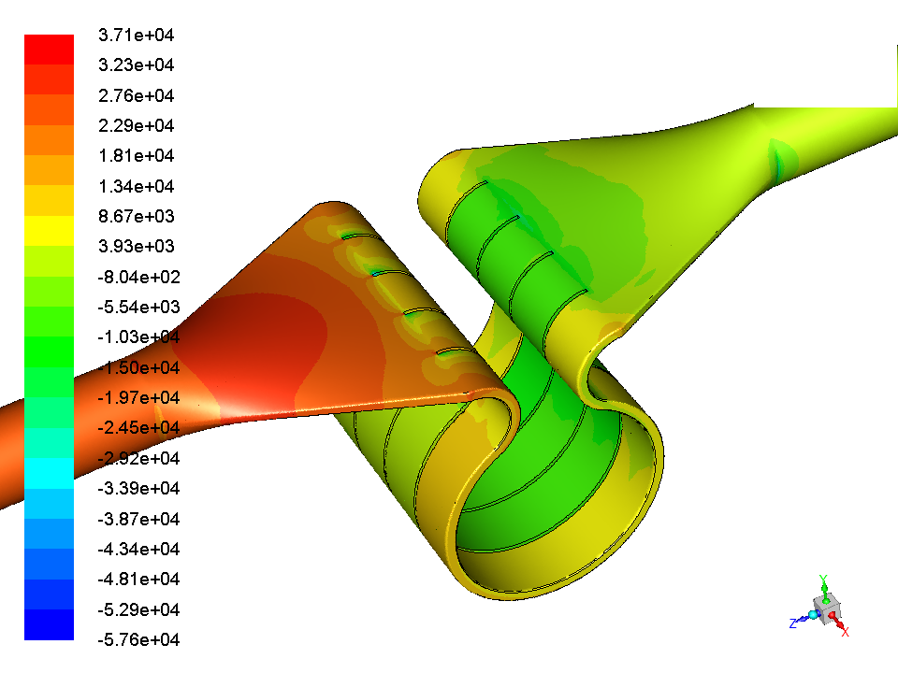
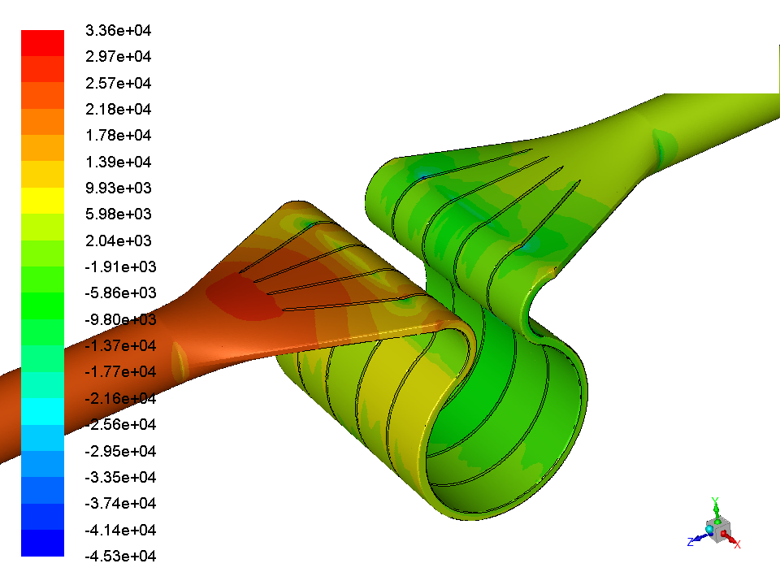
Pressure

Slide 13
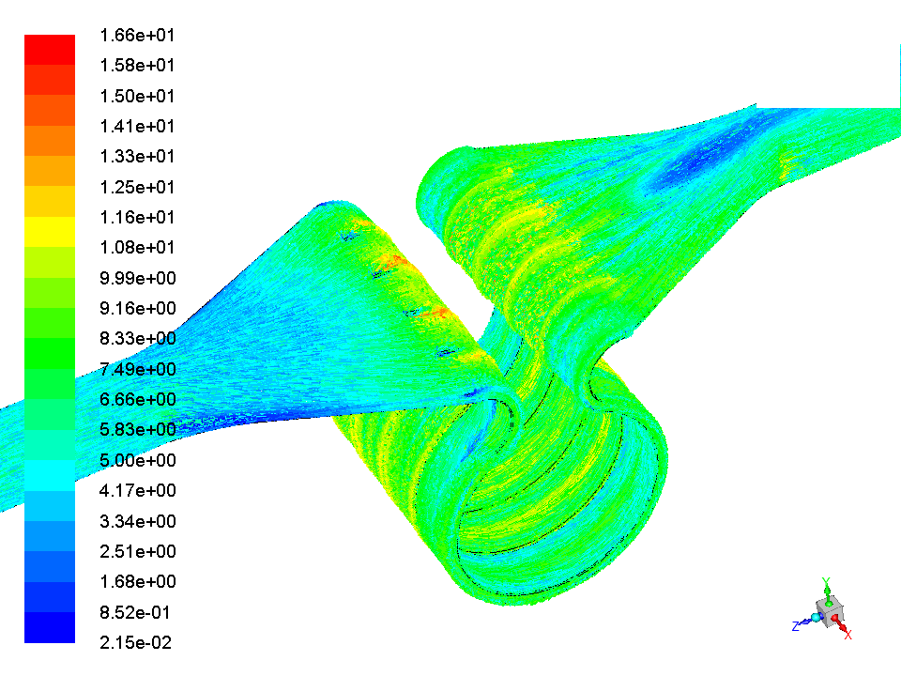
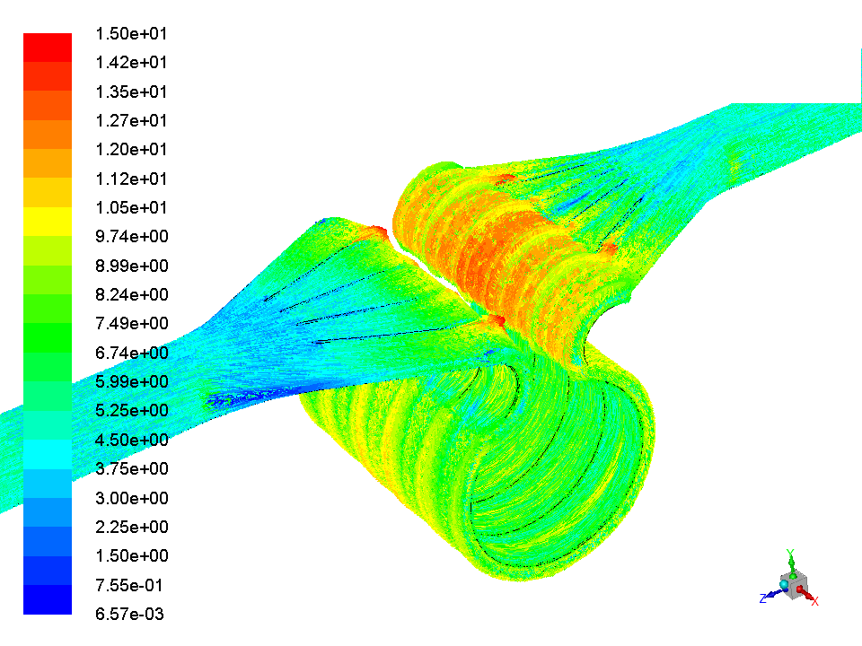
Velocity

Slide 14
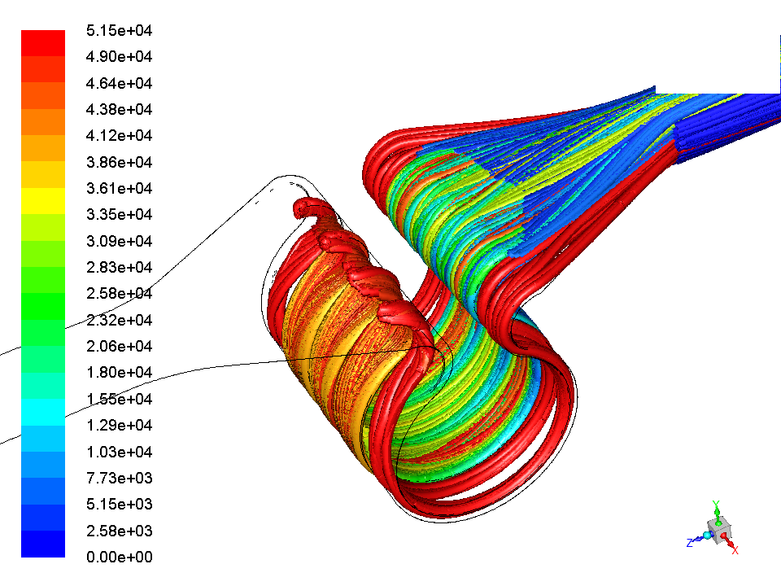
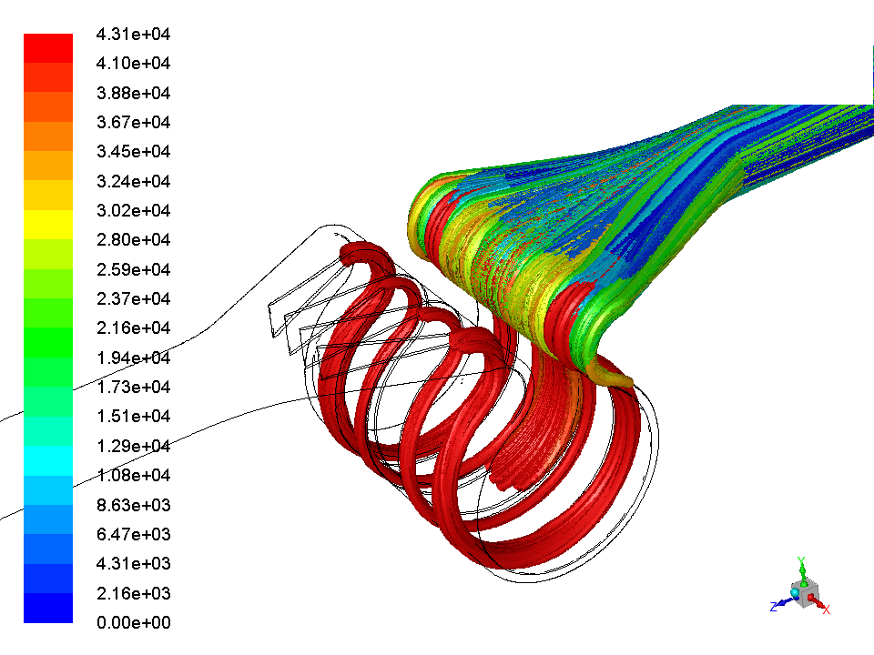
Pathlines from surface P_{inlet}+0.3 bar

Slide 15
Conclusions
Coast-down time can be effectiviely controled by increasing the moment of inertia of rotating EMP parts
Optimization of the design of the EMP for Li at 350 ºC by means of numerical codes is carried out and defines operation conditions for the flow rate of 100 l/s and pressure difference of 4 bar
EMP components tests provide useful information for verification of numerical simulations and design improvements
To reduce cavitation risks, local and global pressure drops should be avoided in EMP inlet zone

Slide 16
Thank you!

