Slide 1
ENS-5.2.3.1-T015-02 Update of the design of the alternative TLIC -2023
M. Tóth, A. Zsákai (EK-CER)

Slide 2
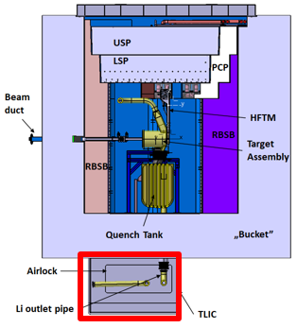
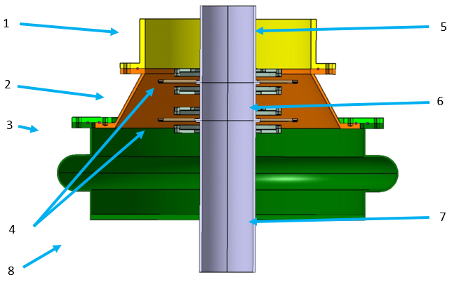
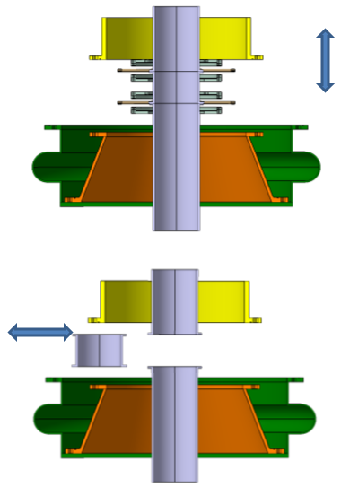
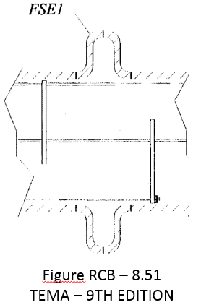
Task definition
Task description:
The aim of the task is to prepare some calculations on the previously proposed alternative design of the TLIC, with the Finite Element Analysis (FEA) method, in order to find out whether the design change is feasible at all.
Current design of TLIC
Conical alternative design

Slide 3
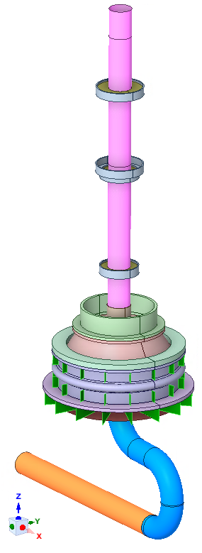
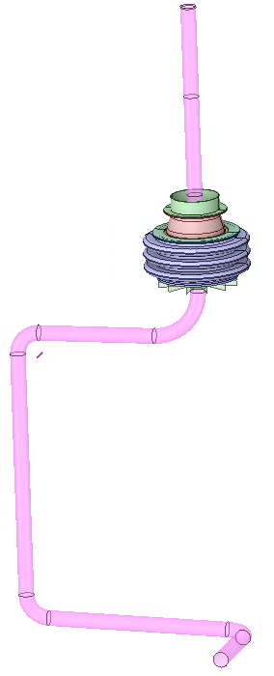
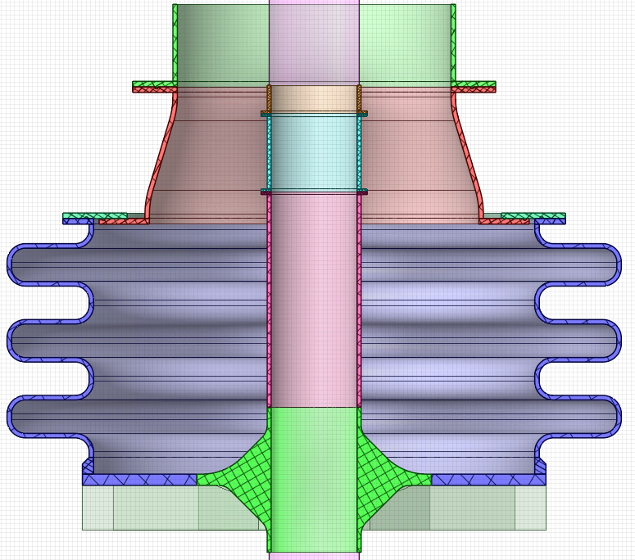
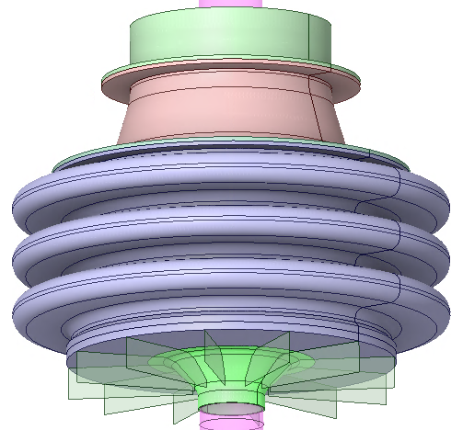
Design modifications
2023
Current alternative design

Slide 4
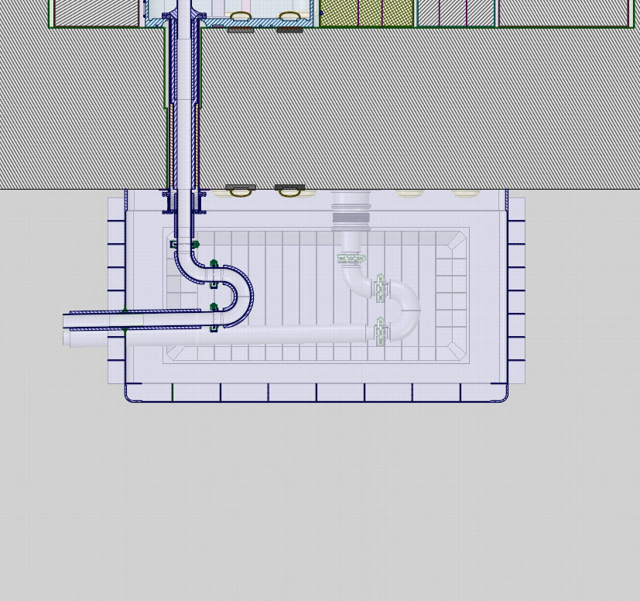
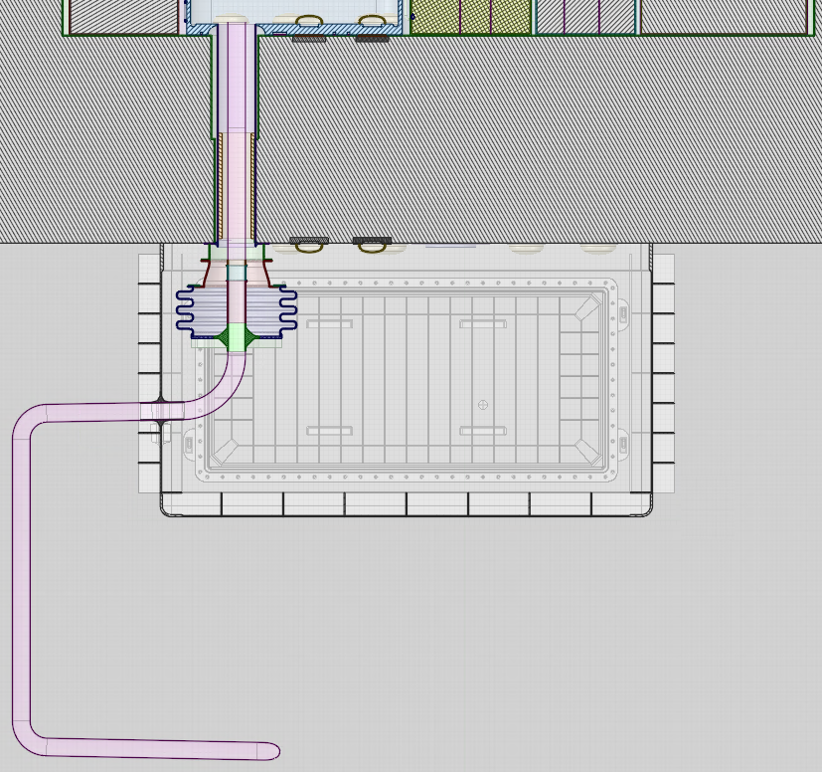
Design modifications
Current design
Alternative design
~900 mm
1100 mm

Slide 5
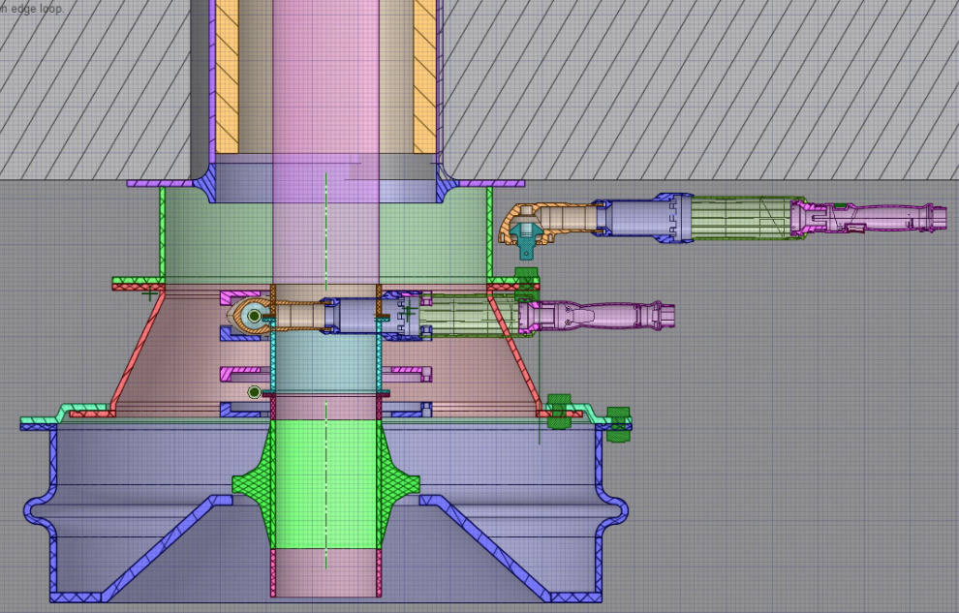

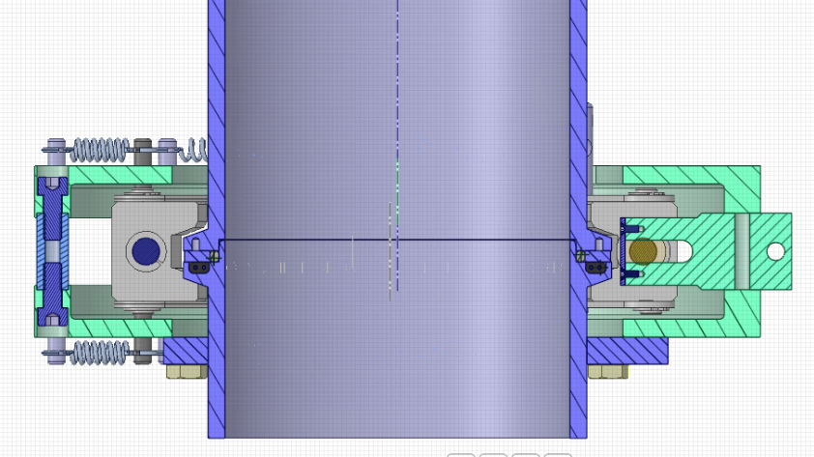
Simulation of maintenance

Slide 6
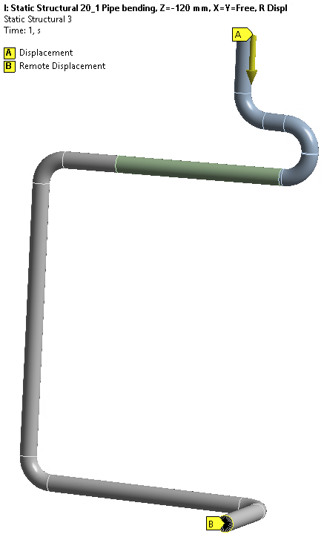
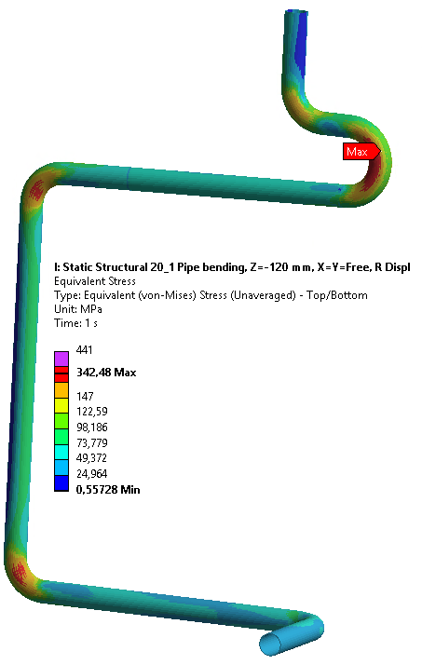


Simulation of maintenance

Slide 7
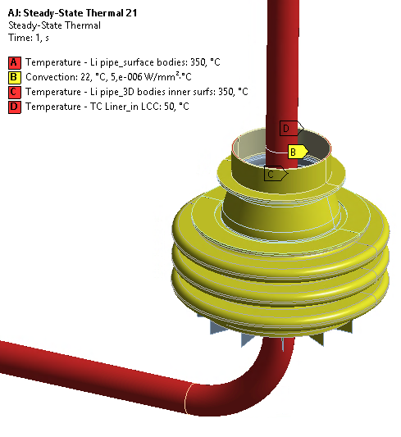
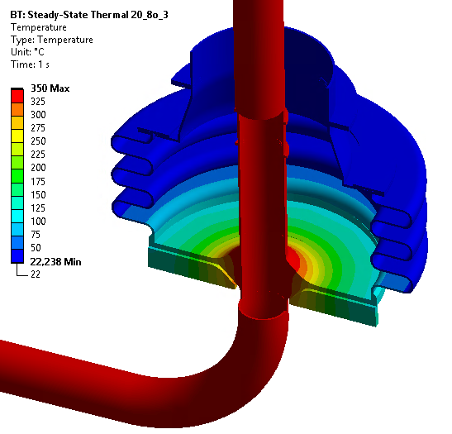
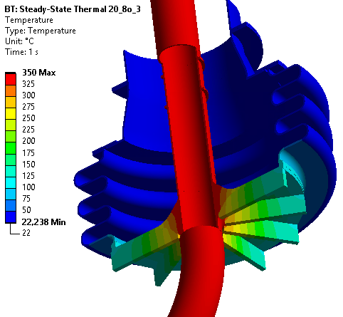
Thermal calculation
Envelope design 350 °C

Slide 8

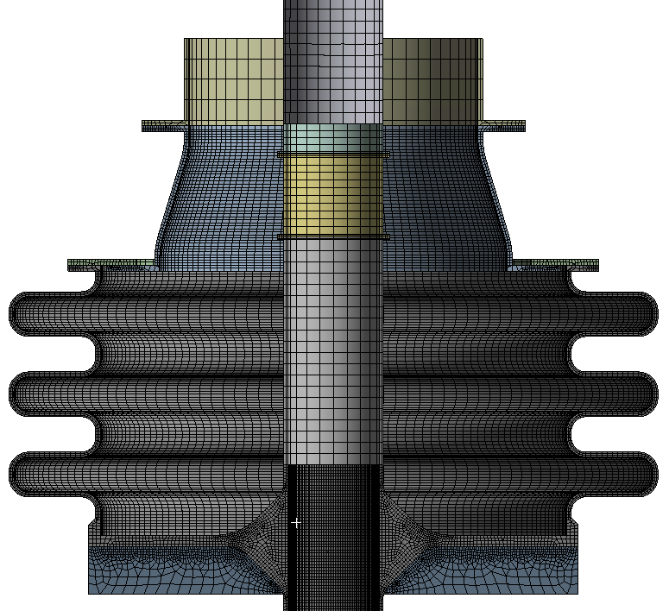
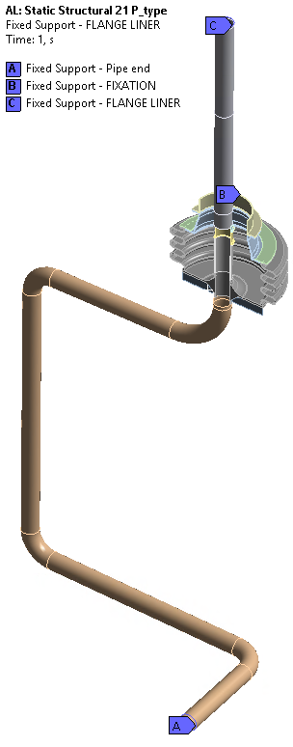
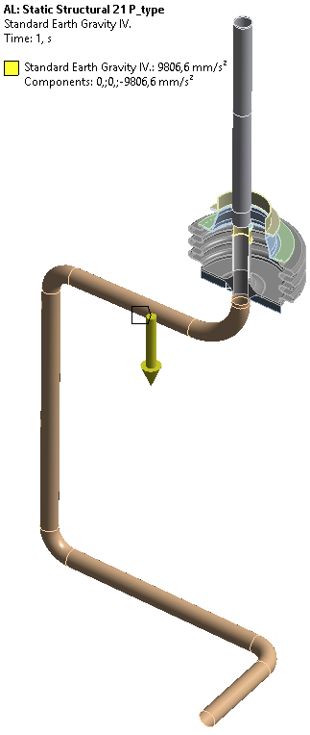
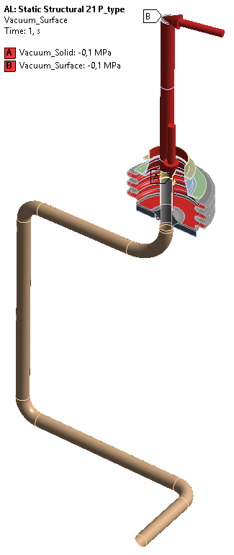
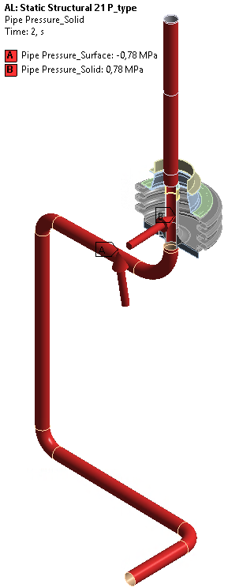
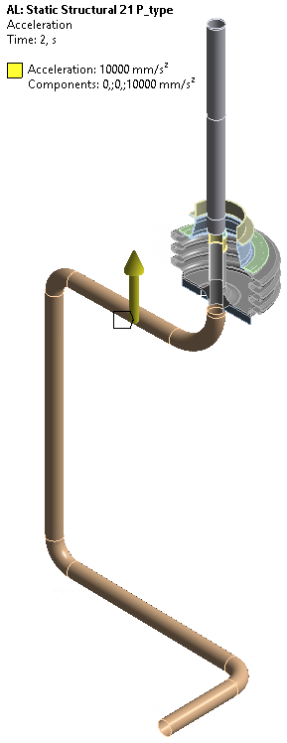
Simulation model, Constraints, Boundary conditions
All the contacts are ideally bonded ones (even between flanges where the bolts and sealings are)
Fix constraints
Loads taken into account:
  PRET: Bolt pretension
  SEALING: (Sealing forces)
  THO: Operational temperature
  DW: Standard Earth Gravity
  VP: Vacuum -1 [bar]
  PP: Li pipe inlet pressure 7.8 [bar]
  SL: Seismic load

Slide 9
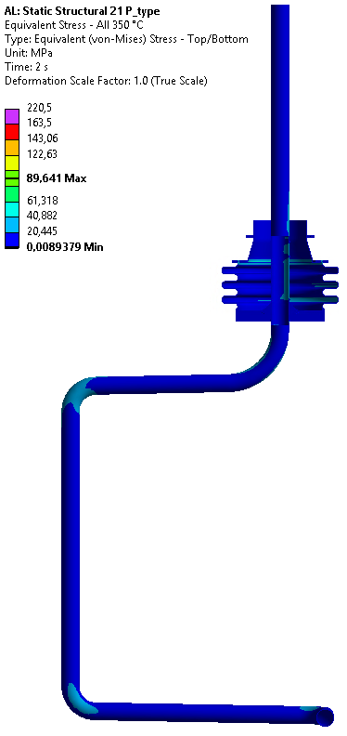
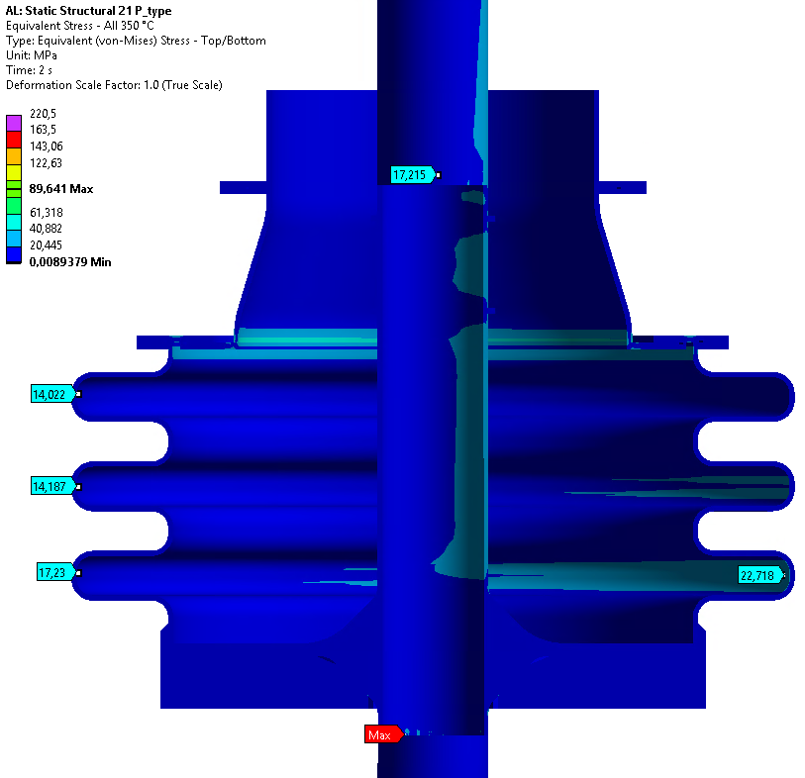
Results - Stress evaluation - P-type

Slide 10
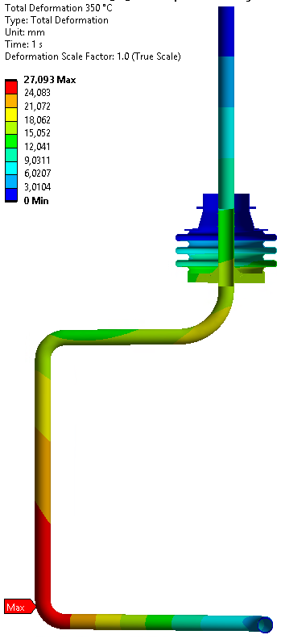
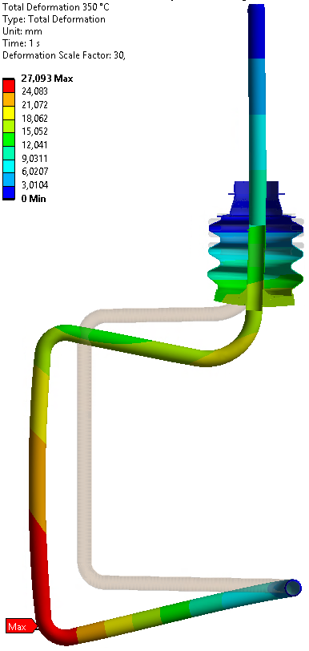
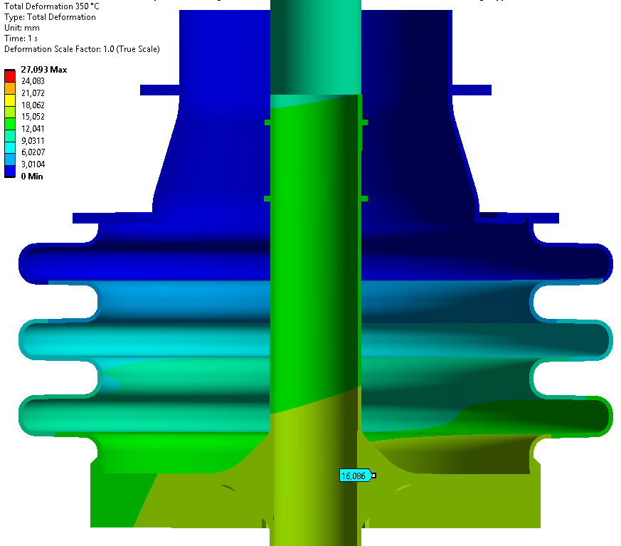
Results - Deformation - S-type
Deformation scale: x1
Deformation scale: x30

Slide 11
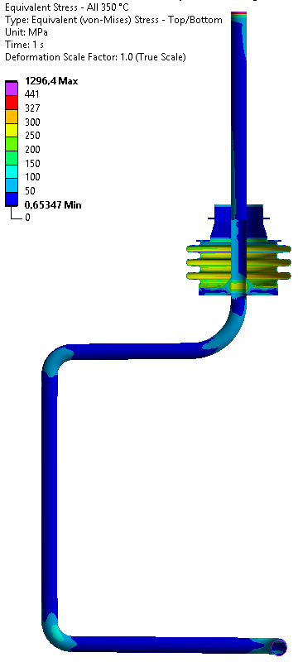
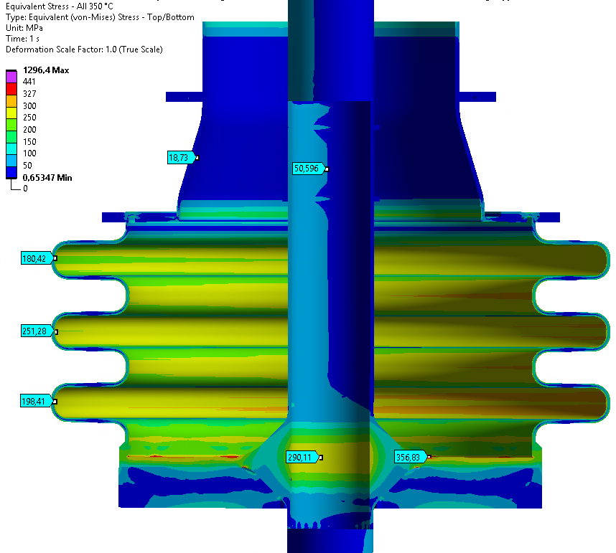
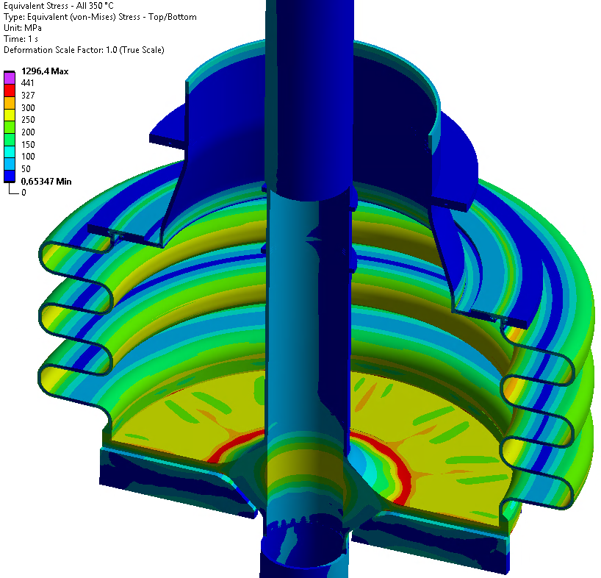
Results - Stress evaluation - S-type

Slide 12

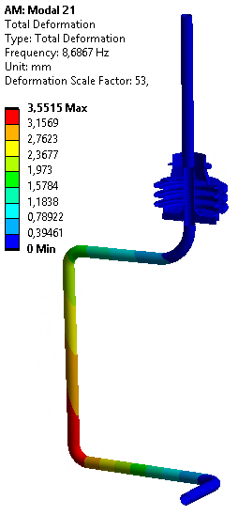
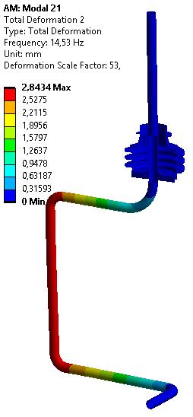
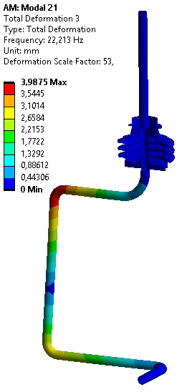
Results - Modal calculation

Slide 13
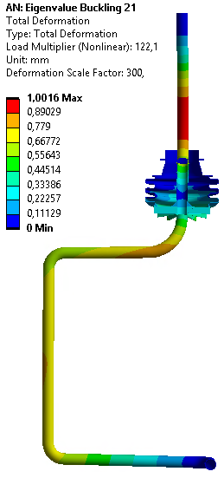
Results - Buckling calculation
Deformation scale: x300
Load Multiplier: 122.1

Slide 14
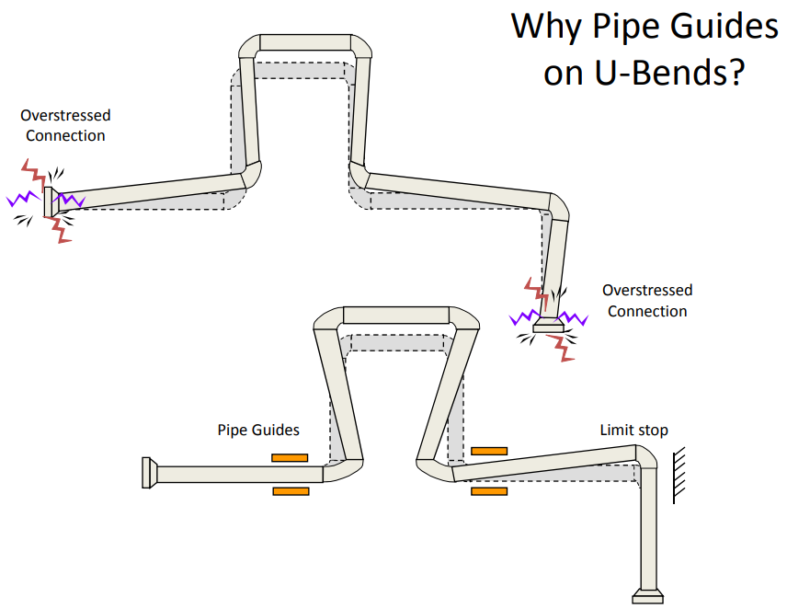
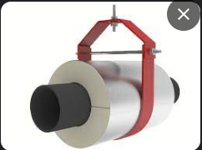
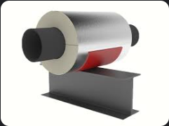
Further development ideas
Further developments could be:
Taking into account the new building and piping layout
Detailed design and optimization of the components
Taking into account the bolting and the sealing
Pipe guide

Slide 15
Thank you for your attention!

