Slide 1
EK-CER Contribution to the Lithium Systems
D. Ferenczy , D. Oravecz, A. Zsákai (EK-CER)

Slide 2
Task definition
Task description:
• Subtask ENS-5.2.4.1-T015-04 Update of the design of Quench Tank
The purpose of this task is to have a main update of the quench tank design and checking of structural integrity taking into account best practices from RCC-MRx code, needs and requirements from interfacing systems, remote handling and manufacturability. Update of the CAD model accordingly.
The following points should be addressed during the development:
• Detail (Thermo-)Mechanical analysis of the Quench tank
• Detailed structural integrity report including the interfaces with Test Cell
• Assessment of the required instruments and mechanical integration in QT
• Analysis and integration of the QT FDS, including RH compatibility assessment.
• Manufacturability
• CAD update

Slide 3
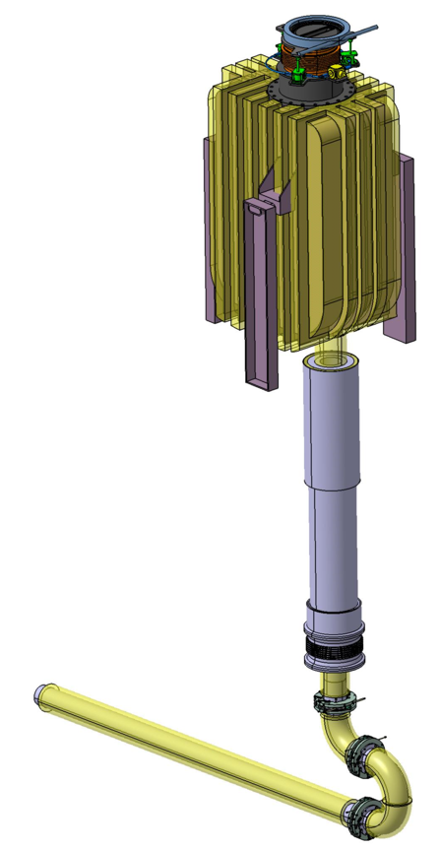
Design Objectives,Loads
Loads: themal, nuclear, seismic
Elimination of the outer ribs
easier thermal insulation installation
Considering different support structures
Simple installation and stability
Welded support
Simpler design
Outlet Plug Assembly Detailed design
Required for simulations

Slide 4
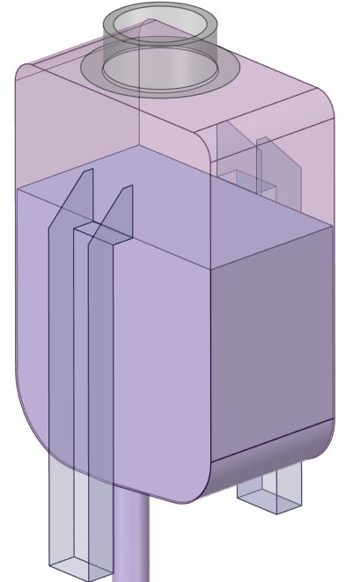
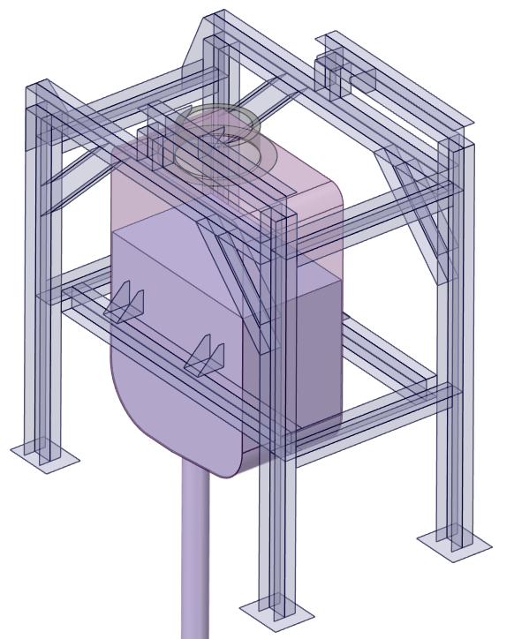
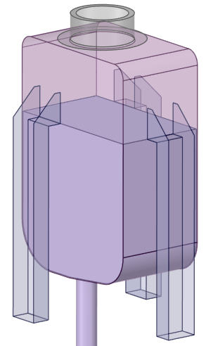
Preliminary Design Versions
2 leg version
3 leg version
Target assembly support version

Slide 5
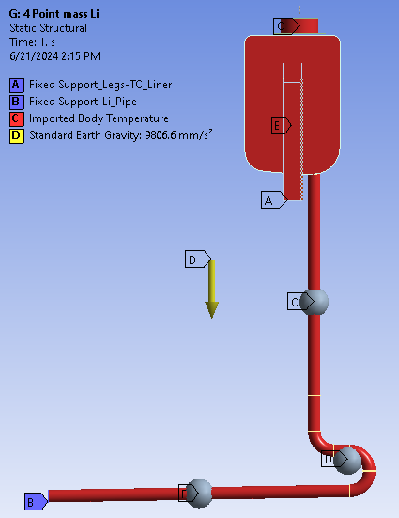
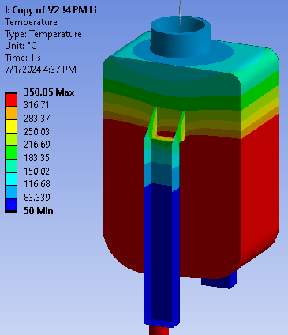
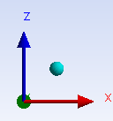
Preliminary Simulation models
Shell model
Uniform 350 C Li + Nuclear Heating (2 Beams)
Thermal Prestress– Static sctructural – Modal
Solid and Point mass scoped Lithium
Bellows modeled with spring connections

Slide 6
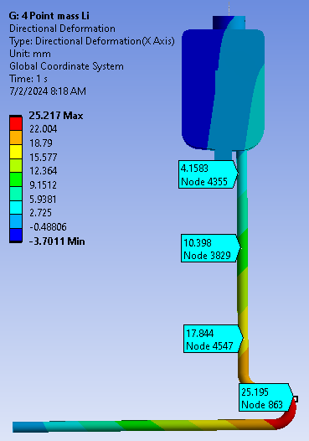
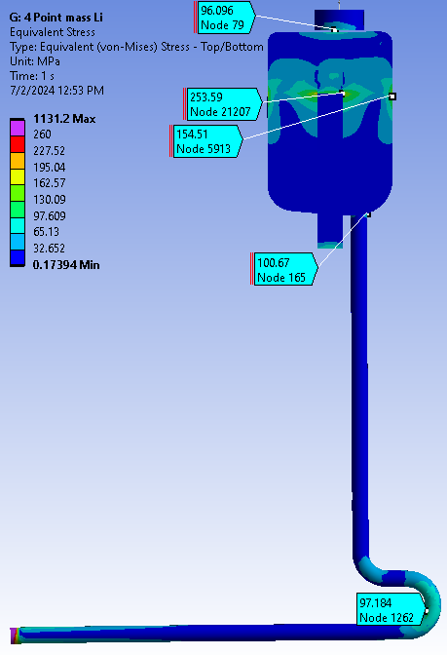
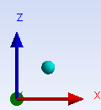
Preliminary Simulation Results

Slide 7
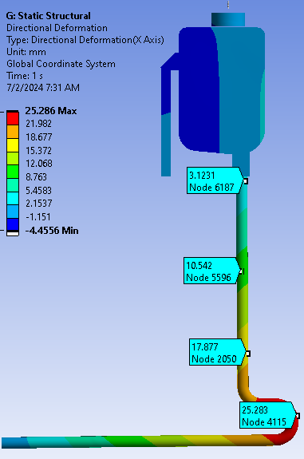
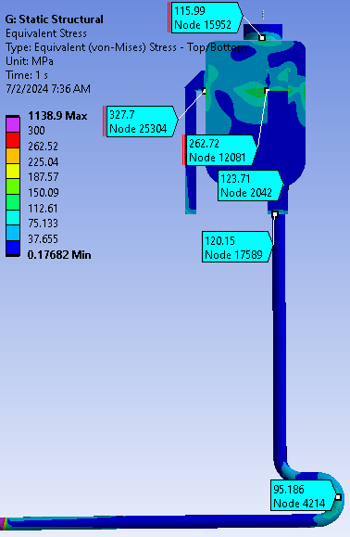
Preliminary Simulation Results

Slide 8
Preliminary Structural Simulations
2 leg version:
  Most simple design
  Eligible stress and displacement values for further developement of the model
  At least 2 segment thermal insulation
3 leg version:
  Same displacement values as the 2 Leg model, but
  Higher stress peaks and stress values at the QT
  At least 3 segment thermal insulation
Target assembly support version:
  3x bigger y direction deformation than the 2 and 3 Leg versions
  Higher stress values at the QT-support connection than at the 2 and 3 Leg versions
  At least 4 segment thermal insulation

Slide 9
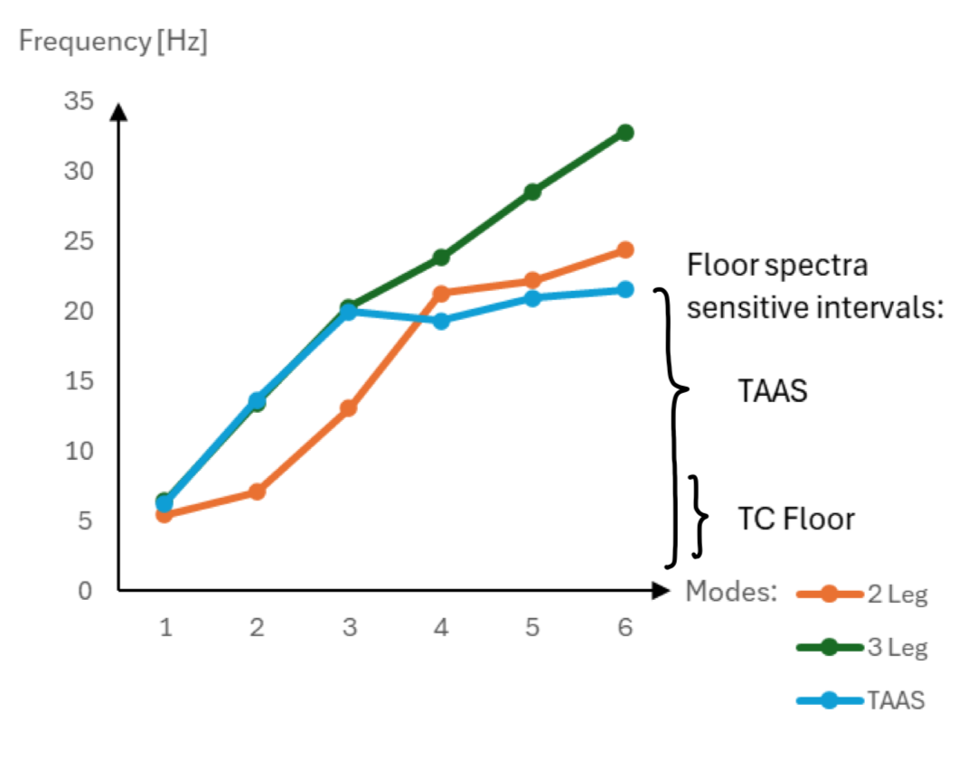
Preliminary Modal Analysis - Seismic response spectrum
Floor spectra source: 2QAPVV_v1
2 and 3 Leg version has no connection with TAAS
TAAS vesion has no direct connection with the TC floor
TAAS version has all the frequencies in the interval
2 Leg version's second frequency has <10% effective mass

Slide 10
Preliminary Simulation Conclusions
Li pipe OPA section deformation in x direction might result in interferece with the TC Liner
metal rings should be applied to protect the pipe insulation
Deformation in y direction:<1 [mm]
Expansion in z direction: 17 [mm]
the bellows can withstand the deformation
One mode is in the resonance frequency range
Design have to be adjusted

Slide 11
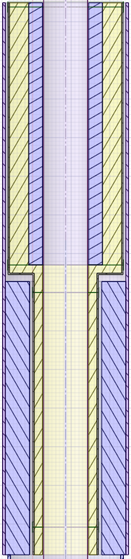
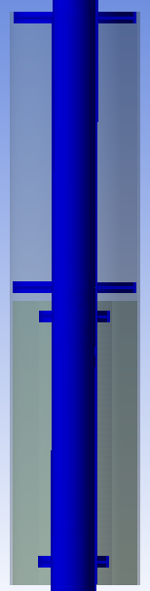
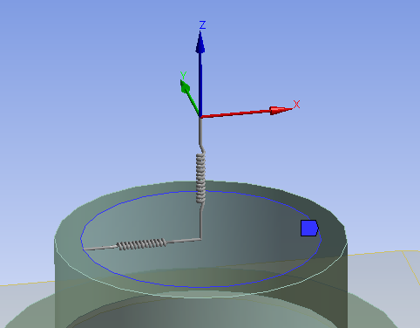
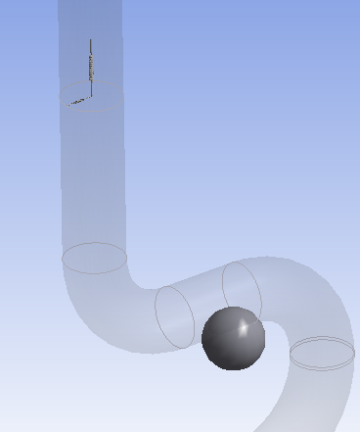
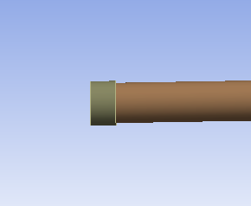
Updated OPA and simulation Model
TC Liner
Claddding
Insulation
Lithium
Pipe
Shielding
Protective
Metal Rings
Bellows' lateral stiffnesses are included
TC Liner and Shielding are rigid bodies
Sliding Li pipe support instead of fixed

Slide 12
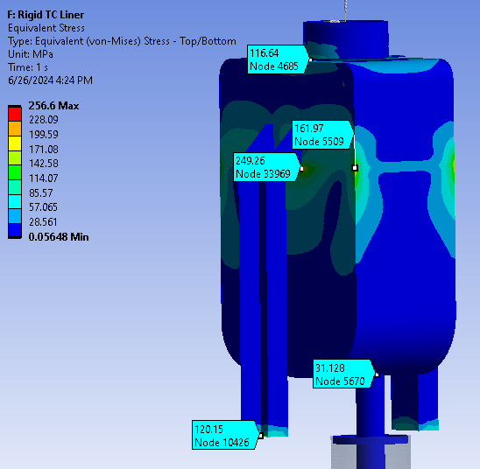
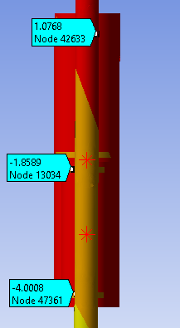
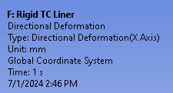
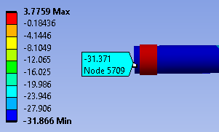
Updated OPA Model with 2 Leg support
Increased stress value due to lateral bellows stiffness
Decreased deformation due to lateral bellows stiffness and
the sliding support
Decreased stress value at the QT
outlet
Expansion a the TLIC outlet: 31 [mm]

Slide 13
Further Improvement plans
Thermal prestress has to be updated with a CFD heat map
Include the minimum required stiffening ribs to lower the stress on the QT walls
Run simulations with a detailed QT-leg welded connection/legs can be connected to the ribs
31 mm deformation should be considered at the Li pipe end that is connected to the heat removal system
Modal analysis results - the structure should be redesigned to elevate modal frequencies
Investigating the seismic load with a random vibration analysis
After the finalized version a detailed RCC-MRx analysis is out to be conducted

Slide 14
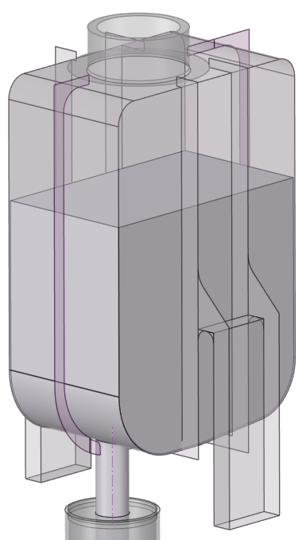
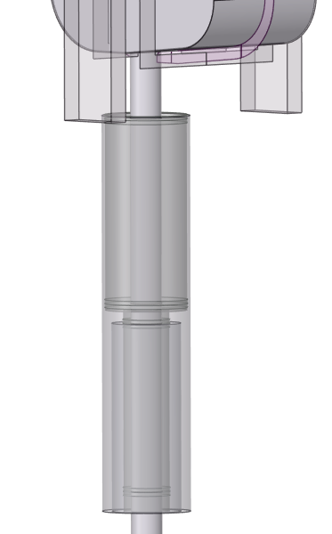
Next Model

Slide 15
Thank you for your attention!

