Slide 1
TM#17 Lithium Systems session
F. S. Nitti and J. Maestre

Slide 2
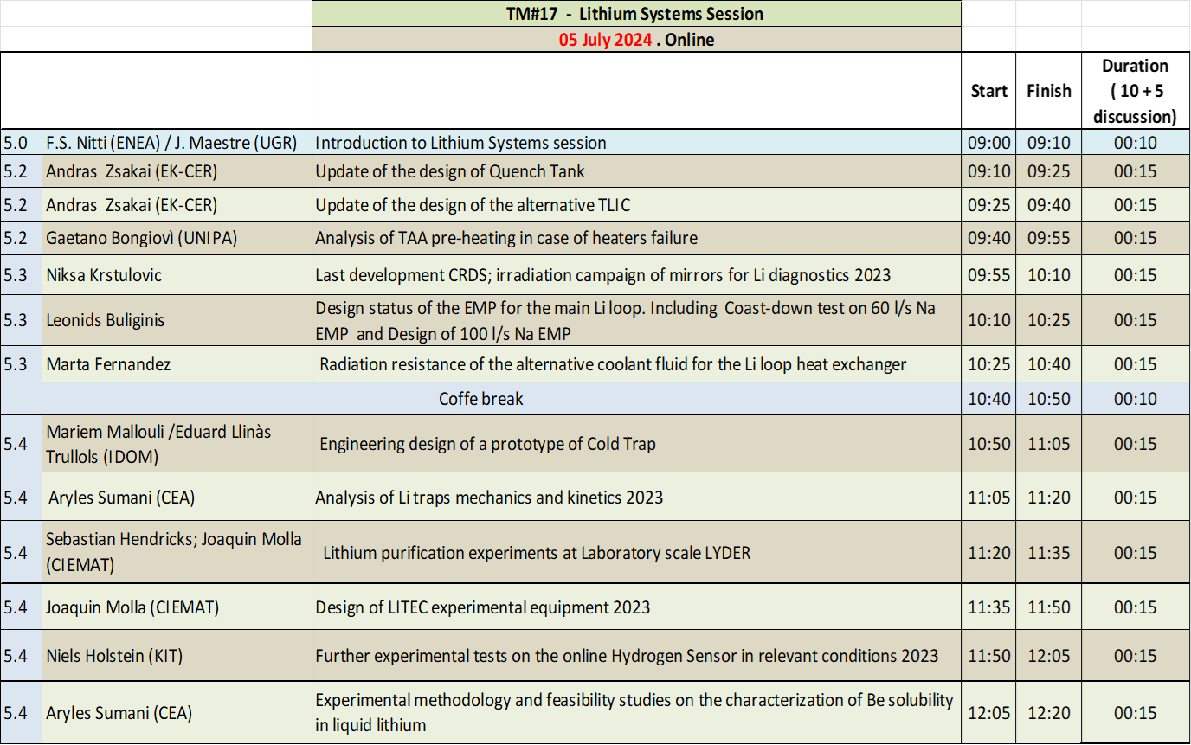
Agenda
TSY
HRL
ICS
Agenda and presentations can be found in
https://indico.ifmif-dones.es/event/35/
12 TALKS
Please, don’t forget to upload the presentation

Slide 3
Status of activities in LS
2021
2022
Total Tasks : 24
Total Tasks : 33
3 tasks are Experimental
Tasks Completed: 24
Tasks Completed: 27
2023
2024
Total Tasks : 28
4 tasks are Experimental
Total Tasks : 28
Tasks Completed: 11
Activities ongoing, to be concluded by December
Please, make an effort to complete the tasks in delay.

Slide 4
Overview of on-going activities in LS
Summary of Integrate activities
Update of the PLO and ICS layout allocated in the Lithium Loop Cell
1D Hydrodynamic model of the Lithium Loop
Summary of TSY activities
Analysis of TAA pre-heating in case of heaters failure
Thermo-mechanical and fluid-dynamic update of the TAS for the worst-case beams delivered by the accelerator systems
Transient hydrodynamic analysis of the TAA during start-up and shut down of the Lithium Loop
Experimental qualification of gaskets compatible with Li system in representative conditions
Manufacturing/detail design assessment of TAA
Update of the design of Quench Tank including Flow incoming unit
Fluid Structure Interaction Analysis of TAS Discharging Target Channel
Update of the design of the alternative TLIC
Conceptual Design of the Electrical Connectors for the Target Assembly
IVVS test on a flowing lithium target
Target Diagnostic based on RF
Desing of CRDS (and irradiation mirror test campaign)
TAS, QT & TLIC
Diagnostics & connetors
Summary of HRL activities
PLO
Final design of the EMP for the main Li loop
Radiation resistance of the alternative coolant fluid for the Li loop heat exchanger
SLO &TLO

Slide 5
Overview of on-going activities in LS
Summary of ICS activities
(Corrosion) Test Campaign for AISI 316L on Lifus-6 facility
Update distribution of CP and ACPs including trapping process
Tritium Migration studies in the LS (series of scenarios) [BAII]
Experimental methodology and feasibility studies on the characterization of Be solubility in liquid lithium
Design of experimental facility for characterization of Be in liquid lithium
Analysis of Li traps mechanics and kinetics
(Nitrogen) Getter material qualification
Design of LYDER experimental campaign and analysis of first results on Li-Yttrium system
Process for the determination of impurity contents in Li samples
Design and execution of experimental tests on online Hydrogen Sensors in relevant conditions
Design of LITEC experimental equipment: traps
Prototype of the Electrochemical Hydrogen Sensor for LITEC
Prototype of the Resistivity meter for LITEC
Integrated analysis
Trapping related
Imp. monitoring
LITEC related
Summary of LSA activities
Design of grounding system

Slide 6
Thank you for the Attention !!
And for your collaboration
francesco.nitti@enea.it
jorge.maestre@ifmif-dones.es

