Slide 1
Low Energy Proton and Helium Beam Irradiation and Post Irradiation Examination Plan for the Study of Second Target Station Beam Interception Materials
Yongjoong Lee
On behalf of
T. Lach, TS Byun, T. Muth, J. Montross and J. Mach
9th Annual RaDIATE Collaboration Meeting

Slide 2
Irradiation and PIE of OFHC copper specimens

Slide 3
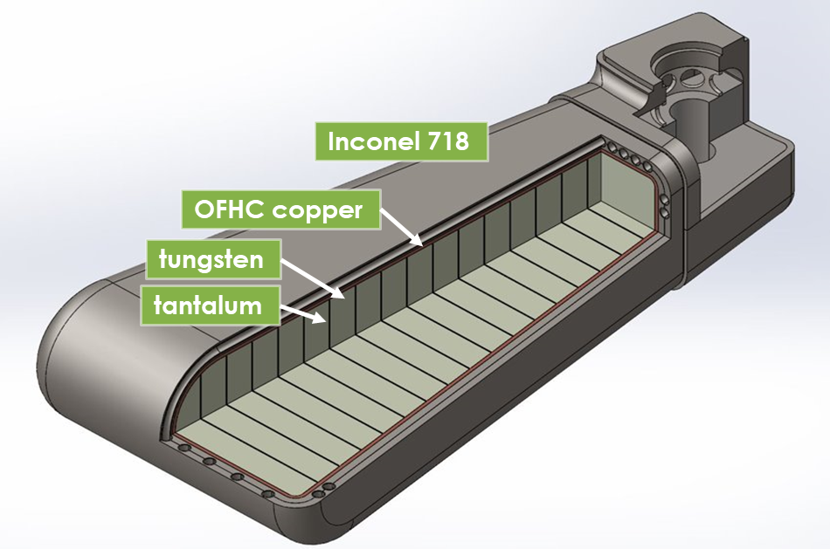
STS Target Materials
Water-cooled rotating tungsten target
  Beam power: 700 kW distributed in 20 independent segments
  Beam energy: 1.3 GeV pulsed at 15 Hz with 700 ns pulse length
  Edge-cooling of tungsten via water channels machined in the structural outer skin made of Inconel 718
  Rolled tungsten plates diffusion bonded to each other with thin tantalum foils
  Spallation volume is bonded to alloy 718 skin via thermal interface material – OFHC copper
Justin Mach (16:10 on Tuesday) for more details about target fabrication R&D

Slide 4
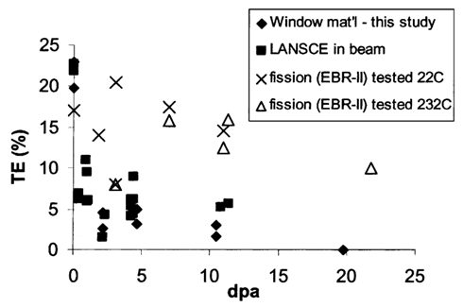
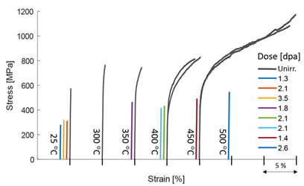
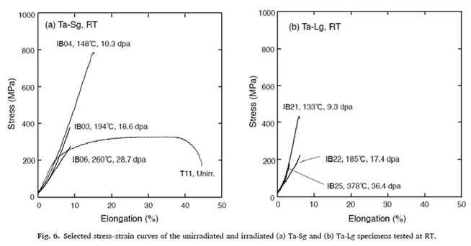
STS Target Materials – Radiation Damage
Inconel 718
  PIE of proton damaged PBWs
    SNS: 9.7 DPA, 1833 He-appm, 7211 H-appm [D. A. McClintock et al., Acta Materialia 231 (2022) 117889]
    LANSCE: 20 DPA at 400oC [M. R. James et al., JNM 296 (2001) 139-144]
  Damage Dose Limit Guide:
    Retains > 5% TE at ~10 DPA
    Unknowns: Fatigue; Nb-94 disposal path
Tantalum
  Successful operations records: TS1 and TS2 at ISIS and L1 target at LANSCE
  PIE data on Ta irradiated in spallation environments
    Tantalum Target at ISIS: Tensile data up to 11 dpa [J. Chen et al., JNM 298 (2001) 248-254]
    STIP Sample: 10.3-36.4 dpa [S. Saito et al., NME 34 (2023) 101338]
Tungsten
  Non-structural
  PIE of STIP samples
    Flexural strength: up to 3.5 DPA [J. Habainy et al., JNM 514 (2019) 189-195]
    Thermal diffusivity: up to 5.8 DPA [J. Habainy et al., JNM 509 (2018) 152-157]; up to 26.5 DPA [H. Sina et al., JNM 601 (2024) 155324]

Slide 5
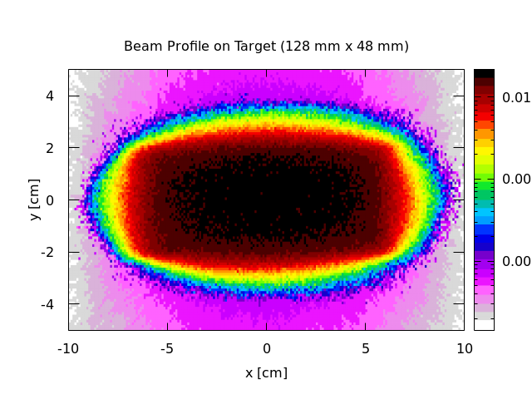
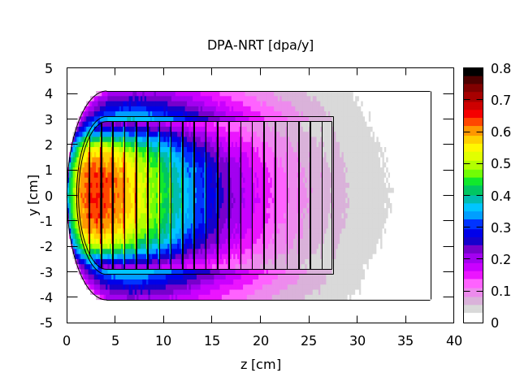
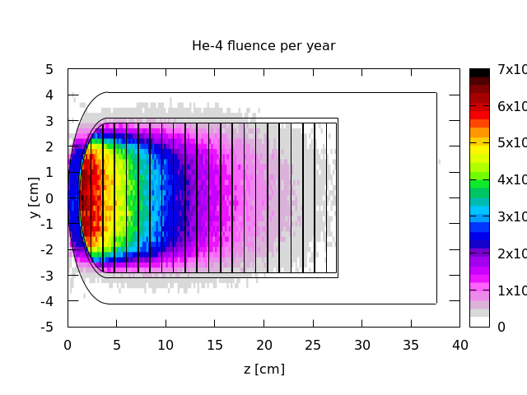
Copper – High He Production Rate
Radiation Damage and Gas Production
Material | Dpa/y | He-appm/y | He-appm/dpa
Tungsten | 0.8 | 84 | 100
Tantalum | 0.8 | 81 | 100
Copper | 0.9 | 42 | 50
Inconel | 0.6 | 41 | 70
Most concerns with copper in spallation environments are:
  Radiation induced void swelling with growing helium bubbles
  Radiation induced helium embrittlement
Swelling and helium embrittlement data are scares with such a high He-appm/dpa ratio

Slide 6
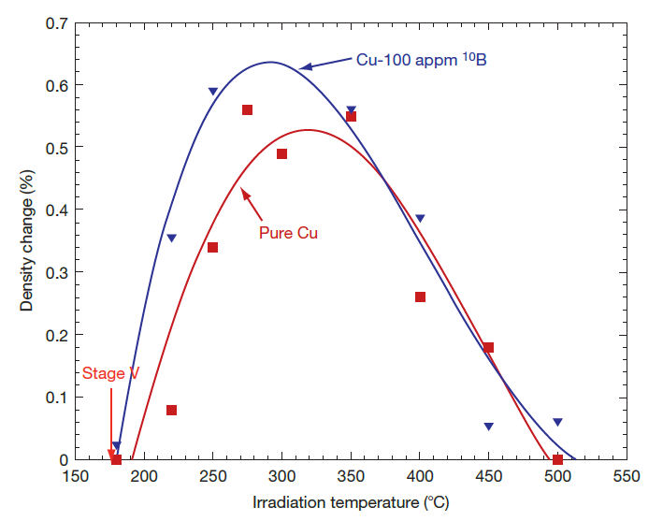
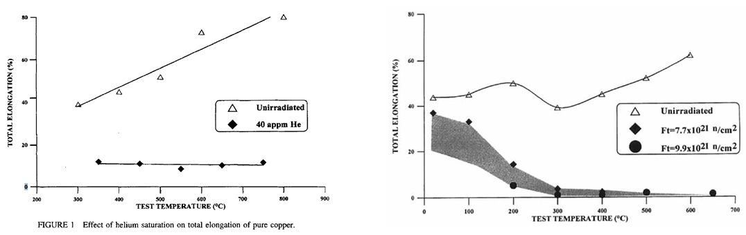
Copper – Radiation Induced Swelling and Embrittlement
Void Swelling
  Temperature Range: 180 – 550 C with a peak at 275 – 325 C
    With 100 He-appm at 1.2 DPA the swelling set off point is about 10 C lower than < 1 He-appm at 1.0 DPA
    The peak swelling temperature shifted by 20 C for a lower dose rate: 2e-7 dpa/s vs 2e-8 dpa/s (STS: 5e-8 dpa/s)
  Peak Swelling Rate: ~0.5 %/DPA
Helium Embrittlement
  Cyclotron with He at E = 40 MeV
    Helium saturated at 40 He-appm
  BOR-60 reactor: Sodium cooled fast reactor
    Fast neutron fluence (~ 2 DPA)
      7.7 - 9.9e21 n/cm2 (Trad = 335 - 345 C)
    Swelling: 3.8%
    2 He-appm => “disastrous” embrittlement
What would be the characteristics of swelling and helium embrittlement
in STS target environment (> 1 DPA & > 100 He-appm)?
S. J. Zinkle et al., JNM 168 (1989) 262;
S. J. Zinkle et al., JNM 179-181 (1991) 994.
S. A. Fabritsiev et al., Plasma Devices and Operations (1997), vol.-5, 133-141

Slide 7
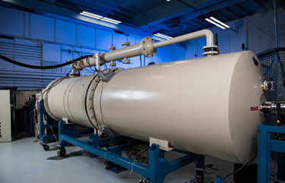
Low Energy Proton/Helium Beam Irradiation
Michigan Ion Beam Laboratory
  3 MV Tandem particle accelerator
    Proton beam < 5.8 MeV/30 uA
  1.7 MV Tandem particle accelerator
    Helium beam < 4.5 MeV/1 uA
Low energy proton/helium irradiation
  > 0.1 dpa in a day beamtime
  > 100 He-appm in a day beamtime
  Sample activation below background
    Beam energy shall be tuned below Coulomb barrier
    Affordable PIE cost by not requiring hotcell operation
  Irradiation temperature shall be high enough to avoid blistering

Slide 8
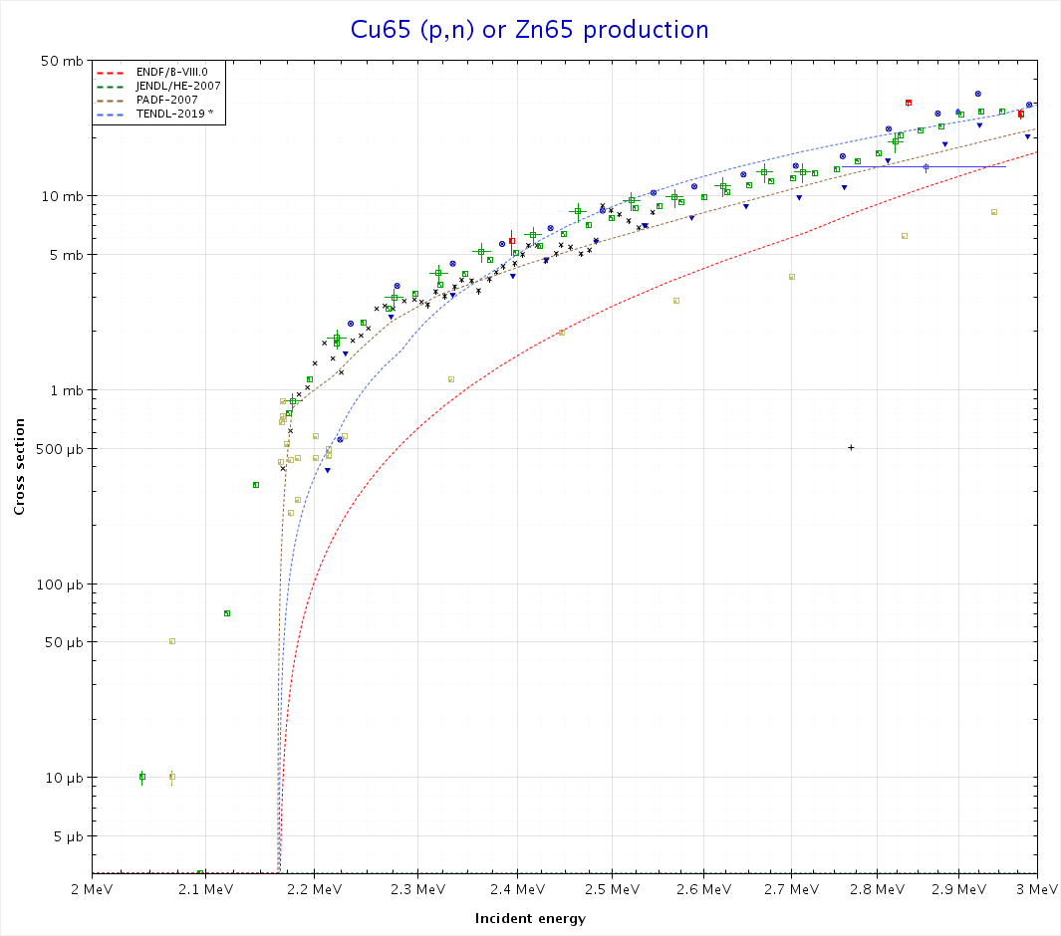
Sequential Proton and Helium Irradiation
Irradiation Sequence
  Step 1: Proton Irradiation
    Below Cu-65 (p,n) Zn-65 (244d HL) => 2 MeV
    Beam current: 20 uA (1.25e14 p/cm2)
    To avoid blistering on the surface => Irradiation temperature at 300 C
      For a 2 MeV beam, the blistering threshold at 150 C is 4.5e18 p/cm2
  Step 2: Helium Irradiation
    Multiple beam energies with max. 4.5 MeV = 1.25 MeV/nucleon => No risk of activation
    Beam current: 0.2 uA (1.25e12 He/cm2)
    Irradiation temperature at 100 C to avoid in situ swelling
V. T. Taskaev et al., IPAC2018 (2018) MOPML063

Slide 9
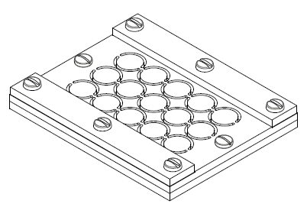
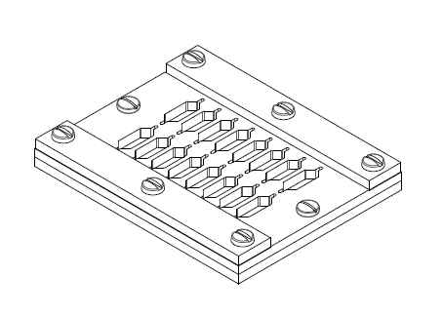
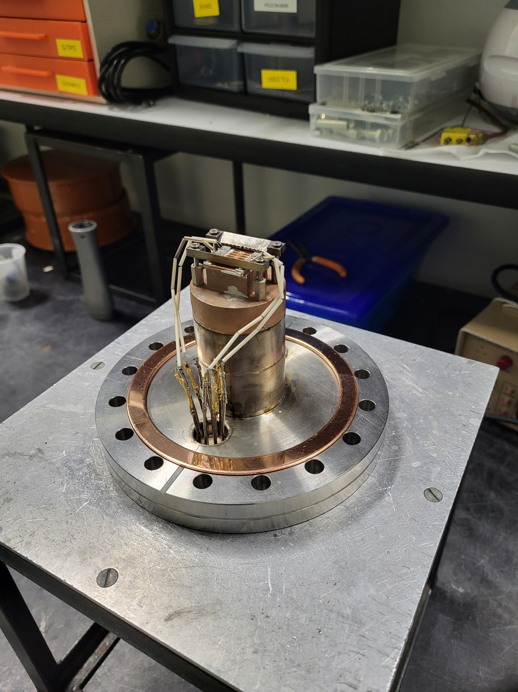
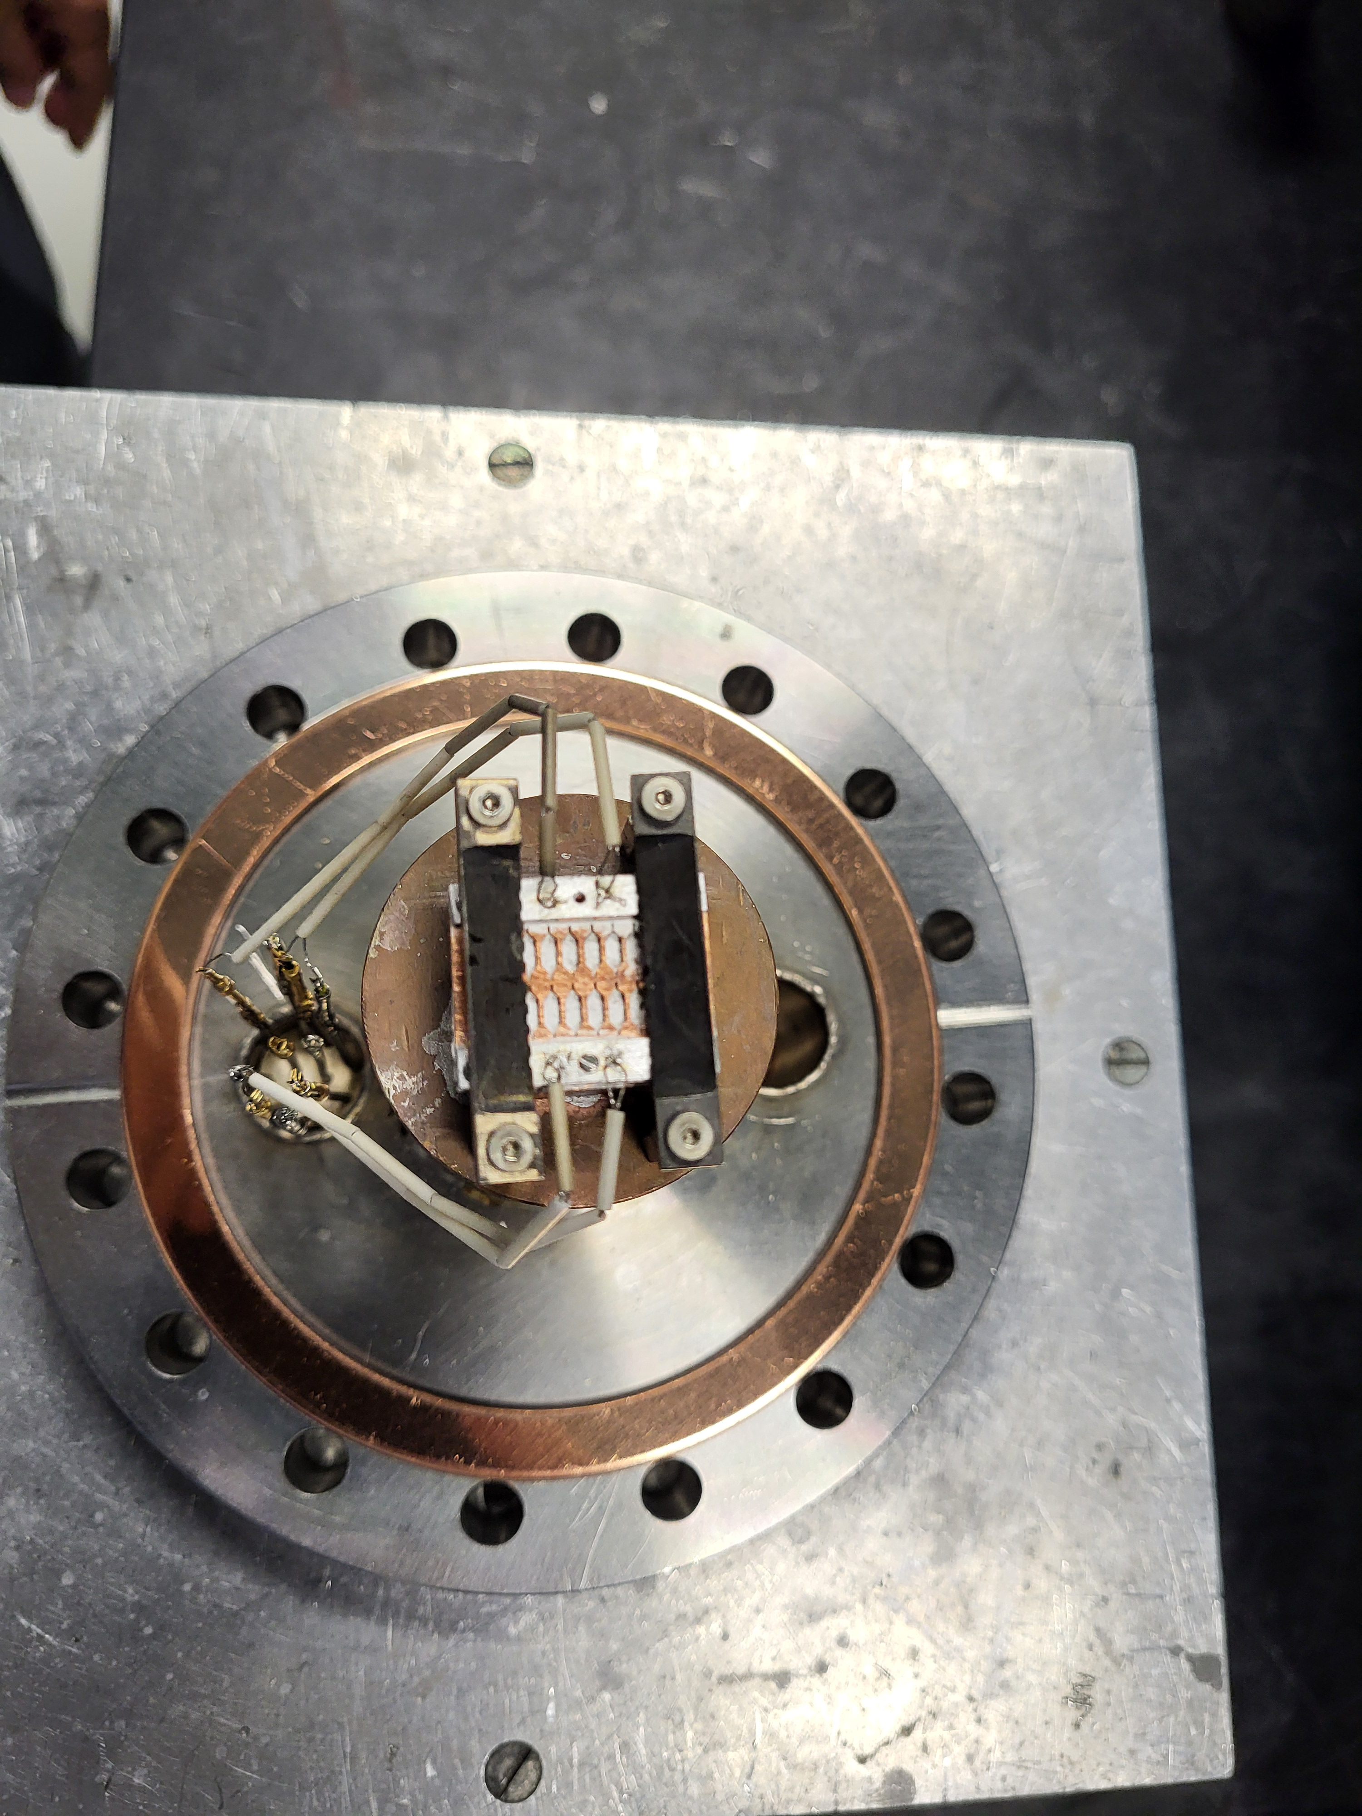
Sample Assembly
4 sample sets
  Miniature tensile specimens – As received and annealed at 950 C
  TEM discs - As received and annealed at 950 C
Each sample set consists of three layers
  Beam stopping plate made of copper
  Sample plate
  Sample holder made of pure aluminum to which TCs are attached
The three plates are screwed together with contact surfaces glued together with silver thermal pastes.
  Sample sets are glued to the sample mount with silver thermal pastes.
  Well defined heat path to the sample mount

Slide 10
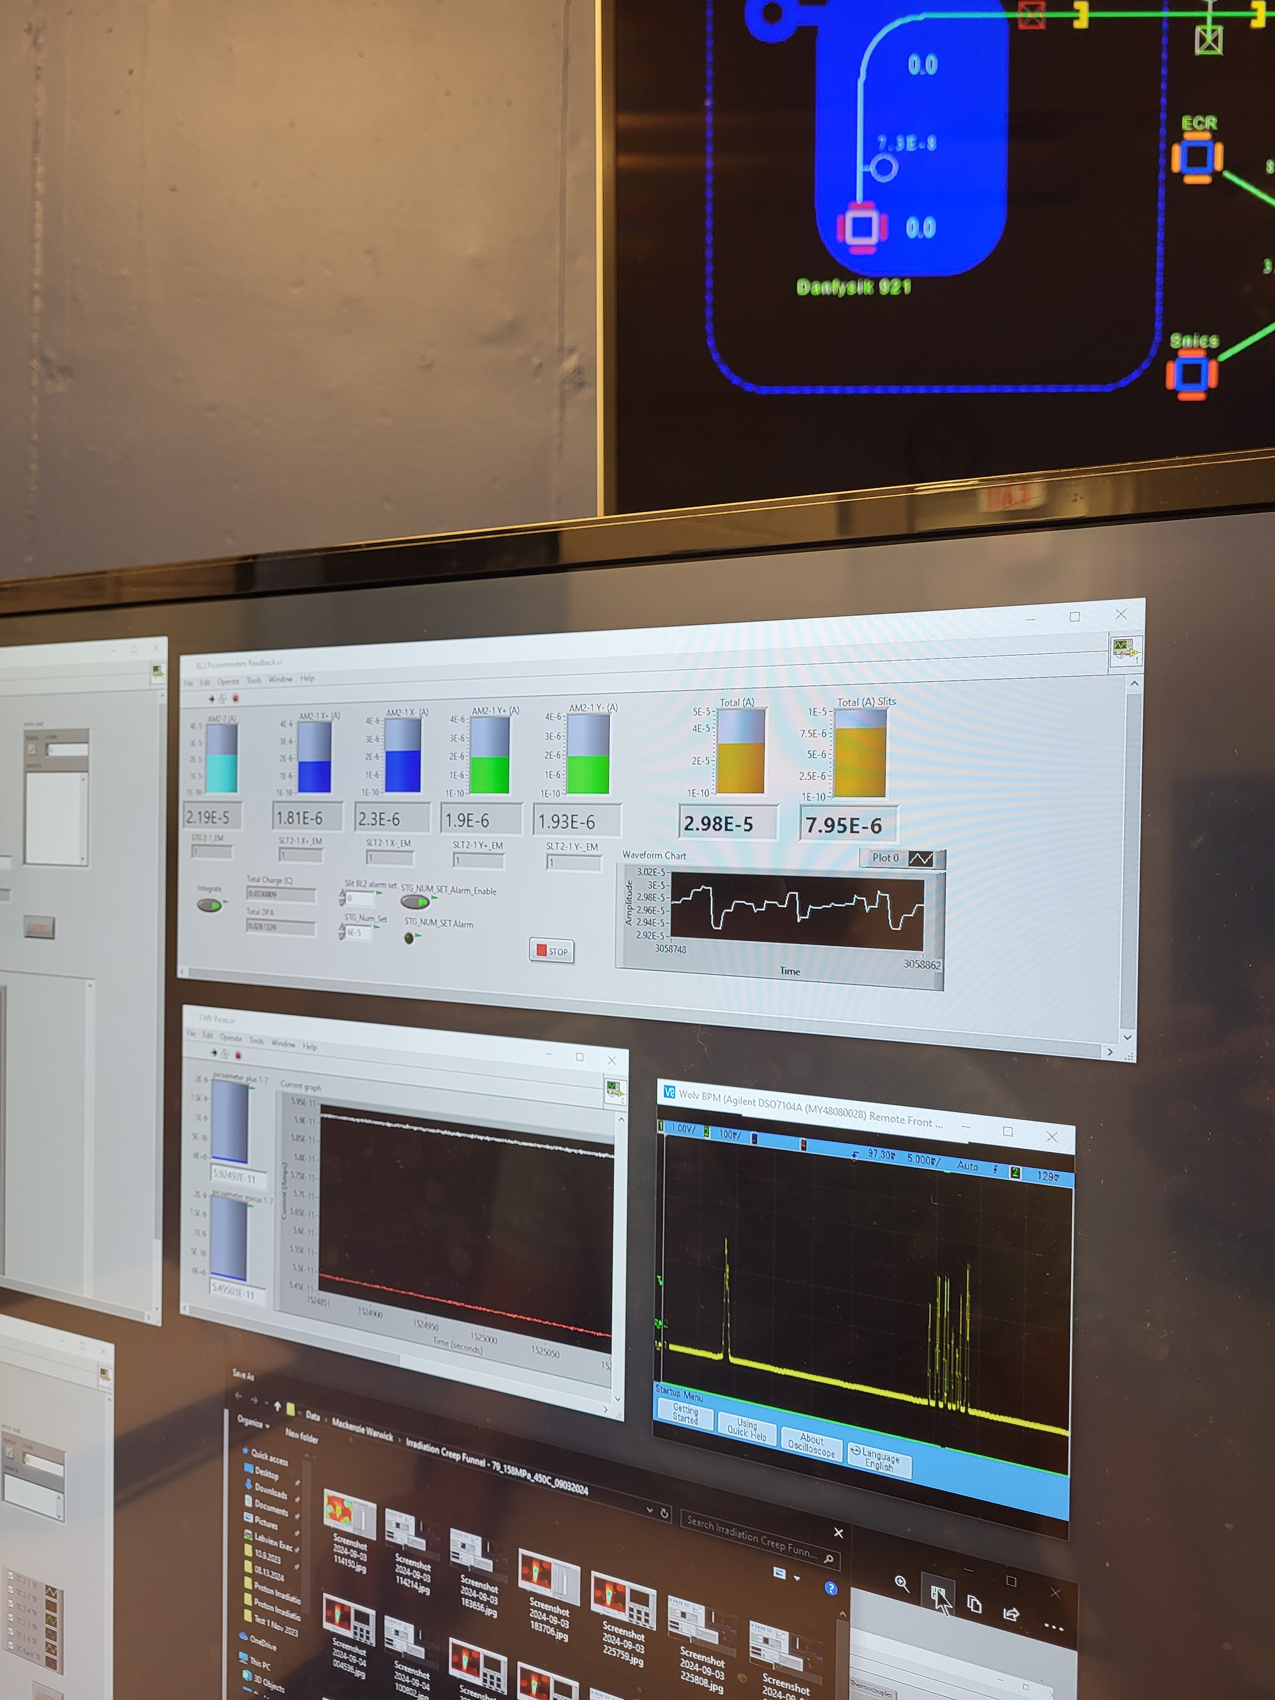
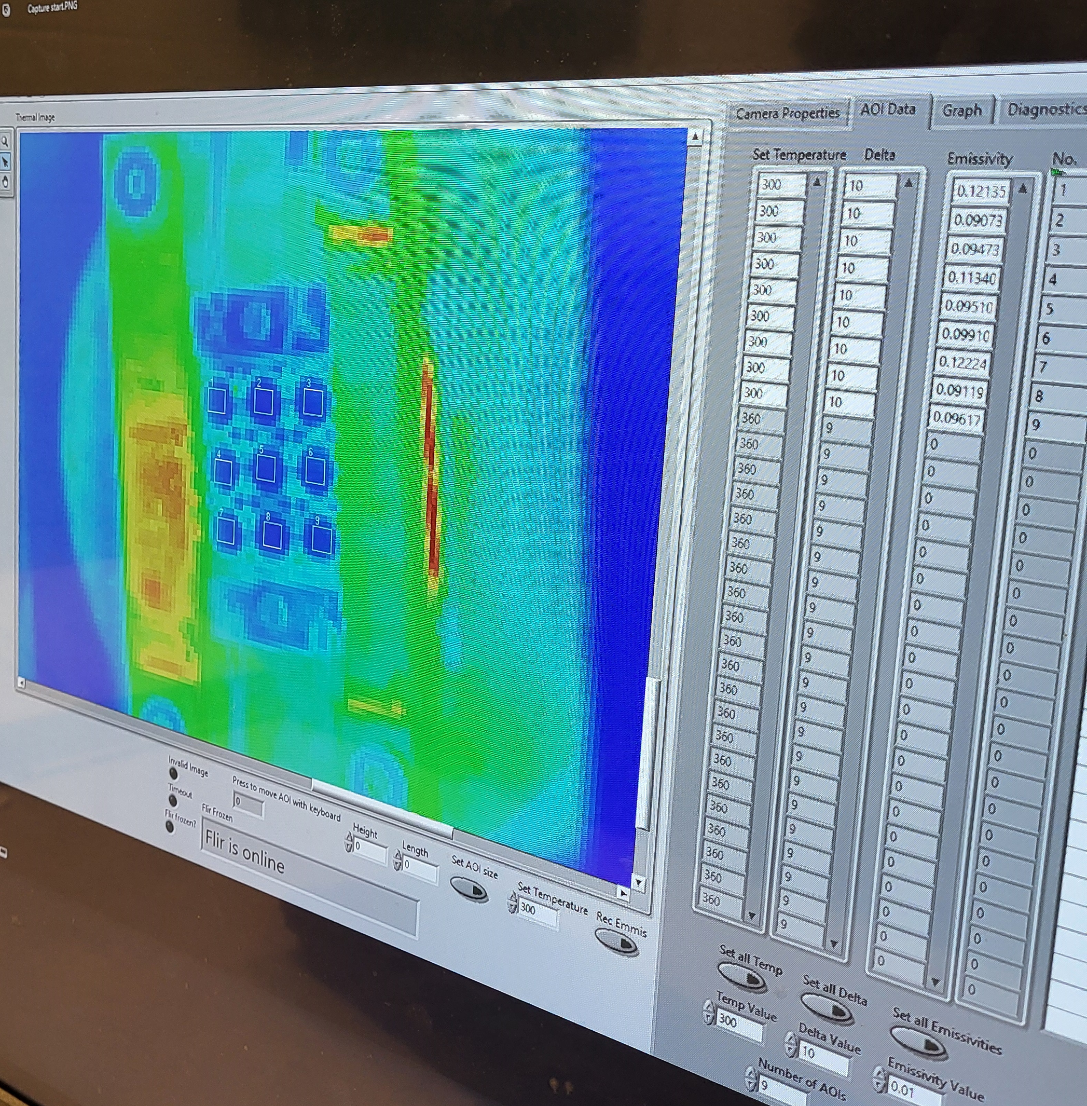
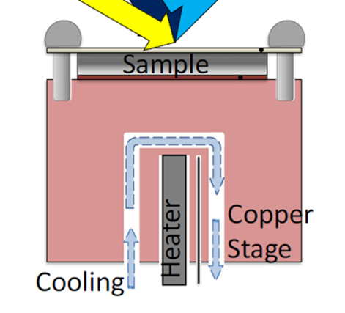
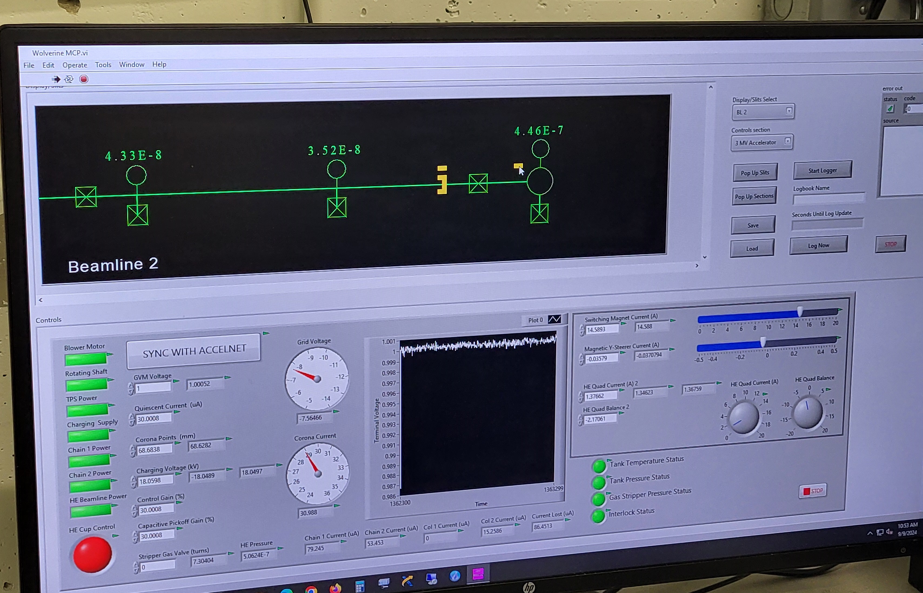
Sample Irradiation
Beam diagnostics and control
  Beam position monitor – Beam centroid position control
  Faraday cups – Beam current control
  Slits – Beam footprint control
  Raster:
    Time averaged beam footprint up to 10 x 10 cm2 by rastering beamlet
    Beamlet size FWHM ~ 3 mm with ~ 1 kHz raster frequency
Temperature Control
  Heater + Beam Energy – Compressed Air
  Initial calibration of IR with TC
  Monitoring and controlling IR temperatures at sample gauge sections

Slide 11
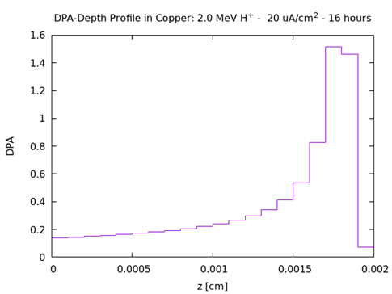
Beam Time and Dose
Proton Radiation
  Beam footprint: 10 mm x 10 mm
  Displacement damage: 0.14 DPA on the surface; 1.5 DPA at the peak
Helium Implant
  Irradiation Temperature: 100 C
  Multiple beam energies to distribute helium density along the thickness
Sample | Energy [MeV] | Current [uA] | Irradiation Temperature [C] | Beam Time [h]
Cu_tensile_ar | 2.0 | 20.0 | 300.0 | 16
Cu_tensile_ht | 2.0 | 20.0 | 300.0 | 16
Cu_tem_ar | 2.0 | 20.0 | 300.0 | 16
Cu_tem_ht | 2.0 | 20.0 | 300.0 | 16
Energy [MeV] | Current [uA] | Beam time [h]
0.5 | 0.2 | 1
1.0 | 0.2 | 1
1.5 | 0.2 | 1
2.0 | 0.2 | 1
2.5 | 0.2 | 1
3.0 | 0.2 | 1
3.5 | 0.2 | 1
4.0 | 0.2 | 1
4.5 | 0.2 | 1
Depth range [um] |  | He-appm
From | To
0.0 | 1.0 | 2.1848
1.0 | 2.0 | 243.2088
2.0 | 3.0 | 288.1523
3.0 | 4.0 | 402.3868
4.0 | 5.0 | 255.2042
5.0 | 6.0 | 237.6217
6.0 | 7.0 | 225.2588
7.0 | 8.0 | 156.3934
8.0 | 9.0 | 125.5488
9.0 | 10.0 | 206.3657

Slide 12
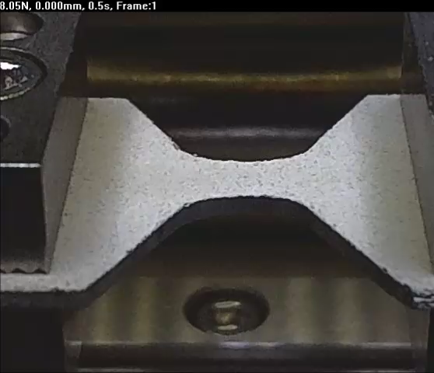
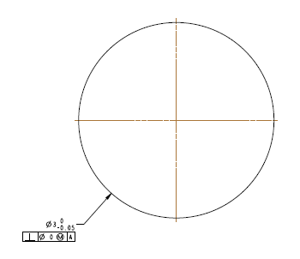
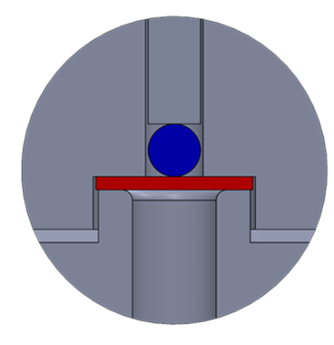
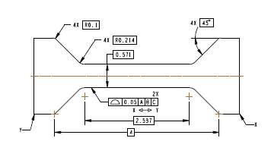
Post Irradiation Examination (Copper) - Plan
SS-2E Tensile Specimens
  Material: OFHC copper – 2 Batches
    As received; Annealed at 950 C
  In situ tensile tests in SEM
  Fractography, SEM
TEM Disc Specimens
  Material: OFHC copper – 2 Batches
    As received; Annealed at 950 C
  TEM to measure void size and density distribution (swelling)
  Ball loaded biaxial bend tests
  Fractography, SEM

Slide 13
Irradiation and PIE plans in the pipeline

Slide 14
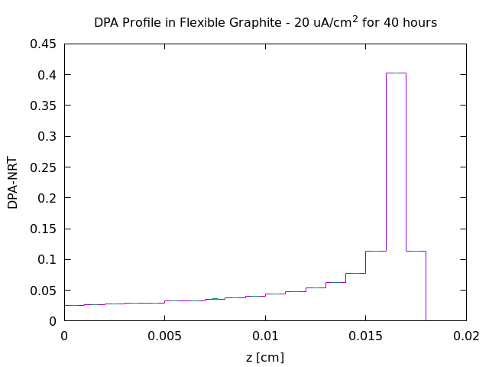
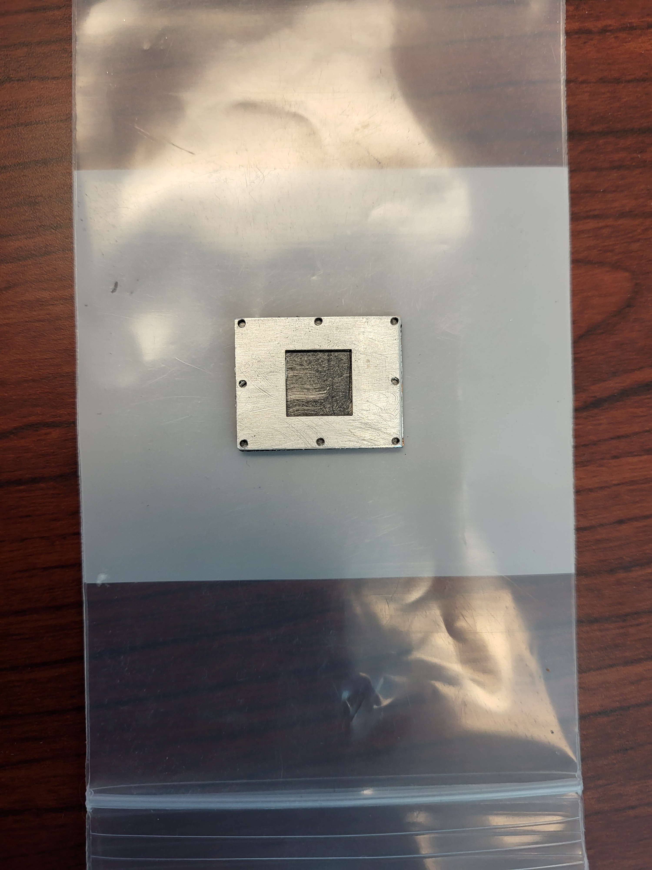
Flexible Graphite – Unbonded TIM
Key Question:
  Radiation induced degradation of expandability after compression
Sample
  0.5 mm thin flexible graphite foil from Goodfellow
Beam and Damage Profile
  Beam energy: 3.0 MeV
  Range: 180 um
  DPA: 0.026 on the surface and 0.4 at the peak
  Negligible risk of sample activation
PIE:
  Flat head indentation test
  SEM

Slide 15
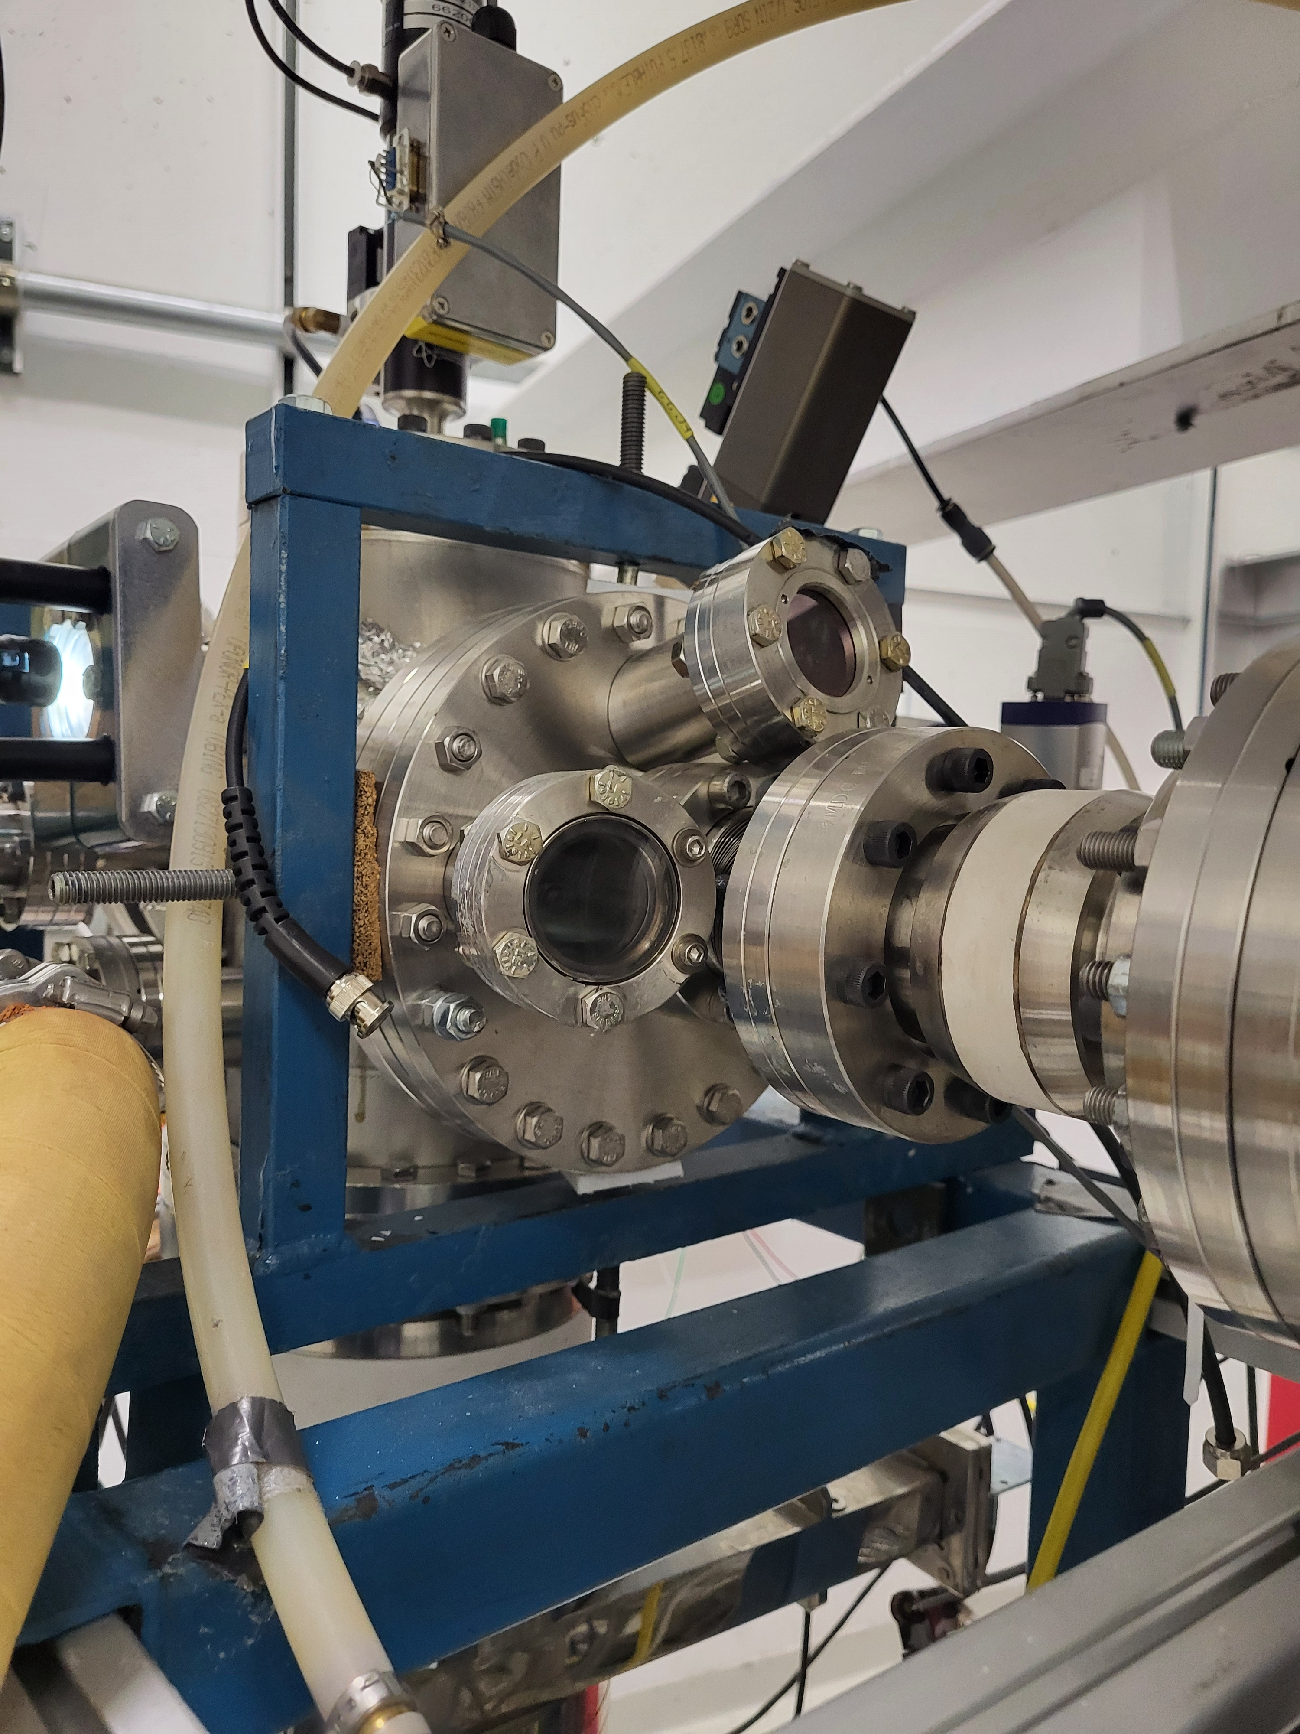
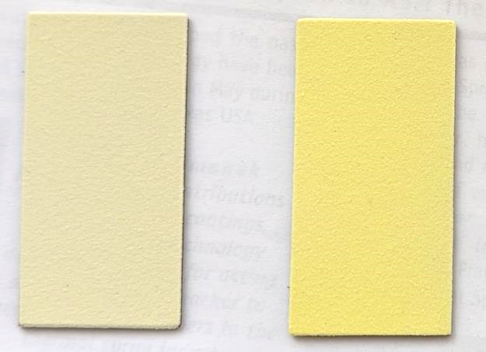
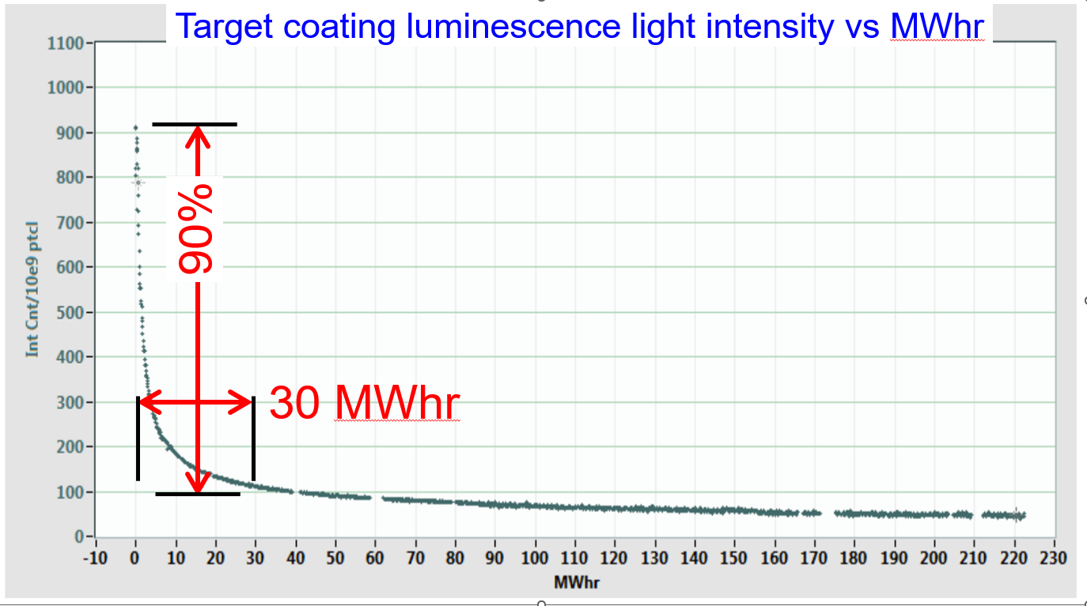
Luminescent Coating
Key Question:
  Characterization of proton induced luminescence of candidate coating solutions
  Radiation induced degradation of luminescence of candidate coating solutions
Sample
  Luminescent materials thermal sprayed on alloy 718 substrate
    Al2O3:Cr
    YAG:Ce
To be determined
  Identification of Coulomb barrier of each material and set beam energy below that
  For the beam energy, set beam current to avoid thermal quenching
  Determine achievable dpa and required beamtime.

Slide 16
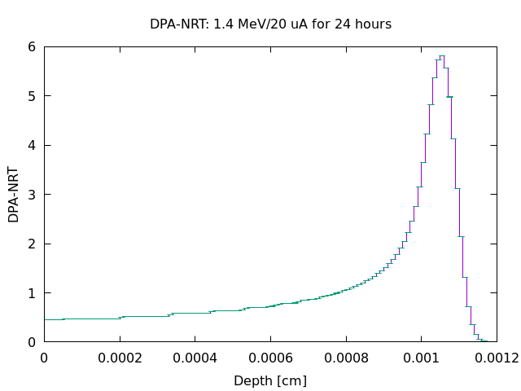
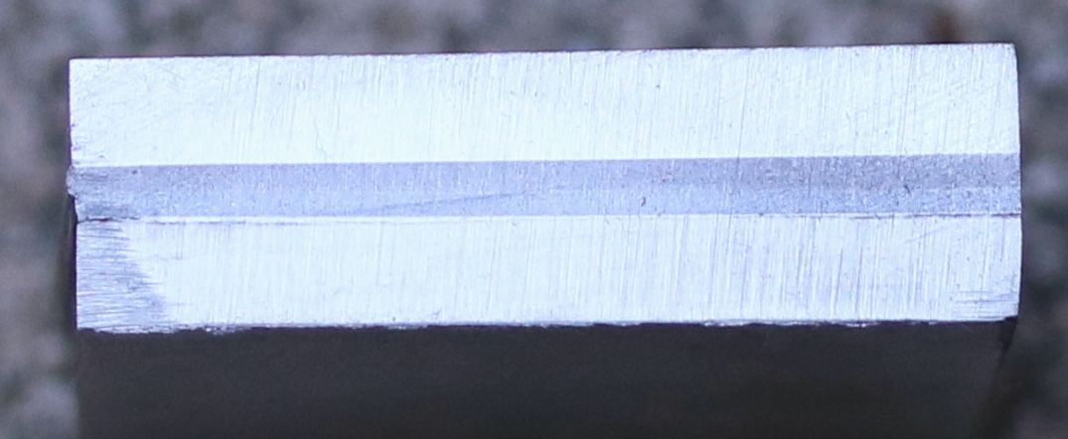
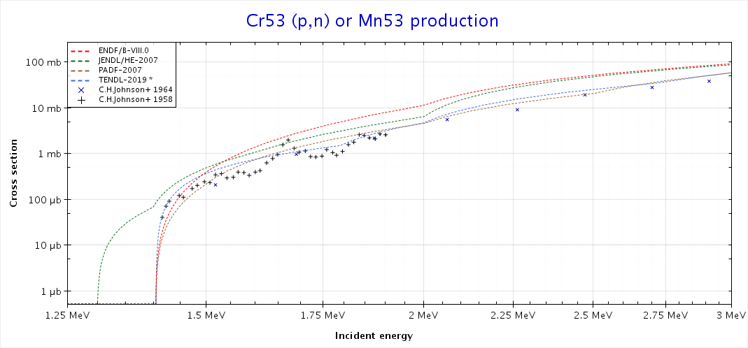
Radiation Induced Stress Relaxation
Key Question:
  Radiation induced stress relaxation of post-HIP alloy 718
Sample
  Diffusion bonded W-Cu-Alloy718 plates
Beam and Damage Profile
  Beam energy: 1.4 MeV to avoid Cr53 (p,n) Mn53 reaction
  Range: 12 um
  DPA: ~0.5 on the surface and ~6 at the peak (1.4 MeV, 20 uA, 24 hours)
PIE:
  Strain measurement with XRD

Slide 17
Summary

Slide 18
Summary
Key challenge with current STS target design is radiation induced void swelling and helium embrittlement of copper
Low energy proton and helium beam irradiation will simulate radiation induced displacement damage and helium production in STS target environment
The irradiated copper samples can be handled and tested in non-radioactive material lab environment
Irradiation and PIE campaigns of flexible graphite, luminescent coating and pre-stressed alloy 718 are planned in FY2025.
Thank you for your attention!
Your feedback on the irradiation programs
will be highly appreciated!

