Slide 1
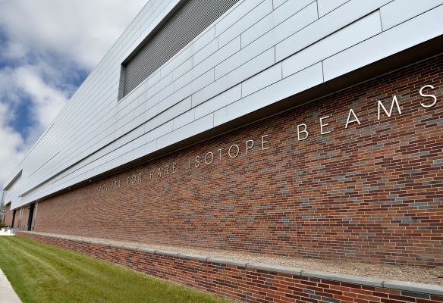
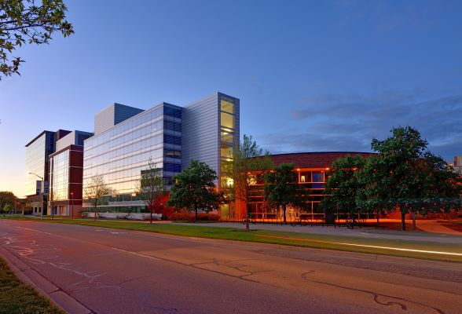
FRIB Facility Status Update
Andreas Stolz
Operations Department Manager
9th Annual RADIATE Collaboration Meeting, September 2024, Granada, Spain

Slide 2
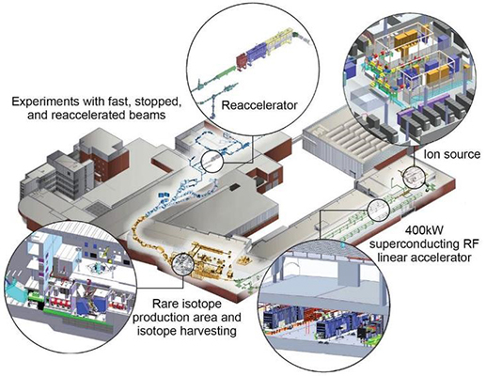
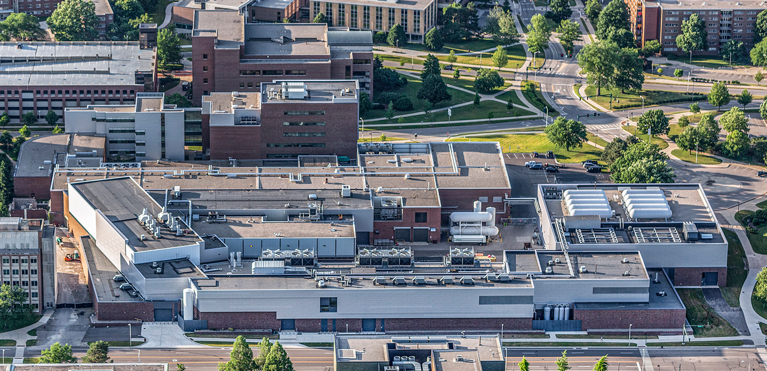
Facility for Rare Isotope Beams (FRIB) at
Michigan State University (MSU)
FRIB is located in East Lansing, Michigan, on the campus of Michigan State University
FRIB is a U.S. Department of Energy Office of Science (DOE-SC) User Facility supporting the mission of the Office of Nuclear Physics
MSU operated the Coupled Cyclotron Facility until November 2021
FRIB user operations started in March 2022

Slide 3
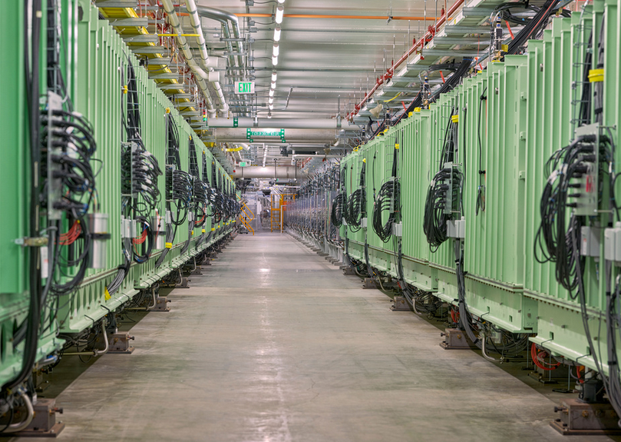
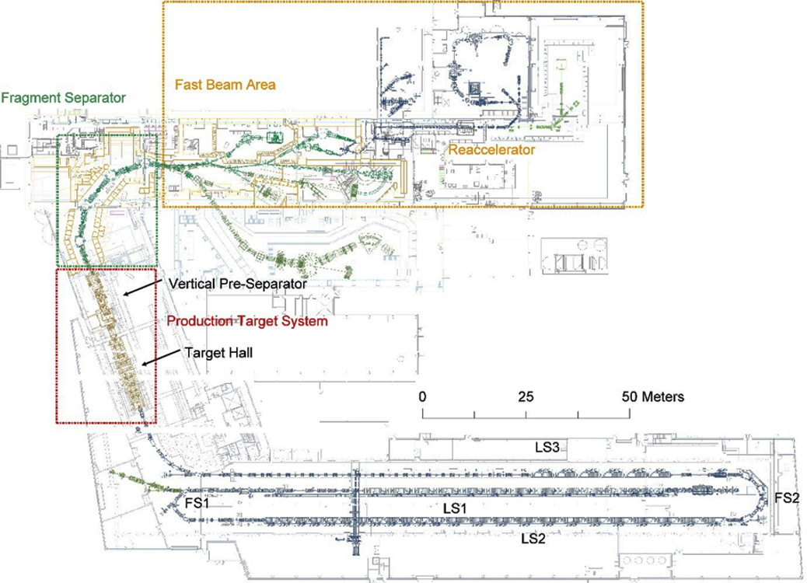
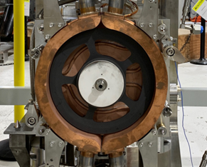
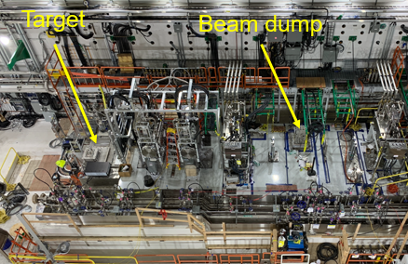
Facility for Rare Isotope Beams Overview
The FRIB accelerator is a 400 kW superconducting linear accelerator which can accelerate stable ions up to uranium to energies of at least 200 MeV/u
Rare isotope beams are
produced in a rotating graphite target and magnetically separated in the fragment separator
The facility is currently commissioned to 10 kW primary beam power. A power increase to 20 kW is planned in fall of 2024

Slide 4
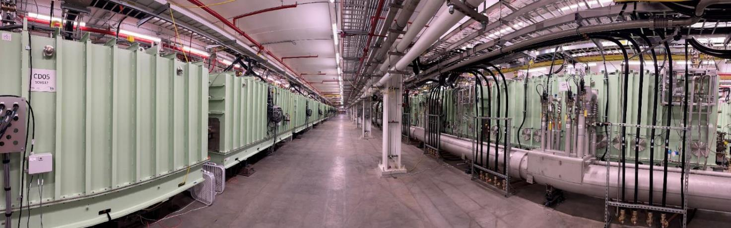
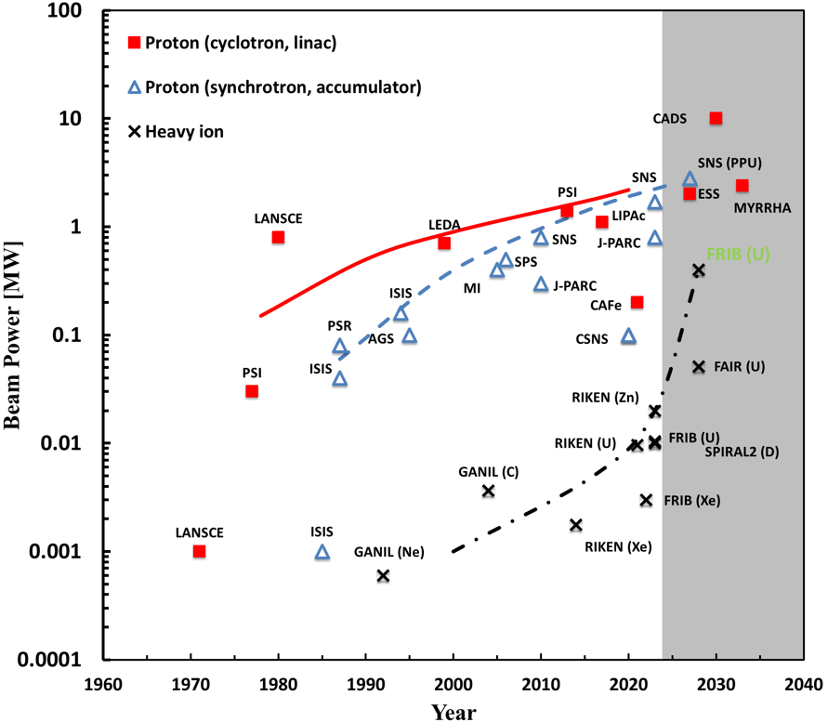
FRIB Driver LINAC Delivers Stable Ions up to Uranium With Energy >200 MeV/u
FRIB driver linac in accelerator tunnel
FRIB (U)
FRIB LINAC with 46 cryomodules, 324 SRF cavities (β from 0.041 to 0.53), operating at 2K & 4K
Accelerating ³⁶Ar¹⁸⁺ beam > 300 MeV/u and most heavier ion beams ~ 200 MeV/u
On December 22, 2023, achieved 10.4 kW of ²³⁸U^{74+,75+,76+} beam accelerated to 177 MeV/u
Heavy ion accelerator power ramp up is much more challenging due to short stopping range of ions and high power density

Slide 5
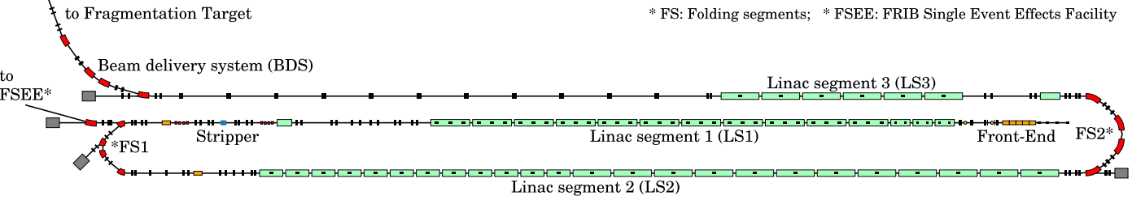
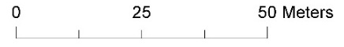
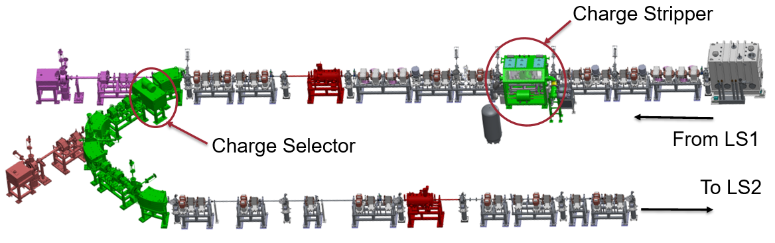
Charge Strippers in FRIB Driver Linac
~200 MeV/u or higher
17-20 MeV/u
Charge strippers are located in Folding Segment 1
  Liquid lithium charge stripper (LLCS)
  Rotating carbon foil stripper
Charge stripper produces multiple charge states after the stripper
Charge selector stops unwanted charge states of the stripped beam
FRIB linac is capable of multi-charge state simultaneous acceleration

Slide 6
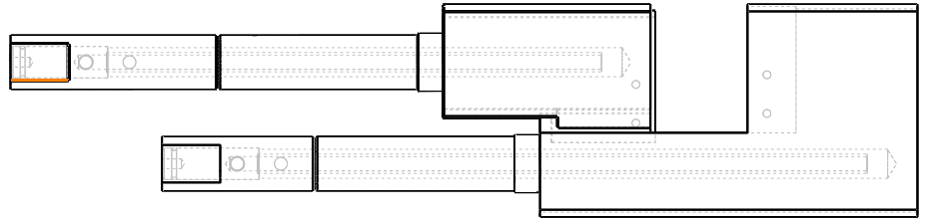
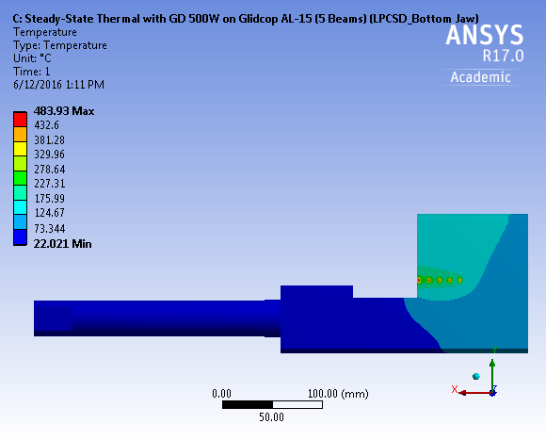
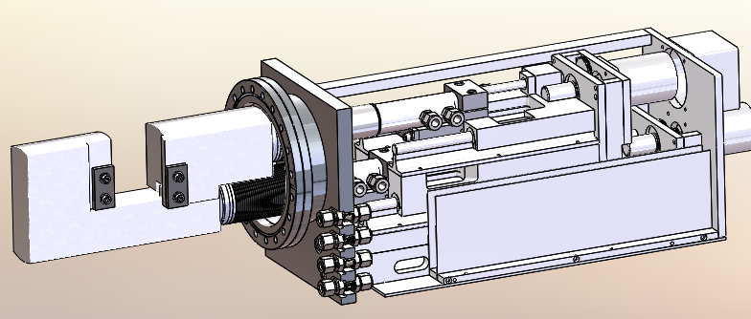
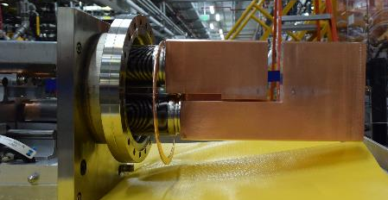
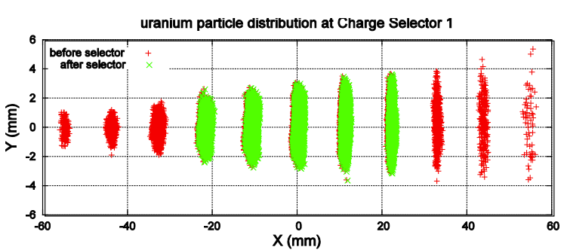
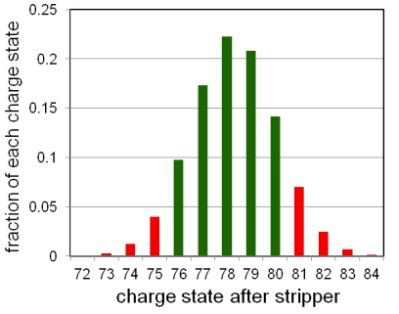
Low-Power Charge Selector (LPCS) in Operation:
Glidcop Jaws Used to Intercept Beams
Static jaws, cooled by water, made of Glidcop, intercept unwanted charge states
Limited to 500 W per beam spot of rms=(0.7x1.25) mm due to thermal stress in Glidcop (Peak temp estimate ~ 480 C)
  Only thermal limit. No radiation damage taken into account.
Plan to be used up to 20-kW-on-target operations
Inner Jaw
Outer Jaw
WATER
INLET
WATER
OUTLET
Five 500 W beam spots with 1.9 LPM water cooling
$σ_{x}=0.7 mm$, $σ_{y}=1.25 mm$
Example: ²³⁸U particle distribution (left) and charge state distribution (right)

Slide 7
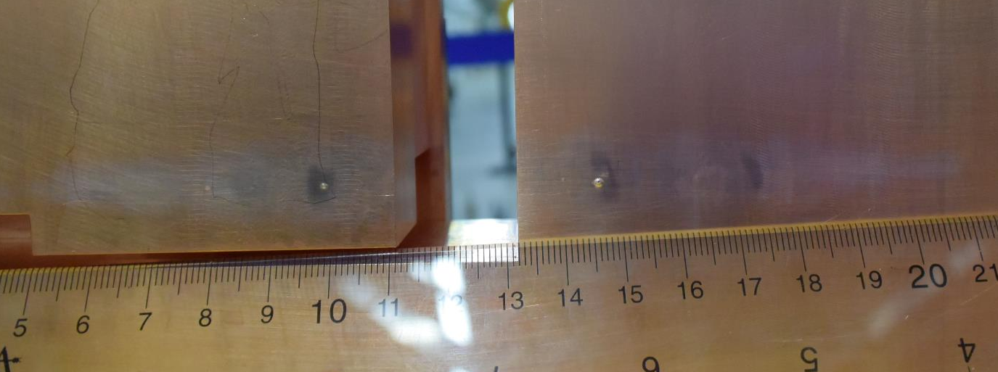
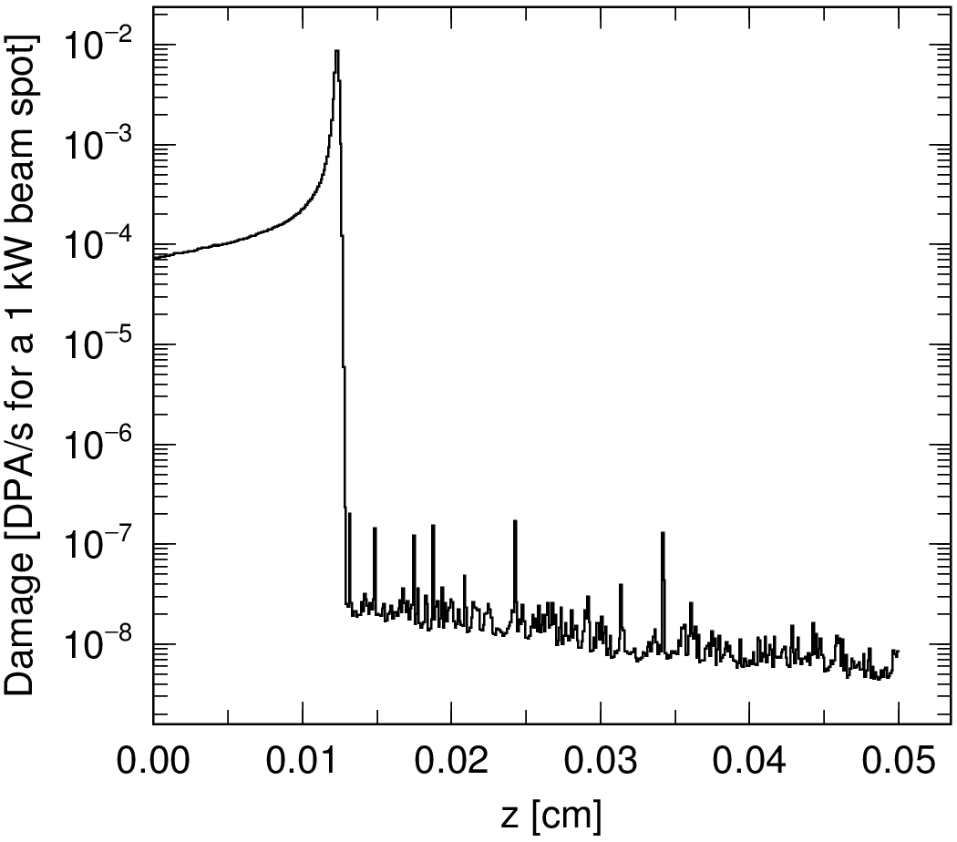
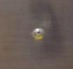
Radiation Damage in Glidcop Jaws:
Inspected August 2023 and To be Replaced September 2024
Small beam spots and very short range (order of 0.1 mm) of heavy ions could create localized radiation damage
Estimated dpa rate: an order of 1 dpa/week/100 W beam spot on surface
Ion implantation rate: an order of 1 at.%/week/100 W beam spot
  Note: Jaws can be moved by one mm or two during operations to distribute damages
The existing jaws to be replaced this summer
Seeking Post Irradiation Examination (PIE) for replaced jaws (grad student PhD thesis project, PNNL as candidate)
Glidcop jaws inspected Aug 2023 after 5 kW user operations
(power deposition < 80 W per beam spot)
On-contact dose: 1000 mR/h
Dose at 30 cm: 25 mR/h
DPA rate estimate with PHITS
17 MeV/u ⁴⁸Ca in Glidcop
Discrete bumps and discoloration
Pinhole at center
Most likely caused by Xe beam

Slide 8
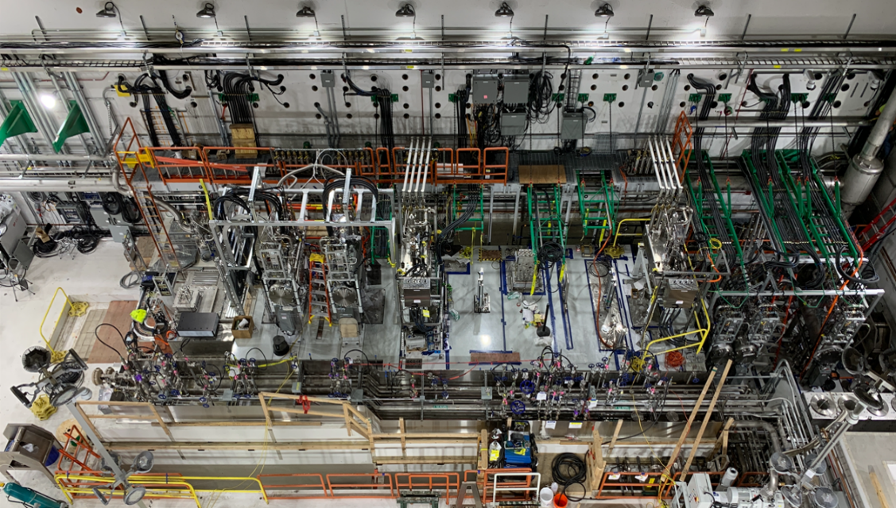
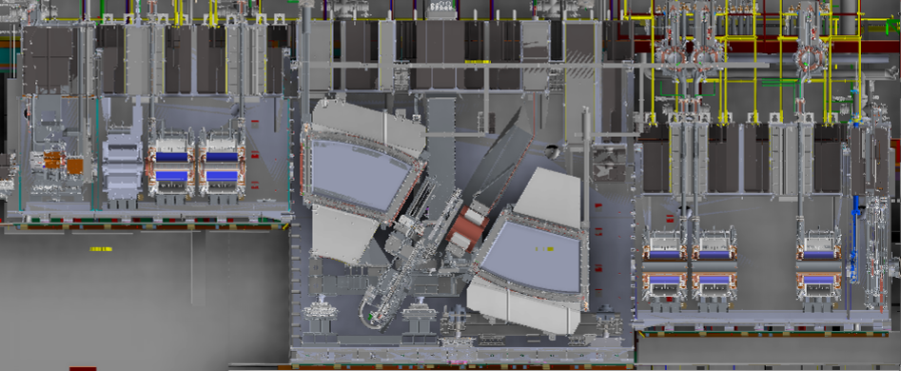
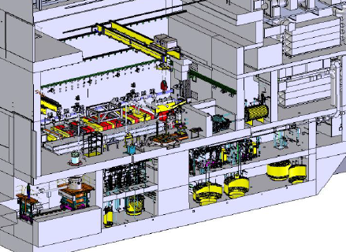
FRIB Rare Isotope Production Facility
Target
Beam dump
FRIB Target Facility is designed for 400 kW Operations
  First part of fragment separator with target and beam dump
  Remote-Handling of activated components
  Non-Conventional Utilities (Cooling Water, Off-Air Filtration
  System)
  Radioactive Waste Handling
Wedge System
unreacted
beam
Target System
WIQ1,2,3
SCD1
Beam Dump
SCD2
WIQ4,5,7

Slide 9
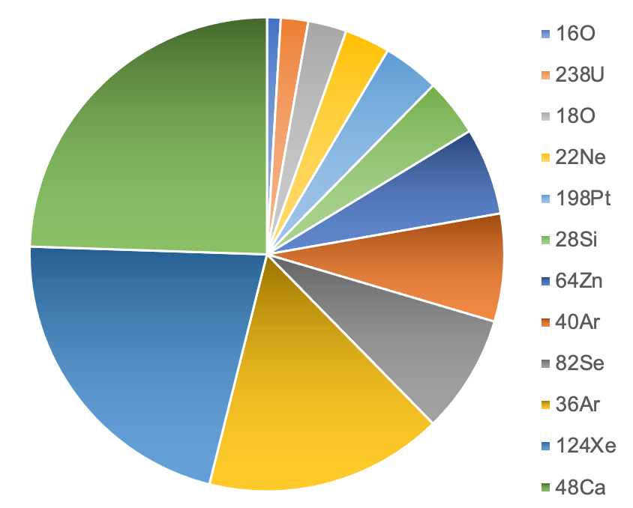
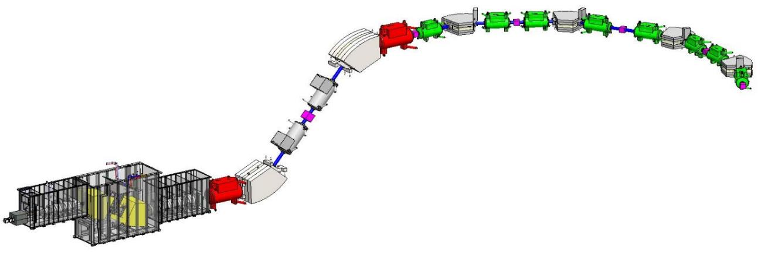
Optimized Rare Isotope Production Requires Frequent Configuration Changes and Primary Beam Changes
Primary beam (isotope and energy), production target, and configuration of the fragment separator need to be optimized for each experiment
Target and wedge degrader changes require remote handling in a high radiation area
Typical length of an experiment is one week
Primary Beam Statistics 10/01/2022 – 04/01/2024
Wedge
Degrader
Fragment Separator
To Experiment
Target
143 primary beam changes, including energy changes

Slide 10
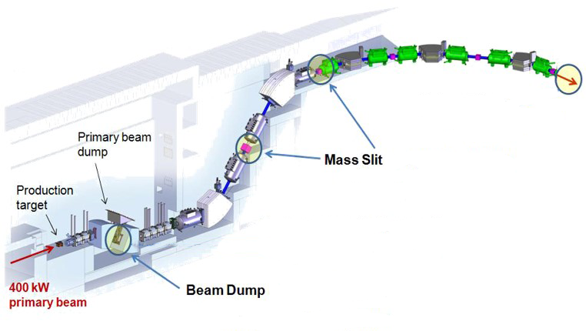
Planned Beam Power Losses in the Fragment Separator
Planned beam power losses change with every experimental setting
  Depend on primary beam, target thickness, and fragment of interest
  Need to be reviewed for every experimental setting of the separator
Planned beam power losses
at full primary beam power (400 kW)
~<0.5 kW
~100 kW
Phased approach:
First two years of
user operation
beam power <10kW
Wedge + Slits
~<5 kW
~300 kW

Slide 11
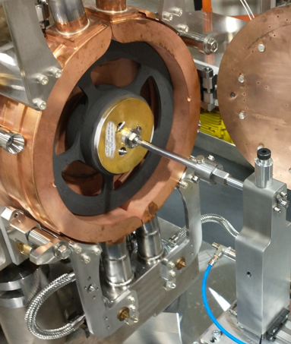
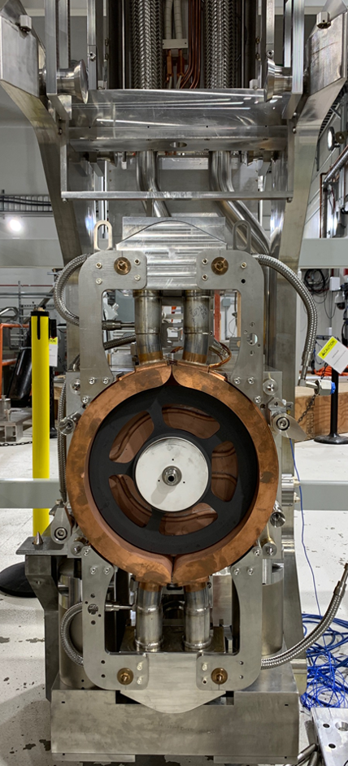
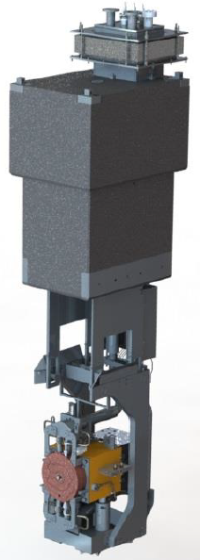
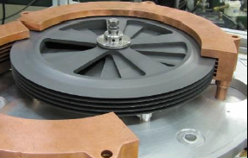
High-Power Target System
Single or multi-slice graphite target
  High power capability up to 100 kW
  >2 weeks lifetime (typical experiment duration 1 week)
  Remote replacement and maintenance
  30 cm graphite disc, 1–20 mm total thickness
  Rotational speed up to 5000 RPM
  Target disc temperature 1900 ºC
Multi-slice disc in operations
Multi-slice disc
module
(prototype)

Slide 12
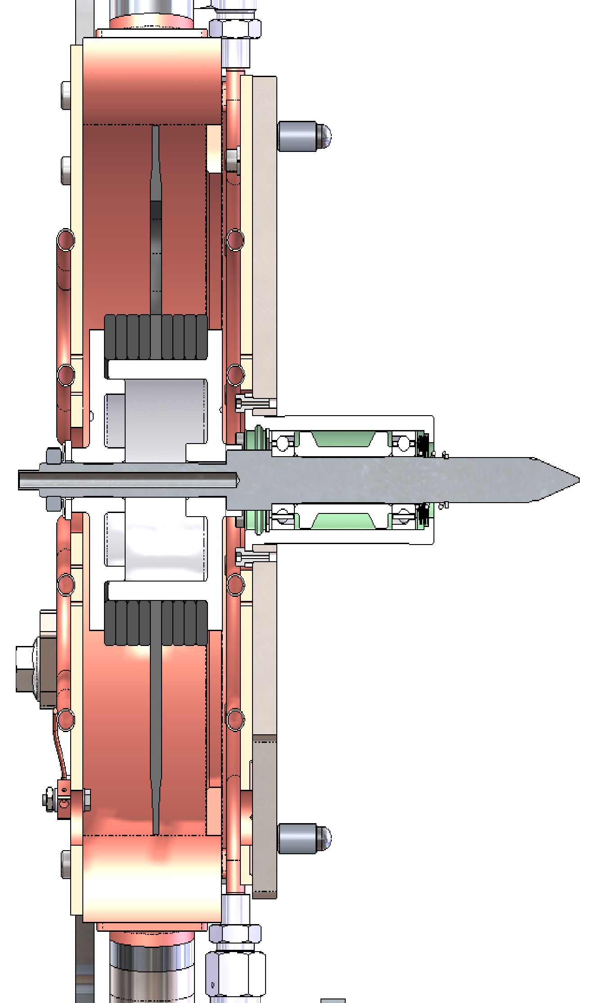
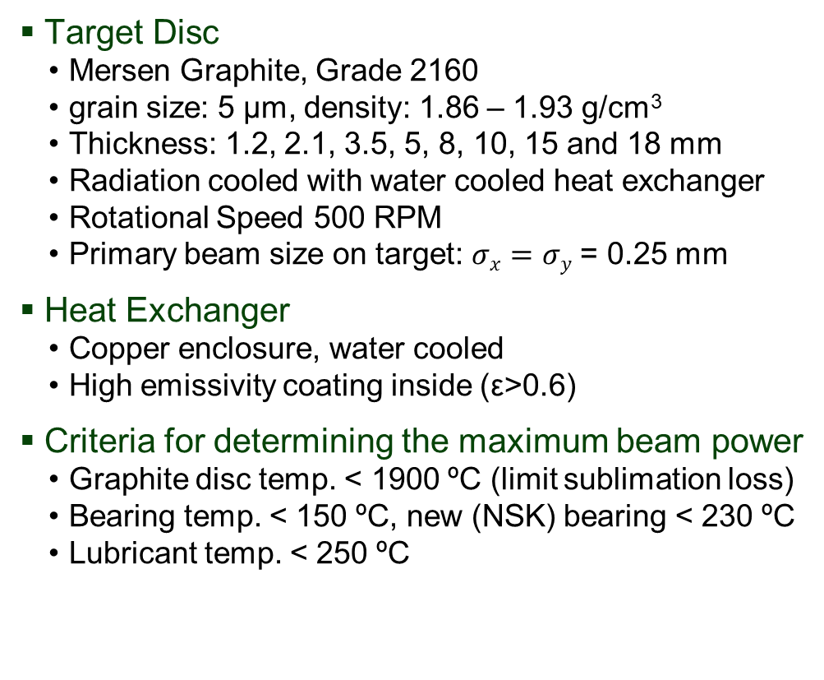
FRIB Single-Slice Production Graphite Target
Target Disc
  Mersen Graphite, Grade 2160
  grain size: 5 μm, density: 1.86 – 1.93 g/cm³
  Thickness: 1.2, 2.1, 3.5, 5, 8, 10, 15 and 18 mm
  Radiation cooled with water cooled heat exchanger
  Rotational Speed 500 RPM
  Primary beam size on target: $σx=$ $σy$ = 0.25 mm
Heat Exchanger
  Copper enclosure, water cooled
  High emissivity coating inside (ε>0.6)
Criteria for determining the maximum beam power
  Graphite disc temp. < 1900 ºC (limit sublimation loss)
  Bearing temp. < 150 ºC, new (NSK) bearing < 230 ºC
  Lubricant temp. < 250 ºC
Radiation Damage
  DPA < 0.05 after one week operation at 10 kW
  Max temp ~ 800-1000 C
  Disc can be re-used multiple times
  No degradation observed
Graphite disc
Beam

Slide 13
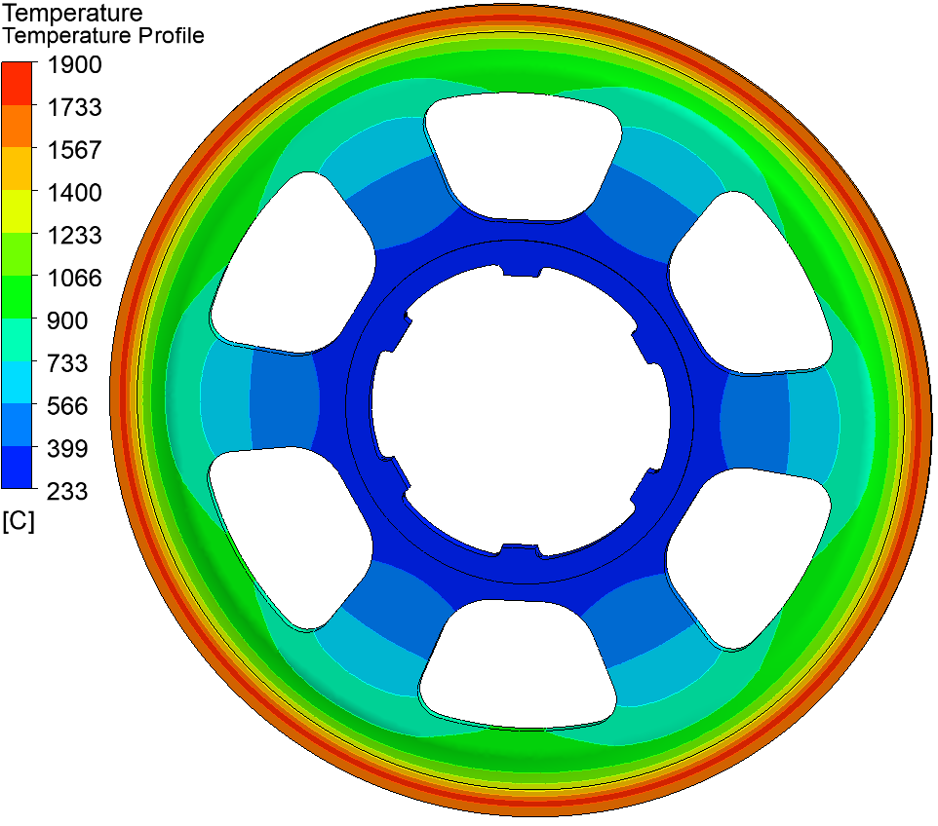
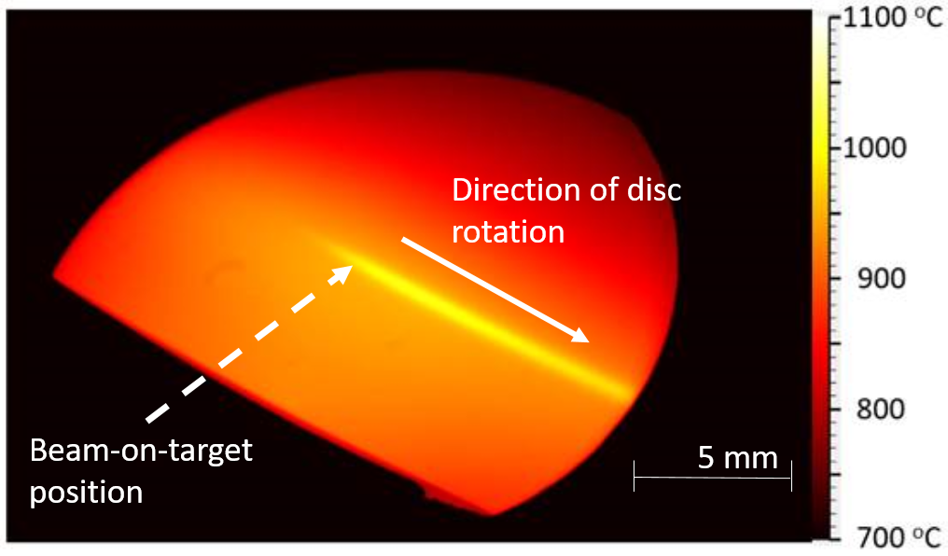
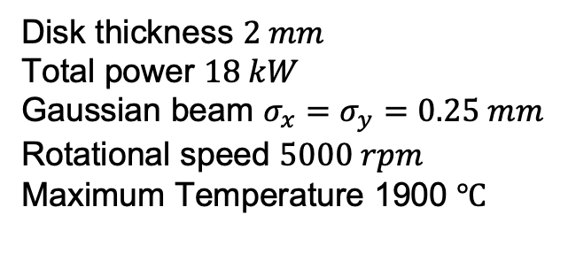
FRIB Production Graphite Target
Single-Slice Target To Be Used Up to 50 kW
Maximum temperature 1900 ºC to mitigate evaporation of graphite
High temperature (>1300 ºC) needed for annealing of radiation induced damage
Rotating target: ~10–5000 RPM
  Disk thickness $2 mm$
  Total power $18 kW$
  Gaussian beam $σ_{x}=σ_{y}=0.25 mm$
  Rotational speed $5000 rpm$
  Maximum Temperature 1900 $℃$
Planned improvements toward 20-kW operations
  Shaft replacement: Invar to Inconel to withstand higher thermal stress
  Bearing replacement: increase temperature limit from 150 ºC to 230 ºC.
Single-slice target will be able to support up to 50 kW
  Power limitation will be the thermal load in the disk
  Multi-slice target will be needed to reduce thermal load per disk
10.4 kW ²³⁸U beam on target rotating at 500 RPM reaching 1004ºC peak temperature

Slide 14
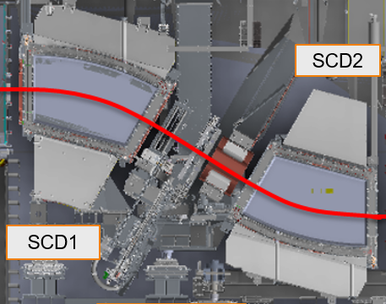
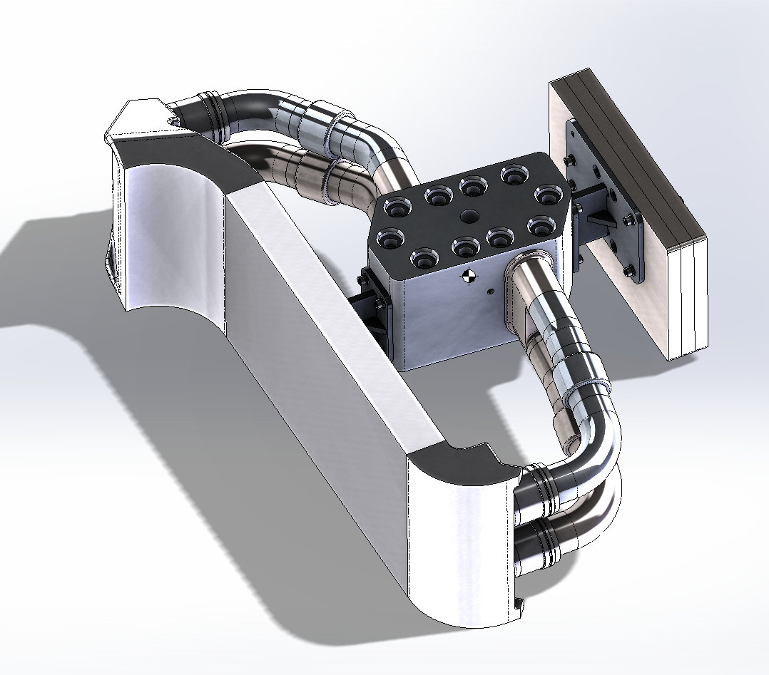
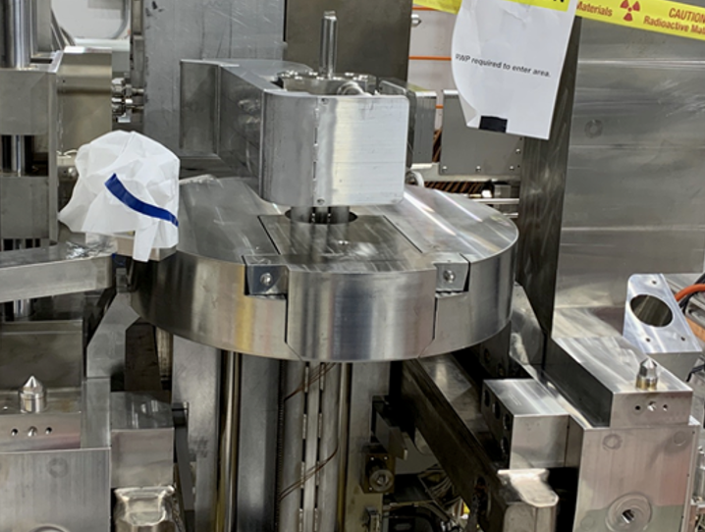
Beam Dump System To Intercept Unreacted Primary Beam
Primary beam intercepted after first dipole of fragment separator in Target Hall
User operations started with static beam dump, intercepting the beam with a 6-degree incident angle
S-Shaped profile adopted to gaussian beam power profile of the primary beam
Primary
Beam
Fragments
Primary beam does not stop in water, allowing for graded commissioning approach for Non-Conventional Utilities (NCU cooling water)
6°

Slide 15
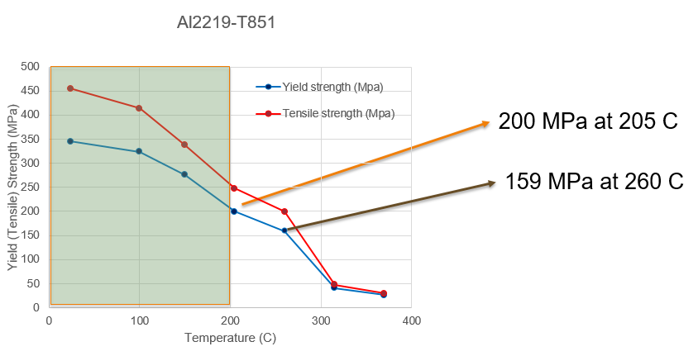
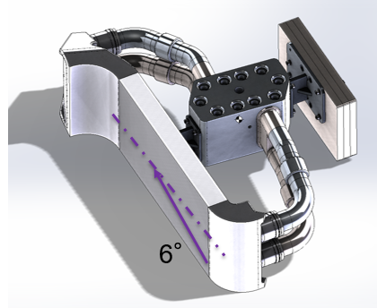
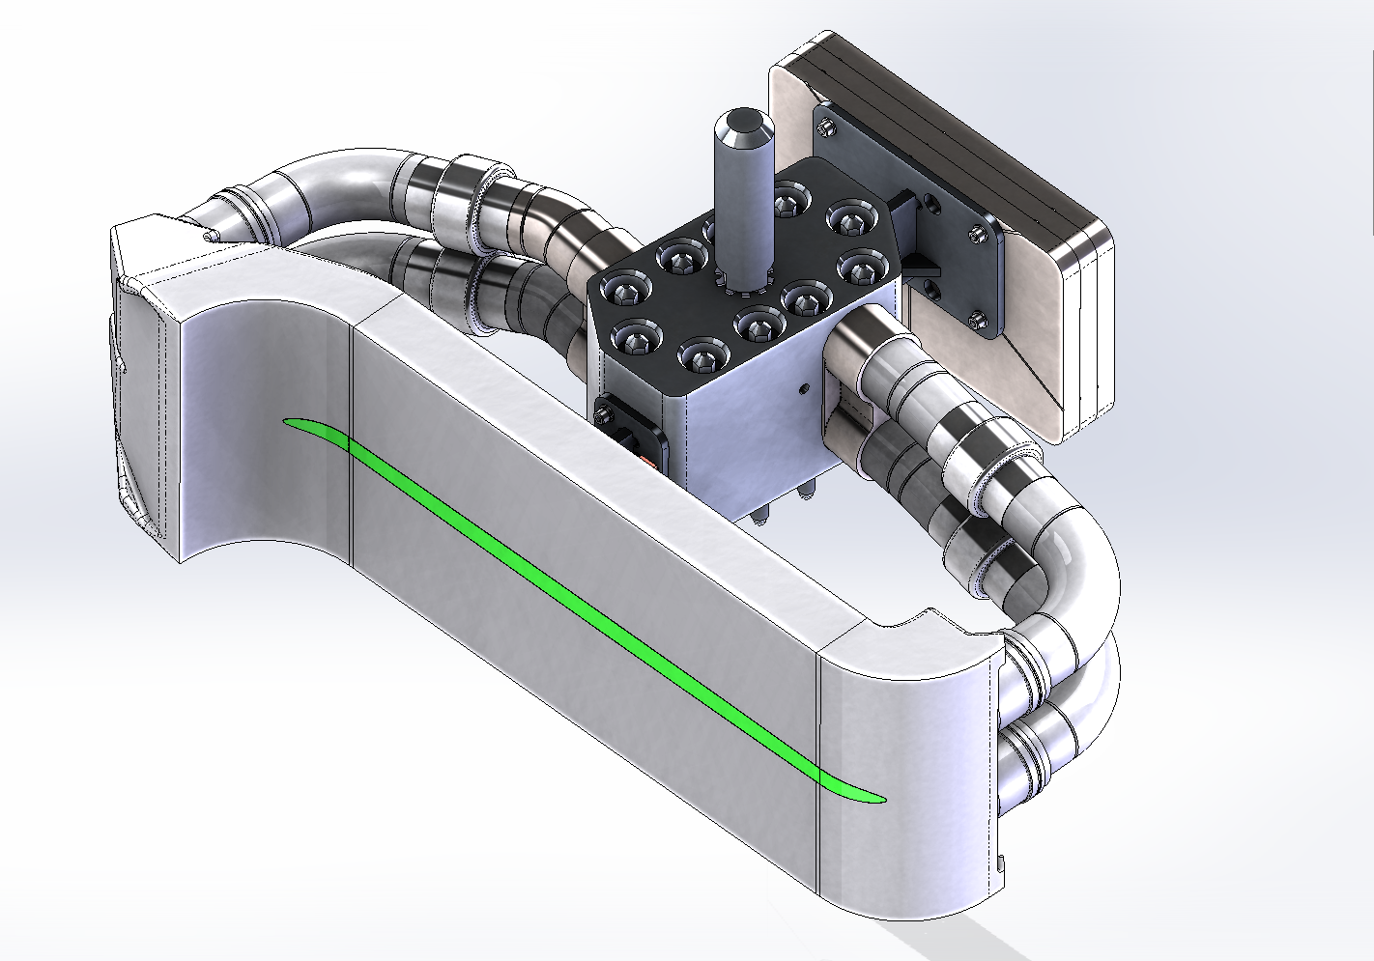
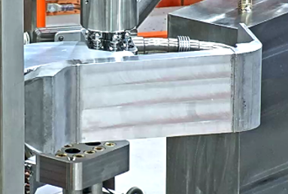
Beam Dump for 10 kW Operations
Materials
  Plate: Al2219-T851; S shape wings: Al2219 (3D-printed)
Criteria for maximum beam power deposition
  Al plate temperature < 200 ºC (stress not to exceed yield strength)
  Water boundary temperature < 130 ºC (avoid boiling)
Actual beam power limit depends on beam power deposition profile
  Different for with each experimental setting
  Depends on primary beam species, energy, target thickness,
  and pre-separator magnetic field optimized for fragment production
Thermal cycles per year (beam on/off events): about 2000 per year
Materials
  Plate: Al2219-T851; S shape wings: Al2219 (3D-printed)

Slide 16
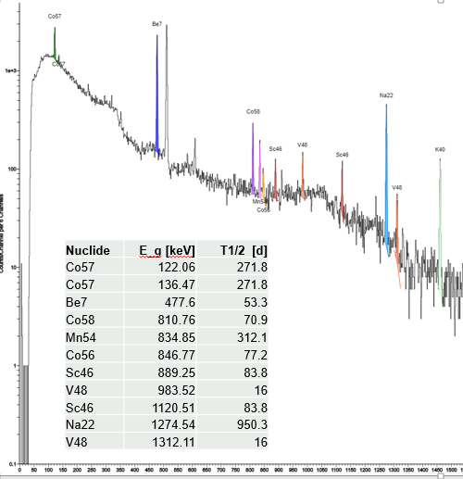
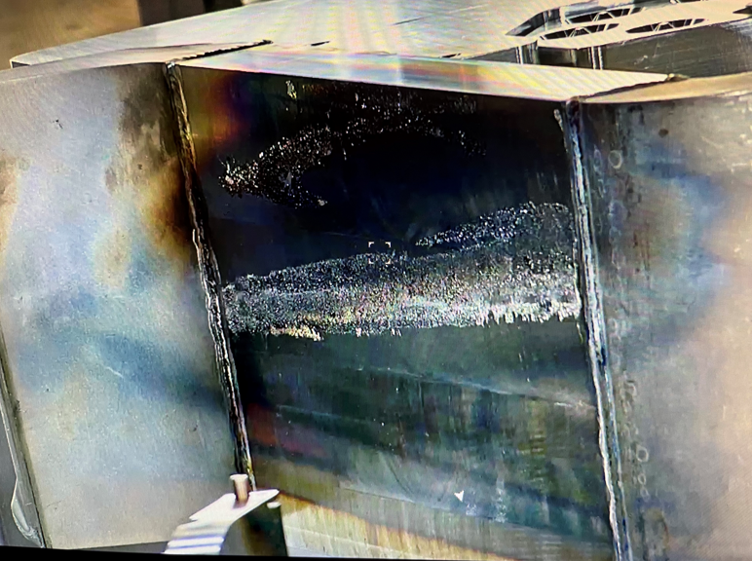
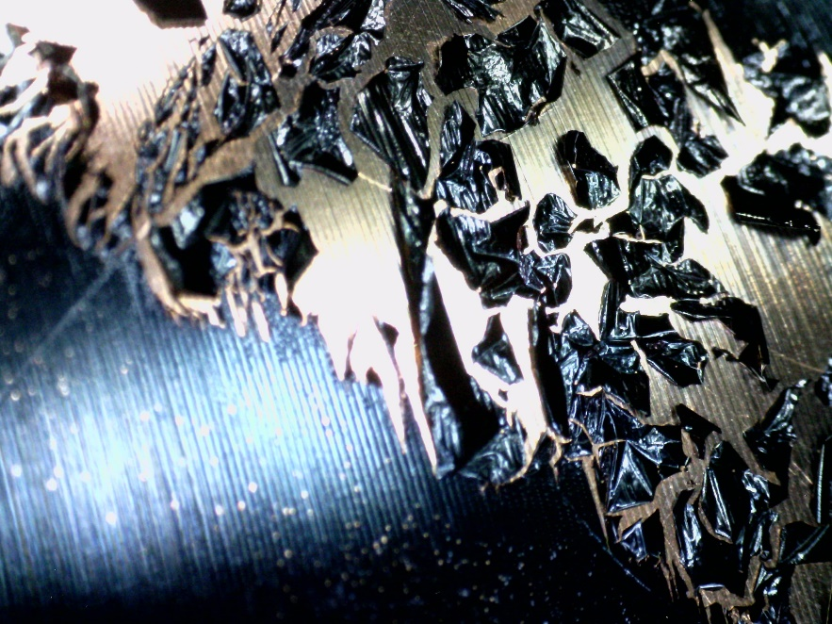
S-Shaped Beam Dump after 1 year of 10 kW Operations
Beam dump surface covered with deposit
  No thermal damage (machine marks visible)
  Similar deposit observed at 5 kW operations in 2023
  Difference: Deposit film is flaking off
  In 2024, vacuum was 10x worse due to water leak (2E-5Torr)
  Gamma activation analysis is consistent with material from beam dump
  Plan to perform SEM/EDS analysis

Slide 17
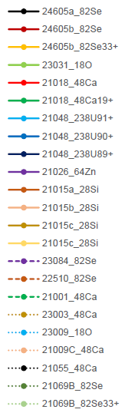
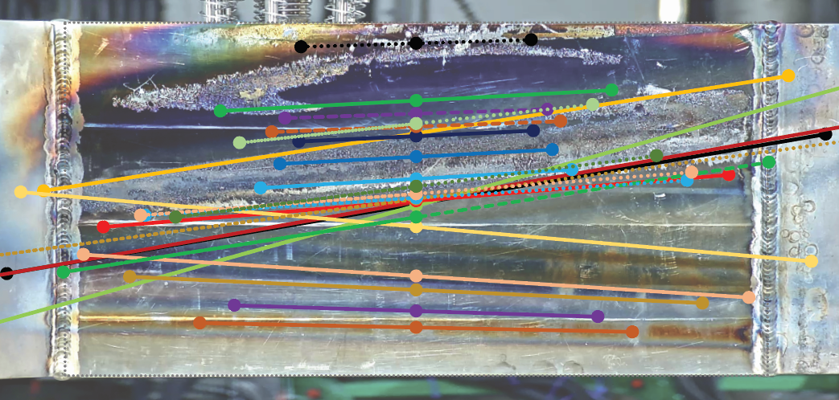
Beams on Beam Dump in FY2024
Overlay of all primary beams on beam dump surface

Slide 18
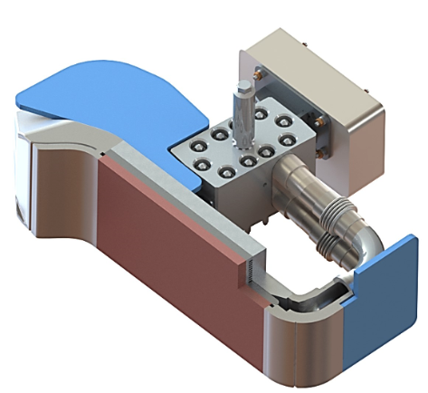





Mini-channel Beam Dump for (MCBD)
The primary beam stops within the
CuCrZr layer
  Penetration depth < 1mm
Beam intercepting plate
  CuCrZr/Al2219 (bimetal)
    Thickness: Cu (15 mm), Al (5 mm)
  Minichannel
    water channel (2mm) wall (2mm)
    Average Heat transfer coefficient:
    30,000 $W/m^{2}K$
Why CuCrZr?
  High thermal conductivity (320 W/m*K)
  High yield strength (380 - 550 MPa @RT)
  High radiation resistance
  Reference
      K. Yoshida et al., High-power beam dump system for the BigRIPS fragment separator at RIKEN RI Beam Factory NIMB 317 (2013)
      A. Cackett et al., Effects of radiation damage and precipitate distribution on micro-pillar compression testing of irradiated CuCrZr Journal of Nuclear Materials 553 (2021)
Temperature limits:
  CuCuZr < 250 ºC, Al2219 < 200 ºC, Water < 130 ºC
  Limits are chosen conservatively due to uncertainty in yield strength
Minichannel Water cooling
CuCrZr
Al2219
2mm width minichannel
$$6^{o}$$
Primary beam
Water Supply
Water Return

Slide 19


Beam Dump System for Increasing Power
Mini-channel beam dump head for 20 kW
  Installation in summer 2024
  Primary beam stops within CuCrZr layer (penetration < 1mm)
Power limit of beam dump depends on rigidity difference between primary beam and fragment of interest
Minichannel Water cooling
$$6^{o}$$
Primary beam

Slide 20

Radiation Damage to Beam Dump
DPA calculation performed for ²³⁸U and ⁴⁸Ca beam
  Beam size: 5 mm x 10 mm (worst case scenario for the ²³⁸U beam with 2.1 mm thick graphite target disc
  Beam power: 20 kW beam power
  DPA Result: ²³⁸U: 12.1 dpa/week; ⁴⁸Ca: 2.2 dpa/week
RIKEN experiment results:
  No void formation in the CuCrZr alloy at 20 dpa
    Reference:
    K. Yoshida et al., High-power beam dump system for the BigRIPS
    fragment separator at RIKEN RI Beam Factory NIMB 317 (2013)
Primary beam position will vary with each
experiment setting
  Radiation dose distributed over larger surface

Slide 21



Toward Next Phase Beam Dump for > 50 kW Operation
FRIB baseline: Rotating water beam dump concept chosen for high power operations
Ti-6Al-4V alloy selected for the beam dump shell
Primary beam stops in water
Design parameters
  Ti-alloy shell thickness 0.5 mm for full power uranium beams to minimize heat deposition in the shell
  1mm shell has been manufactured
  600 rpm and 70 cm diameter to limit maximum temperature
  and amplitude of temperature changes
  60 gpm water flow
  Will fit on on existing beam dump system
Technical challenges
  Rotary water seal
  Radiation damage in Ti-alloy shell, integrity must be guaranteed as pressure boundary
Primary beam
Rotating drum
Primary beam
Water cooling

Slide 22








































Thank You!
“Partners in crime”

