Slide 1
Computational Exploration of High Entropy Alloys as Promising Materials for Future Beam Windows
Gaurav Arora
RaDIATE 2024
17 Sept 2023

Slide 2
Motivation for the work
To design next-generation materials capable of withstanding high beam power for extended periods

Slide 3
Efficient Approaches to Designing Materials
Experiments
Simulations
Conventional and most familiar way
Costly
Time consuming
Difficult to run multiple experiments at one time
Risk of breaking things
Not so familiar method
Cheap
  One-time investment
Less time consuming
Multiple simulations can be run in parallel
No risk of breaking things
The most efficient way to design materials is by combining computational and experimental approaches to save both time and cost

Slide 4
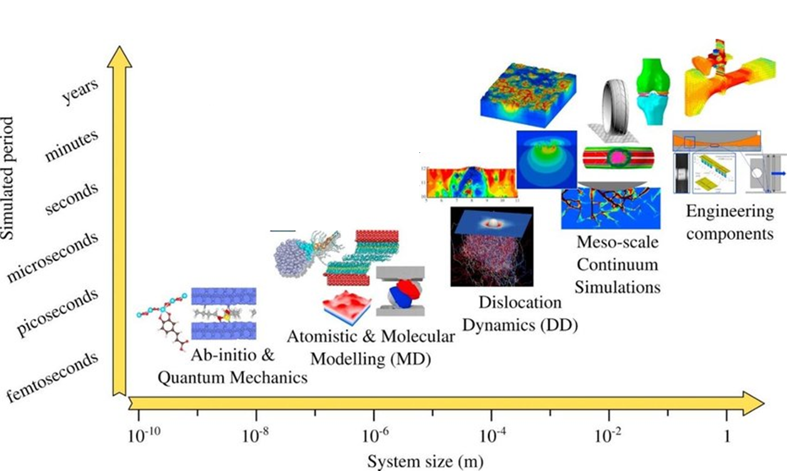
Computational techniques available
Most familiar technique and easy to visualize
BUT!
To simulate behavior of materials under extreme conditions such as high radiation and extreme temperatures for high energy physics (HEP), we need to understand the material at atomic level.
Density functional theory (DFT) and Molecular dynamics (MD) can be used for understanding material at atomic level

Slide 5

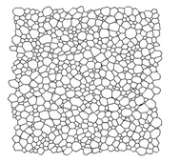
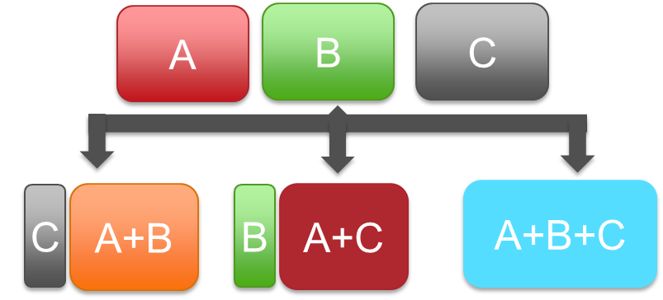
High level introduction to different simulation techniques
CALculation of PHAse Diagrams (CALPHAD)
Density functional theory (DFT)
Molecular dynamics (MD)
CALPHAD: Tool to understand and predict how different materials behave when they are combined and are subjected to different condition
Primarily used for predicting macroscopic properties such as phase diagram, grain growth, etc.
Computationally very fast
Cannot be used to study properties of materials at atomic level
Different phases or one phase?
https://makeagif.com/i/oyxo7C

Slide 6
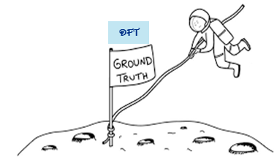
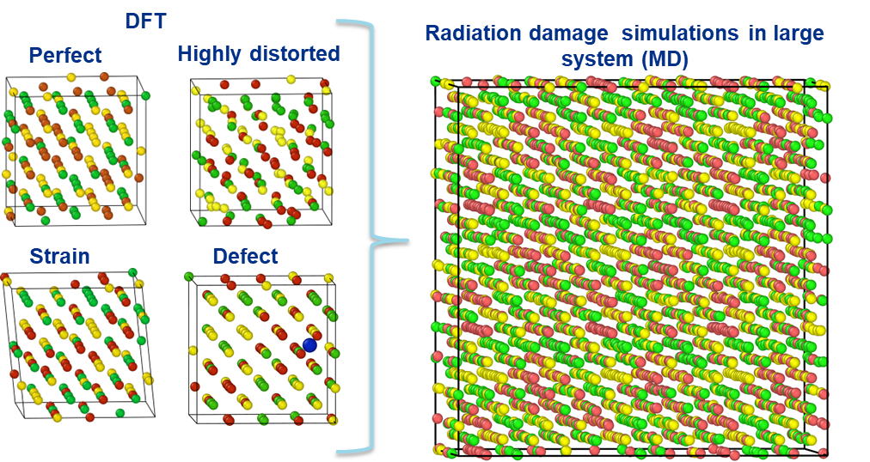
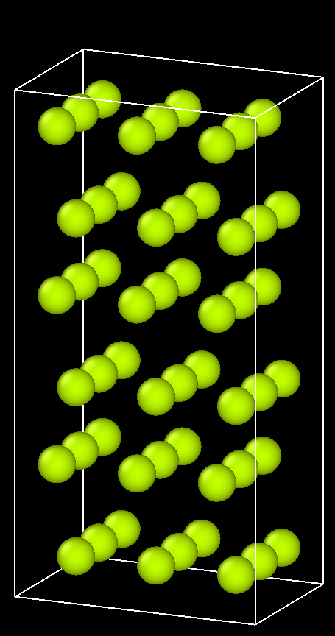


High level introduction to different simulation techniques
Density Functional theory (DFT): Powerful tool for accurately calculating and predicting atomic scale properties
Molecular dynamics (MD): Powerful tool for predicting properties at nanometers to micrometers scale such as radiation damage
Based on newton laws of physics rather than quantum as with DFT.
Not as accurate as DFT.
Accuracy depends upon the quality of fitted data from DFT known as interatomic potential
Large system size
(~millions atoms)
Small system size
(~300 atoms)
Computationally less expensive
Computationally expensive
Combining different computational techniques, different properties of materials can be studied at different time and length scale
https://www.linkedin.com/posts/carl-chesser_it-takes-work-to-keep-a-close-perspective-activity-6979496530156142592-dosU/
https://www.iconfinder.com/icons/981452/speed_indicator_icon
Notes:
Results are equivalent to experimental numbers
Computationally very expensive, limited system size (300 atoms)

Slide 7
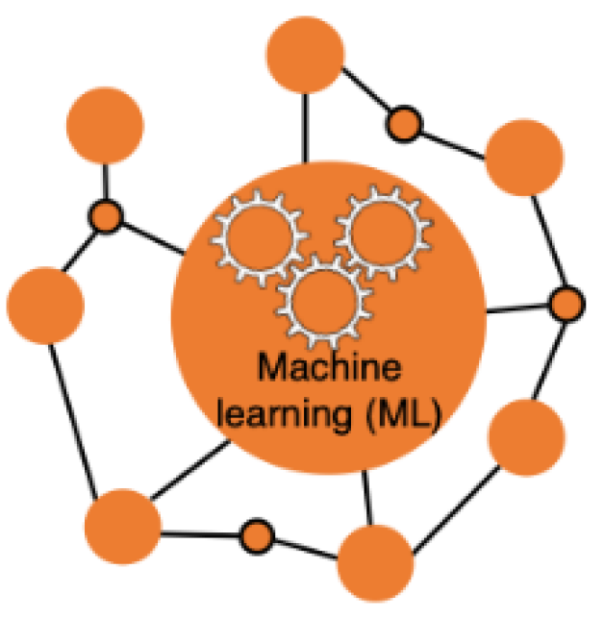
Broad idea
Making of interatomic potential
Use machine learning to learn from DFT and predict properties using MD on larger systems

Slide 8
Design flow for designing materials using different computational tools
Find suitable compositions from the large design space using CALPHAD
Perform density functional theory (DFT) calculations
Most expensive and time-consuming part
Making of new inter-atomic potentials
Running MD simulations for radiation damage
Notes:
Mention that this is general overview for designing materials

Slide 9
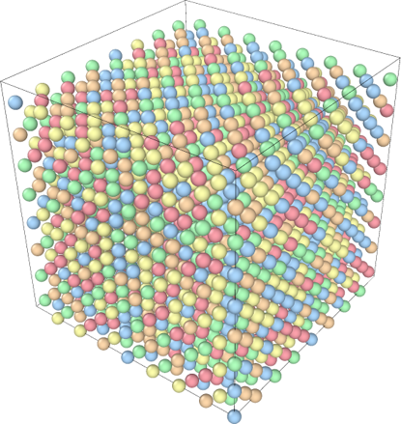
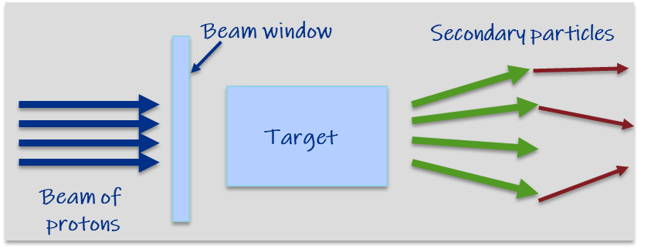
Overview of High entropy alloys (HEAs) and beam window
Desired properties for beam windows
High radiation resistance
Low density
High specific heat
Low coefficient of thermal expansion
High yield strength
HEAs provide large designing space for exploration
Cannot perform DFT on all compositions
Currently we are focused to design materials with high radiation resistance
In collaboration with UM-Madison Materials Degradation under Corrosion and Radiation (MADCOR, Dr. Couet)
Notes:
I ma using previous mentioned tools for HEAs

Slide 10
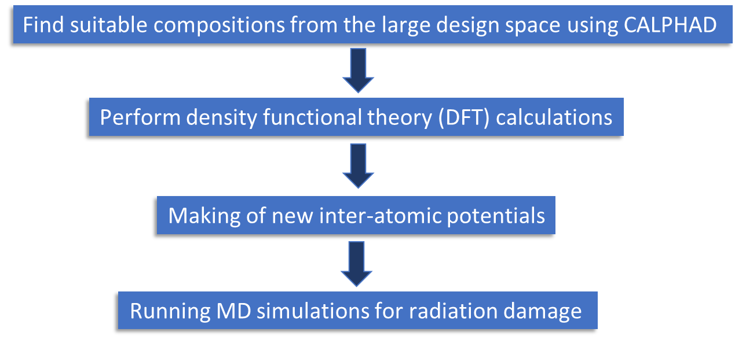
CALPHAD for down selecting compositions
CALPHAD simulations were run to scan Cr-Mn-V-Al-Co-Ti phase space
~120,000 simulations were run
  Chose compositions with broad range of temperatures with BCC/B2 phase
Down-selected compositions
Cr-Mn-V
Cr-Mn-V-Ti7
Cr20-Mn20-V35-Ti10-Al15
Cr20-Mn20-V35-Ti6-Al15-Co4
Al10-Co4-Cr25-Mn26-Ti1-V34
….
…
…
12. Al20-Co2-Mn26-Ti2-V50
Chosen as a base material for beam window
CALPHAD was used to scan vast design space and down select compositions for further exploration
Notes:
Emphasis on the selected composition and also mention they have been prepared/acquired
It was fabricated
Redo this cycle as we add more component

Slide 11
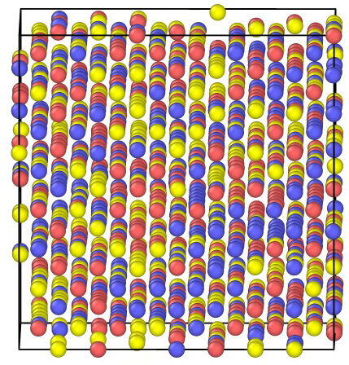
DFT and MD preliminary results
DFT simulations were run to collect data
~15,000 DFT simulations have been performed
1st version of interatomic potentials has been obtained
Phase separation (Random 5000th MC step)
Atomistic simulation predicts ordered structure (Mn-V B2) to be more stable compared to random (first ever simulation result for Cr-Mn-V)
This changes the radiation damage property of a material
Working to confirm the result with experiment
Cr
Mn
V

Slide 12
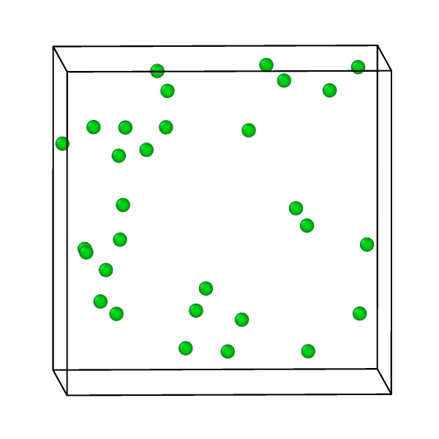
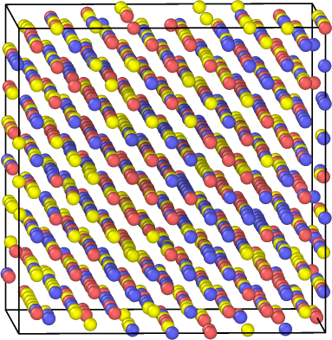
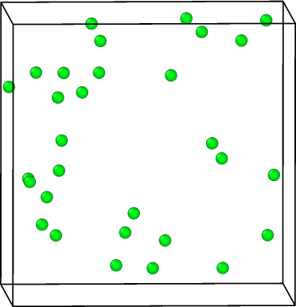
MD result
Calculating mean square displacement (MSD): Seeing how vacancies or defects move through structure
Vacancies are created because of high temperature and radiation
Creating vacancies
Creating vacancies
Tracking vacancies
Tracking vacancies and defects provides insight into their evolution across different temperatures, a process that is challenging to capture through experimental methods

Slide 13
Mean square displacement in random and ordered alloys
With increase in order, MSD for all three elements decreases.
For random configuration, V has highest MSD compared to Cr and Mn.

Slide 14
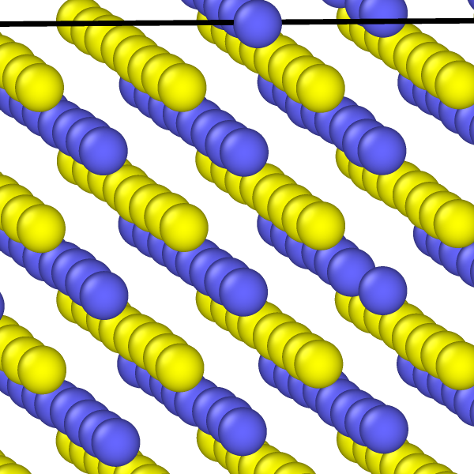
Migration barrier for random and ordered structures
Energy required for a vacancy to move to nearest neighbor site
Structure | Average energy
Random | 1.24 eV
200th MC step | 1.26 eV
500th MC step | 1.30 eV
Ordered (Mn-V phase) | 2.05 eV
With increase in order-ness migration energy for a vacancy also increases resulting for the vacancies hard to hop

Slide 15
Conclusions and Future work
Computational tools such as DFT and MD compliments experiments in designing materials for high energy physics, saving time and money.
For the first time, these tools are being developed and used in high energy physics.
Developed first-ever machine learned interatomic potential for CrMnV BCC alloy.
Ordered phase is more stable than random alloy.
Migration barrier increases with increase in order-ness in the system.
Future work
Use interatomic potential to run radiation damage simulations under different set of conditions.
Add more elements to the list and study the effect of each element on the radiation damage.
Compare and verify simulation results with experiment.
Thank you

