Slide 1
Ab initio study of cementite – ferrite interfaces under irradiation
Pablo Canca
Dpto. Física Atómica, Molecular y Nuclear, University of Granada
9th Annual RaDIATE Collaboration Meeting
16th – 18th September 2024

Slide 2
Pablo Canca
Dpto. Física Atómica, Molecular y Nuclear, University of Granada
Dr. Chu Chun Fu
Université Paris-Saclay, CEA-Saclay
Dr. Christophe Ortiz
Laboratorio Nacional de Fusión - CIEMAT
Prof. Dr. Blanca Biel
Dpto. Física Atómica, Molecular y Nuclear, University of Granada

Slide 3
Irradiation damage characterization: locating carbon in steels
Good simulations require a good understanding of the materials’ microstructure
Carbon complexes have a significant effect on steel structure evolution under irradiation
They are partly responsible for damage accumulation
Many of the mechanisms that explain the arrangement of C in ferrite are still not well understood (C. Ortiz et al., 2009; M. Prester et al., 2022)
Tools: simulations
Collision cascade
Atomistic
fs-ps / nm³
Nucleation/Growth of defects
Mesoscopic
ns - year / nm³ - µm³

Slide 4
Cementite (${Fe}_{3}C$)
Austenite has a higher saturation point of C atoms than ferrite
After cooling austenite to form ferrite, there is saturation of C in the lattice
Some of it forms cementite nanocrystals
Gaganidze, E., & Aktaa, J. (2013). Assessment of neutron irradiation effects on RAFM steels

Slide 5
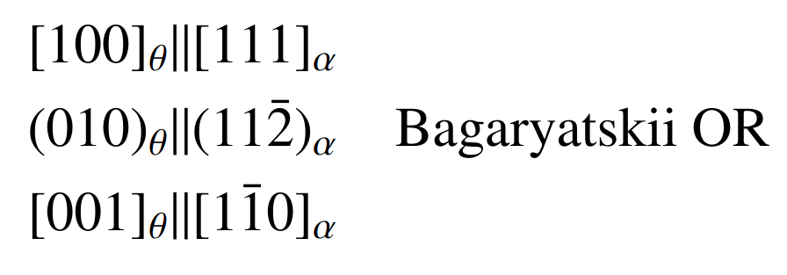
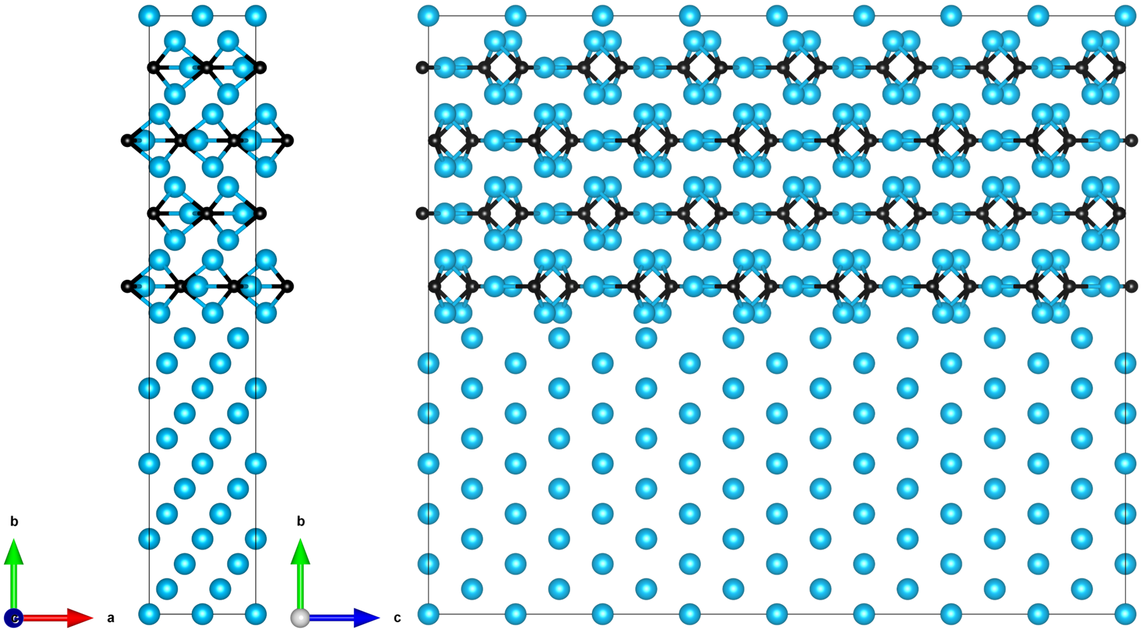
Modelling the ferrite/cementite interface
Experimentally, different orientation relationships (ORs) have been observed
The likelihood of an interface to appear will be directly related to its interfacial energy density ($E_{int})$
We want to understand the arrangement and orientation of the ferrite – cementite ($α−θ$) interface by studying its $E_{int}$

Slide 6
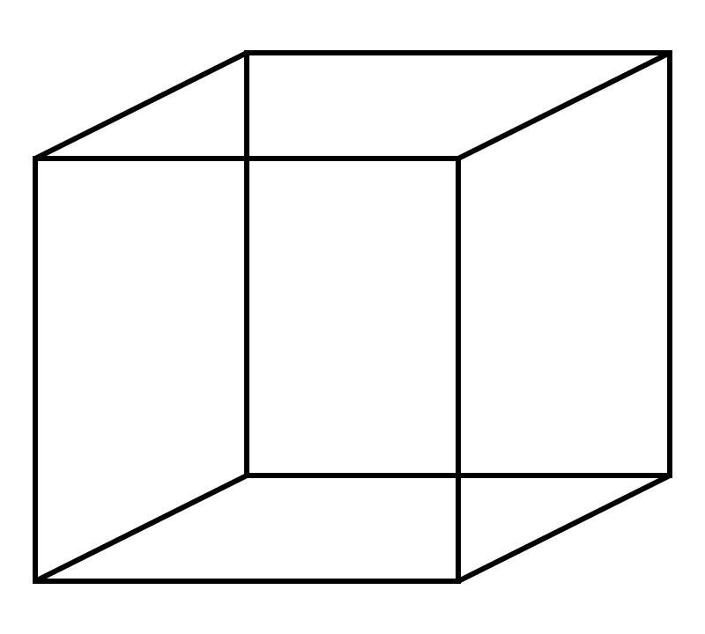
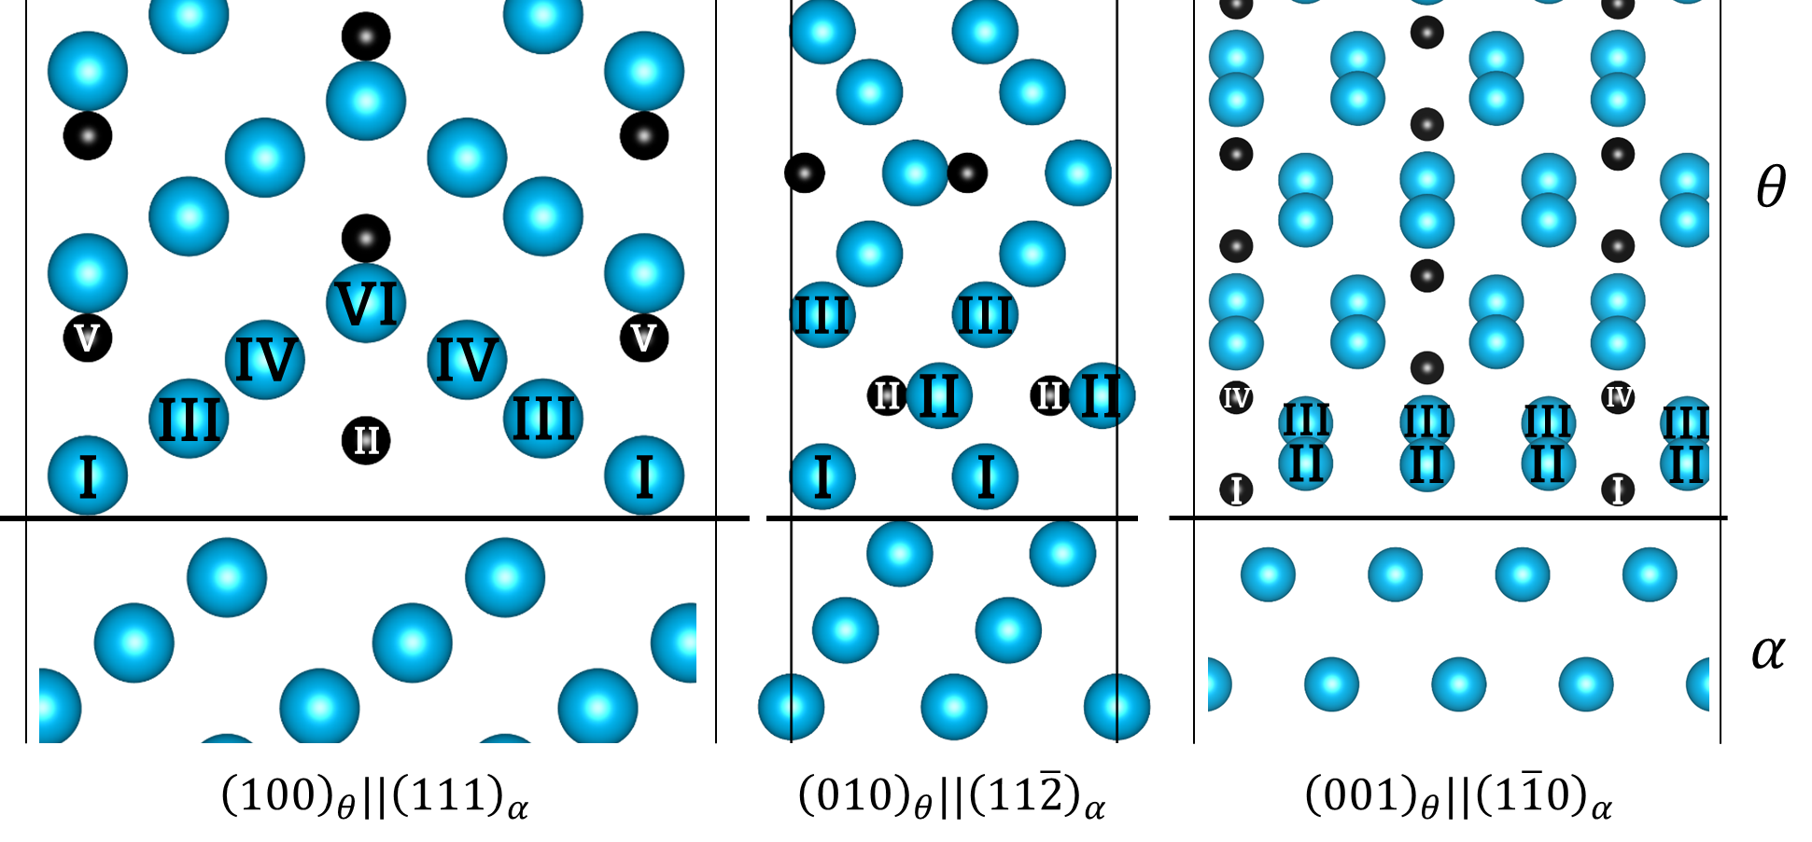
Modelling the ferrite/cementite interface
We will study three distinct interface planes under the same rotation
How does the chemistry of the termination layer influence the interface? 13 in total
$$α$$
$$θ$$
6 terms.
3 terms.
4 terms.

Slide 7
Interface characterization: mismatch
 | $$a_{Fe}/a_{Cem}$$ | $$b_{Fe}/b_{Cem}$$ | $$c_{Fe}/c_{Cem}$$
Mismatch (%) | 2.8 | 3.4 | 11.2
Find common multiples of the lattice constants of both materials that minimizes strain
 | $$a_{Fe}/a_{Cem}$$ | $$c_{Fe}/c_{Cem}$$ | N atoms
Number of UC | 33 / 32 | 10/9 | 34272
Mismatch | 0.29 | 0.71
 | $$a_{Fe}/a_{Cem}$$ | $$b_{Fe}/b_{Cem}$$ | $$c_{Fe}/c_{Cem}$$
Number of UC | 10/9 | 21/22 | 33 / 32
Mismatch (%) | 0.71 | 0.05 | 0.29
What technique should we use?

Slide 8
Multiscale problem
How big is my system?
What timescales am I interested in?
Do I have reliable potentials to study my system using less accurate, more efficient methods?
Lin, K., & Wang, Z. (2023). Communications Materials, 4(1), 66.

Slide 9
DFT vs. MD
Density Functional Theory
Molecular Dynamics
Full quantum description of the system
High accuracy
Ab initio theory, meaning that it computes properties from only theory
Computationally expensive
Limit ~ 10² atoms
Applications:
Defect formation energies
Structural relaxation
The system’s description relies on the quality of the potential
Classical mechanics
Lower accuracy
Computationally cheap
Limit ~ 10⁶ atoms
Applications:
Cascades
Defect evolution
Dislocations

Slide 10
Interface characterization: mismatch
 | $$a_{Fe}/a_{Cem}$$ | $$b_{Fe}/b_{Cem}$$ | $$c_{Fe}/c_{Cem}$$
Mismatch (%) | 2.8 | 3.4 | 11.2
Find common multiples of the lattice constants of both materials that minimizes strain
 | $$a_{Fe}/a_{Cem}$$ | $$c_{Fe}/c_{Cem}$$ | N atoms
Number of UC | 33 / 32 | 10/9 | 34272
Mismatch | 0.29 | 0.71
 | $$a_{Fe}/a_{Cem}$$ | $$b_{Fe}/b_{Cem}$$ | $$c_{Fe}/c_{Cem}$$
Number of UC | 10/9 | 21/22 | 33 / 32
Mismatch (%) | 0.71 | 0.05 | 0.29
Big interfaces with MD
Small interfaces with MD: high strain
Small interfaces with DFT

Slide 11
Interfaces using MD
Use Molecular Dynamics to handle these big systems: LAMMPS
Minimize command, Conjugate Gradient algorithm
We choose a potential that provides an accurate description of the system: MEAM by Liyanage
 | MD | DFT | Exp.
$$a_{Fe} (\dot{A})$$ | $$2.851$$ | $$2.833$$ | $$2.853$$
$$a_{Cem} (\dot{A})$$ | $$5.088$$ | $$5.036$$ | $$5.081$$
$$b_{Cem} (\dot{A})$$ | $$6.669$$ | $$6.721$$ | $$6.753$$
$$c_{Cem} (\dot{A})$$ | $$4.470$$ | $$4.479$$ | $$4.515$$
$$E_{Cem}^{f} \left(\frac{eV}{f.u.}\right)$$ | $$0.225$$ | $$0.204$$ | $$0.165±0.05$$
Notes:
Main focus: lat constants because we want to scale down

Slide 12
Big interfaces using MD
We can compute $E_{int}$ as: $E_{int}=\frac{E_{total}−E_{α}^{bulk}−E_{θ}^{bulk}}{2S} \left(Jm^{−2}\right)$
Can we do this with DFT?
34272 atoms → Not directly

Slide 13
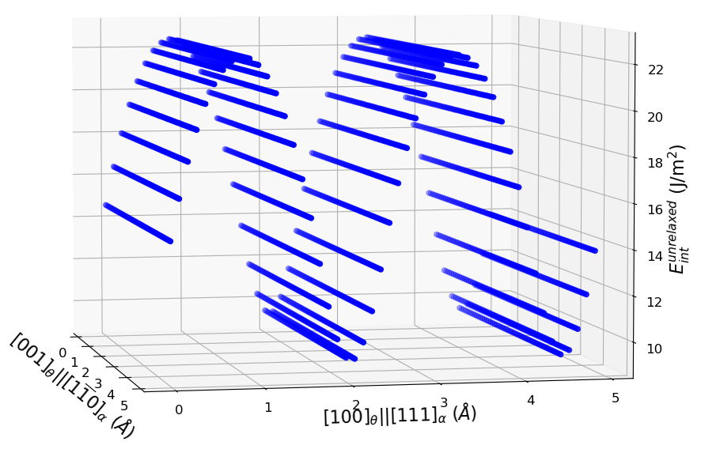
Adapting these systems to DFT: Strain and relative position
Influence of strain: relevant after 4 %
Influence of the relative position

Slide 14
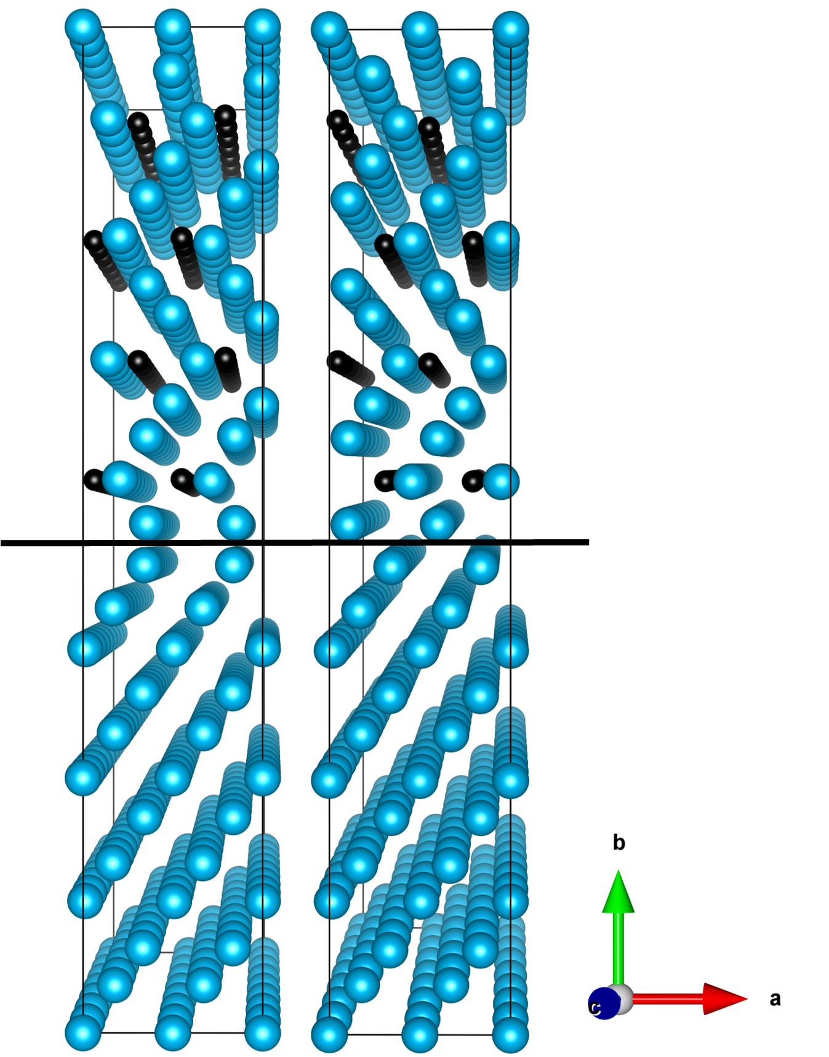
Small interfaces using MD: relative position
 | $$a_{Fe}/a_{Cem}$$ | $$c_{Fe}/c_{Cem}$$ | N Atoms
Number of UC | 1/1 | 8/7 | 416
Mismatch (%) | 2.94 | 3.09
$$θ$$
$$α$$
32,500 simulations!!
Notes:
Does the relative position between cementite and ferrite influence the results?

Slide 15
Adapting the interfaces to DFT using MD
$${\left(010\right)}_{θ}||{\left(11\overline{2}\right)}_{α}$$ | $$a_{Fe}/a_{Cem}$$ | $$c_{Fe}/c_{Cem}$$ | N Atoms
Number of UC | 1/1 | 8/7 | 416
Mismatch (%) | 2.94 | 3.09
We can build systems of adequate strain suited for DFT
We first test them using MD to obtain the optimal relative position
$E_{int}$ barely differs for the ${\left(010\right)}_{θ}||{\left(11\overline{2}\right)}_{α}$ case, but it does for the ${\left(001\right)}_{θ}||{\left(1\overline{1}0\right)}_{α}$ interface
$${\left(001\right)}_{θ}||{\left(1\overline{1}0\right)}_{α}$$ | $$a_{Fe}/a_{Cem}$$ | $$c_{Fe}/c_{Cem}$$ | N Atoms
Number of UC | 1/1 | 1/1 | 136
Mismatch (%) | 2.94 | 4.72

Slide 16
DFT results
$${\left(010\right)}_{θ}||{\left(11\overline{2}\right)}_{α}$$ | $$a_{Fe}/a_{Cem}$$ | $$c_{Fe}/c_{Cem}$$ | N Atoms
Number of UC | 1/1 | 8/7 | 416
Mismatch (%) | 2.52 | 1.99
VASP: GGA-PBE, 10⁻⁶ eV, 10⁻² eV/A
We know that the influence of strain is limited
The calculation is initialized at the best relative position
The system is sufficiently large to reproduce bulk conditions
We can expect an error of about 0.1 J/m² caused by strain
$${\left(001\right)}_{θ}||{\left(1\overline{1}0\right)}_{α}$$ | $$a_{Fe}/a_{Cem}$$ | $$c_{Fe}/c_{Cem}$$ | N Atoms
Number of UC | 1/1 | 1/1 | 136
Mismatch (%) | 2.52 | 3.21
1
[1] X. Zhang et al. Acta Materialia, 2015

Slide 17
Verifying our results Magnetism
For a non-magnetic system, we can use a simple rule of thumb: densest surfaces have the lowest surface energy
For a magnetic system, surface magnetization follows the opposite rule: less dense surfaces lower their surface energy by increasing magnetization

Slide 18
Verifying our results Bond Order
Bond Order is proportional to bond strength
For a surface, the stronger the broken bond’s bond order is, the higher the surface energy will be
There is a clear relation between bond order and surface energy
For the interface: we are working on it…

Slide 19
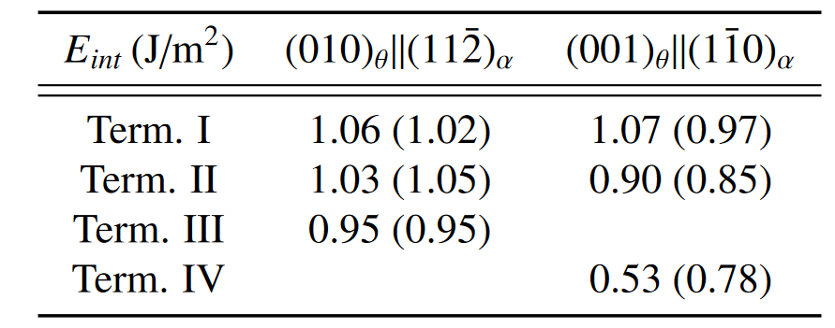
Conclusions
MD - Strained
DFT - Strained
T$he {\left(001\right)}_{θ}||{\left(1\overline{1}0\right)}_{α}$ presents the lowest $Eint$
LAMMPS needs better potentials to study these interfaces
DFT can be implemented to study these interfaces with better accuracy, at the cost of high computational resources

Slide 20
Next steps
Addition of defects
Which defects increase the stability of the interface?
Object Kinetic Montecarlo Simulations (OKMC)
New, DFT-trained potentials using Machine Learning

Slide 21
Ab initio study of cementite – ferrite interfaces under irradiation
Pablo Canca, Chu Chun Fu, Christophe Ortiz, Blanca Biel
Dpto. Física Atómica, Molecular y Nuclear
Université Paris-Saclay, CEA-Saclay
Laboratorio Nacional de Fusión – CIEMAT
9th Annual RaDIATE Collaboration Meeting
16th – 18th September 2024

