Slide 1



Dynamic Thermomechanical Simulations of IFMIF-DONES Target’s Back-Plate Failure
M. Vázquez, C. Torregrosa, J. Maestre
18 Sept 2024

Slide 2
Outline
Introduction to the Problem and Objectives
Methodology Proposed
Results:
  Estimation of the beam energy deposition in the BP as function of the curtain Li thickness
  Finite Element thermal-transient simulations of the BP heat-up process
  General results for Structural Simulations
Conclusion

Slide 3
Introduction
One of the most Critical Accidental Scenarios of the Facility:
Failure of any SSC leading to the loss of liquid lithium curtain without enough time to shut down the beam.
Direct or partial beam impingement on the Backplate (BP). Large among of deposited power (Li curtain instability with at least 4-5 mm thickness reduction).
Melting or Vaporization of the BP material with the eventual mobilization of its radioactive inventory.

Slide 4
Objectives
Characterize the involved timings and modes of failure of the BP in case of reductions of the Li curtain thickness for the two beam operation modes (20x5 and 10x5 cm²). Types of investigated mode of failures:
  Mechanical failure due to thermal stresses and drop of mechanical properties at high temperatures.
  Melting of the BP material.
  Vaporization of the BP material.
Estimate times of accelerator “passive shutdown” once the BP has failed assuming failure of all the active Safety Functions (eventual entrance of He inside the TVC and subsequent increase of pressure in the SRF and RFQ ).
Estimate the maximum amount of volatilized and mobilizable material in the BP.
Results of the current work
MuVacAs

Slide 5
Methodology
Estimation of the beam energy deposition in the BP as function of the Li curtain thickness reduction.
Material properties definition, modelling and meshing.
Finite Element thermal-transient simulations of the BP heat-up process for different Li curtain thicknesses. Estimations of:
  Timings to reach the melting point.
  Timings to reach the vaporization point.
Finite Element structural-transient thermomechanical simulations. Estimations of timing for the mechanical failure of the BP.

Slide 6
STEP 1
Estimation of the beam energy deposition in the BP as function of the Li curtain thickness reduction

Slide 7
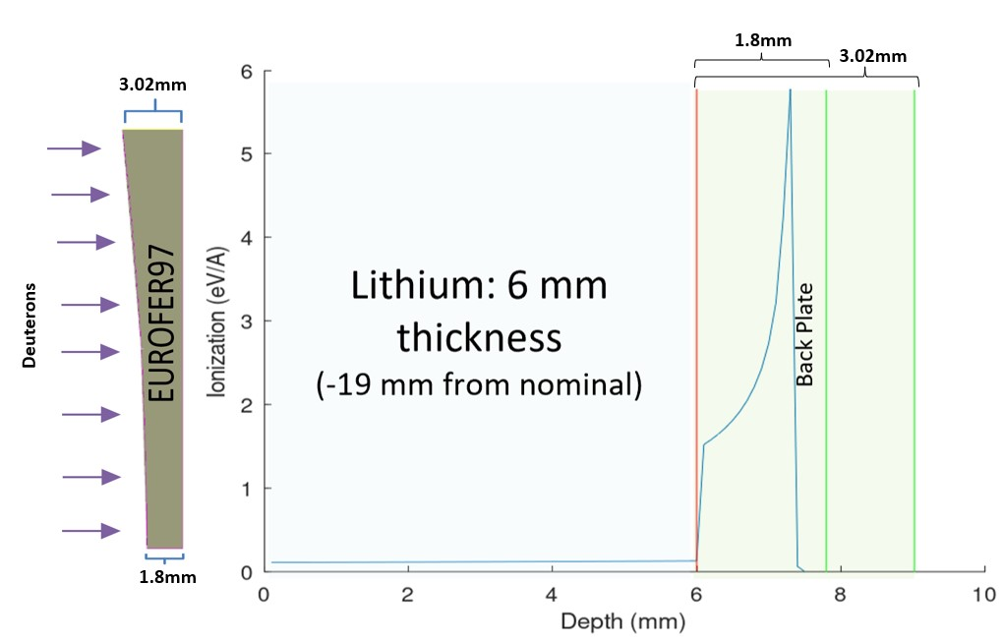
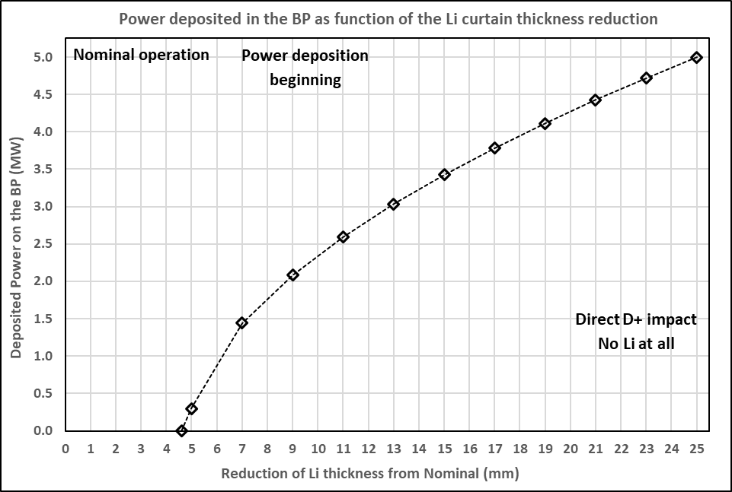
Step 1: Energy deposition in the BP as function of the Li thickness
Use of SRIM Software
(Stopping and Range of Ions in Matter)
Monte Carlo Simulations
Freeware
The Bragg-peak falls inside the BP. The calculation is considering the variation of BP thickness along the FP
Thickness reduction (mm) | Power deposited (MW)
25 | 4.9461
23 | 4.7245
21 | 4.4317
19 | 4.1192
17 | 3.7865
15 | 3.4291
13 | 3.0487
11 | 2.5979
9 | 2.1113
7 | 1.4392
5 | 0.39506
4.6 | 0.0

Slide 8
STEP 2
EUROFER97 properties and geometry modelling & meshing

Slide 9
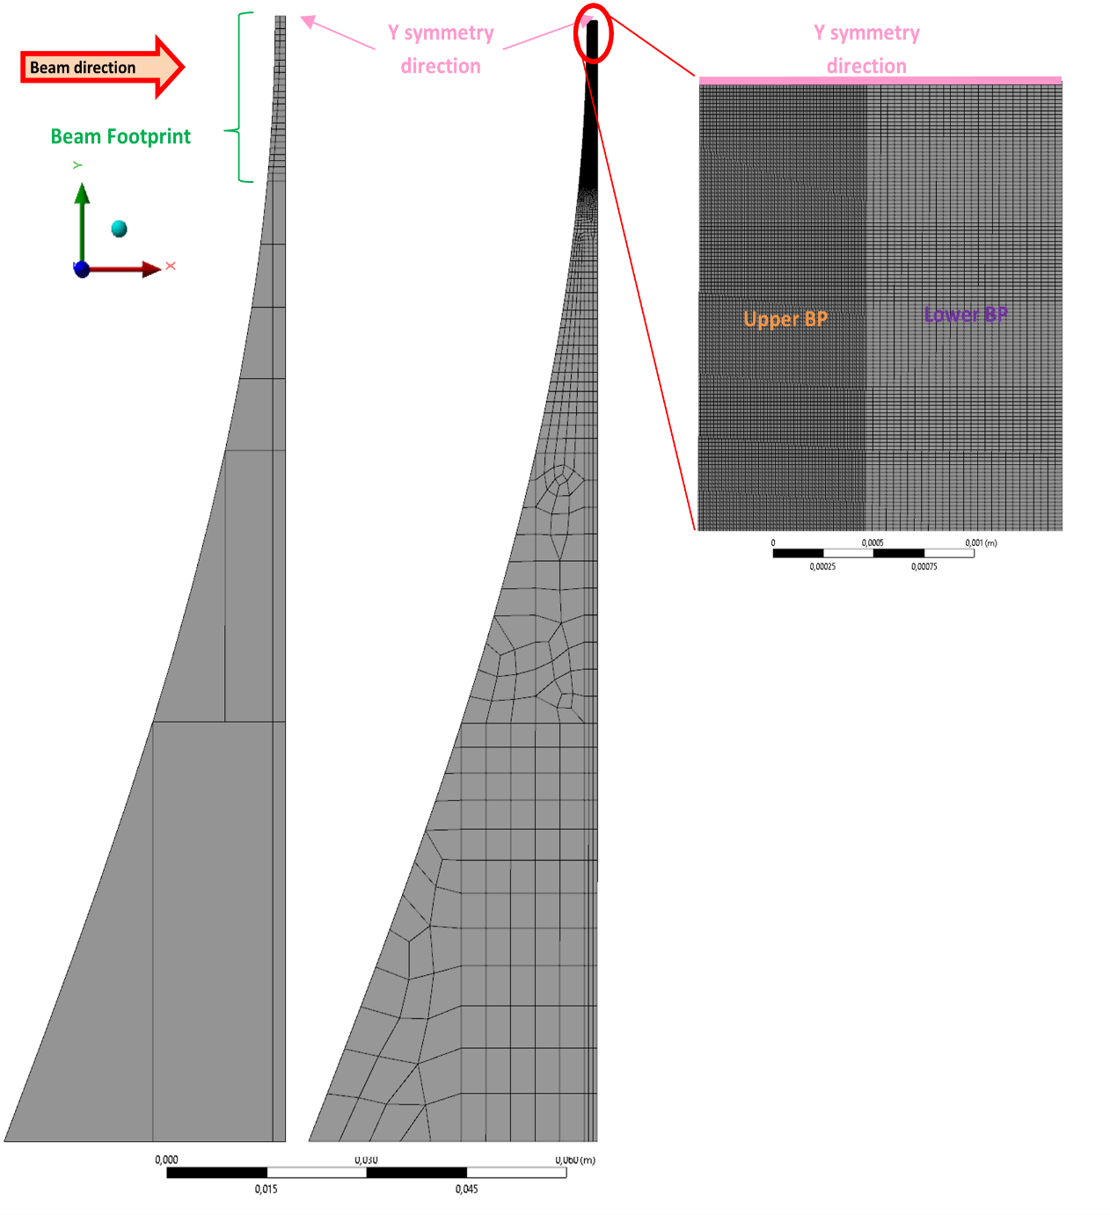
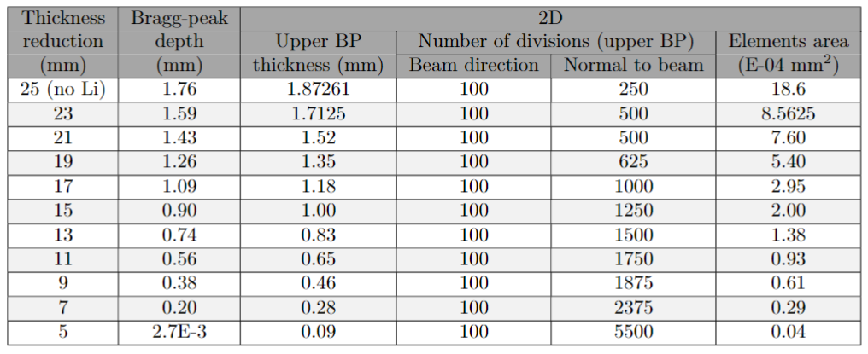

Step 2: modelling and meshing
Plane strain → long constant XZ cross-section (Y direction)
Maximum SRIM space discretization
100 divisions
9kPa
13 mm Li thickness reduction scenario
20x5cm² footprint size
No displacement

Slide 10
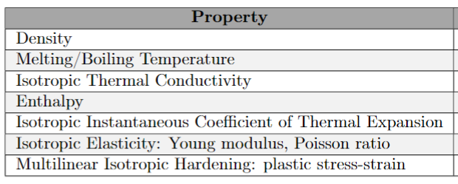
Step 2: EUROFER97 properties
Implementation of temperature-dependent strength models considering plastic deformation
Yield strength, ultimate tensile strength, uniform elongation, strain to rupture
Experimental (continuous) and extrapolated (dashed) stress-strain curves at different temperatures for EUROFER97

Slide 11
STEP 3
Finite Element thermal-transient simulations of the BP heat-up process for different Li curtain thickness reductions

Slide 12
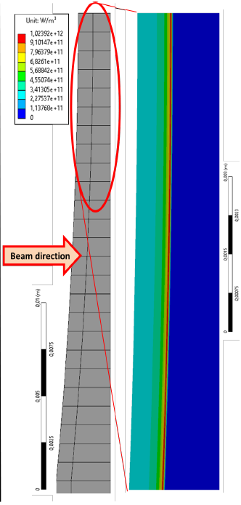
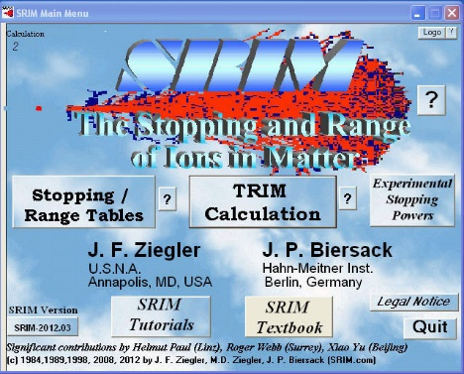

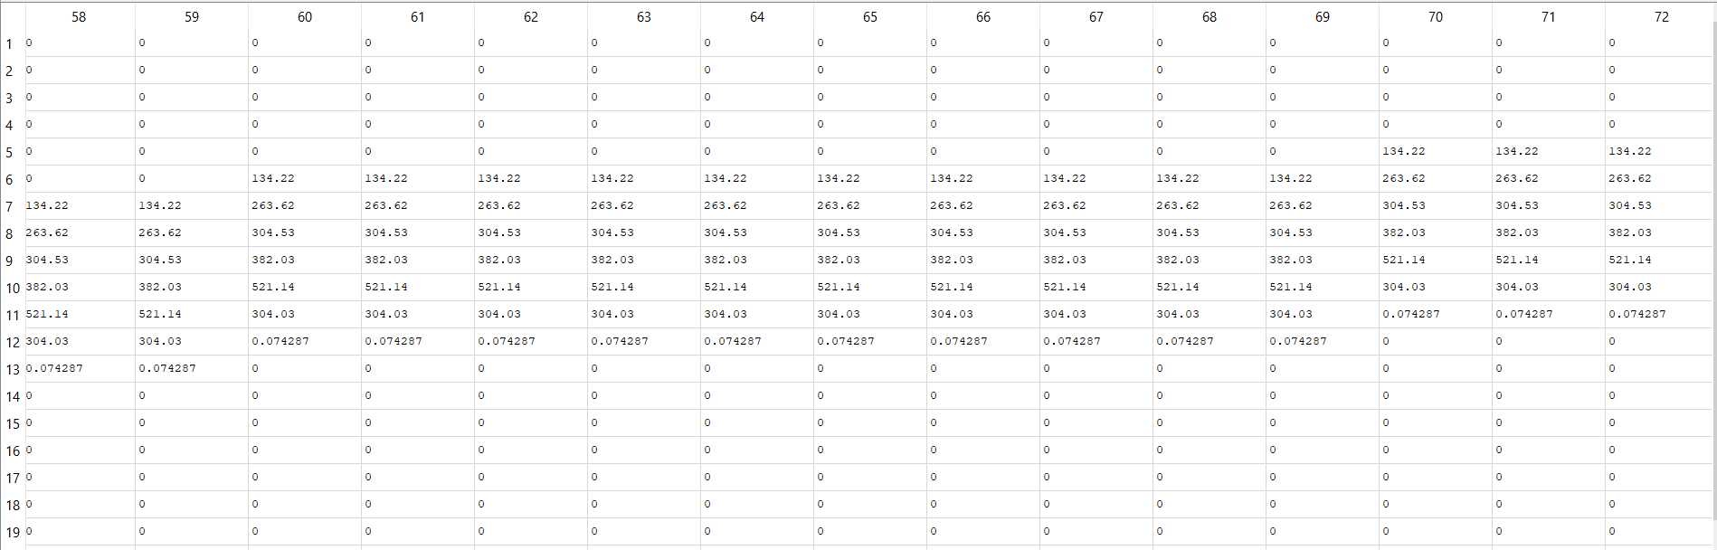

Step 3: Finite Element thermal-transient simulations of the BP
Results of SRIM are post-processed according to the meshing to create Power Density Input Tables onto the BP FE model
Internal Heat Generation
2D
(13 mm thickness reduction - 20x5cm²)

Slide 13
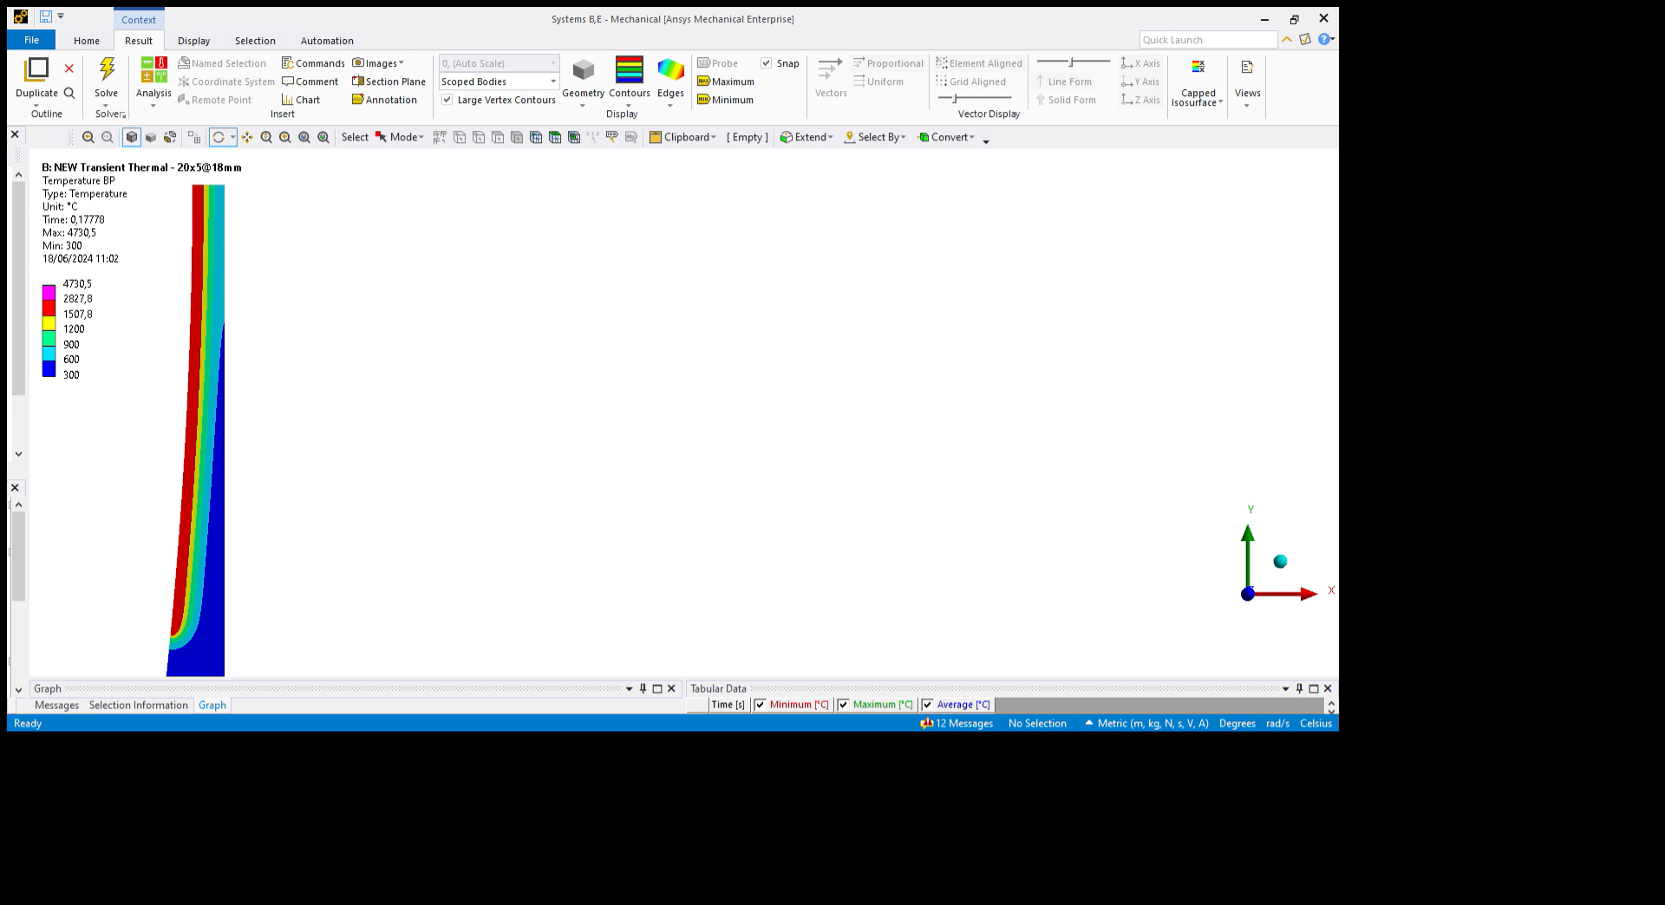
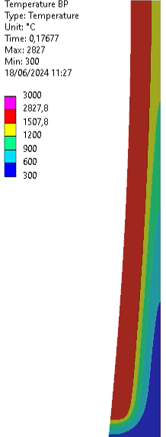
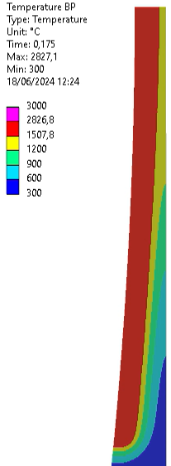
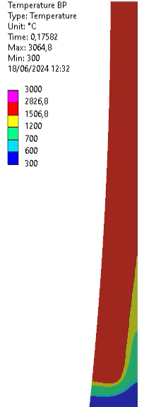

Step 3: thermal-transient simulation results
Temperature profile
7 mm Li thickness reduction 20x5 cm²
Temperature profile
13 mm Li thickness reduction 20x5 cm²
Temperature profile
13 mm Li thickness reduction 10x5 cm²
Temperature profile
23 mm Li thickness reduction 20x5 cm²

Slide 14
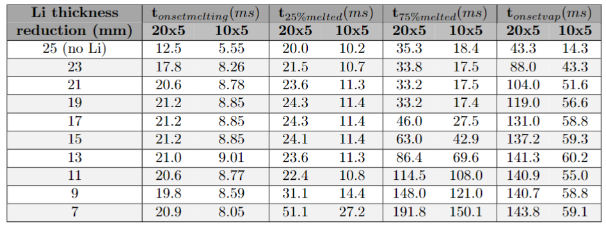
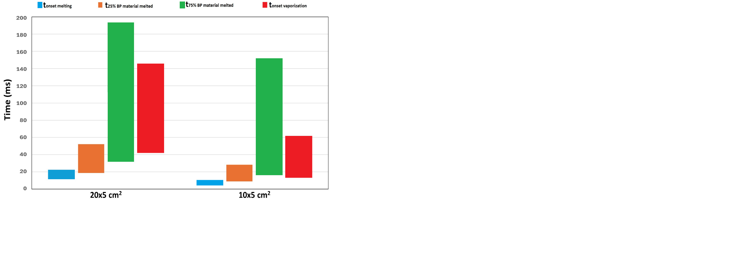
Step 3: Finite Element thermal-transient simulations of the BP
Onset melting (blue)
* 20x5cm²: from 12.5 to 21 ms
* 10x5cm²: from 5.5 to 9 ms
25% melted (orange)
* 20x5cm²: from 20 to 50 ms
* 10x5cm²: from 10 to 27 ms
20x5cm²
75% melted (green)
* 20x5cm²: from 33 to 190 ms
* 10x5cm²: from 17 to 150 ms
Onset vaporization (red)
* 20x5cm²: from 43 to 145 ms
* 10x5cm²: from 14 to 60 ms
10x5cm²

Slide 15
STEP 4
Finite Element structural thermomechanical simulations to estimate mechanical failure of the BP

Slide 16
Step 4: Finite Element structural simulations of the BP
How do we decide if the BP has failed?
At a given time, the melted material “across a sufficiently fraction of the thickness” will lead to the loss of material structural consistency, and failure due to external pressure and deformation (in addition to internal thermal stresses).
As the strain to rupture depends on the temperature, we take the maximum value registered to be conservative (22%@700ºC). Nevertheless, the presence of ΔT>1200ºC over material thickness ~1mm invalidates this criterion because of the progressive plastification and transition to liquid phase before reaching this strain value.

Slide 17
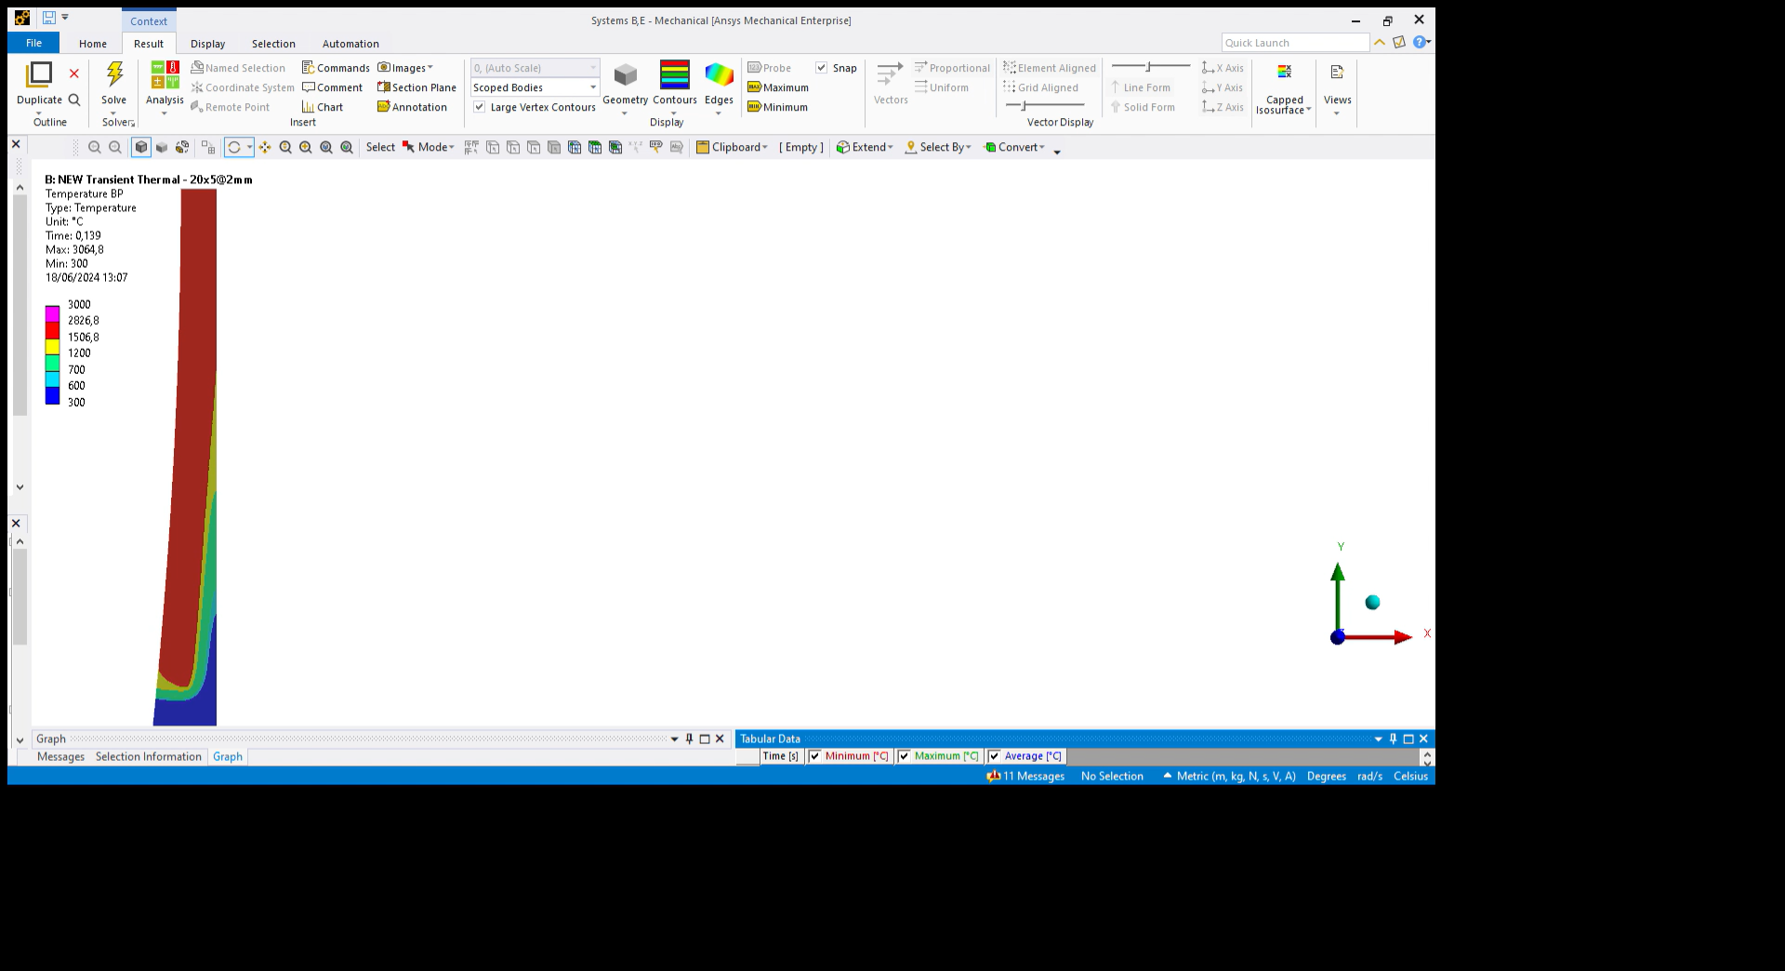
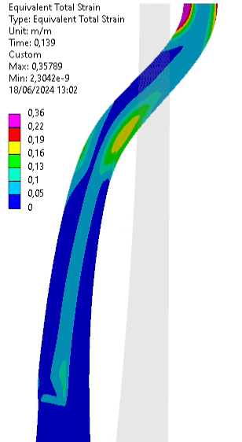
Step 4: Finite Element structural simulations of the BP – 2D
Failure criterion not reached before melting
Plastic deformation in liquid region!!
Temperature profile
23 mm Li thickness reduction 20x5 cm²
Total strain profile
23 mm Li thickness reduction 20x5 cm²
Reduced thickness model

Slide 18
Step 4: Finite Element structural simulations of the BP
50% of BP material above the melting temperature
13 mm Li thickness reduction
20x5 cm² beam size
40 ms after deposition beginning
75% of BP material above the melting temperature
23 mm Li thickness reduction
20x5 cm² beam size
32 ms after deposition beginning

Slide 19
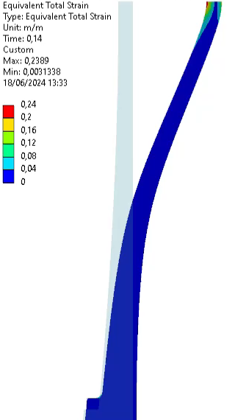
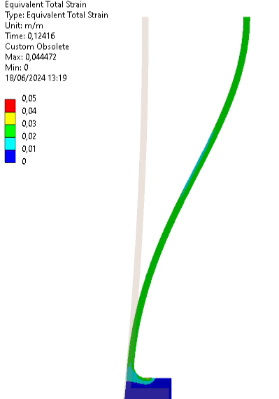
Step 4: Finite Element structural simulations of the BP – 2D
75% of BP material above the melting temperature
23 mm Li thickness reduction
20x5 cm² beam size
32 ms after deposition beginning
50% of BP material above the melting temperature
13 mm Li thickness reduction
20x5 cm² beam size
40 ms after deposition beginning

Slide 20
Conclusions
A detailed characterization of the BP response in case of partial or direct beam impingement and subsequent chains of events is being performed.
This task will allow a far more accurate characterization of the mobilizable inventory in the worse-case accidental scenario → Very useful during licensing process.
Thermal results suggest that:
  Melting point within BP would be reached within 12.5-21 ms (20x5cm²) | 5.5-9 ms (10x5cm²) after Li partial loss.
  Vaporization within 43-145 ms (20x5cm²) | 14-60 ms (10x5cm²).
Structural simulations try to estimate the timings for mechanical failure (after melting) → strain-failure criterion is not reached. The time required to melt 75 % of the BP central axis material thickness is considered sufficient to induce mechanical failure in the remaining solid part.

Slide 21
Thank you very much!!
Suggestions?
Questions?

