Slide 1





Investigation of radiation damage of fine-grain graphite for target applications
9th Annual RaDIATE Collaboration Meeting
Alex Comyn¹, Eric Jiang^{1,2}, Kavin Ammigan³, Frederique Pellemoine³, Chris Densham⁴ and Dong Liu^{1,2}
¹Department of Engineering Science, University of Oxford
²School of Physics, University of Bristol
³Target Systems Department, Fermi National Accelerator Laboratory
⁴ High Power Targets group, Rutherford Appleton Laboratory
Contact email: px23894@bristol.ac.uk & dong.liu@eng.ox.ac.uk

Slide 2

Outline
Outline
Nuclear/synthetic graphite – Target applications applications, Microstructure, effect of radiation damage
Neutron diffraction experiment – characterisation ‘c’-axis expansion of ex-service fin and future experiment.
Ion-implantation – He⁺ Ion implantation at Surrey ion beam
PIE analysis – TEM, TDTR, Raman

Slide 3
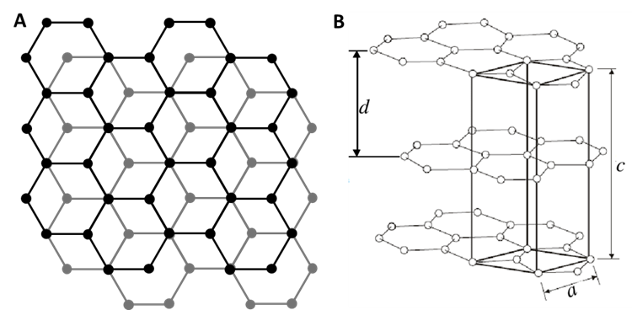
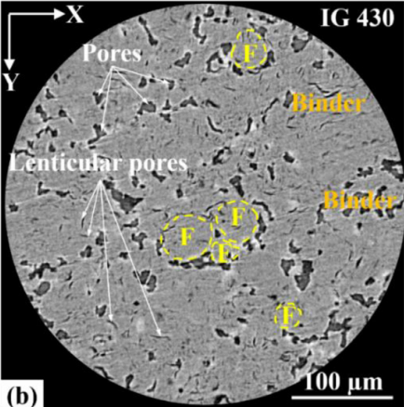
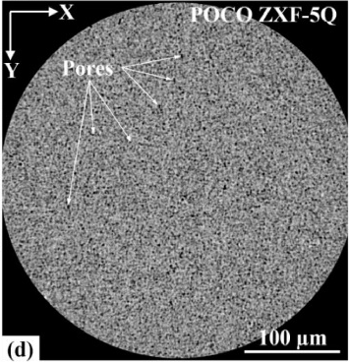
Fine-grain nuclear graphite – Structure & properties
Nuclear/synthetic graphite
Graphite has previously been used as a secondary particle production target – e.g. NoVA (FNAL), T2K (J-Park).
Crystal structure: Hexagonal crystal structure, sp2 hybridization and covalently bonded C-C, weak Van der Walls forces between layers
Microstructure: Filler particles and binder, Filler particle size (100s um to 1um), Porosity
Thermal properties – high thermal conductivity, low thermal expansion, Good thermal shock resistance.
Jiang, Ming, et al. "Multiple length-scale microstructural characterisation of four grades of fine-grained graphite." Journal of Nuclear Materials 550 (2021): 152876.

Slide 4
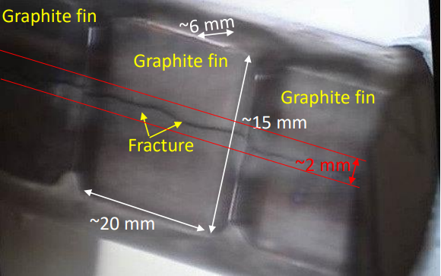
Fine-grain nuclear graphite – Radiation damage (1)
Radiation damage limiting factor in target performance
NT02 target from NuMI target station: 10-15% decrease in neutrino yield. Fracture of fins also observed.
Microstructure and crystal structure changes under irradiation:
  ‘c’-axis expansion and ‘a’-axis contraction
  Fragmentation to smaller coherent graphitized domains (nano-crystallinity),
  Porosity shrinkage

Slide 5
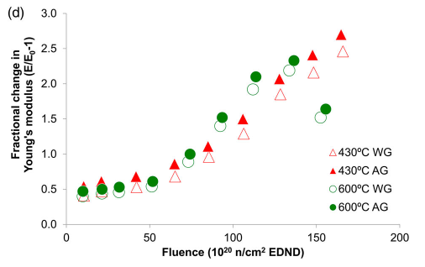
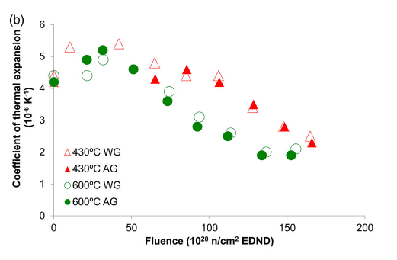
Fine-grain nuclear graphite – Radiation damage (2)
(a)
Radiation damage – Property changes
Mechanical properties
  Increase in Youngs Modulus (a)
  Increase in hardness
Thermal properties
  Decrease thermal conductivity
  Changes in CTE (b) - Depends on Microstructure and annealing effects
Changes in mechanical properties effect target lifetime and thermal shock resistance
(a) and (b) for Gilsocarbon graphite
(b)
Marsden, Barry J., et al. "Dimensional change, irradiation creep and thermal/mechanical property changes in nuclear graphite." International Materials Reviews 61.3 (2016): 155-182.

Slide 6
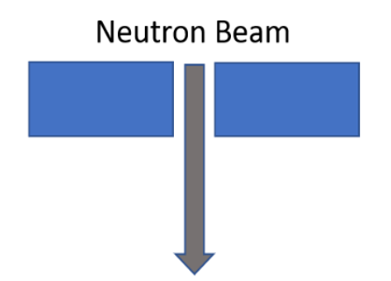
Neutron diffraction – Experiment outline
Time of flight (ToF) Neutron diffraction at EnginX
ISIS is a spallation source producing neutron pulses incident on sample.
Depending on crystal axis, will have different d-spacing. The time of flight (ToF) of neutrons diffracted from the sample to the detector is proportional to the d-spacing.
Detectors 90º to sample gives values from a cubic volume (the Gauge volume)
Due to angle, alignment and movement of gauge volume can be difficult (depending on direction)
45°
Detector 2
South
Detector 1
North
sample
Gauge Volume

Slide 7
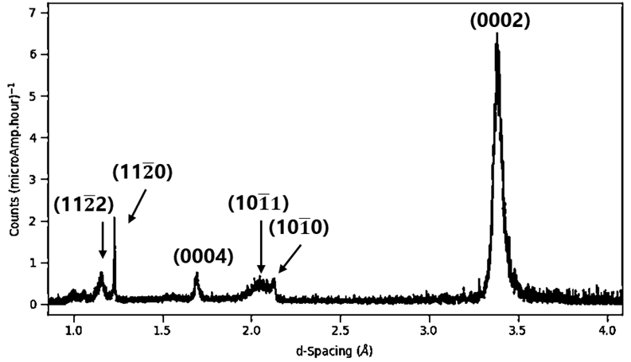
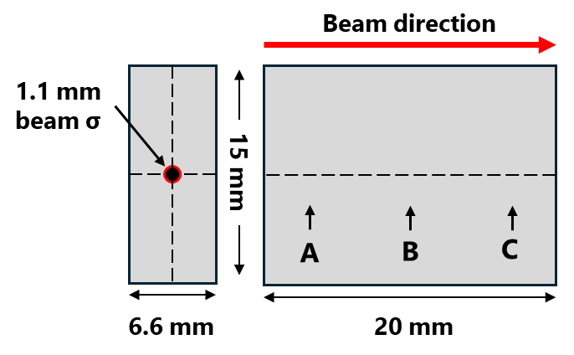
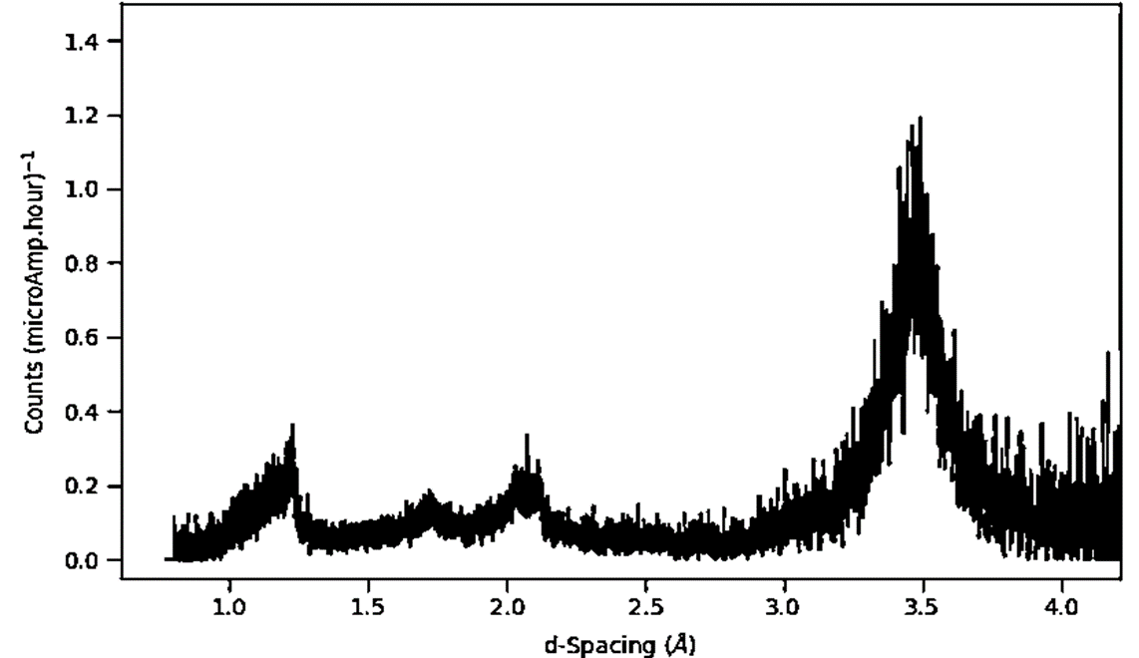
Neutron diffraction – Experiment non/irradiated results
Irradiated POCO fin – Neutron diffraction
Irradiated samples: ex-service upstream fin from NT02 target from NuMI target station at FNAL, POCO ZXF-5Q
Unirradiated vs irradiated neutron diffraction spectra, Gauge volume: 4x4x4 mm vs 3x3x3 mm, respectively, but higher count current for irradiated.
Unirradiated POCO
There is an irradiation gradient across the POCO fin. Using neutron diffraction measurements provide information on spatial variation in radiation damage at different positions of fin
Irradiated POCO (Volume centre)

Slide 8
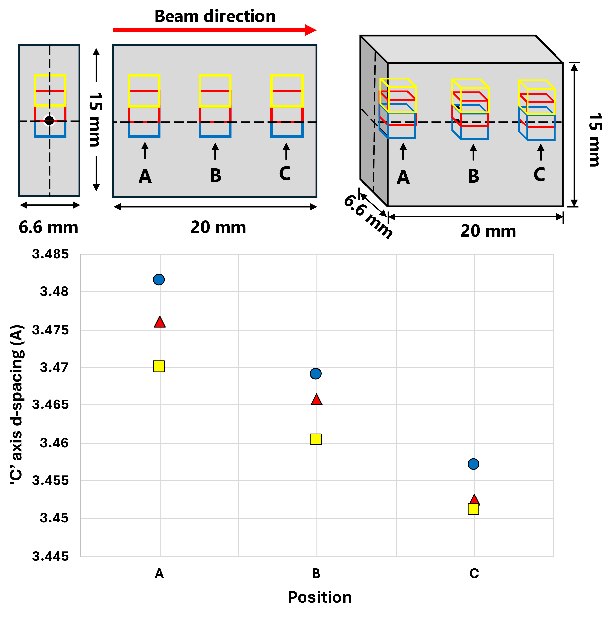
Neutron diffraction – Different positions
C-Axis expansion
Analysis of (002) diffraction peak – ‘c’-axis
Across irradiation Gradient (blue→red→yellow) at 3 different positions across the beam direction (A, B and C)
Increase in ‘c’-spacing as irradiation gradient increases (towards centre)
Basal plane expansion decreases along beam direction, ‘c’-spacing converges away from beam centre at back of fin

Slide 9
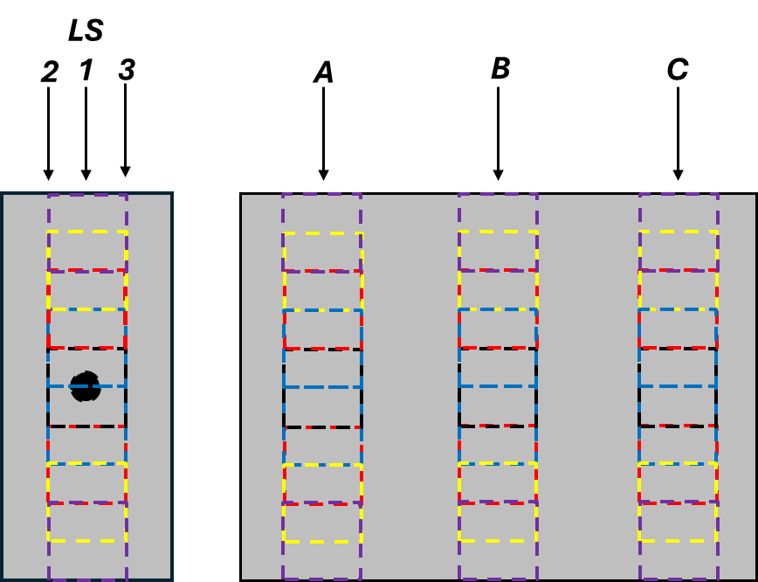
Neutron diffraction – future experiment
Improvement upon initial neutron diffraction experiment
Improved Signal to noise – Longer scan time shows decrease in noise, no improvement in signal
More scans across irradiation gradient – provide fuller picture of radiation damage
Gamma radiation from POCO fin – detection of gamma ray saturates detector pixel and data point is removed. Results in decrease in signal
Absorb gamma rays with minimal absorbing/scattering neutrons – Tin sheets is current plan
Comparison with previous Raman measurements across gradient and future TEM work
45°
Detector 2
South
Detector 1
North
Tin sheets

Slide 10
Ion Implantation - Future grades
Ion implantation grades of graphite
Understanding of radiation damage in new grades proposed target grades:
  IG-510U, IG-430U, G347A, IG-110,
Previous grades, for comparison: POCO ZXF-5Q, IG-430
Highly-oriented pyrolytic graphite (HOPG)
Investigate effect irradiation damage on Microstructure, crystallinity and thermal properties
IG-510U of high interest due to high density (1.9 g/cm³) – better physics performance (higher neutrino yield)
Use of Ion implantation to simulate relevant target irradiation conditions – Faster and safer than proton/neutron irradiation experiments
Grade | ZXF-5Q | IG-510U | IG-430U | IG-110 | G4347A
 | Isotropic |  |  |  | Near-isotropic
Density (g/cm³) | 1.78 | 1.9 | 1.82 | 1.77 | 1.85/1.84
Grain size (µm) | 1 |  | 10-20 | 20 | Avg: 11
Thermal conductivity (W/m.K) | 70 | 140 | 140 | 115 | 116/150
Modulus (GPa) | 14.5 | 11.8 | 10.8 | 9.8 | 10.8/11.5
Flexural strength (MPa) | 112 | 54 | 54 | 39 | 49
Compressive/Tensile strength (Mpa) | 175/ 79 | 103/ 29 | 90/ 37 | 78/ 25 | n/a/ 31

Slide 11
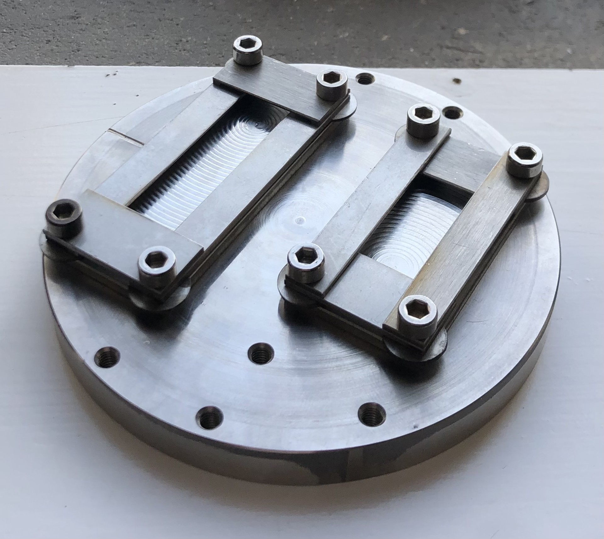
Ion Implantation – Fluence and Temperature
Ion implantation parameters
2 MeV He⁺ ion implantation at Surrey Ion Beam Centre, UK. Implantation depth ~5.75 µm
500ºC - Relevant to future target applications from modelling of LBNF/DUNE target
Chosen Fluences:
  4.5×10¹⁷ ions/cm² ~0.423 peak dpa
  7.5×10¹⁶ ions/cm² ~0.084 peak dpa
  2.3×10¹⁶ ions/cm² ~0.027 peak dpa
Covered and uncovered area – covered area for un-implanted material undergoing the same thermal cycle.
Sample holder for ion-implantation

Slide 12
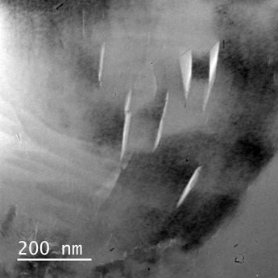
Radiation damage – Transmission electron microscopy (TEM)
Transmission electron microscopy (TEM)
Investigate nano-scale damage in irradiated graphite,
Changes to microstructure for different grades and SAED for changes in lattice parameters
Investigation with HOPG – develop mechanistic understanding effects of irradiation

Slide 13
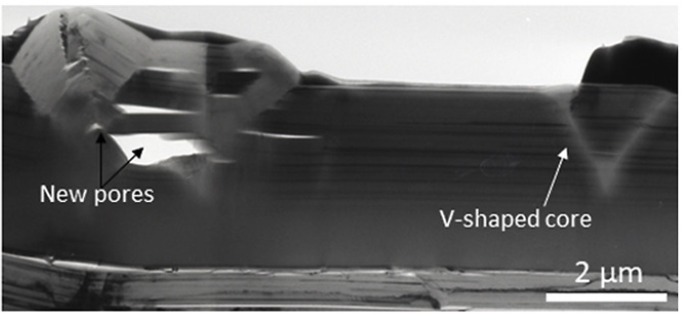
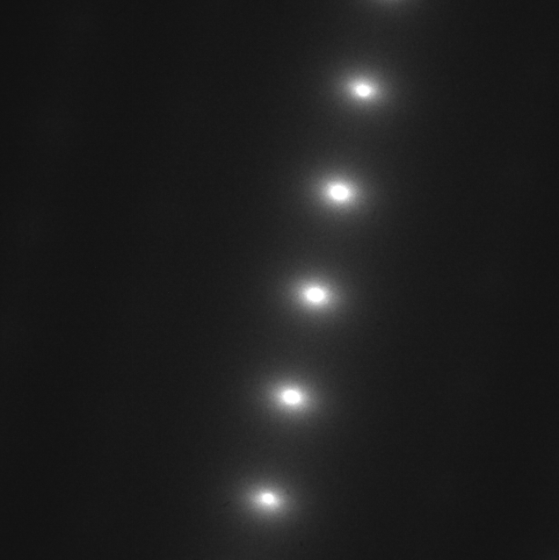
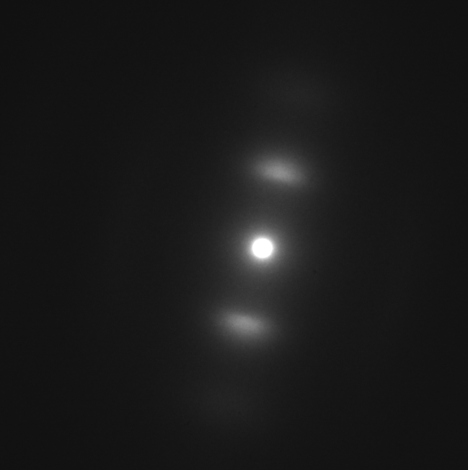
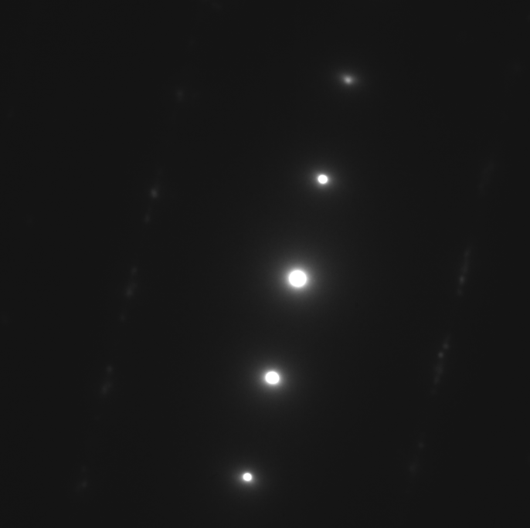
TEM & Selected area electron diffraction (SAED)
Bright field TEM image of Ion irradiated HOPG, with an irradiation gradient across the red arrow
Buckling of graphite layers observed at surface
9 Selected area electron diffraction (SAED) patterns across irradiation gradient – SAED patterns 2, 6 and 9 shown bottom right
(002) spot contraction (‘c’-axis expansion) and broadening from diffraction patten 2 – 6, Pattern 9 from below implantation depth
2
6
9
Liu, Dong, et al. "A macro-scale ruck and tuck mechanism for deformation in ion-irradiated polycrystalline graphite." Carbon 173 (2021): 215-231.

Slide 14
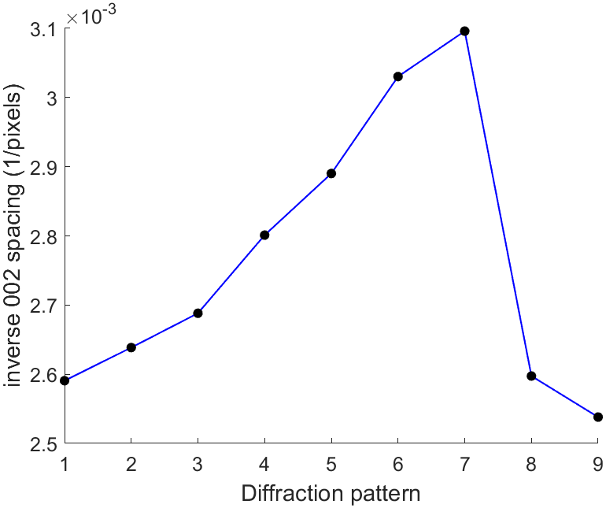
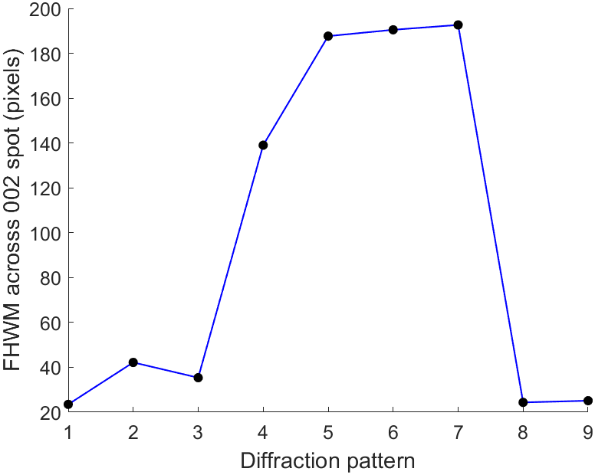
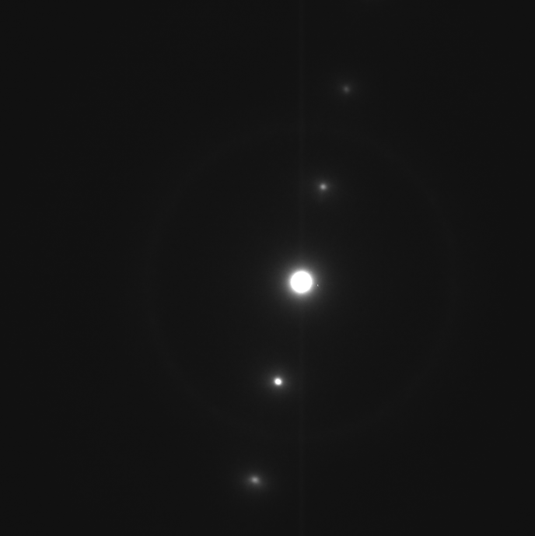
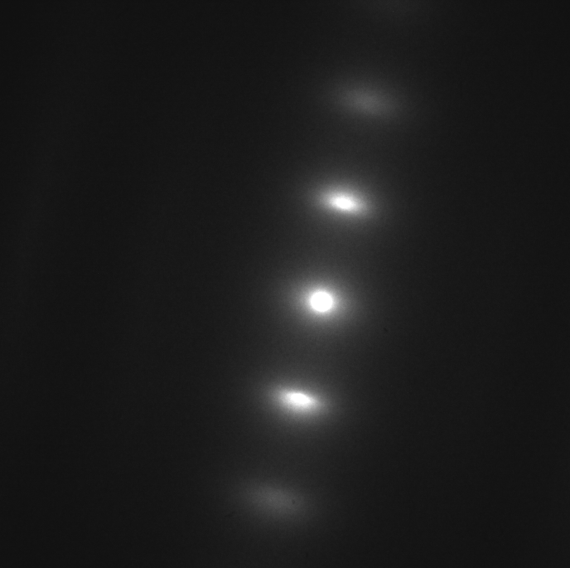

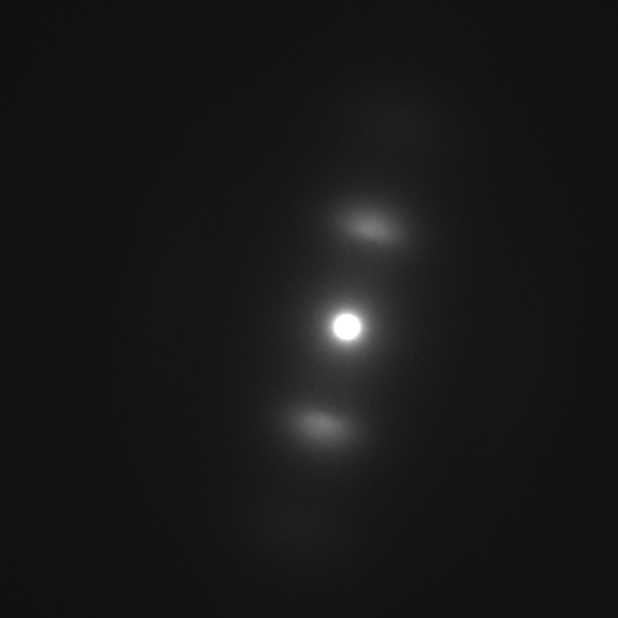
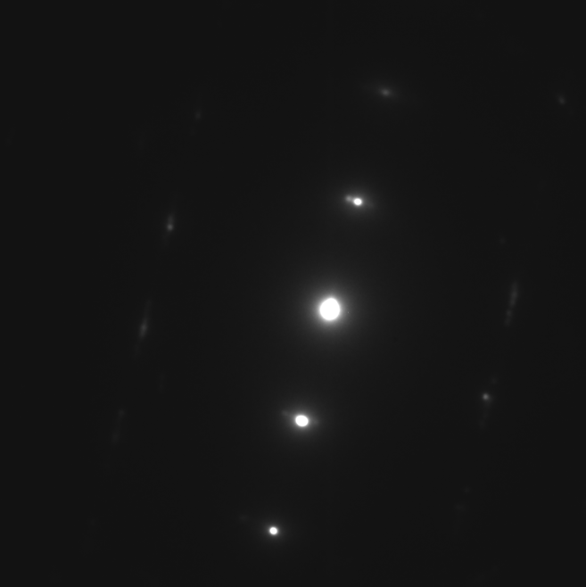
TEM & Selected area electron diffraction (SAED)
C-Spacing changing across irradiation gradient
Observed C-Spacing changes across irradiation gradient
Broadening – FWHM from Pseudo Voigt fitting
Opposing mechanisms behind broadening and ‘c’-axis expansion
1 2 3 4 5 6 7 8 9

Slide 15
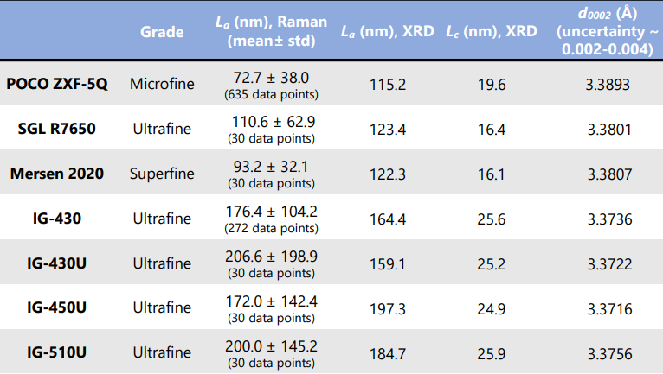
Raman & XRD – Results
Raman spectroscopy – inelastic scattering of optical probe, provide information crystallinity (G peak) and disordering (D peak)
Raman measurements – L_{a} (‘characteristic crystallite size’) values from I(D)/I(G), crystallinity from different grades
XRD – Lattice parameters and crystal coherence length from different grades– High degree of crystallinity for IG grades

Slide 16
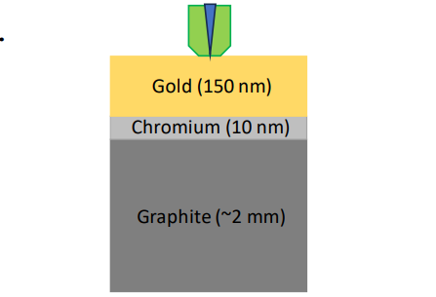
Thermal properties – Time-domain thermoreflectance (TDTR) (1)
Pump–probe laser
(ns-)Time-domain Thermoreflectance (TDTR)
local thermal conductivity: Measurement of the reflectivity changes of gold coating (transducer) due to local heating of graphite.
Pump laser:
  Induces local temperature change
  Ideal focal spot diameter ~ 20 µm;
Probe laser:
  Measures reflectivity
  Ideal focal spot diameter ~ 6 - 7 µm
  Probe depth ~ few µm;
ΔR/R = CTR ΔT
CTR -Thermoreflectance coefficient of gold
ΔR - Reflectance change of gold
R - reference reflectance of gold
ΔT -Temperature change in gold

Slide 17
Thermal properties – Time-domain thermoreflectance (TDTR) (2)
Initial TDTR Results
Silicon wafer
  139±1.1 W/m.K
HOPG graphite
  ‘c’-axis 8.1±3.0 W/m.K
  ‘a’-axis 1790±156.3 W/m.K
Values fit well with literature
Future work: measure effect irradiation on thermal conductivity values of proposed fine-grain graphite target grades by TDTR

Slide 18
Conclusion/Questions
Summary
Graphite target radiation issues
Neutron diffraction experiment
Ion Implantation
Virgin sample analysis and future PIE
Acknowledgements
Fermilab and STFC for funding
Thanks to Dr Eric (Ming) Jiang
Questions?

