Slide 1
Simulating Radiation Damage in ISIS Targets
Dan Wilcox, High Power Targets Group, Rutherford Appleton Laboratory
9th Annual RaDIATE Collaboration Meeting, Granada, Spain
18th September 2024

Slide 2

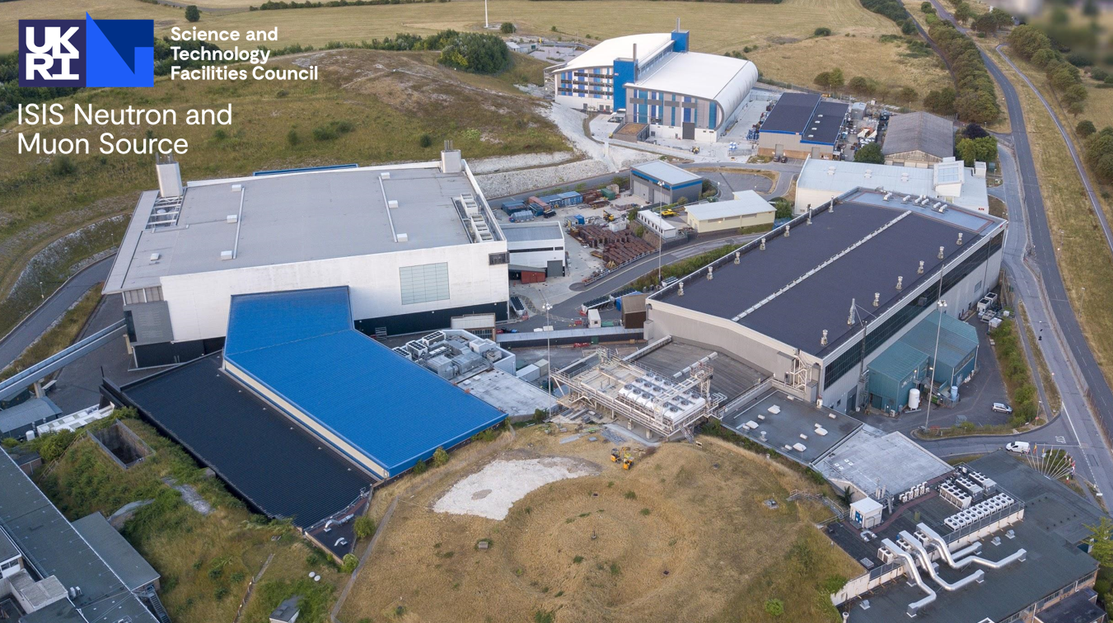
Contents
Introduction to ISIS targets
TS2 target lifetime
  Simulation approach
  Incorporating radiation damage
Future plans
Summary
An ariel photograph of the ISIS facility

Slide 3
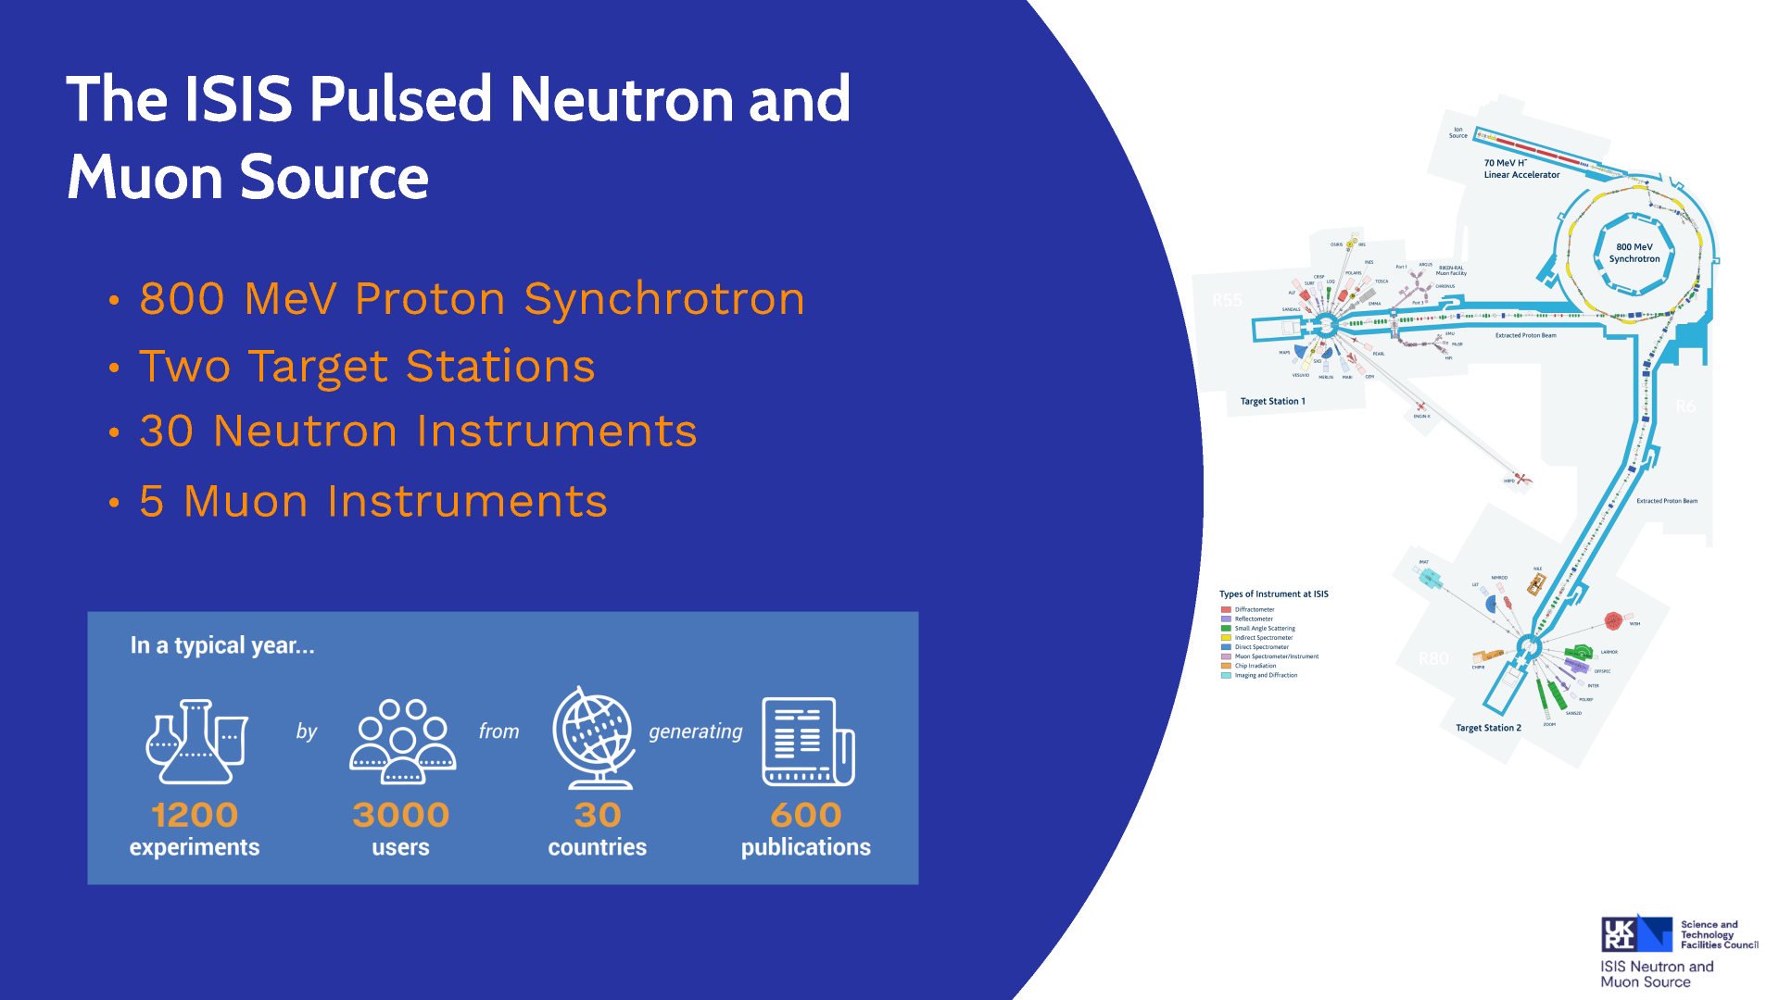

Slide 4
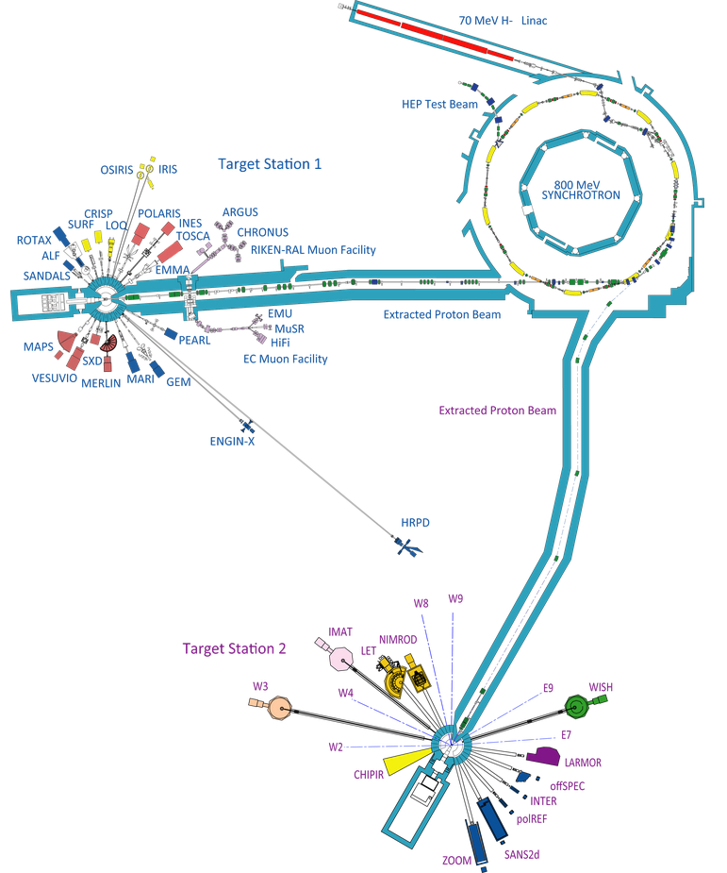
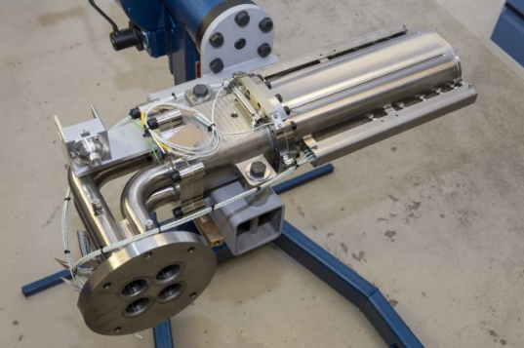
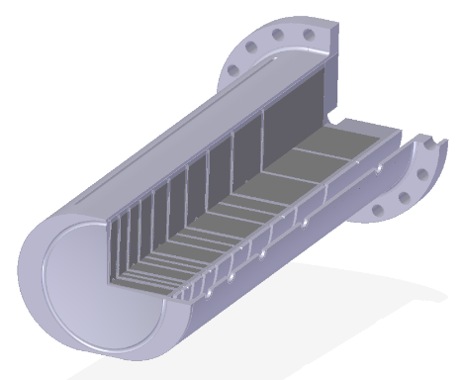
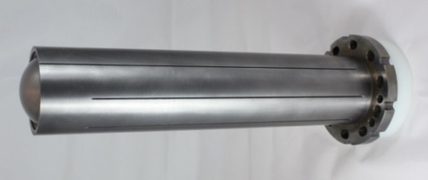
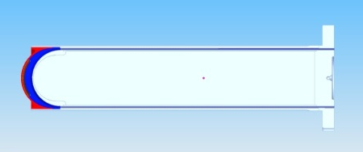
Current ISIS Targets
Synchrotron
192kW, 50Hz, 800MeV protons
Target Station 1
160kW, quasi-50Hz (receives 4/5 beam pulses)
Ta-clad W target, 10 plates (formerly 12)
Proven reliability over many years
New design of target, moderator and reflector installed late 2022, now in operation
Target Station 2
32kW, 10Hz (receives 1/5 beam pulses)
Ta-clad W target, solid rod
High neutronic efficiency, short target lifetimes

Slide 5
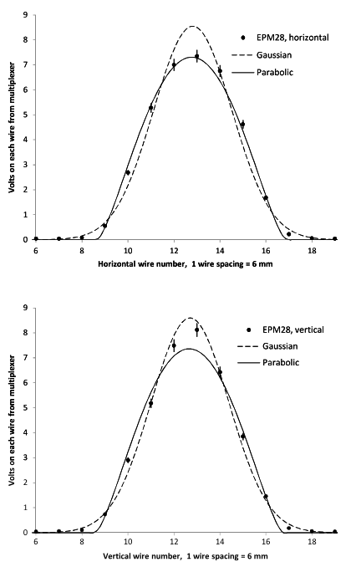
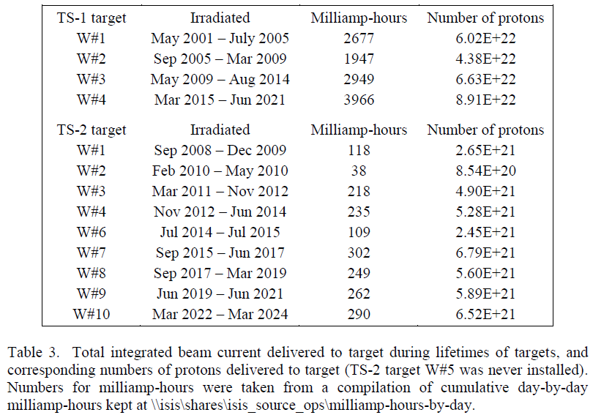
ISIS Target History
TS-1 Target | Lifetime (mAh) | para-Gauss DPA | Gauss DPA
W#1 | 2677 | 17.7 | 24.7
W#2 | 1947 | 12.8 | 18.0
W#3 | 2949 | 19.4 | 27.2
W#4 | 3966 | 26.2 | 36.6
TS-2 Target | Lifetime (mAh) | para-Gauss DPA | Gauss DPA
W#1 | 118 | 6.8 | 9.7
W#2 | 38 | 2.2 | 3.1
W#3 | 218 | 12.6 | 17.8
W#4 | 235 | 13.5 | 19.2
W#6 | 109 | 6.3 | 8.9
W#7 | 302 | 17.4 | 24.7
W#8 | 249 | 14.4 | 20.4
W#9 | 262 | 15.1 | 21.5
W#10 | 290 | 16.7 | 23.7
Table and DPA estimates courtesy of David Findlay, ISIS
“Two-dimensional beam profiles and one-dimensional projections”, D.J.S. Findlay, B. Jones, and D.J. Adams, Nuc. Inst. Meth. A, 2018

Slide 6
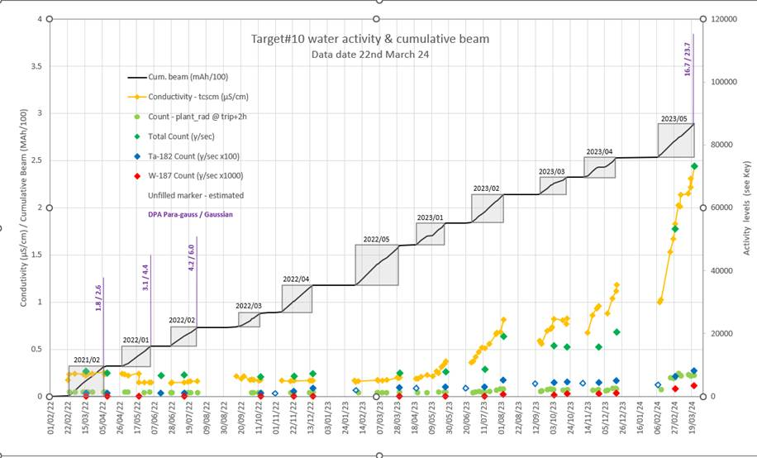
TS2 Target W#10 History
Isotope analysis = tungsten in water = breach in Ta cladding?
Water filters need hands-on maintenance: low activity limit
Rapid activity increase starts at 14.4 / 20.5 DPA
Gradual activity increase starts at 8.6 / 12.3 DPA
Plot courtesy of Paul Morgan, ISIS

Slide 7
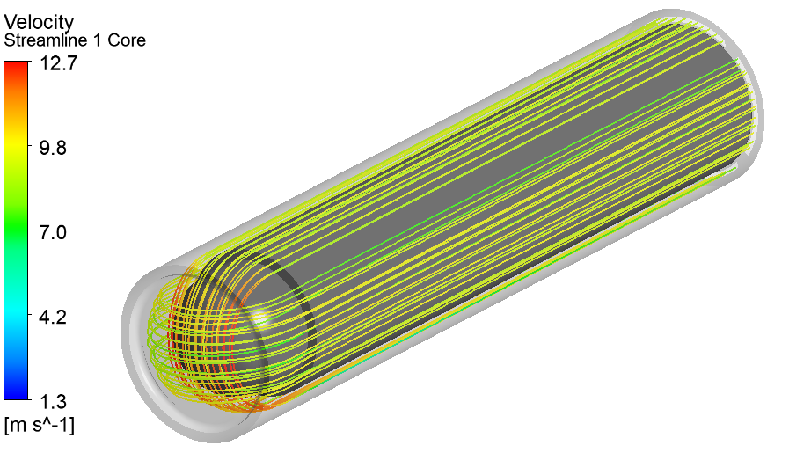
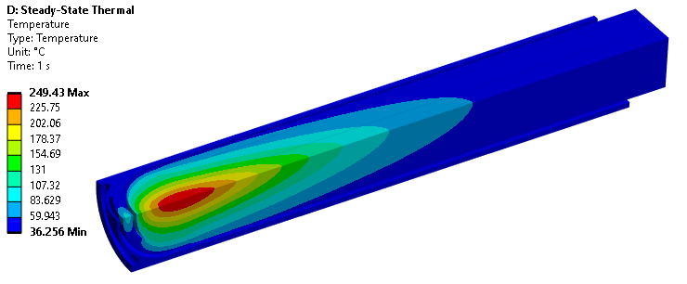
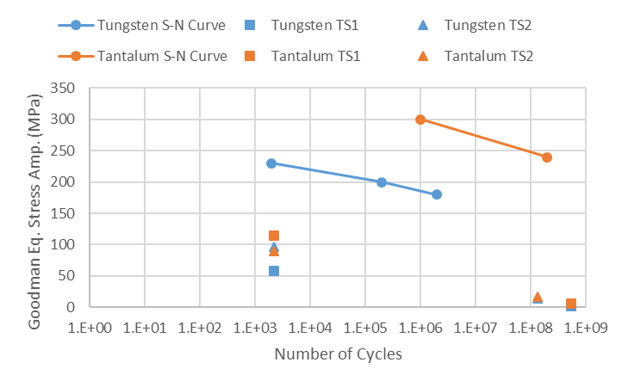
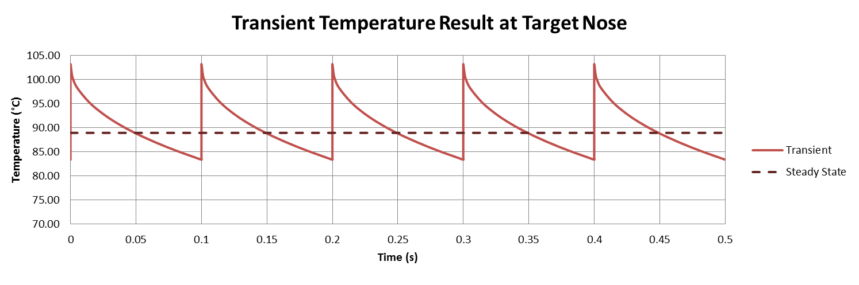
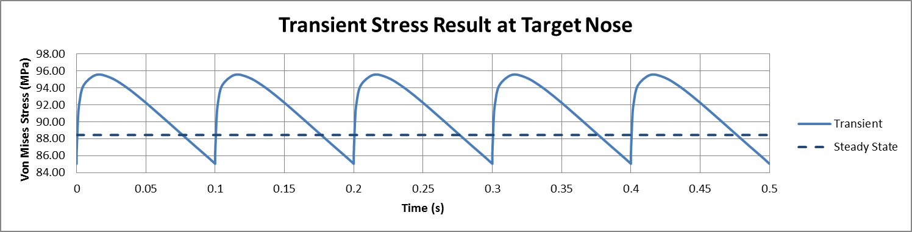
ISIS Target Analysis
Includes:
Conjugate fluid/thermal
Steady, transient and stress wave
Fatigue from beam pulses and beam trips
Higher stress on TS2 than TS1, but large safety factor on both

Slide 8
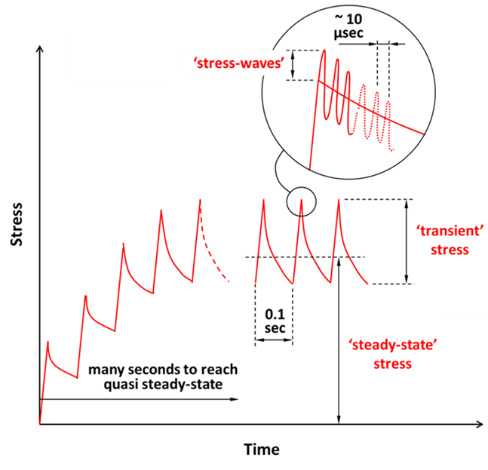
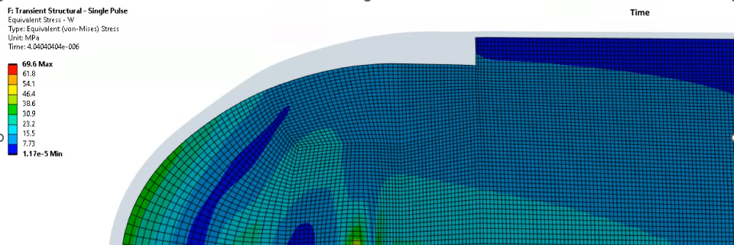
ISIS Target Analysis – Stress Waves
Targets are subjected to thermal stress on several timescales:
  Steady state
  Beam pulses
  Stress waves

Slide 9
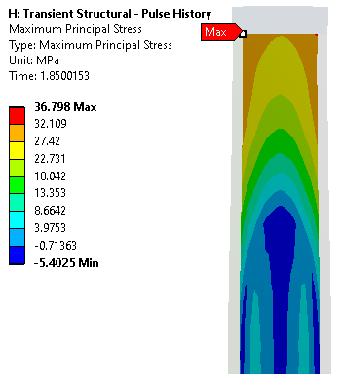
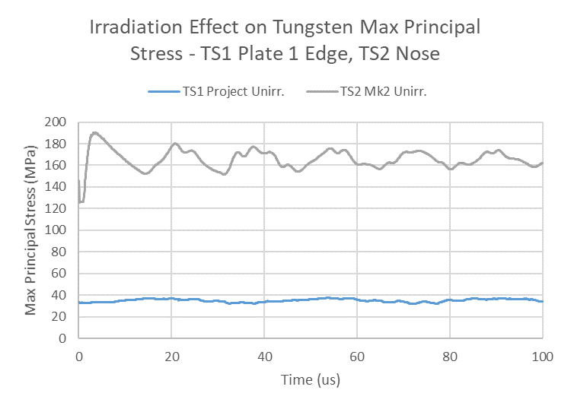
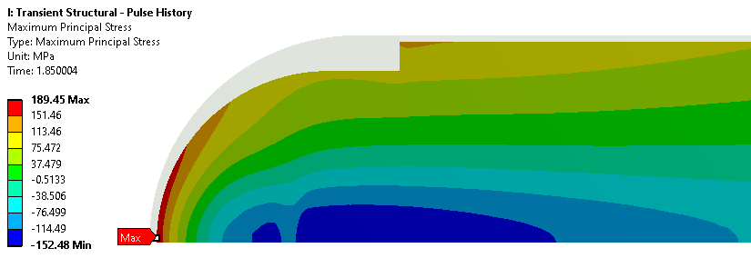
ISIS Target Analysis – Stress Waves
Quasi-static simulation of repeating beam pulses
Start stress wave simulation just before a pulse hits
Higher stress on TS2 than TS1, but large safety factor on both
Tungsten UTS = 550MPa
15.3μs, 37MPa
4μs, 189MPa

Slide 10
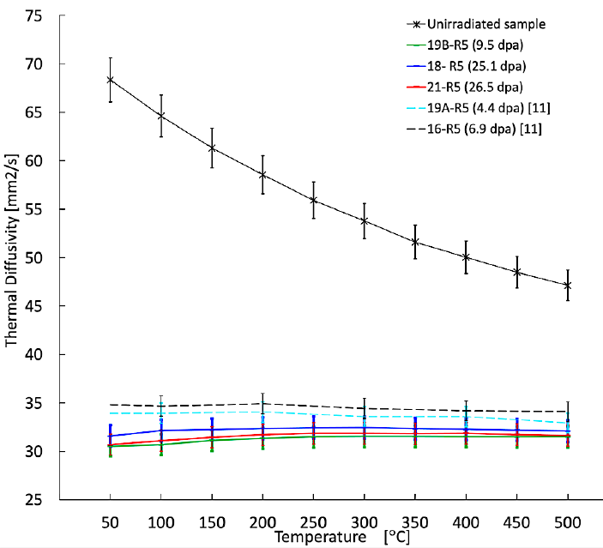
Irradiated Tungsten – Material Property Changes
Ultimate tensile strength
  560 MPa unirradiated
  300 MPa after 1.3 dpa
  Saturated at 300MPa up to 27 dpa
Thermal conductivity
  175 W/(m.K) unirradiated
  88 W/(m.K) after ~2 dpa
  Saturated at 88 W/(m.K) up to 27 dpa
References
J. Habainy et al., “Thermal diffusivity of tungsten irradiated with protons up to 5.8 dpa,” Journal of Nuclear Materials, vol. 509, pp. 152-157, 2018.
J. Habainy et al., “Mechanical properties of tungsten irradiated with high-energy protons and spallation neutrons,” Journal of Nuclear Materials, vol. 514, pp. 189-195, 2019.
Y. Dai, "Recent spallation materials researches performed at PSI", Presentation at HPTW 2023, Monday Nov 6th 2023
Y. Dai, "Thermal diffusivity of tungsten irradiated by protons in spallation environment up to 26.5 dpa", Presentation at HPTW 2023, Thursday Nov 9th 2023

Slide 11
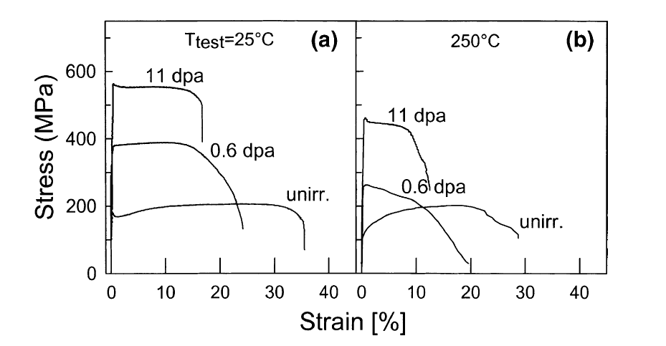
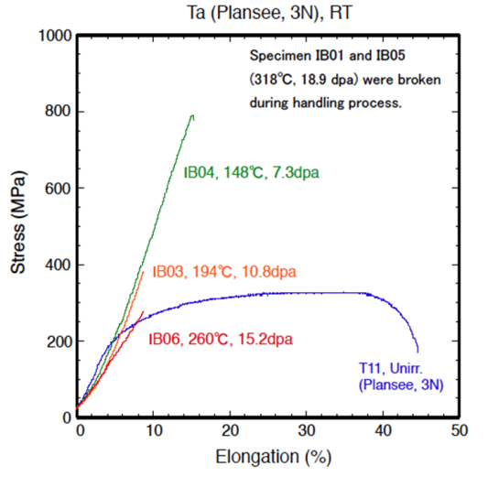
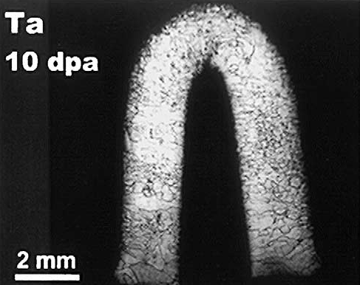
Irradiated Tantalum – Material Property Changes
No data on thermal conductivity
Limited and inconsistent data on tensile strength
ISIS target cut up at FZ-Juelich remained ductile at 11 dpa
STIP-II specimens were brittle by 7.3 dpa
STIP-II tantalum specimens may have been contaminated by extra hydrogen released by other specimens in the same container
UTS after 10.8 DPA is no worse than unirradiated UTS in either case

Slide 12
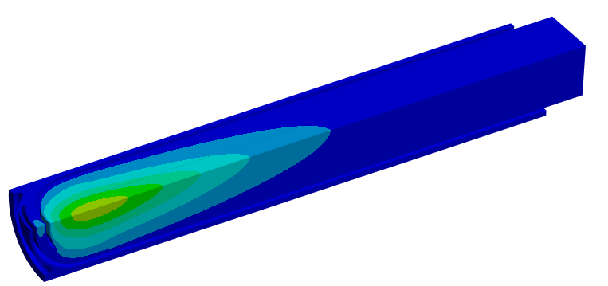
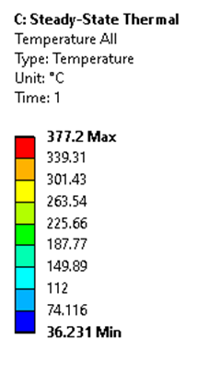
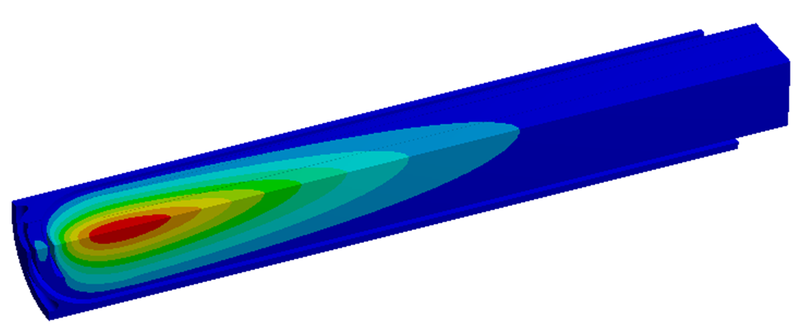
ISIS Target Results – Steady State Temperature
Monolithic TS2 target is much more severely affected by loss of thermal conductivity than TS1 plate target
TS1 Target:
Unirradiated: 185°C
Irradiated: 222°C
Unirradiated Peak
Temperature 249°C
Irradiated Peak Temperature 377°C

Slide 13
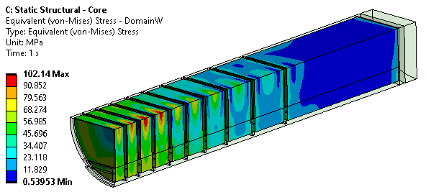
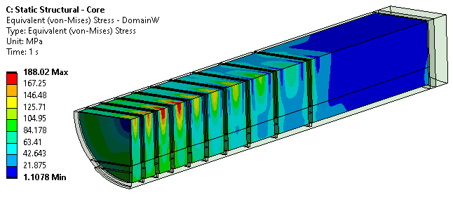
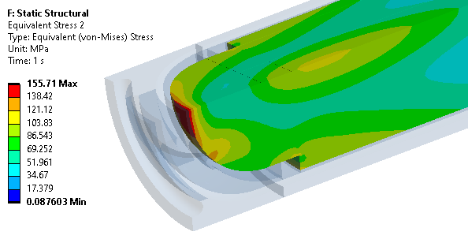
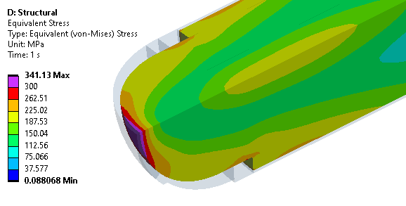
ISIS Target Results – Von Mises Stress in Tungsten
Unirradiated material properties Fully irradiated (2+ dpa) material properties
TS1
Pass
Pass
TS2
Pass
Fail

Slide 14
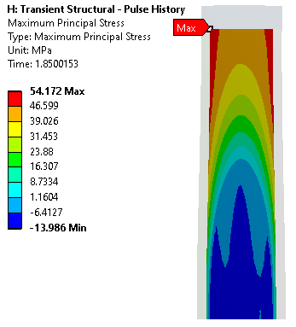
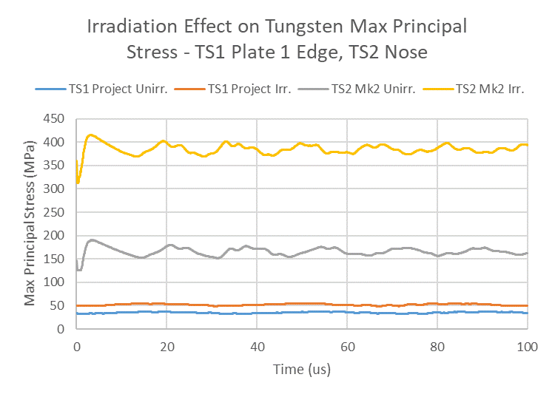
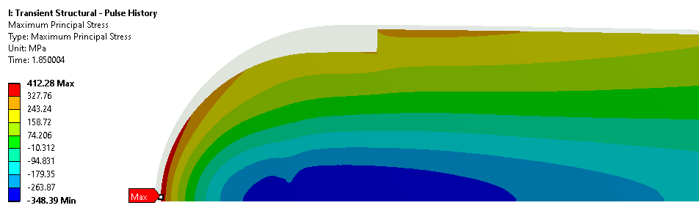
ISIS Target Results – Stress Waves
Effect of thermal conductivity loss is much worse for TS2 monolith
TS2 exceeds the irradiated tungsten UTS, TS1 does not
Irradiated Tungsten UTS = 300MPa
Peak Dose Estimates:
~6dpa/yr on TS1
~15dpa/yr on TS2
15.3μs, 54MPa
4μs, 412MPa

Slide 15
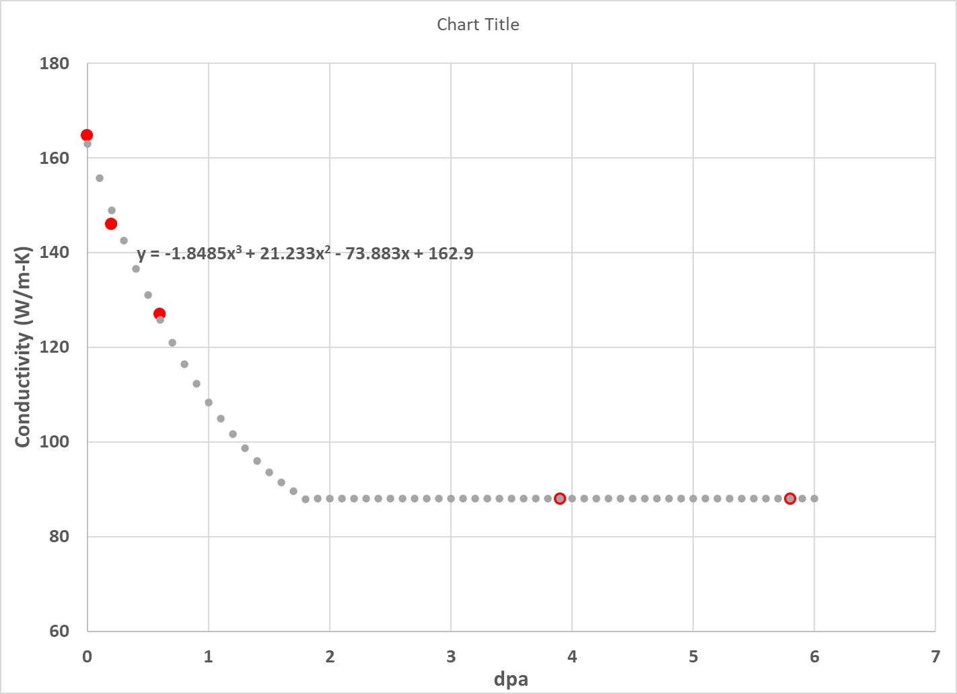
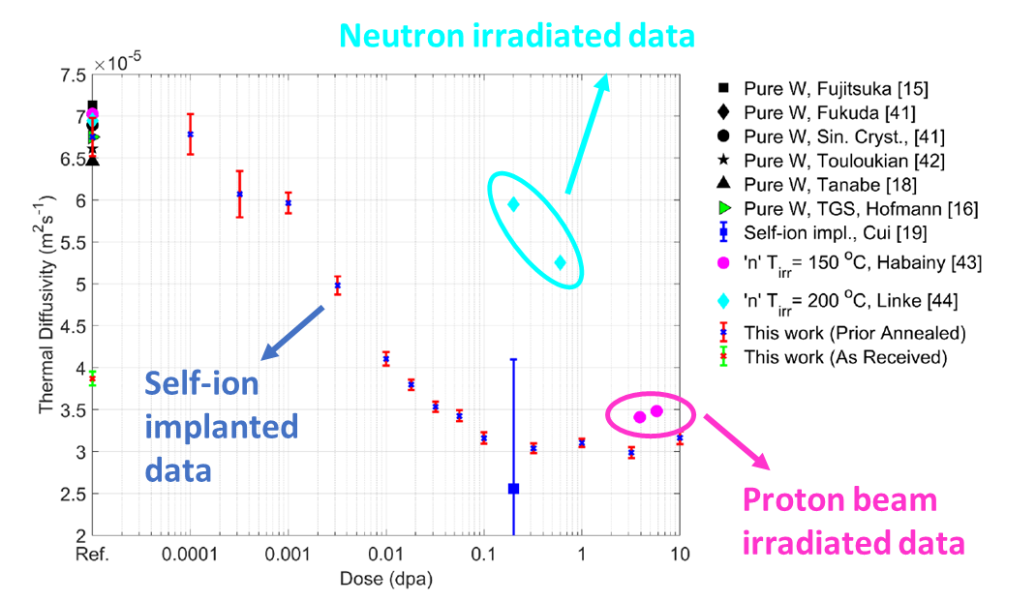
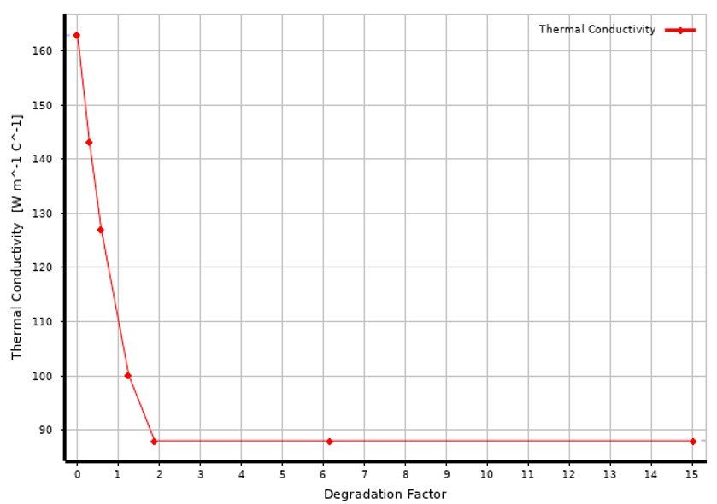
Rate of Thermal Conductivity Reduction
Fit to neutron and proton data, courtesy of SNS:
Our model is based on neutron-irradiated data below 3.9 DPA and proton-irradiated data above that
ANSYS implementation of available data:

Slide 16

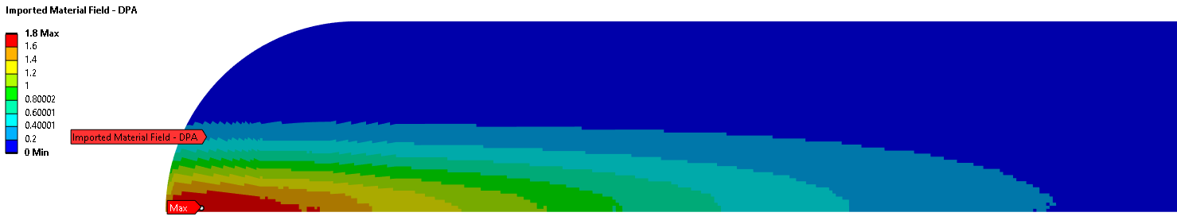
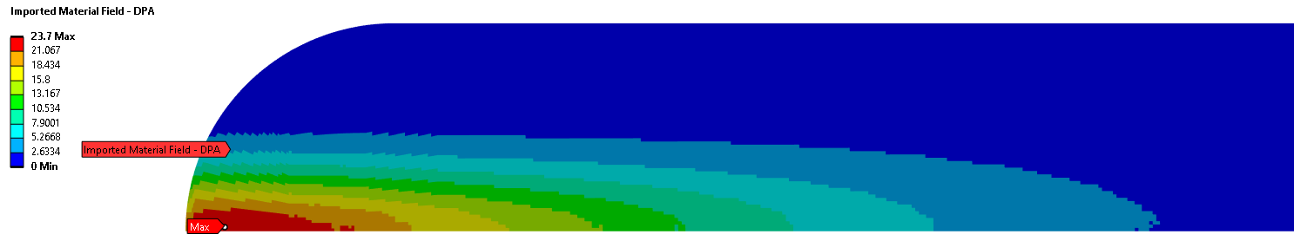

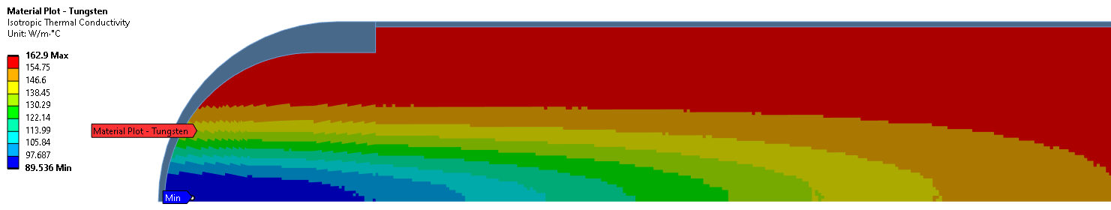
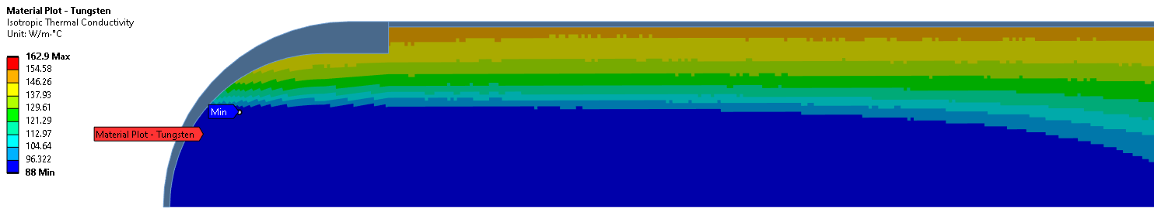
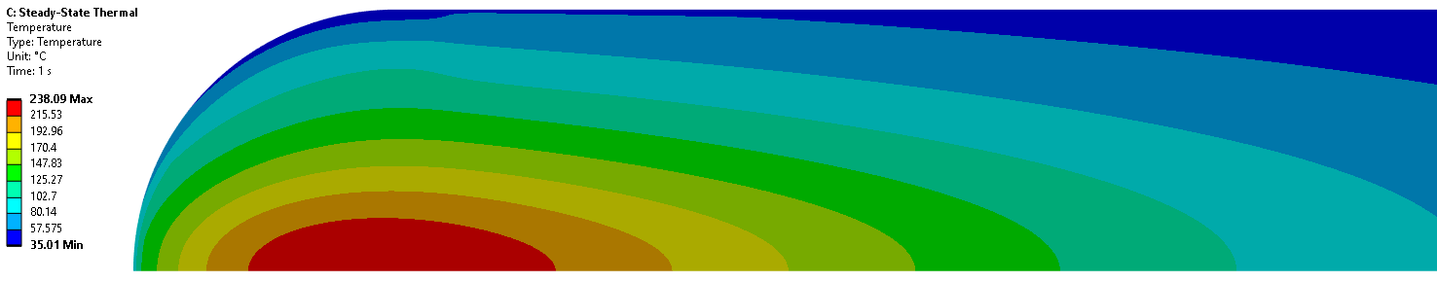
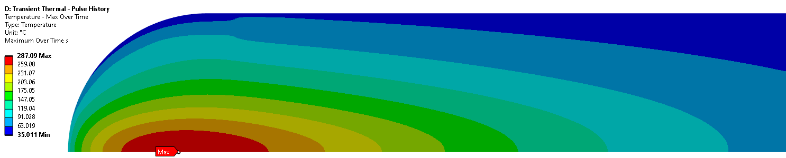
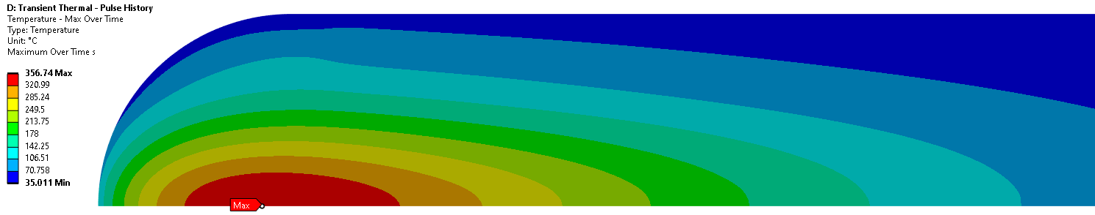
Evolution of Damage in TS2 Target
Dose assumed proportional to heat load
Tungsten thermal conductivity degrades as a function of dose, then saturates above 1.9 DPA
0 DPA
0-1.8 DPA
0-23.7 DPA
163 W/m-K
90-163 W/m-K
88-163 W/m-K
35-238 °C
35-287 °C
35-357 °C

Slide 17
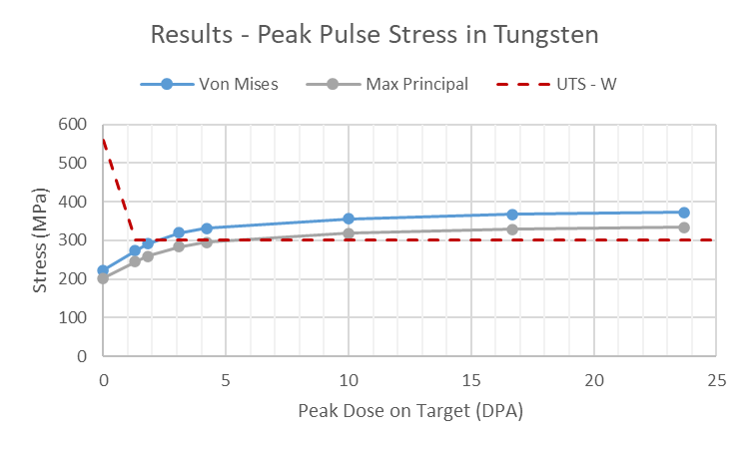
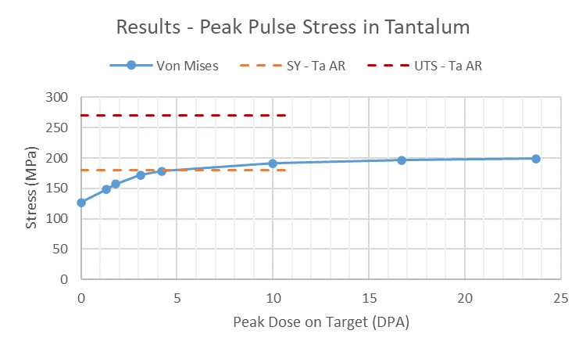
Evolution of Damage in TS2 Target
Tungsten safety factor is initially large but drops rapidly
Tantalum may slightly exceed yield stress but remains below UTS. Limited data at high DPA.
Activity started to rise from around 150mAh (8.6-12.3 DPA) on TS2 W#10 target. Very rapid rise from 250mAh (14.4-20.5 DPA). Ultimately replaced at 290mAh (16.7-23.7 DPA)

Slide 18
Crack Propagation at Ta/W Interface
Testing by SNS Second Target Station team showed cracks in tungsten delaminate rather than penetrate the clad interface
“Tungsten cracks caused delamination damage then cladding failed in fatigue”
From “Current Status of the STS Target Segment Manufacturing Development & Evaluation”, Justin Mach, IWSMT-15, March 2023

Slide 19
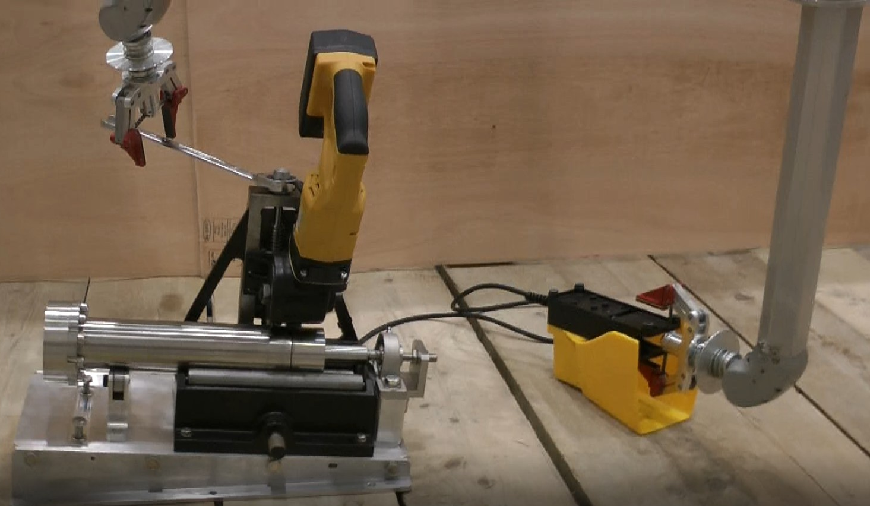
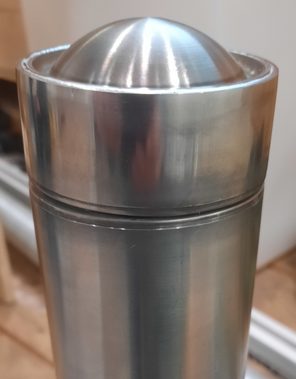
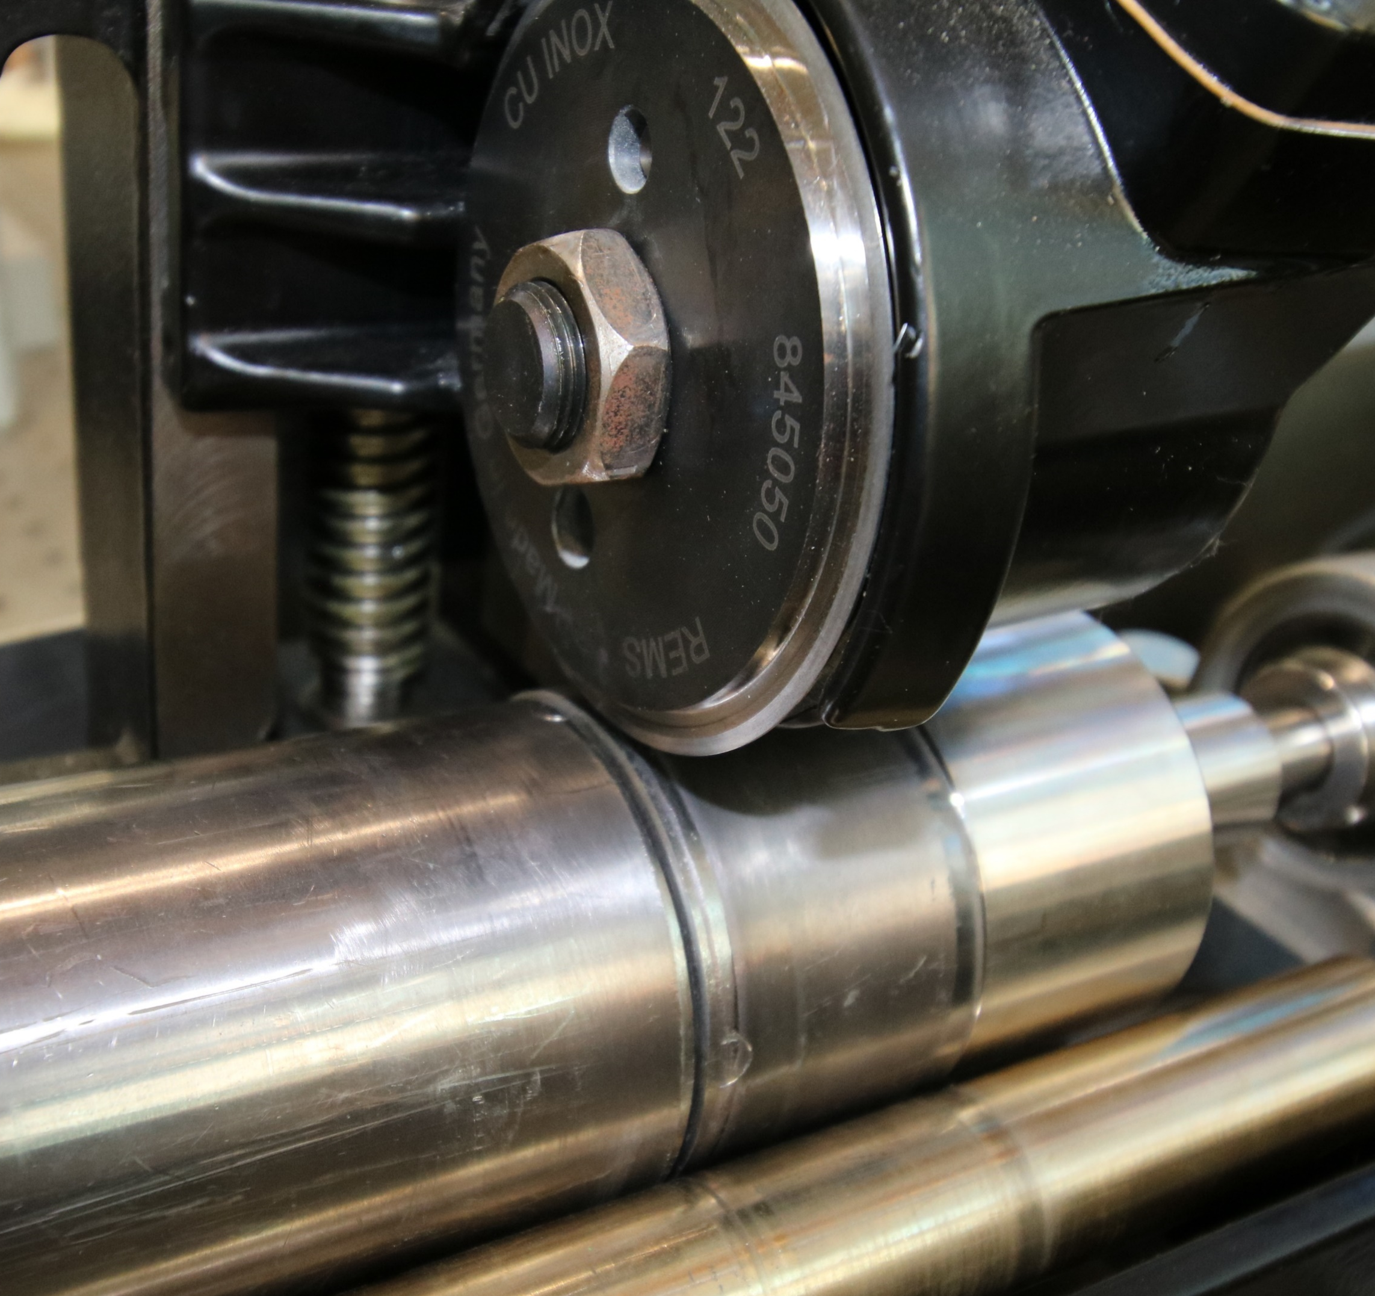
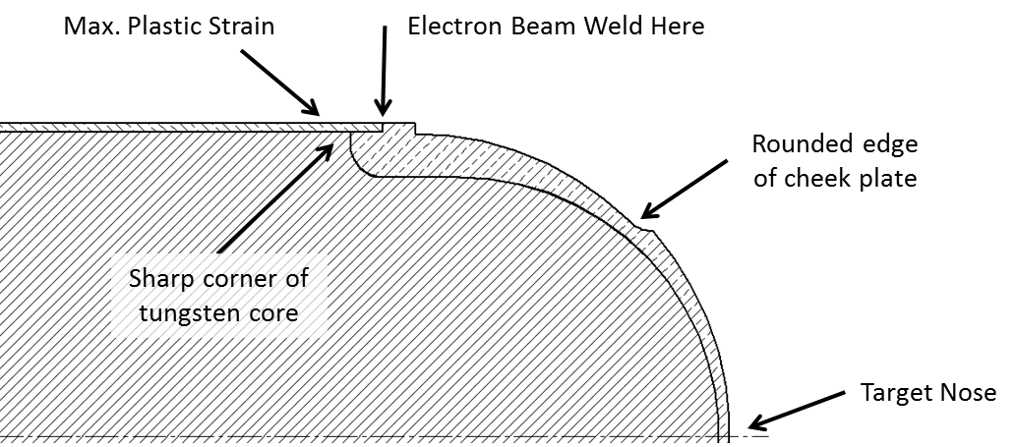

TS2 Target – Other Possible Causes
Cavitation or water erosion at target nose?
Cracking or intergranular corrosion at welds?
Embrittlement of Ta cladding?
PIE rig for spent TS2 targets now in development
(removed on recent iterations)
TS2 PIE Rig: Images courtesy of Leslie Jones

Slide 20
Conclusions on TS2 Target
Tungsten at the target nose predicted to begin cracking after ~2-5 DPA. This will not fail the target unless the crack propagates through the tantalum cladding. It is not clear if or when this may happen.
TS2 targets typically accumulate ~15-25 DPA in their lifetime. Increasing water activity appears some time after the predicted onset of tungsten cracking
Next steps:
  Material tests to better understand delamination and crack propagation at HIPed interface
  PIE to observe predicted failure locations on spent TS2 target W#4 (type Mk2a)

Slide 21




ISIS-II: the next generation MW-class Neutron and Muon source
New accelerator and two new target stations from day one, optimised for different things
  TS1: 128kW → ~1.6MW (12.5x higher)
  TS2: 32kW → ~0.8MW (25x higher)
Preferred location: Greenfield site at RAL

Slide 22



ISIS-II Target Concepts
Baseline material is Tantalum-clad Tungsten, but other options are under consideration
Stationary Target
High radiation damage
Limited by decay heat to ~400kW, or ~800kW with reduced cladding thickness and other improvements
4-Segment Target Wheel
Compact wheel option
Relatively familiar manufacture
15-Segment Target Wheel
Best dissipation of heat and radiation damage
Complex manufacture and handling

Slide 23
Irradiated Material Properties Summary
 | Tungsten | Tantalum
Tensile Data | Product size/form dependent | Some variability – impurities and product form?
Tensile after Irradiation | Good data | Retained ductility quite variable – effect of impurities?
Fatigue | Good data | Good data
High Cycle Fatigue | No data above ~2E6 cycles | Up to ~1E8 cycles, high and low frequency
Fatigue after Irradiation | No data | No data
Thermal Conductivity | Limited data with protons. Critical for core temperature | No data, but small effect from thin cladding
Tantalum can retain high ductility after 11dpa, however there is a lot of scatter in the (limited) available data
  Tantalum impurities and gas production in the irradiation environment may explain this
Peak dose after 5 years operation:
  30 dpa on TS1, 70dpa on TS2
  Very limited data above ~20dpa
Other unknown effects:
  Is HIP residual stress annealed by irradiation?
  Cold creep in Ta?

Slide 24



Overlap with RaDIATE work for LBNF Target
Mesoscale fatigue tests on tantalum and tungsten
  20kHz test = 1E9 cycles in 14 hours
  Already have low frequency data for comparison
  Proof of concept test on 100 µm thick tungsten foil completed
Followed by irradiated fatigue tests if possible
  Ti irradiation with active cooling planned at Birmingham University cyclotron, could be adapted for Ta and W
Small scale laser flash analysis also demonstrated at Oxford University
  Thermal diffusivity measurements on irradiated foils
  In addition to in-situ measurements on new TS1

Slide 25
Summary
Radiation damage in tungsten rapidly reduces the safety factor on ISIS TS2 targets – may explain shorter observed lifetimes
Can simulate radiation damage in high detail, but only if enough experimental data is available
ISIS-II targets now under development – will require more data, combined with the latest simulation techniques to ensure success

Slide 26
Thank you for your attention.
Any questions?

