Slide 1
Novel Target Materials Development at Fermilab: Status and Update
Kavin Ammigan
G. Arora, S. Bidhar, A. Burleigh, F. Pellemoine (FNAL); A. Couet, N. Crnkovich, I. Szlufarska (UW-Madison); W. Asztalos (IIT)
9th Annual RaDIATE Collaboration Meeting
17 September 2024

Slide 2
Outline
Background and motivation
High-Entropy Alloys (HEAs) for beam window applications
  Design approach
  Synthesis and microstructural characterization
  Preliminary bulk thermomechanical property measurements
Electrospun tungsten nanofibers for particle-production targets
  Concept and initial results
  Progress on fabrication, characterization, and next steps
Overview of proposed HiRadMat experiment in 2025
Conclusions

Slide 3
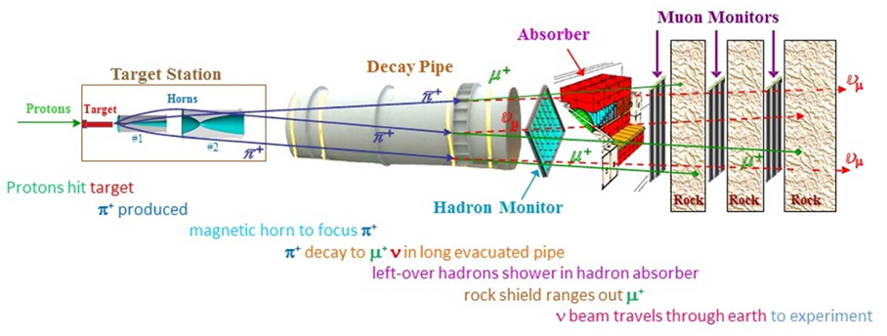
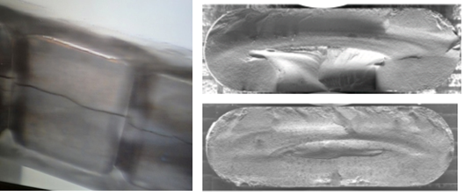
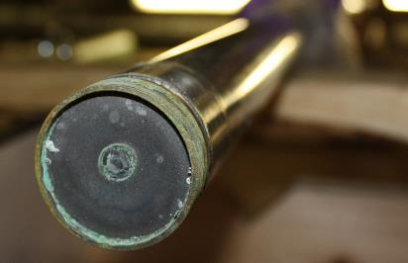
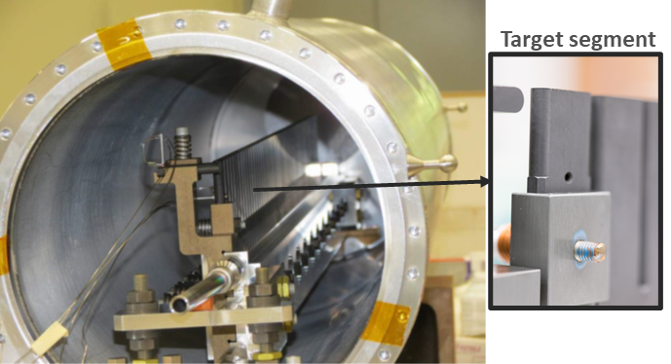
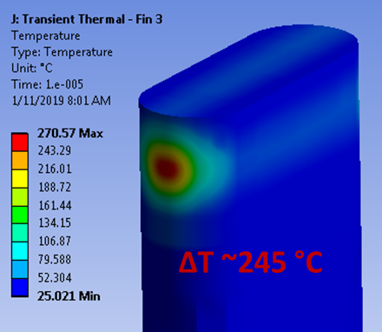
Motivation for Exploring Novel Beam-Intercepting Materials
Particle-production targets, beam windows, absorbers, …
The NuMI beam (Fermilab)
120-GeV proton beam
MINOS NT-02 target failure along beam path: radiation-induced swelling (FNAL)
Primary beryllium window embrittlement (FNAL)
Target components are constantly bombarded by high-energy high-intensity beams
  Operate under extreme conditions, enduring beam-induced thermal shock and radiation damage
  Need to withstand millions of beam pulses
Conventional materials are reaching their limits, and restricting the scope of experiments
NOvA 1-MW target. Peak temperature rise ~ 245 ºC from 10-μs beam pulse (2.5 × 10⁷ K/s)

Slide 4
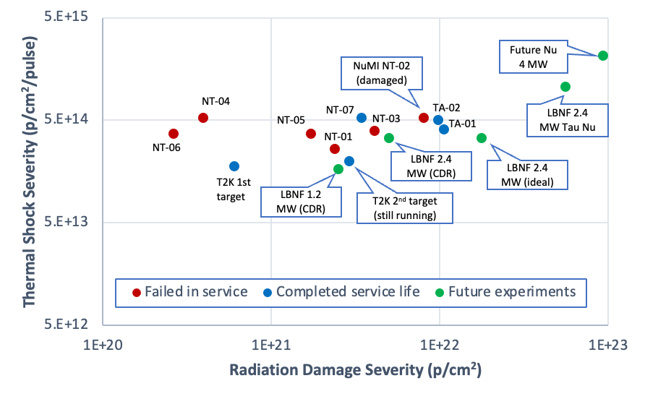
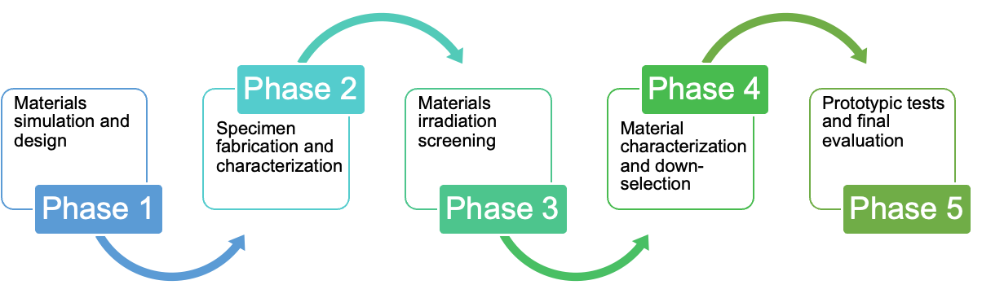
Looking Beyond Conventional Materials
To advance the state-of-the-art of beam-intercepting materials
Enable future multi-MW accelerator target facilities
  LBNF/DUNE 2.4 MW, Mu2e-II, Future Muon Collider and Neutrino Factory (4 MW+), …
Maximize particle production efficiency, improve reliability and operation lifetimes
High-Entropy Alloys and Nanofiber Materials Development Approach
Neutrino HPT R&D Materials Exploratory Map
Expect >10x increase in accumulated proton fluence and power density

Slide 5
High-Entropy Alloys for beam window applications

Slide 6
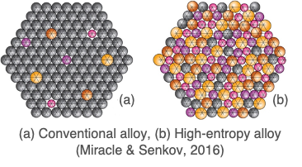
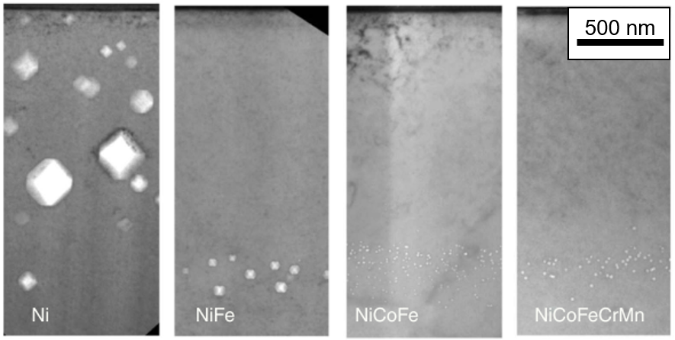
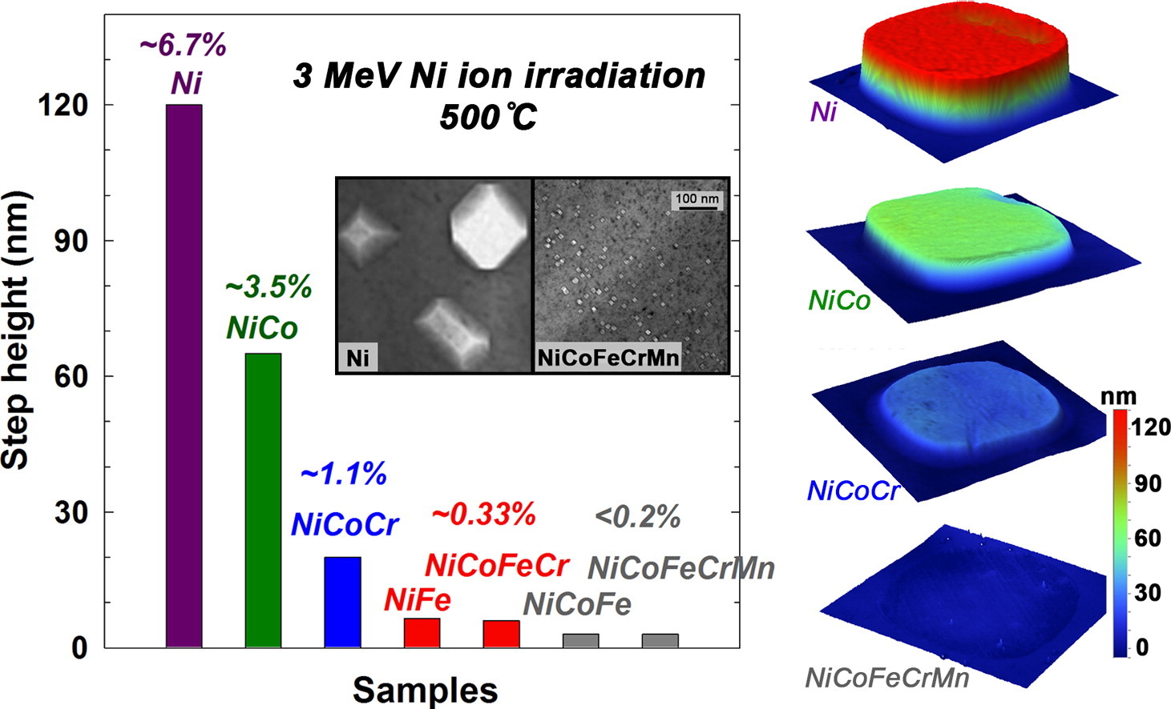
Why High-Entropy Alloys (HEAs)
Unlike conventional alloys, HEAs contain multiple principal elements in roughly equal proportions
Offer large composition space to explore new alloy systems with tunable properties
HEAs have shown promising properties and remarkable radiation damage resistance
High-temperature strength
High specific strength
Improved fatigue and fracture properties
Corrosion and oxidation resistance
Enhanced radiation tolerance
  Greater phonon scattering, sluggish diffusion of atoms/defects, broad migration energies, and more…
Void swelling shown to be less pronounced in more compositionally complex alloys upon heavy-ion irradiation (3-MeV Ni⁺ ions to 5 x 10¹⁶ cm-² at 773 K), Lu et al., Nature Com., 2016
Swelling of increasingly complex alloys under ion irradiation, Jin et al., Scripta Materialia 119 (2016)

Slide 7
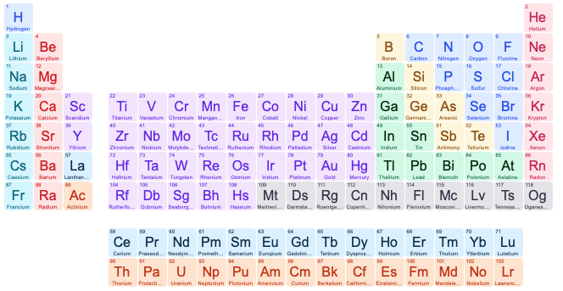
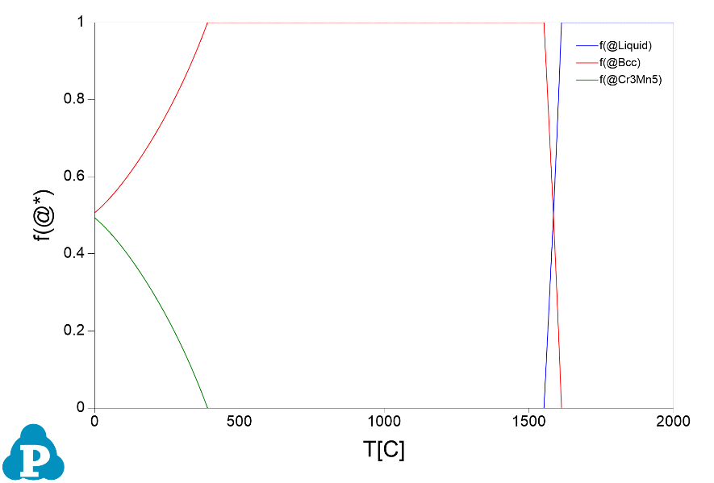
HEAs for Accelerator Beam Windows
Elemental selection considerations
Light-weight elements (low density)
Primarily a single-phase (BCC)
Minimal activation
Cr₃₃Mn₃₃V₃₃
Cr₃₁Mn₃₁Ti₇V₃₁
Al₁₅Cr₂₀Mn₂₀Ti₁₀V₃₅
Al₁₅Co₄Cr₂₅Mn₁₅Ti₆V₃₅
HEA design approach: CALPHAD simulations to predict phase diagrams of the multicomponent alloy system
CrMnV (Barron et al., 2020)
Equimolar BCC single phase
Equimolar CrMnV phase diagram
CrMnTiV
Impurity getter
Single body-centered-cubic phase predicted by CALPHAD (400 – 500 ºC)
AlCrMnTiV
BCC phase stabilizer
AlCoCrMnTiV
Semi-coherent secondary phase

Slide 8
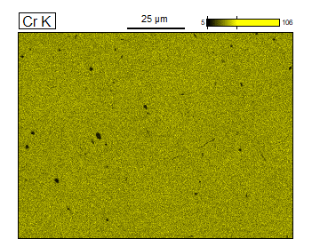
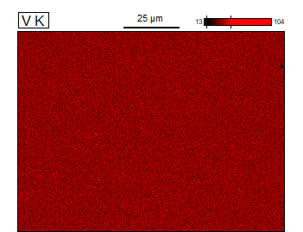
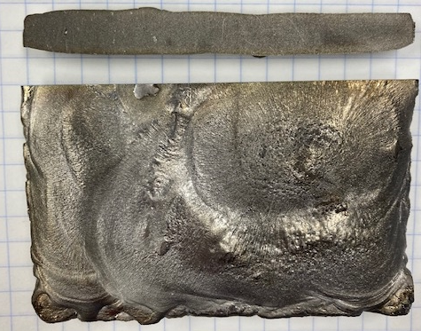
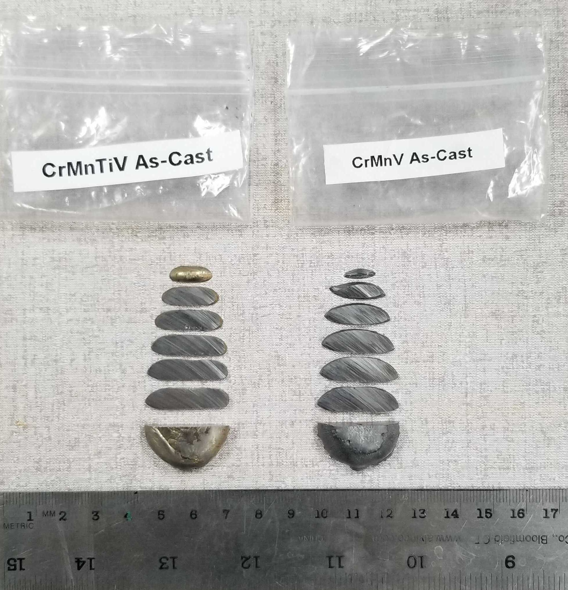
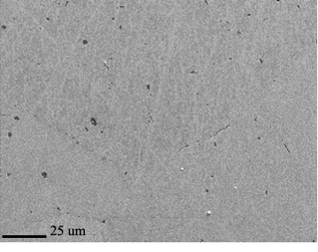
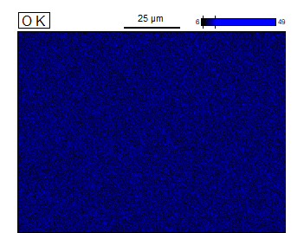
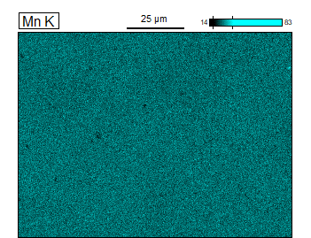
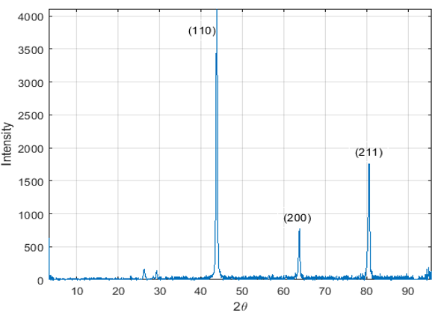
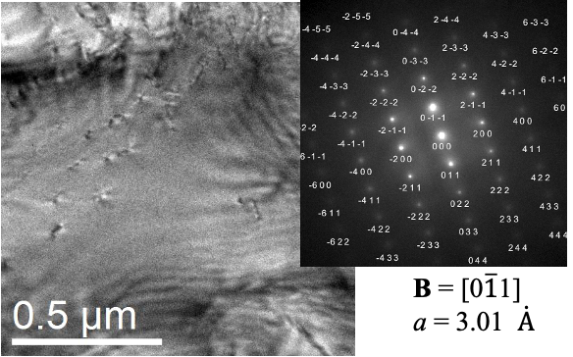
HEA Synthesis & Characterization
SEM-EDS maps of CrMnV alloy
Sectioned arc-melted ingots (UW-Madison)
Larger plates fabrication by Sophisticated Alloys Inc.
Plates underwent heat treatment to promote single phase
  HIP under Ar at 1200 ºC, 15 ksi for 4 hrs
  Homogenized at 1200 ºC for 48 hrs
Achieved target composition within 1 at%
SEM-EDS confirmed homogeneity
XRD confirmed BCC single phase
N. Crnkovich, UW-Madison
BCC XRD peaks

Slide 9
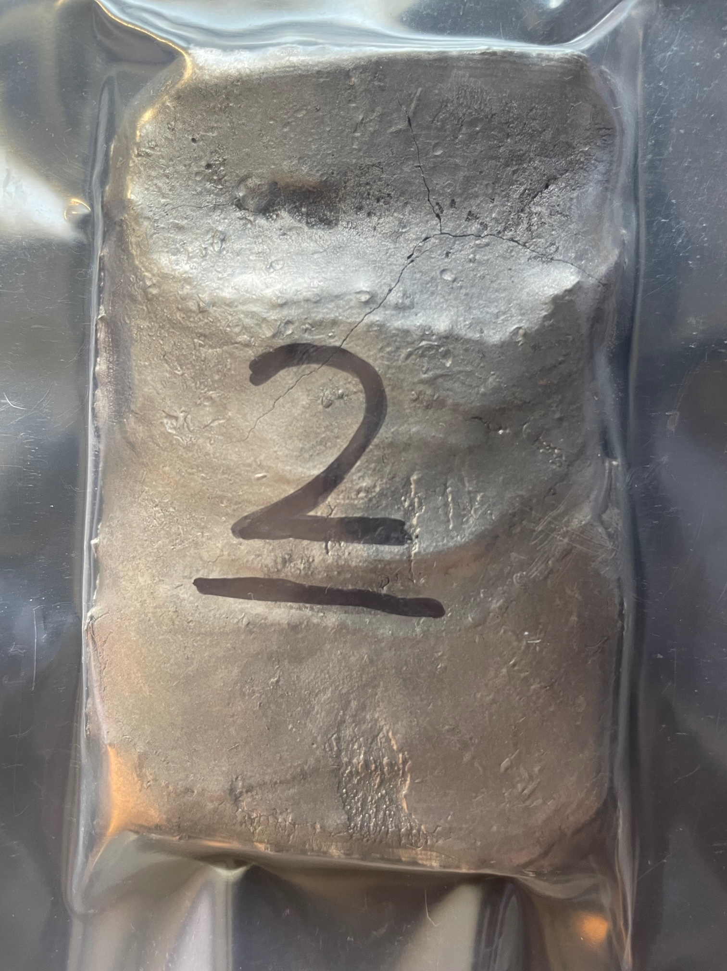
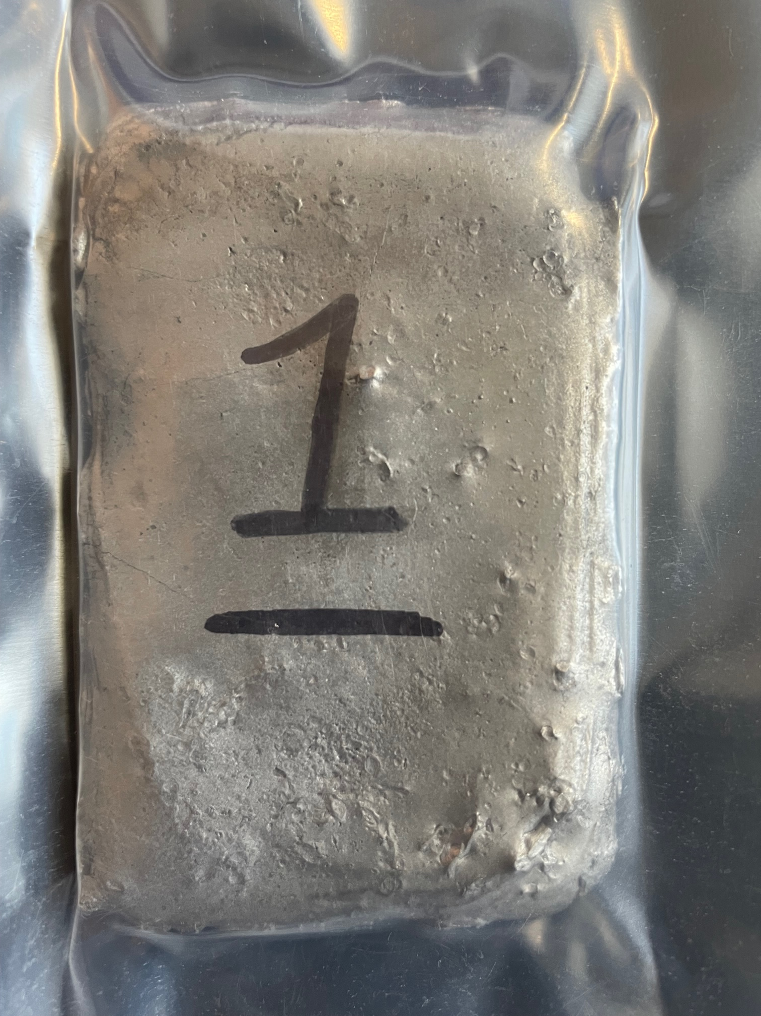
HEA Design Refinement
Systematic compositional space search using high-throughput CALPHAD simulations
  ~120,000 composition explored/optimized
  Broaden BCC single phase region
  Reduce concentration of impurities
  Introduce semi-coherent B2 phase
  Low density
CrMnV (Barron et al., 2020)
Equimolar BCC single phase
CrMnTiV
Impurity getter
AlCrMnTiV
BCC phase stabilizer
2nd. Generation HEAs
Al₁₀Co₄Cr₂₅Mn₂₆Ti₁V₃₄
Al₁₀Co₄Cr₂₇Mn₂₁Ti₄V₃₄
Al₁₆Co₂Cr₂₅Mn₃₀Ti₁V₂₆
Al₁₆Co₄Cr₂₅Mn₃₀Ti₁V₂₄
Al₂₀Co₁Mn₂₇Ti₂V₅₀
Al₁₂Co₃Cr₆Mn₂₇Ti₂V₅₀
Al₁₈Mn₃₀Ti₂V₅₀
Al₂₀Co₂Mn₂₆Ti₂V₅₀
AlCoCrMnTiV
Semi-coherent secondary phase
New batch of optimized HEAs

Slide 10
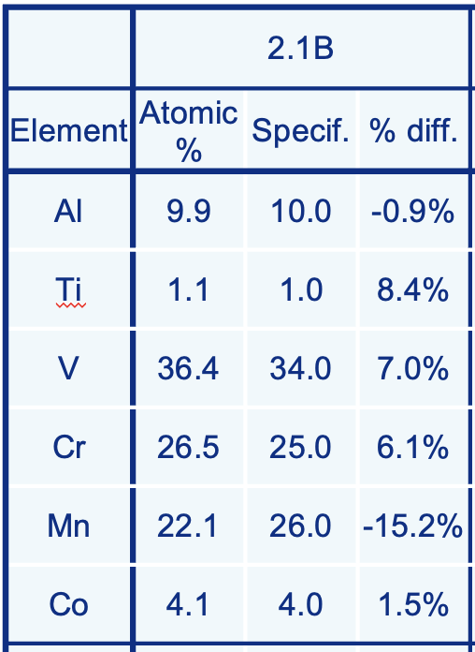
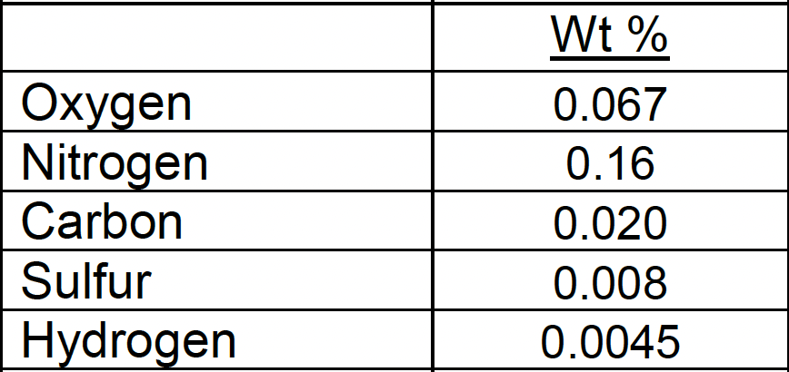
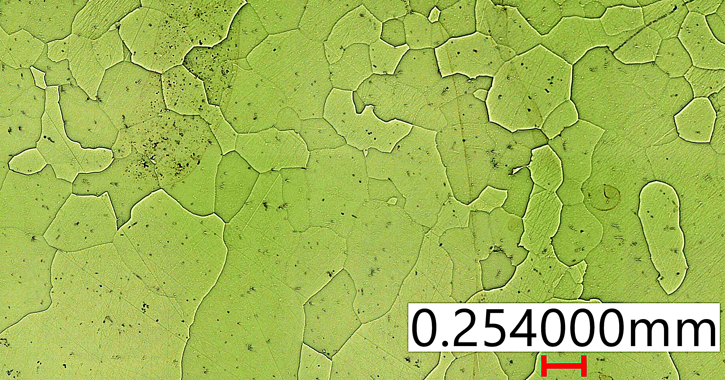
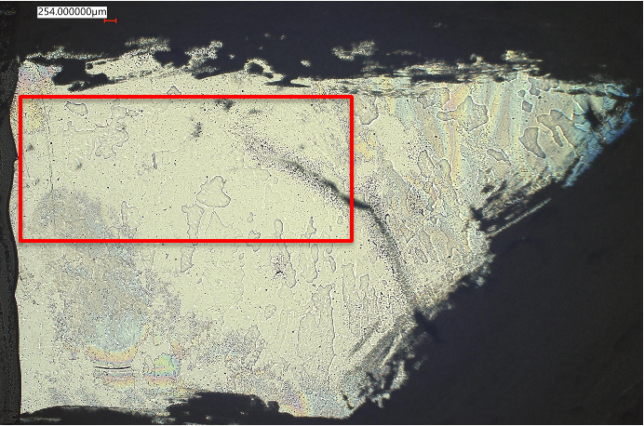
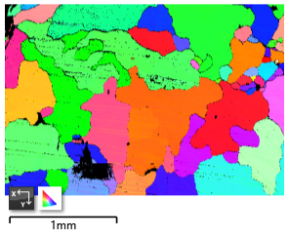
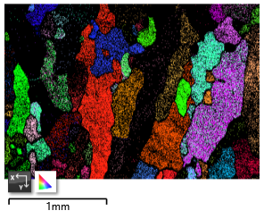

Microstructural Characterization of 2nd Gen. HEAs
Elemental composition from EDS
Chemical analysis revealed relatively low amounts of interstitial elements
SEM/EDS
  Homogeneous distribution of elements
  Achieved target composition
  No significant segregation of impurities SEM/EDS
EBSD reveals grain sizes in the order of 100 μm and elongated grains in some areas
XRD and TEM ongoing to confirm phase
Chemical analysis
Al₁₀Co₄Cr₂₅Mn₂₆Ti₁V₃₄
AlCoCrMnTiV HEA, Grain size $≈$ 150 – 500 $μ$m
A. Burleigh (Fermilab)

Slide 11
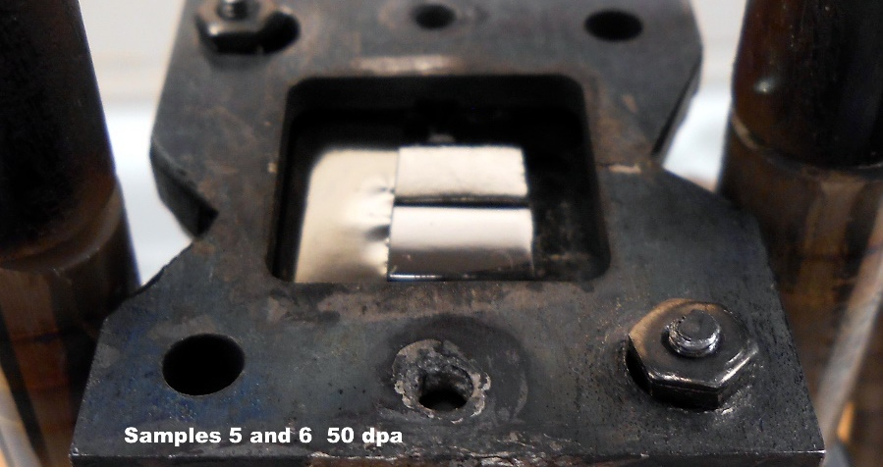
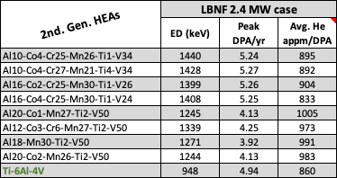
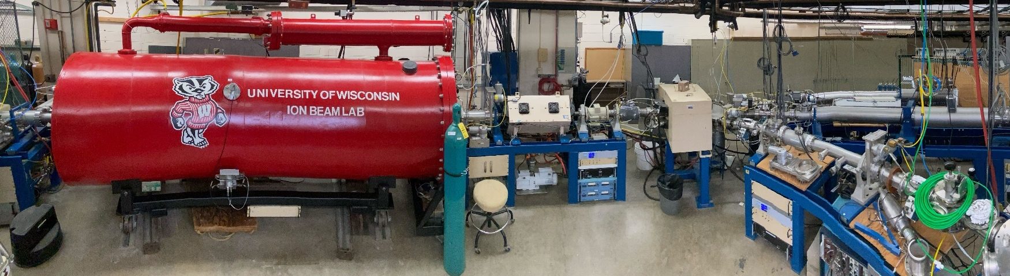
Evaluating Radiation Damage with Low-Energy Ion Irradiation
Study radiation-induced effects evolution
  Voids, dislocation loops, elemental segregation
  Phase stability
  Change in thermomechanical properties
  Benchmark HEA performance with Ti-6Al-4V
1. UW IBL irradiation (2022)
3.7 MeV V²⁺ ions at 500 ºC
50 & 100 DPA
Completed, but ions now V²⁺
Samples in holder prior to irradiation
2. GANIL-IRRSUD irradiation (2024)
36 MeV Ar¹⁰⁺ ions at 500 ºC
Up to 0.4 DPA
Completed
3. UW IBL irradiation (2024)
4.5 MeV Al/Ni ions at 500 ºC
Up to 20 DPA
Planned in the next few weeks
Abe Burleigh to present results at upcoming IWSMT
Wisconsin Ion Beam Laboratory (IBL)

Slide 12
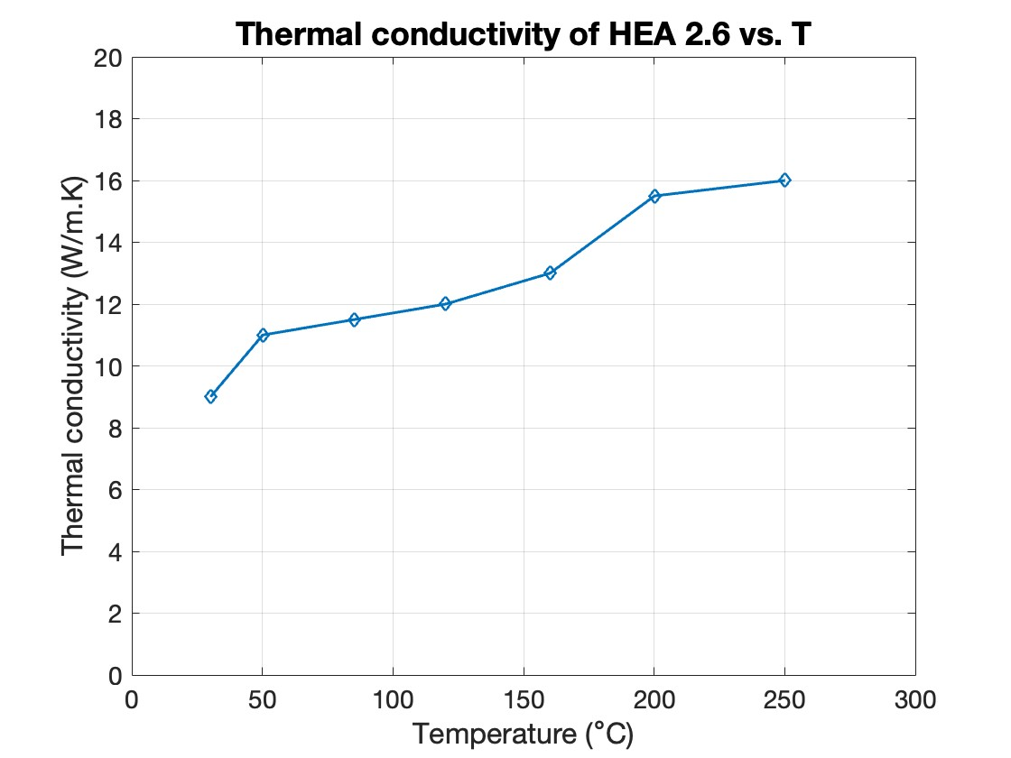
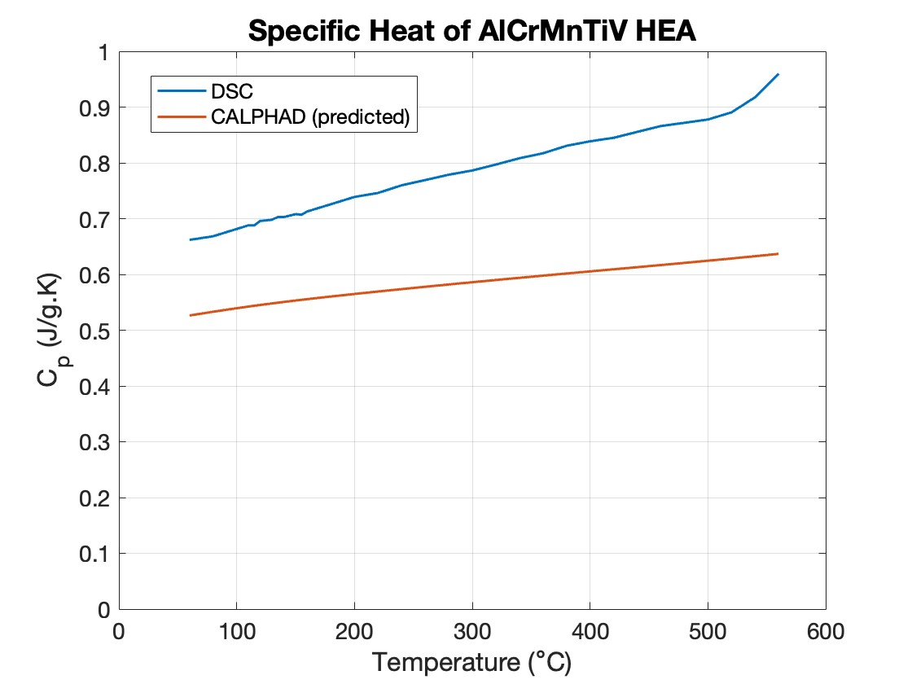
Thermal and Mechanical Properties Measurements
Thermal conductivity
Measured using time-domain thermoreflectance system (TDTR) at UC-Riverside.
k ~ 9 W/m.K at RT
Almost doubles at 250 ºC
Specific heat capacity
Measured with DSC
Validation of CALPHAD predictions for multicomponent alloys
R. Wilson (UC-Riverside)
A. Burleigh, R. Pacheco (Fermilab)

Slide 13
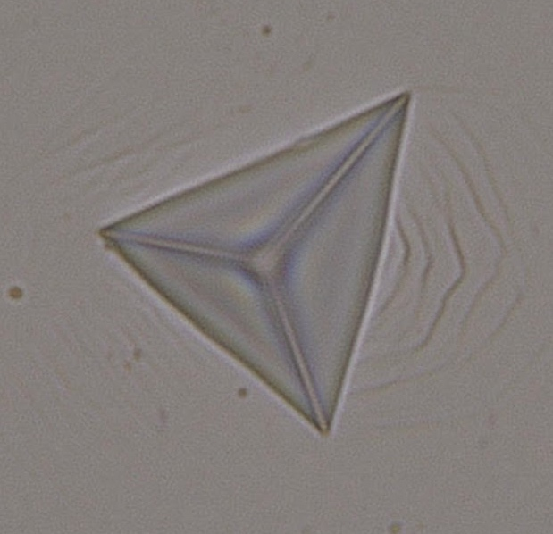
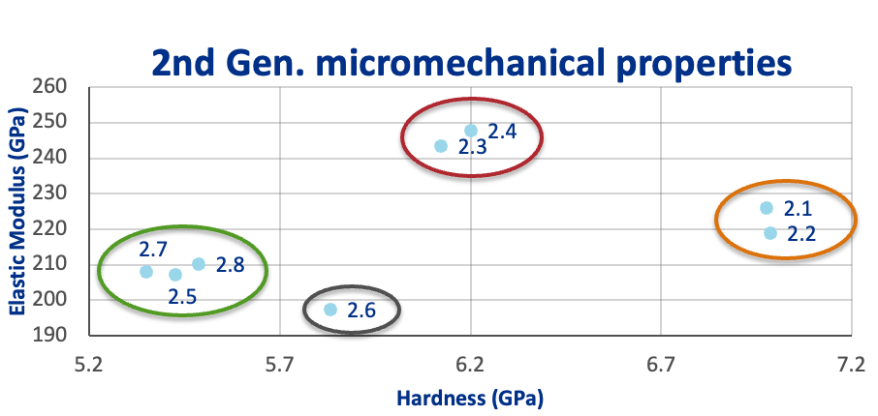
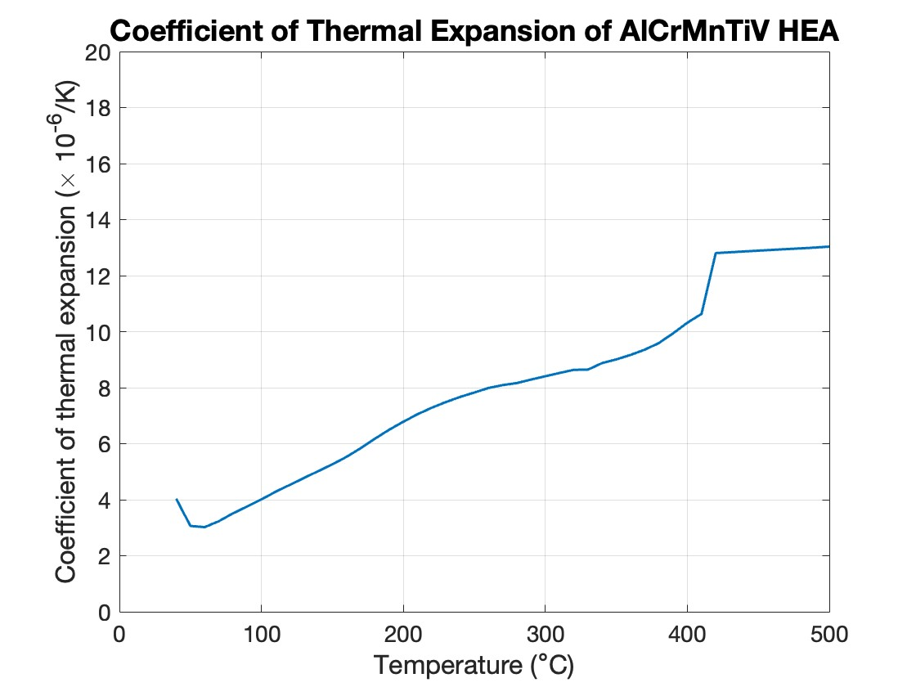
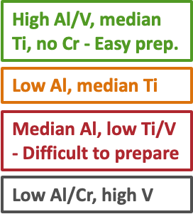
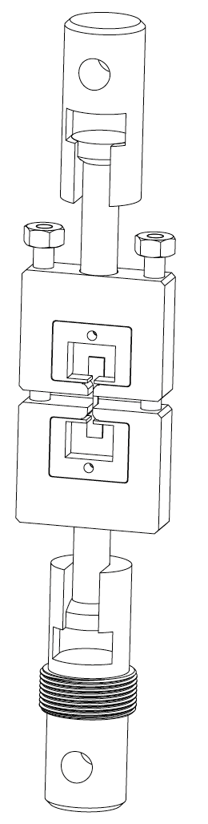
Thermal and Mechanical Properties Measurements
Coefficient of thermal expansion
Dilatometer measurement
Nanoindentation
N. Sigler, A. Burleigh (Fermilab)
Currently fabricating miniature tensile test fixture and implementing DIC for stress-strain measurements
G. Arora, S. Bidhar (Fermilab)

Slide 14
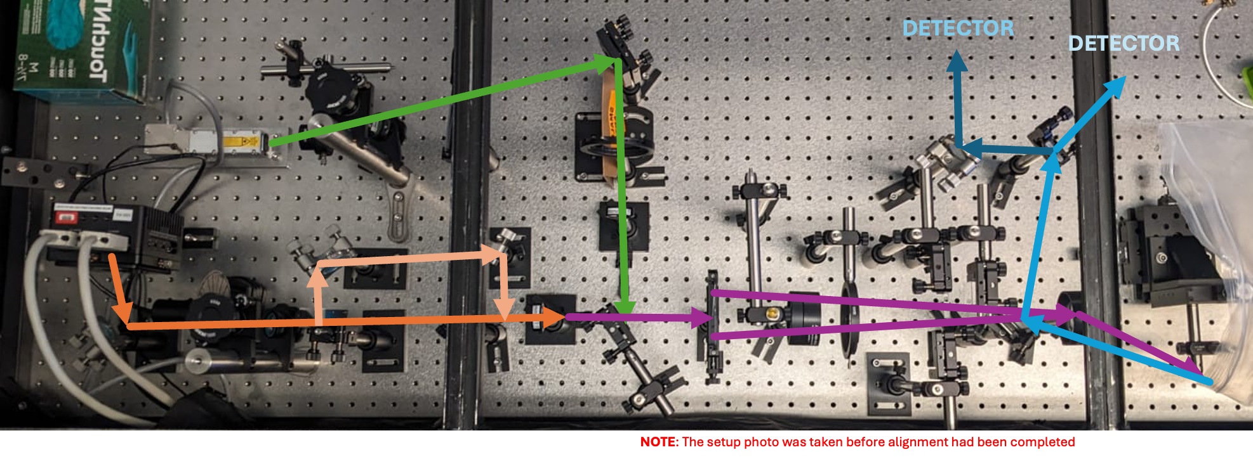
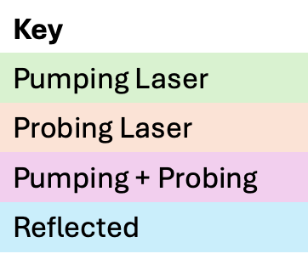
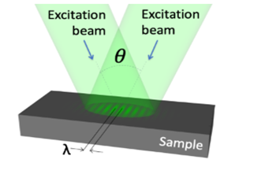
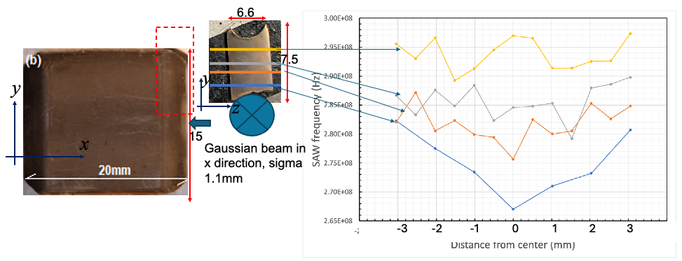
Transient Grating Spectroscopy System at Fermilab
S. Bidhar (Fermilab)
TGS: ultrafast optical technique to study the dynamics of materials by creating a periodic modulation (grating) using two interfering laser pulses
Real-time non-destructive monitoring of properties (thermal diffusivity and elastic modulus)
Applicable to thin damage layer (sub-micro to few microns)
Can reveal how defects form, migrate and anneal with irradiation time, and effective in detecting radiation-induced strain fields, stress waves
TGS test on NT-02 graphite target fin (MIT)

Slide 15
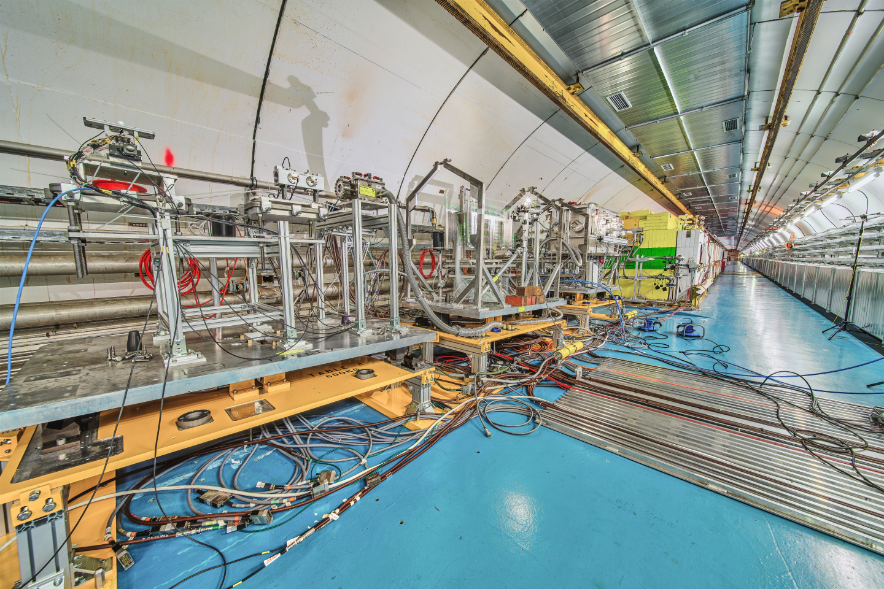
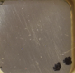
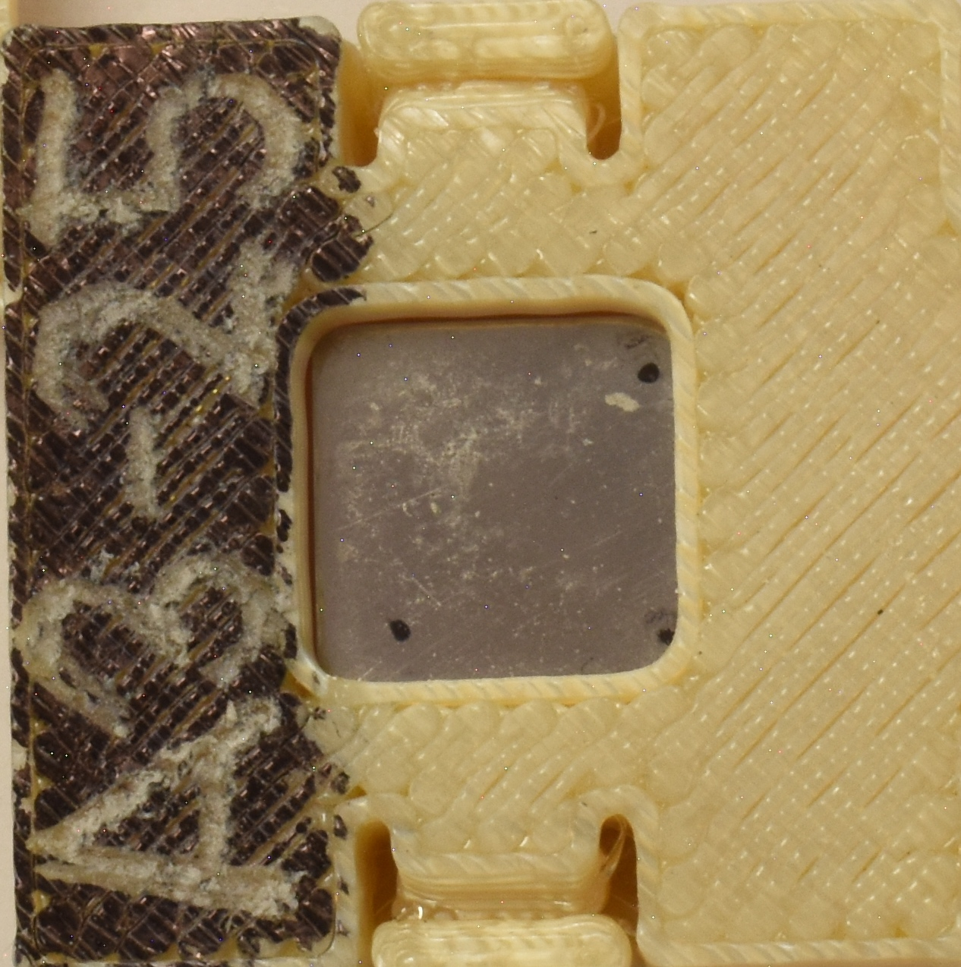
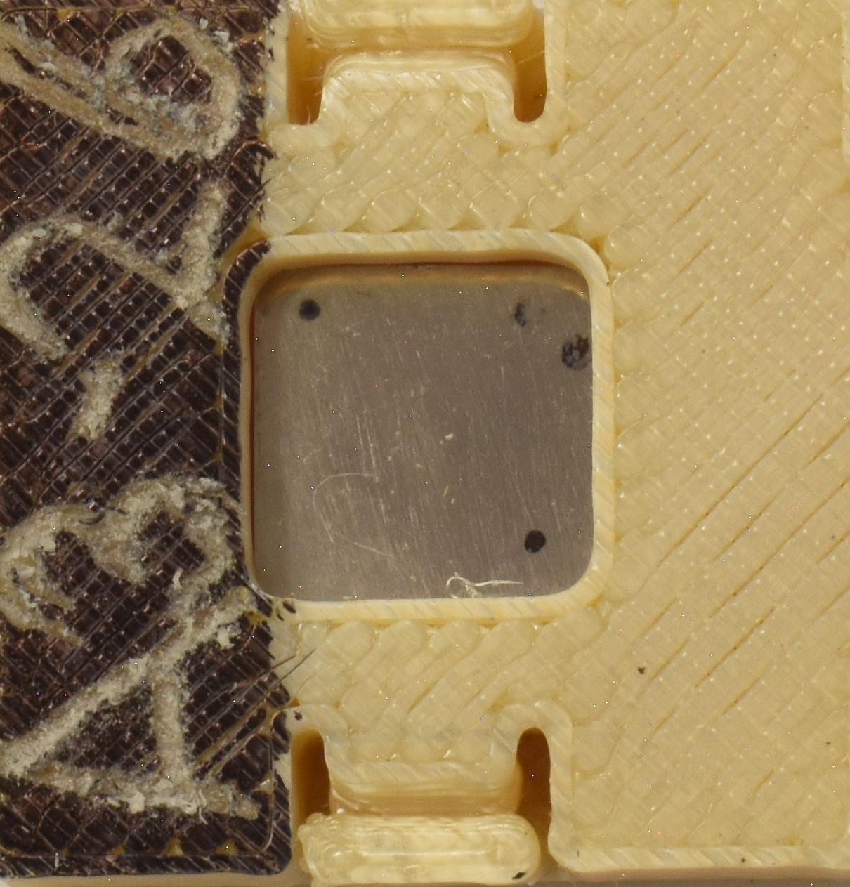
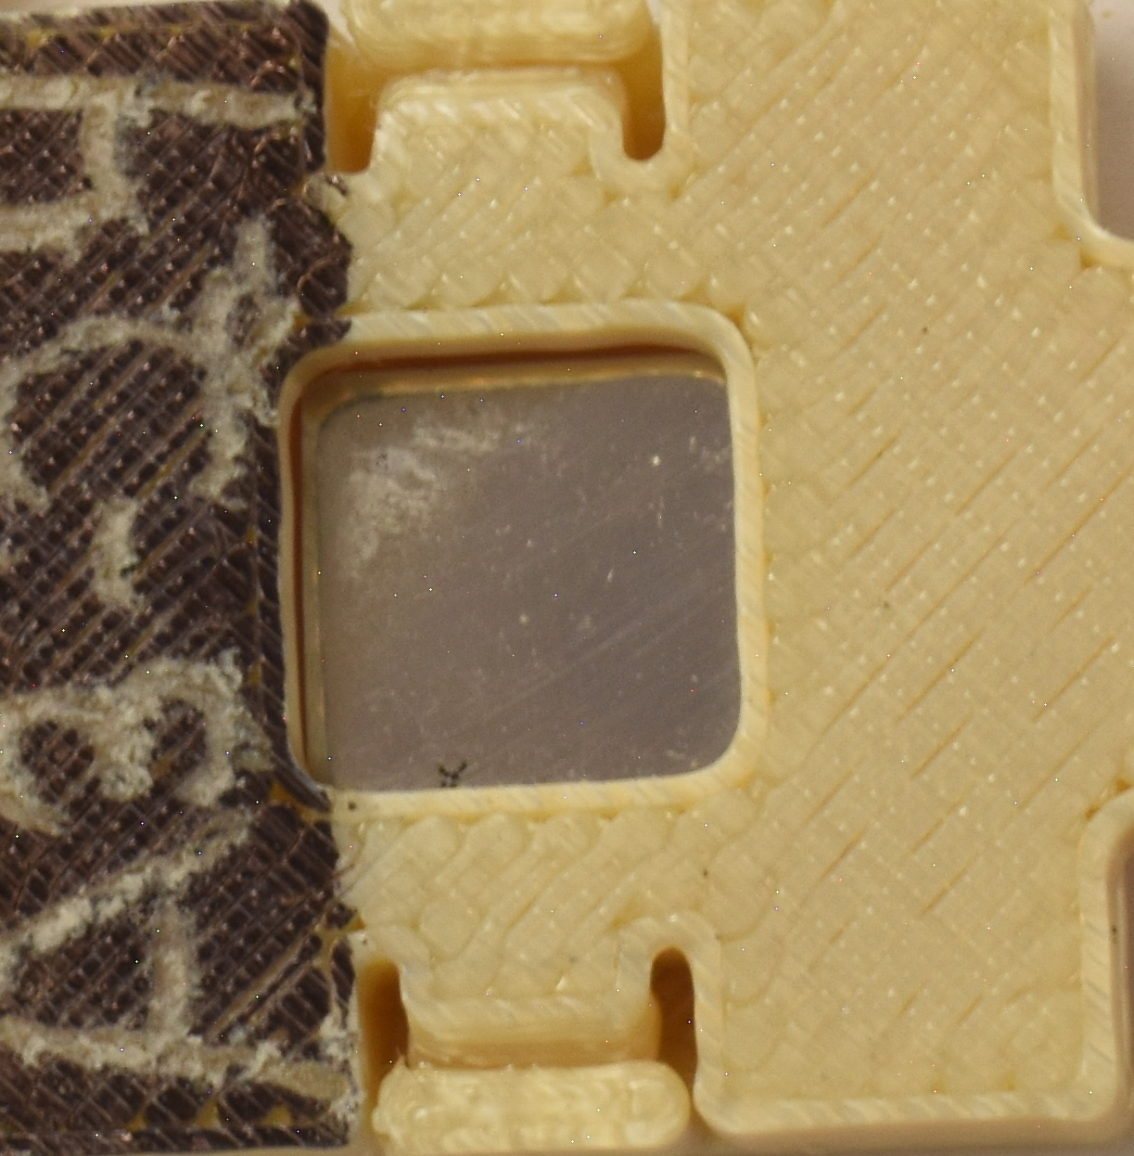
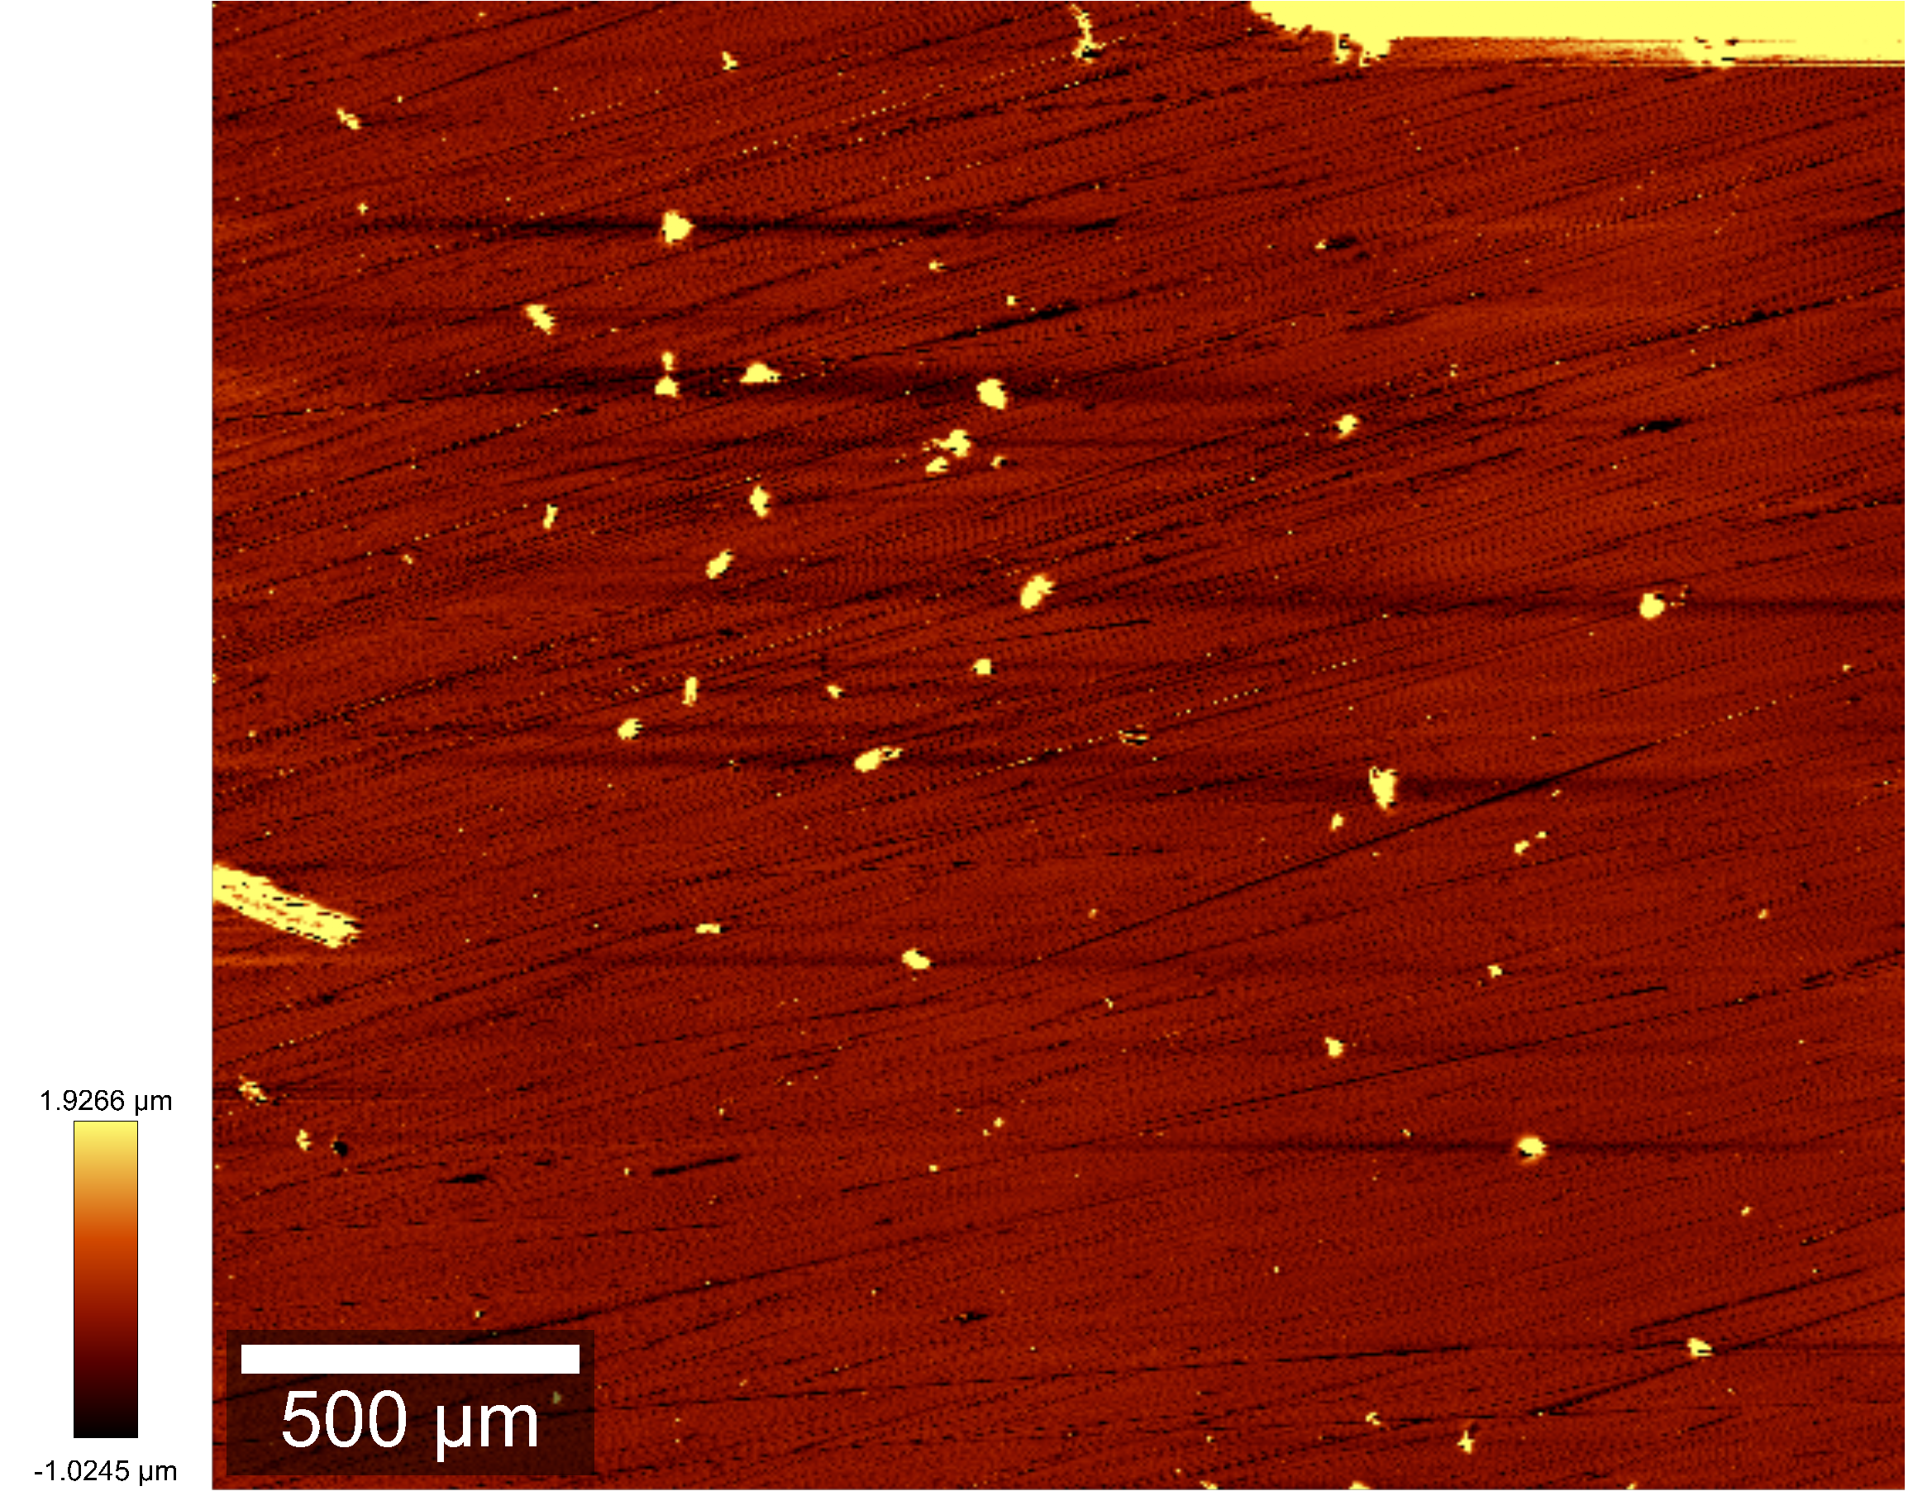
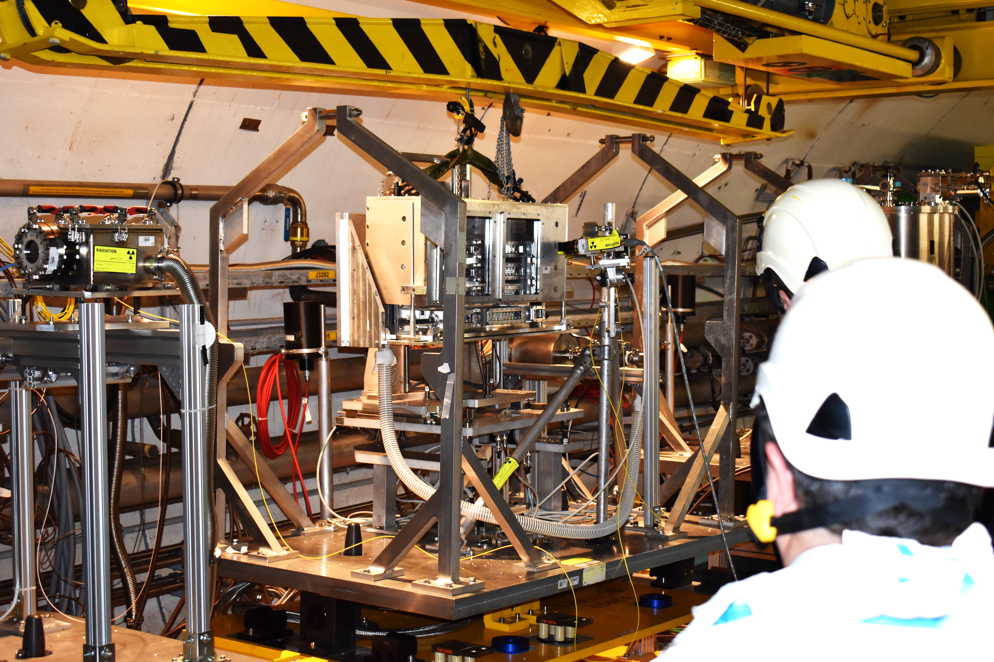

HEAs Tested at CERN’s HiRadMat Facility (2022)
Thermal shock test of several HEA specimens
  Single-shots: 7×10¹² protons/pulse, 440 GeV, 𝜎: 0.25 mm
  ΔT ~1200 ºC in 8 μs
Post-experiment optical images of HEAs
Profilometry and SEM completed at UKAEA-MRF showed no resolvable surface damage

Slide 16
Next steps for HEA development
Irradiation at UW-Madison to higher DPA followed by microstructural characterization
Continue bulk thermal and mechanical property characterization for all HEA compositions
Complete PIE of HiRadMat (HRMT-60, 2022) thermal shock test
Specimen preparation for next HiRadMat experiment (2025)
Continue complementary radiation damage simulations (DFT/MD) – Gaurav’s talk
Further studies on how the composition, microstructure, defects and short-range order of HEAs control their radiation damage resistance
  New DOE HEP grant at UW-Madison

Slide 17
Electrospun Nanofibers for particle production target applications

Slide 18



Why Explore Electrospun Nanofiber Materials?
Intrinsically tolerant to both thermal shock and radiation damage
Nanofiber continuum is discretized at the microscale but continuum at meso-scale
  More uniform heating - fiber diameter orders of magnitude smaller than typical beam spot sizes
  Fiber discontinuity mitigates stress wave propagation
Evidence of radiation damage resistance due to nanopolycrystalline structure of nanofibers
  Large number of grain boundaries acts as defect sinks
Photo: Reidar Hahn, FNAL
Electrospinning technique and Taylor cone.
SEM images of Zirconia nanofibers produced at Fermilab, (a) bulk nanofiber mat, (b) single nanofibers revealing polycrystalline grains (Bidhar et al., PRAB, 24, 2021)

Slide 19





In-Beam Tests of Ceramic Nanofibers
Ion irradiation (in-situ TEM)
Thermal shock test (HiRadMat)
TEM before irradiation
Low packing density
TEM after irradiation
1 MeV Kr²⁺ ion
3.25 x 10¹⁵ ions/cm², 5 dpa
No measurable change in lattice parameter
No defects formation
Initial evidence of radiation damage resistance
High packing density
440 GeV protons, σ: 0.25 mm, 1.21 x 10¹³ protons in 4 µs
Observed damage in higher packing density samples.
Currently validation multiphysics simulations – see Will’s talk
IVEM (ANL)
S. Bidhar, PRAB, 24, 2021

Slide 20


Extending Work to Tungsten Nanofibers
High-density material to compensate for the reduced effective density in nanofiber form (W nanofiber ~2 g/cm³)
Overcame primary challenge of reducing oxides after heat treatment of W-doped polymer nanofiber sample (several iterations)
  In-situ XRD finally showed heat treatment at 850 ºC in forming gas (95%N₂, 5%H₂) produced 99%W-1%WO₂
Currently planning in-situ ion irradiation and micromechanical tests to assess radiation damage behavior and tensile properties
SEM of W nanofibers showing 0.5 μm fiber diameter (S. Bidhar, Fermilab)
In-situ XRD of tungsten nanofibers during heat treatment (IMSERC facility – Northwestern University)

Slide 21



Next Steps: Ion Irradiation and Micromechanical Tests of Nanofibers
In-situ TEM ion irradiation at Michigan Ion Beam Laboratory
  To capture defect formation and evolution during irradiation
  Nanofibers (100– 200 nm diameter) solution casted on TEM grid
  Kr³⁺ ions at 1.2 MeV, 2 nA/mm²
  Up to 100 dpa equivalent in bulk tungsten
In-situ SEM single fiber push-to-pull test at Michigan Center for Materials Characterization
Push-to-pull device using in conjunction with PicoIndenter
Fiber load vs. displacement measured to extract tensile properties
Push

Slide 22
Proposed HiRadMat Test (2025)

Slide 23

HiRadMat Experimental Goals (HRMT-67: 2025)
Expose HEA and Nanofiber samples to intense beam pulses (𝜎 ~1 mm, up to 4.9 × 10¹³ ppp)
  Study effects of multiple beam pulses on 12 different HEA compositions
  Compare response of nanofibers under vacuum and atmospheric pressure (validate simulation work)
Investigate fracture mechanics role in targets under dynamic thermal shock conditions
  Stress field around crack tip is not in equilibrium and inertial effects can not be neglected
Pre-cracked fracture toughness specimens (pure W, WL-10, Ti-6Al-4V)
LDVs to “see” crack propagation via radial and circumferential vibration

Slide 24




HRMT-67 (2025) Experimental Set-Up
Q. Peterson, Fermilab
Sample holders ride on linear rails and carriages (supported by springs)
Samples are pushed by rack and pinion into beamline and seat onto V-block compliance mount
3 arrays for HEA and Nanofiber thin plate specimens

Slide 25

Conclusions
Initial HEA synthesis and characterizations show desired microstructure. Post LE ion-irradiation examination under way
Starting to generate thermal and mechanical properties of the HEAs
Success in fabricating highly pure tungsten nanofibers and now proceeding with radiation damage assessment and mechanical properties
Iterative novel material development process
Microstructural characterization and bulk property testing pre- and post-irradiation (LE ions and HE protons)
Refining composition and microstructure (heat treatment)
Complementary DFT and MD modeling of radiation damage effects to guide material design

Slide 26




Acknowledgements
Fermilab
K. Ammigan, G. Arora, S. Bidhar, A. Burleigh, F. Pellemoine
University of Wisconsin-Madison
A. Couet, N. Crnkovich, M. Moorehead, I. Szlufarska
Illinois Institute of Technology
W. Asztalos, Y. Torun
University of California, Riverside
R. Wilson
The work was supported by Fermi National Accelerator Laboratory, managed and operated by Fermi Research Alliance, LLC under Contract No. DE-AC02-07CH11359 with the U.S. DOE. This material is based upon work supported by the U.S. Department of Energy, Office of Science, Office of High Energy Physics under an Early Career Research Program award to KA. This project has received funding from the European Union’s Horizon Europe Research and Innovation programme, under Grant Agreement No 101057511 (EURO-LABS)

Slide 27
Novel Target Materials Development at Fermilab: Status and Update
Kavin Ammigan
9th Annual RaDIATE Collaboration Meeting
16-18 September 2024

Slide 28
Supplemental Slides

Slide 29




Impacts of Beam-Induced Radiation Damage and Thermal Shock
Radiation Damage: disruption of lattice structure of the material upon irradiation
Expressed by Displacements Per Atom (DPA)
Hardening and embrittlement (loss of ductility)
Bulk swelling (dimensional changes)
Fracture toughness reduction
Thermal conductivity reduction
Coefficient of thermal expansion increase
Transmutation and gas production
…
Dimensional changes after irradiation, D.L. Porter and F. A. Garner, J. Nucl. Mater., 159, p. 114 (1988)
Thermal Shock: Localized energy deposition in the material induces dynamic stress waves
Caused by short pulsed beams
Cyclic loading environment can lead to fatigue failure
Sigraflex graphite (left) and Iridium (right) targets tested at CERN’s HiRadMat facility with high-intensity single-shot beam pulse

Slide 30


