Slide 1

IFMIF-DONES Lithium Systems
J. Maestre
9th Annual RaDIATE Collaboration Meeting. 16-18 Sept. Granada (Spain)

Slide 2
Outline
Validations and prototyping
Target System
Conclusions
Overview to Lithium systems

Slide 3
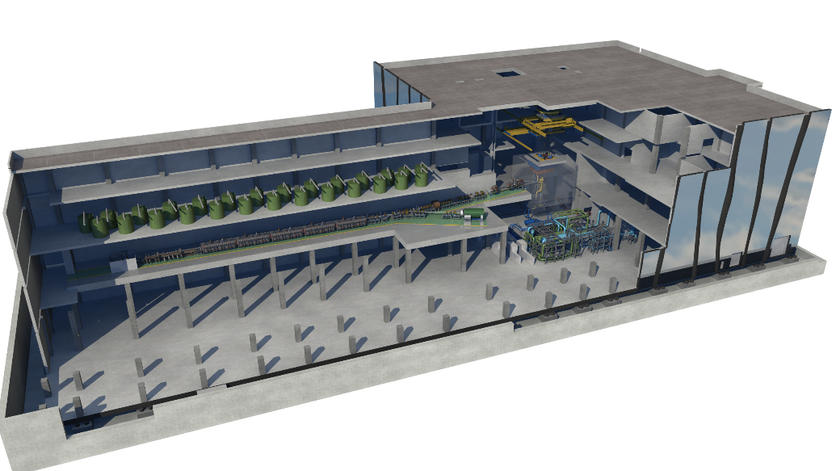
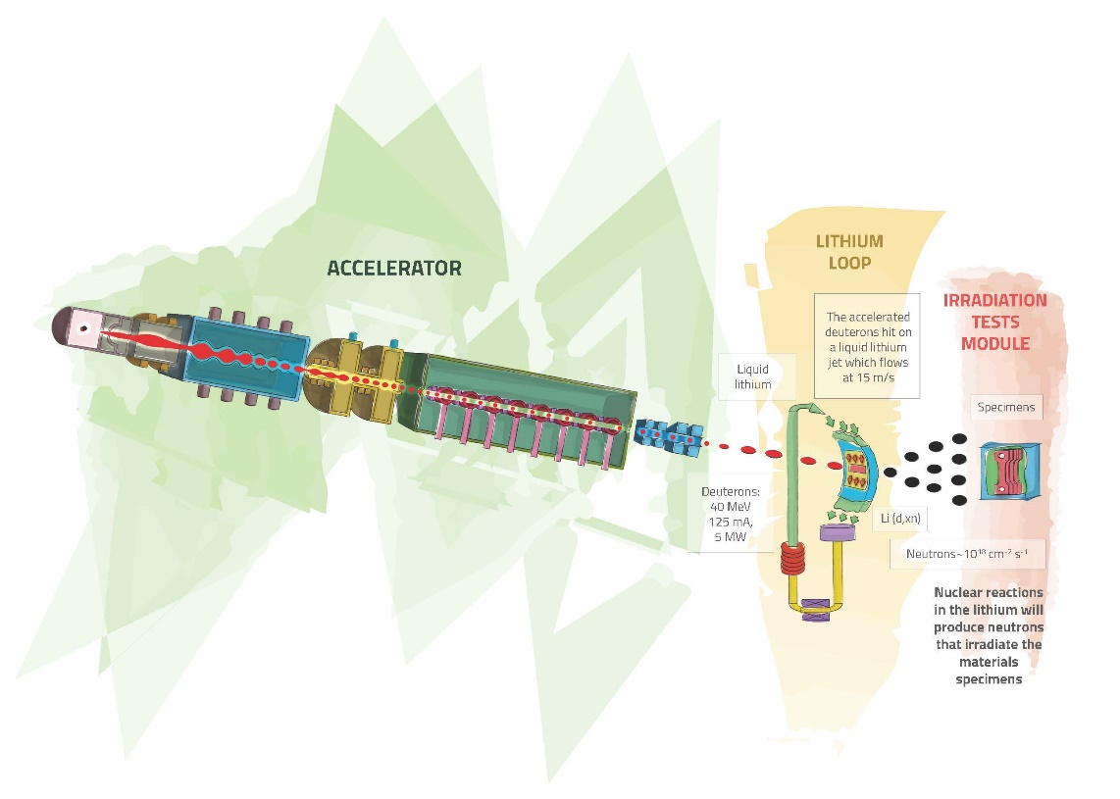
Lithium System: introduction
Lithiujm system
15
A neutron flux of ~ 10¹⁸ – 10¹⁹ n m²/s
is generated with a neutron spectrum up to 55 MeV energy.

Slide 4
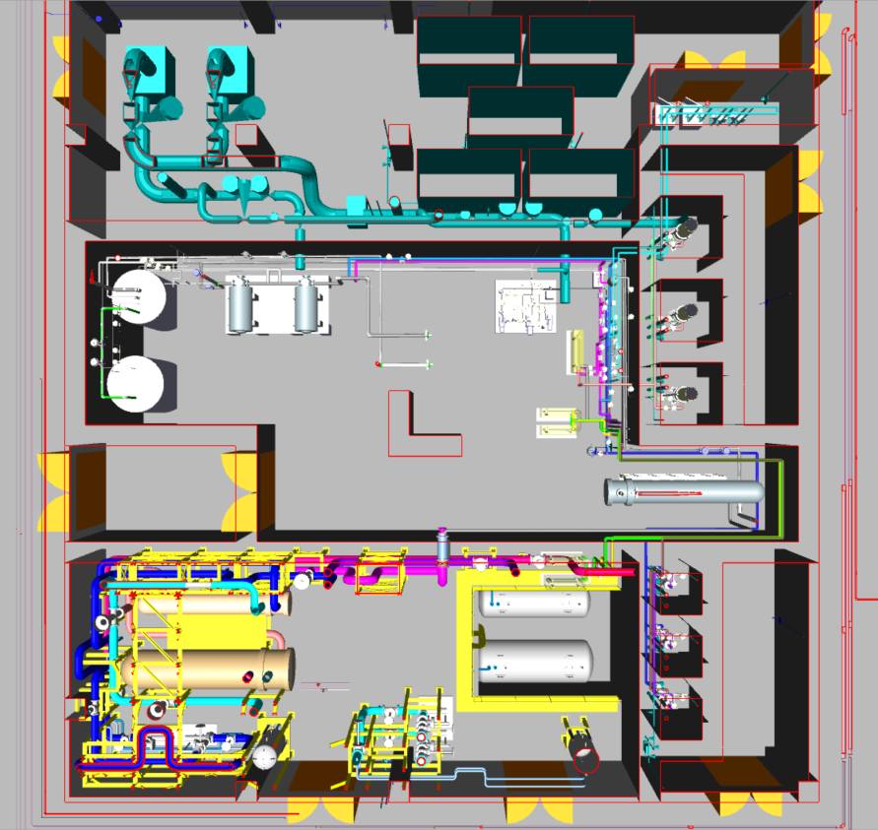
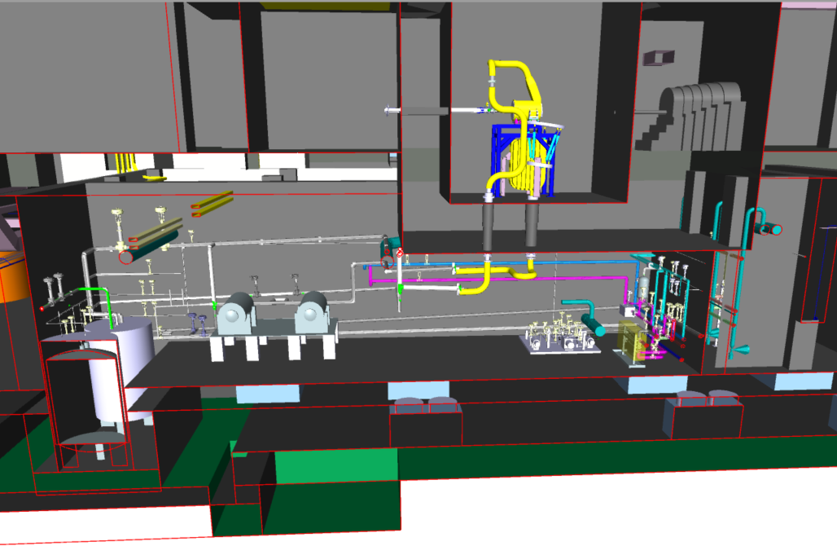
Lithium System: introduction
Liquid lithium Target
R009-1
Cold trap
BEAM
R016
Lithium Loop Cell
R015
Oil Loop Cell
R009-2
H-trap

Slide 5
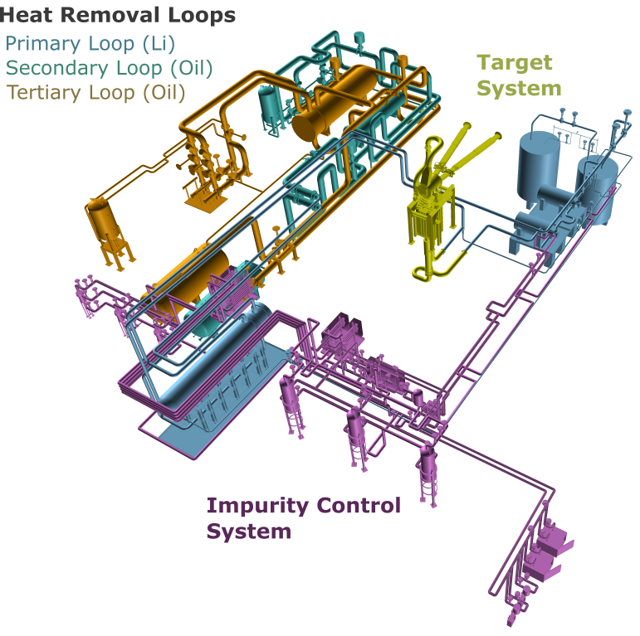
Lithium Systems
Generating a stable liquid lithium target for enabling D-Li stripping reaction and producing an adequate neutron flux to properly irradiate the test modules downstream.
Systems:
Target System: To provide a continuous Li jet whose interaction with D+ beam generates the Neutron flux.
Heat Removal Loop: To remove the energy deposition on the Lithium.
Impurity Control System: To localize and control the impurities in the Lithium.

Slide 6
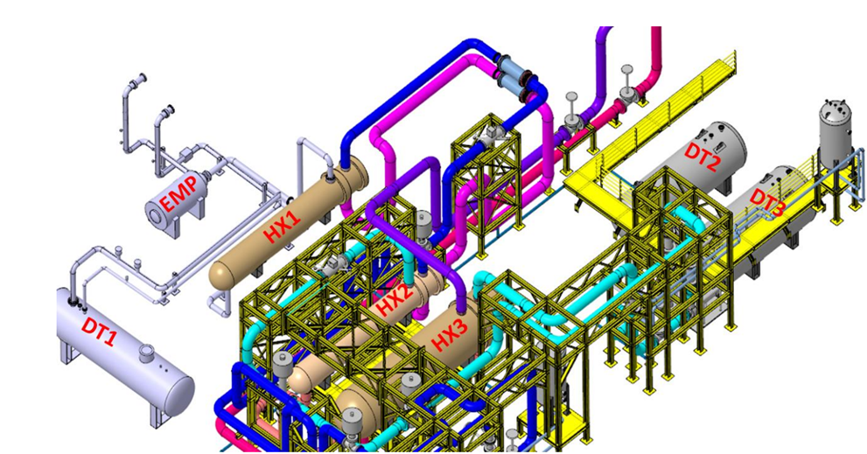
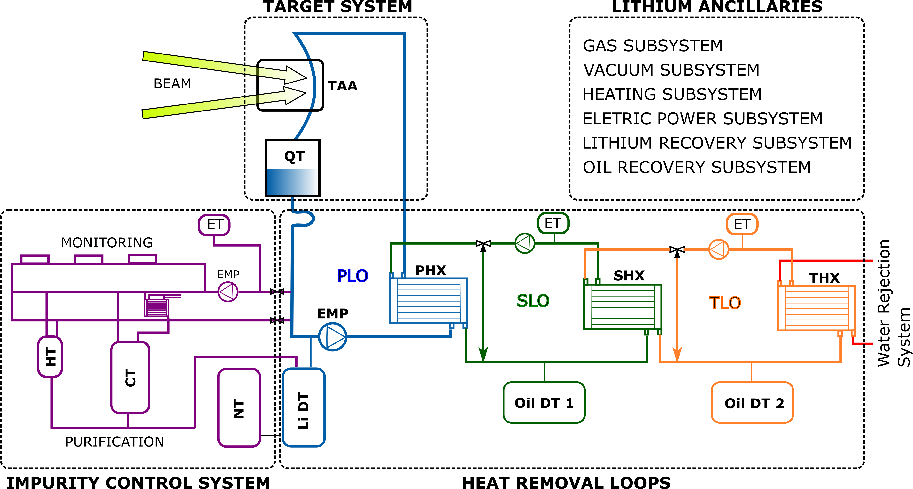
Heat Removal Loop
The system consists of:
Primary Lithium Loop (PLO)
Secondary Oil Loop (SLO)
Tertiary Oil Loop
(TLO)
Water rejection system
Main parameters:
Li inventory ~14 m³
Li flow rate ~100 l/s
Li working temperature (cold side) 300 °C
Deposited power: 5 - 10 MW

Slide 7
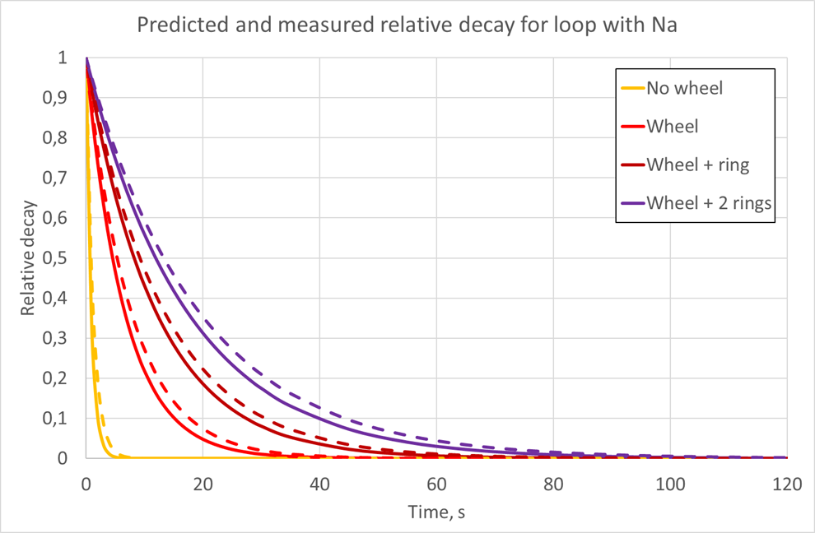
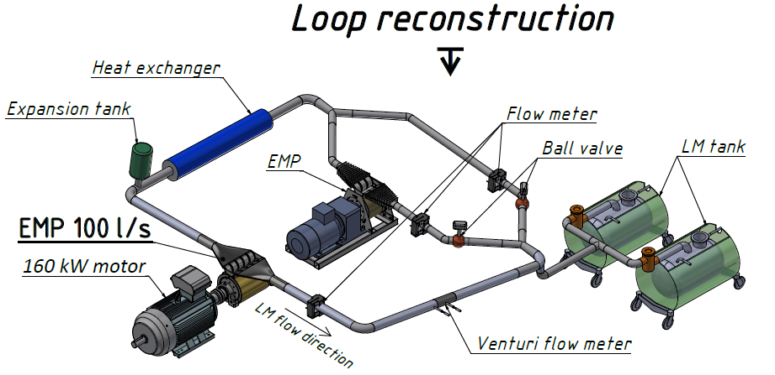
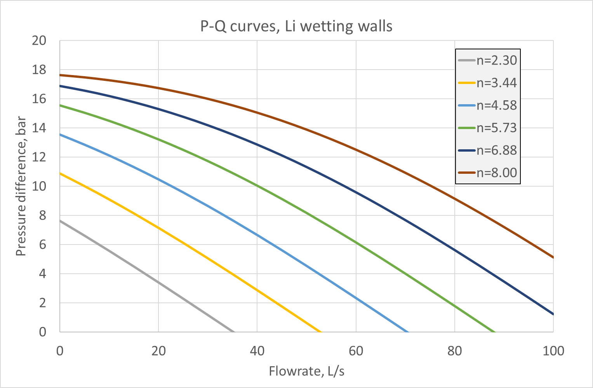
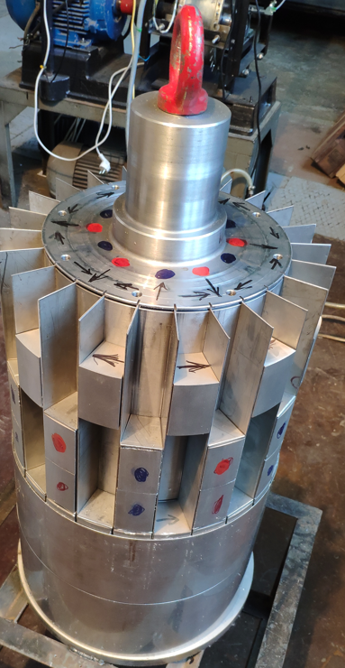
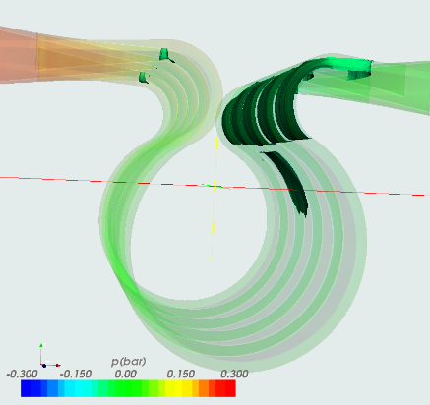
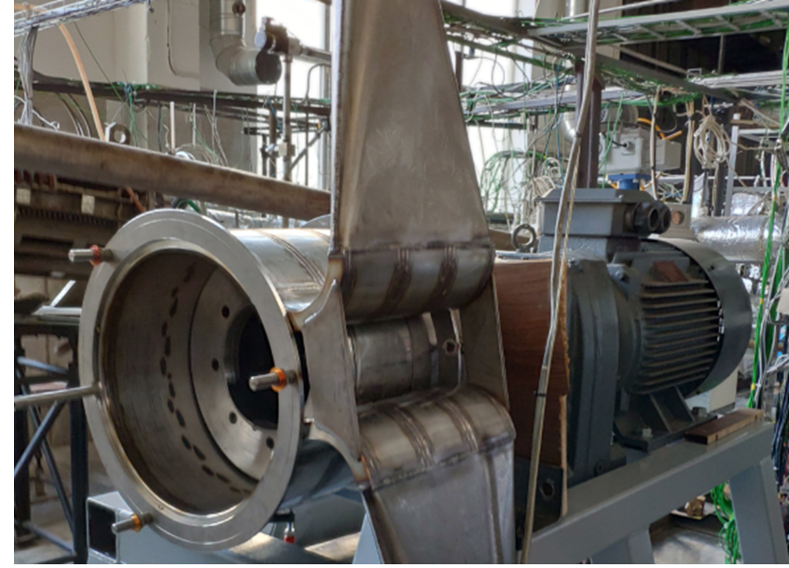
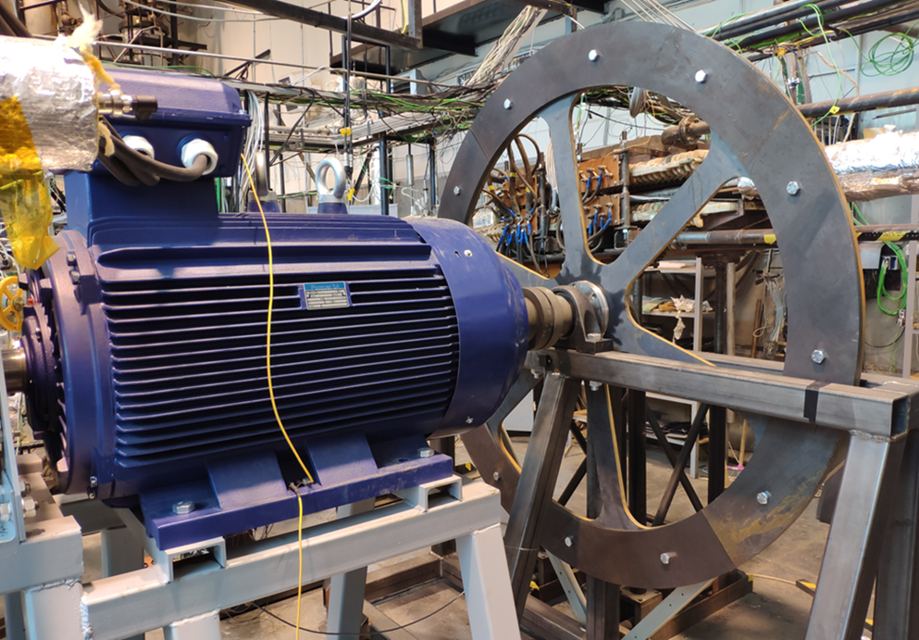
Heat Removal Loop: EMP
Flywheel concept
Main parameters:
Design temp: 350 ºC
Flow rate: 100 l/s
Discharged pressure: 4 bars
Inlet
Pressure increase
Challenge:
Extreme low NPSH (Net Positive Suction Head) < 1 bar

Slide 8
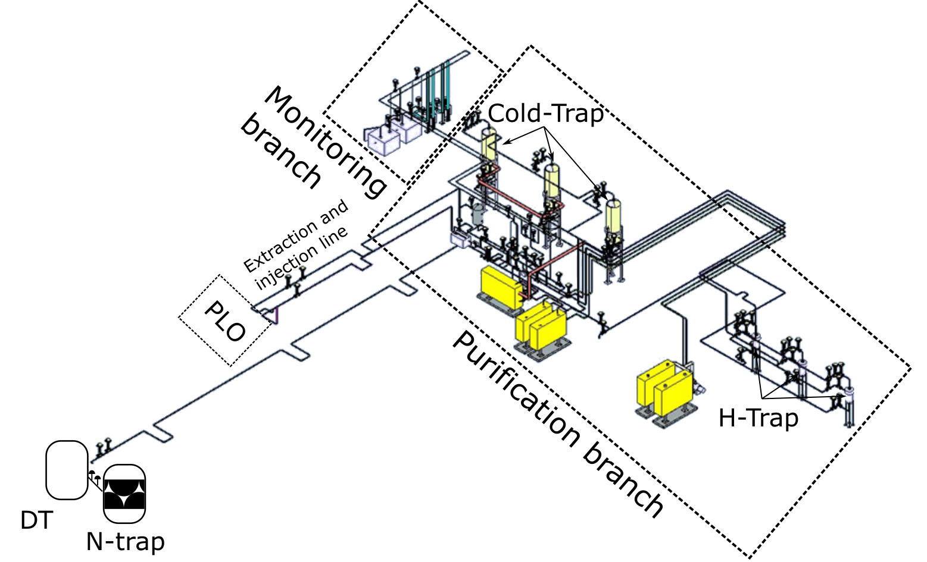
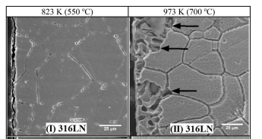
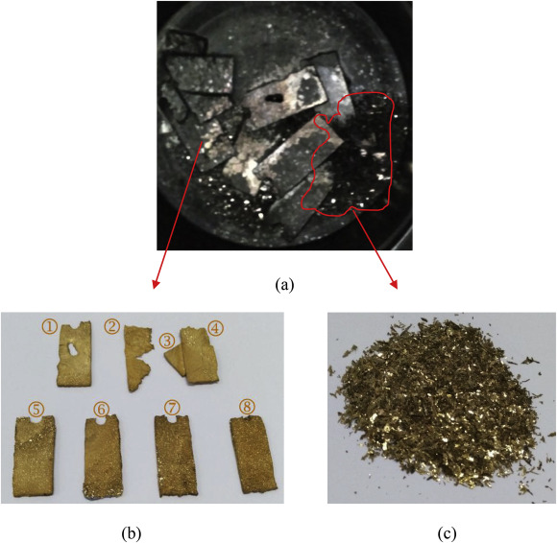
Impurity Control System
Test of structural stainless stell alloys on static liquid lithium [1]
Clear attack to grain and also to grain boundary (see 316L)
Temperature dependent
Impurity dependent (N, O, H)
Functions:
To control and confine the sources of radioactivity such as tritium (T), beryllium-7 (Be-7) and activated corrosion products (ACP), i.e. corroded/eroded metallic elements .
To control and capture the sources of the corrosion and erosion on structural components such as oxygen (O), carbon (C), hydrogen (H) and nitrogen (N).
To monitor the impurities in the liquid lithium and to assure the optimal physical conditions.
Static test of Cooper with Liquid lithium at 620 K for 15 h under high vacuum [2]
[1] S.k. Parida et al. Studies on chemical compatibility of steels with liquid lithium. Journal of Nuclear Materials 526 (2019) 151761
[2] X.C. Meng et al. Corrosion characteristics of copper in static liquid lithium under high vacuum. Journal of Nuclear Materials, Volume 513, January 2019
To control and confine the sources of radioactivity such as tritium (T), beryllium-7 (Be-7) and activated corrosion products (ACP), i.e. corroded/eroded metallic elements .
To control and capture the sources of the corrosion and erosion on structural components such as oxygen (O), carbon (C), hydrogen (H) and nitrogen (N).
To monitor the impurities in the liquid lithium and to assure the optimal physical conditions.

Slide 9
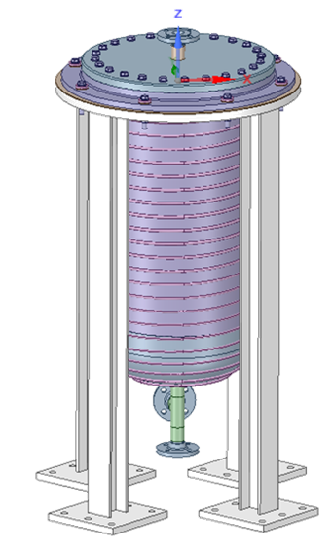
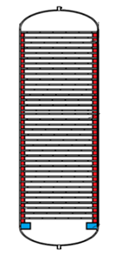
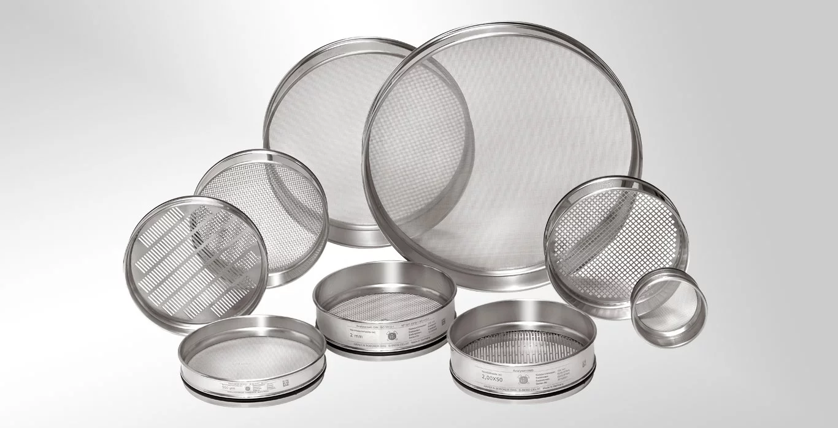
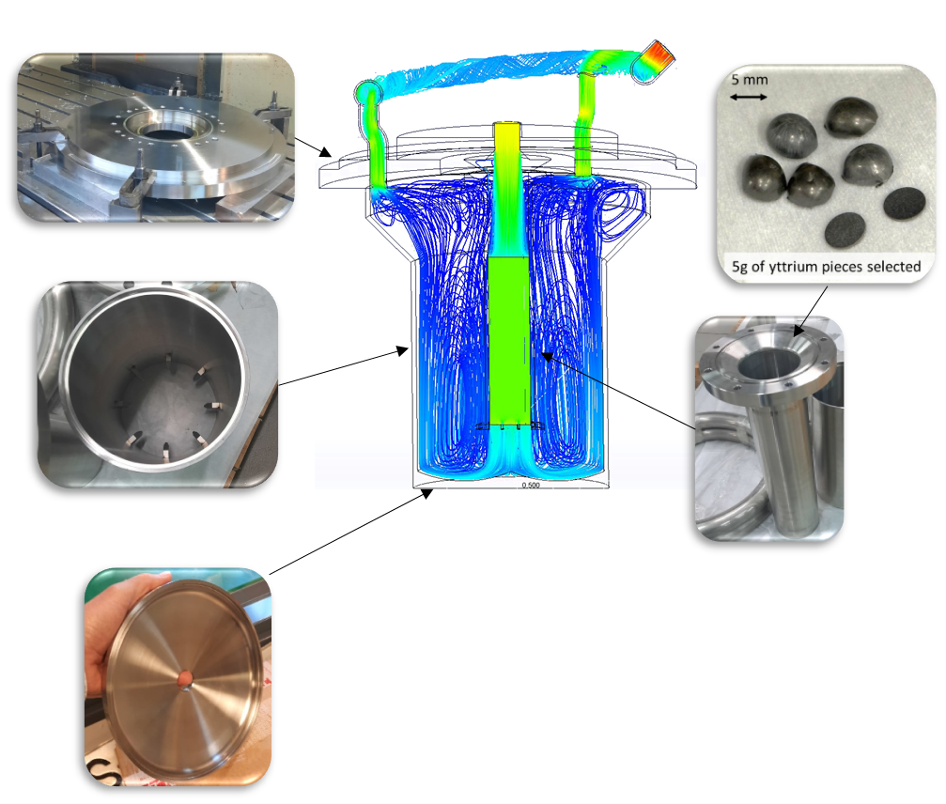
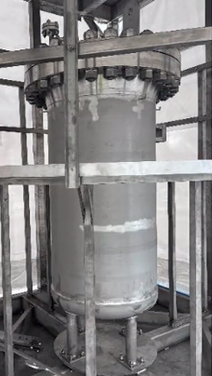
Impurity Control System
Sources
Cold traps: To remove soluble compounds with temperature dependent solubility by crystallization on a wire mesh substrate. The processes are film driven after initial crystallization. Mainly focused of Li with O, H and C; but also for CPs and ACPs, including ⁷Be compounds.
Corrosion Products (CP) are generated continuously due to the contact between the liquid
T and 7Be are produced as results of the nuclear interaction Li-Deuteron beam.
N, O and C may be incorporated due to maintenance or replacement of Li equipment.
Hydrogen traps: To remove the H isotopes by a gettering process similar to the N-trap. Yttrium (Y) has been selected as a suitable getter material. Trap working online.
Nitrogen trap: To remove the Nitrogen from the liquid lithium. The process is driven by mass transfer in the liquid lithium and subsequent N capture and diffusion inside the getter. The trap operates offline on the whole Lithium inventory

Slide 10
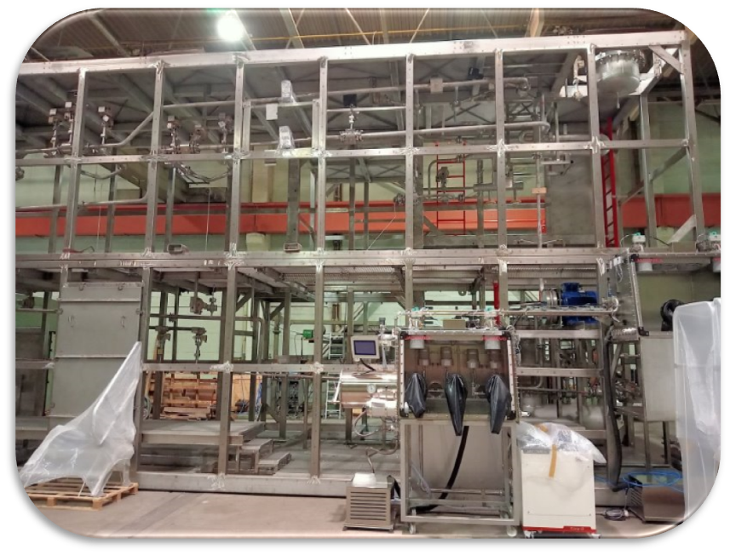
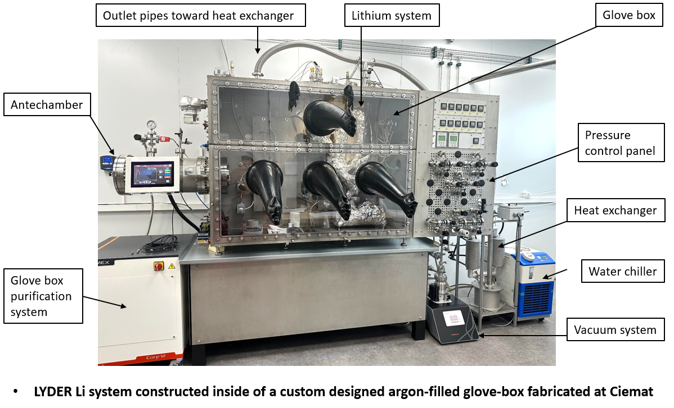
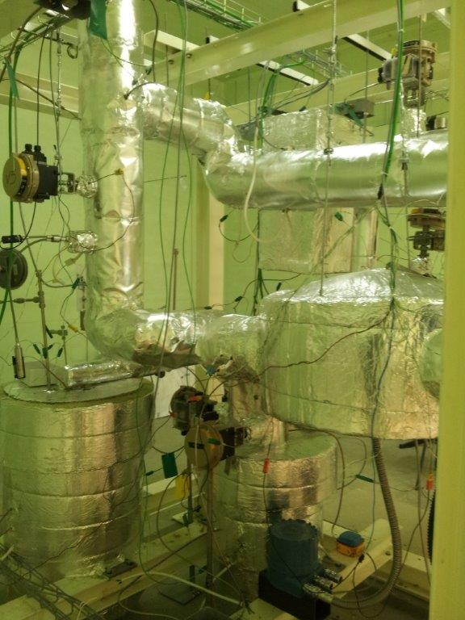
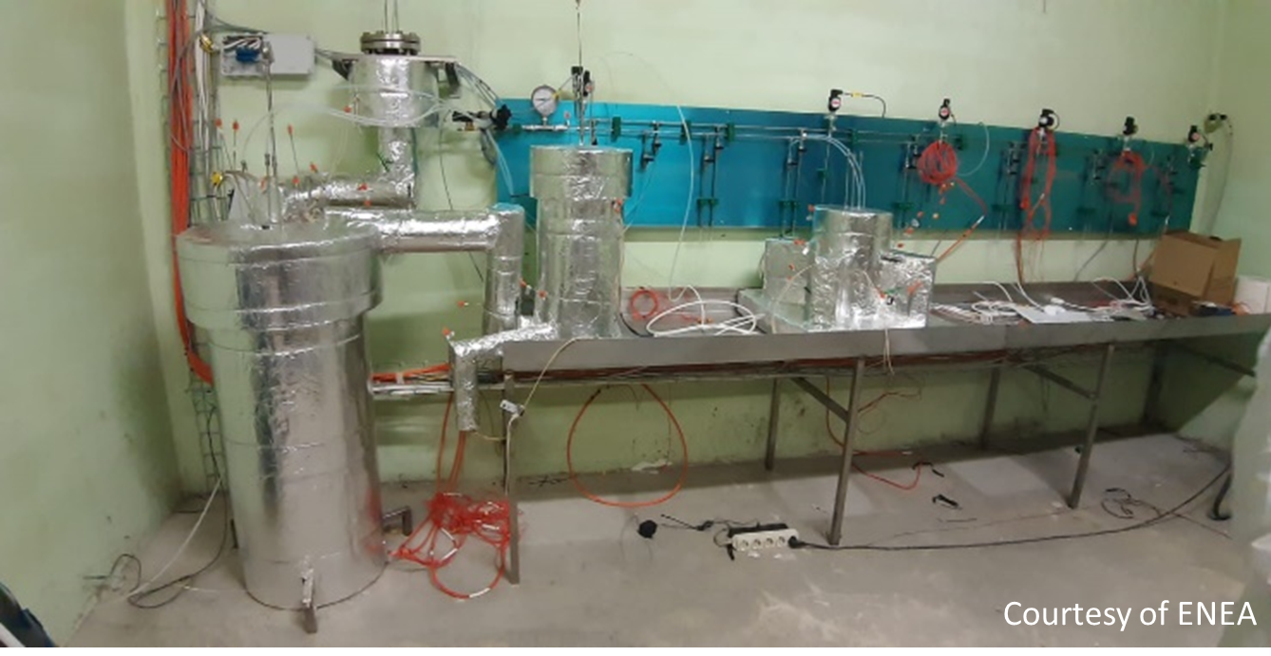
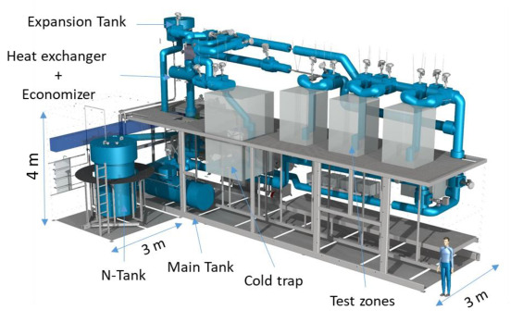
Impurity Control System
Lyder. (CIEMAT-Madrid). Facility aiming at investigating H-getter in liquid lithium at lab scale.
LIFUS 6 (ENEA Brasimone). Facility devoted to corrosion and erosion tests of structural material under flowing lithium.
LITEC (CIEMAT-Granada). Facility aiming at investigating purification and monitoring technologies a full DONES scale under representative conditions
ANGEL facility. (ENEA Brasimone). Facility aiming at investigating getters materials for N trapping in Liquid Lithium at lab scale.

Slide 11
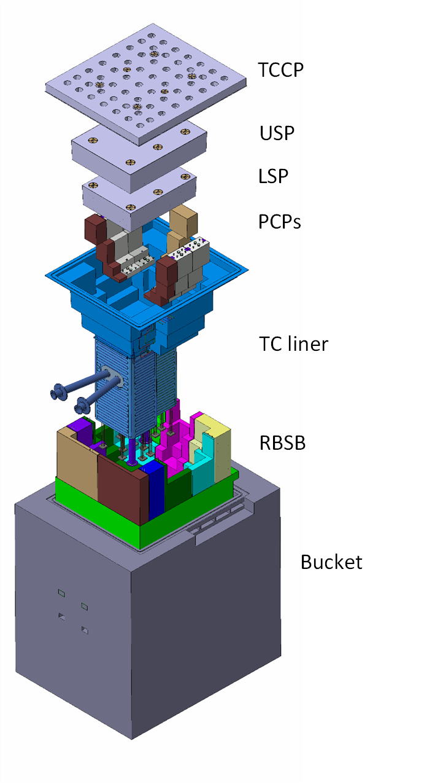
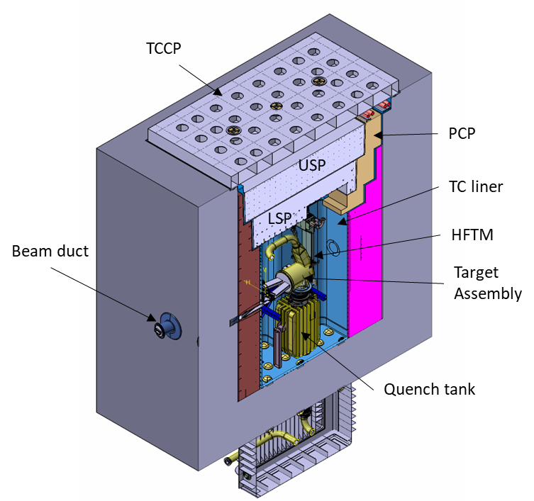
Target System: description
Target is allocated inside Test Cell, concrete cell covered by a stainless-steel liner.
TC shall provide enough shielding to adjacent rooms
TC provides the proper working conditions and boundaries (to the target and experimental modules), controlling the environment (low pressure He or Ar)
Temperature of the liner controlled by water cooling system on the outside
10 m
Beam

Slide 12
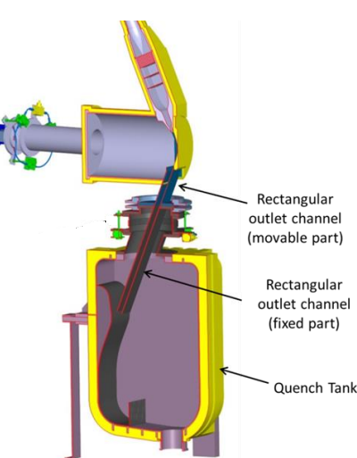

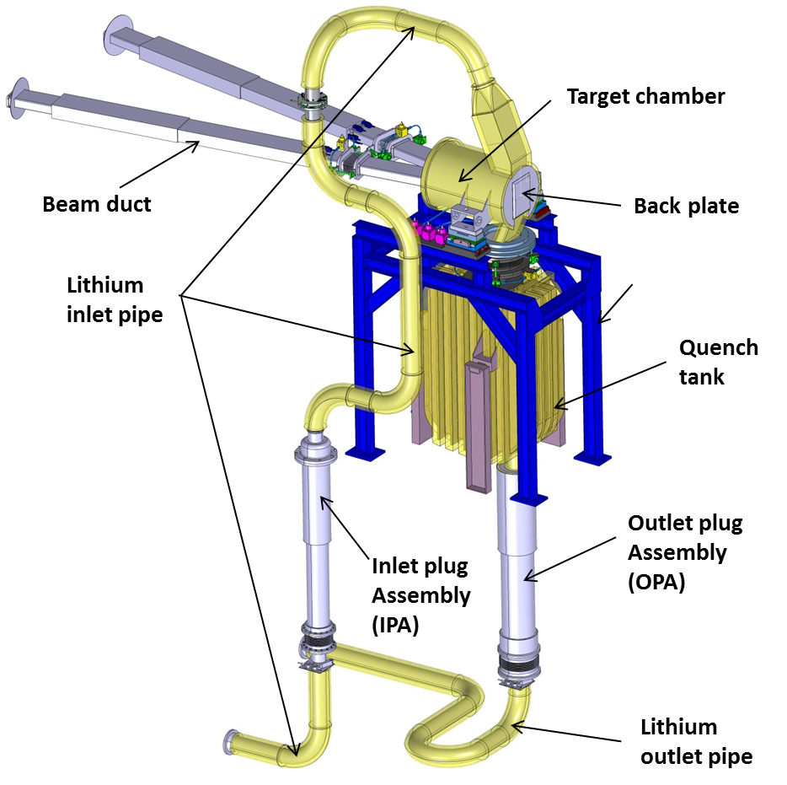
Target System: description
Function
Receive the beam (200 x 50 or 100 x 50 m²) and deliver the neutron flux
Through wall beam duct
Inlet nozzle
Inlet nozzle
BEAM
10E-4 mbar
BackPlate
Nominal liquid Lithium jet speed of 15 m/s at the exit of the nozzle (but up to 20 m/s in case of IFMIF)
Curvature of BP for avoiding Li boiling
25 mm thin Li jet and slim Back Plate to reduce neutron re-absorption (1.8 mm thickness)

Slide 13
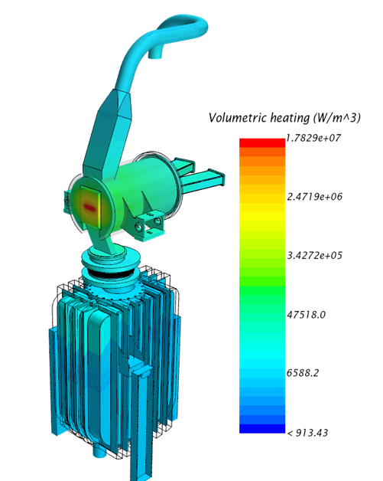
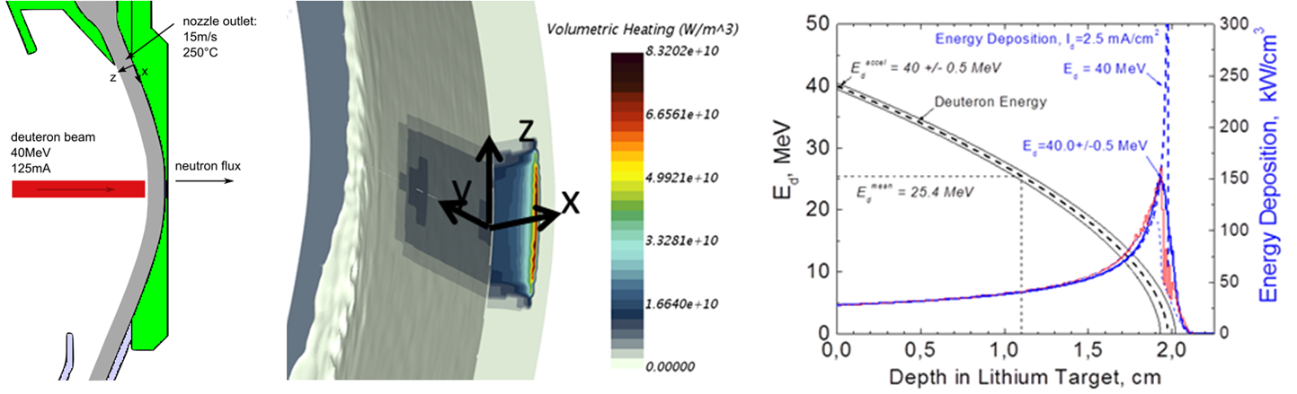
Target System: analysis
Courtesy of S. Gordeev, A. Serikov, Q. Yuefeng (KIT, Germany)
P= 10E-4 mbar
50 mm
200 mm (100)
Fig. Beam energy deposition on the lithium jet
High density power deposition in the Li jet ~85 kW/cm³
Deuterium Bragg - Peak at 20 mm (25±1 mm thickness)
Distribution of power deposition also in the rest of the Target structure due to neutron and photons (~1 W/cm³)
Fig. Heat power deposition on the structure

Slide 14
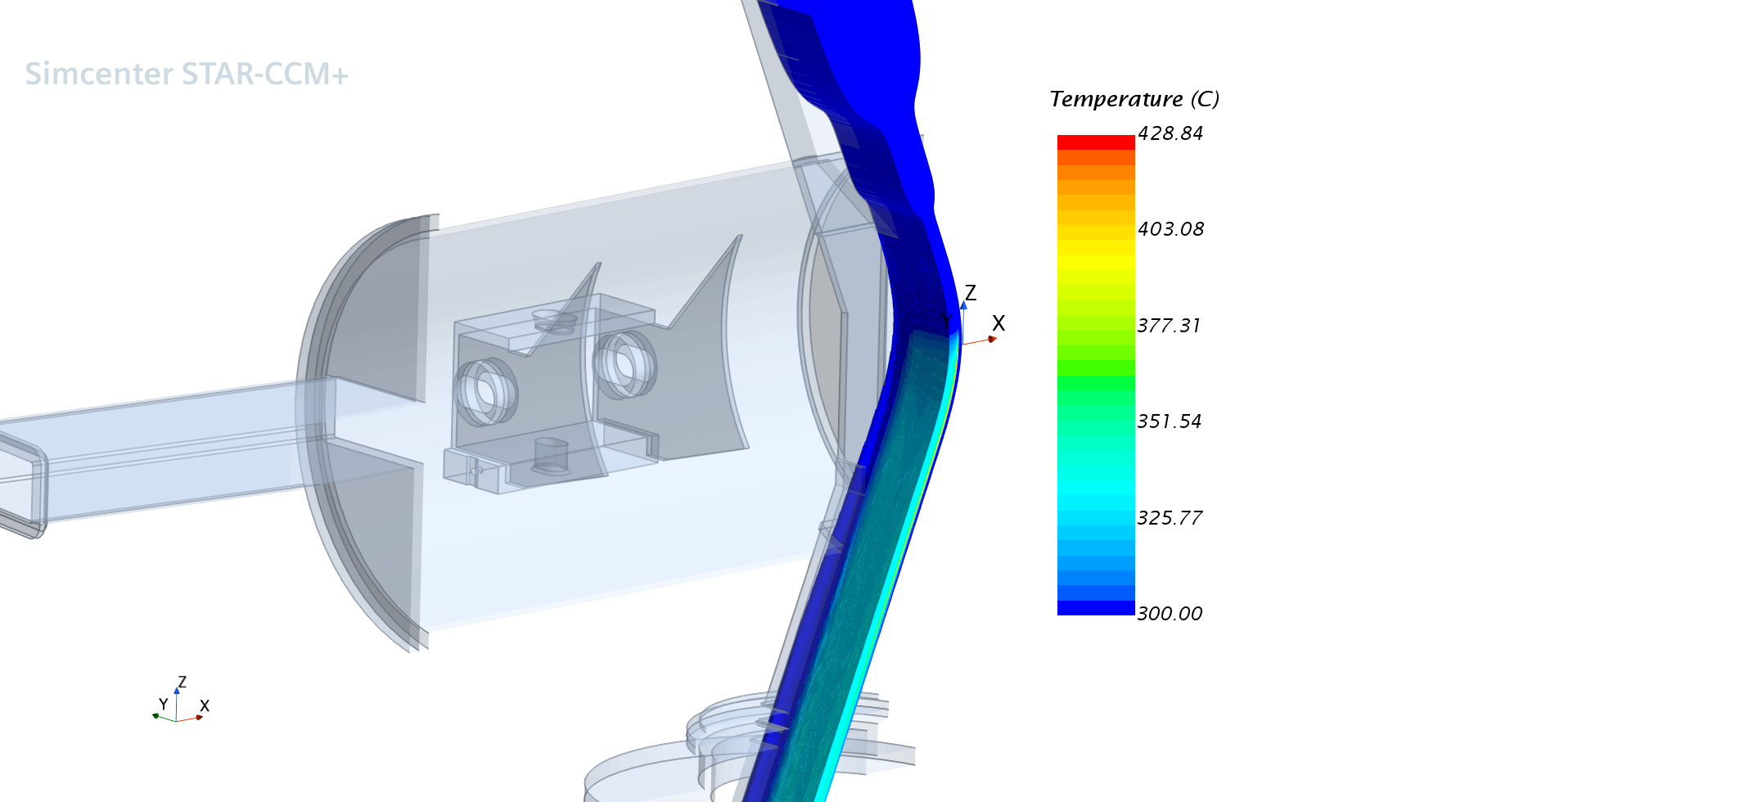
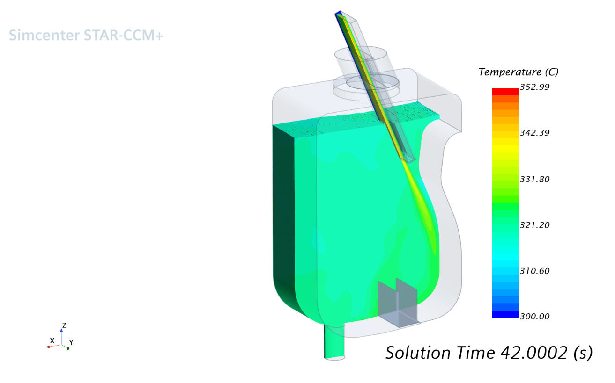
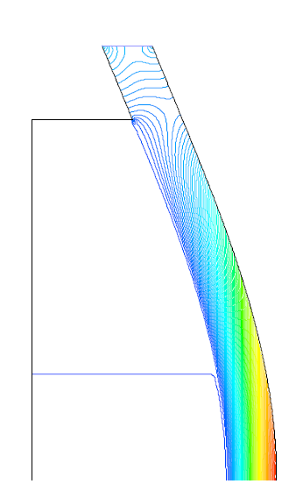
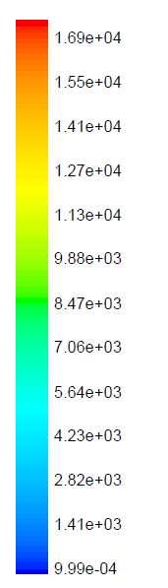
Target System: analysis
Nominal beam size 200 x 50 mm²
Pressure distribution in the Li jet
Q = 97.5 L/s
T_{in} = 300ºC
P [Pa]
- V_{Li} 20 m/s
Margin in temp.
Y
10E-4 mbar
BEAM
Margin in pressure
- V_{Li} 20 m/s
- V_{Li} 15 m/s
P= 10E-2 Pa
- V_{Li} 10 m/s
BEAM
Variable curvature
Fig. Temp distribution in the Li jet and Quench Tank during beam on
High temperature localized in the bulk lithium (~425ºC for nominal beam size), whilst at the free surface is in rather low ~325ºC
QT homogenizes the temperature (318 ºC) and quenches the flowing lithium before being reinjected to the Li loop
Suitable design of the Back plate to prevent boiling at the free surface and inside Li jet.

Slide 15
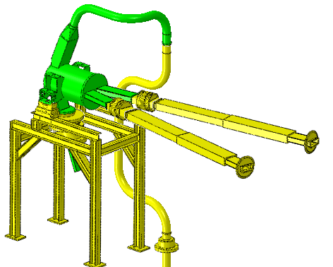
Target System: Material
 | EUROFER-97 (Ferritic-martensitic) | ANSI 316L(N) (Austenitic)
Activation | Low activation stainless steel (fewer long-lived radioactive isotopes) | -
Mech. Prop: temperature | Good mechanical properties at elevated temperatures (<550 °C), suitable thermal conductivity and fatigue behavior (when comparing with other stainless steel). | Acceptable properties at high temperature (<550 )
Mech. Prop: creep/swelling | Lower swelling/creep at high temp (>400 ºC) under irradiation. | Prone to swelling (>400 °C), though negligible a lower temperatures
Mech. Prop: irradiation hardening/ embrittlement | Significant irradiation hardening especially at "low" temperatures (< 300 °C) | Significant embrittlement in the range of 300-350 °C
Corrosion resistance | Good resistance to corrosion and erosion under liquid metals | Acceptable resistance to corrosion and erosion under liquid metals
Other | no qualified | Qualified for nuclear applications (fission) up to 53 dpa
Nominal Wolking temperatura 300-320ºC
Nominal Wolking temperatura 50-150ºC
Eurofer-97
AISI 316L
EUROFER exhibits a shift on its behaviour from ductile to brittle for a given range of temperature, called DBTT. No irradiated one is about ~ -90 °C, so it is not an issue for normal applications.
When the material is irradiated with high energy neutrons, the DBTT increases and, at high doses, it can eventually reach the operating temperature
Lifetime of Target ~ 8 months (yearly replacemente)

Slide 16
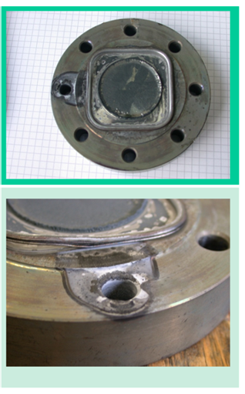
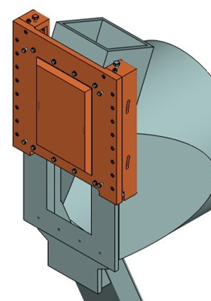
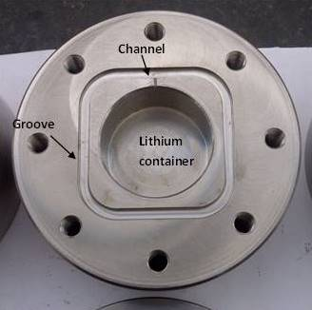
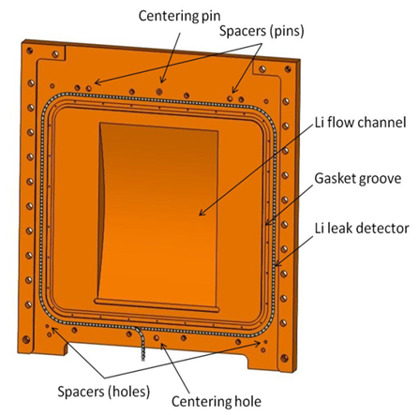
Target System: Bayonet concept (under validation)
Testing campaing on Sealing
Bayonet concept
Only the BP is removed.
Based on on energized gaskets (Helicoflex).
The suitability of the tested gasket to work in lithium environment has been proven up to 5500 hours (i.e., about 7.5 months)
Issue on 1 of 5 the test rig at 7000 hours. After post test analysis, possible ingress air leading to oxidation, so test should be repeted

Slide 17
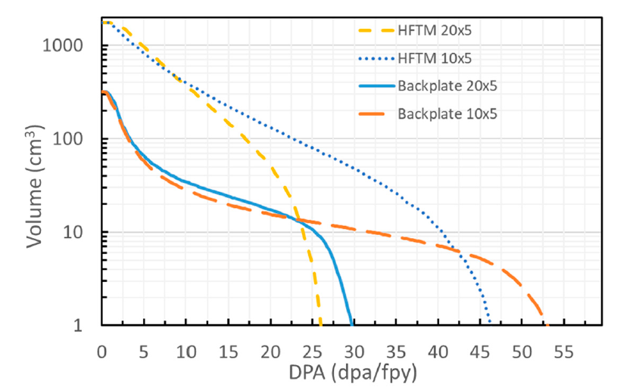
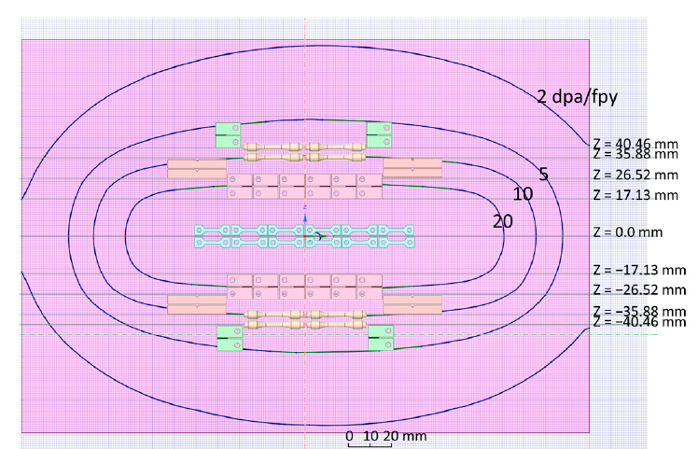
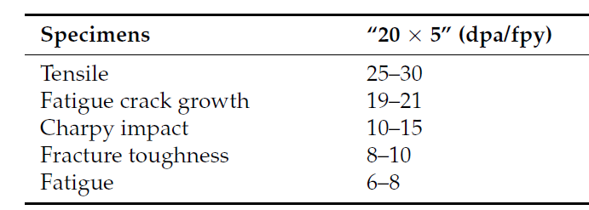
Target System: Irradiation samples
Why to not used the BP for characterization of Eurofer-97?
The back-plate of the IFMIF-DONES target assembly is subjected to strong neutron irradiation
Temperature conditions are quite homogeneous and stable
BP is strongly activated, so dedicated Hot cells and tools required for machining samples
Simulations of expected DPA on the backplate for beam 200 x 50 mm2
Preliminary specimen distribution in the BP

Slide 18
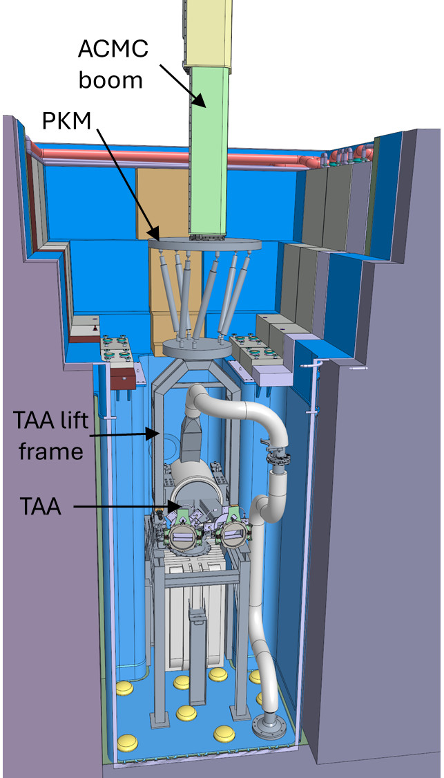
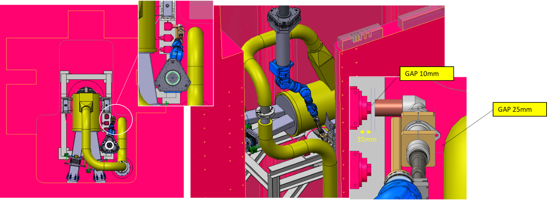
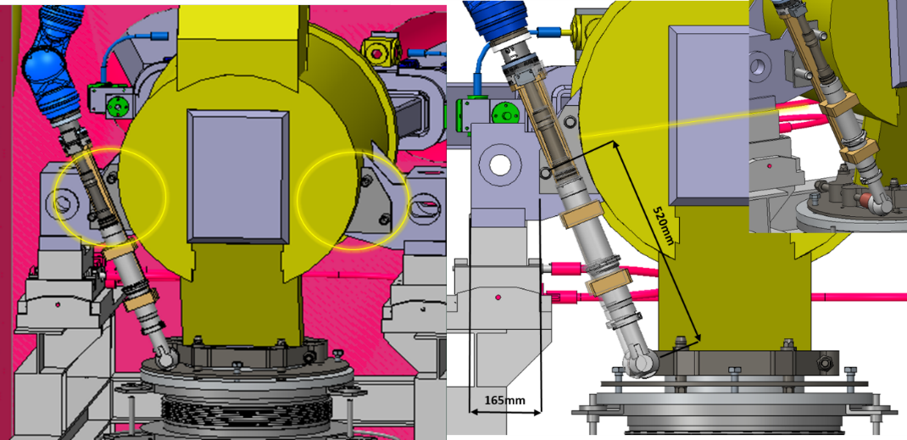
Target System: replacement
Replacement conducted by Remote-Handling means due to high dose inside TC.
Tight space within the TC, with limited accessibility to the components.

Slide 19
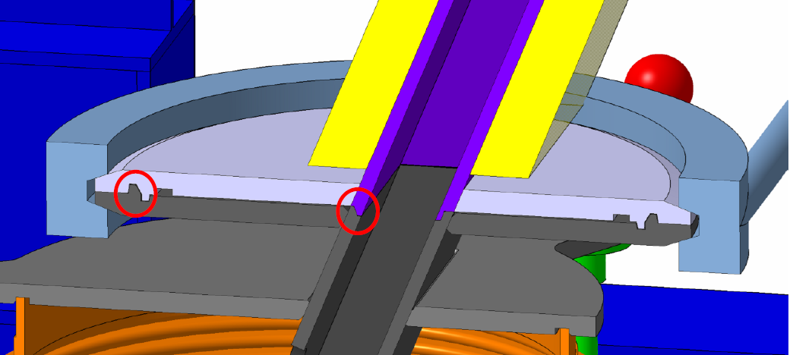
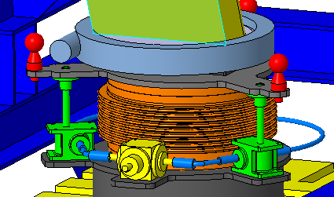








Target System: replacement
Replacement strategy and features
Centering features
Linked with the HFTM
Remote handling compatible
Fiducials
TX
Ball joints, slides
TY
Excentres
TZ
TX
QDS
Quite complex operation!
It should be tested and validated
Spindle drives, slides
Gearboxes, spindle/nut, flexible shafts (remain in the TC)
Small gearboxes
FDS
TZ
Guided Fast disconnection system
TY
TX
Small gearboxes, spindle/nut, slidings (ceramic/ceramic or steel/ceramic)

Slide 20






Validations and prototyping
Prototype of QDS/FDS
Target Mock-up
Results of Target Pre-heating Test (EFDA_D_2NHGLF v1.0)
Manufacturing of prototype for connection and disconnection mechanism (QDS) by remote control in IFMIF-DONES project
Analysis of the RH procedure of the TSY
Manufacturing of prototype for connection of the fast disconnection system (FDS) of the Li inlet pipe
Heating jacket
Back Plate
Analysis of Pre-heating procedures

Slide 21




Validations and prototyping (IFMIF-EVEDA)
Fig. ELTL facility in Japan
Fig. Prototype of the Target
Fig. free jet taken with 2 s and 10 µs exposure time
Engineering validation for lithium target facility of the IFMIF under IFMIF/EVEDA project. Nuclear Materials and Energy, Vol 9, pag. 278-285 (2016)
Validations
Lithium Test Loop (ELTL) at Oarai (Japan) during IFMIF/EVEDA
Lithium loop at real scale 1:1 for loop high and 1:2.6 for target width with respect to DONES.
Long time operation (>3800 h)
Fluid-Dynamic stability of the Li jet (1300 h). Suitable flatness of the free surface (non uniformity < 0.28 mm)
Li jet ranging from 10 - 20 m/s

Slide 22
Summary
Most of design activities are to be concluded soon, though still running some specific activities aim at further definition level.
Currently mostly focused on engineering validation activities.
  Replacement strategy of the Target System and auxiliary sub-systems.
  Diagnostic.
  Lithium Purification technologies
  Removable concept of the Back Plate of the Target.

Slide 23
Thanks
Any advice or suggestion is welcome

Slide 24




Introduction
MAGENETIC CONFINEMENT FUSION
Main challenge:
Materials capable of withstanding the thermal loads and irradiation effects that may occur on the chamber walls.
Engineering Standards
See https://www.euro-fusion.org/eurofusion/roadmap/
1-3 dpa/lifetime
~20 dpa/year
JET (80 m³)
JET started its operations in 1983. It was designed to study plasma behaviour in conditions close to those required for a fusion reactor. (16MW and Q<1 still)
ITER (800 m³)
ITER under construction in Cadarache (France). To demonstrate the scientific feasibility of fusion energy (500 MW of power from fusion energy with Q>10) no connected to the grid.
DEMO (~1000-3500 m³):
Being designed to operate continuously providing electricity to the grid (~2-4 GW), showing commercial nuclear fusion is technically feasible. Q>10, 2050

Slide 25


Introduction
Granada (Escúzar)

Slide 26
Lithium Systems: overview
Test System
Accelerator System
Lithium System

