Slide 1
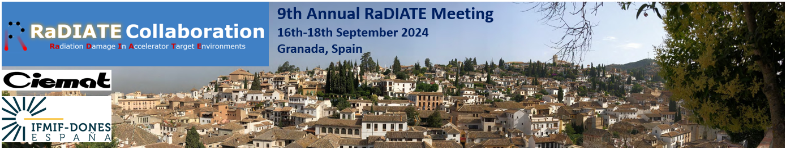

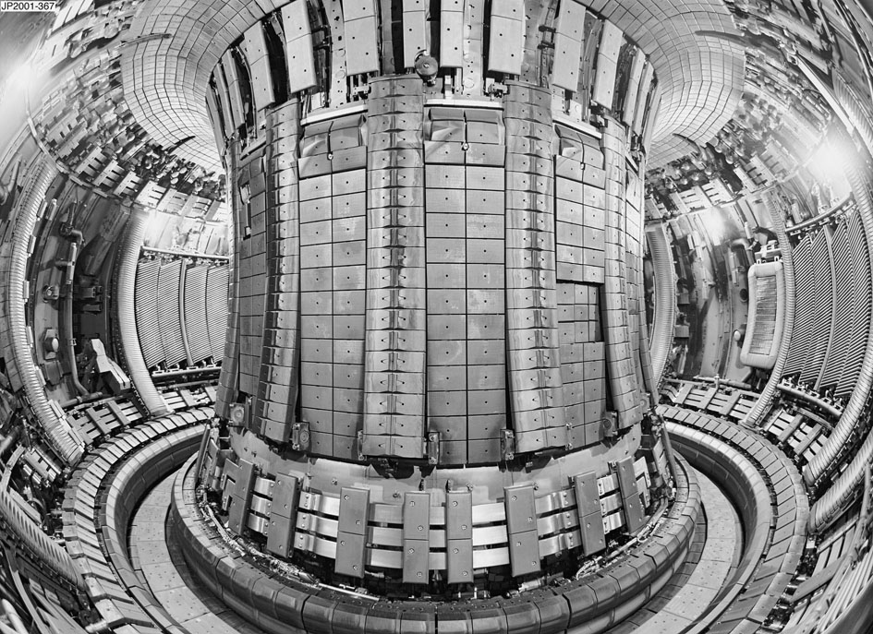
CIEMAT Hot cells project for DONES samples
Rafael Vila
Laboratorio Nacional de Fusión-CIEMAT
EUROFusion Functional Materials WG Deputy
Co-Authors: F. Sánchez, M. Serrano, P.P. Valdivieso, J.M. Perulero and F. Mota
Notes:
I’m happy to be here today and share many concepts on IFMIF-DONES linked to the study of materials.
You’ve seen many….During this talk I'd like to focus on why DONES exists, in the first place.

Slide 2
DONES & FUSION MATERIALS
Radiation
High Temp
Basic science for UNDERSTANDING
Materials & Tritium Technologies
Technological DEVELOPMENTS
Plasma-wall

Slide 3

Key technological pending issues for accelerating fusion energy
Development and characterization of materials able of surviving to the harsh environment of fusion devices
Validation of reactor tritium technology
₁D² + ₁T³ → ₂He⁴ (3.6 MeV) + ₀n¹ (14 MeV)
    Li⁶ + n → He⁴ + T³ (4.8 MeV)

Slide 4
From basic science towards
Materials & Tritium technologies
Irradiation experiments
Design of DONES Irradiation Modules
Materials characterization
&
Tritium technology
Material & Tritium technologies validation for fusion reactors

Slide 5
We have been needing DONES for a very long time
 | Fission (Gen. I) | Fission (Gen. IV) | Fusion (DEMO/PROTO) | Spallation (ADS)
Structural alloy T_{max} | <300˚C | 500-1000˚C | 550-1000˚C | 400-600˚C
Max dose for core internal structures | ~1 dpa | ~30-100 dpa | 30 ~150 dpa | ≤60 dpa/fpy
Max transmutation helium concentration | ~0.1 appm | ~3-10 appm | ~1500 appm (~10000 appm for SiC) | ~2000 appm/fpy
Coolants | H₂O | He, H₂O, Pb-Bi, Na | He, PbLi, Li | PbLi, PbBi
Structural Materials | Zircaloy, stainless steel | Ferritic steel, SS, superalloys, C- composite | Ferritic/ martensitic steel, V alloy, SiC composite | Ferritic/ martensitic steel
A big difference for fusion

Slide 6
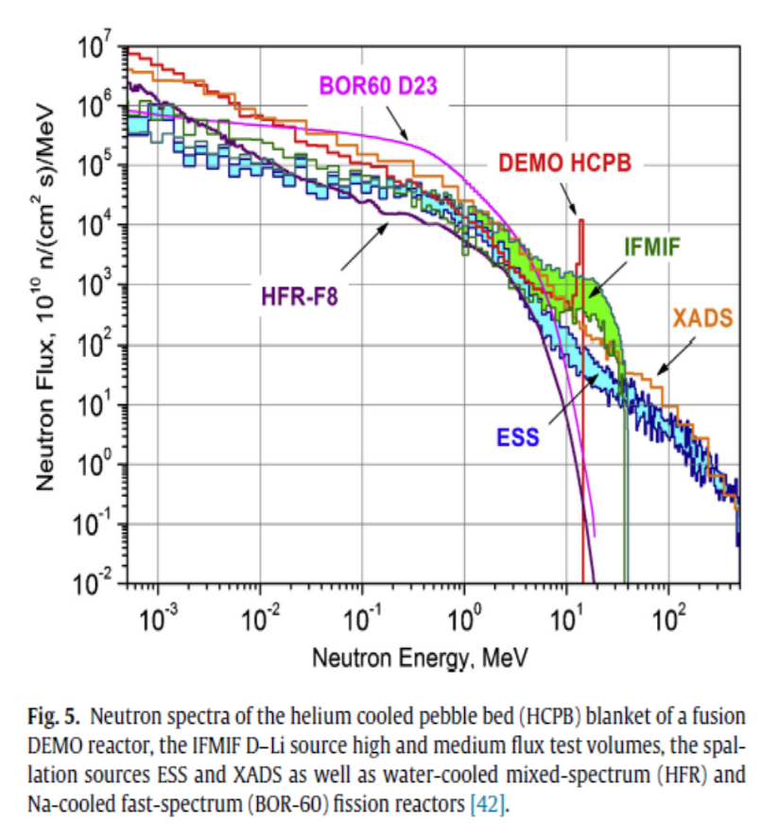
Fusion-like neutron irradiation requirements:
Fission reactors: neutron energy too low. Very few transmutation reactions
Spallation sources: neutron energy too high: He,H/dpa too high, other damaging effects
Lithium stripping reaction:
D+⁶Li →Be+n
D+⁷Li →Be+2n
Efficient, 5 MW D beam will generate 10¹⁷n/s flux
Produces a narrow cone of high energy neutrons
n-spectrum can be tailored to the needs

Slide 7
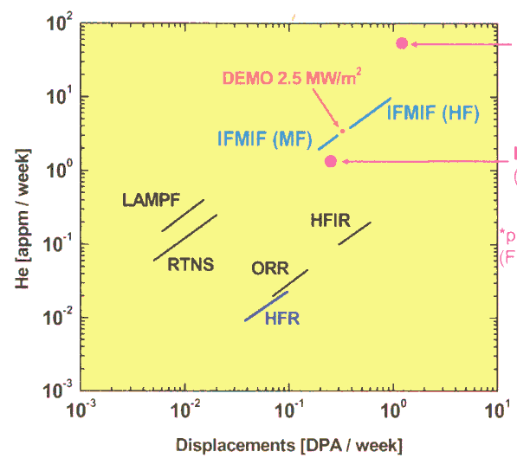
First conclusion
From a materials point of view
IFMIF-DONES is the only solution to really validate/qualify materials /components for operation in a fusion reactor
(or a very similar facility.)
Real neutron spectrum → correct He/dpa + Damage + Transmutation
High dose
Some in-situ testing (limited)

Slide 8
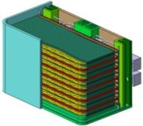
Mission driven materials development
Materials selection
and development
Devices
Requirements
DEMO Blanket
Radiation resistance
  DEMO: ~30 dpa
  FP: 150 dpa
Corrosion resistance &
compatibility with coolants
Attractive physical properties (optical, electrical, dielectrical, thermal)
Predictable constit. laws
Industrial manufacturing &
joining
Fast decay of radioactive inventory
Wide Temperature window
  Blanket: ~250 - 650 °C
  Divertor: ~600 - 1200 °C
Structural materials
 RAFM steels
RAF(M)-ODS steels
SiC/SiC
…..
DEMO Divertor
Functional Materials-I
Neutron multipliers
Be & Be alloys
Ceramic breeders
Li ceramics
……
Diagnostics,
H & CD systems
Tungsten alloys, CFC, CuCrZr, Brazing materials
Functional Materials-II
Oxides (silica, alumina…)
Diamond
SiC/SiC

Slide 9

There is one problem DONES cannot solve…
Even being “low activation”, irradiated materials will be highly activated for testing.
¿How to deal with these materials after irradiation?

Slide 10
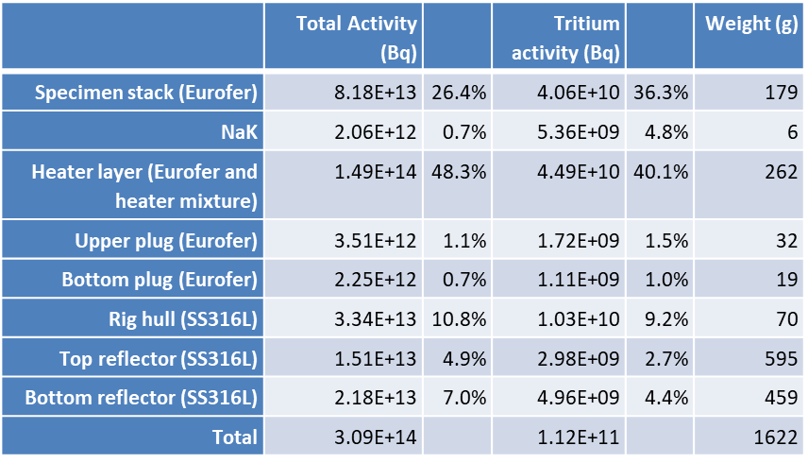
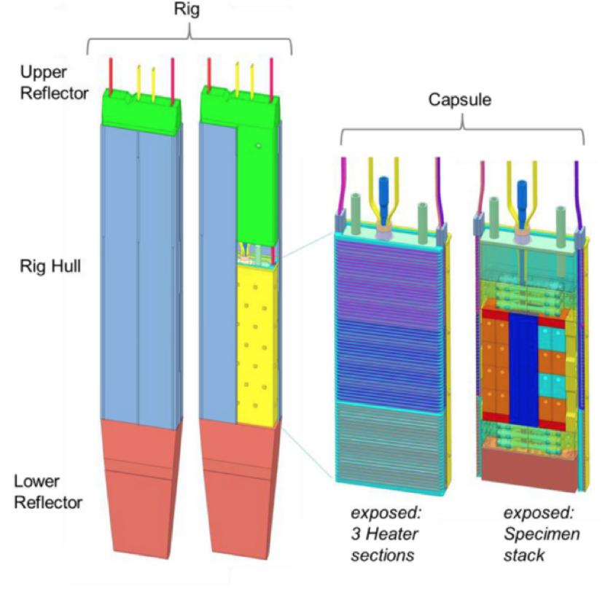
IRRADIATION MODULES
[IFMIF-DONES]

Slide 11
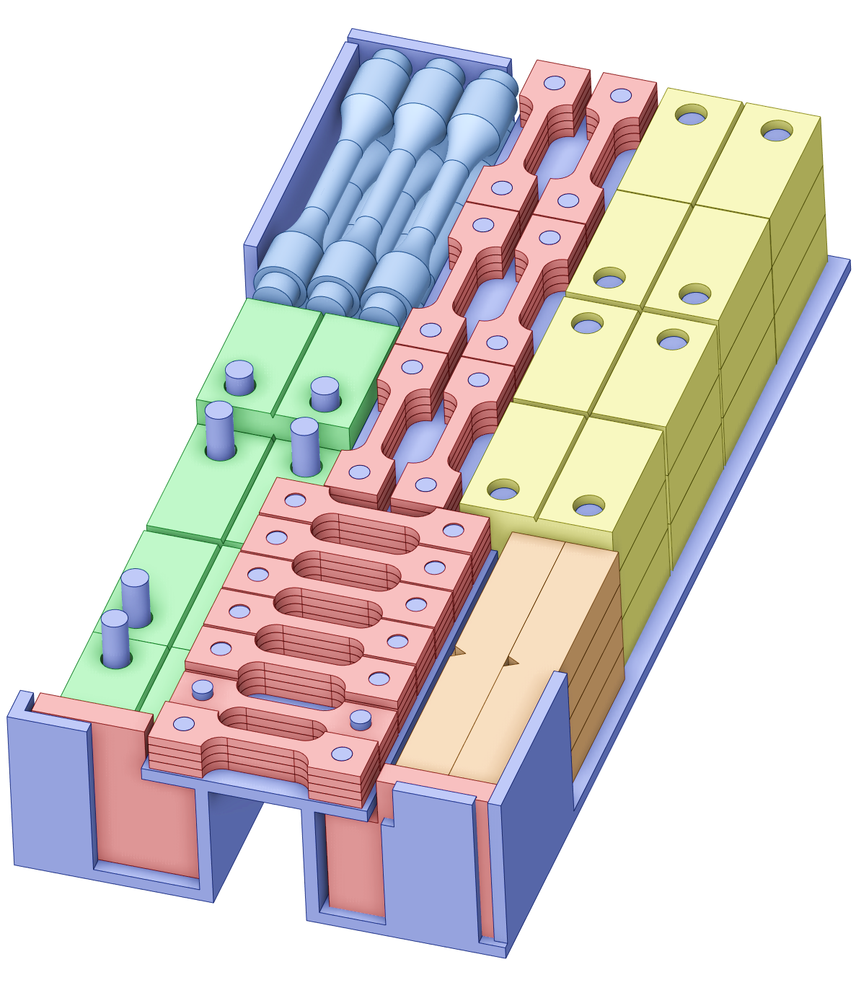
Organization of post-irradiation examination of samples irradiated in IFMIF-DONES
Where should this be done? Who should be involved?
How to optimize the benefit from competencies at the European partners’ sites?
How to use synergies?
How to reduce transports of radioactive material?
How to ensure redundancies? How to avoid overcapacities? How to prevent bottlenecks? …
32 capsules
120 specimens per capsule
Around 850 specimens in the high-flux region
Almost 3000 specimens per irradiation campaign

Slide 12
From basic science towards
Materials & Tritium technologies
Irradiation experiments
Design of DONES Irradiation Modules
Materials characterization
&
Tritium technology
Material & Tritium technologies validation for fusion reactors
Hot cells

Slide 13
Topics identified within DONES-PreP T9.2
Definition of requirements for the facilities to be used for DONES-PIE
  Identifying and defining the requirements of facilities needed for handling and analysis at PIE phase
  Based on definition of samples and QA requirements for standardized, SSTT, and non‐standardized tests
Evaluation of facilities that could be used for DONES-PIE
  Present and prospective status (10‐15 y timeframe)
  Staff, competencies, installations available and planned (including risks)
  Nuclear installations, capability to handle capsules filled with Na
  Quality assurance and safety procedures
  Trade‐off study in order to evaluate the possibilities of
  On‐site materials characterization
  Off‐site materials characterization in existing labs
  Or even a combined approach, in which some properties are analyzed on‐site and others in a distributed network of labs

Slide 14
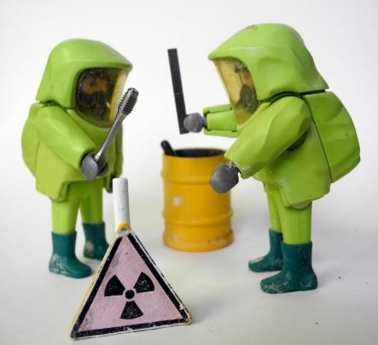
Definition of requirements for the facilities to be used for DONES-PIE
Transportation Coordination:
Activities of 700 TBq (module), 80 TBq (rig), or 0.1 TBq (specimens) will require Type B containers for transport. Typical dimensions for shielding up to 120.9 x 123 x 84.2 cm, weights up to 12.5 tons for shielding
Best solution in our opinion:
  Hot Cell at DONES site to dismantle irradiation modules
  Distribute samples to different labs.
→ Will relax requirements on transport and reduce the amount of activity and volume transported.
Possible effects of Sodium & cleaning procedures: some more work is needed
A list of primary & secondary tests needs to be specified
➔ DONES user Group

Slide 15
CIEMAT proposal
Being the site of the neutron source for the study of fusion materials, it is essential, for Spanish science, to have the capacity to benefit directly from the study of irradiated material.
The site at Ciemat has already been determined and contracts for a detailed study of the condition of the building are underway.
Progress is also being made on the design of the required hot cells incorporating all the technological advances for the efficient and safe processing of activated samples.

Slide 16
Hot cells [irradiated materials]
Cell Nº1:
Reception
&
Storage
Cell Nº2:
Probe cleaning & preparation
Na problem
Cell Nº3:
Micro-structural analysis
(TEM, FIB /SEM, PAS)
Cells Nº 4 -5:
Mechanical
+ Thermal properties+ Permeation + corrosion
Cell Nº 6:
Optical & Dielectric properties
Specific for insulators. Very rare in hot cells
Materials /
Systems
Structural, PFM & Breeder materials
Diagnostics /
H&CD, Safety

Slide 17
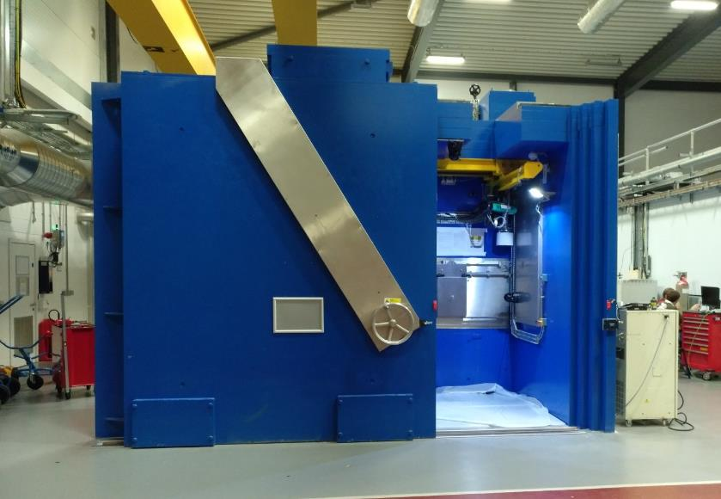
Reception & Storage Cell Nº1
Will require the highest shielding: reception of a full container
Shielding will depend on the worst case (material/dose dependent) and the maximum amount of samples to receive (limited by maximum shielding possible at the reception facility).
Important to be aware of waste management
→ Don’t accumulate samples!
  Reception cell at UKAEA’s Materials Research Facility (MRF)

Slide 18
Hot cells [irradiated materials]
Cell Nº1:
Reception
&
Storage
Cell Nº2:
Probe cleaning & preparation
Na problem
Cell Nº3:
Micro-structural analysis
(TEM, FIB /SEM, PAS)
Cells Nº 4 -5:
Mechanical
+ Thermal properties+ Permeation + corrosion
Cell Nº 6:
Optical & Dielectric properties
Specific for insulators. Very rare in hot cells
Materials /
Systems
Structural, PFM & Breeder materials
Diagnostics /
H&CD, Safety

Slide 19
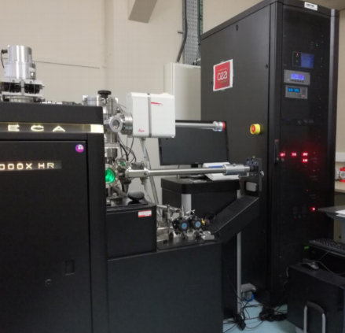
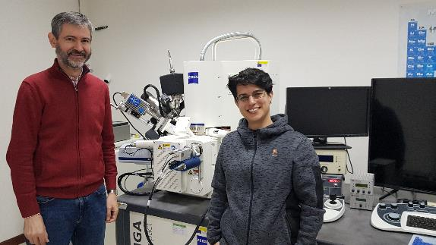
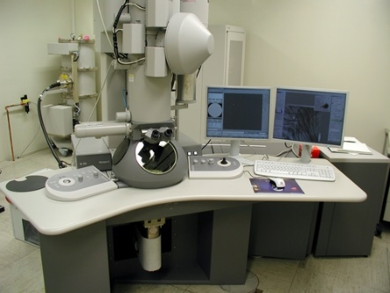
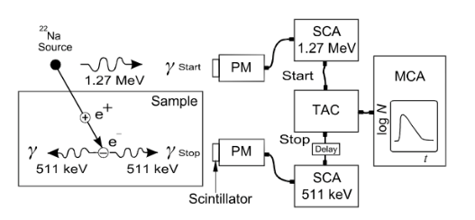
Microstructural investigation tools [Cell 3]
Conventional and advanced microstructural investigation tools
(FIB-SEM, TEM, APT, PAS......) for active samples
FIB-SEM
Atom Probe Tomography
Positron Annihilation Spectroscopy
TEM

Slide 20
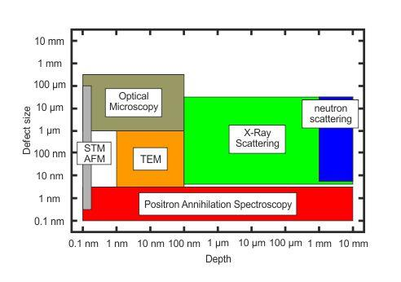
Comparison of Microstructural Tools
Large scale of dimensions ➔ Large Nº of experimental techniques
➔different defect sizes and depth
Highly trained personnel are needed to operate the specialized equipment that is used in these facilities.

Slide 21
Hot cells [irradiated materials]
Cell Nº1:
Reception
&
Storage
Cell Nº2:
Probe cleaning & preparation
Cell Nº3:
Micro-structural analysis
(TEM, FIB /SEM, PAS)
Cells Nº 4 -5:
Mechanical
+ Thermal properties
+ Permeation
+ corrosion
Cell Nº 6:
Optical & Dielectric properties
Specific for insulators. Very rare in hot cells
Materials /
Systems
Structural, PFM & Breeder materials
Diagnostics /
H&CD, Safety

Slide 22
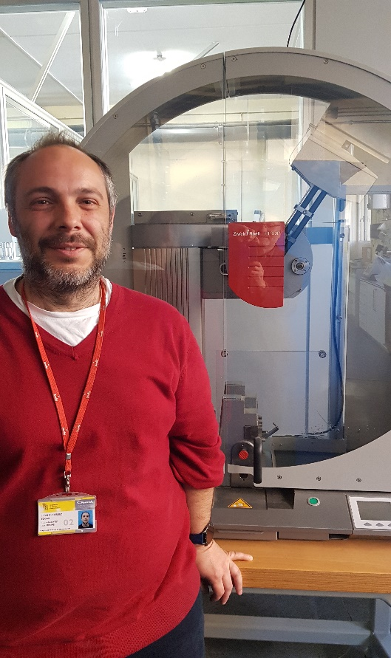
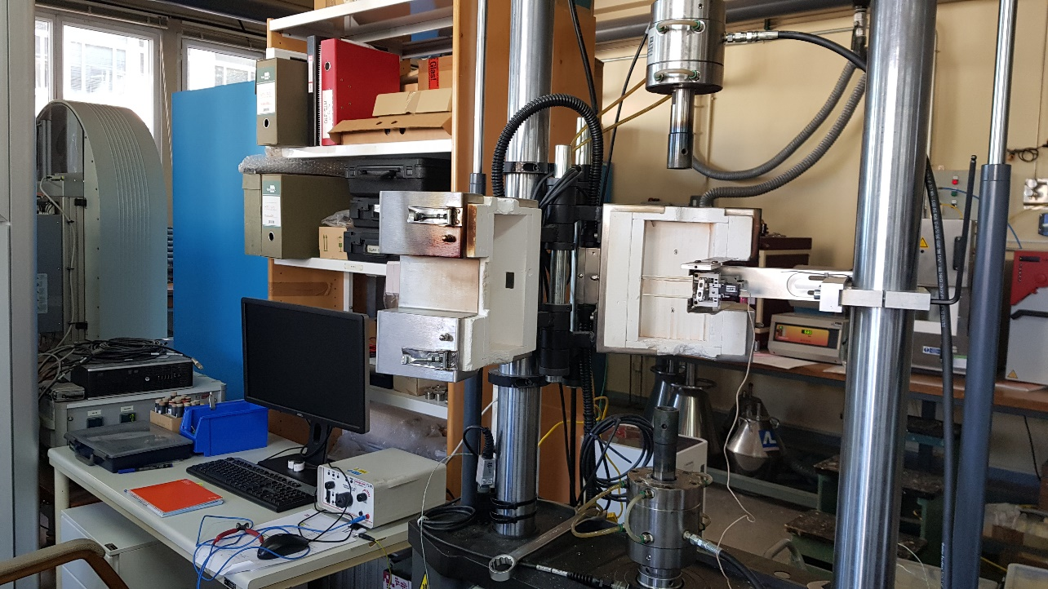
Mechanical testing Cell Nº4
Tensile, impact, fracture toughness, fatigue, crack growth, high/low cycle fatigue tests,…. & High Temp!
Systems already working but with conventional materials or low activation materials ➔ Need to evaluate all the modifications for in-cell remote work
Universal testing machine
to test the mechanical properties (tension, compression etc.) of a given test specimen by exerting tensile, compressive or transverse stresses.
Charpy impact test
To determine the amount of energy absorbed by a material during fracture

Slide 23
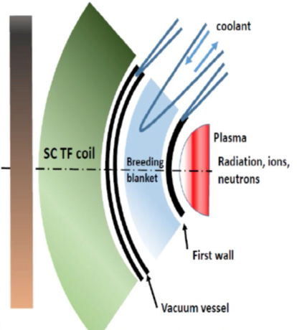
Breeding Blanket technology- Cells nº 4-5
Helium-Cooled Lithium Lead (HCLL)
Helium-Cooled Pebble Bed (HCPB)
Water-Cooled Lithium Lead (WCLL)
Dual Coolant Lithium Lead (DCLL)
₁D² + ₁T³ → ₂He⁴ (3.6 MeV) + ₀n¹ (14 MeV)
    Li₆ + n → He⁴ + T³ (4.8 MeV)
Technology of (ceramic) coatings
Electric insulator
Tritium barrier .
THE LITHIUM/TRITIUM ISSUE
Need to assess “new” and complicated aspects:
Tritium Permeation barriers + Corrosion by LiPb or Li ceramics
+ Li diffusion + Li Peebles degradation…
Part would be done in the DONES irradiation modules (in-situ)
But due to available volume/equipment needed → many would be PIE.
We are carefully deciding which ones we’ll need to incorporate.
Not so common and not easy to do in Hot Cells

Slide 24
Hot cells [irradiated materials]
Cell Nº1:
Reception
&
Storage
Cell Nº2:
Probe cleaning & preparation
Cell Nº3:
Micro-structural analysis
(TEM, FIB /SEM, PAS)
Cells Nº 4 -5:
Mechanical
+ Thermal properties+ Permeation + corrosion
Cell Nº 6:
Optical & Dielectric properties
Specific for insulators. Uncommon or rare in hot cells
Materials /
Systems
Structural, PFM & Breeder materials
Diagnostics /
H&CD, Safety

Slide 25
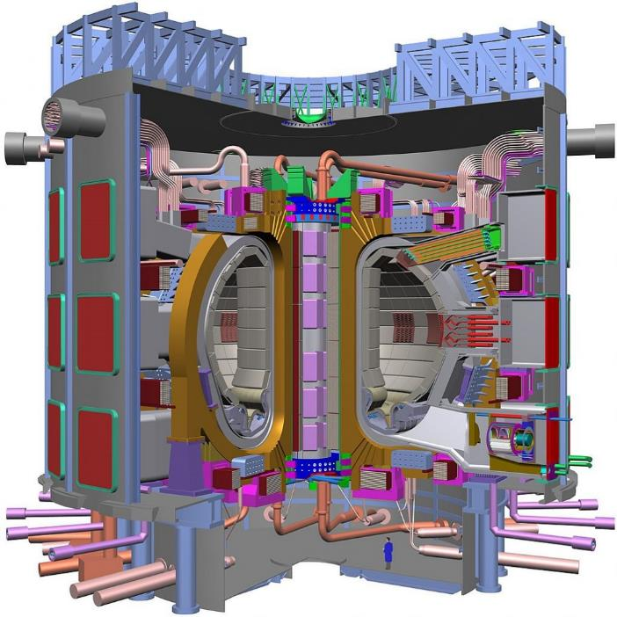
FUNCTIONAL MATERIALS (II) Cell 6
Tokamaks and stellarators are very complicated electromagnetic systems
We need functional materials:
Coils (magnetic confinement)
High power insulating windows (e.g. 2 MW gyrotron)
Optical windows for visual inspection
Optical systems for FW temperature monitoring by IR
Thermocouples
Km`s of optical fibres and cables.
Magnetic sensors
Neutron and gamma detectors…
We need to assess their properties, both PIE and under radiation:
optical absorption, dielectric loss, conductivity (electric and thermal)…
SPECIFIC TECHNIQUES ➔ NOT COMMON ON PRESENT HOT CELLS

Slide 26
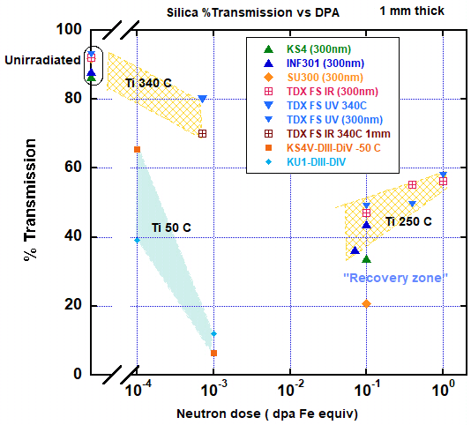
Neutron Dose Evolution: Still need higher doses
Evolution of optical transmission at 300 nm of several silica grades in the as-received state and after neutron irradiation at different doses & T
Initial important damage is stopped and even a slight recovery at higher doses!!
Very important result for Fusion design.
We also observed saturation and recovery in dielectric loss !!
We’ll need validation in IFMIF-DONES and higher dose reactor tests !!
➔ Hot Cells

Slide 27
Hot cells: on-site vs off-site
 | Complete Post Irradiation Examination (PIE) facility at DONES | All PIE executed elsewhere
Site | on | off
Cost of investment | Major additional investment at DONES | Many existing facilities can contribute, so re-investment minimized
Cost of operation | Minimised as no transport costs | Additional costs (transport)
Time to achieve installation | Planning Licensing Build & Commission Years to establish full PIE facility. | Minimal
People | Years of training necessary Experience from other labs not fully used | Larger expert knowledge in a distributed network of labs Exploit experience from other fields (fission, general materials science…): synergies from involvement of “part-time-Fusion” experts with specialist knowledge
The best option is an intermediate one in which the simplest, quickest techniques are undertaken on-site at DONES and more specialist work is undertaken elsewhere
Source: DONES PreP Deliverable D9-2.3 Report

Slide 28
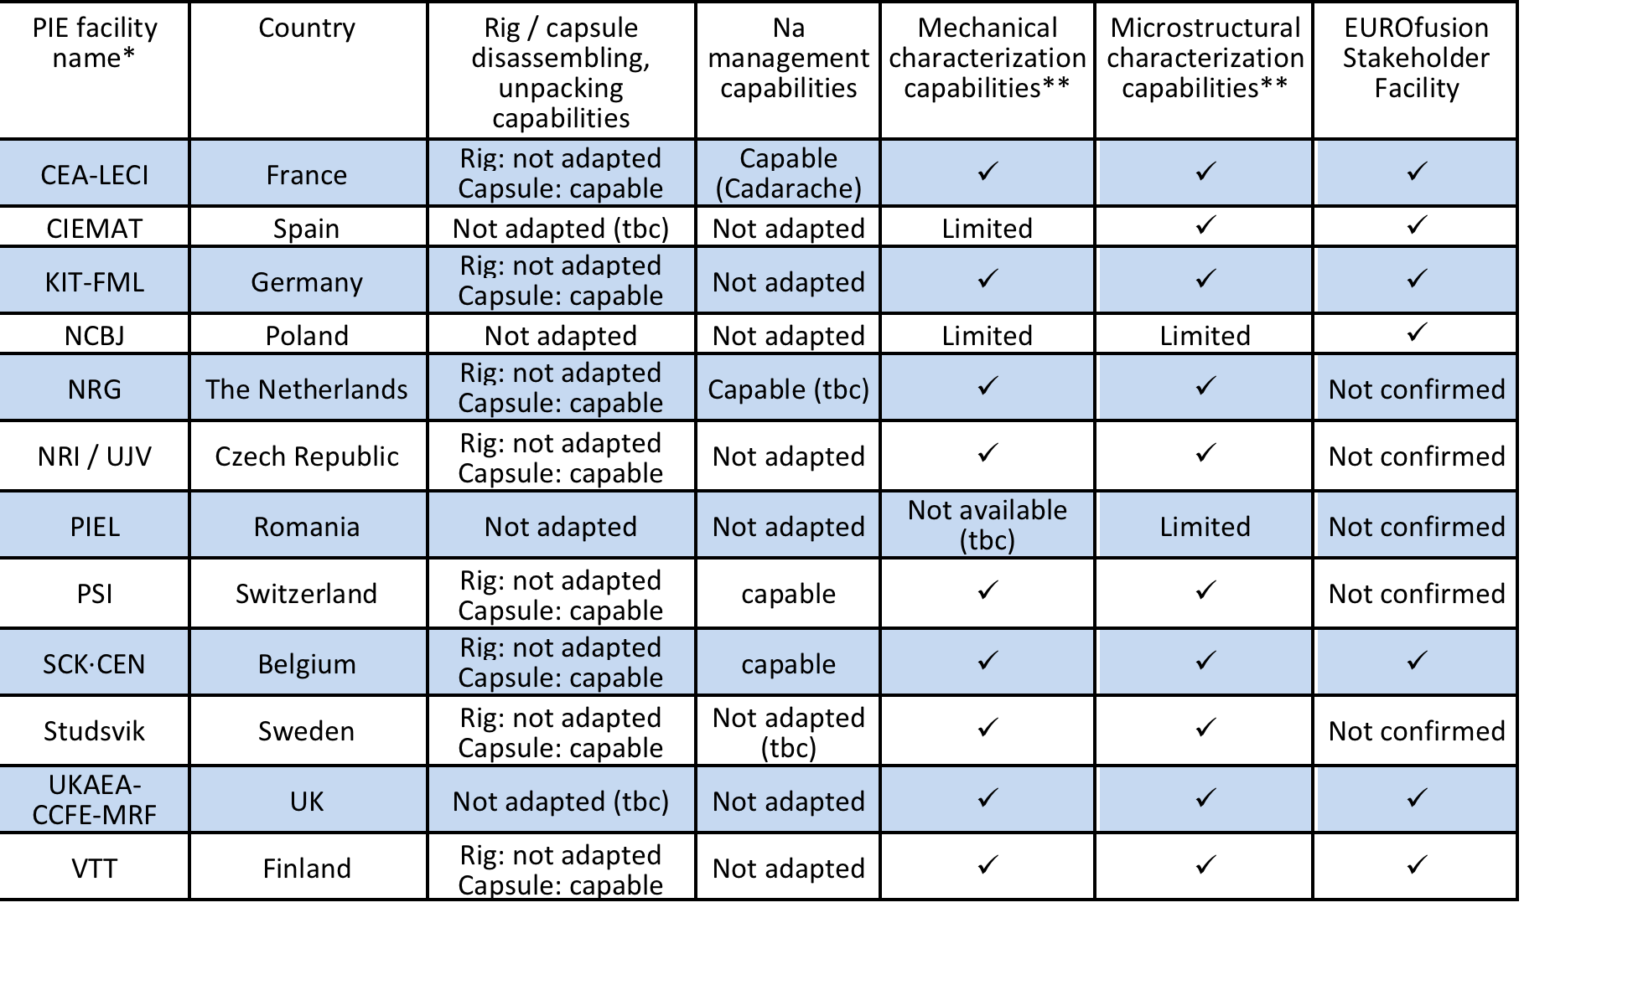
Hot cells in operation or/and under development
CIEMAT Spain upgrade under design & development
Source: DONES PreP Deliverable D9-2.3 Report

Slide 29
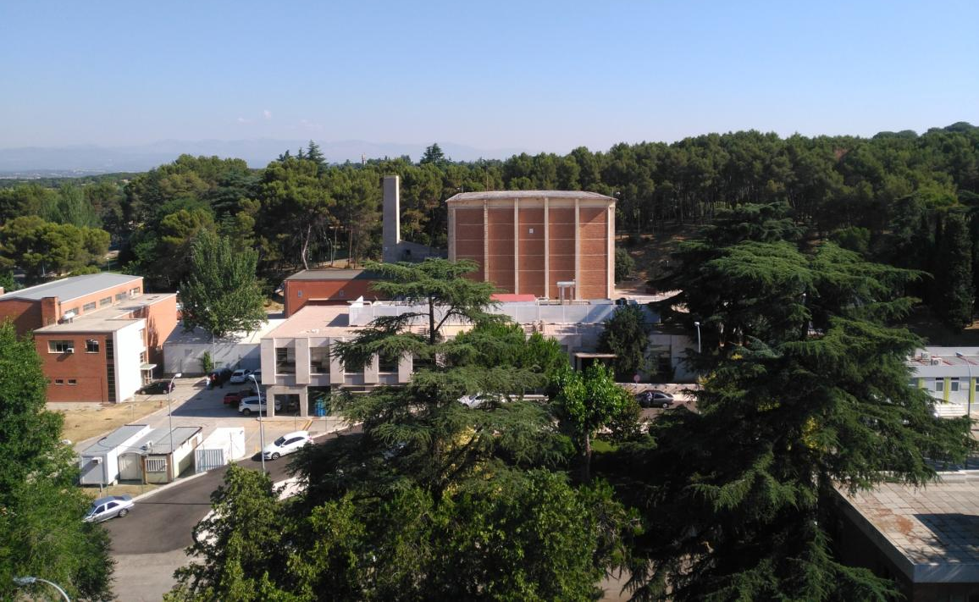
Hot Cells at CIEMAT.
Re-use the old Hot Cells building

Slide 30
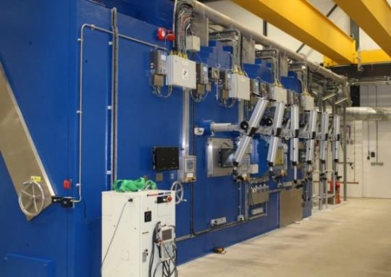
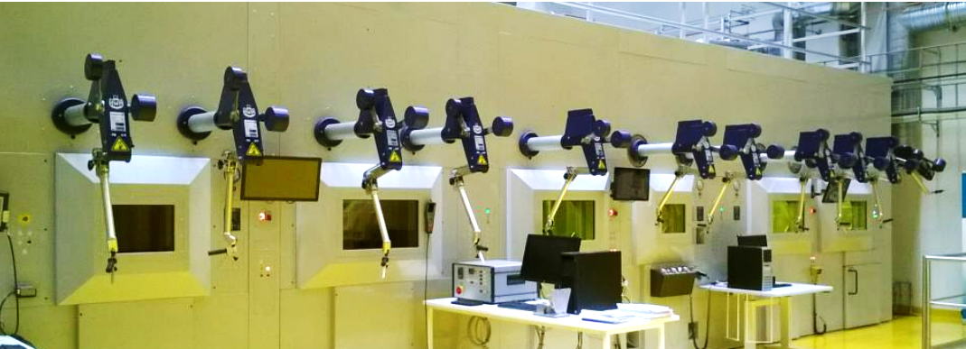
Example: Hot cells in operation
  UKAEA’s Materials Research Facility (MRF)
  The Finnish Hot Cell VTT Centre for Nuclear Safety
The receipt cell (foreground) and three hot cells for sample processing at MRF (UKAEA)
Source: DONES PreP Deliverable D9-2.2 Report

Slide 31
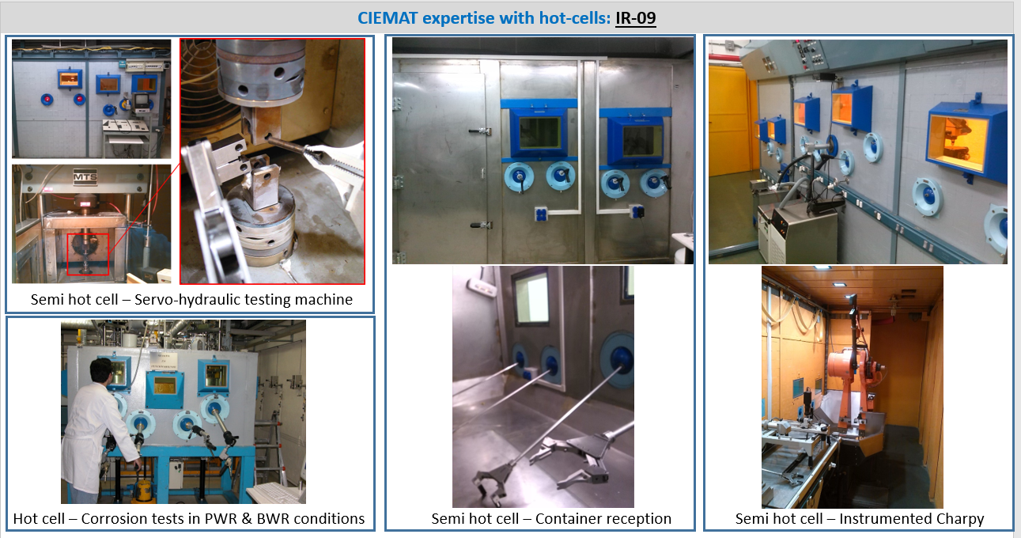
CIEMAT expertise on Hot cells

Slide 32
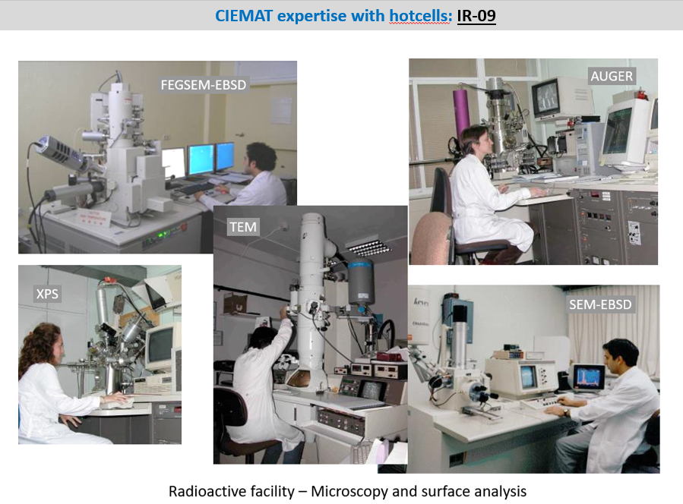
CIEMAT expertise on Hot cells

Slide 33
Hot cells at CIEMAT
Supporting DONES technological exploitation
2024 | 2025 | 2026 | 2027 | 2028 | 2029 | 2030
✓Contracts for structural studies of the building
Building renovation
Equipm TESTS & validation
DONES
Cells commissioning
✓Contracts for Cost evaluation
Cells installation
Definition of cells specifications & experimental techniques.
+ Shielding.
Instrumentation purchase
Training of scientist and technicians
Licensing by CSN

Slide 34
Summary
Hot cells, equipped with powerful experimental tools and the corresponding human expertise, are needed to support the testing of fusion materials for DONES.
They will be crucial in validating the behaviour of materials under fusion conditions and accelerating the development of reliable materials for fusion energy applications.
Science for UNDERSTANDING
IFMIF - DONES
Technological DEVELOPMENTS

Slide 35
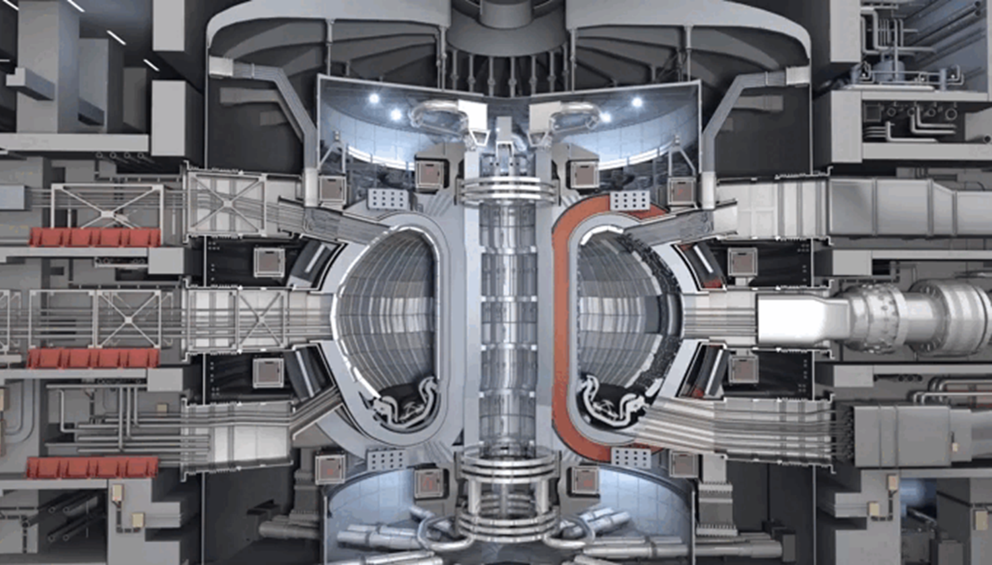
Collaborations are welcome
Thank you for your time and attention
More info: rafael.vila@ciemat.es
Notes:
I’m eager to hear any thoughts or questions you might have

Slide 36
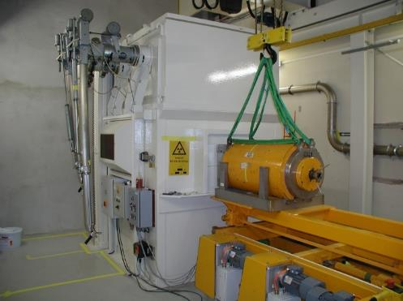
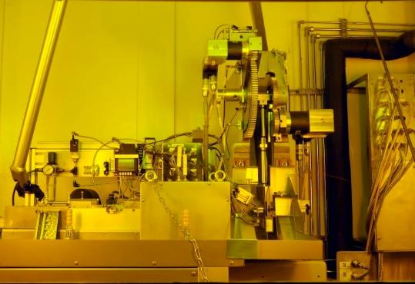
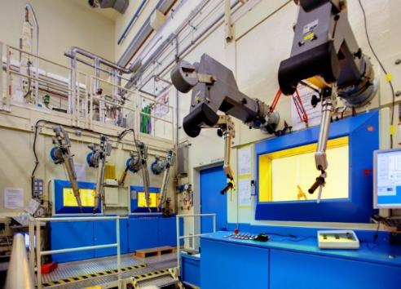
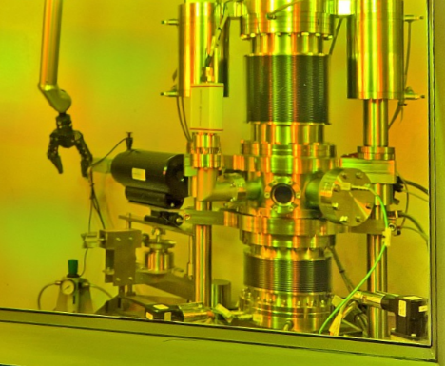
Hot cells in operation: KIT
KIT: transfer cell for transport casks
Charpy impact pendulum
KIT: Metallography cell and materials’ testing cell
Registering hardness tester up to 650°C
Source: DONES PreP Deliverable D9-2.2 Report

Slide 37
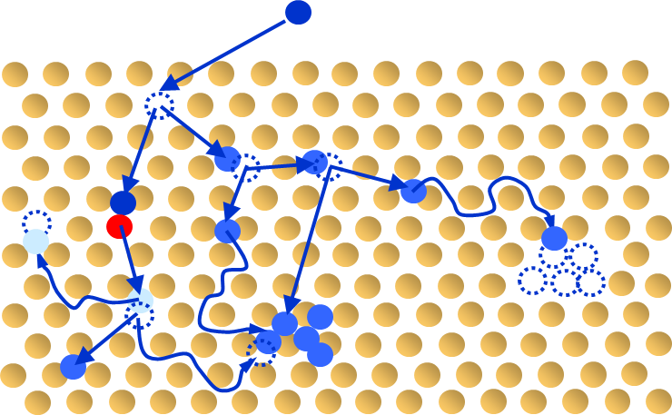
¿what is the effect of radiation in insulators?
Ionizing e-h pairs are immediately created
(NON PERMANENT Effect ) ∆Conductivity, ∆Tan δ, RL
• Also changes charge states of present defects (+ radiolysis)
Displacement Point Defects
( PERMANENT)
Clusters
Dipolar losses, ∆Conductivity
Optical Absorption, Photo-Luminescence,
∆Thermal Cond., Swelling…
Transmutation = Impurities + Intrinsic Defec ( PERMANENT)

Slide 38

Materials R&D “before DONES”
Irradiate with ions. Preferably with 2 or 3 beams to:
- Produce displacement (heavy ions)
- Implant He and H (reproduce gas transmutation effect)
  Problem: Penetration is too short (few microns)
Irradiate with con fision neutrons: → He/dpa ratio too small
“ “ “ using materials pre-doped with Boron.
He is produced via:
Helium can be produced in the right concentration
Problems: - Helium is produced too quickly, as damage begins to build up.
- The steels are contaminated by Li… → Modify properties
4. Irradiation in spallation sources: → He/dpa ratio too large + many nuclear reactions. Would need to re-design the facility and use all the availability.
Notes:
Can be eliminated

