Slide 1
DONES-AANL (YerPhI) POSSIBLE CONNECTIONS
S. Zhamkochyan
A. I. Alikhanyan National Science Laboratory (Yerevan Physics Institute)

Slide 2
Outline
Methodical Studies
Low-pressure MWPC based Technique
Radio Frequency Picosecond Timing Technique
Applications
Nuclear Physics (α-particle spectroscopy, Fission, Low Energy Nuclear Physics, Astrophysics,….)
Industry (neutron tomography)
Nuclear Forensic
Neutron flux monitoring
Reaction History for the Inertial Fusion

Slide 3
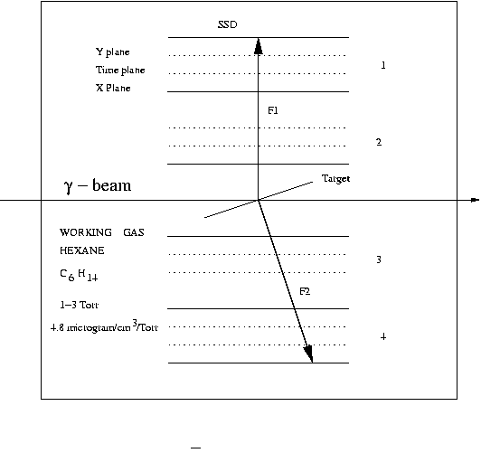
Time-zero fission-fragment detector
The detector is based on the low-pressure multiwire proportional chambers and can provide 200 ps temporal and <1mm positional resolution (FWHM) for fission fragments.
General view of the detector
Schematic of the detector
Related publications
K. Assamagan et al., Time-zero FF detector based on the low-pressure MWPCs, NIM, 426, 1999
Y. Song et al., Kaon, pion, and proton associated photofission of Bi nuclei, Physics of Atomic Nuclei 73 (10), 1707, 2010
X. Qiu et al., Direct measurement of the lifetime of mid-heavy hypernuclei, Nuclear Physics, A973, 2018
A. Margaryan et al., Low-pressure MWPC system for the detection of alpha-particles and fission fragments, AJP 3(4) 282, 2010

Slide 4
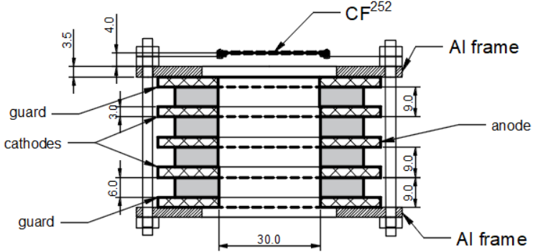
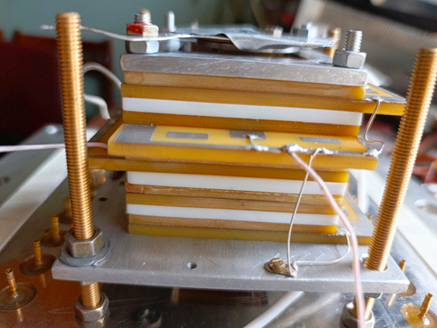
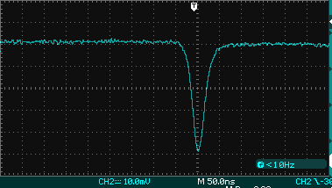
Fission Chamber as a Neutron Flux Monitor in a Harsh Environment
The Low-Pressure MWPC based Fission Fragment Detector
This detector can be used to control the neutron flux
in the presence of high electronic noise environment
Waveform of the raw signals from the anode

Slide 5
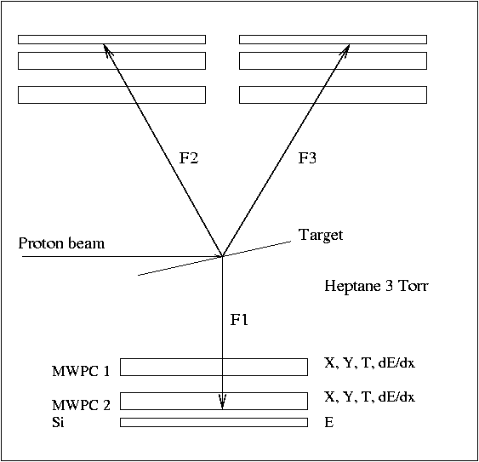
Low EneRgy Nuclear Interaction Chamber
Protons
20-300 keV
Deuterons
50-500 keV
Alpha
>50 keV
More heavy
Range > 100mkg/cm2
Targets
Working gas
H
D
He-3
He-4
C₇H₁₆
C₆H₁₄
CO₂
C₃H₈O₂
Ne
Ar
Kr
Xe
And any thin foil from Mendeelev table
Photon beam
Time resolution: ~400ps
Positional resolution: ~1mm
Schematic of the LERNIC

Slide 6
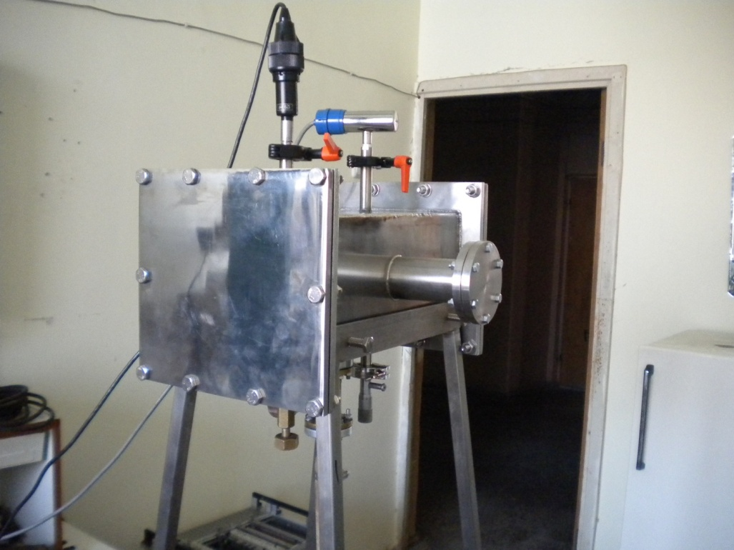
Prototype of LERNIC
General view of the detector
Robert Ajvazyan, John R. M. Annand, Dimiter L. Balabanski et al., Active Oxygen Target for Studies in Nuclear Astrophysics with Laser Compton Backscattered γ-ray Beams, Particles 1(1), 126-137, 2018

Slide 7
Low Pressure MWPC based Fission Chamber Applications in Nuclear Forensic
The detector supresses alpha particles background and is sensitive to FFs of the ²³⁹Pu
left) detected in LPMWPC2 only;
right) detected in LPMWPC1 and LPMWPC2 operated in coincidence mode (14 FF events in 12600sec or 0.0011 FFs per second. Rate of alpha particles is 240000 per second)
A. R. Balabekyan et al., Low-Pressure Multi-Wire Proportional Chamber Based Fission Fragment Sensitive Detection System: Application in Nuclear Forensic Analyses, to be published in Eur. Phys. J. Special Topics, 2024

Slide 8
The RF Timer
(1) mirror, (2) quartz-glass window, (3) incident photons, (4) permanent magnet, (5) collimator, (6) photoelectron, (7) electron transparent electrode, (8) photocathode, (9) electrostatic lens, (10) RF deflector, (11) MCP detector, (12) position sensitive anode.

Slide 9
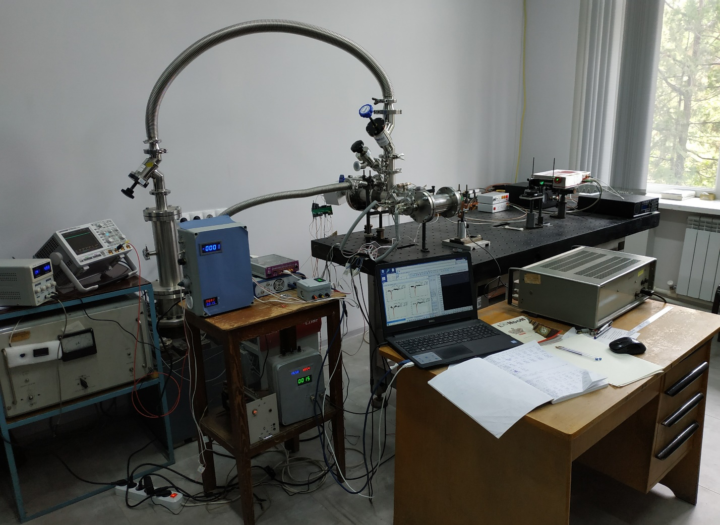
Time-resolved photo-electron emission spectrometer: general view
RF Timer
femtosecond Laser
Vacuum system
RF Synthesizer
Sampic and
Picoscope
HV power supplies

Slide 10
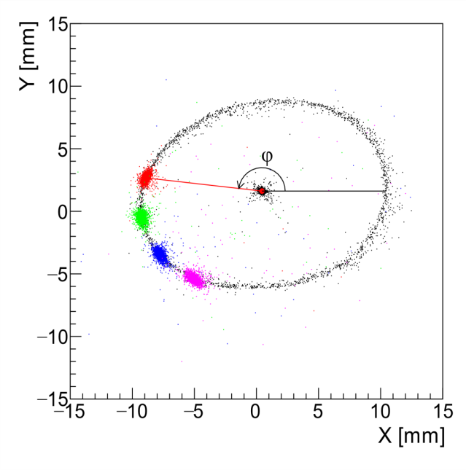
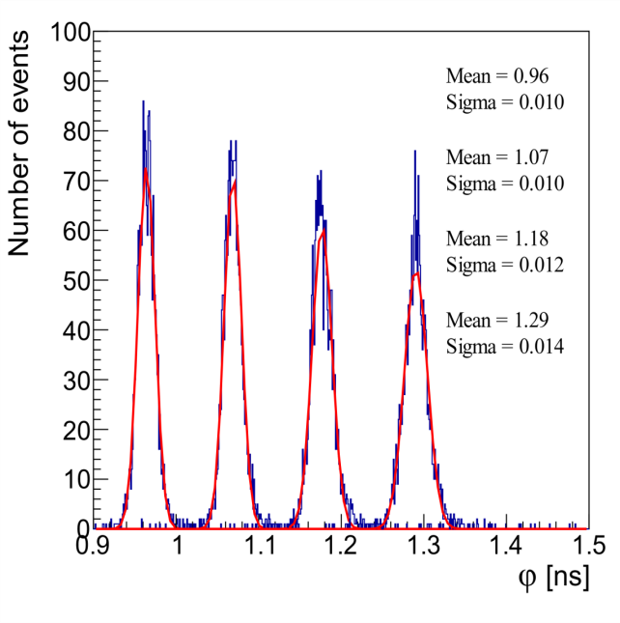
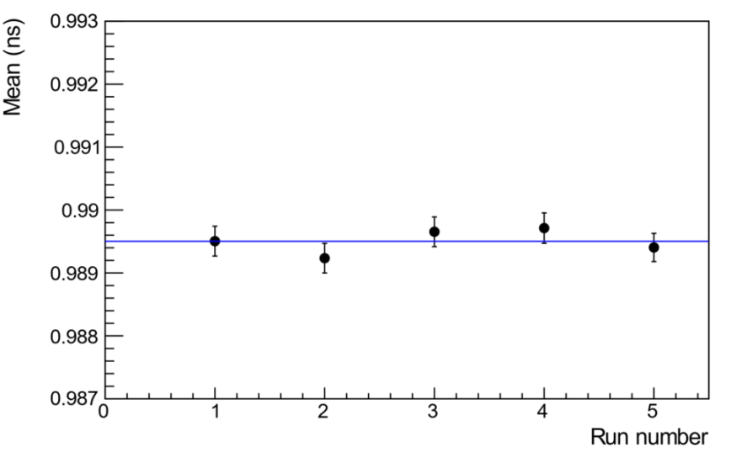
Studies with synchronized femtosecond pulsed laser
Left: 2D image of anode hit positions. The point in the center of the circle is image of electrons with RF turned OFF. The circle is an image of the scanned electrons when the 500 MHz RF is ON, but not synchronized with the laser. The color spots on the circle correspond to phase distributions of the scanned, RF-synchronized photo-electrons for four different fixed phases.
Middle: Distribution of phases (φ), converted into ns, of the scanned electrons in the case of RF synchronized laser.
Right: The mean values of sequentially measured time distributions in a one hour period.
The test studies with the RF-synchronized femtosecond laser beam demonstrated a ∼10 ps time resolution and a 0.2 ps/hour stability.
Amur Margaryan et al., Nucl. Instr. & Meth. A 1038, 166926 (2022)
S. Zhamkochyan et al., JINST 19 C02014 (2024)
Ani Aprahamian et al., arXiv: 2211.16091 (2022)

Slide 11
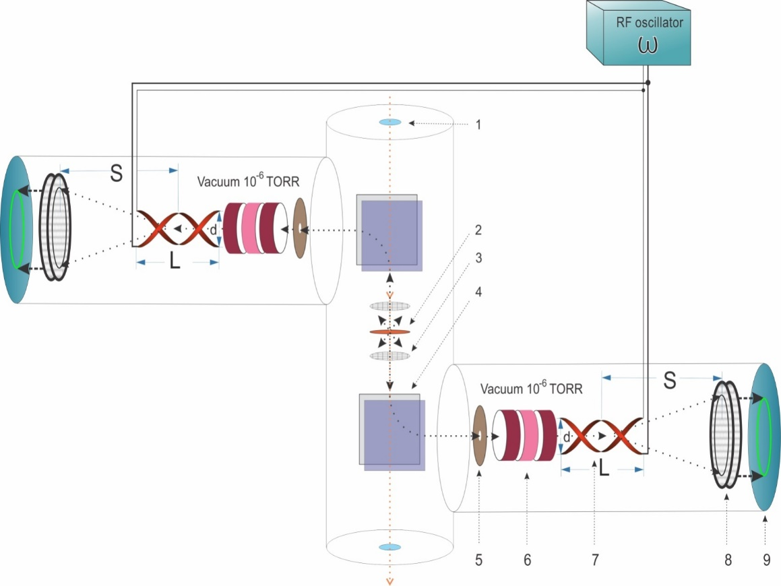
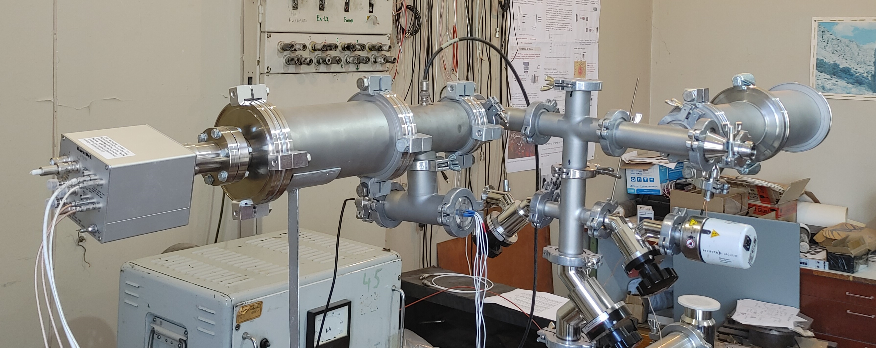
RF Timer based Fission Fragment Detector
1 – beam window, 2 – Target, 3 – Accelerating electrode, 4 – Magnet, 5 – Collimator, 6 – Electrostatic lens, 7 – RF deflector, 8 – MCP detector, 9 – Readout electronics
The detector is being tested in the lab and is proposed to be used for Δ-hypernuclei and fission isomers lifetimes measurements

Slide 12
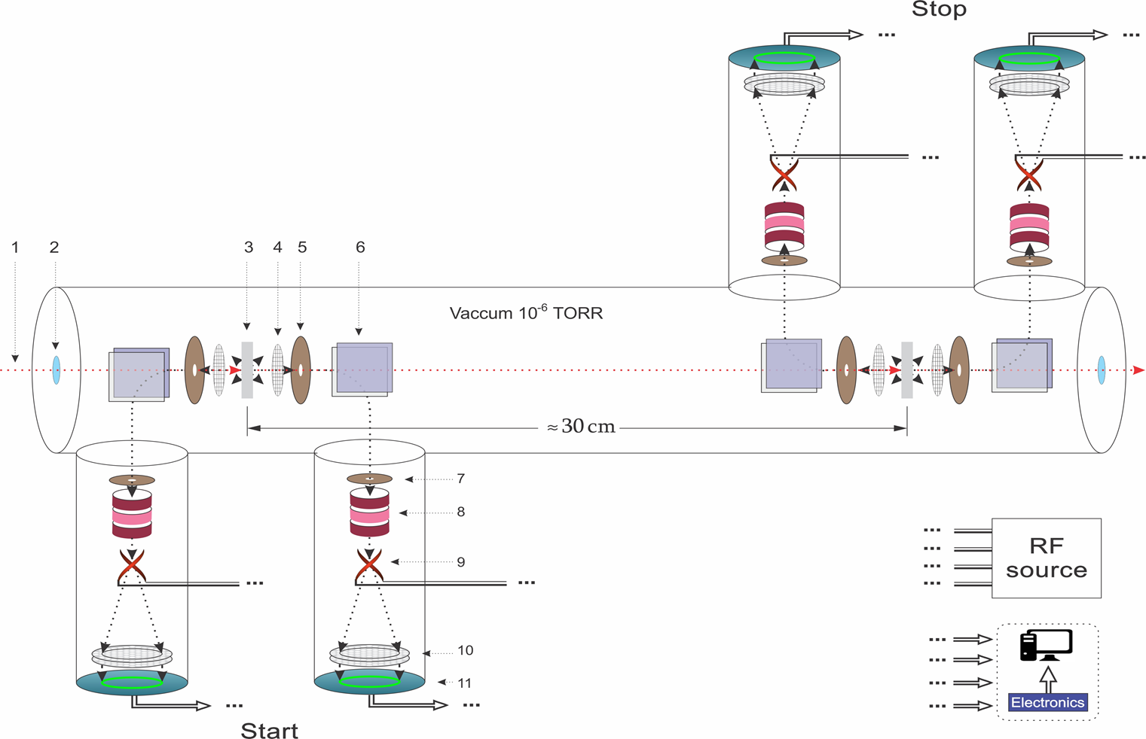
Alpha Particle Time-of-Flight Spectrometer
Alpha particles or photons
Window
Thin foil
Accelerating electrode
Collimator
Magnet
7. Collimator
8. Electrostatic lens
9. RF deflector
9. MCP based electron
detector
10. Position sensitive anode
Estimated resolution is (FWHM) 2-10 keV (depending on distance)

Slide 13
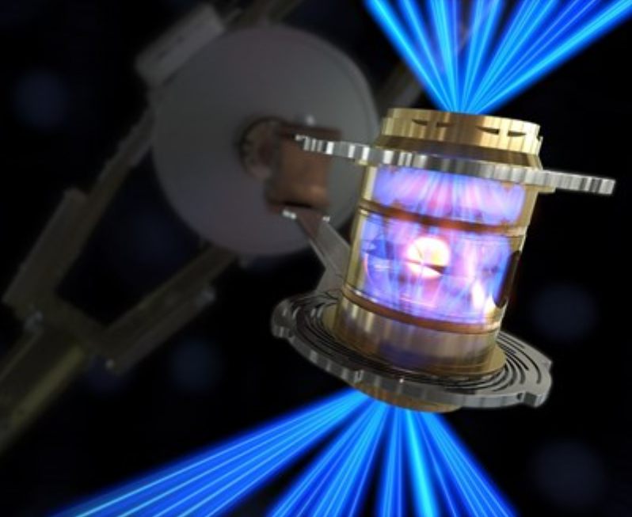
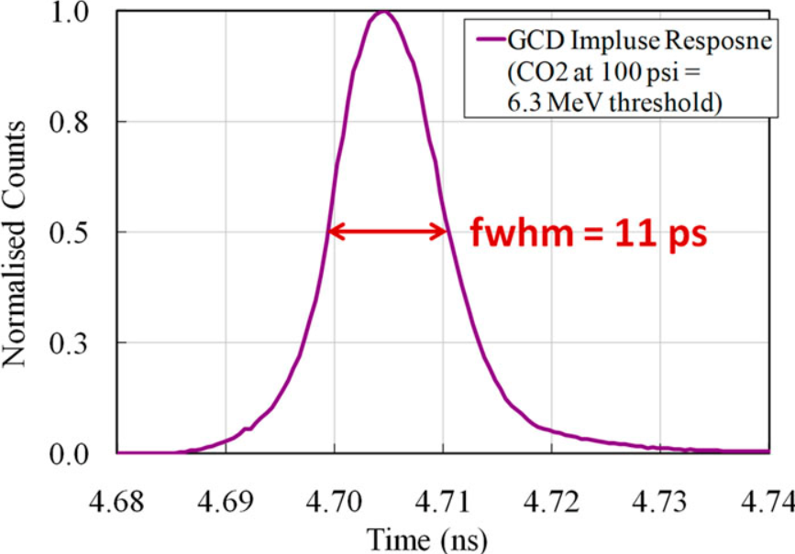
RF Timer for Inertial Fusion γ-ray diagnostics
High-energy γ rays generated from inertial confinement fusion (ICF) experiments are an important signature for studying the dynamics of implosion processes.
Schematic cutaway view of Gas Cherenkov Detector (GCD) fielded at Omega Laser Facility.
The picosecond resolution RF Timer can be used GCDs for precise γ-ray timing
GCD’s temporal response is inherently fast with just over 10 ps of temporal dispersion (without PMT response).
Rev. Sci. Instrum. 94, 041101 (2023)

Slide 14
Possible Activities at Yerevan (AANL)
Methodical Developments
Low-Pressure MWPC based Fission Chamber
Low-Pressure MWPC based LERNIC
Neutron Flux Monitor
RF Timer based reaction history monitor
Possibilities of Experimental Studies at AANL
Αlpha-Particle high Resolution TOF spectrometer
Electron-photon beams from linear accelerator (20-70 MeV)
Proton-neutron beams from 18 MeV Cyclotron
Material Studies by using Femtosecond Laser and RF Timer based experimental setups (time resolved photoemission spectrometer, ultraprecise and ultrafast optical microscopy)

Slide 15
Thank you for your attention!

