Slide 1
3rd IFMIF-DONES Workshop, October 1-2, 2024
Zagreb, Croatia
Irradiation strategies being considered by QST
Kentaro OCHIAI
Rokkasho Institute for Fusion Energy
National Institutes for Quantum Science and Technology (QST)

Slide 2
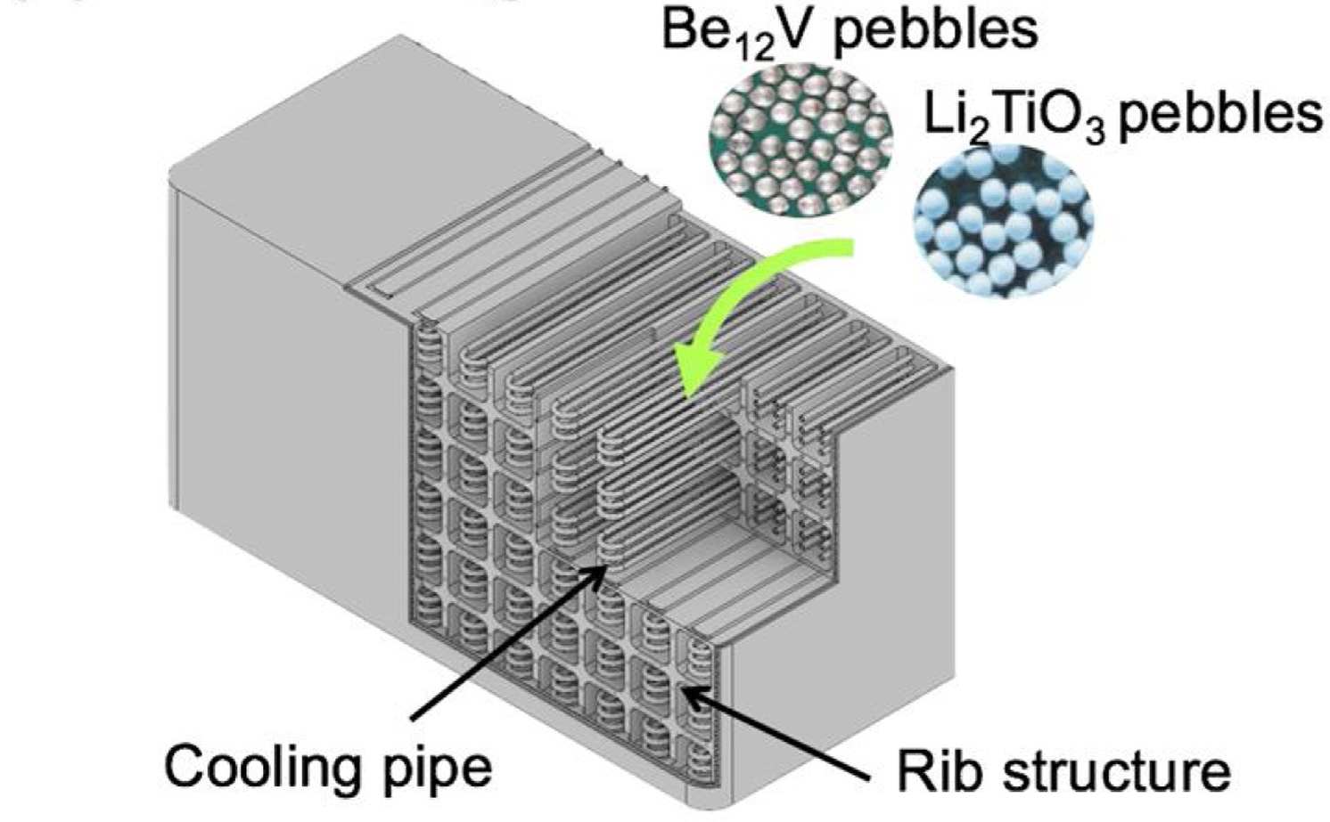
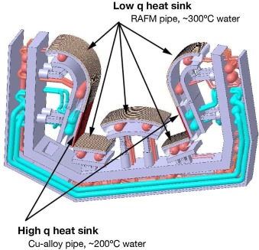
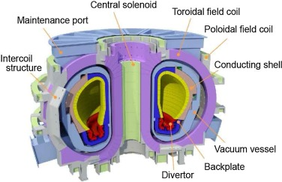
Requirements on neutronic irradiation
Neutron intensity of JA-DEMO
  Main materials for JA-DEMO
P_{fus} ~ 1.5 GW for Steady state
Blanket
Divertor
Neutron Flux:
1.5 x 10¹⁴ n/sec/cm² (1MeV < E) ​
RAFM(F82H)
Blanket
  Blanket: RAFM(F82H ), Breeding material (Li₂TiO₃)
  Neutron multiplier(ex.Be₁₂V)
  Divertor: Tungsten, Cu alloy, F82H cooling pipe.
  Others: Instrumentation and control devices,
  Window(quartz), Mirror(Mo), Semiconductor, etc
Schematic view of JA-DEMO
To verify the durability and functional retention of JA-DEMO candidate materials by high-energy neutron irradiation, irradiation tests using A-FNS are required. In particular, initial irradiation (up to 20 dpa) of RAFM is a top priority. Therefore, From 2021, Engineering Design Activities of the fusion neutron source A-FNS test has been implemented at QST.
2

Slide 3
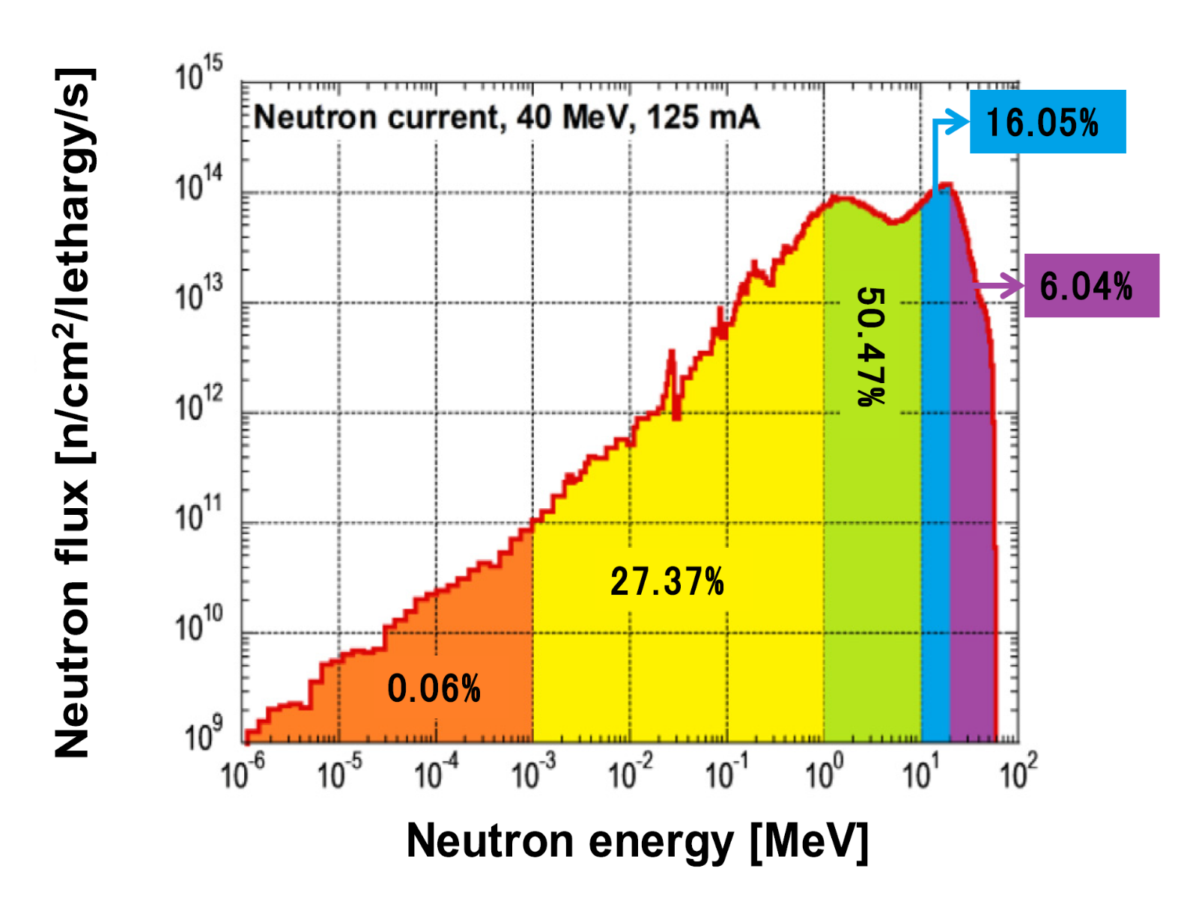
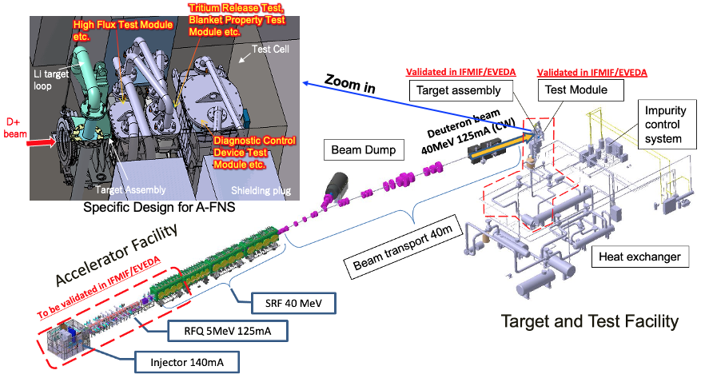
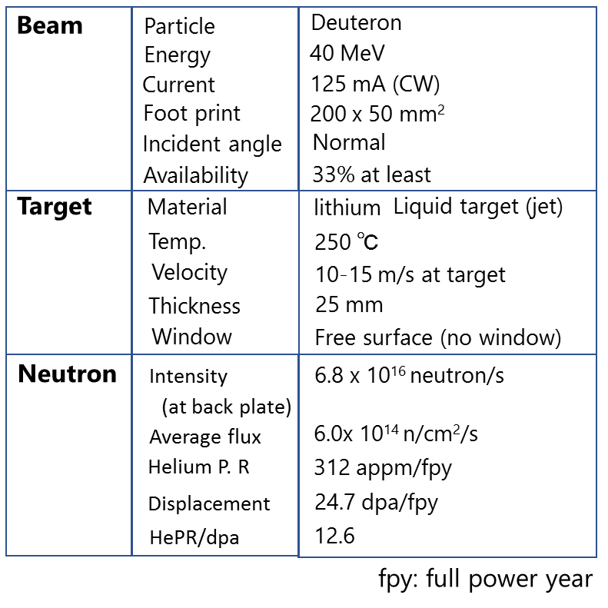
  Specification of A-FNS
• High-intensity neutron source for steady-state power generation in JA-DEMO.
• 14MeV Neutron irradiation data necessary for license of JA-DEMO.
Neutron
Spectrum
88% (Target)
A-FNS is planned to be constructed in Rokkasho, and the neutron irradiation tests are to be conducted on the DEMO reactor materials. It is composed of accelerator facility, lithium target loop facility, irradiation test facility, post irradiation examination facility.

Slide 4
Irradiation plans according to Japanese roadmap
Development according to Japanese roadmap toward JA-DEMO and Action plan
Irradiation demonstration of F82H up to 80dpa for steady operation of JA-DEMO.
Irradiation test of equipment & functions necessary for JA-DEMO system.
Irradiation test of Blanket submodule.
~2030 | ~2040 | ~2050 | ~2060
Construction
of A-FNS
20dpa
40dpa
80dpa
Irradiation 12 y＋PIE 2y
Development of Social environment
1)F82H、2)Functional Material、3)Divertor
Diagnostic Control Device, Advanced Materials
High Flux
Irradiation Plan in A-FNS
T release
Creep
Middle Flux
Submodule
Low Flux
Nuclear Property for Blanket
Diagnostic Control Device
Applications
The use of DONES as well as A-FNS has started to be considered for the early acquisition of F82H irradiation data up to 20 dpa (300 – 500℃)

Slide 5
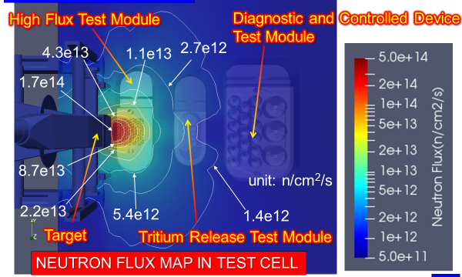
Irradiation Plan (1/2)
In discussion with JA experts in reactor materials and DEMO design, the following contents were categorized by neutron field strength.
For Fusion Material Test
Neutron flux measurement (NFM)
Blanket structure material test (BSM)
Test Cell Facility
Blanket functional material test (BFM)
Many Fusion Material Test Modules
Divertor functional material test (DFM)
Active corrosion production (ACP)
Tritium release test (TR)
Creep fatigue test (CF)
Diagnostic controlling device test (DCD)
Blanket nuclear property test (BNP)
For Industrial Use
RI production (RIP)
Low Energy irradiation
A-FNS is utilized like multi-purposes neutron source.
Neutron beam hole (NBH),
Gas & liquid loop

Slide 6
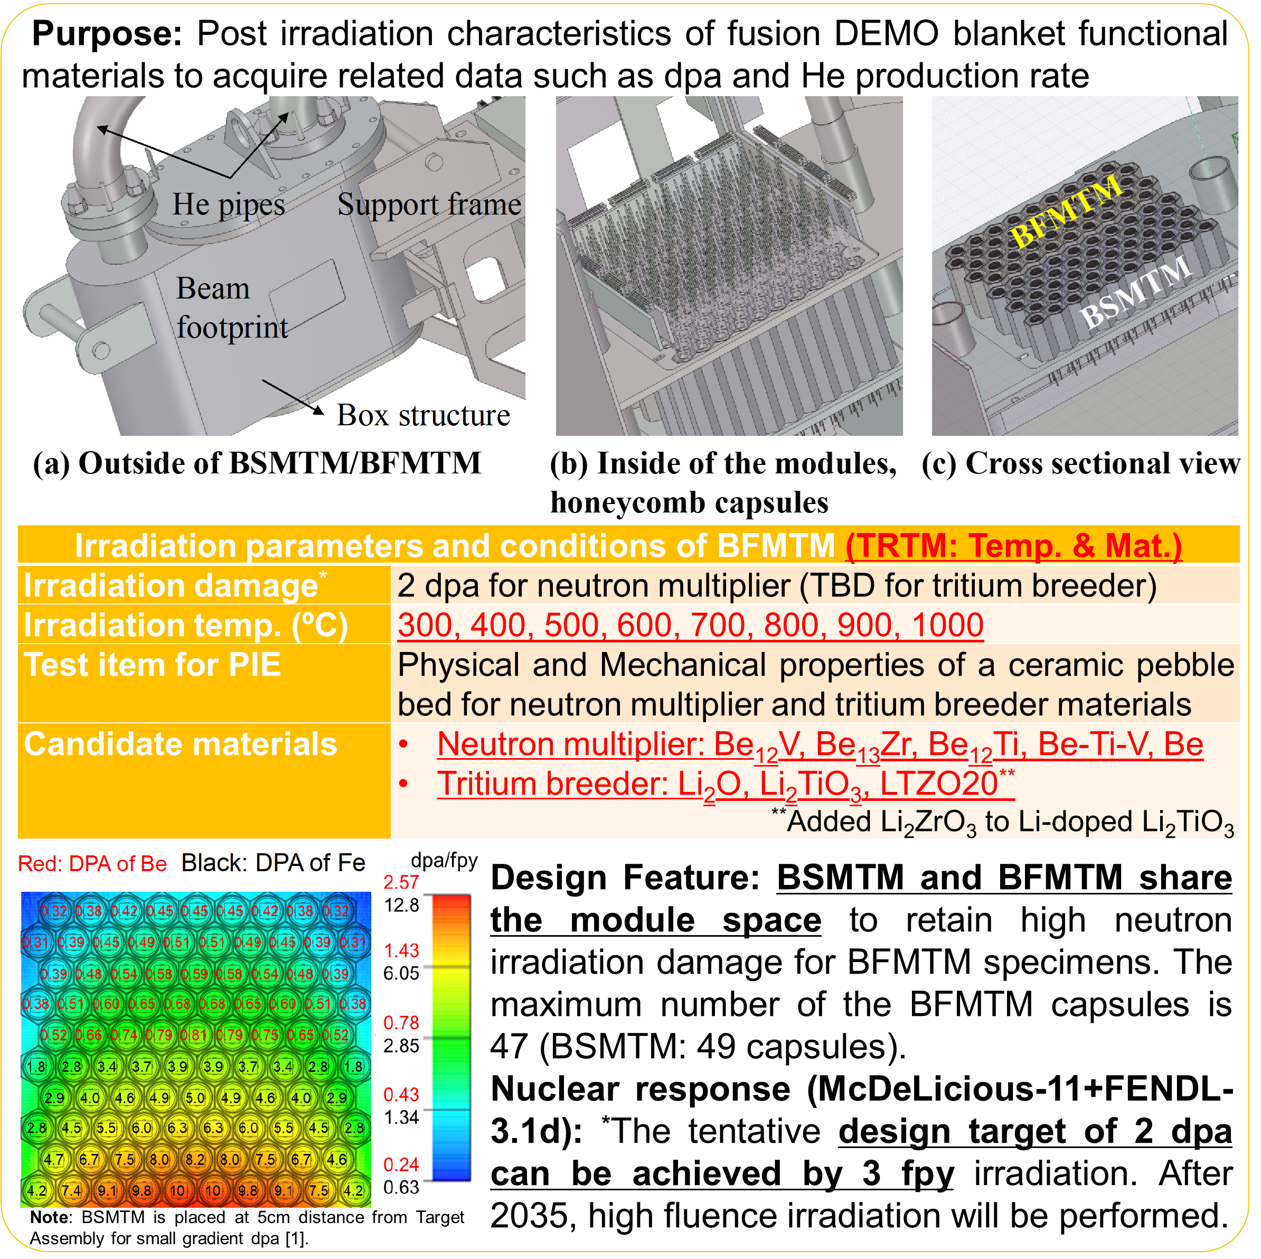
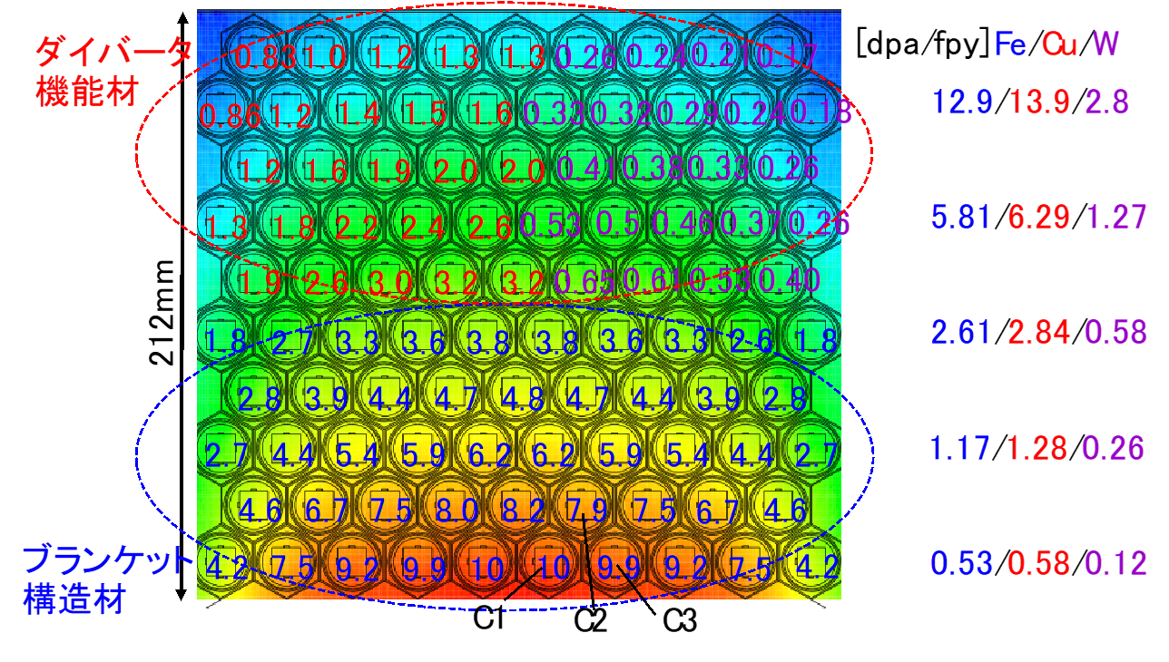
Irradiation plan (2/2)
Priority is given to irradiating materials at temperatures 573, 673 and 773 K.
A module design that enables simultaneous irradiation of structural materials and other candidate materials has been considered.
The DPA and helium production rates of various candidate materials by nuclear analysis have also been analyzed, and nuclear transmutation of W will be studied in the future.
Divertor
materials
Structure
materials

Slide 7
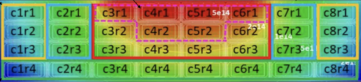
Estimation of 20 dpa irradiation of F82H by DONES
Assumption
JA specimen occupancy of approx. 8%
Operating rate 70%
JA irradiation period at DONES will be 18 years
Base metal and welding material in one rig
c5r2
Replace all rigs
Replace all rigs
Replace all rigs
Replace all rigs
Replace all rigs
300℃
400℃
500℃
Replace all rigs
Finish
Rig replacement every 2-4 years
Data available in 2040 for 10 dpa and by 2052 for 20 dpa.

Slide 8


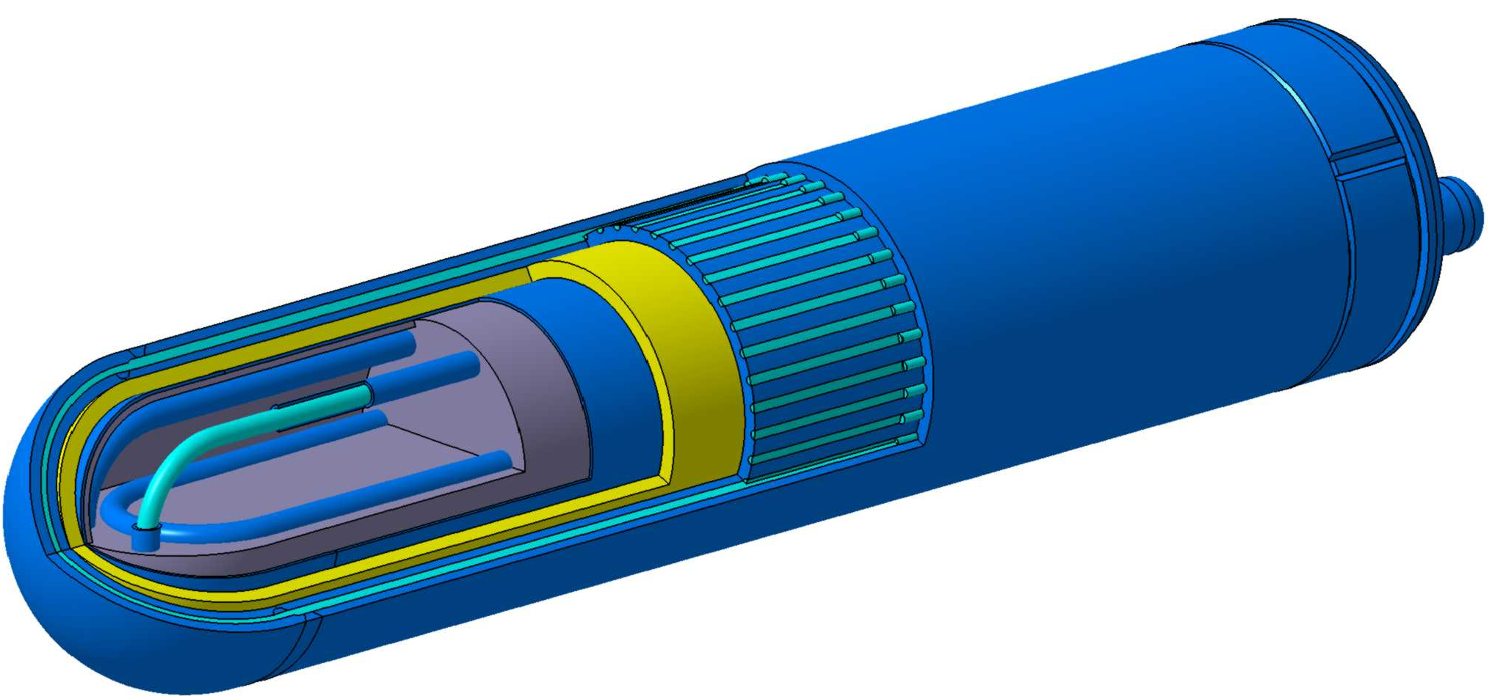
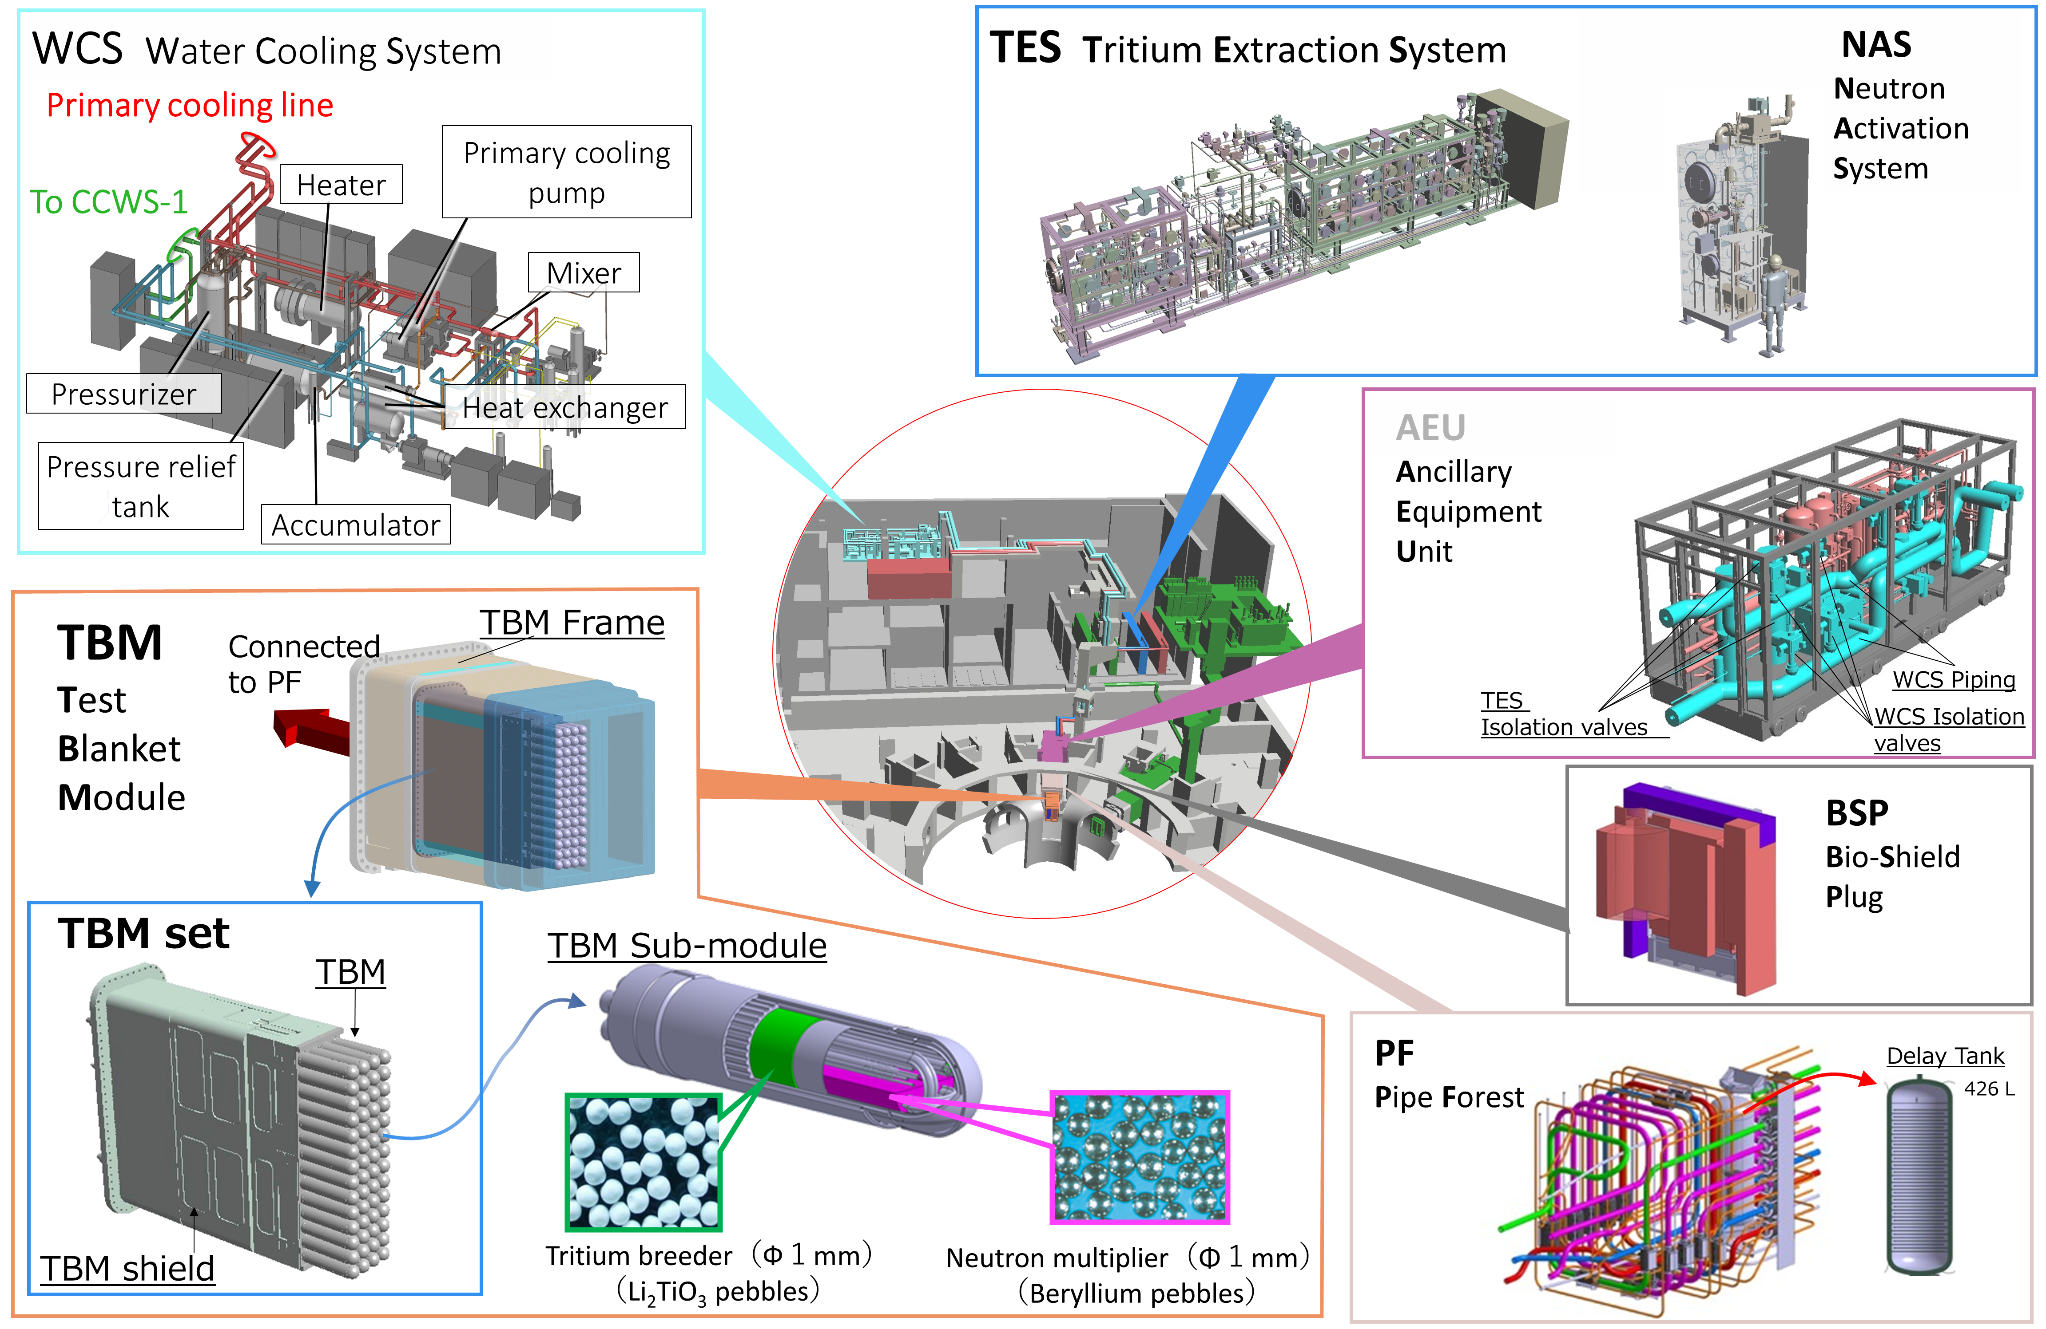
Water Cooling Ceramics Breeding blanket in JA
WCCB-TBM submodule
L 400 x φ 102 mm
Breeder (Li₂TiO₃)
JA is considering the WCCB format as the most promising candidate for an ITER-TBM. The same type of blanket design is being considered for the DEMO reactor.
Coolant pipe
(F82H + H2O)
Multiplier (Beryllium)
Structure (F82H)
2279 mm
Material | Property
Structure | Ferritic steel (F82H) Fe Balance, Cr 8 and W 2 w%
Breeder | Lithium titanate (Li₂TiO₃) Li-6 enrichment more than 30 mol% Pebbles (Target fill rate of at least 65%).
Coolant | Water (up to 325℃）
Multiplier | Beryllium pebbles or Beryllide(Be12Ti)
1703 mm
TBM
4 x 14 submodules
8

Slide 9
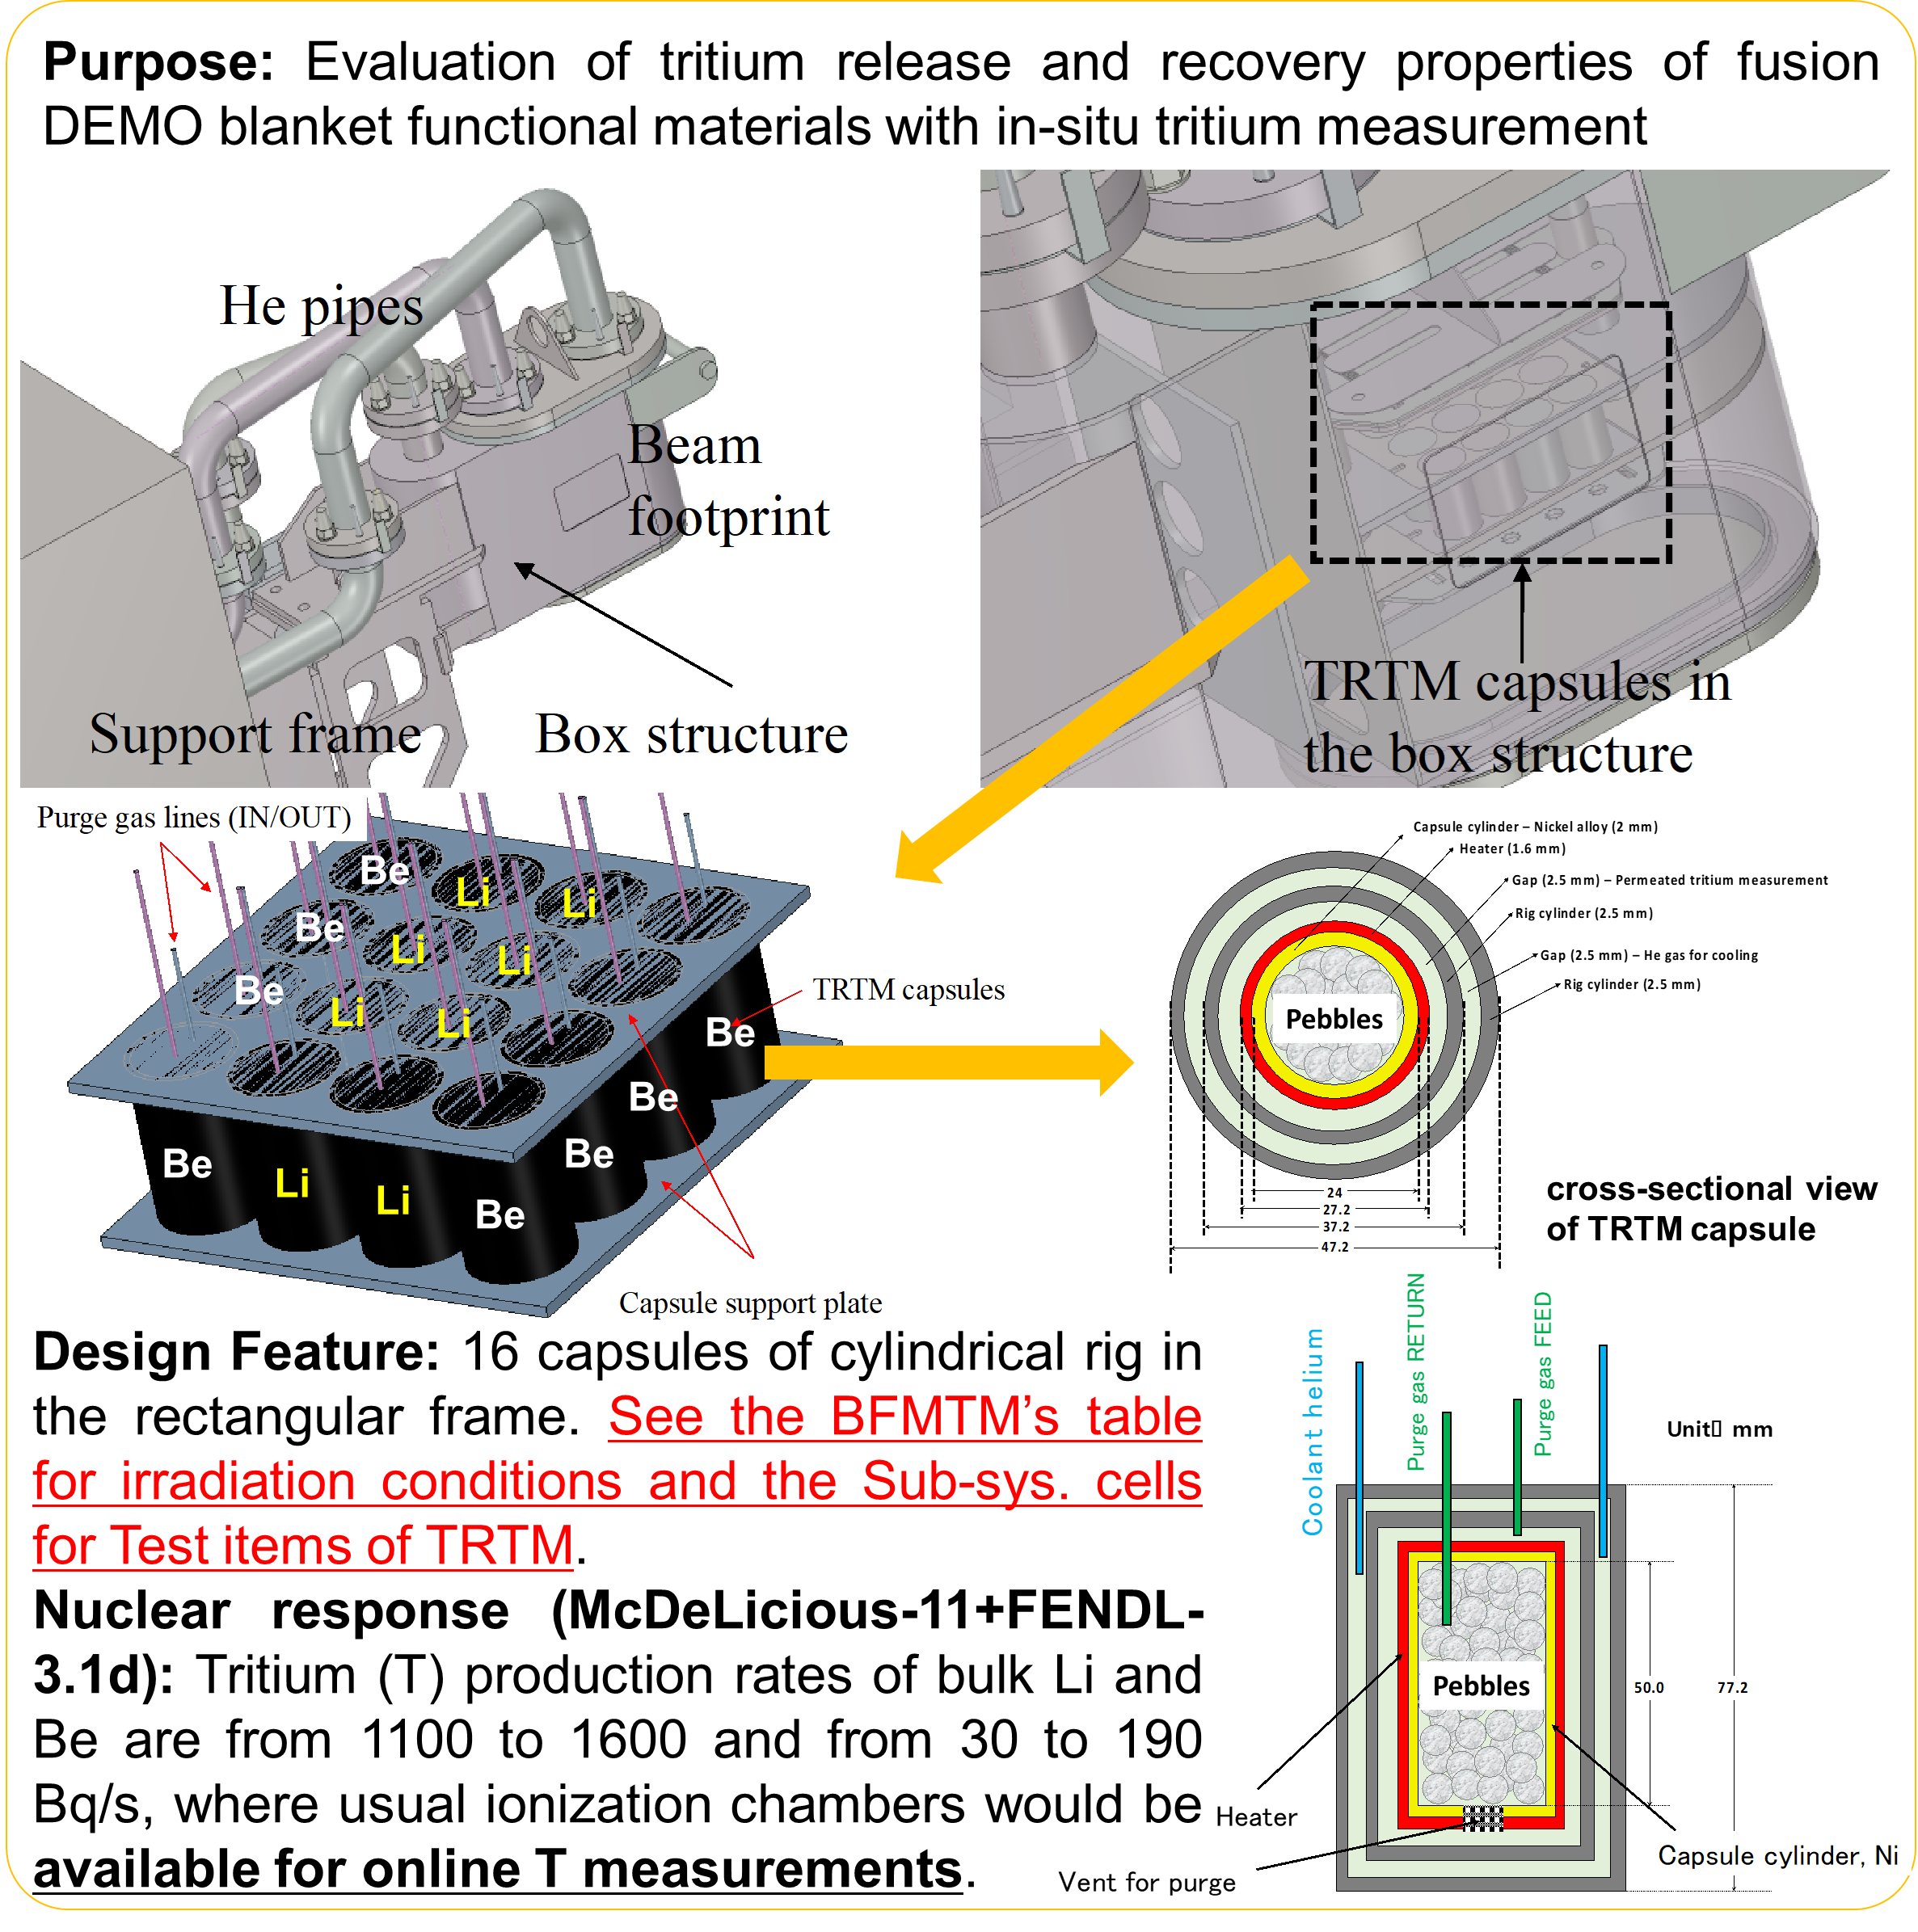
Blanket tritium breeding experiment (1/2)
The most important validation item of TFTR is the tritium recovery rate assessment.
He cylinders added H₂ for purge gas
An ionization chamber for in-situ measurement of tritium released
Water bubblers for measurement of tritium recovered
A sampling system for the water bubbler to measure tritium concentration directly using liquid scintillation counter (LSC)
A copper oxide (CuO) fixed bed to oxidize HT
S. Kwon et al, Nuclear Materials and Energy
Volume 25, December 2020, 100800.
The technical point on TRTM exam. will be required accuracy.

Slide 10
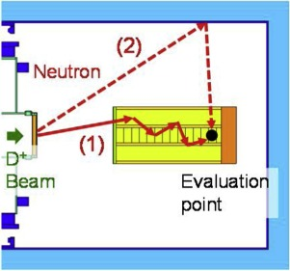
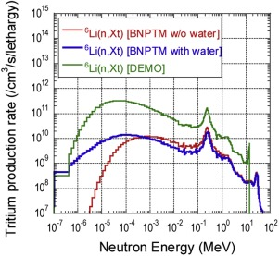
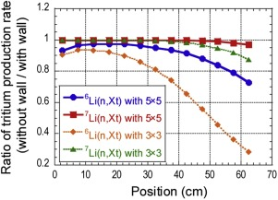
Blanket tritium breeding experiment (2/2)
Blanket experiments with DONES need to consider full consideration of the neutron spectrum, the scattering effects of TC walls and floors, and the shape and size of the module.
There is also a significant need to monitor neutron generation rates (on-line measurements).
M. Ohta et al. Fusion Engineering and Design Volume
157, August 2020
Schematic view of influence of test cell wall.
Spectra of tritium production rates for ⁶Li(n,Xt) reaction at depth position of 22.5 cm in case of 5×5 segments without and with cooling water.
Ratio of tritium production rate with test cell wall to without one in BNPTM in case of 5×5 and 3×3 segments with cooling water.

Slide 11
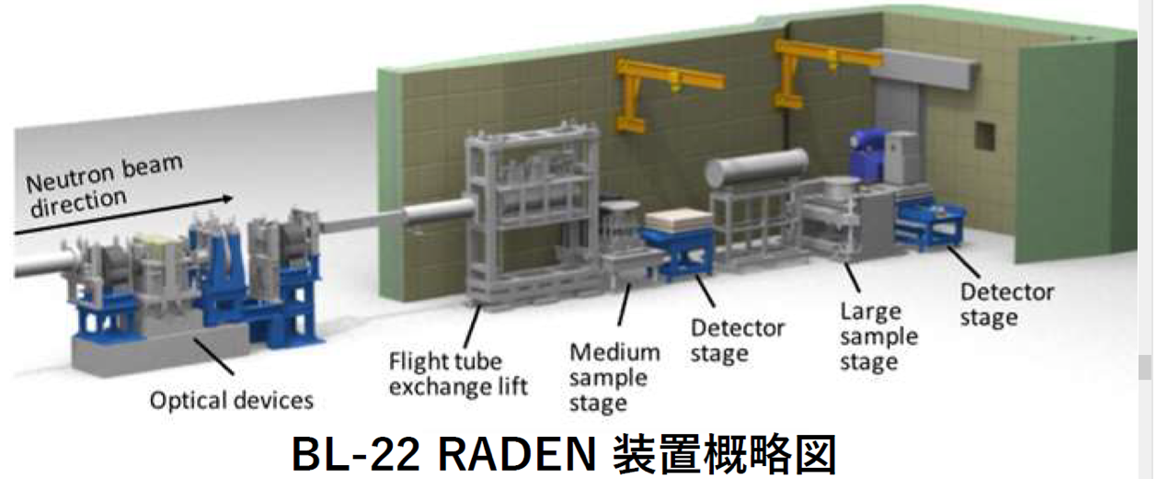
Neutron imaging experiment with fast neutron
Study on the use of fast neutron imaging with fusion neutron sources (QST-Kyoto Univ, JAEA).
The possibility of using imaging with energetic neutrons will be investigated, as the transmission capacity of thermal neutrons is insufficient for large motors and product-like sized fuel cells.
Schematic diagram of the device of RADEN in J-PARC MLF.
As present status of study,
Fast neutron imaging combined with RADEN experiments and PHITS simulations
Preliminary experiment to validate the simulations
Simulation model for FN imaging.
Simulation results (Preliminary).
Experimental apparatus in J-PARC RADEN.

Slide 12
Feasibility as medical usage of fusion neutron
Research on medical applications of fusion neutron sources (QST-Nagoya Univ.).
TC
D-Li
neutron
Moderated neutrons are used in a wide range of fields, including elemental analysis and medicine. Analysis of the moderation effect of aluminum fluoride (AlF3) and verification experiments are performing for the wide use of fusion neutron sources.
CBNS: Cyclotron Based epi-thermal Neutron Source Kyoto Univ.
NUANS: Nagoya University Accelerator-driven Neutron source
As present status of study,
Evaluation of source neutron spectrum and intensity behind the irradiation module
Design of combining moderators and shielding materials and evaluation of neutron performance suitable
Preparation of neutron irradiation field with moderators and shielding materials at DT neutron source OKTAVIAN, Osaka University.
Comparison of neutron emission energy spectra.
AlF₃
Graphite
DT Neutron Source point
Drawings for analysis of OKTAVIAN experiment.

Slide 13
Summary
Based on the Japanese fusion reactor development strategy, the A-FNS irradiation experiment for blanket candidate materials, divertor candidate materials and blanket neutron experiments is being continuously studied.
In accordance with the recent revision of the Japanese DEMO Action plan, DONES irradiation programme for F82H has also been initiated to obtain material irradiation data at an early stage.
Blanket neutron experiments with the D-Li neutron source, in particular tritium production and recovery, are also being investigated. Experimental techniques have to take into account the spectral differences from DT neutrons, the shape and size of the system, as well as the effects of TC walls.
On-line monitoring with an ionization chamber or off-line measurement with bubbler collection are possible candidates for tritium recovery measurement methods. In-situ measurement of neutron generation rates is also an important technique.
Various feasibility studies will be carried out as applications of the fusion neutron source A-FNS, mainly in collaboration with universities in Japanese and research institutes.

